Slide 1

Introduction
to
Programming
Creating and Running Your First C# Program
Firomsa W.
Windows Programming

Slide 2


Table of Contents
What is Computer Programming?
Your First C# Program
What is .NET Framework?
What is Visual Studio?
What is MSDN Library?
2

Slide 3


What is Computer Programming?

Slide 4

Define: Computer Programming
Computer programming: creating a sequence of instructions to enable the computer to do something
Definition by Google

Slide 5
Programming Phases
Define a task/problem
Plan your solution
  Find suitable algorithm to solve it
  Find suitable data structures to use
= Specification
= Design
Write code
Fix program error (bugs) = Testing & Debugging
= Implementation
Make your customer happy
= Deployment

Slide 6

Your First C# Program

Slide 7
First Look at C#
Sample C# program:
using System; class HelloCSharp
{
static void Main()
{
Console.WriteLine("Hello, C#");
}
}
7

Slide 8
C# Code – How It Works?
Define a class called
Include the standard
"HelloCSharp"
namespace "System"
using System;
Define the Main() method – the program entry point
class HelloCSharp
{
static void Main()
{
Console.WriteLine("Hello, C#");
}
}
Print a text on the console by calling the method "WriteLine" of the class
"Console"
8

Slide 9
C# Code Should Be Well
Formatted
Class names should use PascalCase and start with a CAPITAL letter.
using System;
The { symbol should be alone on a new line.
class HelloCSharp
{
ssttaattiicc vvooiidd MMaaiinn(())
{{
CCoonnssoollee..WWrriitteeLLiinnee((""HHeelllloo,, CC##""));;
}}
}
The } symbol should be under the corresponding {.
The block after the
{ symbol should be indented by a TAB.
9

Slide 10
Example of Bad Formatting
Such formatting makes the source code unreadable.
using
System
;
class
HelloCSharp
{
static Main(
WriteLine
void
.
) { Console
("Hello, C#"
)
;Console.
WriteLine
(
)
"Hello again"
;}}

Slide 11

What is "C#"?
Programming language
  A syntax that allow to give instructions to the computer
C# features:
  New cutting edge language
  Extremely powerful
  Easy to learn
  Easy to read and understand
  Object-oriented

Slide 12

What You Need to Program?
Knowledge of a programming language
  C#
Task to solve
Development environment, compilers, SDK
  Visual Studio, .NET Framework SDK
Set of useful standard classes
  Microsoft .NET Framework FCL
Help documentation
✴ MSDN Library

Slide 13


Your First C# Program
Live Demo

Slide 14

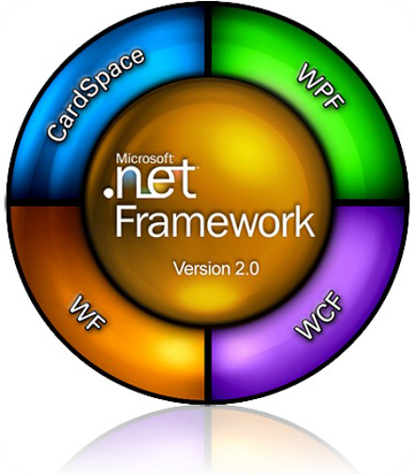

What is .NET Framework?

Slide 15

What is .NET Framework?
Environment for execution of .NET programs
Powerful library of classes
Programming model
Common execution engine for many programming languages
  C#
  Visual Basic .NET
  Managed C++
  ... and many others

Slide 16















Inside .NET Framework
Building blocks of .NET Framework
C# C++ VB.NET
J# F# JScript Perl
Delphi …
WPF Silverlight
ASP.NET
Web Forms, MVC, AJAX Mobile Internet Toolkit
Windows Forms
WCF and WWF (Communication and Workflow Tier) ADO.NET, LINQ and XML (Data Tier)
Base Class Library (BCL) Common Language Runtime (CLR)
Operating System (OS)
FCL
CLR

Slide 17

CLR – The Heart of .NET
Framework
Common Language Runtime (CLR)
  Managed execution environment
Executes .NET applications
Controls the execution process
Automatic memory management (garbage collection)
Programming languages integration
Multiple versions support for assemblies
Integrated type safety and security
CLR

Slide 18
Framework Class Library
Framework Class Library (FCL)
  Provides basic functionality to developers:
    Console applications
    WPF and Silverlight rich-media applications
    Windows Forms GUI applications
    Web applications (dynamic Web sites)
    Web services, communication and workflow
    Server & desktop applications
    Applications for mobile devices

Slide 19

What is Visual Studio?

Slide 20

Visual Studio
Visual Studio – Integrated Development Environment (IDE)
Development tool that helps us to:
  Write code
  Design user interface
  Compile code
  Execute / test / debug applications
  Browse the help
  Manage project's files

Slide 21

Benefits of Visual Studio
Single tool for:
  Writing code in many languages (C#, VB, …)
  Using different technologies (Web, WPF, …)
  For different platforms (.NET CF, Silverlight, …)
Full integration of most development activities (coding, compiling, testing, debugging, deployment, version control, ...)
Very easy to use!

Slide 22
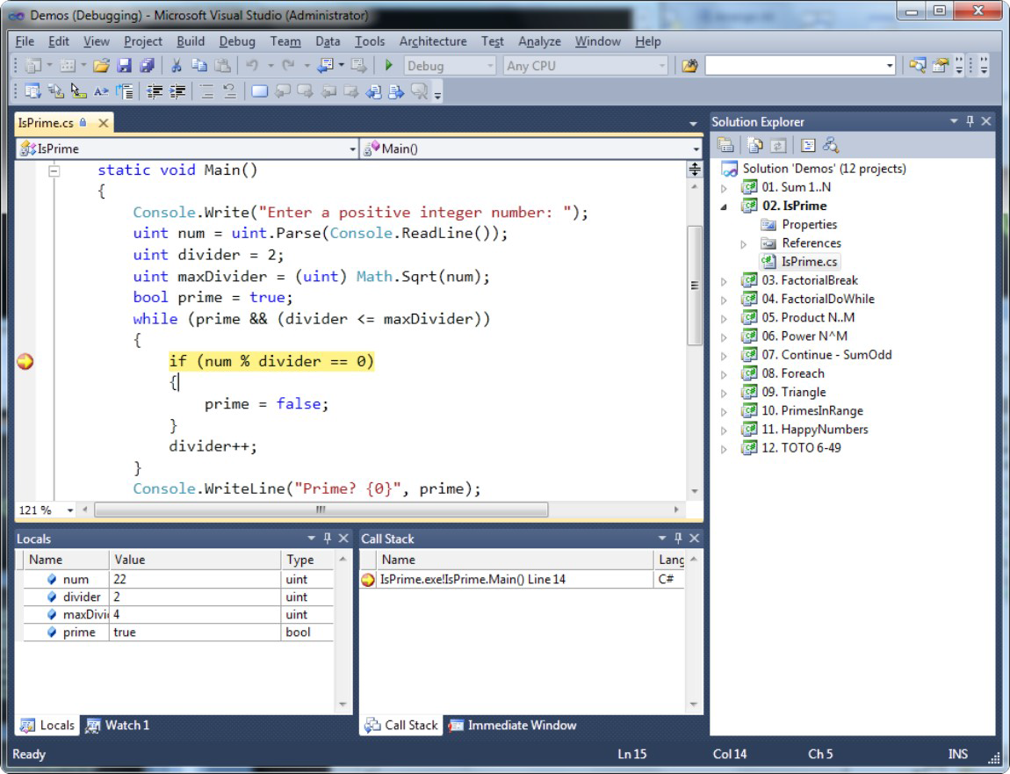
Visual Studio – Example

Slide 23

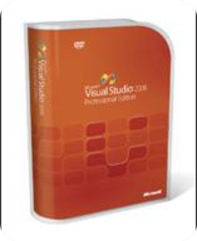
Visual Studio
Compiling, Running and Debugging C# Programs

Slide 24
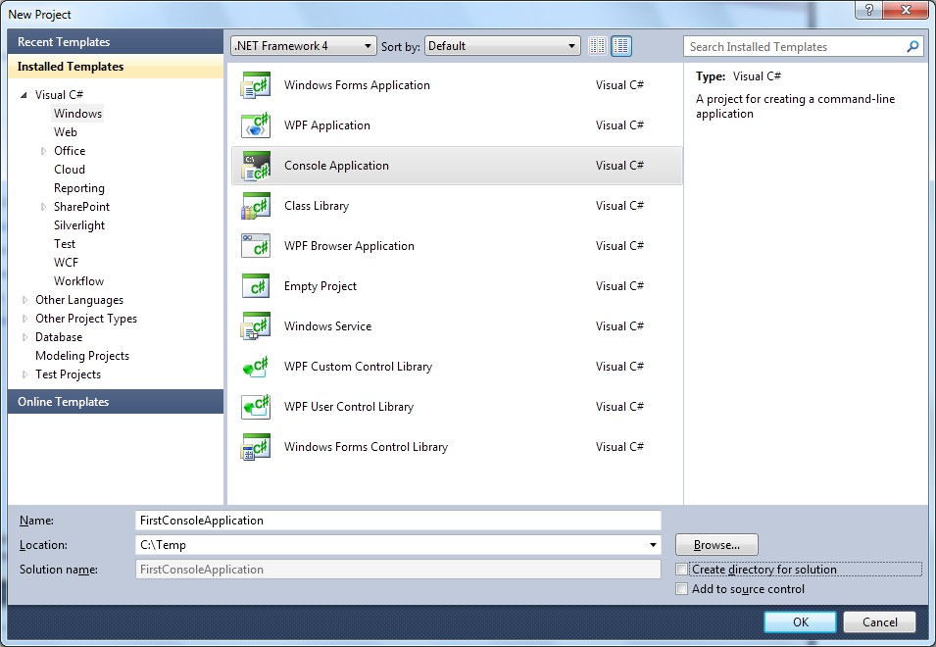
Creating New Console Application
s
File → New → Project ... Choose C# console application
Choose project directory and name
s
e

Slide 25
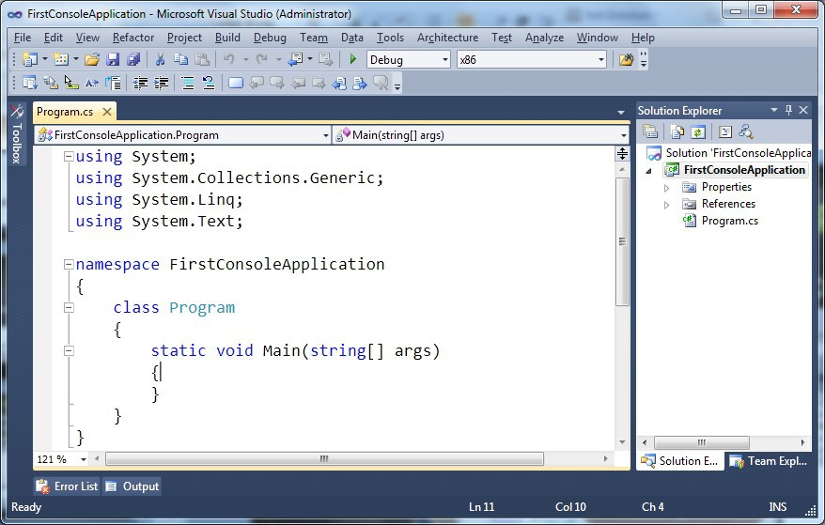
Creating New Console Application (2)
1. Visual Studio creates some source code for you
Namespace not required
Some imports are not required
Class name should be changed

Slide 26
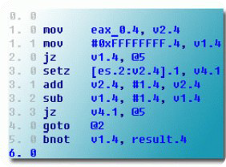
Compiling Source Code
The process of compiling includes:
  Syntactic checks
  Type safety checks
  Translation of the source code to lower level language (MSIL)
  Creating of executable files (assemblies)
You can start compilation by
  Using Build->Build Solution/Project
  Pressing [F6] or [Shift+Ctrl+B]

Slide 27

Running Programs
The process of running application includes:
  Compiling (if project not compiled)
  Starting the application
You can run application by:
  Using Debug->Start menu
  By pressing [F5] or [Ctrl+F5]
* NOTE: Not all types of projects are able to be started!

Slide 28



Debugging The Code
The process of debugging application includes:
  Spotting an error
  Finding the lines of code that cause the error
  Fixing the code
  Testing to check if the error is gone and no errors are introduced
Iterative and continuous process

Slide 29
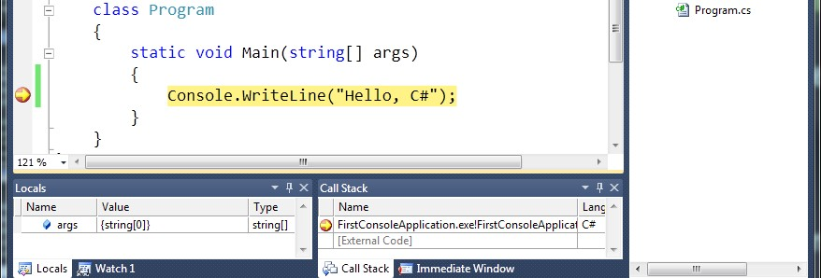
Debugging in Visual Studio
Visual Studio has built-in debugger
It provides:
  Breakpoints
  Ability to trace the code execution
  Ability to inspect variables at runtime

Slide 30


Visual Studio
Compiling, Running and Debugging C# Programs
Live Demo

Slide 31



What is MSDN Library?

Slide 32

What is MSDN Library?
Complete documentation of all classes and their functionality
  With descriptions of all methods, properties, events, etc.
  With code examples
Related articles
Library of samples
Use local copy or the Web version at http:// msdn.microsoft.com/

Slide 33
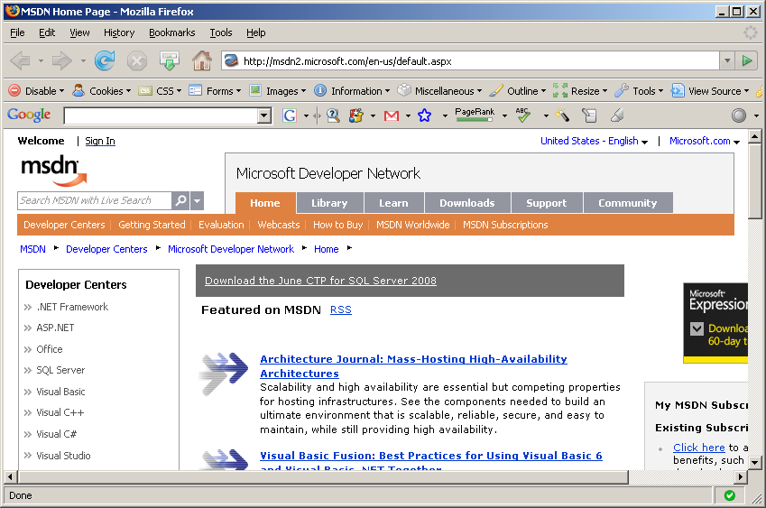
MSDN Library

Slide 34

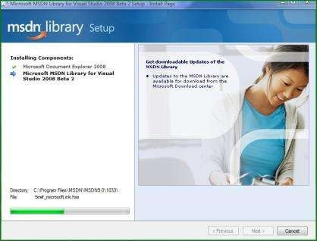
How to Use MSDN Library?
Offline version
  Use the table of contents
  Use the alphabetical index
  Search for phrase or keyword
  Filter by technology
  Browse your favorite articles
Online version
  Use the built-in search

Slide 35


MSDN Library
Browsing and Searching Documentation
Live Demo

Slide 36



Introduction to Programming
Questions?

Slide 37
Exercises
1. Familiarize yourself with:
Microsoft Visual Studio
Microsoft Developer Network (MSDN) Library Documentation
✴
✴
✴
Find information about Console.WriteLine() method.
Create, compile and run a “Hello C#” console application.
Modify the application to print your name.
Write a program to print the numbers 1, 101 and 1001.

Slide 38
Exercises (2)
Install at home:
  Microsoft .NET Framework
  Microsoft Visual Studio (or Visual C# Express)
  Microsoft Developer Network (MSDN)
Create console application that prints your first and last name.
Create a console application that prints the current date and time.
Create a console application that calculates and prints the square of the number 12345.

Slide 39
Exercises (3)
Write a program that prints the first 10 members of the sequence: 2, -3, 4, -5, 6, -7, ...
Provide a short list with information about the most popular programming languages. How do they differ from C#?
Describe the difference between C# and .NET Framework.
* Write a program to read your age from the console and print how old you will be after 10 years.
*NOTE: If you have any difficulties, search in Google.

