Slide 1
CHAPTER 3
Risk Management

Slide 2
Risk Management
Put simply, risk is an unplanned event and if it occurs it may affect any of your project objectives.
There are separate risk response strategies for negative and positive risks.
The objective of a negative risk response strategy is to minimize the impact of negative risks and the objective of a positive risk response strategy is to maximize the chance of positive risks happening.
You might also hear about two more risks terms: known risks and unknown risks.
Known risks are those risks which you have identified during the identify risks process and unknown risks are those risks which you couldn’t identify during the identify risks process.
A contingency plan is made for known risks, and you will use the contingency reserve to manage these risks.

Slide 3
Put simply, risk is an unplanned event and if it occurs it may affect any of your project objectives.
There are separate risk response strategies for negative and positive risks.
The objective of a negative risk response strategy is to minimize the impact of negative risks and the objective of a positive risk response strategy is to maximize the chance of positive risks happening.
You might also hear about two more risks terms: known risks and unknown risks.
Known risks are those risks which you have identified during the identify risks process and unknown risks are those risks which you couldn’t identify during the identify risks process.
A contingency plan is made for known risks, and you will use the contingency reserve to manage these risks.

Slide 4
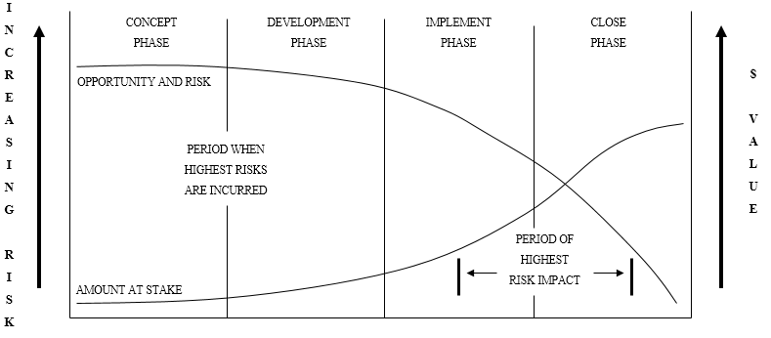
Project Lifecycle
Risk vs. Amount at Stake

Slide 5
What is risk management?
  Identifying, analyzing, prioritizing, and responding to risk events
  Integration of risk management activities into your other project management functions
  Developing responses to risk to meet your project objectives
  Project risk management is PROACTIVE

Slide 6
Risk Management Process

Slide 7
Some of the strategies to deal with negative risk on your projects include:
Avoid and try to eliminate the threat and protect the project from its impact.
Transfer the impact of the thread to a 3rd party and own the response together.
Mitigate the likelihood of occurrence or impact.
Accept the risk and take no action until and unless it occurs.
Some of the strategies to deal with positive risk on your projects include:
Exploit the opportunity and make sure its value is realized.
Enhance the risk by increasing the likelihood of its impact.
Share by allocating the responsibility to a 3rd party who can increase likelihood of capturing the opportunity.
Accept opportunity if it arises, but don’t take proactive approach to make it happen.

