Slide 1





COTM4242 – procurement management and contracts administration
Meseret Hussen (MSC)

Slide 2
COTM 4242: procurement management and contracts administration
CHAPTER 3
CLAIMS AND DISPUTE RESOLUTION
3.1 Claims

Slide 3
Outline
Claims
1. Claims
2. Procedures for Claims
3. Types of Claims

Slide 4
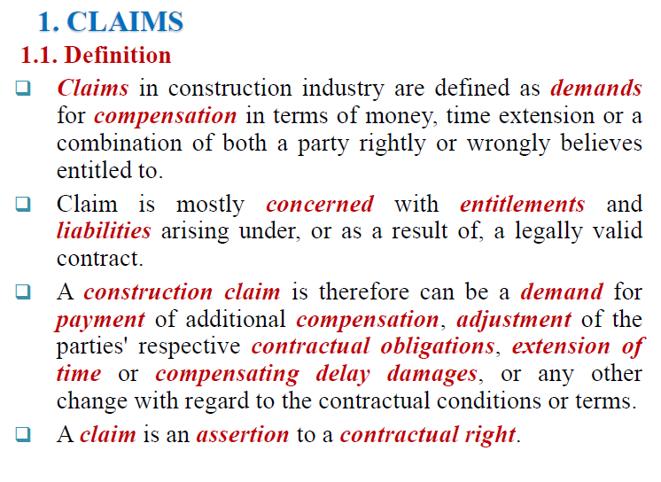

Slide 5
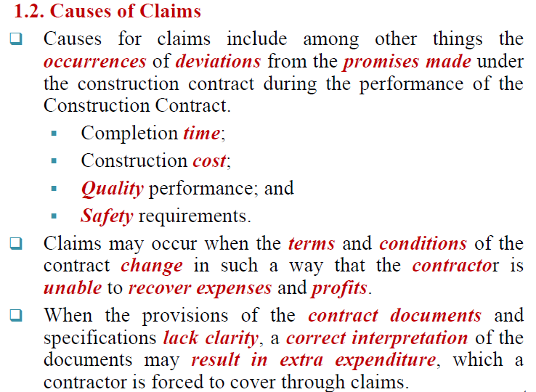
Cont…..

Slide 6
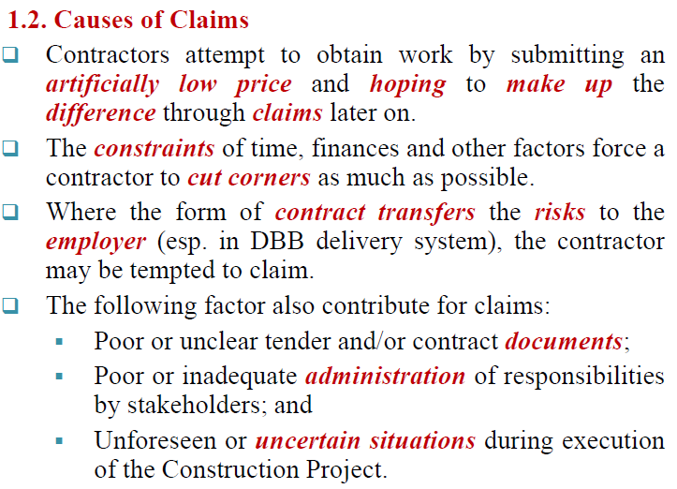
Cont….

Slide 7
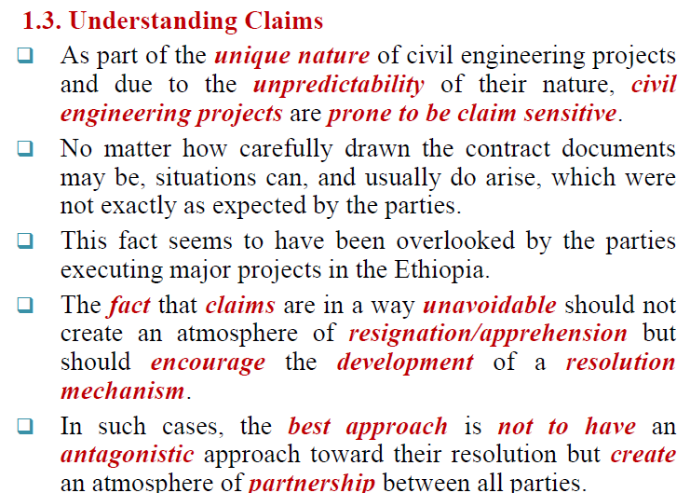
Cont…

Slide 8
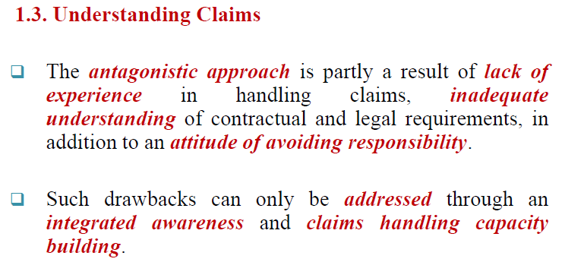
Cont…

Slide 9
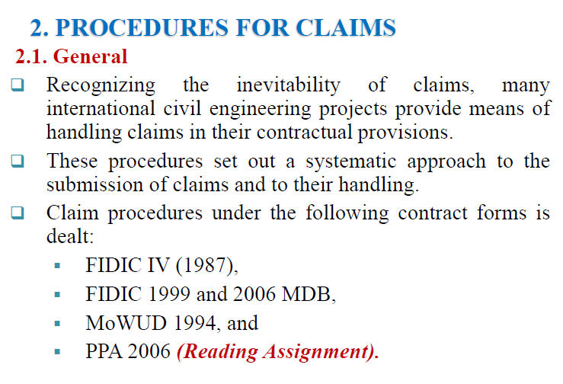

Slide 10
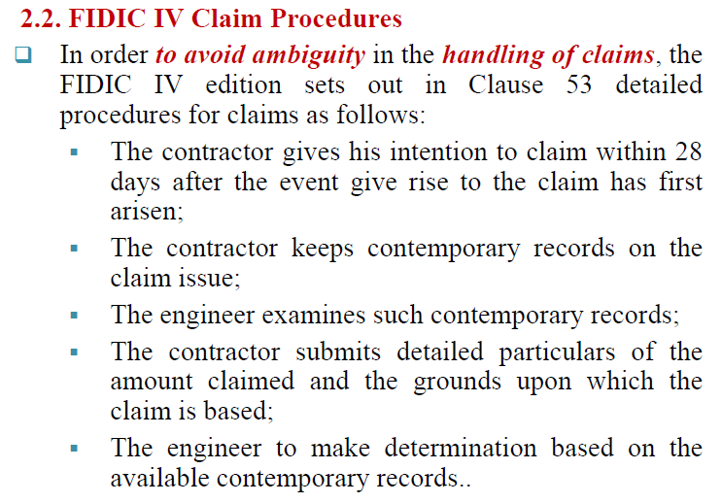
Cont….

Slide 11
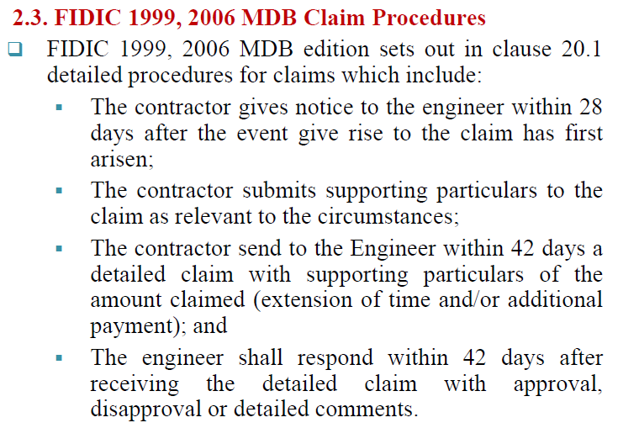
Cont…

Slide 12
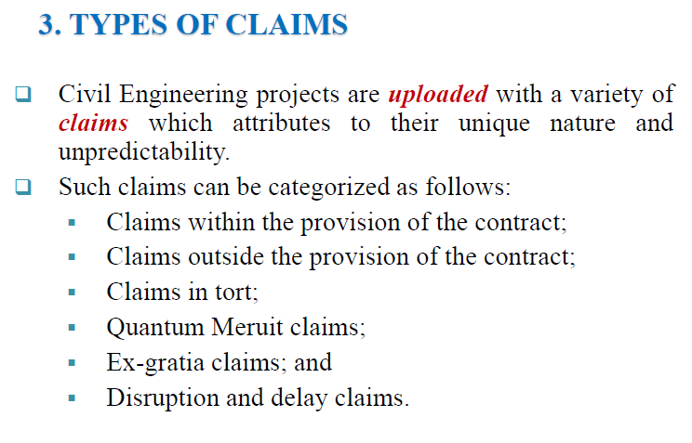

Slide 13
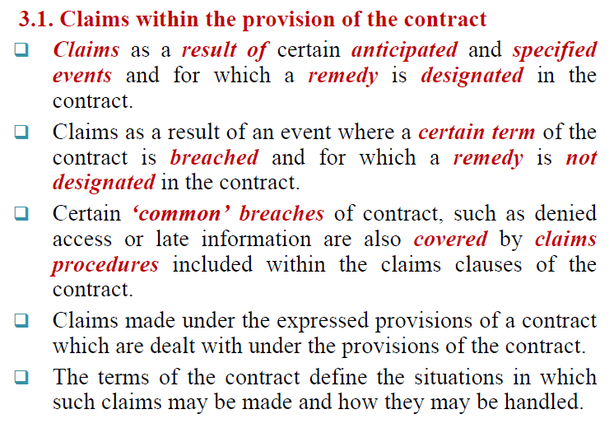
Cont…

Slide 14
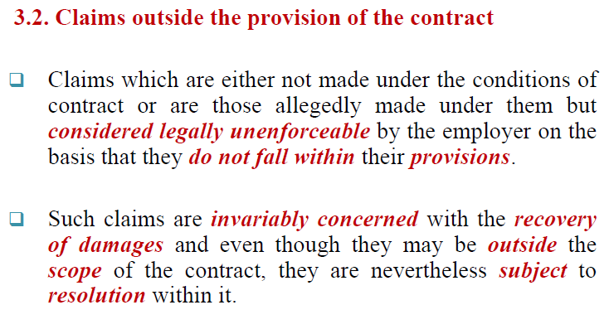
Cont….

Slide 15
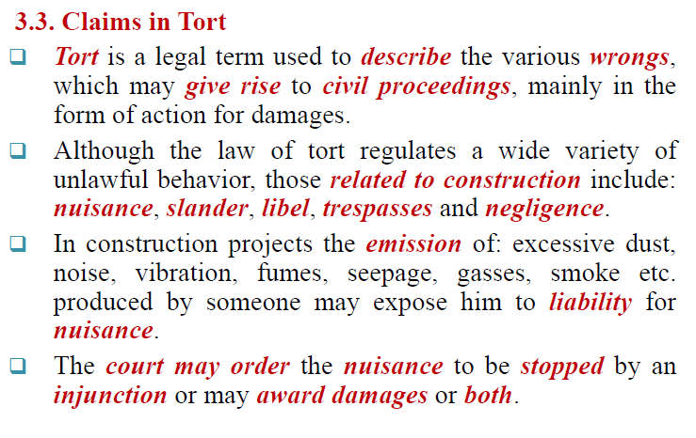
Cont….

Slide 16
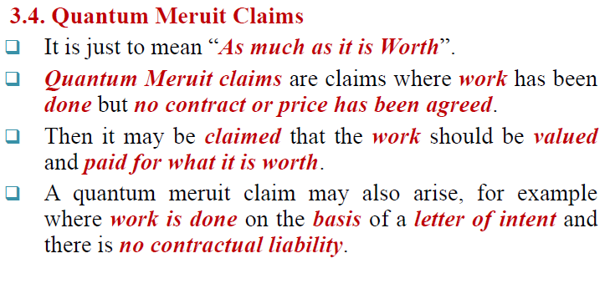
Cont….

Slide 17
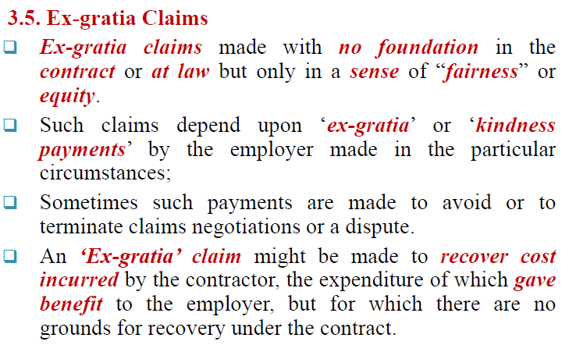
Cont…

Slide 18
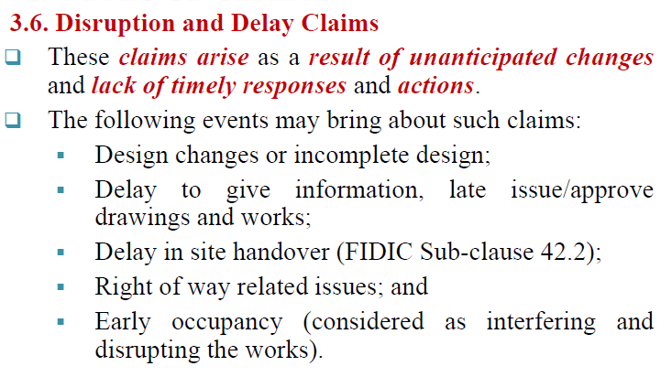
Cont…

Slide 19
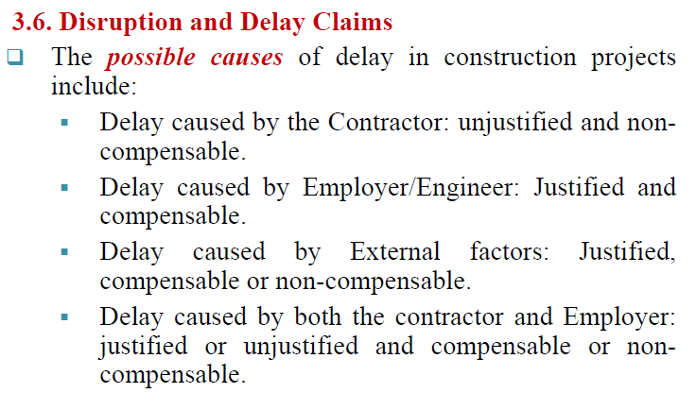
Cont…

Slide 20


