Slide 1
Chapter-Four
Time control and monitoring

Slide 2
Introduction
Scheduling is a mechanical process for laying out the various activities of a certain project or program along a time scale and in a proper sequence.
In other words, scheduling is the preparation of a time table or an action plan which serves as a guide for the implementation of the activities and computation of resources required at different stages in time.
Every construction projects are time bounded.
Due to the above nature, based on the contract time delays results to penalties while early completion might earn rewards
There may be many reasons both foreseeable and unforeseeable, for non-completion of a project on the intended completion time.

Slide 3
…Cont’d
The absence of a project time plan almost makes certain that a project cannot be completed on schedule without incurring extra costs.
Advantages of having a Construction plan/ Work program before the commencing the construction project is:
Formulating directions,
Optimum utilization and orderly arrangements of resources,
control of cost, progress and quality of executed work,
Controlling performance and motivating people

Slide 4
…Cont’d
Planning requires an intimate knowledge of construction methods combined with the ability to visualize distinct work elements and to establish their mutual interdependencies.
Construction planning is a fundamental and challenging activity in the management and execution of construction projects.
A good construction plan is the basis for developing the budget and the schedule for works.

Slide 5
…Cont’d
Construction planning consists of the following basic steps
Choice of technology and method of construction,
Definition of work tasks,
Creating logical relationship among individual tasks
Estimation of the required resources and durations for individual tasks, and

Slide 6
Project schedule
The approved Master schedule, called the schedule baseline, is a component of the overall project plan.
It provides the basis for measuring and reporting schedule performance.
In PPA, the general conditions of contract Clause 29-32 has clear stipulation on project schedule(program),

Slide 7
Time Control (PPA)
Clause 27.1
The Contractor shall submit the work program showing the general methods, arrangements, order, and timing for all the activities in the Works within the time stated in special condition of contract
Clause 27.2
The work program shall be updated based on the progress of the work including any changes
Clause 27.3
The contractor is responsible for updating the work program within the time stated in SCC

Slide 8
…Cont’d
Clause 27.4
The Engineer’s approval of the Program shall not alter the Contractor’s obligations,
The Contractor may revise the Program and submit it to the Engineer again at any time.
A revised Program shall show the effect of Variations and Compensation Events.
Clause 28, Extension of the intended completion date
Clause 28.1
The Engineer shall extend the Intended Completion Date if a Compensation Event occurs or a Variation are issued

Slide 9
…Cont’d
Clause 28.2
The Engineer shall decide whether and by how much to extend the Intended Completion Date within 21 days after recipt of the time extention claim.
If the Contractor has failed to give early warning of a delay or has failed to cooperate in dealing with a delay, the delay by this failure shall not be considered in assessing the new Intended Completion Date.

Slide 10
…Cont’d
Clause 29, (Acceleration)
Clause 29.1 and 29.2
When the Employer wants the Contractor to finish before the Intended Completion Date, the Engineer will obtain priced proposals for achieving the necessary acceleration from the Contractor
If the Employer accepts these proposals,
the Intended Completion Date will be adjusted accordingly and confirmed by both the Employer and the Contractor.
The new proposal will be incorporated in the Contract Price and it will be treated as a Variation.

Slide 11
…Cont’d
Clause 30, (Delays ordered by the Engineer)
Clause 30.1
The Engineer may instruct the Contractor to delay the start or progress of any activity within the Works.
Clause 31, ( Management Meetings)
Clause 31.1
Either the Engineer or the Contractor may require the other to attend a Management meeting,
Clause 31.2
The Engineer shall record the business of management meetings and provide copies of the record to those attending the meeting and to the Employer

Slide 12
…Cont’d
Clause 32, (Early Warning)
Clause 32.1
The Contractor shall warn the Engineer at the earliest opportunity of specific likely future events or circumstances that may adversely affect the quality of the work, increase the Contract Price or delay the execution of the Works.
The Engineer may require the Contractor to provide an estimate of the expected effect of the future event or circumstance on the Contract Price and Completion Date
Clause 32.2
The Contractor shall cooperate with the Engineer in making and considering proposals for how the effect of such an event or circumstance can be

Slide 13
Performance reports
Performance reports provide information on schedule performance such as which planned dates have been met and which have not. It may also alert the project team to issues which may cause problems in the future.
Performance reporting involves collecting and disseminating performance information in order to provide stakeholders with information about how resources are being used to achieve project objectives.

Slide 14
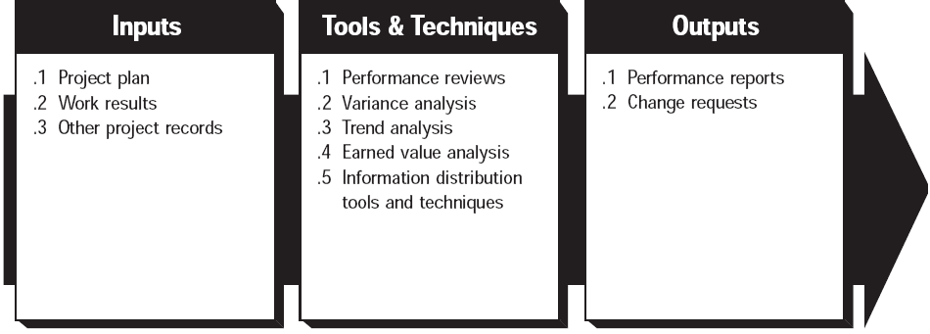
Performance reports
Status reporting_ describing where the project now stands
Progress reporting- describing what the project team has accomplished
Forecasting- predicting future project status and progress.
Performance reporting should generally provide information on scope, schedule, cost, and quality.

Slide 15
Change requests
Change requisites may occur in many forms-oral or written, direct or indirect, externally or internally initiated, and legally mandated or optional. Changes may require extending the schedule or may allow accelerating it

Slide 16
Construction work progress recordings and keeping dairies
Site records
Delay in construction projects are very common specially in countries like Ethiopia.
This demand the follow up of the activities over a prolonged time.
Therefore keeping accurate records plays a significant role, particularly when there is a tendency for varying the work.
It is therefore become imperative to maintain accurate written site records, which include;
Work progress
Material quality➔ for quality control
Weather data
Working hours
Any incidents
Material on sites
Labor and equipment deployed
Instructions issued (co-signed by all)

Slide 17
Construction work progress recordings and keeping dairies
Maintain work progress
Maintain a log sheet of materials delivered/used
Maintain record of instructions, date given and to whom given
Maintain record of variation orders given, date given and to whom given
Keep record of measurements, co-signed
Record details of works before covering up( ex. Foundations)
Keep record of tests and relevant material data

Slide 18
Construction work progress recordings and keeping dairies
The following items should also be a part of the construction administration record keeping
Field observations reports: follow-ups on all unresolved items
Shop drawings, samples, product data, checklist of all required submissions
Submittals: checklist of all required submittals correspondence
Payment requests, schedules of contract sum and time, change orders
Change orders and construction change directives
Drawings and revisions
Specifications and revisions
Status of requests for information's and requests for quotations
Memos on delay caused by weather, strikes, unavailability of materials, and other things.

Slide 19
Reports
The purpose of the inspector’s site visit is to become “generally familiar” with the progress and quality of the work and to determine if the work is being done
in a manner which will yield results consistent with the contract documents.
The supervisor is required to keep the owner informed of the progress and quality of the work.
Most inspectors discharge this continuing obligations by sending the owner a written report of each site visit with a copy sent to the contractor.
The report should be a complete record of the proceedings at the inspector’s job site visit and should include;

Slide 20
Reports
Date
Time, duration
Weather conditions
Persons present
Percentage of work completed by trade
Work progress compared to schedule
Work now being accomplished, work scheduled before next visit
Questions raised by the contractor or owner
Determinations made by the engineer
Any questions or actions which remain pending for appropriate later attention.

Slide 21
…Formats
Site Diary
Progress report
Schedule

