Slide 1

COMPUTE SECURITY
UNIT-3 : Introduction to Cryptography and Historical ciphers

Slide 2
What is Cryptography?
Cryptography is a scientific mix of mathematical theory and computational application which allows the confidential transfer of information.
Example:
Alice and Bob wish to perform some form of communication while Eve is an eavesdropper who wishes to spy on or tamper with the communications between Alice and Bob.

Slide 3
What is Cryptography?
Cryptography is concerned with four facets of data transfer
Confidentiality
Authenticity
Integrity
Non-repudiation

Slide 4
Cryptography..
Confidentiality
  A message sent from Alice to Bob cannot be read by anyone else.
Authenticity
  Bob knows that only Alice could have sent the message he has just received.
Integrity
  Bob knows that the message from Alice has not been tampered with in transit.
Non-Repudiation
  It is impossible for Alice to turn around later and say she did not send the message.

Slide 5
Model of Cryptography
Plaintext : Cleartext or original message
Ciphertext : Message in encrypted form
Cipher - Algorithm for transforming plaintext to ciphertext
Key - Info used in cipher known only to sender/receiver
Encryption : Process of converting Plaintext to ciphered text
Decryption : Process of converting ciphered to Plaintext text
Cryptosystem : System for encryption and decryption of information
Symmetric Cryptography : If the key is same for both encryption and decryption
Asymmetric Cryptography : If the key is not same for both encryption and decryption

Slide 6
Requirements
Two requirements for secure use of symmetric encryption:
  a strong encryption algorithm
  a secret key known only to sender / receiver
Mathematically have:
  Y = E(K, X)
  X = D(K, Y)
assume encryption algorithm is known
implies a secure channel to distribute key
Notes:
Reason of strong encryption: We know the text and algorithm.
There are two requirements for secure use of conventional encryption that mean we assume that it is impractical to decrypt a message on the basis of the cipher- text plus knowledge of the encryption/decryption algorithm, and hence do not need to keep the algorithm secret; rather we only need to keep the key secret. This feature of symmetric encryption is what makes it feasible for widespread use. It allows easy distribution of s/w and h/w implementations.
Can take a closer look at the essential elements of a symmetric encryption scheme: mathematically it can be considered a pair of functions with: plaintext X, ciphertext Y, key K, encryption algorithm E, decryption algorithm D. The intended receiver, in possession of the key, is able to invert the transformation. An opponent, observing Y but not having access to K or X, may attempt to recover X or K.

Slide 7
Cryptographic systems are generically classified along three independent dimensions:
The type of operations used for transforming plaintext to ciphertext
Substitution
Each element in the plaintext is mapped into another element
Transposition
Elements in the plaintext are rearranged
Fundamental requirement is that no information be lost
Product systems
Involve multiple stages of substitutions and transpositions
The number of keys used
Referred to as symmetric, single-key, secret-key, or conventional encryption if both sender and receiver use the same key
Referred to as asymmetric, two-key, or public-key encryption if the sender and receiver each use a different key
The way in which the plaintext is processed
Block cipher processes the input one block of elements at a time, producing an output block for each input block
Stream cipher processes the input elements continuously, producing output one element at a time, as it goes along

Slide 8
Symmetric Encryption
symmetric encryption, also referred to as conventional encryption or single-key encryption, was the only type of encryption in use prior to the development of public-key encryption in the 1970s.
It remains by far the most widely used of the two types of encryption.
All traditional schemes are symmetric / single key / private-key encryption algorithms, with a single key, used for both encryption and decryption. Since both sender and receiver are equivalent, either can encrypt or decrypt messages using that common key.
8
Notes:
Symmetric encryption, also referred to as conventional encryption or single-key encryption, was the only type of encryption in use prior to the development of public-key encryption in the 1970s. It remains by far the most widely used of the two types of encryption. All traditional schemes are symmetric / single key / private-key encryption algorithms, with a single key, used for both encryption and decryption. Since both sender and receiver are equivalent, either can encrypt or decrypt messages using that common key.

Slide 9
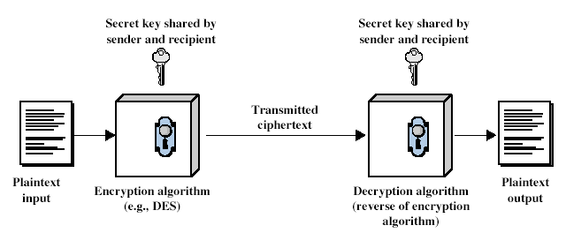
Symmetric Cipher Model
Detail the five ingredients of the symmetric cipher model, shown in Figure :
Plaintext - original message
Encryption Algorithm – performs substitutions/transformations on plaintext
Secret Key – control exact substitutions/transformations used in encryption algorithm
Ciphertext - scrambled message
Decryption Algorithm – inverse of encryption algorithm
9
Notes:
Detail the five ingredients of the symmetric cipher model, shown in Stallings Figure 2.1:
plaintext - original message
encryption algorithm – performs substitutions/transformations on plaintext
secret key – control exact substitutions/transformations used in encryption algorithm
ciphertext - scrambled message
decryption algorithm – inverse of encryption algorithm

Slide 10
Cryptanalysis
Process of attempting to discover plaintext or key
Typically objective is to recover the key in use rather then simply to recover the plaintext of a single ciphertext. There are two general approaches:
  Cryptanalytic attack (knowledge): Relies on the nature of the algorithm plus perhaps some knowledge of the general characteristics of the plaintext or even some sample plaintext- ciphertext pairs. This type of attack exploits the characteristics of the algorithm to attempt to deduce a specific plaintext or to deduce the key being used.
  Brute-force attack (every possible key) : Try every possible key on a piece of ciphertext until an intelligible translation into plaintext is obtained. On average, half of all possible keys must be tried to achieve success.
If either type of attack succeeds in deducing the key, the effect is catastrophic: All future and past messages encrypted with that key are compromised.

Slide 11
Cryptanalysis and Attacks
According to Diffie and Hellman Skill in the production of cryptanalysis has always been heavily on the side of the professionals, but innovation, particularly in the design of new types of cryptographic systems, has come primarily from amateurs.
Among the types of attacks are
  Ciphertext only attacks
  Known plaintext attacks
  Chosen plaintext attacks
  Chosen ciphertext attacks
  Man-in-the-middle attacks

Slide 12
Attack scenarios .. Contd..
We wrap up our general discussion of encryption with a brief discussion of some basic types of attacks against encryption schemes. In order of severity, these are:
Ciphertext Only Attack
A ciphertext only attack (COA) is a case in which only the encrypted message is available for attack, but because the language is known a frequency analysis could be attempted. In this situation the attacker does not know anything about the contents of the message, and must work from ciphertext only.
Known Plaintext Attack
In a known plaintext attack (KPA) both the plaintext and matching ciphertext are available for use in discovering the key.
The attacker knows or can guess the plaintext for some parts of the ciphertext. For example, maybe all secure login sessions begin with the characters LOGIN, and the next transmission may be PASSWORD. The task is to decrypt the rest of the ciphertext blocks using this information. This may be done by determining the key used to encrypt the data, or via some shortcut.

Slide 13
Attack scenarios .. Contd..
Chosen Plaintext Attack
A chosen plaintext attack (CPA) occurs when the attacker gains access to the target encryption device - if, for example, it is left unattended. The attacker then runs various pieces of plaintext though the device for encryption. This is compared to the plaintext to attempt to derive the key.
In an adaptive chosen plaintext attack (ACPA), the attacker not only has access to the plaintext and its encryption, but can adapt or modify the chosen plaintext as needed based on results of the previous encryptions.
Chosen Ciphertext Attack
In a chosen ciphertext attack (CCA), the cryptanalyst can choose different ciphertexts to be decrypted and has access to the decrypted plaintext.
This type of attack is generally applicable to attacks against public key cryptosystems. An adaptive chosen ciphertext attack involves the attacker selecting certain ciphertexts to be decrypted, then using the results of these decryptions to select subsequent ciphertexts. The modifications in the ciphertext help in deciphering the key from the decryptions.

Slide 14
Attack scenarios .. Contd..
Man-in-the-Middle Attack
Cryptographic communications and key exchange protocols are susceptible to an attack in which the attacker is able to place himself on the communication line between two parties.
In this "man-in-the-middle attack" the attacker is able to position himself to intercept the key exchange between two parties. He performs his own key exchange with each. Then, with both parties thinking they have set up a secure channel, the attacker decrypts any communications with the proper key, and encrypts them with the other key for sending to the other party. The parties think that they are communicating securely, but in fact the adversary is reading everything.
Preventing a man-in-the-middle attacks is possible if both sides compute a cryptographic hash function of the key exchange, sign it using a digital signature algorithm, and send the signature to the other side. The recipient then verifies that the hash matches the locally computed hash and the signature came from the desired other party.

Slide 15
Summary - Attacks
Cryptanalysis is the science of cracking codes and decoding secrets. It is used to violate authentication schemes, to break cryptographic protocols, and, more benignly, to find and correct weaknesses in encryption algorithms.
The major categories of cryptanalysis include ciphertext only, known plaintext, chosen plaintext, and chosen ciphertext. These involve deriving the key from analysis of the pieces provided.
In a man-in-the-middle attack, the attacker intercepts the key exchange between the parties. This allows him to decrypt a message from one party, read it, then re-encrypt it with the sender's key before transmitting it on to the intended recipient. The sender and recipient have no way of knowing that their supposedly confidential communication has been intercepted.

Slide 16
TYPES OF CRYPTOGRAPHIC ALGORITHMS
There are several ways of classifying cryptographic algorithms. They will be categorized based on the number of keys that are employed for encryption and decryption, and further defined by their application and use. The three types of algorithms that will be discussed are (Figure 1):
Secret Key Cryptography (SKC): Uses a single key for both encryption and decryption; also called symmetric encryption. Primarily used for privacy and confidentiality.
Public Key Cryptography (PKC): Uses one key for encryption and another for decryption; also called asymmetric encryption. Primarily used for authentication, non-repudiation, and key exchange.
Hash Functions: Uses a mathematical transformation to irreversibly "encrypt" information, providing a digital fingerprint. Primarily used for message integrity.
Notes:
Unconditional security would be nice, but the only known such cipher is the one-time pad (later). For all reasonable encryption algorithms, have to assume computational security where it either takes too long, or is too expensive, to bother breaking the cipher.

Slide 17
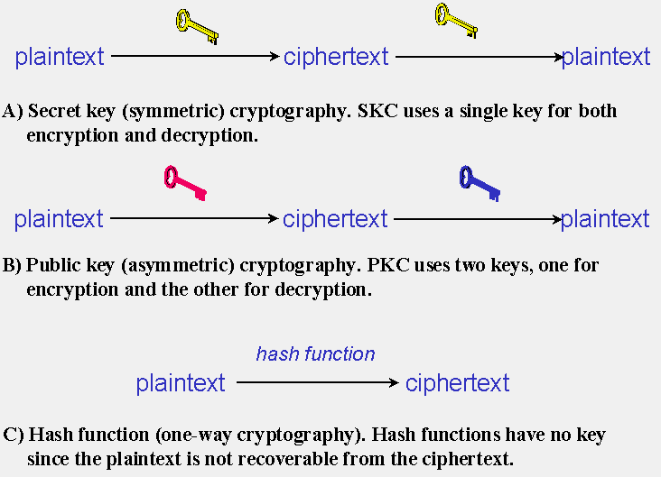
TYPES OF CRYPTOGRAPHIC ALGORITHMS

Slide 18
INTRODUCTION - HISTORICAL CIPHERS
There are a variety of different types of encryption. Algorithms used earlier in the history of cryptography are substantially different from modern methods, and modern ciphers can be classified according to how they operate and whether they use one or two keys.
Historical
Historical pen and paper ciphers used in the past are sometimes known as classical ciphers. They include simple substitution ciphers and transposition ciphers For example, "GOOD DOG" can be encrypted as "PLLX XLP" where "L" substitutes for "O", "P" for "G", and "X" for "D" in the message. Transposition of the letters "GOOD DOG" can result in "DGOGDOO". These simple ciphers and examples are easy to crack, even without plaintext-ciphertext pairs.
Simple ciphers were replaced by polyalphabetic substitution ciphers (such as the Vigenère) which changed the substitution alphabet for every letter. For example, "GOOD DOG" can be encrypted as "PLSX TWF" where "L", "S", and "W" substitute for "O". With even a small amount of known or estimated plaintext, simple polyalphabetic substitution ciphers and letter transposition ciphers designed for pen and paper encryption are easy to crack.[4] It is possible to create a secure pen and paper cipher based on a one-time pad though, but the usual disadvantages of one-time pads apply.
During the early twentieth century, electro-mechanical machines were invented to do encryption and decryption using transposition, polyalphabetic substitution, and a kind of "additive" substitution. Although these encryption methods were more complex than previous schemes and required machines to encrypt and decrypt,

Slide 19
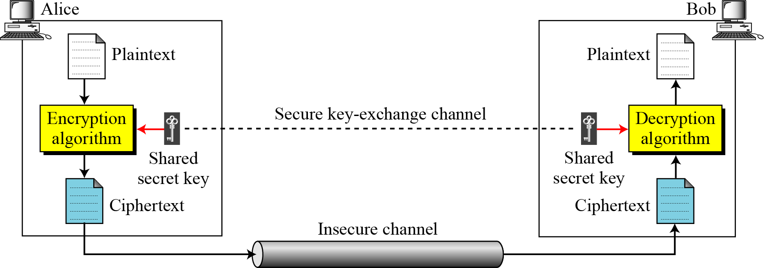
Continued..
Figure 3.1 shows the general idea behind a symmetric-key cipher. The original message from Alice to Bob is called plaintext; the message that is sent through the channel is called the ciphertext. To create the ciphertext from the plaintext, Alice uses an encryption algorithm and a shared secret key. To create the plaintext from ciphertext, Bob uses a decryption algorithm and the same secret key.
Figure 3.1 General idea of symmetric-key cipher

Slide 20
Continued..
If P is the plaintext, C is the ciphertext, and K is the key,
We assume that Bob creates P₁; we prove that P₁ = P:

Slide 21
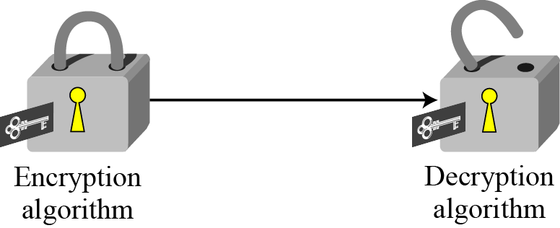
Continued…
Figure 3.2 Locking and unlocking with the same key

Slide 22

SUBSTITUTION CIPHERS
A substitution cipher replaces one symbol with another. Substitution ciphers can be categorized as either monoalphabetic ciphers or polyalphabetic ciphers.
Note
A substitution cipher replaces one symbol with another.
Topics discussed in this section:
Monoalphabetic Ciphres
Polyalphabetic Ciphers

Slide 23
Monoalphabetic Ciphers
Note
In monoalphabetic substitution, the relationship between a symbol in the plaintext to a symbol in the ciphertext is always one-to-one.

Slide 24
Continued..
Example 3.1
The following shows a plaintext and its corresponding ciphertext. Is the cipher monoalphabetic?
Plaintext: HELLO Ciphertext: KHOOR
Solution
The cipher is probably monoalphabetic because both occurrences of L’s are encrypted as O’s.
Example 3.2
The following shows a plaintext and its corresponding ciphertext. Is the cipher monoalphabetic?
Plaintext: HELLO Ciphertext: ABNZF
Solution
The cipher is not monoalphabetic because each occurrence of L is encrypted by a different character. The first L is encrypted as N; the second as Z.

Slide 25
Monoalphabetic Substitution Cipher
Figure 3.12 An example key for monoalphabetic substitution cipher
We can use the key in Figure 3.12 to encrypt the message
The ciphertext is

Slide 26
Transposition Ciphers
In a transposition cipher, there is no substitution of characters; instead, their locations change. A character in the first position of the plaintext may appear in the tenth position of the ciphertext. A character in the eighth position may appear in the first position. In other words,A transposition cipher reorders the symbols in a block of symbols.
A transposition cipher reorders (permutes) symbols in a block of symbols.
Key In a transposition cipher, the key is a mapping between the position of the symbols in the plaintext and cipher text. For example, the following shows the key using a block of four characters:
  Plaintext : 2 4 1 3
  Ciphertext : 1 2 3 4
In encryption, we move the character at position 2 to position 1, the character at position 4 to position 2, and so on. In decryption, we do the reverse. Note that, to be more effective, the key should be long, which means encryption and decryption of long blocks of data. Figure 30.8 shows encryption and decryption for our four-character block using the above key. The figure shows that the encryption and decryption use the same key. The encryption applies it from downward while decryption applies it upward

Slide 27
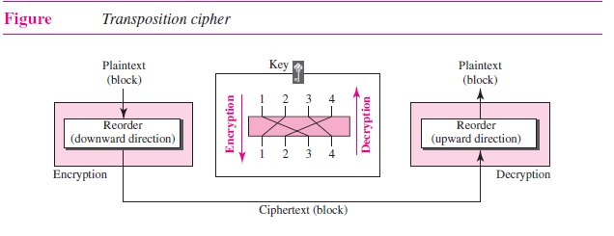
Transposition Cipher

Slide 28
Example - Transposition Ciphers
Example
Encrypt the message “HELLO MY DEAR,” using the above key.
Solution
We first remove the spaces in the message. We then divide the text into blocks of four characters.
We add a bogus character Z at the end of the third block. The result is HELL OMYD EARZ. We
create a three-block ciphertext ELHLMDOYAZER.
Example
Using Example 30.5, decrypt the message “ELHLMDOYAZER”.
Solution
The result is HELL OMYD EARZ. After removing the bogus character and combining the characters,
we get the original message “HELLO MY DEAR.”

Slide 29
Keyed Transposition Ciphers
The keyless ciphers permute the characters by writing plaintext in one way and reading it in another way
  The permutation is done on the whole plaintext to create the whole ciphertext
Keyed transposition cipher
  Divide the plaintext into groups of predetermined size, called blocks
  and then use a key to permute the characters in each block separately

Slide 30
Keyed Transposition Ciphers
Alice needs to send the message “Enemy attacks tonight” to Bob..
The key used for encryption and decryption is a permutation key, which shows how the character are permuted.
The permutation yields

Slide 31
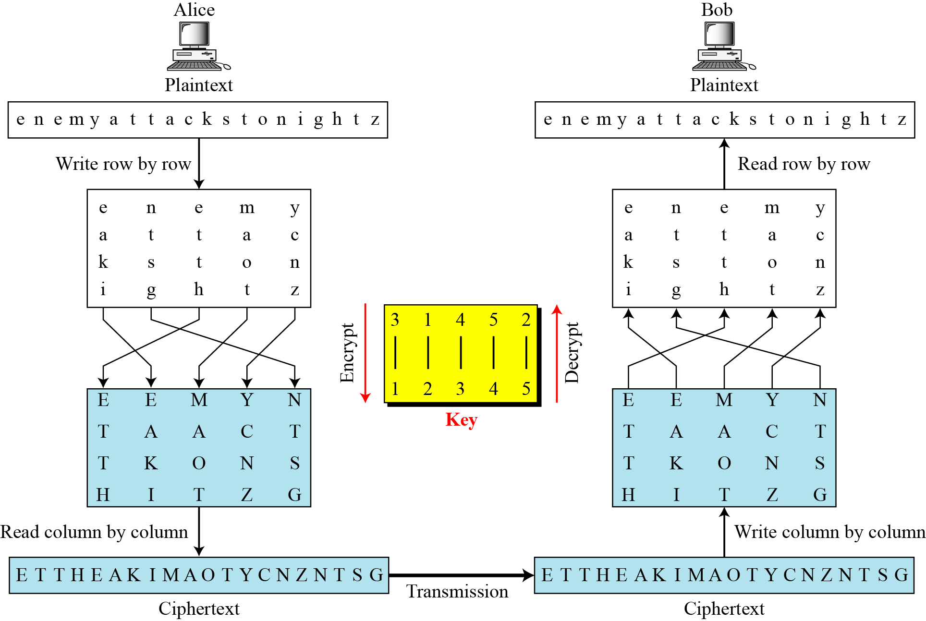
Combining two approaches

Slide 32
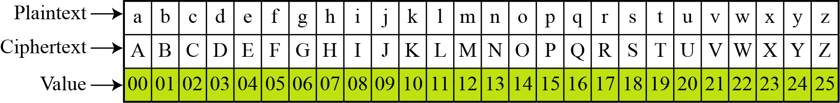
Additive Cipher
The simplest monoalphabetic cipher is the additive cipher. This cipher is sometimes called a shift cipher and sometimes a Caesar cipher, but the term additive cipher better reveals its mathematical nature.
Figure 3.8 Plaintext and ciphertext in Z₂₆

Slide 33
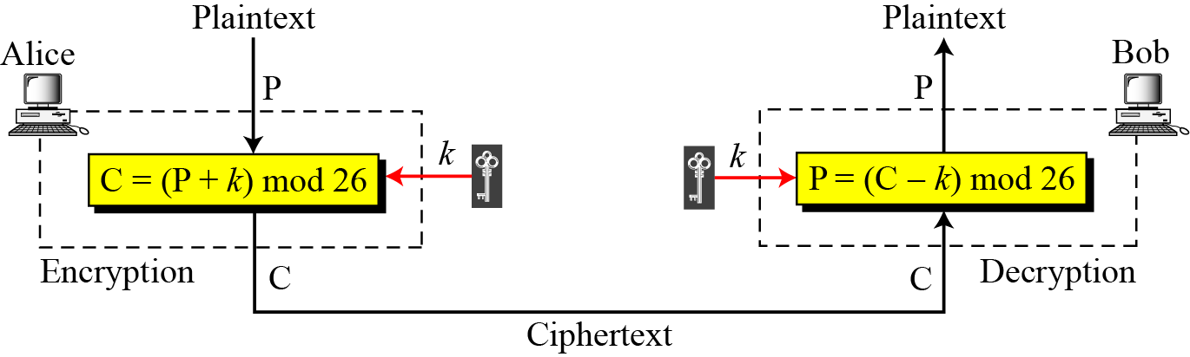
Additive Cipher
Note
When the cipher is additive, the plaintext, ciphertext, and key are integers in Z₂₆.

Slide 34
Additive Cipher - Continued
Use the additive cipher with key = 15 to encrypt the message “hello”.
Solution
We apply the encryption algorithm to the plaintext, character by character:

Slide 35
Additive Cipher - Continued
Use the additive cipher with key = 15 to decrypt the message “WTAAD”.
Solution
We apply the decryption algorithm to the plaintext character by character:

Slide 36
Shift Cipher and Caesar Cipher
Historically, additive ciphers are called shift ciphers. Julius Caesar used an additive cipher to communicate with his officers. For this reason, additive ciphers are sometimes referred to as the Caesar cipher. Caesar used a key of 3 for his communications.
Note
Additive ciphers are sometimes referred to as shift ciphers or Caesar cipher.

Slide 37
Example - Continued
Eve has intercepted the ciphertext “UVACLYFZLJBYL”. Show how she can use a brute-force attack to break the cipher.
Solution
Eve tries keys from 1 to 7. With a key of 7, the plaintext is “not very secure”, which makes sense.

Slide 38
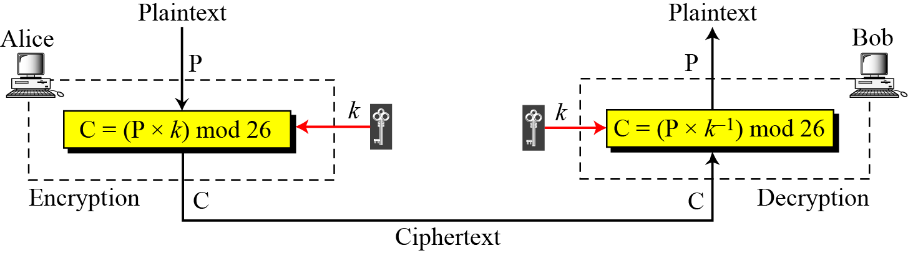
Multiplicative Ciphers
Figure 3.10 Multiplicative cipher
Note
In a multiplicative cipher, the plaintext and ciphertext are integers in Z₂₆; the key is an integer in Z26*.

Slide 39
Multiplicative Ciphers - Continued
Example 3.7
What is the key domain for any multiplicative cipher?
Solution
The key needs to be in Z₂₆*. This set has only 12 members: 1, 3, 5, 7, 9, 11, 15, 17, 19, 21, 23, 25.
We use a multiplicative cipher to encrypt the message “hello” with a key of 7. The ciphertext is “XCZZU”.
Example 3.8

Slide 40
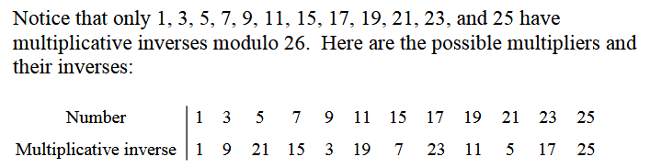
Multiplicative Ciphers - Continued

Slide 41
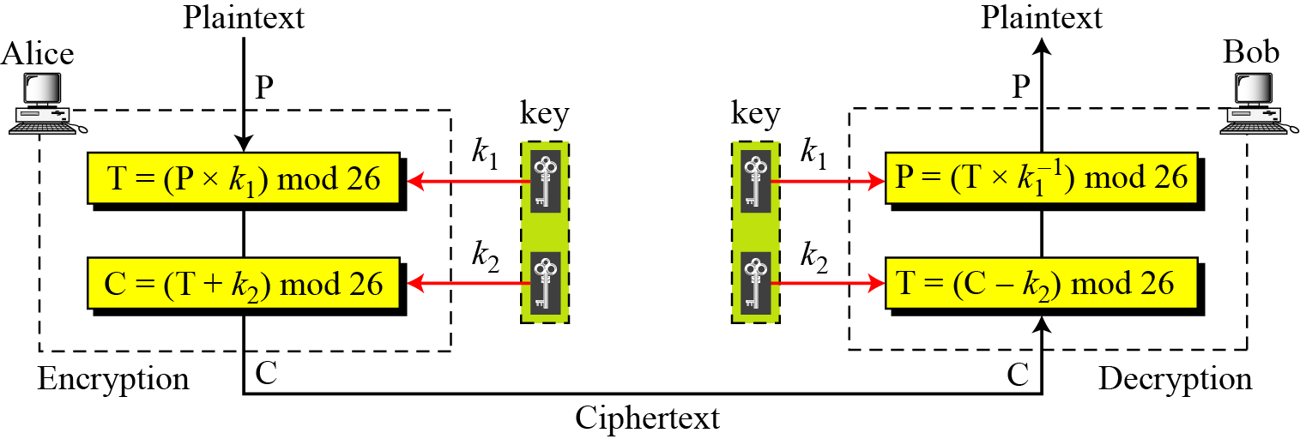
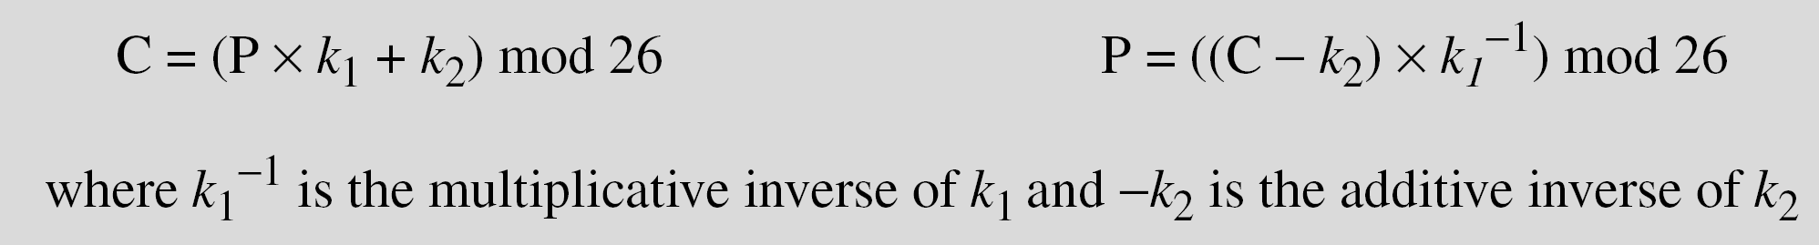
Affine ciphers

Slide 42
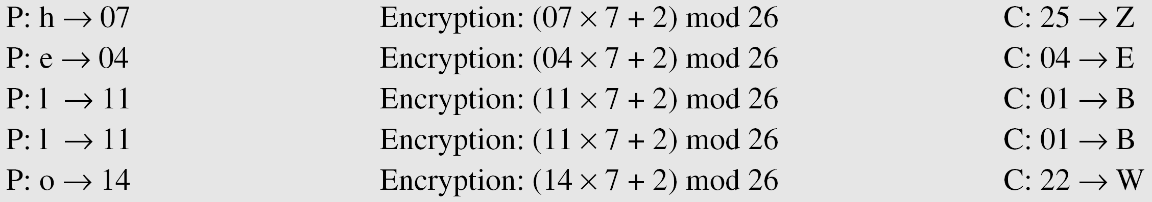
Affine ciphers
The affine cipher uses a pair of keys in which the first key is from Z₂₆* and the second is from Z₂₆. The size of the key domain is 26 × 12 = 312.
Use an affine cipher to encrypt the message “hello” with the key pair (7, 2).

Slide 43
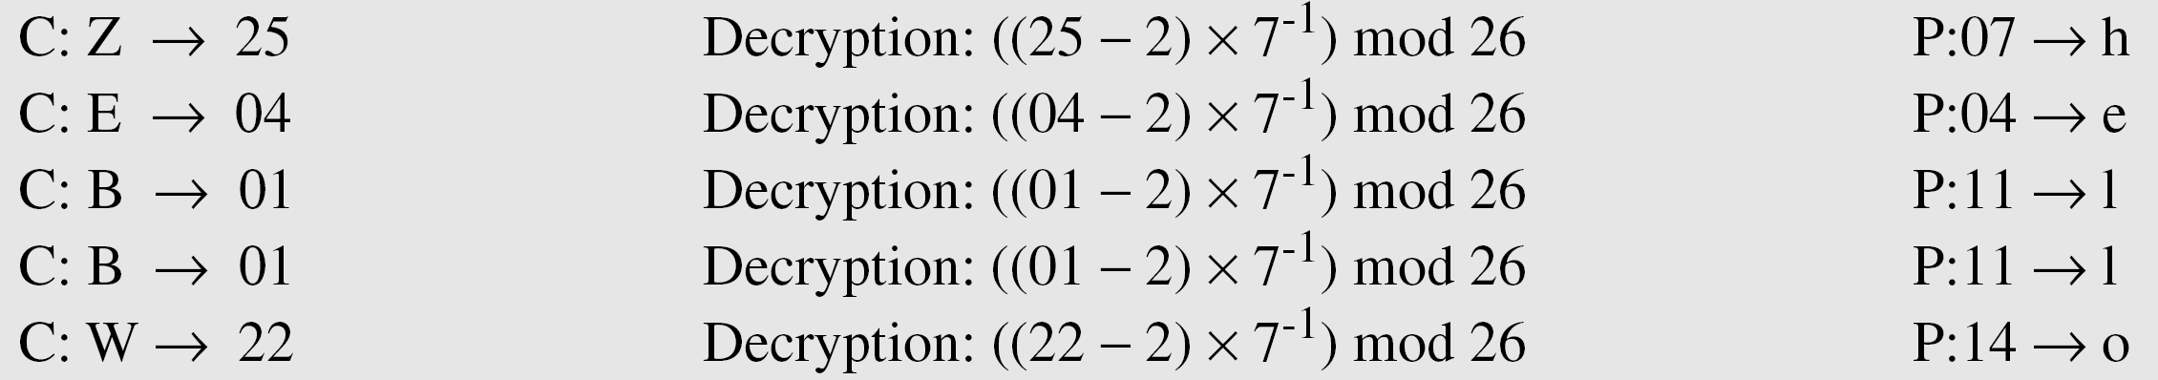
Affine ciphers
Use the affine cipher to decrypt the message “ZEBBW” with the key pair (7, 2) in modulus 26.
Solution

Slide 44
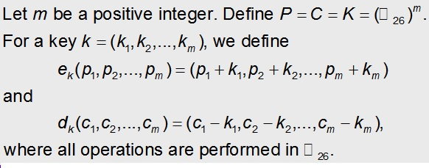
The Vigenere Cipher( Polyalphabetic Cipher )
The Vigenère Cipher is a polyalphabetic cipher. Thus the cipher can map an alphabetic character to several other characters.
This cipher is named after Blaise de Vigenère (16th century). Yet it was first described by Giovan Batista Belaso in 1553.
The number of possible keywords of length m is 26^{m}.

Slide 45
The Vigenere Cipher
A | B | C | D | E | F | G | H | I | J | K | L | M
0 | 1 | 2 | 3 | 4 | 5 | 6 | 7 | 8 | 9 | 10 | 11 | 12
N | O | P | Q | R | S | T | U | V | W | X | Y | Z
13 | 14 | 15 | 16 | 17 | 18 | 19 | 20 | 21 | 22 | 23 | 24 | 25
To encipher a message we again make use of the table
  Both the key and the original plaintext have to be written as sequence of integers.
  An integer string corresponding to the message is split on n blocks of size m, where m is length of the key.
  The keyword is added (modulo 26) to each block.
Decryption is similar, except that the keyword is subtracted (modulo 26) from each ciphertext block.

Slide 46
The Vigenere Cipher
A simple example:
The plaintext is “attackatdawn” and the keyword is “cipher”, thus m = 6.
The numerical equivalent of k is (2 8 15 7 4 17).
The plaintext can be written using integers as
(0 19 19 0 2 10 0 19 3 14 22 13).
Now we split the plaintext message in two blocks of six, and add the keyword modulo 26 to each of them
0 19 19 0 2 10 0 19 3 14 22 13
2 8 15 7 4 17 2 8 15 7 4 17
2 1 8 7 6 1 2 1 18 21 0 4
Thus the ciphertext is “CBIHGBCBSVAE”.

Slide 47
The Vigenere Cipher
A simple example (cont.):
To decrypt the ciphertext “CBIHGBCBSVAE”, we follow the same sequence of steps.
The numerical equivalent of k is (2 8 15 7 4 17).
The ciphertext can be written using integers as
(2 1 8 7 6 1 2 1 18 21 0 4).
Now subtract the keyword modulo 26 from the ciphertext
2 1 8 7 6 1 2 1 18 21 0 4
2 8 15 7 4 17 2 8 15 7 4 17
0 19 19 0 2 10 0 19 3 14 22 13
We were able to recover the original plaintext, which is “attackatdawn”.

