Slide 1
Chapter-5
Design and Analysis of soil Retaining structure

Slide 2
Objectives
At the end of the course, participants should:
  Appreciate the preliminary decision making process necessary for retaining wall design
  Understand the nature, variability and impact of geotechnical considerations on the overall design
  Appreciate the effects of the construction process and sequence on the design and performance of retaining walls

Slide 3
Introduction
The design and construction of retaining structures forms an integral part of many civil engineering projects.
They comprise a number of elements and may restrain the soil by virtue of their mass, or because they are embedded, propped and/or anchored.
To design a retaining structure it is necessary to understand the soil and its behavior, the ground water conditions, how wall is constructed and how the soil and the structure interact.

Slide 4
Retaining wall

Slide 5
Classification of retaining walls
In general retaining walls classified into two major categories further subdivisions:
  Conventional retaining walls
    Gravity retaining walls
    Semi-gravity retaining walls
    Cantilever retaining walls
    Counter fort retaining walls
  Mechanically stabilized earth walls (MSE)

Slide 6
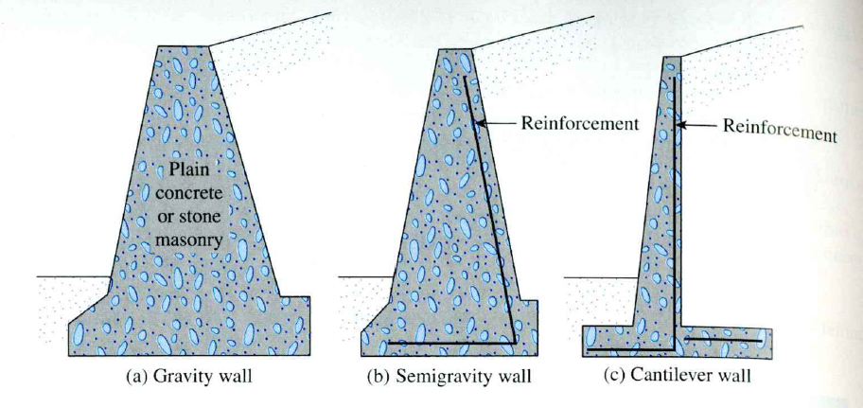

Slide 7
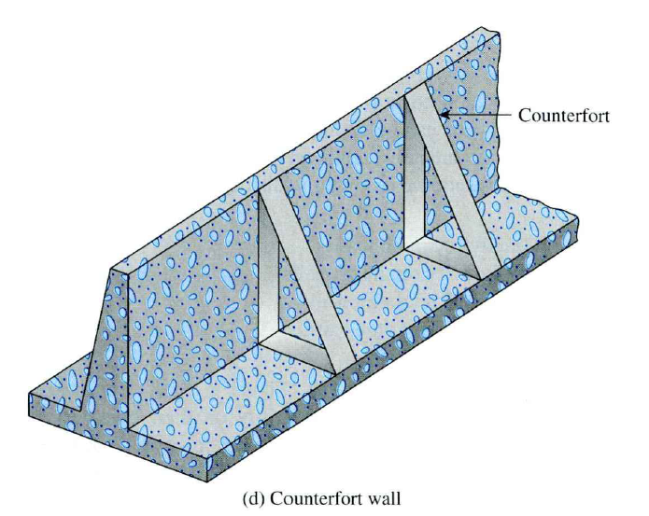

Slide 8
O’Rourke & Jones classification
O’Rourke & Jones (1990) classified earth-retaining structures into two broad categories:
  Externally stabilized systems and
  Internally stabilized systems
    Reinforced soils e.g. MSE
    In-situ reinforcement e.g. soil nailing
Externally stabilized systems are those that resist the applied earth loads by virtue of their weight & stiffness.
Internally stabilized systems reinforce the soil to provide the necessary stability.

Slide 9
Earth-retaining structure
Externally stabilized systems
Internally stabilized systems
In-situ walls
Gravity walls
Reinforced soils
In-situ Reinforcement
Cantilevered
Braced
Tied-Back

Slide 10
Design of conventional Retaining wall
The stability of a gravity wall is maintained mostly by its weight and partly by the passive resistance mobilized by the soil at the front of the wall.
There are two phases of design in retaining wall:
  1st the LEP known, the structure as a whole is checked for stability, overturning, sliding, and bearing capacity failures.
  2nd each component of the structure is checked for strength, and the steel reinforcement of each component is determined.

Slide 11
Design Steps
Determine:
earth pressures
resultant thrust behind wall
soil reactions at base of wall (footing)
location of resultant soil reaction on base
  take moments of all forces about toe of wall
Note:-
  N must be located within the middle third of the base to avoid tensile stress under the heel.
  The contact pressure at the toe must be equal to or less than the allowable bearing pressure.
  The settlement of the toe must be within the tolerable limits.

Slide 12
Gravity and cantilever walls
In designing retaining walls, an engineer must assume some of the dimensions– proportioning
If the stability analysis yields undesirable results, the section can be changed and rechecked.
The figures in the next slide shows the general proportions of various retaining-wall components that can be used for initial check.

Slide 13
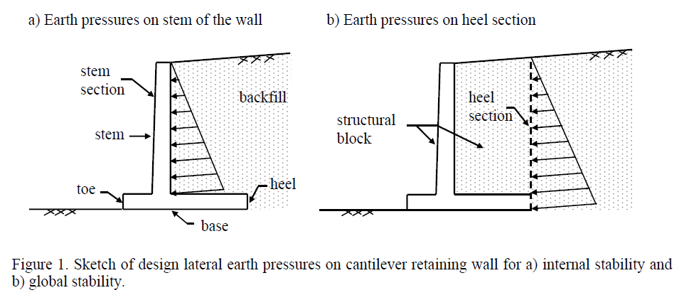
Global stability (e.g. sliding and overturning) and
Internal stability (e.g. structural adequacy of the stem and base of the wall).

Slide 14
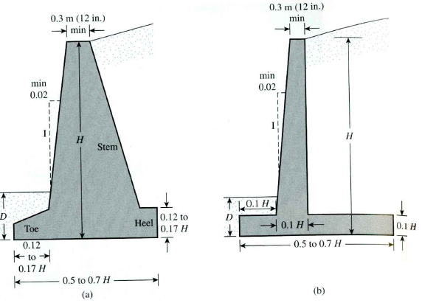

Slide 15
Counterfort retaining wall
Long cantilever retaining walls are often supported along their length by counterforts to increase their rigidity and strength.
The general proportioning of the stem and the base slab is the same as for cantilever walls.
However, the counterfort slabs may be about 0.3 m thick and spaced at center-to-center distances of 0.3H to 0.7H.

Slide 16
Application of lateral earth pressures theories to design
In the case of cantilever walls, the use of Rankine’s earth pressure theory for stability checks involves drawing a vertical line AB through the point A as shown in the next slide.
In the analysis of the wall’s stability, the force P_{a(Rankine)}, the weight of the soil above the heel, and the weight W_{c} of the concrete all should be taken into consideration.
The assumption for the development of Rankine active pressure along the soil face AB is theoretically correct if the shear zone bounded by the line AC is not obstructed by the stem of the wall.

Slide 17
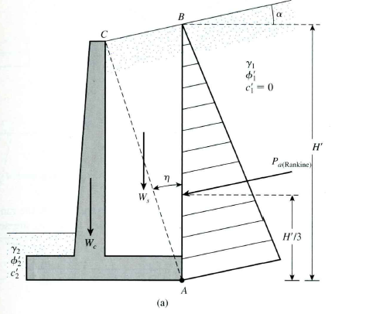
The angle, η, that the line AC makes with the vertical is:

Slide 18
Gravity walls
Similar analysis can be carried out for gravity walls in Rankine’s theory.
Coulomb’s active earth pressure theory can also be used for gravity walls with the consideration of only P_{a(Coulomb)} and W_{c} as shown in the next slid.

Slide 19
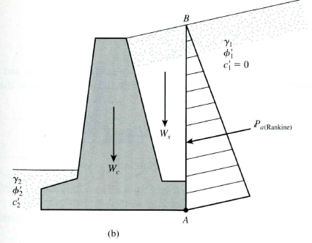
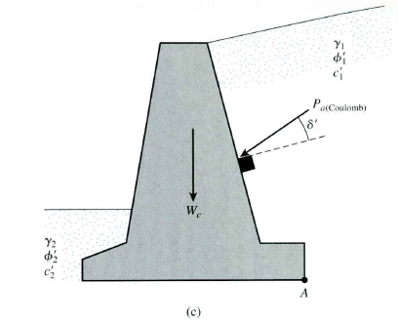

Slide 20
Failure mechanism of retaining walls
A retaining wall may fail in any of the following ways:
  It may overturn about its toe.
  It may slide along its base.
  It may fail due to the loss of bearing capacity of the soil supporting the base.
  It may undergo deep-seated shear failure
  It may go through excessive settlement.

Slide 21
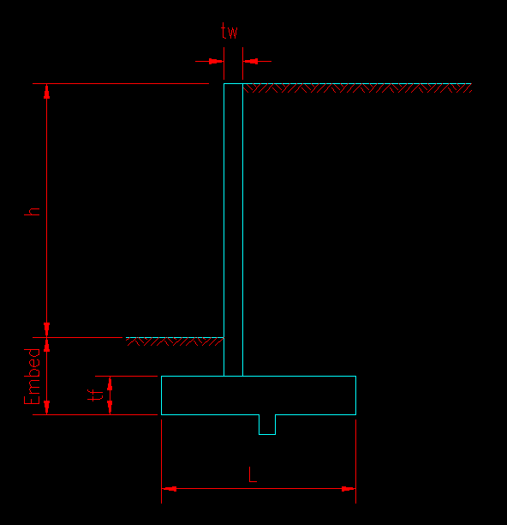
Cantilever Retaining Wall
Stem
Toe
Heel
Shear Key

Slide 22
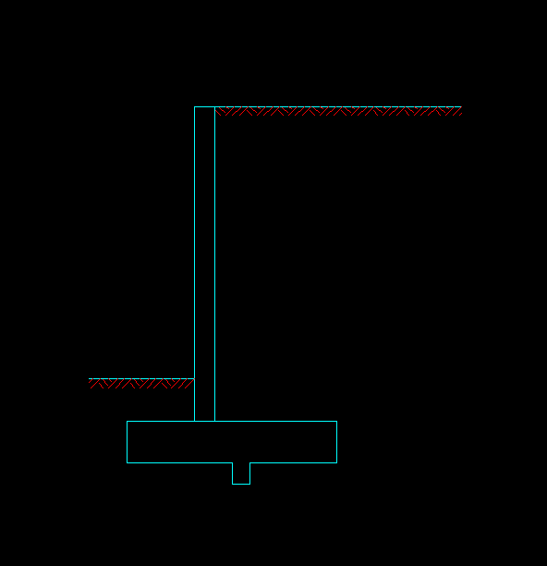
Forces ACTING ON the Wall
Soil on Heel
Active Lateral Soil Pressure
Wall
Soil on Toe
Footing
Shear Key

Slide 23
Reactions
Passive Lateral Soil Pressure
ACTUAL FRICTION
is not the same as FRICTION CAPACITY!
Friction
Vertical Reaction

Slide 24
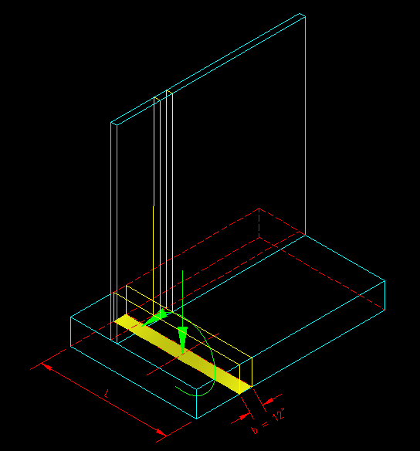
Computing Soil Bearing Stress
Resolve applied forces into a concentric vertical force and moment on the contact area.
I_{x} = bL³/12
A = bL
c = L/2
σ_{max} = P/A + Mc/I_{x}
σ_{min} = P/A – Mc/I_{x}
P
M

Slide 25
Sliding
V_{slide} = Driving Force = Demand
V_{resist} = sum(Resisting Forces) = Capacity
Driving Force
FS = V_{resist} / V_{slide}
Resisting Capacity
Design for
FS > 1.5
Friction CAPACITY = μ N
Not Actual Friction Reaction

Slide 26
Overturning
M_{OT} = Driving Force*arm = Demand
Resisting Forces
M_{ROT} = sum(Resisting Moments) = Capacity
Driving Force
FS = M_{ROT} / M_{OT}
Design for
FS > 2.0
Point of Rotation

Slide 27
Draw FBDs
Stem
Toe
Heel

Slide 28
Stability Criteria
The stability of the retaining wall should be checked against :
FOS against overturning (recommended FOS = 2.0)
(ii) FOS against sliding (recommended FOS = 2.0)

Slide 29
Stability Analysis
The stability of the retaining wall should be checked against :
FOS against overturning (recommended FOS = 2.0)
∑ V
Pa
P_{p}
.. overturning about A
A

Slide 30
Stability Criteria
FOS against sliding (recommended FOS = 2.0)
∑ V
Pa
P_{p}
Friction & wall base adhesion

Slide 31
Stability Criteria
  For base pressure (to be compared against the bearing capacity of the founding soil. Recommended FOS = 3.0)
Now, Lever arm of base resultant
Thus eccentricity

Slide 32
Stability Analysis
∑ V
P_{a}
P_{p}
Base pressure on the founding soil

Slide 33
Worked example :
Figure below shows the cross-section of a reinforced concrete retaining structure. The retained soil behind the structure and the soil in front of it are cohesionless and has the following properties:
SOIL 1 : φ = 35º, γ_{d} = 17 kN/m³,
SOIL 2 : φ = 30º, δ = 25º , γ_{d} = 18 kN/m³,
γ_{sat} = 20 kN/m³
The unit weight of concrete is 24 kN/m³. Taking into account the passive resistance in front of the wall, determine a minimum value for the width of the wall to satisfy the following design criteria:
Factor of safety against overturning > 2.5
Factor of safety against sliding > 1.5
Maximum base pressure should not exceed 150 kPa

Slide 34
PROBLEM
30 kN/m²
0.5 m
SOIL 1
2.0 m
4.0 m
GWT
SOIL 2
2.9 m
SOIL 2
0.6 m
4.5 m
2.0 m

Slide 35
SOLUTION
30 kN/m²
0.5 m
SOIL 1
W1
2.0 m
P₁
P₃
W3
GWT
4.0 m
SOIL 2
P₂
P₄
W41
2.9 m
W2
SOIL 2
P_{P}
P₆
0.6 m
P₅
4.5 m
2.0 m

Slide 36
Determination of the Earth Pressure Coefficients

Slide 37
LATERAL EARTH PRESSURE
Stability Analysis

Slide 38
To check for stability of the retaining wall
FOS against overturning
> 2.5
(ii) FOS against sliding > 1.5
Thus it is not OK

Slide 39
  (iii) For base pressure
Now, Lever arm of base resultant
Thus eccentricity
Therefore

Slide 40
q_{b} = 120.8 and 80.5 kPa
Since maximum base pressure is less than the bearing pressure of the soil, the foundation is stable against base pressure failure.
DISTRIBUTION OF BASE PRESSURE
80.5 kPa
120.8 kPa
In conclusion the retaining wall is not safe against sliding. To overcome this the width of the base may be increased or a key constructed at the toe.

Slide 41
Structural Design Process
Select the overall dimensions (height, embedment, footing length and position, and estimated footing & wall thicknesses) based on stability (sliding and overturning) and soil strength (max/min bearing pressures) using service level loads.
Check slab (wall and footing) thicknesses using shear criteria and factored loads. Adjust thicknesses as necessary, rechecking stability and soil strength of the values change.
Select the flexural steel for the three cantilever slab elements using factored loads.
Select the temperature and shrinkage steel for wall and footing.
Draw the resulting wall cross section (to scale!)

Slide 42
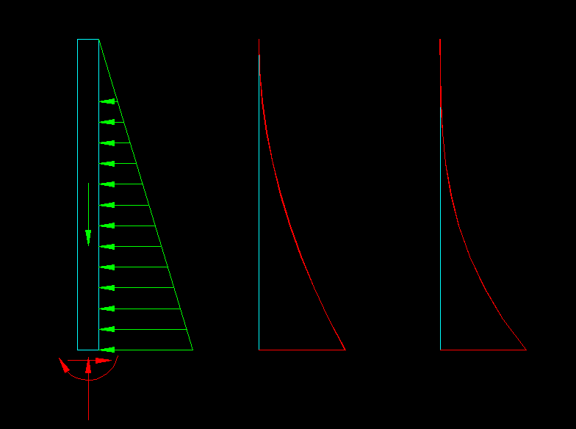
Shear
Moment
FBD
Make stem thick enough for shear
Add T&S Steel
Capacity
Demand
Capacity
Demand
Select Steel to provide flexural capacity

Slide 43
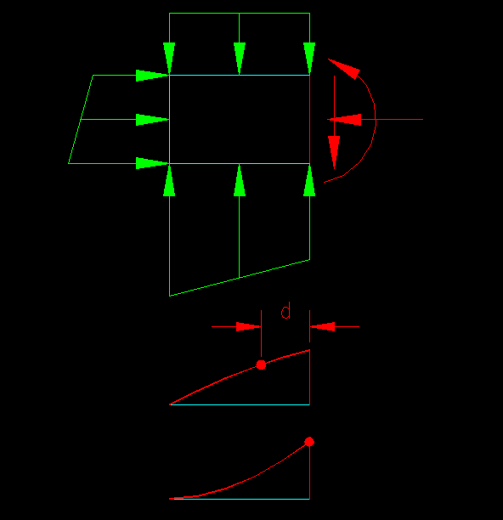
Toe
Add T&S Steel
V_{u} can be calculated a distance ‘d’ from face of wall since there is a compressive reaction with the wall.
Flexural Steel extends a development length into the heel and should develop within the length of the toe.
Design Shear
Shear
M_{u} is computed at the face of the wall.
Design Moment
Moment

Slide 44
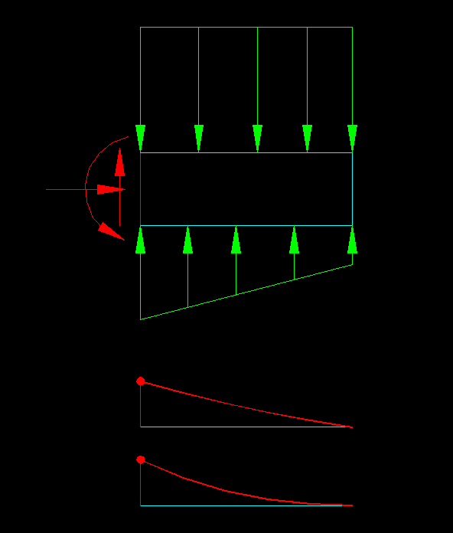
Heel
V_{u} must be calculated at the face of wall since there is a tensile reaction with the wall.
Flexural Steel extends a development length into the toe and should develop within the length of the heel.
Add T&S Steel
Design Shear
M_{u} is computed at the face of the wall.
Shear
Design Moment
Moment

Slide 45
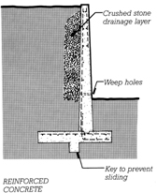
Design Elements to Prevent Failure
Relieve water pressure
  (for all 3 types of failure)
  Crushed stone
  Weeps
Overturning
  Cantilevered Footing
  Reinforcing
Sliding
  Key

Slide 46
Mechanically Stabilized Retaining Walls

Slide 47
Introduction
Recently, soil reinforcement has been used in the construction and design of foundations, retaining walls, embankment slopes, and other structures.
Depending on the type of construction, the reinforcements may be galvanized metal strips, geotextiles, geogrids, or geocomposites.
Reinforcement materials such as metallic strips, geotextiles, and geogrids are now being used to reinforce the backfill of retaining walls, which are generally referred to as mechanically stabilized retaining walls.

Slide 48
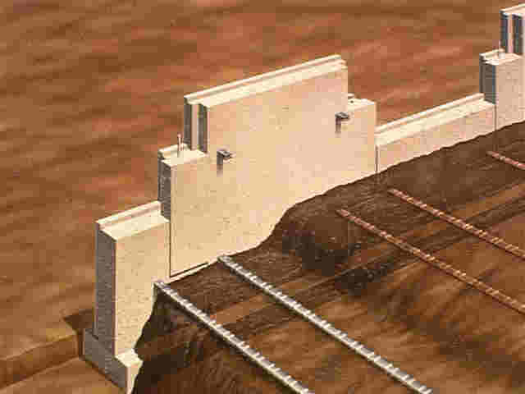
Mechanically Stabilized Earth (MSE) Retaining Walls

Slide 49
Introduction …
The beneficial effects of soil reinforcement derive from:
  the soil’s increased tensile strength and
  the shear resistance developed from the friction at the soil reinforcement interfaces.
Such reinforcement is comparable to that of concrete structures.

Slide 50
Improved earth walls or internally stabilized systems
Improved earth walls consist of stabilized backfill soil and facing elements.
Improvement of the soil (apart from compaction) is carried out either by means of chemicals such as cement or lime or other chemicals or by using inclusions. Woven
Soils stabilized by cement or lime normally fall into the category of a Mohr-Coulomb material with improved shear strength parameters.

Slide 51
Soil reinforcement
A mechanically stabilized soil is reinforced by strips or grids that may be metallic, polymeric or organic.
A mixture of soil and polymeric elements of fine diameter and small length has also been used.
The main objective is to transfer the tensile stresses to reinforcement elements.
Anchored earth systems combined by soil reinforcement have been developed and applied successfully in highway construction.

Slide 52
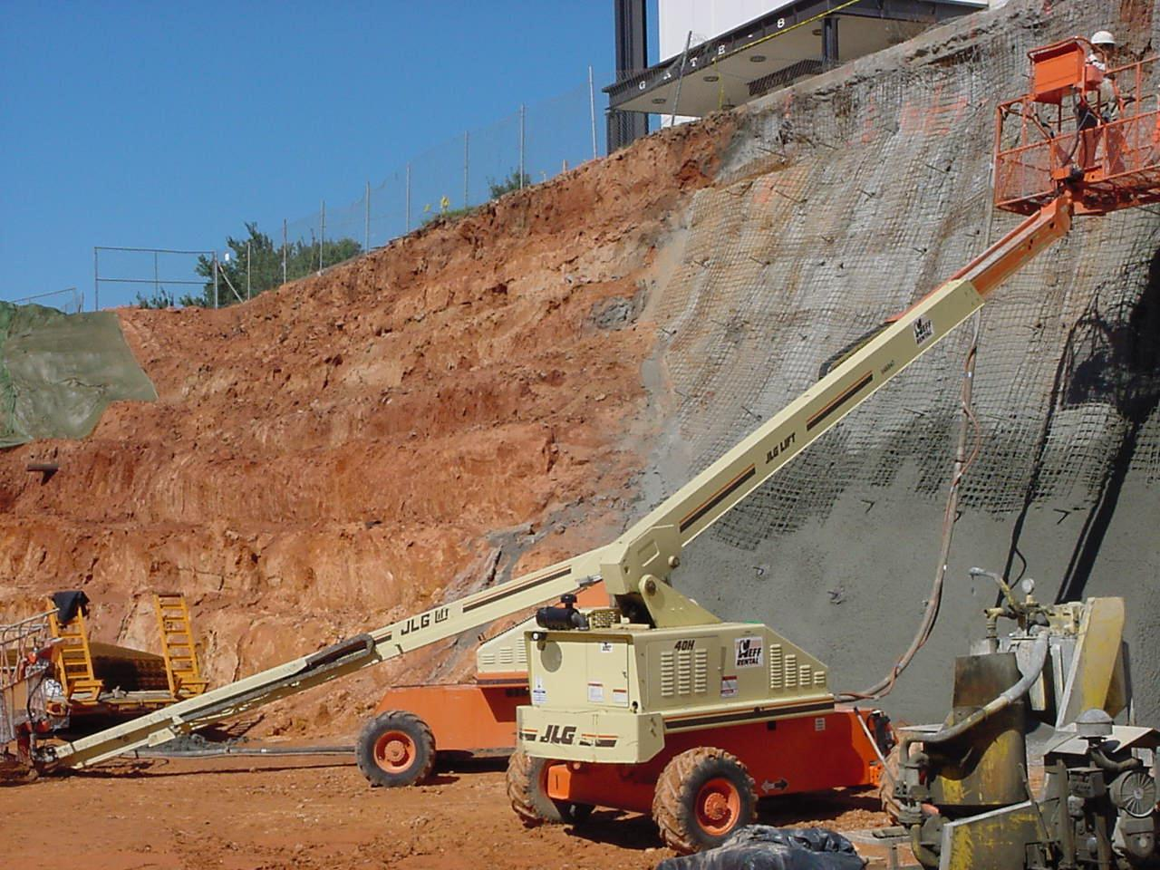
Bank Requiring a Retention System
The in-situ reinforcement includes soil nailing and dwelling by means of grouted bars as shown in Figure.

Slide 53
Considerations in Soil Reinforcement
Metal Strips : In most instances, galvanized steel strips are used as reinforcement in soil.
Non-biodegradable Fabrics: Non-biodegradable fabrics are generally referred to as geotextiles.

Slide 54
Reinforcement Material
There are two types of materials used
  Metallic reinforcements
    Typically mild steel (galvanized / epoxy coated)
  Nonmetallic reinforcement
    Generally polymeric materials (polypropylene, polyethylene or polyester)

Slide 55
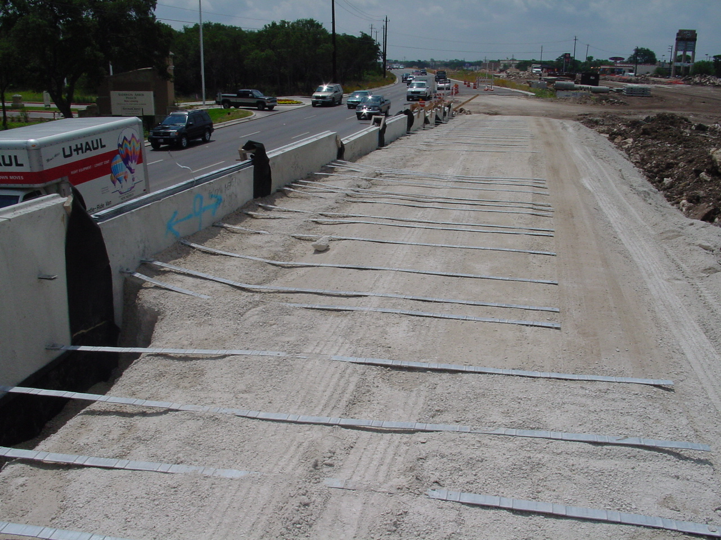
Reinforcement Material
Galvanized Steel Strips

Slide 56
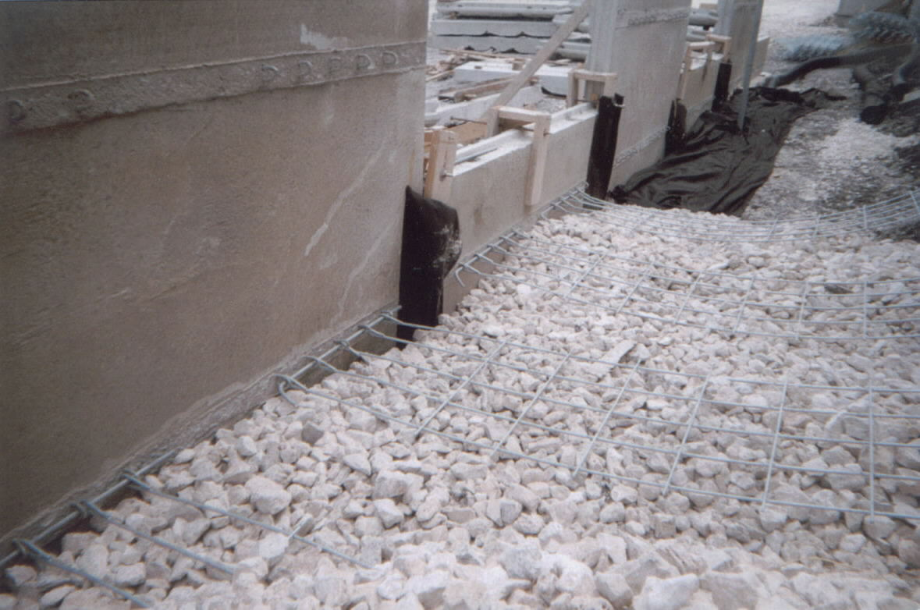
Reinforcement Material
Galvanized Wire Mesh

Slide 57
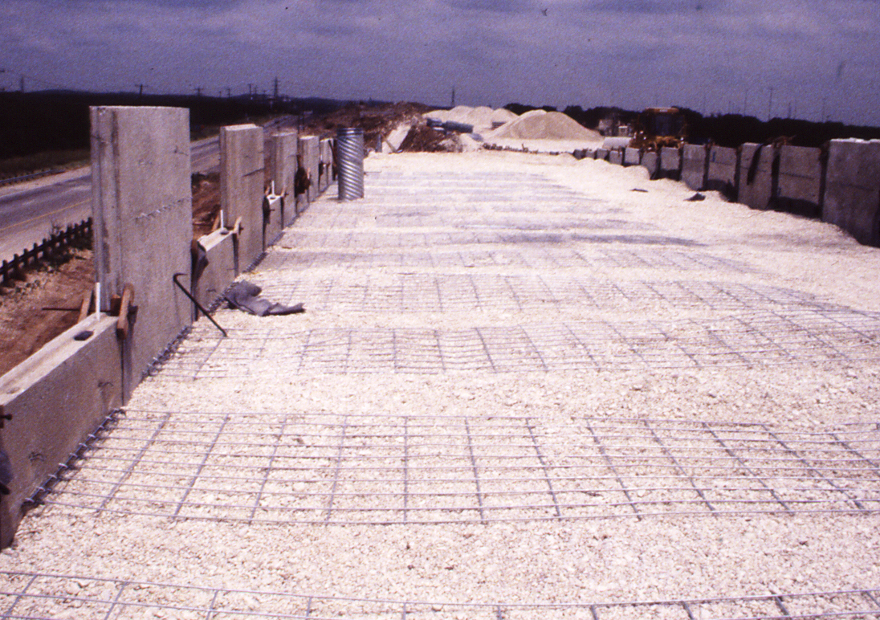
Reinforcement Material
Galvanized Wire Mesh

Slide 58
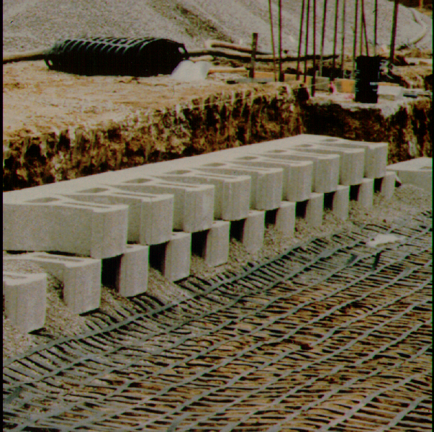
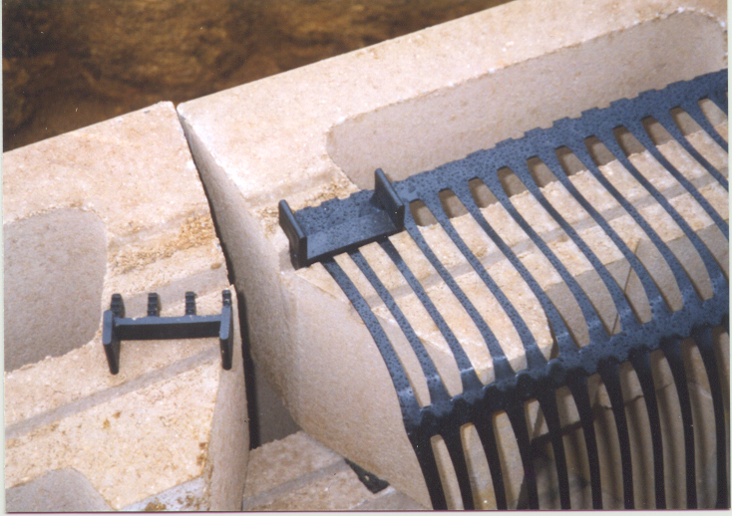
Reinforcement Material
Geogrids

Slide 59
Primary uses Geo-textiles
Geo-textiles have four primary uses in foundation engineering:
Drainage: The fabrics can rapidly channel water from soil to various outlets, thereby providing a higher soil shear strength and hence stability.
Filtration: When placed between two soil layers, one coarse grained and the other fine grained, the fabric allows free seepage of water from one layer to the other. However, it protects the fine-grained soil from being washed into the coarse-grained soil.

Slide 60
Primary uses Geo-textiles
Separation: Geo-textiles help keep various soil layers separate after construction and during the projected service period of the structure. For example, in the construction of highways, a clayey sub-grade can be kept separate from a granular base course.
Reinforcement: The tensile strength of geo-fabrics increases the load-bearing capacity of the soil.

Slide 61
Geogrids
Geogrids are high-modulus polymer materials, such as polypropylene and polyethylene, and are prepared by tensile drawing.
The major function of geogrids is reinforcement.
Geogrids are relatively stiff netlike materials with openings called apertures that are large enough to allow interlocking with the surrounding soil or rock to perform the function of reinforcement or segregation (or both).

Slide 62
Geogrid types
Geogrids generally are of two types:
  Uniaxial and
  Biaxial
Uniaxial TENSAR grids are manufactured by stretching a punched sheet of extruded high-density polyethylene in one direction under carefully controlled conditions - results in a product with high one-directional tensile strength and a high modulus.

Slide 63
  Biaxial
Biaxial TENSAR grids are manufactured by stretching the punched sheet of polypropylene in two orthogonal directions.
This process results in a product with high tensile strength and a high modulus in two perpendicular directions.

Slide 64
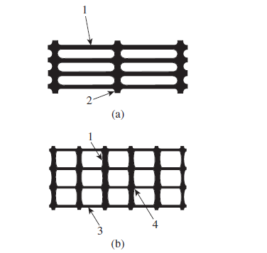
Figure Geogrids: (a) uniaxial; (b) biaxial
(Note: 1—longitudinal rib; 2—transverse bar; 3—transverse rib; 4—junction)

Slide 65
General Design Considerations
The general design procedure of any mechanically stabilized retaining wall can be divided into two parts:
Satisfying internal stability requirements
Checking the external stability of the wall
The internal stability checks involve determining tension and pullout resistance in the reinforcing elements and ascertaining the integrity of facing elements.
The external stability checks include checks for overturning, sliding, and bearing capacity failure.

Slide 66
Retaining Walls with Metallic Strip Reinforcement
Reinforced-earth walls are flexible walls. Their main components are
  Backfill, which is granular soil
  Reinforcing strips, which are thin, wide strips placed at regular intervals, and
  A cover or skin, on the front face of the wall
The simplest and most common method for the design of ties is the Rankine method.

Slide 67
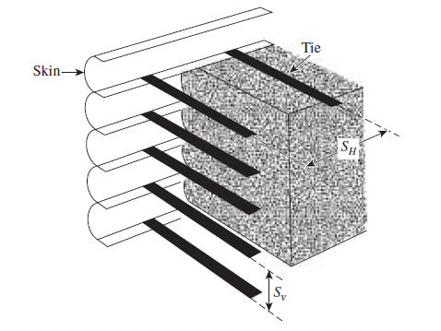

Slide 68
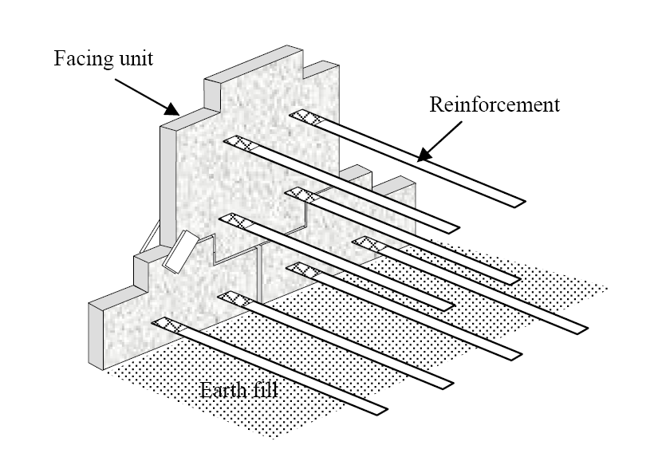
Component of E.R. Wall

Slide 69
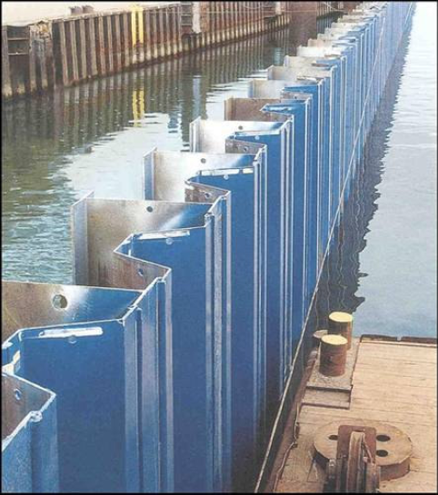
Sheet pile Walls

Slide 70
Introduction
Steel sheet piles were originally used for temporary cofferdams. Since 1930 they have been used for permanent maritime works, such as quay walls, jetties, locks, dikes, dry docks and floodwalls. However, their use was limited by a lack of understanding their structural behavior.
Steel sheet piles are also used for bridge abutments, retaining walls in cuts and underpasses for railroads and highways, support elements in underground parking.

Slide 71
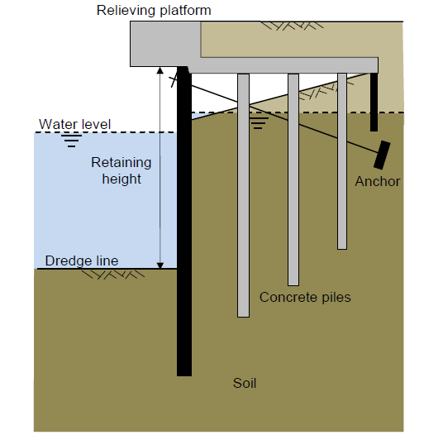
Schematic view of the quay wall

Slide 72
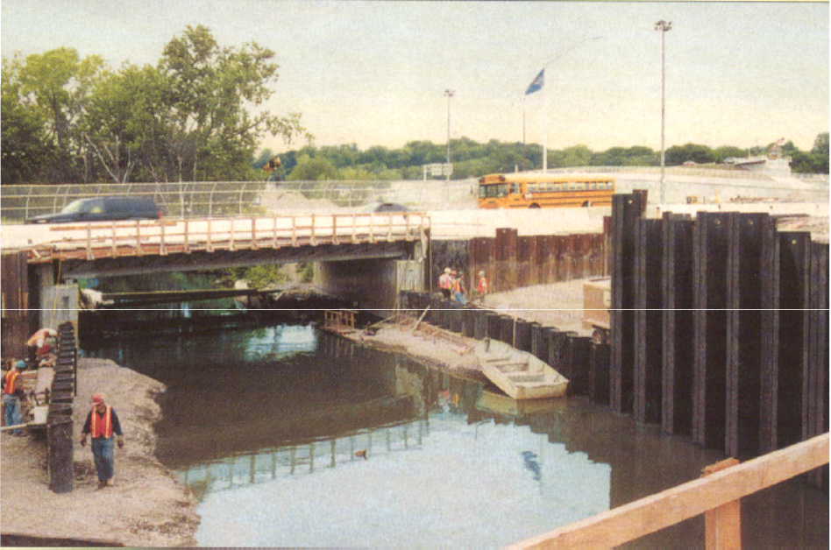
Sheet piling used to expand a bridge’s width, while maintaining highway and river traffic

Slide 73
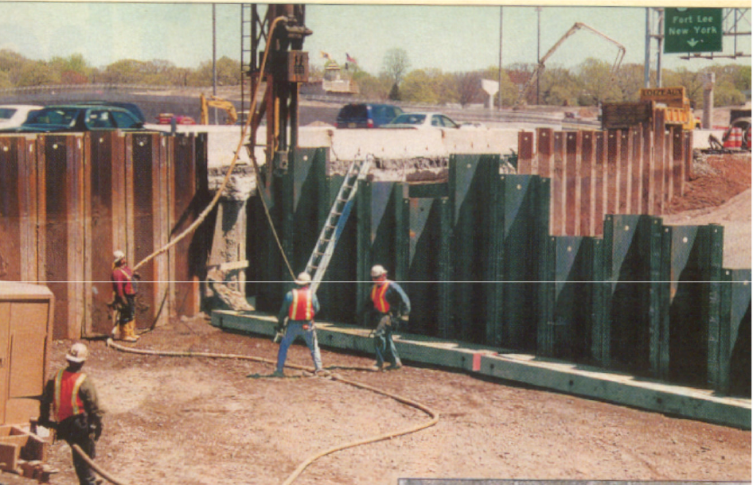
Impact driving of large sized AZ 36 steel sheet piling

Slide 74
Types of Sheet Piles
Wooden sheet piles are typically 2”x12” tongue-and-groove boards. They are only useful for very low walls with a free height of H 3 m. Currently they are only used to stabilize the walls of temporary trenches in order to install sewers and other utilities. They are placed to a working stress of ƒ_{w} = 0.65 to 0.95 f_{y}.
Pre-cast concrete panels.
Steel sheet piles are the most commonly used because they are the only type that can be driven into soft rocks or gravelly soils. They are driven or vibrated into position with high working ƒ_{w} = 0.60 - 0.90 f_{y}. The advantages of using steel sheet piling for walls are,
  they are resistant to high driving stresses
  they are relatively of light weight
  pile length can be increased by welding a new sheet on top of the driven sheet, and
  they can be removed from the ground when finished, and reused.
Aluminum sheet piles.
Plastic sheet (PVC) piles.

Slide 75
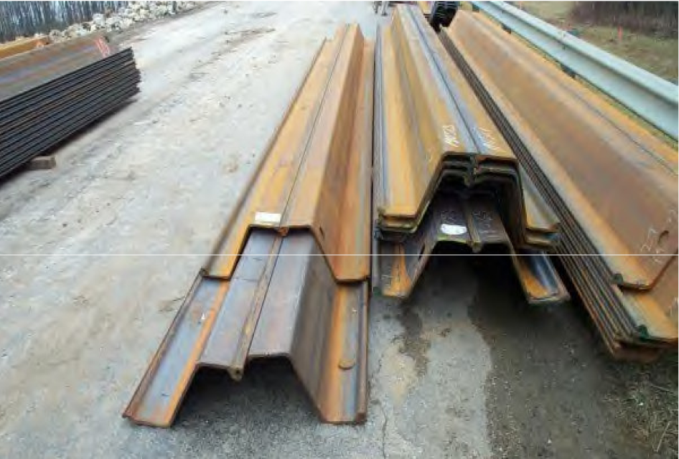
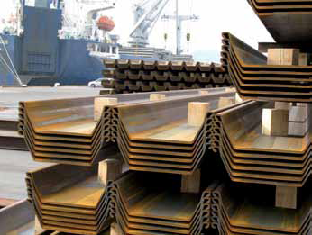

Slide 76
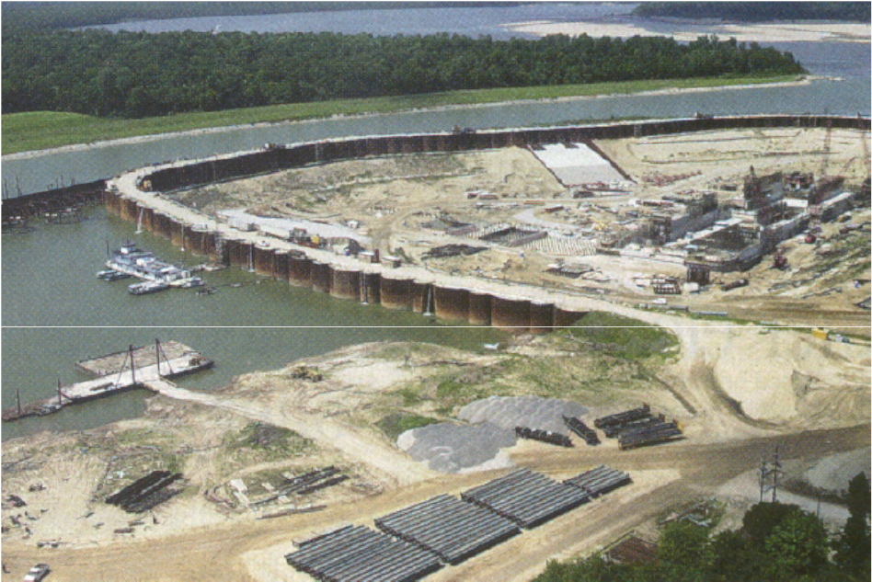
Sheet-piling used to divert a river while building a dam and locks on the White River in Arkansas

Slide 77
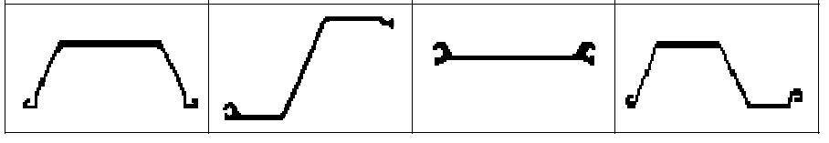
Shape Classifications
Z-type (Z) used for intermediate to deep wall construction | Larssen and other "U" types (U) used for applications similar to Z-piles. | Flat or straight - web types (SA), (S) with strong interlocks, and little beam strength, for filled cell construction | Arch shaped and lightweight "gauge" sheets (A) used for shallower wall construction.

Slide 78
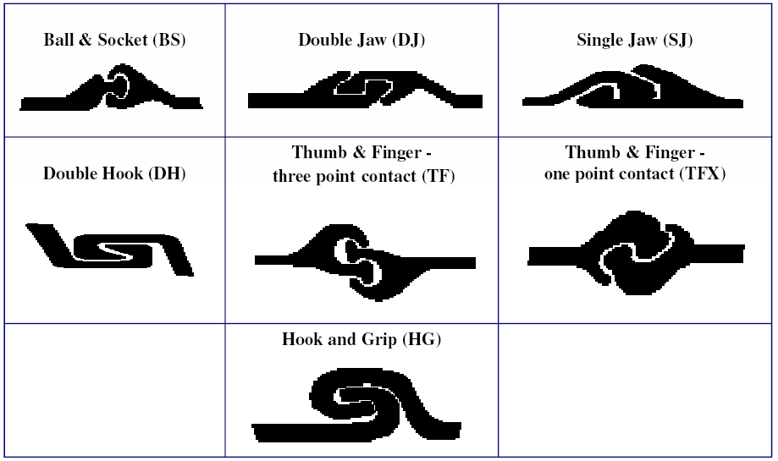
Types of interlocks

Slide 79
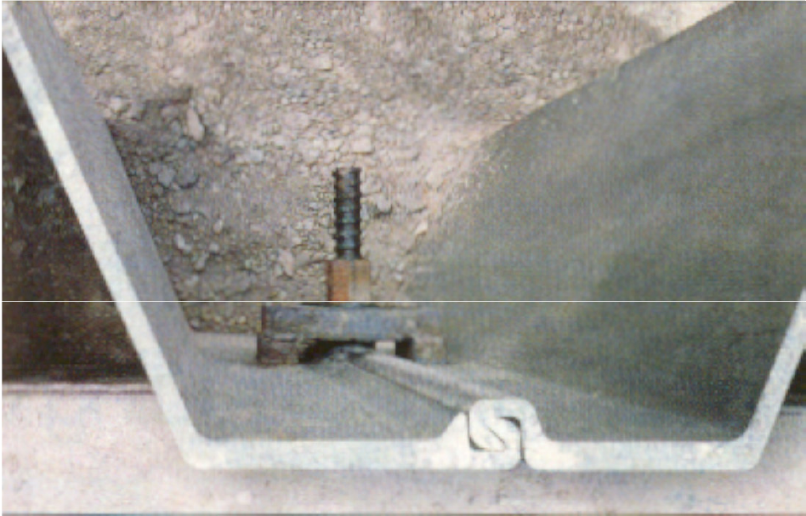

Slide 80
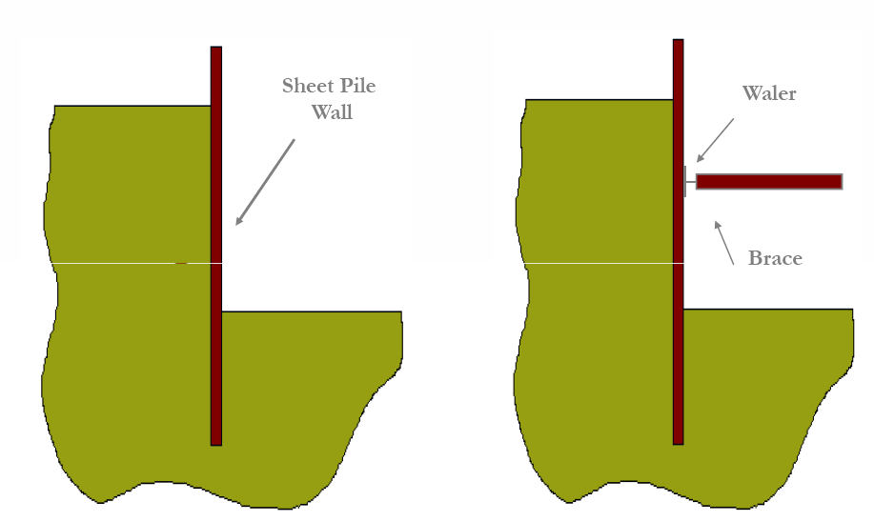
The cantilever wall is like a balcony beam Wall with internal bracing

Slide 81
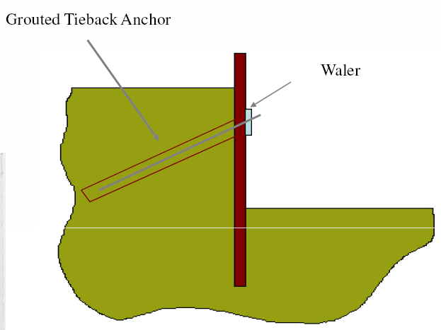
Wall with Tieback Anchors
Earth anchors (tiebacks) are tensile members that apply a stabilizing forces onto the slope. They generally consist usually of steel rods or post-tensioning cables. Their anchoring must be sufficiently extended well beyond the critical failure surface. They are more expensive than internal bracing, such as struts or rakers, but provide an uncluttered excavation and increase the safety of the site.

Slide 82
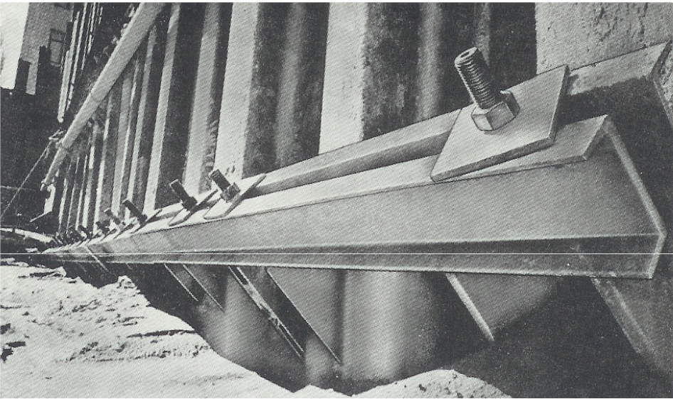
This anchored steel sheet pile wall uses double channel beams for walers. The anchors are Dywidag (threaded) bars bearing on steel plates.

Slide 83
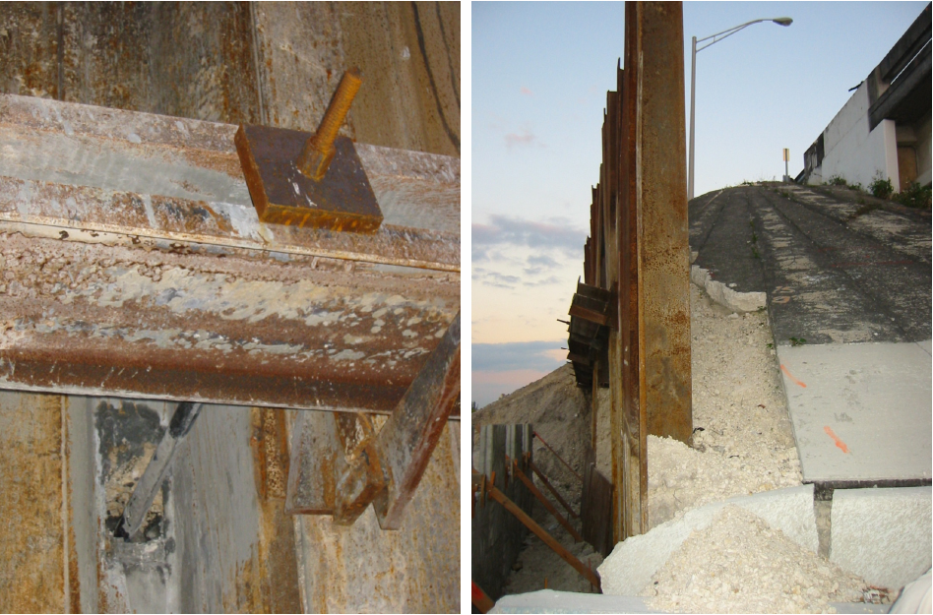
Anchored temporary walls used for a highway bridge lane expansion.

Slide 84
Construction methods
Sheet pile walls (SPW) may be divided into two basic categories:
  Cantilever and
  Anchored
Construction method generally can be divided into 2 categories:
  Backfilled structure
  Dredged structure
Notes:
In construction of SPW, the pile may be driven into the ground & then backfill placed on the land side, or the sheet may first be driven into the ground & the soil in front dredged.

Slide 85
Thank you.,!

