Slide 1
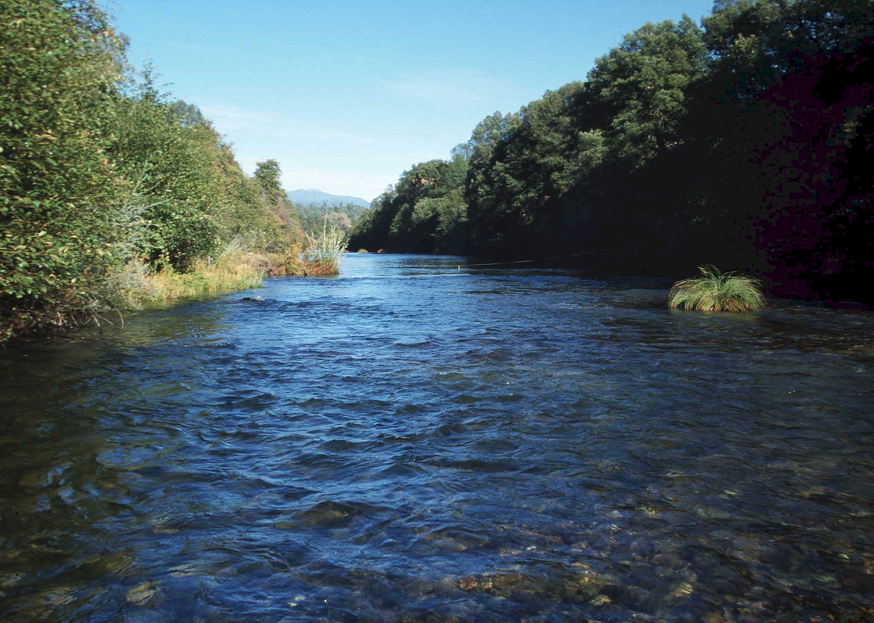
Introduction to
Open Channel Flow
Chapter-One

Slide 2
Chapter One
1.1 Introduction to open channel flow
When the flow takes place in a channel or pipe such that the water has a free surface exposed to the atmosphere, we spoke of open channels, curvets, spillways, and similar human made structures are designed & analyzed by the method of open channel hydraulics
The primary differences b/n the confined flow in pipes & open channel flow is that the pipe flow is closed channel, which is the top surface is covered by solid boundary, it is not exposed to atmospheric pressure …

Slide 3
But open channel flow is exposed to atmospheric pressure
In open channels the cross-sectional area of the flow is variable that depends on many parameters of the flow
For this reason hydraulic computations related to open channel flow are more complicated
The prime motivating force (the force causing motion) for open channel flow is gravity or the slope provided at the bottom (bed)

Slide 4
Let’s compare the two flow types using figure
EL
H_{f}
Y₁
HGL
EL
HGL
Y₁
Y₂
Y₂
Z₂
Z₁
Z₂
Fig 1(a) Pipe flow
Fig. 1(b) Open channel flow

Slide 5
Where
HGL - Hydraulic grade line (coincide with water surface)
EGL - Energy grade line
Hf - head loss due to friction
V²/2g - velocity head
Despite the similarity between these two flows it is much more difficult and complex to solve problems of the open channel case
This is due to the fact that the flow condition in open channel flow varies as per time and place

Slide 6
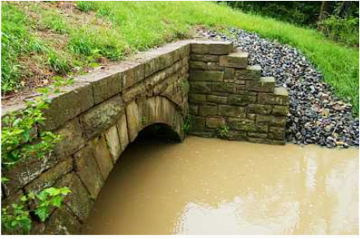
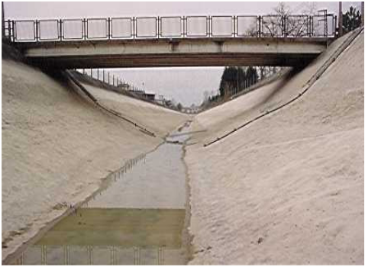
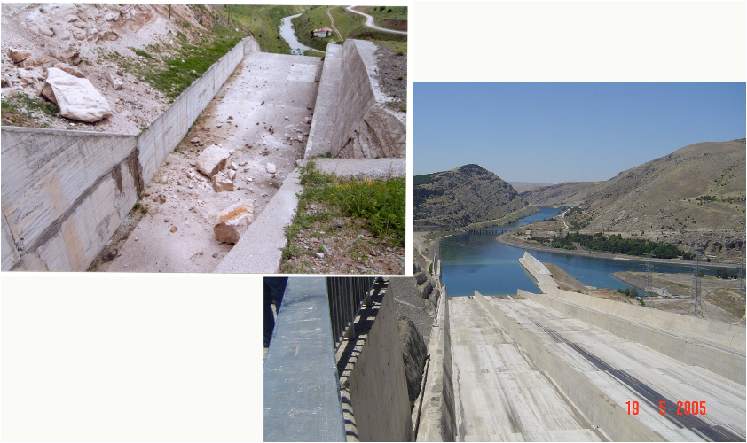

Slide 7
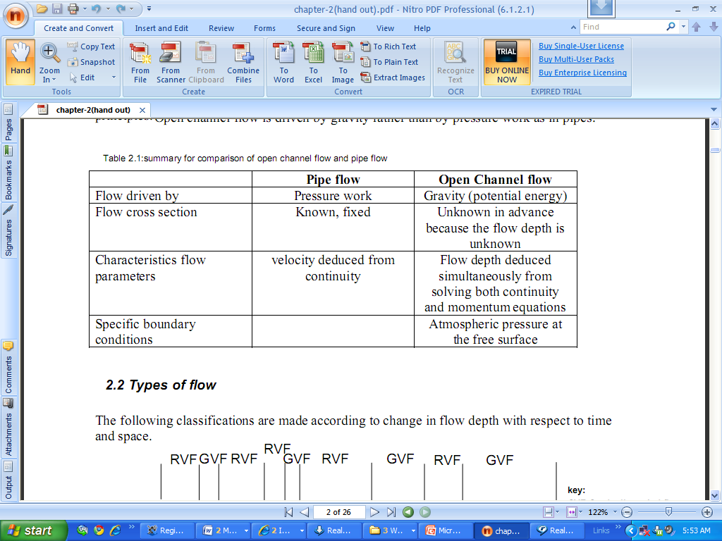
Introduction---
Open channel flow Vs pipe flow.

Slide 8
Types of channels
Artificial channels
  man-made
  Regular in shape and prismatic
  irrigation canals, navigation canals, spillways, sewers, culverts and drainage ditches.
  Constructed of concrete, steel and earth
  approximately uniform roughness

Slide 9
Natural channels
  irregular and nonprismatic
  roughness: f( distance and elevation)
  Mainly earth material
  Analysis of flow in channels is more complicated than natural channels.

Slide 10
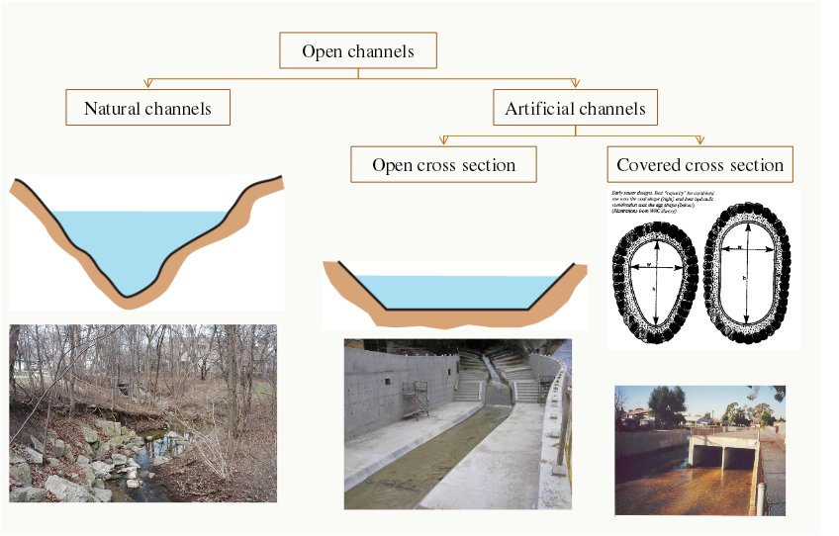
Summary

Slide 11
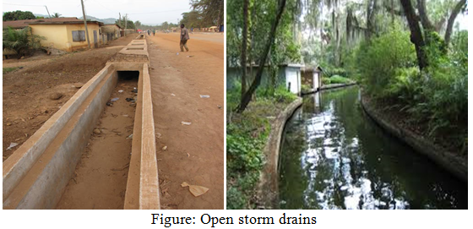

Slide 12
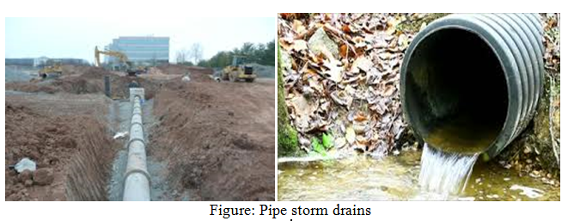

Slide 13
When we say the flow condition it includes depth of flow, cross-sectional area and slope of the channel
In turn the depth of flow, discharge and slope of the channel and water surface are related to each other
In addition the bed roughness varies greatly leading the selection of friction coefficient to uncertainty
The cause of flow in open channel the gravitational forces and viscous shear forces along the channel wetted perimeter resists flow

Slide 14
Types of channels
Natural channels: These channels naturally exist without the influence of human beings
E.g. Rivers, streams, tidal estuaries, aqueducts
Aqueducts are under ground conduits which carry water with free surface
Artificial channels: Such channels are formed by man’s activity for various purposes
E.g. irrigation channel, navigation channel, sewerage channel, culverts, power canal…… etc.

Slide 15
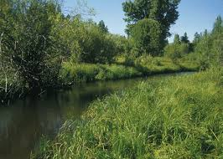
Natural channels

Slide 16
The above two channels can have either of the following features:
    Prismatic channel: - channels with constant shape and
    slope
    Non-prismatic channels: - channels with varying shape
    and slope
Generally the natural channels fall into the non prismatic group That is why intensive study of the behavior of flow in natural channels requires other fields of studies like, sediment transport, geomorphology, hydrology, river engineering

Slide 17
Types of flow in open channel
According to the characteristics of the flow with respect to time and place, different categories can be set
A. Steady flow:- Here the criterion is time. A flow can be said steady if the fluid characteristics like velocity, pressure density, depth of flow doesn’t change or if it can be assumed constant between the time of consideration
B. Unsteady flow:- Here the fluid characteristics vary with time such that

Slide 18
C. Uniform flow:- A space as a criterion is used . Open channel flow is said to be uniform if the depth of flow, velocity remains constant or the same at every section of the channel
Uniform flow may be steady or unsteady, depending on whether or not the depth changes with time
,
D. Non uniform flow:- In case when the velocity, depth of flow in a channel changes with space:

Slide 19
E. Steady uniform flow:- The depth of flow does not change during time interval and space under consideration
F. Unsteady uniform flow:- This is a rare phenomenon when the depth of flow fluctuates while remaining parallel to the channel bottom
G. Unsteady uniform flow:- This is a flow in which the depth is varying time but not with space
H. Unsteady non uniform flow:- Is the flow in which the depth is varying with space and time

Slide 20
Geometric elements of open channel section
Geometric elements are properties of a channel section that can be defined entirely by the geometry of the section and the depth of flow
The most used geometric properties include:
  Depth of flow(y): it the vertical distance from the lowest point of the channel to the free surface
  Top width (T): it is the width of channel section at free surface
  Stage (h): is the elevation or vertical distance of the free surface above a datum

Slide 21
Wetted perimeter (p): it is the length of the channel boundary which is in contact with water
Wetted area (A): is the cross-sectional area of the flow normal to the direction of flow
Hydraulic radius(hydraulic mean depth)(R) : it is the ratio of wetted area to its wetted perimeter
Hydraulic depth(D): the ratio of wetted area to the top width,

Slide 22
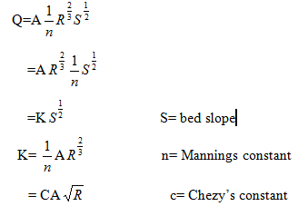
Section factor (Z): is the product of the wetted area and the two- third power of the hydraulic radius
Conveyance (K) :
Q=VA………………………….V=

Slide 23
1.2 Hydraulic Efficiency of Channel Cross -Section
A channel section is said to be efficient if it gives the maximum discharge for the given shape, area and roughness
The velocity in an open channel is:
V= f (R,S)……………………………………..(a)
Q=A*V=Af (R,S)……………………………..(b)
Equation (b) indicates that for the given area of cross section and slope the discharge Q will be maximum when R is maximum
Since, R=A/P, R will be maximum when P is minimum for a given area

Slide 24
We can conclude that for the most efficient and economical channel section the wetted perimeter should be minimum & also frictional resistance , τo is minimum
For example, a rectangular channel of depth Y and width, B
A=BY………………………….(i)
P=B+2Y……………………….(ii)
From eqn. (i), B=A/Y
Substituting in (ii) P=A/Y+2Y………….(iii)

Slide 25
For maximum Q, P - is minimum
So, B=2Y (or Y=B/2)
Thus the rectangular channel is most efficient and economical when the depth of water is one half of the width of the channel and the discharge flow will be maximum

Slide 26
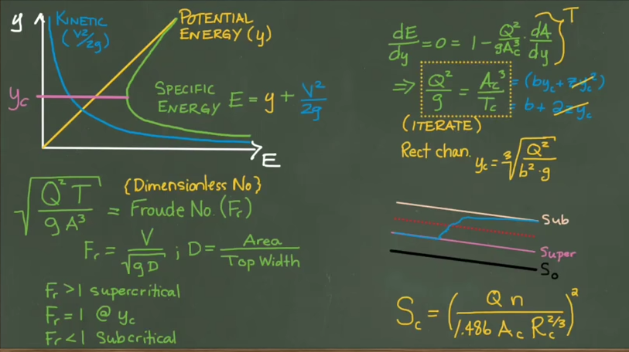

Slide 27
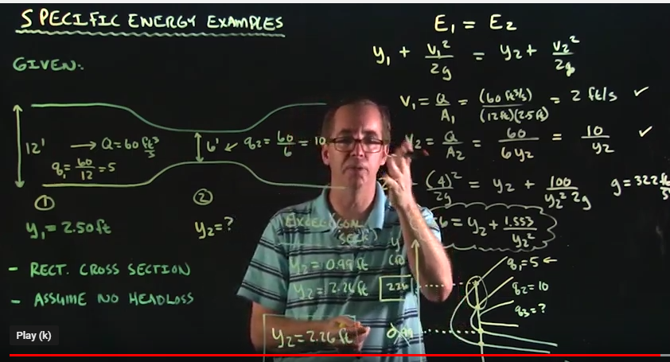

Slide 28
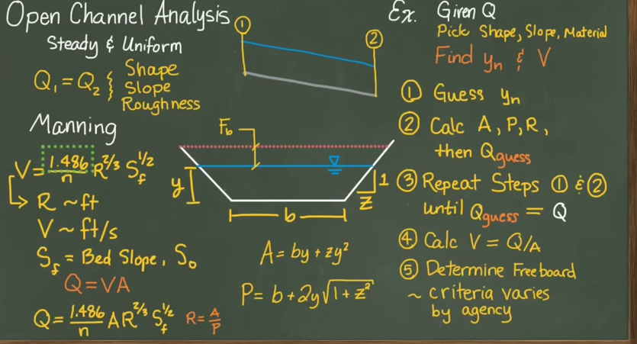

Slide 29
