Slide 1
CHAPTER-2
DIMENSIONAL ANALYSIS, SIMILITUDE AND HYDRAULIC MODELS

Slide 2
Objectives
Understand the concept and application of dimensional homogeneity
Understand dimensional analysis and know its uses.
Be capable of solving and proving equations using the two methods of dimensional analysis.
Know and explain the different types of hydraulic similarities.
Classify and explain the different types of hydraulic models.

Slide 3
Physical quantities can be divided into:
Fundamental quantities
Mass
Length
Time
Temperature (Only for compressible fluids)
Derived quantities this are quantities which are expressed in terms of fundamental quantities
The dimension of any physical quantities can be expressed as,
In M-L-T system
In F-L-T system

Slide 4
Dimensions of various physical quantities
S.No. | Quantity | Symbol | Dimensions
 |  |  | M-L-T | F-L-T
1 | Length | L | L | L
2 | Time | T | T | T
3 | Mass | m | M | M
4 | Force | F | M L T ⁻² | F
5 | Velocity | V | L T ⁻¹ | L T ⁻¹
6 | Acceleration | a | L T ⁻² | L T ⁻²
7 | Area | A | L² | L²
8 | Discharge | Q | L³ T ⁻¹ | L³ T ⁻¹

Slide 5
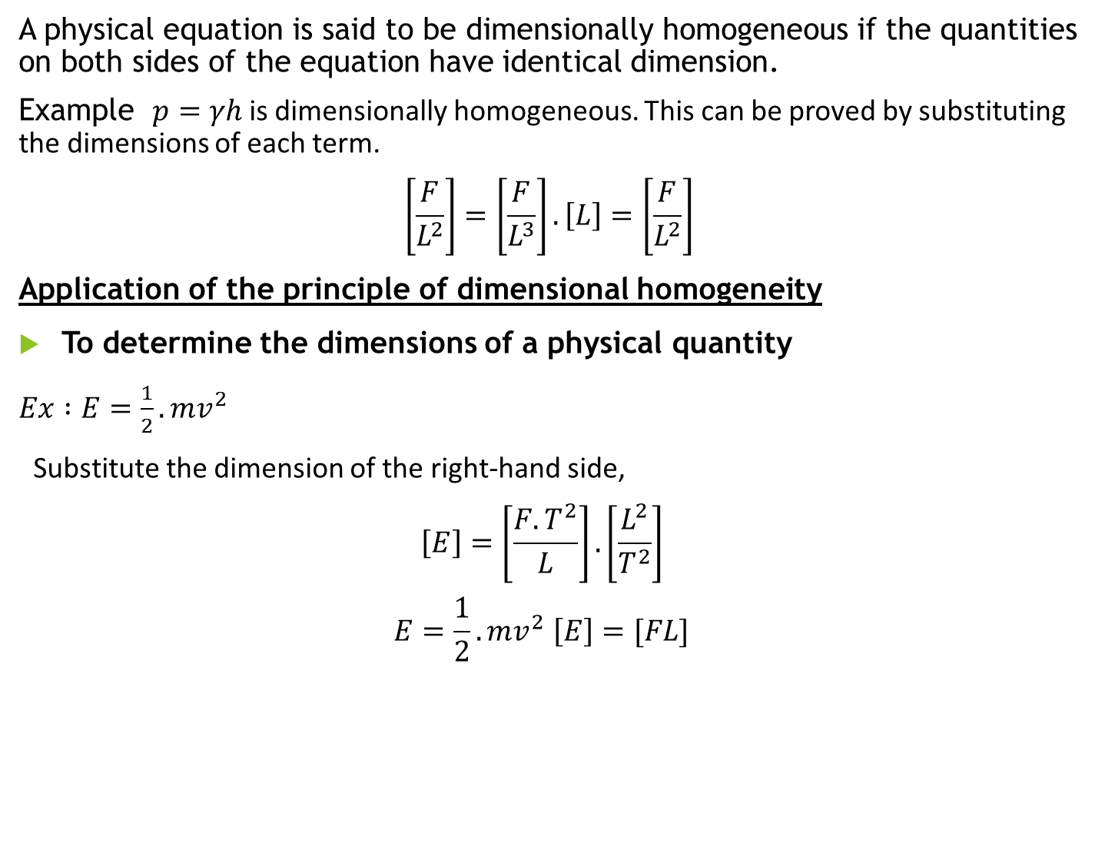
Dimensional homogeneity
A physical equation is said to be dimensionally homogeneous if the quantities on both sides of the equation have identical dimension.
Example $p=γh$is dimensionally homogeneous. This can be proved by substituting the dimensions of each term.
$$\left[\frac{F}{L^{2}}\right]=\left[\frac{F}{L^{3}}\right].\left[L\right]=\left[\frac{F}{L^{2}}\right]$$
Application of the principle of dimensional homogeneity
To determine the dimensions of a physical quantity
$Ex :E=\frac{1}{2}.mv^{2}$
Substitute the dimension of the right-hand side,
$$\left[E\right]=\left[\frac{F.T^{2}}{L}\right].\left[\frac{L^{2}}{T^{2}}\right]$$
$$E=\frac{1}{2}.mv^{2} \left[E\right]=[FL]$$

Slide 6
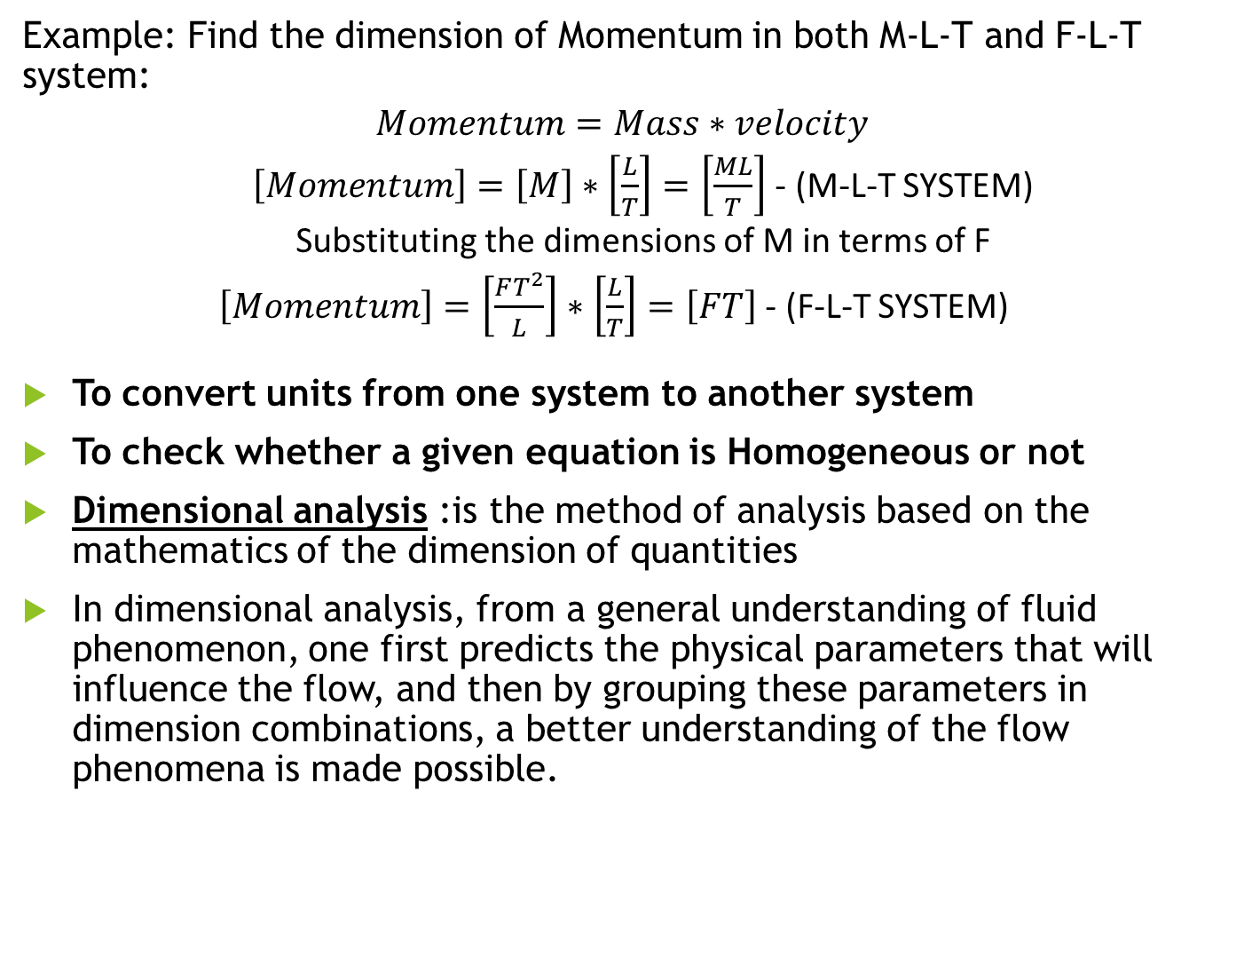
Example: Find the dimension of Momentum in both M-L-T and F-L-T system:
$$Momentum=Mass∗velocity$$
$\left[Momentum\right]=\left[M\right]∗\left[\frac{L}{T}\right]=\left[\frac{ML}{T}\right]$ - (M-L-T SYSTEM)
Substituting the dimensions of M in terms of F
$\left[Momentum\right]=\left[\frac{FT^{2}}{L}\right]∗\left[\frac{L}{T}\right]=\left[FT\right]$ - (F-L-T SYSTEM)
To convert units from one system to another system
To check whether a given equation is Homogeneous or not
Dimensional analysis :is the method of analysis based on the mathematics of the dimension of quantities
In dimensional analysis, from a general understanding of fluid phenomenon, one first predicts the physical parameters that will influence the flow, and then by grouping these parameters in dimension combinations, a better understanding of the flow phenomena is made possible.

Slide 7
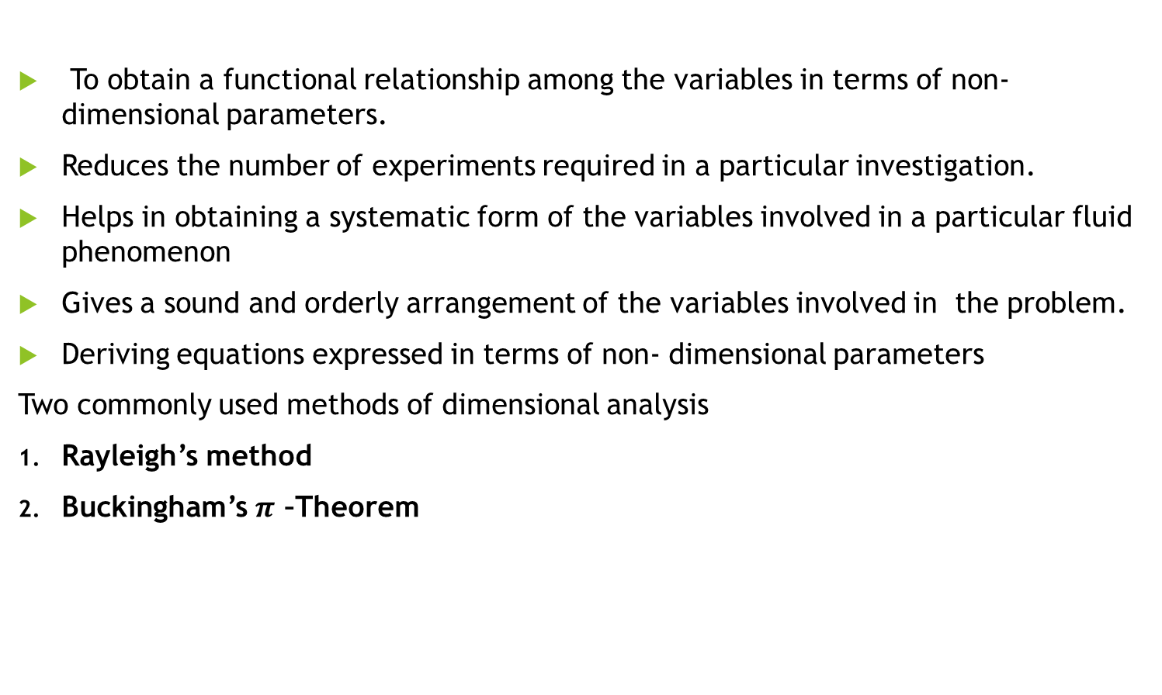
Uses Of dimensional analysis
To obtain a functional relationship among the variables in terms of non-dimensional parameters.
Reduces the number of experiments required in a particular investigation.
Helps in obtaining a systematic form of the variables involved in a particular fluid phenomenon
Gives a sound and orderly arrangement of the variables involved in the problem.
Deriving equations expressed in terms of non- dimensional parameters
Two commonly used methods of dimensional analysis
Rayleigh’s method
Buckingham’s $π$ –Theorem

Slide 8
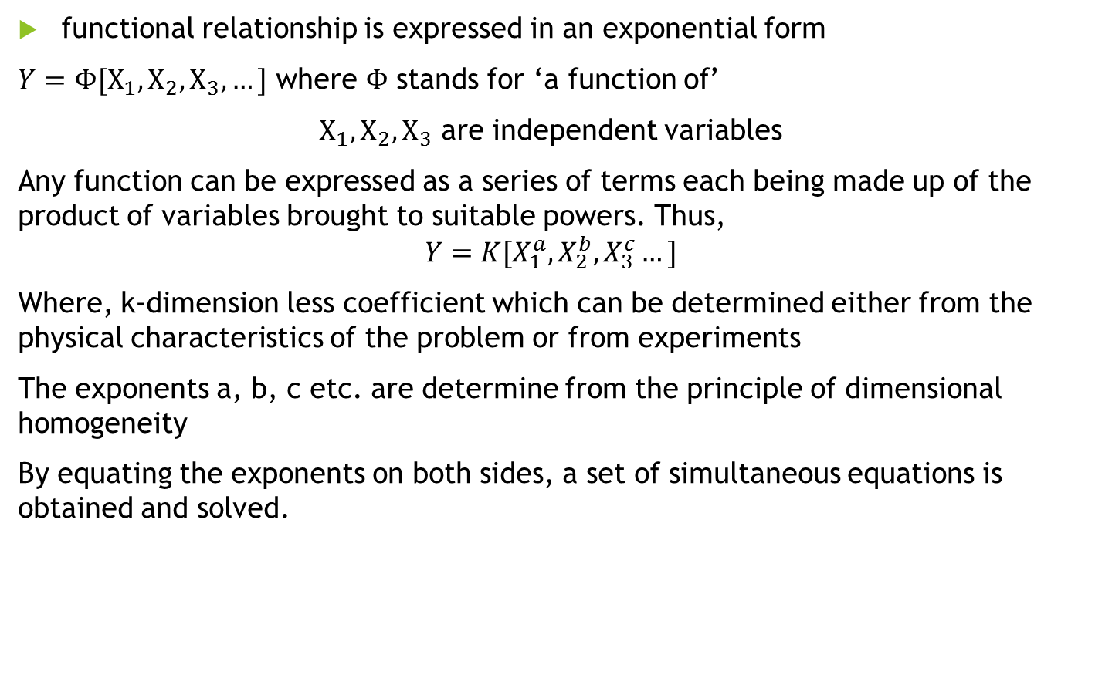
Rayleigh’s method
functional relationship is expressed in an exponential form
$Y=Φ[X_{1}, X_{2},X_{3}, …]$ where $Φ$ stands for ‘a function of’
$X_{1}, X_{2},X_{3}$ are independent variables
Any function can be expressed as a series of terms each being made up of the product of variables brought to suitable powers. Thus,
$$Y=K[X_{1}^{a},X_{2}^{b},X_{3}^{c}…]$$
Where, k-dimension less coefficient which can be determined either from the physical characteristics of the problem or from experiments
The exponents a, b, c etc. are determine from the principle of dimensional homogeneity
By equating the exponents on both sides, a set of simultaneous equations is obtained and solved.

Slide 9
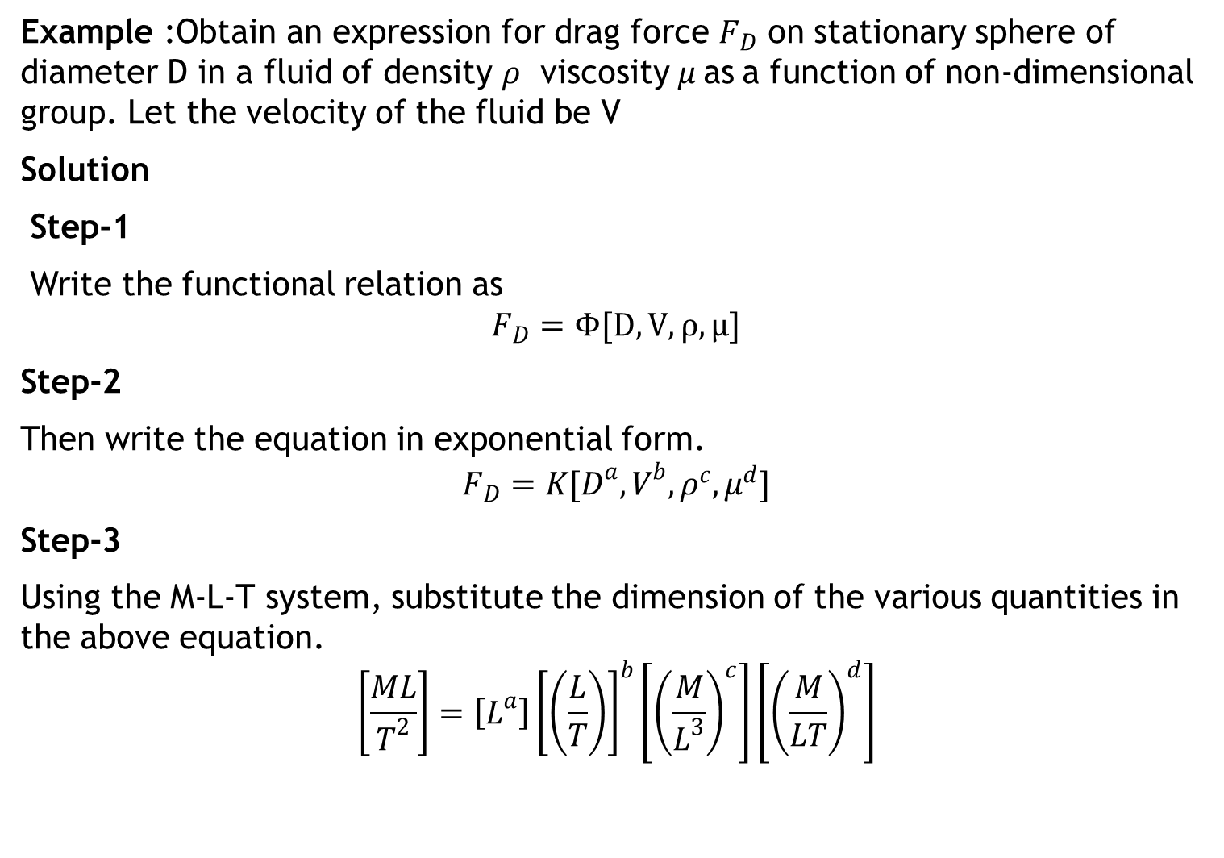
Example :Obtain an expression for drag force $F_{D}$ on stationary sphere of diameter D in a fluid of density $ρ$ viscosity$μ$as a function of non-dimensional group. Let the velocity of the fluid be V
Solution
Step-1
Write the functional relation as
$$F_{D}=Φ[D,V,ρ,μ]$$
Step-2
Then write the equation in exponential form.
$$F_{D}=K[D^{a},V^{b},ρ^{c},μ^{d}]$$
Step-3
Using the M-L-T system, substitute the dimension of the various quantities in the above equation.
$$\left[\frac{ML}{T^{2}}\right]=\left[L^{a}\right]{\left[\left(\frac{L}{T}\right)\right]}^{b}\left[{\left(\frac{M}{L^{3}}\right)}^{c}\right]\left[{\left(\frac{M}{LT}\right)}^{d}\right]$$

Slide 10
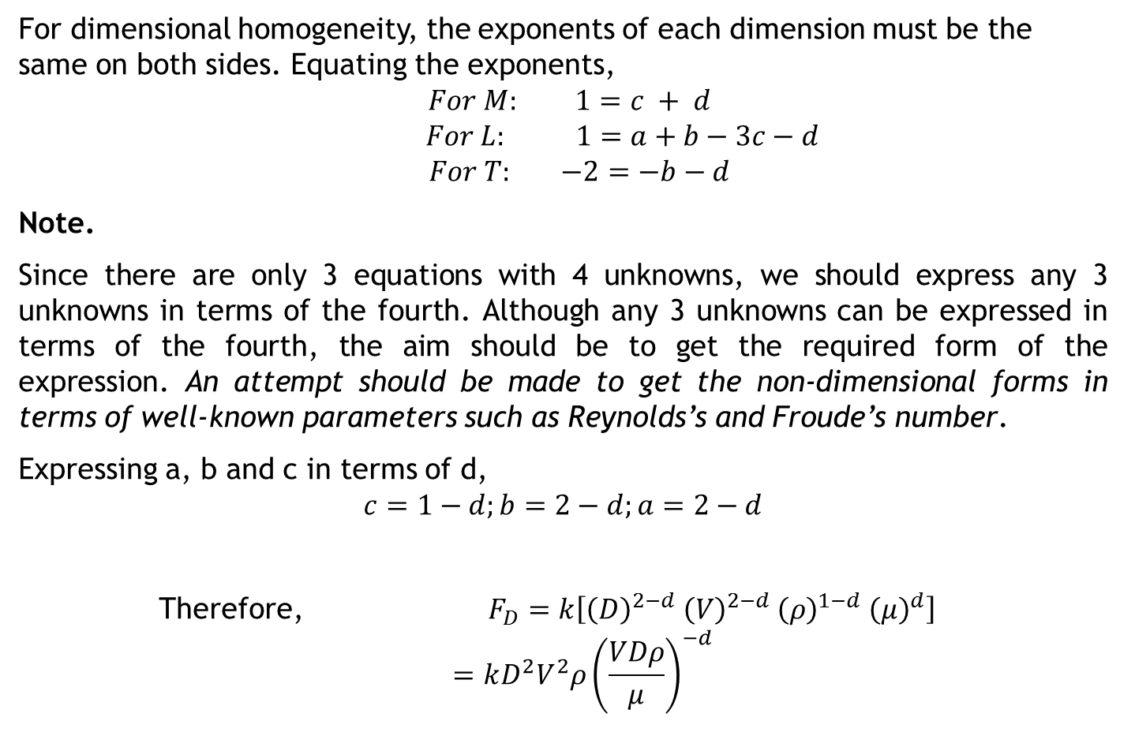
For dimensional homogeneity, the exponents of each dimension must be the same on both sides. Equating the exponents,
$$For M: 1=c + d$$
$$For L: 1=a+b−3c−d$$
$$For T: −2=−b−d$$
Note.
Since there are only 3 equations with 4 unknowns, we should express any 3 unknowns in terms of the fourth. Although any 3 unknowns can be expressed in terms of the fourth, the aim should be to get the required form of the expression. An attempt should be made to get the non-dimensional forms in terms of well-known parameters such as Reynolds’s and Froude’s number.
Expressing a, b and c in terms of d,
$$c=1−d;b=2−d;a=2−d$$
Therefore, $F_{D}=k\left[{\left(D\right)}^{2−d}{ \left(V\right)}^{2−d} {\left(ρ\right)}^{1−d} {\left(μ\right)}^{d}\right]$
$$=kD^{2}V^{2}ρ{\left(\frac{VDρ}{μ}\right)}^{−d}$$

Slide 11
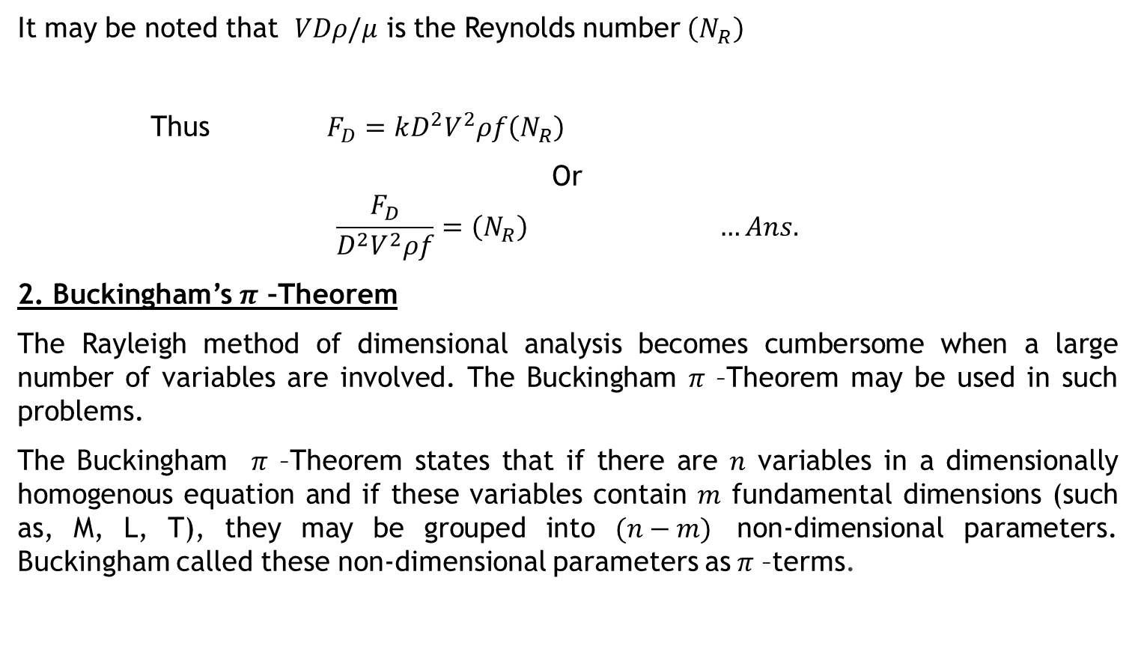
It may be noted that $VDρ/μ$ is the Reynolds number $\left(N_{R}\right)$
Thus $F_{D}=kD^{2}V^{2}ρf\left(N_{R}\right)$
Or
$$\frac{F_{D}}{D^{2}V^{2}ρf}=\left(N_{R}\right) …Ans.$$
2. Buckingham’s $π$ –Theorem
The Rayleigh method of dimensional analysis becomes cumbersome when a large number of variables are involved. The Buckingham $π$ –Theorem may be used in such problems.
The Buckingham $π$ –Theorem states that if there are $n$ variables in a dimensionally homogenous equation and if these variables contain $m$ fundamental dimensions (such as, M, L, T), they may be grouped into $(n−m)$ non-dimensional parameters. Buckingham called these non-dimensional parameters as$π$ –terms.

Slide 12
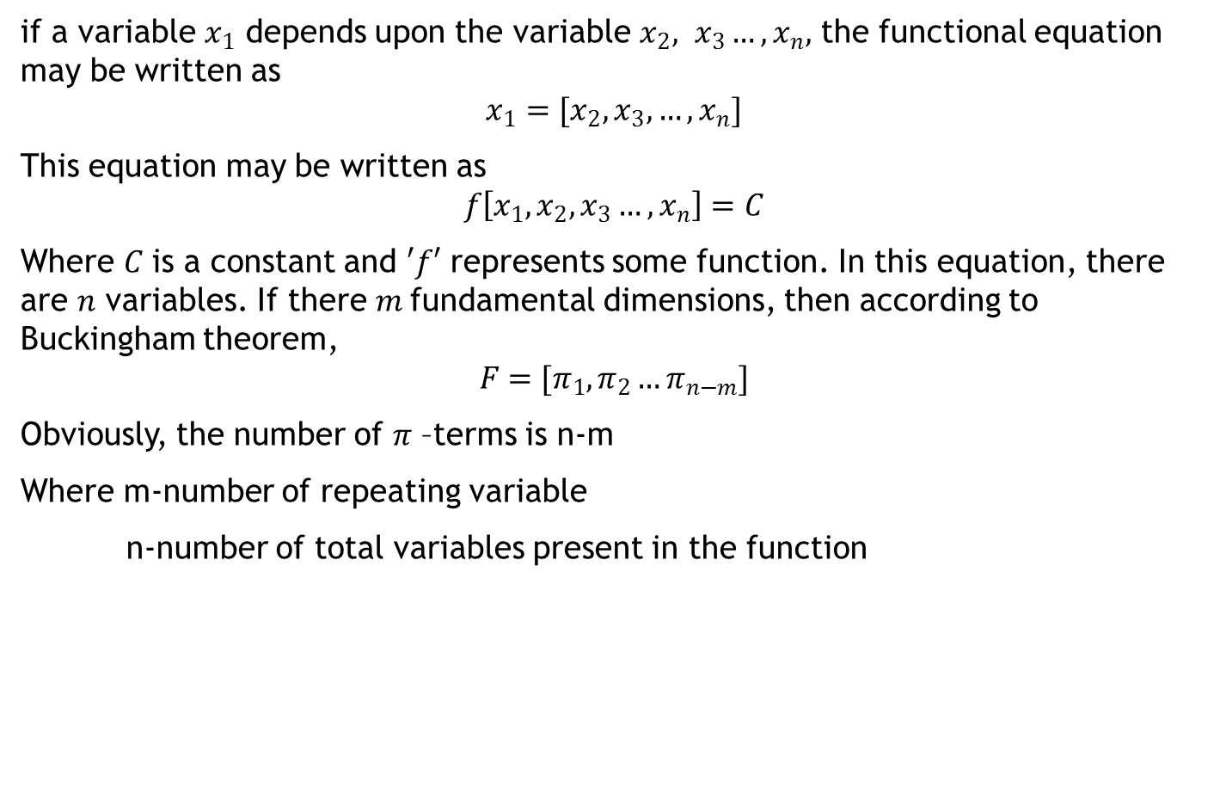
if a variable $x_{1}$ depends upon the variable $x_{2}, x_{3}…, x_{n},$ the functional equation may be written as
$$x_{1}=[x_{2}, x_{3},…,x_{n}]$$
This equation may be written as
$$f\left[x_{1}, x_{2}, x_{3}…,x_{n}\right]=C$$
Where $C$ is a constant and $′f′$ represents some function. In this equation, there are $n$ variables. If there $m$fundamental dimensions, then according to Buckingham theorem,
$$F=[π_{1}, π_{2}…π_{n−m}]$$
Obviously, the number of $π$ –terms is n-m
Where m-number of repeating variable
n-number of total variables present in the function

Slide 13
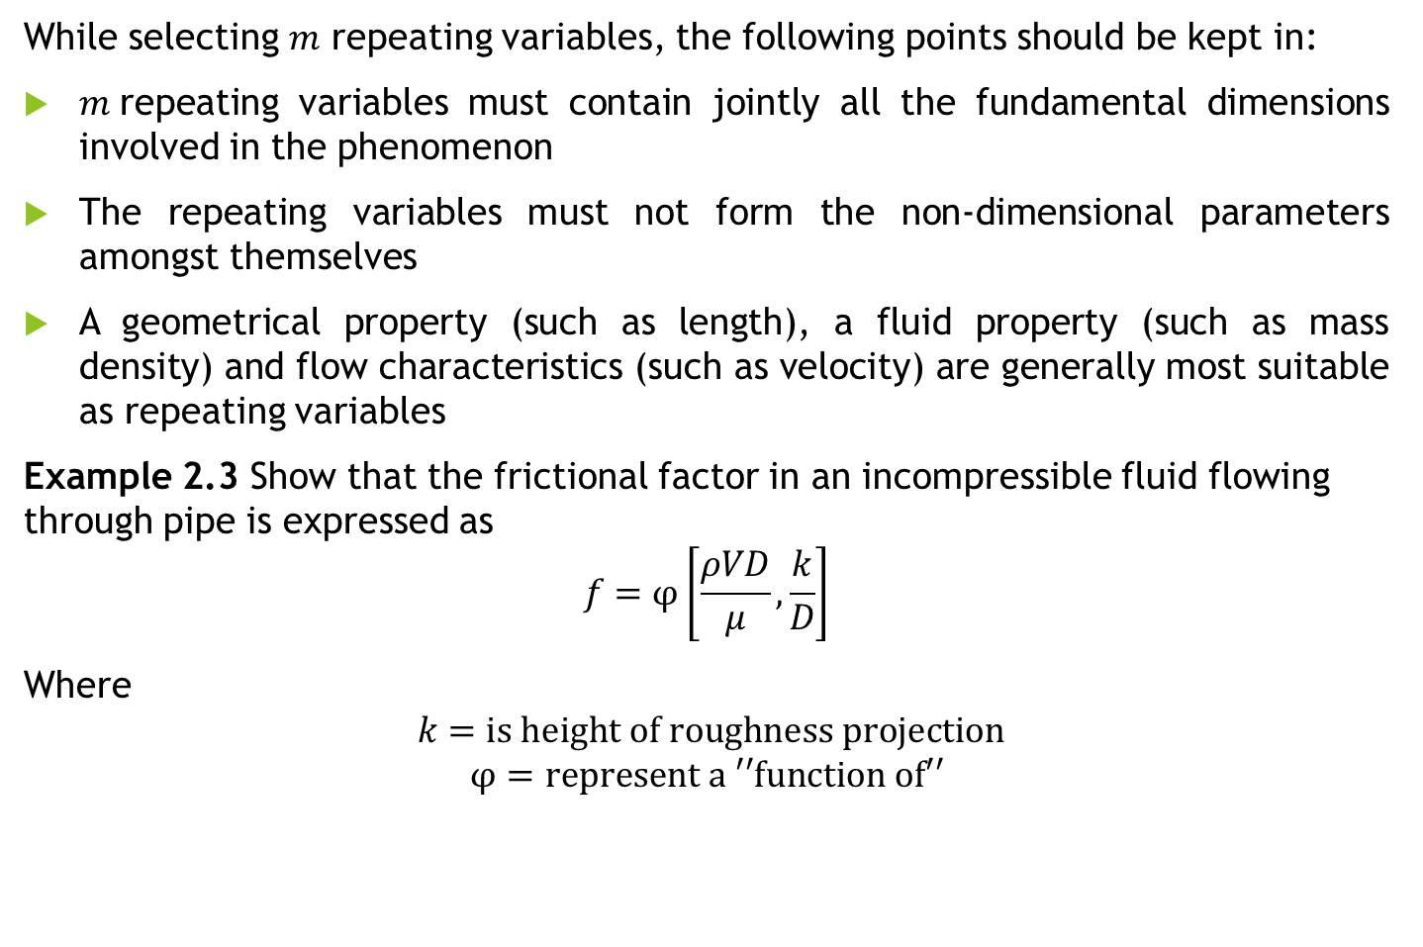
While selecting $m$ repeating variables, the following points should be kept in:
$m$repeating variables must contain jointly all the fundamental dimensions involved in the phenomenon
The repeating variables must not form the non-dimensional parameters amongst themselves
A geometrical property (such as length), a fluid property (such as mass density) and flow characteristics (such as velocity) are generally most suitable as repeating variables
Example 2.3 Show that the frictional factor in an incompressible fluid flowing through pipe is expressed as
$$f=φ\left[\frac{ρVD}{μ},\frac{k}{D}\right]$$
Where
$$k=is height of roughness projection$$
$$φ=represent a ′′function of′′$$

Slide 14
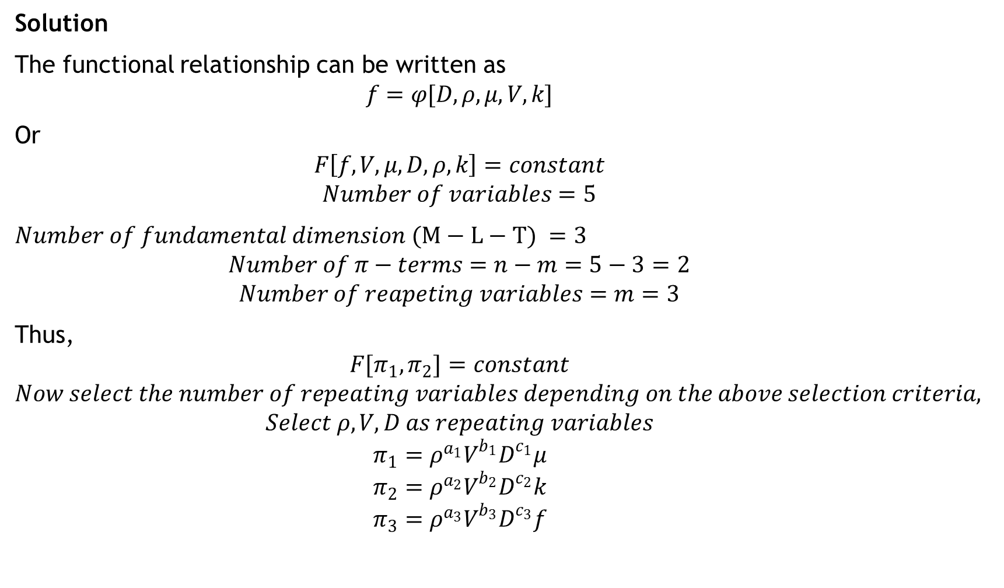
Solution
The functional relationship can be written as
$$f=φ[D,ρ,μ,V,k]$$
Or
$$F\left[f,V,μ,D,ρ,k\right]=constant$$
$$Number of variables=5$$
$Number of fundamental dimension (M−L−T) =3$
$$Number of π−terms=n−m=5−3=2$$
$$Number of reapeting variables=m=3$$
Thus,
$$F[π_{1},π_{2}]=constant$$
$$Now select the number of repeating variables depending on the above selection criteria,$$
$$Select ρ,V,D as repeating variables$$
$$π_{1}=ρ^{a_{1}}V^{b_{1}}D^{c_{1}}μ$$
$$π_{2}=ρ^{a_{2}}V^{b_{2}}D^{c_{2}}k$$
$$π_{3}=ρ^{a_{3}}V^{b_{3}}D^{c_{3}}f$$

Slide 15
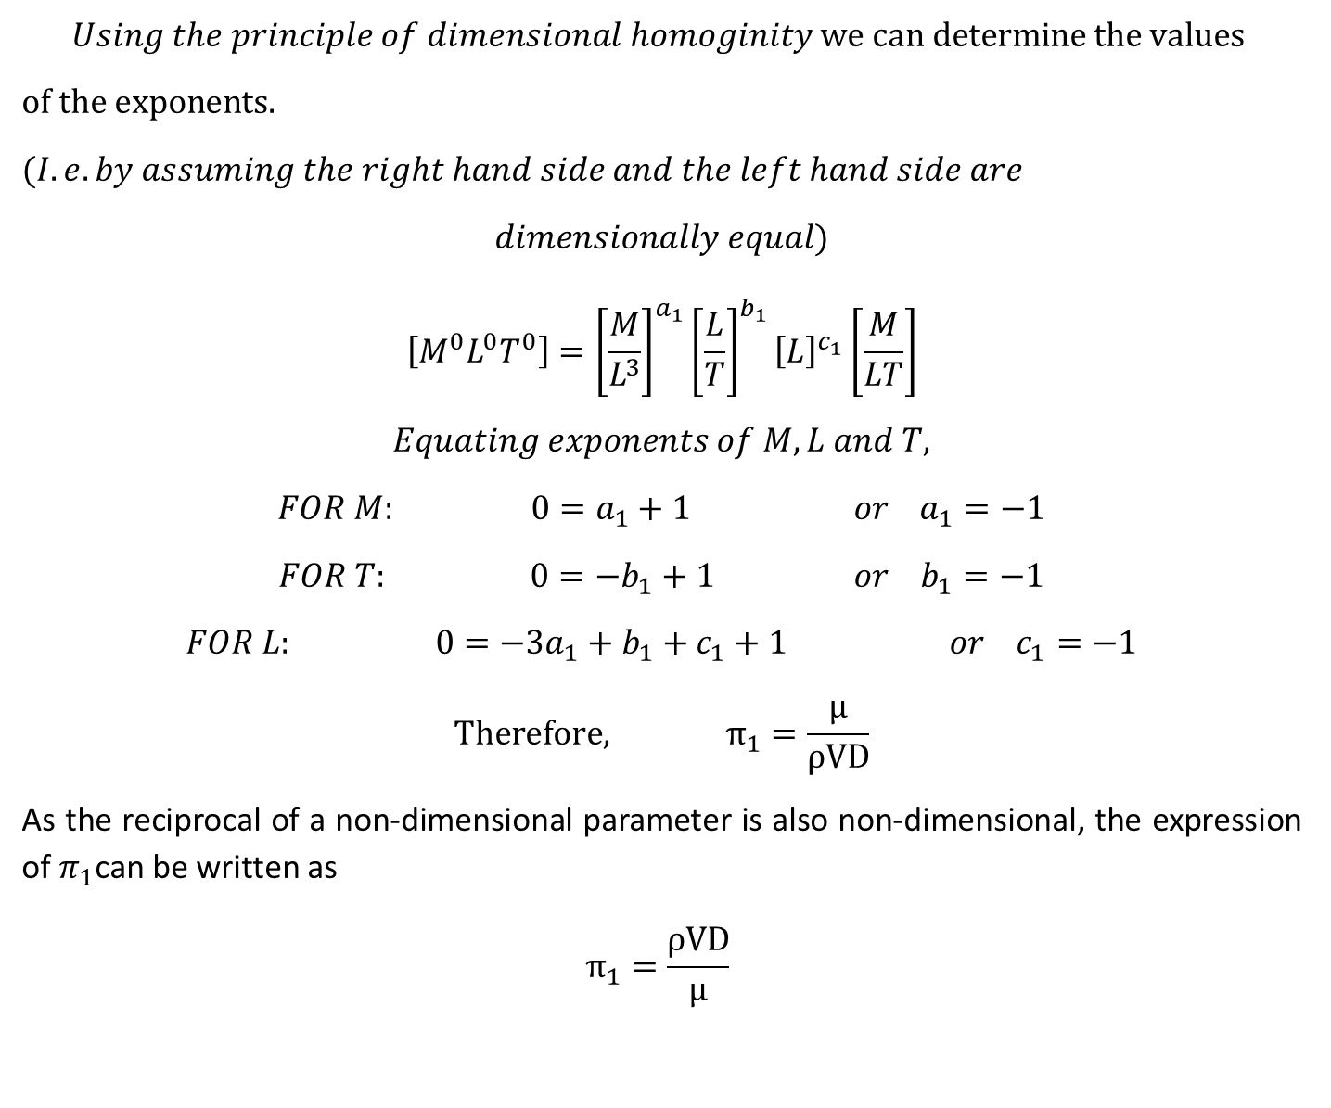
$$Using the principle of dimensional homoginity we can determine the values$$
$of the exponents.$
$$(I.e. by assuming the right hand side and the left hand side are$$
$$dimensionally equal)$$
$$\left[M^{0}L^{0}T^{0}\right]={\left[\frac{M}{L^{3}}\right]}^{a_{1}}{\left[\frac{L}{T}\right]}^{b_{1}}{\left[L\right]}^{c_{1}}\left[\frac{M}{LT}\right]$$
$$Equating exponents of M, L and T,$$
$$FOR M: 0=a_{1}+1 or a_{1}=−1$$
$$FOR T: 0={−b}_{1}+1 or b_{1}=−1$$
$$FOR L: 0=−3a_{1}+b_{1}+c_{1}+1 or c_{1}=−1$$
$$Therefore, π_{1}=\frac{μ}{ρVD}$$
As the reciprocal of a non-dimensional parameter is also non-dimensional, the expression of $π_{1}$can be written as
$$π_{1}=\frac{ρVD}{μ}$$

Slide 16
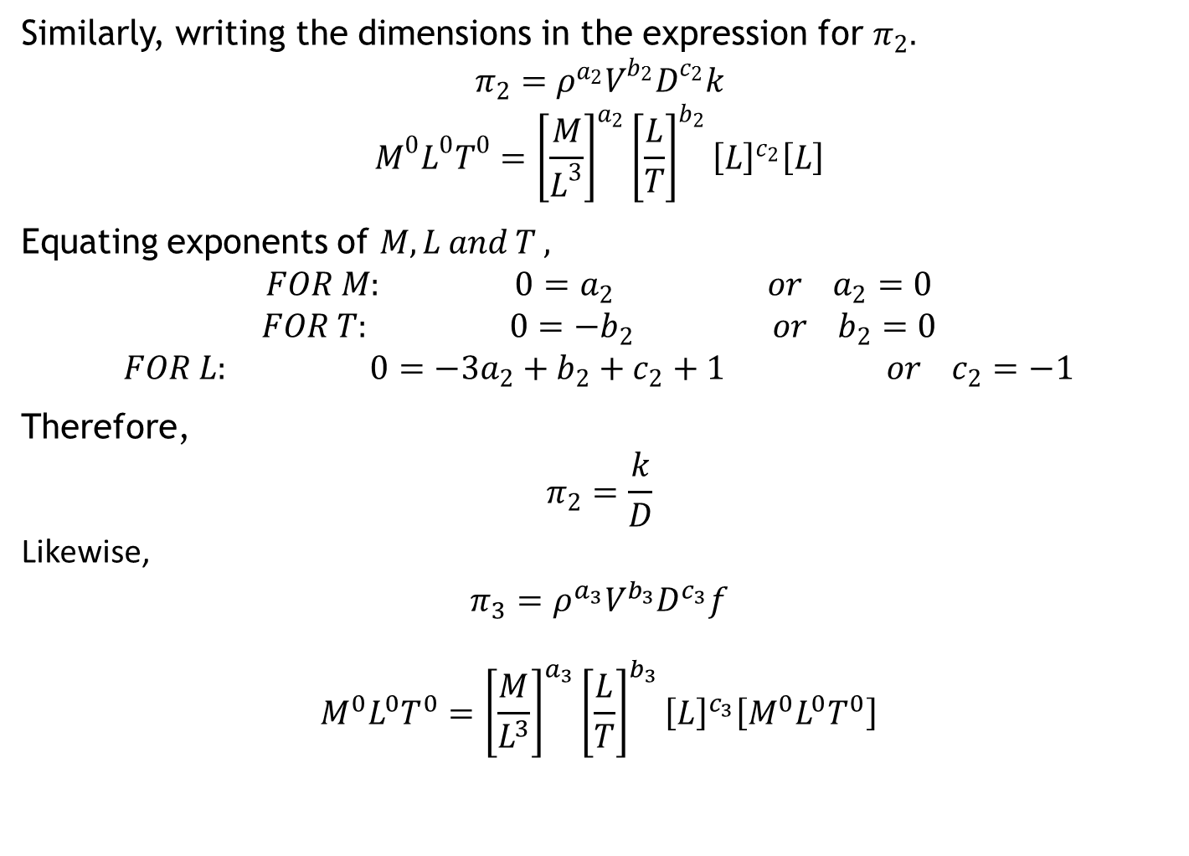
Similarly, writing the dimensions in the expression for $π_{2}.$
$$π_{2}=ρ^{a_{2}}V^{b_{2}}D^{c_{2}}k$$
$$M^{0}L^{0}T^{0}={\left[\frac{M}{L^{3}}\right]}^{a_{2}}{\left[\frac{L}{T}\right]}^{b_{2}}{\left[L\right]}^{c_{2}}\left[L\right]$$
Equating exponents of $M,L and T ,$
$$FOR M: 0=a_{2} or a_{2}=0$$
$$FOR T: 0={−b}_{2} or b_{2}=0$$
$$FOR L: 0=−3a_{2}+b_{2}+c_{2}+1 or c_{2}=−1$$
Therefore,
$$π_{2}=\frac{k}{D}$$
Likewise,
$$π_{3}=ρ^{a_{3}}V^{b_{3}}D^{c_{3}}f$$
$$M^{0}L^{0}T^{0}={\left[\frac{M}{L^{3}}\right]}^{a_{3}}{\left[\frac{L}{T}\right]}^{b_{3}}{\left[L\right]}^{c_{3}}\left[M^{0}L^{0}T^{0}\right]$$

Slide 17
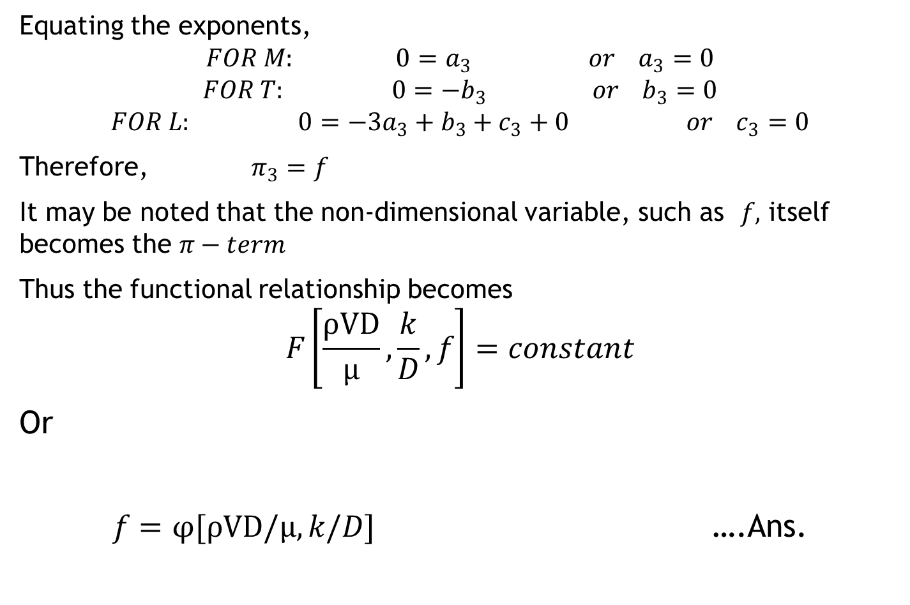
Equating the exponents,
$$FOR M: 0=a_{3} or a_{3}=0$$
$$FOR T: 0={−b}_{3} or b_{3}=0$$
$$FOR L: 0=−3a_{3}+b_{3}+c_{3}+0 or c_{3}=0$$
Therefore, $π_{3}=f$
It may be noted that the non-dimensional variable, such as $f,$ itself becomes the $π−term$
Thus the functional relationship becomes
$$F\left[\frac{ρVD}{μ},\frac{k}{D},f\right]=constant$$
Or
$f=φ[ρVD/μ,k/D]$ ….Ans.

Slide 18
SECTION-2: SIMILITUDE AND HYDRAULIC MODELS
Model: small scale representation for the actual object
Prototype: Actual object
Model testing is done to obtain useful quantitative or quantitative information that can be safely utilized in the design of the prototype
Similitude=Similarity
Complete similarity can be obtained between the model and its prototype if the two systems are geometrically, kinematically and dynamically similar

Slide 19
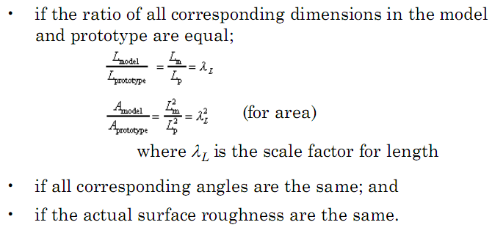
Geometric Similarity

Slide 20
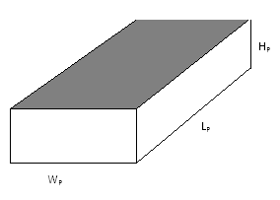
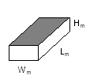
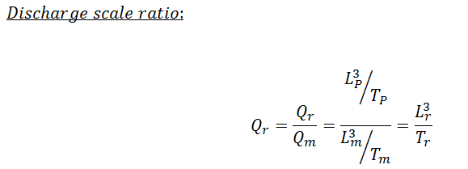
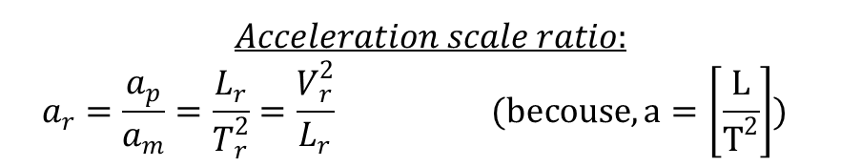
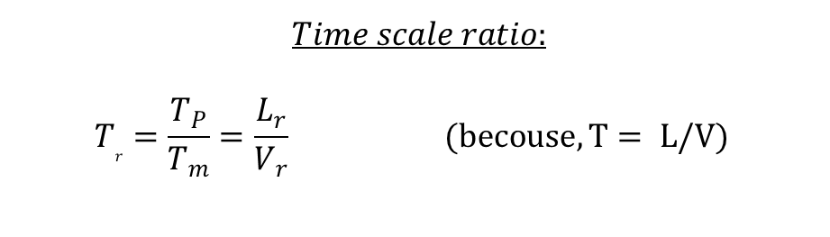

Kinematic similarity
It is the similarity of motion
$$The velocity ratio is:$$
$${V }_{r}=\frac{V_{P}}{V_{m}}$$
$$Acceleration scale ratio:$$
$$a_{r}=\frac{a_{p}}{a_{m}}=\frac{L_{r}}{T_{r}^{2}}=\frac{V_{r}^{2}}{L_{r}} (becouse, a=\left[\frac{L}{T^{2}}\right])$$
$$Time scale ratio:$$
$$T_{r}=\frac{T_{P}}{T_{m}}=\frac{L_{r}}{V_{r}} (becouse, T= L/V)$$

Slide 21
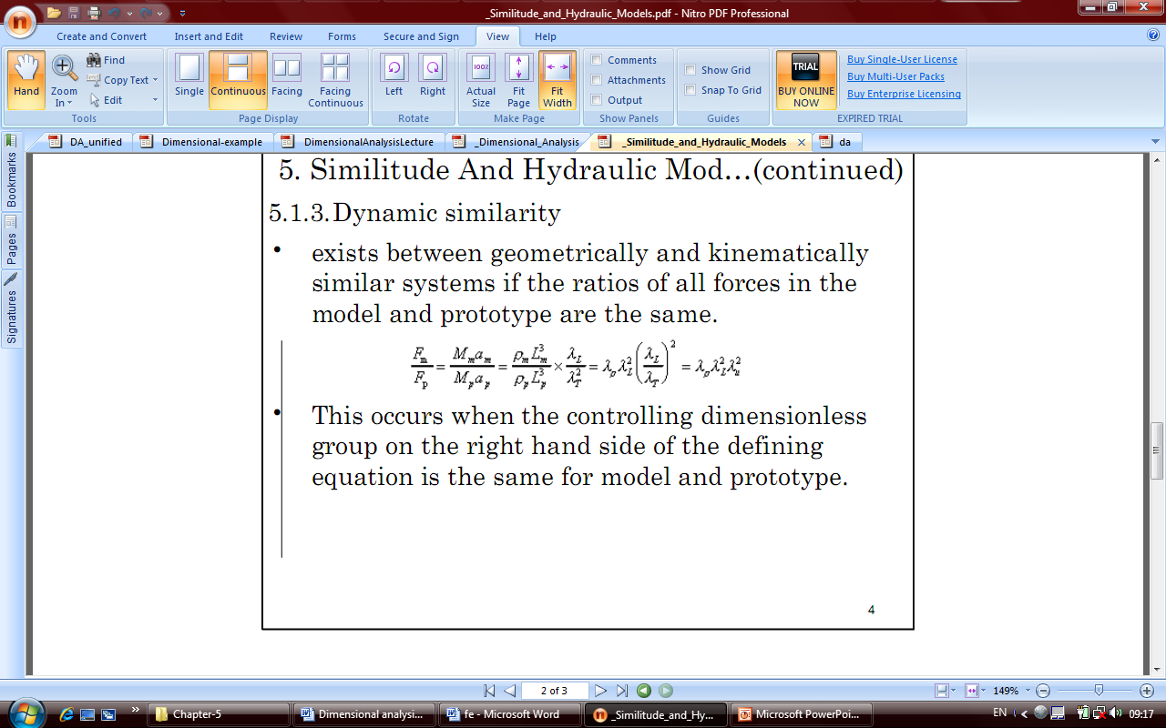
Dynamic Similarity

Slide 22
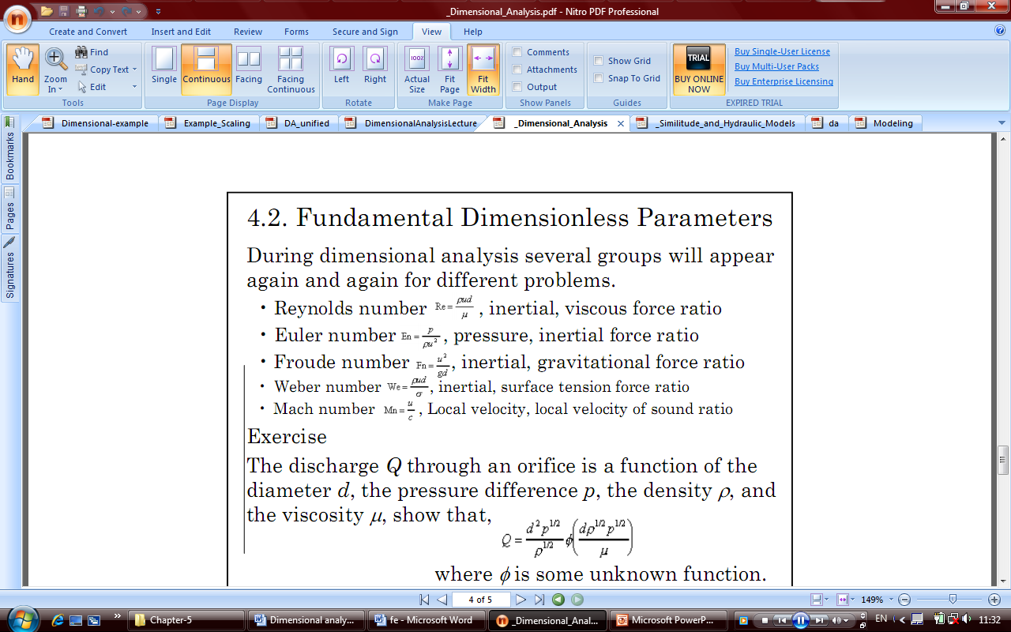
The forces acting may be any one or a combination of several of the following: viscous, pressure, gravity, elasticity, surface tension, inertia forces etc.

Slide 23
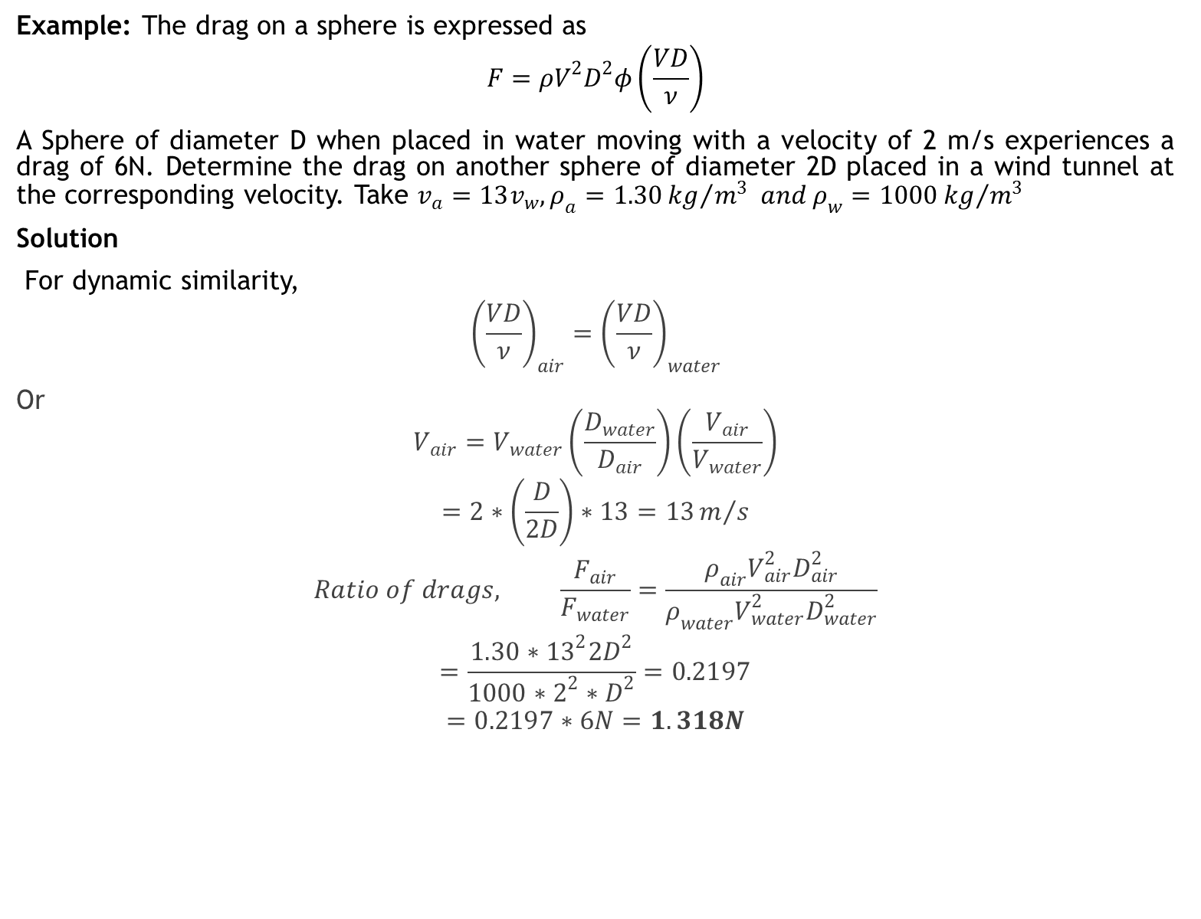
Example: The drag on a sphere is expressed as
$$F=ρV^{2}D^{2}φ\left(\frac{VD}{ν}\right)$$
A Sphere of diameter D when placed in water moving with a velocity of 2 m/s experiences a drag of 6N. Determine the drag on another sphere of diameter 2D placed in a wind tunnel at the corresponding velocity. Take $v_{a}=13v_{w}, ρ_{a}=1.30{kg}/{m^{3}} and ρ_{w}=1000{kg}/{m^{3}}$
Solution
For dynamic similarity,
$${\left(\frac{VD}{ν}\right)}_{air}={\left(\frac{VD}{ν}\right)}_{water}$$
Or
$$V_{air}=V_{water}\left(\frac{D_{water}}{D_{air}}\right)\left(\frac{V_{air}}{V_{water}}\right)$$
$$=2∗\left(\frac{D}{2D}\right)∗13=13m/s$$
$$Ratio of drags, \frac{F_{air}}{F_{water}}=\frac{ρ_{air}V_{air}^{2}D_{air}^{2}}{ρ_{water}V_{water}^{2}D_{water}^{2}}$$
$$=\frac{1.30∗{13}^{2}{2D}^{2}}{1000∗2^{2}∗D^{2}}=0.2197$$
$$=0.2197∗6N=1.318N$$

Slide 24
TYPES OF MODELS
Undistorted Models: - if a model is geometrically similar to its prototype.
Distorted models: - if one or more terms of the models are not identical with the prototype it is known as distorted models. The distortion may be geometrical, or material or hydraulic quantities or a combination of these.
Geometrical distortion
The distortion can be either of dimensions or that of configuration.
Dimensional Distortion
The distortion can be either of longitudinal, transverse, & vertical dimensions.

Slide 25
Distortion of configuration
results when the general configuration of the model doesn’t have resemblance with its prototype.
Material distortion
is occurred when the physical properties of the material used in the model and prototype are different.
Distortion of hydraulic quantities
is occurred for certain uncontrollable hydraulic quantities such as time, discharge etc.

