Slide 1
CHAPTER THREE
3. Urbanization, Unemployment and Migration
Urbanization : refers to an increase in the proportion of people living in towns and cities.
It is a major aspect of socio-economic change.
In urban centers, the majority of people is engaged in non-agricultural economic activity.
Urbanization and Development
There is positive association between urbanization and per capita income.
The more developed the country, measured by per capita income, the greater the share of population living in urban areas.

Slide 2
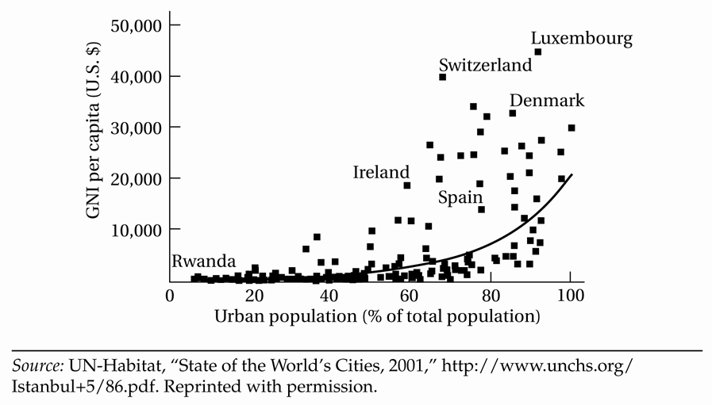
The highest-income countries, such as Denmark, are among the most urbanized.
The very poorest countries, such as Rwanda, are among the least urbanized.
Urban Population and Per Capita Income

Slide 3
Although urbanization is closely associated with economic growth, it is happening everywhere in the world whether economic growth is positive or negative.
These days, there is rapid growth of cities in developing countries.
In 1950, 38% of the world urban population were living in cities of the developing world.
By 2010, over three-quarters of all urban dwellers are living in metropolitan areas of low- and middle-income countries.
Africa is the least urbanized of all the continents in the world.
Only 38% of the continent’s population live in urban areas.

Slide 4
However, the continent has the world’s highest rate of urbanization, which is about 5.4% per year. Why?
Very high rate of rural-urban migration
High fertility in the urban areas
Urbanization in Africa is not associated with industrialization as it was in the now-developed countries.
Stages of Urbanization
Initial stage : rural society
represents least developing countries
Transitional stage: urbanization stage
represents developing countries
Terminal stage : urban society
represents developed countries

Slide 5
Stages of Urbanization
Initial Stage
Transition Stage
Terminal Stage
100
Demographic transition
Rural to urban migration
Developed countries
80
Rural
Society
Developing
countries
Urban
Society
60
Urban Population
40
Least developed
countries
20
Urbanization
0
Time
Source: Adapted from Peters and Larkin, Population Geography, 1999.
Notes:
Source: Adapted from Peters and Larkin, 1999.

Slide 6
The Role of Cities
Agglomeration economies
Cities are formed because they provide cost advantages to producers and consumers.
Agglomeration economies refers to cost advantages to producers and consumers from location in cities and towns.
It takes two forms :
Urbanization economies: agglomeration effects captured by all sectors of an economy as a result of the general growth of a concentrated geographic region.
Localization economies: agglomeration effects captured
by particular sectors of the economy, such as finance or automobiles, as they grow within an area.

Slide 7
Localization economies often take the form of forward and backward linkages.
Forward linkage
Users of outputs of an industry reduce their transportation costs by locating nearby to the industry.
They can easily find a new job.
Backward linkage
Firms of the same or related industries may benefit from being located in the same city. B/c
They can obtain a large pool of workers with the specific skills.
They benefit from specialized infrastructure.
Workers with specialized skills appropriate to the industry prefer to be located there as well so that they can easily find new job or be in a position to take advantage of better opportunities.

Slide 8
Industrial Districts and Clustering
An economic definition of a city is “an area with relatively high population density that contains a set of closely related activities”.
Firms doing similar work often prefer to be located around one place. Alfred Marshall called this industrial districts.
Benefits of industrial districts:
Passive collective efficiency ---location
they can learn from each other
marketing advantages
Active collective efficiency -----collective action
Lobbying the government for needed infrastructure as an industry rather than as individual firms
Developing training facilities

Slide 9
Efficient Urban Scale and Congestion Costs
Localization economies do not imply that it is efficient for all industries to be located together in a single city.
Localization economies extend across closely related industries (those with strong backward and forward linkages).
There are fewer productivity benefits for unrelated industries to locate together.
Urban scale is said to be economically efficient if average costs for industries are lowest.
An increase in urban density leads to congestion costs.
Congestion: an action taken by one agent that decreases the incentives for other agents to take similar actions.

Slide 10
Congestion leads to :
Higher costs of real estate
urban land costs become high which leads to skyscrapers
Greater transportation costs
Workers travel longer distances and may demand higher wages to cover transportation costs
Higher costs of infrastructure (water and sewer systems)
“Black hole” effect
If costs of transportation of finished goods are high, consumers are located in the largest city to avoid paying those transportation costs.
Economic activities are indefinitely concentrated within a city.

Slide 11
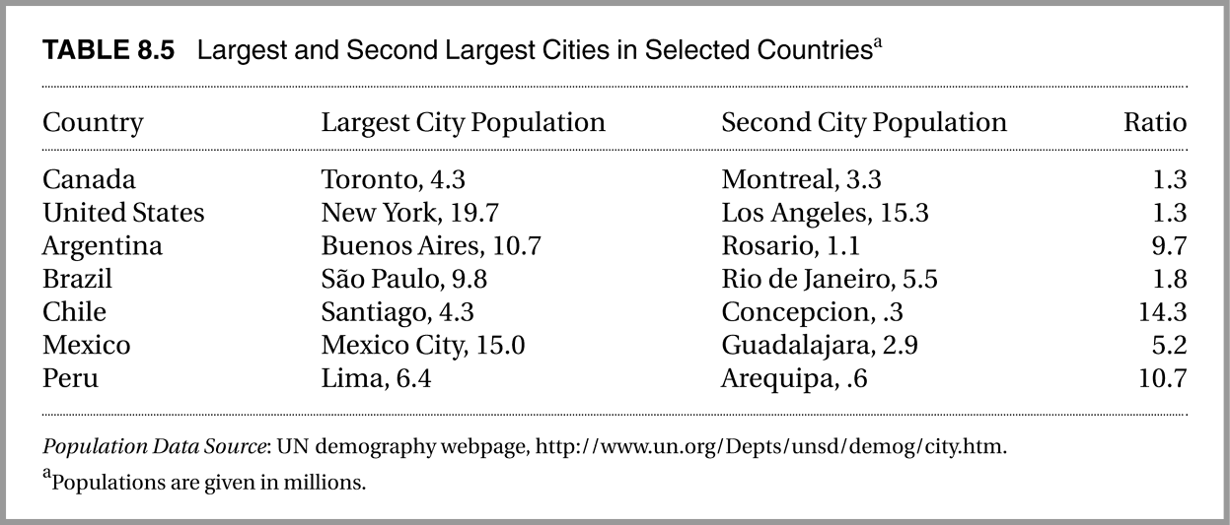
The Urban Giantism Problem
It occurs when capital cities or other “urban giants” suffer from enormous levels of congestion, but adequate mid-size cities that might provide alternative locations for growth are lacking the problem of congestion.

Slide 12
Causes: the urban giantism problem is a combined effect of
The “hub-and-spoke” transportation system
- In developing countries, the main transportation routes are often a legacy of colonialism.
The colonialists developed the transportation system with the aim of extraction of a country’s natural resources.
In many cases, the capital cities of colonized countries are located near the outlet of this system on the seacoast.
Then, producers located and plant their firm in this area, which transportation facility is very high, and large consumers also available.
This type of transportation system is also called a “hub-and-spoke” system.
2. The location of the political capital in the largest city

Slide 13
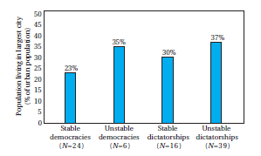
A well designed infrastructure development program can alleviate the urban giantism problem;
more efficient links between medium-size cities and
better roads, utilities, and telecommunications within these cities
However, Dictatorship provide bread and infrastructure for the first largest city to prevent unrest.
Governments policy toward the rest of the world
Import substitution- leads to urban giantism-firm located nearer to the center
Export promotion & low-trade barriers reduce urban giantism-firm operate nearer to the port and border
Politics and Urban Concentration: % of urban population living in largest city

Slide 14
First-City Bias : occurs when a country’s largest or “first-place” city receives a disproportionately large share of public investment and incentives for private investment in relation to the country’s second-largest city and other smaller cities.
As a result, the first city receives a disproportionately and inefficiently large share of population and economic activity.
The Urban Informal Sector and Unemployment
The urban economy of developing countries is decomposed into formal and informal sectors.
Informal sector: part of urban economy of developing countries characterized by small competitive individual or family firms, petty retail trade and services, labor-intensive methods, free entry, and market-determined factor and product prices.

Slide 15
Characteristics of informal sector
Individually or family-owned small scale production and service activities
Use simple and labor-intensive technology
Operate like monopolistically competitive firms
Have less formal education and are generally unskilled
Lack access to financial capital
Worker productivity and income are lower
Workers do not enjoy the measure of protection (job security, old-age pensions)
Many workers entering this sector are recent migrants from rural areas who unable to find employment in the formal sector.
They live in slums and squatter settlements, which generally lack minimal public services such as electricity, water, drainage, transportation, and educational and health services.

Slide 16
Why urban informal sector is promoted?
- generates surplus despite hostile environment
creates jobs since it is labour intensive
Provides access to training and apprenticeships at lower cost
creates demand for unskilled workers
uses appropriate technologies and local resources
plays an important role in recycling waste materials
more benefits to poor, especially women who are concentrated in the informal sector
With the failure of formal sectors to absorb additions to the labor force in developing countries, more attention is given to the informal sector in reducing unemployment problem.
In many developing countries, about half of the employed urban population works in the informal sector.

Slide 17
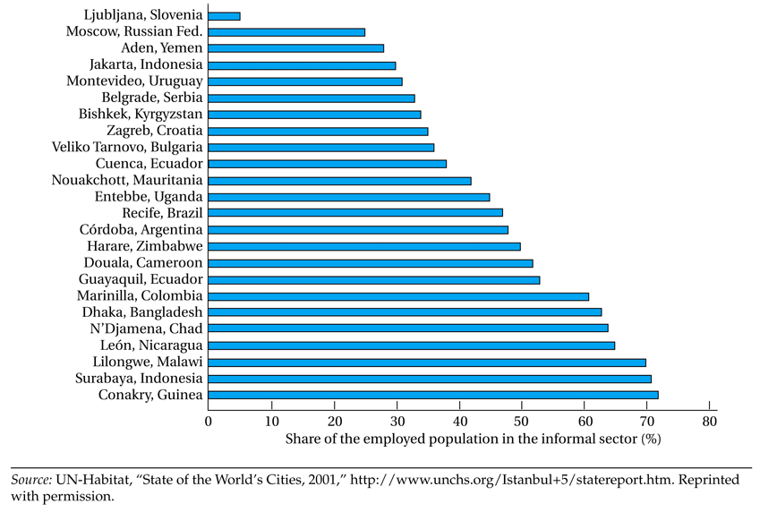
Importance of Informal Employment in Selected Cities

Slide 18
Disadvantages of informal sector
There is strong relationship between rural-urban migration and labor absorption in the informal sector
promoting income and employment opportunities in the informal sector could aggravate the urban unemployment problem by attracting more labor.
Negative environmental consequences: many informal-sector activities cause pollution and congestion.
Measures to promote the informal sector
Adopting a more positive attitude toward informal sector
Facilitating training
Provision of credit
Providing infrastructure and suitable locations for work

Slide 19
Economic Model of Rural- Urban Migration
As a pattern of development, the more developed the economy, the more urbanized.
Developing nations witnessed a massive rural-urban migration, i.e., they are being too rapidly urbanized.
However, there is rising levels of urban unemployment and underemployment in developing countries.
This combination suggests the migration and urbanization dilemma.-Todaro
1. Lewis Model
Lewis model is based on a particular view of the underdeveloped economy and the development process.
Lewis viewed development process as a structural change involving transformation of primarily agricultural economy to an industrial one.
The engine of development is industry and development requires rapid growth of industry. The growth of industry depends on three things:
1. Capital accumulation and investment in industry
2. Availability of labor to industry
3. Availability of food to industrial workers

Slide 20
Main Assumptions of Lewis model
Two-Sectors (two goods): Agriculture and Industry.
Diminishing marginal productivity of labor in both sectors.
Dual Economy: Underdeveloped economies are characterized by dualism which is coexistence of traditional and modern sectors.
Traditional sector is characterized by backward or traditional technology and low capital intensity.
The production is normally organized on the basis of family labor with overall output distributed not in the form of wages and profits, but in the form of shares that accrue to each family member.
Producers in this sector maximize family income and not profit.

Slide 21
Modern sector on the other hand is characterized by advanced technology and relatively high-capital intensity.
Producers in this sectors are profit maximizer’s.
Interaction between agriculture and industry:
Agriculture supplies labor to industry and the surplus food which sustains nonagricultural labor force. In the Lewis model, agricultural sector was assumed to be the traditional sector and industry to be the modern sector.
The flow of labor and food from agriculture to industry are known as two fundamental resource flows.
Surplus Labor: Central to the Lewis model is the idea of surplus labor in the agricultural or traditional sector.
Lewis assumed that a significant section of agricultural workers can be shifted to industry or modern sector without adversely affecting agricultural output.
More formally, workers in the agricultural sector are employed even though there marginal product is zero.

Slide 22
Todaro migration model
shows the paradoxical relationship between accelerated rural-urban migration and rising urban unemployment.
Hypotheses:
Migration is an individual rational decision
Migration proceeds in response to urban-rural differences in expected income rather than
Rural-urban migration is a rational economic decision despite the existence of high urban unemployment.
Migrants calculate (present value of) expected urban income and move if this exceeds average rural income.

Slide 23
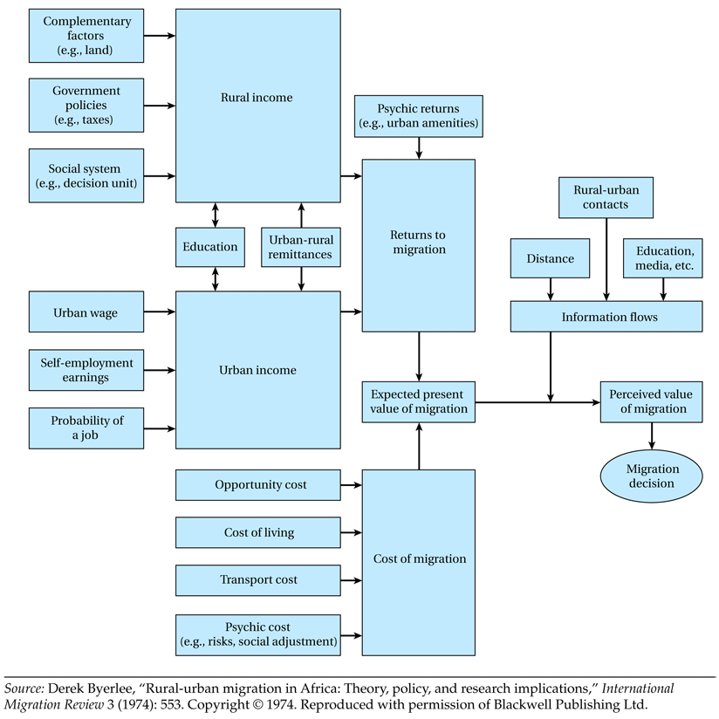
Schematic Framework for Analyzing the Rural-to-Urban Migration Decision

Slide 24
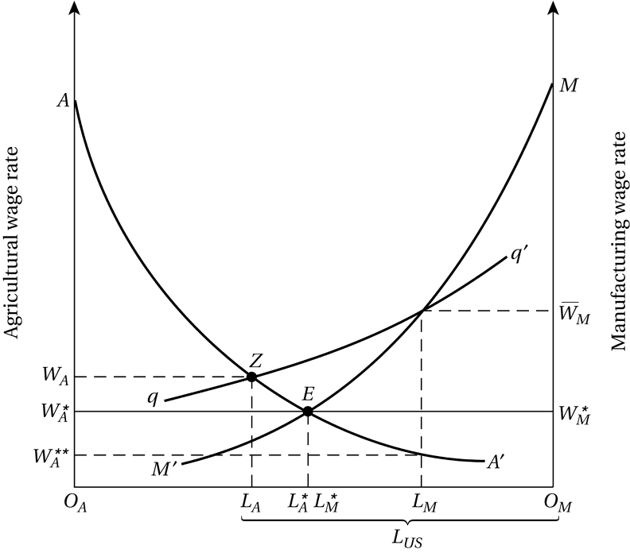

Slide 25
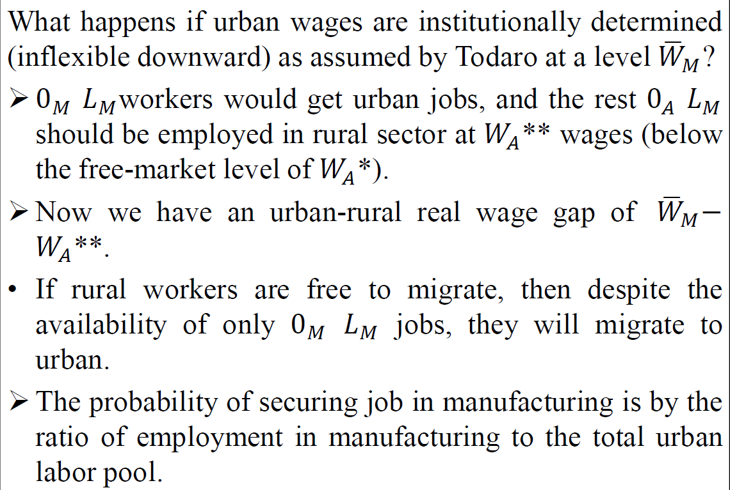

Slide 26
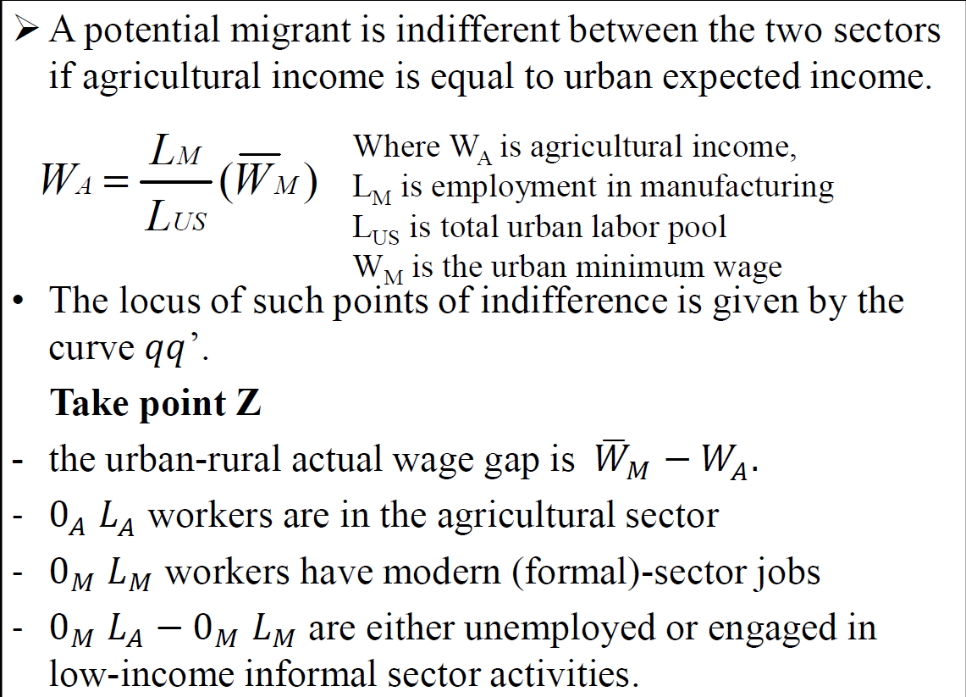

Slide 27
Rural-to-urban migration continues despite there exists high urban unemployment.
Although it is privately rational for an individual to migrate to the city despite high urban unemployment, it is socially very costly.
The Todaro migration model has four basic characteristics:
Migration is stimulated primarily by rational economic considerations of relative benefits and costs of urban sector.
The decision to migrate depends on expected urban-rural real-wage differentials where the expected differential is determined by the actual urban-rural wage differential and the probability of successfully obtaining employment in the urban sector.

Slide 28
3. The probability of obtaining an urban job is directly related to the urban employment rate and thus inversely related to the urban unemployment rate.
4. Rural-urban migration rates in excess of urban job opportunity growth rates are rational and possible when there is wide urban-rural expected income differentials .
Five Policy Implications
Reduction of imbalances between economic opportunities in rural and urban sectors.
Improvement of rural economic opportunities
Urban job creation is not sufficient solution for the urban unemployment problem.
The creation of more urban jobs without improving rural incomes and employment opportunities can result in higher levels of urban unemployment.

Slide 29
The Process in which the creation of urban jobs raises expected incomes and induces more people to migrate from rural areas is known as induced migration.
3. Curtailing public investment in higher education
Educational expansion will lead to further migration and unemployment.
If the probability of success in securing a modern-sector job is higher for people with more education, their expected income differential will be higher, and they will be more likely to migrate to the cities.
4. Elimination of wage distortions
Actual urban wages generally exceed the market or “correct” wage as a result of a variety of institutional factors.
5. Encouraging integrated rural development programs.

Slide 30
Policies need to focus on the urban employment and supply of labor in rural areas.
A Comprehensive Migration and Employment Strategy
policy approaches designed to improve the very serious migration and employment situation in developing countries:
Creating an appropriate rural-urban economic balance
Expansion of small-scale, labor-intensive industries
Eliminating factor price distortions
Choosing appropriate labor-intensive technologies of production
Modifying the linkage between education and employment
Reducing population growth
Decentralizing authority to cities and neighborhoods

Slide 31
Quiz (5%)
What is the difference between Lewis and todaro’s migration model?
Why the migration and urbanization dilemma arise?

