Slide 1
General Information
Course Name: Water Supply & Urban Drainage
Course Code: CENG-3182
Prerequisites: Hydraulics-II (CEng-2162 ) Engineering Hydrology (Ceng-3164)
Duration of the course: 12 Weeks (Tentative)

Slide 2
Evaluation
Exams (Quiz/Assignments + Test + Final Exam)
Assignments
Requirements - Individual
Completeness
Genuine attempt
Project
Requirements - Group
Completeness
Genuine attempt

Slide 3
Required skills
Word processing, spread sheet
Water distribution modeling
AutoCAD

Slide 4


Reference Materials
Hammer and Steel available in softcopy.
Tesfaye Nigussie available in Book Store.

Slide 5
Contact
In person
Via email
NO PHONE CALL

Slide 6

GENERAL INTRODUCTION
Brainstorming:
Why do we need water?
How much water do we consume per day?
How much water exists in your body?

Slide 7
GENERAL INTRODUCTION
Water use:
Domestic=> Drinking, Cooking, Washing, Carrying away wastes
Non-Domestic => Industries, Recreation, Commercial, Public uses

Slide 8
GENERAL INTRODUCTION
The existence of living things depend on water
70% of human body is water
Water loss: 1% thirst; 5% hallucinations; 15% death
Basic requirements for safe water
  Drinking: 2–3 liters/day
  Minimum acceptable standard for living (WHO)
  20-50 liters/capita/day for cooking and basic hygiene
Notes:
7.5 litres per capita per day will meet the requirements of most people under most conditions. This water needs to be of a quality that represents a tolerable level of risk. However, in an emergency situation, a minimum of 15 litres is required. A higher quantity of about 20 litres per capita per day should be assured to take care of basic hygiene needs and basic food hygiene. Laundry/bathing might require higher amounts unless carried out at source. - https://www.who.int/water_sanitation_health/emergencies/qa/emergencies_qa5/en/

Slide 9
GENERAL INTRODUCTION
We study about water supply because:
It is one of the basic needs humans;
Water is naturally available but we have come to alter it;
The amount and availability of water varies both temporally and spatially along with demand;
Technological intervention to adjust the variation to the best advantage of man is necessary
Note - ancient civilizations developed along river banks;

Slide 10
GENERAL INTRODUCTION
Where do we get water from?
Collect/carry water everyday for their day to day need from unprotected sources and from very long distance.
From improved WS system

Slide 11
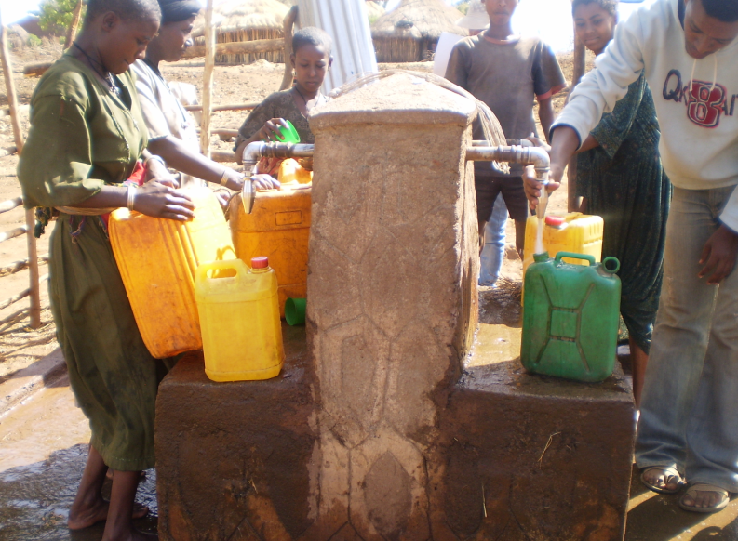
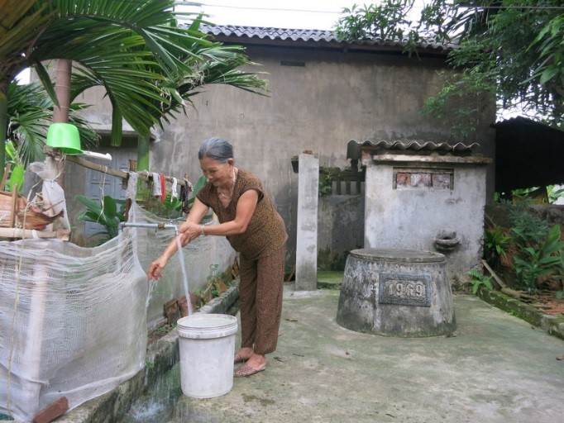
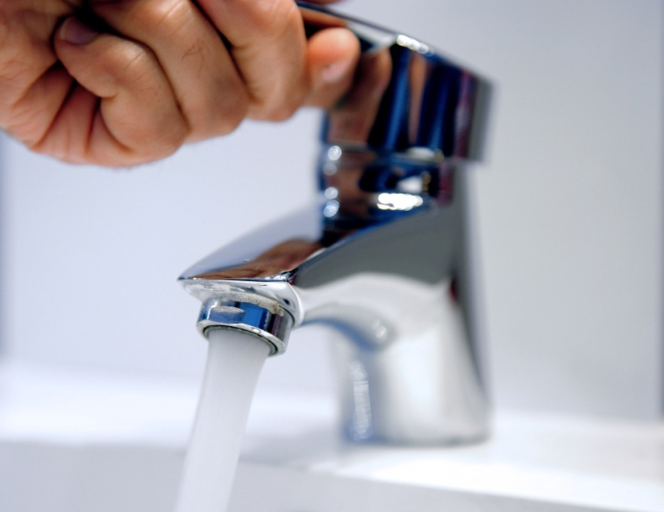
General Introduction
An “improved” water supply:
Treated rainwater
Protected springs
Protected dug wells
Protected deep well/boreholes
Public tap/standpipes
Piped water into yard/plot
Piped water into dwelling

Slide 12
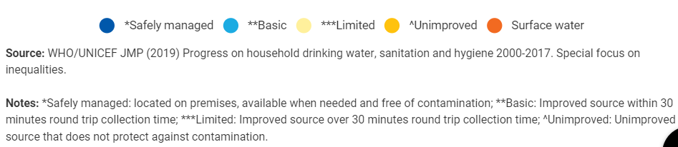
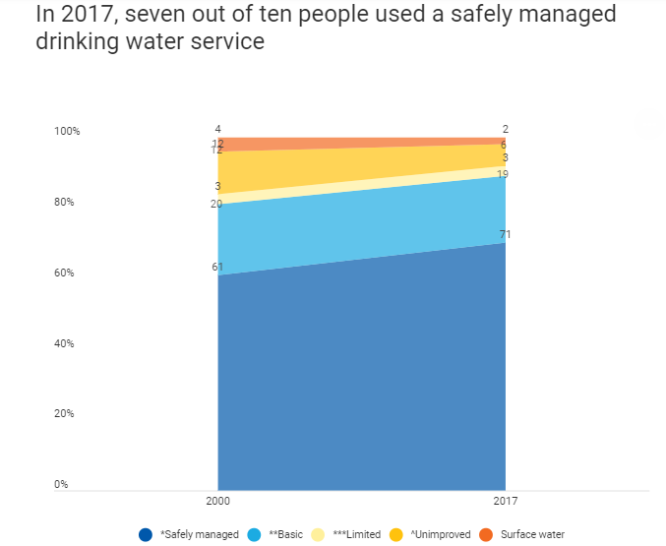
Access to safe water - World
Notes:
https://data.unicef.org/topic/water-and-sanitation/drinking-water/

Slide 13
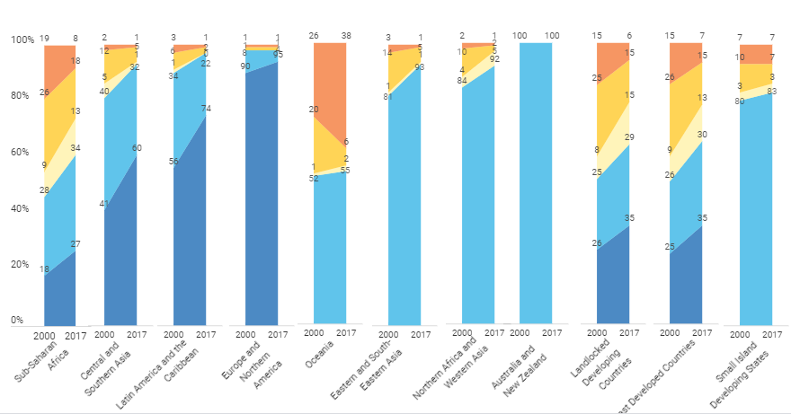
Access to safe water – World

Slide 14
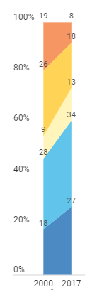
Access to safe water – Sub-Sahran Africa

Slide 15
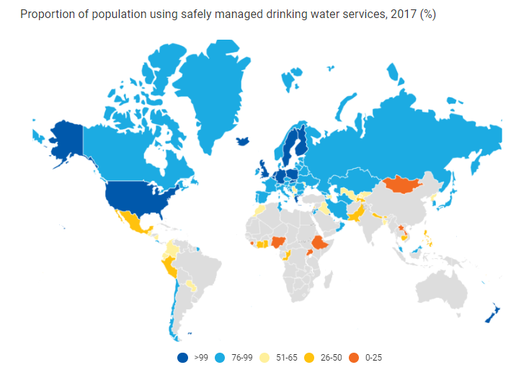
*Safely managed
11%

Slide 16
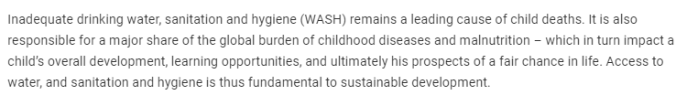
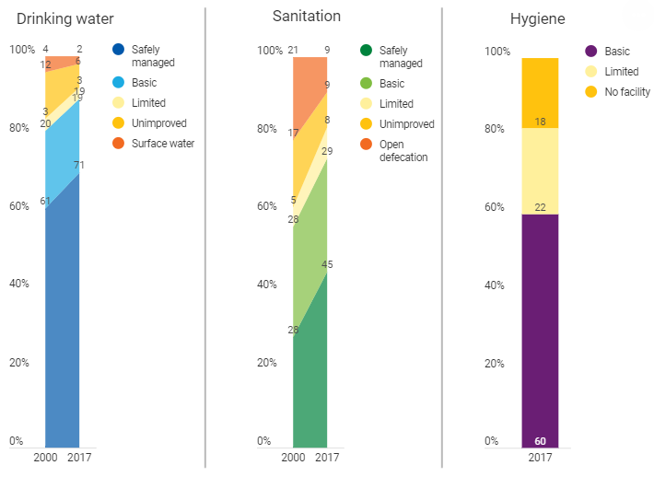
Water, Sanitation and Hygiene (WASH)

Slide 17
Ethiopia - GTP I and II (2010/11- 2014/15)
At the end of GTP I - Coverage of clean drinkable water supply - 82, 91 and 84% at rural, urban and country level respectively.
This was through providing 15 liters/person/day within the radius of 1.5 Kilometer at the rural level and 20 liters/person/day within the radius of 0.5 Kilometer at urban areas.
According to the new standard, at the end of GTP II, the rural clean drinking water coverage grows to 25 liters/person/day within the radius of one kilometer (20 %t will be from tap water).
Similarly, the urban clean water supply is planned to be 100 liters/person/da at first grade towns. As well, 80 liters, 60 liters, 50 liters and 40 liters at the second, third, fourth and fifth grade towns respectively.
From MoWIE, in the middle of the five years GTP II, the clean water supply coverage has grown to 68.5, 54.7 and 65.7 % at rural, urban and country level respectively.

Slide 18
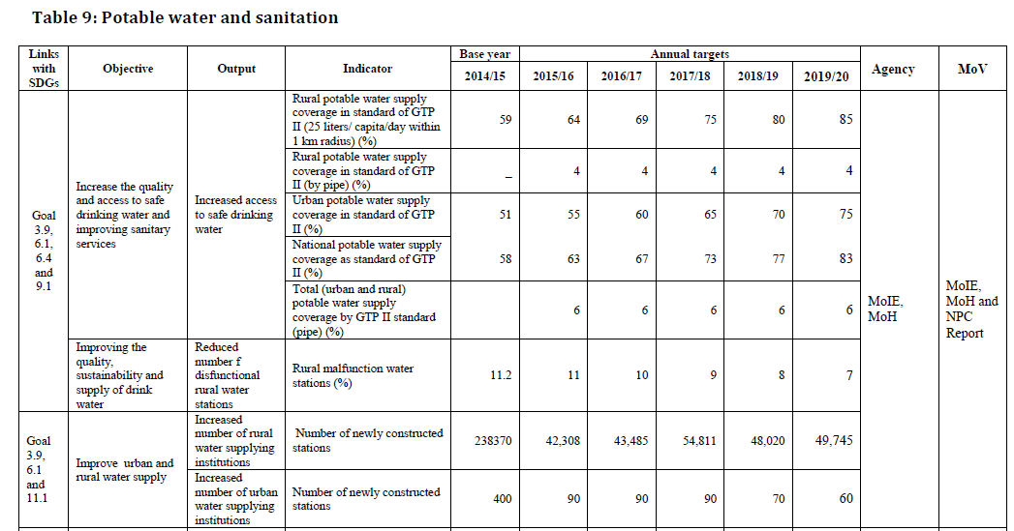
Ethiopia – GTP II (2015/16-2019/20)

Slide 19
Why do worry about water supply and also urban drainage?

Slide 20
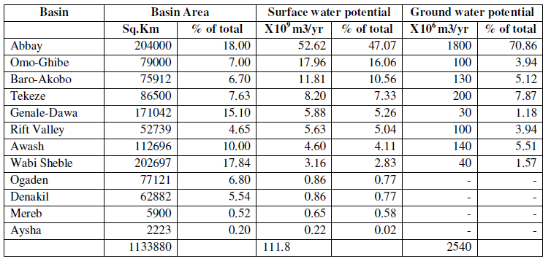
Ethiopia – Water Source
Ethiopian Context:
12 River basins = 122 BCM
2.6 to 6.5 BCM of groundwater potential

Slide 21

General Introduction
Safe and convenient WS system ensures human development
i.e., It’s poor accessibility is the main obstacle for human development
Therefore, throughout history, people have been improving sources beyond their natural condition to make getting and using water more safe and convenient.
Unsafe water leads to health impact due to pollution caused by natural and anthropogenic actions /processes (typhoid, cholera). Which further leads to less time spent on other productive activities and education especially by women and children (Back ache, vulnerable situation for attack)

Slide 22
Course objectives
To have basic knowledge on:
Water Supply and Sewerage Systems
Factors Considered in Water Supply and Sewerage Systems Planning
Design of Water Supply Systems
Design of Urban Drainage Systems

Slide 23
Course Content
1. Water demand & quantity
2. Sources of water supply
3. Collection and distribution of water
4. Water supply for buildings
5. Wastewater and storm water collection system

Slide 24
Course Outline
Chapter 1: Water Demand and Quantity
General Introduction
Water supply system planning
Population forecasting
Population density
Components of water demand
Variations in water consumption
Design periods for water supply system components
Water conservation

Slide 25
Course Outline
Chapter 2: Sources of Water Supply
The water cycle
Types of water sources
Water quality considerations
Source siting and selection
Storage reservoirs
Groundwater hydraulics
Alternative water supply sources

Slide 26
Course Outline
Chapter 3: Collection and Distribution of Water
Surface water intakes
Water conveyance systems
Pipes and appurtenances
Distribution systems
Layout of distribution systems
Design of distribution systems
Distribution reservoirs
Pumps and pumping station
Construction and maintenance of distribution systems

Slide 27
Course Outline
Chapter 4: Water Supply and Sanitary Installation for Building
Water supply for buildings
Wastewater collection system for buildings

Slide 28
Course Outline
Chapter 5: Wastewater and Storm water Collection System
General introduction
Sources and quantities of wastewater
Fluctuations in sewage flow
Sewerage system
Sewer materials and appurtenances
Design of sanitary sewer systems
Design of storm sewers
Sewerage system construction and maintenance
Non-conventional sewerage systems

Slide 29
Chapter One
Water demand and Quantity
Chapter objectives
Understand importance of water supply system
Factors affecting demand of water
Estimate the demand flow rate for the average day, maximum day, and peak hour

Slide 30
1.1. General Introduction
Water Supply System Objectives
Safe and wholesome water
Adequate quantity
Readily available to encourage personal and household hygiene
Water Supply Engineering
Planning, design, construction, operation and maintenance of water supply systems.
Planning should be economical, socially acceptable, and environmentally friendly that meet the present as well as future requirement.

Slide 31
1.2 Water Supply System Planning
A typical modern system comprises the following major components:
  Source (groundwater or surface water)
  Raw water collection structures, reservoir, well, spring box
  Intake structure, (surface water)
  Transmission line
  Treatment units
  Clear water storage
  Distribution systems (pipes, pumps, different appurtenances)

Slide 32
Water Supply system Components /arrangement
1.2 Water Supply System Planning
Source
Storage
Pipe I
LLP
Treatment Plant
HLP
Pipe II
Pipe III
Distribution system

Slide 33
1.2 Water Supply System Planning
Water supply system planning involves
  identification of service needs
  evaluation of options
  determination of optimal strategy to meet services
  development of implementation strategies
The planning exercise involves:
  collection of pertinent data
  consideration of relevant factors and
  preparation of project documents and cost estimates

Slide 34
1.2 Water Supply System Planning
Bottlenecks in sustainable water supply in Ethiopia
Pressures to expand coverage
Patchy monitoring and information
Capacity constraints when ‘the priority is always drilling’
A slow moving supply chain
Accountability to whom?

Slide 35
1.2 Water Supply System Planning
Factors to be considered???

Slide 36
1.2 Water Supply System Planning
Factors to be considered
  Population
  Per capita requirement living standard, type of industries, commercial establishments in the town etc.
  Public places, parks, institutions etc
  Industries existing industries as well as future
  Sources of water detailed survey
  Conveyance of water: from source to water treatment units depend on relative levels

Slide 37
1.2 Water Supply System Planning
Factors to be considered
  Quality of water: the analysis of the raw water quality should be made to know the various impurities present in it , and to decide on the required treatment processes
  Treatment works: Sizes and number of treatment units
  Pumping units for treated water
  Storage: the entire city or town should be divided into several pressure zones and storage facility should be provided in each zone.
  Distribution system: it should be designed according to the master plan of the town
  Economy and reliability
Notes:
If large differences in ground elevation occur in a network, PRV's are often installed in a
sequence of pipes to prevent excessively large pressures in the lower part of the network.
Such a series of PRV's may cause pressures in one subregion to be completely independent
of the remainder of the network. Such isolation creates what are commonly called separate
pressure zones. When separate pressure zones are created, it is normally better to form subnetworks and analyze each one separately, starting with the subnetwork at the lower elevation. The solution from the isolated lower subnetwork can then be used to determine the
demands at the nodes of the next higher network, and so on.

Slide 38
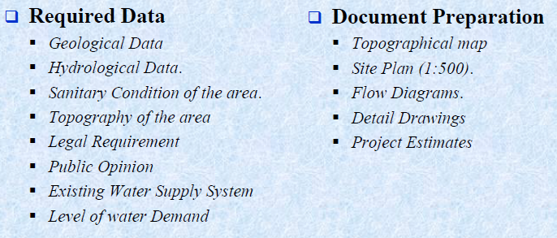
1.2 Water Supply System Planning
Notes:
If large differences in ground elevation occur in a network, PRV's are often installed in a
sequence of pipes to prevent excessively large pressures in the lower part of the network.
Such a series of PRV's may cause pressures in one subregion to be completely independent
of the remainder of the network. Such isolation creates what are commonly called separate
pressure zones. When separate pressure zones are created, it is normally better to form subnetworks and analyze each one separately, starting with the subnetwork at the lower elevation. The solution from the isolated lower subnetwork can then be used to determine the
demands at the nodes of the next higher network, and so on.

Slide 39
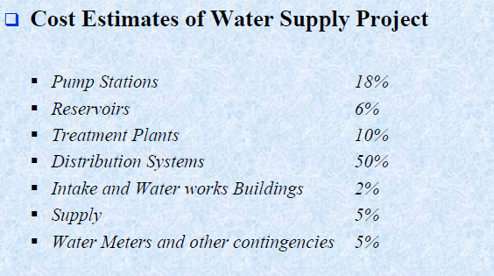
1.2 Water Supply System Planning
Notes:
If large differences in ground elevation occur in a network, PRV's are often installed in a
sequence of pipes to prevent excessively large pressures in the lower part of the network.
Such a series of PRV's may cause pressures in one subregion to be completely independent
of the remainder of the network. Such isolation creates what are commonly called separate
pressure zones. When separate pressure zones are created, it is normally better to form subnetworks and analyze each one separately, starting with the subnetwork at the lower elevation. The solution from the isolated lower subnetwork can then be used to determine the
demands at the nodes of the next higher network, and so on.

Slide 40
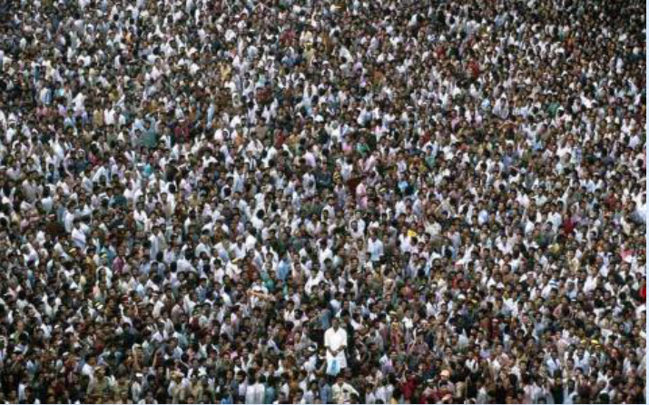
1.3. Population Forecasting
(WATER DEMAND AND QUANTITY)

Slide 41
1.3. Population Forecasting
(WATER DEMAND AND QUANTITY)
A fundamental requirement to begin the design of water supply facilities is a determination of the design capacity/ water demand.
Water demand: is defined as the volume of water required to satisfy the needs of users at the end of the design period for the respective component designed(expressed in l/d).
No of users:- knowledge of future population (for domestic demand as well as other demand components)
Quantity (l/d) = avg. demand (l/user/d) x no of users

Slide 42
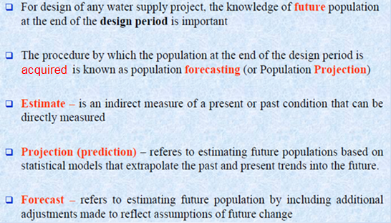
1.3. Population Forecasting

Slide 43
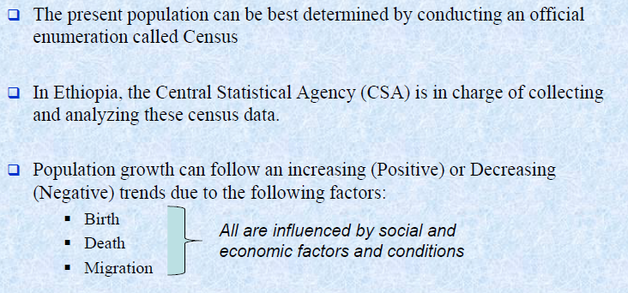
1.3. Population Forecasting

Slide 44
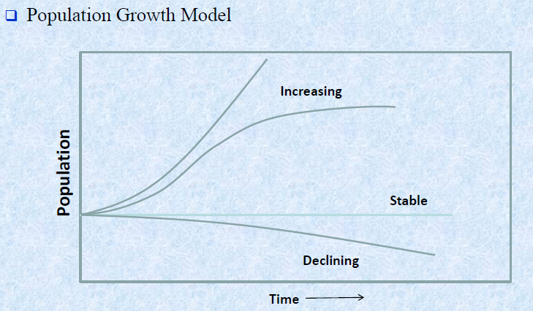
1.3. Population Forecasting

Slide 45
1.3. Population Forecasting…
Population forecasting
Several methods /trends are available to project population
Arithmetic progression
Geometric progression
Exponential growth
Decreasing rate of growth
Incremental increase method
Logistic curve method
Simple graphical method
Master plan or zoning method
Area proportion method
Each method utilizes different assumption
Selection depends on the amount and type of data available
Two important data are required
  Base population (initial population)
  Growth rate
These data can be obtained from CSA or derived from past population history of the area

Slide 46
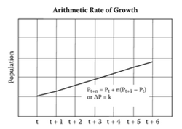
1.3. Population Forecasting…
ARITHMETIC METHOD: the rate of population growth /amount of growth is assumed to be constant/uniform.
This method is most reliable only for short period of time (1-5 years) projection
Mathematically the hypothesis may be expressed as
k is determined graphically/mathematically from successive population figures.
And the future population is given by P_{t} = P_{o} +kt
Where, P_{t} = population at some time in the future
P_{o}= present population
t = period of projection
K = average of increment of population

Slide 47
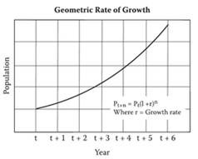

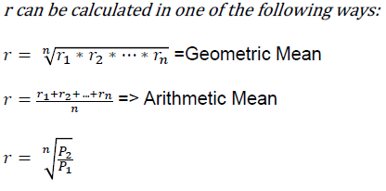
1.3. Population Forecasting…
GEOMETRIC INCREASE METHOD:
Rate of increase which is proportional to the population
The average percentage increase of the last few decades/years is determined,
And the forecasting is done on the basis of the assumption that the percentage increase per decade/year /will be uniform.
Thus, the population at the end of n years or decades is given as
………………For young cities/fast growing tows
Where, AGR(r) = annual growth rate/percentage of the population
P_{n} = population at time n in the future
P_{o} = present population
n = periods of projection

Slide 48
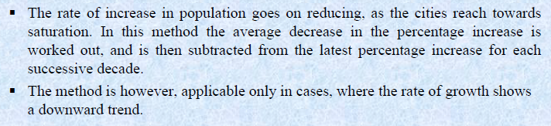
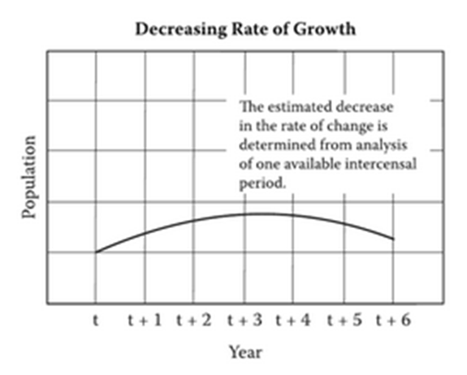
1.3. Population Forecasting…
DECREASING RATE OF GROWTH METHOD:

Slide 49
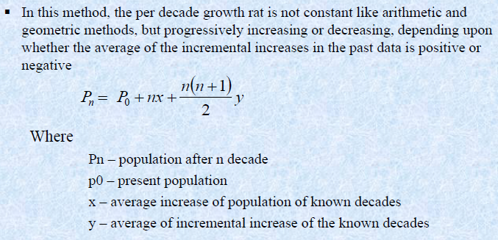
1.3. Population Forecasting…
INCREMENTAL INCREASE METHOD:

Slide 50
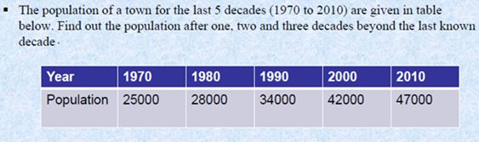
Example 1
Use
- arithmetic method
- geometric method
- decreasing rate of growth method
- incremental increase method

Slide 51
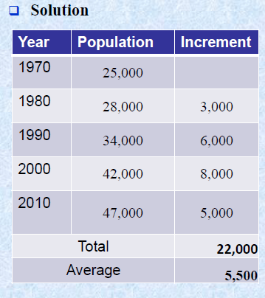
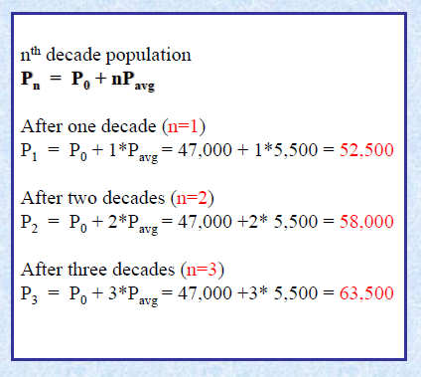
Using arithmetic method

Slide 52
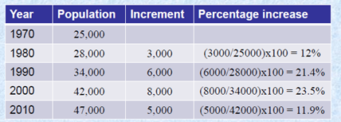
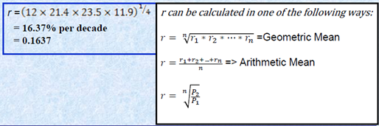
Using geometric method

Slide 53
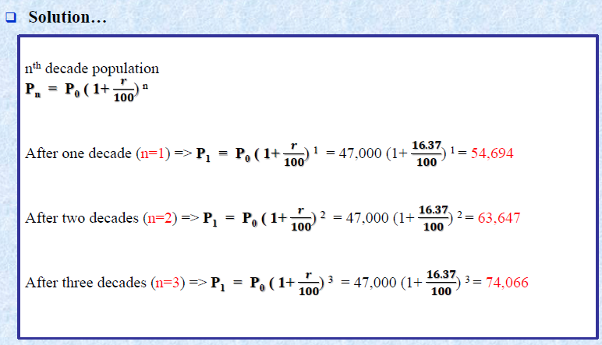
Using geometric method

Slide 54
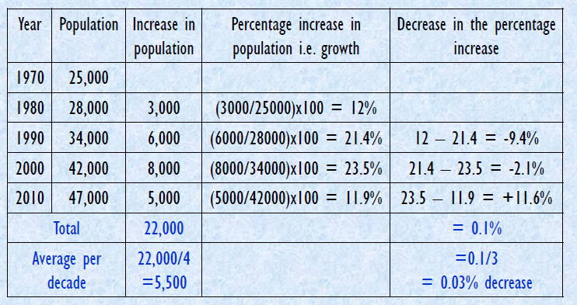
Using decreasing rate of growth method

Slide 55
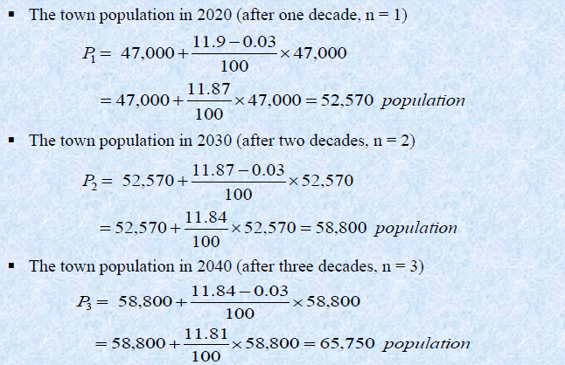
Using decreasing rate of growth method

Slide 56
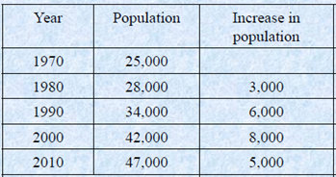
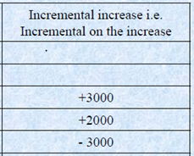

Using incremental increase method

Slide 57
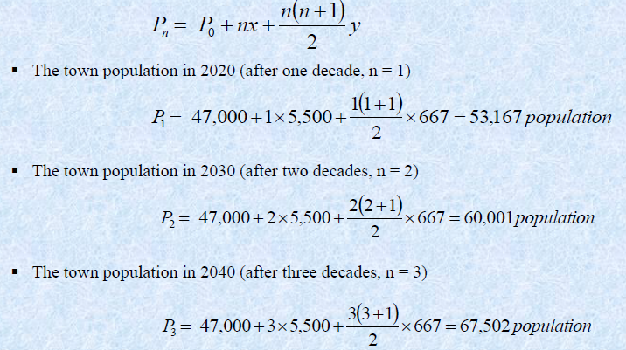
Using incremental increase method

Slide 58
Comparison
Number of years (n) | Arithmetic | Geometric | Decreasin rate of growth | Incremental increase
After 1 decade | 52500 | 54694 | 52570 | 53167
After 2 decades | 58000 | 63647 | 58800 | 60001
After 3 decades | 63500 | 74066 | 65750 | 67502

Slide 59
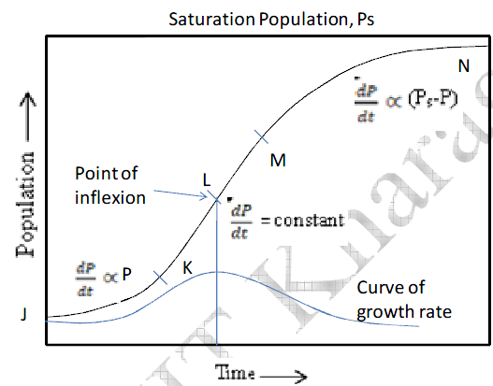
1.3. Population Forecasting…
LOGISTIC CURVE METHOD (DECLINING INCREASE):

Slide 60
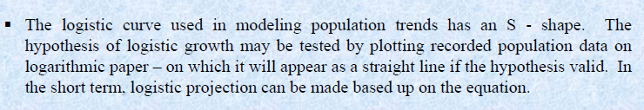
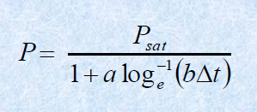
1.3. Population Forecasting…
LOGISTIC CURVE METHOD:
Where
Psat is the saturation population of the community a and b are constants
Psat, a and b may be determined from three successive census populations

Slide 61
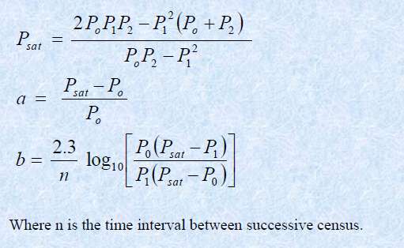
1.3. Population Forecasting…
LOGISTIC CURVE METHOD:

Slide 62
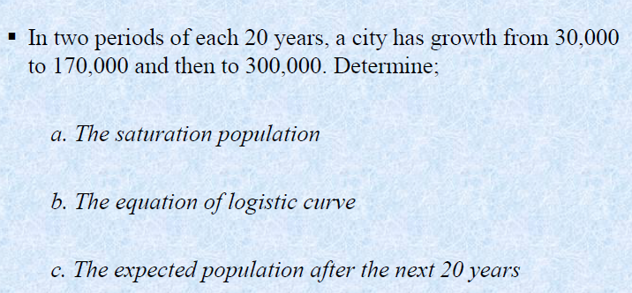
Example 2

Slide 63
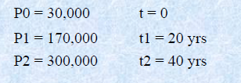
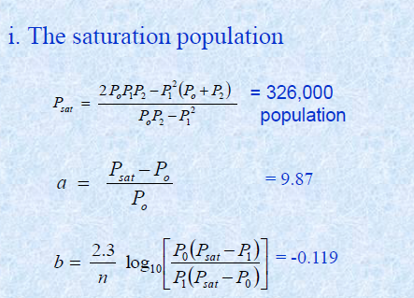
Solution

Slide 64
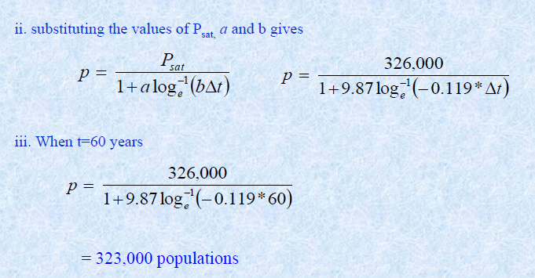
Solution

Slide 65
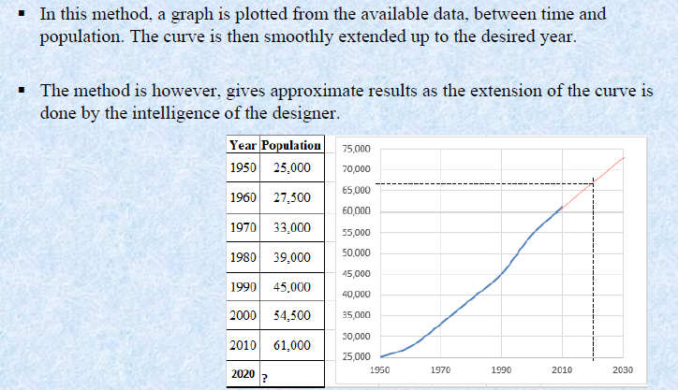
1.3. Population Forecasting…
SIMPLE GRAPHICAL METHOD:

Slide 66
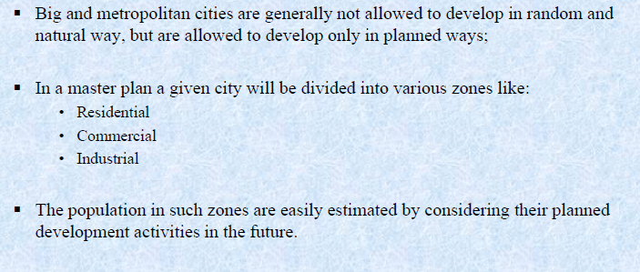
1.3. Population Forecasting…
MASTER PLAN OR ZONING METHOD:

Slide 67
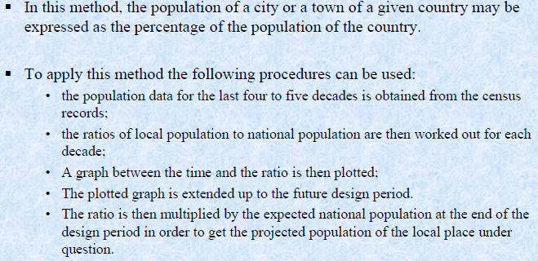
1.3. Population Forecasting…
AREA PROPORTION METHOD:

Slide 68
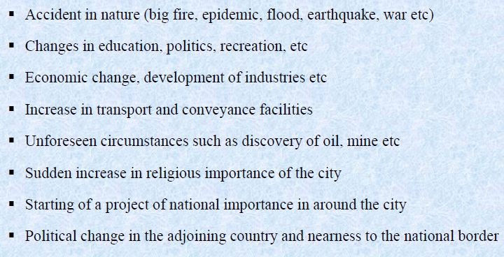
Factors affecting population forecasting

Slide 69
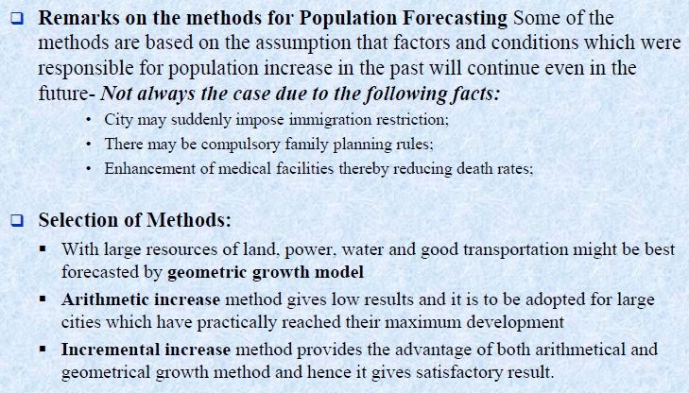
Remarks

Slide 70
1.4. Population Density
Physical distribution of the population
Population density varies widely depending on the land use of a city/town
It may be estimated from zoning master plan
Important to estimate flow and to design the distribution network

Slide 71
Example 3
The census figure of a city shows population as follows
Work out the probable population after one, two and three decades using arithmetic increase and geometric increase methods.
Before three decades | 41,000
Before two decades | 43,500
Before one decade | 47,100
Present population | 50,000

Slide 72
Solution
Arithmetic Increase
Increase in second and third decade
  43,500 – 41,000 = 2,500
Increase in first and second decade
  47,100 – 43,500= 3,600
Increase in present and first decade
  50,000 – 47,100 = 2,900
Average increase , k= (2,900+3,600+2,500)/3 = 3000
P_{t} = P_{o} + kt
Population after 1st decade = 50,000 + 3000 = 53,000
Population after 2nd decade = 50,000 + 6000 = 56,000
Population after 3rd decade = 50,000 + 9000 = 59,000

Slide 73
Solution
Geometric increase
Percent increase in second and third decade
  (2500/ 41,000)*100 = 6.09 %
Percent increase in first and second decade
  (3600/ 43,500 )*100 = 8.26 %
Percent increase in present and first decade
  (2900/ 47,100)*100 = 6.16 %
Average increase = (6.16 + 8.26 + 6.09)/3 = 6.84 %
P after 1st decade = 50,000 (1 + 6.84/100)¹ = 53,420
P after 2nd decade = 50,000 (1 + 6.84/100)² = 57,074
P after 3rd decade = 50,000 (1 + 6.84/100)³ = 60,978

Slide 74
Assignment
Write a report on water supply of Addis Ababa.
Points to be covered:
- Sources and the amount supplied by each source
- Which source serves which parts of the city
Pressure zones in the city and location of distribution of reservoirs
Maximum of two pages in:
Calibri body
font size 11
normal spacing
Submission date – March 26

Slide 75
Example 4
The following data shows the variation in population of a town from 1944 to 2004.
Estimate the population of the city in the year 2014 and 2019 by arithmetic and geometric increase methods.
Year | 1944 | 1954 | 1964 | 1974 | 1984 | 1994 | 2004
Population | 40,185 | 44,522 | 60,395 | 75,614 | 98,886 | 124,230 | 158,800

Slide 76
Solution
Year | 1944 | 1954 | 1964 | 1974 | 1984 | 1994 | 2004
Population | 40,185 | 44,522 | 60,395 | 75,614 | 98,886 | 124,230 | 158,800
Change |  | 4337 | 15873 | 15219 | 23272 | 25344 | 34570
% Change |  | 10.79 | 35.65 | 25.20 | 30.78 | 25.63 | 27.83
Average change , k= (4337+15873+15219+23272+25344+34570)/6 =19,770 per decade
Average % change , AGR= (10.79+35.65+25.20=30.78+25.63+27.83)/6 = 25.98 % per decade
Using Arithmetic Method
P₂₀₁₄ = P₂₀₀₄ + 1 x 19,770 = 158,800 + 19770 = 178570
P₂₀₁₉ = P₂₀₀₄ + 1.5 x 19770 = 158,800 + 1.5 x 19770 =188455
Using Geometric Method
P₂₀₁₄ = P₂₀₀₄(1 + AGR/100)¹ = 158,800 (1 + 25.98/100)¹ = 200,057
P₂₀₁₉ = P₂₀₀₄ (1+ AGR/100)^{1.5} =158,800 (1 + 25.98/100)^{1.5} = 224,545

Slide 77
Example 5
The Annual Growth Rate of a town in Ethiopia is 3.5%. Assuming the present population of the town (in 2010) is 4500, what would be the population in 2025?

Slide 78
Solution
AGR=3.5%; P_{O} =4500
n= 2025-2010=15
P_{n} = P_{o}(1+AGR/100)^{n}
P₁₅ = 4500(1+3.5/100)¹⁵ =7540

Slide 79
1.5. Water Demand
A fundamental requirement to begin the design of water supply facilities is a determination of the design capacity/ water demand.
Water demand: is defined as the volume of water required to satisfy the needs of users at the end of the design period for the respective component designed(expressed in l/d).
Demand is the theoretical while consumption is actual.
The determination of water demand consists of four steps:
(1) Selection of a design period,
(2) Estimation of unit water use,
(3) Estimation of the population, commercial, and industrial growth, components of water demand &
(4) Estimation of the variability of the demand.
Quantity (l/d) = avg. demand (l/user/d) x no of users

Slide 80
1.5. Water Demand
A complete water supply project involves huge and costly constructions.
All these works cannot be replaced /expanded easily
Therefore, before designing and constructing, the primary duty should be to assure that, the water works have sufficient capacity to meet the future water demand of the town.
This future period when the facility is expected to reach its full design capacity is its Design period
It depends on…
???

Slide 81
1.5. Water Demand
A complete water supply project involves huge and costly constructions.
All these works cannot be replaced /expanded easily
Therefore, before designing and constructing, the primary duty should be to assure that, the water works have sufficient capacity to meet the future water demand of the town.
This future period when the facility is expected to reach its full design capacity is its Design period
It depends on
The rate of population growth.
Regulatory constraints.
Capital expenditure
Useful life time
Ease of expansion and
Performance in early years of life under minimum hydraulic load.

Slide 82
1.5. Water Demand
Design period…
Design periods that are commonly employed in practice and commonly experienced life expectancies are shown below
The design period of different system components may vary as shown;
Component | Design period | Design life (life expectancy | Characteristics
Source: Groundwater Surface sources | 5-10 20-50 | 25 50 | Period less than design life due to ease for expansion Long period due to difficulty to expand
Treatment plant | 10-15 | 50 | Less due to ease for expansion
Pumping units | 10 | 20 | Less due to ease for expansion
Distribution pipes | Up to life time of the material | 50 | Longer period due to difficulty to expand & its long life time
Notes:
The design period is not the same as the life expectancy. The design
period is the length of time it is estimated that the facility will be able to meet the demand, that is,
the design capacity. The life expectancy of a facility or piece of equipment is determined by wear
and tear. Typical life expectancies for equipment range from 10 to 20 years. Buildings, other
structures, and pipelines are assumed to have a useful life of 50 years or more.

Slide 83
1.6. Estimation of Unit Water Demand
Per unit use (l/c/d) = Average daily demand per no. of units using that water
Average daily demand = the average of the total amount of water used each day during a 1-year period.
Since the amount of water required for different purposes vary, demand should be broken down in to its components based on the use of water for analysis

Slide 84
1.6. Estimation of Unit Water Demand
Water Demand Components
Domestic
Non domestic
Commercial
Industrial
Institutional
Public uses
Losses and leakage
Fire fighting
Agricultural

Slide 85
1.6.1. Domestic Water Demand
Is the water required at domestic level for drinking, cooking, bathing, lawn sprinkling, gardening, sanitary purposes, etc.
Also known as residential water demand: it accounts for about 50 to 60% of the total demand
Per-capita domestic water demand varies from place to place depending on life style, climatic conditions, living standard, mode and level of services
Design tip: When the proposed project is in a community with an existing water supply, the community’s historic records provide the best estimate of growth rate in demand. Otherwise, data from nearby similar community can be used.

Slide 86
1.6.1. Domestic Water Demand
In water supply system design, domestic water demand is estimated based on mode of services:
House connection: is a water service pipe connected with in-house plumbing to one or more taps,
Yard connection: is quite similar to a house connection, the only difference being that the tap is placed in the yard outside the house. No in-house piping and fixtures are provided. and
Public fountain /stand pipes/: are taps that are shared by a clearly defined group of households, often neighbors

Slide 87
1.6.1. Domestic Water Demand
Typical /gross estimate/ of Average Domestic Water Demand (l/c/d) in our country
From structure/master plan of the project area, percentage distribution of population by mode of service can be determined
The figures presented in the table can be used for guidance only.
However, these gross estimates must be modified to consider the following local factors that :
Climate
Socio-economic condition
Mode of connection | Unit | 2007 | 2017 | 2027
House Connection | lpcd | 90 | 100 | 110.0
Own Yard Connection | lpcd | 25.4 | 31.7 | 38.0
Shared Yard Connection | lpcd | 16.9 | 18.9 | 21.0
Public Tap | lpcd | 11.3 | 12.6 | 14.0

Slide 88
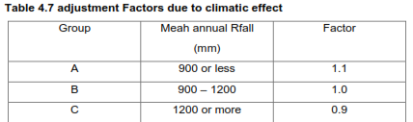
1.6.1. Domestic Water Demand
However, these gross estimates must be modified to consider the following local factors that :
climate
Socio-economic condition
Table – Adjustment factors due to climate

Slide 89
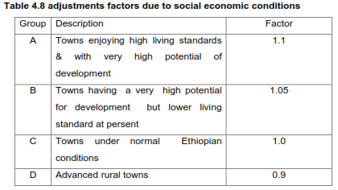
1.6.1. Domestic Water Demand
Table – Adjustment factors due to socio-economic conditions

Slide 90
1.6.2. Commercial water demand
Water demand for commercial areas such as hotels, shopping centers, service stations, movie houses, airports, etc
The commercial water demand may vary greatly depending on the type and number of establishments.
Depending on the type of service offered, the quantity of water required /demand/ by a commercial /institutional/ establishments can be related to aspects such as;
number of users (l/employee/day), (no of pupil/day)
service area (l/seat/day), (l/bed/day), etc

Slide 91
1.6.2. Commercial and institutional water demand
Typical commercial and institutional average day water demands
Category | Typical rate of water use per day
Day schools | 5 | l/pupil
Boarding schools | 50 | l/pupil
Hospitals | 100 | l/bed
Hostels | 80 | l/bed
Mosques | 5 | l/visitor
Cinema houses | 5 | l/visitor
Offices | 5 | l/employee
Public baths | 100 | l/visitor
Hotels | 100 | l/bed
Restaurant/Bar | 10 | l/seat
Notes:
Some categorize certain institutional demands like schools under public demand

Slide 92
1.6.3. Industrial water demand
This refers to the water demand by various industries like tannery, brewery, dairy, sugar factory, etc
The quantity of water required for industry purposes can be related to such factors as number of employees, floor area of the establishment, or units produced.
Since large scale industries impose high demand on domestic, institutional and commercial demands they have to develop their own water supply system.

Slide 93
1.6.3. Industrial water demand
Type of Industry | Liters per unit product
Carbonated soft drinks | 1.5 - 5 per liter
Fruit juices | 3 - 15 per liter
Beer | 4 - 22 per liter
Wine | 1 - 4 per liter
Fresh Meat | 1.5 - 9 per kg
Canned vegetables/fruits | 2 -27 per kg
Bricks | 15 - 30 per kg
Cement | 4 per kg
polyethylene | 2.5 - 10 per kg
Paper | 4 - 35 per kg
Textiles | 100 - 300 per kg
Cars | 2500 - 8000 per car

Slide 94
1.6.4. Public water demand
The quantity of water required for public utility purposes
Includes water for public parks, washing and sprinkling of roads, use of public fountains, clearing wastewater conveyance, etc.
Usually the demand may range from 2-5% of the total demand.
Often the quantity of water used for public watering is only limited by the available supply.

Slide 95
1.6.5. Unaccounted system (losses and leakage)
Water is lost or unaccounted for because of;
Defective joints in the main, broken and cracked pipes, defective house connections, faulty plumbing and unauthorized water connection
For a community supply system that includes a new distribution system, water loss through leaks is not a major factor in estimating demand.
For a new plant with an existing old distribution system, water loss through leaks may be a major consideration.
Should be taken in to account while estimating the total requirements.

Slide 96

Typical figures

Slide 97
1.6.6. Fire fighting demand
Fire may outbreak at any time and have a serious damages, if not controlled efficiently.
Water demand for fire fighting purposes shall be assessed on a town by town basis, depending on the existence of equipment and the capacity of any fire fighting service.
Fire fighting system may use either of the following
Hydrant systems
Hose-reel systems
Sprinkler systems
Portable fire extinguishers
Notes:
Hydrant systems
Fitted to the water mains
Residual pressure of 190Kpa
Flow rate=4l/s
Minimum reserve-2hrs

Slide 98
1.6.6. Fire fighting demand
The quantity of water required for fire protection should be easily available and kept always stored in storage reservoirs.
For example:
If a rate of 1100 liter/minute is required for fire fighting in a town and if six fires break out in a day and each stands for 3 hours,
the total water required shall be
= 6 x 1100 x (3 x 60) = 1,188,000 liter/day
Quantity = Rate x Duration

Slide 99
1.6.6. Fire fighting demand
The following empirical equation may be used to estimate fire demand.
1) National Board of Fire Underwriters (NBFU)
Where, Q_{F} = is fire demand (m³/hr);
P = Population in 1000’s.
NOTE: This formula is used for sizing reservoir not for distribution system pipe design.
The quantity of water required for fire protection should be easily available and kept always stored in storage reservoirs.
Quantity = Rate x Duration

Slide 100
1.6.6. Fire fighting demand
Fire flow rate and duration
Required fire flow, m³/min | Duration, hrs
7.6 | 2
11.3 | 3
15.1 | 4
18.9 | 5
22.7 | 6
26.5 | 7
30.2 | 8
34.0 | 9
37.8 | 10

Slide 101

1.6.6. Fire fighting demand
2) From Insurance services office (ISO)- (For a particular building)
For single building (ISO Method)
$Q_{F}=227C√A$
Q_{F} = fire demand(l/min)
A = floor area excluding basements, m²
C = Coefficient for construction material
= 1.5 for wood frame
= 1 for ordinary construction
= 0.8 for non combustible construction
= 0.6 for fire resistant construction
Notes:
(should be greater than 1900 lpm but less than 22700lpm (single story structure) 30270 (single building); 45400 (Single fire)

Slide 102

1.6.6. Fire fighting demand
For group of building (ISO Method)
NFF = needed fire flow (l/min)
C = the construction factor based on the size of the building and its construction, (l/min)
O = the occupancy factor reflecting the kinds of materials stored in the building (ranging from 0.75 to 1.25), and
(X+P) = the sum of the exposure and communication factors that reflect the proximity and exposure of the other buildings.

Slide 103


1.6.6. Fire fighting demand
C, construction factor
A (m²) = the effective floor area, typically equal to the area of the largest floor plus 50% of all other floors,
F = a coefficient based on the class of construction

Slide 104

1.6.6. Fire fighting demand
Occupancy factors, O_{i}

Slide 105

Example
Take X+P = 1.4

Slide 106
Example

Slide 107
Example
For a town having population of 60,000 estimate average daily demand of water. Assume industrial use 10%, institutional & commercial use 15 %, public use 5% and live stock 10% of domestic demand. Take per capita consumption of 50 l/day and leakage to be 5%.

Slide 108

Example
For a town having population of 60,000 estimate average daily demand of water. Assume industrial use 10%, institutional & commercial use 15 %, public use 5% and live stock 10% of domestic demand. Take per capita consumption of 50 l/day and leakage to be 5%.
Solution:

Slide 109
  1.7. Variations in water demand
Hourly demand in wet season
average

Slide 110
  1.7. Variations in water demand
There are wide variations in seasonal, daily and hourly water demands.
  Working days have higher demand than holidays
  Hot and dry days have more demand than wet or cold days
  Peak demands within a day are in the morning when the day’s activities start and in the evening when the activities end
  In general, there are three design demands
    Average Day Demand
    Maximum Day Demand
    Peak Hour Demand
    Coincident draft (the sum of maximum daily demand and the fire demand)
Notes:
Water consumption changes with the seasons of a year, days of the week, and the hours of the day.

Slide 111
  1.7. Variations in water demand
The unit demand estimates are averages. Therefore, in designing water supply system it is necessary to estimate the quantity of water that is required considering its timely variations.
Qday-avg (Annual average day demand)
The average daily demand over a period of one year. For economical calculations and fire fighting.
Q_{day-max} (Maximum day demand )
The amount of water required during day of maximum consumption in a year. The maximum total amount of water used during any 24-hour period. Important for water treatment plants and water storages.
Q_{hr-max} (Peak hour demand )
The amount of water required during the hour of maximum consumption in a given day. The maximum amount of water used in any single hour of any day

Slide 112
  1.7. Variations in water demand
When the proposed project is in a community with an existing water supply, the community’s historic records provide the best estimate
Peaking factors are developed from such data as follows so that it can be adopted to the average demand.
Max day factor = Maximum day demand
Average day demand
Peak hour factor = Maximum hour demand i.e. Peak demand
Average day demand
Population | Maximum Day Factor | Peak Hour Factor
0 to 20,000 | 1.30 | 2.00
20,001 to 50,000 | 1.25 | 1.90
50,001 and above | 1.20 | 1.70
Typical Peak Factors

Slide 113
  1.7. Variations in water demand
Hourly demand in wet season
average

Slide 114

  1.7. Variations in water demand

Slide 115
  1.7. Variations in water demand
Component | Design capacity
Source: Groundwater Surface sources | Q_{day-max}
Pipe mains (Type I and Type II) | Q_{day-max}
Treatment plant | Q_{day-max}
Pumping units | Pump: 3Q_{day-avg} or 4/3Q_{day-max} whichever is greater
Service reservoir | Design should consider: Hourly fluctuations of flow The emergency/breakdown reserve The provision required when pumps satisfy the entire days demand in less than 24 hrs. The fire demand Q_{F}.
Type III pipe and distribution pipes | Q_{hr-max} or Q_{day-max}+Q_{F} = Q_{cd}, whichever is greater (calculated for anticipated maximum growth)

Slide 116
Example
Calculate the water requirements for a community that will reach a population of 120,000 at the design year. The estimated municipal water demand for the community is 300 l/c/d.
Calculate the fire flow, design capacity of the water treatment plant, and design capacity of the water distribution system. Use NBFU formula for fire flow.
Population | Maximum Day Factor | Peak Hour Factor
0 to 20,000 | 1.30 | 2.00
20,001 to 50,000 | 1.25 | 1.90
50,001 and above | 1.20 | 1.70

Slide 117
Solution
P = 120,000
Q_{day-avg} = 300 x 120,000 =36,000,000 L/d = 36,000 m³/d
Take P.F. for Q _{day-max} = 1.2 and
for Q_{peak-hr} = 1.7
Q _{day-max} =1.2 x 36,000= 43,200 m³/d
Q_{peak-hr} = 1.7 x 36,000 = 61,200 m³ /d
Fire flow rate =
= 2,259.13 m³/hr = 54,219 m³/day

Slide 118
Solution
Design capacity of treatment plant = Q _{day-max}
= 43,200 m³/day
Distribution system Design capacity
= maximum [Q _{peak-hr} , (Q _{day-max} +fire flow rate)]
= maximum [61,200, (43,200 +54,219)]
= 97,419 m³/day

Slide 119
Summary
Factors Affecting Water Demand
Size of the city
Presence of Industries and Commercial centers
Quantity of water supplies
Cost of water
Climatic condition
Characteristic of the population
Policy of metering and method of charging
Efficiency of water work administration
Pressure in the distribution system

Slide 120
Water Conservation
Urban level
Urban water conservation depends on changing behaviors by water users, which may be influenced by personal factors (related to variables such as age, income, education, etc.)
Stimuli coming from the economic (i.e., pricing), technological, or public awareness spheres.

Slide 121
Water Conservation
Individual level
Check all faucets, toilets and showerheads for leaks.
Insulate your water pipes.
Install a low-flow showerhead.
Install a water-saving toilet.
Wash your car the water-efficient way.
Turn off the faucet while washing dishes.
Turn the faucet off while you brush your teeth.
Be water conscious!

Slide 122
Summary
Procedure to estimate Water Demand
1. Estimate the future population of the project area for the initial and design years and for the staging periods.
2. Using the historical water usage and billing information, develop annual water consumption data for domestic, institutional, commercial, and industrial demands and calculate the annual average water demand.
3. Based on the climatic condition of the project area, living standard of the community and the mode of services of domestic demand, make appropriate adjustments for the domestic demand

Slide 123
Summary
4. Develop factors for maximum day demand and peak hour demand based on the annual average day data developed in step 2. If there is no recorded data, use the recommended maximum day factors.
5. The average day demand and peaking factors of maximum day and peak hour developed above should be used to determine the design demands: average day, maximum day and peak hour demands.

