Slide 1
MANUFACTURING
Engineering II
CHAPTER 1.2
SAND CASTING
AAiT
Lecture By Dr Shanthakumar G C

Slide 2
The 10 Rules for good castings
Rule 1. Start with a good-quality melt Immediately prior to casting, the melt shall be prepared, checked, and treated, if necessary, to bring it into conformance with an acceptable minimum standard. Prepare and use so far as possible only near defect- free melt.
Rule 2. Avoid turbulent entrainment of the surface film on the liquid This is the requirement that the liquid metal front (the meniscus) should not go too fast. Maximum meniscus velocity is approximately 0.5 m s–1 for most liquid metals. This requirement also implies that the liquid metal must not be allowed to fall more than the critical height corresponding to the height of a sessile drop of the liquid metal. The maximum velocity may be raised to 1.0 m s–1 or even higher, and the critical fall height might be correspondingly raised to approximately 50 mm, in sufficiently constrained running systems or thin section castings.

Slide 3
Rule 3. Avoid laminar entrainment of the surface film on the liquid This is the requirement that no part of the liquid metal front should come to a stop prior to the complete filling of the mold cavity. The advancing liquid metal meniscus must be kept ‘alive’ (i.e. moving) and therefore free from thickened surface film that may be incorporated into the casting. This is achieved by the liquid front being designed to expand continuously. In practice this means progress only uphill in a continuous uninterrupted upward advance; i.e. in the case of gravity poured casting processes, from the base of the sprue onwards. This implies:
Only bottom gating is permissible.
No falling or sliding downhill of liquid metal is allowed.
No horizontal flow of significant extent.
No stopping of the advance of the front due to arrest of pouring or waterfall effects, etc.

Slide 4
Rule 4. Avoid bubble entrainment No bubbles of air entrained by the filling system should pass through the liquid metal in the mold cavity. This may be achieved by:
Properly designed off-set step pouring basin; fast back-fill of properly designed sprue; preferred use of stopper; avoidance of the use of wells and all other volume-increasing features of filling systems (such as expanding channels sometimes known as ‘diffusers’); small volume runner and/or use of ceramic filter close to sprue/runner junction; possible use of bubble traps. A naturally pressurized filling system fulfills most of these criteria.
No interruptions to pouring.
Rule 5. Avoid core blows
No bubbles from the outgassing of cores or molds should pass through the liquid metal in the mold cavity. Cores to be demonstrated to be of sufficiently low gas content and/or adequately vented to prevent bubbles from core blows.
No use of impermeable clay-based core or mold repair paste.

Slide 5
Rule 6. Avoid shrinkage
No feeding uphill in larger section thickness castings. Feeding against gravity is unreliable because of (i) adverse pressure gradient and (ii) complications introduced by convection.
Demonstrate good feeding design by following all seven Feeding Rules, by an approved computer solidification model, and by test castings.
Once good feeding is attained, fix the temperature regime by controlling (i) the level of flash at mold and core joints; (ii) mold coat thickness (if any), and (iii) temperatures of metal and mold.
Rule 7. Avoid convection
Assess the freezing time in relation to the time for convection to cause damage. Thin and thick section castings automatically avoid convection problems. For intermediate sections either (i) reduce the
problem by avoiding convective loops in the geometry of the casting and rigging, (ii) avoid feeding uphill, or (iii) eliminate convection by roll-over after filling.

Slide 6
Rule 8. Reduce segregation
Predict segregation to be within limits of the specification, or agree out-of-specification compositional regions with customer. Avoid channel segregation formation if possible.
Rule 9. Reduce residual stress
No quenching into water (cold or hot) following solution treatment of light alloys. (Polymer quenchant or forced air quench may be acceptable if casting stress can be shown to be acceptable.)
Rule 10. Provide location points
All castings to be provided with location points for pick-up for dimensional checking and machining.
Proposals to be agreed with quality auditor, machinist, etc.

Slide 7
CASTING Working Design
The general foundry work cycle design for a sand casting techniques:
The first step is casting design and
Definition of the (3D) shape of the cast part.
Obviously, some changes have to be made with respect to the final part.
Casting geometry must comply with foundry constraints:
All shapes may not be cast with each process,
Holes with high length to diameter ratio,
Flat perpendicular smooth surfaces etc. may give problems.
In general, a subsequent machining is required for at least some part features.
A correct casting design requires:
  The whole foundry cycle and,
Changes in some of the part details to satisfy casting-related constraints.

Slide 8
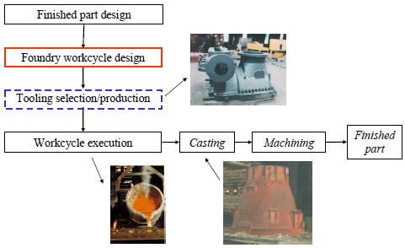
CASTING Working Design

Slide 9
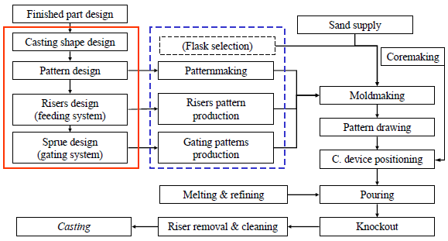
CASTING Working Design

Slide 10
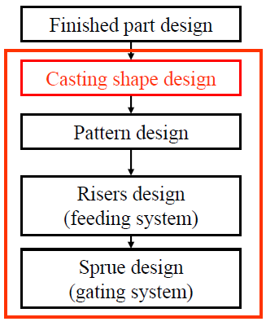
CASTING Working Design
First step is casting shape design, hence (in this order) pattern, risers & sprue design.
At each step we need information from the previous ones.
Shape changes can be made, but only if necessary & after part designer approval.
Process design is circular: at each step, a feasibility control is made. If this check fails, modification of the previous results is required to continue.

Slide 11
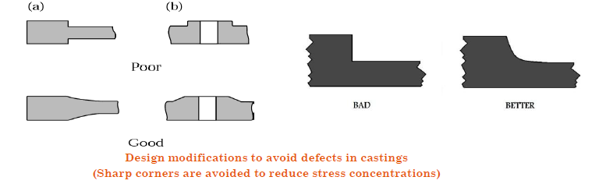
Corners Angles and section thickness
Sharp corners, angles and filets should be avoided because they act as stress risers and may cause cracking and tearing of the metal(as well as die) during solidification.
Fillet radii should be selected to reduce stress concentrations and to ensure proper liquid-metal flow during the pouring process.
Fillet radii usually ranges from 3mm to 25 mm.
If the fillet radii are too large ,the volume of the material in those regions is also large and consequently, the rate of cooling is too low.

Slide 12
FROM PRODUCT TO CASTING
Casting design must deal with the following issues:
Patterns must be extracted (drawn) from the mold (easily & without damaging it);
There are some geometrical constraints, typical of the casting process (“deep holes”, thickness distribution…);
Casting tolerances are broad, some features require finishing by machining: Stock allowances must be left on some surfaces;
Small fillet radii cannot be cast because of casting stresses;
Cooling (solidification) speed should be kept under control, smooth & directional thickness change is extremely important;… etc.

Slide 13
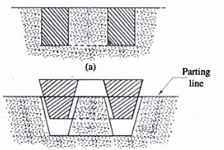
Pattern
Draft : A pattern can be drawn satisfactorily from the sand and good casting made only if its sides are tapered away from the parting line. In addition, projections such as bosses on the sides of the casting away from the parting line
The allowance which facilitate easy withdrawal of pattern from mould walls
Slight taper or draft is provided to vertical side of mould walls all around
Drat allowance is additive: 1 – 1.5 % of length

Slide 14
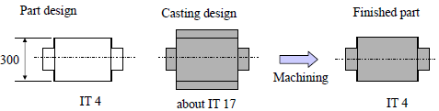
FROM PRODUCT TO CASTING
Stock allowance
Casting accuracy is rather low.
When higher precision is needed machining is required
Almost all functional surfaces fall within precision
A subsequent machining (that is, chip removal) is mandatory.
The right amount of stock allowance to be left on the casting
Need for extra material to compensate inaccuracy of the casting,
Leaving at least some rough material to be removed;
Need to reduce the amount of part left

Slide 15
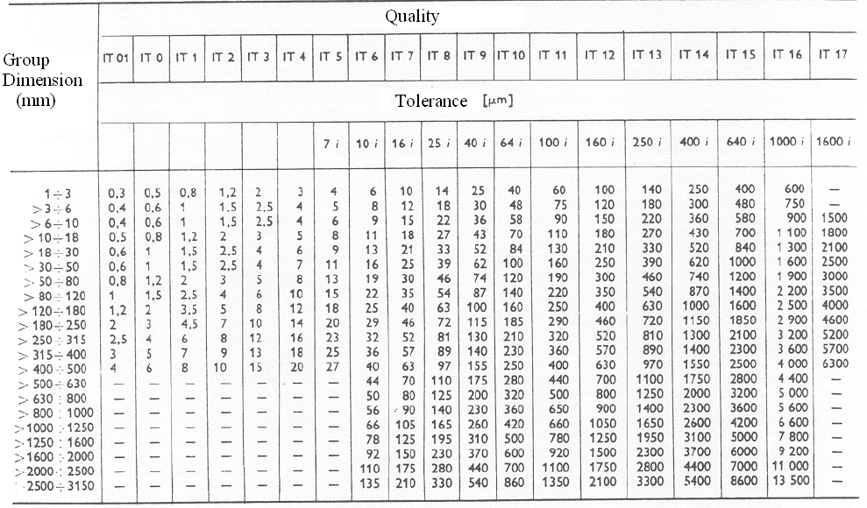
FROM PRODUCT TO CASTING
Stock allowance

Slide 16
Tolerance
Tolerance of plus or minus 1.5 mm for dimensions up to about 300 mm are commercial practice for sand castings.
Tolerances as close as plus or minus 0.8 mm are held by some foundries but at extra cost that should not be incurred unless necessary.

Slide 17
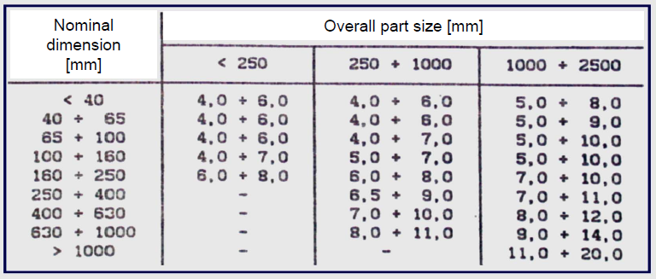
FROM PRODUCT TO CASTING
Stock allowance
Stock allowance thickness depends on both:
Overall part size and
Individual part dimensions.
The effect of overall part size is due to:
Mold deformation, under Metallostatic forces &
                Part weight.

Slide 18
1.When designing patterns for casting, patternmakers use special rulers that automatically incorporate solid shrinkage allowances into their designs. Therefore, a 12-in. patternmaker’s ruler is longer than a foot. How long should a patternmaker’s ruler be for the making of patterns for (1) aluminum castings (2) malleable cast iron and (3) high-manganese steel?

Slide 19
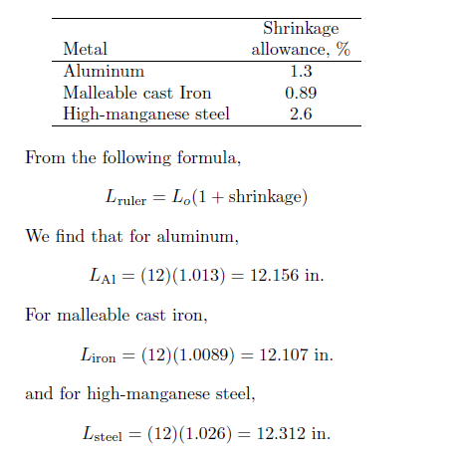

Slide 20
Note that high-manganese steel and malleable cast iron were selected for this problem because they have extremely high and low shrinkage allowances, respectively. The aluminum ruler falls within the expected range, as do most
other metals.

Slide 21
2.The blank for the spool shown in the accompanying figure is to be sand cast out of A-319, an aluminum casting alloy. Make a sketch of the wooden pattern for this part. Include all necessary allowances for shrinkage and machining.

Slide 23
The sketch for a typical green-sand casting pattern for the spool is shown below. A cross sectional view is also provided to clearly indicate shrinkage and machining allowances, as well as the draft angles. The important elements of this pattern are as follows (dimensions in inches):
(a) Two-piece pattern.
(b) Locating pins will be needed in the pattern plate to ensure that these features align properly.
(c) Shrinkage allowance = 5/32 in./ft.
(d) Machining allowance = 1/16 in.
(e) Draft = 3⁰

Slide 24
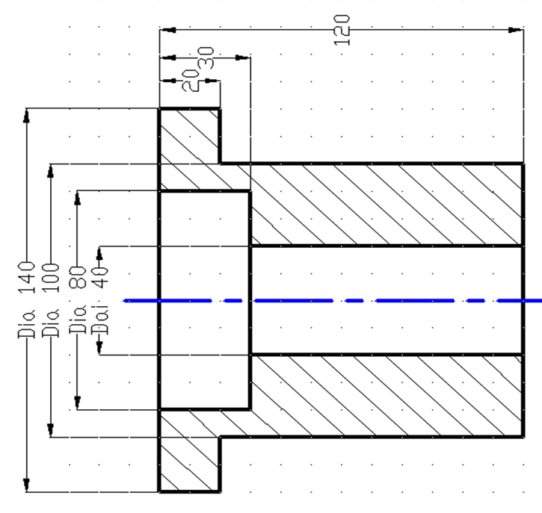
3.For the sketch shown , Starting from the finished part design of the mechanical part, evaluate the complete pattern design and the feeding system considering.

Slide 25
Stock allowance 3mm
Linear shrinkage 1%
Draft angle 2⁰
Compute the stock allowance, shrinkage allowance and draft angle for the product part drawing.
Add the core print according to the dimension.
Design the feeding system (Riser) of the steel rough sowed with the help of sketch.considering the geometry of the riser is square.
The Number of riser and position
Dimension for a riser
Dimension for a riser neck

Slide 26
No | Nominal Dimensions |  | Shrinkage Allowance 1% |  | Stock shrinkage |  | Pattern shape design
1 | External | φ140 | 140x0.01 | 1.4 | +3 | +3 | 147.4 | 147
2 | External | φ100 | 100x0.01 | 1.0 | +3 | +3 | 107 | 107
3 | Internal | φ80 | 80x0.01 | 0.8 | -3 | -3 | 74.8 | 75
4 | Internal | φ40 | 40x0.01 | 0.4 | -3 | -3 | 34.4 | 34
5 | Linear | 20 | 20x0.01 | 0.3 | +3 | +3 | 26.2 | 26
6 | Linear | 30 | 30x0.01 | 0.3 | +3 | -3 | 30.3 | 30
7 | Linear | 120 | 120x0.01 | 1.2 | +3 | +3 | 127.2 | 127

Slide 27
For the Hole/Core
No | Nominal Dimension |  | Shrinkage Allowance 1% |  | Stock Shrinkage |  | Pattern shape design
1 | Internal | φ80 | 80x0.01 | 0.8 | -3 | -3 | 74.8 | 75
2 | Internal | φ40 | 40x0.01 | 0.4 | -3 | -3 | 34.4 | 34
3 | Linear | 30 | 30x0.01 | 0.03 | +3 | -3 | 30.3 | 30
4 | Linear | 120 | 120x0.01 | 1.2 | +3 | +3 | 127.2 | 127

Slide 28
For the feeding system
Calculate the volume and surface area
Volume 1= [π(D²-d²)h]/4= [π(140²-80²)20]/4=207345m³
Volume 2= [π(D²-d²)h]/4= [π(100²-80²)10]/4=28274m³
Volume 3= [π(D²-d²)h]/4= [π(100²-40²)90]/4=593761m³
Surface area 1= [{π(D²-d²}h]/4+ [{π(D²-d²}h]/4+πDh+ πdh
= = {π(140²-80²} 4+ [{π(140²-100²}/4+πx140x20+ πx80x20]=31728mm²
Surface Area 2= πDh+ πdh= πx100x10+ πx80x20=5654mm²
Surface Area 3=[{π(D²-d²}h]/4+ [{π(D²-d²}h]/4+πDh+ πdh
= [{π(100²-40²}/4+ {π(80²-40²}/4+πx100x90+ πx40x90= 49949mm2
Total Volume= V= 207345+28274+ 593761=829380 mm3
Total Surface Area =TSA=31728+5654+49949=87331mm2

Slide 29
Modulus of Casting= (Volume of Casting)/Surface Area of Casting
=829380mm³/87331mm²=9.49mm
Now Taking Modulus of Riser=1.2 Modulus of Casting
Modulus of Riser= 1.2x9.49=11.38mm
Now,
Modulus of riser (shape of riser is square)=Vol. of Riser/SA Riser
=H³/5H²=H/5 =
Height of Riser= Modulus of Riserx5
Therefore,
Height of Riser=5x11.38=56.94mm=Riser Diameter
Riser Neck Dimension=0.4xH=0.4x56.94mm= 22.7mm
Riser Neck Length=0.16xH =0.16x56.94 mm=9.11 mm

Slide 30
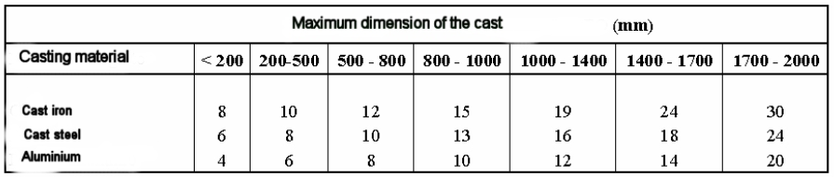
FROM PRODUCT TO CASTING
Minimum thickness
Some thin parts are difficult to obtain by sand casting:
FROM PRODUCT TO CASTING –Holes
Some holes are difficult to make in a casting:
Slender holes (large H/D ratios): they would require a core that is too weak.
Small holes (small D): core making techniques are unable to produce cores smaller than about 5 mm in diameter.
Better made by drilling.

Slide 31
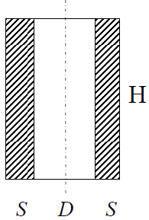
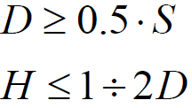
FROM PRODUCT TO CASTING –Holes
As a “rule of thumb”, we can use cores when:-
The hole diameter is at least once the wall thickness
When the core diameter is larger than the wall thickness, the core has a positive effect on the casting, since it cools the wall till the end of solidification.
On the contrary when the core diameter is considerably small, the core starts to cool the wall. However during the wall solidification the core is overheated.
As a consequence the core reduces wall solidification, which at the end presents porosity & shrinkage.
The same happens when the core height is considerably higher than the core diameter.

Slide 32
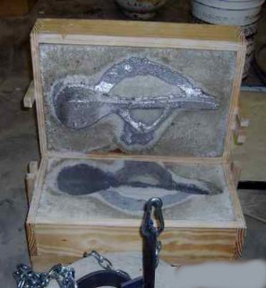
FROM PRODUCT TO CASTING
Cope and Drag
We always start from parting plane (parting line) selection;
All other decisions will depend on this one;
Try & avoid undercuts (easy drawing);
Exploit symmetry, if present (for symmetric metallurgical structure);
Place gate & risers in a suitable position (aesthetic of some as-cast surfaces);
Use just one pattern half (cheaper molding);
Reduce cavity depth (less extra material for draft).

Slide 33
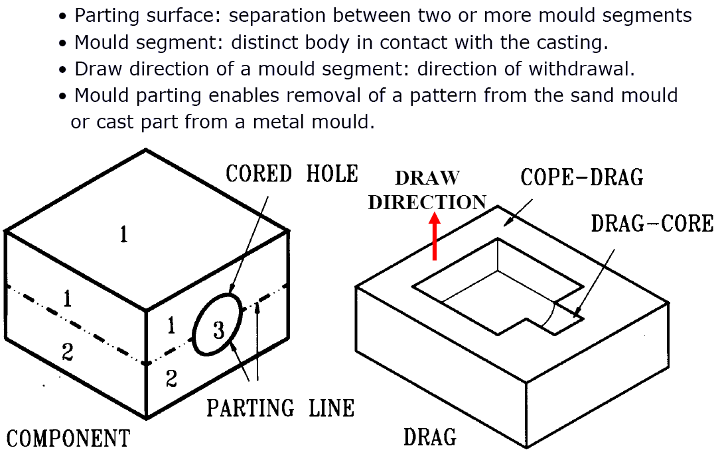
FROM PRODUCT TO CASTING
Cope and Drag

Slide 34
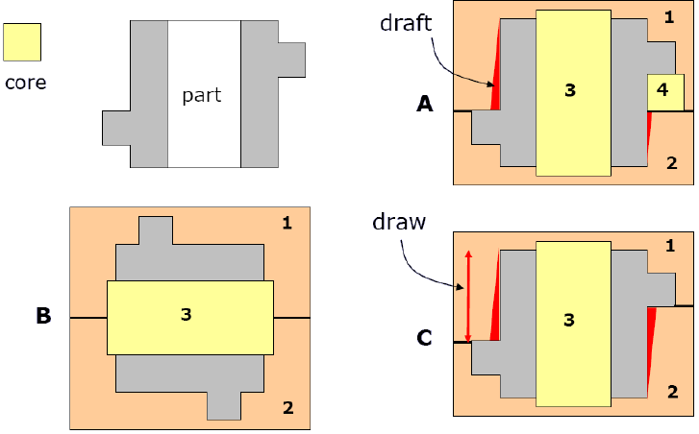
FROM PRODUCT TO CASTING –Patterns
Pattern extraction is made possible by:
1) Correct positioning b/n cope & drag
2) Using more than two flasks:
3) Using sand inserts (“external cores”):
Dividing the pattern into more than two parts:
GOAL:
Minimize the number & complexity of mould elements to create the casting cavity closest to the desired geometry, & ensure good internal quality.

Slide 35
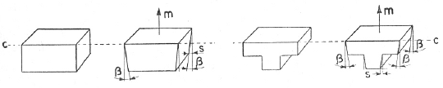
FROM PRODUCT TO CASTING –Draft
Pattern drawing (stripping) is a critical operation.
Pattern surfaces parallel to drawing direction are likely to damage the mold, requiring a manual mold repair.
For this reason, these surfaces are tapered by a suitable draft angle for easy drawing, so that the drawing movement itself disconnects the pattern from the mold walls.
Drafts cause extra material to be lie on some surfaces of the pattern, thus always increasing stock.

Slide 36
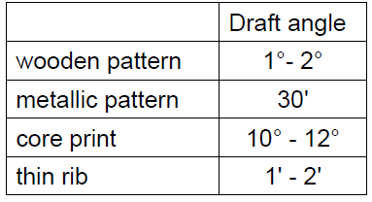
FROM PRODUCT TO CASTING – Draft
Draft angles are generally small.
They depend on both surface properties of the pattern (i.e. pattern material) and
Height of the part to be tapered.

Slide 37
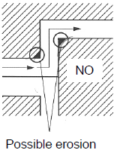
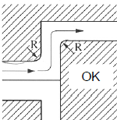
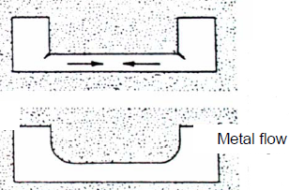
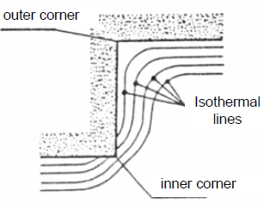
FROM PRODUCT TO CASTING
Fillets
Sharp corners (both inner & outer) should be avoided on castings.
Sharp corners should be replaced by fillets, because of:
Unacceptable differences in solidification & cooling velocities
Notch effect on castings (located in areas where casting stresses are remarkable)
Unacceptable mold wear because of metal flow erosion during filling

Slide 38

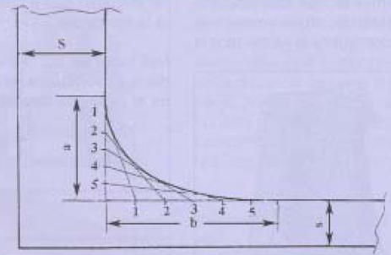
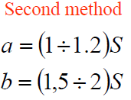
FROM PRODUCT TO CASTING
Fillets
Fillet radii:- Outer fillet radii = Stock allowance - inner corners:
Empirical equation or interpolation rule:
Divide a & b in the same number of segments
Connect 1 with 1, 2 with 2 & so on
Draw the curve tangent to the connection lines

Slide 39
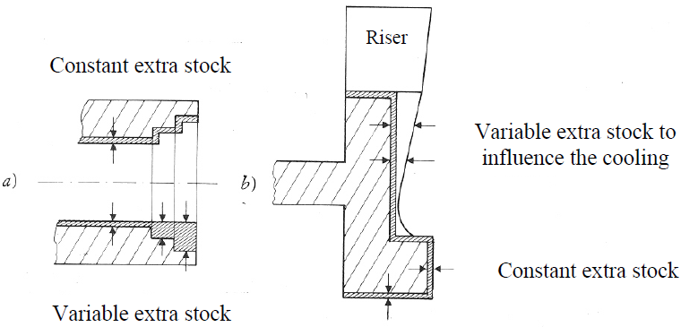
FROM PRODUCT TO CASTING
Stock allowance
Sometimes, some extra stock is left for special purposes:
  a. Simplify core shape (economical reason);
  b. Allow directional solidification (padding action).

Slide 41
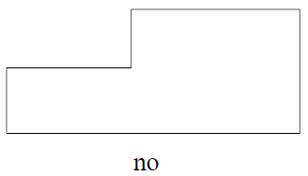
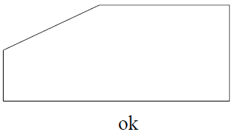
FROM PRODUCT TO CASTING
Thickness
Changes in casting thickness must be as smooth as possible, to control casting stresses (due to solid shrinkage).
Moreover, a regular change in thickness is beneficial, since a directional solidification contributes to the feeding action.

Slide 42
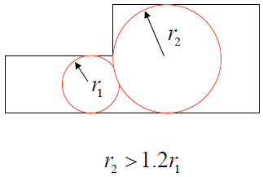
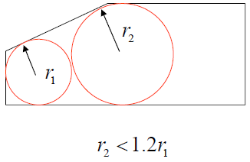
FROM PRODUCT TO CASTING
Thickness
Heuvers’ circles may be used to evaluate thickness rate of variation.
An Heuvers’ circle is the biggest circle that can be inscribed in a casting cross-section.
The difference b/n the diameter of any pair of adjoining circles (tangent to each other) should not exceed 15 -20%.

Slide 43
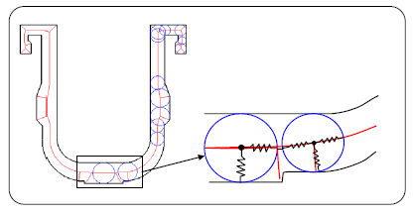
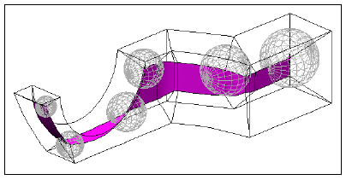
FROM PRODUCT TO CASTING
Thickness

Slide 44
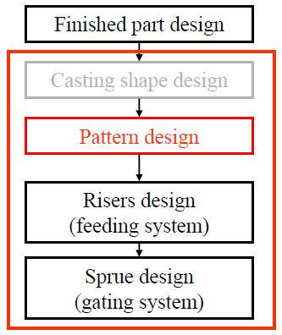
CASTING WORK CYCLE DESIGN
Once casting shape is designed, it is possible to start pattern definition.

Slide 45
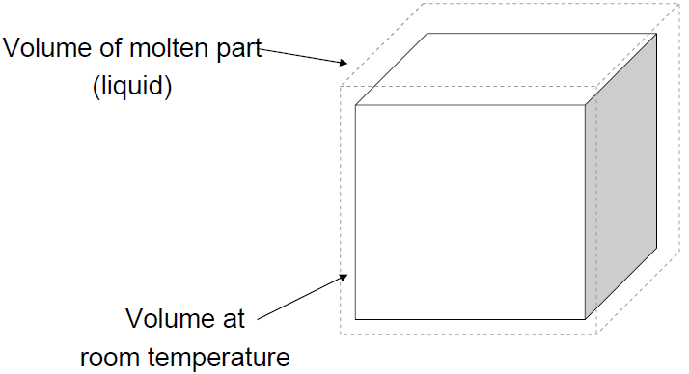
SHRINKAGE
Undesired (yet unavoidable) phenomenon in casting processes.
All foundry materials, during cooling, shrink.
Shrinkage affects part accuracy & even its soundness.
There is a liquid, solidification & solid shrinkage:

Slide 46
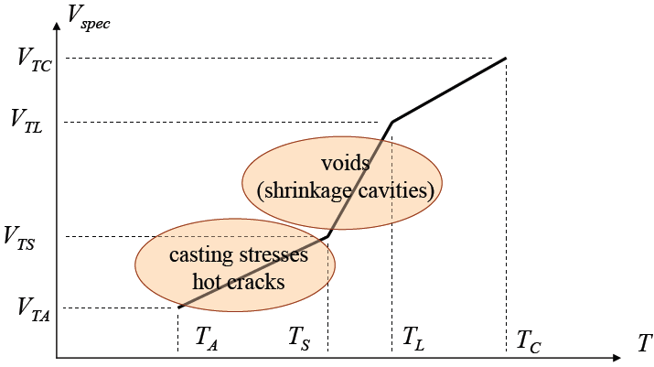
SHRINKAGE
From cast to room temperature 3 (Three) different kinds of shrinkage take place:
1. Liquid shrinkage (VTC–VTL), not critical.
2. Solidification shrinkage (VTL–VTS), isothermal for pure metals & eutectic alloys.
3. Solid shrinkage (VTS–VTA), i.e. thermal expansion/contraction.

Slide 47
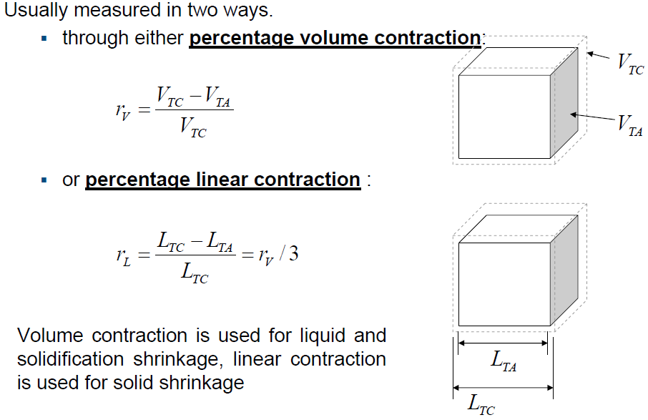
SHRINKAGE

Slide 48
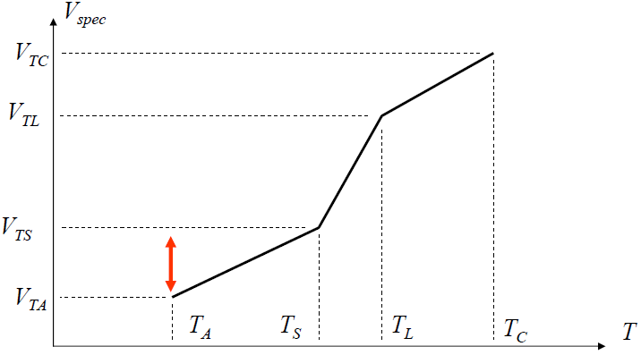
SOLID SHRINKAGE
Solid shrinkage must be controlled b/se of the following problems:
Dimensions: at room temperature the cast part is smaller than mold cavity, this problem may be handled using a correct design;
Casting stresses: due to inhomogeneous cooling velocity, they may lead to hot cracks.

Slide 49
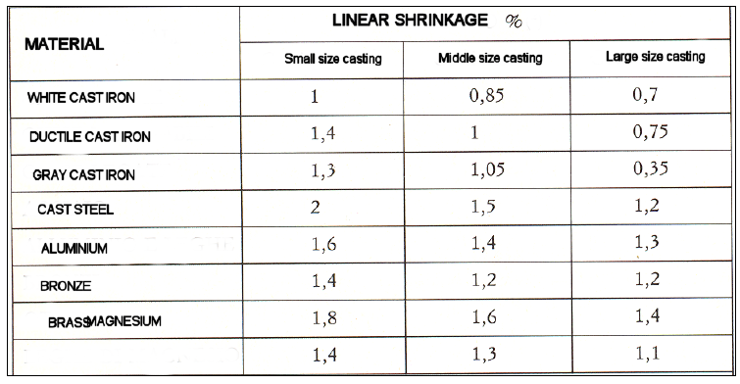
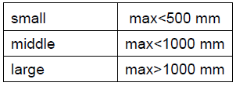
SOLID SHRINKAGE –dimensions
Linear solid shrinkage depends on cast material properties:

Slide 50
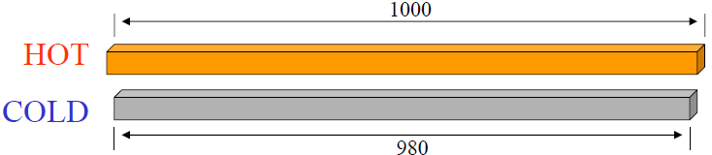
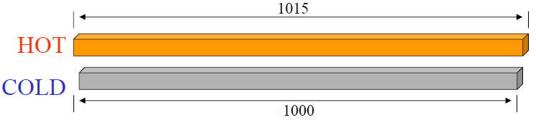
SOLID SHRINKAGE dimensions
Example: the shrinkage of Carbon steel is about 1,5%. Thus, cooling from melting Temp. a 1-meter-long bar we get 980 mm.
To get the correct final length we can oversize the mold cavity by the same amount. Therefore, to cast our one-meter-long bar we should use a cavity 1015 mm long.

Slide 51
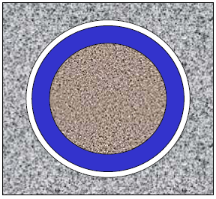
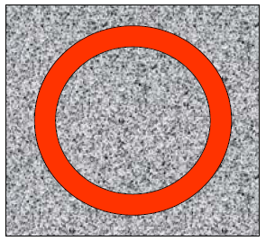

FROM CASTING TO PATTERN
Solid shrinkage
It is worth noting that shrinkage is a linear contraction:
Hollow parts shrink in the same way as solid parts (a hole reduces its diameter).
As a consequence, during solid shrinkage, cores are “squeezed” by the casting. Core sand cannot be over-compacted b/se cores are not supposed to hinder contraction too much (it would cause extra stresses during cooling, moreover light compact design increases core permeability).

Slide 52
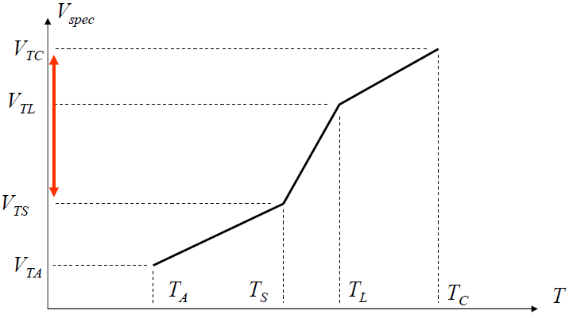
LIQUID & SOLIDIFICATION SHRINKAGE
Liquid & solidification shrinkage (VTC–VTS) is controlled through the feeding system, composed of one or more risers, placed so that they supply liquid metal to compensate metal lacks.
To work, they must be the last parts where solidification ends.

Slide 53
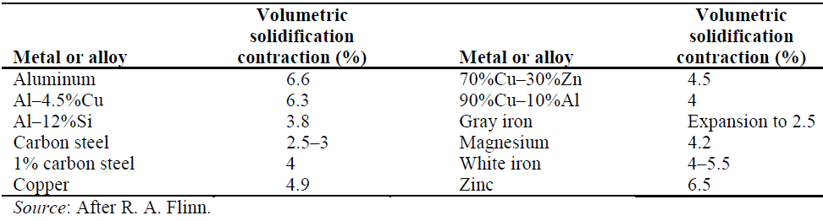
LIQUID & SOLIDIFICATION SHRINKAGE
Volume contraction while solidification depends on cast material & on external pressure.
NOTE: Gray iron has negative volume contraction (expansion).
This is due to metallurgical transformation during phase change (formation of graphite, with lower density).
When it happens, this phenomenon is generally helpful.

Slide 54
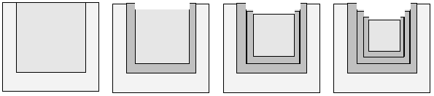
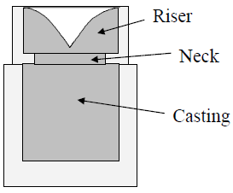
LIQUID & SOLIDIFICATION SHRINKAGE
In an open mold, Solidification always starts near to the surface.
Since volume decreases, liquid surface gets lower.
As solidification goes on, a shrinkage cone is generated.
We need an extra metal supply (riser), where solidification occurs later.

Slide 55
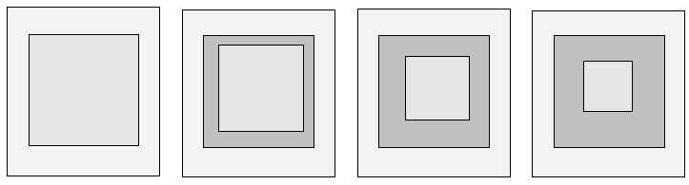
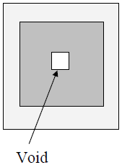
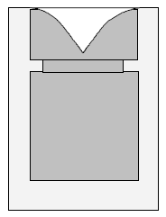
LIQUID & SOLIDIFICATION SHRINKAGE
In a closed mold, shrinkage produces voids (i.e. shrinkage cavities), always located very far from the surface .
Well designed risers (last in solidifying) can control this effect also in this case.

Slide 56
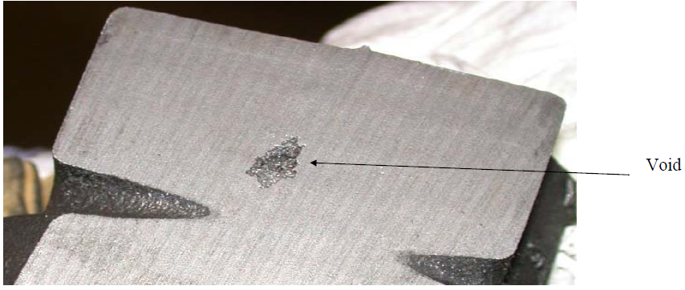
LIQUID & SOLIDIFICATION SHRINKAGE
Example of a void:

Slide 57


SOLUBILITY OF GASES
Some gases are far less soluble in solid metals than in their molten phase. Example: Hydrogen in Aluminum alloys.
The excess of gas is released & it forms bubbles (gas porosity, pinhole porosity). Do not confuse with dendritic micro-voids.

Slide 58
SOLUBILITY OF GASES
Hydrogen is especially harmful in castings:
It comes mainly from dissociation of atmospheric humidity (at high temperatures water vapor splits into H & O).
Gas content in molten metal (Example. Al) can be controlled by:
  Chemical degassing: specific compounds are added to molten metal to form insoluble compounds; these are removed with the slag (compound removal is often assisted by Argon fluxing).
  Vacuum melting, vacuum casting: very low pressure procedures to prevent contamination from air & to remove gases already dissolved in the metal.
  In die-casting, low pressure helps metal injection.
  Pressure casting: such as in injection molding, die casting, squeeze casting etc.; pressure on the molten metal during die filling helps in reducing porosity.

Slide 59

Casting Pattern shape Design
Starting from the finished part design of the mechanical part, evaluate the complete pattern design & the core design.
Stock allowance 3mm,
Linear shrinkage of 1%,
Draft angle 2⁰
Compute the stock allowance, shrinkage allowance & the draft angle for the product drawing.
Add the core print to the pattern according to the dimension.

Slide 60
Casting Pattern Design
For the pattern negligible the draft allowance
No | Nominal Dimension |  | Shrinkage allowance 1% |  | Stock shrinkage |  | Pattern shape design
1 | External | Ø140 | 140*0.01 | 1.4 | + 3 | + 3 | 147.4 | 147
2 | External | Ø100 | 100*0.01 | 1.0 | + 3 | + 3 | 107 | 107
3 | Internal | Ø80 | 80*0.01 | 0.8 | -3 | -3 | 74.8 | 75
4 | Internal | Ø40 | 40*0.01 | 0.4 | -3 | -3 | 34.4 | 34
5 | Linear | 20 | 20*0.01 | 0.2 | + 3 | + 3 | 26.2 | 26
6 | Linear | 30 | 30*0.01 | 0.3 | + 3 | -3 | 30.3 | 30
7 | Linear | 120 | 120*0.01 | 1.2 | + 3 | + 3 | 127.2 | 127
The draft allowance for the hole / core
No | Nominal Dimension |  | Shrinkage allowance 1% |  | Stock shrinkage |  | Core shape design
1 | Internal | Ø80 | 80*0.01 | 0.8 | -3 | -3 | 74.8 | 75
2 | Internal | Ø40 | 40*0.01 | 0.4 | -3 | -3 | 34.4 | 34
3 | Linear | 30 | 30*0.01 | 0.3 | + 3 | -3 | 30.3 | 30
4 | Linear | 120 | 120*0.01 | 1.2 | + 3 | + 3 | 127.2 | 127

Slide 61

CASTING WORK CYCLE DESIGN
Once the pattern is designed, it is possible to start designing the feeding systems.

Slide 62

FEEDING SYSTEM
Feeding system design includes (in this order):
Choice of riser(s) location;
Choice of riser(s) number;
Choice of riser type;
Dimensioning of each riser;
Dimensioning of each riser neck (connection b/n the riser to the casting).

Slide 63


FEEDING SYSTEM
Basing on experimental investigation,
Chvorinov showed that solidification time Ts depends on casting geometry
Namely, on solidification modulus M according to the following law:
Where α & β depend on both casting & mold material.
As an example, in sand casting of steel α = 0.9 & β= 2,
when Modulus M is expressed in mm & Ts in seconds.

Slide 64

FEEDING SYSTEM
Let us evaluate the modules of elementary shapes:
Thus, a sphere with radius R & a cube of side 2R
have the same modulus.
NOTE: anyway, they do not have THE SAME VOLUME!

Slide 65




FEEDING SYSTEM
For a plate:
Plate with thickness T:
For an infinitely broad plate (heat exchange on the sides is negligible)

Slide 66




FEEDING SYSTEM
For other geometries:
Long bars:
Cylinder with radius R & height H:
Only when BOTH base surfaces are effective (very often at least one is adiabatic …).

Slide 67

FEEDING SYSTEM
As an example, let us consider a casting having this shape:
Let us find a correct riser(s) position.

Slide 68


FEEDING SYSTEM
Let us decompose the casting into three elementary parts A, B and C, then evaluate the modulus of each single part (take care of adiabatic surfaces).

Slide 69
FEEDING SYSTEM
Assuming the following part dimensions, we have the following modules:
L = 200 mm
RA = RB = 50 mm
HA = 400 mm
HB = 150 mm
MA = 23.5 mm
MB = 35.7 mm
MC = 21.4 mm
Since: MB > MA > MC
we can conclude that solidification takes place first in C, then in A and last in B.

Slide 70
FEEDING SYSTEM
Take care not to overestimate the accuracy of Chvorinov’s law. Remember the assumption underlying this empirical rule:
  Constant heat flux on all surfaces (e.g., In some cases surfaces exchanging towards cores are fictitiously reduced to take into account a lower heat flux, due to core overheating);
  Perfectly adiabatic (ideal) surfaces of contacting parts;
  The effect of chills (or other thermally affecting devices) is neglected;
  Dendrite solidification (affecting metal flow) is neglected;
  …
In practice, we can reasonably assume that part A will solidify after part B (for neighboring parts, this means that A will feed B during solidification) if its modulus is at least 10% larger:
  M_{A} ≥ 1.1*M_{B}

Slide 71

FEEDING SYSTEM
Thus, by dividing the casting into parts & evaluating part modulus, we can follow casting solidification.
During solidification, “slower” parts can feed the neighboring “fast” parts, supplying molten metal & compensating solidification shrinkage, that is, they act as risers.
The slowest casting part must be fed by the riser. To be sure in general, it is required that:
M_{Riser} ≥ 1.2*M_{Part}

Slide 72

FEEDING SYSTEM

Slide 73

FEEDING SYSTEM

Slide 74

FEEDING SYSTEM

Slide 75

FEEDING SYSTEM

Slide 76

FEEDING SYSTEM
The “fineness "of casting division (number of sub-parts) for modulus evaluation should be enough to represent directional solidification, but not excessive because too many sub-parts would not increase the amount of information (while increasing the amount of computation).
As a general rule, it is better to chose parts with simple (elementary) geometry.

Slide 77


FEEDING SYSTEM
A directional solidification may be achieved by modifying the heat flux (rather than the geometry).
It is possible:
To increase heat flux where a fast cooling is desired (chills)
To decrease heat flux where a slow cooling is desired (insulating pads and sleeves).
This solution is more often used on risers than on castings.
Chills may be of several kinds:
Blocks & plates embedded in the mold sand (or in the core);
Heat conductive blocks in contact with molten metal;

Slide 78

FEEDING SYSTEM
Once riser(s) location is decided, we must check for range of effect. A riser has a well defined range of effect, beyond which the feeding effect vanishes. An explanation to this phenomenon is given by dendrite growth:
Some molten metal is “trapped” b/n dendrites.
Thus, when risers are too far away,
Some part of the casting maybe porous.

Slide 79

FEEDING SYSTEM
Directional solidification resulting from a gradual variation of thickness helps avoiding porosity.
Thickness changes & resulting thermal gradient should be enough to prevent porosity, although not too high that solid shrinkage could cause problems.

Slide 80
Location of Risers
The thermal gradient, with in the casting, during the last stage of cooling is the most important factor.
The minimum allowable gradient depends on the shape and size of the cross section.
Normally, for a casting with low A/V ratio(e.g,. Cube,sphere),one central is able to feed the entire casting.
On the other hand, for a casting with high A/V ratio(e.g,. For a bar and plate)usually more than one riser is necessary.
In such a case, a proper location of riser has to be decide
For a plate of up to 100 mm thickness, one central is satisfactory if the maximum feeding distance is less than 4.5 times the plate thickness.
The feeding distance should be measured from the edge of the riser in the figure.

Slide 81
It should be noted that, of the total distance 4.5t,the riser gradient prevails up to a distance 2t, where as the wall gradient prevails in the remaining distance2.5t.
Thus, the maximum distance between edges of two consecutive riser is 4t and not 9t.
A bar of square cross section with sides measuring 50-200 mm can be fed satisfactorily from a single riser, up to a maximum distance of 30√s, where s is side of the square expressed in mm.
The maximum distance between the edges of two consecutive riser is found to be 1.2s
The presence of chill in the mould increases the feeding distance of the riser. This is achieved by providing a sharp thermal gradient with consequent decrease in feeding resistance.
It is obvious chill should be placed at the ends if a single riser is used.
For more than one riser, the chill should be placed midway between two risers.
Figure shows schematically the proper placements and chills.
Also the maximum permissible distances for various cases are also indicated in the figure.

Slide 82

FEEDING SYSTEM
There are several empirical rules to estimate the range of effect of a riser: Metals Handbook: plates having thickness T& width > 3T

Slide 83

FEEDING SYSTEM
Metals Handbook: bars (square cross section, side T)

Slide 84

FEEDING SYSTEM
Giusti Santochi:
with
k= 3.5 –5 for steel
k= 5 for iron
k= 5 –8 for bronze
k= 5 –7 for aluminum alloys

Slide 85


FEEDING SYSTEM
To be able to use these empirical rules, we must decompose the casting into bars and plates. For other parts a high level of approximation cannot be avoided.

Slide 86

FEEDING SYSTEM

Slide 87
FEEDING SYSTEM
Then, it is necessary to choose the riser geometry.
They may be either cylindrical (more efficient) or rectangular (simpler), or sometimes with different shapes (semispherical, oval cross section etc.) depending on the shape of the available room inside the mold.
Like all cavity details, risers are made using a pattern. In general, standard patterns are employed.

Slide 88
FEEDING SYETEM
Finally, each riser must be dimensioned.
Depending on riser geometry, different dimensions must be defined:
spherical and semispherical: radius;
cylindrical (very common): diameter and height;
oval, rectangular cross sections: two cross-sectional parameters and height.
Definition of riser modulus gives us just one constraint.

Slide 89
FEEDING SYSTEM
The method based on the shrinkage cone size is based on an experimental consideration. At the end of the solidification (if a sound part is produced), the material loss (volume Vl) in the riser (volume Vr) is found to be about:
  14% for cylindrical and oval risers;
  20% for spherical and semispherical risers.
Vl = a . Vr
It’s also experimentally verify that:
Vl = b . (Vr + Vp)
where b is the volume contraction of casting metal and Vpis the volume of the piece.

Slide 90


FEEDING SYSTEM
Solving the two equations of the previous screen, we get the riser volume as a function of the casting part volume(just the modulus of the casting part fed by the riser under design should be considered MX):
This is the final equation expressing the volume constraint. Together with the modulus constraint:
It is possible to design all riser dimensions.

Slide 91

CYLINDERICAL FEEDING SYSTEM

Slide 92




FEEDING SYSTEM
Also riser insertion, that is the channel connecting riser and casting, needs to be dimensioned.
For directional solidification we need:
Depending on riser type, some results are available:

Slide 93
Casting feeding Design
Starting from the finished part design of the mechanical part, evaluate the complete the feeding system.
Considering the geometry of the riser is square.
The number of riser & position,
Dimension for a riser.
Dimension for a riser neck

Slide 94

For the feeding system

Slide 95
For the feeding system

Slide 96

CASTING WORKCYCLE DESIGN

Slide 97

GATING SYSTEM (SPRUE)
The gating system connects the mold cavity to the “outside”. Composed of:
Pouring basin: a cuplike cavity where molten metal is poured in, it may hold filters and skimmers to prevent dross (or slug) from entering the cavity;
sprue: vertical channel connecting the basin with the runner;
runner: a channel (generally horizontal) from sprue to gate(s), (runner box is a distribution box dividing molten metal into several streams before it enters the mold cavity);
gate(s): the portion of the runner through which molten metal enters the mold cavity.

Slide 98

GATING SYSTEM: TYPES
Metal supply may be by top or bottom pouring, with several types of gate:
Horizontal
Vertical.

Slide 99

HORIZONTAL GATING SYSTEM: LOCATION

Slide 100
GATING SYSTEM
The gating system needs accurate design, especially to select channel cross sectional area.
The main design criterion is pouring time Tr, to fill completely the mold (or die) cavity. When Tr is:
short: fast flow, that may cause
    mold erosion, due to excessive metal speed;
    material waste, because all gating system is bigger.
long: some problem may arise
    early solidification in thin and far parts;
    mold damage by irradiation from the molten metal.

Slide 101

GATING SYSTEM

Slide 102

GATING SYSTEM –Choice of Tr

Slide 103

GATING SYSTEM

Slide 104

GATING SYSTEM
For a steady-state flow of an ideal fluid, it is possible to compute the exit speed from an opening:
where C= [0.6 –0.7].
When dealing with filling, one must consider that:
At the end of the filling, metal flow is slowed because of the pressure due to the metal already present in the cavity;
Resistances to the flow are not negligible, both localized and distributed (this latter item is less important, since metal flow is laminar).

Slide 105

GATING SYSTEM
Once the narrowest section SSTR is dimensioned, one must decide where it is located (on either Ssp: sprue, Srn: runner or Sgt: gate). The cross-sectional dimensions of the other sections have to be evaluated as well.
In general, two (very different) kind of gating system are used:
  With pressurization: SSTR is the gate section;
  Without pressurization: SSTR is the sprue section.
The choice between these gating depends on casting material, casting weight and molding procedure. For cast steels we use the pressurized one.

Slide 106
GATING SYSTEM
With pressurization:
SSTR= Sgt
the flow at the gate section is more uniform;
metal enter the mold with higher speed (risk of mold erosion).
Without pressurization:
SSTR= Ssp
the speed of the molten metal in the gate is lower (less turbulence);
they are advisable for metals with high tendency to form oxydes(Al, Mg, Zn);
the flow at the gate sections is less uniform.

Slide 107

GATING SYSTEM
The remaining cross-sectional areas are designed so that there is a constant ratio between these areas (standard values, from casting practice):
For a pressurized system, it may be:
While the non pressurized systems are often designed by fixing:

Slide 108


GATING SYSTEM
The shape of gate cross-section is often rectangular or triangular (easier to draw). According to good design practice the cross-sectional dimensions may be chosen as follows:

Slide 109
METALLOSTATIC LIFT
Once the mold cavity is full of molten metal, this metal (like any other liquid) exchanges an hydrostatic pressure on the cavity walls.
Such pressure may deform the molds, affecting dimensional accuracy.
This phenomenon is controlled by using stiff flasks and lateral reinforcements for particularly high copes.
Besides, mold deformation may be not uniform because of inhomogeneous sand compacting. The effect on part accuracy (both dimensional and geometric) is in this case more severe.

Slide 110

METALLOSTATIC LIFT
In the physical sciences, Pascal's law or Pascal's principle states that the fluid pressure at all points in a connected body of an incompressible fluid at rest, which are at the same absolute height, is the same.
p is the hydrostatic pressure (Pa);
ρ is the liquid density (Kg/m3);
g is gravitational acceleration (m/s2);
h is the height of fluid above (m).

Slide 111




METALLOSTATIC LIFT
The pressure of a fluid in a point p is:
where γm is the fluid density and z is the depth of p(distance from p to the free surface).
Thus, the force dF acting on the small surface dS is:
And its vertical component (dFv) is:
with α being the angle between the normal vector of dS and the vertical direction.

Slide 112

METALLOSTATIC LIFT
where γm is the fluid density and zis the depth of p(distance from p to the free surface).

Slide 113


METALLOSTATIC LIFT Evaluation
Total metallostatic lift Fml on the cope may be evaluated by integrating over the contacting surface between metal and cavity (note: dealing with cores, not all the surface is in contact…):

Slide 114

METALLOSTATIC LIFT Evaluation
As an example, for a horizontal cylinder having length L and radius R:

Slide 115





METALLOSTATIC LIFT Evaluation

Slide 116

METALLOSTATIC LIFT Evaluation
The metallostatic lift can also be evaluated in another way, to avoid integration .
Let us take into account the amount of metal present in the cope and write the equilibrium conditions along the vertical direction.
On this volume, two kind of forces are acting:
volume force: the metal weight P(vertical)
surface forces: let us consider two actions by decomposing the total surface
on the cope cavity Fml (our goal)
on the parting plane Fps

Slide 117



METALLOSTATIC LIFT Evaluation
By writing the vertical equilibrium on the volume:
Where the evaluation of Fps is easy, since all points on the parting plane have same depth h:
being Sps the projection of cope surface onto the parting plane. In conclusion:
where Vcm is the volume of the cope cavity.

Slide 118



METALLOSTATIC LIFT Evaluation
Moreover, the volume V’:
is the cope part just above the cope surface (see figure).The metallostatic lift is equal to the weight of the volume V’, when filled with molten metal:
In this way, a precise evaluation of metallostatic lift is easy. Do not forget to include other mold cavities(such as runners, blind risers…) into the computation.

Slide 119

BOUYANCY LAW (ARCHIMEDE LAW)
A solid body immersed in a fluid will have an upward buoyant force acting on it equal to the weight of displaced fluid. This is due to the hydrostatic pressure in the fluid.
When a rigid object is submerged in a fluid (completely or partially), there exits an upward force on the object that is equal to the weight of the fluid that is displaced by the object.

Slide 120


METALLOSTATIC LIFT Evaluation
Since core sand is lighter* than molten metal, cores do “float” in the metal. As a consequence, cores experience a metallostatic lift that, when greater than core weight itself, is supported by core prints.
Such lift may be evaluated by using Archimedes’ principle:
* Except for Mg alloys.
where Vai is the volume of the core portion that is actually immersed in molten metal. If we subtract the weight of the core:
where Va is the volume of the whole core, we get the (total) force Fa on the core prints, to be added to cope lift.

Slide 121





METALLOSTATIC LIFT Evaluation
Thus, if
the total force on the core prints is:
If
the core “sinks”, giving no contribution to cope lift (in this case a small force would be supported by the drag). Thus

Slide 122

METALLOSTATIC LIFT Evaluation
Vertical cores do not contribute to cope lift, because metal pressure on their surfaces is always horizontal. Vertical cores cannot be regarded as “immersed”.

Slide 123


METALLOSTATIC LIFT Evaluation
Total cope lift (Fcl) is therefore equal to the sum of metal pressure on its surface (Fml) and, if present, of the contribution of core prints (Fa):
Cope lift takes place when Fcl is larger than the cope weight Cw (including the weight of the cope flask). Thus:
When this value is less than zero, the cope weight is enough to support metallostatic lift.
Extra weight may be added for safety, but overloading the cope may result in mold deformation and casting inaccuracy.

Slide 124


SOLID SHRINKAGE –casting stresses
Solid shrinkage must be controlled because of the following problems:
  dimension errors: at room temperature the cast part is smaller than mold cavity;
casting stresses: due to inhomogeneous cooling velocity, they may lead to hot cracks.

Slide 125
“DESIGN FOR MANUFACTURABILITY”
“Design for manufacturability’’ means taking particular care of production issues during the product design phase, to reach a more efficient (economical) production.
As a general approach, some critical geometries are discussed, leading to processing problems. New part geometries are suggested (part redesign) to reduce production cost.
Attention: when estimating production cost savings, the whole process plan should be taken into account (not only foundry operations).
A case history is reposted as follows.

Slide 126

“DESIGN FOR MANUFACTURABILITY”
Rule n. 1
Reduce undercuts.

Slide 127



“DESIGN FOR MANUFACTURABILITY”
Rule n. 2 Keep parts thickness as constant as possible. Use particular care for contact/intersection between features.

Slide 128

“DESIGN FOR MANUFACTURABILITY”
Rule n. 3 Control casting stresses by allowing relative displacement among features. Do not design “stiff” structures unless necessary.

Slide 129

“DESIGN FOR MANUFACTURABILITY”
Rule n. 4 Take into account all possible parting planes (some placements may lead to undercuts). Remember that not all flasks are standard or easy to mold.

Slide 130

“DESIGN FOR MANUFACTURABILITY”
Rule n. 5
Try and avoid mold protrusion beyond the parting plane. Molding will be easier.

Slide 131

“DESIGN FOR MANUFACTURABILITY”
Rule n. 6
Design internal walls about 20% thinner than outer walls, to take into account a less efficient heat exchange towards cores.

Slide 132


“DESIGN FOR MANUFACTURABILITY”
Rule n. 7
Make subsequent machining easier. When drilling is required, it is very helpful to provide surfaces normal to the hole axis. Surfaces for positioning the casting on a machine tool are useful as well.

Slide 133

“DESIGN FOR MANUFACTURABILITY”
Rule n. 8
Provide reinforcement to the rim of holes made by casting.

Slide 134
COMPUTER AIDED CASTING DESIGN
Recently, a new generation of FEM software codes was developed to assist casting design. These simulative packages are able to model:
  cavity filling
  solidification and cooling
Such codes are able to predict the risk of potential defects, such as:
air holes
shrinkage cavities
porosity
casting stresses
hot cracks
…

Slide 135
COMPUTER AIDED CASTING DESIGN
Cavity filling simulation is complex because of boundary modifications (the free surface of the molten metal is moving). Mathematical models of metal flow are based on:
Bernoulli’s equation (“simpler” software)
Navier-Stokes’ equation (more refined)
Mold cooling (liquid, solidification and solid phenomena) exploits:
Fourier’s equation of heat diffusion
Basing on evaluated parameters (temperatures, stresses etc.), defects may be predicted using:
  physical laws;
  empiric rules.
The above mentioned prediction may be:
  deterministic or
  probabilistic.

Slide 136

COMPUTER AIDED CASTING DESIGN
Solidification & cooling alone are simpler to model: the number of commercial codes able to perform such analysis is larger.

