Slide 1
Melting and Pouring Analysis Gating and Risering
Furnaces are used to heat (and melt) the metal to a molten temperature sufficient for casting. The total heat energy required is the sum of
(1) the heat to raise the temperature to the melting point,
(2) the heat of fusion to convert it from solid to liquid, and
(3) the heat to raise the molten metal to the desired temperature for pouring

Slide 2
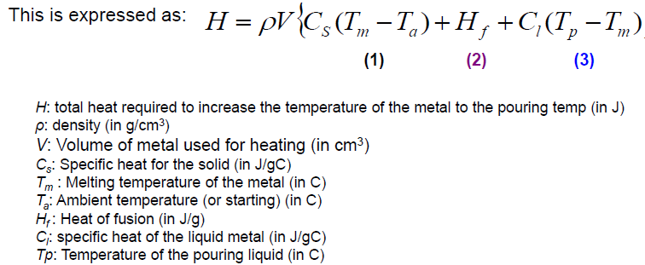
Heating the metal

Slide 3
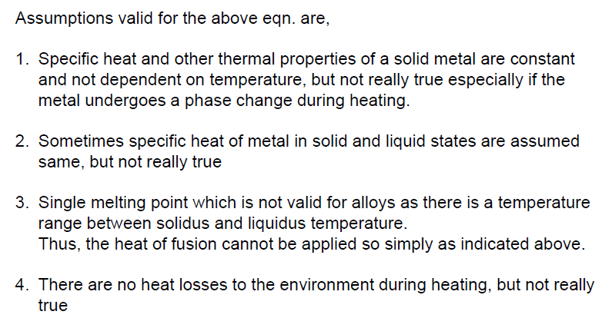

Slide 4
Example
A disk 40 cm in diameter and 5 cm thick is to be cast of pure aluminum in an open mold casting operation. The melting temperature of aluminum = 660°C, and the pouring temperature will be 800°C. Assume that the amount of aluminum heated will be 5% more than what is needed to fill the mold cavity. Compute the amount of heat that must be added to the metal to heat it to the pouring temperature, starting from a room temperature of 25°C. The heat of fusion of aluminum = 389.3 J/g. Assume the specific heat has the same value for solid and molten aluminum. Take density ρ = 2.70 g/cm³ and specific heat C = 0.21 Cal/g-°C = 0.88 J/g-°C

Slide 5
Volume V = πD²h/4= π(40)²(5)/4 = 6283.2 cm³
Assuming that the amount of aluminum heated will be 5% more than what is needed to fill the mold cavity.
Volume of aluminum to be heated = 6283.2(1.05) = 6597.3 cm³
Heat required to melt the metal is given by the equation
Heat required = 2.70(6597.3){0.88(660-25) + 389.3 + 0.88(800-660)}
= 17,812.71{558.8 + 389.3 + 123.2} = 19,082,756 J

Slide 6
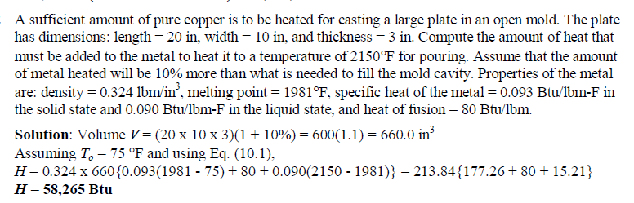

Slide 7
Pouring of the metal
After heating, the metal is ready for pouring. Introduction of molten metal into the mold, including its flow through the gating system and into the cavity, is a critical step in the casting
process. For this step to be successful, the metal must flow into all regions of the mold before solidifying.
Factors affecting the pouring operation include
pouring temperature,
Pouring rate, and
Turbulence.

Slide 8
The pouring temperature is the temperature of the molten metal as it is introduced into the mold.
What is important here is the difference between the temperature at pouring and the temperature at which freezing begins (the melting point for a pure metal or the liquidus temperature for an alloy).
This temperature difference is sometimes referred to as the superheat.
This term is also used for the amount of heat that must be removed from the molten metal between pouring and when solidification commences.
Pouring rate refers to the volumetric rate at which the molten metal is poured into the mold.
If the rate is too slow, the metal will chill and freeze before filling the cavity.
If the pouring rate is excessive, turbulence can become a serious problem

Slide 9
Turbulence in fluid flow is characterized by erratic variations in the magnitude and direction of the velocity throughout the fluid.
The flow is agitated and irregular rather than smooth and streamlined, as in laminar flow.
Turbulent flow should be avoided during pouring for several reasons.
It tends to accelerate the formation of metal oxides that can become entrapped during solidification, thus degrading the quality of the casting. Turbulence also aggravates mold erosion, the gradual wearing away of the mold surfaces due to impact of the flowing molten metal.
The densities of most molten metals are much higher than water and other fluids we normally deal with. These molten metals are also much more chemically reactive than at room temperature. Consequently, the wear caused by the flow of these metals in the mold is significant, especially under turbulent conditions.
Erosion is especially serious when it occurs in the main cavity because the geometry of the cast part is affected.

Slide 10
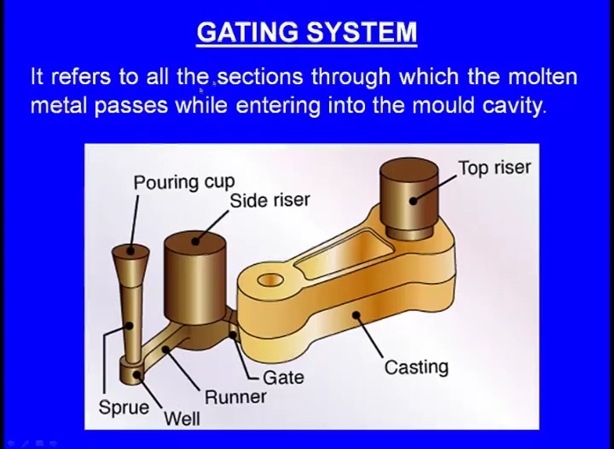
ENGINEERING ANALYSIS OF POURING
All the sections through which the molten metal passes while, entering into the mould cavity is known as the Gating system. Gating system means it is the group of elements through which the molten metal passes while entering into the mould cavity. Gating system includes the pouring cup, it includes the sprue, it includes the sprue well, it includes the runner, it includes the gate

Slide 12
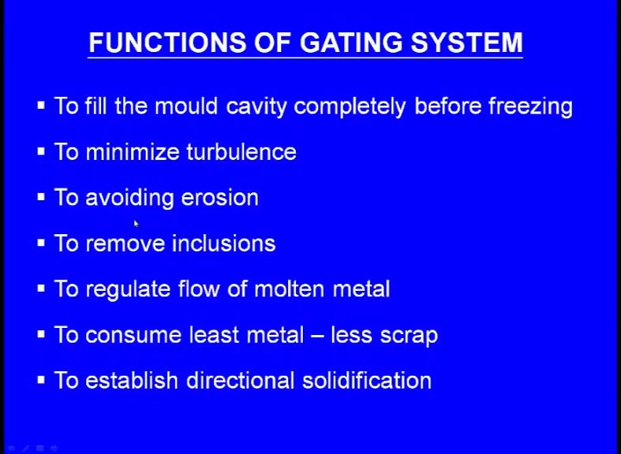

Slide 13
Functions of the Gating system
Fill the mould cavity completely before freezing
Introduce the liquid metal into the mould cavity with low velocity and with little turbulence, so that mould erosion, metal oxidation and gas pick up is prevented.
Proper gating system must help to promote temperature gradient favourable for proper directional solidification.
Incorporate traps for the separation of non-metallic inclusions which are either introduced with the molten metal or are dislodged in the gating system
Regulate the rate at which liquid metal enters into the mould
Consume least metal. In other words, the solidified in sprue, runner, gates and risers should be minimum because gates, riser etc, are removed from the final casting; the gating system should provide maximum yield.

Slide 14
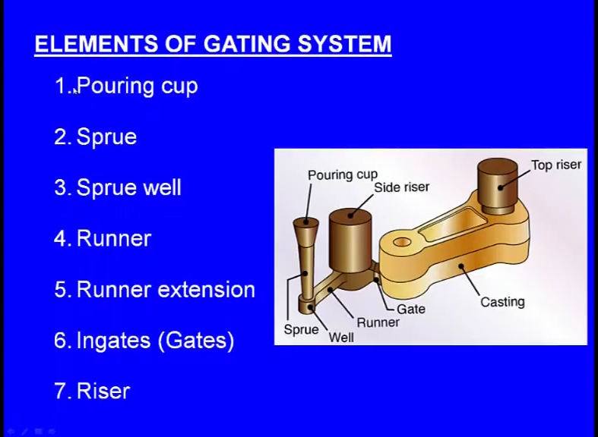

Slide 15
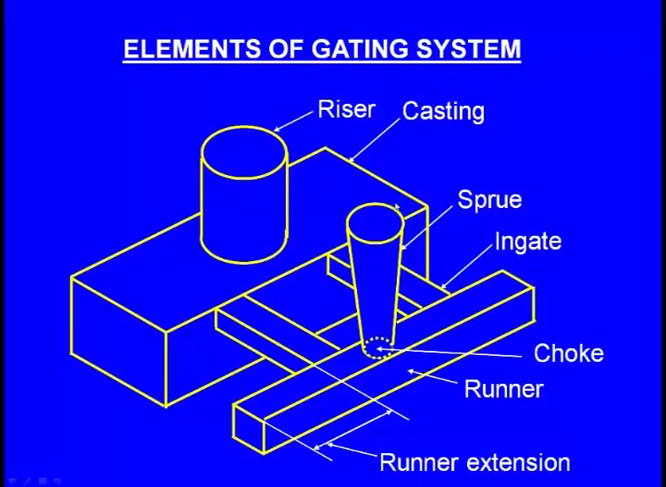

Slide 17
Objectives achieved From Good Gating Design
To fill the mould cavity rapidly without braking the flow of liquid metal and without using very high pouring temperature.
To avoid corrosion of cores and mould cavity.
To stop scum, slag, dross and eroded sand particles from entering the mould cavity.
To minimize turbulence and dross formation
To prevent aspiration ( Entering of the gases from baking of organic compounds present in the mould into to molten metal stream) of air or mould gases in the liquid metal stream.
To obtain favorable temperature gradient to promote directional solidification

Slide 18
Defects occurring due to improper design of gating system
Oxidation of metal
Inclusion of slag, dross and other foreign matters
Cold shuts
Rough surface
Shrinkage
Mould erosion
Porosity
Entrapped gases
Misruns
Penetration of liquid metal ito mould wall

Slide 19
Turbulence in Gating System
The molten metal may enter the mould cavity either in
1. A streamlined LAMINAR fashion or in
2. TURBULENT manner
The liquid metal flow in gating system is normally turbulent
In turbulent flow the metal atoms travel from side to side as well as move in the forward direction
Stream line flow involve very small ( liquid metal ) velocities and a gating system is impractical to design to achieve these velocities
Normally if turbulence is not excessive, it does not affect the casting quality
Normally, the gating design aims at reducing metal turbulence rather tan eliminating it completely
The flow of fluids in ducts is related by their Reynold Number, Rn

Slide 20
Rn= (Mean velocity of flow x diameter of duct x Density of liquid) / Kinematic viscosity of liquid
Rn= (V.d.ϼ) / µ Rn is a dimensionless number
A liquid with a Reynold number less than 2000 experinces true streamline flow
Turbulence flow results when the Reynold number goes above 2000
Ordinary Gating systems experience Reynold number ranging from 2000 to 20000
Steel flows under turbulence condition wth Rn above 3500

Slide 21
Turbulence will occur at lower values if smooth flow is disrupted by sudden changes in the dimensions and direction of the passages.
Under most foundry conditions, given the minimum passage dimensions and flow velocities needed to avoid premature freezing, turbulent flow is encountered; a primary function of the gating system is to minimize its violence by shaping a smooth path for the liquid and by using the lowest flow rates compatible with mould filling.
Streamlined passages are thus ideal.

Slide 22
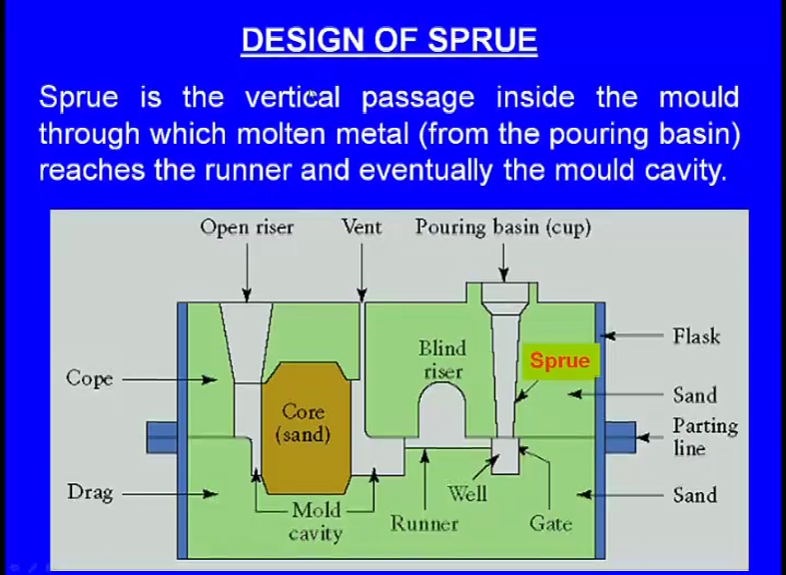

Slide 23
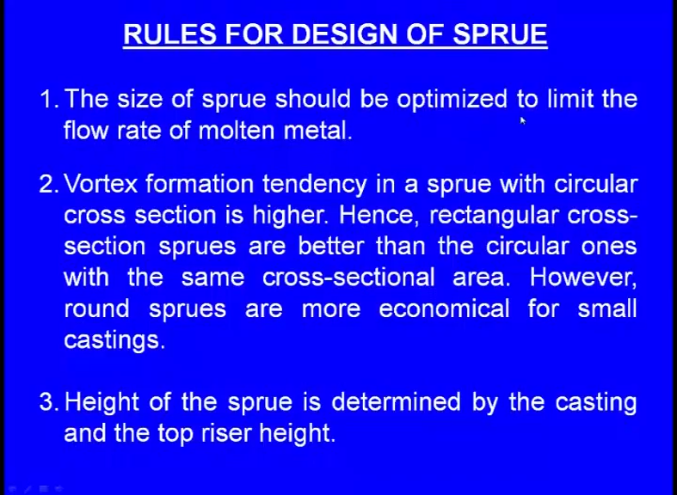

Slide 24
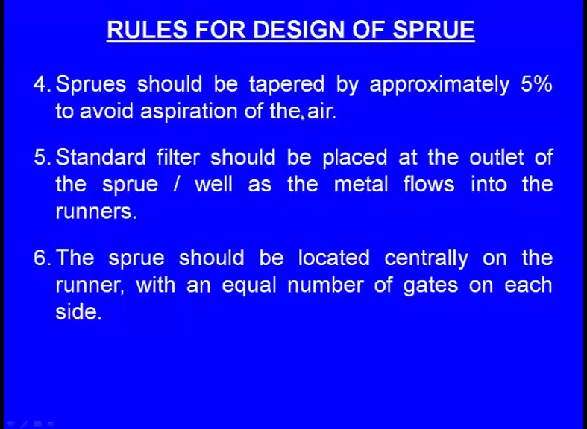

Slide 25
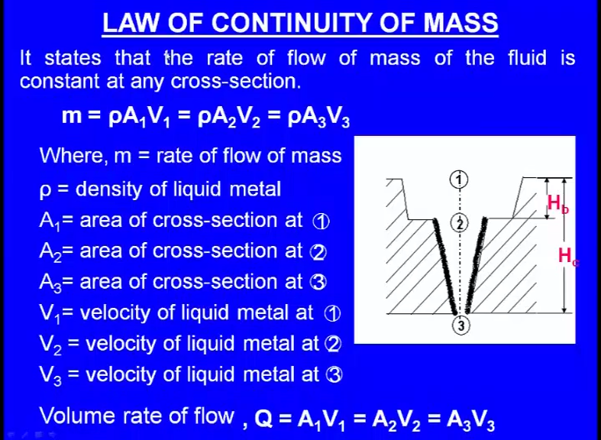

Slide 26
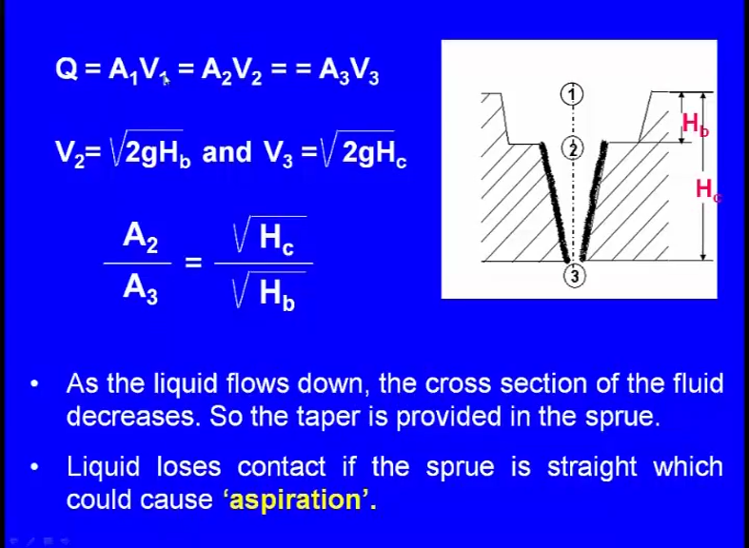

Slide 27
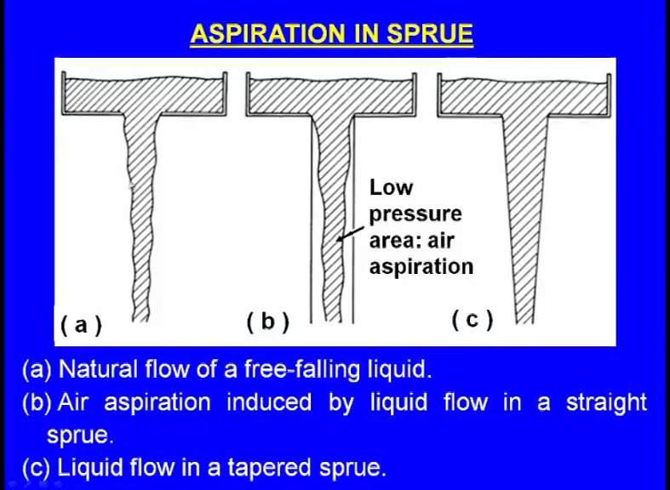

Slide 28
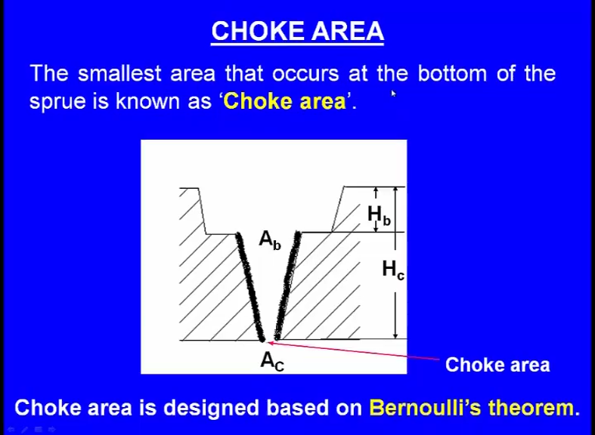

Slide 29
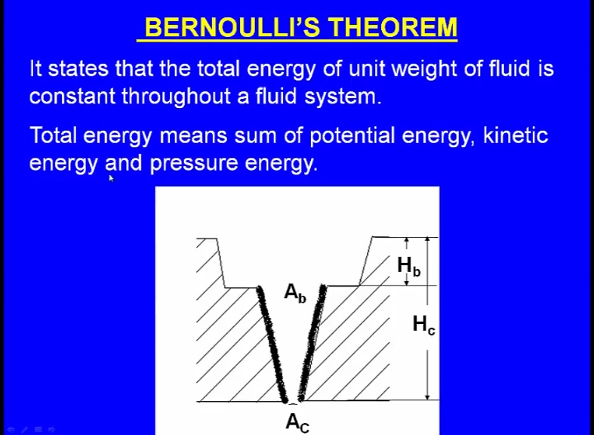

Slide 30
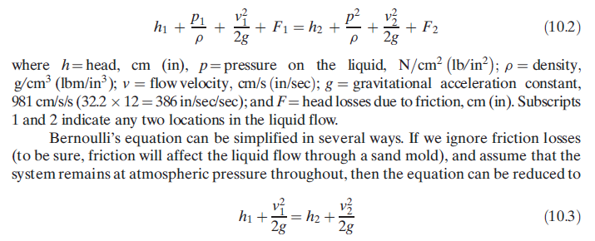
There are several relationships that govern the flow of liquid metal through the gating system and into the mold.
An important relationship is Bernoulli’s theorem, which states that the sum of the energies (head, pressure, kinetic, and friction) at any two points in a flowing liquid are equal.
This can be written in the following form:

Slide 31
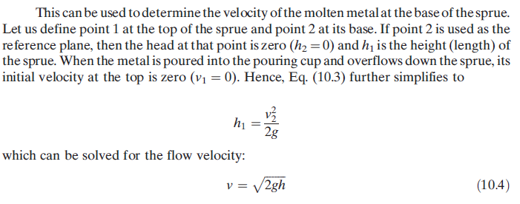

Slide 32
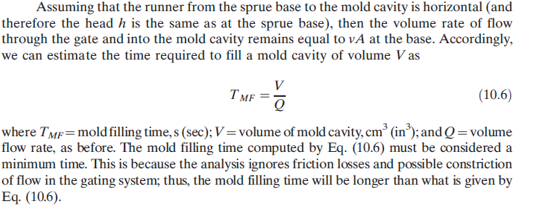

Slide 33
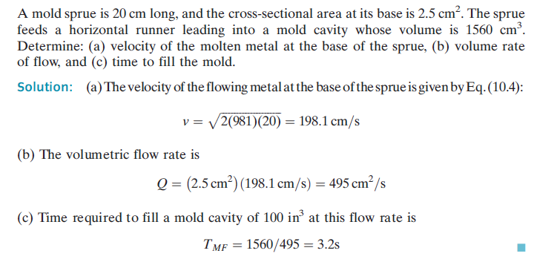

Slide 34
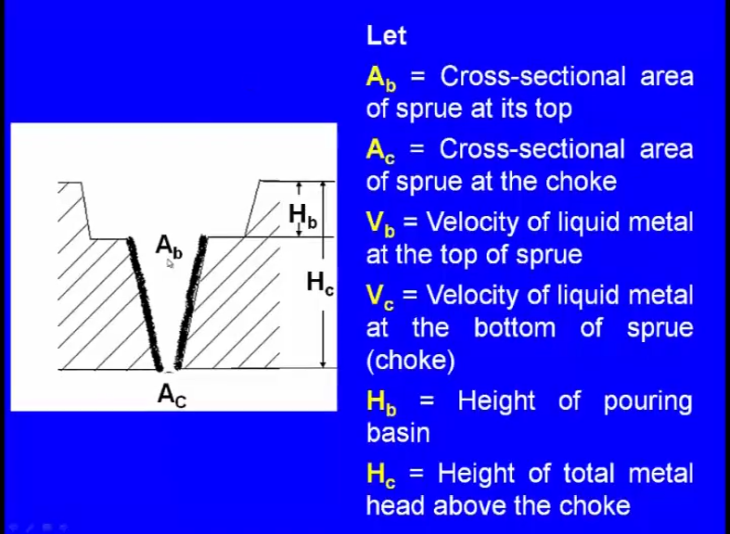

Slide 35
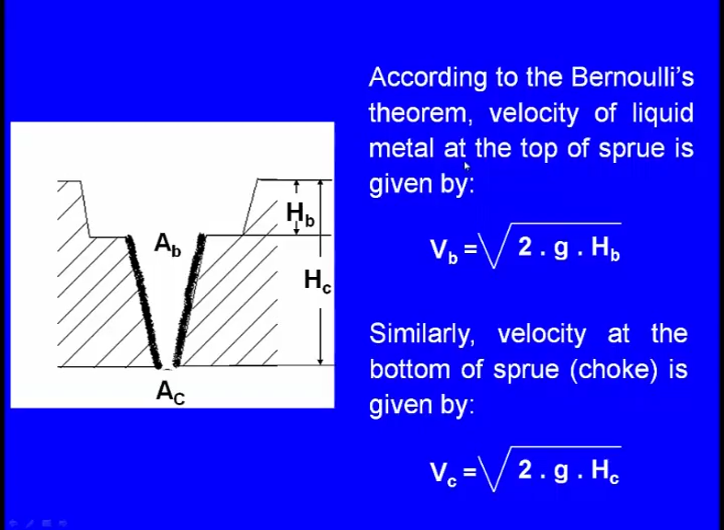

Slide 36
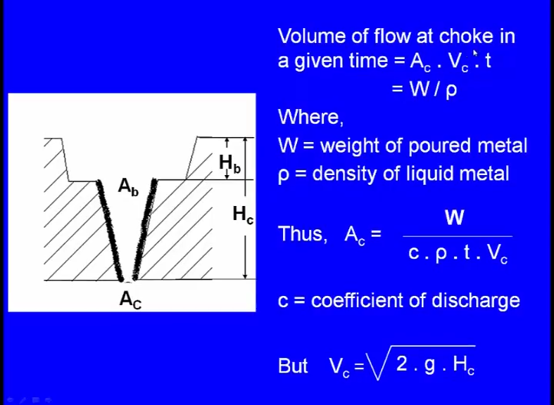

Slide 37
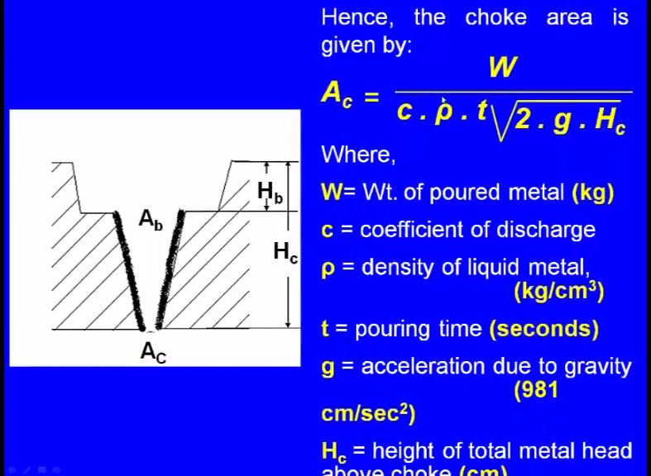

Slide 38
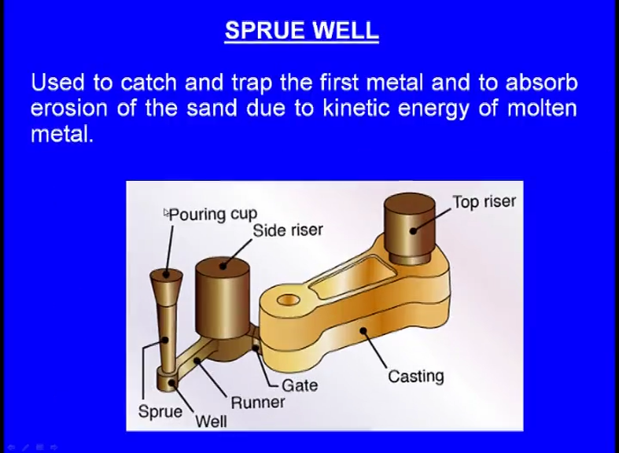

Slide 39
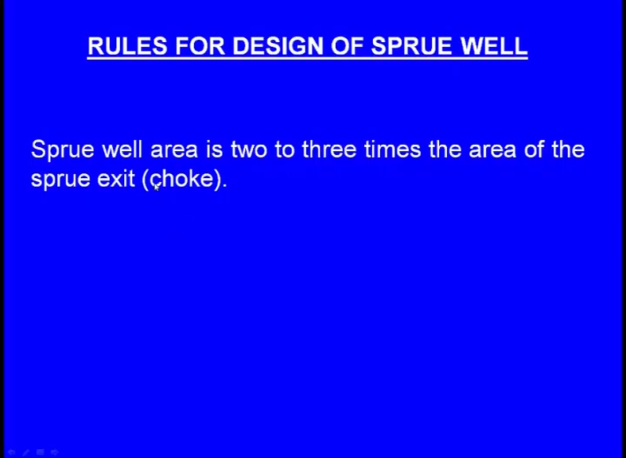
So, to prevent the erosion of the molding wall and to catch the first metal and to observe the erosion of the sand due to kinetic energy, we keep this sprue well here. So, that is the purpose of the sprue well rules for design of the sprue well.
The sprue well area is two to three times the area of the sprue at exit that is the choke means what is the choke area, we have to calculate and the sprue well area what say cross sectional area should be 2 to 3 times the cross sectional area of the choke

Slide 40
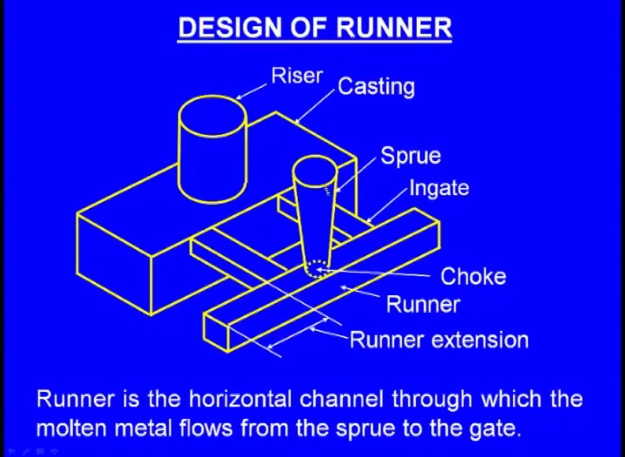

Slide 41
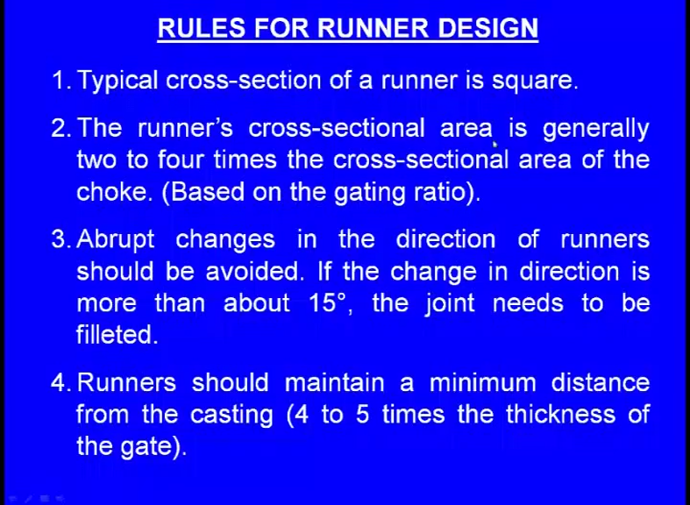

Slide 42
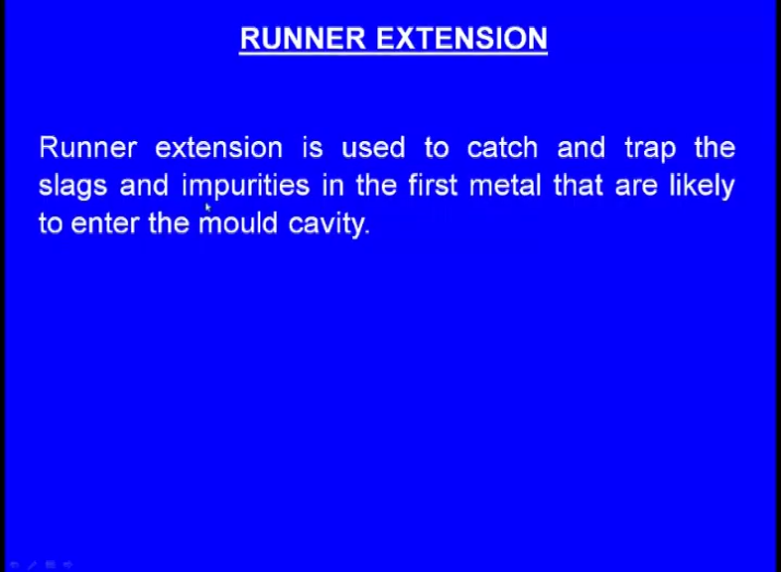

Slide 43
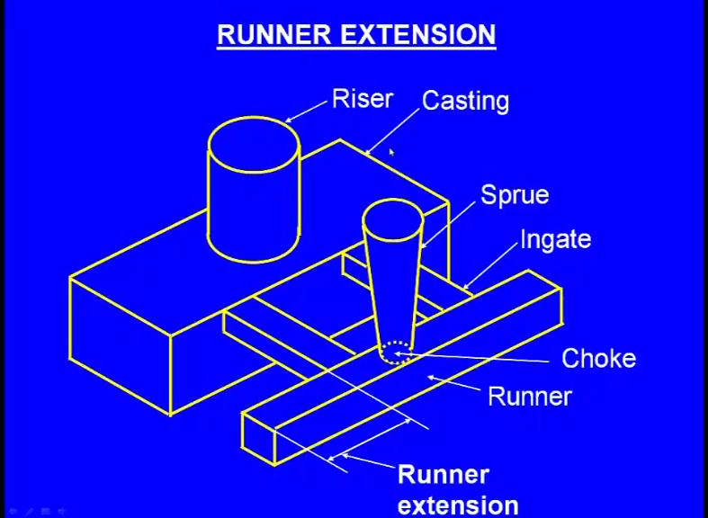
Runner extension is used to catch and trap the slags and impurities in the first metal that are likely to enter into the mould cavity that is the purpose of the runner extension.

Slide 44
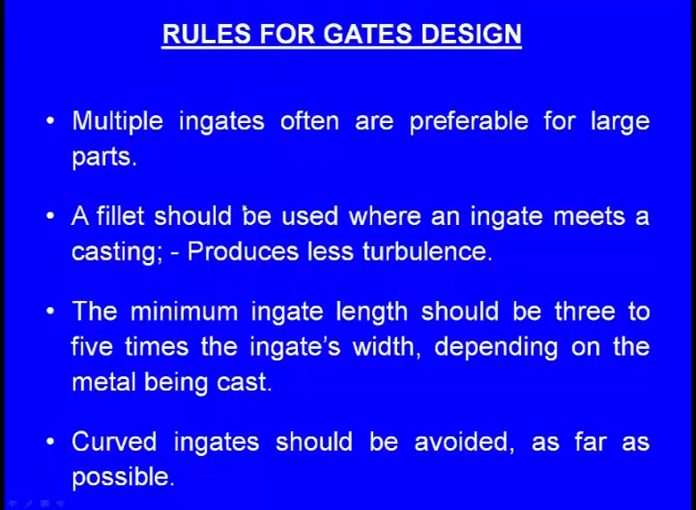

Slide 45
Now, calculation of the pouring time. In the previous slide, we have seen there is pouring time. So, how to calculate this pouring time? For gray iron castings, and that too when the casting weight is less than 1000 pounds, pouring time is given by this formula:

Slide 46
pouring time t is equal to K into 0.95 plus T by 0.853 multiplied by root of W; where K is the fluidity factor, which depends upon the temperature and composition of the molten metal and this K varies between 1 to 1.6. T is the average thickness of the casting in inches. W is the weight of the casting in pounds. Pouring time in seconds.

Slide 49


Slide 57
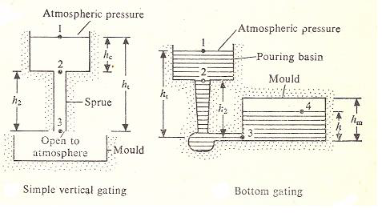
Vertical gating: the liquid metal is poured vertically, directly to fill the mould with atmospheric pressure at the base end.
Bottom gating: molten metal is poured from top, but filled from bottom to top. This minimizes oxidation and splashing while pouring.
Horizontal gating is a modification of bottom gating, in which some horizontal portions are added for good distribution of molten metal and to avoid turbulence

Slide 58
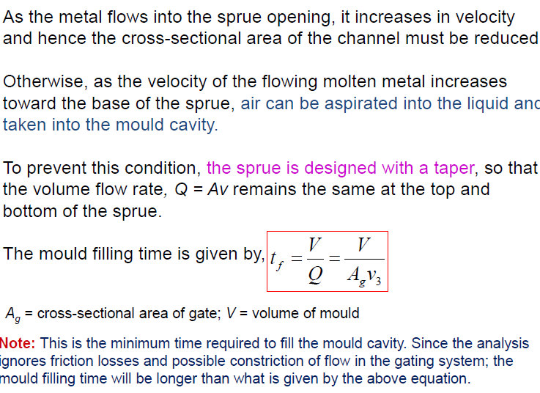

Slide 59
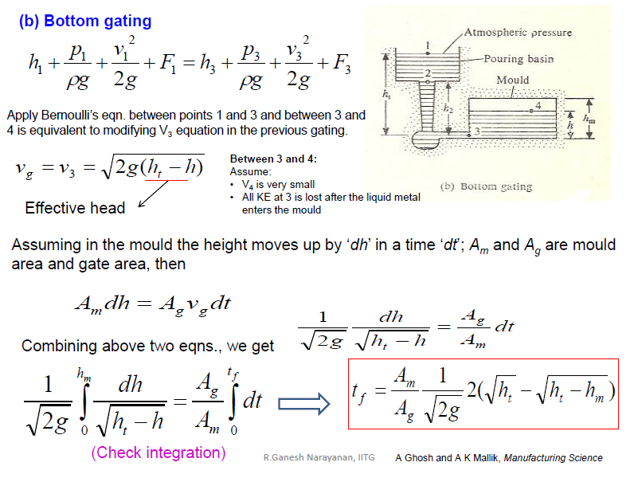

Slide 60
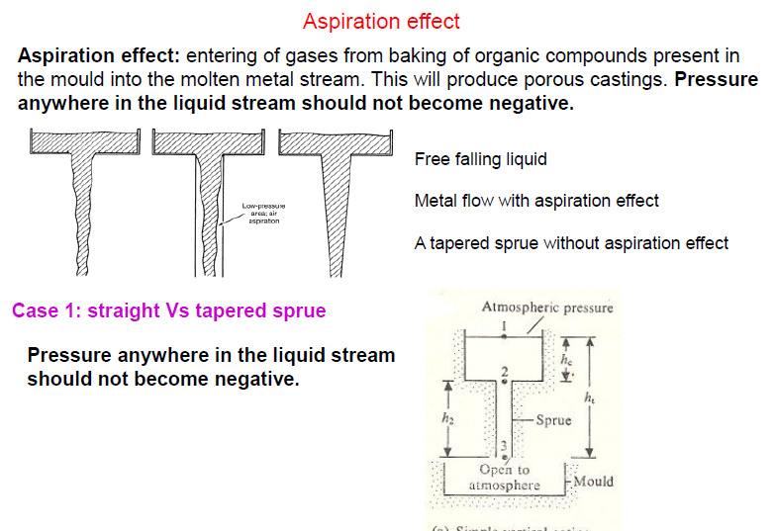

Slide 61
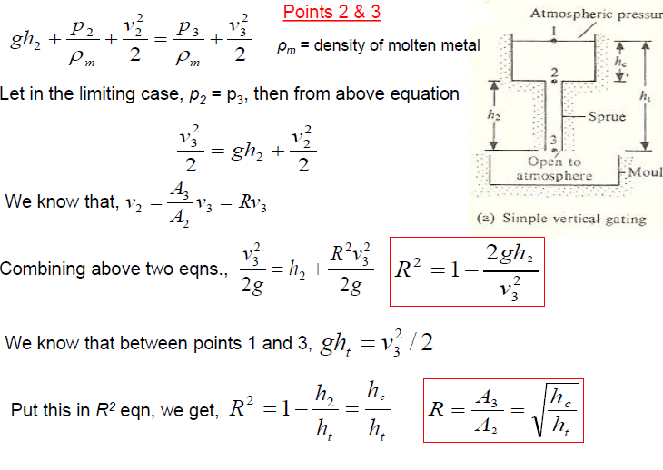

Slide 62
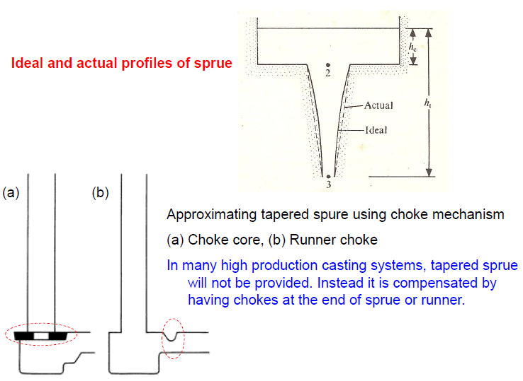

Slide 63
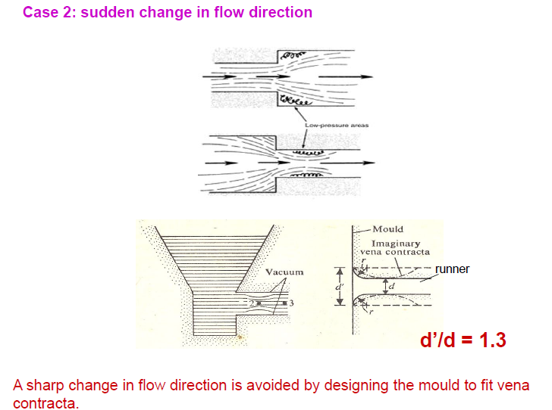

Slide 64
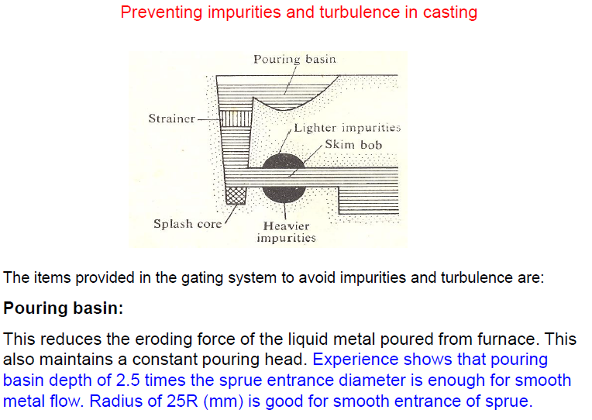

Slide 65
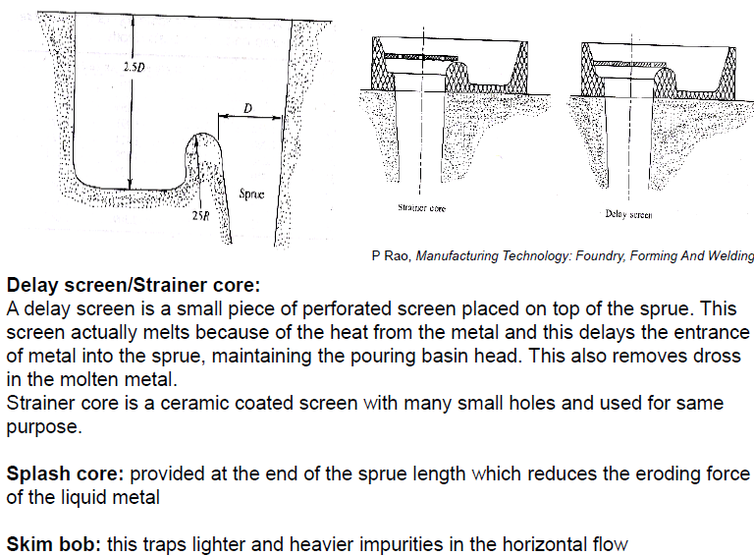

Slide 66
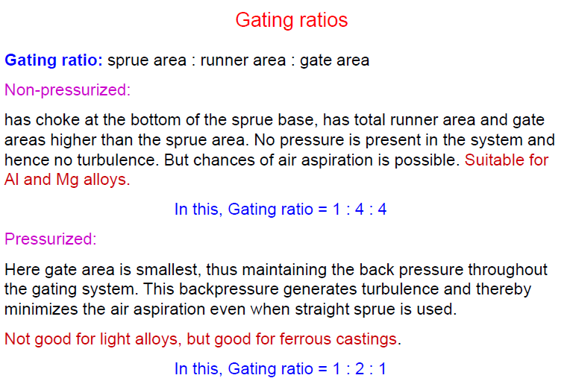

Slide 67
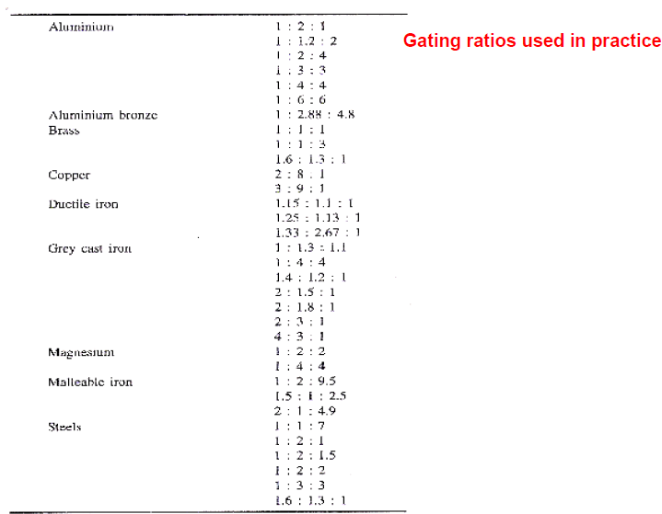

Slide 71
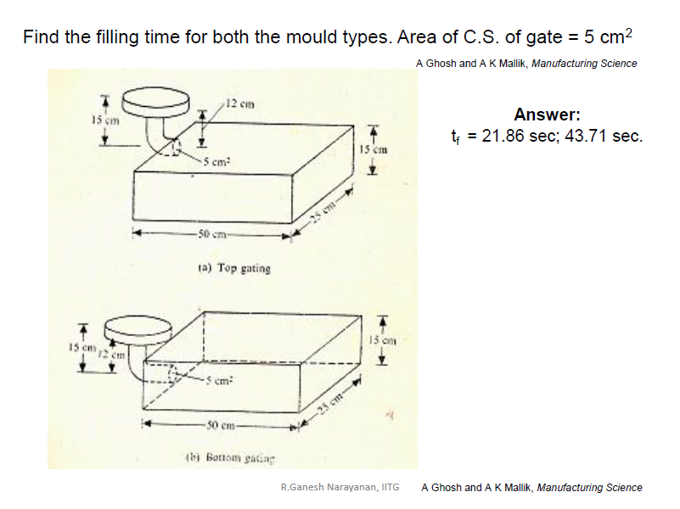
Quiz-2 20/04/2019

Slide 72
Numerical Example on Pouring
The downsprue leading into the runner of a certain mold has a length = 175 mm. The cross-sectional area at the base of the sprue is 400 mm². The mold cavity has a volume = 0.001 m³.
Determine
(a) the velocity of the molten metal flowing through the base of the down sprue,
(b) the volume rate of flow,
and (c) the time required to fill the mold cavity.
Solution: (a) Velocity v = (2 x 9815 x 175)^{0.5} = (3,435,096)^{0.5} = 1853 mm/s
(b) Volume flow rate Q = vA = 1853 x 400 = 741,200 mm³/s
(c) Time to fill cavity TMF = V/Q = 1,000,000/741,200 = 1.35 s

Slide 73
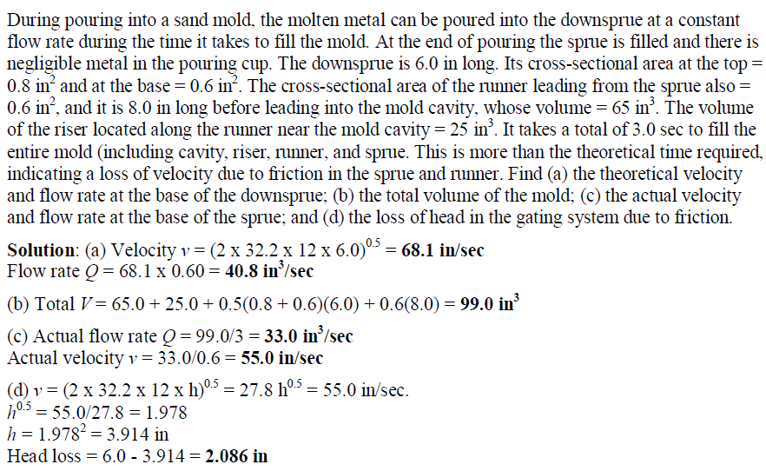

Slide 74
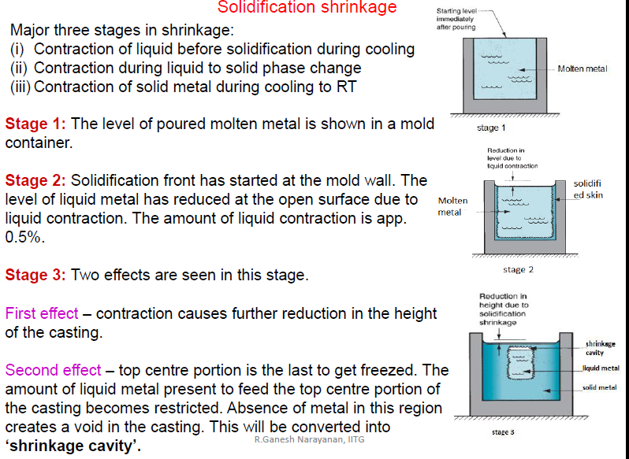

Slide 75
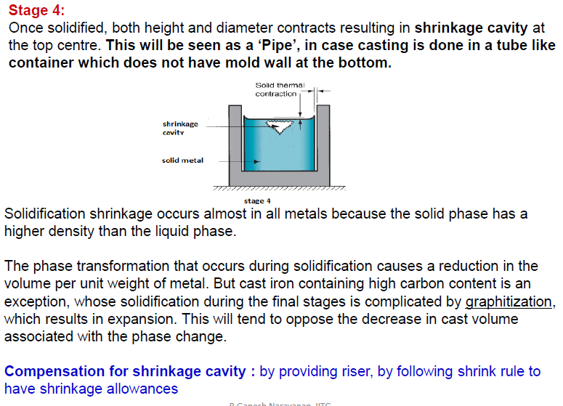

Slide 76
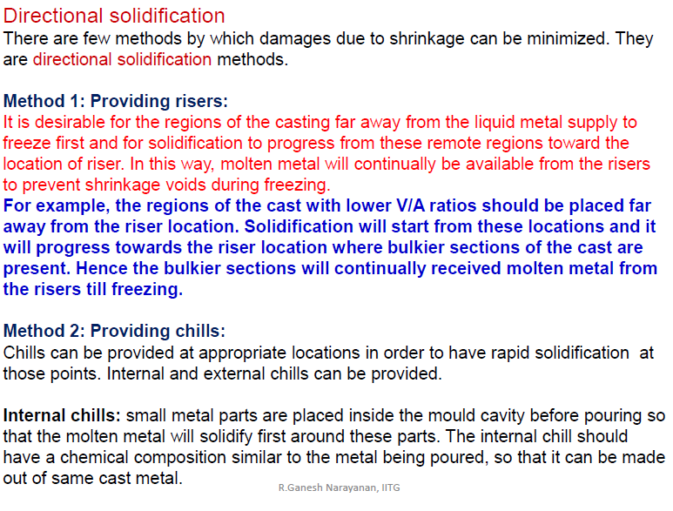

Slide 77
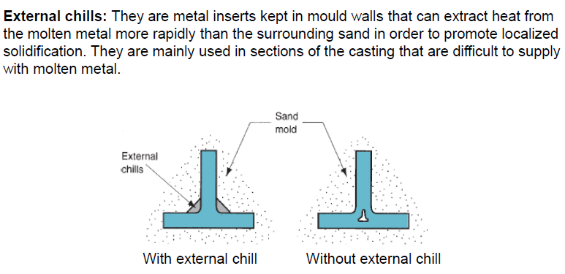

Slide 78
Solidification Time
Whether the casting is pure metal or alloy, solidification takes time. The total solidification time is the time required for the casting to solidify after pouring.
This time is dependent on the size and shape of the casting by an empirical relationship known as Chvorinov’s rule, which states:
TTS = Cm (V/A)^{n}
whereTTS=total solidification time, min;
V=volume of the casting, cm³ (in³);
A=surface area of the casting, cm² (in²);
n is an exponent usually taken to have a value =2;
and Cm is the mold constant.

Slide 79
Given that n = 2, the units of Cm are min/cm² (min/in²), and its value depends on the particular conditions of the casting operation, including mold material (e.g., specific heat, thermal conductivity), thermal properties of the cast metal (e.g., heat of fusion, specific heat, thermal conductivity), and pouring temperature relative to the melting point of the metal.
The value of Cm for a given casting operation can be based on experimental data from previous operations carried out using the same mold material, metal, and pouring temperature, even though the shape of the part may be quite different.

Slide 80
Chvorinov’s rule indicates that a casting with a higher volume-to-surface area ratio will cool and solidify more slowly than one with a lower ratio.
This principle is put to good use in designing the riser in a mold.
To perform its function of feeding molten metal to the main cavity, the metal in the riser must remain in the liquid phase longer than the casting. In other words, the TTS for the riser must exceed the TTS for the main casting. Since the mold conditions for both riser and casting are the same, their mold constants will be equal.
By designing the riser to have a larger volume-to-area ratio, we can be fairly sure that the main casting solidifies first and that the effects of shrinkage are minimized.
Before considering how the riser might be designed using Chvorinov’s rule, let us consider the topic of shrinkage, which is the reason why risers are needed.

Slide 81
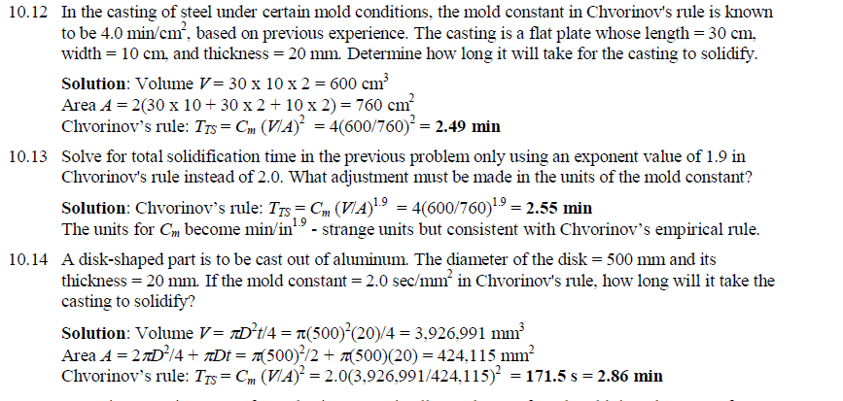

Slide 82
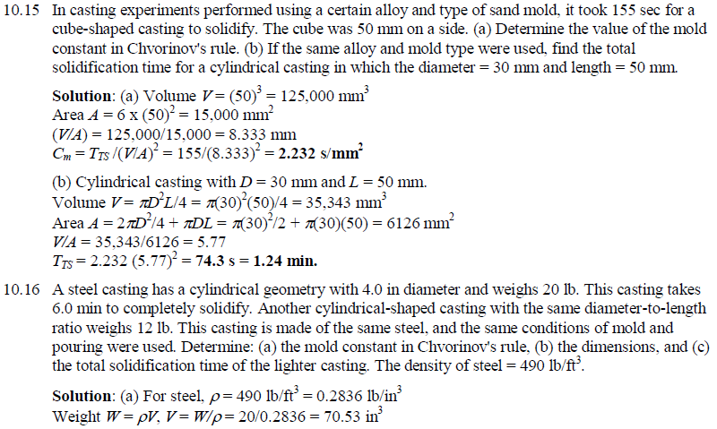

Slide 83
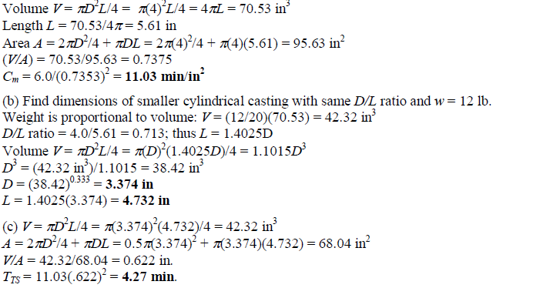

Slide 84


Slide 85



Slide 86

Riser Design

Slide 87


Slide 88


Slide 89


Slide 90


Slide 91



Slide 92

What is the primary function of a riser? It should acts as a reservoir of the molten metal in the mould to compensate the shrinkage during solidification.

Slide 93


Slide 94


Slide 95


Slide 96
So, here this is the method suggested by the Caine. He has suggested that we have to find out two ratios before we judge whether a riser will give us a sound casting or a defective casting.
One ratio is riser volume by casting volume we have to find out.
And we have to find out another ratio, which is known as freezing ratio.
This freezing ratio is given by this expression: casting surface area by casting volume whole divided by riser surface area by riser volume.
So, when we design a riser for a casting, these two ratios we have to find out. And if these two ratios are meeting somewhere here, means that is a sound casting, means here he has plotted a curve, which will judge the nature of the casting, which we are going to obtain after solidification; here is the curve we can see

Slide 97
So, if these two ratios, if these two points are meeting on the right side of the curve, then we will get a sound casting. On the other hand, if these two ratios are meeting on the left side of this curve, then there will be a shrinkage. That is how we can judge whether the riser is effective or not, whether the riser, which we have designed will lead to a sound casting or it will result in a shrinkage casting

Slide 98

Next one - the riser design using modulus method. Here we can see modulus of solidification. Modulus of solidification of a casting or riser is defined as the ratio of its volume to surface area. So, this is the expression - modulus of solidification is the volume divided by surface area. This method is based on Chvorinov’s rule.

Slide 99


Slide 100


Slide 101

The modulus of the riser must be greater than the modulus of the casting. If that be the case, it should be greater by how much? From the experiments, it was found that the modulus of the riser must be at least 1.2 times the modulus of the casting. If the modulus of the riser is 1.2 times the modulus of the casting, then the riser can successfully feed the casting.

Slide 102



Slide 103


Slide 104
Let us see two cases. Here we can see one casting where there is no riser, but we can see after solidification here there is a shrinkage; but here one portion, it is solidified successfully without any shrinkage. Riser was not required for this portion, and here also we can see this portion has solidified successfully; riser was not required, because it was exposed to the walls of the mould. So, this portion was solidified; even though there was no riser, it was solidified successfully; riser is not required for this portion.
So, the portion of the casting, which was solidified without any shrinkage due to the walls of the mould that is known as the end effect. End effect means, walls of the mould, they are able to solidify the casting without any shrinkage, so that is equal to 2.5 t where t is the thickness of the casting. So, here we can see one portion is solidified without any shrinkage that is 2.5 t and this side another portion 2.5 t.
Let us see another case in which there is a riser; this is the riser, because we have kept a riser this time, there is no shrinkage, means this portion; previously there was a shrinkage that is compensated by this riser; because we have kept a riser, this portion, we did not get any shrinkage, means this portion is taken care by the riser.

Slide 105
So, this is the riser effect; riser effect means it is the shrinkage compensation taken care by the riser and that comes to be 2 t where t is the thickness of the casting. So, that total feeding distance when we keep a riser will be 4.5 t. So, here we can see the influence of end effect, and here we can see the influence of end effect and riser effect.
Feeding distance for steel castings where the castings are of the shapes, plates and bars end effect will be up to 2.5 t, even though there is no riser, the casting will be solidified up to a distance of 2.5 t; that is the end effect.
When we place the riser, because of the riser, certain area will be there without any shrinkage; that is the riser effect and that will be 2 t; and the total feeding distance will be sum of end effect and riser effect, that will be 4.5 t.

Slide 106


Slide 107
Feeding distance with two risers. This is a longer casting, so we have kept two risers. So, this side there is end effect and riser effect; end effect is 2.5 t and riser effect is 2 t. So, this side it is 4.5 t; and this side riser affect 2 t; this side riser effect 2 t. So, this total distance is 4 t. And this side again from here to here it will be riser effect; from here to here it will be end effect. So, the total feeding distance here it will be 4.5 t. So, the total feeding distance will be about 13 t with a casting, where there are two risers.

Slide 108


Slide 109
Feeding distance of large castings. Previously we have seen the feeding distance in the case of the steel castings of bars and plates. Here we will see the feeding distance for large steel castings, where the volume is more and the surface area is more. And here, one shape factor will come into picture, which is defined as L plus W divided by T; where L denotes the length, W denotes the width, and T denotes the thickness. And L should be greater than W, and W should be greater than T.

Slide 110


Slide 111
That be the case, now here we have to make… again two factors are there. One is L plus W by T; that is the shape factor is plotted on the x-axis; and the ratio of Vr by Vc that is the volume of the riser and the volume of the casting is plotted along y-axis. And if these two ratios are meeting on the right side of this curve, then a casting will be a sound casting without any shrinkage. And if these ratios are meeting on the left side of this curve, then the casting will have a shrinkage. That is how we can judge whether the riser - that we have designed - is sufficient to feed the casting or not.

Slide 112


Slide 113



Slide 114


Slide 115


Slide 116


Slide 117


Slide 118


Slide 119


Slide 120



Slide 121


Slide 122


Slide 123

It is the capability of the molten metal to flow and fill into the mould cavities, and it was found that pure metals act with good fluidity.

Slide 124


Slide 125


Slide 126


Slide 127
In this fluidity spiral tube method, here we can see a pattern. That pattern will be like this: there will be pouring cup, and there will be sprue; and there will be a spiral, this will be molded inside the molding boxes, and when we withdraw this pattern the mould will have a small tube - a spiral tube. Then, we pour the molten metal through the pouring cup and through the sprue. The molten metal passes through this way and it passes through the spiral cavity - like this, and the length of the molten metal that is passing through this spiral cavity will be dependent on fluidity of the metal.
If the molten metal has got higher fluidity, it travels in this spiral for a longer distance; and if it has got a lower fluidity, it travels for a shorter distance. So the length - that is length of the molten metal - that is solidified in this spiral cavity is the measure of the fluidity.

