Slide 1
Dynamic Force Analysis
Addis Ababa Institute of Technology

Slide 2
Introduction
If a moving links in a mechanism is running with considerable amount of linear and/or angular accelerations, inertia forces are generated and these inertia forces also must be overcome by the driving motor as an addition to the forces exerted by the external load or work the mechanism does.
So, and are no longer applicable. The consideration that says all forces on components of machine systems are in balance (static and dynamic equilibrium ) is seldom in real machines (except when the machine is stopped)
Governing rules will be:
I and m are inertial (bodily) properties. At this stage we need to know the description of the inertial properties.

Slide 3
Intro
Of course techniques for static force analysis are important, not only because stationary structures must be designed to withstand their imposed loads, but also because they introduce concepts and approaches that can be built upon and extended to non equilibrium conditions .
Therefore the purpose of this chapter is to learn how much acceleration will result from a system of unbalanced forces and also learn how these dynamic forces can be assessed for systems that are not in equilibrium

Slide 4
Centroid
Centroid is the point where the resultant of distributed force system is assumed to act and generate the same dynamic results.

Slide 5
Mass Centre
If the distributed force is gravity force acting on each particle of mass, then concentrated force itself is called the “weight” and the centroid is called the “center of gravity” or “mass center”.
Mass times distance, mr, is called as the first mass moment. This concept of first mass moment is normally used in deriving the center of mass of a system of particles or a rigid body. In figure a series of masses are located on a line. The center of mass or centroid is located at

Slide 6
Mass Centre
The coordinates of the masses located on a plane can be obtained as:

Slide 7
Mass Centre
This procedure can be extended to masses concentrated in a volume by simply writing an equation for the z axis. A more general form of mass center location for three dimensional body can be obtained by using integration instead of summation. The relations then become

Slide 8
Mass Moment of Inertia
Mass moment of inertia is the name given to rotational inertia, the rotational inertia analog of mass for linear motion. It appears in the relationships for the dynamics of rotational motion. The Mass Moment of Inertia of a solid measures the solid's ability to resist changes in rotational speed about a specific axis.
The moment of inertia for a point mass is just the mass times the square of perpendicular distance to the rotation axis. The mass moment of inertia for a single particle is given as:

Slide 9
Mass Moment of Inertia
When calculating the mass moment of inertia for a rigid body, one thinks of the body as a sum of particles, each having a mass of dm. Integration is used to sum the moment of inertia of each dm to get the mass moment of inertia of body. The equation for the mass moment of inertia of the rigid body is

Slide 10
Mass Moment of Inertia
The integration over mass can be replaced by integration over volume, area, or length. For a fully three dimensional body using the density ρ one can relate the element of mass to the element of volume.
r_{y}
r_{x}
r_{z}
These three integrals are called the principle mass moment of inertia of the body. Another three similar integrals are
}
mass products of inertia of the body

Slide 11
Radius of gyration
Sometime in place of the mass moment of inertia the radius of gyration k is provided. The mass moment of inertia can be calculated from k using the relation
where m is the total mass of the body. One can interpret the radius of gyration as the distance from the axis that one could put a single particle of mass m equal to the mass of the rigid body and have this particle have the same mass moment of inertia as the original body.

Slide 12
Parallel-axis theorem
The moment of inertia around any axis can be calculated from the moment of inertia around parallel axis which passes through the center of mass. The equation to calculate this is called the parallel axis theorem and is given as

Slide 13
Example 1
What are the mass moments of inertial of a point mass about an axis passing through itself and about an axis r distance away from it ?
o
m
o
Solution: Mass moments of inertial of a point mass about an axis passing through itself

Slide 14
Example 1
What are the mass moments of inertial of a point mass about an axis passing through itself and about an axis r distance away from it ?
Solution: Mass moments of inertial of a point mass about an axis passing through itself
o
m
o
Mass moments of inertial of a point mass about an axis r distance away from it. Using parallel axis theorem
o
x
r
m
o
x

Slide 15
Example 2
Find the mass moment of inertia of a slender rod of length L (slender rod means that it has a length, and the remaining dimensions are negligible small) about an axis perpendicular to the rod and passing through its mass center.
o
o
L/2
L
Solution:
o
x
dx
o
L/2
Let density of the material is ρ in kg/m. Then, infinitesimal mass dm=ρdx. Substituting this into above equation,
L

Slide 16
Example 3
An uniform steel bar shown in the figure is used as an oscillating cam follower. Drive the equation of mass moment of inertia of the follower about an axis through O. Use the density of steel ρ=7800 kg/m³.

Slide 17
Example 3
Solution:

Slide 18
Example 3
Solution:

Slide 19
Example 3
Solution:
mass moment of inertia about O can be found by parallel axis theorem

Slide 20
DYNAMICS OF MACHINERY
Inertial forces and D’Alembert’s Principle

Slide 21
Example
The slender bar of mass m is released form rest in the horizontal position as shown. At that instant, determine the force exerted on the bar by the support A.
Freebody Diagram
Equations Of Motion

Slide 22
Example
The slender bar of mass m is released form rest in the horizontal position as shown. At that instant, determine the force exerted on the bar by the support A.
Freebody Diagram
Equations Of Motion
Kinematics of the slender rod

Slide 23
Example
The slender bar of mass m is released form rest in the horizontal position as shown. At that instant, determine the force exerted on the bar by the support A.
Kinematics of the slender rod
r
At the instant bar is released, its angular velocity

Slide 24
Example
Equations Of Motion
Freebody Diagram

Slide 25
D’Alembert’s Principle
D’Alembert’s principle permits the reduction of a problem in dynamics to one in statics. This is accomplished by introducing a fictitious force equal in magnitude to the product of the mass of the body and its acceleration, and directed opposite to the acceleration. The result is a condition of kinetic equilibrium.
m, I
a
ΣF
CG
α
m, I
a
−Ια
ΣF
CG
α
fictitious force and torque
-ma
The meaning of the equation; i.e. indication of a dynamic case still holds true, but equation, having zero on right hand side becomes very easy to solve, like that in a “static force analysis” problem.

Slide 26
Solution of a Dynamic Problem Using D’Alembert’s Principle
Do an acceleration analysis and calculate the linear acceleration of the mass centers of each moving link. Also calculate the angular acceleration of each moving link.
Masses and centroidal inertias of each moving link must be known beforehand.
Add one fictitious force on each moving body equal to the mass of that body times the acceleration of its mass center, direction opposite to its acceleration, applied directly onto the center of gravity, apart from the already existing real forces.
Add fictitious torque on each moving body equal to the centroidal inertia of that body times its angular acceleration, direction or sense opposite to that of acceleration apart from the already existing real torques.
Solve statically.

Slide 27
Example 1
In the figure, a double- slider mechanism working in horizontal plane is shown. The slider at B is moving rightward with a constant velocity of 1 m/sec. Calculate the amount of force on this mechanism in the given kinematic state.
AB=10 cm, AG₃=BG₃=5 cm, θ=60º
m₂=m₄=0.5 kg, m₃=0.8 kg, I₃=0.01 kg.m²

Slide 28
Example 1 cont
In the figure, a double- slider mechanism working in horizontal plane is shown. The slider at B is moving rightward with a constant velocity of 1 m/sec. Calculate the amount of force on this mechanism in the given kinematic state.
0

Slide 29
Example 1 cont
G₃

Slide 30
Example 1 cont
G₃
D’Alembert forces and moments

Slide 31
Example 1 cont

Slide 32
Example 1 cont
y
+
x

Slide 33
Example 1 cont
h
h

Slide 34
Example 1 cont
h
h

Slide 35
Example 1 cont
y
+
x
h

Slide 36
Example from Shigley 3rd ed page 481-485
At the crank angle shown and asuming that gravity and friction effects are negligible, find all the constraint forces and the driving torque required to produce the velocity and acceleration conditions specified.

Slide 37
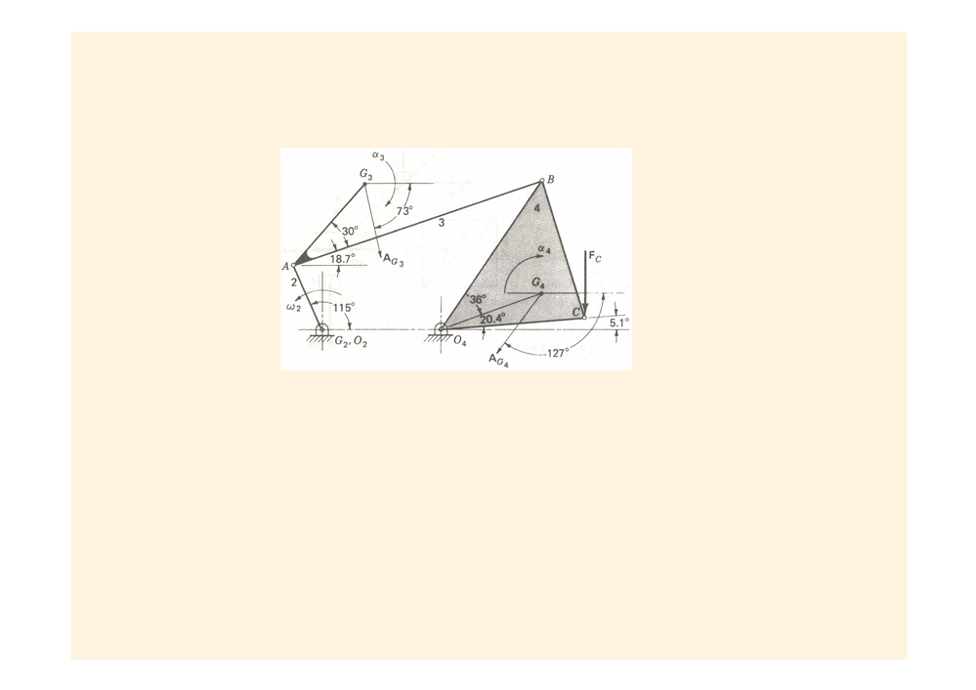
Example 15.4:
RAO= 60 mm, RO
ˆ
2
ˆ
m4 = 5 kg, IG
= 0.025 kg · m2, IG
= 0.012 kg · m2, IG
= 0.054 kg · m2, α 2 = 0, α 3 = -119k rad/s2, α 4 = -625k rad/s2, AG
= 162∠-
2
3
4
3
73.2° m/s2, AG
= 104∠233° m/s2, FC = -0.8 j kN.
4
Figure 15.9
Calculate the inertia forces and inertia torques
−
m
A
=
2
G
0
−
2
m
A
=−
(1.5)(46.8
i
−
155j)
=−
70.2
i
+
233
j
(
N
3
G
)
−
3
m
A
=−
(5.0)(
−
62.6
i
−
83.1j)
=−
313
i
+
415
j
(
N
4
G
)
−
4
I
α
=
G
2
0
−
2
I
α
=−
(0.012)(
−
119k)
=
1.43
k
(
N ⋅m
G
3
)
−
3
I
α
=−
(0.054)(
−
625k)
=
33.8
k
(
N ⋅m
G
4
)
4
15-12

Slide 38
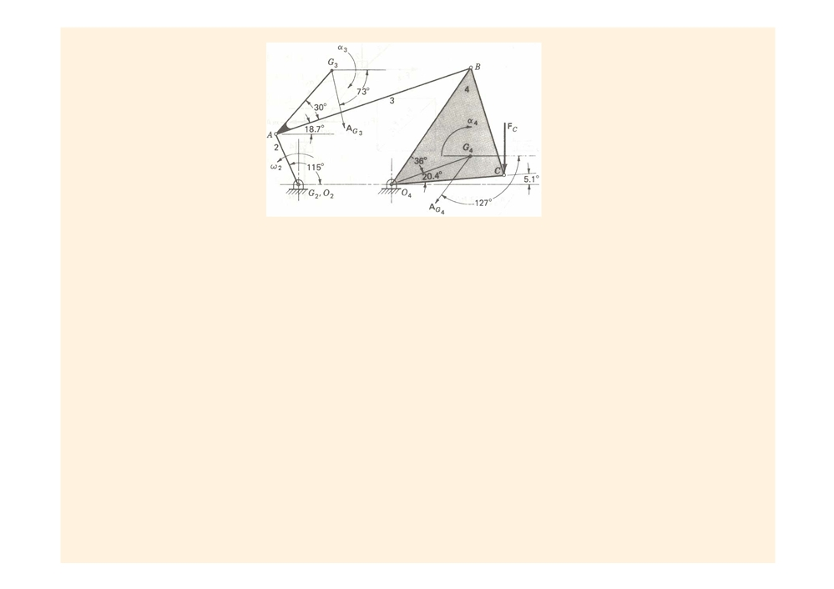
Considering the free-body diagram of link 4 and 3 respectively,
∑
M
=
R
×
(
−
m
A
)
+
(
−
I
α
)
+
R
×
F
+
R
×
4
4
F
=
0
O
G
O
G
G
CO
c
BO
34
∑
M
4
4
4
4
4
4
4
=
R
×
(
−
m
A
)
+
(
−
I
α
)
+
R
×
3
3
F
=
0
A
G
A
G
G
BA
43
∑
M
=
3
3
3
x
y
25.2
k
+
33.8
k
−
96
k
+
(
−
125
F
+
83
F
)
O
34
34
k
=
0
∑
M
4
x
y
=
18.6
k
+
1.43
k
+
(70.5
F
−
208
F
)
A
34
34
k
=
0
F
=−
300
i
−
39
34
j
∑
F
=
F
+
F
+
F
+
(
−
m
A
)
4 Summing forces on the link 2,3,4,
=
0
i
4
14
34
C
4
G
F
=−
13
i
+
390
j
(
N
14
)
∑
F
=
F
+
F
+
(
−
m
A
)
i
=
0
3
23
43
3
G
F
=−
230
238
3
i
−
j
(
N
23
)
∑
F
=
F
+
F
+
(
−
m
A
)
i
=
0
2
12
32
2
G
F
=
F
=−
F
2
12
23
32
∑
M
=
R
×
F
+
M
+
(
−
I
α
)
O
AO
32
12
G
2
=
0
M
2
2
2
=−
R
×
F
=
18.6
k
(
N ⋅m
12
AO
32
)
2
15-13

Slide 39

15.5 The Principle of Superposition
Linear System: the response or output of a system is directly proportional to the drive or input to the system. In the absence of Coulomb or dry friction, most mechanisms are linear for force analysis purpose.
The principle of superposition: for linear systems the individual responses to several disturbances or driving functions can be superposed on each other to obtain the total response
of the system.
Example:
nonlinear factor: static or Coulomb friction, systems with clearances or backlash systems with springs that change stiffness as they are deflected
Complete dynamic force analysis of a planar motion mechanism: (1) make a kinematic analysis of the mechanism. (2) make a complete static force analysis of the mechanism.
(3) calculate the inertia forces and inertia torques for each link or element of the mechanism. make another complete force analysis of the mechanism.
(4) add the results of steps 2 and 3 to obtain the resultant forces and torques on each link.
15-14

Slide 40
Example 2
Crank AB of the mechanism shown is balanced such that the mass center is at A. Mass center of the link CD is at its mid point. At the given instant, link 4 is translating rightward with constant velocity of 5 m/sec. Calculate the amount of motor torque required on crank AB to keep at the given kinematics state.
AC=10 cm, CB=BD=4 cm,
AF=2 cm CG3=4 cm,
m2=m3=m4=5 kg,
I2=I3=I4=0.05 kg-m²

Slide 41
Example 2 cont.
Crank AB of the mechanism shown is balanced such that the mass center is at A. Mass center of the link CD is at its mid point. At the given instant, link 4 is translating rightward with constant velocity of 5 m/sec. Calculate the amount of motor torque required on crank AB to keep at the given kinematics state.
AC=10 cm, CB=BD=4 cm, AF=2 cm CG3=4 cm, m2=m3=m4=5 kg, I2=I3=I4=0.05 kg-m2
5 m/s

Slide 42
Example 2 cont.
Crank AB of the mechanism shown is balanced such that the mass center is at A. Mass center of the link CD is at its mid point. At the given instant, link 4 is translating rightward with constant velocity of 5 m/sec. Calculate the amount of motor torque required on crank AB to keep at the given kinematics state.
AC=10 cm, CB=BD=4 cm, AF=2 cm CG3=5 cm, m2=m3=m4=5 kg, I2=I3=I4=0.05 kg-m2

Slide 43
Example 2 cont.
Crank AB of the mechanism shown is balanced such that the mass center is at A. Mass center of the link CD is at its mid point. At the given instant, link 4 is translating rightward with constant velocity of 5 m/sec. Calculate the amount of motor torque required on crank AB to keep at the given kinematics state.
AC=10 cm, CB=BD=4 cm, AF=2 cm CG3=5 cm, m2=m3=m4=5 kg, I2=I3=I4=0.05 kg-m2
α₃
α₂
B

Slide 44
Example 2 cont
D’Alembert forces and moments
m2=m3=m4=5 kg, I2=I3=I4=0.05 kg-m2
-m₃a_{B}
−Ι₃α₃
τ
−Ι₂α₂
B

Slide 45
Example 2 cont
-m₃a_{B}
−Ι₃α₃
τ
−Ι₂α₂
4000 N
1000 Nm
τ
504 Nm
τ_{A4}

Slide 46
Example 2 cont
4000 N
1000 Nm
τ
504 Nm
τ_{A4}

Slide 47
Example 2 cont
4000 N
1000 Nm
τ
504 Nm
τ_{A4}

Slide 48
Example 2 cont
4000 N
1000 Nm
τ
504 Nm
τ_{A4}

Slide 49
Example 2 cont
4000 N
1000 Nm
τ
504 Nm
τ_{A4}

Slide 50
DYNAMICS OF MACHINERY
Dynamic Force Analysis III

Slide 51
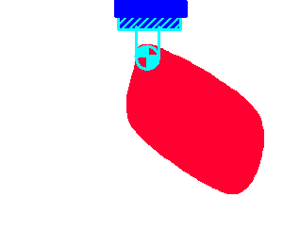
Measuring Mass Moment of Inertia
If the boundaries (surfaces) of the volume is well defined mathemetically, we calculate Mass Moment of Inertia by integration. if this is not possible and a specimen exist, we move it and measure the motion. Motion is related to the mass moment of inertia.
O
G
G
θ

Slide 52
Measuring Mass Moment of Inertia by Compound Pendulum
r_{G}
O
θ
G
mgsinθ
mgcosθ
mg
Differential equation of motion of the compound pendulum. This is a second order nonlinear differential equation. To ease the solution this equation must be linearized which can be linearized by using Taylor series expansion then

Slide 53
Measuring Mass Moment of Inertia by Compound Pendulum
r_{G}
O
θ
G
mgsinθ
mgcosθ
mg
ω²_{n}
Where A&B are arbitrary coefficient related with the initial values of the motion
t is time
ω_{n} is natural circular frequency

Slide 54
Measuring Mass Moment of Inertia by Compound Pendulum
r_{G}
O
θ
G
mgsinθ
mgcosθ
When
mg

Slide 55
Measuring Mass Moment of Inertia by Compound Pendulum
1 cycle
Elapsed time for one cycle is called period τ

Slide 56
Measuring Mass Moment of Inertia by Compound Pendulum
Procedure
Measure time; say 20 cycles by a stopwach.
Calculate one period by dividing this time into 20, which minimize the personal mistakes.
With only unknown I₀

Slide 57
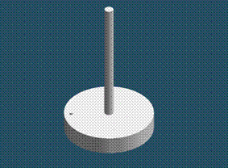

Measuring Mass Moment of Inertia by Torsional Pendulum
k
θ
τ
Differential equation of motion of the Torsional pendulum.
With only unknown I₀

Slide 58
Measuring Mass Moment of Inertia by Filar Pendulum
b
0.5mgcosφ
l
φ
mg/2
mg/2
φ
G
0.5mgsinφ
mg
G
0.5mgsinφ
θ
0.5mgsinφ

Slide 59
Measuring Mass Moment of Inertia by Filar Pendulum
b
l
mg/2
mg/2
φ
G
mg
G
θ

Slide 60
Measuring Mass Moment of Inertia by Filar Pendulum
b
l
mg/2
mg/2
φ
G
mg
G
θ

Slide 61
ME 302 DYNAMICS OF MACHINERY
Dynamic Force Analysis IV
Dr. Sadettin KAPUCU
© 2007 Sadettin Kapucu

Slide 62
Preliminary
Coordinate Transformation
  Reference coordinate frame OXYZ
  Body-attached frame O’uvw
Point represented in OXYZ:
Point represented in O’uvw:
O,
O’
Two frames coincide ==>

Slide 63
Preliminary
Properties: Dot Product
Let and be arbitrary vectors in and be the angle from to , then
x
y
Properties of orthonormal coordinate frame
Mutually perpendicular
Unit vectors

Slide 64
Preliminary
Coordinate Transformation
  Rotation only
How to relate the coordinate in these two frames?

Slide 65
Preliminary
Basic Rotation
  , , and represent the projections of onto OX, OY, OZ axes, respectively
  Since

Slide 66
Preliminary
Basic Rotation Matrix
  Rotation about x-axis with

Slide 67
Preliminary
Is it True?
  Rotation about x axis with

Slide 68
Basic Rotation Matrices
  Rotation about x-axis with
  Rotation about y-axis with
  Rotation about z-axis with

Slide 69
Preliminary
Basic Rotation Matrix
  Obtain the coordinate of from the coordinate of
Dot products are commutative!
<== 3X3 identity matrix

Slide 70
Example 2
A point is attached to a rotating frame, the frame rotates 60 degree about the OZ axis of the reference frame. Find the coordinates of the point relative to the reference frame after the rotation.

Slide 71
Example 3
A point is the coordinate w.r.t. the reference coordinate system, find the corresponding point w.r.t. the rotated OU-V-W coordinate system if it has been rotated 60 degree about OZ axis.

Slide 72
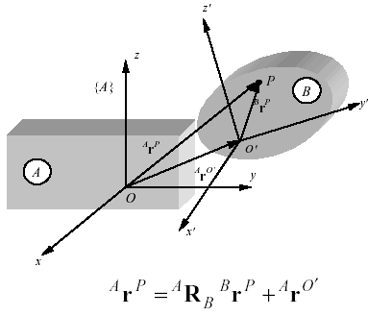
Coordinate Transformations
position vector of P in {B} is transformed to position vector of P in {A}
description of {B} as seen from an observer in {A}
Rotation of {B} with respect to {A}
Translation of the origin of {B} with respect to origin of {A}

Slide 73
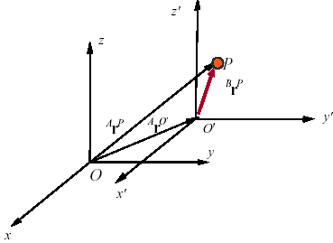
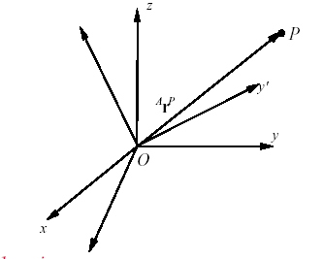
Coordinate Transformations
Two Special Cases
  1. Translation only
  Axes of {B} and {A} are parallel
  2. Rotation only
  Origins of {B} and {A} are coincident

Slide 74
Homogeneous Representation
Coordinate transformation from {B} to {A}
Homogeneous transformation matrix
Rotation matrix
Position vector
Scaling

Slide 75
Homogeneous Transformation
Special cases
  1. Translation
  2. Rotation

Slide 76
Example 5
Translation along Z-axis with h:
h
O, O’
O, O’

Slide 77
Example 6
Rotation about the X-axis by

Slide 78
Homogeneous Transformation
Composite Homogeneous Transformation Matrix
Rules:
  Transformation (rotation/translation) w.r.t (X,Y,Z) (OLD FRAME), using pre-multiplication
  Transformation (rotation/translation) w.r.t (U,V,W) (NEW FRAME), using post-multiplication

Slide 79
Example 7
Find the homogeneous transformation matrix (T) for the following operation:

Slide 80
Homogeneous Representation
A frame in space (Geometric Interpretation)
Principal axis n w.r.t. the reference coordinate system

Slide 81
Homogeneous Transformation
Translation

Slide 82
DYNAMICS OF MACHINERY
Dynamic Force Analysis V

Slide 83
Preliminary
Kinematics of a Rigid Body
Arbitrary point in the body
Rigid body angular velocity wrt inertial frame
Body coordinate system it rotates at the same angular velocity as the body
O’
O
Inertial Frame

Slide 84
Preliminary
Kinematics of a Rigid Body
Position of P
O’
The position of P wrt inertial coordinate frame
O
The absolute velocity of P is

Slide 85
Preliminary
Kinematics of a Rigid Body
The absolute velocity of P is
O’
}
}
O
Becomes zero
because body is rigid

Slide 86
Preliminary
Kinematics of a Rigid Body
The absolute velocity of P is
O’
O

Slide 87
Preliminary
Kinematics of a Rigid Body
The absolute velocity of P is
Acceleration of P wrt inertial coordinate system is
O’
O

Slide 88
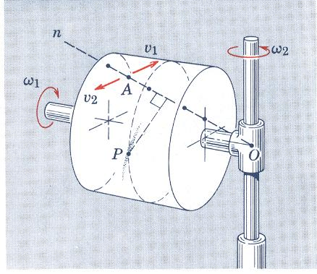
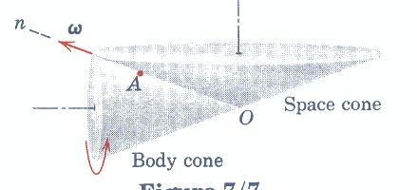
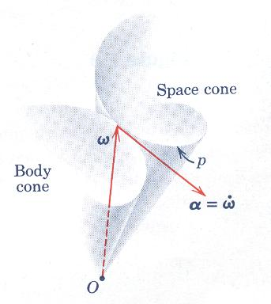
Preliminary Kinematics of a Rigid Body
Notes:
To aid in visualizing the concept of the instantenous axis of rotation we will cite a specific example.

Slide 89
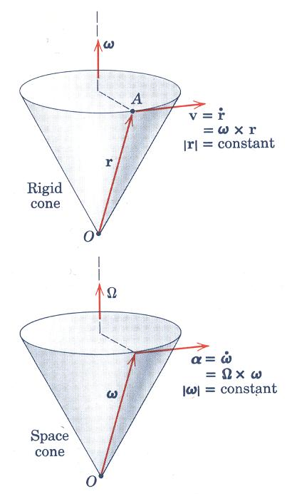
Preliminary Kinematics of a Rigid Body
Notes:
To aid in visualizing the concept of the instantenous axis of rotation we will cite a specific example.

Slide 90
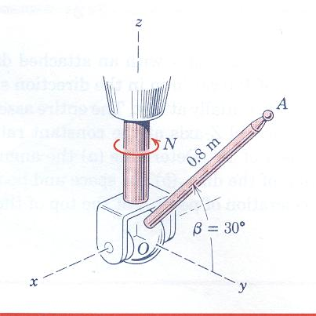
Kinematics of a Rigid Body
Example
The 0.8 m arm OA for a remote-control mechanism is pivoted about the horizontal x-axis of the clevis, and the entire assembly rotates about the z-axis with a constant speed N=60rev/min. Simultaneously the arm is being raised at the constant rate . For the position where β=60º determine (a) angular velocity of OA, (b) the angular acceleration of OA, (c) the velocity of point A, and (d) the acceleration of point A.

Slide 91
Kinematics of a Rigid Body
Example
The 0.8 m arm OA for a remote-control mechanism is pivoted about the horizontal x-axis of the clevis, and the entire assembly rotates about the z-axis with a constant speed N=60rev/min. Simultaneously the arm is being raised at the constant rate . For the position where β=60º determine (a) angular velocity of OA, (b) the angular acceleration of OA, (c) the velocity of point A, and (d) the acceleration of point A.

Slide 92
Kinematics of a Rigid Body
Example
The electric motor with an attached disk is running at a constant low speed of 120 rey/mm in the direction shown. Its housing and mounting base are initially at rest. The entire assembly is next set in rotation about the vertical Z-axis at the constant rate N=60 rev/min with a fixed angle γ of 30⁰. Determine (a) the angular velocity and angular acceleration of the disk, (b) the space and body cones, and (c) the velocity and acceleration of point A at the top of the disk for the instant shown.

Slide 93
Kinematics of a Rigid Body
Example
The electric motor with an attached disk is running at a constant low speed of 120 rey/mm in the direction shown. Its housing and mounting base are initially at rest. The entire assembly is next set in rotation about the vertical Z-axis at the constant rate N=60 rev/min with a fixed angle γ of 30⁰. Determine (a) the angular velocity and angular acceleration of the disk, (b) the space and body cones, and (c) the velocity and acceleration of point A at the top of the disk for the instant shown.

Slide 94
Kinematics of a Rigid Body
Example
The electric motor with an attached disk is running at a constant low speed of 120 rey/mm in the direction shown. Its housing and mounting base are initially at rest. The entire assembly is next set in rotation about the vertical Z-axis at the constant rate N=60 rev/min with a fixed angle γ of 30⁰. Determine (a) the angular velocity and angular acceleration of the disk, (b) the space and body cones, and (c) the velocity and acceleration of point A at the top of the disk for the instant shown.

Slide 95
Kinematics of a Rigid Body
Example
The electric motor with an attached disk is running at a constant low speed of 120 rey/mm in the direction shown. Its housing and mounting base are initially at rest. The entire assembly is next set in rotation about the vertical Z-axis at the constant rate N=60 rev/min with a fixed angle γ of 30⁰. Determine (a) the angular velocity and angular acceleration of the disk, (b) the space and body cones, and (c) the velocity and acceleration of point A at the top of the disk for the instant shown.

Slide 96
Kinematics of a Rigid Body
Example
The electric motor with an attached disk is running at a constant low speed of 120 rey/mm in the direction shown. Its housing and mounting base are initially at rest. The entire assembly is next set in rotation about the vertical Z-axis at the constant rate N=60 rev/min with a fixed angle γ of 30⁰. Determine (a) the angular velocity and angular acceleration of the disk, (b) the space and body cones, and (c) the velocity and acceleration of point A at the top of the disk for the instant shown.

Slide 97
Preliminary
Kinematics of a Rigid Body
Body coordinate frame rotates with this angular velocirty
coordinate system rotates with this angular velocirty
B
O
Letting
Denote the angular velocity of the reference wrt the body frame, the angular
velocity of the body is related to that of the coordinate system
The velocity of a point of the body may be represented by

Slide 98
Preliminary
Kinematics of a Rigid Body
Body coordinate frame rotates with this angular velocirty
coordinate system rotates with this angular velocirty
B
The velocity of a point of the body may be represented by
O
Acceleration of a point of the body is obtained as:

Slide 99
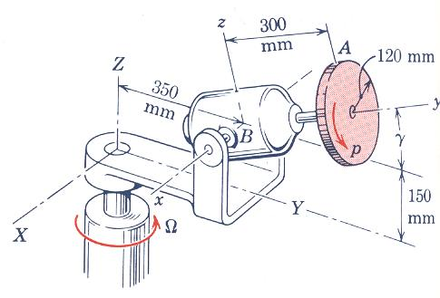
Kinematics of a Rigid Body
Example
The motor housing and its bracket rotate about the Z axis at the constant rate
The motor shaft and disk have a constant angular velocity of spin with respect to the motor housing in the direction shown. If γ constant at 30º, determine the velocity and acceleration of point A at the top of the disk and angular acceleration α of the disk.

Slide 100
Kinematics of a Rigid Body
Example
The motor housing and its bracket rotate about the Z axis at the constant rate
The motor shaft and disk have a constant angular velocity of spin with respect to the motor housing in the direction shown. If γ constant at 30º, determine the velocity and acceleration of point A at the top of the disk and angular acceleration α of the disk.

Slide 101
DYNAMICS OF MACHINERY
Dynamic Force Analysis VI

Slide 102
Kinetics of a Rigid Body
Equation of Motion (EOM)
CG

Slide 103
Kinetics of a Rigid Body
Equation of Motion (EOM)
CG

Slide 104
Kinetics of a Rigid Body
Equation of Motion (EOM)
CG

Slide 105
Kinetics of a Rigid Body
Equation of Motion (EOM)
CG

Slide 106
Kinetics of a Rigid Body
Equation of Motion (EOM)
CG

Slide 107
Kinetics of a Rigid Body
Equation of Motion (EOM)
CG

Slide 108
Kinetics of a Rigid Body
Equation of Motion (EOM)
CG

Slide 109
Kinetics of a Rigid Body
Equation of Motion (EOM)
CG

Slide 110
Kinetics of a Rigid Body
Equation of Motion (EOM)
CG

Slide 111
Kinetics of a Rigid Body
Equation of Motion (EOM)
CG

Slide 112
Kinetics of a Rigid Body
Equation of Motion (EOM)
CG

Slide 113
Kinetics of a Rigid Body
Equation of Motion (EOM)
CG

Slide 114
Kinetics of a Rigid Body
Equation of Motion (EOM)
CG

Slide 115
Kinetics of a Rigid Body
Equation of Motion (EOM)
CG

Slide 116
Kinetics of a Rigid Body
Equation of Motion (EOM)
CG

Slide 117
Kinetics of a Rigid Body
Equation of Motion (EOM)
CG

