Slide 1
TWO-DIMENSIONAL, STEADY-STATE CONDUCTION

Slide 2
In many situations the one-dimensional approach of heat conduction is oversimplification. Multidimensional effects must be accounted for.
4.1 Alternative Approaches
Here the two-dimensional, steady state heat conduction will be treated. Again the two major objectives in conduction analysis is determining the temperature field, T(x,y) and then the heat transfer.
For two-dimensional steady-state conduction with no generation and constant k, the PDE to be solved is

Slide 3
Methods of solving include analytical, graphical, and numerical (finite difference, finite-element, or boundary element) approaches.
The analytical gets the exact solution of the PDE for only a restricted set of simple geometries and boundary conditions. Often the solutions are in series form. The method of separation of variables will be used for this solution.
Graphical and numerical solutions give approximate results at discrete points.
Graphical solution is restricted to two-dimensional problems involving adiabatic and isothermal boundaries.

Slide 4
The method is based on the fact that isotherms must be perpendicular to heat flow lines figchp-4\fig4.1.pptx. It requires good construction skills.
Numerical methods may be used to obtain accurate results for complex, two- or three-dimensional geometries involving a variety of boundary conditions.
4.2 The method of Separation of variables
Consider the system shown in figchp-4\fig4.2.pptx. Assumption made is that heat transfer from end surfaces is negligible or (∂²T/∂z²)≈0 . This will make it a two dimensional problem.

Slide 5
To simplify the solution, the following transformation is used
Substituting gives
For the complete solution of the above PDE two boundary conditions are required for each of the coordinates and these are
T(0,y)=T₁ and T(x,0)=T₁ or θ(0,y) = 0 and θ(x,0)=0
T(L,y)=T₁ and T(x,W)=T₂ or θ(L,y) = 0 and θ(x,W)=1

Slide 6
Because of the transformation, the BC’s have been restricted to 0’s and 1.
The method of separation of variables assumes a product solution of the form
θ(x,y) = X(x) . Y(y)
Substitution in the PDE of θ gives

Slide 7
Indeed the differential equation is separable. Another observation is that the left hand side expression is only a function of x and the right one only a function of y. The equality can be satisfied only if the expression is independent of x and y. Only a constant can satisfy this condition. Let this constant be λ². This makes the equation
0 or –λ² could have been the constants. But λ² satisfies the prescribed boundary conditions.

Slide 8
The resulting differential equations are
And the solutions are
X = C₁ cos λx + C₂ sin λx
Y = C₃ e^{λy} + C₄ e^{-λy}
This will give θ as
θ = XY = (C₁ cos λx + C₂ sin λx)(C₃ e^{λy} + C₄ e^{-λy})
Using the boundary conditions
θ(0,y) = 0 → C₁ = 0
θ(x,0) = 0 → (C₂ sin λx)(C₃+ C₄) = 0
The only possibility is (C₃+ C₄) = 0. If C₂ = 0

Slide 9
It will result in θ = 0 (not the required solution)
This will then give C₃ = – C₄
(3) θ(L,y) = 0 Gives C₂C₄ sin λL (e^{λy} – e^{-λy}) = 0
As C₂ and C4 can not be zeros, the only possibility is
sin λL = 0 → λL = nπ n=0, 1, 2, 3,…
n=0 makes θ(x,y) = 0 which is not acceptable. So n=0 will be precluded or n = 1, 2, 3, …
The solution then becomes
Combining the two constants, knowing that the new constant may depend on n will give

Slide 10
Since = 2 sinh (nπy/L)
As the sum of the solutions is also a solution, then the general solution becomes
To obtain C_{n}, we will apply the last boundary condition
(4) θ(x,W)=1=

Slide 11
To determine C_{n}, some manipulation is required. This requires the knowledge of orthogonality.
An infinite set g₁(x), g₂(x), …, g_{n}(x) is said to be orthogonal in the domain if
Most functions exhibit orthogonality including trigonometric functions

Slide 12
If f(x) is expressed in terms of series of orthogonal functions as
Then manipulating the above equation as follows
And then using the principles of orthogonality, on the right side all the expressions will be zero except one term and the result is given by

Slide 13
Solving for A_{m} and switching the subscript to n will give
For our situation g_{n}(x) = sin (nπx/L), f(x)=1 and substitution will give

Slide 14
Substitution in the series representation of f(x) gives
Recalling the equation of the result of the fourth boundary condition and comparing gives
And the resulting final solution will be
Isotherms and heat flow lines are shown in figchp-4\fig4.3.pptx.

Slide 15
4.3 THE CONDUCTION SHAPE FACTOR AND DIMENSIONLESS CONDUCTION HEAT RATE
Conduction shape factors, S are used to report the existing solutions of heat conduction equations. The steady-state heat transfer rate is expressed in dimensionless conduction heat rate, .
Heat transfer rate in terms of shape factors may be expressed as
q = SkΔT₁₋₂
Where ΔT₁₋₂ is the temperature difference between boundaries.

Slide 16
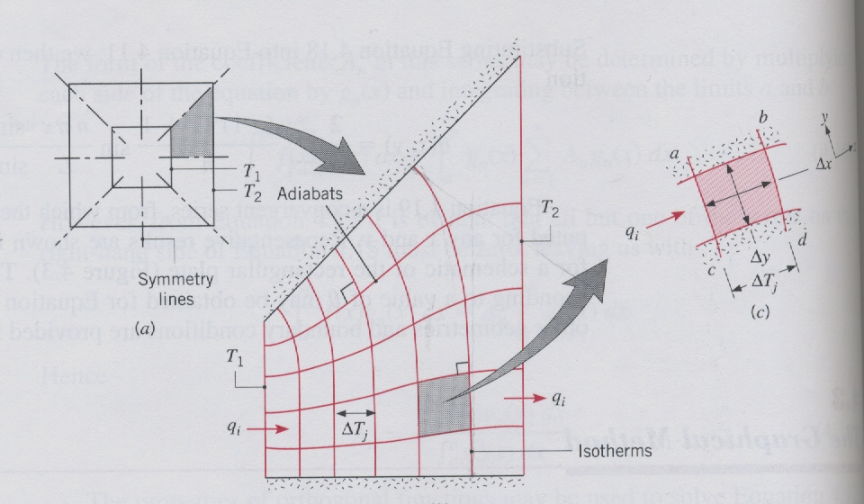
Two dimensional conduction in a square channel of length L. (a) Symmetry planes. (b) Flux plot. (c) Typical curvilinear square.

Slide 17
If properly constructed, q_{i} will be the same for all lanes
M = Number of lanes
Application of Fourier’s law for the approximate square in a lane
For equal temperature increments across the isotherms

Slide 18
If the construction is made with Δx ≈Δy then the heat transfer can be estimated by
The above equation gives the two dimensional conduction shape factor, S, as
S = Ml/N

Slide 19
Accordingly the two-dimensional conduction resistance as
Shape factors have been obtained analytically for numerous two- and three-dimensional systems and the results are summarized in tables.docx. Case 9 is a three dimensional case.
For one dimensional cases, shape factors may also be defined for the familiar shapes as follows:
Plane wall: A/L Cylinder:
Sphere: 4πr₁r₂/(r₂-r₁)

Slide 20
Cases 12 through 15 are for conduction heat rates from isothermal objects at T₁ embedded within an infinite medium of uniform temperature (T₂) and to facilitate the procedure a characteristic length is defined as
L_{c} ≡ (A_{s}/4π)^{1/2}
where A_{s} is the surface area of the object.
Heat transfer rate to the infinite medium is given in terms dimensionless conduction heat rate as
Values which have been determined analytically and numerically are given as cases (12)-(15) in

Slide 21
Table 4.1.
Example 4.1
A metallic electrical wire of diameter d=5mm is to be coated with insulation of thermal conductivity k=0.35 W/m.K. It is expected that, for the typical installation, the coated wire will be exposed to conditions for which the total coefficient associated with convection and radiation is h=15W/m².K. To minimize the temperature rise of the wire due to ohmic heating, the insulation thickness is specified so that the critical insulation radius is achieved. During the wire coating process, however, the insulation thickness sometimes varies around the periphery of the wire, resulting in eccentricity

Slide 22
of the wire relative to the coating. Determine the change in the thermal resistance of the insulation due to an eccentricity that is 50% of the critical insulation thickness.
Figure for example 4.1

Slide 23
Solution
r_{cr} =k/h = 0.35/15= 0.023 m = 23 mm
Critical insulation thickness
t_{cr} = r_{cr} – d/2 = 0.023 – 0.005/2 = 0.021 m = 21 mm
For concentric geometry the thermal resistance is given by
For the eccentric wire, use case 7 where
z=0.5t_{cr} = 0.5 x 0.021 = 0.010 m

Slide 24
= 0.91 m.K/W
The reduction in the thermal resistance of the insulation is 0.09 m.K/W or 9%.

Slide 25
4.4 FIFNITE DIFFERENCE EQUATIONS
Large number of two-dimensional problems involve geometries and/or boundary conditions which makes analytical solutions impossible. The best alternative, in such cases is to use numerical technique such as finite difference, finite element or boundary element method. Due to its ease of application, finite difference method will be treated.
4.4.1 The Nodal Network
Numerical solution enables determination of temperature at only discrete points. This requires subdividing the medium of interest into a number of small regions with reference points at the centers

Slide 26
of the regions as shown in figchp-4\fig4.4.pptx. This reference point is termed as nodal point or node, and the aggregate of points is termed a nodal network, grid, or mesh.
m, n represents the node and the temperature at m, n is a measure of the average temperature of the region (shaded area), in this case represented by T_{m,n}. The temperature distribution shown in (b) is discontinuous. Accuracy of the method depends on how fine the mesh is.

Slide 27
4.4.2 Finite Difference Form of the Heat Equation
Considering the second derivative (∂²T/∂x²) of an interior node, the value of this derivative at the nodal point m, n may be approximated as
The above can be determined as

Slide 28
Substitution in the 2nd derivative gives
Using similar procedures for the y-coordinate will give

Slide 29
Substitution in the differential equation gives
Using a network for which Δx = Δy will give
T_{m,n+1} + T_{m,n-1} + T_{m+1,n} + T_{m-1,n} - 4T_{m,n} = 0
Thus the PDE is reduced to an algebraic equation which gives the temperature at a node as the average of the temperatures of the four neighboring nodes.

Slide 30
4.4.3 The Energy Balance Method
This is an alternative method to develop the finite difference equations for nodes. The approach is more versatile than the one seen before. It uses energy conservation principle and assumes that all heat transfer is into the node as shown in figchp-4\fig4.5.pptx.The analysis will consider heat generation too. For a unit depth

Slide 31
The conduction heat rate from each node can be written as

Slide 32
Using Δx =Δy and substituting in the summation equation will give
T_{m,n+1} + T_{m,n-1} + T_{m+1,n} + T_{m-1,n} - 4T_{m,n} = 0
With no heat generation it gives the same equation.
Equations must also be developed for nodes lying on the boundary surface of the object. The surface may enjoy convection heat transfer as shown in figchp-4\fig4.6.pptx which is an internal corner.
The equations can be developed as

Slide 33
Convection:

Slide 34
With no energy generation and steady-state and network with Δx = Δy
Nodal energy balance equations for several common geometries is given in Table 4.2.
Example 4.2
Using the energy balance method, derive the finite difference equation for the m, n nodal point located on a plane, insulated surface of a medium with

Slide 35
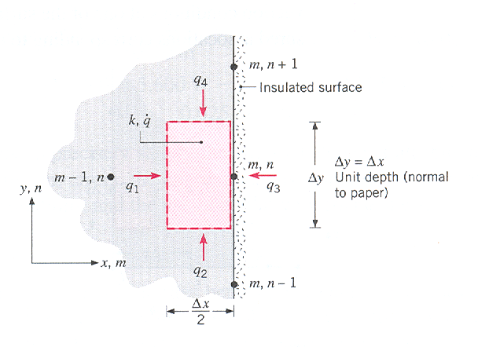
uniform heat generation.

Slide 36
Solution
Using the energy conservation for node m,n

Slide 37
Substituting in the energy balance equation and simplifying gives

Slide 38
The finite difference equations may also be formulated using the thermal resistance concept. For the example of the corner node (internal)
The utility of the resistance can come when considering two nodes of dissimilar materials with a contact resistance between them figchp-4\fig4.7.pptx.

Slide 39
Where
4.5 SOLVING THE FINITE DIFFERENCE EQUATIONS
These equations are the result of the nodal equations. For N-nodal points there will be N equations. The result is N linear algebraic with N unknown temperatures.
Two types of solutions will be dealt with
Direct and iterative

Slide 40
For small equations, direct is suitable while for larger ones, iterative is better.
4.5.1 The Matrix Inversion Method
This is a direct solution. The nodal equations are

Slide 41
Using matrix notation, the above can be written as
[A][T] = [C]
where
,

Slide 42
Since
[A]⁻¹[A] = I , then [A]⁻¹[A][T]= [A]⁻¹[C] or
[T] = [A]⁻¹[C]
If the inverse of A is defined as

Slide 43
The solution then becomes
T₁ = b₁₁C₁ + b₁₂C₂ + … + b_{1N}C_{N}
T₁ = b₁₁C₁ + b₁₂C₂ + … + b_{1N}C_{N}
. . . … .
. . . … .
. . . … .
T₁ = b₁₁C₁ + b₁₂C₂ + … + b_{1N}C_{N}
Matrix inversion can easily be done by calculators and computers. For large equation, this procedure is time consuming.

Slide 44
4.5.2 Gauss-Seidel Iteration
This is an iteration procedure and is good for large equations. The following procedure is followed.
As much as possible, the equations should be reordered to have the largest coefficient at the diagonal for quick convergence.
After reordering, each of the N equations should be written in explicit form as

Slide 45
where i = 1, 2, ….., N. The superscript k refers to the level of iteration.
An initial (k=0) value is assumed for each temperature T_{i}.
Setting k=1 in the equation, values of T_{i}⁽¹⁾ are then calculated by substituting assumed values in the second summation or new values in the first summation. This step is the first (k=1) iteration.
New values of T_{i}^{(k)}are determined from T_{j}^{(k)} values of the current iteration, where 1 ≤ j≤ i-1, and the
T_{j}^{(k-1)} values of the previous iteration, where
i+1 ≤ j ≤N

Slide 46
The iteration is terminated when a prescribed criterion is satisfied.
where ε represents an error margin.
Example 4.3
A large industrial furnace is supported on a long column fire clay brick, which is 1m by 1m on a side. During steady-state operation, installation is such that three surfaces of the column are maintained at 500 K while the remaining surface is exposed to an airstream for which T∞ = 300 K and h = 10 W/m².K. Using a grid of Δx = Δy = 0.25 m, determine the two dimensional

Slide 47
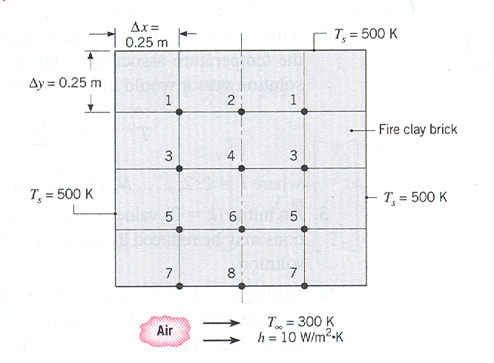
temperature distribution in the column and the heat rate to the airstream per unit length of column.

Slide 48
Solution
There are 12 nodes. By symmetry the unknowns will be reduced to 8.
For interior nodes 1, 2, 3, 4, 5, and 6, the finite difference equations are
Node 1: T₂ +T₃ + 1000 - 4T₁ = 0
Node 2: 2T₁ +T₄ + 500 - 4T₂ = 0
Node 3: T₁ +T₄ + T₅+ 500 - 4T₃ = 0
Node 4: T₂ +2T₃ + T₆ – 4T₄ = 0
Node 5: T₃ +T₆ +T₇ + 500 - 4T₅ = 0
Node 6: T₄ +2T₅ + T₈ - 4T₆ = 0

Slide 49
For the surface nodes 7 and 8, use equation 4.42 using
h Δx/k=2.5
Node 7: 2T₅ + T₈ + 2000 - 9T₇ = 0
Node 8: 2T₆ + 2T₇ + 1500 - 9T₈ = 0

Slide 50
-4T₁ + T₂ + T₃ + 0 + 0 + 0 + 0 + 0 = -1000
2T₁ - 4T₂ + 0 + T₄ + 0 + 0 + 0 + 0 = -500
T₁ + 0 - 4T₃ + T₄ + T₅ + 0 + 0 + 0 = -500
0 + T₂ +2T₃ - 4T₄+ 0 + T₆+ 0 + 0 = 0
0 + 0 + T₃ + 0 -4T₅ +T₆ +T₇ + 0 = -500
0 + 0 + 0 + T₄ +2T₅-4T₆ + 0 + T₈ = 0
0 + 0 + 0 + 0 +2T₅+ 0 -9T₇+ T₈ = -2000
0 + 0 + 0 + 0 + 0 +2T₆+2T₇-9T₈= -1500

Slide 51
In matrix form [A][T]=[C]

Slide 52
The solution given by
[T]=[A]⁻¹[C] is the column vector

Slide 53
The heat transfer from the column to the airstream per unit length will be
To check the solution, the equality of the conduction and convection heat transfers can be checked.

Slide 54
The temperature distribution of the above example can also be determine using the Gauss-Seidel iteration method.
As the equations give a diagonal dominant coefficient matrix, it does not need any reordering. This is a typical behavior of finite difference solutions to conduction problems.
The explicit form of the equation according to step 2 is

Slide 55
With initial assumption at k=0 and convergence criterion of ε=0.2 K, the following table is generated.

Slide 56
The results given in row 8 are in excellent agreement with those obtained by matrix inversion
k | T1 | T2 | T3 | T4 | T5 | T6 | T7 | T8
0 | 480.0 | 470.0 | 440.5 | 430.0 | 400.0 | 390.0 | 370.0 | 350.0
1 | 477.5 | 471.3 | 451.9 | 441.3 | 428.0 | 411.8 | 356.2 | 337.3
2 | 480.8 | 475.7 | 462.5 | 453.1 | 432.6 | 413.9 | 355.8 | 337.7
3 | 484.6 | 480.6 | 467.6 | 457.4 | 434.3 | 415.9 | 356.2 | 338.3
4 | 487.0 | 482.9 | 469.7 | 459.6 | 435.5 | 417.2 | 356.6 | 338.6
5 | 488.4 | 484.0 | 470.8 | 460.7 | 436.1 | 417.9 | 356.7 | 338.8
6 | 488.7 | 484.5 | 471.4 | 461.3 | 436.5 | 418.3 | 356.9 | 338.9
7 | 489.0 | 484.8 | 471.7 | 461.6 | 436.7 | 418.5 | 356.9 | 339.0
8 | 489.1 | 485.0 | 471.9 | 461.8 | 436.8 | 418.6 | 356.9 | 339.0

