Slide 1
AutoCAD
“A Journey Of Thousand Miles begins
With a single step”
By:
Bruck Alemu

Slide 2
CHAPTER 1 Introducing AutoCAD
Aim of this chapter
The contents of this chapter are designed to introduce features of the AutoCAD window and methods of operating AutoCAD.
.

Slide 3
INTRODUCTION
The Word AutoCAD is made up of two words “Auto(logo of company)”and CAD “(computer aided design)”.
AutoCAD is 2D and 3D modeling software.
It is developed by Autodesk company.
Autodesk is an U.S.A based company.
It is widely used in industry for 2D drawing and 3D modeling.
In another way we can say that AutoCAD is a designing course , which is performed by the help of computer.

Slide 4
VERSION OF AUTOCAD
AutoCAD software was firstly launched by Autodesk company in Dec. 1982.
The first version of AutoCAD was R1 after that R2,R3,R4…………… and so on.
In 2000,Autodesk launched a version of AutoCAD 2000 after that 2001,2002…… so on.
This time, we have the latest version of AutoCAD is 2018.
Latest version is easy to use and over come the difficulties of old version.

Slide 5
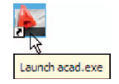
Opening AutoCAD 2010
AutoCAD is designed to work in a Windows operating system. In general, to open AutoCAD , either double-click on the AutoCAD shortcut in the Windows desktop (Fig. 1.1), or right-click on the icon, followed by a left-click on Open in the menu which then appears.
When AutoCAD 20-- is opened a window appears, depending upon whether a Classic AutoCAD, a 3D Modeling or an 2D Drafting & Annotation workspace has been used previously
Fig. 1.1 The AutoCAD shortcut icon on the Windows desktop

Slide 6
Fig. 1.2 T he AutoCAD 2010 2D Drafting and Annotation workspace

Slide 7
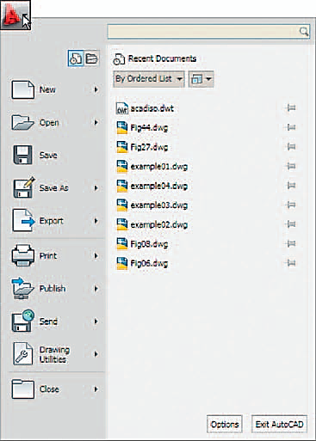
Fig. 1.4 T he Menu Browser

Slide 8
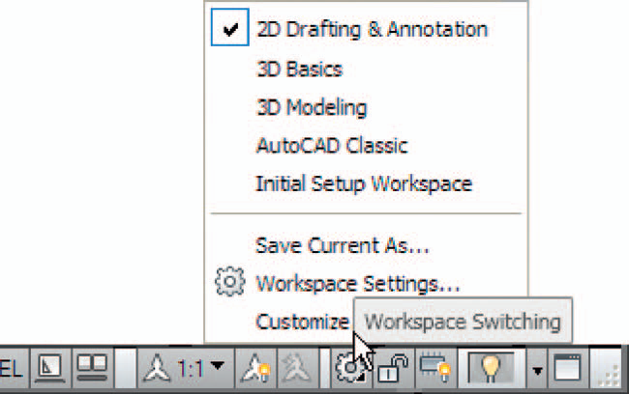
Fig. 1.5 T he Workspace Switching popup menu

Slide 9
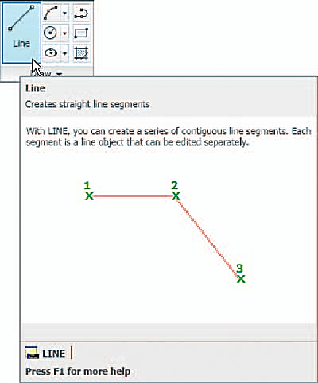
Fig. 1.7 The descriptive tooltip appearing with a click on the
Line tool icon

Slide 10
Fig. 1.8 T he tooltip for the Circle tool and its popup menu

Slide 11
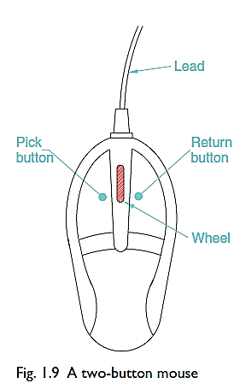
The mouse as a digitiser
Many operators working in AutoCAD will use a two-button mouse as the digitizer (Device for converting analogue signals into digital signals). Fig. shows a mouse which has two
buttons and a wheel. To operate this mouse pressing the Pick button is a left-click.
Pressing the return button is a right-click. Pressing the Return button usually has the same result as pressing the Enter Ekey key of the keyboard. When the wheel is pressed drawings in the AutoCAD screen can be panned. Moving the wheel forward enlarges (zooms in) the drawing on screen. Moving the wheel backwards reduces the size of a drawing.

Slide 12
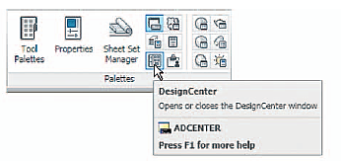
Palettes
A palette has already been shown – the Command palette.
Two palettes which may be frequently used are the Design Center palette and the Properties palette. These can be called to screen from icons in the View/Palettes panel.
Fig. 1.11 A left-click on the View/Design Center icon brings the Design Center palette to screen

Slide 13
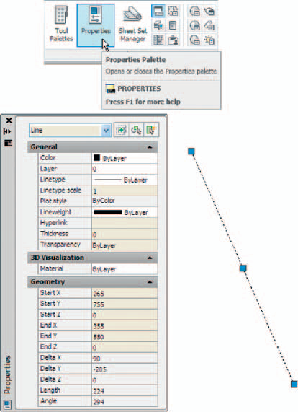
Properties palette:
Fig. 1.12 shows the Properties palette, in which the general features of a selected line are shown. The line can be changed by entering new figures in parts of the palette.

Slide 14
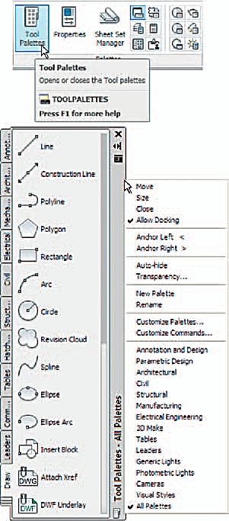
Tool palettes Click on Tool Palettes in the View/Palettes panel and the Tool Palettes –All Palettes
palette appears ( Fig. 1.13 ).

Slide 15
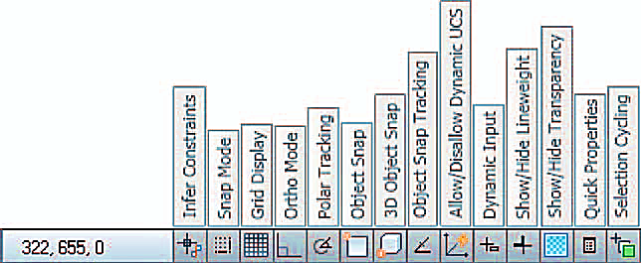
Buttons at the left-hand end of the status bar
Snap Mode : Also toggled using the F9 key. When snap on, the cursor under mouse control can only be moved in jumps from one snap point to another .
Grid Display : Also toggled using the F7 key. When set on, a series of grid points appears in the drawing area .

Slide 16
Ortho Mode : Also toggled using the F8 key. When set on, lines, etc. can only be drawn vertically or horizontally.
Polar Tracking : Also toggled using the F10 key. When set on, a small tip appears showing the direction and length of lines, etc. in degrees and units.
Object Snap : Also toggled using the F3 key. When set on, an osnap icon appears at the cursor pick box .
Object Snap Tracking : Also toggled by the F11 key. When set on, lines, etc. can be drawn at exact coordinate points and precise angles.

Slide 17
The AutoCAD coordinate system
In the AutoCAD 2D coordinate system, units are measured horizontally in terms of X and vertically in terms of Y.
A 2D point in the AutoCAD drawing area can be determined in terms of X,Y where 0,0 is the origin of the system.
3D coordinates include a third coordinate (Z), in which positive Z units are towards the operator as if coming out of the monitor screen and negative Z units going away from the operator as if towards the interior of the screen.

Slide 18
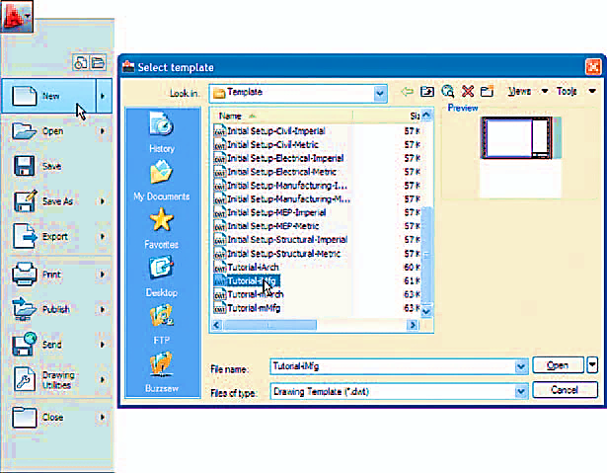
Drawing templates
Drawing templates are files with an extension .dwt . Templates are files which have been saved with predetermined settings – such as Grid spacing and Snap spacing.
Templates can be opened from the Select template dialog called by clicking the New … icon in the Quick Access

Slide 20
Aims of this chapter (part I)
CHAPTER 2
INTRODUCING DRAWING
The contents of this chapter are designed to introduce:
1. The construction of 2D drawing in the Classic AutoCAD workspace.
2. The drawing of simple outlines using the Line, Circle and Polyline tools from the Draw toolbar or the 2D Draw control panel.
3. Drawing to snap points.
4. Drawing to absolute coordinate points.
5. Drawing to relative coordinate points.
6. Drawing using the ‘tracking’ method.
7. The use of the Erase, Undo and Redo tools.

Slide 21
The 2D Classic AutoCAD workspace
Illustrations throughout this chapter will be shown using the AutoCAD Classic workspace.
If the Draw toolbar/2D Draw control panel is on screen, tools can be selected from the panel.
Whether working with the Draw toolbar or the 2D Draw control panel, the sequences and prompts which appear at the command line will be the same.

Slide 22
Drawing with the Line tool
First example – Line tool - absolute coordinate entry
1. Open AutoCAD. The drawing area will show the settings of the acadiso.dwt template – Limits set to 420,297, Grid set to 10, Snap set to 5 and Units set to mm.
2. Left-click on the Line tool in the Draw toolbar
Note
(a) The tooltip which appears when the tool icon is clicked.
(b) The prompt Command:_line Specify first point: which appears in the command window at the command line

Slide 23
3. Make sure Snap is on by either pressing the F9 key or the SNAP button in the status bar. Snap on will show in the command window.
4. Move the mouse around the drawing area. The cursors’ pick box will jump from point to point at 5 unit intervals. The position of the pick box will show as coordinate numbers in the status bar (left-hand end).
Move the mouse until the coordinate numbers show (60,240,0) and press the Pick button of the mouse (left-click)
In the same way (260,240,0), (260,110,0), (60,110,0), (60,240,0). The result is as shown bellow

Slide 24
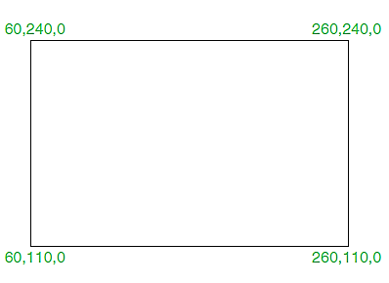
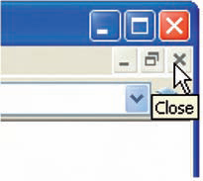
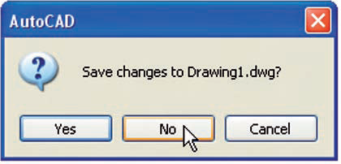
Second example – Line tool - absolute coordinate entry
1. Clear the drawing from the screen with a click on the Close drawing button (Fig. 2.4). Make sure it is not the AutoCAD 20-- window button.
2. The warning window Fig. 2.5 appears in the centre of the screen. Click its No button.

Slide 25
3. . Left-click on New . . . in the File drop-down menu and from the Select template dialog which appears double-click on acadiso.dwt.
4. Left-click on the Line tool icon and enter figures as follows at each prompt of the command line sequence:
Command:_line Specify first point: enter 80,235 right-click
Specify next point or [Undo]: enter #275,235 right-click
Specify next point or [Undo]: enter #295,210 right-click
In the same way enter (295,100), (230,100), (230,70), (120,70),
(120,100), (55,100), (55,210),
. Specify next point or [Close/Undo]: enter c (Close) right-click
Command:
The result is as shown on the next slide

Slide 26
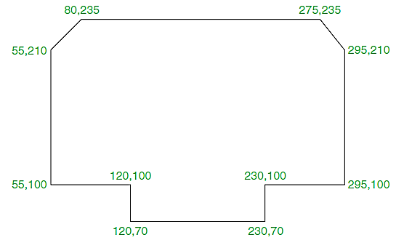
Third example - relative coordinate entry
Left-click on the Line tool icon and enter figures as follows at each prompt of the command line sequence:
Command: line Specify first point: enter 60,210 right-click
Specify next point or [Undo]: enter @50,0 right-click
(@0,20), (@130,0), (@0,-20), (@50,0), (@0,105), (@-50,0), (@0,-20), (@-130,0), (@0,20), (@-50,0),
Specify next point or [Close/Undo]: enter c (Close) right-click
Command: The result is as shown bellow

Slide 27
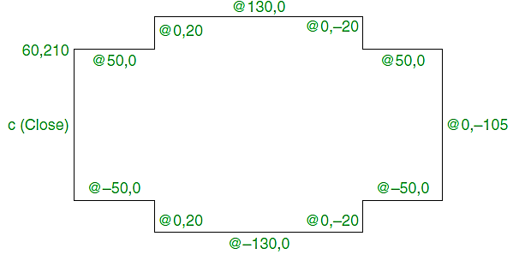
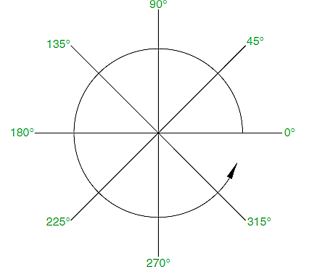
Notes
Coordinate points can be shown as positive or negative numbers.
+ ve x entry is to the right
- ve x entry is to the left
+ ve y entry is upwards
- ve y entry is downwards.
Counter clockwise angles +ve
Clockwise angles –ve

Slide 28
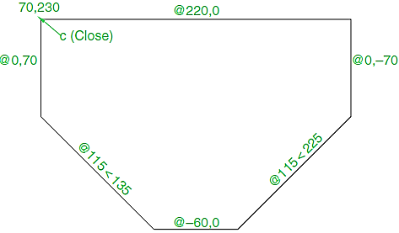
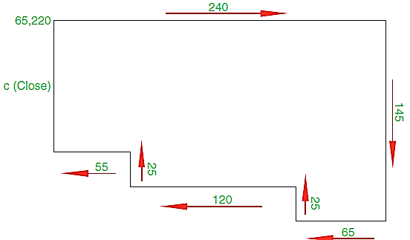

Slide 29
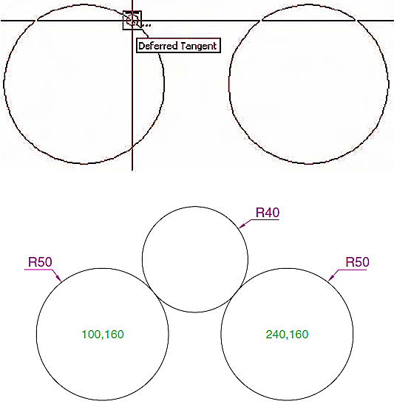
Drawing with the Circle Tool
1. Left-click on the Circle tool icon and construct two circles as shown in the drawing in the positions and with the radii 50
2. Click the Circle tool again and against the first prompt enter t (the abbreviation for the prompt tan tan radius), followed by a right-click.

Slide 30
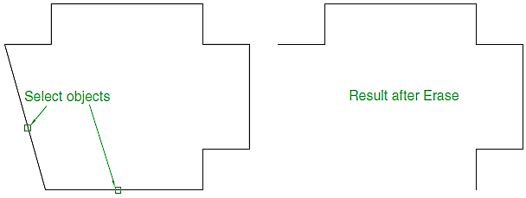
The Erase tool
If an error has been made when using any of the AutoCAD tools, the object or objects which have been incorrectly constructed can be deleted with the Erase tool. The Erase tool icon can be selected from the Modify toolbar or by entering e at the command line.

Slide 31
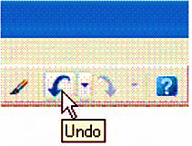
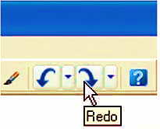
Undo and Redo tools
Two other tools of value when errors have been made are the Undo and Redo tools. To undo the last action taken by any tool when constructing a drawing, either left-click the Undo tool in the Standard toolbar or type u at the command line. No matter which method is adopted the error is deleted from the drawing.
To bring back objects that have just been removed by the use of Undo’s, left-click the Redo tool icon in the Standard toolbar) or enter redo at the command line.

Slide 32
Osnap, AutoSnap and Draw tools
Aims of this session (Part II)
To describe the use of the Arc, Ellipse, Polygon and
Rectangle tools from the Draw toolbar.
2. To describe the uses of the Polyline Edit (pedit) tool.
3. To introduce the AutoSnap system and its uses.
4. To introduce the Object Snap (osnap) system and its uses.
5. To introduce the Dynamic Input (DYN) system and
its uses.

Slide 33
The Arc tool
In AutoCAD, arcs can be constructed using any three of the following characteristics of an arc: its Start point; a point on the arc (Second point); its Center; its End; its Radius; Length of the arc; Direction in which the arc is to be constructed; Angle between lines of the arc.
To call the Arc tool click on its tool icon in the Draw toolbar
or click on Arc in the Draw drop-down menu. A sub-menu shows the possible methods of constructing arcs. The abbreviation for calling the Arc tool is a.

Slide 35
First example – Arc tool
Left-click the Arc tool icon. The command line shows:
Command:_arc Specify start point of arc or [Center]: 100,220
Specify second point of arc or [Center/End]: 55,250
Specify end point of arc: 10,220
Command:
Second example – Arc tool
Command: right-click brings back the Arc sequence
ARC Specify start point of arc or [Center]: c (Center)
Specify center point of arc: 200,190
Specify start point of arc: 260,215
Specify end point of arc or [Angle/chord Length]: 140,215
Command:

Slide 36
Third example – Arc tool
Command: right-click brings back the Arc sequence
ARC Specify start point of arc or [Center]: 420,210
Specify second point of arc or [Center/End]: e (End)
Specify end point of arc: 320,210
Specify center point of arc or [Angle/Direction/Radius]: r (Radius)
Specify radius of arc: 75
Command:

Slide 37
The Ellipse tool
Ellipses can be regarded as what is seen when a circle is viewed from directly in front of the circle and the circle rotated through an angle about its horizontal diameter. Ellipses are measured in terms of two axes – a major axis and a minor axis; the major axis being the diameter of the circle and the minor axis being the height of the ellipse after the circle has been rotated through an angle.

Slide 38
To call the Ellipse tool, click on its tool icon in the Draw toolbar or click its name in the Draw drop-down menu. The abbreviation for calling the Ellipse tool is el.
First example – Ellipse
Left-click the Ellipse tool icon. The command line shows Command:_ellipse
Specify axis endpoint of elliptical arc or [Center]: 30,190
Specify other endpoint of axis: 150,190
Specify distance to other axis or [Rotation]: 25
Command:
Second example – Ellipse
Command: right-click ELLIPSE
Specify axis endpoint of elliptical arc or [Center]: c
Specify center of ellipse: 260,190
Specify endpoint of axis: 205,190
Specify distance to other axis or [Rotation]: 30
Command:

Slide 39
Third example – Ellipse
In this third example, after setting the positions of the ends of the major axis, the angle of rotation of the circle from which an ellipse can be obtained is entered.
Command: right-click ELLIPSE
Specify axis endpoint of elliptical arc or [Center]: 30,100
Specify other endpoint of axis: 120,100
Specify distance to other axis or [Rotation]: r (Rotation)
Specify rotation around major axis: 45
Command:

Slide 40
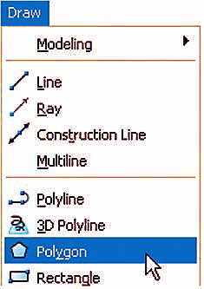
Polygon tool
First example – Polygon tool
Call the Polygon tool – either with a click on its tool icon in the 2D Draw control panel, by entering pol or polygon at the command line. Or it can be called from the Draw drop-down menu . The command line shows:
Command:_polygon Enter number of sides 4: 6
Specify center of polygon or [Edge]: 60,210
Enter an option [Inscribed in circle/Circumscribed
about circle] I: right-click (accept Inscribed)
Specify radius of circle: 60
Command:
2. In the same manner construct a 5-sided polygon of centre 200,210 and radius 60.

Slide 41
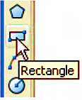
Second example – Rectangle tool
Call the Rectangle tool – either with a click on its tool icon in the Draw toolbar or by entering rec or rectangle at the command line. Or it can be called from the Draw drop-down menu. The command line shows:
Command:_rectangle
Specify first corner point or [Chamfer/Elevation/Fillet/Thickness/ Width]: 25,240
Specify other corner point or [Area/Dimensions/Rotation]: 160,160
Command:

Slide 42
Osnap, AutoSnap and Dynamic Input
In previous chapters several methods of constructing accurate drawings have been described – using Snap; absolute coordinate entry; relative coordinate entry and tracking. Other methods of ensuring accuracy between parts of constructions are by making use of Object Snaps (Osnaps), AutoSnap and Dynamic Input (DYN).
Snap, Grid, Osnap and DYN can be set from the buttons in the status bar or by pressing the keys F3 (Osnap), F7 (Grid), F9 (Snap) and F12 (DYN).
Object Snaps (Osnaps)
Osnaps allow objects to be added to a drawing at precise positions in relation to other objects already on screen. With osnaps, objects can be added to the end points, mid points, to intersections of objects, to centres and quadrants of circles, etc

Slide 43
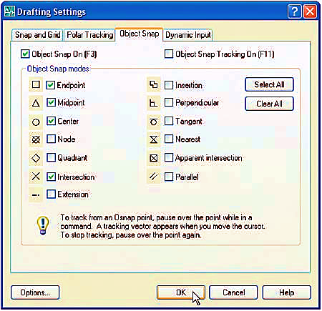
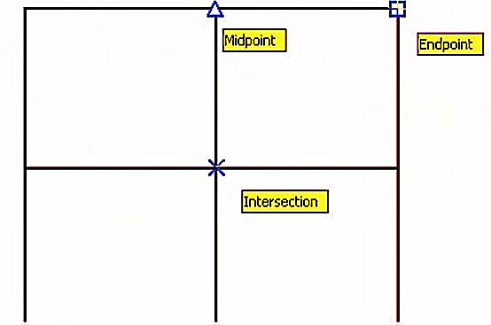
To set Osnaps, at the command line:
Command: enter os
And the Drafting Settings dialog appears. Click the Object Snap tab in the upper part of the dialog and click in each of the check boxes.

Slide 44
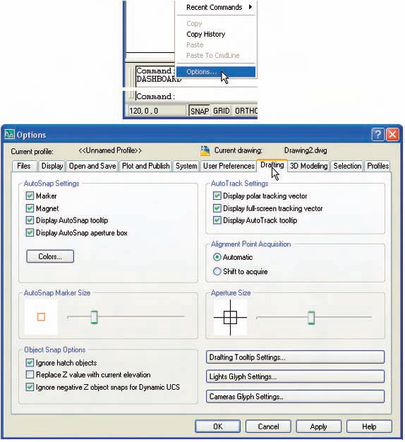
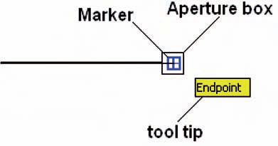
Using AutoSnap
AutoSnap is similar to Osnap. To set AutoSnap, right-click in the command window and from the menu which appears click Options . . . The Options dialog appears. Click the Drafting tab in the upper part of the dialog and set the check boxes against the AutoSnap Settings on (tick in boxes). OSNAP must be set ON for the AutoSnap features to show when constructing
a drawing with their aid.

Slide 45
Dynamic Input
When DYN is set on by either pressing the F12 key or with a click on the DYN button in the status bar, dimensions, coordinate positions and commands appear as tips when no tool is in action
With a tool in action, as the cursor hairs are moved in response to movement of the mouse, DYN tips showing the coordinate figures for the point of the cursor hairs will show, together with other details.
To see the drop-down menu giving the prompts available with DYN press the down key of the keyboard and click the prompt to be used. Fig. below shows the Arc prompt as being the next to be used.

Slide 46
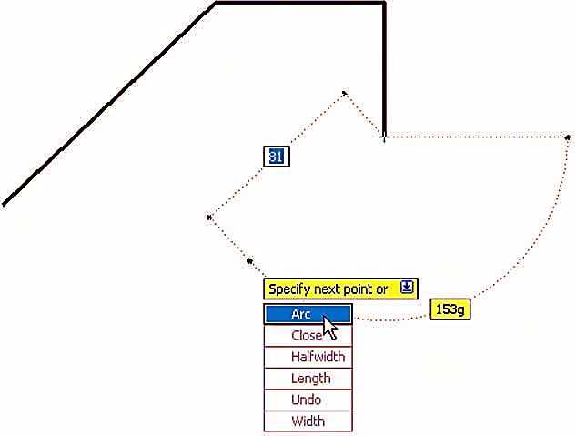
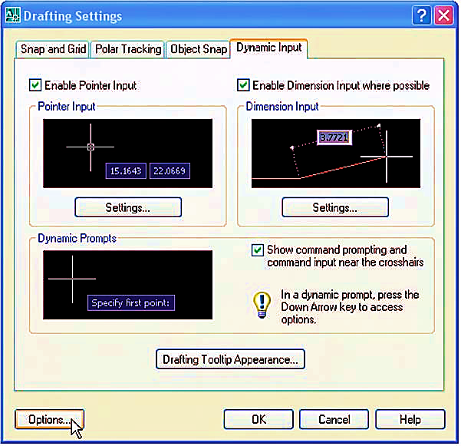

Slide 47
Drawing with the Polyline tool
First Example
Left-click the Polyline tool icon. The command line shows:
Command:_pline Specify start point: 50,220
Current line width is 0
[prompts]: w (Width)
Specify starting width 0: 0.5
Specify ending width 0.5: right-click
Specify next point or [prompts]: 120,220
Specify next point or [prompts]: a (Arc)
Specify end point of arc or [prompts]: s (second pt)
Specify second point on arc: 150,200
Specify end point of arc: 180,220
Specify end point of arc or [prompts]: l (Line)
Specify next point or [prompts]: 250,220

Slide 48
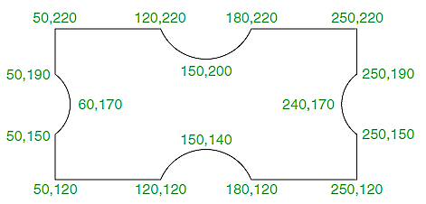
Specify next point or [prompts]: 250,190
Specify next point or [prompts]: a (Arc)
Specify end point of arc or [prompts]: s (second pt)
Specify second point on arc: 240,170
Specify end point of arc: 250,150
Specify end point of arc or [prompts]: l (Line)
Specify next point or [prompts]: 250,150
Specify next point or [prompts]: 250,120
And so on until the outline in Fig. below is completed.

Slide 49
Second example
Left-click the Polyline tool icon. The command line shows:
Command: pline Specify start point: 60,180
Current line width is 0
Specify next point or [prompts]: w (Width)
Specify starting width 0: 1
Specify ending width 1: right-click
Specify next point or [prompts]: 190,180
Specify next point or [prompts]: w (Width)
Specify starting width 1: 20
Specify ending width 20: 0
Specify next point or [prompts]: 265,180
Specify next point or [prompt]: right-click
Command:

Slide 50
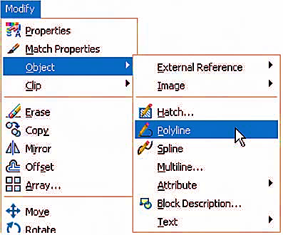
The Polyline Edit tool

Slide 51
An example of using DYN
This is a simple example of how DYN can be used to construct drawings in a Clear Screen workspace.
1. Turn DYN on with a click on its button in the status bar.
2. Turn OSNAP off with a click at the status bar.
3. Click the Clear Screen button at the bottom-right of the AutoCAD 20-- screen.
4. Enter commandlinehide to hide the command palette.
5. Enter pl (for Polyline) at the keyboard followed by pressing Return.
6. Enter 100,100 Return.
7. Enter 250,0 Return.
8. Enter 0,135 Return.
9. Enter -250,0 Return.
10. Enter 0,-50 Return.

Slide 52
11. Enter 80,0 Return.
12. Enter 0,-35 Return.
13. Enter -80,0 Return.
14. Enter c Return.
15. Enter pe (for Polyline Edit) Return.
16. Press the down arrow key of the keyboard.
17. In the menu which appears click Width Return.
18. Click on the pline just drawn and enter 2 Return.
The result is shown below

Slide 53
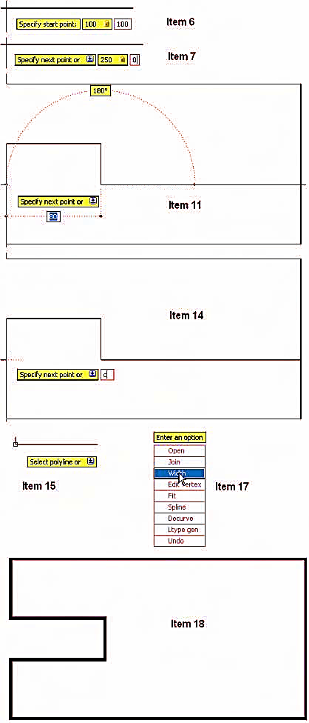

Slide 55
The Modify tools
Aim of this chapter
To describe the uses of tools for modifying parts of drawings.
Introduction
These tools are among the most frequently used tools of AutoCAD. Their tool icons are found in the Modify drop-down menu or in the Modify toolbar in the 2D Classic AutoCAD workspace or in the lower set of tool icons in the Draw control panel.

Slide 56
The Copy tool
Example – Copy
1. Construct Fig below using Polyline. Without dimension
2. Call the Copy tool – either left-click on its tool icon in the Modify toolbar, or pick Copy from the Modify drop-down menu, or enter cp or copy at the command line, or left-click its tool icon in the 2D Draw control panel. The command line shows:
Command:_copy
Select objects: pick the cross 1 found
Select objects: right-click
Specify base point or [Displacement] Displacement: end of pick
Specify second point of displacement or use first point as displacement: pick
Specify second point or [Exit/Undo] Exit: right-click
Command:
The result is given in Fig. as shown below

Slide 57
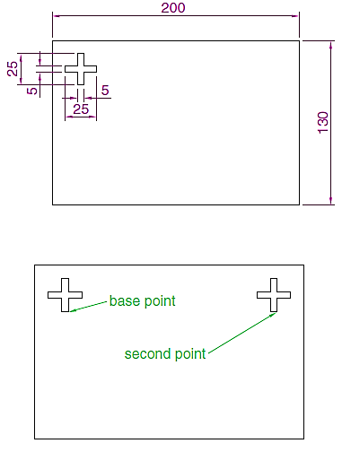

Slide 58
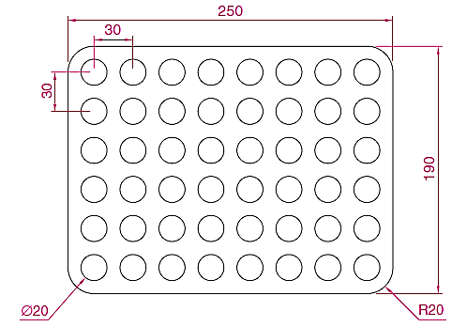

Slide 59
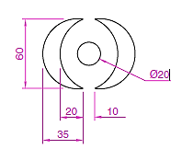

Slide 60
The Mirror tool
First example – Mirror
1. Construct the outline in Fig. below using Line and Arc tools.
2. Call the Mirror tool – either left-click on its tool icon in the Modify toolbar, or pick Mirror from the Modify drop-down menu, or enter mi or Mirror at the command line. The command line shows:
Command:_mirror
Select objects: pick first corner Specify opposite corner: pick 7 found
Select objects: right-click
Specify first point of mirror line: end of pick
Specify second point of mirror line: end of pick Delete source objects [Yes/No] N: right-click
Command:
The result is shown in Fig.

Slide 61
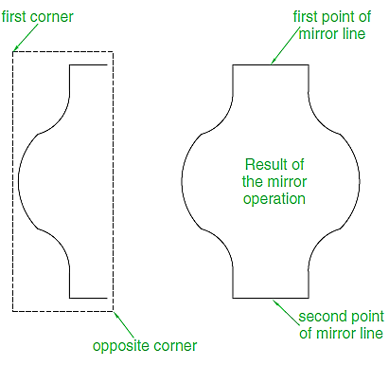

Slide 62
The Offset tool
Examples – Offset
1. Construct the four outlines shown in Fig. 1 below.
2. Call the Offset tool – either left-click its tool icon in the 2D Draw control panel, or pick the tool name in the Modify dropdown menu, or enter o or offset at the command line. The command line shows:
Command:_offset
Current settings: Erase sourceNo LayerSource OFFSETGAPTYPE 0
Specify offset distance or [Through/Erase/Layer] Through: 10
Select object to offset or [Exit/Undo] Exit: pick drawing 1
Specify point on side to offset or [Exit/Multiple/Undo] Exit: pick inside the rectangle
Select object to offset or [Exit/Undo] Exit: right-click
Command:
3. Repeat the same for drawings 2, 3 and 4 in Fig. as shown below

Slide 63
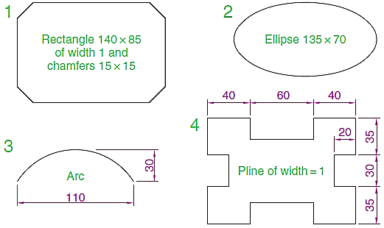
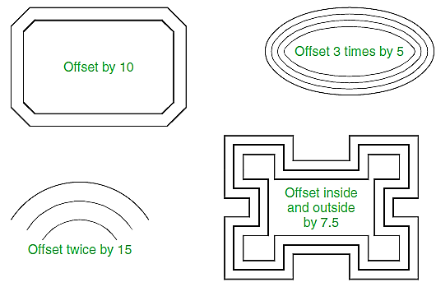

Slide 64
The Array tool

Slide 66
Row offset field – enter 50 (note the minus sign)
Column offset field – enter 50
4. Click the Select objects button and the dialog disappears. Window the drawing. The dialog reappears.
5. Click the Preview button. The dialog disappears and the array appears with a warning dialog in the centre of the array.
6. If satisfied click the Accept button. If not click the Modify button and make revisions to the Array dialog fields.

Slide 67
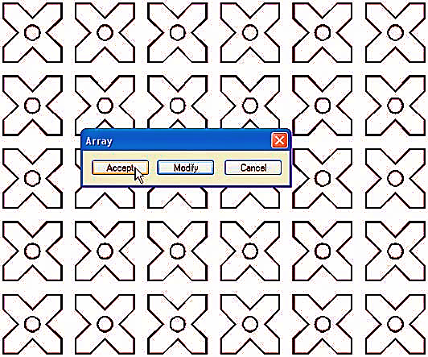

Slide 68
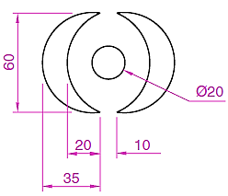
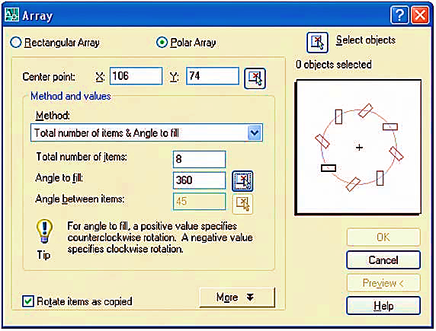
Second example – Polar Array
1. Construct the drawing in below.
2. Call Array. The Array dialog appears. Make settings as shown in Fig.

Slide 69
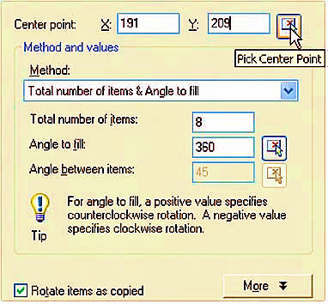
3. Click the Select objects button of the dialog and window the drawing. The dialog returns to screen. Click the Pick Center Point button and when the dialog disappears, pick a centre point for the array.
4. The dialog reappears. Click its Preview button and when the array appears with its warning dialog, if satisfied with the result, click the Accept button of this dialog.

Slide 70
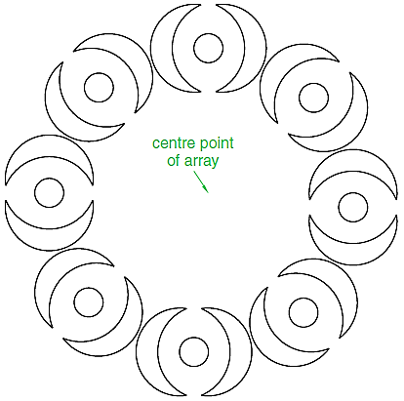

Slide 71
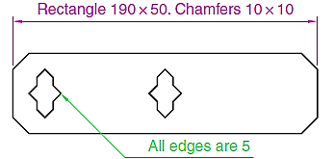
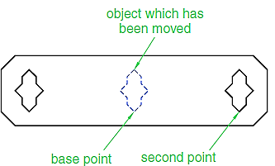
The Move tool
1. Construct the drawing in left Fig. below
2. Call Move – either click the Move tool icon in the Modify toolbar, or pick Move from the Modify drop-down menu, or enter m or move at the command line, which then shows:
Command:_move
Select objects: pick the shape in the middle of the drawing 1 found
Select objects: right-click
Specify base point or [Displacement] Displacement: pick
Specify second point or use first point as displacement: pick
Command:
The result is given in right Fig. above.

Slide 72
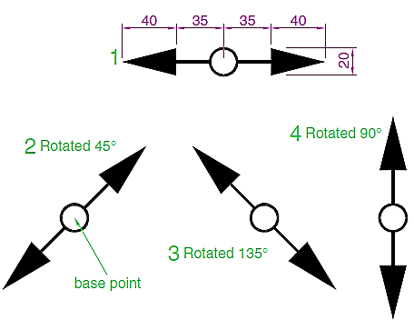
The Rotate tool
When using the Rotate tool remember that the default rotation of objects within AutoCAD is counterclockwise (anticlockwise).

Slide 73
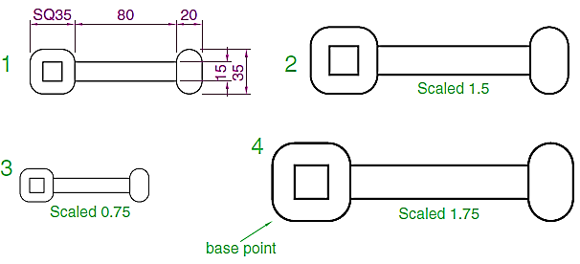
The Scale tool

Slide 74
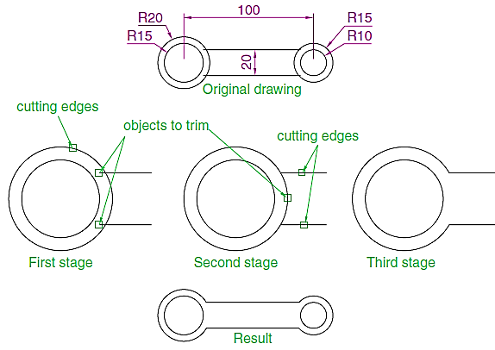
The Trim tool
This tool is one which will be frequently used for the construction of drawings.

Slide 75
Break tool
Examples – Break
1. Construct the rectangle, arc and circle
2. Call Break – either click its tool icon in the Modify toolbar, or click Break from the Modify drop-down menu, or enter br or break at the command line, which then shows as given below.
For drawings 1 and 2
Command:_break Select object pick at the point
Specify second break point or [First point]: pick
Command:
For drawing 3
Command:_break Select object pick at the point
Specify second break point or [First point]: enter f right-click
Specify first break point: pick
Specify second break point: pick
Command:
The results are shown below

Slide 76
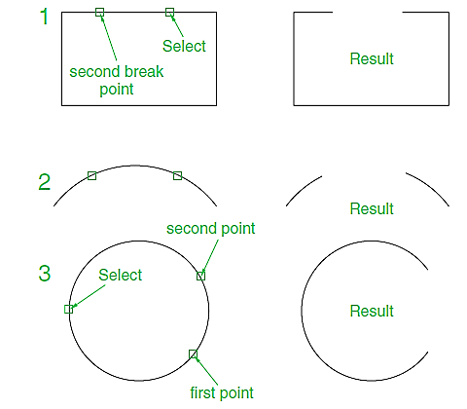
Note: Remember that the default rotation of AutoCAD is counterclockwise. This applies to the use of the Break tool.

Slide 77
The Extend tool

Slide 78
The Chamfer and Fillet tools
There are similarities in the prompt sequences for these two tools.
The major difference is that two settings (Dist1 and Dist2) are
required for a chamfer, but only one (Radius) for the fillet.
Chamfer
Command:_chamfer
(TRIM mode) Current chamfer Dist11, Dist21
Select first line or[Undo/Polyline/Distance
/Angle/Trim/mEthod/ Multiple]: enter d (Distance) right-click
Specify first chamfer distance 1: 10
Specify second chamfer distance 10: right-click
Command:

Slide 79
Fillet
Command:_fillet
Current settings: ModeTRIM, Radius1
Select first object or [Polyline/Radius
/Trim/mUltiple]: enter r (Radius) right-click
Specify fillet radius 1: 15
Command:

Slide 80
Hatching
There are a large number of hatch patterns available when hatching drawings in AutoCAD. Some examples from the Other Predefined set of hatch patterns (Fig. below).
Other hatch patterns can be selected from the ISO or ANSI hatch pattern palettes, or the operator can design their own hatch patterns and save them to the Custom hatch palette.

Slide 81
First example – hatching a sectional view
Fig. below shows a two-view orthographic projection which includes a sectional end view. Note the following in the drawing:
1. The section plane line, consisting of a centre line with its ends marked A and an arrow showing the direction of viewing to obtain the sectional view.

Slide 82
2. The sectional view labeled with the letters of the section plane line.
3. The cut surfaces of the sectional view hatched with the ANSI31 hatch pattern, which is in general use for the hatching of engineering drawing sections.
Second example – hatching rules
Fig. below describes the stages in hatching a sectional end view of a lathe tool holder. Note the following in the section:
1. There are two angles of hatching to differentiate in separate parts of the section.
2. The section follows the general rule that parts such as screws, bolts, nuts, rivets, other cylindrical objects, webs and ribs and other such features are shown within sections as outside views.

Slide 85
Dimensions and Text
Aims of this chapter
1. To describe the variety of methods of dimensioning drawings.
2. To describe methods of adding text to drawings.
Introduction
First we have to set a dimension style (Like My_Style) for our drawing template, then we can commence adding dimensions to drawings using this dimension style.
The Dimension tools
There are several ways in which the dimension tools can be called.
1. Click Dimension in the menu bar. Tools can be selected from the
drop-down menu which appears (Fig. Below).

Slide 87
Any one of these methods can be used when dimensioning a drawing, but some operators may well decide to use a combination of the four methods.
Adding dimensions using the tools
First example – Linear Dimension
1. Construct a rectangle 180 110 using the Polyline tool.
2. Left-click on the Linear Dimension tool icon in the Command Tools
palette or on Linear in the Dimension toolbar (Fig. Above).
The command line shows:

Slide 88
Command:_dimlinear
Specify first extension line origin or [select object]: pick
Specify second extension line origin: pick
Specify dimension line location or [Mtext/Text/Angle/Horizontal/
Vertical/Rotated]: pick
Dimension text 180
Command:
Follow exactly the same procedure for the 110 dimension.

Slide 89
Notes
1. If necessary use Osnaps to locate the extension line locations.
2. The prompt Specify first extension line origin or [select object]: also allows the line being dimensioned to be picked.
Second example – Aligned Dimension

Slide 90
Third example – Radius Dimension

Slide 91
Adding dimensions from the command line
In the flyout from the Linear tool icon it will be seen that there are some dimension tools from this flyout which have not been described in examples. Some operators may prefer entering dimensions from the command line. This involves abbreviations for the required dimension
such as:
For Linear Dimension – hor (horizontal) or ve (vertical)
For Aligned Dimension – al
For Radius Dimension – ra
For Diameter Dimension – d
For Angular Dimension – an
For Dimension Text Edit – te
For Quick Leader – I
And to exit from the dimension commands – e (Exit).

Slide 92
First example – hor and ve (Horizontal and vertical)
1. Construct the outline in Fig. below using the Line tool.
2. At the command line enter dim. The command line will show:
Command: enter dim right-click
Dim: enter hor (horizontal) right-click
Specify first extension line origin or
select object: pick
Specify second extension line origin: pick
Specify dimension line location or [Mtext/
Text/Angle]: pick
Enter dimension text 50: right-click
Dim: right-click
HORIZONTAL
Specify first extension line origin or select object: pick
Specify second extension line origin: pick
Specify dimension line location or [Mtext/Text/Angle/Horizontal/
Vertical/Rotated]: pick
Enter dimension text 140: right-click
Dim: right-click

Slide 93
3. Continue to add the right-hand 50 dimension. Then when the command line shows:
Dim: enter ve (vertical) right-click
Specify first extension line origin or select object: pick
Specify second extension line origin: pick
Specify dimension line location or [Mtext/Text/Angle/Horizontal/
Vertical/Rotated]: pick
Dimension text 20: right-click
Dim: right-click
VERTICAL
Specify first extension line origin or select object: pick
Specify second extension line origin: pick
Specify dimension line location
or [Mtext/Text/Angle/Horizontal/
Vertical/Rotated]: pick
Dimension text 100: right-click
Dim: enter e (Exit) right-click
Command:
The result is shown in Fig. .

Slide 94
Second example – an (Angular)
Construct the outline in Fig. below – a pline of width1.
2. At the command line:
Command: enter dim right-click
Dim: enter an right-click
Select arc, circle, line or specify vertex: pick
Select second line: pick
Specify dimension arc line location or [Mtext/Text/Angle]: pick
Enter dimension 90: right-click
Enter text location
(or press ENTER): pick
Dim:

Slide 95
Third example – I (Leader)
1. Construct Fig. below
2. At the command line:
Command: enter dim right-click
Dim: enter I (Leader) right-click
Leader start: enter nea (osnap nearest) right-click to pick one of the
chamfer lines
To point: pick
To point: pick
To point: right-click
Dimension text 0: enter
CHA 10 10 right-click
Dim: right-click

Slide 96
Symbols used in text
When text has to be added by entering letters and figures as part of a dimension, the following symbols must be used:
To obtain Ø75 enter %%c75
To obtain 55% enter 55%%%
To obtain +0.05 enter %%p0.05
To obtain 90° enter 90%%d.
Dimension Text Edit
The Arc Length tool
the Jogged tool

Slide 98
Blocks and Inserts
Aims of this chapter
1. To describe the construction of blocks and wblocks (written blocks).
2. To introduce the insertion of blocks and wblocks into other drawings.
3. To introduce the use of the DesignCenter palette.
4. To explain the use of the Explode and Purge tools.
Introduction
Blocks are drawings which can be inserted into other drawings. Blocks are contained in the data of the drawing in which they have been constructed. Wblocks (written blocks) are saved as drawings in their own right, but can be inserted into other drawings if required.

Slide 99
First example – Blocks (Fig. 9.3)
1. Construct the building symbols as shown in Fig. 9.1 to a scale of 1:50.
2. Left-click the Make Block tool (Fig. 9.2). The Block Definition dialog (Fig. 9.3) appears. To make a block from the Double bed symbol drawing:
(a) Enter double bed in the Name field.
(b) Click the Select objects button. The dialog disappears. Window the drawing of the double bed. The dialog reappears. Note the icon of the double bed in the top right-hand corner of the dialog.

Slide 100
(c) Click the Pick point button. The dialog disappears. Click a point on the double bed drawing to determine its insertion point. The dialog reappears. Note that the coordinates of the insertion point appears in the Base point area of the dialog.
(d) If thought necessary enter a description in the Description field of the dialog. The drawing is now saved as a block in the drawing. Fig. 9.3 The Block Definition dialog with entries for the double bed Fig. 9.4

Slide 102
Inserting blocks into a drawing
There are two methods by which symbols saved as blocks can be inserted into another drawing.
Example – first method of inserting blocks
Ensuring that all the symbols saved as blocks using the Make Block
tool are saved in the
data of the drawing in
which the symbols
were constructed,
erase the drawings
of the symbols and
in their place
construct the outline
of the plan of a
bungalow to a scale of
1:50 (Fig. 9.5). Then:

Slide 103
Left-click the Block tool icon in the 2D Draw control panel or the Insert Block tool in the Draw toolbar (Fig. 9.6). The Insert dialog appears on screen (Fig. 9.7). From the Name popup list select the name of the block which is to be inserted, in this example the 2.5 window.
2. Make sure the check box against Explode is off (no tick in box). Click the dialog’s OK button, the dialog disappears. The symbol drawing appears with its insertion point at the intersection of the cursor hairs ready to be dragged into its position in the plan drawing.

Slide 104
3. Once all the block drawings are placed, their positions can be adjusted. Blocks are single objects and can thus be dragged into new positions as required under mouse control. Their angle of position can be amended at the command line, which shows:
Command:
INSERT
Specify insertion point or [Basepoint/Scale/X/Y/Z/Rotate/PScale/
PX/PY/PZ/PRotate]: enter r (Rotate) right-click
Specify insertion angle: enter 180 right-click
Specify insertion point: pick
Command:
Selection from these prompts allows scaling, stretching along any axis, previewing, etc. as the block is inserted.
4. Insert all necessary blocks and add other details as required to the plan outline drawing. The result is given in Fig. 9.8.

Slide 106
Example – second method of inserting blocks
1. Save the drawing which includes all the blocks to a suitable file name (building_symbols.dwg). Remember this drawing includes data of the blocks in its file.
2. Left-click DesignCenter in the Palettes sub-menu of the Tools dropdown menu (Fig. 9.9). The DesignCenter palette appears on screen (Fig. 9.10).

Slide 107
3. With the outline plan (Fig. 9.5) on screen the symbols can all be dragged into position from the DesignCenter.

Slide 108
Notes about DesignCenter palette
1. As with other palettes, the DesignCenter palette can be re-sized by dragging the palette to a new size from its edges or corners.
2. Clicks on one of the three icons at the top-right corner of the palette (Fig. 9.11) have the following results:
(a) Tree View Toggle – changes from showing two areas – a Folder
List and icons of the blocks within a file – to a single area showing
the block icons.
(b) Preview – a click on the icon opens a small area at the base of the palette showing an enlarged view of the selected block icon (Fig. 9.12).
(c) Description – a click on the
icon opens another small area
with a description of the block.

Slide 110
Wblocks
Wblocks or written blocks are saved as drawing files in their own right and are not part of the drawing in which they have been saved.
Example – wblock
1. Construct a light emitting diode (LED) symbol and enter w at the command line. The Write Block dialog appears (Fig. 9.20).

Slide 111
2. Click the button marked with three dots (. . .) to the right of the File name and path field and from the Browse for Drawing File dialog which comes to screen select an appropriate directory. The directory name appears in the File name and path field. Add LED.dwg at the end of the name.
3. Make sure the Insert units is set to Millimeters in its popup list.
4. Click the Select objects button, window the symbol drawing and when the dialog reappears, click the Pick point button, followed by selecting the left-hand end of the symbol.
5. Finally click the OK button of the dialog and the symbol is saved in its selected directory as a drawing file LED.dwg in its own right.

Slide 112
Note on the Design Center
Drawings can be inserted into the AutoCAD window from the Design- Center by dragging the icon representing the drawing into the window (Fig. 9.21).

Slide 113
When such a drawing is dragged into the AutoCAD window, the command line shows a sequence such as:
Command:_INSERT Enter block name or [?] Fig26: ‘Chapter07\ inserts\Fig25.dwg’
Specify insertion point or [prompts]: pick
Enter X scale factor 1: right-click
Enter Y scale factor use X scale factor: right-click
Specify rotation angle 0: right-click
Command:

Slide 115
Drawing Organization Layers

Slide 116
Introduction
Imagine a filing system that has only one category into which you put all your records.
However, as soon as you start to accumulate more documents, you would want to start separating them into meaningful categories, perhaps alphabetically or by their use, so you could find them more easily.
The same is true for drawings.
If you have a simple drawing with only a few objects, you can get by without using layers.
But as soon as your drawing gets the least bit complicated, you will want to start sorting your objects into layers to keep track of what is what.

Slide 117
Introduction Cont’d …
In this chapter, you will learn how to create and use layers to keep your drawings organized.
In this chapter, you will learn to do the following:
Organize information with layers
Control layer visibility
Keep track of blocks and layers

Slide 118
Organizing Information with Layers
You can think of layers as overlays on which you keep various types of information
In a floor plan of a building, for example, you want to keep the walls, ceiling, plumbing fixtures, wiring, and furniture separate so that you can display or plot them individually or combine them in different ways.
It is also a good idea to keep notes and reference symbols, as well as the drawing’s dimensions, on their own layers.
As your drawing becomes more complex, you can turn the various layers on and off to allow easier display and modification.

Slide 119
Cont’d …
For example, one of your consultants might need a plot of just the dimensions and walls, without all the other information; another consultant might need only a furniture layout.
With AutoCAD, you can turn off the layers you don’t need and plot a drawing containing only the required information.

Slide 120
Creating and Assigning Layers
You will start your exploration of layers by using a palette to create a new layer, giving it a name, and assigning it a color.
Then you will look at alternate ways of creating a layer through the command line.
Next you will assign the new layer to the objects in your drawing.
1. Open a new AutoCAD.
2. To display the Layer Properties Manager, click the Layer Properties tool in the Home tab’s Layers panel, or type LA and enter to use the keyboard shortcut.

Slide 121
Cont’d …
3. Click the New Layer button at the top of the palette. The button has an icon that looks like a star next to a sheet.
4. Type Wall. As you type, your entry replaces the Layer1 name in the list box.
5. With the Wall layer name highlighted, click the Color icon in the Wall layer listing to display a dialog box in which you can assign a color to the Wall layer. The Color icon can be found under the Color column and currently shows White as its value. The icon is just to the left of the word white.

Slide 122
Cont’d …
6. In the row of standard colors next to the ByLayer button, click the green square, and then click OK. Notice that the color swatch in the Wall layer listing is now green.
7. Click the X at the top of the Layer Properties Manager’s title bar to close it.
From this point on, any object assigned to the Wall layer will appear green unless the object is specifically assigned a different color.

Slide 123
Understanding the Layer Properties Manager Palette
The bar at the top of the list of layers offers several buttons for the various layer properties.
Above the layer list, you can see four tool buttons.
The tool next to the New Layer tool, the New Layer VP Frozen in All Viewports tool, looks similar to the New Layer tool and performs a similar function. The main difference is that the New Layer VP Frozen tool freezes the newly created layer.
To delete layers, you select a layer or group of layers and then click the Delete Layer tool. Be aware that you can’t delete layer 0, locked layers, or layers that contain objects.
The Set Current tool enables you to set the current layer, the one on which you want to work.

Slide 124
Controlling Layers through the Layer Command
you can also control layers through the Command prompt.
Use these steps to control layers through the Command prompt:
1. Press the Esc key to make sure any current command is canceled.
2. At the Command prompt, enter –Layer↵. Make sure you include the minus sign in front of the word Layer. The following prompt appears:
Enter an option
[?/Make/Set/New/Rename/ON/OFF/Color/Ltype/LWeight/TRansparency/MATerial/ Plot/Freeze/Thaw/LOck/Unlock/stAte/ Description/rEconcile]:
You’ll learn about many of the options in this prompt as you work through this chapter.
3. Enter N↵ to select the New option.
4. At the Enter name list for new layer(s): prompt, enter Wall2↵. The [?/Make/Set/ New/Rename/ON/OFF/Color/Ltype/LWeight/TRansparency/MATerial/Plot/Freeze/ Thaw/LOck/Unlock/stAte/rEconcile]: prompt appears again.
5. Enter C↵.

Slide 125
Cont’d …
6. At the New color [Truecolor/COlorbook]: prompt, enter Yellow↵. Or, you can enter 2↵, the numeric equivalent of the color yellow in AutoCAD.
7. At the Enter name list of layer(s) for color 2 (yellow) <0>: prompt, enter Wall2↵. The [?/Make/Set/New/Rename/ON/OFF/Color/Ltype/LWeight/TRansparency/MATerial/Plot/Freeze/Thaw/LOck/Unlock/stAte/rEconcile]: prompt appears again.
8. Press ↵ to exit the Layer command.
Each method of controlling layers has its own advantages.
The Layer Properties Manager offers more information about your layers at a glance.
On the other hand, the Layer command offers a quick way to control and create layers if you’re in a hurry.

Slide 126
Assigning Layers to Objects
When you create an object, that object is assigned to the current layer. Until now, only one layer has existed—layer 0—and it contains all the objects you’ve drawn so far.
Now that you’ve created some new layers, you can reassign objects to them by using the Properties palette: to show the steps let’s use the drawing in the following figure

Slide 127
Cont’d …
1. Select the four lines that represent the bathroom walls. If you have trouble singling out the wall to the left, use a window to select the wall line.
2. With the cursor in the drawing area, right-click and choose Properties from the shortcut menu to open the Properties palette. This palette lets you modify the properties of an object or a set of objects. (See the upcoming sidebar “Understanding Object Properties.”)
3. Click the Layer option on the list in the Properties palette. Notice that an arrow appears in the layer name to the right of the Layer option.
4. Click the downward-pointing arrow to the far right of the Layer option to display a list of all the available layers.
5. Select the Wall layer from the list. Notice that the wall lines you selected change to a green color. This tells you that the objects have been assigned to the Wall layer. (Remember that you assigned a green color to the Wall layer.)
6. Close the Properties palette by clicking the X at the top of its title bar.

Slide 128
Cont’d …
The bathroom walls are now on the new layer called Wall, and the walls are changed to green. Layers are more easily distinguished from one another when you use colors to set them apart.
Next, you’ll practice the commands you learned in this section and try some new ones by creating new layers and changing the layer assignments of the rest of the objects in your bathroom:
1. Click the Layer Properties tool in the Home tab’s Layers panel to open the Layer Properties Manager. Create a new layer called Fixture, and give it the color blue.
You can change the name of a layer in the Layer Properties Manager. Select the layer name that you want to change and click it again so that the name is highlighted, or press the F2 function key. You can then rename the layer. This works in the same way as renaming a file or folder in Windows.
2. Click the Tub and Toilet blocks, and then right-click and choose Properties from the shortcut menu to open the Properties palette.
3. Click Layer in the list of properties, and then select Fixture from the drop-down list to the right of the layer listing.
4. Click the X at the top of the title bar of the Properties palette to dismiss it, and then press the Esc key to clear your selection.

Slide 129
Cont’d …
5. Create a new layer for the door, name the layer Door, and make it red. In a block, you can change the color assignment and linetype of only those objects that are on layer 0.
6. Just as you’ve done with the walls and fixtures, use the Properties palette to assign the door to the Door layer.
7. Use the Layer Properties Manager to create three more layers, one for the ceiling, one for the door jambs, and one for the floor. Create these layers, and set their colors as indicated (remember that you can open the Select Color dialog box by clicking the color swatch of the layer listing):
Ceiling Magenta (6)
Jamb Green (3)
Floor Cyan (4)
With only one object selected, AutoCAD displays options that apply specifically to that object. With several objects selected, you’ll see a more limited set of options because AutoCAD can change only those properties that are common to all the objects selected.

Slide 130
Working on Layers
In this section, you’ll learn how to use the layer drop-down list in the Properties panel to assign layers to objects.
The current layer is still layer 0, and unless you change the current layer, every new object you draw will be on layer 0. Here’s how to change the current layer:
1. First press the Esc key to clear any selections, and then click the Layer list box on the Home tab’s Layers panel.
2. Click the Jamb layer name. The drop-down list closes and the name Jamb appears in the panel’s layer name box. Jamb is now the current layer.
You can also use the Layer command to reset the current layer. To do this here, enter –Layer↵ S↵ and then enter Jamb↵↵.

Slide 131
3. Zoom in on the door, and draw a 5inch line; start at the lower-right corner of the door and draw toward the right. Metric users should draw a 13 cm line.
4. Draw a similar line from the top-right end of the arc. Your drawing should look like Figure.
Because you assigned the color green to the Jamb layer, the two lines you just drew to represent the door jambs are green. This gives you immediate feedback about which layer you’re on as you draw.

Slide 132
Now you’ll use the part of the wall between the jambs as a line representing the door header (the part of the wall above the door). To do this, you’ll have to cut the line into three line segments and then change the layer assignment of the segment between the jambs:
1. Click the Break at Point tool in the Home tab’s expanded Modify panel.
2. At the Select object: prompt, click the wall between the two jambs.
3. At the Specify first break point: prompt, use the Endpoint osnap override to pick the endpoint of the door’s arc that is touching the wall, as shown previously in Figure .
4. Click Break at Point on the expanded Modify panel again and then repeat steps 2 and 3, this time using the jamb near the door hinge location to locate the break point (see Figure).

Slide 133
Next you’ll change the Layer property of the line between the two jambs to the Ceiling layer. But instead of using the Properties palette as you’ve done in earlier exercises, you’ll use a shortcut method:
1. Click the line between the door jambs to highlight it. Notice that the layer listing in the Layers panel changes to Wall. Whenever you select an object to expose its grips, the Color, Linetype, Lineweight, and Plot Style listings in the Properties panel change to reflect those properties of the selected object.
2. Click the layer name in the Layers panel to open the layer drop-down list.
3. Click the Ceiling layer. The list closes and the line you selected changes to the magenta color, showing you that it’s now on the Ceiling layer. Also notice that the Object Color list in the Properties panel changes to reflect the new color for the line.
4. Press the Esc key twice to clear the grip selection. Notice that the layer returns to Jamb, the current layer.
5. Click the Zoom Previous tool from the Zoom flyout in the navigation bar. You can also enter Z↵ P↵.

Slide 134
Now, you’ll finish the bathroom by adding a sink to a layer named Casework:
1. Open the Layer Properties Manager, and create a new layer called Casework.
2. With the Casework layer selected in the layer list, click the Set Current button at the top of the palette.
3. Click the color swatch for the Casework layer listing, and then select Blue from the Select Color dialog box. Click OK to exit the dialog box.
4. Click X in the Layer Properties Manager palette. Notice that the Layer drop-down list in the Layers panel indicates that the current layer is Casework.
5. Next you’ll add the sink. As you draw, the objects will appear in blue, the color of the Casework layer.
6. Choose All from the Zoom flyout on the View tab’s Navigate panel, or type Z↵ A↵ .

Slide 135
7. Click the Insert tool on the Home tab’s Block panel, and then click the Browse button in the Insert dialog box to open the Select Drawing File dialog box.
8. Locate the sink.dwg file, and double-click it.
9. In the Insert dialog box, make sure the Specify On-Screen options in both the Scale and Rotation groups aren’t selected; then, click OK.
10. Place the sink roughly in the upper-right corner of the bathroom plan, and then use the Move command to place it accurately in the corner, as shown in Figure.

Slide 136
Controlling Layer Visibility
To turn off a layer so that it becomes invisible, you click the Off button in the Layer Properties Manager, as shown in these steps:
1. Open the Layer Properties Manager by clicking the Layer Properties tool in the Layers panel.
2. Click the Ceiling layer in the layer list.
3. Click the lightbulb icon in the layer list, next to the Ceiling layer name. The lightbulb icon changes from yellow to gray to indicate that the layer is off.
4. Click the X at the top of the Layer Properties Manager’s title bar to close it. The door header (the line across the door opening) disappears because you’ve made it invisible by turning off its layer.

Slide 137
You can also control layer visibility by using the Layer drop-down list on the Layers panel:
1. On the Home tab’s Layers panel, click the Layer drop-down list.
2. Find the Ceiling layer, and notice that its lightbulb icon is gray. This tells you that the layer is off and not visible.
3. Click the lightbulb icon to make it yellow.
4. Click the drawing area to close the Layer drop-down list; the door header reappears. Figure below explains the roles of the other icons in the Layer drop-down list.

Slide 138
Finding the Layers You Want
With only a handful of layers, it’s fairly easy to find the layer you want to turn off. It becomes much more difficult, however, when the number of layers exceeds 20 or 30.
The Layer Properties Manager offers some useful tools to help you find the layers you want quickly.
Suppose you have several layers whose names begin with C, such as C-lights, C-header, and C-pattern, and you want to find those layers quickly. You can click the Name button at the top of the layer list to sort the layer names in alphabetic order.
To select those layers for processing, click the first layer name that starts with C, and then scroll down the list until you find the last layer of the group and Shift+click it.
All the layers between those layers are selected.
If you want to deselect some of those layers, hold down the Ctrl key while clicking the layer names you don’t want to include in your selection.
Another option is to Ctrl+click the names of other layers you want selected.

Slide 139
The Color and Linetype buttons at the top of the list let you sort the list by virtue of the color or linetype assignments of the layers.
Now try changing the layer settings again by turning off all the layers except Wall and Ceiling, leaving just a simple rectangle. In this exercise, you’ll get a chance to experiment with the On/Off options of the Layer Properties Manager:
1. Click the Layer Properties tool in the Layers panel.
2. Click the top layer name in the list box; then Shift+click the last layer name. All the layer names are highlighted.
3. Another way to select all the layers at once in the Layer Properties Manager is to right-click the layer list and then choose the Select All option from the shortcut menu. If you want to clear your selections, right-click the layer list and choose Clear All.
4. Ctrl+click the Wall and Ceiling layers to deselect them and thus exempt them from your next action.
5. Click the lightbulb icon of any of the highlighted layers.
6. A message appears, asking if you want the current layer on or off. Select “Keep the current layer on” in the message box. The lightbulb icons turn gray to show that the selected layers have been turned off.
7. Close or minimize the Layer Properties Manager. The drawing now appears with only the Wall and Ceiling layers displayed. It looks like a simple rectangle of the room outline.
8. Open the Layer Properties Manager again, select all the layers as you did in step 2, and then click any of the gray lightbulbs to turn on all the layers at once.
9. Click the X at the top of the Layer Properties Manager’s title bar to close it.

Slide 140
Assigning Linetypes to Layers
You’ll often want to use different linetypes to show hidden lines, center lines, fence lines, or other noncontinuous lines.
You can assign a color and a linetype to a layer.
AutoCAD comes with several linetypes, as shown in Figure

Slide 141
Adding a Linetype to a Drawing
To see how linetypes work, you’ll add a DASHDOT line in the bathroom plan to indicate a shower curtain rod:
1. Open the Layers Properties Manager.
2. Click New, and then type Pole to create a new layer called Pole.
If you’re in a hurry, you can simultaneously load a linetype and assign it to a layer by using the Layer command. In this exercise, you enter –Layer↵ at the Command prompt. Then enter L↵, DASHDOT↵, and pole↵ and press ↵ to exit the Layer command.
1. In the Pole layer listing, under the Linetype column, click the word Continuous to open the Select Linetype dialog box. To find the Linetype column, you may need to scroll the list to the right by using the scroll bar at the bottom of the list

Slide 142
The word Continuous truncates to Contin when the Linetype column is at its default width and the Continuous option is selected.
2. The Select Linetype dialog box offers a list of linetypes to choose from. In a new file such as the Bath file, only one linetype is available by default. You must load any additional linetypes you want to use. Click the Load button at the bottom of the dialog box to open the Load or Reload Linetypes dialog box. Notice that the list of linetype names is similar to the layer drop-down list. You can sort the names alphabetically or by description by clicking the Linetype or Description heading at the top of the list
3. In the Available Linetypes list, scroll down to locate the DASHDOT linetype, click it, and then click OK.
4. Notice that the DASHDOT linetype is added to the linetypes available in the Select Linetype dialog box.

Slide 143
5. Click DASHDOT to highlight it; then click OK. DASHDOT appears in the Pole layer listing under Linetype.
6. With the Pole layer still highlighted, click the Set Current button to make the Pole layer current.
7. Click X to exit the Layer Properties Manager.
Controlling Lineweights
You may have noticed a Lineweight column in the Layer Properties Manager. If you click this option for a given layer, the Lineweight dialog box opens, which enables you to control the plotted thickness of your lines.

Slide 144
Auto CAD 3D

Slide 145
After completing this Chapter, you will be able to use the following features (cont’d on the next slide) :
Working with 3D
Working with Coordinate System
View in 3D
Creating 3D objects
Create Meshes
Creating solid shapes
Create composite solids
Editing 3D solids
Obtaining the mass properties of a solid
Removing Hidden Lines
Place a multiview in paper space
Generate Views in viewports
Generate profiles

Slide 146
What is 3D?
In three-dimensional drawings you work with the Z axis, in addition to the X and Y axes.
Plan views, sections, and elevations represent only two dimensions. Isometric, perspective, and axonometric drawings, on the other hand, represent all three dimensions. By default, AutoCAD stores the Z value as your current elevation with a thickness of zero.

Slide 147
Drawing objects in 3D provides three major advantages:
An object is drawn once and then can be viewed and plotted from any angle (viewpoint).
A 3D object holds mathematical information that can be used in engineering analysis such as finite element analysis and computer numerical control (CNC) machinery.
Shading and rendering enhances the visualization of an object.

Slide 148
A box drawn by Wireframe, Surface and Solid methods

Slide 149
Coordinate Systems
AutoCAD provides two types of coordinate systems:
World Coordinate System (WCS) is fixed and cannot be changed. In this system (when viewing the origin from 0,0,1), the X axis starts at the point 0,0,0, and values increase as the point moves to the operator’s right; the Y axis starts at 0,0,0, and values increase as the point moves to the top of the screen; and finally, the Z axis starts at the 0,0,0 point, and values get larger as it comes toward the user. User Coordinate System (UCS) allows you to change the location and orientation of the X, Y, and Z axes. The UCS command lets you redefine the origin of your drawing and establish the positive X and the positive Y axes.

Slide 150
Right-hand rule
The directions of the X, Y, and Z axes change when the UCS is altered; hence, the positive rotation direction of the axes may become difficult to determine. The right-hand rule helps in determining the rotation direction when changing the UCS or using commands that require object rotation. To determine the rotation direction: 1. Hold your right hand with the thumb, forefinger, and middle finger pointing at right angles to each other.
2. Consider the thumb to be pointing in the positive direction of the X axis.
3. The forefinger points in the positive direction of the Y axis.
4. The middle finger points in the positive direction of the Z axis.

Slide 151
Setting the Display of the UCS icon
The UCS icon provides a visual reminder of how the UCS axes are oriented, where the current UCS origin is, and the viewing direction relative to the UCS XY plane. AutoCAD provides two methods of displaying icons: 2D UCS style and 3D UCS style, and displays different coordinate system icons in paper space and in model space.
UCS icons for Model Space
UCS icon for Paper Space
UCS icon with Grips

Slide 152
The display and placement on the origin of the UCS icon is handled by the UCSICON command.
View menu | Choose Display > UCS Icon
On-screen prompt | ucsicon (ENTER)
ON/OFF selection sets the icon to ON if it is OFF or OFF if it is ON in the current viewport respectively. Noorigin selection (default setting) display the icon at the lower left corner of the viewport, regardless of the location of the UCS origin.

Slide 153
Origin selection forces the icon to be displayed at the origin of the current coordinate system. All selection determines whether the options that follow affect all of the viewports or just the current active viewport. This option is selected before each and every option if you want to affect all viewports. Properties selection displays the UCS Icon dialog box in
which you can control the style, visibility, and location of the UCS icon.

Slide 154
Defining a New UCS
The UCS command lets you redefine the origin by any of the following five methods:
Specify a data point for an origin, specify a new XY plane by providing three data points, or provide a direction for the Z axis.
Define an origin relative to the orientation of an existing object.
Define an origin by selecting a face. Define an origin by aligning with the current viewing direction.
Define an origin by rotating the current UCS around one of its axes.

Slide 155
Viewing a Drawing from Plan View
PLAN command provides a convenient means of viewing a drawing from plan view. You can select the plan view of the current UCS, a previously saved UCS, or the WCS.
View toolbar | Choose 3D Views > Plan View
On-screen prompt | plan (ENTER)

Slide 156
Viewing in 3D
You can view a drawing from any point in model space. The direction from which you view your drawing or model is called the viewpoint. From your selected viewpoint, you can add objects, modify existing objects, or suppress the hidden lines from the drawing. Available tools include:
Viewing a Model by VPOINT command
ViewCube

Slide 157
Viewing a Model by VPOINT command
VPOINT command sets the viewing direction for a three-dimensional visualization of the drawing.
The default viewpoint is 0,0,1; that is, you are looking at the model from 0,0,1 (on the positive Z axis above the model) to 0,0,0 (the origin).
View toolbar | Choose 3D Views > Plan View
On-screen prompt | plan (ENTER)

Slide 158
ViewCube tool
The VeiwCube Tool is used to control viewing of a model from various points in model space.
The ViewCube tool is a 3D navigation tool that is displayed when you are working in a 3D visual style. With the ViewCube tool, you can switch between standard and isometric views.

Slide 159
The location, size, opacity, and other settings of the ViewCube can be controlled by right-clicking on the ViewCube and selecting ViewCube Settings from the shortcut menu.

Slide 160
You can dynamically manipulate the viewpoint by placing the cursor on the View- Cube, holding the pick button down, and moving the cursor. The scene changes with the cursor movements as objects in the model are viewed from the changing viewpoints.
Placing the cursor on the ring with the N, E, S, and W holding the pick button down, and moving the cursor causes the viewpoint to rotate around the origin of the current UCS. Clicking one of the compass direction letters causes the view to change, the viewpoint being from the direction chosen.

Slide 161
Selecting the Home icon above and to the left of the ViewCube returns the display to the previous view. Selecting one of the arrows near and pointing toward the ViewCube causes the display to change the view to the one on that side of the ViewCube.
For example, if the Left View is in effect and you select the arrow to the right of the ViewCube, the view will change to the Front View. Selecting the WCS icon below the ViewCube displays a shortcut menu from which coordinate systems can be managed.

Slide 162
Creating 3D objects
AutoCAD supports three types of 3D modeling:
Wireframe model consists of only points, lines, and curves that describe the edges of the object. Surface model defines not only the edges of a 3D object but also its surfaces. Solid modeling is the unambiguous and informationally complete representation of the shape of a physical object. Solid modeling differs from wireframe or surface modeling in two ways: The information is more complete in the solid model. The method of construction of the model itself is inherently straightforward.

Slide 163
Creating a Region Object
REGION command converts an object that encloses an area
into a region object. Regions are two-dimensional areas created from closed shapes or loops. Closed polylines, lines, and curves are valid selections. Curves include circular arcs, circles, elliptical arcs, ellipses, and splines. The boundary of the region consists of end-connected curves where each point shares only two edges.
Region object can be extruded it with the EXTRUDE command to make a 3D solid. You can create a composite region with the UNION, SUBTRACTION, and INTERSECTION commands.

Slide 164
Drawing 3D Polylines
The 3DPOLY command draws polylines with independent X, Y, and Z axis coordinates using the continuous linetype. The 3DPOLY command works similar to the PLINE command, with a few exceptions. Unlike the PLINE command, 3DPOLY draws only straight-line segments without variable width.
Editing a 3D polyline with the PEDIT command is similar to editing a 2D polyline, except for some options. 3D Polylines cannot be joined, curve-fit with arc segments, or given a width or tangent.
Draw menu | Choose 3D Poly command
On-screen prompt | 3dpoly (ENTER)

Slide 165
Creating Solid Shapes
Solids are the most informationally complete and least ambiguous of the modeling types.
Solids are created from one of the basic solid shapes. The user-defined solids can be created by extruding or revolving 2D objects and regions to define a 3D solid. In addition, you can create more complex solid shapes by combining solids together by performing a Boolean operation—union, subtraction, or intersection.

Slide 166
Creating a Solid Box
BOX command creates a solid box or cube. The base of the box is defined parallel to the current UCS by default. The solid box can be drawn by one of two options: by providing a center point or a starting corner of the box.

Slide 167
Cube selection allows you to create a box in which all edges are of equal length. Length selection lets you create a box by defining its length, width, and height. Center selection allows you to create a box by locating its center point. Once you locate the center point, a line rubber bands from this point to help you visualize the size of the rectangle.

Slide 168
Creating a Solid Cone
CONE command creates a cone, either round or elliptical.
By default, the base of the cone is parallel to the current UCS. Solid cones are symmetrical and come to a point along the Z axis.

Slide 169
The solid cone can be drawn two ways: by providing a center point for a circular base or by selecting the elliptical option to draw the base of the cone as an elliptical shape.

Slide 170
Creating a Solid Cylinder
CYLINDER command creates a cylinder of equal diameter on each end, similar to an extruded circle or an ellipse.

Slide 171
You can create a solid cylinder by means of one of two options: by providing a center point for a circular base, or by selecting the elliptical option to draw the base of the cylinder as an elliptical shape.

Slide 172
Creating a Solid Sphere
SPHERE command creates a 3D body in which all surface points are equidistant from the center.

Slide 173
The sphere is drawn in such a way that its central axis is coincident with the Z axis of the current UCS.

Slide 174
Creating a Solid Torus
TORUS command creates a solid with a donut-like shape.

Slide 175
If a torus were a wheel, the center point would be the hub. When created, the torus lies parallel to and is bisected by the XY plane of the current UCS.

Slide 176
Creating a Solid Wedge
WEDGE command creates a solid like a box that has been a cut in half diagonally along one face. The face of the wedge is always drawn parallel to the current UCS, with the sloped face tapering along the Z axis. The solid wedge can be drawn by one of two options: by providing a center point of the base or by providing the starting corner of the box.

Slide 177
Creating a Polysolid
The polysolid command creates a solid shape with preset width and height along a path that is created in a manner similar to creating a Polyline. The Polysolid is useful for creating walls in civil and architectural applications.

Slide 178
Creating a Solid Pyramid
The pyramid command creates a pyramid with a polygonal base of the number of sides you specify. By default, the base of the pyramid is parallel to the current UCS. Solid pyramids are symmetrical and come to a point along the Z axis.

Slide 179
Creating Solids from existing 2D objects
EXTRUDE command creates a unique solid by extruding circles, closed polylines, polygons, ellipses, closed splines, donuts, and regions. Because a polyline can have virtually any shape, the EXTRUDE command allows you to create irregular shapes. In addition, AutoCAD allows you to taper the sides of the extrusion.

Slide 180
Creating Solids from existing 2D objects
Path selection allows you to select the extrusion path based on a specified curve object.

Slide 181
Creating Solids by means of Revolution
REVOLVE command creates a unique solid by revolving or sweeping a closed polyline, polygon, circle, ellipse, closed spline, donut, and region. Polylines that have crossing or self-intersecting segments cannot be revolved. The REVOLVE command is similar to the REVSURF command. The REVSURF command creates a surface of revolution, whereas REVOLVE creates a solid of revolution.

Slide 182
Object selection allows you select an existing line or single polyline segment that defines the axis about which to revolve the object. X axis selection uses the positive X axis of the current UCS as the axis of the revolution.
Y axis selection uses the positive Y axis of the current UCS as the axis of the revolution.

Slide 183
Creating Solids by means of Sweeping
The sweep command creates a new solid or surface by sweeping an open or closed planar curve (profile) along an open or closed 2D or 3D path. Polylines that have crossing or self-intersecting segments cannot be revolved.

Slide 184
Creating Solids by means of Lofting
The loft command creates a new solid or surface by lofting (drawing a solid or surface) through a set of two or more cross-section curves. The cross sections define the profile (shape) of the resulting solid or surface. The curves or lines that define the cross sections can be closed or open.

Slide 185
Creating Solids by means of Helix and Sweeping
The helix command creates an open 2D or 3D spiral along which you can sweep an object to form a coil spring-like or thread-like solid.

Slide 186
Creating Composite Solids
AutoCAD allows to create a new composite solid or region by combining two or more solids or regions via boolean operations. You can select both the solids and regions in a single use of the commands, but solids are combined with solids, and regions combined only with regions. Also, in the case of regions you can make composite regions only with those that lie in the same plane.
Union
Subtraction
Intersection

Slide 187
Union operation
Union is the process of creating a new composite object from one or more original objects. The union operation joins the original solids or regions in such a way that there is no duplication of volume. Therefore, the total resulting volume can be equal to or less than the sum of the volumes in the original solids or regions.
The UNION command performs the union operation.

Slide 188
You can select more than two objects at once. The objects (solids or regions) can be overlapping, adjacent, or nonadjacent.

Slide 189
Subtraction operation
Subtraction is the process of forming a new composite object by starting with one object and removing from it any volume that it has in common with a second object. In the case of solids, they are created by subtracting the volume of one set of solids from another set.
The SUBTRACTION command performs the subtraction operation.

Slide 190
You can select one or more objects as source objects. If you select more than one, they are automatically unioned.

Slide 191
Intersection operation
Intersection is the process of forming a composite object from only the volume that is common to two or more original objects. In the case of solids, you can create a new composite solid by calculating the common volume of two or more existing solids.
The INTERSECTION command performs the intersection operation.

Slide 192
An example for intersection operation

Slide 193
Editing in 3D
The following commands perform various 3D editing operations:
Align
Rotate
Mirror
Array
Extend and Trim

Slide 194
Aligning Objects
ALIGN command allows to translate and rotate objects in 3D space regardless of the position of the current UCS. Three source points and three destination points define the move. The ALIGN command lets you select the objects to move, and then subsequently prompts for three source points and three destination points.
Draw menu | Choose 3D Operation > Align
On-screen prompt | align (ENTER)

Slide 195
Rotating Objects about a 3D Object
ROTATE3D command lets you rotate an object about an arbitrary 3D axis.
Draw menu | Choose 3D Operation > Rotate 3D
On-screen prompt | rotate3d (ENTER)

Slide 196
Mirroring about a Plane
MIRROR3D command lets you mirror a selected object about a plane.
Draw menu | Choose 3D Operation > Mirror 3D
On-screen prompt | mirror3d (ENTER)

Slide 197
Creating a 3D Array
3DARRAY command is used to make multiple copies of selected objects in either rectangular or polar array in 3D.
In the rectangular array, specify the number of columns (X direction), the number of rows (Y direction), the number of levels (Z direction), and the spacing between columns, rows, and levels. In the polar array, specify the number of items to array, the angle that the arrayed objects are to fill, the start point and endpoint of the axis about which the objects are to be rotated, and whether or not the objects are rotated about the center of the group.
Draw menu | Choose 3D Operation > Array 3D
On-screen prompt | array3d (ENTER)

Slide 198
Extending and Trimming in 3D
AutoCAD allows to extend an object by means of the EXTEND command to any object in 3D space or to trim an object to any other 3D space by means of the TRIM command regardless of whether the objects are on the same plane or parallel to the cutting or boundary edges. Before you select an object to extend or trim in 3D space, specify one of the three available projection modes: None, UCS, or View.
None selection specifies no projection. UCS selection specifies projection onto the XY plane of the current UCS.
View selection specifies projection along the current view direction.

Slide 199
Editing 3D Solids
AutoCAD has several editing tools specifically designed to work on solids in addition to using the modify and construct commands, such as MOVE, COPY, ROTATE, SCALE, and ARRAY to edit solids.
Chamfer
Fillet
Section
Slicing
Interference
Editing Faces
Imprinting Solids
Separating Solids
Shelling Solids
Cleaning
Checking

Slide 200
Chamfering Solids
The CHAMFER command can be used to bevel the edges of an existing solid object.

Slide 201
Filleting Solids
The FILLET command can be used to round the edge of an existing solid object.

Slide 202
Sectioning Solids
SECTION command creates a cross-section of one or more solids. The cross-section is created as one or more regions, created on the current layer and is inserted at the location of the cross-section. With MOVE command the cross-section can be moved to another location.

Slide 203
Slicing Solids
SLICE command allows you to create a new solid by cutting the existing solid and removing a specified portion. If necessary, you can retain both portions of the sliced solid(s) or just the portion you specify. The sliced solids retain the layer and color of the original solids.

Slide 204
Solid interference
INTERFERE command checks the interference between two or more solids and creates a composite solid from their common volume.

Slide 205
Editing faces of 3D Solids
AutoCAD allows you to edit solid objects by:
Extruding faces
Copying faces
Offsetting faces
Moving faces
Rotating faces
Tapering Faces
Coloring Faces
Deleting Faces

Slide 206
SOLIDEDIT with Extrude Faces selection extrude selected faces of a 3D solid object to a specified height or along a path. Tapering the selected face with a positive angle tapers the face inward, and a negative angle tapers the face outward.

Slide 207
The SOLIDEDIT command with Copy Faces selection allows to copy selected faces of a 3D solid object. AutoCAD copies selected faces as regions or bodies. Prompts are similar to the regular COPY command.

Slide 208
SOLIDEDIT command with Offset Faces selection allows to uniformly offset selected faces of a 3D solid object by a specified distance. New faces are created by offsetting existing ones inside or outside at a specified distance from their original positions. Specifying a positive value increases the size or volume of the solid; a negative value decreases the size or volume of the solid.

Slide 209
The SOLIDEDIT command with Move Faces selection allows to move selected faces of a 3D solid object. You can move holes from one location to another location in a 3D solid. Prompts are similar to the regular MOVE command.

Slide 210
SOLIDEDIT command with Rotate Faces selection allows to rotate selected faces of a 3D solid object by choosing a base point to relative or absolute angle. All 3D faces rotate about a specified axis.

Slide 211
SOLIDEDIT command with Taper Faces selection allows to taper selected faces of a 3D solid object with a draft angle along a vector direction. Tapering the selected face with a positive angle tapers the face inward, and a negative angle tapers the face outward.

Slide 212
SOLIDEDIT command with Color Faces allows to change color of selected faces of a 3D solid object. You can choose a color from the Select Color dialog box. Setting a color on a face overrides the color setting for the layer on which the solid object resides.

Slide 213
SOLIDEDIT command with Delete Faces selection allows to delete selected faces, holes, and fillets of a 3D solid object.

Slide 214
Editing edges of 3D Solids
AutoCAD allows you to copy individual edges and change color of edges on a 3D solid object.
Copying Edges
Coloring Edges

Slide 215
SOLIDEDIT command with Copy Edges selection allows you to copy selected edges of a 3D solid object. AutoCAD copies selected edges as lines, arcs, circles, ellipses, or splines. Prompts are similar to the regular COPY command.

Slide 216
SOLIDEDIT command with Color Edges selection allows you to change the color of selected edges of a 3D solid object. You can choose a color from the Select Color dialog box. Setting a color on an edge overrides the color setting for the layer on which the solid object resides.

Slide 217
Imprinting Solids
SOLIDEDIT command with Imprint selection allows to have an imprint of an object on the selected solid. The object to be imprinted must intersect one or more faces on the selected solid in order for imprinting to be successful.
Imprinting is limited to the following objects: arcs, circles, lines, 2D and 3D polylines, ellipses, splines, regions, bodies, and 3D solids.

Slide 218
Separating Solids
SOLIDEDIT command with Separate selection separates solids from a composite solid. But it cannot separate solids if the composite 3D solid object shares a common area or volume. After separation of the 3D solid, the individual solids retain the layers and colors of the original.

Slide 219
Shelling Solids
SOLIDEDIT command with Separate selection creates a shell or a hollow thin wall with a specified thickness from the selected 3D solid object. It creates new faces by offsetting existing ones inside or outside their original positions. AutoCAD treats continuously tangent faces as single faces when offsetting. A positive offset value creates a shell in the positive face direction; a negative value creates a shell in the negative face direction.

Slide 220
Cleaning Solids
SOLIDEDIT command with Clean selection allows to remove edges or vertices if they share the same surface or vertex definition on either side of the edge or vertex. All redundant edges on the selected 3D solid, imprinted as well as used, are deleted.

Slide 221
Checking Solids
SOLIDEDIT command with Check selection checks to see if the selected solid object is a valid 3D solid object. With a 3D solid model, you can modify the object without incurring ACIS failure error messages. If the selected solid 3D model is not valid, you cannot edit the object.

Slide 222
Mass Properties of a Solid
The MASSPROP command calculates and displays the mass properties of selected solids and regions.
The mass properties displayed for solids are mass, volume, bounding box, centroid, moments of inertia, products of inertia, radii of gyration, and principal moments with corresponding principal directions. The mass properties are calculated based on the current UCS.

Slide 223
Mass Properties listing

Slide 224
Removing Hidden lines
The HIDE command hides objects (or displays them in different colors) that are behind other objects in the current viewport. HIDE considers circles, solids, traces, wide polyline segments, 3D faces, polygon meshes, and the extruded edges of objects with a thickness to be opaque surfaces hiding objects that lie behind them. The HIDE command remains active only until the next time the display is regenerated.

Slide 225
Placing Multiviews in Paper Space
The SOLVIEW command creates untiled viewports (Layout) using orthographic projection to lay out orthographic views and sectional views.
View-specific information is saved with each viewport as you create it. The information that is saved is used by the SOLDRAW command, which does the final generation of the drawing view.
The SOLVIEW command automatically creates a set of layers that the SOLDRAW command uses to place the visible lines, hidden lines, and section hatching for each view.

Slide 226
Generating Views in Viewports
The SOLDRAW command generates sections and profiles in viewports that have been created with the SOLVIEW command. Visible and hidden lines representing the silhouette and edges of solids in the viewports are created and then projected to a plane perpendicular to the viewing direction. AutoCAD deletes any existing profiles and sections in the selected viewports, and new ones are generated. In addition, AutoCAD freezes all the layers in each viewport, except those required to display the profile or section.

Slide 227
Generating Profiles
The SOLPROF command creates a profile image of a solid, including all of its edges, according to the view in the current viewport. The profile image is created from lines, circles, arcs, and/or polylines.
SOLPROF will not give correct results in perspective view; it is designed for parallel projections only.
The SOLPROF command will work only when you are working in layout tab and you are in model space.

