Slide 1
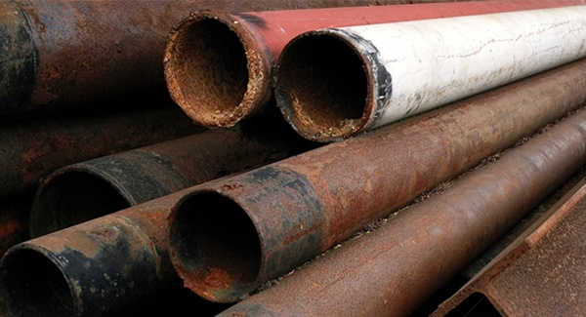
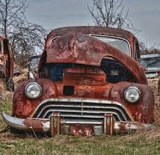

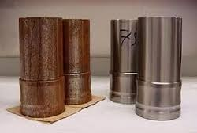
Corrosion Control
GIRMA M.

Slide 2
OUTLINE
What is Corrosion
Mechanism Of Electrochemical Corrosion
Corrosion Control

Slide 3
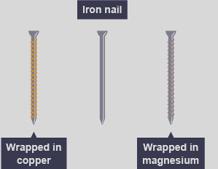
Question
In an experiment, one iron nail is wrapped in magnesium, another in copper and one left alone.
Which nail corrode first and why ???????

Slide 4
The nail wrapped in magnesium is not corroded.
There is slight corrosion on the normal nail and massive corrosion on the copper wrapped nail. Connecting a more reactive metal from higher in the series protects from corrosion. A lower (less reactive) metal accepts electrons from iron and speeds up the rusting process

Slide 5
Why we study corrosion?
1- To understand how material destroys by corrosion and how they must be protected by applying corrosion protection technology "keep material and precious resources"
2- Engineering knowledge is incomplete without understanding corrosion , areoplanes, ships automobiles and others cannot be designed without knowledge to corrosion behavior of material used in these structure
3- Corrosion is a treat to the environment i.e. water can become contaminated by corrosion products and unsuitable for consumption.

Slide 6
Importance of Corrosion Studies
The importance of corrosion studies is two folds. The first is economic, including the reduction of material losses resulting from the wasting away or sudden failure of piping, tanks, metal components of machines, ships, hulls, marine, structures…etc.
The second is conservation, applied primarily to metal resources, the world’s supply of which is limited, and the wastage of which includes corresponding losses of energy and water resources accompanying the production and fabrication of metal structures.

Slide 7
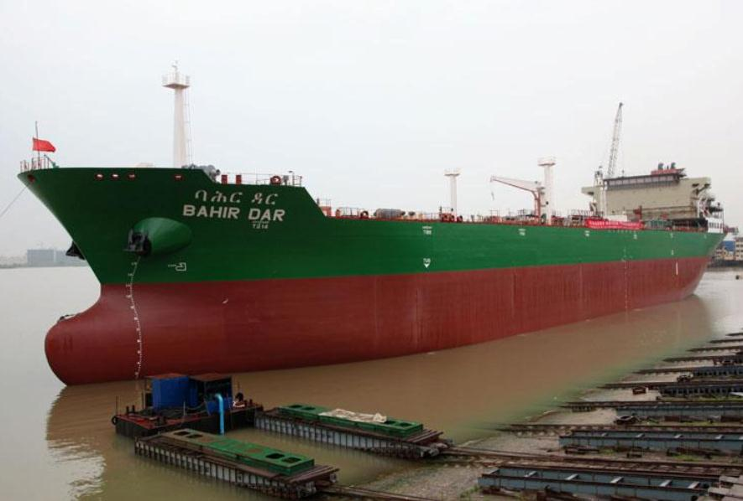
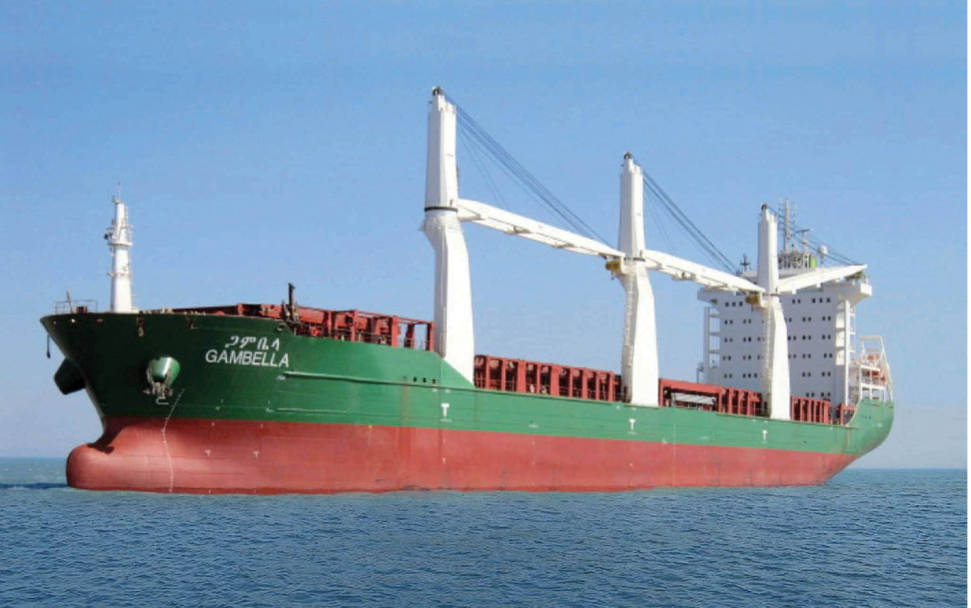

Slide 8
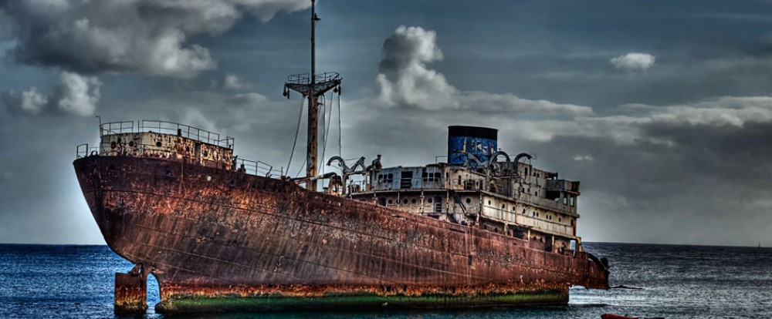
Corrosion at sea

Slide 9
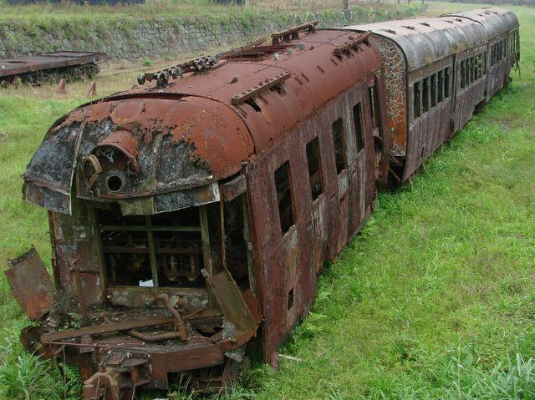

Slide 10
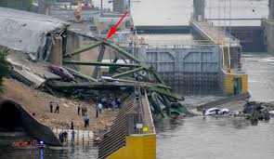
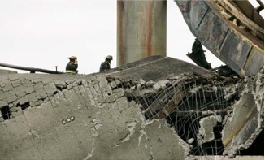
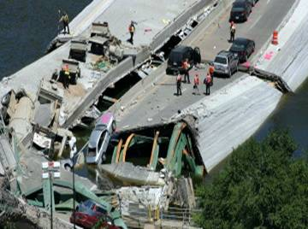

Slide 11
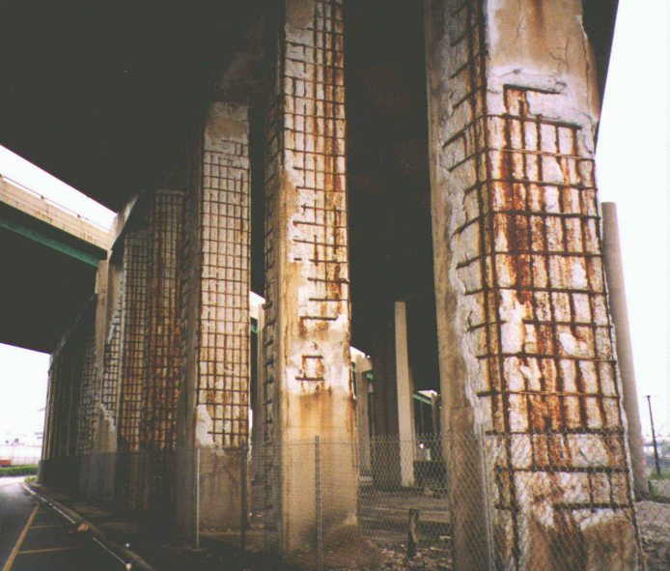
Bridge Columns Damaged by Corrosion of Reinforcing Steel Due to De-icing Chemical Exposure

Slide 12
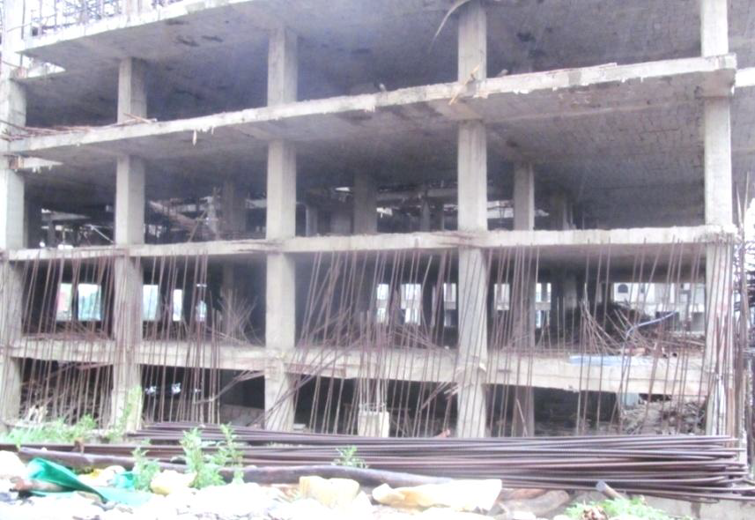
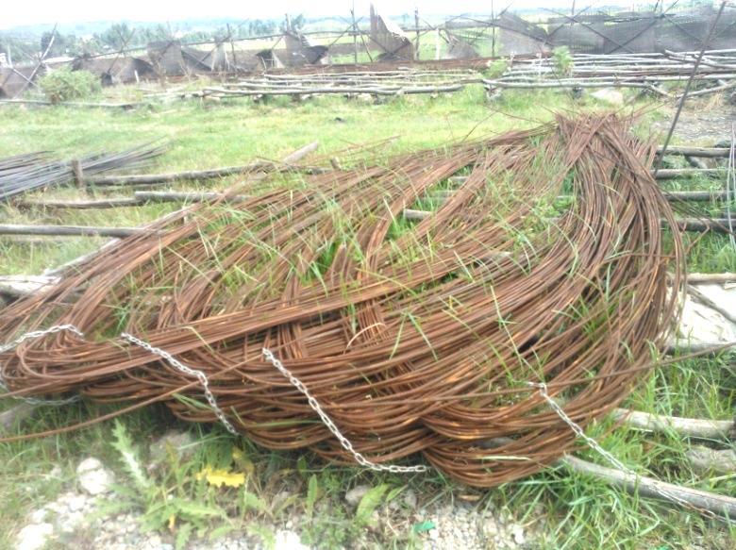
CORROSION CONSIDERATION IN ETHIOPIAN PRACTICE

Slide 13
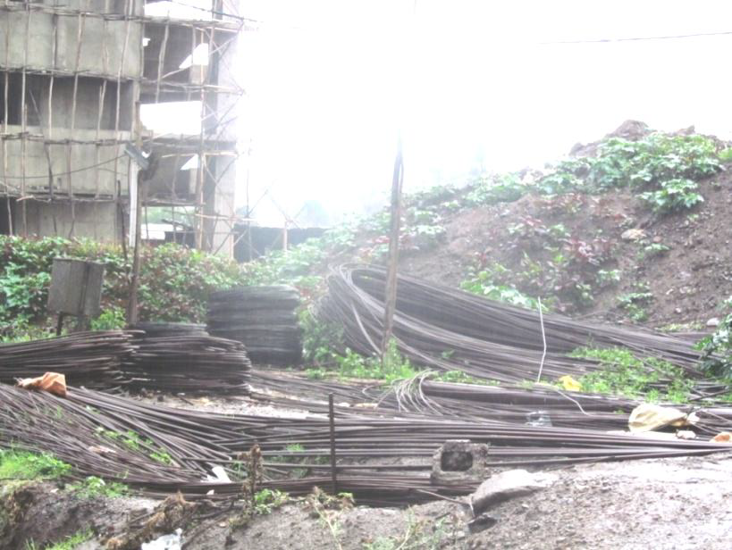

Slide 14
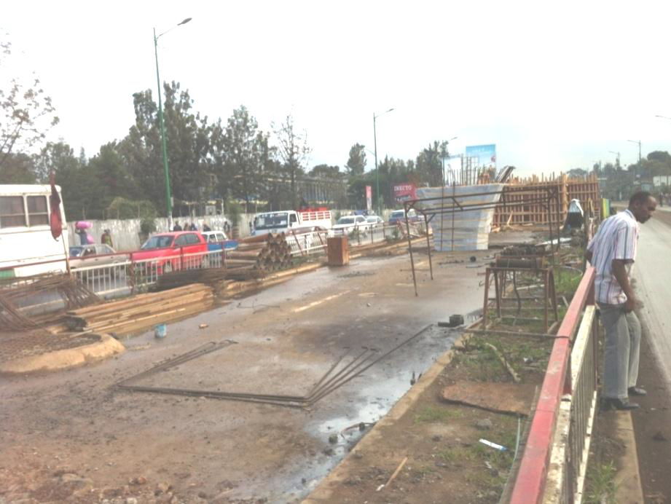
railway project around Meskel square, Addis Ababa

Slide 15
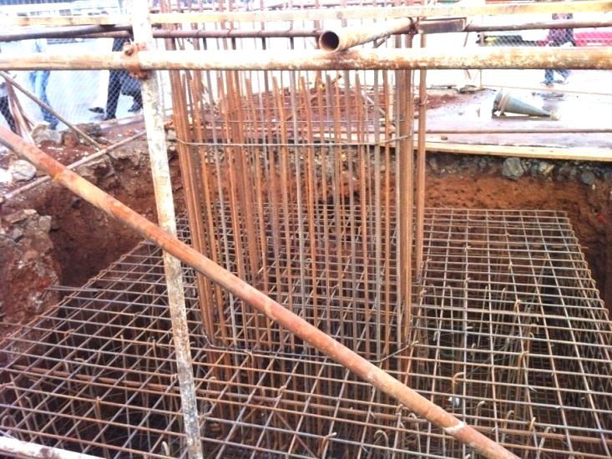
Railway project around Meskel square

Slide 16
What is Corrosion
The chemical or electrochemical reaction between a material and its environments that produces a deterioration of the material and its properties.
Corrosion is the deterioration of metallic materials by chemical interaction with their environment.
The term corrosion is sometimes also applied to the degradation of plastics, concrete and wood, but generally refers to metals.

Slide 17
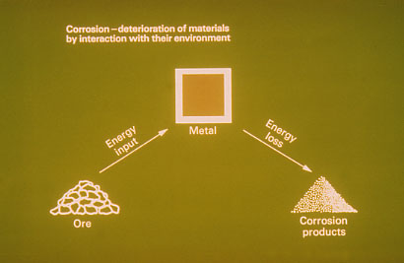
What is Corrosion

Slide 18
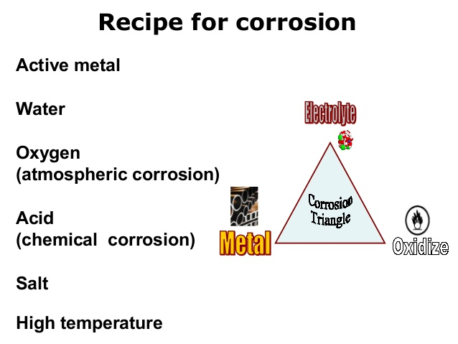

Slide 19
For corrosion to occur four basic elements are required:
Anode - site where corrosion occurs and current flows from.
Cathode - site where no corrosion occurs and current flows to.
Electrolyte - a medium capable of conducting electric current by ionic current flow (i.e. soil, water or concrete).
Metallic Path - connection between the anode and cathode, which allows current return and completes the circuit.

Slide 20
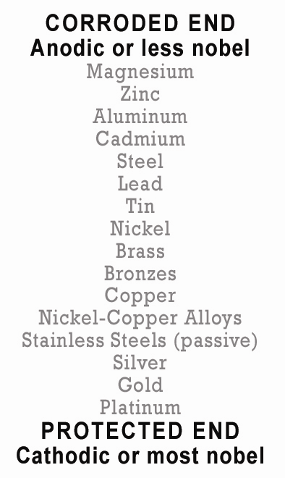
ZINC - Anode
STEEL - Cathode
This arrangement of metals
determines what metal will
be the anode and cathode
when the two are put in a
electrolytic cell (arrangement
dependent on salt water as
electrolyte).

Slide 21
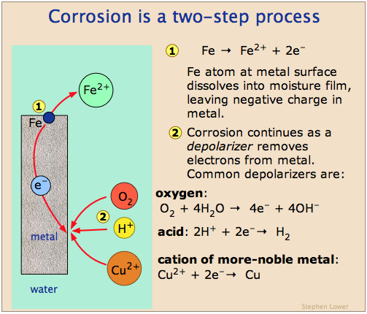

Slide 22
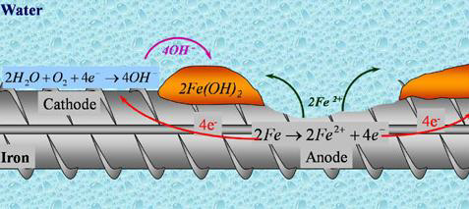
Oxidation process of reinforcing steel

Slide 23
Factors Influence Corrosion
The nature and extent of corrosion depend on the metal and the environment. The important factors which may influence the corrosion process are:
a) Nature of the metal, nature of the environment and the corrosion products.
b) Temperature.
c) Concentration of electrolyte.
d) Electrode potential.
f) Aeration.
g) Agitation.
h) pH of the electrolyte.

Slide 24
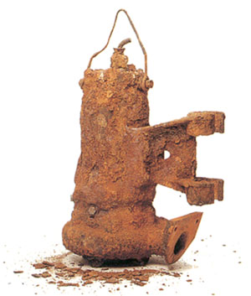
Forms of corrosion
Uniform corrosion
Uniform corrosion, as the name suggests, occurs over the majority of the surface of a metal at a steady and often predictable rate.
Differences in electrical potential occur on the surface of a piece of metal due to small differences in chemical composition, phase differences, etc.
These differences set up small corrosion cells each with an anode and cathode.

Slide 25
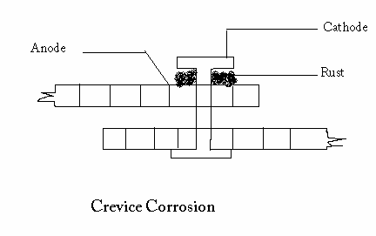
Forms of corrosion
  Crevice Corrosion
  Crevice corrosion is a localized attack on a metal adjacent to the crevice between two joining surfaces (two metals or metal-nonmetal crevices). The corrosion is generally confined to one localized area to one metal.
  narrow crevice filled with ionized solution
  Oxygen-rich on the outside, oxygen-poor on the inside
  metals oxidize with salt anions FeCl₂ and pH rises in cathodic zone
  H⁺ may destroy passivity
  This type of corrosion can be initiated by concentration gradients (due to ions or oxygen).
Bolts, nuts, rivets, joints are examples for this type of corrosion.

Slide 26
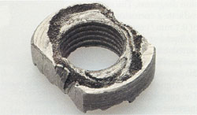
Crevice corrosion
Crevice corrosion on a stainless steel nut exposed to seawater.

Slide 27
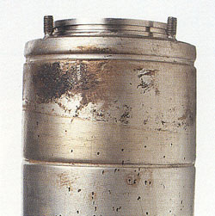
Pitting Corrosion
  Localized corrosion forming holes or indentations
  Difficult to initially detect
Formed as a result of pit and cavities
Localized attack and formed by cracking protective coating
Pitting corrosion on a stainless steel stator housing operating in seawater.

Slide 28
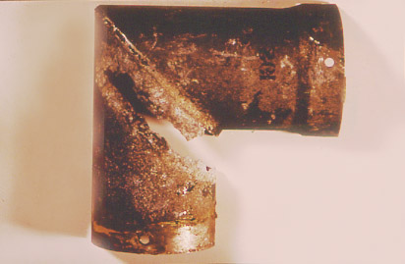
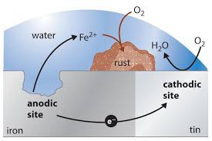
Galvanic Corrosion
  2 dissimilar metals, electrolyte, electrical connection and oxygen
This rainwater guttering is made of aluminium and would normally resist corrosion well. Someone tied a copper aerial wire around it, and the localised bimetallic cell led to a “knife-cut” effect.

Slide 29
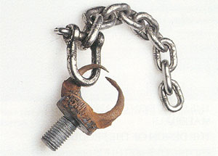
Galvanic corrosion
Galvanic corrosion of eye bolt connected to a stainless

Slide 30
Corrosion Control
Selection of metal and alloy:
  Using pure and noble metals
  Practically not possible because of low strength of pure metal
  Use of metal alloys which are homogeneous
2. Proper design of metal:
    Minimal contact with medium
    Prevention from moisture
    Adequate ventilation and drainage
    Welding
    Avoid cervices b/w adjacent parts
    Bend should be smooth
    Bimetallic contacts should be avoided
    Paint cathodic portion
    Prevent uneven stress

Slide 31
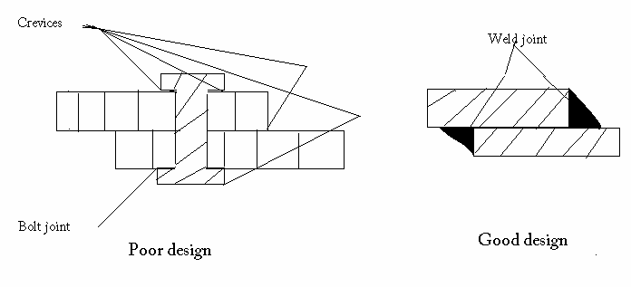
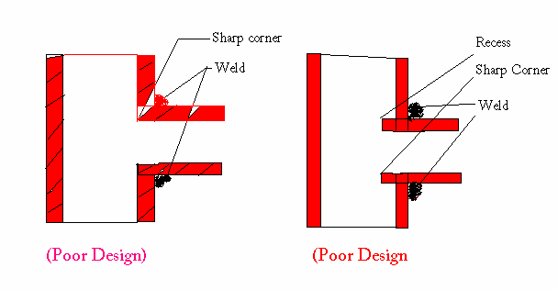
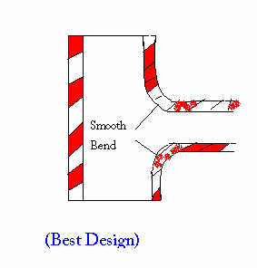

Slide 32
Corrosion Control:
3. Cathodic Protection
Force the metal to be protected to behave like cathode.
Sacrificial anodic protection
  Metal to be protected from corrosion connected to more anodic metal
  Commonly used metals Mg, Zn, Al and their alloys
Impressed current method
  Direct current is applied in opposite direction to nullify the corrosion current
  Converts the corroding metal from anode to cathode.

Slide 33
Corrosion Control:
4. Modifying Environment
Eliminating dissolved oxygen:
  De-aeration
  By using chemical substances like sodium sulphite and hydrazine. Also called Deactivation.
Reducing Moisture:
  Dehumidification by using silica gels
Reducing Acidity:
  Neutralizing the acidic environment by adding lime, NaOH, Ammonia
  Commonly used in refineries

Slide 34
5. Protective coating:
  Application of coating
  Coating material should be chemically inert under particular temp and pressure.
An example of a coating system for a bridge might be: Zinc Rich Primer, Epoxy Intermediate Coat, Urethane Topcoat

Slide 35
Corrosion Control:
6. Use of corrosion Inhibitor
Anodic Inhibitor:
  These are oxygen and oxidizing agent.
  They combine the anodic metal forming an oxide film which reduce corrosion
Cathodic Protection:
  Organic inhibitors like amines, mercaptans, urea and thiourea reduces the H ion diffusion by adsorption
  Mercury, arsenic and antimony deposits films at cathodic area which raise the hydrogen over volume.
  Eliminating Oxygen from the medium by adding sodium sulphate and hydrazine.

Slide 36
Corrosion Control:
CATHODIC PROTECTION
Cathodic protection systems (CP) have an excellent track record in corrosion control of steel and reinforced concrete structures.
The principle of CP is that the electrical potential of the steel reinforcement is artificially decreased by providing an additional anode system at the concrete surface.
An external current is required between anode and cathode that diminishes the corrosion rate along embedded reinforcement.
The current may be produced either by a sacrificial anode system or using an impressed current from an external power source.

Slide 37
Sacrificial anode
Sacrificial anode systems consist of metals higher than steel in the electrochemical series (e.g. zinc).
The external anode corrodes preferentially to the steel and supplies electrons to the cathodic steel surface.
Sacrificial anode systems are most effective in submerged structures where the concrete is wet and resistivity is low.
Warm temperatures are also generally required for sacrificial CP systems (i.e. above 200C).

Slide 38
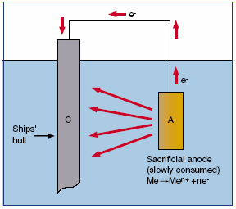
Sacrificial anode

Slide 39
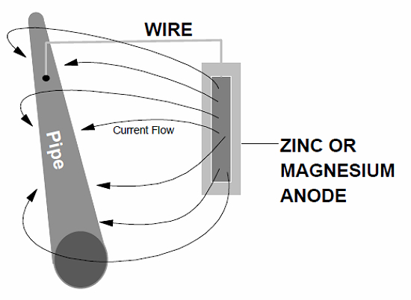
Corrosion Control:

Slide 40
Cathodic Protection
Impressed Current
External source of direct current power is connected (or impressed) between the structure to be protected and the ground bed (anode). Ideal impressed current systems use ground bed material that can discharge large amounts of current and yet still have a long life expectancy may require the following basic components:
DC power supply (rectifier).
Inert anode material, such as catalyzed titanium anode mesh.
Wiring and conduit.
Instrumentation, such as embedded silver/silver-chloride reference electrodes

Slide 41
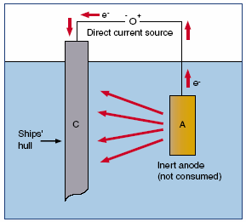

Slide 42
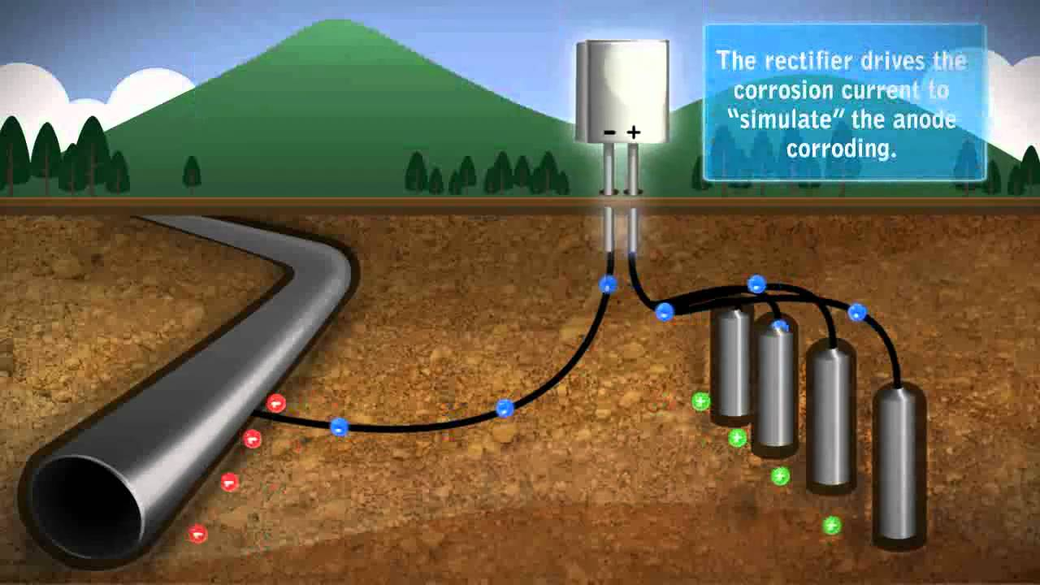

Slide 43
Avoiding Corrosive Situations
Choose couple metals close on the galvanic series
Use large anode, and small cathode areas
Electrically insulate dissimilar metals
Connect a more anodic metal to the system
Avoid turbulent flow and impingements in pipe systems

Slide 44
Why Corrosion Rates Matter
Corrosion rates determine the life span of metal-based structures. This reality dictates the choice of metals used for different purposes, and in different environments.
It also determines the maintenance requirements for structures: a metal structure in a wet environment may require more frequent maintenance than a similar structure in a drier location.
Maintenance schedules are developed based on the types of calculations described above.

Slide 45
Thermodynamics vs. Kinetics
Corrosion resistance depends on both thermodynamics and kinetics.
From a corrosion standpoint, thermodynamics is the study of materials’ tendency to corrode, while kinetics is the study of the rate of corrosion.
Thermodynamics answers the question “can a metal corrode?” and kinetics answers the question “how fast will it corrode?”

Slide 46
What does Corrosion Rate mean?
Corrosion rate is the speed at which any metal in a specific environment deteriorates. It also can be defined as the amount of corrosion loss per year in thickness.
The speed or rate of deterioration depends on the environmental conditions and the type and condition of the metal under reference.
It is found by: R = d/t expressed in µm/y but can also be expressed in terms of weight loss g/m2, mg/dm2.day, oz/ft2, among others.

Slide 47
Corrosion Rate
Several pieces of data must be collected when calculating the corrosion rate of any given metal. Required data includes:
Weight lost (the decrease in weight of the metal during the period of reference)
Density of the metal
Total surface area initially present
Length of time taken

Slide 48
What does Mils Penetration Per Year (MPY) mean?
Mils penetration per year (MPY) is a unit of measurement equal to one thousandth of an inch. Mils penetration per year is commonly known as mil in the U.S. measurement system.
Mils penetration per year is used to gauge a coupon’s corrosion rate. This unit may also be used to measure a coating's thickness or tolerance.

Slide 49
Mils Penetration Per Year (MPY)
The corrosion rate is the speed at which metals undergo deterioration within a particular environment.
This rate depends on environmental conditions and the condition or type of metal.
To calculate the corrosion rate, the following must be determined:
Weight loss (reduction in weight during reference time)
Area (initial surface area)
Time (length of reference time)
Density

Slide 50
The following charts provide a simple way to convert data between the most common corrosion units in usage, i.e. corrosion current (mA cm⁻²) , mass loss (g m⁻² day⁻¹) and penetration rates (mm y⁻¹ or mpy) for all metals or for steel

Slide 51
Example
a. 15mpy =?????????pm/s
b. 15mpy=?????????mm/yr

Slide 52
solution
15mpy =12.1pm/
15mpy =0.4mm/yr

Slide 53
Faraday's Law
Relation ship between charge produced and metal reacted:
Q=nmf equivalent = mole of charge
Q=Charge in C
N-Equivalents per mole(eq/mol)
m- numbers of mole
F-Faradys constant (96500C/mol)
Current=charge/time I=Q/t=nmF/t
Current density =current/area i= I/A =nmF/At

Slide 54
Corrosion rate can have different units.
 | Units
R = x/t, thickness loss per unit time | mils per year (mpy) mm per year (mm/y)
R = m/At, weight loss per unit area per unit time | mg/dm2/day (mdd)
i = I/A = Q/At, current density = nFm/MAt | Amperes/cm2 (A/cm2)

Slide 55
Converting Corrosion Rates:
To convert corrosion rate between the mils per year and the metric equivalent millimeter per year (mm/y), you can use the following equation:
1 mpy = 0.0254 mm/y = 25.4 microm/y
To calculate the corrosion rate from metal loss:
mm /y = 87.6 x (W / DAT)
where:
W = weight loss in milligrams
D = metal density in g /cm3
A = area of sample in cm2
T = time of exposure of the metal sample in hours

Slide 56
Example: 1 Calculation of Weight Loss
Steel corrodes in an aqueous solution, the corrosion current is measured as 0.1 mA/cm². Calculate the rate of weight loss per unit area in unit of mdd.
if the metal is steel or iron (Fe), n =2, M = 55.85 g/mol and d = 7.88 g cm⁻³

Slide 57


Example
A copper surface area, is exposed to an acid solution. After 24 hours, the loss of copper due to corrosion (oxidation) is
Calculate
a) the current density in μA/cm2
b) the corrosion rate(mm/yr)
Use the data:

Slide 58
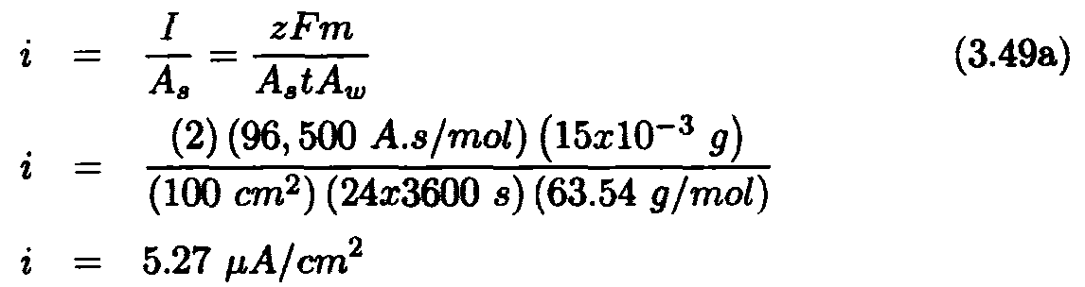
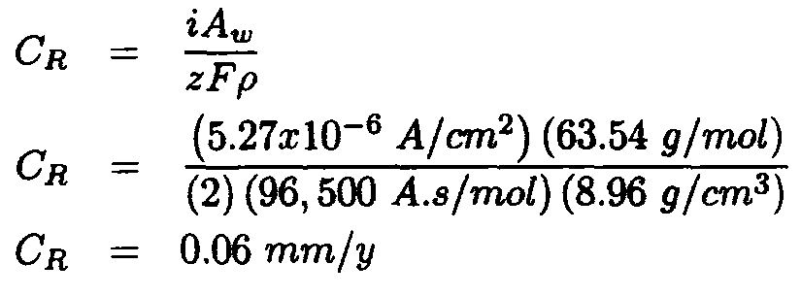

Slide 59
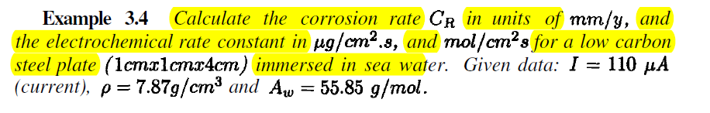
Quiz 2 5%

Slide 61
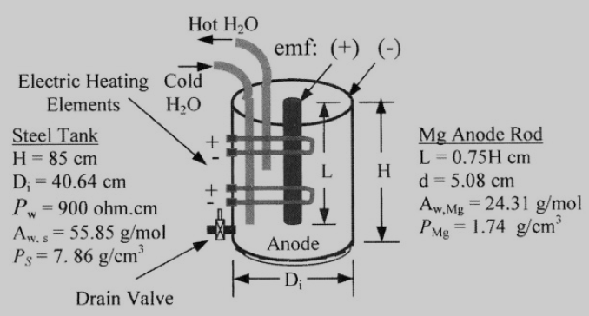

Slide 62
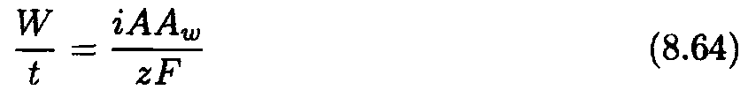
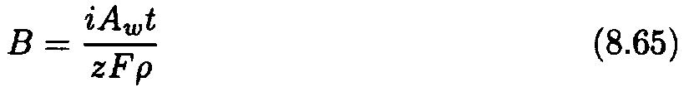
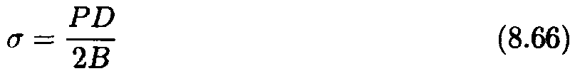
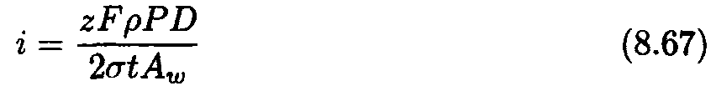
Solving for the thickness B yields
For a cylindrical pressure vessel, the thickness B in eq. (8.65) must satisfied
the average hoop stress (average tangential stress) equation defined by
where P = Internal pressure (MPa)
D = Internal diameter
Combining eqs. (8.65) and (8.66) yields the current density

Slide 63
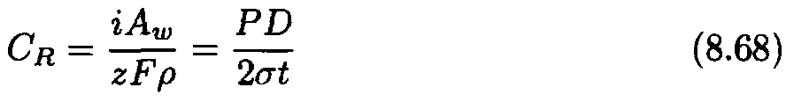
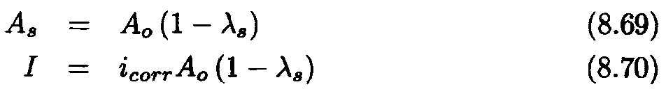
and the corrosion rate becomes
For coated structures, wisely assume or determine the coating efficiency in
order to compute the bare surface and the corresponding current that must
protect the bare surface from corrosion. The bare area and the current are
easily determined as
where As= Fraction of the protected surface area
Ao= Total surface area

Slide 64
examples
Suppose that a buried steel structure is to be cathodically
protected using a rectifier capable of delivering 1 volt and 5 amperes through the wiring system. Assume that the soil resistance is 80% of the external resistance.
Calculate
a) the soil resistance when the anode bed is 4-meter long, and 0.10-meter in diameter and
b) the current density.

Slide 65
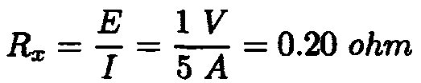

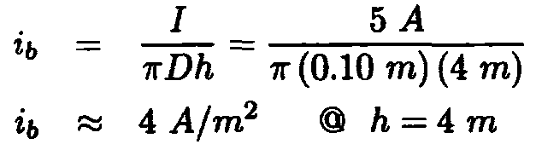
a) Using Ohm’s law yields the external resistance as
Thus, the soil resistance is
b) From eq. (8.8),

Slide 66
steel coupon with an anode surface area of 1000 cm2 is placed in an electrolyte. The corrosion current is measured to be 1 mA. What mass of steel will be lost in 6 hours? What is the corrosion rate in μg/cm2/day? In mpy? Assume valence of 2.

Slide 67

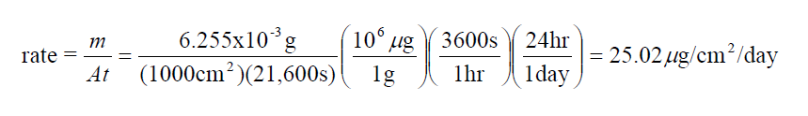

Slide 68
Exercise
A 2-m diameter steel tank containing water is pressurized at 200 kPa. The hoop stress, thickness, and height are 420 MPa, 2 cm, and 8 cm, respectively.
If the measured corrosion rate is 0.051 mm/y, determine a) the tank life and b) the developed current.
Data: density =7.86 g/cm3
Aw=55.86 g/mol

Slide 70
Calculate the weight of zinc required for 35 year cathodic protection (CP) design life?
Given
      Current demand 6010A
      Anode capacity 780Ah/kg
      Utillization 90%

Slide 71
Mass=2,624880 kg

Slide 72
GIVEN Anode dimensions 500mmx115mmx65mm
Anode resistance calculated using LIOYDS formula,0.32ohms
VOLTAGE 0.25 V
Density 2700kg/m3
Anode capcity 2830Ah/kg
Current required A,236
no of anode to supply current
    Calculate total current capacity for the anode
    Design life of the system

Slide 73
Total current capacity 28,558Ah
Design life 3.8 year

Slide 74


A vertical cylindrical steel pressure vessel containing oxygenerated water is subjected to 15 MPa internal pressure and it is to be cathodically protected using one (Galvorod) anode rod and the NACE recommended potential of T the hoop stress is limited to half the yield strength of the steel; that is, The tank inside diameter is D = 40 cm. If the design life is 10 years and if the bare inner surface area is 98% coating-protected, calculate
a) the corrosion rate as a measure of the rate of thickness reduction and the vessel thickness at the end of its lifetime,
b) the effective mass of the anode rod, which has 50% current efficiency due to hydrogen evolution,
c) the system current density (Ca= 1,125Ah/Kg)
d)Corrosion rate of Mg-Alloy
e) Will the tank burst at the end of 10 years?
Data for steel: (uniform), i= corrosion 65µA/cm2 Aw= 55.85g/mol density= 7.7g/cm3
H = 80 cm (height of tank) and for the sacrificial Mg anode rod: L = 30 cm,
d = 12 cm, B = 1.30 cm, and

Slide 75
A vertical cylindrical steel pressure vessel containing oxygenerated water is subjected to 15 MPa internal pressure and it is to be cathodically protected using one (Galvorod) anode rod and the NACE recommended potential of the hoop stress is limited to half the yield strength of the steel; that is, The tank inside diameter is D = 40 cm. If the design life is 10 years and if the bare inner surface area is 98% coating-protected, calculate
Data for steel: (uniform), i= corrosion 65µA/cm2 Aw= 55.85g/mol density= 7.7g/cm3H = 80 cm (height of tank) and
for the sacrificial Mg anode rod: L = 30 cm,
d = 2 cm,,
B = 1.30 cm
the corrosion rate as a measure of the rate of thickness reduction and the vessel thickness at the end of its lifetime
b) the effective mass of the anode rod, which has 50% current efficiency due to hydrogen evolution,

Slide 76
a) the corrosion rate as a measure of the rate of thickness reduction and the vessel thickness at the end of its lifetime,
b) the effective mass of the anode rod, which has 50% current efficiency due to hydrogen evolution,
c) the system current density (Ca= 1,125Ah/Kg)
d)Corrosion rate of Mg-Alloy
e) Will the tank burst at the end of 10 years?

Slide 77
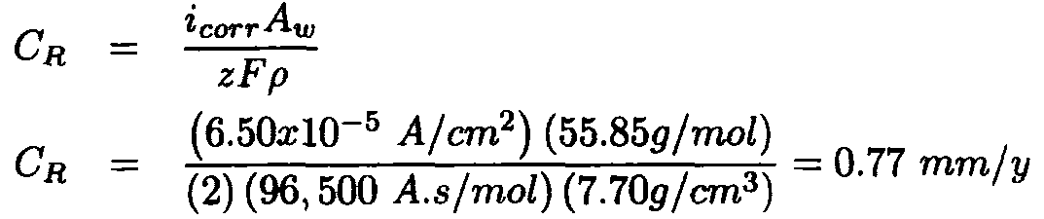
The thickness reduction of the steel vessel is

Slide 78
The anode volume and its useful mass based on 50% anode current efficiency
are, respectively

Slide 79


The inner bare area of the vessel is
This is the area to be protected by the anode for 10 years. Thus, the average selfimposed
spontaneous protective current (Table 8.4) and current density imparted
by the sacrificial anode are, respectively Then, the
anode capacity

Slide 80

The corrosion rate of Mg alloy the is

Slide 81



Now, the final thickness due to corrosion at the end of 10 years is
Therefore, the vessel will burst because This particular design can
be enhanced by using a thicker steel vessel so that

Slide 82
Quiz 5 %
A thick wall steel sheet area of 100 in2 is exposed to air near the ocean. After a one year period it was found to experience a weight loss of 485 g due to corrosion. To what rate corrosion , in both mpy and mm/yr ,does this correspond ?
Additional in formations
F = 96500 C/Mol
1 inch =2.54 cm
Mwt (g/mol)
Fe 55.85 density 7.87 (g/cm3)

