Slide 1
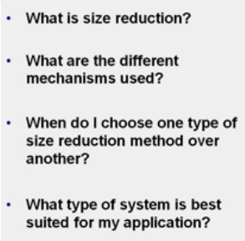
Size reduction

Slide 2
Size reduction
Objective of size reduction (communition) is to increase surface area
  Some of the practical benefits:
    For reactions taking place b/n solid and gas or soild and liquid
      E.g. combustion of solid particles
    Leaching or extraction
    Drying
    Properties of a material
      E.g. color and covering power of a pigment
    Mixing of solids

Slide 3
Size reduction
Mechanism of size reduction
  When a single lump of material is subjected to a sudden impact, it will break into
    Few relatively large particles + intermediate particle sizes + number of fine particles
  When the energy of impact increases, the larger particles will further disintegrate while the size of finer particles will not much altered.
    The size of fine particles is closely connected with the internal structure of the material but larger particles with the process by which the size reduction is effected

Slide 4
Size reduction
The process of size reduction consists of two parts:
    Opening up any small fissures which are already present
    Secondly forming new surface
From the point of energy utilization, size reduction is a very inefficient process
    Between 0.1 and 2% of the energy supplied to the machine appears to effectively increase the surface
The efficiency of the process depends on
    The rate at which the load is applied
    The magnitude of the load
    The nature of the force exerted

Slide 5
Size reduction
The method of application of the force to the particles
  Impact: produced by a single rigid force
  Compression: particle disintegration by two rigid force
  Shear: produced by a fluid or by particle-particle interaction
  Attrition: arising from particles scraping against one another or against a rigid surface

Slide 6
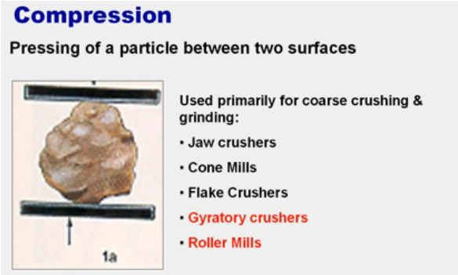
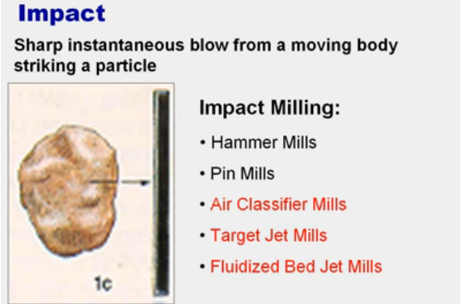
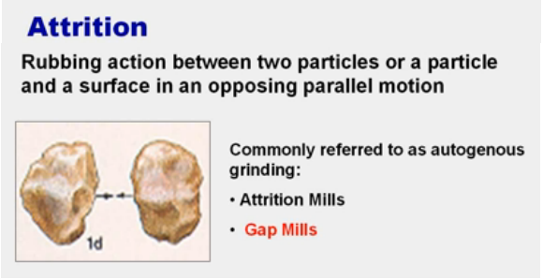
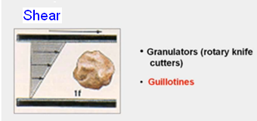
Size reduction

Slide 7
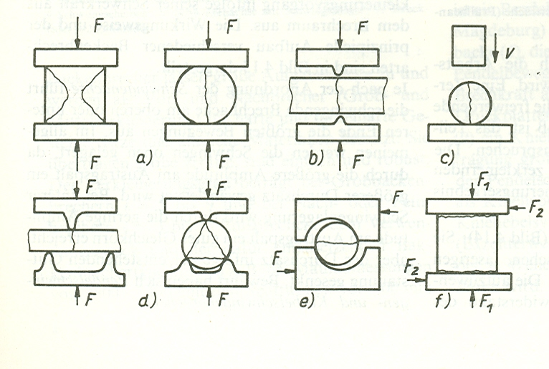
Force patterns

Slide 8
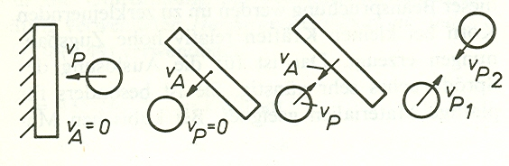
Impact forces

Slide 9
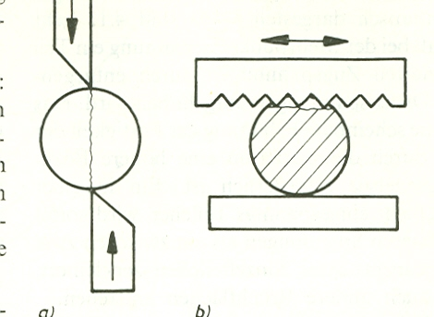
Rubbing and shear force

Slide 10
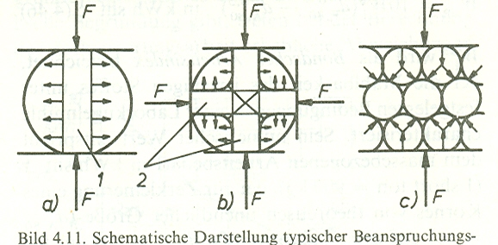
Force in the internal structure

Slide 11
MUO (size reduction)
Types of size reduction equipments

Slide 12
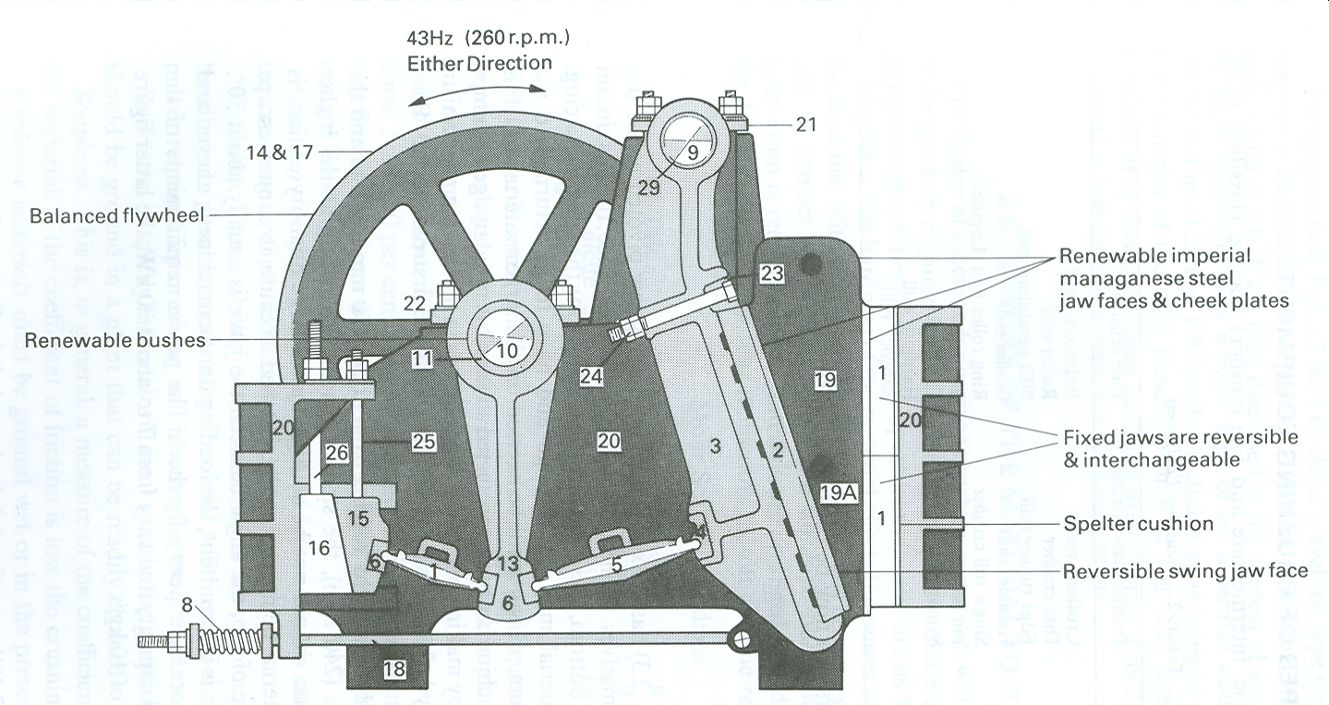
Jaw crusher
Notes:
The crushing faces of the jaw crusher formed of manganese steel.
Since the maximum movement of the jaw is at the bottom, there is little tendency for the machine to clog, though some uncrushed material may fall through and have to be returned to the crusher.
The angle of nip, the angle between the jaws, is usually about 30◦.
Because the crushing action is intermittent, the loading on the machine is uneven
and the crusher therefore incorporates a heavy flywheel. The power requirements of the
crusher depend upon size and capacity and vary from 7 to about 70 kW, the latter figure
corresponding to a feed rate of 10 kg/s.

Slide 13
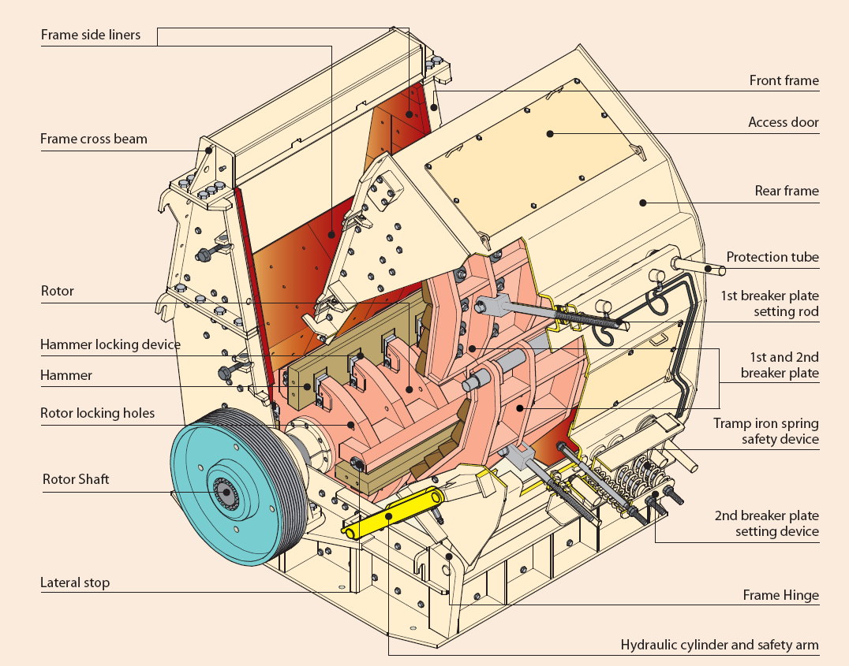
Jaw crusher

Slide 14
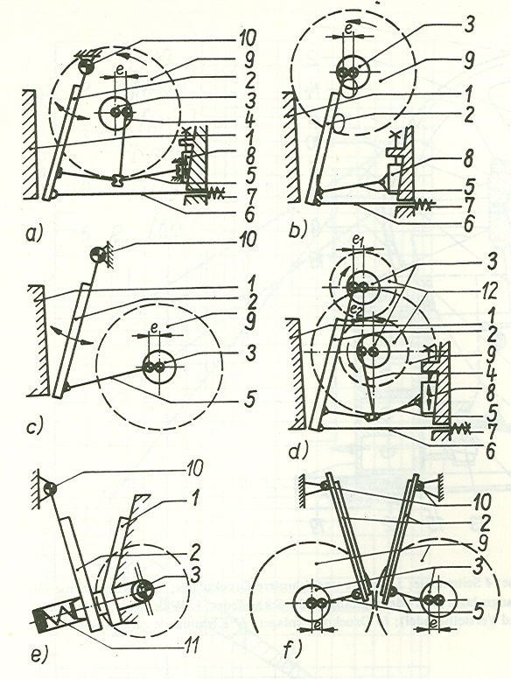
Jaw crusher

Slide 15
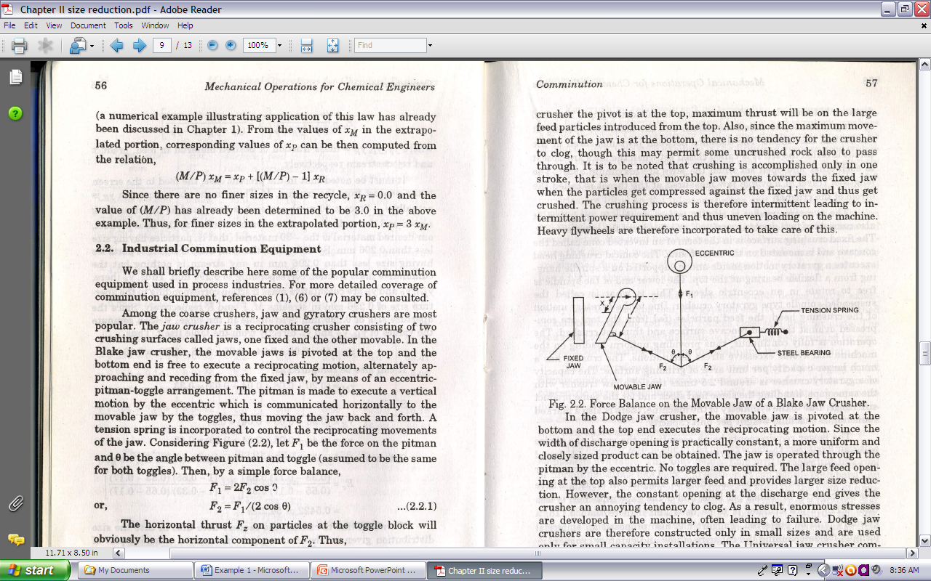
The forces exerted on the particle are quite larger than the force F₁ as θ gets closer to 90º
The horizontal force on the particles inside the jaw :
For a particle at position x, moment about the pivot point of the swinging jaw gives:

Slide 16
Jaw crusher

Slide 17
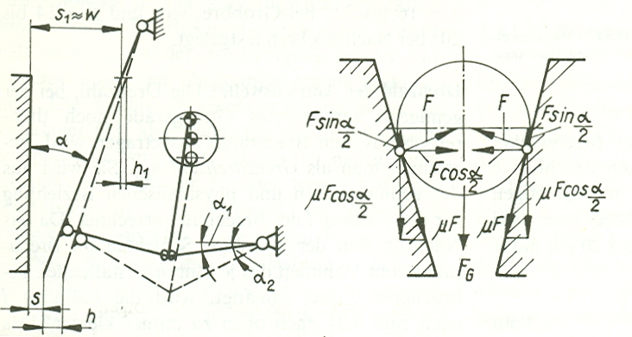
Jaw crusher

Slide 18
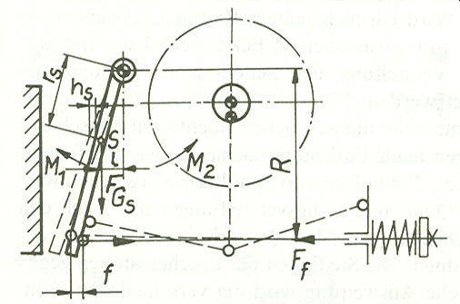
Jaw crusher

Slide 19
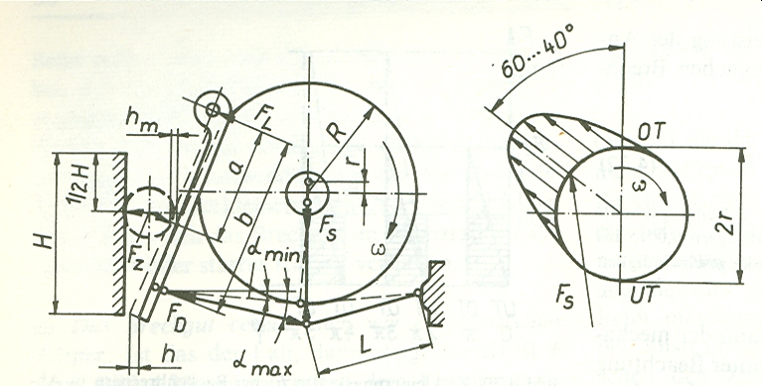
Jaw crusher

Slide 20
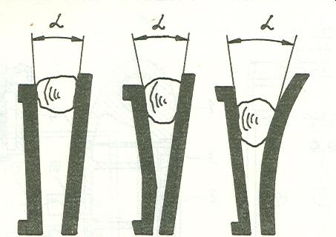
Jaw crusher

Slide 21
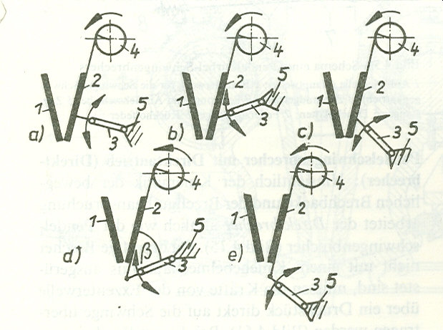
Jaw crusher

Slide 22
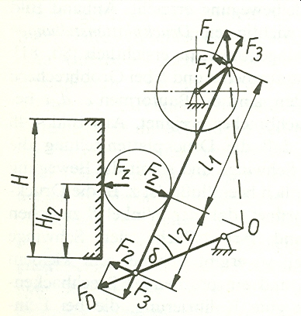
Jaw crusher

Slide 23
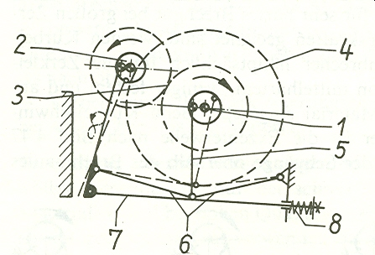
Jaw crusher

Slide 24
Ball mill

Slide 25
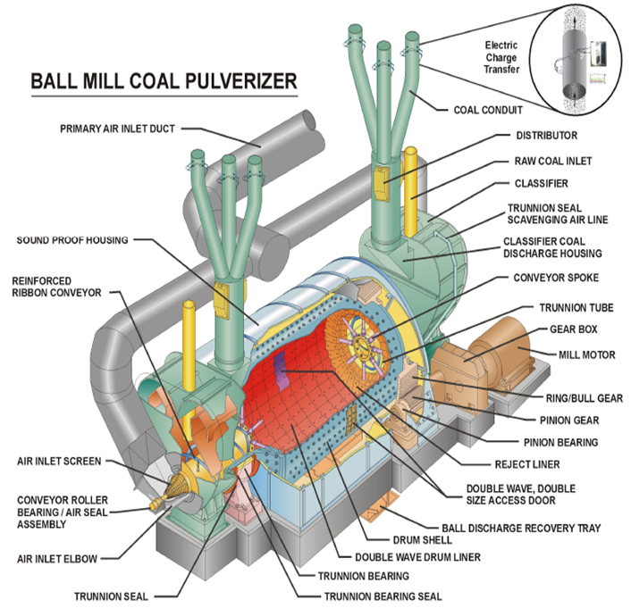

Slide 26
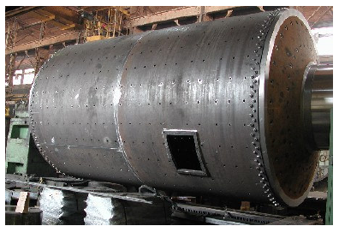
Ball mill

Slide 27
Ball mill
Notes:
In its simplest form, the ball mill consists of a rotating hollow cylinder, partially filled with balls, with its axis either horizontal or at a small angle to the horizontal.
The outlet is normally covered with a coarse screen to prevent the escape of the balls.
The inner surface of the cylinder is usually lined with an abrasion-resistant material such as manganese steel, stoneware or rubber.
The ball mill is used for the grinding of a wide range of materials, including coal, pigments, and felspar for pottery, and it copes with feed up to about 50 mm in size.
The efficiency of grinding increases with the hold-up in the mill, until the voids between the
balls are filled. Further increase in the quantity then lowers the efficiency.
The balls are usually made of flint or steel and occupy between 30 and 50 per cent of the volume of the mill.
The diameter of ball used will vary between 12 mm and 125 mm and the optimum diameter is approximately proportional to the square root of the size of the feed, with the proportionality constant being a function of the nature of the material.
During grinding, the balls wear and are constantly replaced by new ones so that the mill contains balls of various ages, and hence of various sizes. This is advantageous since the large balls deal effectively with the feed and the small ones are responsible for giving a fine product.
In the compound mill, the cylinder is divided into a number of compartments by vertical perforated plates. The material flows axially along the mill and can pass from one compartment to the next only when its size has been reduced to less than that of the perforations in the plate. Each compartment is supplied with balls of a different size. The large balls are at the entry end and thus operate on the feed material, whilst the small balls come into contact with the material immediately before it is discharged. This results in economical operation and the formation of a uniform product. It also gives an improved residence time distribution for the material, since a single stage ball mill approximates closely to a completely mixed system.
In wet grinding the power consumption is generally about 30 per cent lower than that for dry grinding and, additionally, the continuous removal of product as it is formed is facilitated.

Slide 28
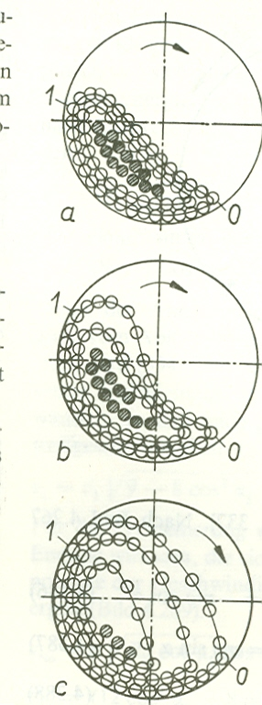
Ball mill
Notes:
Factors influencing the size of the product
(a) The rate of feed. With high rates of feed, less size reduction is effected since the
material is in the mill for a shorter time.
(b) The properties of the feed material. The larger the feed the larger is the product
under given operating conditions. A smaller size reduction is obtained with a hard
material.
(c) Weight of balls. A heavy charge of balls produces a fine product. The weight of the
charge can be increased, either by increasing the number of balls, or by using a
material of higher density. Since optimum grinding conditions are usually obtained
when the bulk volume of the balls is equal to 50 per cent of the volume of the
mill, variation of the weight of balls is normally effected by the use of materials
of different densities.
The effect on grinding performance of the loading of balls in a mill has been studied
by KANO et al.(22), who varied the proportion of the mill filled with balls from 0.2
to 0.8 of the volume of the mill. The grinding rates were found to be a maximum
at loadings between 0.3 and 0.4. The effect of relative rotational speed, the ratio of
actual speed to critical speed, was found to be complex. At loadings between 0.4
and 0.8, the grinding rate was a maximum at a relative rotation speed of about 0.8,
although at lower loadings the grinding rate increased up to relative speeds of 1.1
to 1.6.
(d) The diameter of the balls. Small balls facilitate the production of fine material
although they do not deal so effectively with the larger particles in the feed.
(e) The slope of the mill. An increase in the slope of the mill increases the capacity
of the plant because the retention time is reduced, although a coarser product is
obtained.
(g) The speed of rotation of the mill. At low speeds of rotation, the balls simply roll
over one another and little crushing action is obtained. At slightly higher speeds,
the balls are projected short distances across the mill, and at still higher speeds
they are thrown greater distances and considerable wear of the lining of the mill
takes place. At very high speeds, the balls are carried right round in contact with
the sides of the mill and little relative movement or grinding takes place again. The
minimum speed at which the balls are carried round in this manner is called the
critical speed of the mill and, under these conditions, there will be no resultant
force acting on the ball when it is situated in contact with the lining of the
mill in the uppermost position, that is the centrifugal force will be exactly equal
to the weight of the ball. It is found that the optimum speed is between one-half and three-quarters of the critical speed.

Slide 29
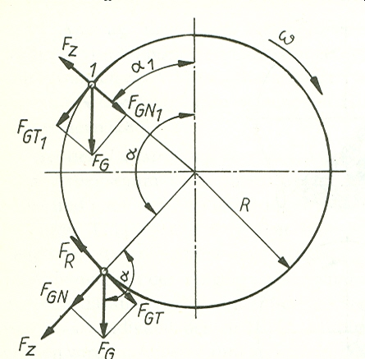
Ball mill
The critical speed is when
the ball reaches the vertical
top position of the shell
without being free to fall.

Slide 30
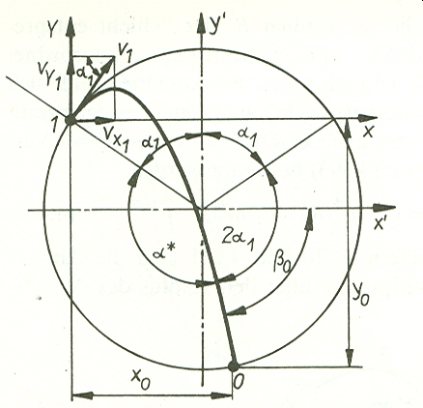
Ball mill

Slide 31
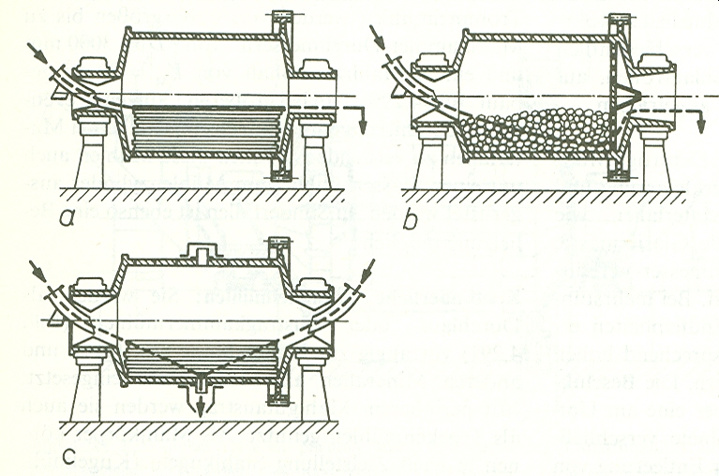
Ball mill
&
Rod mills

Slide 32
Ball mill

Slide 33
Rod mill

Slide 34
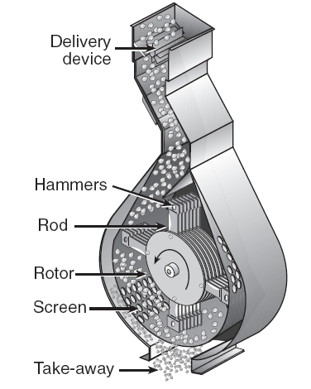
Hammer mill
Notes:
The hammer mill is an impact mill employing a high speed rotating disc, to which are fixed a number of hammer bars which are swung outwards by centrifugal force.
Material is fed in, either at the top or at the centre, and it is thrown out centrifugally and crushed by being beaten between the hammer bars, or against breaker plates fixed around the periphery of the cylindrical casing.
The material is beaten until it is small enough to fall through the screen which forms the lower portion of the casing.
Since the hammer bars are hinged, the presence of any hard material does not cause damage to the equipment.
The bars are readily replaced when they are worn out.
The machine is suitable for the crushing of both brittle and fibrous materials, and, in the latter case, it is usual to employ a screen with cutting edges.
The size of the product is regulated by the size of the screen and the speed of rotation.
Since a large current of air is produced, the dust must be separated in a cyclone separator or a bag filter.

Slide 35
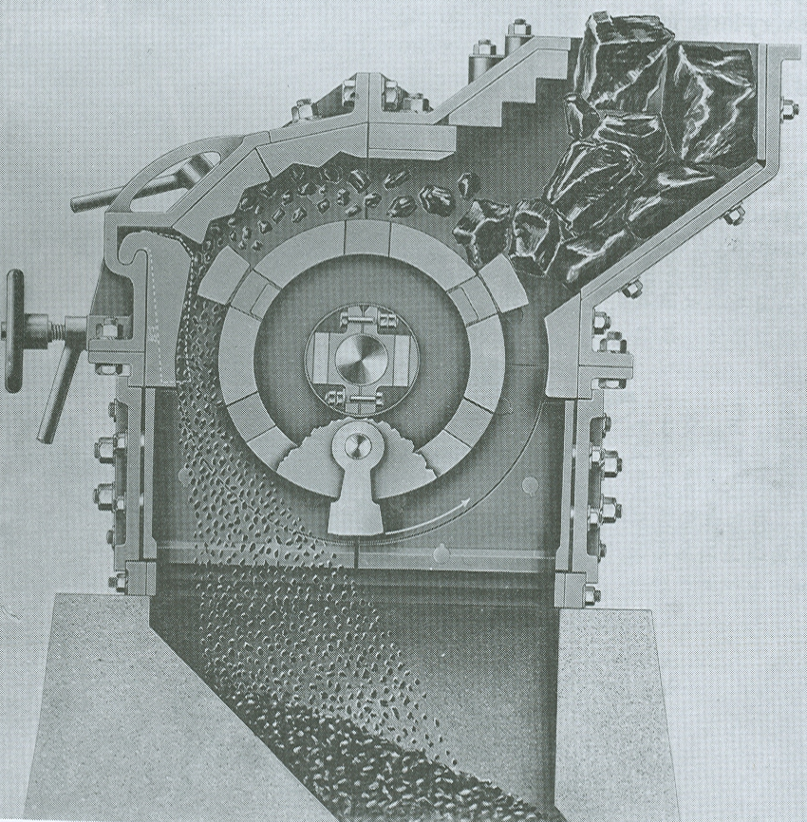
Hammer mill

Slide 36
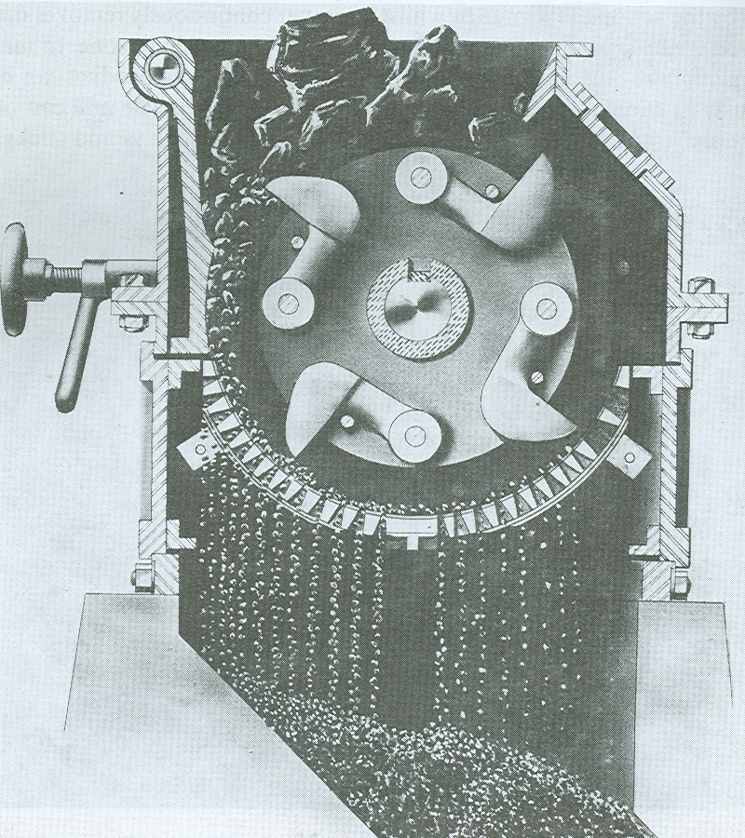
Hammer mill

Slide 37
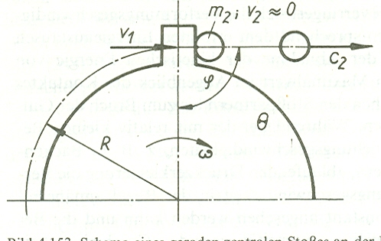
Hammer mill

Slide 38
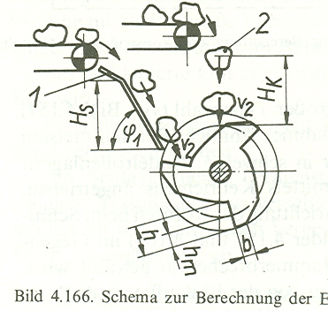
Hammer mill

Slide 39
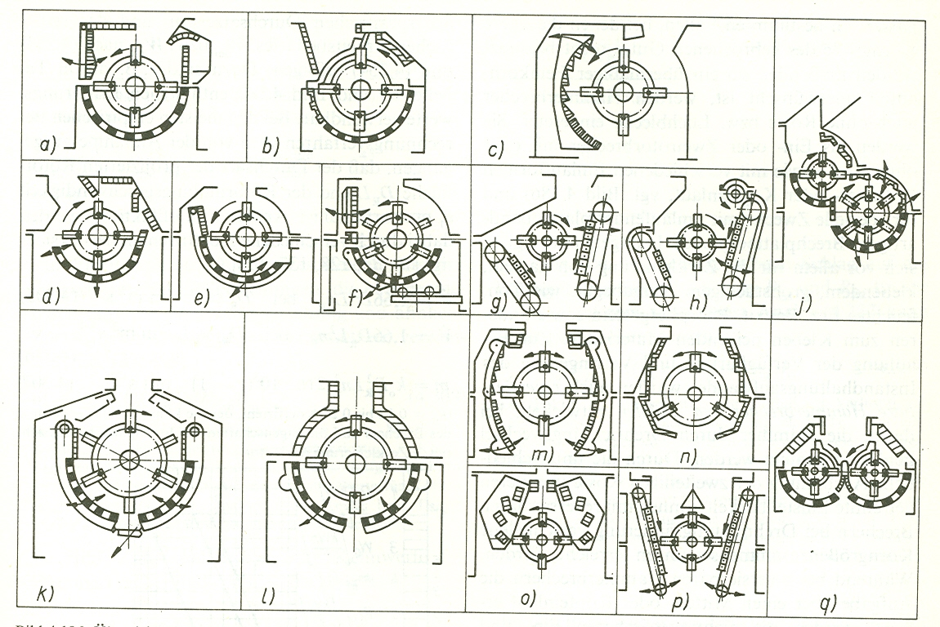
Hammer mills

Slide 40
Rollers

Slide 41
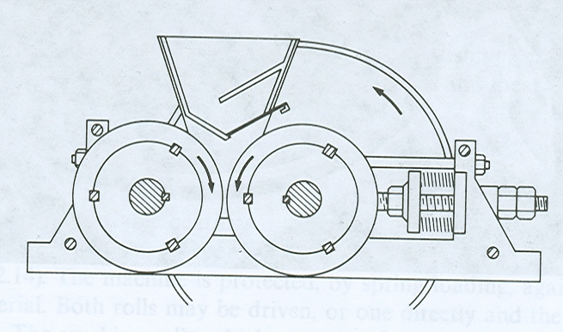
Roller mill
Notes:
Two rolls, one in adjustable bearings, rotate in opposite directions as shown in the figure and the clearance between them can be adjusted according to the size of feed and the required size of product.
The machine is protected, by spring loading, against damage from very hard material.
Both rolls may be driven, or one directly and the other by friction with the solids. The crushing rolls, which may vary from a few centimeters up to about 1.2 m in diameter, are suitable for effecting a small size reduction ratio, 4 : 1 in a single operation, and it is therefore common to employ a number of pairs of rolls in series, one above the other.
Roll shells with either smooth or ridged surfaces are held in place by keys to the main shaft.
The capacity is usually between one-tenth and one-third of that calculated on the assumption that a continuous ribbon of the material forms between the rolls.

Slide 42
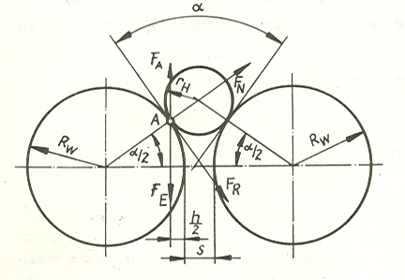
Roller mill
Notes:
An idealized system where a spherical or cylindrical particle of radius r_{H} is being fed to crushing rolls of radius R_{W} is in the figure. α is the angle of nip, the angle between the two common tangents to the particle and each of the rolls, and S is the distance between the rolls. It may be seen from the geometry of the system that the angle of nip is given by the formula given.
For steel rolls, the angle of nip is not greater than about 32◦.
Crushing rolls are extensively used for crushing oil seeds and in the gunpowder industry and they are also suitable for abrasive materials. They are simple in construction and do not give a large percentage of fines.

Slide 43
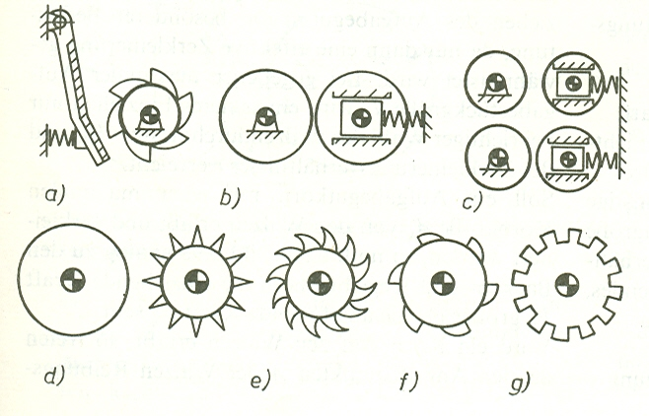
Rollers

Slide 44
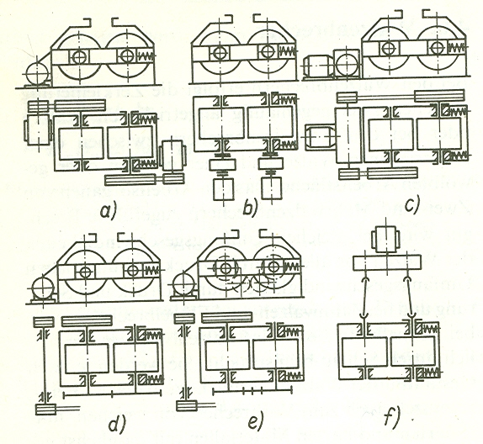
Rollers

Slide 45
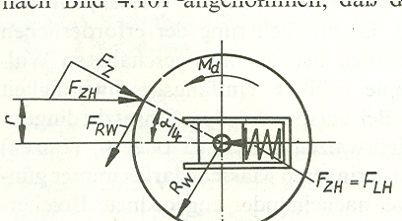
Roller

Slide 46
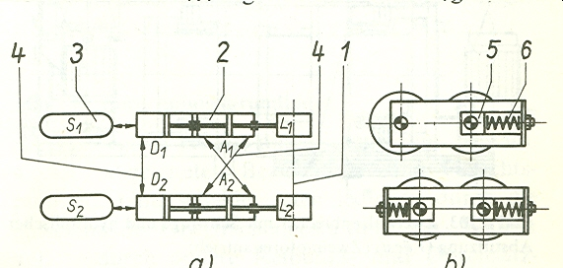
Rollers

Slide 47
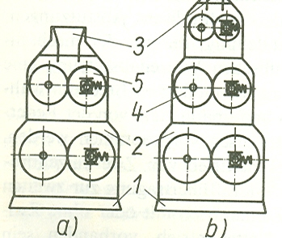
Rollers

Slide 48
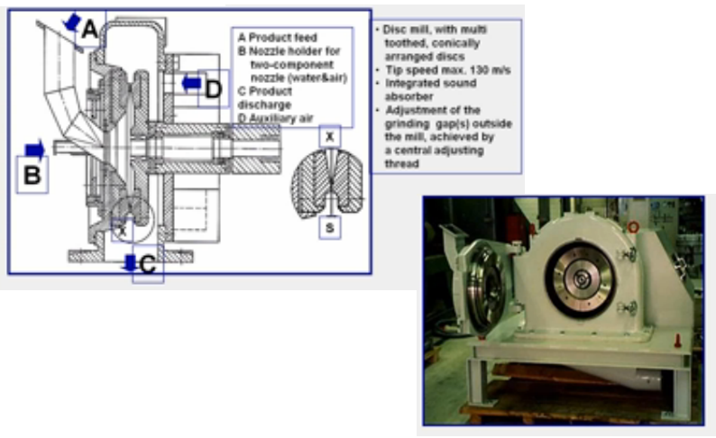
Attrition Mill

Slide 49
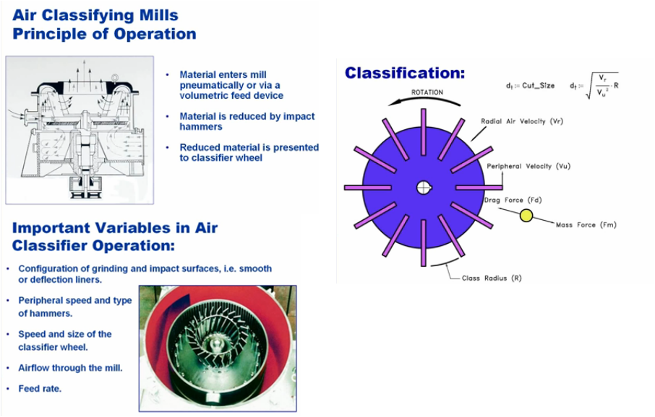
Air classifying Mills

Slide 50

Notes:
Another form of mill which does not give quite such a fine product is the jet pulveriser, in which the solid is pulverised in jets of high pressure superheated steam or compressed air, Supplied at pressures up to 3.5 MN/m² (35 bar).
The pulverising takes place in a shallow cylindrical chamber with a number of jets arranged tangentially at equal intervals around the circumference.
The solid is thrown to the outside walls of the chamber, and the fine particles are formed by the shearing action resulting from the differential velocities within the fluid streams. The jet pulveriser will give a product with a particle size of 1–10 μm.
The microniser, probably the best known of this type of pulveriser, effects comminution by bombarding the particles of material against each other. Pre-ground material, of about 500 μm in size, is fed into a shallow circular grinding chamber which may be horizontal or vertical, the periphery of which is fitted with a number of jets, equally spaced, and arranged tangentially to a common circle.
Gaseous fluid, often compressed air at approximately 800 kN/m2 (8 bar) or superheated steam at pressures of 800–1600 kN/m² (8–16 bar) and temperatures ranging from 480 to 810 K, issues through these jets, thereby promoting high-speed reduction in the size of the contents of the grinding chamber, with turbulence and bombardment of the particles against each other.
An intense centrifugal classifying action within the grinding chamber causes the coarser particles to concentrate towards the periphery of the chamber whilst the finer particles leave the chamber, with the fluid, through the central opening.
The majority of applications for fluid energy mills are for producing powders in the sub-sieve range, of the order of 20 μm and less, and it may be noted that the power consumption per kilogram is proportionately higher than for conventional milling systems which grind to a top size of about 44 μm.

Slide 51
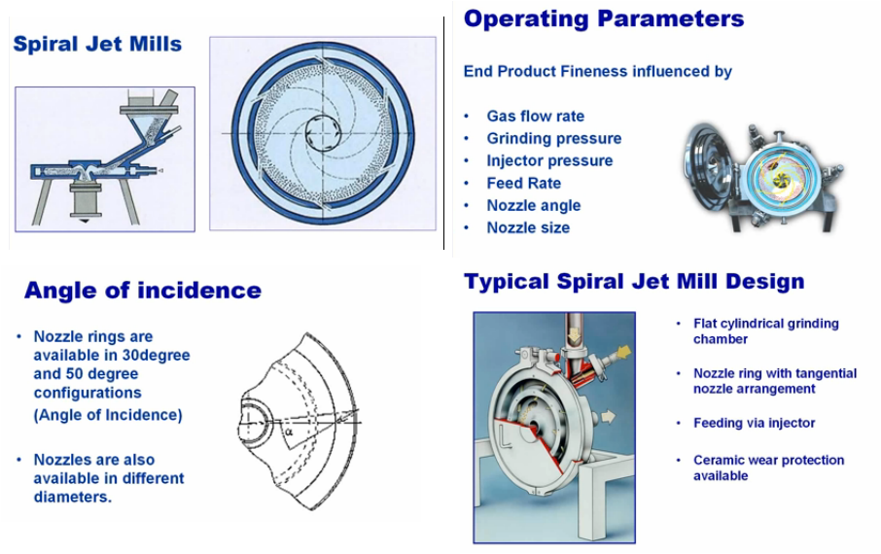
Spiral Jet Mills

Slide 52
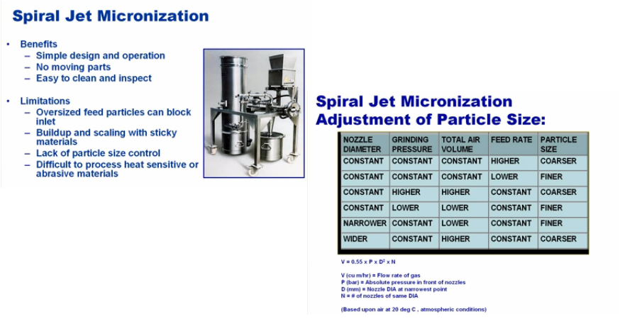
Spiral Jet Mills

Slide 53
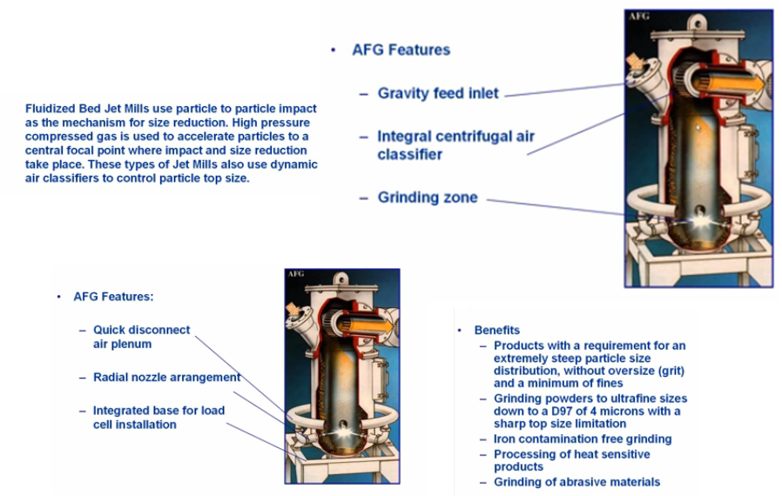
Fluidized Bed Jet Mills

Slide 54
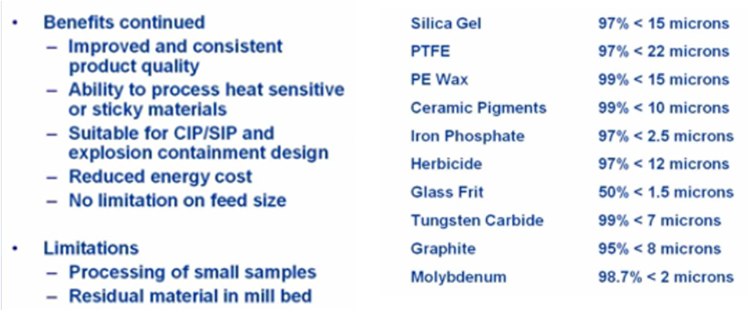
Fluidized Bed Jet Mills

Slide 55
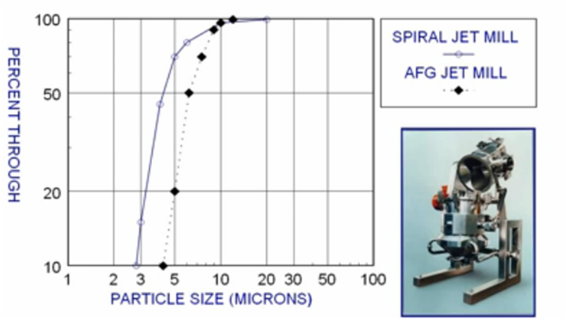
Fluidized Bed vs. Spiral Jet Mills

Slide 56
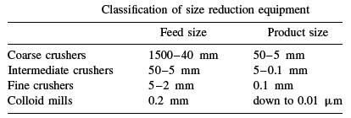
Size reduction equipment classification
Notes:
Grinding may be carried out either wet or dry, although wet grinding is generally
applicable only with low speed mills. The advantages of wet grinding are:
(a) The power consumption is reduced by about 20–30 per cent.
(b) The capacity of the plant is increased.
(c) The removal of the product is facilitated and the amount of fines is reduced.
(d) Dust formation is eliminated.
(e) The solids are more easily handled.

Slide 57

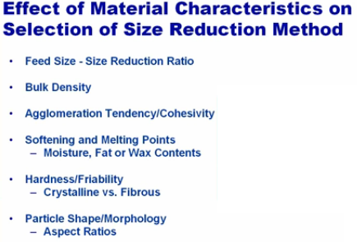
Size reduction equipment selection
Notes:
Structure. Normal granular materials such as coal, ores and rocks can be effectively
crushed employing the normal forces of compression, impact, and so on. With fibrous
materials a tearing action is required.
Moisture content. It is found that materials do not flow well if they contain between
about 5 and 50 per cent of moisture. Under these conditions the material tends to cake
together in the form of balls. In general, grinding can be carried out satisfactorily outside
these limits.
Crushing strength. The power required for crushing is almost directly proportional to
the crushing strength of the material.
Friability. The friability of the material is its tendency to fracture during normal
handling. In general, a crystalline material will break along well-defined planes and the
power required for crushing will increase as the particle size is reduced.
Stickiness. A sticky material will tend to clog the grinding equipment and it should
therefore be ground in a plant that can be cleaned easily.
Soapiness. In general, this is a measure of the coefficient of friction of the surface of
the material. If the coefficient of friction is low, the crushing may be more difficult.
Explosive materials must be ground wet or in the presence of an inert atmosphere.
Materials yielding dusts that are harmful to the health must be ground under conditions
where the dust is not allowed to escape.

Slide 58
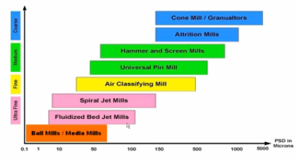
Milling classification

Slide 59
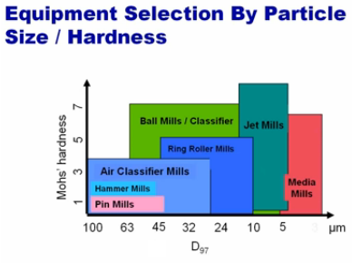
Milling classification

Slide 60


Methods of size reduction
Methods of operating size reduction equipments
  Open circuit grinding
  Closed circuit grinding
Notes:
In many plants, the product is continuously removed, either by allowing the material to fall on to a screen or by
subjecting it to the action of a stream of fluid, such that the small particles are carried away and the oversize material falls back to be crushed again.
The separators in the right side figure may be either a cyclone type, as typified by the Bradley
microsizer or a mechanical air separator.

Slide 61

Closed circuit Milling

Slide 62
Energy for size reduction
Energy utilization:
  Producing elastic deformation of the particles before fracture occurs
  Producing inelastic deformation which results in size reduction
  Causing elastic distortion of the equipment
  Friction between particles, and between particles and the machine
  Noise, heat and vibration in the plant
  Friction losses in the plant
Notes:
During the course of the size reduction processes, much energy is expended in causing
plastic deformation and this energy may be regarded as a waste as it does not result in
fracture.
The efficiency of utilization of energy as supplied by a falling mass has been compared with that of energy applied slowly by means of hydraulic pressure. Up to three or four times more surface can be produced per unit of energy if it is applied by the latter method.

Slide 63
Energy for size reduction
Draw back:
The energy required to reduce 100mm to 50mm is the same to that required for reducing 1mm to 0.5mm.
High energy is required to reduce finer particles
Can be applied for coarse crushing
Kick’s law: the work required for
crushing a given quantity of material
is constant for a given reduction ratio
irrespective of original size.

Slide 64
Energy for size reduction
Rittinger’s law: the work required for size reduction is directly proportional to
the new surface created.

Slide 65

Energy for size reduction
Applicable for intermediate and
Coarse size reduction
Overall energy efficiency = (energy required to create new surface)/Total energy supplied

Slide 66

Energy for size reduction
Bond’s law: The total work useful in breakage that has been applied to a given weight of material is inversely proportional to the square root of the average particle size of the product and the feed.
is calculated based on work index
Work index : is defined as the gross energy (in kWh/tonne of feed) necessary to reduce
a very large feed to such a size that 80% of product particles will pass through a 0.1 mm screen
If
then
For dry grinding, multiply this values by 1.34
Applicable for fine size reduction

Slide 67
Example: A grinder is to be used (which is 8% efficient) to handle 10 tonnes/hr of siliceous ore (specific gravity = 2.65). The feed and product analysis are given below: The grinder operates on a 24 hour basis for 300 days per year. Electricity costs 0.7Birr per kWh. If the work index is 13.57 kWh/tonne, then calculate the annual energy cost.
Screen Size [mm] | Feed mass fraction | Product mass fraction
-3.327+2.362 -2.362+1.651 -1.651+1.168 -1.168+0.833 -0.833+0.589 -0.589+0.417 -0.417+0.295 -0.295+0.208 -0.208+0.147 -0.147+0.104 -0.104 | 0.143 0.211 0.230 0.186 0.120 0.076 0.034 0.0 0.0 0.0 0.0 | 0.0 0.0 0.0 0.098 0.234 0.277 0.149 0.101 0.068 0.044 0.029

Slide 68
Solution:
Energy per unit mass based on Bond’s law
From the cumulative distribution plot, the diameters from which 80% of particles are less for the product and the feed can be read.

Slide 69

Oversize
Undersize

Slide 70


