Slide 1
Heat exchanger design
Lecture 4
Example and Important formula’s
©Kalid.H
2019

Slide 2
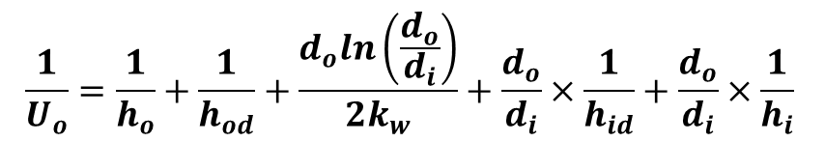
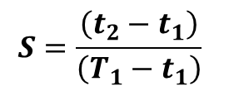

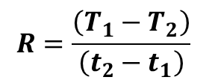
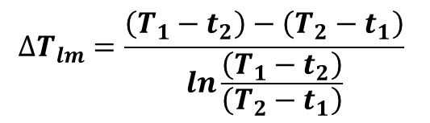

The general equation for heat transfer across a surface
$$Q=UA∆T_{m}=\dot{mC∆T}$$
h_{i} and h_{o} are tube side and shell side heat transfer Coefficients; calculated by empirical correlations.
h_{id} and h_{od} are fouling factors for tube side and shell side fluid and can be read from books or handbooks.
d_{i} and d_{o} are tube inside and out side diameter.
$$\frac{1}{U_{o}}=\frac{1}{h_{o}}+\frac{1}{h_{od}}+\frac{d_{o}ln\left(\frac{d_{o}}{d_{i}}\right)}{2k_{w}}+\frac{d_{o}}{d_{i}}×\frac{1}{h_{id}}+\frac{d_{o}}{d_{i}}×\frac{1}{h_{i}}$$
$$∆T_{m}=F_{t}∆T_{lm}$$
$$∆T_{lm}=\frac{\left(T_{1}−t_{2}\right)−\left(T_{2}−t_{1}\right)}{ln\frac{\left(T_{1}−t_{2}\right)}{\left(T_{2}−t_{1}\right)}}$$
F_{t} = f (R,S)
$$R=\frac{\left(T_{1}−T_{2}\right)}{\left(t_{2}−t_{1}\right)}$$
$$S=\frac{\left(t_{2}−t_{1}\right)}{\left(T_{1}−t_{1}\right)}$$

Slide 3
Example
This example is taken from Coulson and Richardson “Chemical Engineering design” vol6 chapter 12 example 12.3
Design a shell-and-tube exchanger for the following duty. 20,000 kg/h of kerosene (42° API) leaves the base of a kerosene side-stripping column at 200°C and is to be cooled to 90°C by exchange with 70,000 kg/h light crude oil (34° API) coming from storage at 40°C. The kerosene enters the exchanger at a pressure of 5 bar and the crude oil at 6.5 bar. A pressure drop of 0.8 bar is permissible on both streams. Allowance should be made for fouling by including a fouling factor of 0.0003 (W/m^{2 °}C) ⁻¹ on the crude stream and 0.0002 (W/m2 °C) ⁻¹ on the kerosene stream.

Slide 4
Step 1 :Specification
The specification is given in the problem statement.
    Mass flow rate of kerosene = 20,000 kg/h
    Mass flow rate of crude oil = 70,000 kg/h
    Kerosene inlet temperature = 200°C
    Kerosene out let temperature = 90°C
    crude oil inlet temperature = 40°C.
    crude oil outlet temperature = ? (not specified in the problem statement ; need to perform material and energy balance)
    The kerosene pressure 5 bar, the crude oil pressure 6.5 bar.
    Permissible pressure drop of 0.8 bar on both streams.
    Fouling factors: crude stream 0.00035 (W/m^{2 °}C) ⁻¹ , kerosene stream 0.0002 (W/m^{2 °}C) ⁻¹ .
The specification is not complete without calculating the out side temperature of crude oil and Q

Slide 5
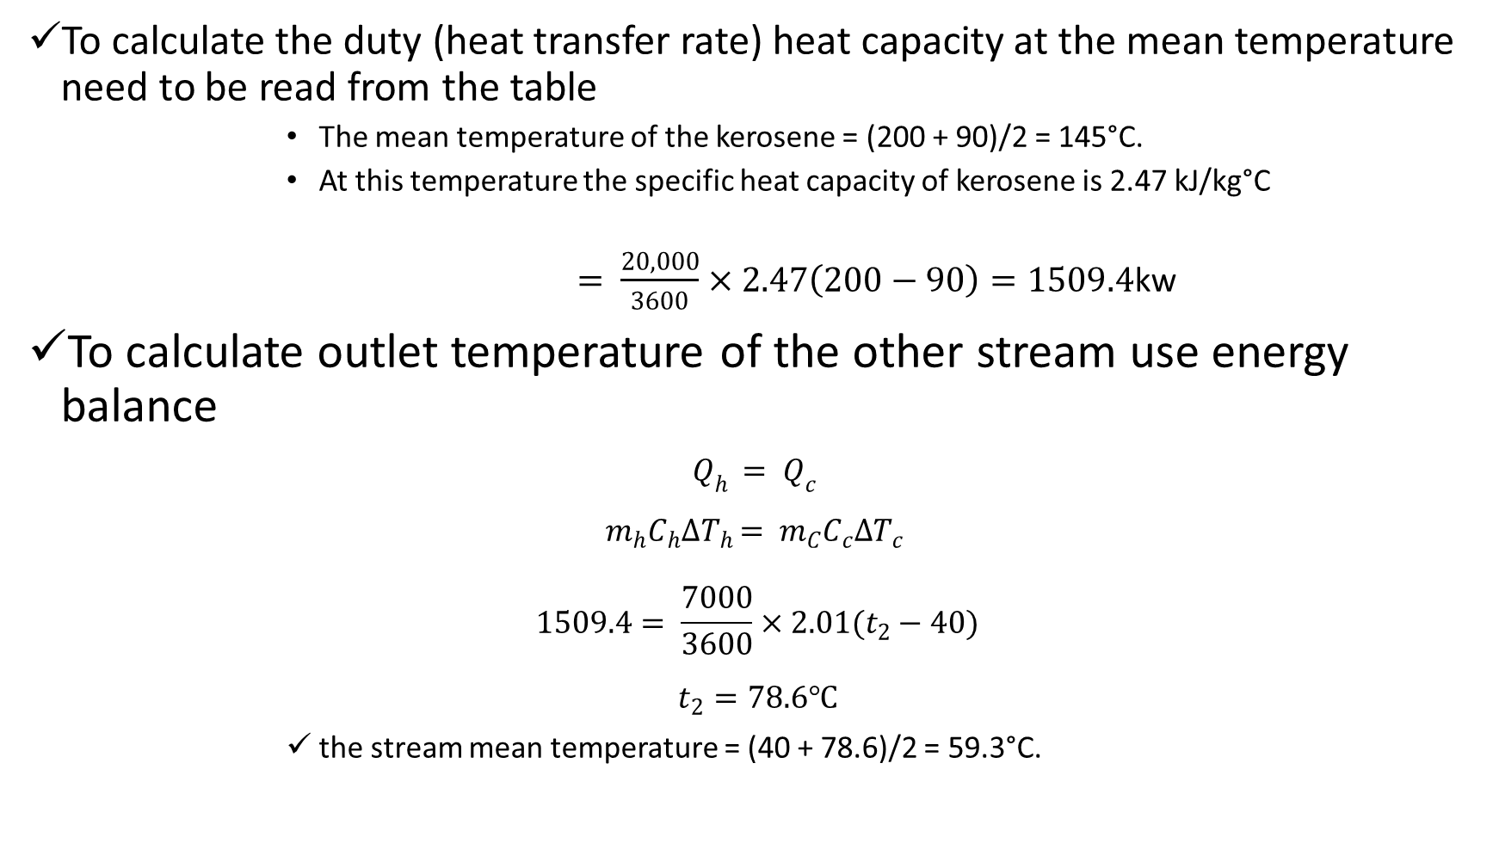
To calculate the duty (heat transfer rate) heat capacity at the mean temperature need to be read from the table
        The mean temperature of the kerosene = (200 + 90)/2 = 145°C.
        At this temperature the specific heat capacity of kerosene is 2.47 kJ/kg°C
        $= \frac{20,000}{3600}×2.47\left(200−90\right)=1509.4$kw
To calculate outlet temperature of the other stream use energy balance
$$Q_{h }= Q_{c }$$
$$m_{h}C_{h}{∆T}_{h }= m_{C}C_{c}{∆T}_{c }$$
$$1509.4= \frac{7000}{3600}×2.01(t_{2}−40)$$
$$t_{2}=78.6℃$$
        the stream mean temperature = (40 + 78.6)/2 = 59.3°C.
Q = ḿCΔT
As a first trial take the mean temperature of the crude oil as equal to the inlet temperature,
40°C; specific heat capacity at this temperature = 2.01 kJ/kg°C.
The specific heat at this temperature is 2.05 kJ/kg°C. A second trial calculation using this value gives t2 = 77.9°C and a new mean temperature of 58.9°C. There is no significant change in the specific heat at this mean temperature from the value used, so take the crude stream outlet temperature to be 77.9°C, say 78°C.

Slide 6
Step 2: Physical Properties
Kerosene | inlet | mean | outlet
temperature | 200 | 145 | 90 °C
specific heat | 2.72 | 2.47 | 2.26 kJ/kg°C
thermal conductivity | 0.130 | 0.132 | 0.135 W/m°C
density | 690 | 730 | 770 kg/m3
viscosity | 0.22 | 0.43 | 0.80 mN sm⁻²
Crude oil | inlet | mean | outlet
temperature | 78 | 59 | 40 °C
specific heat | 2.09 | 2.05 | 2.01 kJ/kg°C
thermal conductivity | 0.133 | 0.134 | 0.135 W/m°C
density | 800 | 820 | 840 kg/m3
viscosity | 2.4 | 3.2 | 4.3 mN sm⁻²
temperature | 78 | 59 | 40 °C
specific heat | 2.09 | 2.05 | 2.01 kJ/kg°C

Slide 7
Step 3: Guess overall coefficient
Use figure 12.1 and Table 12.1(Coulson vol.6, chapter 12) or other heat exchanger design books to locate U0
Start with initial guess of Uo = 300

Slide 8
Step 4: Exchanger type and dimensions
An even number of tube passes is usually the preferred arrangement
    Start with one shell pass and 2 tube passes
read value of Ft from Figure 12.19
Calculate

Slide 9
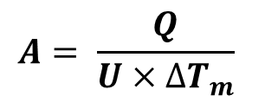

Ft = 0.88
$$∆T_{m}= ∆T_{lm}×F_{t}$$
Step 5: Heat transfer area
$$A= \frac{Q}{U×{∆T}_{m}}$$

Slide 10
Step 6: Layout and tube size
Exchanger type
    Using a split-ring floating head exchanger for efficiency and ease of cleaning.
Construction material
    Neither fluid is corrosive, and the operating pressure is not high, so a plain carbon steel can be used for the shell and tubes.
Fluid allocation
    The crude is dirtier than the kerosene, so put the crude through the tubes and the kerosene in the shell.
Tube dimension
    Use 19.05 mm (3/4 inch) outside diameter, 14.83 mm inside diameter, 5 m Long tubes (a popular size) on a triangular 23.81 mm pitch (pitch/dia. = 1.25).

Slide 11
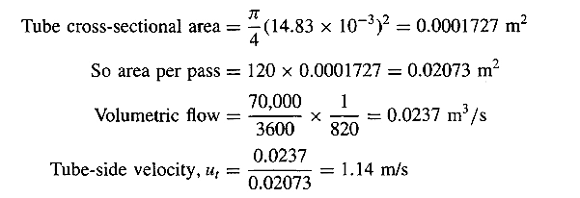


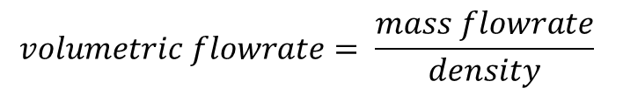

Step 7: Number of tubes
$$Number of tubes\left(Nt\right)= \frac{Total heat transfer area}{area of one tube}= \frac{A_{o}}{πd_{o}L}$$
$Area of one tube= πd_{o}L$ = $π×19.05×{10}^{−3}×5=0.2992m^{2}$
$$Number of tubes= \frac{70.89}{0.2992}=237 ≅240$$
So, for 2 passes, number of tubes per pass = 120
Check the tube-side velocity at this stage to see if it looks reasonable
$$Tube side velocity \left(U_{t}\right)= \frac{volumetric flowrate}{Area per pass}$$
$$volumetric flowrate= \frac{mass flowrate}{density}$$
$$Area per pass=Tube cross sectional area ×number of tubes per pass$$

Slide 12
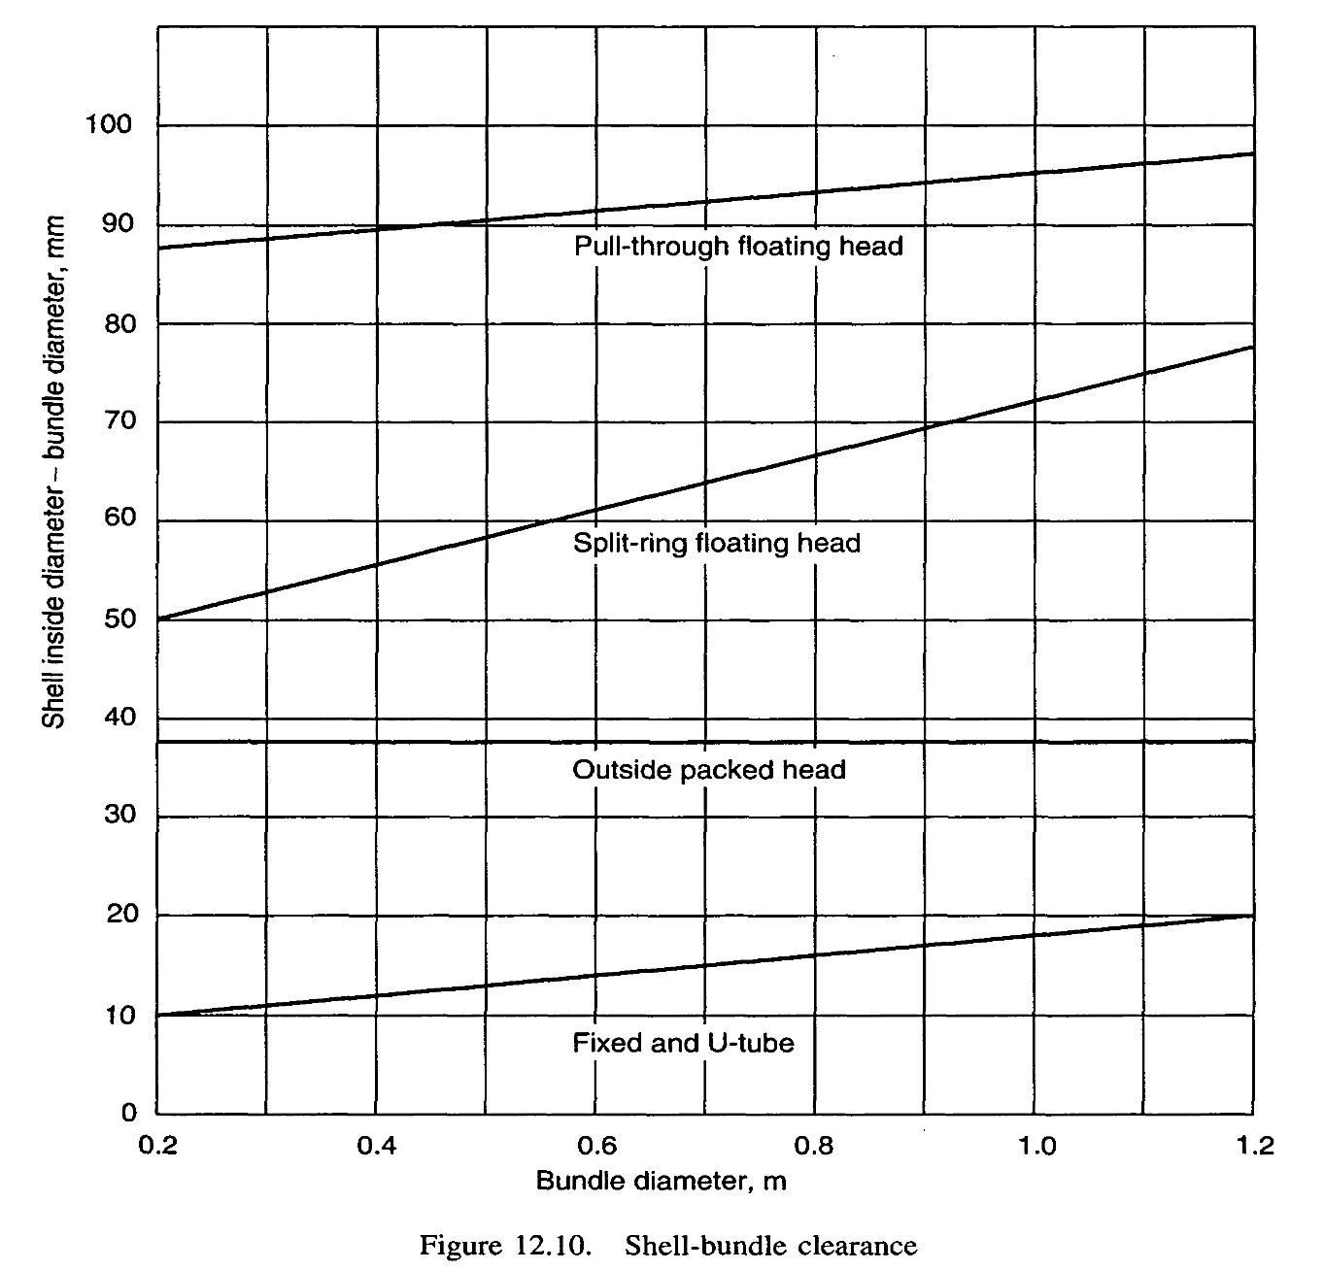


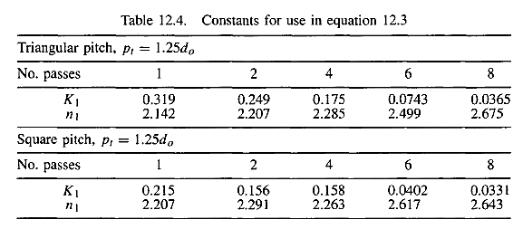

Step 8: Bundle and shell diameter
From Table 12.4, for 2 tube passes, Kl = 0.249, n, = 2.207,
$$shell diameter= boundle diameter +shell clearance$$
Shell clearance can be read from Figure 12.10, so for a split-ring floating head exchanger the shell clearance is 56 mm

Slide 13
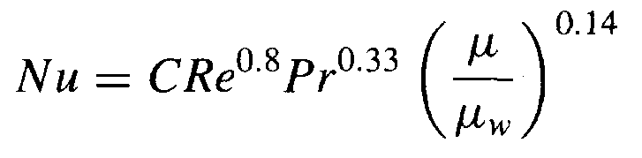
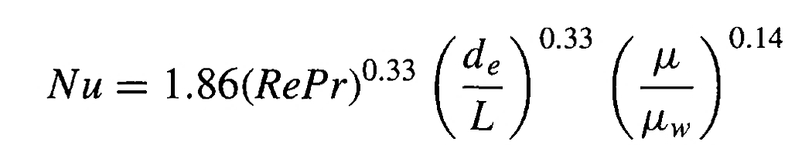
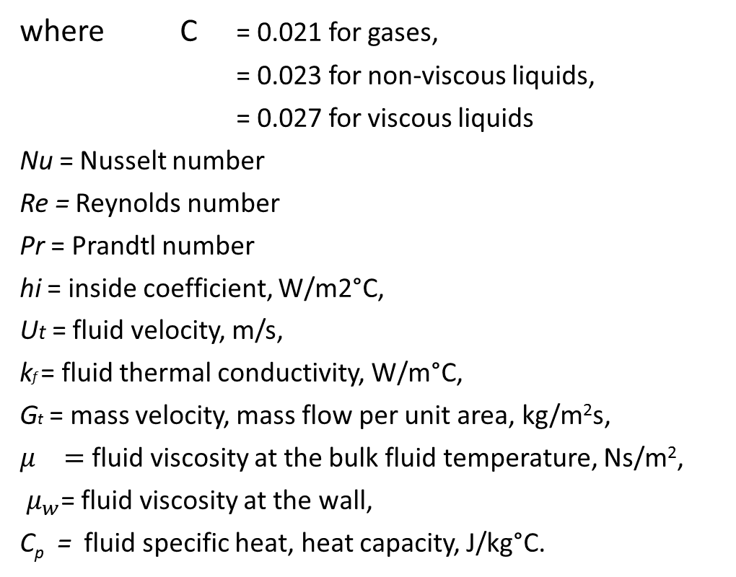

Step 9: Tube-side heat transfer coefficient
For turbulent flow
where C = 0.021 for gases,
= 0.023 for non-viscous liquids,
= 0.027 for viscous liquids
Nu = Nusselt number
Re = Reynolds number
Pr = Prandtl number
hi = inside coefficient, W/m2°C,
Ut = fluid velocity, m/s,
kf = fluid thermal conductivity, W/m°C,
Gt = mass velocity, mass flow per unit area, kg/m²s,
$μ_{}=$ fluid viscosity at the bulk fluid temperature, Ns/m²,
$μ_{w}$= fluid viscosity at the wall,
C_{p} = fluid specific heat, heat capacity, J/kg°C.
$$N_{u}=C{Re}^{a}{Pr}^{b}{\left(\frac{μ}{μ_{w}}\right)}^{0.14}= \frac{h_{i}d_{e}}{k_{f}}$$
$$Re= \frac{ρu_{t }d_{e}}{μ} = \frac{G_{t}d_{e}}{μ}$$
$$\operatorname{Pr}{= \frac{C_{p}μ}{k_{f}}}$$
$$d_{e}= \frac{4×cross−sectional area for flow}{wetted perimeter}$$
For laminar flow

Slide 14

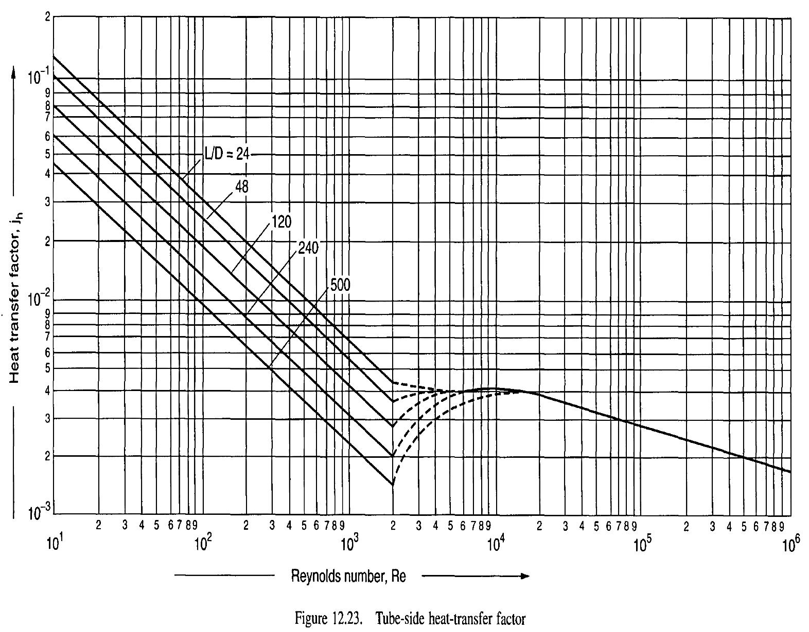
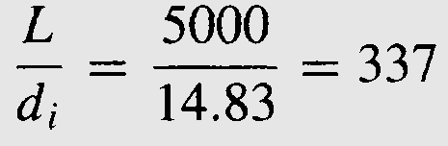

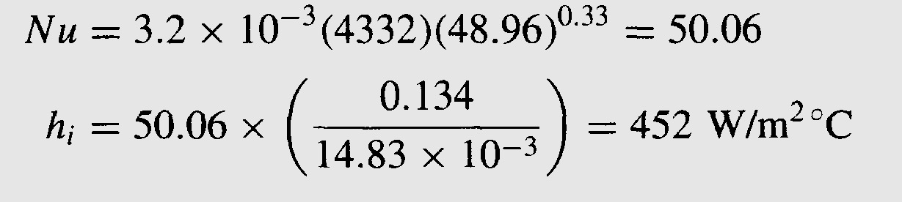
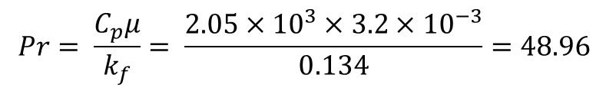
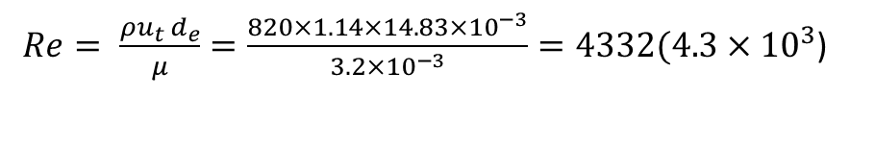
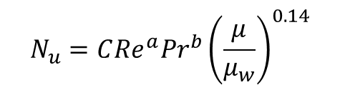
Heat transfer correction factor which is similar to the friction factor
used for pressure drop
Read jh factor from figure 12.23
$$N_{u}=C{Re}^{a}{Pr}^{b}{\left(\frac{μ}{μ_{w}}\right)}^{0.14}$$
$Re= \frac{ρu_{t }d_{e}}{μ}=\frac{820×1.14×14.83×{10}^{−3}}{3.2×{10}^{−3}}=4332(4.3×{10}^{3}$)
$$\operatorname{Pr}{= \frac{C_{p}μ}{k_{f}}= \frac{2.05×{10}^{3}×3.2×{10}^{−3}}{0.134}=48.96}$$

Slide 15
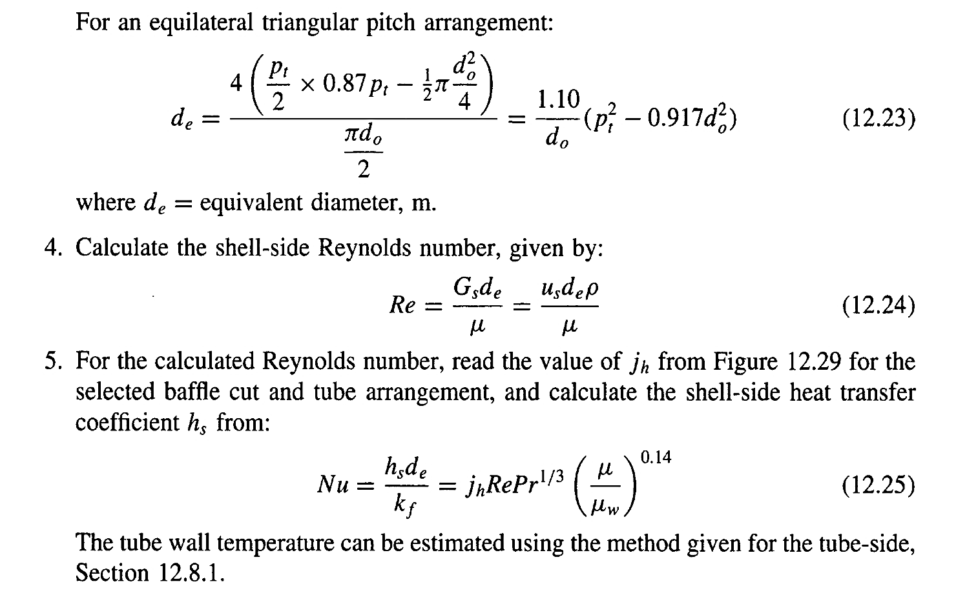
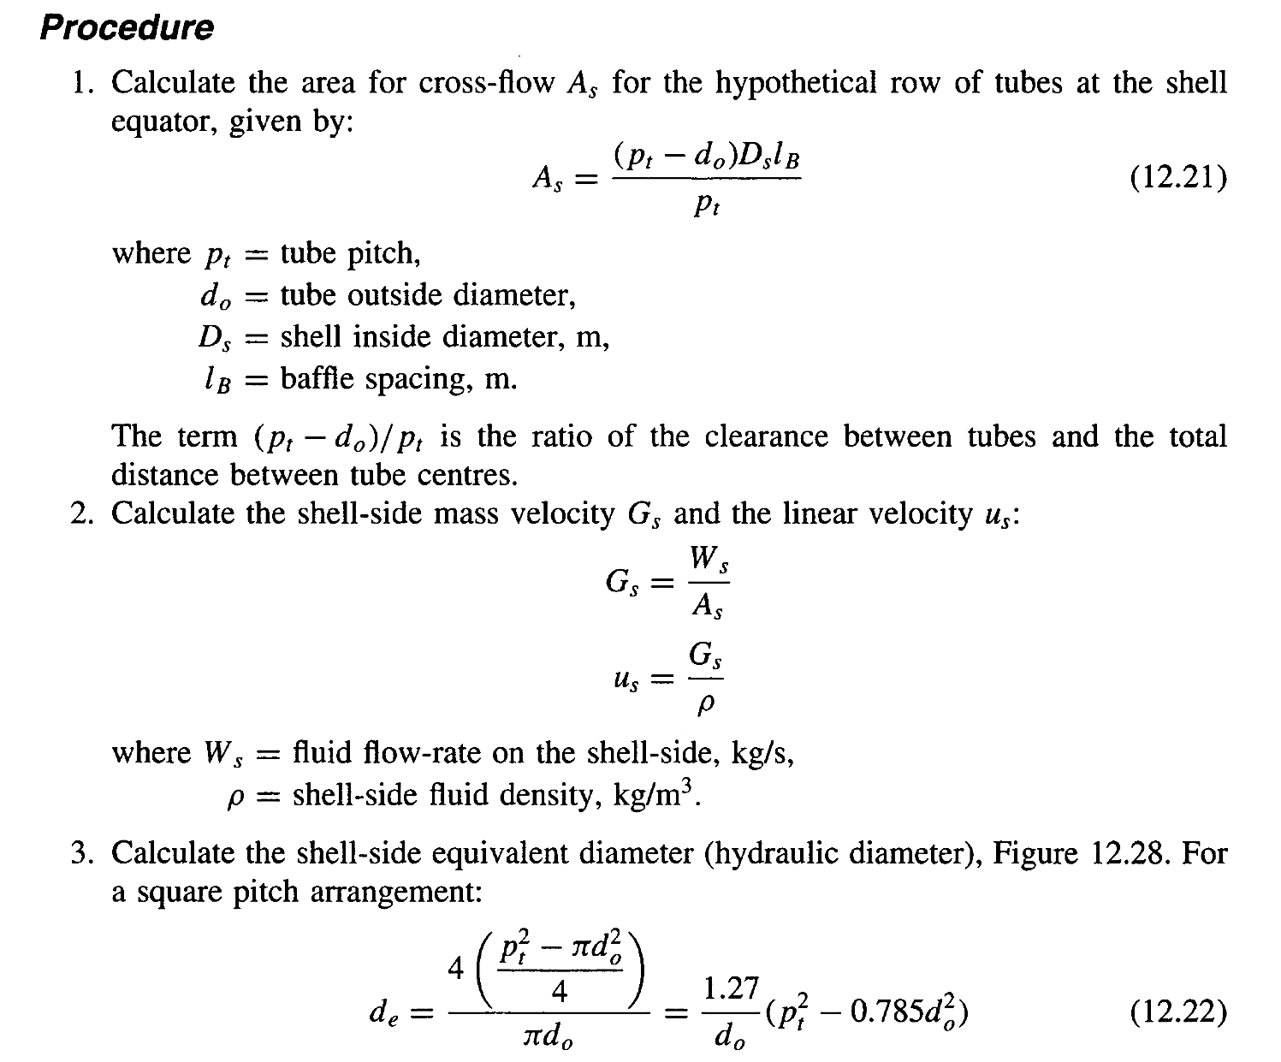
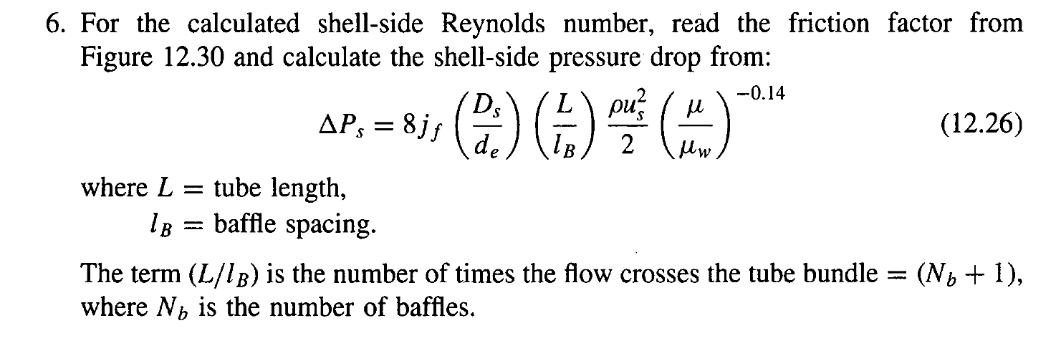
Step 10: Shell-side heat transfer coefficient

Slide 16
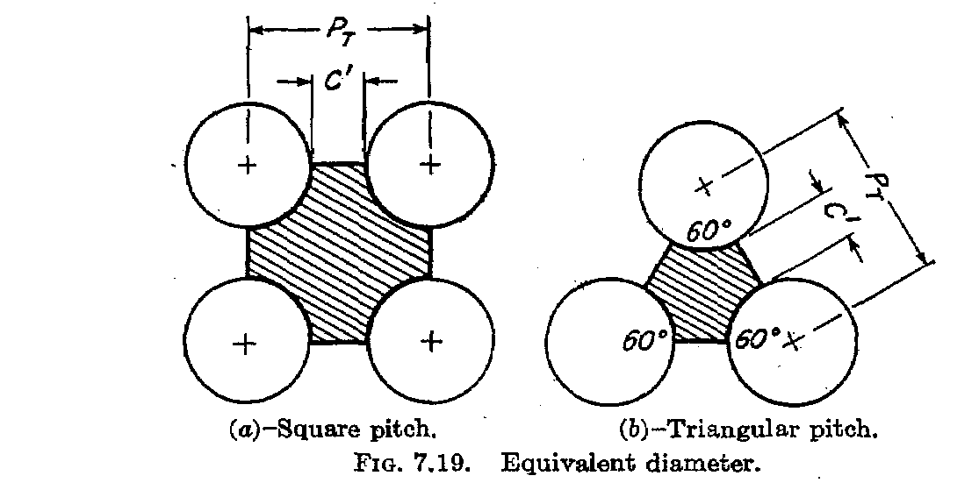

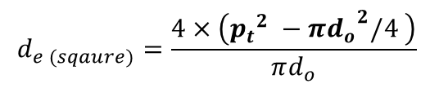
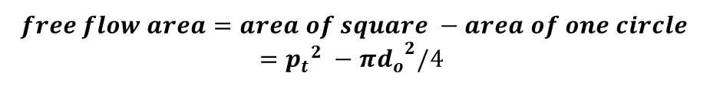

$$πd_{o}$$
$$d_{e}=\frac{4×free flow area}{wetted perimeter}$$
Wetted perimeter = the part of pipe in contact with the fluid
$$free flow area=area of square −area of one circle$$
$$={p_{t}}^{2} −π{d_{o}}^{2}/4$$
$$d_{e (sqaure)}=\frac{4×\left({p_{t}}^{2} −π{d_{o}}^{2}/4 \right)}{πd_{o}}$$
Free Flow Area for Triangular Layout:
Wetted Perimeter for triangular layout

Slide 17
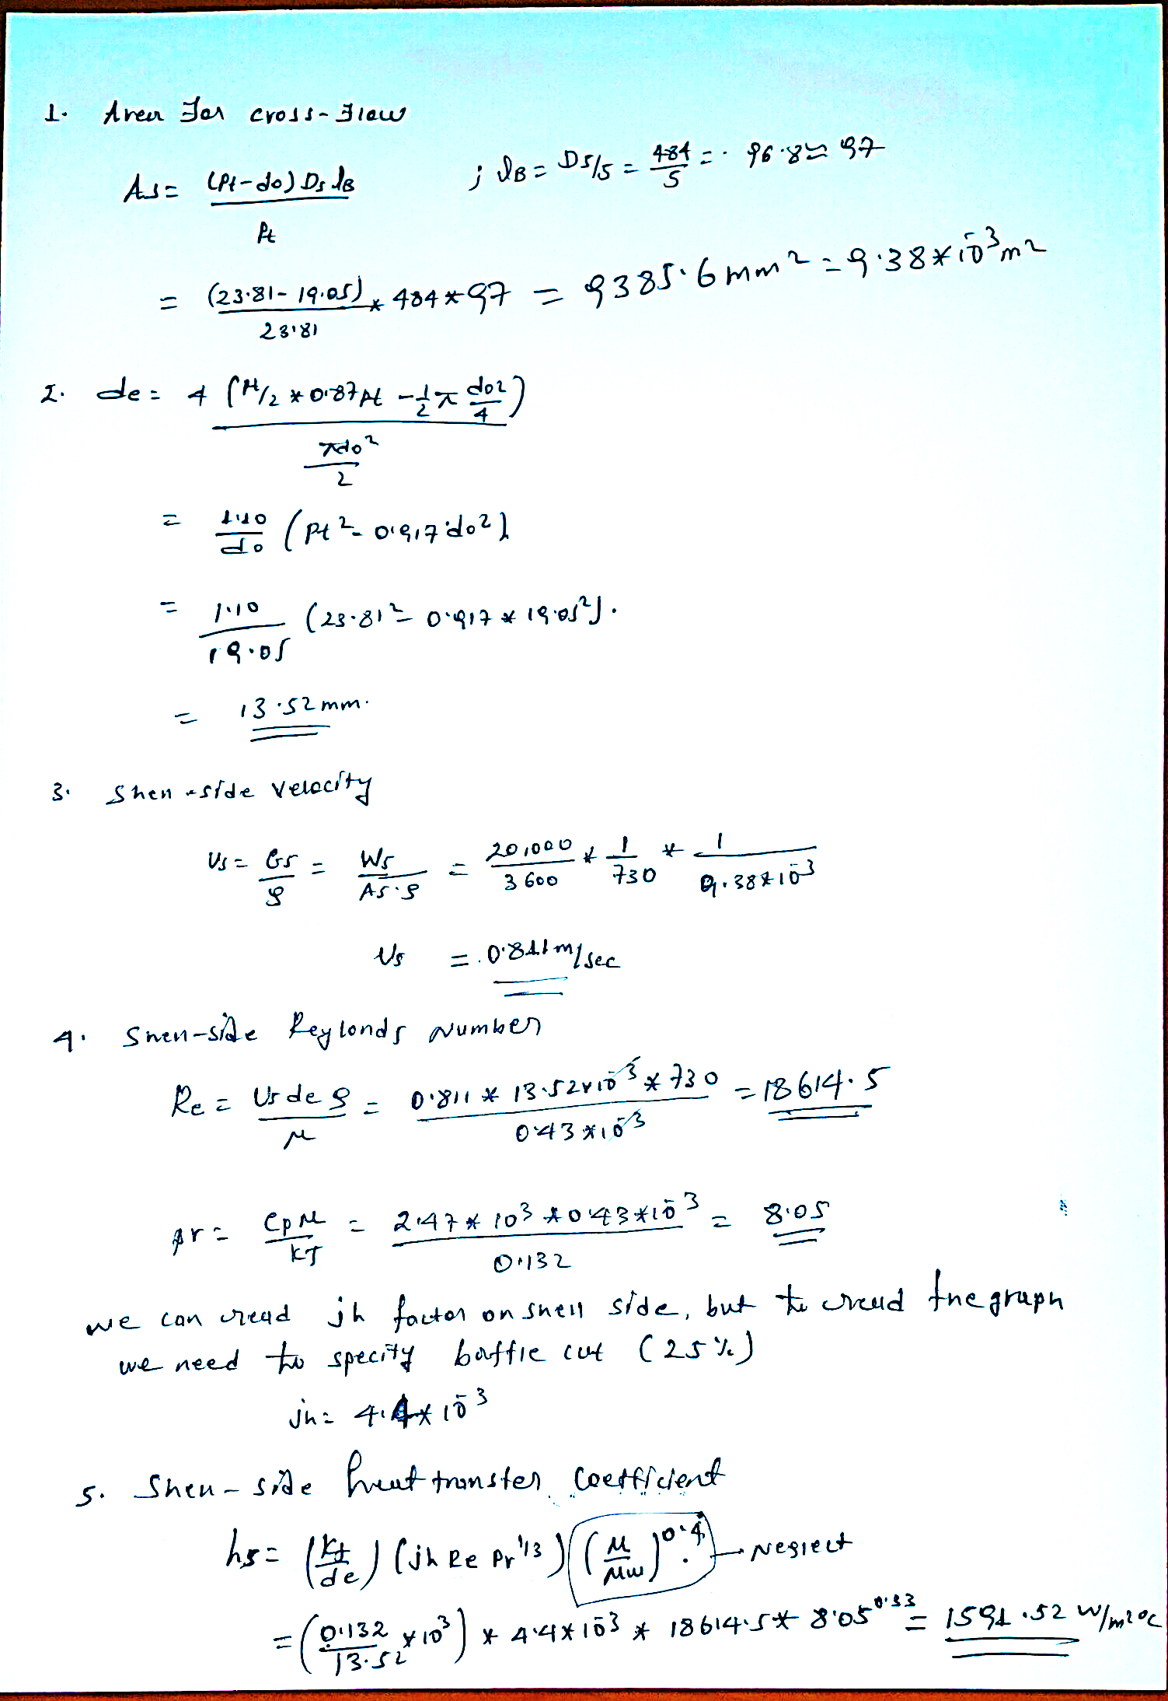
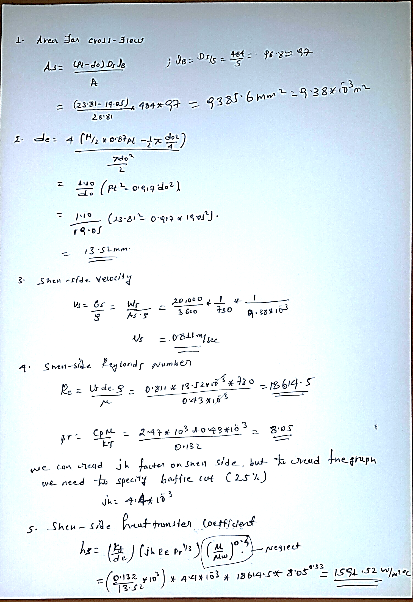
Step 10 ………………..

Slide 18
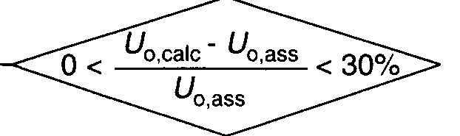
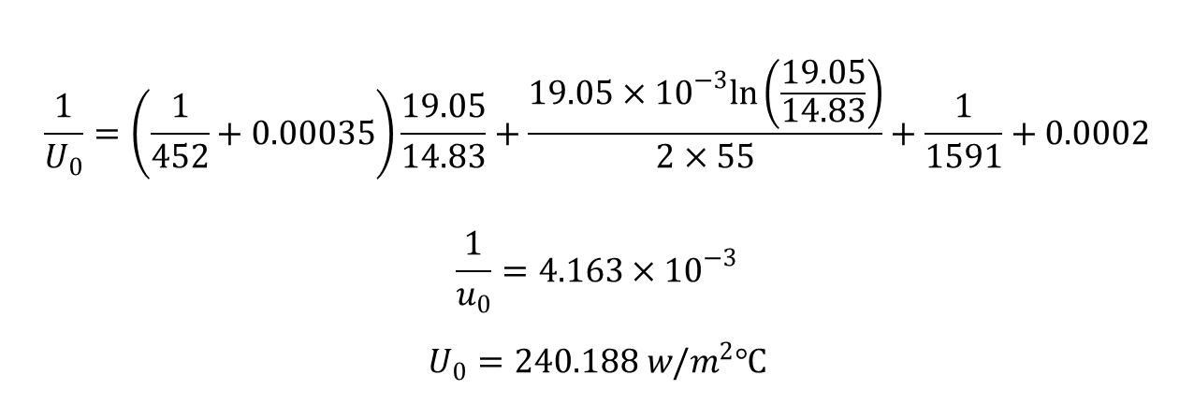
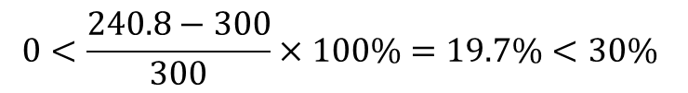
Step 11: Overall coefficient
$$0<\frac{240.8−300}{300}×100\%=19.7\%<30\%$$
$$\frac{1}{U_{0}}=\left(\frac{1}{452}+0.00035\right)\frac{19.05}{14.83}+\frac{19.05×{10}^{−3}ln\left(\frac{19.05}{14.83}\right)}{2×55}+\frac{1}{1591}+0.0002$$
$$\frac{1}{u_{0}}=4.163×{10}^{−3}$$
$$U_{0}=240.188 w/m^{2}℃$$
This is below the initial estimate of 300 W/m²°C.

Slide 19
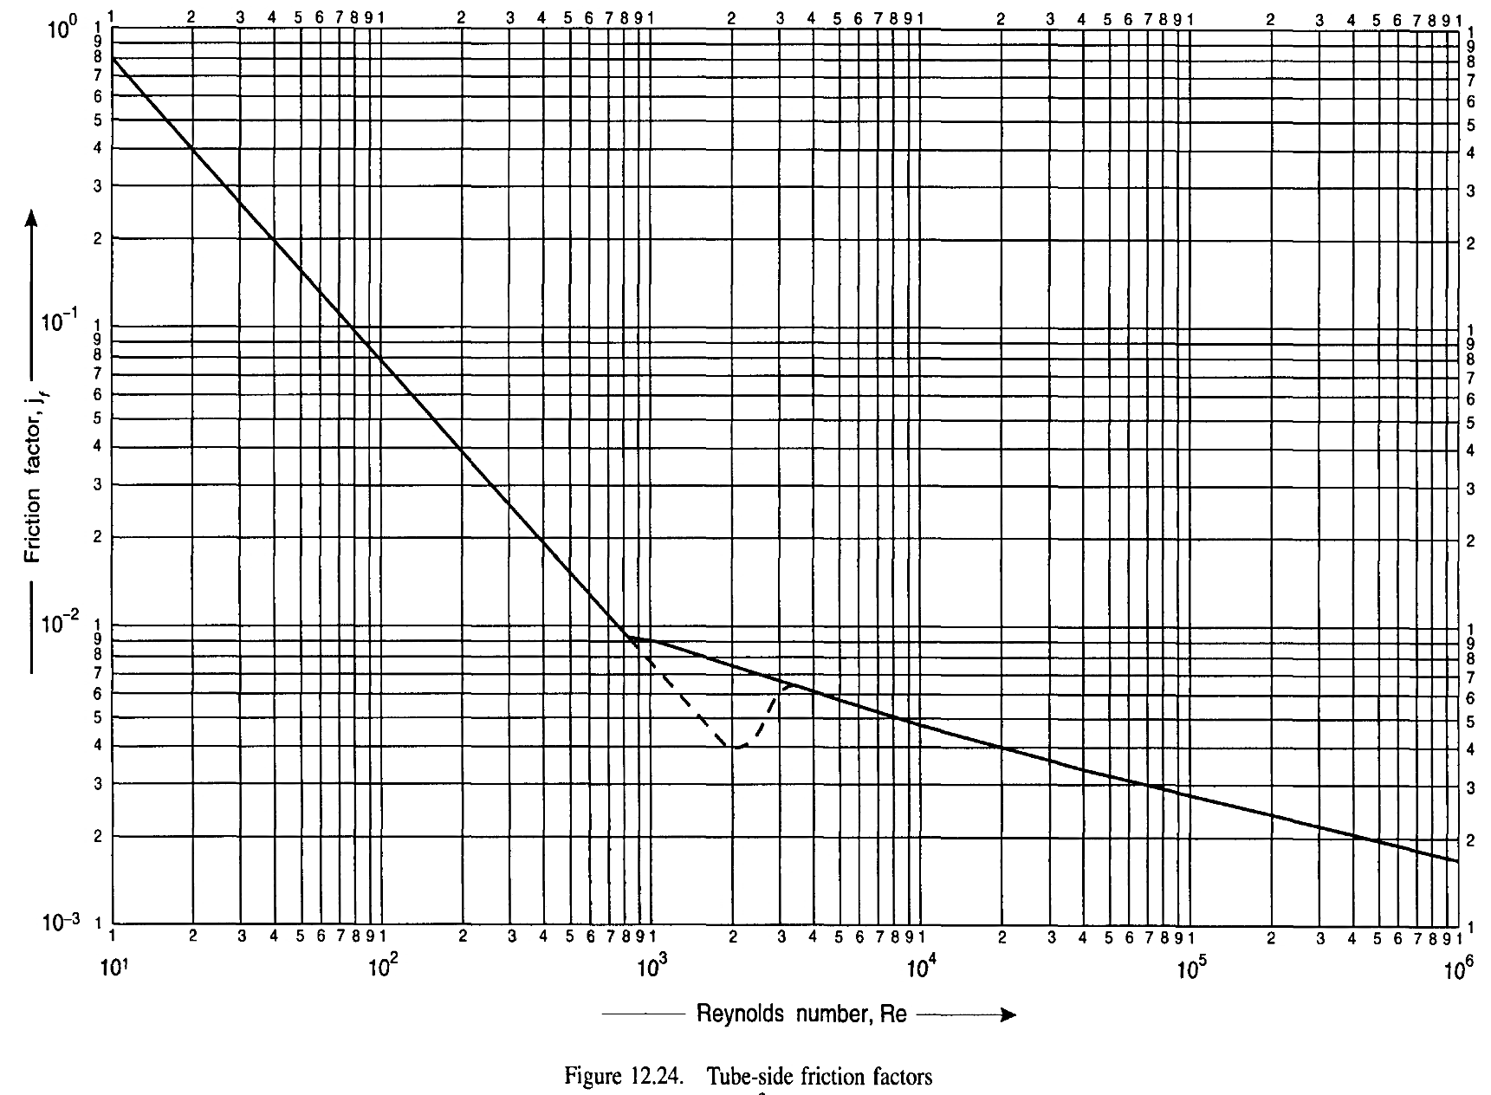
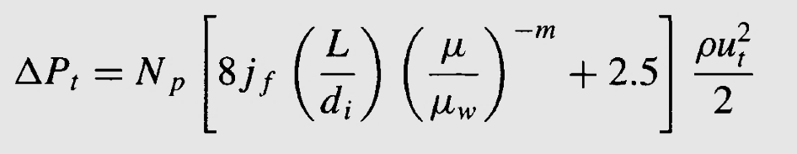

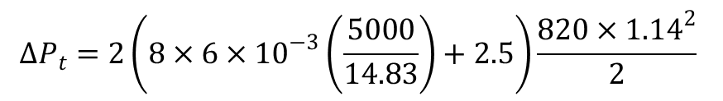

Step 12: Pressure drop
(tube side)
$Re= 4332(4.3×{10}^{3}$)
J_{f}= 6 x 10 ⁻³
$$∆P_{t}=2\left(8×6×{10}^{−3}\left(\frac{5000}{14.83}\right)+2.5\right)\frac{820×{1.14}^{2}}{2}$$
$∆P_{t}=$19910.38 N/m²
= 0.199 bar
The pressure drop is within acceptable range
N.B the example in the book follows correcting the pressure drop since it exceeds the limit, so you have to refer the
Text for possible procedure in adjusting the pressure drop.

