Slide 1
Bahir Dar University
Institute of Land Administration
BSC degree in Land Administration and Surveying Program
Course Title: Macro-economics for land administration
Course Code: LaAd3073
Instructor Name : Wudu Muluneh
Target group: Third Year Land Administration Students
Total contact hour: 135

Slide 2
Course Objectives
Upon the completion of the course, students will be able to:
Understand and describe the goals of macroeconomic policies and describe how these goals are measured;

Slide 3
Cont’d
Explain the interrelatedness of markets, fiscal and monetary policy and how they work;
Apply graphs and algebra to explain the use of fiscal and monetary policy to achieve full employment, price stability and economic growth;
and Understand the role of financial institutions in economic growth.

Slide 4
Mode of delivery
Aimed at Promoting Active Learning
Lecturing supported by Power Point Presentations
Class Room Group Discussions
Exercises and Tutorials
Class Room Question and Answer
Independent Reading and Book reviews

Slide 5
Mode of Assessment
The weight breakdown of the assessment method is as follows;
  Final Examination…………………40%
  Mid Examination..…………………25%
  Group Assignment……………….12%
  Individual Assignment……………11%
  Quizzes……………………………12%
  Total ….…………………………100%

Slide 6
Course Policy
Attendance is mandatory
Expectation for Classroom Behavior
  Contribute in class discussion
  Meet assignment deadlines
  Courtesy and respect
  Discipline
  Punctuality
  Cell phones must be Silent/switched off
Late submission is not acceptable
Missing Exam and Tests (medical case & emergency only)

Slide 7
Course Contents
Chapter One: An overview to macroeconomics
Chapter Two: National Income Accounting
Chapter Three: Aggregate Demand and Aggregate Supply
Chapter Four: Theory of Money Demand and Supply
Chapter Five: Fiscal and Monetary Policy
Chapter Six: Dynamics and Macro policy

Slide 8
Any Questions?
If not…Let’s start

Slide 9
Keynote speech 1: 2 hrs.
Chapter One: An overview to macroeconomics
Contents
What is Macroeconomics?
Macroeconomic Goals

Slide 10
1. What Is Macroeconomics?
Economics as a subject is mainly studied under two major Branches, namely microeconomics and macroeconomics.
Microeconomics examines the behavior of basic elements in the economy, including individual agents (such as households and firms or as buyers and sellers) and markets, and their interactions.
Macroeconomics analyzes the entire economy and issues affecting it, such as unemployment, inflation, economic growth, and monetary and fiscal policy.
Notes:
Forest vs. trees. Macroeconomics is study of the forest. Microeconomics is study of individual trees.
Aggregate - (n) a total, a mass or amount, brought together. (v) to collect or form into an aggregate.
Aggregate demand represents the total spending on all final goods and services in an economy by all consumers.
Problem with aggregation of preferences. Could add pro-con votes as in an election. But, how do you account for differences in intensity of preferences?

Slide 11
Cont’d
Microeconomics (“small” economics) and Macroeconomics (“big” economics).
Microeconomics - deals with the economic behavior of individual decision-making units such as consumers, resource owners, business firms and individual markets, industries, organizations etc.
For instance, we measure the price of a specific product, the number of workers employed by a single firm, the revenue or expenditures of a particular firm or government entity, etc.

Slide 12
Cont’d
The major goal of microeconomics is to understand how the prices of particular commodities influence decisions.
Because of its preoccupation with prices and trading of goods and services, microeconomics is sometimes called price theory.
Macroeconomics- examines the economy as a whole or its basic sub-divisions or aggregates such as the government, household and business sector.

Slide 13
Cont’d
An aggregate is a collection of specific economic units treated as if they were one unit.
These aggregate macro variables include the aggregate level of output, national income, and aggregate employment, the general price level, national consumption, national saving and investment, money supply, exchange rate, etc.

Slide 14
Cont’d
Macroeconomics looks at the economy from a broader perspective by considering its overall performance and the way various sectors of the economy relate to one another.
The performance of an economy is judged by the total value of annual production/ income, the capacity of the economy to provide jobs/ create employment, stability of prices (inflation, interest rate, and exchange rate).

Slide 15
Cont’d
Macroeconomics is said to be policy oriented branch of economics as it helps in explaining the causes of economic fluctuations and to suggest appropriate policy measures.
National policies are formulated based on macroeconomic data.

Slide 16
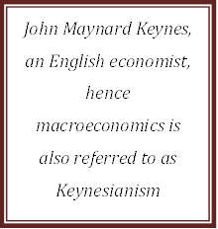
Who introduced macroeconomics?
Notes:
In 1936, John Maynard Keynes published The General Theory of Employment, Interest, and Money.
Keynes believed governments could intervene in the economy and affect the level of output and employment.
During periods of low private demand, the government can stimulate aggregate demand to lift the economy out of recession.

Slide 17
2. Macroeconomic Goals
Economists—and society at large—agree on three important macroeconomic goals:
The goal of a high, but sustainable , rate of economic growth
The goal of price stability
The goal of low unemployment/ full employment
Notes:
List of goals is not exhaustive. Many other economic goals such as:
equitable distribution of income
balanced government budget
balanced international trade
low real interest rates

Slide 18
A. The goal of Economic growth
Economic growth
  Economic growth tends to be measured in terms of the rate of change of real GDP(Gross Domestic Product)
  Real GDP measures the total income/output of everyone in the economy (adjusted for the level of prices)
  Increases in real GDP, an indication of the expansion of the economy’s total output
Notes:
Economic Growth
The percentage rate of increase of real GDP
Inflation
The annual percentage rate of change of the general price level

Slide 19
B. The goal of Price Stability
Inflation and Deflation
  Inflation is an increase in the overall price level.
  The inflation rate measures how fast prices are rising.
  Hyperinflation is a period of very rapid increases in the overall price level.
  Deflation is a decrease in the overall price level.
  Prolonged periods of deflation can be just as damaging for the economy as sustained inflation.
  For prices to be stable, the inflation rate should be zero
Notes:
Hyperinflations are rare, but have been used to study the costs and consequences of even moderate inflation.

Slide 20
Types of Inflation
On the Basis of Causes:
1. Currency inflation
This type of inflation is caused by the printing of currency notes
2. Credit inflation
Being profit –making institutions, commercial banks sanction more loans and advances to the public than what the economy needs. Such credit expansion leads to a rise in price level.

Slide 21
Cont’d
3. Deficit- induced inflation
The budget of the government reflects a deficit when expenditure exceeds revenue.
To meet this gap , the government may ask the central bank to print additional money.
Since pumping of additional money is required to meet the budget deficit, any price rise may be called deficit-induced inflation

Slide 22
Cont’d
4.) Demand-pull inflation
An increase in aggregate demand over the available output leads to a rise in the price level.
Such inflation is called demand-pull inflation.
5.) Cost –push inflation
Inflation in an economy may arise from the overall increase in the cost of production.

Slide 23
Cont’d
On the Basis of Speed or Intensity
Creeping or Mild Inflation
  If the speed of upward thrust in prices is slow but small then we have creeping inflation
  2-3% inflation
Walking Inflation
  if the rate of annual price increase lies between 3-4 %, then we have a situation of walking inflation.

Slide 24
Cont’d
Galloping and Hyperinflation
Walking inflation may be converted into running inflation
Running inflation is dangerous
If it is not controlled, it may ultimately be converted to galloping or hyperinflation.
It is an extreme form of inflation when an economy gets shattered.
Inflation in the double or triple digit range of 20,100 or 200 % a year is labeled ‘’ galloping inflation’’

Slide 25
Cont’d
Government’s Reaction to Inflation
Inflationary situation may be open or suppressed.
Because of anti-inflationary policies pursed by the government, inflation may not be an embarrassing one.

Slide 26
C. The Goal of Low Unemployment
One aspect of economic performance is how well an economy uses its resources.
Because an economy’s workers are its chief resource, keeping workers employed is a dominant concern of economic policy makers.

Slide 27
Discussion Question
Can you guess what is the difference between employed and unemployed?

Slide 28
Measuring Unemployment Rate
Employed
  People currently working
    Full time or part time
Unemployed
  People not currently working
    Temporarily laid-off, expected to return
    Actively looking for a job (4 weeks)
Notes:
The labour force is defined as the sum of the employed and unemployed, and the unemployment rate is defined as the percentage of the labour force that is unemployed.

Slide 29
Cont’d
Not in labor force
  Not looking for work
    Includes students, retired workers and persons who could not work because of a long term illness or disability.
Hidden / disguised unemployment
  Involuntary part-time
  Loss of overtime
  Shortened work hours
  Discouraged workers
  Not included in official unemployment statistics

Slide 30
Cont’d
Unemployment rate
  Number of unemployed people ×100
  Labor force
If actual GDP grows slower than potential
  Unemployment rate – rises
If actual GDP grows faster than potential
  Unemployment rate – falls
The unemployment rate measures the fraction of the labour force that is out of work.
Notes:
The unemployment rate is the percentage of the labor force that is unemployed.
The unemployment rate is a key indicator of the economy’s health.
The existence of unemployment seems to imply that the aggregate labor market is not in equilibrium.
The labour force is defined as the sum of the employed and unemployed, and the unemployment rate is defined as the percentage of the labour force that is unemployed.
Labour fource= Number of Employed + Number of Unemployed

Slide 31
Cont’d
A related statistics is the Labour-force-participation Rate, the percentage of the adult population that is in the labour force:
Labour- Force Participation Rate ;
Labour Force × 100
Adult Population

Slide 32
Illustration
Spouses the Statistical Authority in Ethiopia have the following result from the census taken in 1994. The number of unemployed is 45 billion, employed 20 billion and adult population 50 billion.
Find
1. Unemployment Rate
2. Labour-Force Participation rate

Slide 33
Solution
To find the unemployment rate first we need to have the Labour Force;
Labour Force= Unemployed + Employed
= 45 billion + 20 Billion
= 65 billion
Then;
Unemployment rate
  Number of unemployed people ×100
  Labor force

Slide 34
Cont’d
Unemployment rate = 45 billion ×100
65 billion
Unemployment rate= 0.6923 percent

Slide 35
Cont’d
Labour-Force participation rate can be also calculated as follows:
Labour- Force Participation Rate = Labour Force × 100
Adult Population
Labour- Fource Participation Rate = 65 Billion × 100
50 Billion
Labour- Fource Participation Rate = 1.3 Percent

Slide 36
Types of Unemployment
Frictional unemployment
    Normal turnover in labor market
    Temporarily between jobs
      Moving / changing occupations
Structural unemployment
    Displaced by automation
    Skills - no longer in demand
Cyclical unemployment
    Decline in economy’s total production
    Rises during recessions
Notes:
Frictional unemployment is the normal movement of workers from one job to another.
Structural unemployment exists when workers’ characteristics do not fit with employers’ requirements.
Cyclical unemployment occurs when the level of economic activity declines

Slide 37
Full Employment
Full employment
  Everyone willing & able to work can find a job
  Only frictional and structural unemployment exist
  “Full Employment” = zero cyclical unemployment ≠ zero unemployment
  4-6%

Slide 38
The end of Chapter One!!
Comments?
Questions ?

Slide 39
Chapter 2:
National Income Accounting (NIA)
Keynote speech : Two
Time Allotted for this Keynote is 2:00 hours.

Slide 40
What is National Income Accounting (NIA)?
When we talk about national income accounting we talk about measuring the total quantity of goods and services produced in an economy in a given period of time-usually one year.

Slide 41
The Purposes of National Income Accounting
In general National Income Accounting helps to:
  Evaluate the production/income and standard of living of a nation over a given period of time;
  Compare growth performance of a country's economy in different years
  Compare economic condition of a nation with other countries in the world;
  Provides a basis for planning, formulation and application of appropriate public policies in order to improve economic performance.

Slide 42
Definition of key terms
Gross National Product (GNP) is the total market value of all final goods and services produced during a given period of time by the residents (citizens) of a given country, regardless of the place of the production
  it includes factor income from abroad (FIA) and excludes factor payments to abroad(FPA)
Gross Domestic Product (GDP) is the market value of all final goods and services produced within the geographical territory of a country in a given period of time
  it includes factor payments to abroad (FPA) and excludes factor income from abroad(FIA)

Slide 43
Key issues in the definition
“GDP is the Market Value . . .”
  Output is valued at market prices.
“. . . of All Final . . .”
  It records only the value of final goods, not intermediate goods (the value is counted only once).
“. . . Goods and Services . . . “
  It includes both tangible goods (food, clothing, cars) and intangible services (haircuts, housecleaning, doctor visits).
“. . . Produced . . .”
  It includes goods and services currently produced, not transactions involving goods produced in the past.
“ . . . Within a Country . . .”
  It measures the value of production within the geographic confines of a country.
“. . . In a Given Period of Time.”
  It measures the value of production that takes place within a specific interval of time, usually a year or a quarter (three months).

Slide 44
The distinction between GDP and GNP
GNP = GDP + Net Factor Income from Abroad (NFIA)
NFIA - measures the difference between the earnings of Ethiopian residents in other countries and foreign residents in the Ethiopia economy.
NFIA = FIR- FIP,
Where FIR is factor income received by Ethiopian Nationals from abroad; and FIP is a factor income paid to foreigners from the Ethiopian economy.

Slide 45
Important Features of GDP
GDP is measured using market values, not quantities
  GDP is the total value in dollars of all goods and services produced.
GDP includes only the market values of final goods.
  Only counting final goods and services avoids double counting.
GDP includes all items produced in the economy and sold legally in markets.

Slide 46
Cont’d
GDP measures production within a country regardless of who does the production.
GDP does not include items produced and consumed at home that never enter the marketplace.
GDP excludes items produced and sold illicitly, such as illegal drugs.

Slide 47
Cont’d
GDP includes only current production and excludes second hand (used goods) sales
  GDP measures an amount of production during a given time period.
Financial transactions and income transfers are excluded

Slide 48
Cont’d
Only domestic production is counted
GDP includes some imputed values of non marketable goods and services.
  For example, police services are estimated to provide value at cost.
Some types of production are not counted.
  Underground and home production are excluded from GDP.

Slide 49
Approaches to GNP/GDP/ Measurement
GDP can be measured using any of the following three approaches:
    Output or Product Method/Approach
    Expenditure Method
    Income Method
Total production=Total expenditure= Total income is an identity

Slide 50
1. Output or Product Method/Approach
This method in turn has two approaches:
A. Final Output Method: again so as to avoid multiple counting of the intermediate goods in the production process, only the final product, excluding all intermediate goods and resources, will be accounted as part of GDP.
  GDP = Pi(Gi) + Pi(Si) + [imputed values of non-marketable goods and services]
  Where P = Market price , G = All Final goods, S = All final Services

Slide 51
Cont’d
B. Value-added Method: is the added of a product that takes place at each stage of the production process.
Value added is a measure of each firm’s contribution to total output, i.e., the amount of market value produced (added) by that firm.

Slide 52
Cont’d
GDP for a given year is calculated by summing up all values added in the economy at each stage of production
It avoids the statistical problem of double counting.

Slide 53
Value Added Method
The production of most goods and services involves a series of stages.
To accurately measure GDP we must distinguish intermediate goods from final goods.
Intermediate goods are goods or services purchased for use as input in the production of final goods or services of other Gs and Ss.
Final goods - goods and services that directly goes to consumers

Slide 54
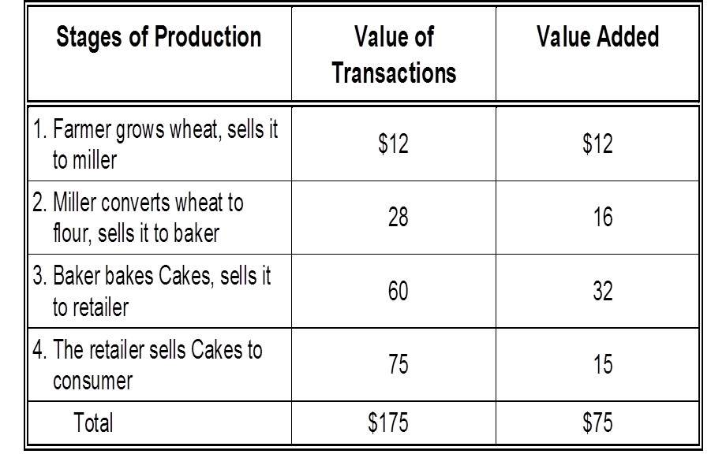
Value Added in Various Stages of Production

Slide 55
Final goods, value added, and GDP
GDP = value of final goods produced
OR
= sum of value added at all stages of production.
The value of the final goods already includes the value of the intermediate goods, so including both the value of intermediate and final goods together in GDP calculation would be multiple counting.

Slide 56
2. Expenditure Approach
GDP for a given year is calculated by adding up the expenditures needed to purchase the final output of goods and services (final demand) produced in that year by all economic agents.
    Personal Consumption expenditure (C)
    Gross Private Domestic Investment expenditure ( I )
    Government purchases of goods and services (expenditure) ( G )
    Net exports of Goods and Services (NX)

Slide 57
Personal Consumption expenditure (C)
The value of all goods and services bought by households includes:
    durable goods
    last a long time
    e.g., cars, home appliances
    nondurable goods
    last a short time
    e.g., food, clothing
    services
    work done for consumers
    e.g., dry cleaning, air travel

Slide 58
Gross Private Domestic Investment Expenditure (I)
Spending on goods for further production of other goods (i.e., capital goods)
Includes:
  Business fixed investment- Spending on plant and equipment
  Residential fixed investment- Spending on housing units
  Non-residential fixed investment- Spending on non-residential build units
  Inventory investment- The change in the value of all firms’ inventories (Ending INV- Beginning INV)
    If inventories have increased over the year, inventory investment is positive
    If inventories have decreased over the year, inventory investment is negative

Slide 59
Cont’d
Excludes:
All portfolio investments (buying and selling financial assets: bonds, securities, shares, treasury bills etc.)
Note: Investment is spending on new capital only.

Slide 60
Government purchases of goods and services (Government expenditure) ( G )
G - includes all government spending on goods and services.
Government expenditure Includes:
  State, local and federal government spending on everything
Government expenditure Excludes:
  All transfer payments (e.g., unemployment insurance payments), because they are not made in exchange for currently produced goods or services.

Slide 61
Net Exports of Goods and Services (NX)
Net exports /trade balance/ = Exports (X) – Imports (M)
    Exports (X): items that firms produce and sell to the rest of the world
    Imports (M): items that households, firms and government buy from the rest of the world
GDP cannot be accurately measured without adding in the nation’s exports (X) and subtracting out the nations imports (M) of goods and services.
    X > M, we have a trade surplus, Positive Sign
    X < M, we have a trade deficit, Negative Sign
Why subtract imports from GDP?
  Spending on imports is included in consumption expenditure, investment, and government purchases, but is not produced in this country

Slide 62
The Expenditure Approach
Hence in this approach GDP is the sum of the following variables:
  Consumption (C)
  Investment (I)
  Government Purchases (G)
  Net Exports (NX)
GDP = C + I + G + NX

Slide 63
3. Income Approach
GDP for a given year is calculated by adding up the factor incomes and other claims generated by the act of production
Therefore value of production= value of income claims generated by participants of that production- owners of all resources used
  Factor payments (wages, rent, interest, and profits)
  Nonfactor payments
    Indirect taxes net of subsidies
    Depreciation

Slide 64
Income Approach
This approach has two components
1. Income components:
Compensation to employees (W): Wages and salaries
Rents (R): Rental income to person's /payments made to land/
Interest (I): Payment made to capital
Profit (P): Payment made to entrepreneurs
2. Non -Income components / equalizing items/
Depreciation (D): allowance to capital equipment, machines, buildings etc to replace their used up part in the year.

Slide 65
Cont’d
Indirect Business Taxes (IBT): (excise tax, sales tax, service tax etc.) are cost to business firms and increase prices of such products. Since GNP is calculated at market price which includes indirect business taxes, we have also to include indirect business taxes to GNI calculation so that the identity:
GNP = GNE = GNI holds
Subsidy (S): it is a negative tax and should be treated opposite to tax.
Hence,
GDP = W + R + I + P + D + IBT – S.

Slide 66
Nominal GDP Vs Real GDP
Changes in GDP may be brought about because of a change in the Quantity of Output produced, or because of a change in price level or because of the two.
Changes in GDP brought about by changes in the price level can give a distorted view of economic activity.
Distinguishing increases in quantity from increases in prices is done by distinguishing between real GDP and nominal GDP.

Slide 67
Nominal GDP Vs Real GDP
Nominal GDP values the production of goods and services at current prices.
Real GDP values the production of goods and services at constant (base year) prices.
An accurate view of the economy requires adjusting nominal to real GDP by using the GDP deflator.

Slide 68
Real GDP controls for inflation
Changes in nominal GDP can be due to:
  changes in prices.
  changes in quantities of output produced.
Changes in real GDP can only be due to changes in quantities,
Thus real GDP is computed by using some constant base-year prices.

Slide 69
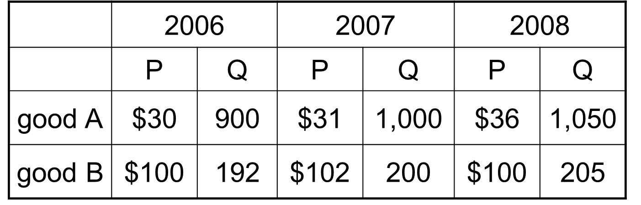
EXAMPLE 1
Compute nominal GDP in each year.
Compute real GDP in each year using 2006 as the base year.

Slide 70
Answers to EXAMPLE 1
Nominal GDP multiply Ps & Qs from same year
2006: $46,200 = $30 × 900 + $100 × 192
2007: $51,400
2008: $58,300
Real GDP multiply each year’s Qs by 2006 Ps
2006: $46,200
2007: $50,000
2008: $52,000 = $30 × 1050 + $100 × 205

Slide 71
GDP Deflator
The GDP deflator is a measure of the price level calculated as the ratio of nominal GDP to real GDP
is an index which shows the changes in the aggregate price level of goods and services produced in a given country
Thus, GDP deflator is calculated as follows:

Slide 72
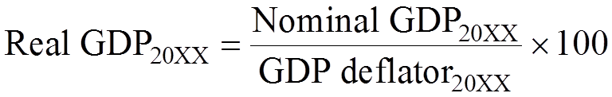
Cont’d
Converting Nominal GDP to Real GDP is possible as follows:

Slide 73
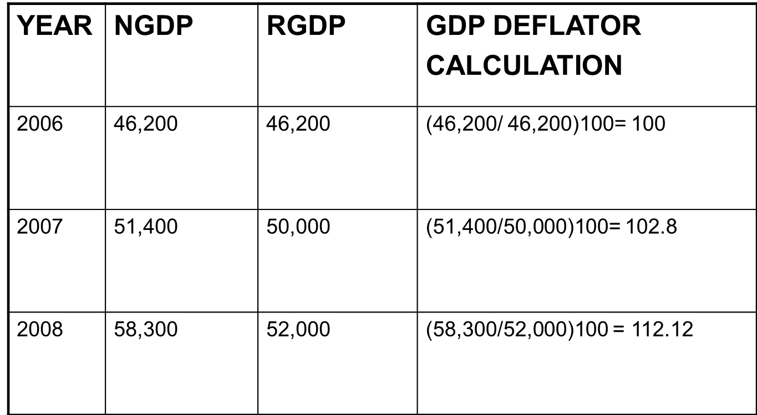
From the EXAMPLE 1 Data
Notes:
The GDP DEFLATOR in 2007 is equals 102.8. This means that the aggregate level of prices increased by 2.8 percent from the base year to the current year.

Slide 74
From National Income to Personal Disposable Income
  Net National Product
NNP = GNP - Depreciation
  National Income(NI):- It can be calculate it two ways
  (a) NI = NNP - Indirect business taxes + Subsidies
(b) NI = W + PI + R + I + P + NFIA
  Personal Income (PI): It refers to the amount of income that households received actually in the given year.
    PI = NI- Corp income taxes - Retained earnings - social security contributions + transfer payments received. (i.e., Transfer payments include: gifts, pension, unemployment compensation etc)
  Personal Disposable Income (PDI)
  PDI = PI - Personal taxes
Notes:
Retained earnings : Profits generated by a company that are not distributed to stockholders (shareholders) as dividends but are either reinvested in the business or kept as a reserve for specific objectives (such as to pay off a debt or purchase a capital asset).
Read more: http://www.businessdictionary.com/definition/retained-earnings.html
Corporate Income Tax: An assessment levied by a government on the profits of a company.
Read more: http://www.businessdictionary.com/definition/corporate-income-tax.html

Slide 75
The Flow of Income

Slide 76
Cont’d

Slide 77
Weakness of GDP as a measure of Welfare
Measures only output that is traded in markets
Does not include illegal activities (the underground economy)
Does not include changes in qualities of products
Does not include pollution, or other externalities
Does not include the value of leisure to people
Does not measure the quality of education
GDP also says nothing about the distribution of income

Slide 78
Measuring The Cost of Living
Inflation refers to a situation in which the economy’s overall price level is rising.
Rate of inflation is the percentage change in the overall level of prices.
The basic measure of cost of living is the Consumer Price Index.

Slide 79
Consumers Price Index
Consumer Price Index (CPI): is a measure of the overall cost of the goods and services bought by a typical consumer.
The consumer price index is used to monitor changes in the cost of living overtime.
The CPI measures the retail prices of a fixed “market basket” of several thousand goods and services purchased by households.
It is an explicit price index in the sense that it directly measures movements in the weighted average of the prices of the goods and services in the market basket.

Slide 80
Consumers Price Index
When the CPI rises, the typical family has to spend more dollars to maintain the same standard of living.
Steps to calculate CPI
  1. Fix the Basket: Determine what prices are most important to the typical consumer.
    The CSA identifies a market basket of goods and services the typical consumer buys, and assign weights for the prices of those goods and services.
  2. Find the Prices: Find the prices of each of the goods and services in the basket for each point in time.

Slide 81
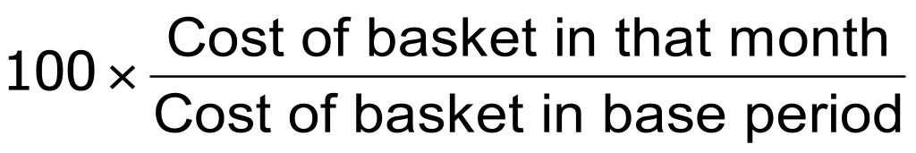
Consumers Price Index
  3. Compute the Basket’s Cost: Use the data on prices to calculate the cost of the basket of goods and services at different times.
  4. Choose a Base Year and Compute the Index:
    Designate one year as the base year, making it the benchmark against which other years are compared
    CPI in any month equals

Slide 82
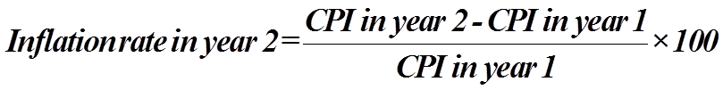
Consumers Price Index
  5. Compute the inflation rate: The inflation rate is the percentage change in the price index from the preceding period.
  The Inflation Rate is calculated as follows:

Slide 83
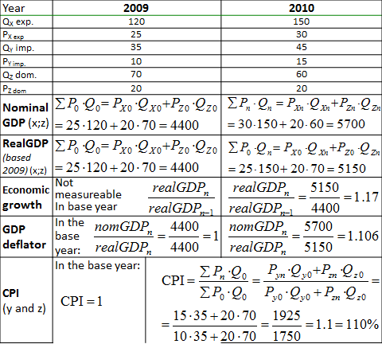

Slide 84
Problems of Measuring the Cost of Living
The CPI is an accurate measure of the selected goods that make up the typical bundle, but it is not a perfect measure of the cost of living.
Three weakness of CPI as a measure of Cost of living
  Substitution bias
  Introduction of new goods
  Unmeasured quality changes

Slide 85
Problems of Measuring the Cost of Living
1. Substitution Bias: the basket does not change to reflect consumer reaction to changes in relative prices.
  Consumers substitute toward goods that have become relatively less expensive.
  The index overstates the increase in cost of living by not considering consumer substitution.

Slide 86
Problems of Measuring the Cost of Living
2. Introduction of New Goods: the basket does not reflect the change in purchasing power brought on by the introduction of new products.
  New products result in greater variety, which in turn makes each dollar more valuable.
  Consumers need fewer dollars to maintain any given standard of living.

Slide 87
The end of Chapter 2
Thank You
for your attention!
Further questions?

Slide 88
Keynote speech 3: 2hrs
Chapter 3: Aggregate Demand and Supply Analysis
Aggregate Demand and Supply Analysis
Time Allotted for this Keynote is 2:00 hours.

Slide 89
The Income-Expenditure Model
There are several assumptions that we make in constructing this model.
All of the assumptions except for the first two are for convenience only, to simplify the analysis.
The assumptions are the following:
The price level is fixed.
Suppliers will supply any level of output that is demanded at the fixed price level.

Slide 90
Cont’d
There are no government expenditures or net exports.
The interest rate in the economy is determined outside the model.
There are no taxes.

Slide 91
Aggregate Expenditures
Aggregate Expenditures is the aggregate amount that consumers, investors, government, and foreigners wish to spend on the purchase of final goods and services produced in the domestic borders, given the price level.
This definition is identical to Aggregate Demand
Aggregate Expenditures is simply the sum of these elements, or
AE = C + I + G + NX.

Slide 92
Cont’d
Because we assume that government expenditures and net exports are zero, the equation reduces to AE = C + I.
In order to determine the level of Aggregate Expenditures, we need to determine the level of consumption spending and the level of investment.
We begin with consumption.

Slide 93
Determining Consumption in the Income-Expenditure Model
Consumption is the largest component of Aggregate Expenditures, accounting for two-thirds of GDP.
Factors that influence Consumption are Disposable Income (DI), wealth, interest rates, and expectation of consumer incomes. Disposable income is perhaps the most important explanatory variable. Recall that Disposable Income is after tax income, or DI = Y - T + Tr. When Disposable Income rises, consumption will be likely to increase as well.

Slide 94
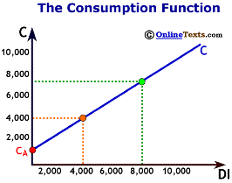
The Consumption Function
As the figure titled "The Consumption Function" illustrates, a consumption function shows the relationship between total consumer expenditures and total disposable income, holding all other determinants of consumption constant. No other factors are considered. The consumption function also assumes the relationship between consumption and disposable income is linear. The equation for the consumption function is:
C = C_{A} + MPC (DI)

Slide 95
Cont’d
Where C is total consumption; CA is autonomous consumption, MPC is the marginal propensity to consume, and DI is disposable income.
The value for autonomous consumption is shown on the graph where the consumption function intersects the vertical axis. Not too much should be made of this value. It is primarily a "statistical leftover."

Slide 96
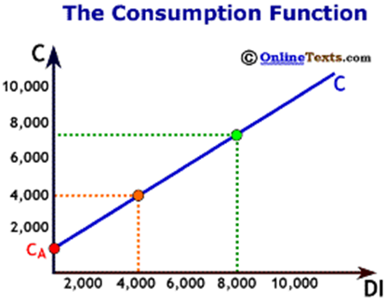
Cont’d
We fit the best possible line between consumption and disposable income, and the line has to cross the vertical axis somewhere. The point where it crosses the axis is the value for C_{A}

Slide 97
Cont’d
The Marginal Propensity to Consume (MPC) tells us how much of an additional dollar of disposable income will be spent. For example, if the MPC = 0.80, then $0.80 of the next dollar earned will be spent.
The MPC for an economy always lies between zero and one, 0 < MPC < 1.

Slide 98
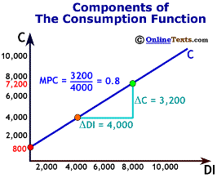
Cont’d
Suppose the consumption function for the economy is the following:
C = 800 + 0.80 (DI), and DI = $6,000.
From this we know that C_{A} = 800, the MPC = 0.80, and total consumption is,
C = $800 + 0.80 * ($6,000) = $5,600

Slide 99
Cont’d
Two more points about the consumption function: First, as we have already stated above, the point at which the consumption function crosses the vertical axis is the level of Ca, autonomous consumption.
In the figure titled "Components of the Consumption Function", the value for CA is $800.

Slide 100
Cont’d
Second, the slope of the chart is the rise/run, or the change in C divided by the change in DI. Notice that this is exactly the same thing as the MPC.
Therefore, the slope of the consumption is equal to the MPC.
The slope of the line in the same figure is 0.80.

Slide 101
The Marginal Propensity to Save
The Marginal Propensity to Save (MPS) is the complement to the Marginal Propensity to Consume. The MPS is defined as the change in saving divided by the change in disposable income. Since all Disposable Income is either consumed or saved, then the portion of additional disposable income not consumed must be saved.
Therefore, MPC + MPS = 1, or
MPS = 1 - MPC.
For example, if the MPC = 0.75 then the MPS = 0.25.

Slide 102
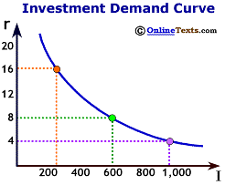
Cont’d
Determining Investment in the Income-Expenditure Model

Slide 103
Cont’d
Investment is the most volatile component of GDP. It accounts for approximately 17% of GDP. Investment is determined by interest rates, business confidence, taxes, and capacity utilization.
In our simplified model, we assume that interest rates are already determined, and we assume that all other determinants of investment (such as business confidence) remain unchanged.
Given a particular interest rate, we can determine the level of investment that will take place in the economy

Slide 104
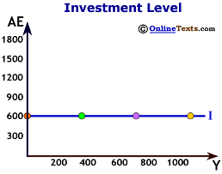
Cont’d
For example, suppose that the interest rate is 8.0 percent, and that rate corresponds to $600 of investment. We plot the level of investment in the figure titled "Investment Level." Aggregate expenditures go on the vertical axis while the level of income or GDP (Y) goes on the horizontal axis. The investment line is simply a horizontal line at $600. It has a slope of zero because we assume that investment does not vary with the level of income in the economy.

Slide 105
Aggregate Expenditures in the Income-Expenditure Diagram
We have all the components necessary to plot the level of Aggregate Expenditures as a function of the level of income in the economy.
Recall that the two components of Aggregate Expenditures are Consumption and Investment.
Consumption depends upon the level of disposable income while investment and income are independent.

Slide 106
Cont’d
If there are no taxes (which we assumed above), then disposable income (DI) and national income (Y) are equal to one another. So we can write:
C = CA + MPC (DI) = CA + MPC (Y), and
I = IA,where IA is autonomous investment, or the level of investment independent of the level of income. We sum the two together to calculate Aggregate Expenditures:
AE = C + I = CA + MPC (Y) + IA

Slide 107
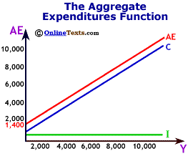
Cont’d
The level of Aggregate Expenditures depends upon the level of national income. As Y rises, so does AE. Therefore the Aggregate Expenditure schedule slopes upwards.
In the figure labeled "The AE Schedule," the consumption function has the following form:
C = 800 + 0.8(Y), and
I = 600, so
AE = 1400 + 0.8(Y).

Slide 108
Cont’d
Notice that when Y=0, AE = 800 + 0.8(0) + 600 = 1400. But when Y = 100, AE = 800 + 0.8(100) + 600 = 1480.
On the chart, the Aggregate Expenditure schedule is simply the vertical summation of the consumption function and the investment schedule at each level of output.

Slide 109
Equilibrium in the Income-Expenditure Model
We have to add one more piece to complete the model. We have seen how Aggregate Expenditures are calculated, summing the components of consumption and investment. But we don't know at which level of output and aggregate expenditures the economy will settle at.
To do so, we need to understand what is meant by equilibrium in this model.
As we saw from the Aggregate Demand/Aggregate Supply model, equilibrium is the point where the quantity produced (Y) is equal to the quantity demanded (AE), or
Y = AE.

Slide 110
The 45 degree line

Slide 111
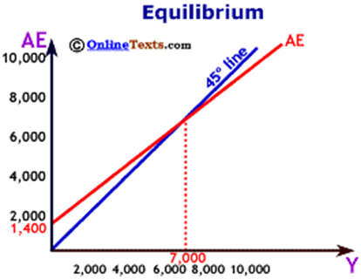
Bringing it all together
The figure titled "Equilibrium" puts all the elements together to determine the equilibrium level of income and Aggregate Expenditures in the economy. Notice that the AE line crosses the 45 degree line at $7,000. This is the only point on the chart where output (Y) is equal to expenditures (AE). Thus, the equilibrium level of output is $7,000.

Slide 112
Cont’d
If income (Y) were less than $7,000, say $6,000, then Aggregate Expenditures would exceed income, demand would be greater than output, and inventories would begin unexpectedly to shrink.
If income (Y) were greater than $7,000, then Aggregate Expenditures would be less than output, and unwanted inventories would build. Only at $7,000 does production of final goods and services equal demand for final goods and services.

Slide 113
The Algebra of the Income-Expenditure Model
Recall that the equilibrium occurs when Y = AE.
Since AE = C + I, then the equilibrium condition reduces to
Y = C + I.
And since
C = CA + MPC(Y), and
I = IA, then
Y = CA + MPC(Y) + IA.

Slide 114
Cont’d
We wish to solve for Y, but we must get all the Y's on the left-hand side. To do so, we subtract MPC(Y) from both sides, and we get
Y - MPC(Y) = C_{A} + I_{A}
We distribute the Y term this way:
(1 - MPC)Y = C_{A} + I_{A}
and then we divide both sides by (1 - MPC) to obtain
Y = (C_{A} + I_{A})/(1 - MPC)

Slide 115
Cont’d
In our example above, we had the following equations:
C = 800 + 0.8 (Y), and
I = 600, so
Y = 800 + 0.8 (Y) + 600
Y - 0.8(Y) = 1400
(1- 0.8)Y = 1400
Y = 1400/(1 - 0.8)
Y = 1400/(0.2)
Y = 7,000

Slide 116
Thank you for your attention!
Further questions
Comments

Slide 117
Chapter Four: Theory of Money Demand and Supply
Introduction
Money Demand
Money supply
Equilibrium in the money market

Slide 118
Keynote speech 3:
Introduction :What Is Money?
Money is anything that serves as a medium of exchange.
A medium of exchange is anything that is widely accepted as a means of payment.

Slide 119
The Functions of Money
Money serves three basic functions.
A Medium of Exchange
A Unit of Account(A means of measuring the value of things)
A Store of Value

Slide 120
Types of Money
Although money can take an extraordinary variety of forms, there are really only two types of money:
    money that has intrinsic value (Commodity money )
        Gold and silver are the most widely used forms of commodity money
    and money that does not have intrinsic value(Fiat money is money that some authority, generally a government, has ordered to be accepted as a medium of exchange)
        The currency (paper money and coins ), checkable deposits

Slide 121
Cont’d
To qualify as “money,” something must be widely accepted as a medium of exchange.

Slide 122
Measuring Money
The total quantity of money in the economy at any one time is called the money supply. Economists measure the money supply because it affects economic activity.
What should be included in the money supply?
We want to include as part of the money supply those things that serve as media of exchange.

Slide 123
Cont’d
The basic money supply was measured as the sum of currency in circulation, traveler’s checks, and checkable deposits.
Currency serves the medium-of-exchange function very nicely but denies people any interest earnings. (Checking accounts did not earn interest before 1980.)
Different measures of money:
    M1 and M2

Slide 124
Cont’d
M1 is the narrowest of the Fed’s money supply definitions. It includes currency in circulation, checkable deposits, and traveler’s checks.
M2 is a broader measure of the money supply than M1.
It includes M1 and other deposits such as small savings accounts (less than $100,000), as well as accounts such as money market mutual funds (MMMFs) that place limits on the number or the amounts of the checks that can be written in a certain period.

Slide 125
Cont’d
M2 is sometimes called the broadly defined money supply, while M1 is the narrowly defined money supply.
The assets in M1 may be regarded as perfectly liquid; the assets in M2 are highly liquid, but somewhat less liquid than the assets in M1. Even broader measures of the money supply include large time-deposits, money market mutual funds held by institutions, and other assets that are somewhat less liquid than those in M2.
Notes:
Money is not the same as wealth.

Slide 126
Cont’d
M1, the narrowest definition of the money supply, includes assets that are perfectly liquid.
M2 provides a broader measure of the money supply and includes somewhat less liquid assets.

Slide 127
The end!!
Thank you!!

Slide 128
Keynote speech 4: 2hrs
The Demand for Money
The demand for money is the relationship between the quantity of money people want to hold and the factors that determine that quantity.

Slide 129
Cont’d
We will think of the demand for money as a curve that represents the outcomes of choices between the greater liquidity of money deposits and the higher interest rates that can be earned by holding a bond fund.
The difference between the interest rates paid on money deposits and the interest return available from bonds is the cost of holding money.

Slide 130
Motives for Holding Money
Why people keep money?
There are 3 reasons/motives.
Transactions demand for money
  For every day transaction of goods and services
Precautionary demand for money
  Unforeseen events
  The money people hold for contingencies
Speculative purposes
  Expectations of bond prices

Slide 131
Interest Rates and the Demand for Money
The quantity of money people hold to pay for transactions and to satisfy precautionary and speculative demand is likely to vary with the interest rates they can earn from alternative assets such as bonds
When interest rates rise relative to the rates that can be earned on money deposits, people hold less money. When interest rates fall, people hold more money.

Slide 132
Cont’d
The logic of these conclusions about the money people hold and interest rates depends on the people’s motives for holding money.
The quantity of money households want to hold varies according to their income and the interest rate; different average quantities of money held can satisfy their transactions and precautionary demands for money

Slide 133
The Demand Curve for Money
The demand curve for money is derived like any other demand curve, by examining the relationship between the “price” of money (which, we will see, is the interest rate) and the quantity demanded, holding all other determinants unchanged.
We have seen that the transactions, precautionary, and speculative demands for money vary negatively with the interest rate.

Slide 134
Cont’d
Putting those three sources of demand together, we can draw a demand curve for money to show how the interest rate affects the total quantity of money people hold.
The demand curve for money shows the quantity of money demanded at each interest rate, all other things unchanged.
An increase in the interest rate reduces the quantity of money demanded. A reduction in the interest rate increases the quantity of money demanded.

Slide 135
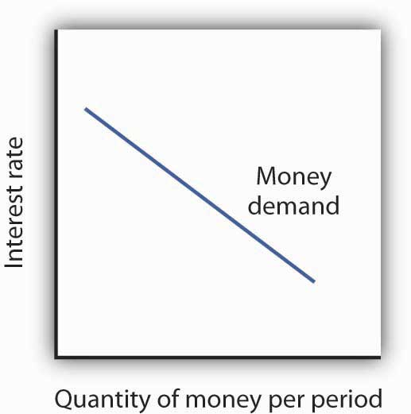
Figure. The Demand Curve for Money
The demand curve for money shows the quantity of money demanded at each interest rate.
Its downward slope expresses the negative relationship between the quantity of money demanded and the interest rate.

Slide 136
Cont’d
The relationship between interest rates and the quantity of money demanded is an application of the law of demand.
If we think of the alternative to holding money as holding bonds, then the interest rate—or the differential between the interest rate in the bond market and the interest paid on money deposits—represents the price of holding money.
As is the case with all goods and services, an increase in price reduces the quantity demanded.

Slide 137
Other Determinants of the Demand for Money
We draw the demand curve for money to show the quantity of money people will hold at each interest rate, all other determinants of money demand unchanged.
A change in those “other determinants” will shift the demand for money.
Among the most important variables that can shift the demand for money are the level of income and real GDP, the price level, expectations, transfer costs, and preferences.

Slide 138
Real GDP
An increase in real GDP increases incomes throughout the economy. The demand for money in the economy is therefore likely to be greater when real GDP is greater.

Slide 139
The Price Level
The higher the price level, the more money is required to purchase a given quantity of goods and services.
All other things unchanged, the higher the price level, the greater the demand for money.

Slide 140
Expectations
Expectations about future price levels also affect the demand for money.
The expectation of a higher price level means that people expect the money they are holding to fall in value.
Given that expectation, they are likely to hold less of it in anticipation of a jump in prices.

Slide 141
Transfer Costs
In general, the demand for money will increase as it becomes more expensive to transfer between money and nonmoney accounts.
The demand for money will fall if transfer costs decline. In recent years, transfer costs have fallen, leading to a decrease in money demand.

Slide 142
Preferences
Some people place a high value on having a considerable amount of money on hand. For others, this may not be important.

Slide 143
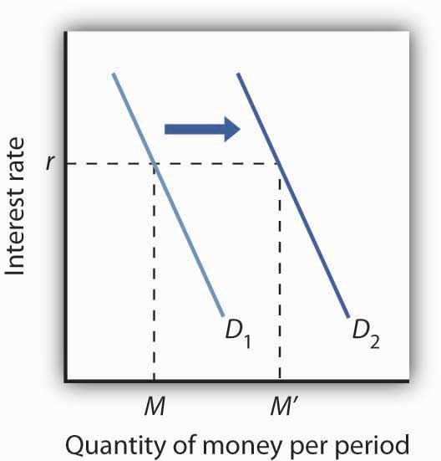
Figure. "An Increase in Money Demand
Such an increase could result from a higher real GDP, a higher price level, a change in expectations, an increase in transfer costs, or a change in preferences.
An increase in real GDP, the price level, or transfer costs, for example, will increase the quantity of money demanded at any interest rate r, increasing the demand for money from D₁ to D₂.
The quantity of money demanded at interest rate r rises from M to M′. The reverse of any such events would reduce the quantity of money demanded at every interest rate, shifting the demand curve to the left.

Slide 144
The Supply of Money
The supply curve of money shows the relationship between the quantity of money supplied and the market interest rate, all other determinants of supply unchanged.
The Supply Curve of Money is a vertical line, determined by the Fed’s monetary policies

Slide 145
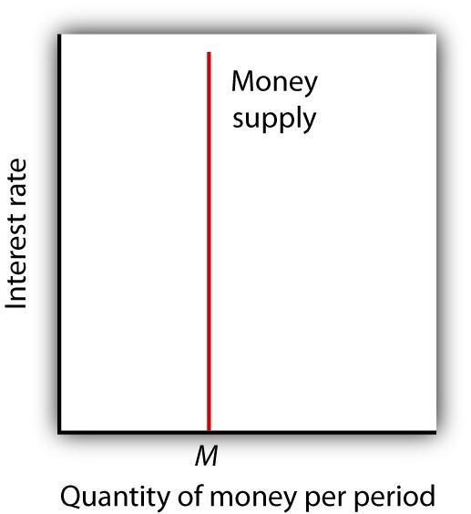
Cont’d
We assume that the quantity of money supplied in the economy is determined as a fixed multiple of the quantity of bank reserves, which is determined by the Fed.
The supply curve of money is a vertical line at that quantity.

Slide 146
Money supply shifters
  Open market operations
  Reserve requirements
  Discount rate

Slide 147
The end!!
Further questions ?
Comments?

Slide 148
Equilibrium in the Market for Money
The money market is the interaction among institutions through which money is supplied to individuals, firms, and other institutions that demand money.
Money market equilibrium occurs at the interest rate at which the quantity of money demanded is equal to the quantity of money supplied.

Slide 149
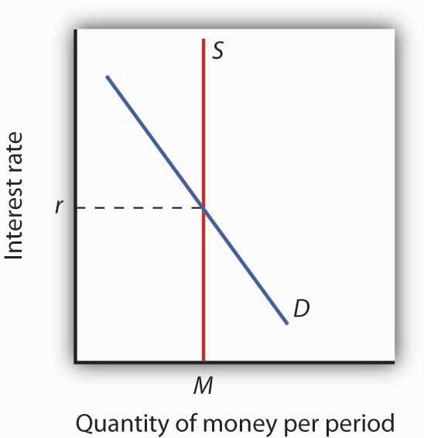
Figure: Money Market Equilibrium
The Figure shows "Money Market Equilibrium“.
It combines demand and supply curves for money to illustrate equilibrium in the market for money.
With a stock of money (M), the equilibrium interest rate is r.
The market for money is in equilibrium if the quantity of money demanded is equal to the quantity of money supplied. Here, equilibrium occurs at interest rate r.

Slide 150
Effects of Changes in the Money Market
A shift in money demand or supply will lead to a change in the equilibrium interest rate.
Let’s look at the effects of such changes on the economy.

Slide 151
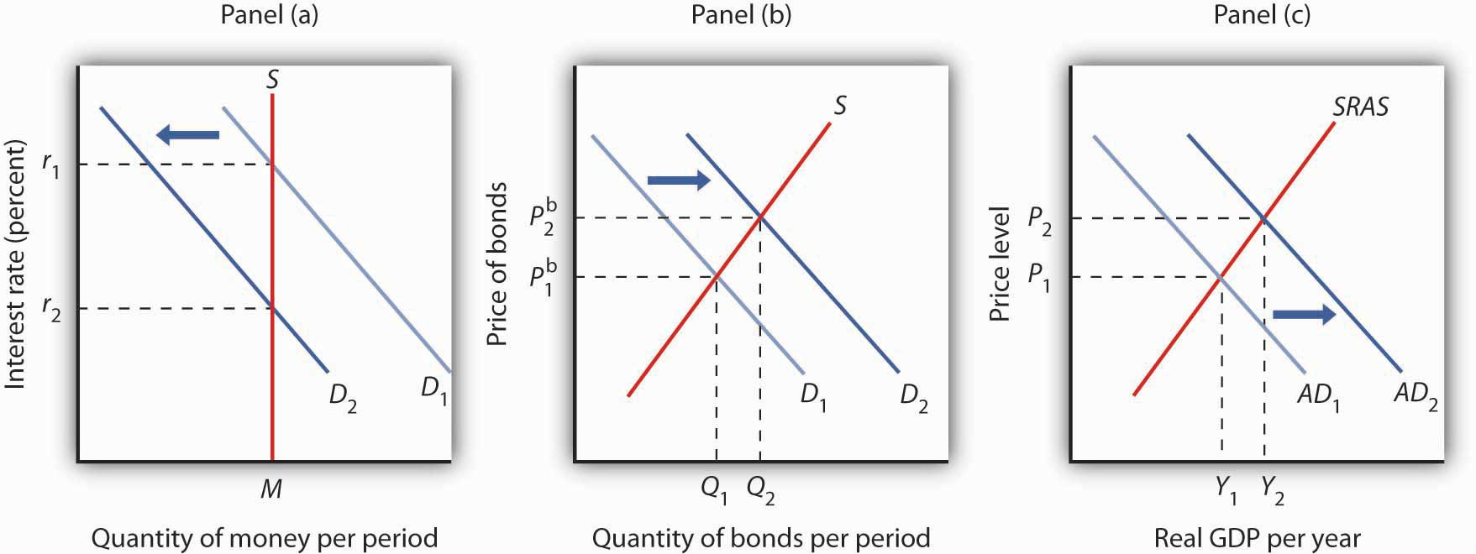
Changes in Money Demand
A decrease in the demand for money due to a change in transactions costs, preferences, or expectations, as shown in Panel (a), will be accompanied by an increase in the demand for bonds as shown in Panel (b), and a fall in the interest rate.
The fall in the interest rate will cause a rightward shift in the aggregate demand curve from AD₁ to AD₂, as shown in Panel (c). As a result, real GDP and the price level rise.

Slide 152
Cont’d
An increase in money demand due to a change in expectations, preferences, or transactions costs that make people want to hold more money at each interest rate will have the opposite effect.
The money demand curve will shift to the right and the demand for bonds will shift to the left.

Slide 153
Cont’d
The resulting higher interest rate will lead to a lower quantity of investment.
Also, higher interest rates will lead to a higher exchange rate and depress net exports.
Thus, the aggregate demand curve will shift to the left. All other things unchanged, real GDP and the price level will fall.

Slide 154
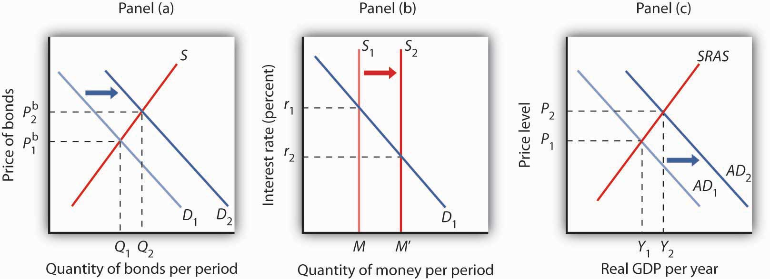
Changes in the Money Supply
A) An Increase in the Money Supply
The Fed increases the money supply by buying bonds, increasing the demand for bonds in Panel (a) from D₁ to D₂ and the price of bonds to P^{b}₂. This corresponds to an increase in the money supply to M′ in Panel (b).
The interest rate must fall to r₂ to achieve equilibrium. The lower interest rate leads to an increase in investment and net exports, which shifts the aggregate demand curve from AD₁ to AD₂ in Panel (c). Real GDP and the price level rise.

Slide 155
Individual Assignment: 11%
Discuss the following questions by using appropriate graphs.
Show the impact of a decrease in money supply.
Show the impact of an increase in money demand.
Show the effect of simultaneous changes in money demand and supply.

Slide 156
The end of Chapter - 4
Comments?
Questions?

Slide 157
Chapter 5: Fiscal and Monetary Policy
Fiscal Policy
Monetary Policy
Interaction and differences between Fiscal and Monetary policy
Notes:
Demand Side Policies are attempts to increase or decrease aggregate demand in order to affect output, employment and inflation.Demand Side Policies can be classified into fiscal policy and monetary policy.

Slide 158
Fiscal Policy
In economics , fiscal policy is the use of government revenue collection (mainly taxes) and expenditure (spending) to influence the economy.
According to Keynesian economics, when the government changes the levels of taxation and government spending, it influences aggregate demand and the level of economic activity.
Fiscal policy is often used to stabilize the economy over the course of the business cycle.

Slide 159
Cont’d
Changes in the level and composition of taxation and government spending can affect the following macroeconomic variables, amongst others:
  Aggregate demand and the level of economic activity;
  Saving and investment;
  Income distribution.

Slide 160
Types of Fiscal Policy
EXPANSIONARY
Increase Spending and Lower Taxes
  More money stimulates the economy
  Cuts taxes increases disposable income
  Businesses expand and create jobs
  Result: increased growth and higher employment

Slide 161
EXPANSIONARY FISCAL POLICY
the multiplier at work...
$5 billion initial
increase in spending
AS
Full $20 billion
increase in
aggregate
demand
P₁
Price level
AD₂
AD₁
$490 $510
Real GDP (billions)

Slide 162
CONTRACTIONARY FISCAL POLICY
CONTRACTIONARY
Increase Taxes and Lower Spending
  Increase taxes to slow the economy and reduce inflation
  Less disposable income
  Slower business activity leads to lower profits
  Result: low inflation rates and stable growth

Slide 163
CONTRACTIONARY FISCAL POLICY
the multiplier at work...
$5 billion initial
decrease in spending
AS
P₂
Full $20 billion
decrease in
aggregate
demand
Price level
P₁
AD₃
AD₄
$510 $522
Real GDP (billions)

Slide 164
Monetary Policy
Monetary policy is the macroeconomic policy laid down by the central bank. It involves management of money supply and interest rate and is the demand side economic policy used by the government of a country to achieve macroeconomic objectives like inflation, consumption, growth and liquidity.
Monetary Policy refers policies that affect the interest rate or money supply.
Monetary policy affects Aggregate Demand (AD).

Slide 165
Types of Monetary policy
Monetary policy is referred to as being
    either expansionary
    or contractionary.

Slide 166
Expansionary policy
Expansionary policy occurs when a monetary authority uses its tools to stimulate the economy.
An expansionary policy maintains short-term interest rates at a lower than usual rate or increases the total supply of money in the economy more rapidly than usual.
It is traditionally used to try to combat unemployment in a recession by lowering interest rates in the hope that less expensive credit will entice businesses into expanding.
Notes:
What is an expansionary fiscal policy?
An increase in government purchases, decrease in net taxes, or some combination of the two aimed at increasing aggregate demand
When would the government use expansionary fiscal policies?
To stimulate the economy when unemployment is greater than the natural rate

Slide 167
Cont’d
This increases aggregate demand (the overall demand for all goods and services in an economy), which boosts short-term growth as measured by gross domestic product (GDP) growth.
Expansionary monetary policy usually diminishes the value of the currency relative to other currencies (the exchange rate).

Slide 168
Contractionary monetary policy
The opposite of expansionary monetary policy is contractionary monetary policy, which maintains short-term interest rates higher than usual or which slows the rate of growth in the money supply or even shrinks it.
This slows short-term economic growth and lessens inflation.
Notes:
What is a contractionary fiscal policy?
A decrease in government purchases, increase in net taxes, or some combination of the two aimed at reducing aggregate demand
When would the government use contractionary fiscal policies?
To slow down the economy when inflation is more than desired

Slide 169
Cont’d
Contractionary monetary policy can lead to increased unemployment and depressed borrowing and spending by consumers and businesses, which can eventually result in an economic recession if implemented too vigorously

Slide 170
Fiscal Policy vs. Monetary Policy
Fiscal policy relates to government spending and revenue collection. For example, when demand is low in the economy, the government can step in and increase its spending to stimulate demand.
Or it can lower taxes to increase disposable income for people as well as corporations.

Slide 171
Cont’d
Monetary policy relates to the supply of money, which is controlled via factors such as interest rates and reserve requirements (CRR) for banks.
For example, to control high inflation, policy-makers (usually an independent central bank) can raise interest rates thereby reducing money supply.

Slide 172
The end of Chapter 5
Comments?
Questions ?

