Slide 1
SOCIAL MARKETING IN AECD
Prepared by:
Selam Worku
Department of AECD

Slide 2
Marketing Definition
What does the term marketing mean?
Marketing must be understood not in the old sense of making a sale 'selling' - but in the new sense of satisfying customer needs.
Marketing, more than any other business function, deals with customers. Creating customer value and satisfaction are at the very heart of modern marketing thinking and practice.

Slide 3
Marketing definition
Marketing is the delivery of customer satisfaction at a profit.
The goal of marketing is to attract new customers, and to keep current customers by delivering satisfaction.
Marketing is the business activity concerned with the flow of goods and services from producers to consumers.
Marketing generates and facilitates exchange
The concept of marketing lies on needs, wants, and demands of customers.
Marketing is greater than selling.
Marketing is an integrated activity.
Marketing is concerned with customer satisfaction.

Slide 4
Core marketing concept
Needs:-The most basic concept underlying marketing is that of human needs. Humans have many complex needs. Thus include:-
basic physical needs for food, clothing, warmth and safety
social needs for belonging and affection
Individual needs for knowledge and self-expression.
Needs are basis for motivation of people and they constitute basic human requirements. People need food, water, air, and shelter to survive.
People also do have strong needs for recreation, education, and entertainment.

Slide 5
2. Wants:-Human wants are the form taken by human needs as they are shaped by culture and individual personality. A hungry person in Bahrain may want a vegetable curry, mango chutney and lassi. A hungry person in Eindhoven may want a ham and cheese roll, salad and a beer. Wants are wish to willingness to buy.
3. Demands:-Demands are wants for specific products that are backed by an ability and willingness to buy them. Demands are the ability to purchase the goods and services we seek.
Demand =Ability + Willingness

Slide 6
Nature of Marketing
As a field of study, marketing began in early 20thC. The focus of marketing courses in 1950s & 1960s was on ‘how to do it’, with an emphasis on marketing techniques.
Product/Services deliver Orgn succeeds/fails for d/t reasons.
H/ever, mostly marketing is central to its outcome. B/s its focus is on customers and their changing needs.
If Orgn doesn’t have customers, it doesn’t have any business.
Orgns are succeed not only in getting customers but also in keeping them through being constantly aware of their changing needs.
The purpose of establishing Orgn is to create & keep customers by two central functions (i.e. Marketing & Innovation).
Goal of marketing is long-term customer satisfaction (not short-term). Since, its basic function is to attract & retain customers.

Slide 7
Marketing concept(Mc)
MC is expressed as an ‘achievement of corporate Goals by meeting customer needs better than competition’.
Three conditions must be met before the MC can be applied.
1st, Original activities should be focused on providing customer satisfaction rather than simply producing products.
2nd, the achievement of customer satisfaction relies on integrated effort. Marketing is the responsibility of everyone in the Orgn .
3rd, for integrated effort to must believe that corporate goals can be achieved through satisfied customers.

Slide 8
MC is a business philosophy that puts customers and their satisfaction at Centre of things.
Key Components of MC are three:
Customer Orientation
Integrated Effort
Goal Achievement

Slide 9
Marketing concept
Achievement of corporate goals through meeting & exceeding customer needs better than competition
Customer orientation: Corporate Activities are focused upon providing customer satisfaction
Integrated effort:
All staff accepts the responsibility for creating customer satisfaction
Goal achievement:
The belief that corporate goals can be achieved through customer satisfaction

Slide 10
The Marketing Mix
MM consists primarily ‘4-Ps’ of such FOUR major elements: Product, Price, Promotion and Place
The 6 P’s of Marketing
• Product – the item or service you offer
• Place – distribution channels where a consumer can get access
• Price – enough to make a profit and not too much for the market to bear
• Promotion - how you communicate the existence of your product or service and its benefits
• People - staff and customers
• Positioning - brand or corporate identity

Slide 11
Marketing vs selling
Selling
Selling is the process by which the salesman tries to dispose of the product at the best possible price.
selling is just one activity in the marketing chain of activities.
Actual selling (exchanging at hand)

Slide 12
Marketing
marketing activities start once goods and services have been produced.it includes selling and advertising, analyzing consumer needs, utility of products, maintaining relationship customers with suppliers etc.
Marketing is the process of planning and executing the conception, pricing, promotion and distribution of ideas, goods and services to create exchanges that satisfy individual and organizational objectives
Simply put: Marketing is the delivery of customer satisfaction at a profit.

Slide 13
Point in difference | selling | marketing
Starting point | factory | Market place
focus | Existing product | Customer needs
means | Selling and promoting | Integrated marketing
end | Profit though volume | Profit through satisfaction

Slide 14
Marketing Comprehensive term in term of meaning Philosophy of business Profit through customer satisfaction Integrated approach Long term perspective Customer first then product | Selling Narrow term in term of meaning Routine day to day physical process Profit through sale volume Fragmented approach short term perspective Product first then customer

Slide 15
Social Marketing Defined
Variety of dfns have been proposed by social marketers and debate continues about SM
But, SM is typically defined as a pr/m planning process that applies commercial marketing concepts & techniques to promote voluntary b/r change.
SM facilitates the acceptance, rejection, modification, or maintenance of particular b/r by the target audience.
uses commercial marketing strategies.
involves influencing voluntary (not forced/coerced) b/r change (not just increased awareness or k/ge).
promotes an end goal of improved personal & societal welfares.

Slide 16
In general, SM is NOT:
Advertising
Bumper sticker ( a sign that people stick on sth with a message on it)
Slogan
Short-term Effort
SM works by:
Offering benefits that people want
Reducing barriers that people face, and
Persuading, not just informing.

Slide 17
Social Media for Social Marketing
While social media and social marketing sound the same, the tools and processes they refer to are distinctly different.
However, by using social media to create effective social marketing campaigns your brand.

Slide 18
Features of SM emanate from marketing’s conceptual framework, w/c include:
Exchange of Theory
Audience Segmentation
Competition
Marketing Mix
Consumer/ Customor Orientation
Continuous Monitoring
Let us see each of them in detail Next.

Slide 19
Theory of Exchange:
It views customers acting primarily out of self interest as they seek ways to optimize value by doing what gives them a greatest benefit in least cost.
It reminds social marketers that they must:
offer benefits that the customers truly values.
recognize customers often pay intangible costs (time & psychic discomfort) associated with changing b/r; and
ack/ge that everyone involved in the exchange must receive valued benefits in return for their efforts.

Slide 20
Audience Segmentation:
Social marketers know, it is NOT possible to be “all things to all people.”
Marketing popn into sub-groups who share needs/wants, lifestyles, b/r, and values.
Eg. A/Edrs recognized intra-group d/ces within popn, but they typically use ethnicity, age, gender, or other demographics as the basis for identifying sub-groups.

Slide 21
Social marketers are more likely to divide popn into distinct segments on the basis of:
Current b/r
Future intentions
Readiness to change
Product/service loyalty, and
Psycho-graphics (lifestyle, values, and personality ch/tics).
Compared with other systematic planning processes, SM devotes more attention & resources to segmentation Research.

Slide 22
Competition:
The marketing mindset asks the ffg Qns:
What products (b/r, services) compete with the Orgn is promoting?
How do the benefits compare to those offered by competing b/r?
W/c b/r are best to promote?
W/c segments are best to target?
In SM, thinking about where, how and with whom to compete are very vital.

Slide 23
Marketing Mix:
It is another core concept adopted from the commercial sector, and commonly known as the 4Ps’ (Product, Price, Place, And Promotion).
These key elements of SM are central to the planning & implementation of an integrated marketing strategy.
Consumer/Customer Orientation:
Marketing’s conceptual framework demands a steadfast commitment in understanding consumers.
The premise is that all pr/m planning decisions must emanate from a consideration of the consumers’ needs.
Qn. How can we understand the Potential Customers/ Consumers?

Slide 24
The backbone of customer orientation is customer research to gain a deeper understanding of target audience’s needs, aspirations & values.
Consumers’ perceptions of the products/ services, benefits, and costs that motivate & deter their b/r are also considered in consumer research.
Research also provides information on distinct popn subgroups and the social & cultural Env’ts in w/c the people act on b/rl decisions.

Slide 25
Continuous Monitoring:
Plans for Monitoring & Evaluating SM intervention begin at the outset of planning process.
As pr/m interventions are implemented, each of the ffg is monitored:
to assess its effectiveness to determine if it is worthy of being sustained
to identify activities that require mid-course revision.

Slide 26
Differences and Similarities Between Commercial Marketing and Social Marketing

Slide 27
Commercial vs social marketing c
Point of difference | Commercial Marketing | Social Marketing
Product | Selling of tangible goods and services | Selling desired behavior change
Primary objective | to satisfy customer by selling products to them and fulfilling their needs and earn profit | to benefit society in term of social gain.
Focus | Focus on physical products or services | Focus on to reach the target audience and change the behavior.
Marketing tools | Marketing tools use for selling products | Marketing tool use for changing behaviors.
Satisfying needs | marketers satisfy individual needs. | marketers satisfy society needs.
Competition | Other organizations offering similar goods and services | Audiences current or preferred behavior and associated benefit

Slide 28
Similarities Between Commercial Marketing and Social Marketing
A customer orientation is critical.
Exchange theory is fundamental.
Market research is used throughout the process.
Audiences are segmented.
The proper target market is selected.
All 4 P’s are considered.
Results are measured and evaluated and used for improvement.

Slide 29
Social Marketers
Commercial organizations do not do social marketing.
There are other organizations that develop and process social marketing campaigns:
Public sector organizations
World Health Organization (WHO)
Centers for Disease Control and Prevention (CDC)
Department of Health
NGO’s
Department of Social and Human Services
National Highways Traffic Safety Administration
Schools, Parks, community health clinics
Governments

Slide 30
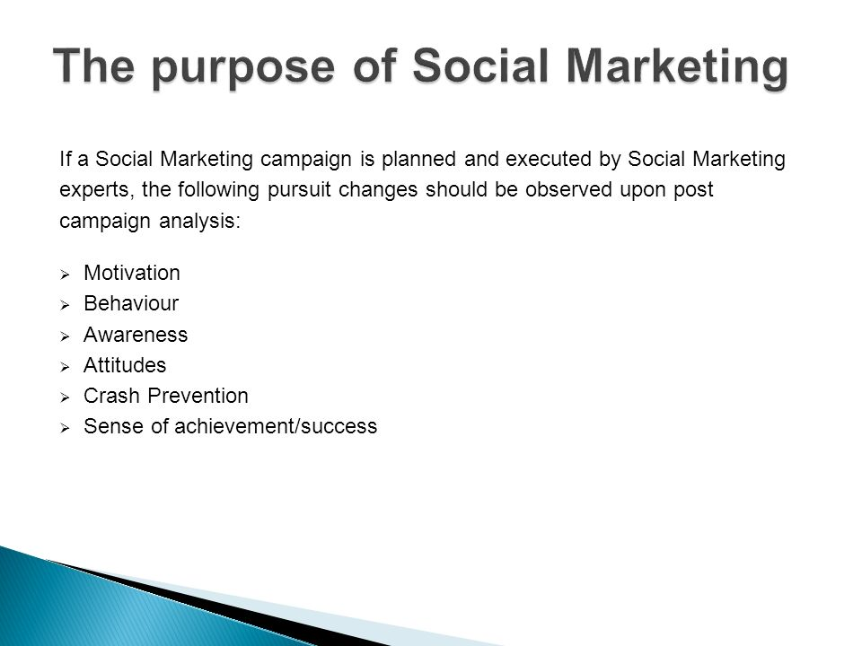

Slide 31
Purpose of SM
The two-fold purpose of SM is:
To encourage potential Lrs to think critically on specific ways that a pr/m might benefit them and problems it might help to solve,
To encourage people’s active participation in pr/m dev’t and pr/m maintaining.
In general, marketing a certain kinds of social issue or pr/m serves:
To provide preliminary information about the issue and what is necessary to establish or provide and maintain the issue.
To invite representatives from stakeholders groups to work in a specific area
To encourage stakeholders to gain resources for implementation.

Slide 32
Chapter Two
Tools, Principles & Processes of SM
Issues to be discussed here include:
Tools of SM
Principles of SM
  Tips of SM
The Processes of SM
  Developing SM Plan
  Benefits of SM in pr/m process
  Factors Influencing SM Effectiveness

Slide 33
SM Tools
Consumer Research/Analysis of the Env’t: Tools that allow to better understand people & Env’t. Thus, SM pr/ms are more effective.
Applies Segmentation & Targeting: People are unique, this means a social marketer must offer d/t pr//ms for d/t people. Segmentation improves the quality of SM pr/ms.
Sets Objectives & Goals: Objectives must be realistic & measurable.

Slide 34
4. The « 4P’s » : Called as the marketing mix
Product (What): A ‘real’ product/service, or a b/r and value
Price (how much): Price for real product & service (money).
Or price in SM (non-monetary costs to give up a b/r)
Place (Where): SM product must be available in relevant places
Promotion: Advertising messages for communication.
5. Evaluation of the pr/m: Comeback to the objective and relate the impact with it.

Slide 35
SM Principles
Start with target markets most ready for action.
Take advantage of prior and existing successful pr/ms or campaigns.
Promote single, simple, doable b/r- one at a time.
Identify & remove barriers to b/r change.
Bring real benefits into the present.
Highlight costs of competing b/r.
Promote a tangible object/service to help target audiences perform a b/r.
8. Consider non-monetary incentives for recognition & appreciation.
9. Have a little fun with the pr/m messages.
10. Use d/t channels at the point of M
11. Use prompts (punctualities) for sustainability.

Slide 36
  Tips of SM
There are various SM tips. Some of them w/c are mainly used in our contexts, include:
Start with goals and think long-term.
Understand & segment the various audiences for the Orgn’s products/services.
Understand the people and the Env’t in a better way through consumer research.
Produce inspiring & educational social issue that is so compelling that people want to share it. This is the foundation of pr/m marketing. i.e., Provide sth of value for the target audiences.

Slide 37
5. Identify benefits of the Orgn’s products/services for specific audiences. People do things in exchange for benefits they hope to receive.
6. Don’t talk information and don’t talk emotion. Outline the benefits to potential users in order to make them to be persuaded.
7. Serve the target audiences, and also the specified communities.
As a pr/m provider, don’t always be looking to serve yourself and your business.
Thus, you’re following with sth that helps the target community that may not necessarily help the Orgn.
8. Learn from and interact with the target audiences.

Slide 38
Mid Exam covered

Slide 39
Process of SM
SM is a continuous & iterative process that can be described as consisting of six major steps/phases:
Describe the problem
Conduct the Market Research
Create the Marketing Strategy
Plan the Intervention
Plan pr/m monitoring & evaluation
Implement the Intervention and Evaluation

Slide 40
1. Describe the problem:
At this process, pr/m provider & stakeholders develop a description of specified social issue to be addressed and a compelling rationale for pr/m.
It is based on:
a thorough review of data,
the current literature on b/ral theory, and
the best practices of other pr/ms addressing similar problems.
By SWOT analysis, provider identifies factors that can affect the pr/m being developed.
Finally, provider develops strategy team (comprised of staff, partners, and stakeholders) to help develop and promote pr/m.

Slide 41
2. Conduct Market Research:
SM depends on deep understanding of consumers.
In this phase, pr/m provider would research:
what makes target audience tick, and
what makes audience segments alike and d/t from one another.
Research aims to get inside consumer’s head, understanding:
what consumer wants in exchange for what pr/m wants her/him to do, and
what consumer struggles with in order to engage in that b/r.
It is also called formative assessment, or consumer/ audience research.

Slide 42
Objective of research is to determine:
How to cluster target audience into useful segments?
W/c target audience segments are most ready to change their b/r?
What they need most in order to do that?
3. Create Marketing Strategy:
Based on findings, begin by selecting a target audience segment and desired b/r to be promoted.
Then, specify the benefits the target audience will receive for doing that b/r.
The provider can also specify key barriers that the pr/m will help the target audience overcome in order to perform the desired b/r.

Slide 43
4. Plan the intervention:
This involves developing interventions & tactics in FOUR areas:
new or improved products/services,
staff training,
policy change, and
communication.
These processes & considerations:
involve keeping on strategy,
involve ensuring that each intervention addresses the respective target benefit or barrier,
are accessible & appropriate for target audience,
are ready to go when it needs to be.

Slide 44
Pr/m provider & other supporters:
develop plan, timeline and budget for each proposed interventions, and
highlight where key partners & stakeholders are needed and how to engage them.
At the end of this phase, provider should have a comprehensive work plan that describes & ties together all pieces.

Slide 45
5. Plan pr/m Monitoring & Evaluation:
During this phase, determining:
what information needs to be collected,
how information are gathered, and
how data analysis & reporting take place should be considered.
SM is based on interactive model, so monitoring data are used to ensure pr/m is being implemented as planned and to examine whether strategy & tactics are suitable.
Provider also put a proverbial finger to consider if Env’tal factors (such as policies, economic conditions, new pr/ms, structural change or improvement) have changed in ways to affect pr/m.

Slide 46
6. Implement the Intervention and Evaluation:
After all planning, Orgn is ready to implement pr/m and evaluation.
This phase follows some steps:
Launching the pr/m;
Producing materials;
Procuring needed services;
Sequencing, managing, and coordinating interventions;
Staying on strategy;
Fielding the evaluation;
Capturing & disseminating findings & lessons learned;
Modifying activities as warranted.

Slide 47
To show SM process in actual social issue (eg. Adult Literacy Pr/m) the process involves such steps:
Identifying market segment: to determine w/c group Ad/Lr popn is under-represented in the literacy pr/m and over- represented in the community.
Assessing needs & desires: to begin to develop a marketing plan to attract the Ad/Lrs who require literacy services.
Developing marketing plan: Communicating via a message or well-defined theme
Communicating message: Creation and implementation of the marketing plan for the pr/m.
Assessing match b/n services & clients to ensure literacy services are relevant to the market segment in the area.
Evaluating techniques & results.

Slide 48
In developing successful pr/m marketing, four points to consider include:
1. Develop & maintain credibility: Be consistent with high quality pr/ming. This will build rapport or r/ship with potential audiences.
2. Build on success: Be innovative. Listen to past participants and take heed when reading evaluations from previous pr/ms. Make changes for the better.
3. Know the competition: This will help in forming partnerships, and learning more about the target audience. Know what they charge, topics they cover, and how they market.
4. Find a market niche/place & time: Offer pr/ms that are unique and timely.
Qn:- So, w/n is the proper time to run SM Campaign?

Slide 49
Of course, proper time to run a SM campaign depends on pr/m or Orgn type. For example:
When we are trying to change the b/r of a large number of people.
When we are trying to change b/r over a long period of time.
When a pr/m provider has the resources necessary to manage a comprehensive effort

Slide 50
Developing SM Plan
  Throughout SM planning process, several concepts re-occur in many of the phases.
  Plan components of SM include:
  Problem or social issue
  Target audience
  Behavior, and
  Strategy for change

Slide 51
 | Plan Component | Questions to Ask
1 | Problem (Social issue) | What is the problem we need to address?
2 | Target audience | Who is affected by the problem and how can they be reached?
3 | B/r | What do we want the audience to do?
4 | Strategies for change | How can we get the target audience to adopt the desired b/r (s)?

Slide 52
Benefits of SM
More effective programs
2. More efficient use of very limited resources
3. Increased opportunities for funding

Slide 53
More effective programs:
It allows making well informed decisions about each element of pr/m from problem analysis to evaluation.
It prevents from relying totally on assumptions and “expert” opinions by requiring pr/m provider to speak & listen to the needs of target audiences.
This allows developing customized comprehensive strategies that are more likely to lead to true b/r change.

Slide 54
2. More efficient use of very limited resources:
When funding is limited or pr/ms are being eliminated, it is critical to know where pr/m provider can receive the best return on his/her investment w/c often means focusing his/her efforts on narrowly defined priority populations.
3. Increased opportunities for funding:
More funders of a specified pr/m are using SM. Put the pr/m in advantageous position to receive funding by incorporating SM into work. The pr/ms will stand out from the competition.

Slide 55
Factors Influencing SM Effectiveness
Market analysis problems
Market segmentation problems
Product strategy problems
Pricing strategy problems
Channel strategy problems
Communications strategy problems
Orgnal design & planning problems
Evaluation problems

Slide 56
In general speaking, there are four major factors - cultural, social, personal, and psychological - that influence consumer buyer b/r in SM.
Buying B/r is a decision processes & acts of people involved in buying & using products.
Here, we need to understand:
Why consumers make the purchases that they make?
What factors influence consumer purchases?
The changing factors in our society.

Slide 57
Some examples for each inflecting factor are the following.
Cultural Factors include consumer’s culture, sub-culture and social class.
These are often inherent in our values and decision processes.
Social Factors include groups (reference groups, aspirational groups and member groups), family, roles and status.
This refers the outside influences of others on our purchase decisions either directly or indirectly.
Personal Factors include such variables: age & lifecycle stage, occupation, economic circumstances, lifestyle (activities, interests, opinions & demographics), personality and self concept.
These refer to why our preferences often change as our `situation' changes.
Psychological Factors include motivation (Maslow's hierarchy of needs), perception, learning, beliefs and attitudes can affect our purchase d.cision

Slide 58
Group Assignment
1. Discuss the role of social media for social marketing
  2. Discuss Social Marketing Practices and Opportunities in Ethiopia (Please write the actual practice in Ethiopian context,)
  write maximum of 6 pages including summary and conclusion
  Criteria of evaluation
  Coherence
  Clarity
  readability
  Focus
  Individual Assignment
  1. Discuss the difference between promotion and social marketing(maximum of two pages)
  The criteria for group work is applicable for individual assignment too.
  Due date 25/09/2012

