Slide 1
Chapter 2: Liquid Piping Systems
Part 1: Pipe Flow Review

Slide 2
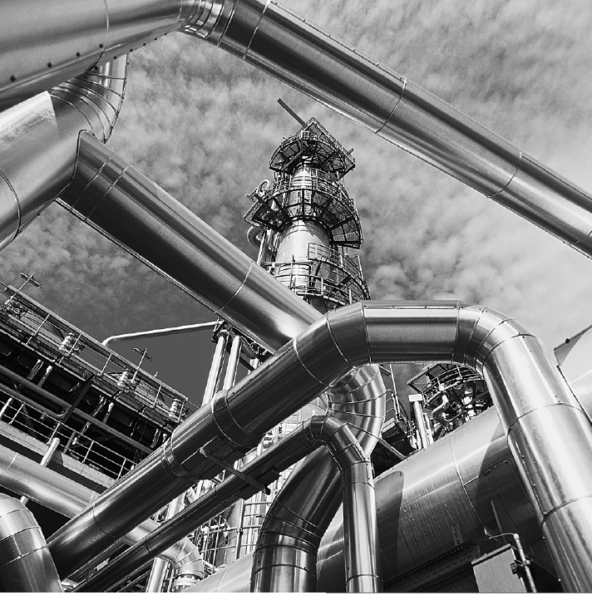
Internal flows through pipes, elbows, tees, valves, etc., as in this oil refinery, are found in nearly every industry.

Slide 3
Objectives
Have a deeper understanding of laminar and turbulent flow in pipes and the analysis of fully developed flow
Calculate the major and minor losses associated with pipe flow in piping networks and determine the pumping power requirements
Understand various velocity and flow rate measurement techniques and learn their advantages and disadvantages

Slide 4
3–1 ■ INTRODUCTION
Liquid or gas flow through pipes or ducts is commonly used in heating and cooling applications and fluid distribution networks.
The fluid in such applications is usually forced to flow by a fan or pump through a flow section.
We pay particular attention to friction, which is directly related to the pressure drop and head loss during flow through pipes and ducts.
The pressure drop is then used to determine the pumping power requirement.
Circular pipes can withstand large pressure differences between the inside and the outside without undergoing any significant distortion, but noncircular pipes cannot.

Slide 5
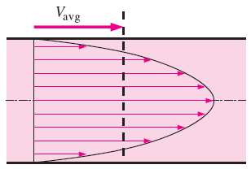
Theoretical solutions are obtained only for a few simple cases such as fully developed laminar flow in a circular pipe.
Therefore, we must rely on experimental results and empirical relations for most fluid flow problems rather than closed-form analytical solutions.
The value of the average velocity V_{avg} at some streamwise cross-section is determined from the requirement that the conservation of mass principle be satisfied
The average velocity for incompressible flow in a circular pipe of radius R
Average velocity V_{avg} is defined as the average speed through a cross section. For fully developed laminar pipe flow, V_{avg} is half of the maximum velocity.

Slide 6
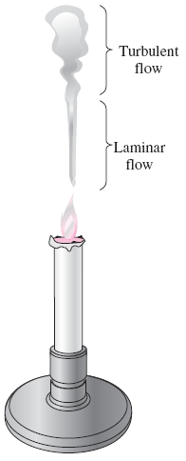
3–2 ■ LAMINAR AND TURBULENT FLOWS
Laminar flow is encountered when highly viscous fluids such as oils flow in small pipes or narrow passages.
Laminar: Smooth streamlines and highly ordered motion.
Turbulent: Velocity fluctuations and highly disordered motion.
Transition: The flow fluctuates between laminar and turbulent flows.
Most flows encountered in practice are turbulent.
The behavior of colored fluid injected into the flow in laminar and turbulent flows in a pipe.
Laminar and turbulent flow regimes of candle smoke.

Slide 7
Reynolds Number
At large Reynolds numbers, the inertial forces, which are proportional to the fluid density and the square of the fluid velocity, are large relative to the viscous forces, and thus the viscous forces cannot prevent the random and rapid fluctuations of the fluid (turbulent).
At small or moderate Reynolds numbers, the viscous forces are large enough to suppress these fluctuations and to keep the fluid “in line” (laminar).
The transition from laminar to turbulent flow depends on the geometry, surface roughness, flow velocity, surface temperature, and type of fluid.
The flow regime depends mainly on the ratio of inertial forces to viscous forces (Reynolds number).
Critical Reynolds number, Re_{cr}: The Reynolds number at which the flow becomes turbulent.
The value of the critical Reynolds number is different for different geometries and flow conditions.
The Reynolds number can be viewed as the ratio of inertial forces to viscous forces acting on a fluid element.

Slide 8
For flow through noncircular pipes, the Reynolds number is based on the hydraulic diameter
For flow in a circular pipe:
The hydraulic diameter D_{h} = 4A_{c}/p is defined such that it reduces to ordinary diameter for circular tubes.
In the transitional flow region of 2300 ≤ Re ≤ 10,000, the flow switches between laminar and turbulent seemingly randomly.

Slide 9
3–3 ■ THE ENTRANCE REGION
Velocity boundary layer: The region of the flow in which the effects of the viscous shearing forces caused by fluid viscosity are felt.
Boundary layer region: The viscous effects and the velocity changes are significant.
Irrotational (core) flow region: The frictional effects are negligible and the velocity remains essentially constant in the radial direction.
The development of the velocity boundary layer in a pipe. The developed average velocity profile is parabolic in laminar flow, but somewhat flatter or fuller in turbulent flow.

Slide 10
Hydrodynamic entrance region: The region from the pipe inlet to the point at which the boundary layer merges at the centerline.
Hydrodynamic entry length L_{h}: The length of this region.
Hydrodynamically developing flow: Flow in the entrance region. This is the region where the velocity profile develops.
Hydrodynamically fully developed region: The region beyond the entrance region in which the velocity profile is fully developed and remains unchanged.
Fully developed: When both the velocity profile the normalized temperature profile remain unchanged.
Hydrodynamically fully developed
In the fully developed flow region of a pipe, the velocity profile does not change downstream, and thus the wall shear stress remains constant as well.

Slide 11
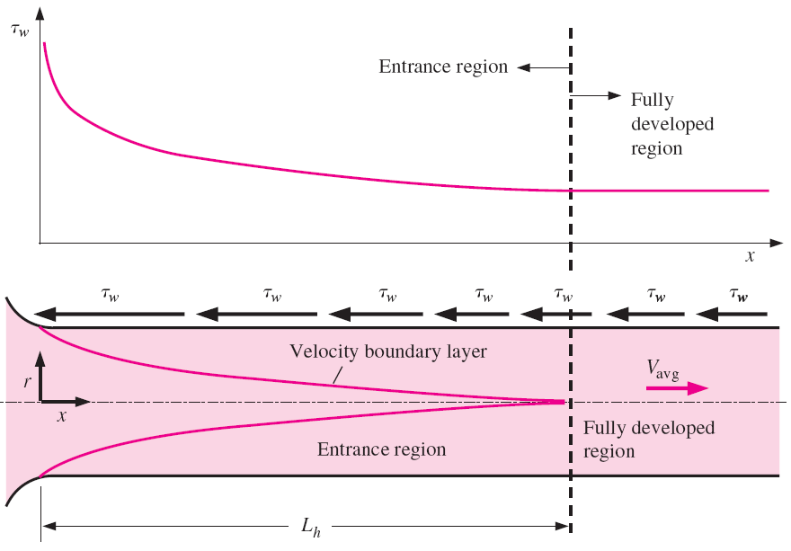
The pressure drop is higher in the entrance regions of a pipe, and the effect of the entrance region is always to increase the average friction factor for the entire pipe.
The variation of wall shear stress in the flow direction for flow in a pipe
from the entrance region into the fully developed region.

Slide 12
Entry Lengths
The hydrodynamic entry length is usually taken to be the distance from the pipe entrance to where the wall shear stress (and thus the friction factor) reaches within about 2 percent of the fully developed value.
The pipes used in practice are usually several times the length of the entrance region, and thus the flow through the pipes is often assumed to be fully developed for the entire length of the pipe.
This simplistic approach gives reasonable results for long pipes but sometimes poor results for short ones since it underpredicts the wall shear stress and thus the friction factor.
hydrodynamic entry length for laminar flow
hydrodynamic entry length for turbulent flow
hydrodynamic entry length for turbulent flow, an approximation

Slide 13
3–4 ■ LAMINAR FLOW IN PIPES
We consider steady, laminar, incompressible flow of a fluid with constant properties in the fully developed region of a straight circular pipe.
In fully developed laminar flow, each fluid particle moves at a constant axial velocity along a streamline and the velocity profile u(r) remains unchanged in the flow direction. There is no motion in the radial direction, and thus the velocity component in the direction normal to the pipe axis is everywhere zero. There is no acceleration since the flow is steady and fully developed.
Free-body diagram of a ring-shaped differential fluid element of radius r, thickness dr, and length dx oriented coaxially with a horizontal pipe in fully developed laminar flow.

Slide 14




Boundary conditions
Average velocity
Velocity profile
Maximim velocity at centerline
Free-body diagram of a fluid disk element of radius R and length dx in fully developed laminar flow in a horizontal pipe.

Slide 15

Pressure Drop and Head Loss
A pressure drop due to viscous effects represents an irreversible pressure loss, and it is called pressure loss ΔP_{L}.
pressure loss for all types of fully developed internal flows
Circular pipe, laminar
dynamic pressure
Darcy friction factor
Head loss
In laminar flow, the friction factor is a function of the Reynolds number only and is independent of the roughness of the pipe surface.

Slide 16
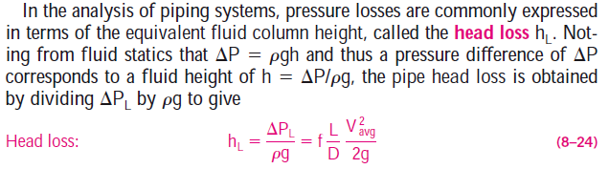
The head loss hL represents the additional height that the fluid needs to be raised by a pump in order to overcome the frictional losses in the pipe.
The head loss is caused by viscosity, and it is directly related to the wall shear stress.

Slide 17



Equations 8–21 and 8–24 are valid for both laminar and turbulent flows in both circular and noncircular pipes, but Eq. 8–23 is valid only for fully developed laminar flow in circular pipes.
Once the pressure loss (or head loss) is known, the required pumping
power to overcome the pressure loss is determined from

Slide 18

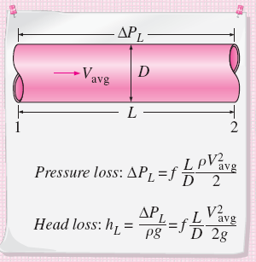
Horizontal pipe
Poiseuille’s law
For a specified flow rate, the pressure drop and thus the required pumping power is proportional to the length of the pipe and the viscosity of the fluid, but it is inversely proportional to the fourth power of the diameter of the pipe.
The relation for pressure loss (and head loss) is one of the most general relations in fluid mechanics, and it is valid for laminar or turbulent flows, circular or noncircular pipes, and pipes with smooth or rough surfaces.
The pumping power requirement for a laminar flow piping system can be reduced by a factor of 16 by doubling the pipe diameter.

Slide 19

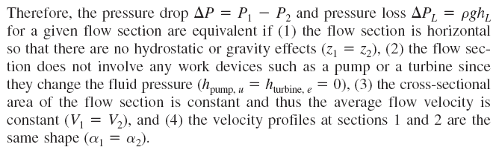
The pressure drop ΔP equals the pressure loss ΔP_{L} in the case of a horizontal pipe, but this is not the case for inclined pipes or pipes with variable cross-sectional area.
This can be demonstrated by writing the energy equation for steady, incompressible one-dimensional flow in terms of heads as

Slide 20
Effect of Gravity on Velocity and Flow Rate in Laminar Flow
Free-body diagram of a ring-shaped differential fluid element of radius r, thickness dr, and length dx oriented coaxially with an inclined pipe in fully developed laminar flow.

Slide 22
Laminar Flow in Noncircular Pipes
The friction factor f relations are given in Table 8–1 for fully developed laminar flow in pipes of various cross sections. The Reynolds number for flow in these pipes is based on the hydraulic diameter D_{h} = 4A_{c} /p, where A_{c} is the cross-sectional area of the pipe and p is its wetted perimeter

Slide 29
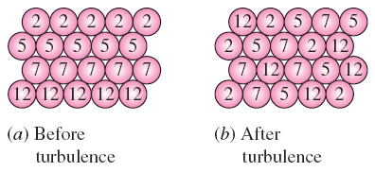
3–5 ■ TURBULENT FLOW IN PIPES
Most flows encountered in engineering practice are turbulent, and thus it is important to understand how turbulence affects wall shear stress.
Turbulent flow is a complex mechanism dominated by fluctuations, and it is still not fully understood.
We must rely on experiments and the empirical or semi-empirical correlations developed for various situations.
Turbulent flow is characterized by disorderly and rapid fluctuations of swirling regions of fluid, called eddies, throughout the flow.
These fluctuations provide an additional mechanism for momentum and energy transfer.
In turbulent flow, the swirling eddies transport mass, momentum, and energy to other regions of flow much more rapidly than molecular diffusion, greatly enhancing mass, momentum, and heat transfer.
As a result, turbulent flow is associated with much higher values of friction, heat transfer, and mass transfer coefficients
The intense mixing in turbulent flow brings fluid particles at different momentums into close contact and thus enhances momentum transfer.

Slide 30



The laminar component: accounts for the friction between layers in the flow direction
The turbulent component: accounts for the friction between the fluctuating fluid particles and the fluid body (related to the fluctuation components of velocity).
Fluctuations of the velocity component u with time at a specified location in turbulent flow.
The velocity profile and the variation of shear stress with radial distance for turbulent flow in a pipe.

Slide 31

Turbulent Shear Stress
turbulent shear stress
Turbulent shear stress
eddy viscosity or turbulent viscosity: accounts for momentum transport by turbulent eddies.
Total shear stress
Fluid particle moving upward through a differential area dA as a result of the velocity fluctuation v.
kinematic eddy viscosity or kinematic turbulent viscosity (also called the eddy diffusivity of momentum).

Slide 32
Turbulent Velocity Profile
The very thin layer next to the wall where viscous effects are dominant is the viscous (or laminar or linear or wall) sublayer.
The velocity profile in this layer is very nearly linear, and the flow is streamlined.
Next to the viscous sublayer is the buffer layer, in which turbulent effects are becoming significant, but the flow is still dominated by viscous effects.
Above the buffer layer is the overlap (or transition) layer, also called the inertial sublayer, in which the turbulent effects are much more significant, but still not dominant.
Above that is the outer (or turbulent) layer in the remaining part of the flow in which turbulent effects dominate over molecular diffusion (viscous) effects.
The velocity profile in fully developed pipe flow is parabolic in laminar flow, but much fuller in turbulent flow. Note that u(r) in the turbulent case is the time-averaged velocity component in the axial direction (the overbar on u has been dropped for simplicity).

Slide 33

The Moody Chart and the Colebrook Equation
Colebrook equation (for smooth and rough pipes)
The friction factor in fully developed turbulent pipe flow depends on the Reynolds number and the relative roughness ε /D.
Explicit Haaland equation
The friction factor is minimum for a smooth pipe and increases with roughness.

Slide 34
The Moody Chart

Slide 35
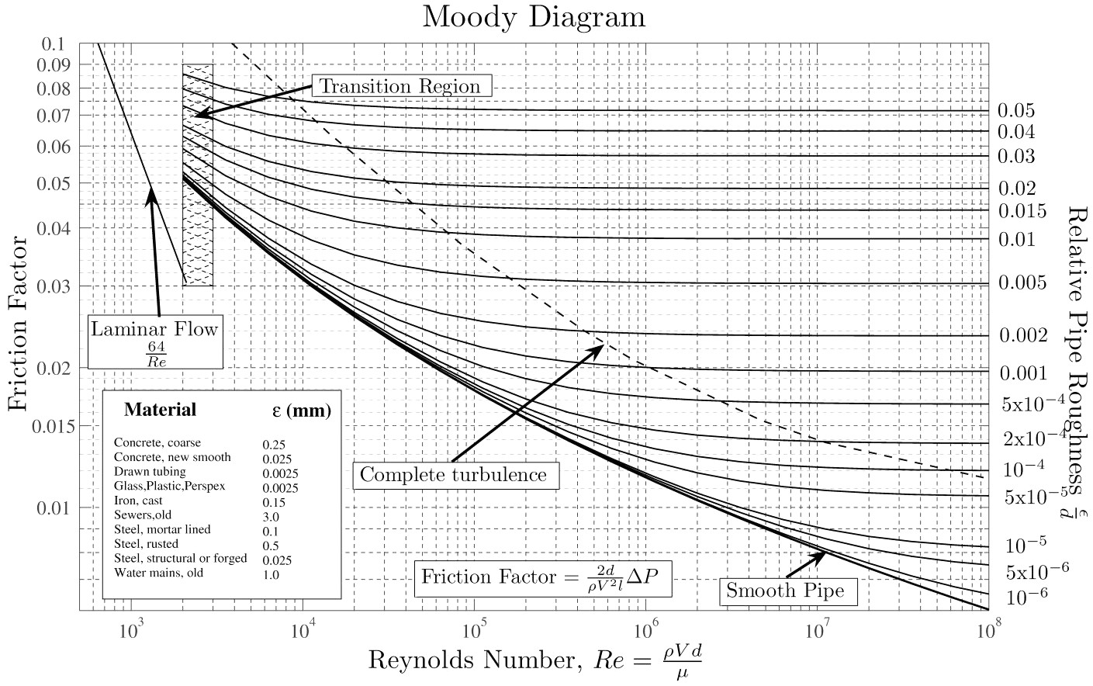

Slide 36
Observations from the Moody chart
For laminar flow, the friction factor decreases with increasing Reynolds number, and it is independent of surface roughness.
The friction factor is a minimum for a smooth pipe and increases with roughness. The Colebrook equation in this case (ε = 0) reduces to the Prandtl equation.
The transition region from the laminar to turbulent regime is indicated by the shaded area in the Moody chart. At small relative roughnesses, the friction factor increases in the transition region and approaches the value for smooth pipes.
At very large Reynolds numbers (to the right of the dashed line on the Moody chart) the friction factor curves corresponding to specified relative roughness curves are nearly horizontal, and thus the friction factors are independent of the Reynolds number. The flow in that region is called fully rough turbulent flow or just fully rough flow because the thickness of the viscous sublayer decreases with increasing Reynolds number, and it becomes so thin that it is negligibly small compared to the surface roughness height. The Colebrook equation in the fully rough zone reduces to the von Kármán equation.

Slide 37
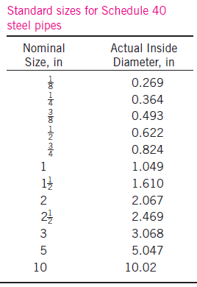
In calculations, we should make sure that we use the actual internal diameter
of the pipe, which may be different than the nominal diameter.
At very large Reynolds numbers, the friction factor curves on the Moody chart are nearly horizontal, and thus the friction factors are independent of the Reynolds number. See Fig. A–12 for a full-page moody chart.

Slide 38
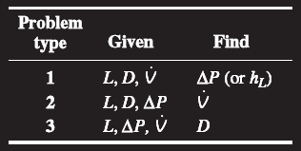
Types of Fluid Flow Problems
Determining the pressure drop (or head loss) when the pipe length and diameter are given for a specified flow rate (or velocity)
Determining the flow rate when the pipe length and diameter are given for a specified pressure drop (or head loss)
Determining the pipe diameter when the pipe length and flow rate are given for a specified pressure drop (or head loss)
The three types of problems encountered in pipe flow.
To avoid tedious iterations in head loss, flow rate, and diameter calculations,
these explicit relations that are accurate to within 2 percent of the Moody chart may be used.

Slide 39
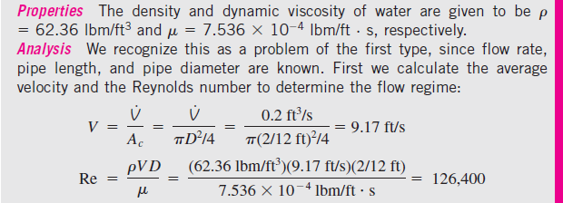
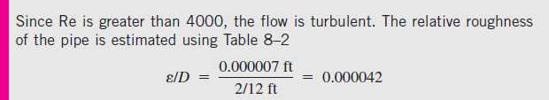

Slide 40
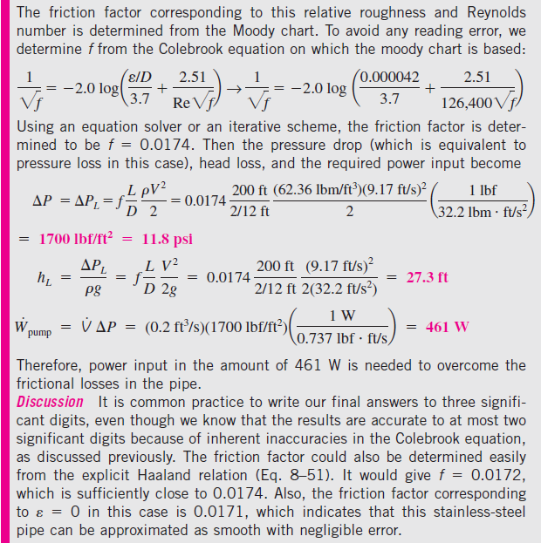

Slide 41
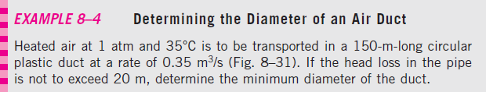
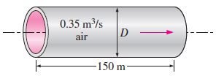
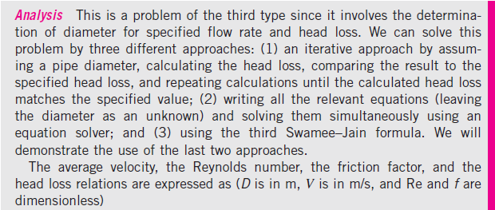

Slide 42
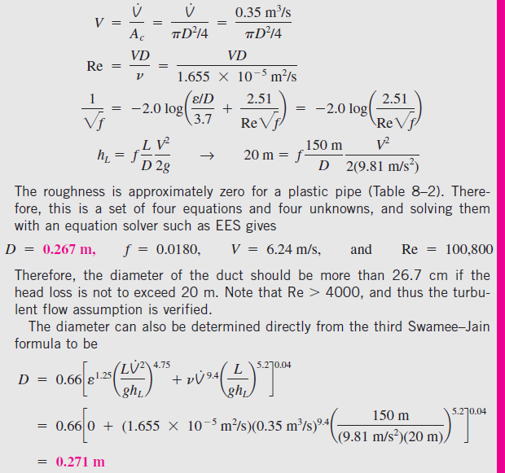

Slide 43
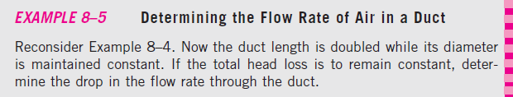

Slide 47

3–6 ■ MINOR LOSSES
The fluid in a typical piping system passes through various fittings, valves, bends, elbows, tees, inlets, exits, enlargements, and contractions in addition to the pipes.
These components interrupt the smooth flow of the fluid and cause additional losses because of the flow separation and mixing they induce.
In a typical system with long pipes, these losses are minor compared to the total head loss in the pipes (the major losses) and are called minor losses.
Minor losses are usually expressed in terms of the loss coefficient K_{L}.
For a constant-diameter section of a pipe with a minor loss component, the loss coefficient of the component (such as the gate valve shown) is determined by measuring the additional pressure loss it causes and dividing it by the dynamic pressure in the pipe.
Head loss due to component

Slide 48
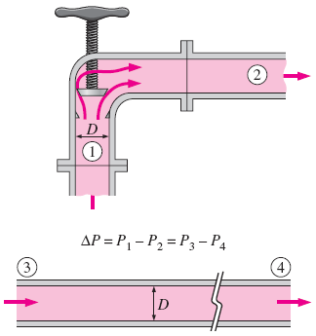


When the inlet diameter equals outlet diameter, the loss coefficient of a component can also be determined by measuring the pressure loss across the component and dividing it by the dynamic pressure:
K_{L} = ΔP_{L} /(ρV²/2).
When the loss coefficient for a component is available, the head loss for that component is
Minor loss
Minor losses are also expressed in terms of the equivalent length L_{equiv}.
The head loss caused by a component (such as the angle valve shown) is equivalent to the head loss caused by a section of the pipe whose length is the equivalent length.

Slide 49
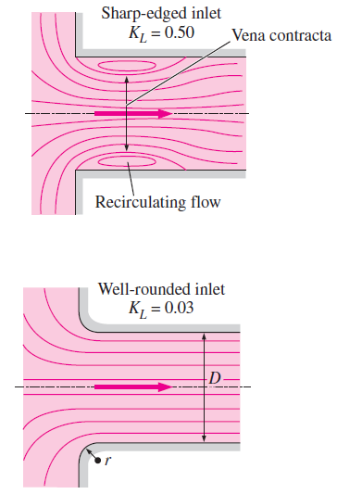
Total head loss (general)
Total head loss (D = constant)
The head loss at the inlet of a pipe is almost negligible for well-rounded inlets (K_{L} = 0.03 for r/D > 0.2) but increases to about 0.50 for sharp-edged inlets.

Slide 53
The effect of rounding of a pipe inlet on the loss coefficient.
Graphical representation of flow contraction and the associated head loss at a sharp-edged pipe inlet.

Slide 54
All the kinetic energy of the flow is “lost” (turned into thermal energy) through friction as the jet decelerates and mixes with ambient fluid downstream of a submerged outlet.
The losses during changes of direction can be minimized by making the turn “easy” on the fluid by using circular arcs instead of sharp turns.

Slide 55
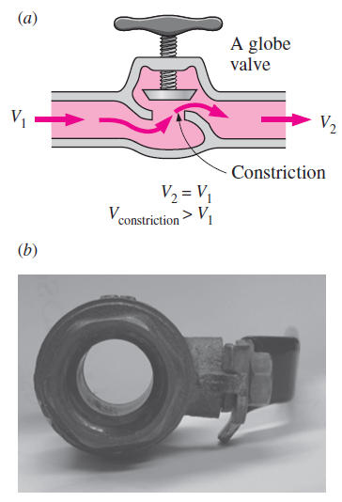
(a) The large head loss in a partially closed valve is due to irreversible deceleration, flow separation, and mixing of high-velocity fluid coming from the narrow valve passage.
(b) The head loss through a fully-open ball valve, on the other hand, is quite small.

Slide 57
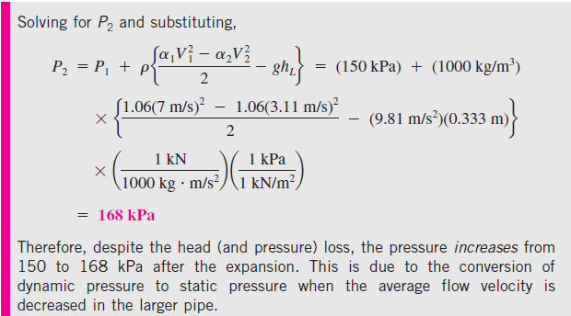

Slide 58
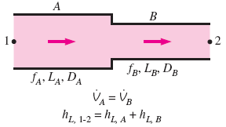
3–7 ■ PIPING NETWORKS AND PUMP SELECTION
For pipes in series, the flow rate is the same in each pipe, and the total head loss is the sum of the head losses in individual pipes.
A piping network in an industrial facility.
For pipes in parallel, the head loss is the same in each pipe, and the total flow rate is the sum of the flow rates in individual pipes.

Slide 59
The relative flow rates in parallel pipes are established from the
requirement that the head loss in each pipe be the same.
The flow rate in one of the parallel branches is proportional to its diameter to the power 5/2 and is inversely proportional to the square root of its length and friction factor.
The analysis of piping networks is based on two simple principles:
Conservation of mass throughout the system must be satisfied. This is done by requiring the total flow into a junction to be equal to the total flow out of the junction for all junctions in the system.
Pressure drop (and thus head loss) between two junctions must be the same for all paths between the two junctions. This is because pressure is a point function and it cannot have two values at a specified point. In practice this rule is used by requiring that the algebraic sum of head losses in a loop (for all loops) be equal to zero.

Slide 60
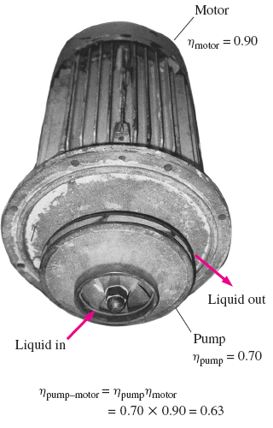

Piping Systems with Pumps and Turbines
the steady-flow energy equation
When a pump moves a fluid from one reservoir to another, the useful pump head requirement is equal to the elevation difference between the two reservoirs plus the head loss.
The efficiency of the pump–motor
combination is the product of the
pump and the motor efficiencies.

Slide 61
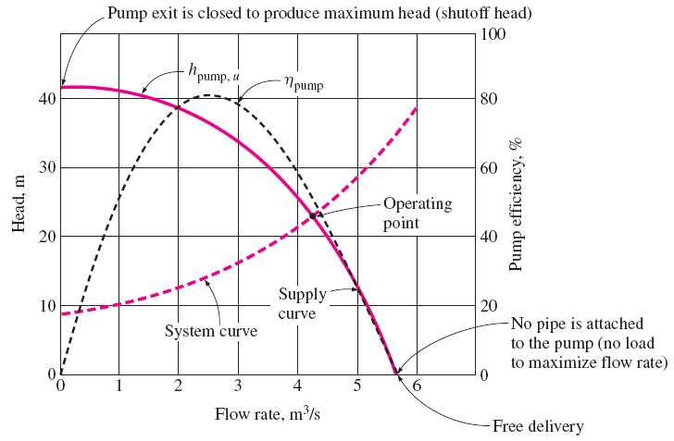
Characteristic pump curves for centrifugal pumps, the system curve for a piping system, and the operating point.

Slide 62
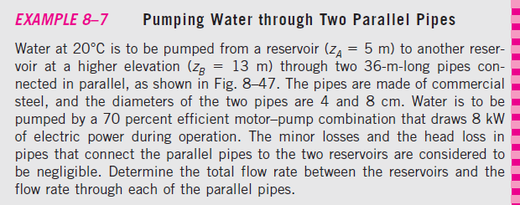
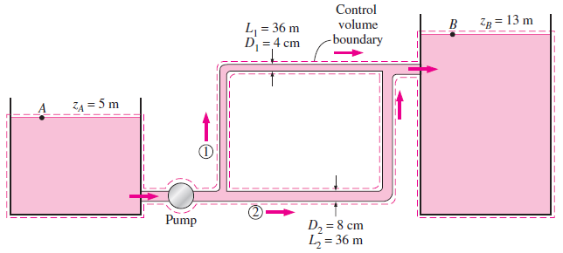

Slide 66


Slide 69

Assignment

