Slide 1

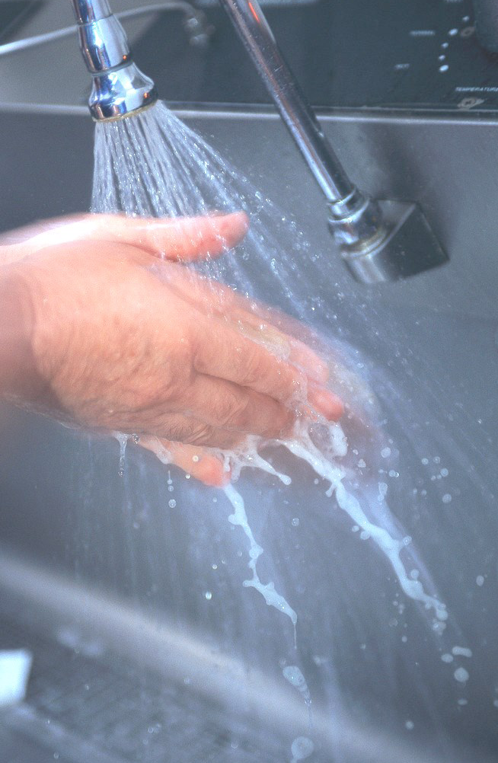
&
BUILDING WATER SUPPLY
CHAPTER 4
AAiT.SCEE

Slide 2
Purpose of WS system
Provide potable water supply to fixtures from water sources
For sanitation (toilets, shower/bath and laundry)
Cooking (kitchen)
Gardening and
Fire protection

Slide 3
Types of System
Direct connection from the main to all fixtures
Direct connection to overhead tank and then to all fixtures
Pumped system
- Direct pumping to fixtures (fire fighting)
Combined (pump & over head tank) system
- Pumping from ground/underground/ storage to overhead tank, then to all fixtures

Slide 4
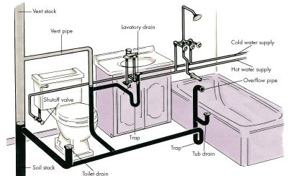
Building areas requiring water supply system
WH
Hand wash basin
Water closet
Bath tub

Slide 5
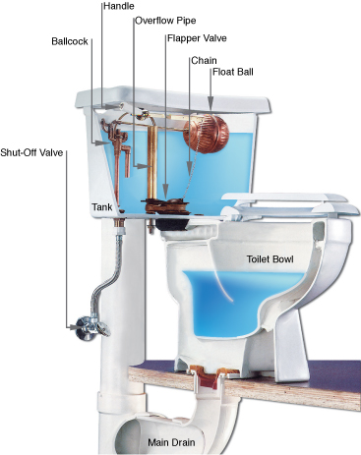
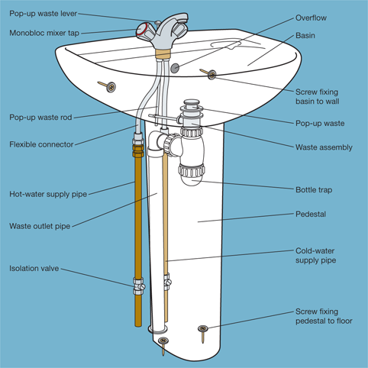
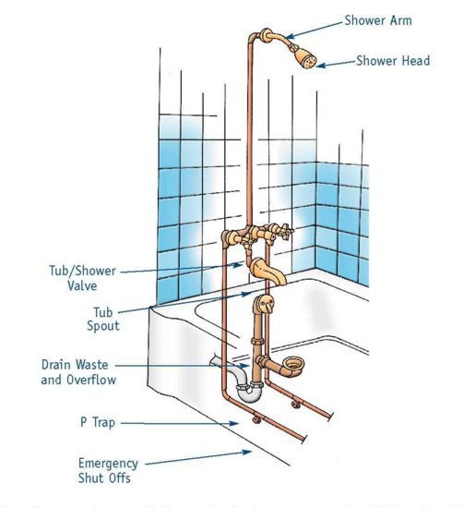
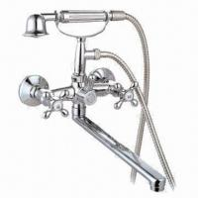
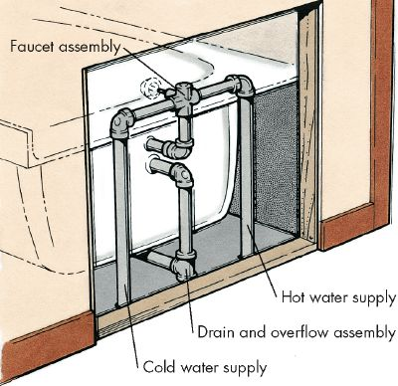
Hand wash Basin (HWB)
Water closet (WC)
Bath tub faucet
Bath Tub (BT)
Shower head (SH)

Slide 6
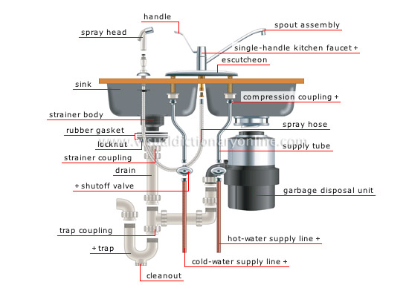
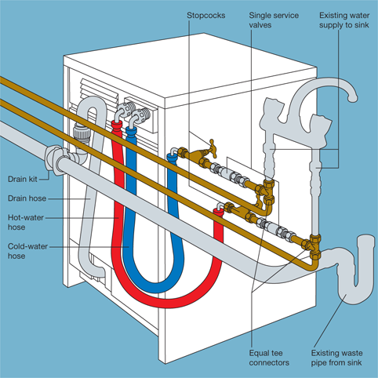
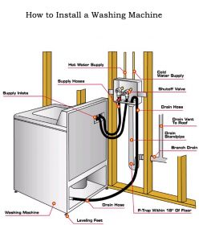
Kitchen sink (KS)
Dish Washer (DW)
Laundry (LA)

Slide 7
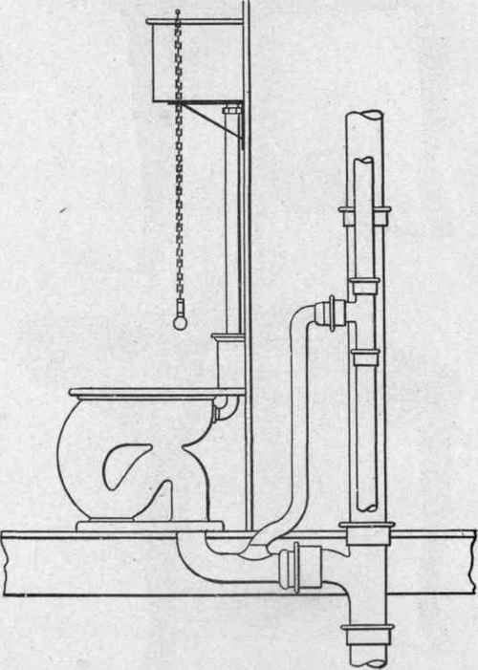
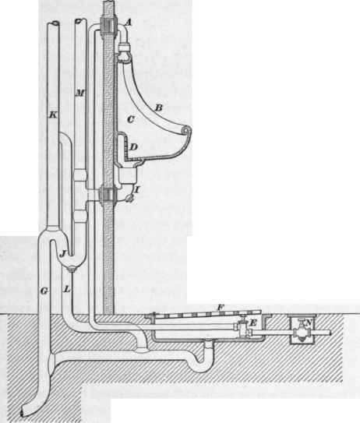
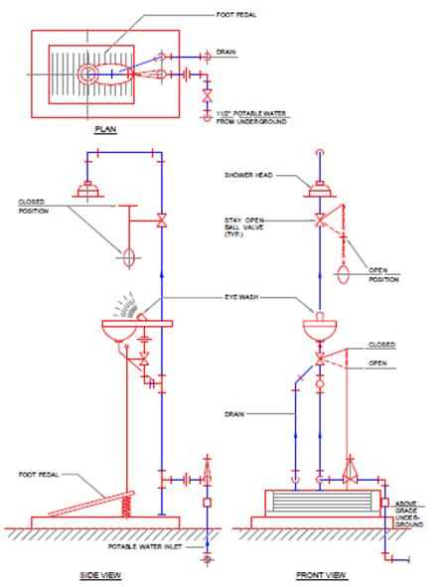
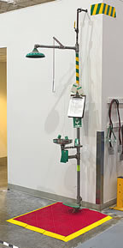
Urinals (UR)
Emergency Shower (ESH)
Eye wash (EW)

Slide 8
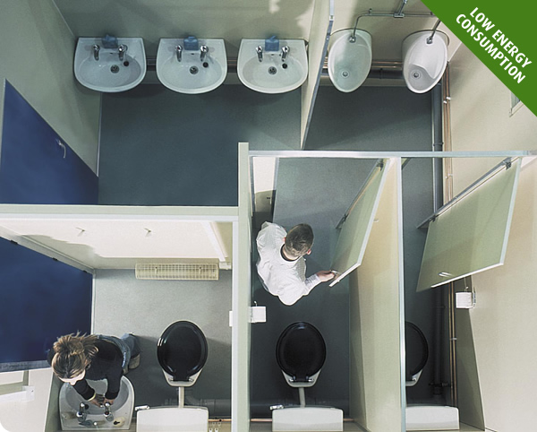
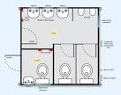
Design of building WS system
Steps;
Obtain architectural drawings (elevation, section and floor plans)
Decide on the type of system and location of storage

Slide 9
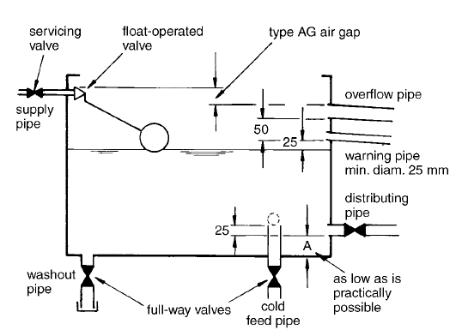
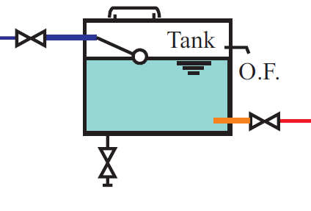
Design of building WS system
Storage tank /cistern Capacity
  Likelihood and frequency of supply breakdown
  Type and use of buildings
  Number of occupants
  Recommended min. storage in l/h/d is given in EBCS 9 (Table 3.3)
  Offices = 25
  Hotels (per bed) = 100-150
  Restaurant (per seat) = 60
Notes:
l/h/d = consumption per head per day (l)

Slide 10
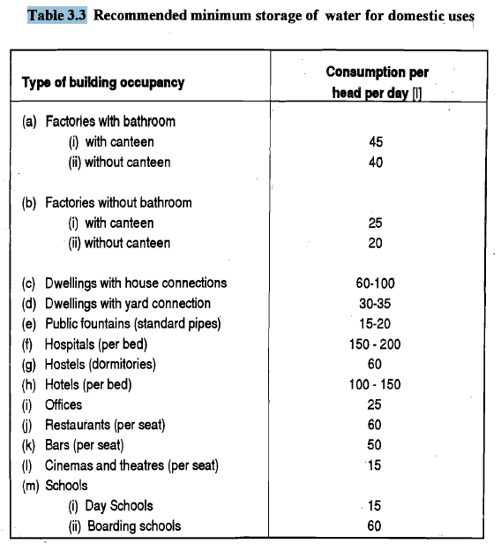
Design of building WS system
Storage tank /cistern Capacity

Slide 11
Design of building WS system
Pipe sizing
Prepare layout of pipes & valves for the rooms requiring water supply installation (from source to each fixtures)
Isolation valve location (ref. Table 3-4, EBCS 9)
Location for valve
At water meter
At each flushing cistern
At each appliance
At each pumping apparatus
At each storage tank
At each branch serving each floor in buildings
Note: criteria for water meter placement
ref: Page 41 EBCS 9)
Read: - on max. length for pipes for hot water
from heater (Table 3.5)
- Ref. hot water storage (Table 3.6)
Notes:
If the length of the pipes are exceeded than that stated in the Table, the pipe should be insulated

Slide 12
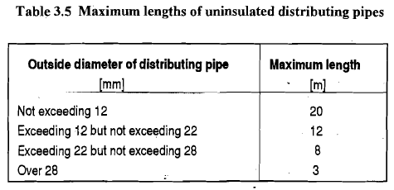
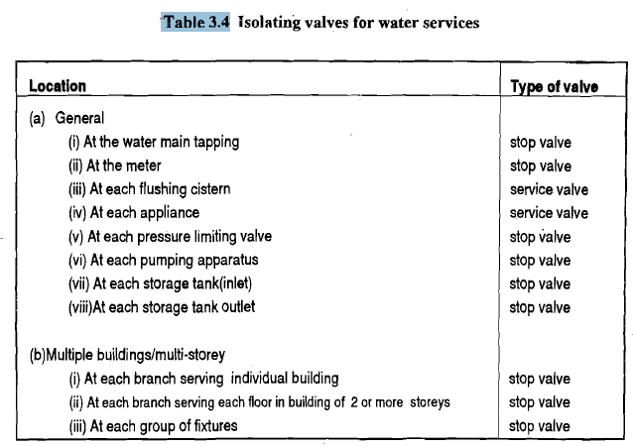
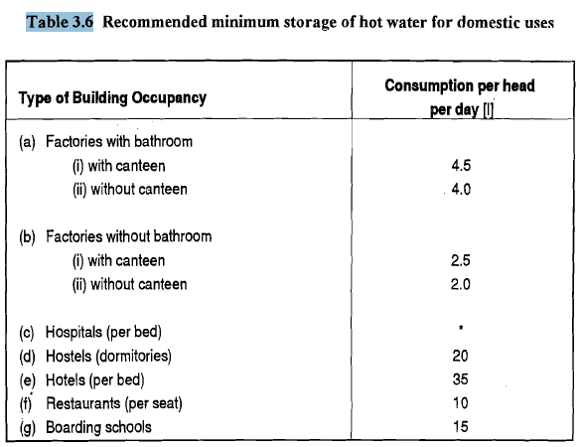

Slide 13
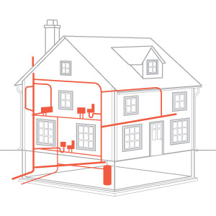
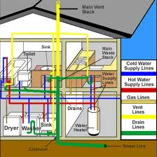
Pipe sizing

Slide 14
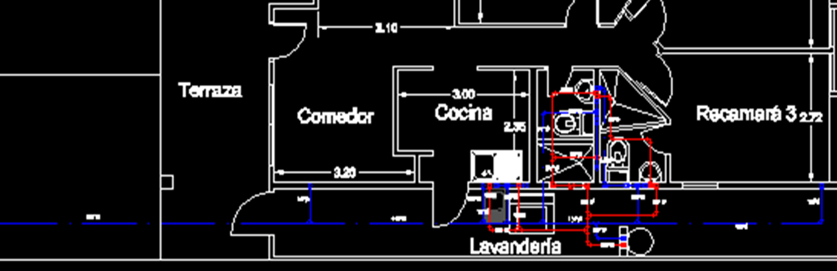
Pipe sizing

Slide 15
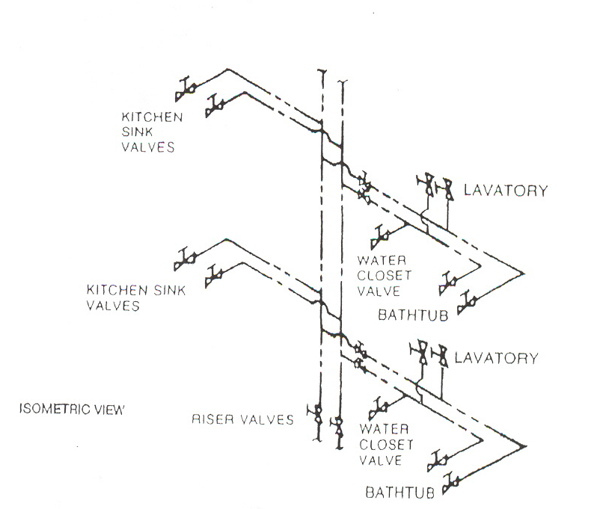
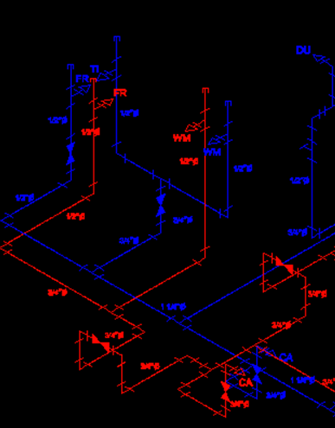
Pipe sizing
Riser diagrams are isometric drawings which show all piping fittings and equipment that constitute the plumbing system.

Slide 16
Pipe sizing
Riser diagrams are isometric drawings which show all piping fittings and equipment that constitute the plumbing system.

Slide 17
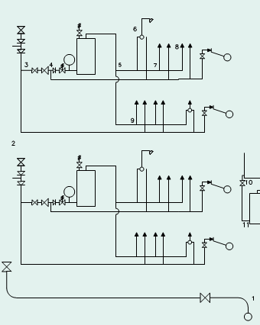
Pipe sizing
wb bath wc
First floor
sink w/m cloaks wc
Ground floor
Riser diagrams are isometric drawings which show all piping fittings and equipment that constitute the plumbing system.
main at 3 bar minimum pressure

Slide 18
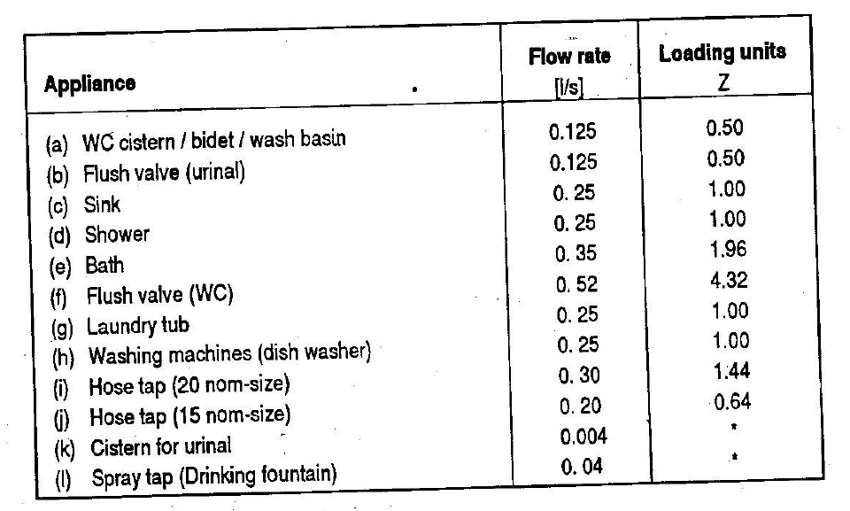
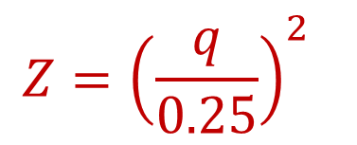

Pipe sizing
Determine the flow rate by fixture loading units
Loading units - a factor or number given to an appliance relating flow rate to the duration and frequency of use (probable simultaneous usage).
$$Z={\left(\frac{q}{0.25}\right)}^{2}$$
For fixtures where simultaneous
flow is unlikely
Q= Probable design flow
Q$=0.25\sqrt{Z_{1}+Z_{2}+…+Z_{n}}$

Slide 19
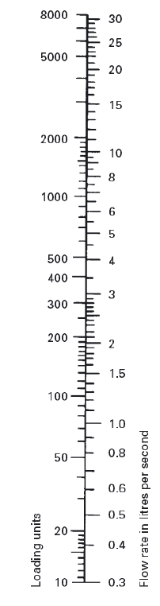
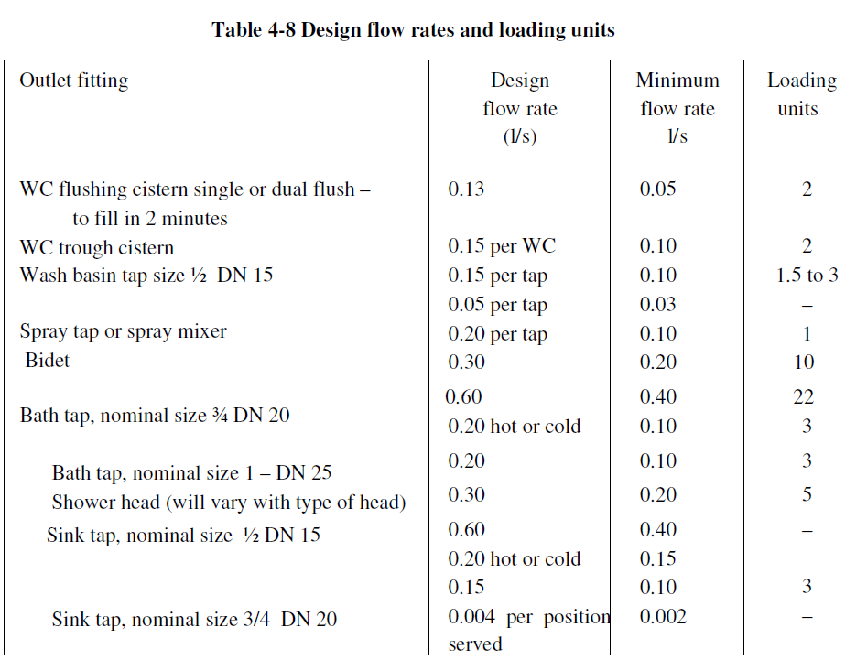
Pipe sizing
Modified EBCS-9
Conversion chart - loading unit to flow rate

Slide 20
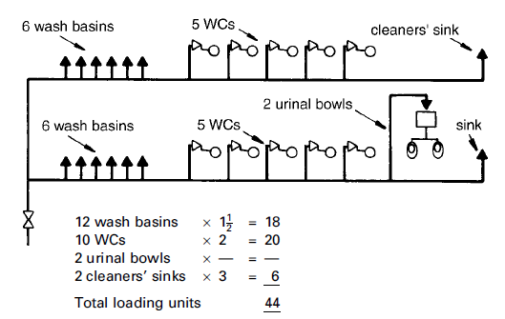

Pipe sizing
3
5
2
4
1
$$Q=0.25\sqrt{44}=1.65 l/sec$$

Slide 21
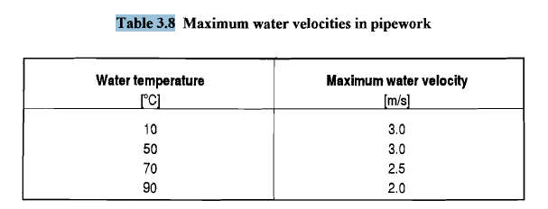
Pipe sizing
Select velocity; Maximum water velocities in pipe work are given in table 3.8 (EBCS 9) for different water temperature
Assume a pipe diameter based on selected velocity

Slide 22
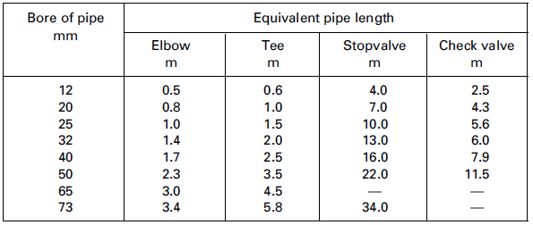
Pipe sizing
Head loss estimation
The total head loss in a piping system is the head loss through pipes and fittings.
The head loss through fittings is also determined from equivalent length of straight pipe
Effective length = Measure pipe length + equivalent pipe length for fittings and draw-offs
Table B1, EBCS 9
15

Slide 23
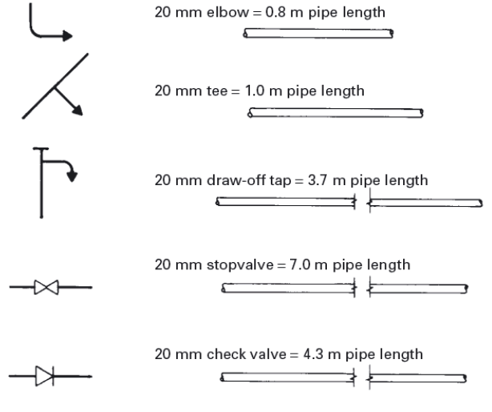
Pipe sizing
Examples of equivalent pipe length

Slide 24
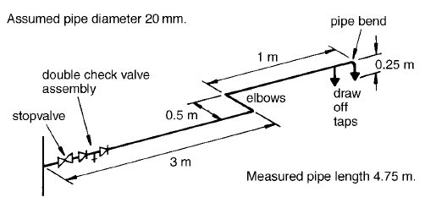
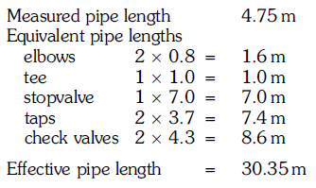
Pipe sizing

Slide 25
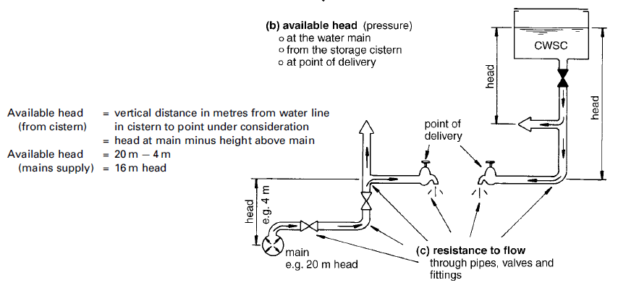

Pipe sizing
Calculate the available head at the point of concern

Slide 26
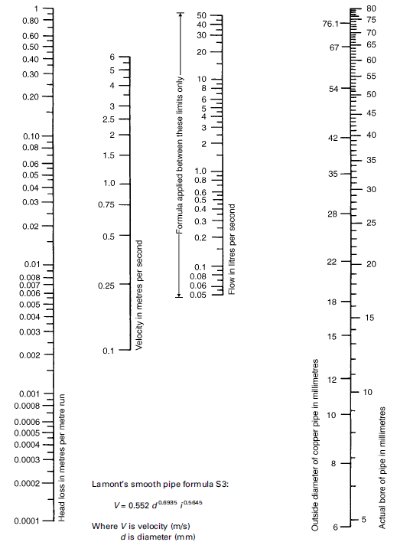
Determine percentage head loss for the selected velocity from nomograph and multiply by the effective length
or
Calculate the head loss in the pipe for the determined effective length of pipe, discharge and diameter using Hazen William or Darcy Waybach.
Then calculate the residual head and if it is less than the head required for a particular fitting, repeat steps by assuming another set of velocity & diameter
Notes:
A pipe size of 20 mm has been assumed. This pipe size must give the design flow rate without the permissible head loss being exceeded. If it does not, a fresh pipe size must be assumed and the procedure worked through again. Figure 4.10 relates pipe size to flow rate, flow velocity and head loss. Knowing the assumed pipe size and the calculated design flow rate, the flow velocity and the head loss can be found from the figure as follows.
(1) Draw a line joining the assumed pipe size (20 mm) and the design flow rate (0.4 l/s).
(2) Continue this line across the velocity and head loss scales.
(3) Check that the loss of head (0.12 m/m run) does not exceed the calculated permissible head loss of 1.48 m/m run.
(4) Check that the flow velocity (1.4 m/s) is not too high by referring to 4.11
A typical shower will require a minimum of 1m head
A basin tap needs 0.5m and
A bath tap 0.8m to give a satisfactory discharge.

Slide 27
Pipe sizing tabulation chart Initial mains head available = __ m
1 | 2 | 3 | 4 | 5 | 6 | 7 | 8 | 9 | 10 | 11 | 12 | 13 | 14
Pipe reference | Loading units | Design flow rate (l/s) | Velocity (m/s) | Assume tube diameter (mm) | Head loss (m/m) | Pipe length (m) |  | Total head loss | Vertical drop(+) or rise(-) | Available head | Residual head (11-9) | Residual head required at fitting | Final tube diameter (mm)
 |  |  |  |  |  | Actual | Effective
1-2
2-3
3-4
4-5
5-6
6-7
7-8
5-9

Slide 28
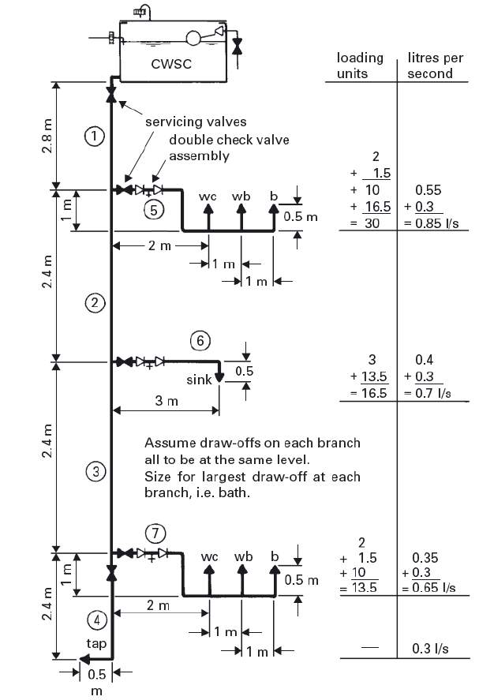
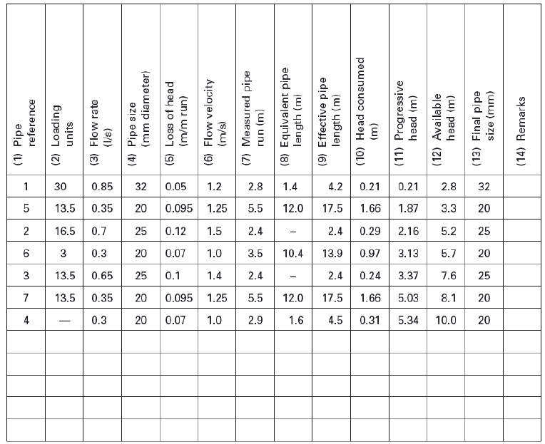
Calculation sheet – example of use (EBCS-9)

Slide 29
Figure 4-13 Calculation sheet – example of use (EBCS-9)

Slide 30
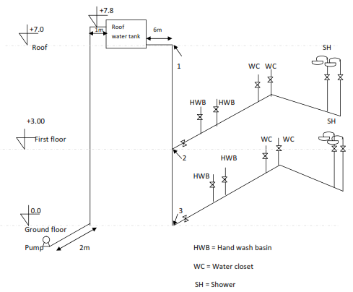
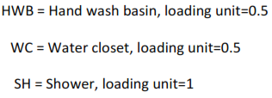
Example
Suppose you have a water supply system in a G+1 building as shown in the riser diagram.
a) Determine velocities in pipes 1-2 & 2-3 and residual pressure at points 2 & 3 if diameter of pipe from reservoir to first floor (pt. 2) =25mm and 2-3 =20mm.
b) Assuming pump will be operational for 1 hr a day, and storage required is 800lit, determine the pump head and discharge required if 32mm diameter pipe is used to convey water from pump to the roof water tank.
Use; Hazen Williams loss equation with C=150.
Equivalent length for ф25mm elbow = 1m, ф25mm stop valve=10m, ф32mm elbow=1.4m, ф32mm stop valve=13m

Slide 32
a. Q₁₋₂ = 0.25√(Z₁+Z₂+….Z_{n})
= 0.25*√((4*0.5)+(4*0.5)+(4*1)) = 0.707l/s = 0.000707m³/s
A₁₋₂ = π *(0.025)²/4
= 0.00490m²
V₁₋₂ = Q₁₋₂/A₁₋₂
= 0.000707/0.00490 = 1.44m/s
Q₂₋₃= 0.25√(Z₁+Z₂+….Z_{n})
= 0.25*√((2*0.5)+(2*0.5)+(2*1)) = 0.5l/s = 0.0005m³/s
A₁₋₂ = π *(0.020)²/4
= 0.000314m²
V₁₋₂ = Q₁₋₂/A₁₋₂
= 0.0005/0.000314 = 1.59m/s

Slide 33

Residual pressure at pt 2 = H_{available}- H_{L} _{up to pt. 2}
H_{L} up to pt. 2 is H_{L} due to;
L_{1-2 effective}= 10m ф25mm pipe +equivalent length of 1 elbow + equivalent length of 1 valve
= 10+1+10 = 21m
D₁₋₂ = 25cm
H_{L} = 10.7*(0.000707/150)^{1.85}*21/(0.025^{4.866})
= 2.0m
Residual pressure at pt 2 = H_{available}-H_{L} up to pt. 2
= 4.8-2.0 = 2.8m

Slide 34
Residual pressure at pt 3 = H_{available at pt 2} + H_{available from pt 2 to 3} - H_{L} _{from pt 2 to 3}
H_{L} up to pt. 2 is H_{L} due to;
L=3m ф20mm pipe
H_{L} = 10.7*(0.0005/150)^{1.85}*3m/(0.02^{4.866}) = 0.44m
Residual pressure at pt 3 = H_{available at pt 2} + H_{available from pt 2 to 3} -H_{L} _{from pt 2 to 3}
= 2.8 +3 -0.44 = 5.36m

Slide 35
b. Assuming pumping is done at time of 0 demand, Q= Volume/t
Q = 800l/(1hr*3600)sec
Q = 0.22l/s
H_{pump} = H_{static} + H_{L} 2 elbows 1 valve
H_{static} = 7.8m
H_{L} for L= 2m +7.8m +1m +(2*1.4m)+13m
L = 26.6m
H_{L} = 10.68*(0.00022/150)^{1.85} *26.6/ (0.032^{4.866})
= 0.089m
H_{pump} = H_{static} + H_{L}
H_{pump} = 7.8+0.089m = 7.89m

Slide 36
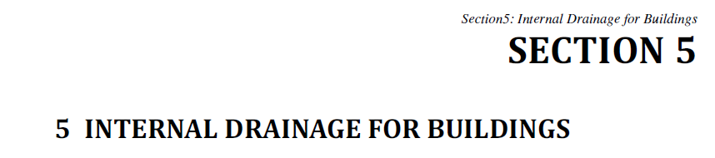
Reading Assignment
SCOPE AND DEFINITIONS
ADMINISTRATION
SANITARY FIXTURES
WATER SUPPLY AND DISTRIBUTION

