Slide 1
BEST MANAGEMENT PRACTICE
Sustainable Storm Water Management

Slide 2
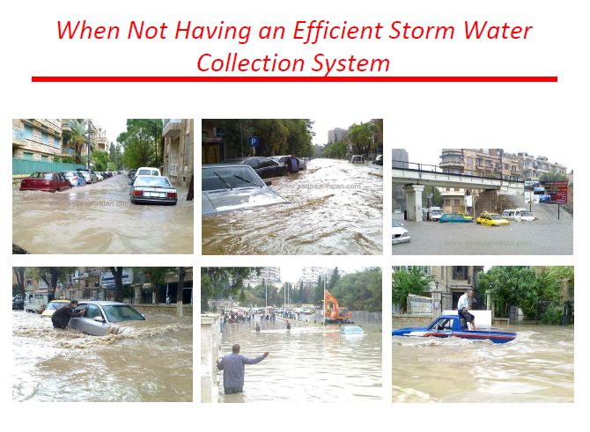

Slide 3
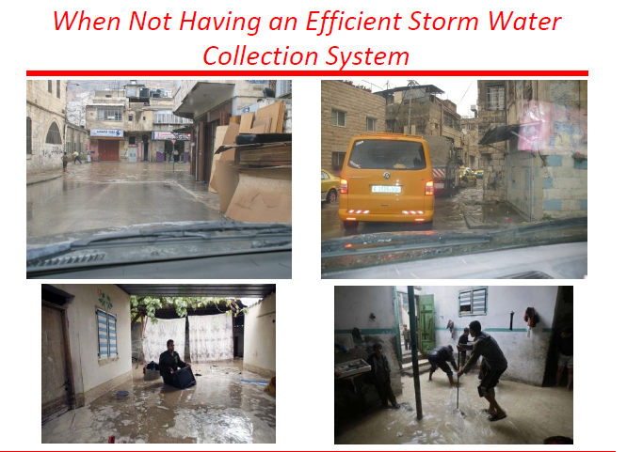

Slide 4
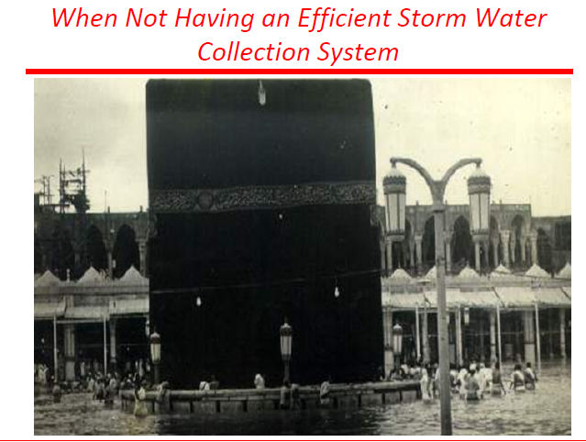

Slide 5
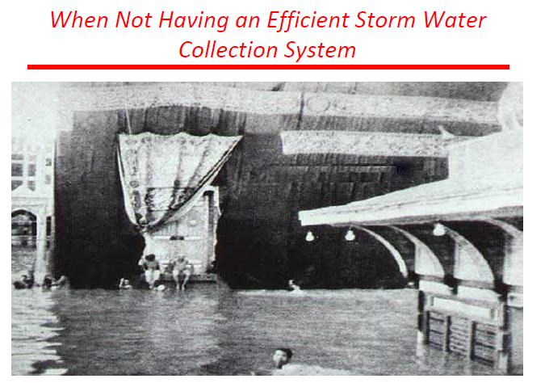

Slide 6
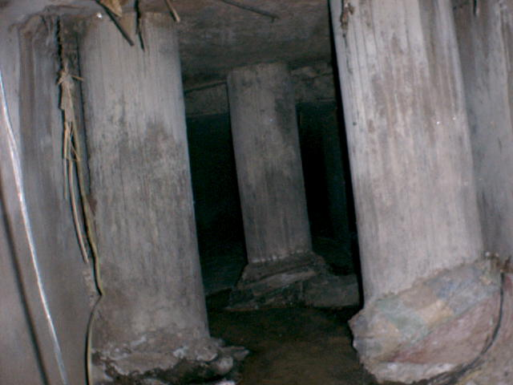
Obstruction of the flow

Slide 7
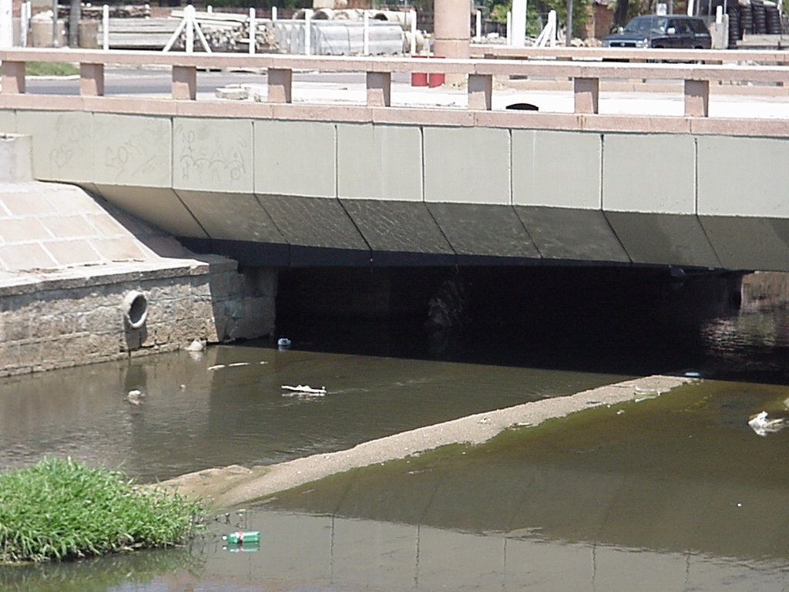
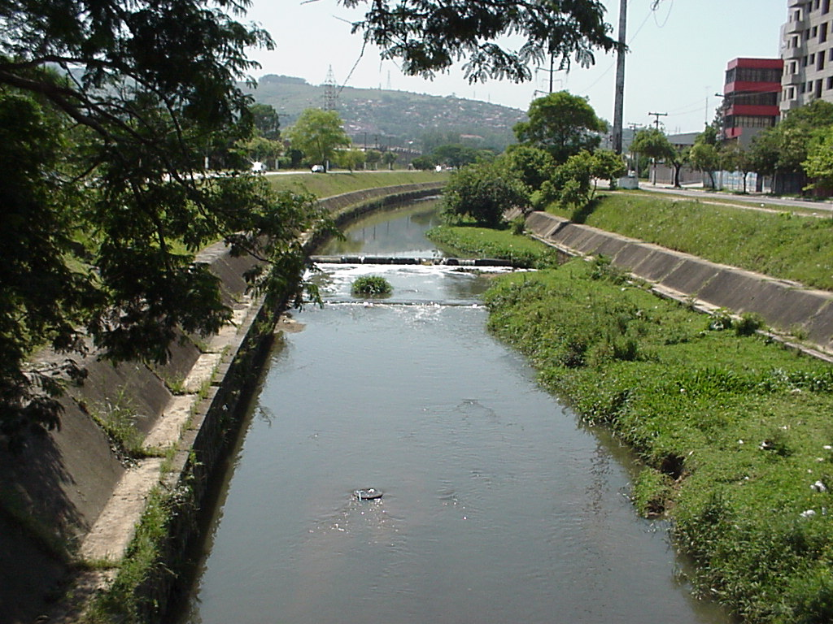
Bad design
7

Slide 8
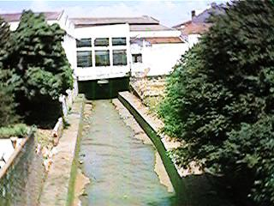
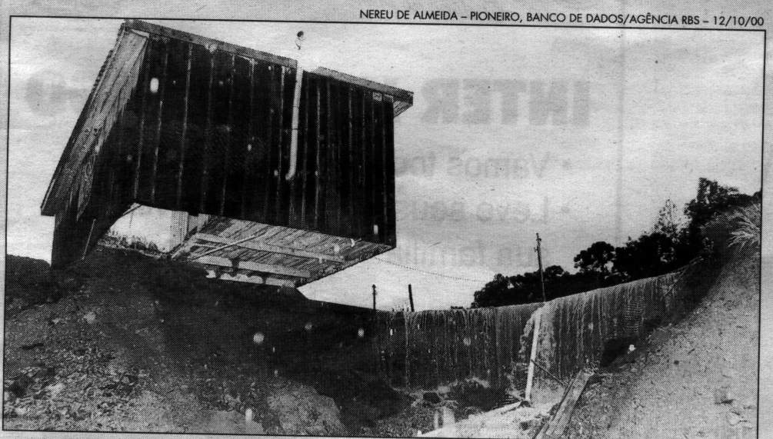
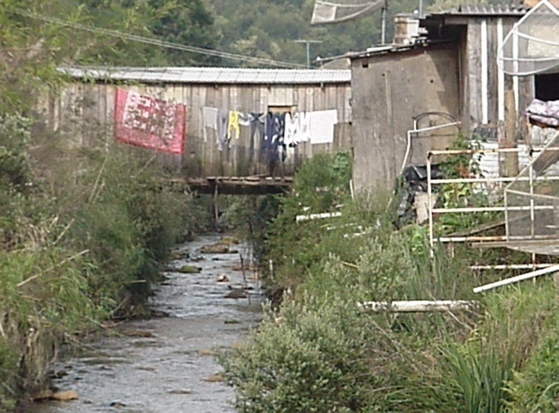
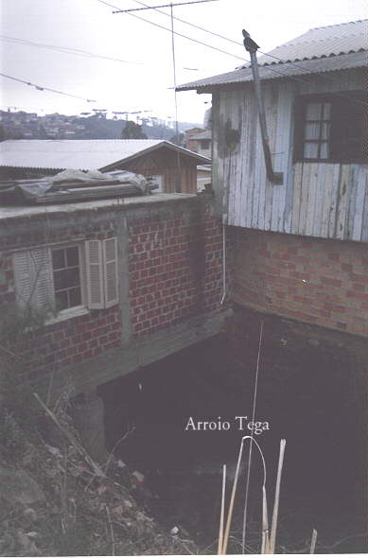
Population in risk areas

Slide 9
WHY STORM WATER - FLOOD ???

Slide 10
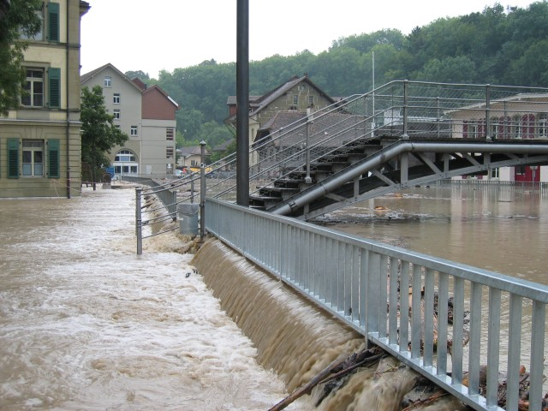
Flood
Historical demands of urbanisation and its consequences;
When a city starts to grow near a river, initially, inundation occurs during extreme events only;
Urbanisation changes landscape patterns, aggravating floods by increasing surface runoff;
Floods become greater in magnitude and frequency.

Slide 11
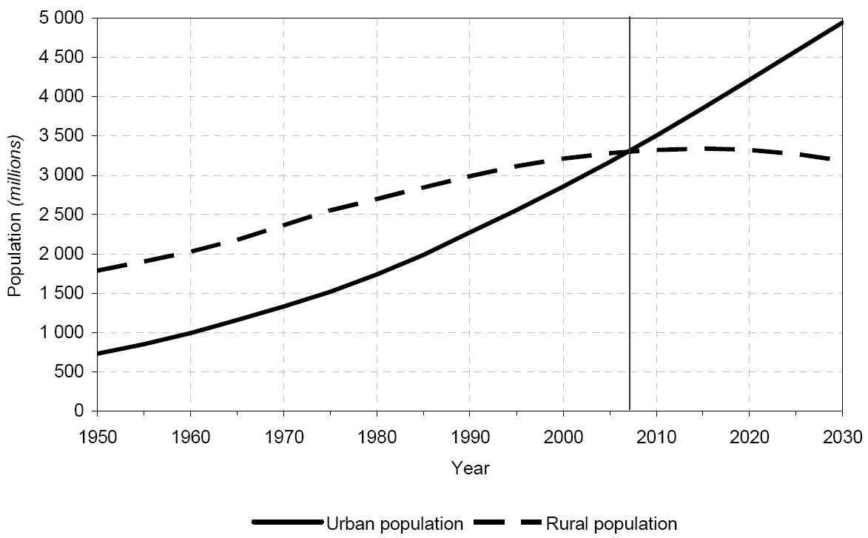
Urban and rural population of the world: 1950-2030
Source: WORLD URBANIZATION PROSPECTS: THE 2003 REVISION
11
Notes:
world’s urban population continues to grow faster than the total population of the world
world’s urban population is estimated at 3 billion in 2003 and is expected to rise to five billion by 2030
rural population is anticipated to decline slightly from 3.3 billion in 2003 to 3.2 billion in 2030
the fifty per cent mark will be crossed in 2007
The proportion of the population that is urban is expected to rise to 61 per cent by 2030
During 2000-2030, the world’s urban population is projected to grow at an average annual rate of 1.8 per cent, nearly double the rate expected for the total population of the world (almost 1 per cent per year)
Migration from rural to urban areas and the transformation of rural settlements into urban places are important determinants of the high urban population growth anticipated in the less developed regions
In contrast, the urban population of the more developed regions is expected to increase very slowly

Slide 12
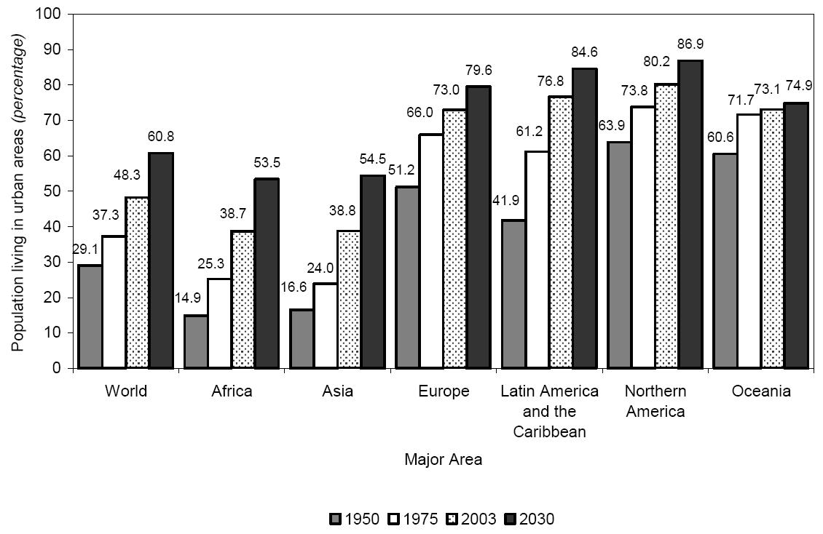
Percentage of population residing in urban areas by region: 1950 - 2030
Source: WORLD URBANIZATION PROSPECTS: THE 2003 REVISION
12
Notes:
Latin America and the Caribbean is highly urbanized, with 77 per cent of its population living in urban settlements in 2003. This proportion is twice as high as those for Africa and Asia.

Slide 13

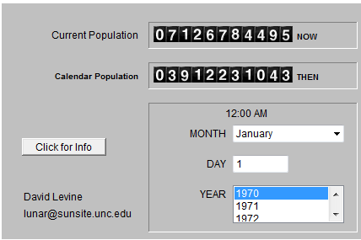
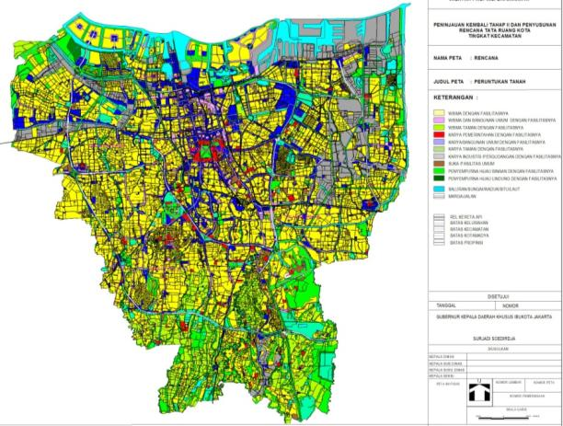
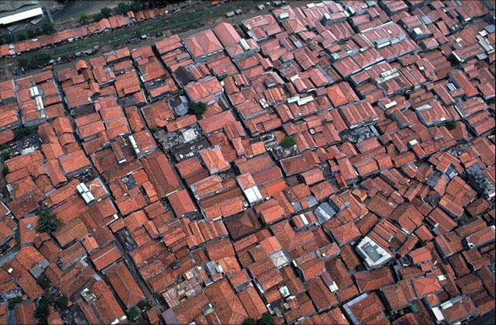
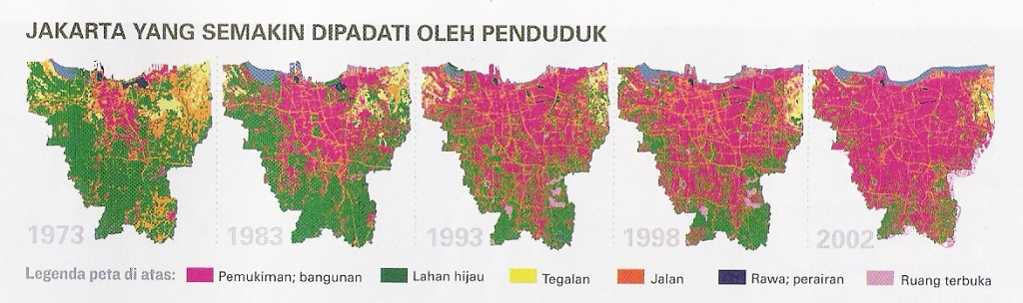
Urbanization in Jakarta
JULI 2011
JAN 1970
World
Population
RTH 13,954
1973
1983
1993
1998
2002
Settlement, Building
Source: Ministry of Public Works, Indonesia
13

Slide 14


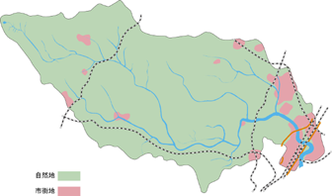
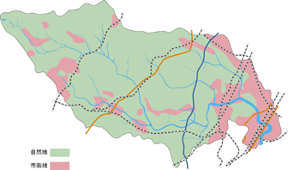
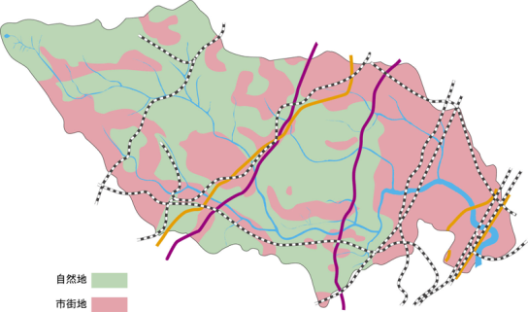
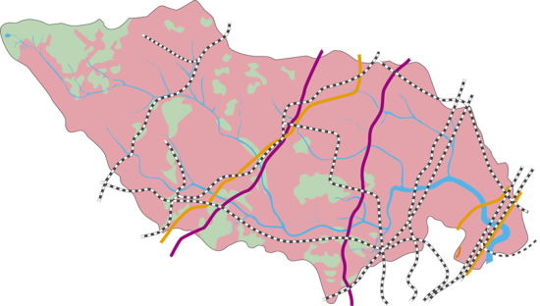
Transition of urban areas in Tsurumi River Basin, Japan
Natural area
Transport networks developed between the two period
Urban area
1958
1966
1975
2003
第三京浜
小田急多摩線
小田急小田原線
南武線
東急東横線
東急田園都市線
京浜急行線
新幹線
東急
市営地下鉄
東海道線
こどものくに線
横浜線
第二京浜
国道246号
国道
246
号
東名高速道路
第一京浜
Urbanization rate: 10 %
Population: 450,000
Urbanization rate: 20 %
Population: 700,000
Urbanization rate: 60 %
Population: 1.2 million
Urbanization rate: 85 %
Population: 1.88 million
River basin area ：235 km²
Length of main river ：43 km
Population in the river basin ：1.88 million
Population in the inundation area： 0.3 million
Tokyo
Kanagawa Pref.
Source: Ministry of Land, Infrastructure, Transport and Tourism, Japan

Slide 15
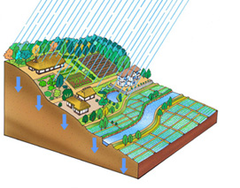
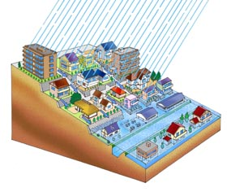
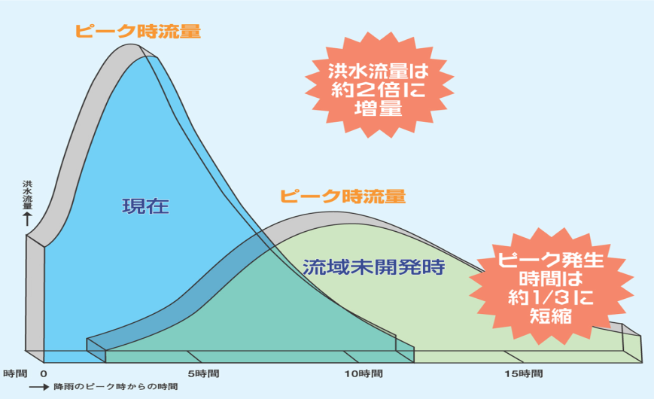
Runoff increase by urbanization
Urbanization weakens the function of keeping and deterring
water in river basin.
JAN 1970
Before
development
After
development
Peak runoff
・Runoff reaches its peak in shorter time
・Peak runoff increases
Runoff volume doubles
Present
Peak runoff
Runoff reaches its peak in 1/3 of time
Rapid urbanization in river basins
→Flood damages have become more frequent.
Before development
Source: Ministry of Land, Infrastructure, Transport and Tourism, Japan

Slide 16
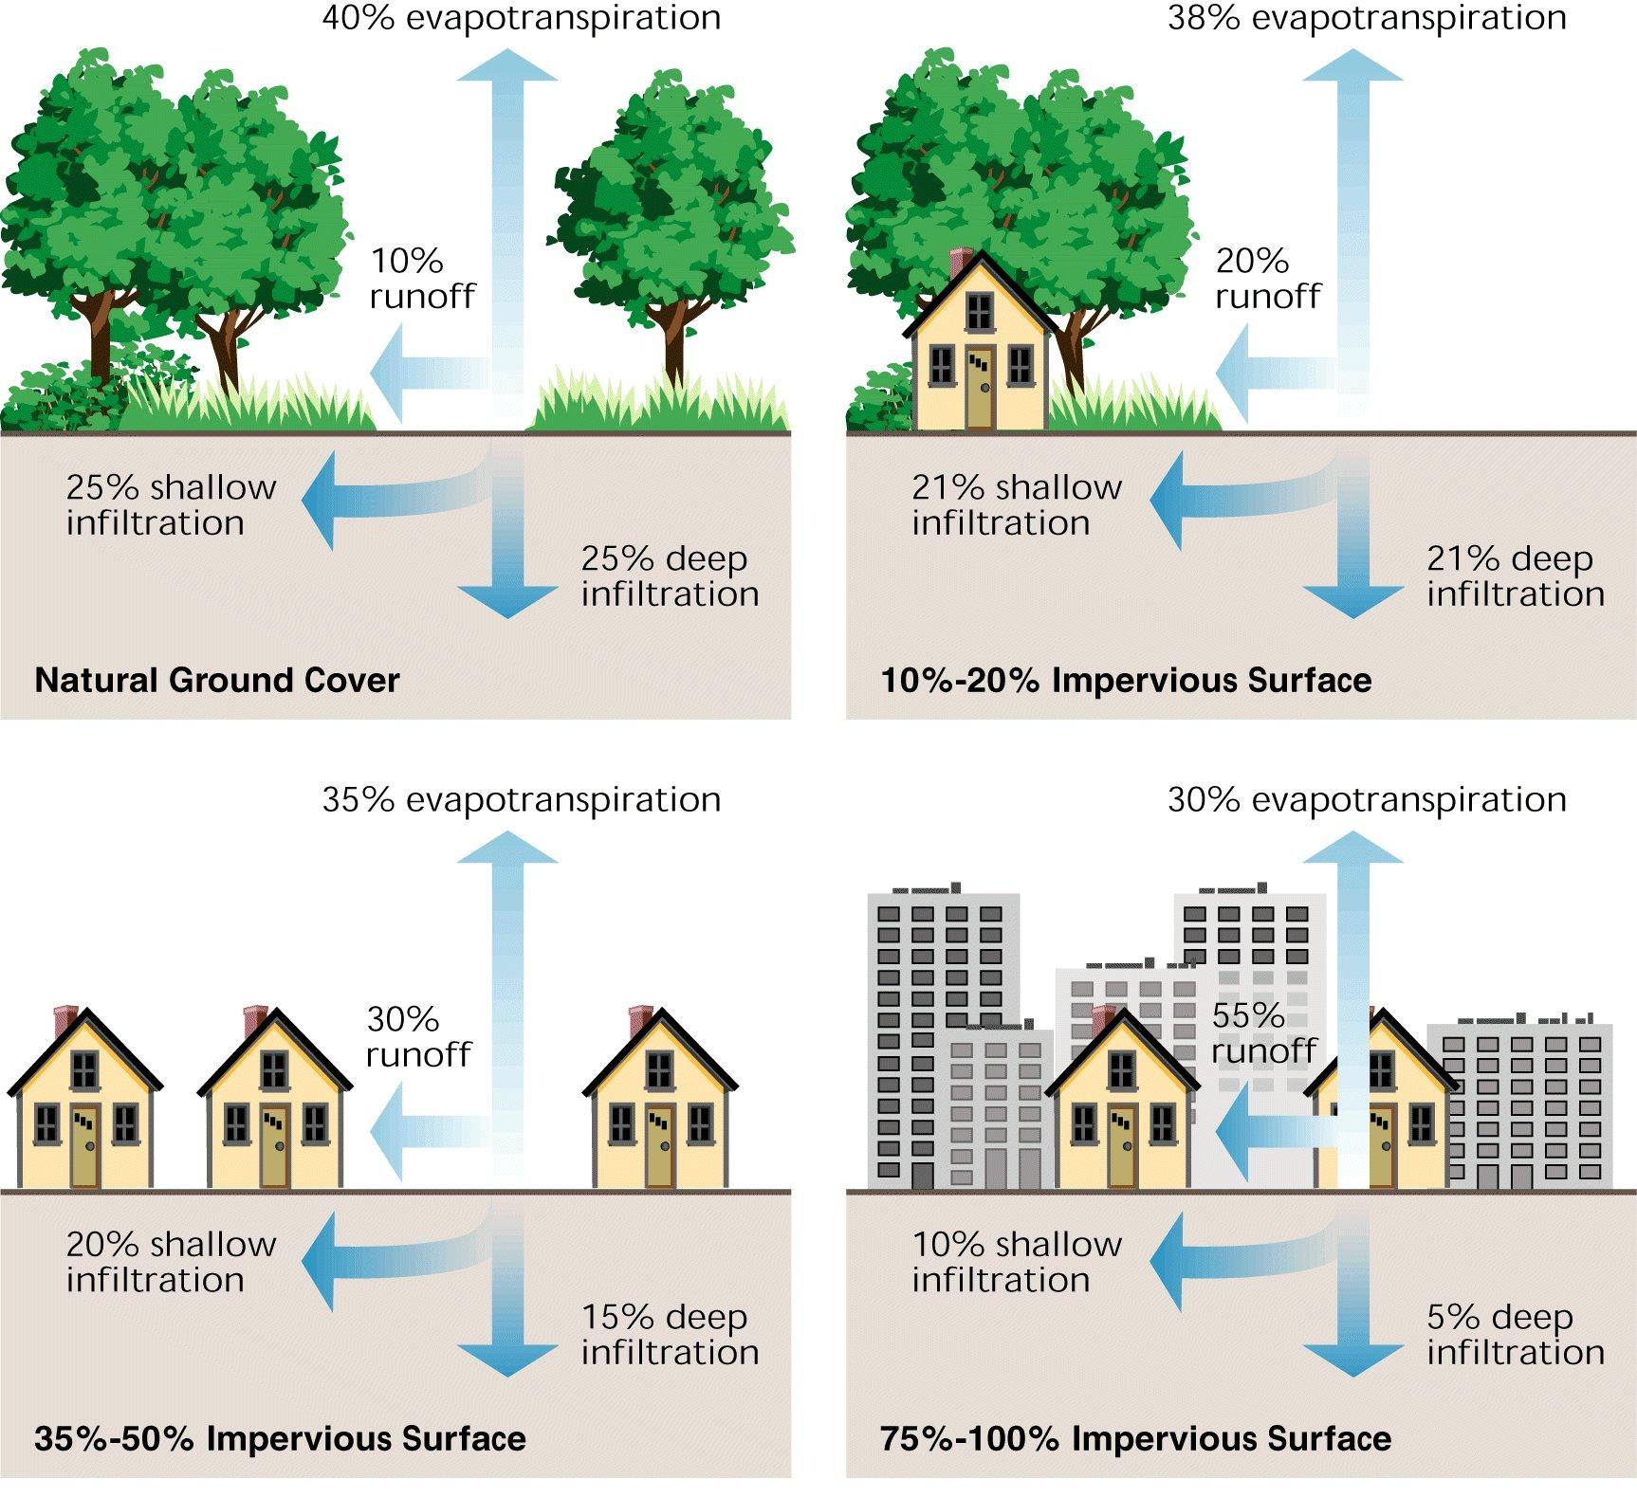
Influence of urbanization on water cycle
16
Source: Federal Stream Corridor Restoration Handbook (US Government)
Notes:
http://www.nrcs.usda.gov/wps/portal/nrcs/detailfull/national/technical/alphabetical/water/restoration/?&cid=nrcs143_026903
How urbanization leads to decreased rates of infiltration and increased surface runoff
Relationship between impervious cover and surface runoff. Impervious cover in a watershed results in increased surface runoff. As little as 10 % impervious cover in a watershed can result in stream degradation

Slide 17
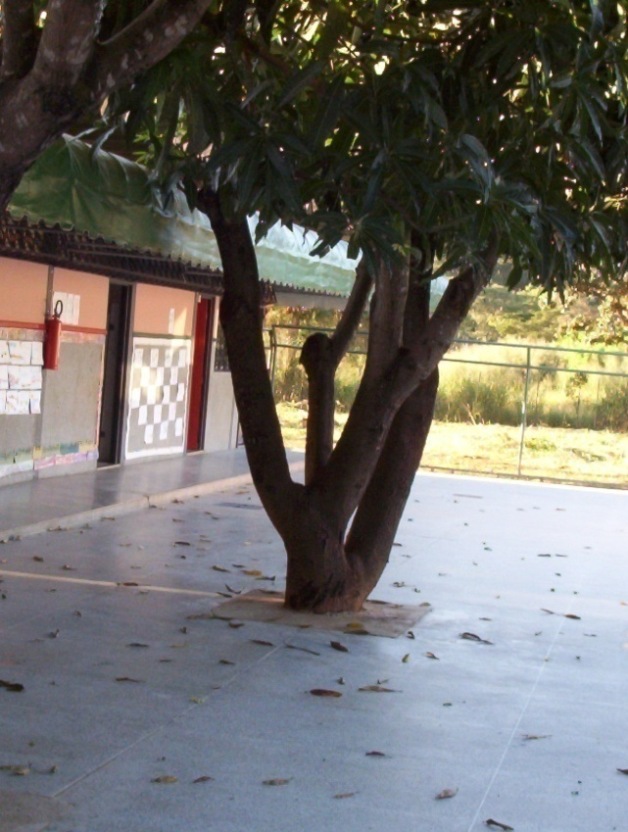
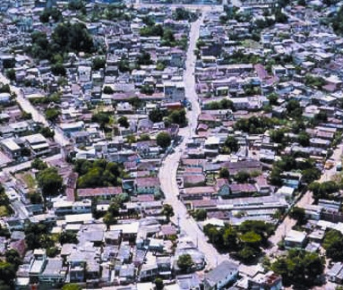
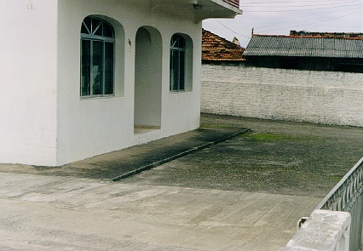
IMPERVIOUS AREAS

Slide 18
Urban characteristics related to flood risks
Concentrated population due to income earning opportunities
Large impermeable surfaces and construction of buildings
Concentration of solid and liquid waste without formal disposal systems
Obstructed drainage systems
Intensive economic activities
High value of infrastructure and properties
Forcing out the poor from official land markets and resulting in informal settlements
Housing without meeting health and hygiene standards
Changes in suburbs around cities
18
Notes:
Urban floods have large impacts particularly in terms of economic losses both direct and indirect. Flood risks are a function of exposure of the people and the economic activities along with the vulnerability of social and economic fabric. As such the impact of such floods on the lives and livelihoods of people, a function of their vulnerability, needs to be understood. A number of urban characteristics particularly in low and middle income countries that have relevance to the increased flood risks are:
The human settlements and infrastructure behind such embankments assume the area to be free from flood risks grossly ignoring the residual risks that are associated with any flood protection scheme. The infrastructure such as underground transportation systems, multi layered basements used for storage and the telecommunication networks that have indirect impacts on the economies have spiralled over the past few decades.

Slide 19
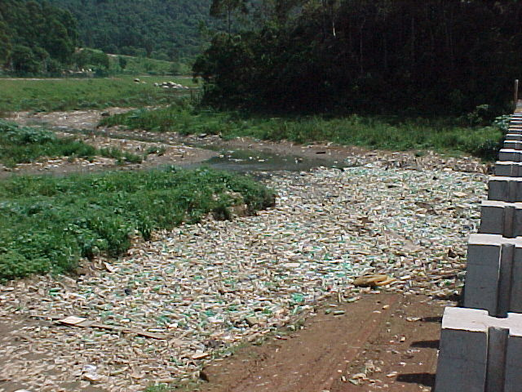
Solid Waste
Solid waste
SW = Tc + Tli + Td
Tc = collected
Tli = from cleaning
Td = storm water
When the first two terms are not developed or are not efficient the last term increases, leaving for the environment

Slide 20
Categories of urban flood by causes
Local flood
    by intense rainfall, excess of drainage capacity
Riverine flood
    by excess of river runoff volume
Coastal flood
    by high tides, storm surges
Flash flood
    by rapid accumulation and release of runoff waters
20
Notes:
20
20

Slide 21
Factors affecting flood
Meteorological | Hydrological | Human
Rainfall Cyclonic storms Small-scale storms Temperature Snowfall and snowmelt | Soil moisture level Groundwater level prior to storm Natural surface infiltration rate Presence of impervious cover Channel cross-sectional shape and roughness Presence or absence of over bank flow, channel network Synchronization of run-offs from various parts of watershed High tide impeding drainage | Land-use changes increase run-off and sedimentation Occupation of the flood plain obstructing flows Inefficiency or non-maintenance of infrastructure Too efficient drainage of upstream areas increases flood peaks Climate change affects magnitude and frequency of precipitations and floods Urban microclimate may enforce precipitation events
21
Notes:
Floods result from a combination of meteorological and hydrological extremes as indicated in the table below. In most cases floods are additionally influenced by human factors. Although these influences are very diverse, they generally tend to aggravate flood hazards by accentuating flood peaks. Thus flood hazards in built environments have to be seen as the consequence of natural and man-made factors.

Slide 22
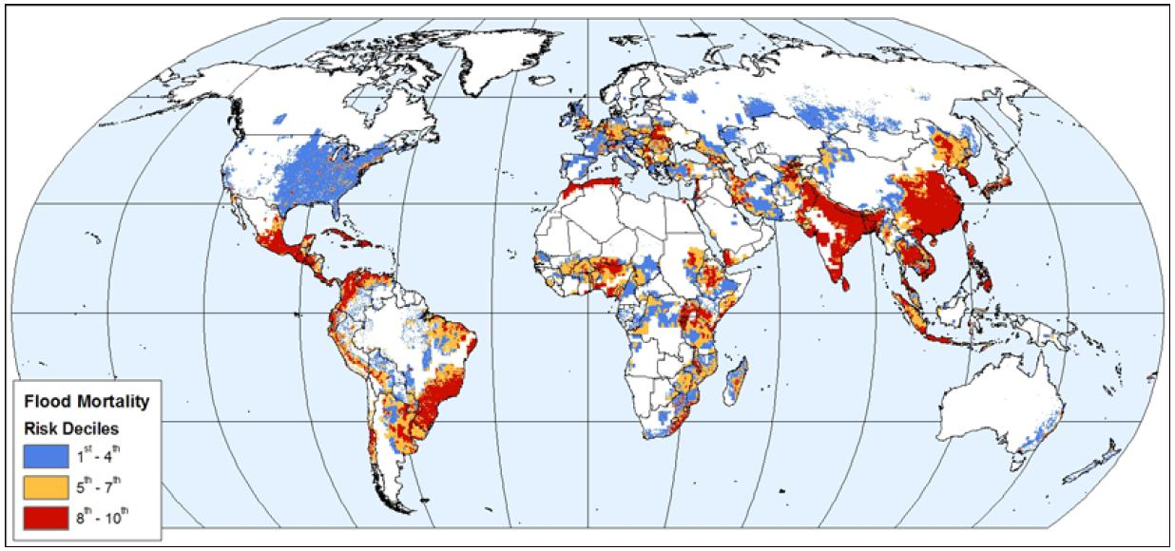
Global distribution of flood risk
- Mortality
Source: Natural Disaster Hotspots: A Global Risk Analysis
22
Notes:
http://www.ldeo.columbia.edu/chrr/research/hotspots/
Disaster losses are caused by interactions between hazard events and the characteristics of exposed elements that make them susceptible to damage. The destructive power of natural hazards, combined with vulnerabilities across a spectrum of exposed elements, can lead to large-scale covariate losses during hazard events in areas where population and economic investment are concentrated.

Slide 23
Losses/Damages due to floods
Direct loss: Loss resulting from direct contact with flood water
  damages to buildings and infrastructure
Indirect loss: Loss resulting from the event but not from its direct impact
  transport disruption, business interruption, temporary houses
Tangible losses: Loss of things that have a monetary (replacement) value
  buildings, livestock, infrastructure
Intangible losses: Loss of things that cannot be bought and sold
  lives and injuries, cultural heritage, memorabilia, ecosystem
23

Slide 24
Categorization of flood losses
Flood Losses
Tangible
Direct Losses
Tangible
Indirect Losses
Intangible
Human/Other Losses
Primary
Secondary
Tertiary
24
Notes:
Primary-secondary-tertiary: express time series

Slide 25
Tangible direct losses
Damage to:
Buildings, houses, contents of buildings
Infrastructure (roads, bridges)
Crops, animals
Primary
Flood causes fire and fire damage
Salt in seawater contaminates land and reduces crop yields
Flood cuts electricity supply, damaging machines and computers
Secondary
Enhanced rate of property deterioration and decay
Long-term rot and damp
Structures are weakened, making them more damage prone
in next floods
Tertiary
25
Notes:
It is important to understand the construct of likely flood damages in a given situation in order to take preventive actions to mitigate these likely damages. Both direct and indirect primary potential losses can be prevented through better land use planning, which also impact the potential secondary losses. Better flood emergency response mechanisms help reduce potential secondary losses.

Slide 26
Traditional Approach of Flood Control

Slide 27
The traditional approach focused on the drainage net itself: Conveyance Approach.
Arranging channels & pipes in an artificial flow network system, to convey exceeding water away;
Initially, this solution was able to deal with floods in a certain area, transferring water downstream with no major consequences;
As urbanisation grows and more areas of the watershed turn impervious, upstream development stresses the system as a whole and the conveyance approach fails.

Slide 28
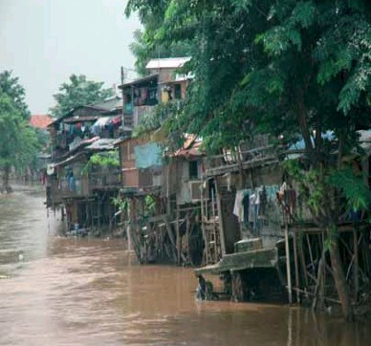
Urbanisation itself limits river canalisation enlargement
It becomes difficult to depend exclusively on improving channels conveyance capacity to try to adjust the system behaviour;
Streets, buildings and urban facilities now occupy banks and the original flood plain;
Upstream reaches of the main river cannot be canalised without aggravating downstream problems.

Slide 29
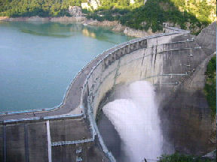
Shift from Conveyance to Storage Approach
A city can influence runoff pattern changes and the state of ecological systems not only within itself but also in the whole river system downstream, including its surroundings;
This fact resulted in shifting the traditional conveyance approach to the storage approach with a focus on detention, retention and recharge (1970);
During 1980s and 1990s, the storage approach was considered a significant source of pollution since water quality aspects were not considered.

Slide 30
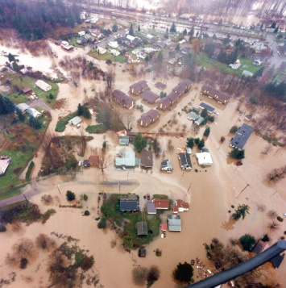
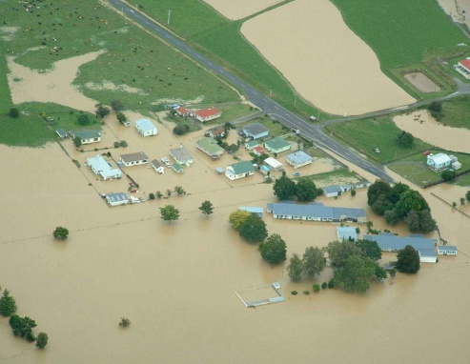
Flood control & protection practices
Reactive practices to reduce flooding;
Problem Driven & Symptom Combatment;
Project approach: solution seems self-evident without giving any thought to the impacts;
Largely relied on Structural Measures;
Ad-hoc & essentially mono-disciplinary;
Thinking in engineering solutions, and not in options or concepts.

Slide 31
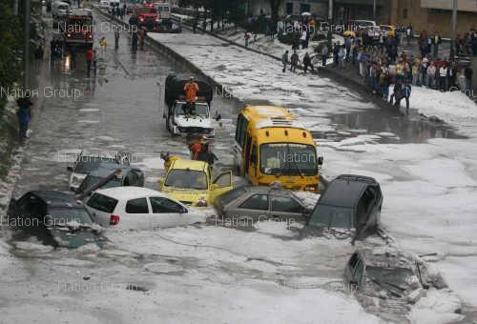
Traditional Interventions
Source control: runoff control, infiltration, afforestation;
Storing runoff: reservoirs, detention basins;
Increasing river capacity: deepening, widening;
Separate river and population: embankment, flood proofing, land use control;
Emergency: flood warning, fighting, evacuation;
Recovery: counseling, compensation, insurance.

Slide 32
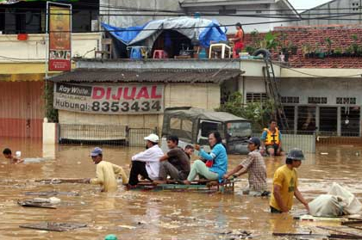
Traditional interventions
Fallen short!
Structural measures generally disturbed eco-system balance;
Rather than mitigating flood risk we largely succeeded in only shifting them (reactive response):
  Impact on the river & users elsewhere,
  Tendency to shift the problem spatially & temporarily.
Non-structural measures:
  weak coordination,
  poor communication strategies,
  limited or passive participation civil society.

Slide 33
Integrated Flood Management

Slide 34
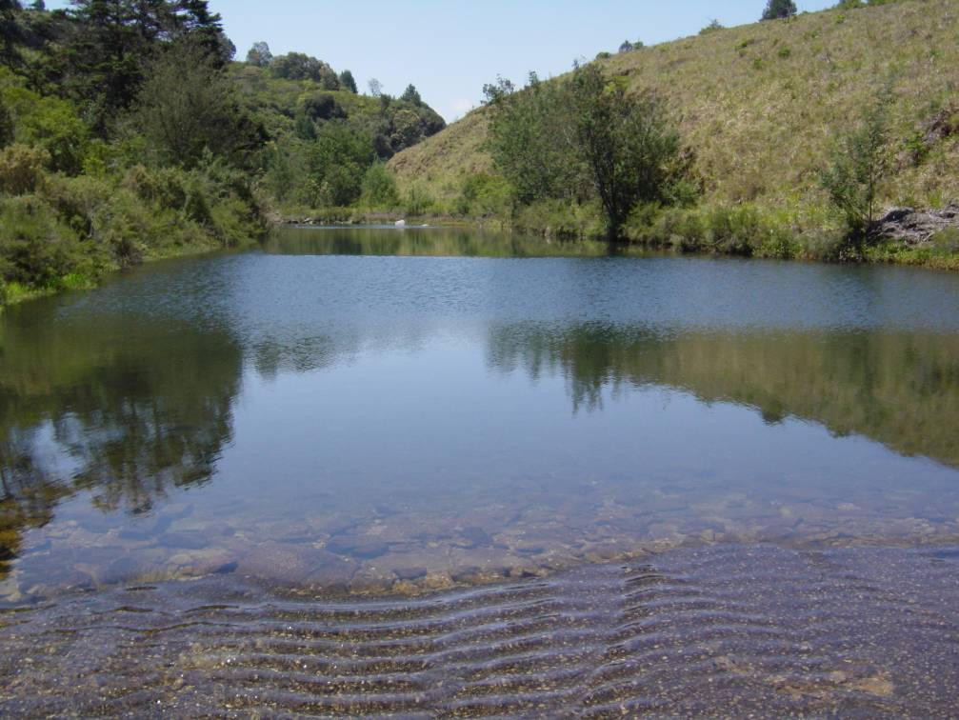
Key WRM functions
Stakeholder participation
Water Allocation
Pollution Control
HOW WILL THEIR APPLICATION IMPROVE MANAGEMENT OF URBAN FLOODS?
WATER RESOURCES MANAGEMENT
Basin Planning
Monitoring
Information Management
Flood & Drought Management
Financial Management

Slide 35
Integrated Flood Management (IFM)
Flood Management in the context of Integrated Water Resources Management, aiming at:
  Sustainable development:
    Balancing development needs and flood risks
  Maximizing net benefits from floodplains:
    Livelihood security and poverty alleviation by addressing vulnerability
  Minimizing loss of life:
    Flood forecast and warning systems
    Preparedness planning for extreme events
  Environmental preservation:
    Ecosystem services
35

Slide 36
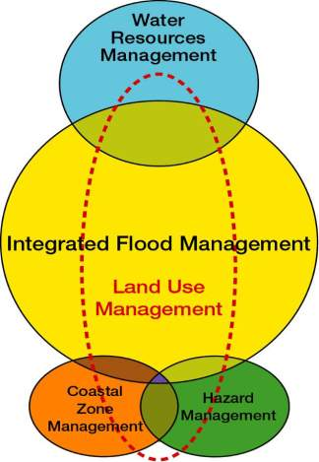
IFM:
Integrates……?
  Land and water management
  Upstream and downstream
  Short term and long-term plans
  Local and basin level measures
  Structural and non-structural measures
  Top down and bottom up decision making
  Ecology and economic concerns
36

Slide 37
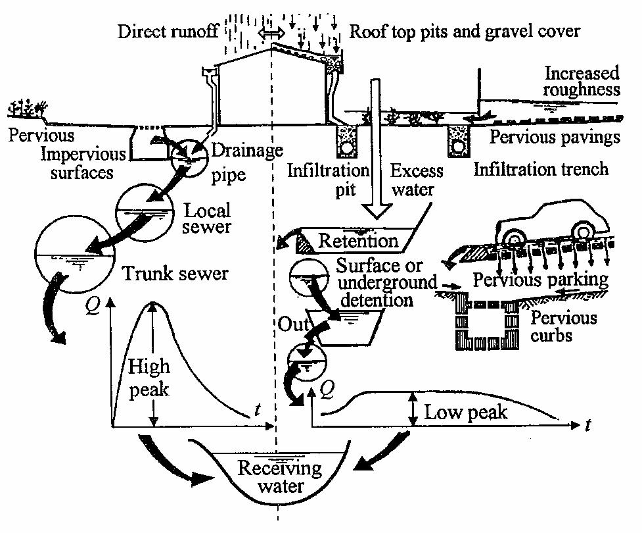
Two types of
urban drainage control
Direct runoff
Source control
Source: Measurements of Water Quantity in Urban Areas
37

Slide 38
IFM:
Towards sustainable development
  Integrate and mix strategies
  Balance development needs and environmental concerns
  Addresse all aspects of flood management
    Social
    Environmental
    Economic
    Legal and institutional
    Scientific and engineering
  Implement adaptive management
  Involve communities
38

Slide 39
Beneficial aspects of floods
Water sources
  Recharge aquifer and reservoirs
Agriculture
  Provide nutrients and sediments
Fishery
  Provide ecological triggers for spawning and migration
Rejuvenation of the river ecosystem
  Provide seasonal variability and variable sediment
  Wash down pollutants and contaminants
  Flush out organic substances
Provide livelihood opportunities
39
Notes:
Historically, flood plains have been a magnet for humans and have helped transform them from food gatherers to settlers. Floods provide a variety of services and help to develop fulfilling livelihoods. The beneficial aspects of floods are recharging water sources, agriculture, fishery and rejuvenation of the river ecosystem.
Inundation of the flood plains helps recharge the groundwater, which is an important source of drinking water and is essential for agriculture. They are an important source for restocking local man-made water sources such as ponds, reservoirs, dams and irrigation channels, meeting round-the-year demand.
Floodwaters carry nutrients and sediments, which are deposited on flood plains, enriching the soil; artificial nourishment such as fertilizers is not required.
Seasonal habitats on the flood plain, created by variable flow regimes, are essential for various stages of the life cycle of species. Floods provide an ecological trigger for both the spawning and migration of certain species, which provides an abundant supply of fish and alternative income sources at the household level.
Seasonal variability and variable sediment and flow regimes help maintain ecological biodiversity. Surface runoff and flooding can help wash down pollutants and contaminants deposited on land. They also flush out accumulated organic substances brought by untreated drainage water from farmlands, stockyards, factories and domestic use and restore the ecological health of stagnant rivers and streams by diluting them and providing clean water.
All these are contributing to provide livelihoods opportunities to the society.

Slide 40
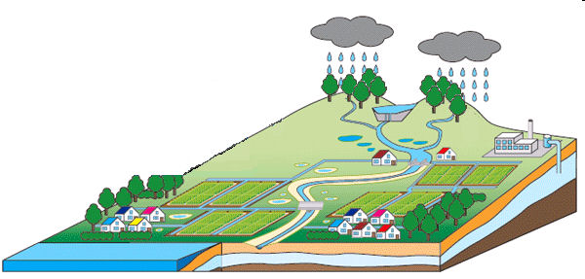
Different flood management measures for different floods
Whatever strategy is selected, one has to understand the type of flood and the potential negative impact of the strategy.
Mountainous area
Runoff control
Sediment control
River corridor
Regulating flow
Detaining water
Flashing flow
Floodplain
Detaining water
Diverting water
40
Notes:
40
Flood characteristics differ, depending on the parts of river.
Accordingly, flood management measures also differ.
Forestation, check dam, sabo dam

Slide 41
Flood management options
Source control to reduce runoff
  (permeable pavements, forestation)
Storing runoff
  (detention basins, wetlands, reservoirs)
Increasing the carrying capacity of flood flows
  (dykes, bypass channels, channel expansion )
Separating flood water from the population
  (land use control, flood map, flood proofing)
Emergency response during flooding
Recovery from disasters
41
Notes:
41
Reduce hazard, exposure, valnerability
Source control takes the form of storage in the soil or via the soil and involves intervention in the process of the formation of runoff from rainfall. It is normally considered with its consequential impact on the erosion process, the time of concentration and evapo-transpiration. In assessing the likely effectiveness of source control, pre-flood conditions (e.g. frozen or saturated ground) need to be considered. Thus, a potential drawback with some forms of source control, and other forms of land use modification such as afforestation, is that their capacity to absorb or store rainfall depends on the antecedent conditions of the catchment.
In the traditional approach to decreasing the challenge presented by the flood, an attempt is made to modify the flood to make it easier to cope with: slow rising, with a long time to peak, and with a low peak level. Surface water storage, by way of dams and detention basins, is usually adopted to attenuate flood peaks. More often than not, such storage serves multiple purposes and the exclusive flood storage can be the first casualty in any conflict situation. Moreover, by completely eliminating the low floods such measures give a false sense of security. Storage has to be used in an appropriate combination with other structural and non-structural measures.
Dikes or flood embankments are most likely to be appropriate for flood plains that are already intensely used. Increasing the carrying capacity of the rivers, while disturbing its natural morphological regimes, has impacts on other river uses and has a tendency to shift the problem spatially and temporally. Deepening of channels may also affect the groundwater regime in the region.
Land use control is generally adopted where intensified development on a particular flood plain is undesirable. Providing incentives for development to be undertaken elsewhere can probably work better than simply trying to stop development on the flood plain. However, where land is under development pressure, especially from informal development, such planning constraints are unlikely to be effective. Flood-proofing or house raising are most likely to be appropriate where development intensities are low and properties are scattered or where the warning times are short. In frequently flood prone areas flood-proofing of the infrastructure and communication links can reduce the debilitating impacts of floods on the economy.
Flood warnings and timely emergency action are complementary to all forms of intervention. A combination of clear and accurate warning messages with a high level of community awareness gives the best level of preparedness for self-reliant action during floods. It is important to put in place public education programmes for hazard warnings to be successful in achieving the desired objective of not allowing the hazard to turn into a disaster. Flash floods present the greatest risk to life. However, in flash flood prone catchments it is unwise to rely upon a formal flood warning system as dissemination takes time.
Evacuation is an essential constituent of emergency planning. Depending upon circumstances, evacuation may be upward (e.g. into a flood refuge to a higher elevation) or outward. Outward evacuation is generally necessary where the depths of water are significant, flood velocities are high and buildings are flimsy (e.g. not masonry or concrete framed). For outward evacuation to be successful it must be planned in advance and the population concerned must know what to do in a flood emergency. To be effective evacuations require active participation of the communities right from the planning stage.

Slide 42
Stormwater infiltration
Means
Establish pervious and semi-pervious surfaces
Collecting e.g. roof water in infiltration devices
Conditions
Land use of sub-catchment
Composition of soil
Distance to drinking water extraction
Effects
Reduction of runoff
Reduction of loads in CSOs
Increase of groundwater recharge (small)

Slide 43
Optimum range for infiltration
Gravel
Fine gravel
Sandy gravel
Coarse sand
Sand
Fine sand
Loamy sand
Loam
Clayey loam
Clay
10⁻¹⁰
10⁻⁸
10⁻⁶
10⁻⁴
10⁻²
1
High sorption capacity ←
→ High infiltration capacity

Slide 44
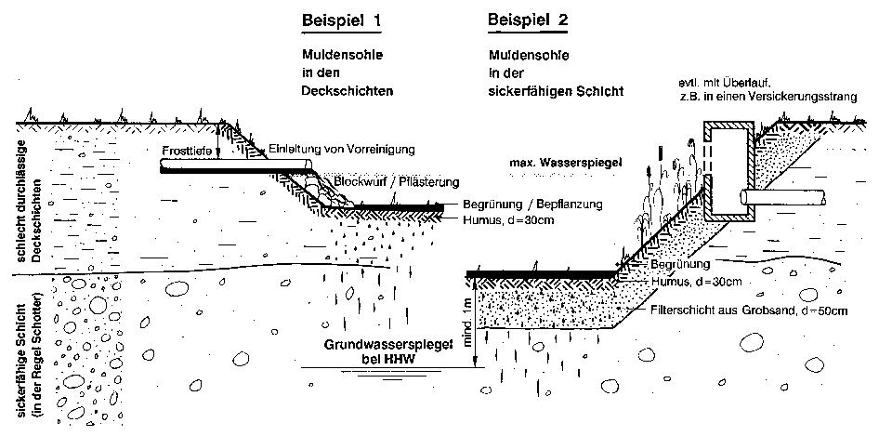
Trough infiltration
ev. overflow
Frost protection
Max. water level
Upper layer with low permeability
Bank protection
Humus,
h = 30 cm
Filter layer, sand,
h = 50 cm
Maximum groundwater level
min. 1 m
lower layer with high permeability

Slide 45
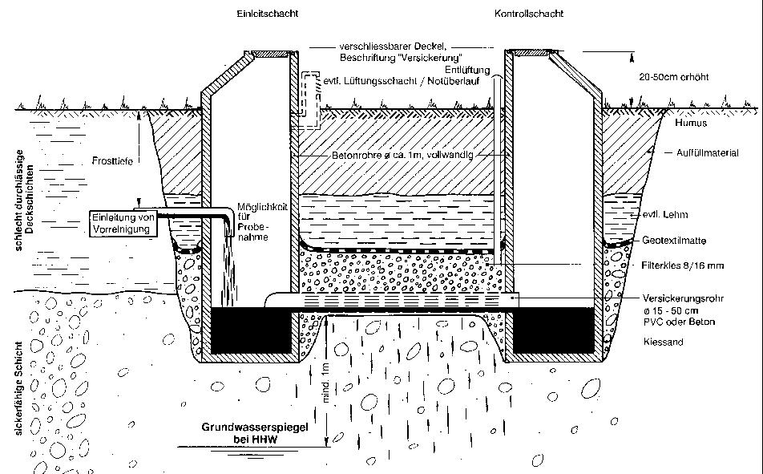
Infiltration pipe

Slide 46
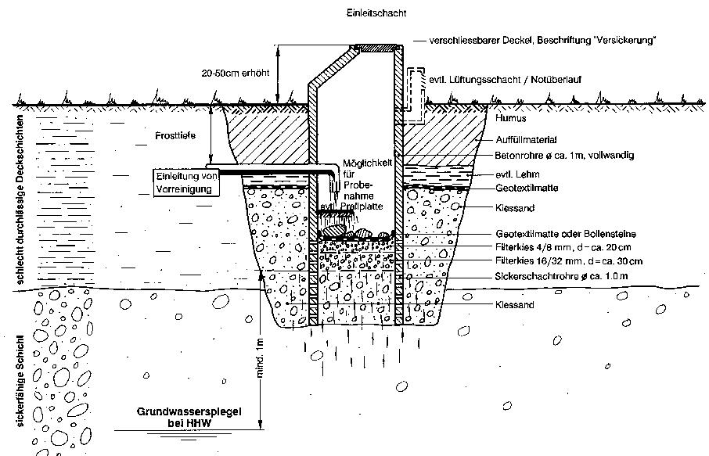
Infiltration shaft

Slide 47
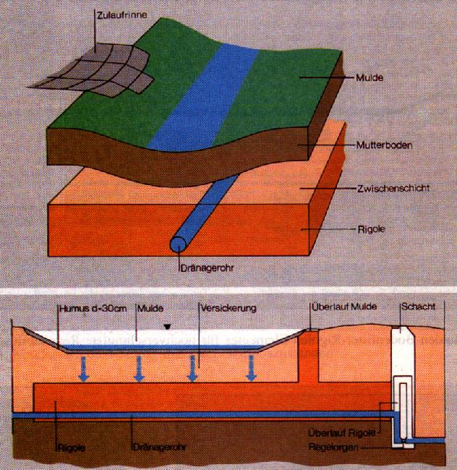
Trough-trench system

Slide 48
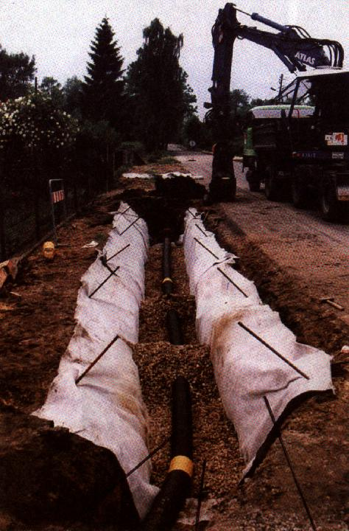
Trough-trench system

Slide 49
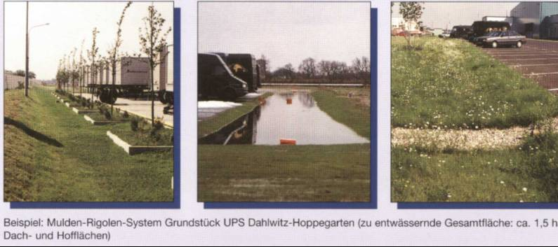
Trough-trench syestem

Slide 50
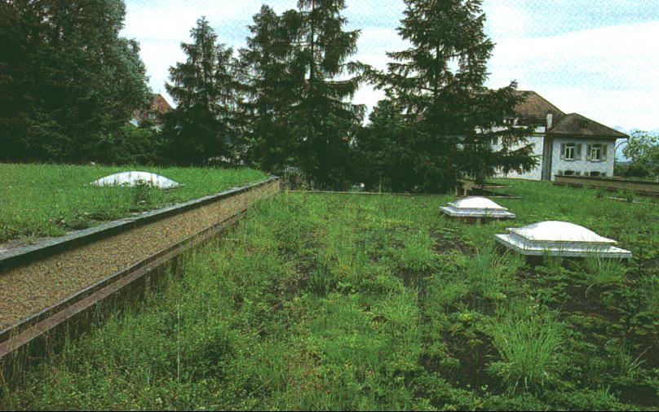
Stormwater retention; green roof

Slide 51
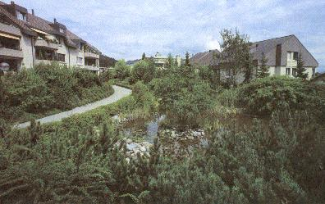
Biotope for stormwater retention

Slide 52
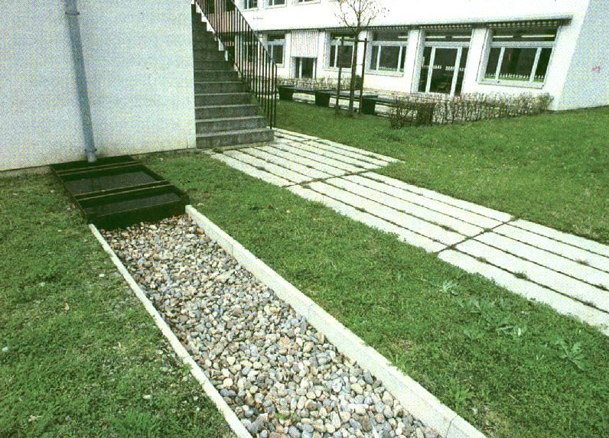
Infiltration

Slide 53

Stormwater runoff at surface

Slide 54

Retention and infiltration pond

Slide 55

Stormwater use

Slide 56

Pervious area

Slide 57

Surface runoff and infiltration

Slide 58


House elevated

Slide 59
Source control/
conveyance
Swales
Source control/conveyance
Swale
Site control
Detention basins
Site control
Detention basins
Site control
Detention basins
Source control
Green roof
Prevention/
Source control
Water butts
Source control
Permeable surface
Source control
Permeable surface
Source control/ conveyance
Underdrained swale
Source control/ conveyance
Underdrained swale
Source control/ conveyance
Underdrained swales
Regional control
Retention pond
Source: CIRIA, UK
Notes:
The site uses source control and the SuDS management train.
Full attenuation of the 1 in 100 year storm is provided through the use multi use of open space (which is more cost effective).
The storage required the use of Public Open Space, which includes basins in play areas.
Overland flow routes were provided for runoff in excess of the design volume, sacrificial storage was provided for storms in excess of 1 in 100 year event.
Quality, quantity and amenity were considered equally although particular attention was required to consider flood risk management.
Engagement with the residents also took place to ensure that they understood how the site functioned.
The SuDS Mgt Train
Prevention – Water Butts provide prevention, lots of grassed areas as well.
Drainage from impermeable areas leads into permeable pavement – source control.
There is a token gesture of green roofs – however, depending on construction can provide 30-50% (if not more) this is regarded as a source control measure.
Roof water is also collected into swales – which is a source control measure and the conveyed onwards to basins.
Swales convey the water to detention basins that act as site control and only get wet in a 1 in 100 year event.
The swale network then conveys water to a retention pond which acts a regional control at the bottom of the site.

Slide 60



Urban Drainage Components
Swale in a school, Exeter
Robert Bray Associates
Linear wetland, Scotland
CIRIA
J4 Services, M8, Scotland
Wetland pond, London
CIRIA
Notes:
60
SuDS can be both landscaped, soft as this slide or hard engineered – in the next slide.
Linear wetland
This linear wetland, is along a highway in Scotland. The wetland provides conveyance to a larger wetland downstream. During this process the water is conveyed and treated in the wetland. The potential for storage and vegetation provides and opportunity to breakdown pollutants.
Swales
A swale is a shallow vegetated channel, this one collects runoff from the highway and provides conveyance to other parts of the SuDS management train. SuDS are becoming increasingly common in schools (there a number of case studies on the CIRIA SuDS website). Careful management and education enables the SuDS scheme to be a used within the curriculum – and can be a valuable educational resource.
Wetland pond
This pond provides valuable amenity and ecology benefits and is integral to this nature reserve.
Other soft or landscapes components include raingardens, detention basins, retention ponds.

Slide 61



Urban Drainage Components
Green roof, London
Lambeth Council
Permeable pavement, Stamford
Robert Bray Associates
Bioretention, Portland, Oregon
Environmental Protection group
Notes:
61
This slide shows some hard or “engineered” SuDS components. Other examples include; rainwater harvesting, geocellular storage, proprietary products, filter drains etc.
Permeable pavement
Permeable pavements (or surfaces such as gravel, porous asphalt) allow water to soak into the ground or a gravel-filled base. Permeable surfaces can attenuate the flow and provide treatment. It’s great for constrained sites as it provides a drainage and car parking function. This example at Stamford uses permeable paving and geocellular drainage.
Green roof
This primarily is as close to the source as you can get and primarily is a roof covered in vegetation or another medium. The effectiveness of a green or living roof will depend on the thickness of the substrate on the roof, it provides attenuation and other benefits such as biodiversity enhancement and thermal cooling. CIRIA has produced guidance on green roofs and further information is also available from Livingroofs.org.
Bioretention
Are depressions filled with engineering soil and vegetation. Water enters through a vegetated surface and trickled into a perforated pipe at the bottom before being transported downstream. It provides attenuation and water quality treatment.

Slide 62




Source control
Cambourne
Permeable paving
Swale - Greenway
Green roof
Swale – internal swale
Notes:
Images are from early stages of the development of the site.
Permeable/pervious pavement
The permeable pavement is a load-bearing construction surfaced with materials that allow surface water to enter the underlying construction. Small gaps between the block paving.
Runoff is stored and conveyed through the sub-base construction.
Provides attenuation, infiltration as well as some water treatment.
Green roof
Normally a multi layered system that covers a roof with vegetation over a drainage layer.
This can reduce the volume of runoff and attenuate peak flows from the roof.
Can reduce the size of other SuDS components – normally looks good too!
Swales
Shallow channels designed to collect, convey and treat water.
Development has two types of swales, normal and underdrained swales – provide greater drainage – often dry.
Swale on the green way (perimeter of the site) also provides opportunities for enhanced biodiversity.

Slide 63



Site control
Cambourne
Detention basin – near entrance
Detention basin – near play area
Detention basin – near golf course (NE)
Notes:
Detention basins
Depressions designed to detain runoff for a period of time (primarily during extreme events).
The compete system and SuDS management train enables the development to meet flood risk management considerations and water quality criteria.

Slide 64




Underground storage elements

Slide 65

Integrated with landscape and landuse

Slide 66
What are the Challenges?
Weak Institutions: Integration & coordination at River basin & Municipal Levels:
  Administration,
  Management,
  Water Plans,
  Strategic & Investment Plans,
Climate Variability & Change, and their impact on water resources;
Changing mindsets:
  Absolute safety from flooding is a Myth!
  Change in decision making process,
  Risk management in development planning & management.

Slide 67
What is required?
Clear and objective policies supported with legislation, regulations & law enforcement;
Institutional Structure through appropriate linkage;
Community Based Institutions;
Information and Knowledge Management, Exchange and Sharing;
Appropriate Economic & Fiscal Instruments;
Institutional & Community Capacity Building.

Slide 68
Summary
Local and isolated solutions tend to transfer flood problems;
New approaches focus on storage, infiltration measures, preventive actions, complementing the traditional ones;
Classic site-specific planning needs to be replaced by a watershed oriented planning;
Urban drainage systems to be managed and linked with land use and urban spatial planning.
Notes:
68
A more sustainable approach to drainage can be embraced on any site.
SuDS can deliver multiple benefits and will help us manage regulatory and environmental challenges.
SuDS delivery will require good communication and engagement and partnerships.
SuDS can be delivered, there are variety of information sources available.

Slide 69

USACE flood damage reduction projects
$6 returned for every $1 invested
Source: CORPS OF ENGINEERS—CIVIL WORKS (USACE)
69
Notes:
http://www.gpoaccess.gov/usbudget/fy03/pdf/bud24.pdf
Flood Damage Reduction
The Corps estimates that its existing flood damage reduction projects prevent about $21 billion in damages in an average year, and over time have returned $6 for every $1 invested. These benefits vary greatly from year-to-year depending on flood events. Despite these federal investments, flood damage nationwide is increasing. Federal, state, and local decisions can diminish
or increase flood risks and affect flood damages.
3rd UN World Water Development Report
Note: 1999 US$ billions, adjusted using Construction Cost Index
Investments in environmental sustainability and water management to prevent water-related disasters can have large payoffs, so countries need not wait to invest until they have achieved middle- or high-income status. Investments in water infrastructure by the US Army Corps of Engineers between 1930 and 1999, for example, yielded returns of $6 for each $1 spent and controlled flood damage despite rising population numbers and property value at risk over the period

Slide 70
FLOOD RISK MANAGMENT

Slide 71

What is risk?
Risk = function (Hazard x Exposure x Vulnerability)
Dangerous phenomenon
(e.g. flood)
People & property subject to losses
(e.g. people living in floodways)
Characteristics susceptible to hazards
(e.g. poorly designed buildings)
Source: Terminology on disaster risk reduction (UNISDR)
71
Notes:
http://www.unisdr.org/we/inform/terminology#letter-v
Hazard
A dangerous phenomenon, substance, human activity or condition that may cause loss of life, injury or other health impacts, property damage, loss of livelihoods and services, social and economic disruption, or environmental damage.
Comment: The hazards of concern to disaster risk reduction as stated in footnote 3 of the Hyogo Framework are “… hazards of natural origin and related environmental and technological hazards and risks.” Such hazards arise from a variety of geological, meteorological, hydrological, oceanic, biological, and technological sources, sometimes acting in combination. In technical settings, hazards are described quantitatively by the likely frequency of occurrence of different intensities for different areas, as determined from historical data or scientific analysis.
Exposure
People, property, systems, or other elements present in hazard zones that are thereby subject to potential losses.
Comment: Measures of exposure can include the number of people or types of assets in an area. These can be combined with the specific vulnerability of the exposed elements to any particular hazard to estimate the quantitative risks associated with that hazard in the area of interest.
Vulnerability
The characteristics and circumstances of a community, system or asset that make it susceptible to the damaging effects of a hazard.
Comment: There are many aspects of vulnerability, arising from various physical, social, economic, and environmental factors. Examples may include poor design and construction of buildings, inadequate protection of assets, lack of public information and awareness, limited official recognition of risks and preparedness measures, and disregard for wise environmental management. Vulnerability varies significantly within a community and over time. This definition identifies vulnerability as a characteristic of the element of interest (community, system or asset) which is independent of its exposure. However, in common use the word is often used more broadly to include the element’s exposure.

Slide 72

Risk & disaster management cycle
Source: National Platform for Natural Hazards (Swiss Confederation)
72
Notes:
http://www.planat.ch/en/home/

Slide 73
Example of risk management
EU Floods Directive (2007)
EU Member States will prepare:
  Preliminary flood risk assessment by 2011
    Identify areas where potential significant flood risk exists
  Flood hazard & risk maps by 2013
    Identify areas with a medium likelihood of flooding (at least a 1 in 100 year event) and extreme events or low likelihood events
    Indicate expected water depths
    Indicate the number of inhabitants potentially at risk, the economic activity and the environmental damage potential
  Flood risk management plans by 2015
    Include measures to reduce the probability of flooding
    Focus particularly on prevention, protection and preparedness
Source: EU Floods Directive (European Commission)
Notes:
http://ec.europa.eu/environment/water/flood_risk/index.htm
focus particularly on prevention (i.e. preventing damage caused by floods by avoiding construction of houses and industries in present and future flood-prone areas or by adapting future developments to the risk of flooding), protection (by taking measures to reduce the likelihood of floods and/or the impact of floods in a specific location such as restoring flood plains and wetlands) and preparedness

Slide 74
Indicators to determine flood risk areas
 | Indicators
Human health | Number of people Critical services (schools, hospitals, nursing homes, power and water services)
Economic activity | Non-residential properties (shops, businesses) Agricultural land (area of land based on agricultural grade) Roads and rail
Environment | Area of internationally or nationally designated site (special areas of conservation, special protection areas, Ramsar sites, sites of special scientific interest) Number of nationally/internationally important heritage features (world heritage sites, monuments, listed buildings, registered parks and gardens)
Source: Selecting and reviewing Flood Risk Areas for local sources of flooding (Defra)

Slide 75

IFM Tool Series
“Urban Flood Risk Management”
This publication explains the combination of spatial, technical and organizational measures lead to more sustainable and effective management of urban flood risks.
The Tool covers:
Different aspects of urban flood risks
Risk management approach
Successful risk management measures
http://www.apfm.info/ifm_tools.htm

Slide 76

IFM Help Desk
http://www.apfm.info/helpdesk.htm

