Slide 1
URBAN DRAINAGE
SYSTEM COMPONENT
Lecture 1

Slide 2
CENG 6408 : Urban Drainage
The course is designed to enable participants plan, design and manage sustainable sewage and storm water management systems in urban areas or sustainable urban drainage system (SUDS). Topics include– type of sewage disposal system, estimation and design of sewage collection and disposal systems, modeling of sewage disposal system, ; and urban hydrology; options for urban drainage- conventional systems, best management practices; design of storm water management systems; urban runoff quality; urban runoff modeling

Slide 3
Introduction to urban Drainage
• What is UD?
• Types of UD System
– Piped/natural
– Separate/combined/hybrid
• Storm drainage Systems
– Building Drainage
– Sewers
– Manholes

Slide 4
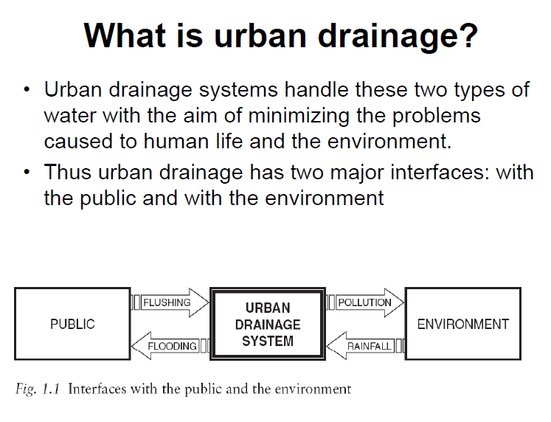

Slide 5
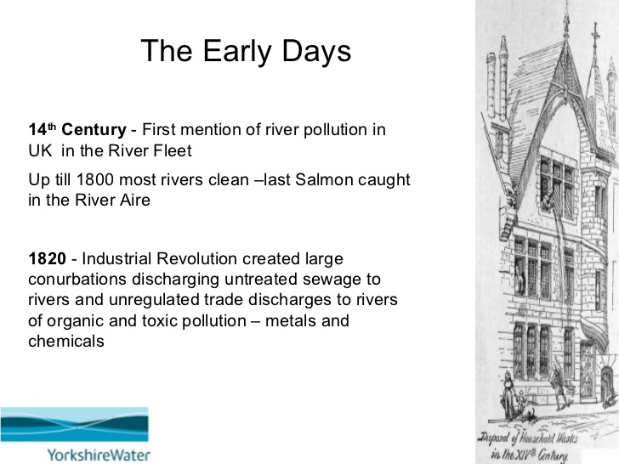
Notes:
Modern Sewerage an Storm water management is a recent phenomenon though there are some historical records

Slide 6
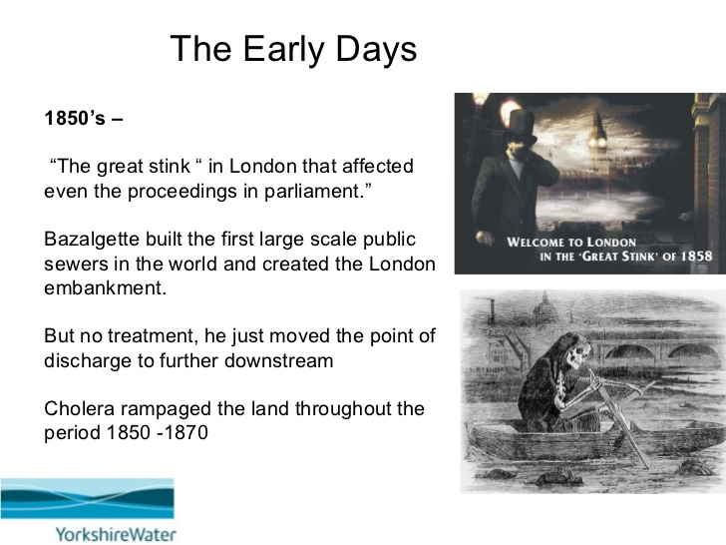
Notes:
The Great Stink forced the search for the solution which leads to the necessity of proper collection of sewage and later stage to its treatment

Slide 7
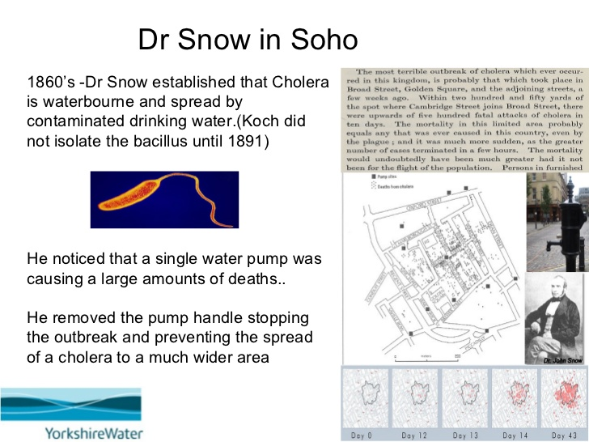

Slide 8
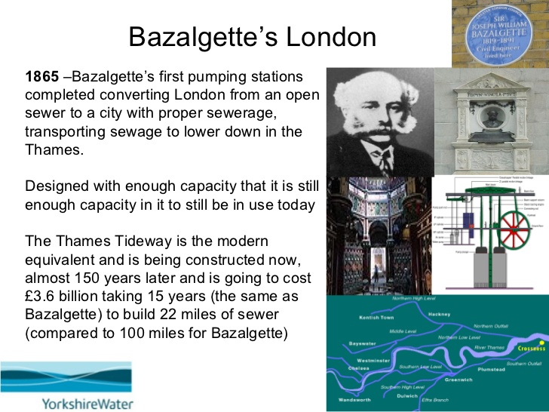

Slide 9
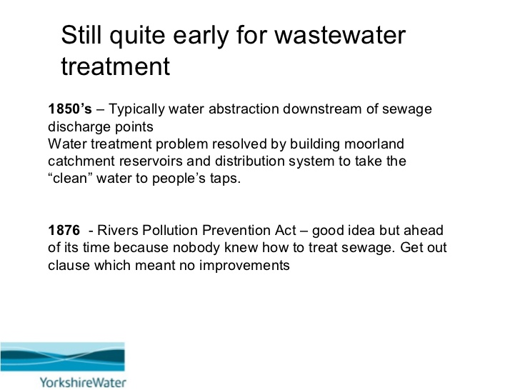

Slide 10
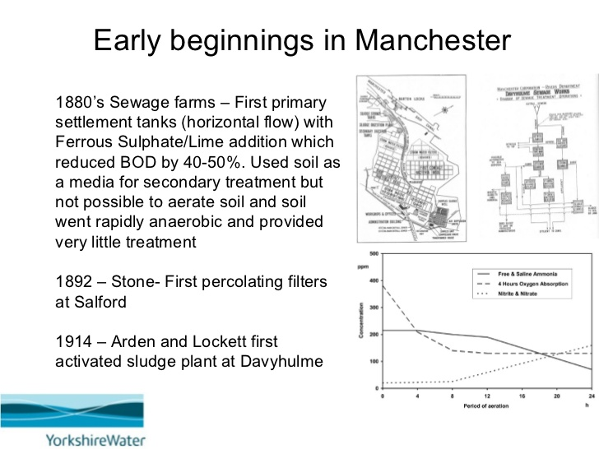

Slide 11
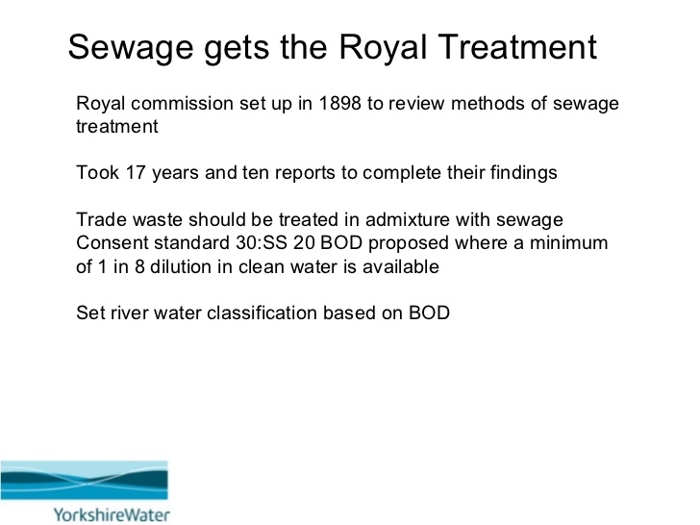

Slide 12
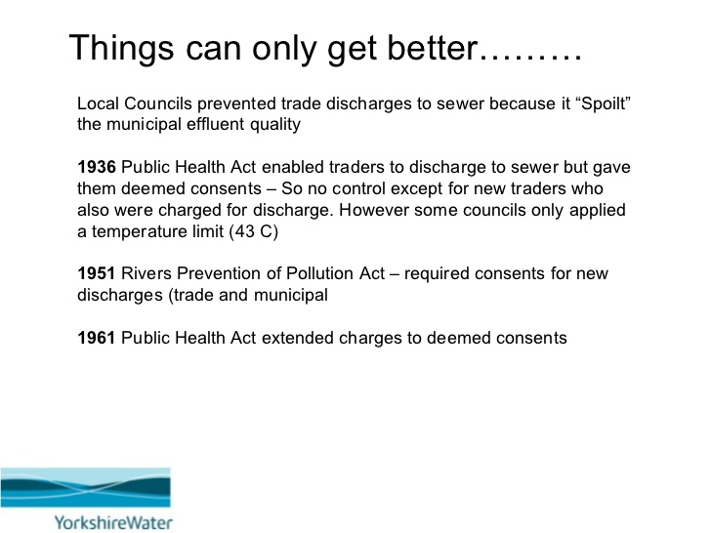

Slide 13
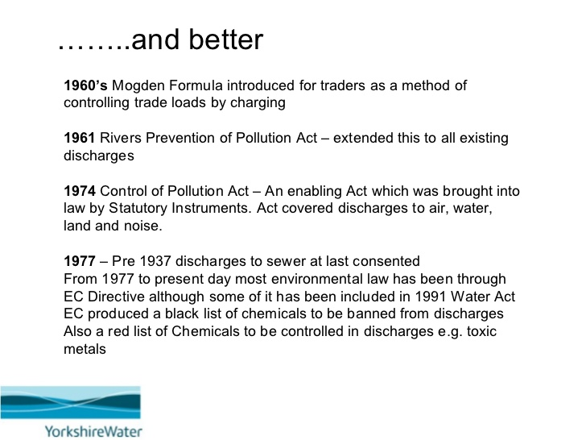

Slide 14
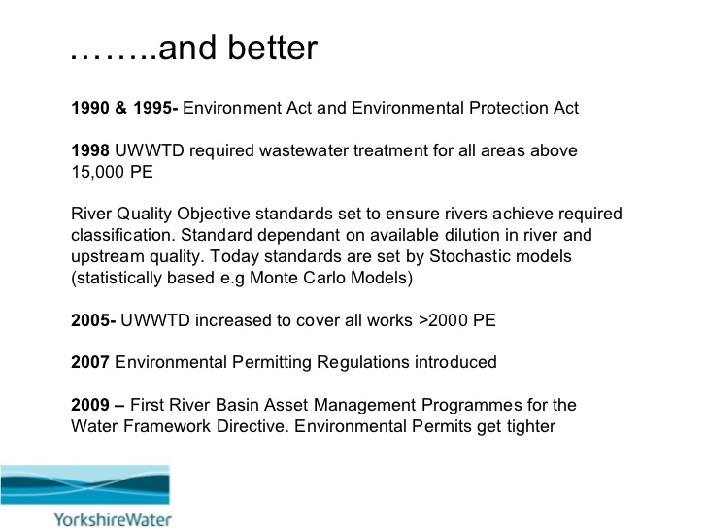

Slide 15
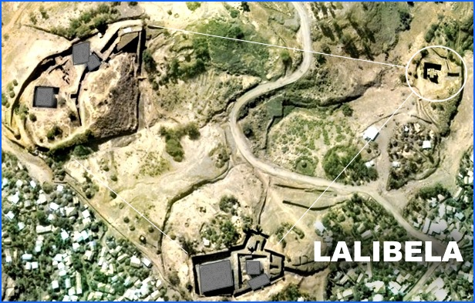
History..
Proper Drainage System at Rock Hewn Churches of Lalibela (12th and 13th Century AD) &
Presence of Sauna Bath and Other Water Features at Fasiledes (16th Century AD)
Jegol/Harar Sullage Storm water drainage system

Slide 16
WHY CONCERNED
about
URBAN DRAINAGE?

Slide 17
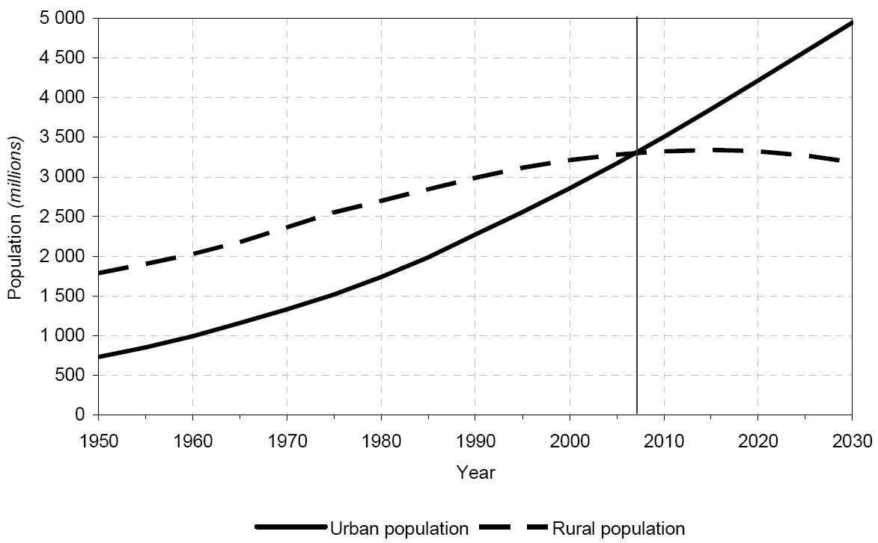
Urban and rural population of the world: 1950-2030
Source: WORLD URBANIZATION PROSPECTS: THE 2003 REVISION
17
Notes:
world’s urban population continues to grow faster than the total population of the world
world’s urban population is estimated at 3 billion in 2003 and is expected to rise to five billion by 2030
rural population is anticipated to decline slightly from 3.3 billion in 2003 to 3.2 billion in 2030
the fifty per cent mark will be crossed in 2007
The proportion of the population that is urban is expected to rise to 61 per cent by 2030
During 2000-2030, the world’s urban population is projected to grow at an average annual rate of 1.8 per cent, nearly double the rate expected for the total population of the world (almost 1 per cent per year)
Migration from rural to urban areas and the transformation of rural settlements into urban places are important determinants of the high urban population growth anticipated in the less developed regions
In contrast, the urban population of the more developed regions is expected to increase very slowly

Slide 18
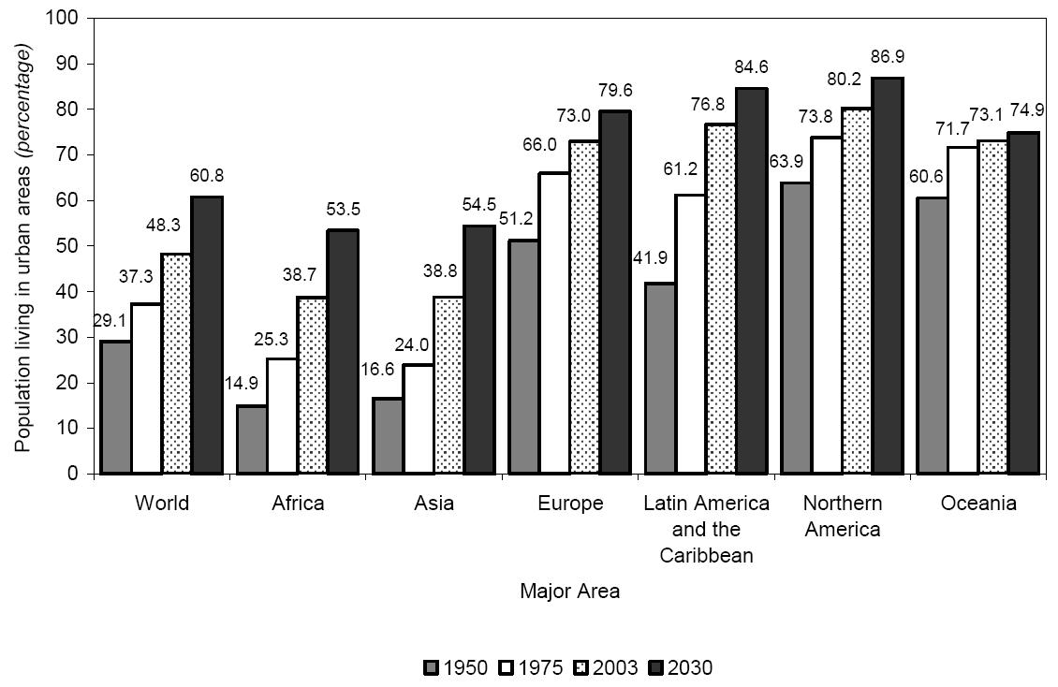
Percentage of population residing in urban areas by region: 1950 - 2030
Source: WORLD URBANIZATION PROSPECTS: THE 2003 REVISION
18
Notes:
Latin America and the Caribbean is highly urbanized, with 77 per cent of its population living in urban settlements in 2003. This proportion is twice as high as those for Africa and Asia.

Slide 19
Urban Population Ratio/Growth Rate
Country | Urban population ratio (% of total, 2010) | Urban population growth rate (annual %, 2010)
Argentina | 92 | 1.1
Brazil | 87 | 1.4
Colombia | 75 | 1.8
Costa Rica | 64 | 2.3
El Salvador | 61 | 1.0
Trinidad & Tobago | 14 | 2.9
Burundi | 11 | 5.3
Ethiopia | 18 | 3.9
Kenya | 22 | 4.0
Zimbabwe | 38 | 2.0
World | 51 | 2.0
Source: World Bank (http://data.worldbank.org)
Notes:
Japan 67% (2010), US 82%, UK 90%
Urban population refers to people living in urban areas as defined by national statistical offices. It is calculated using World Bank population estimates and urban ratios from the United Nations World Urbanization Prospects.
World Bank Staff estimates based on United Nations, World Urbanization Prospects.
Catalog Sources World Development Indicators

Slide 20
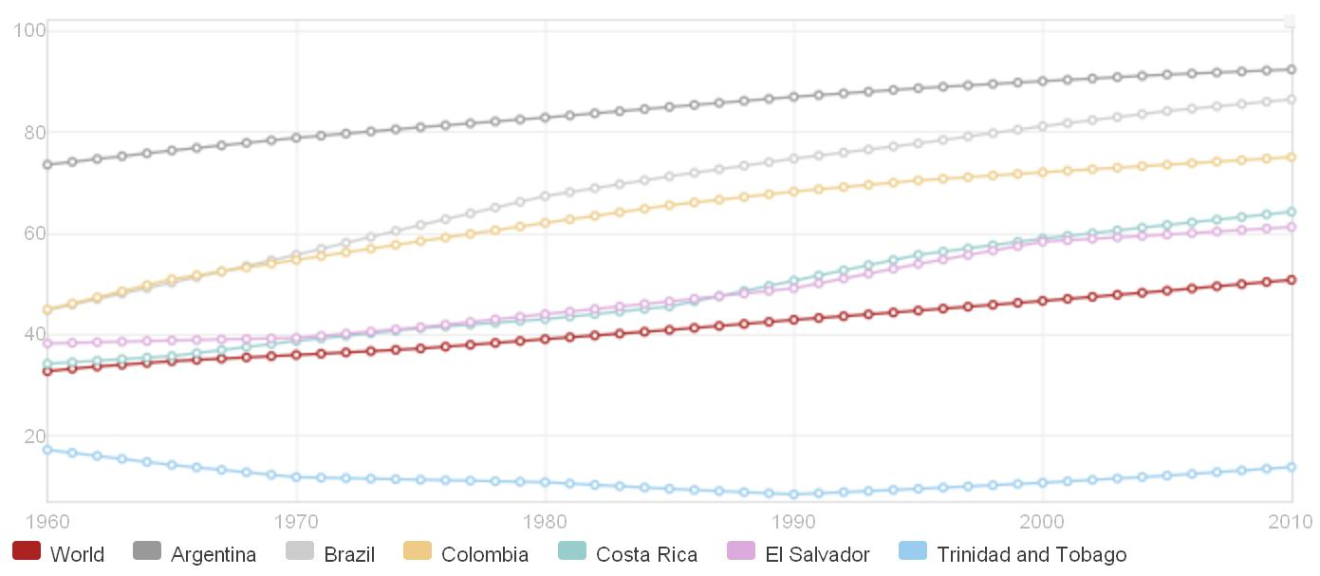
Change in Urban Population Ratio
1960
1970
1980
1990
2000
2010
100%
80%
60%
40%
20%
51% 92% 87% 75% 64% 61% 14% In 2010
Source: World Bank (http://data.worldbank.org)
Notes:
Japan 67% (2010), US 82%, UK 90%
Urban population refers to people living in urban areas as defined by national statistical offices. It is calculated using World Bank population estimates and urban ratios from the United Nations World Urbanization Prospects.
World Bank Staff estimates based on United Nations, World Urbanization Prospects.
Catalog Sources World Development Indicators

Slide 21
Change in Urban Population Ratio
1960
1970
1980
1990
2000
2010
100%
80%
60%
40%
20%
2.0% 1.1% 1.4% 1.8% 2.3% 1.0% 2.9% From 2009
to 2010
Source: World Bank (http://data.worldbank.org)
Notes:
Japan 67% (2010), US 82%, UK 90%
Urban population refers to people living in urban areas as defined by national statistical offices. It is calculated using World Bank population estimates and urban ratios from the United Nations World Urbanization Prospects.
World Bank Staff estimates based on United Nations, World Urbanization Prospects.
Catalog Sources World Development Indicators

Slide 22
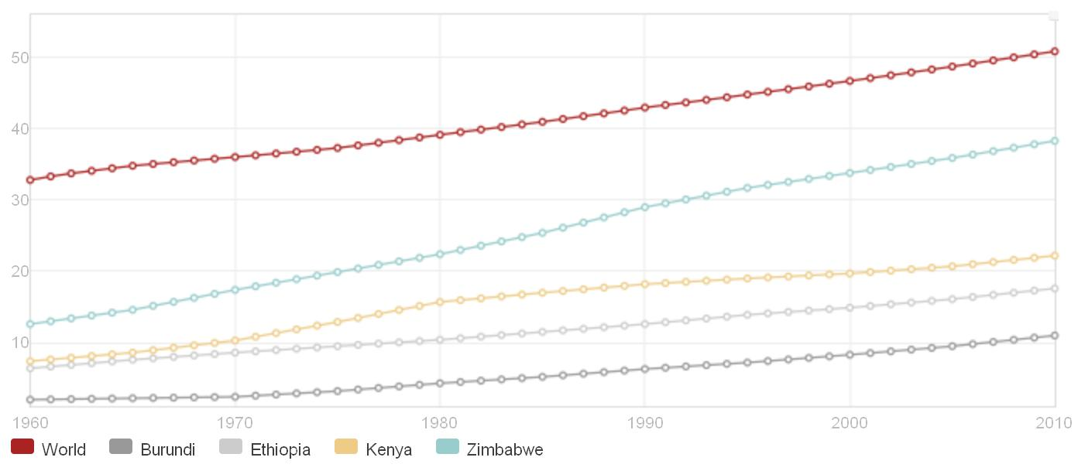
Change in Urban Population Ratio
1960
1970
1980
1990
2000
2010
50%
40%
30%
20%
10%
51% 11% 18% 22% 38% In 2010
Source: World Bank (http://data.worldbank.org)
Notes:
Japan 67% (2010), US 82%, UK 90%
Urban population refers to people living in urban areas as defined by national statistical offices. It is calculated using World Bank population estimates and urban ratios from the United Nations World Urbanization Prospects.
World Bank Staff estimates based on United Nations, World Urbanization Prospects.
Catalog Sources World Development Indicators

Slide 23

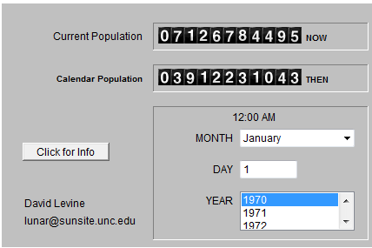
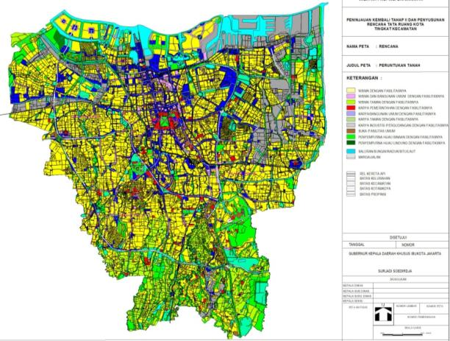
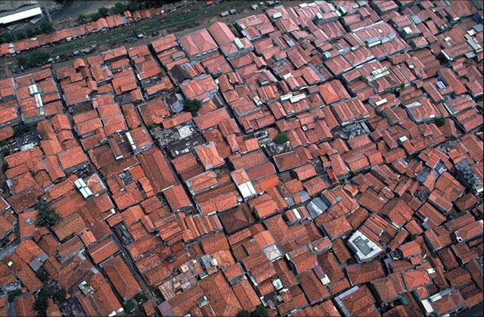
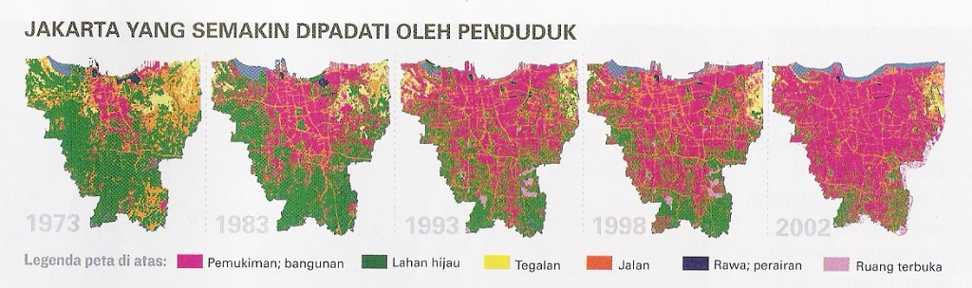
Urbanization in Jakarta
JULI 2011
JAN 1970
World
Population
RTH 13,954
1973
1983
1993
1998
2002
Settlement, Building
Source: Ministry of Public Works, Indonesia
23

Slide 24
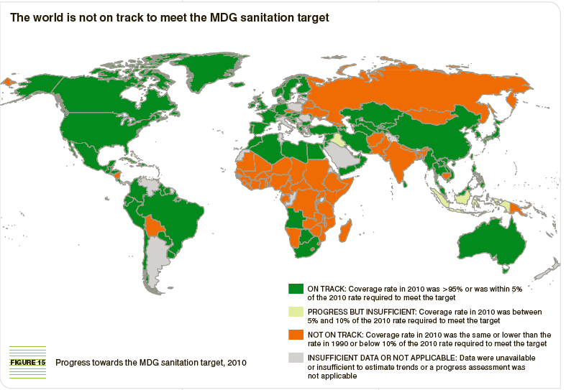
SANITATION

Slide 25
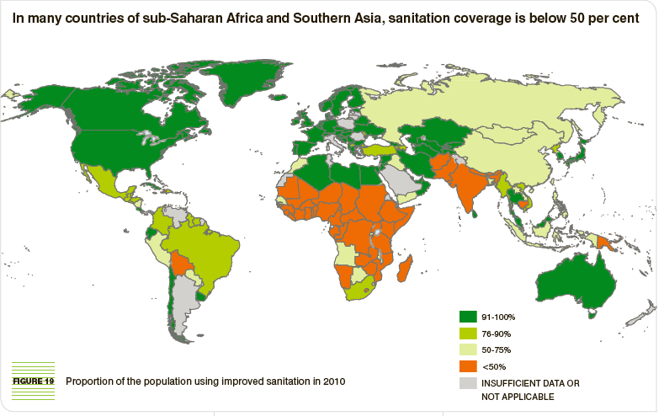
SANITATION…

Slide 26
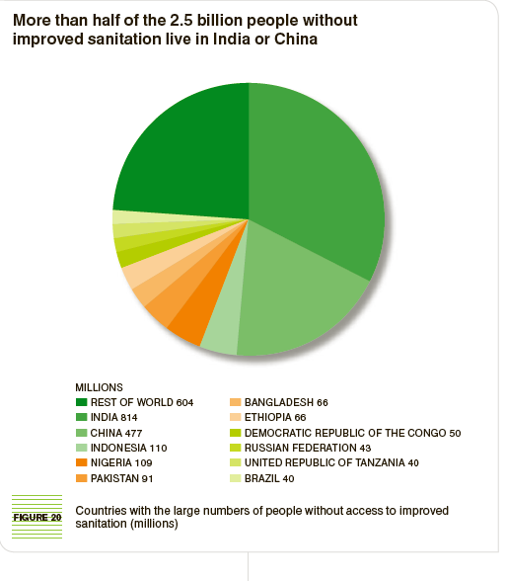
SANITATION…

Slide 27
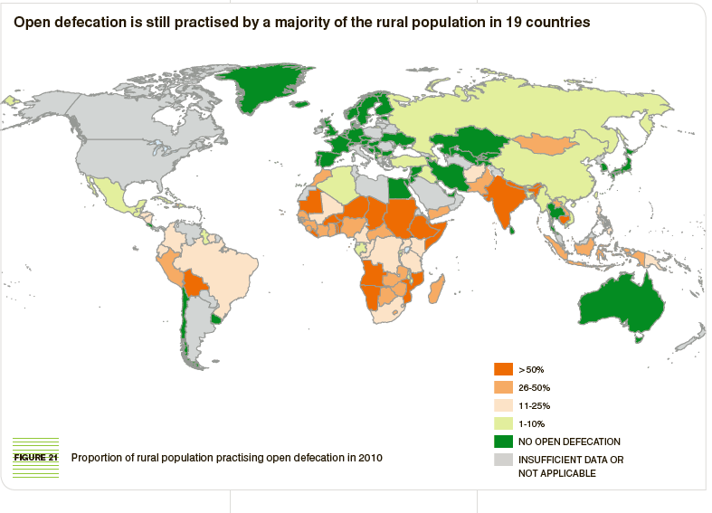
SANITATION…

Slide 28
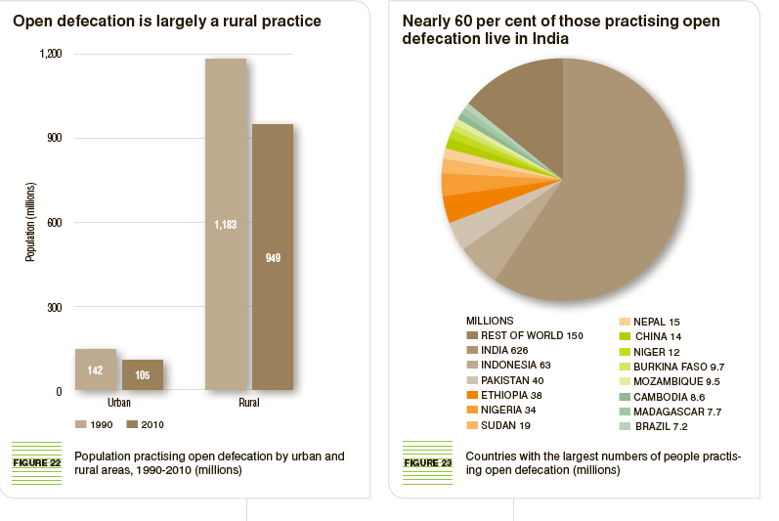
SANITATION…

Slide 29
Collection and Conveyance of Sewage
Conservancy System
Water Carriage System

Slide 30
Collection…/Conservancy
Old and outdated system of disposal
Mostly used in villages / undeveloped urban areas
Different types of refuses are collected, conveyed and disposed off
  Dry refuse (with no excreta) collected by cart and disposed out of city (combustibles burnt)
  Dirty water/Storm water /Sullage flows in open drains and join water bodies
  Night soil collected from latrines by cart/trucks buried and converted into manure
  Industries have own arrangement for disposal of their sewage

Slide 31
Collection…/Conservancy
Disadvantage
  Liquid from latrines get into ground
  Cause contamination of groundwater
  Openly disposed non-liquid wastes also cause diseases

Slide 32
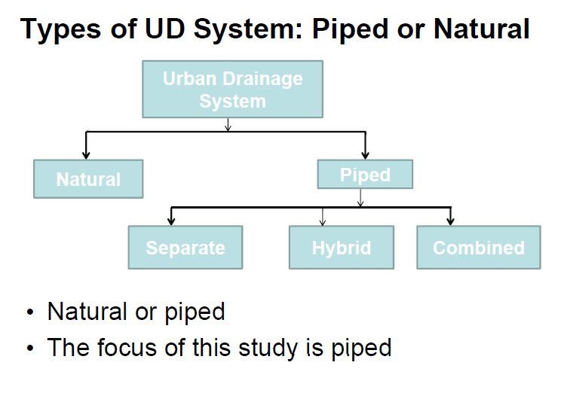

Slide 33
Water Carriage Systems
Collection, Conveyance and Disposal of the Wastes is done with the help of water
Latrines used are of special design called Water Closets (WCs)
Flushing of WCs is done with water 5 to 10 l
WC’s waste and Sullage from kitchen and bathroom form sewage
Sewage flows through underground pipes to treatment plants and disposed of for irrigation or as dilution

Slide 34
Water Carriage …
In such a system
  Garbage is disposed as in conservancy system
  Storm water may or may not be allowed to enter the sewers (storm water can also be disposed off through an open surface drains / not dirty)
Water carriage system is most modern method of disposal and is recommended
Initial cost of installation is very high and might be difficult to install it for poor communities
It might need to be implemented by phase

Slide 35
Sanitary System Choice
Water carriage system is the most modern
It has so many advantages over conservancy
It is more advantageous for big cities where there is large concentration of population
Can be economical for big cities where there is a possibility to raise fund
However for small cities and towns adoption of water carriage system becomes difficult as it is not easy to raise fund
Thus conservancy system is recommended for small cities and towns as they prove to be economical
Availability of space in small towns and lack of it in big cities is also the cause for the different choice of the system

Slide 36
Classification of Water Carriage System
Separate System of Sewerage
  Two sets of sewer one carrying sewage and the other storm water
Combined System of Sewerage
  Single sewer carrying both sewage and storm water
Partially Combined or Partially Separate System
  Single sewer laid but in small rain period it is used for both but as amount of storm water is increased storm water is collected by open channel and drained to river or stream

Slide 37
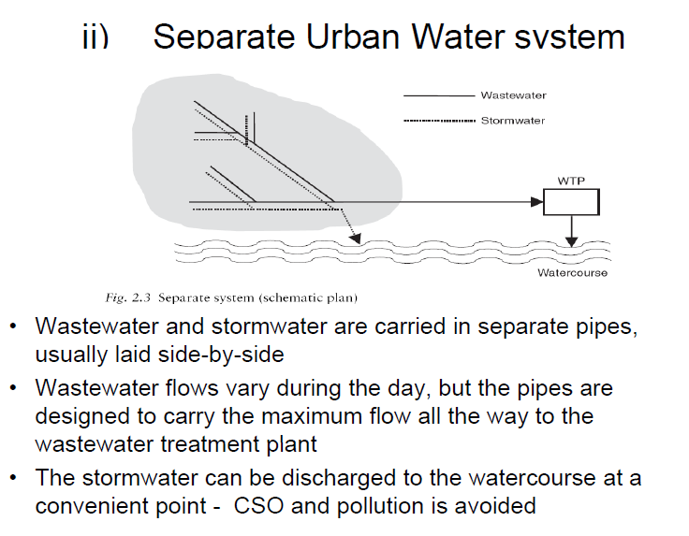

Slide 38
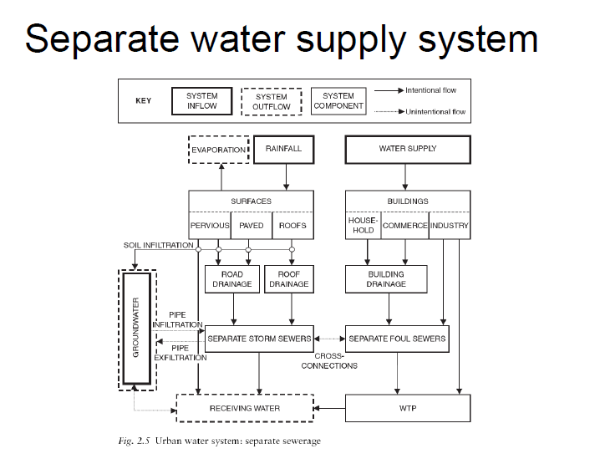

Slide 39
Separate system
Groundwater, drainage, …
Rain water
Domestic and industrial sewage
∼clean
polluted
Storm sewer
Sewage sewer
Rainwater treatment
WWTP
Groundwater, drainage, …
Rain water
Domestic and industrial sewage
∼clean
polluted
Storm sewer
Sewage sewer
Infiltration
Rainwater treatment
WWTP
Groundwater aquifer

Slide 40
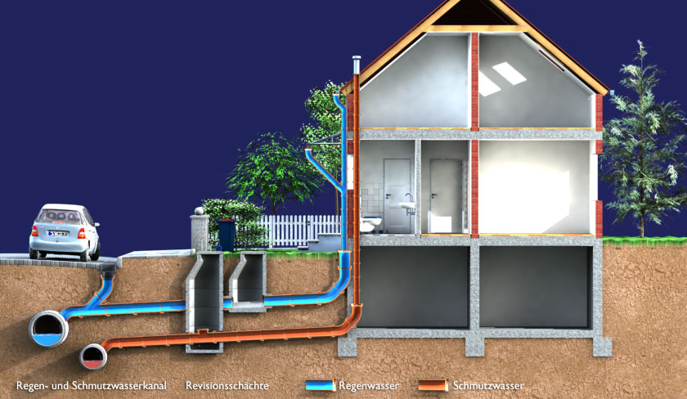
Separate system

Slide 41
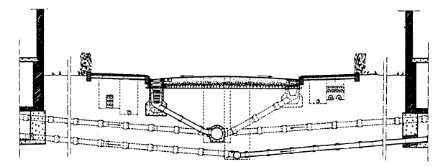
Separate system
Cross section through street underground
Gully
Manholes
Street water
Roof water
House connection: sewage
DIN (1998)

Slide 42
Separate System of Sewerage
Advantages
Disadvantages
Size of sewers are small
Sewage load on treatment unit is small
River or stream waters are not polluted
Storm water can be discharged into streams or rivers without any treatment
In case pumping of sewage is required it is economical
Sewers being small, difficult to clean
Likely to choke frequently
Costly since two sets need to be laid
Storm water sewer used only in rainy season – can be dumping place of garbage in dry period and get choked

Slide 43
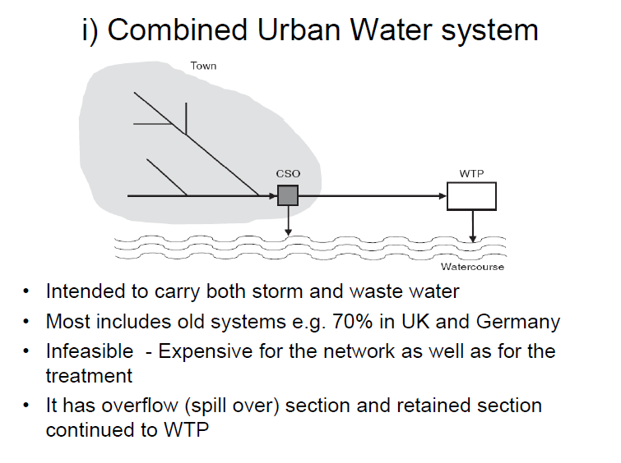

Slide 44
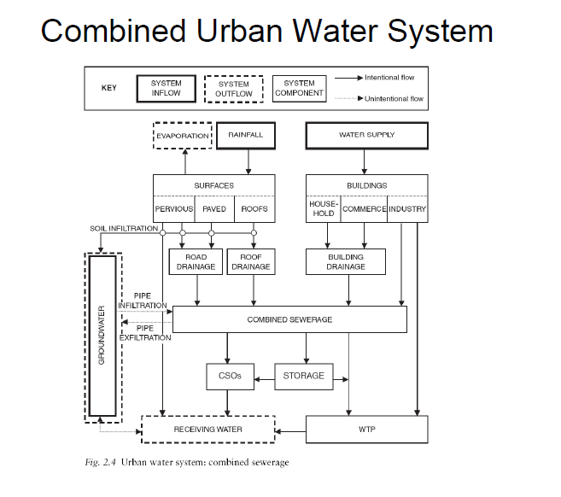

Slide 45
Combined system
Groundwater , Drainage, …
Rain water
Domestic and industrial sewage
∼clean
polluted
Comb syst
CSO
WWTP
Groundwater , Drainage, …
Rain water
Domestic and industrial sewage
∼clean
polluted
Comb syst
Infiltration
Groundwater aquifer
CSO
WWTP

Slide 46
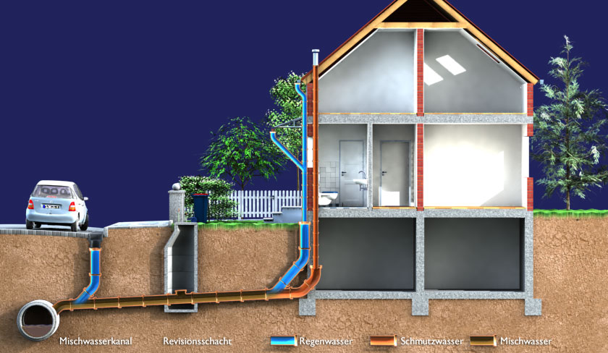
Combined system

Slide 47
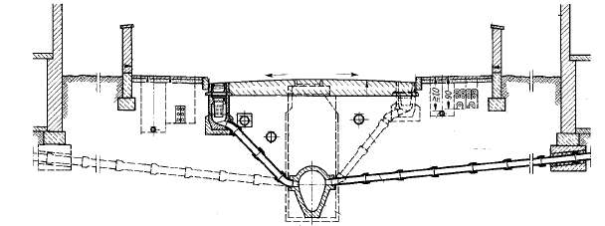
Combined system
Cross section through street underground
Gully
Manhole
House connection
No access for rehabilitation
(DIN 1998)

Slide 48
Combined System of Sewerage
Advantages
Disadvantages
Large sewer size; easy to clean and less probability of choking
Single set needed thus economical
Sewage strength will be diluted hence nuisance level reduced
Reasonable maintenance cost
Difficult to handle and transport large size sewers
Load on treatment plants unnecessarily increased due to storm water
Overflow of sewers during heavy rain may create unhygienic condition
In dry season it becomes difficult to maintain proper flow as the sewers are large
Unnecessary pollution of storm water

Slide 49
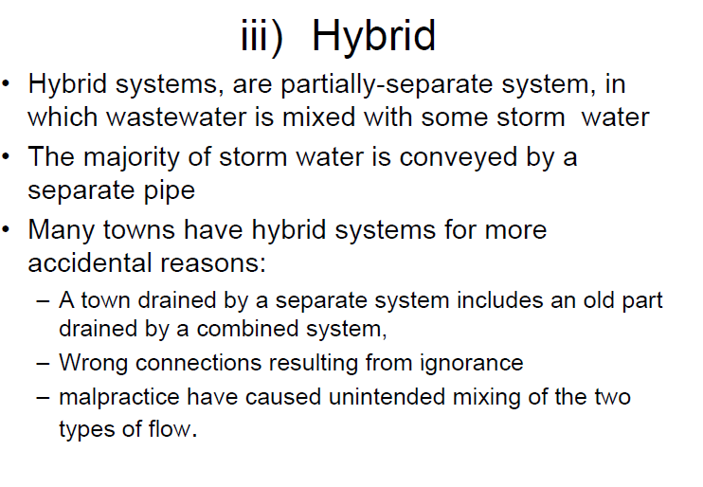

Slide 50
Partially Combined or Partially Separate System
Advantages
Disadvantages
Size of sewer not very large since it takes only part of storm water
Combines advantages of the two systems (Separate/Combine)
No silting problem
Problem of disposing of storm water from residence is simplified
Flow velocity may be low during dry period
Storm water increases load on treatment plants and pumps

Slide 51
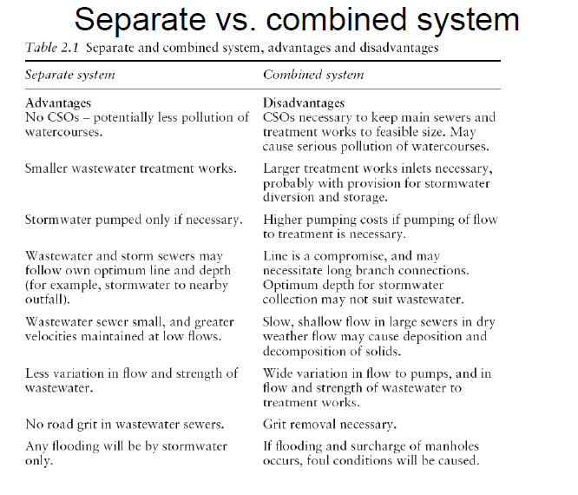

Slide 52
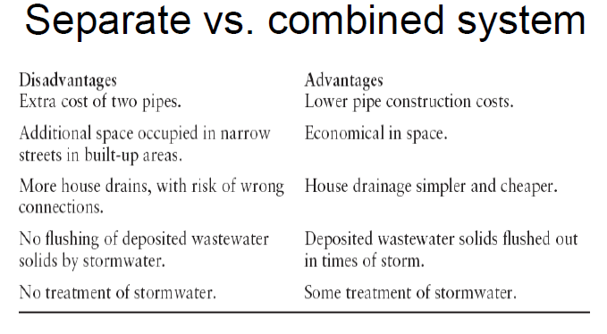

Slide 53
Conditions to Adapt Separate System
In flat areas where deep excavation is required
Lack of fund, only sewage with sewer storm with channels
Rainfall not all year round but concentrate for a short period
Proximity / Nearness natural rivers or stream if near storm water can be drained to wet bodies separately
If pumping is necessary quantity of sewage is small in separate system
Where existing sewerage is separate and can not handle storm water
Rocky area where it is difficult to lay larger sewers
Where there is no sufficient gradient and there is risk of backflow
Where drainage area is small and steep, storm can drain naturally quickly

Slide 54
Suitable Conditions for Combined Sewer
Rainfall continues evenly throughout the year
If pumping is required for both sanitary sewage and storm water
Space available to lay sewers is limited
Where regulators can be provided to divert excess flow during rainy season and possible to manage dry weather flow in the sewer
If an existing storm water sewer is to be converted into combined sewer; and if only if sanitary sewage is small compared to that of rainfall

Slide 55
Choice of System
Modern trend to use separate system which avoids contamination of storm water and reduce the load of treatment plant
For highly metropolitan city, separate system is recommended since in case of combined system overflow would create heavily unhygienic situation
Separate system is mostly adapted, if fund is in shortage, storm water can be handled open drains…

Slide 56
Pattern of Collection
Pattern of sewage collection depends on four factors
  Area to be drained
  Topographical and hydrological features of the area
  Sewerage system adopted
  Location and methods of treatment and disposal works
Different Types of Patterns (Reading Assignment)
  Radial
  Perpendicular
  Interceptor
  Fan and
  Zonal

