Slide 1
Part II - Sanitary Systems
Chapter 2a : Component General / Conveyance System
Geremew Sahilu (PhD)

Slide 2
Outline
General
Sewerage Line
Sanitary Appurtenances

Slide 3
Major Components
Conservancy
Water Based
Source / Containment:
  Latrines of different types
Conveyance
  Vacuum Trucks and other means
Treatment
  Fecal sludge management
Disposal / Reuse
Source / Containment
  WCs / Septic Tanks
Conveyance
  Sewer pipes / appurtenances
Treatment
  Different types
Disposal / Reuse

Slide 4
Sewerage Line
A closed Conduit System that transport sewage from source to treatment plant
Usually circular
Not flowing full except at pumping location
Gravity Flow
Different materials used – CP / DCI / uPVC / PVC…

Slide 5
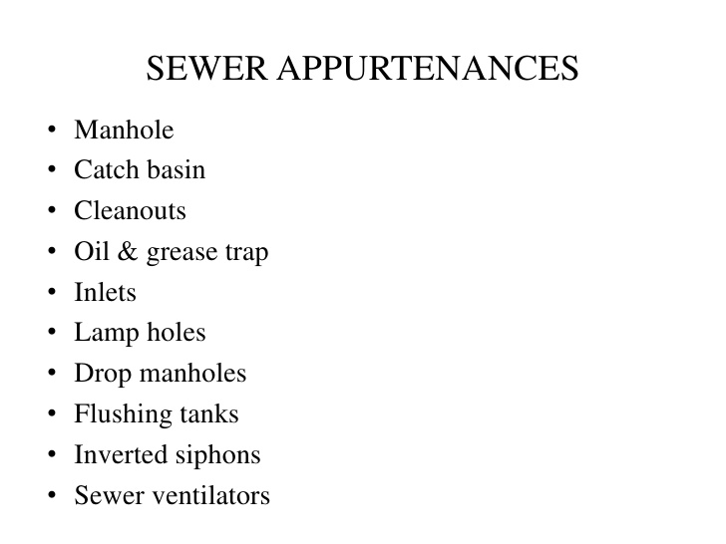

Slide 6
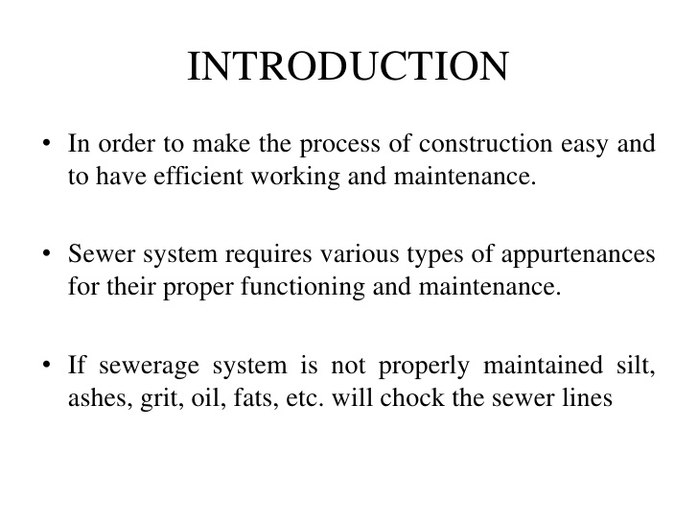

Slide 7
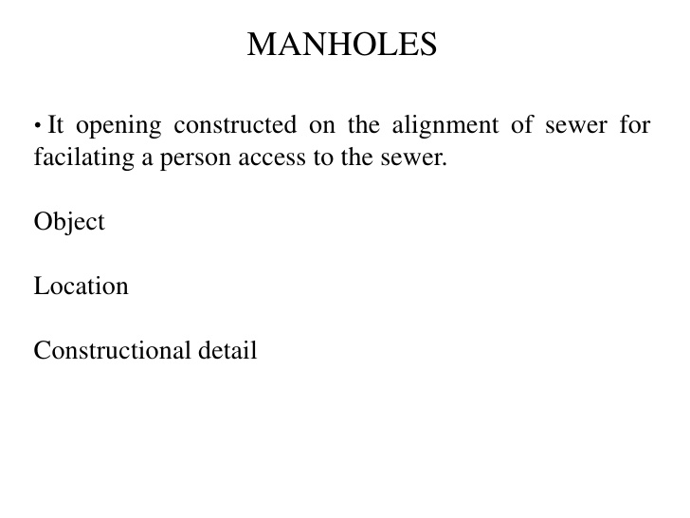

Slide 8
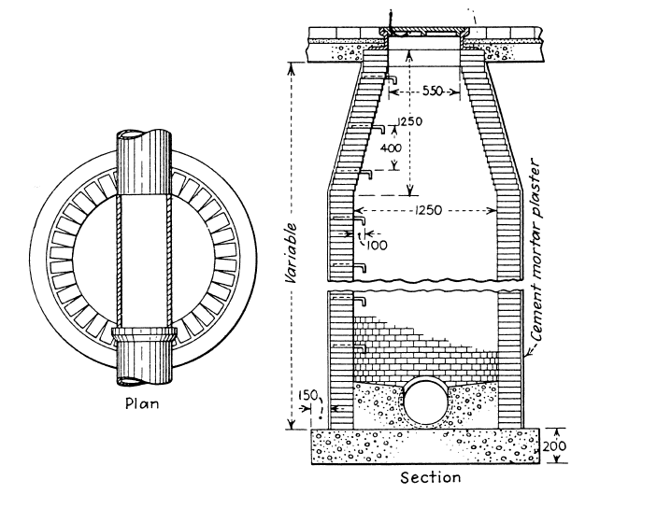

Slide 9
Manhole…
Objective
Permit entry of person inside the sewer for inspection, cleaning and maintenance
Dividing sewer line into smaller length called blocks facilitating easy location and opening of chokes
Ventilating the sewer line
Allow joining of sewers or change in the direction or alignment or both
Components
Working chamber
Access shaft
Cover
Classification (depth)
Shallow (75 to 90 cm)
Normal (about 150 cm)
Deep (> 150 cm)

Slide 10
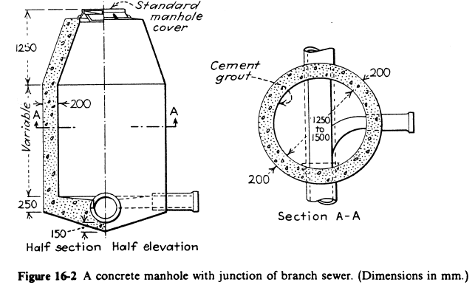

Slide 11
Centre to centre distance between subsequent manholes (without change of direction)
No. | Size (D) of the sewer line (cm) | Distance (m)
1 | D<= 60 | 75
2 | 60 < D<= 90 | 125
3 | 90 < D<= 120 | 190
4 | 120 < D<= 150 | 250
5 | > = 150 | 300 to 400

Slide 12
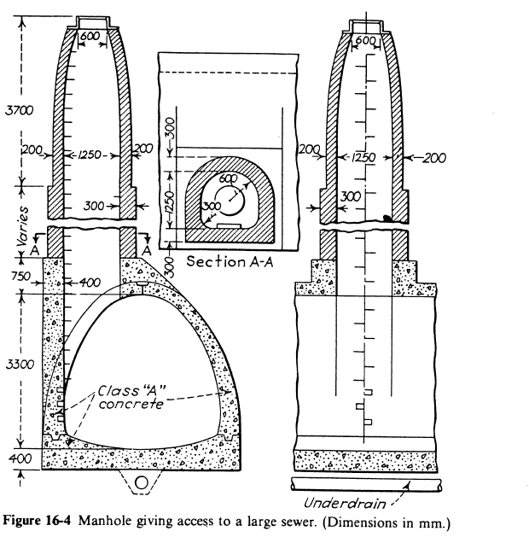

Slide 13
Depth and recommended manhole chamber size
Depth (d) of Manhole (m) | Recommended Size (mxm)
<= 0.8 | 0.75 x 0.75
0.8< d<= 2.1 | 1.2 x 0.9
> 2.1 | Circular chamber with minimum diameter of 1.4 m or rectangular chamber with minimum internal dimension of 1.2x0.9 m

Slide 14
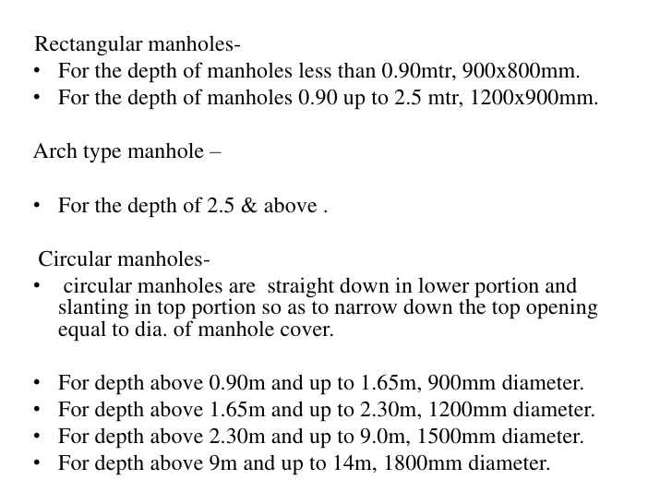
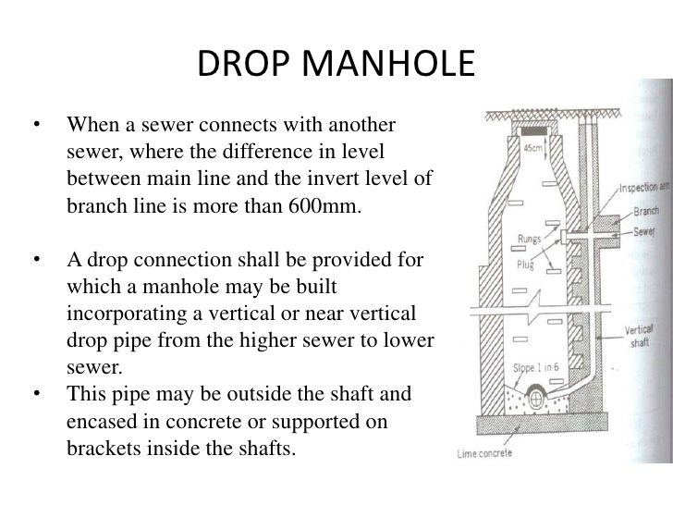

Slide 15
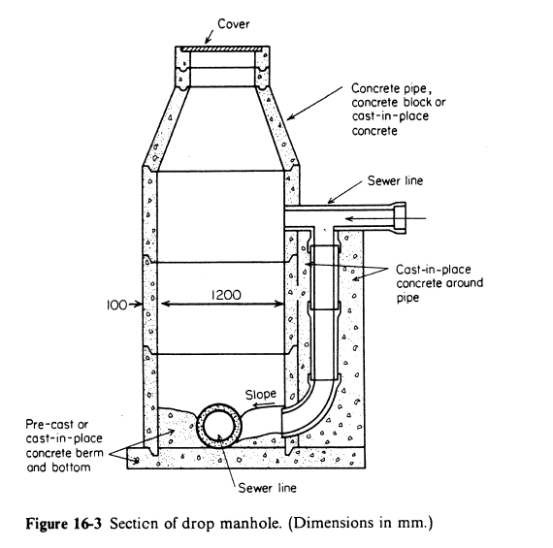

Slide 16
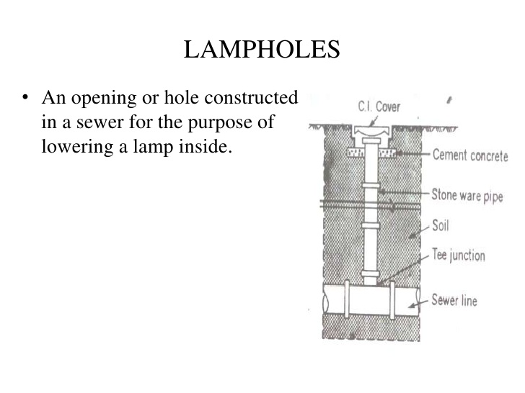

Slide 17
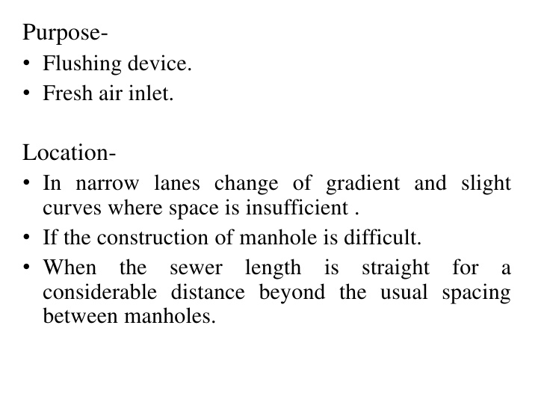

Slide 18
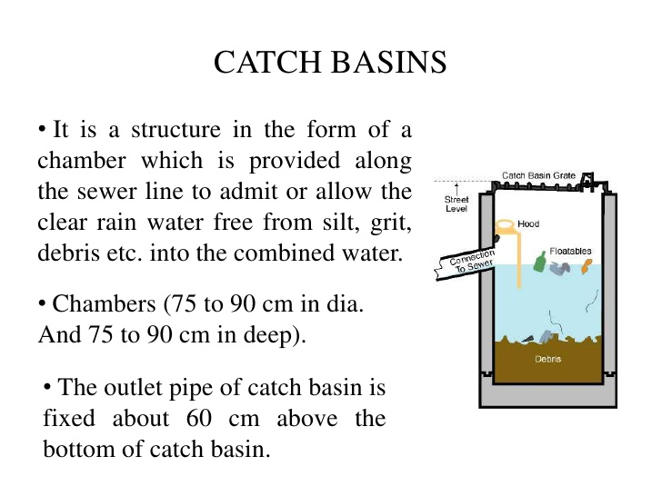

Slide 19
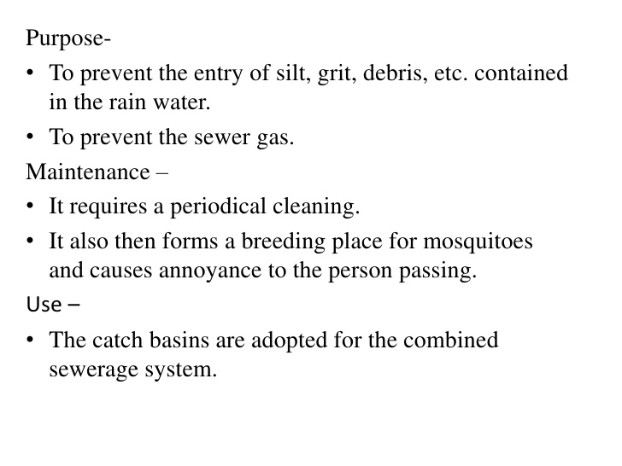

Slide 20
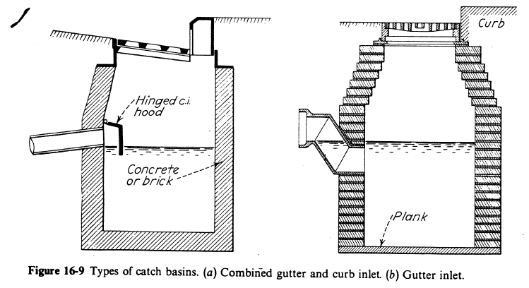

Slide 21
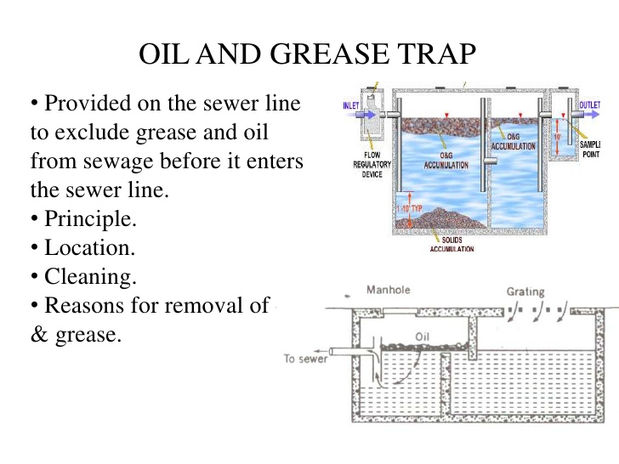

Slide 22
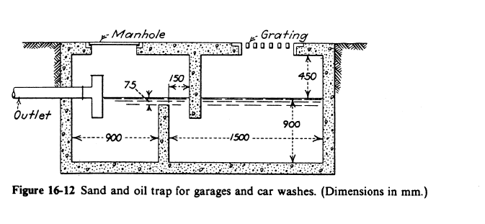

Slide 23
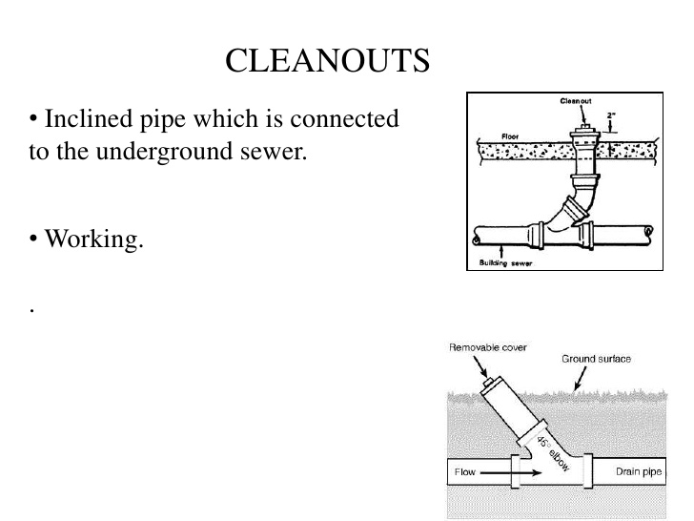

Slide 24
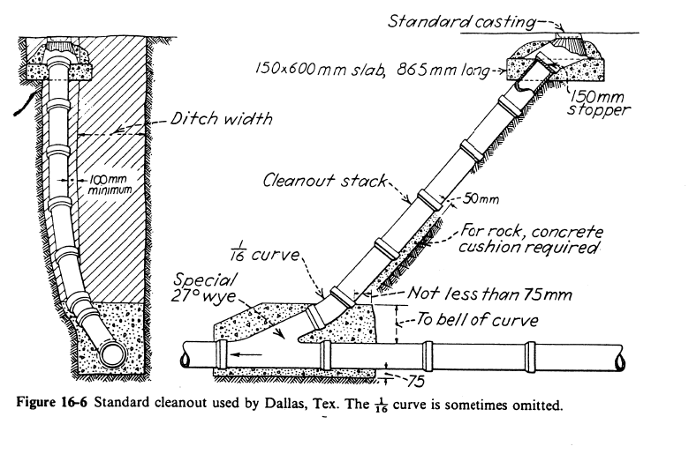

Slide 25
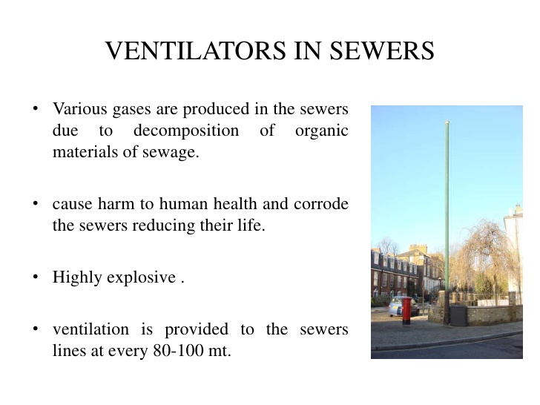

Slide 26
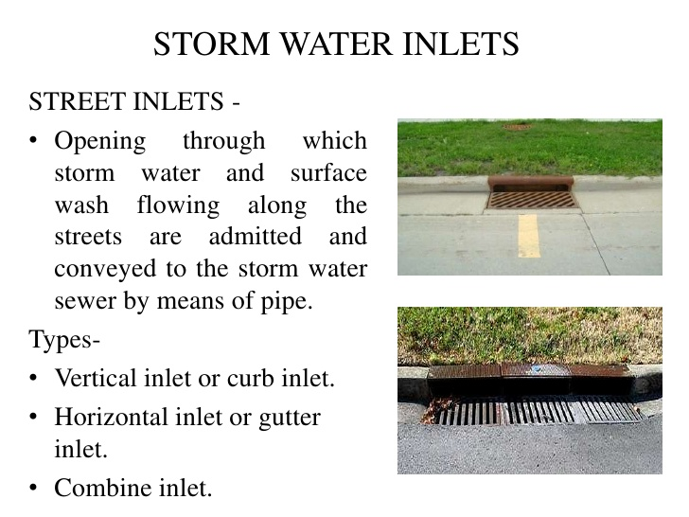

Slide 27
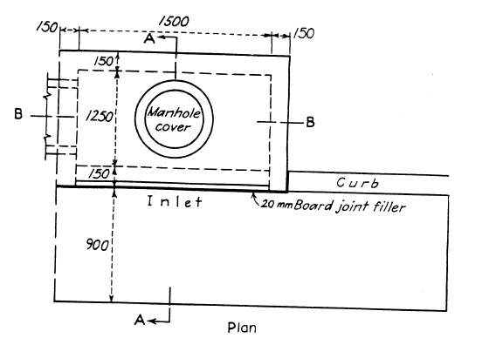

Slide 28
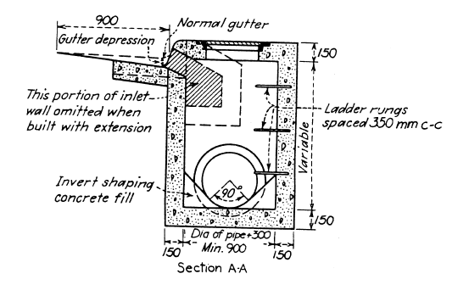
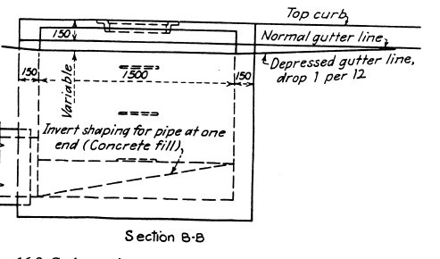

Slide 29
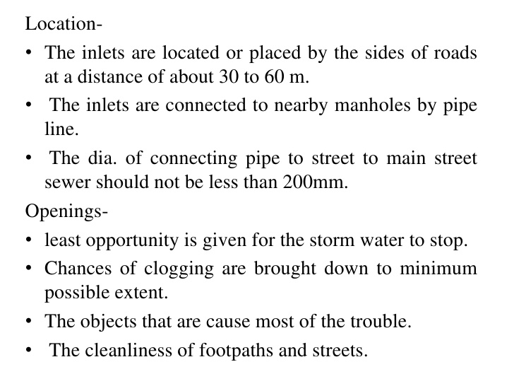

Slide 30
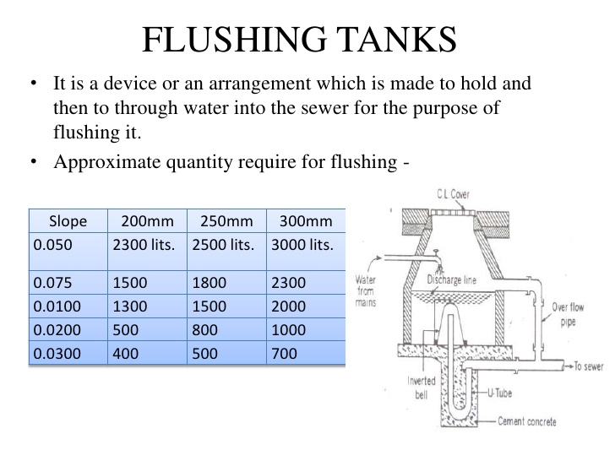

Slide 31
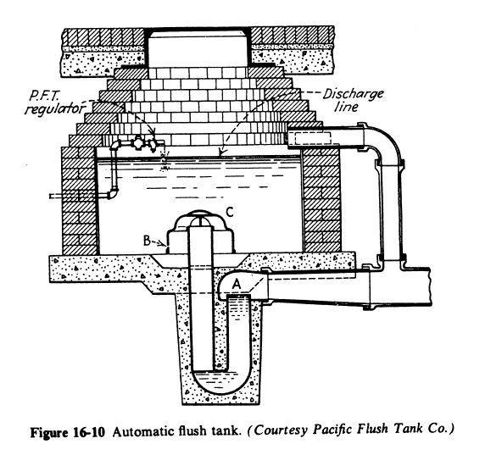

Slide 32
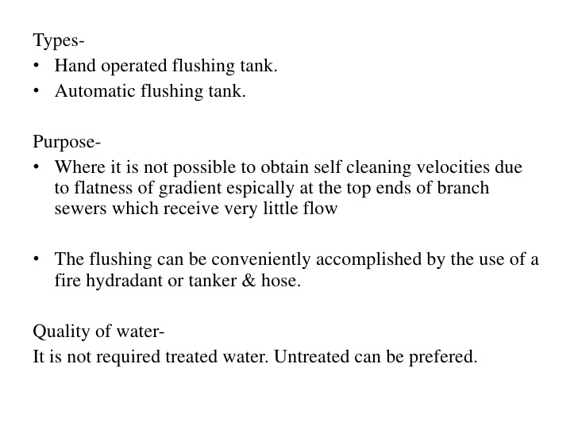

Slide 33
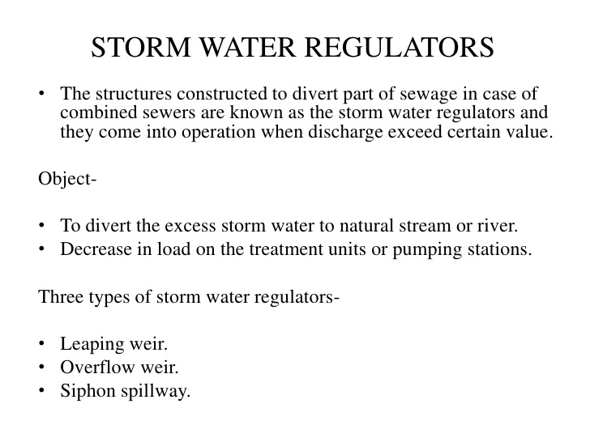

Slide 34
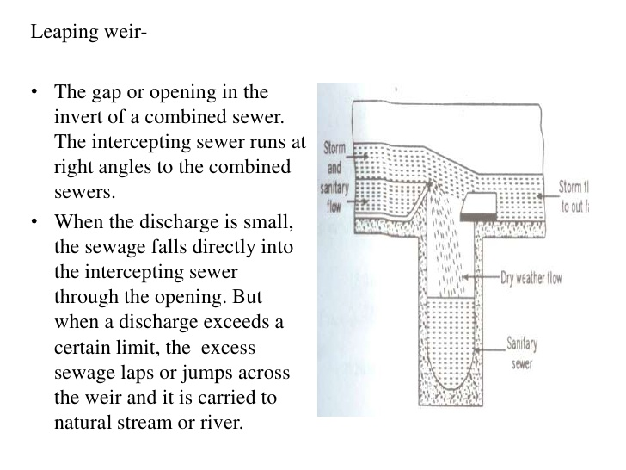

Slide 35
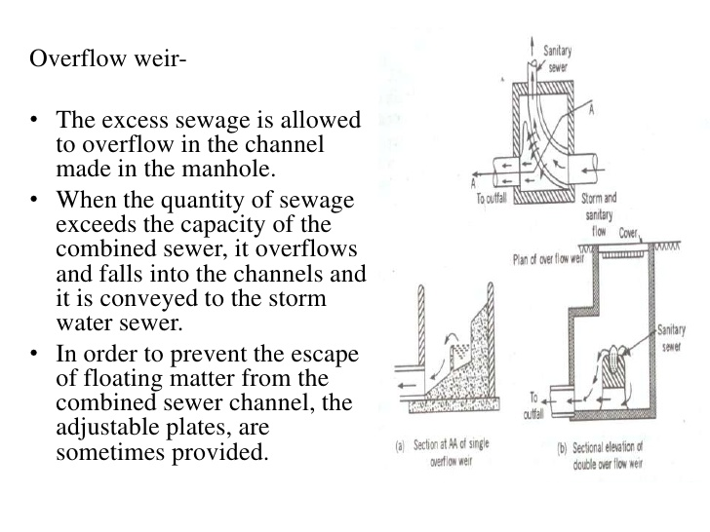

Slide 36
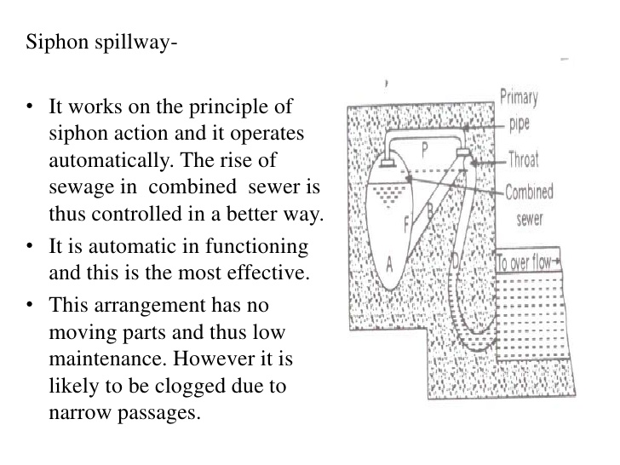

Slide 37
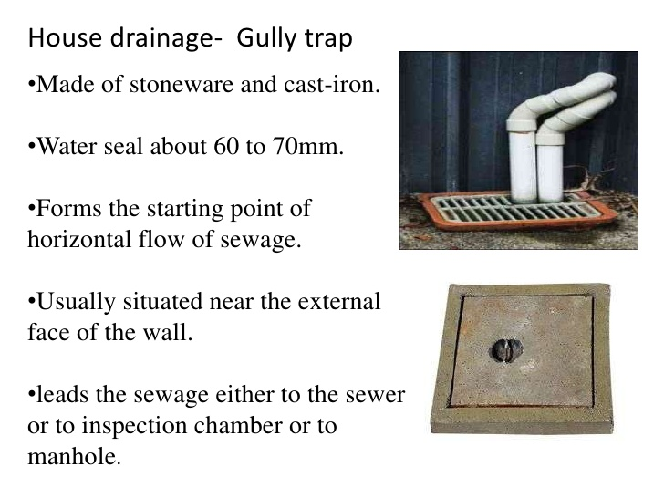

Slide 38
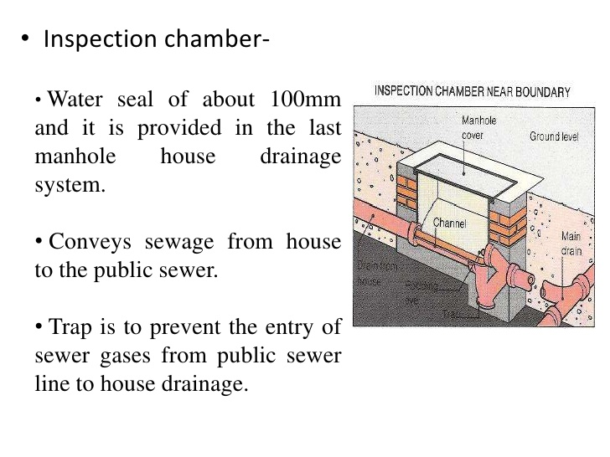

Slide 39
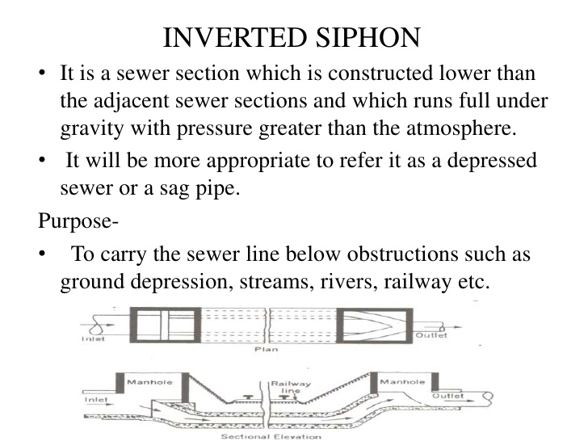

Slide 40
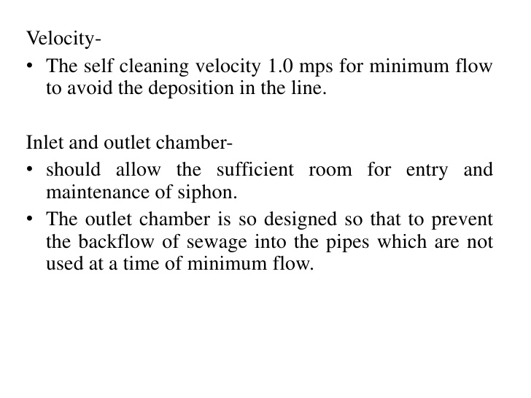

Slide 41
Questions?
Considering your town and possible location of WWTP
  What problem could you face?
Which sanitary appurtenances you may require?

