Slide 1
Part II Sanitary Systems
Chapter 1 : Introduction and Types of Sanitary System System

Slide 2
Outline
Introduction
Definition / SDGs
Conservancy System
Water based System

Slide 3
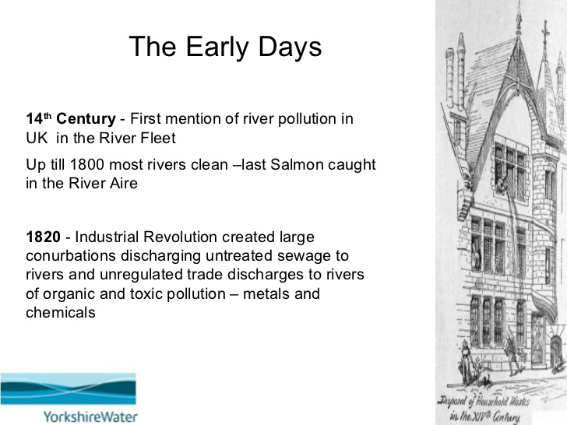
Rise of Sanitary Engineering /Env. Eng.
When Did We Become Concerned???
Notes:
Modern Sewerage an Storm water management is a recent phenomenon though there are some historical records

Slide 4
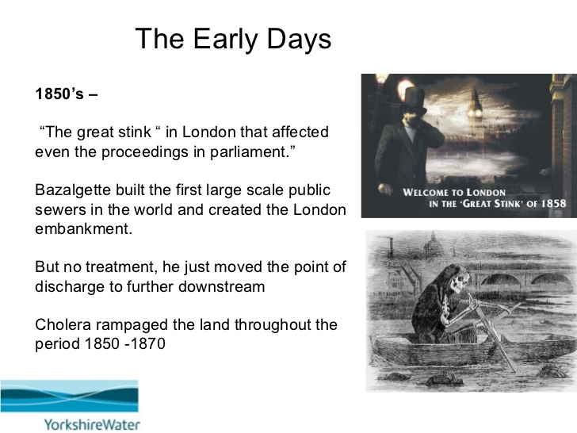
Rise of Sanitary …..
Notes:
The Great Stink forced the search for the solution which leads to the necessity of proper collection of sewage and later stage to its treatment

Slide 5
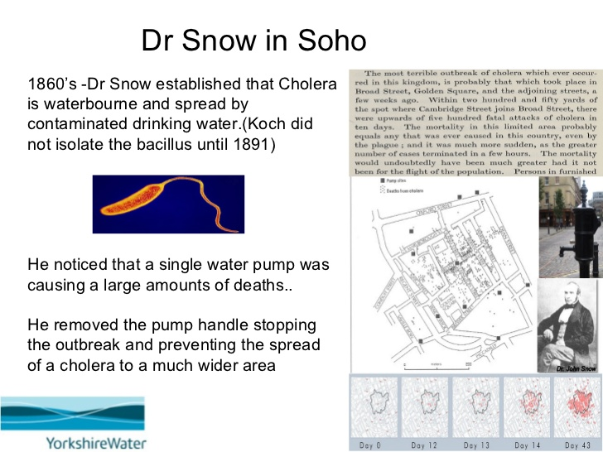
Rise of Sanitary …

Slide 6
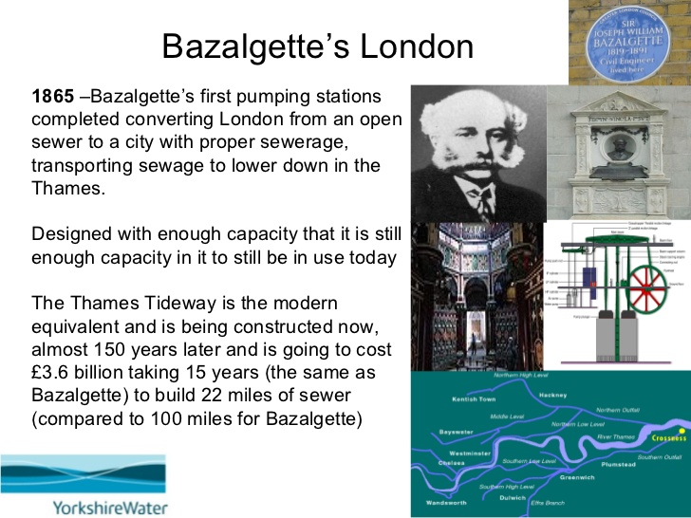
Rise of Sanitary …

Slide 7
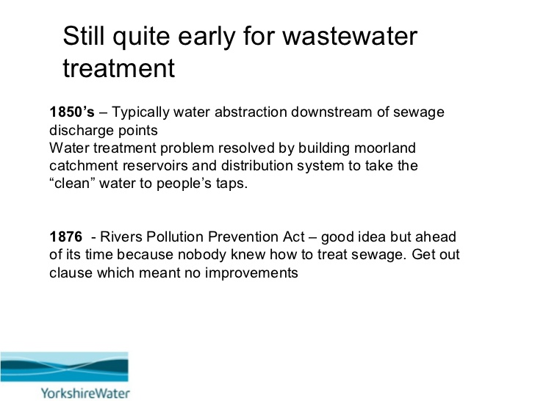
Rise of Sanitary …

Slide 8
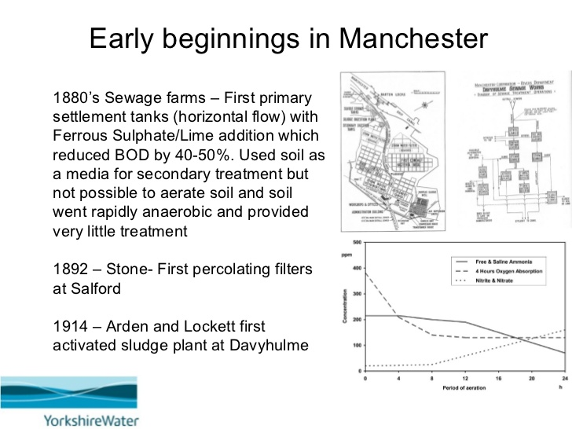
Rise of Sanitary …

Slide 9
WASH/Recent History
WHO and UNICEF conduct pilot projects focusing on rural sanitation
Reduce disease through introduction of safe water technologies and demonstration of excreta disposal methods.
  Report from the League of Nations Health Organization on water supply and sewage treatment
Changed universal access goal from 1990 to 2000
Water
Supply and Sanitation Collaborative Council (WSSCC) established
United Nations Conference on Water in 1977
Adopt programmes with realistic standards for quality and quantity to provide water for urban and rural areas by 1990, if possible
1990
1936
1950s
1970s
Environmental Sanitation
Field activities
Community Water Supply
Health and Environment
Water and Sanitation
Health and Development
1948
1960s
1980s
WHO established, Committee on Environmental Sanitation established
Promote the improvement of environmental hygiene, including sanitation. Minimize the burden of water associated ill-health.
Established Community Water Supply (CWS) Programme
Develop water supplies that were adequate, in quality and quantity, to provide for all public, agricultural and industrial needs
International Drinking Water Supply and Sanitation Decade
Priority to the poor, less privileged and to water scarce areas
1990s
Emphasized focus on high-risk communities and sanitation
Notes:
IDWSSD
commitment of national Governments to provide all people with water of safe quality and adequate
quantity and basic sanitary facilities by 1990, according priority to the poor and less privileged and to
water scarce areas; and (c) larger allocation to this sector from the total resources available for general
economic and social development

Slide 10
Johannesburg
South Africa
UN Headquarters
New York
Rio de Janeiro
2002: World Summit on Sustainable Development
Reaffirmed the global community's commitments to poverty eradication and the environment, and built on Agenda 21 and the Millennium Declaration by including more emphasis on multilateral partnerships
2000: Millennium Summit-
The Summit led to the elaboration of eight Millennium Development Goals (MDGs) to reduce extreme poverty by 2015
1992: Earth Summit-
A comprehensive plan of action to build a global partnership for sustainable development to improve human lives and protect environment (Agenda 21)
1945 Establishment of UN.

Slide 11
Sendai
Addis Ababa
New York
France
2015: Several Agreements -
Sendai Framework for Disaster Risk Reduction (March 2015)
Addis Ababa Action Agenda on Financing for Development (July 2015)
Transforming our World: the 2030 Agenda for Sustainable Development (Sep. 2015)
Paris Agreement on Climate Change (Dec. 2015)
UN Headquarters
New York
UN Headquarters
New York
2015: General Assembly -
Began the negotiation process on the post-2015 development agenda. Culminated in the subsequent adoption of the 2030 Agenda for sustainable development with 17 SDGs at its core
2013: General Assembly -
Set up a 30-member Open Working Group to develop a proposal on the SDGs
Rio de Janeiro
2012: UN Conference on Sustainable Development-
“The future we want”- decided to launch a process to develop set of SDGs to build upon the MDGs and establish the UN High-Level Political Forum on Sustainable Development

Slide 12
Definition : Sanitation
the United Nations resolution on the human right to sanitation that defines sanitation as “a system for the collection, transport, treatment and disposal or reuse of human excreta and associated hygiene” (United Nations, General Assembly, 2009a, para. 63).
  Addresses the use of “safely managed” sanitation services. These are systems that safely separate excreta and wastewater from human contact, either by safe containment, treatment and disposal in situ, or by safe trans-port and treatment off site.

Slide 13
SDG6 Goals / Targets / Indicators
SDG 6 Ensure availability and sustainable management of water and sanitation for all
  Target 6.1: Achieve access to safe and affordable drinking water
  Target 6.2: Achieve access to sanitation and hygiene and end open defecation

Slide 14
SDG6 …
Indicator 6.1.1:
Proportion of population using safely managed drinking water services
A safely managed drinking water service is defined as:
  providing drinking water from an improved source
    that is accessible on premises,
    available when needed, and
    free from fecal and priority chemical contamination.

Slide 15
SDG6…
Indicator 6.2.1a:
Proportion of population using safely managed sanitation services, including a hand washing facility with soap and water
Indicator 6.2.1b:
Proportion of population with a handwashing facility with soap and water available on premises
  Focuses on the presence of handwashing facilities with soap and water on premises. Handwashing with soap and water is a top priority for improving global health and is one of the most cost-effective public health interventions.

Slide 16
JMP Ladder for Global Monitoring of Drinking Water

Slide 17
JMP Ladder for Global Monitoring of Sanitation

Slide 18
Sanitary Systems

Slide 19
Conservancy System
Old and outdated system of disposal
Mostly used in villages / undeveloped urban areas
Different types of refuses are collected, conveyed and disposed off
  Dry refuse (with no excreta) collected by cart and disposed out of city (combustibles burnt)
  Dirty water/Storm water /Sullage flows in open drains and join water bodies
  Night soil collected from latrines by cart/trucks buried and converted into manure
  Industries have own arrangement for disposal of their sewage

Slide 20
Conservancy
Disadvantage
  Liquid from latrines get into ground
  Cause contamination of groundwater
  Openly disposed non-liquid wastes also cause diseases

Slide 21
Water Carriage Systems
Collection, Conveyance and Disposal of the Wastes is done with the help of water
Latrines used are of special design called Water Closets (WCs)
Flushing of WCs is done with water 5 to 10 l
WC’s waste and Sullage from kitchen and bathroom form sewage
Sewage flows through underground pipes to treatment plants and disposed of for irrigation or as dilution

Slide 22
Water Carriage …
In such a system
  Garbage is disposed as in conservancy system
  Storm water may or may not be allowed to enter the sewers (storm water can also be disposed off through an open surface drains / not dirty)
Water carriage system is most modern method of disposal and is recommended
Initial cost of installation is very high and might be difficult to install it for poor communities
It might need to be implemented by phase

Slide 23
Sanitary System Choice
Water carriage system is the most modern
It has so many advantages over conservancy
It is more advantageous for big cities where there is large concentration of population
Can be economical for big cities where there is a possibility to raise fund
However for small cities and towns adoption of water carriage system becomes difficult as it is not easy to raise fund
Thus conservancy system is recommended for small cities and towns as they prove to be economical
Availability of space in small towns and lack of it in big cities is also the cause for the different choice of the system

Slide 24
Classification of Water Carriage System
Separate System of Sewerage
  Two sets of sewer one carrying sewage and the other storm water
Combined System of Sewerage
  Single sewer carrying both sewage and storm water
Partially Combined or Partially Separate System
  Single sewer laid but in small rain period it is used for both but as amount of storm water is increased storm water is collected by open channel and drained to river or stream

Slide 25
Separate system
Groundwater, drainage, …
Rain water
Domestic and industrial sewage
∼clean
polluted
Storm sewer
Sewage sewer
Rainwater treatment
WWTP
Groundwater, drainage, …
Rain water
Domestic and industrial sewage
∼clean
polluted
Storm sewer
Sewage sewer
Infiltration
Rainwater treatment
WWTP
Groundwater aquifer

Slide 26
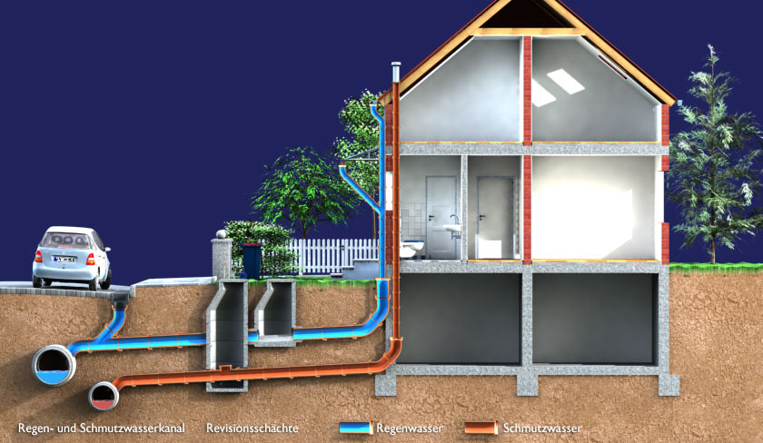
Separate system

Slide 27
Separate System of Sewerage
Advantages
Disadvantages
Size of sewers are small
Sewage load on treatment unit is small
River or stream waters are not polluted
Storm water can be discharged into streams or rivers without any treatment
In case pumping of sewage is required it is economical
Sewers being small, difficult to clean
Likely to choke frequently
Costly since two sets need to be laid
Storm water sewer used only in rainy season – can be dumping place of garbage in dry period and get choked

Slide 28
Combined system
Groundwater , Drainage, …
Rain water
Domestic and industrial sewage
∼clean
polluted
Comb syst
CSO
WWTP
Groundwater , Drainage, …
Rain water
Domestic and industrial sewage
∼clean
polluted
Comb syst
Infiltration
Groundwater aquifer
CSO
WWTP

Slide 29
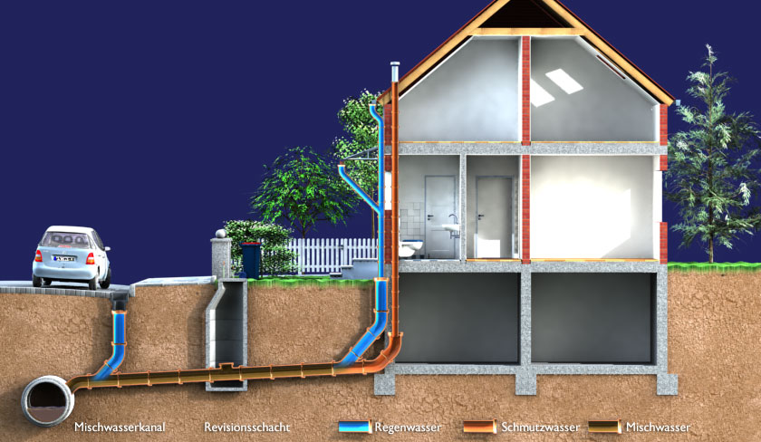
Combined system

Slide 30
Combined System of Sewerage
Advantages
Disadvantages
Large sewer size; easy to clean and less probability of choking
Single set needed thus economical
Sewage strength will be diluted hence nuisance level reduced
Reasonable maintenance cost
Difficult to handle and transport large size sewers
Load on treatment plants unnecessarily increased due to storm water
Overflow of sewers during heavy rain may create unhygienic condition
In dry season it becomes difficult to maintain proper flow as the sewers are large
Unnecessary pollution of storm water

Slide 31
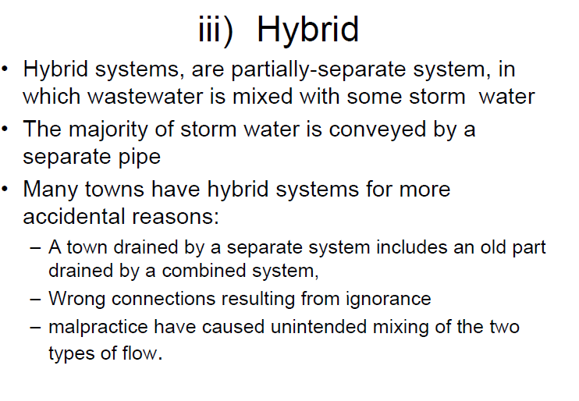

Slide 32
Partially Combined or Partially Separate System
Advantages
Disadvantages
Size of sewer not very large since it takes only part of storm water
Combines advantages of the two systems (Separate/Combine)
No silting problem
Problem of disposing of storm water from residence is simplified
Flow velocity may be low during dry period
Storm water increases load on treatment plants and pumps

Slide 33
Choice of System
Modern trend to use separate system which avoids contamination of storm water and reduce the load of treatment plant
For highly metropolitan city, separate system is recommended since in case of combined system overflow would create heavily unhygienic situation
Separate system is mostly adapted, if fund is in shortage, storm water can be handled open drains…

Slide 34
On-Site
Global = 38%
Sub-Saharan = 39%
Least Developed = 44%
Sewer
Global = 38%
Sub-Saharan = 7%
Least Developed = 3%

Slide 35
Questions?
Which system applies to your town or city?
  Conservancy
  Water Based
  Separate
Considering this project what is the current status and the planned after 25 years????

