Slide 1
5. SOURCE PROTECTION

Slide 2
Multiple Barrier Approach
Catchment
Source
Treatment
Distribution
Safe drinking
water

Slide 3
Source Assessment and Protection
Location of drinking water source
Delineation of source areas and protection zone
Physical barrier effectiveness list
Inventory of contaminant sources
Assessing hazards and prioritizing risks
Source protection measures

Slide 4
Inventory of contaminant sources
Purpose is to identify the existence and proximity to the water source of past, present and proposed activities that might be a potential threat to the water supply.
Review of information on potential contaminant sources
Conduct a contaminant source survey

Slide 5
Sources of water pollution
POINT SOURCES
NONPOINT SOURCES
Power plants:
Heated water
Agricultural runoff
Sediments, fertilizers, pesticides, organics, microorganisms
Feedlots
Organics, solids, nutrients, microorganisms
T
Mining
Suspended solids, acid-mine drainage
Water body
Industries
Organics, chemicals, color and foam, salts, toxins, heated water
T
Urban runoff
Litter, sediments, organics, nitrogen, phosphorus, heavy metals, petroleum substances, microorganisms
Municipalities
Domestic wastewater: Microorganisms, nitrogen, phosphorus
T

Slide 6
Factors influencing susceptibility to contamination in source area
Physical integrity of works supplying water
Physical, geologic, hydrologic, chemical, and biological characteristics that influence source water and contaminant flow to the supply point
Type, number and locations of potential contaminant sources and land use within the assessment area of a water supply
Nature and quantity of contaminants that have been or potentially could be released within a source area; the measures in place to prevent such releases

Slide 7
Contaminant source- Required information
Time of travel from release point to intake
  Release location
  Stream velocity, discharge
Type and characteristics of contaminant
Release type: continuous or instantaneous
Concentration of contaminant at intake point
Contaminant transport mechanism
Transformation processes that may lower contaminant concentration

Slide 8
PZ3
C
B
PZ2
A
PZ1
Abstraction Point
Groundwater Well Head Protection Areas (WHPA)
Surface Water Protection Zones (PZ)

Slide 13
Urbanization – Shewa Robit : GW
Downstream – Logia : GW
Upstream – Dessie :Tossa Spring

Slide 14
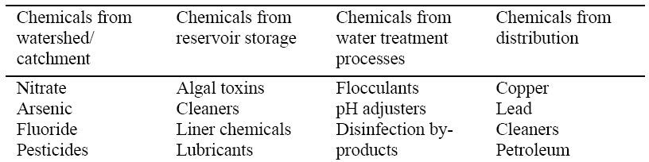
Assessing hazards
Hazard
Hazardous event
Risk
Biological: bacteria, viruses, protozoa, etc.
Chemical: example
Physical: sediment
Radiological

Slide 15
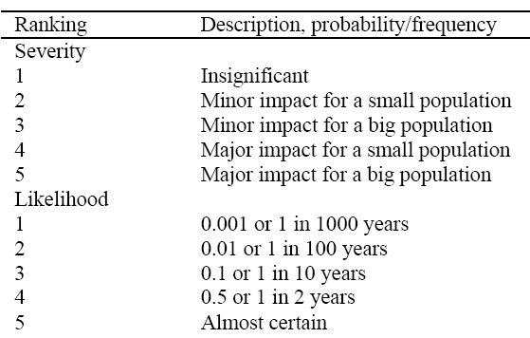
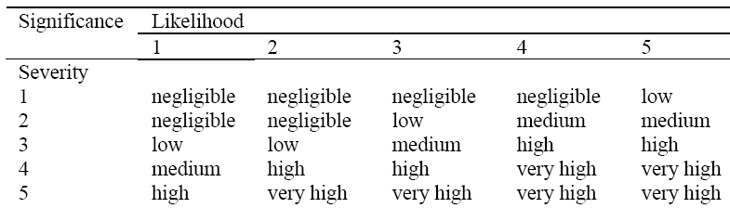
Risk analysis

Slide 16
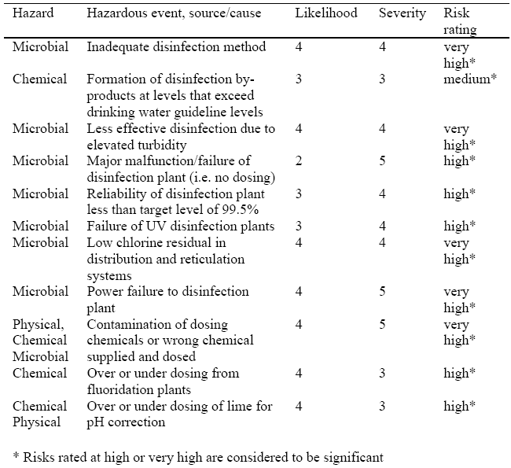
Example- Hazard assessment

Slide 17
Surface water pollution control methods
Pollution prevention
  Source reduction: input changes, processes changes, product changes
  Recycling/reuse, water conservation
  Minimizing illicit wastewater discharge
  Improving solid waste management, etc.
  Regulate rate, frequency and amount of fertilizer application
Reducing waste after generation
  Conventional wastewater treatment
  Alternative treatment methods
Increasing assimilative capacity of a watercourse
  Low flow augmentation
  Artificial reaeration

Slide 18
Surface water pollution control methods…
Making better use of assimilative capacity of a watercourse
  Regulated discharge, i.e., to temporarily store water during low flow period and to release it later when flow is high.
  To collect individual effluents to a common treatment plant and discharge it at a point where impact on quality is minimized.
Landuse planning
  Zoning
  Restrictions on population density and settlement on sensitive areas
  Erosion control
  Reducing impervious surfaces
  Reducing directly connected impervious surfaces
  Low impact land development

Slide 19
Reducing waste after generation
Treat wastewater to the required level before discharging into the receiving water system
Typical characteristics of domestic wastewater
Constituent | Weak (mg/L) | Medium (mg/L) | Strong (mg/L)
Alkalinity (as CaCO₃) BOD₅ Suspended solids TDS TKN (as N) Total phosphorus (as P) | 50 100 100 200 20 5 | 100 200 200 500 40 10 | 200 300 350 1000 80 20

Slide 20
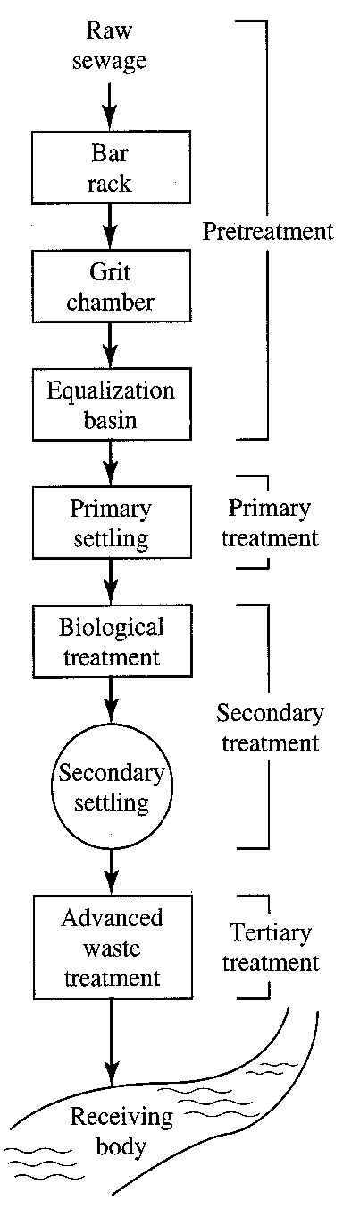
Conventional wastewater treatment
  Pretreatment – removes materials that can cause operational problems, equalization optional
  Primary treatment – remove ~60% of solids and ~35% of BOD
  Secondary treatment – remove ~85% of BOD and solids
  Advanced treatment – varies: 95+ % of BOD and solids, N, P

Slide 21
Biological wastewater treatment
Biological secondary treatment
Suspended growth
Attached growth
Dual biological
Trickling filters
Biotowers
Rotating biological contactors
Activated sludge
Stabilization ponds
Aerated lagoons
Containment ponds
Constructed wetlands
Plug flow
Complete mix
Oxidation ditch
Contact stabilization
Sequencing batch reactors
Conventional
Extended aeration
High rate
Step feed
Tapered aeration

Slide 22
Biological Nitrogen removal
Anoxic tank
Aerobic tank
Secondary clarifier
Influent
Denitrification
BOD + Nitrification
Effluent
Return nitrate
WAS
Return sludge

Slide 23
Biological Nitrogen removal
Aerobic tank
Anoxic tank
Aeration
Methanol
Influent
BOD + Nitrification
Denitrification
Effluent
Return sludge
Return nitrate
WAS
WAS
Nitrification in aerobic environment
Organic matter + O₂ → NH₃ + CO₂ + microorganisms
NH₃ + 2O₂ → NO₃⁻ + H⁺ + H₂O + microorganisms
Denitrification in an anoxic environment (no free oxygen)
Organic matter + NO₃⁻ → N₂ + microorganisms

Slide 24
Two-stage biological P removal
Secondary clarifier
Anaerobic tank
Aerobic tank
Influent
Effluent
Return sludge
WAS

Slide 25
Alternative Treatments
Waste Stabilization Ponds
Comprises series of man-made shallow ponds
They can achieve any required degree of treatment at the lowest cost and with minimum of maintenance by unskilled operators
The removal of pathogens is considerably greater than that in other methods of sewage treatment
They are well able to withstand both organic and hydraulic shock loads
They can effectively treat a wide variety of industrial and agricultural wastes
They can easily be designed so that the degree of treatment is readily altered
The method of construction is such that, should at some future time the land be required for some other purpose, it I easily reclaimed
The algae produced in the pond are potential sources of high-protein food which can be conveniently exploited by fish farming

Slide 26
Waste stabilization ponds
F
M
M
M
a
A
F
M
M
M
b
Pond layouts (a) Weak-medium strength wastes (b) Strong wastes
A: Anaerobic pond F: Facultative pond M: Maturation pond

Slide 27
Functions and requirements of ponds
Pond | Main function | Design factors
Anaerobic Facultative Maturation | Treat strong organic waste (70% reduction in BOD5) BOD removal Fecal coliform removal (99.9%) | Depth: 2-4 m Detention time: 5 days Temp/pH: > 15°C/>6 Depth: 1-1.5 m Exposed to wind Large land area Desludging: 10-15 years Depth: 1-1.5 m
Processes in a facultative pond

Slide 28
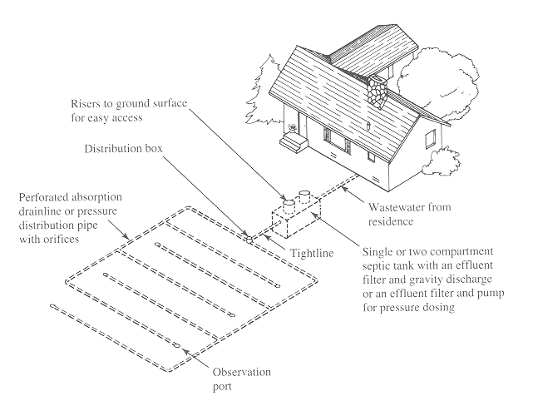
Alternative treatments- Septic systems

Slide 29
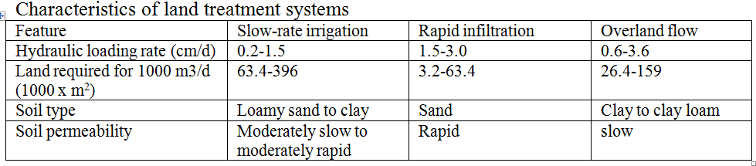
Land treatment methods
Application of wastewater on the land
Plants and soil play roles in pollutant removal
Three types of application:
  Slow rate infiltration
  Rapid infiltration
  Overland flow

Slide 30
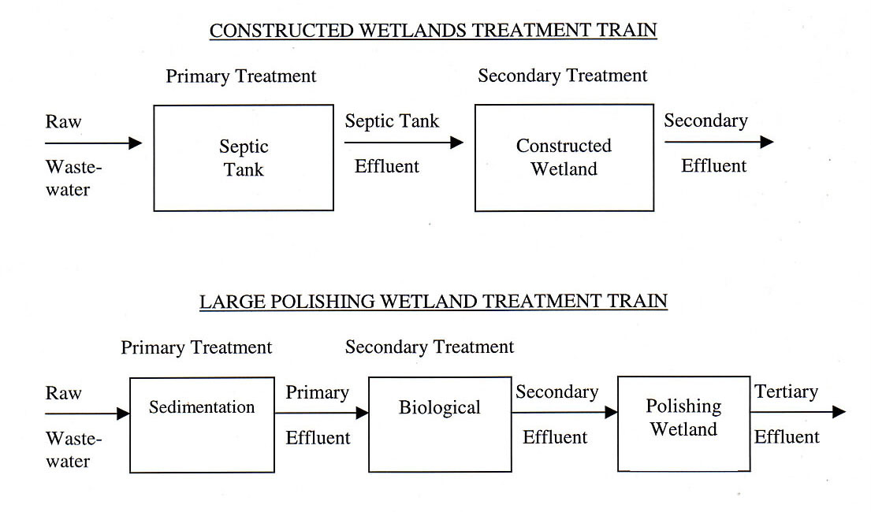
Alternative treatments- Constructed wetlands

Slide 31
Groundwater Quality Management
Groundwater pollution risk
Aquifer pollution vulnerability
Groundwater pollution hazard
  Sensitivity to contamination determined by the natural intrinsic characteristics of the geological strata
  Probability that the groundwater in an aquifer will become polluted
  Threats posed by groundwater pollution hazard to human health
Groundwater protection
measures

Slide 32
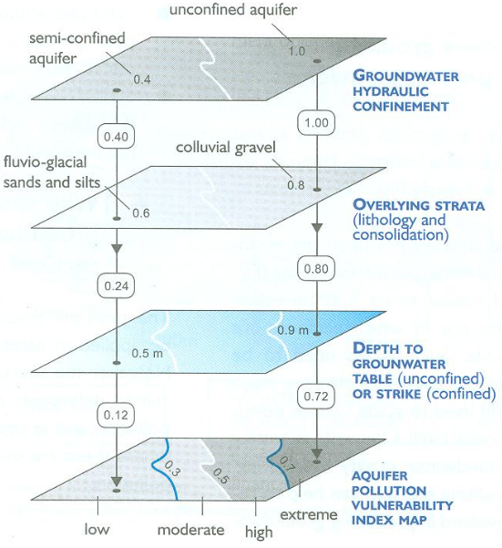
Key factors in aquifer vulnerability

Slide 33
Groundwater quality management practices
Assessing actual groundwater quality status
Prohibition of certain activities in vulnerable areas
Prohibiting the disposal of certain level of waste except in sealed facilities
Management of waste effluents
Monitoring compliance with regulations/permits
Remedial actions:
  Pumping and treating polluted groundwater
  Pumping/well injection to reverse the hydraulic gradient
  Construction of physical barriers
  Chemical or bacterial in-situ treatment of contaminated groundwater

Slide 34
Groundwater / DRASTIC Model
Initial | Description | Interpretation
D | Depth to the Water Table | The shallower the depth ??
R | Recharge of the Aquifer | Higher Rate of Recharge
A | Aquifer Media | Highly permeable aquifer media
S | Soil Media | Depth and type of soil media
T | Topography | The flatter the topography…
I | Impact of the Vadose Zone | Soil or rock type in the unsaturated zone
C | Hydraulic Conductivity | The higher hydraulic Conductivity
Score and Weight – The higher the weighted sum..

Slide 35
Agricultural water pollution
Point sources
- Uncovered exercise or feeding areas
- Animal waste storage facilities
- Silage effluent handling facilities
- Pesticides storage and handling facilities
Nonpoint sources
- Agricultural production areas
- Transport agents
- Excess precipitation
-Drainage water through soil
- Wind

Slide 36
Agricultural point source controls
Site selection
  As far as practicable from surface waters and down gradient from nearby (50 to 75 m) groundwater wells
  Suitable surface and subsurface soil conditions (low organic matter, low shrink-swell potential, good compactability and adequate bearing capacity, deep water table, etc.)
Sizing of structural facilities
  Adequate capacities to hold the pollutants (and rainwater in the case of uncovered structures)
Design and construction
  Design according to accepted engineering standards and procedures
  Use corrosion resistant construction materials
  Follow accepted construction practices

Slide 37
Non-structural BMPs for controlling Agricultural NPSP
Education: awareness on the threats of ANPSP and importance of their control
Water management: reduce erosion and nutrient losses in runoff by minimizing or slowing water flow off fields.
Examples: contour tillage, buffer strips, diversions and terraces
Landuse
  designating areas suitable for various types of development or conservation
Erosion and sediment control for cultivated crops: focuses on minimization of exposed soil and time of exposure.
Examples: conservation cover/stabilization practices, conservation tillage, cover crop, buffer zones, critical area planting, residue use, delayed seedbed preparation, indigenous weed management, mulching, strip cropping, conservation cropping;

Slide 38
…. BMPs for controlling Agricultural NPSP
Erosion and sediment controls for livestock areas:
Example: deferred grazing, heavy use area protection
Pesticide/nutrient control:
  Good housekeeping practices, plant and soil analyses, nutrient management plan, integrated pest management, proper application of phosphorus and nitrogen, use of natural fertilizers, leguminous plants in rotation;
Pathogens: focuses on livestock and manure management;
Proper management of solid waste

Slide 39
Structural BMPs for controlling ANPSP
Erosion control:
  Contour farming, diversions, terracing, fencing, wind erosion control
Sediment control:
  Filter strips, grassed waterways, sediment basins
Pathogens:
  Waste storage ponds, stream crossing

Slide 40
Leachate Control
PR
Leachate is a water-type liquid that seeps out of a landfill
The liquid comes from rain infiltration and moisture fraction of the MSW
Has a long residence time in a landfill in a predominantly anaerobic environment
It is contaminated with organics and heavy metals- highly toxic
EP
SRT
SRO
Landfill
LC

Slide 41
Composition of typical landfill leachate
Constituent | < 2 years (mg/L) | > 10 years (mg/L)
BOD5 TOC COD TSS Organic nitrogen Ammonia nitrogen Nitrate Total phosphorus Ortho-phosphorus Alkalinity as CaCO3 pH Total hardness as CaCO3 Calcium Magnesium Potassium Sodium Chloride Sulfate Total iron | 2000-30000 1500-20000 3000-60000 200-2000 10-800 10-800 5-40 5-100 4-80 1000-10000 4.5-7.5 300-10000 200-3000 50-1500 200-1000 200-2500 200-3000 50-1000 50-1200 | 100-200 80-160 100-500 100-400 80-120 20-40 5-10 5-10 4-8 200-1000 6.6-7.5 200-500 100-400 50-200 50-400 100-200 100-400 20-50 20-200

Slide 42
Leachate management
Liners
  Objective: To minimize infiltration of leachate into aquifer system
  Selection of liner: function of geology and environmental requirements
  - If there is no groundwater a single compacted clay layer could be sufficient
  - If groundwater pollution hazard is high use a composite liner composed of clay and geosynthetic liners
Collection systems
  accomplished by using a series of sloped terraces and a system of collection pipes
Treatment
  Recycling; evaporation; treatment + spray disposal; wetlands; treatment with domestic sewage

Slide 43
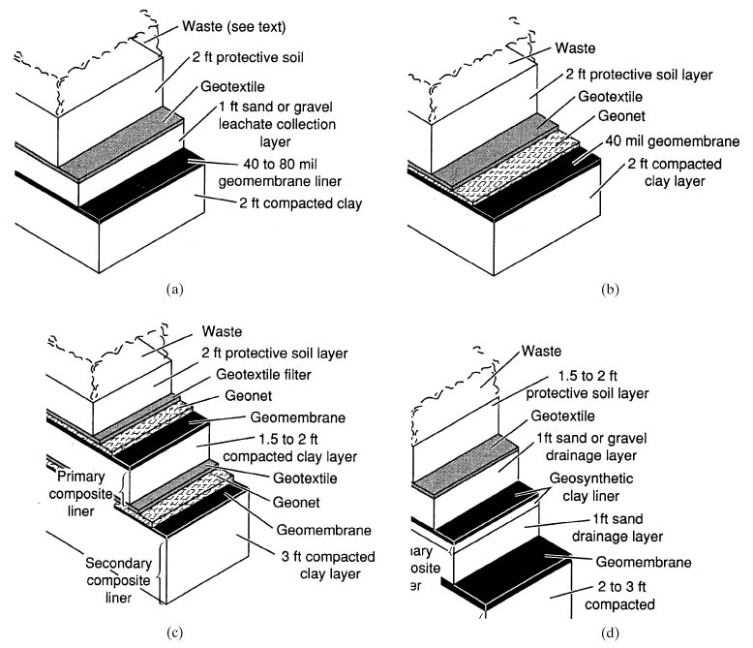
Leachate liners

Slide 44
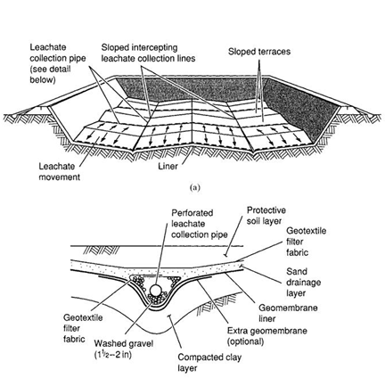
Typical leachate collection system

