Slide 1
Part I – Water Supply
CHAPTER 3
DEVELOPMENT OF WATER SUPPLY SYSTEM

Slide 2
OUTLINE
PRECONSTRUCTION PHASE
CONSTRUCTION PHASE
POSTCONSTRUCTION PHASE

Slide 3
POLICY/ GOVERNANCE
(Operating rules and regulations)
WATER
(SUPPLY)
POPULATION
(DEMAND)
WATER SUPPLY SYSTEM
SOCIO-ECONOMY
(DEMAND)
ENVIRONMENT
(Availability / Climate / Pollution)
SETTLEMENT
(Demand Centre)

Slide 4
Preconstruction Phase
In house assessment
Invitation to Bidders / NCB or ICB for Services
Procurement of Services
Existing System Assessment
Demand Determination
Gap Identification
Source Selection
Treatment Type
Main Transmission Lines
Distribution System
Financial Analysis/ Tariff
Institutional Setup
Tender Document
Funding Arrangement
Procurement

Slide 5
Construction Phase
Source Development / Groundwater or Surface water
Treatment Plant Installation
Main transmission lines / Laying
Distribution System implementation – Pipes / Reservoirs / Valves / Pumping Stations / Pump Installation
Civil / Electromechanical Works
System Testing
Contract Administration
  Client Perspective / Consultant / RE
  Contractors Perspective / Conventional / DB
  Supervision of works
  Interim Acceptance
  Temporary Acceptance
  Final Acceptance

Slide 6
Post-construction Phase
Asset Management
  Operation
  Maintenance
  Repair
  Rehabilitation
  Replacement
NRW/Leakage Control/ Tariff
Environmental Management
Proactive Planning for next design period
Phased Implementation / Expansion / Decommissioning

Slide 7
WATER TARIFF ISSUES

Slide 8
WATER ABSTRACTION CHARGES

Slide 9
WATER TARIFF TYPES / INTERNATIONAL EXPERIENCE

Slide 10
LOCAL EXPEREINCE - URBAN

Slide 11
WATER DEMAND

Slide 12
Typical procedure for estimating future water demand
1. Estimate the future population of the service area for the initial and
design years.
2. From the historical annual water usage data and population served, determine the average per capita daily water demand.
3. Plot annual average per capita demand versus the year.
4. Considering water-conservation efforts and other general trends in water demand, establish for the desired future years the annual
average per capita water demands.
5. Develop the ratio of maximum day (of the year) usage record and the
annual average day data developed in step 2.
6. Establish an appropriate maximum day to average day ratio for future projections.
7. From records taken during high-demand hours, establish the ratio of
peak hour to maximum day demand.
8. Determine the projected average day, maximum day, and peak hour
demands.

Slide 13
System Demand & Design Flow
Annual average day demand: This is the average of the total amount of water used each day during a 1-year period
Maximum day demand: This is the amount of water required during the day of maximum consumption in a year
Peak hour demand: This represents the amount of water required during the maximum consumption hour in a given day

Slide 14
Variations in Water Demand
Factors that affect water consumption
The climatic condition
Cost of water
Hygienic practice standards
Type of supply (continuous or intermittent)
Custom and habits of inhabitants
Pressure in pipe lines
Accessibility of water source
Population
Amount of water available
Percentage of area of garden and lawns
Financial position of population
Efficiency of management system
Type of industrial activities
Fire extinguishing service, etc.
Seasonal variation
Daily variation
Hourly variation

Slide 15
Water Use Variation
Rainy day
average

Slide 16
Real and Apparent Losses
Real loss: water lost from the distribution system through leaking pipes, joints, and fittings; leakage from reservoirs and tanks; reservoir overflows; and improperly open drains or system blow-offs.
Apparent loss: water that is not physically lost but does not generate revenue because of inaccuracies related to customer metering (under-recording customer meters), consumption data handling errors, or any form of theft or illegal use.
The volume of real losses occurring in developing countries alone is sufficient to supply approximately 200 million people!

Slide 17
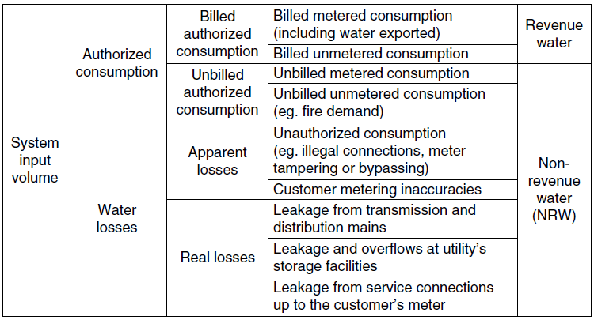
Water Losses

Slide 18
Causes of Real Losses (Leakage)
Poor installation and workmanship
Poor materials
Mishandling of materials prior to installation
Incorrect backfill
Pressure transients
Pressure fluctuations
Excess pressure
Corrosion
Vibration and traffic loading
Environmental conditions such as cold weather
Lack of proper scheduled maintenance

Slide 19
Location of Leakages & their severity
Transmission mains
Distribution mains
Service pipes
Service leaks often cause the largest volumes of real loss.
Pressure has a much greater impact on leakage. System design should take into account maximum pressure limits as well as minimum ones.

Slide 20
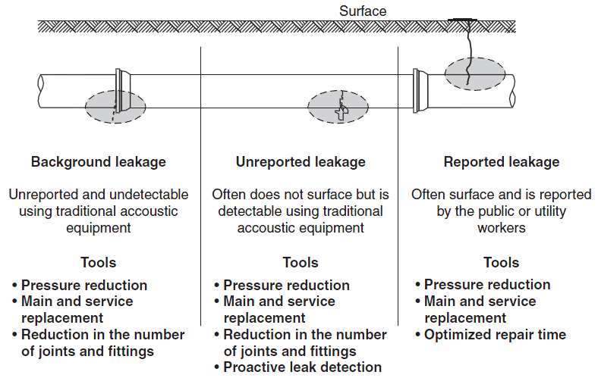
Components of Real Losses

Slide 21
Ways of Apparent Losses
Customer meter inaccuracies
Errors in water accounting
Unauthorized consumption
Apparent losses are a very important component for the water supplier to keep under control as they have a direct negative impact on suppliers’ revenue generation for a product that was delivered to the customer.

Slide 22
Global Water Loss Volumes Estimated by the World Bank
 | Real loss, BMC/year | Apparent loss, BMC/year | NRW, BMC/year
Developed countries | 9.8 | 2.4 | 12.2
Developing countries | 16.1 | 10.6 | 26.7
Ethiopia | ? | ? | ?
Estimated water loss in Addis Ababa (% of system input volume)
Real loss = 27%
Apparent loss = 12.5 %
NRW = 39.5 %

Slide 23
Water Balance (m³) for fiscal year 2010/11(AAWSA, 2012)

Slide 24
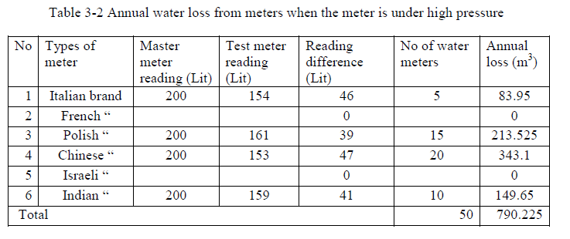
Kombolcha Town (Amhara/South Wollo)

Slide 25
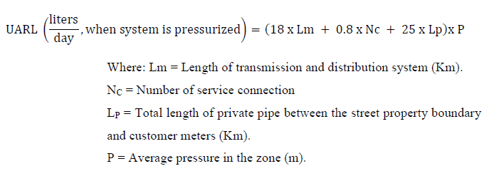


CARL = Current Amount of Real Losses

Slide 26
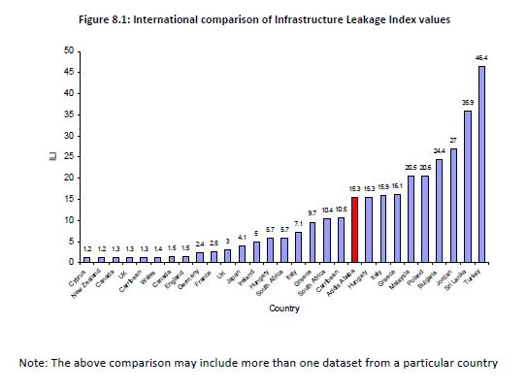

Slide 27
Assessment of Water Loss in Water Supply Networks
(A Case of Debre Markos Town)
/ Quantity Issue

Slide 28
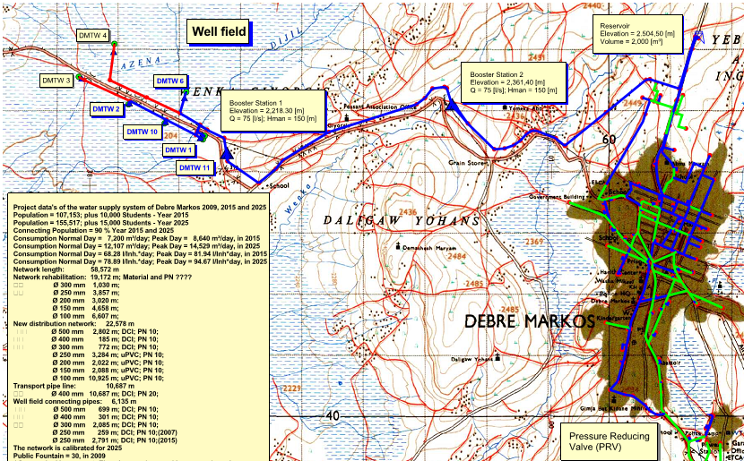

Slide 29
Introduction
Objective
Basic Information
Determine Amount/Cause of Water Loss in the distribution System
Methodology
  Secondary Dater Review
  Primary data collection/measurement
  Modeling /WATERCAD
Population – 90,000+
Water Supply Coverage – 67%
Visible Water Loss
Source: Groundwater
Treatment - Chlorination
Pumping to Service Reservoir and Gravity Distribution

Slide 30
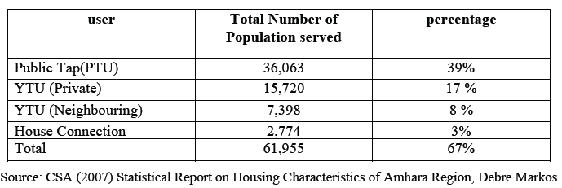
Water Supply by Category

Slide 31
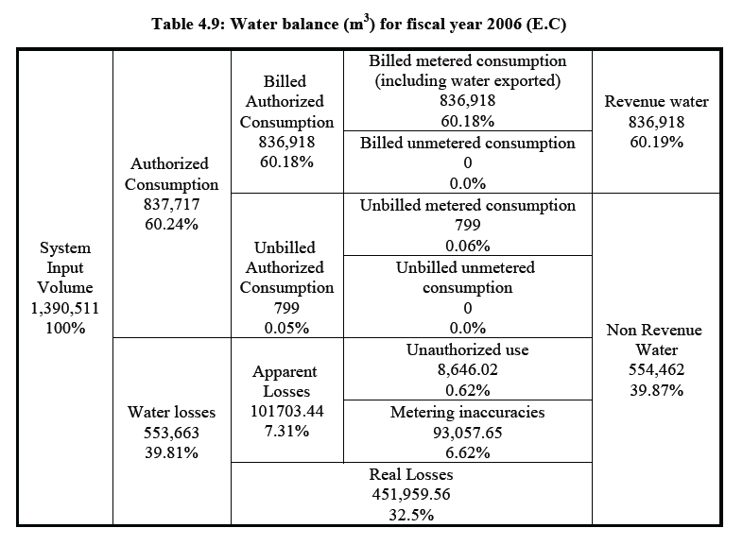

Slide 32
Pipe Age and Water Loss Per Km
Material type | Age Categories | Length (km) | Length (%)
UPVC | 10 year &less | 19.27 | 34.58
Cast iron | 10 year &less | 7.7 | 13.82
Galvanized steel pipe | 20-30 | 20.8 | 37.33
 | 30-40 | 5.36 | 9.62
 | 40 and more | 2.53 | 4.54
Cast iron | 30 and more | 0.06 | 0.11
Total |  | 55.72 | 100.00
Loss per length |  | 27.22m³/km/day

Slide 33
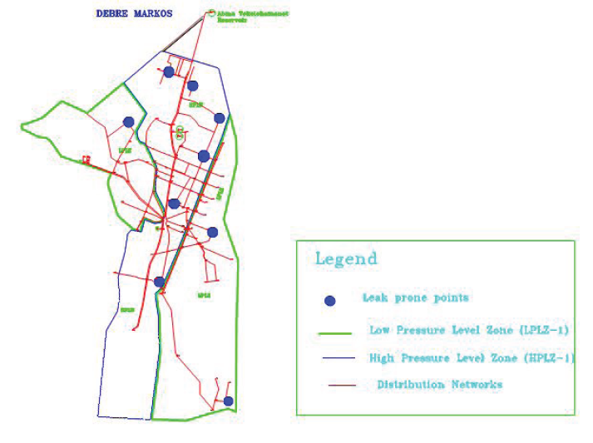
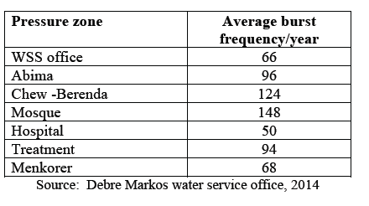

Slide 34
Interpretation of the condition of pipe material from pipe burst rates
Burst rate (number of bursts per km of water main per annum) | Significance
< 0.1 | Pipe material in excellent condition with 100% of useful life remaining
0.1<…<0.2 | Pipe material in excellent condition with 75% of useful life remaining
0.2<…<0.6 | Pipe material in excellent condition with 50% of useful life remaining: Replacement required within 10 to 30 years (depending on material)
0.6<…<1.0 | Pipe material in excellent condition with 25% of useful life remaining. Replacement within 10 years
…>1 | Unacceptable condition. Derelict. Pipe material has failed and its useful life has expired. Urgent replacement required.

Slide 37



UARL =154,030 m³/year
= 3.59
NRW = 553,663 m³/year

Slide 38
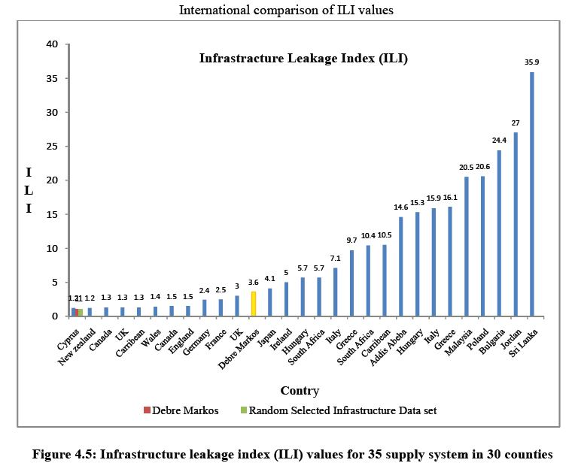

Slide 39

Cont...
Technical performance category | Rank | ILI | Physical Losses (Liters/connection/day) (When the system is pressured) at an average pressure of:
 |  |  | 10m | 20m | 30m | 40m | 50m
Developing Countries | A (Good) | 1-4 | <50 | <100 | <150 | <200 | <250
 | B (Potential for marked improvements) | 4-8 | 50-100 | 100-200 | 150-300 | 200-400 | 250-500
 | C (Poor) | 8-16 | 100-200 | 200-400 | 300-600 | 400-800 | 500-1000
 | D (Bad) | >16 | >200 | >400 | >600 | >800 | >1000
Table: Physical loss target matrix; World Bank Institute
(Source: Farley, et al., 2008)

