Slide 1
Finite Element Method Applications in Geotechnical Engineering
Tensay Gebremedhin (PhD, PE)
tensay@engineer.com
School of Civil & Environmental Engineering
Addis Ababa Institute of Technology
Addis Ababa University

Slide 2
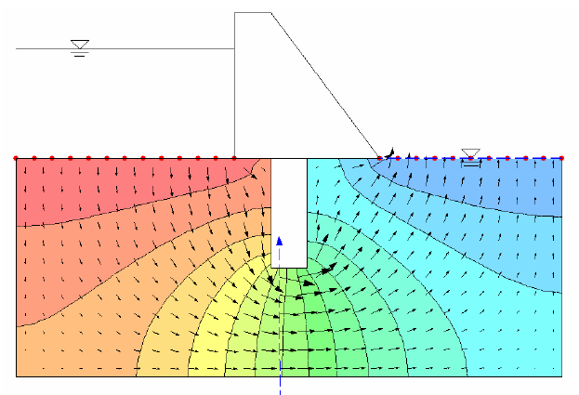
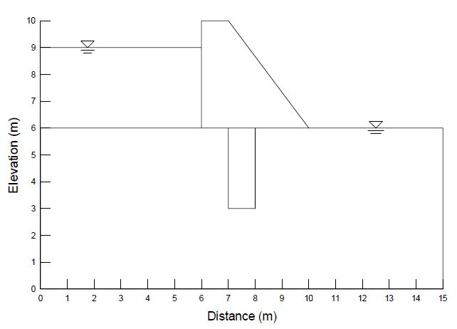
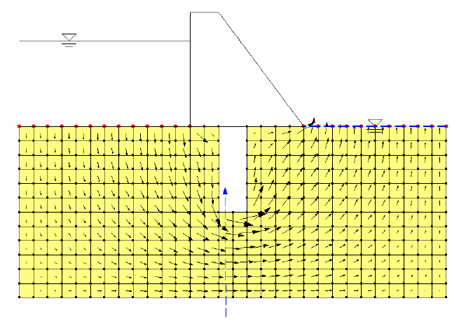
General of FE programs

Slide 3
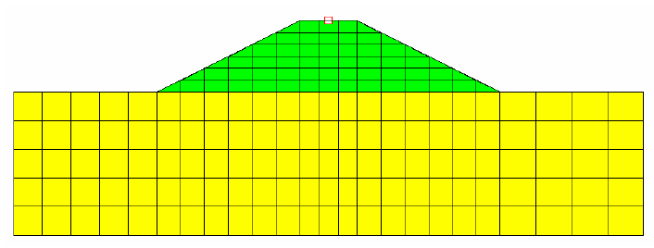
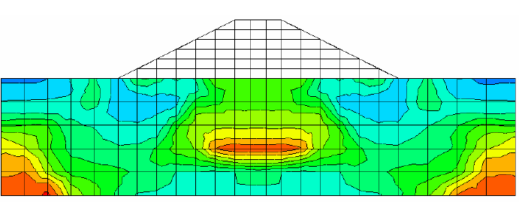
General Overview

Slide 4
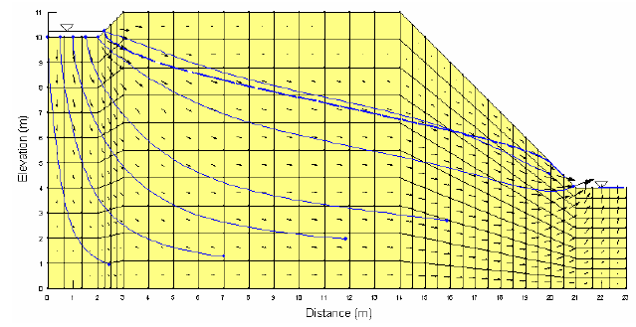
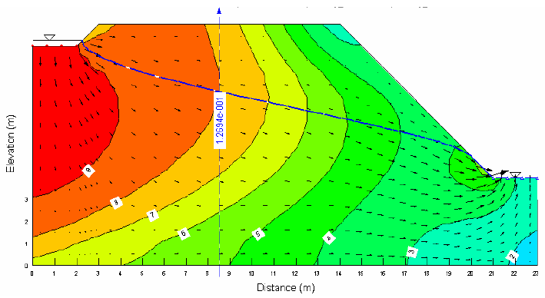
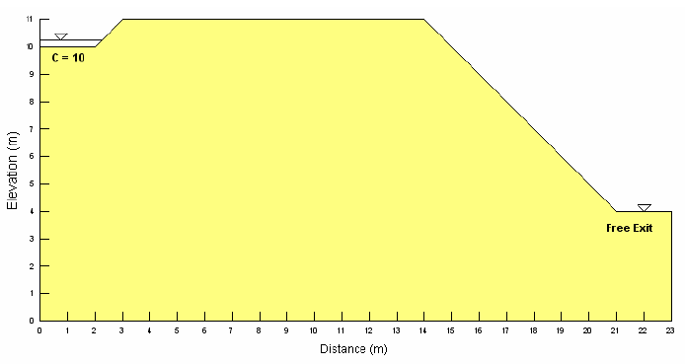
General Overview

Slide 5
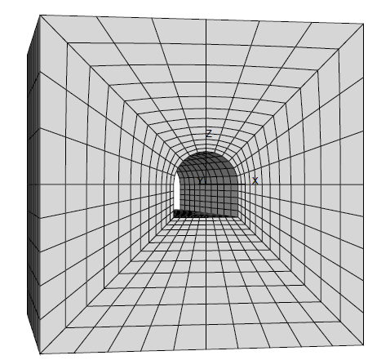
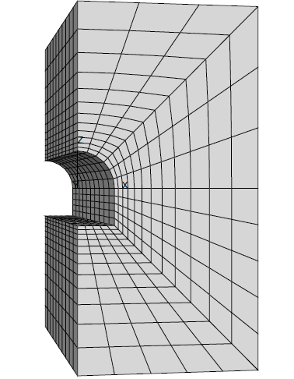
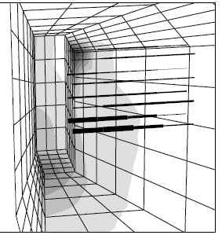
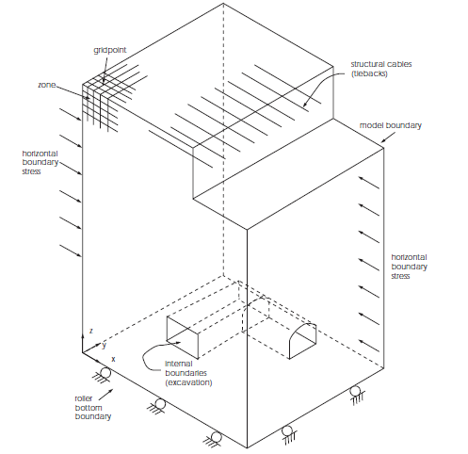
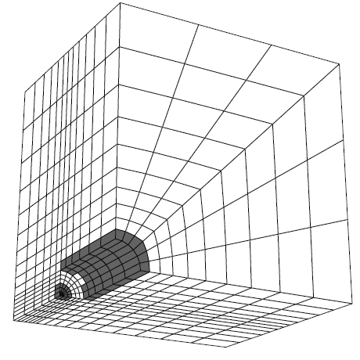
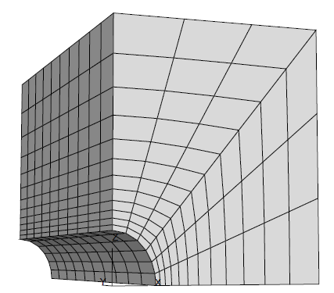
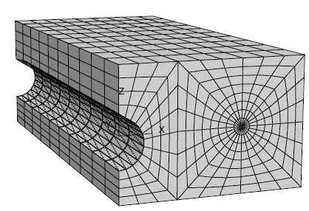
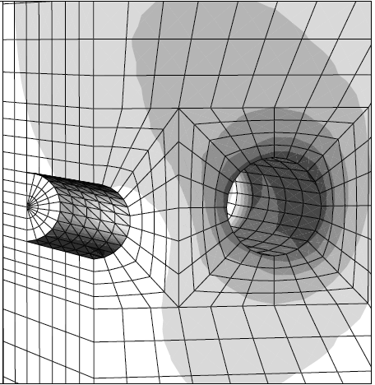
General Overview

Slide 6
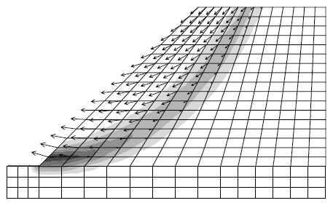
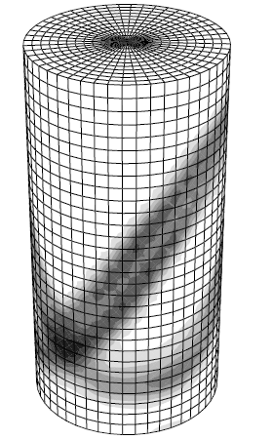
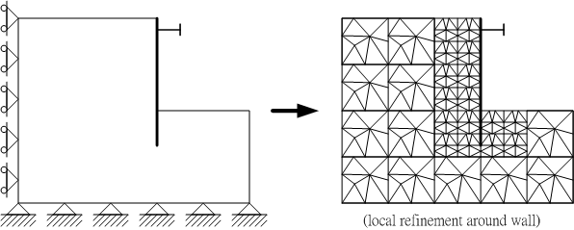

Slide 7
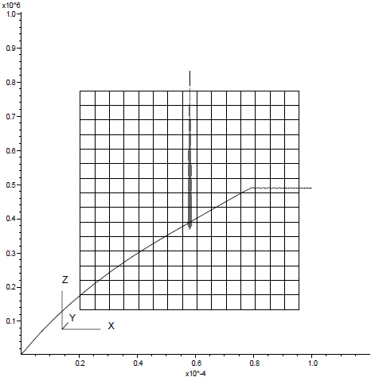
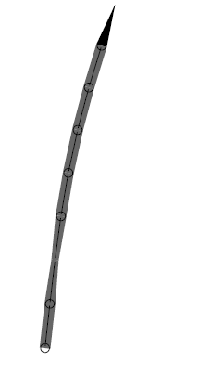
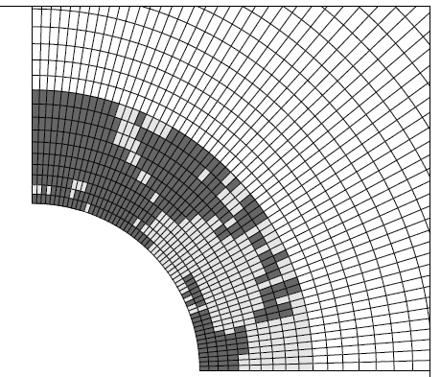
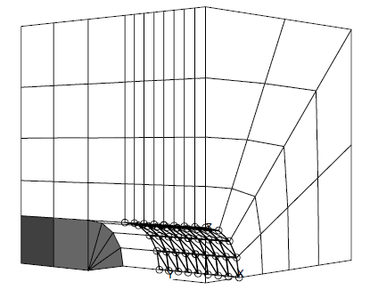
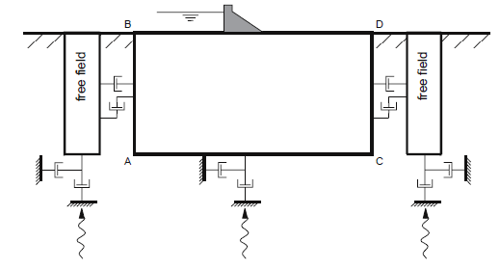

Slide 8
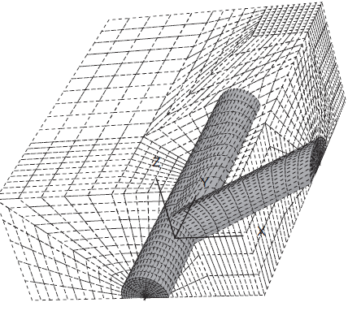
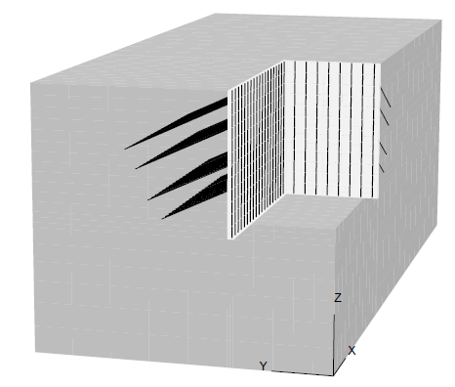
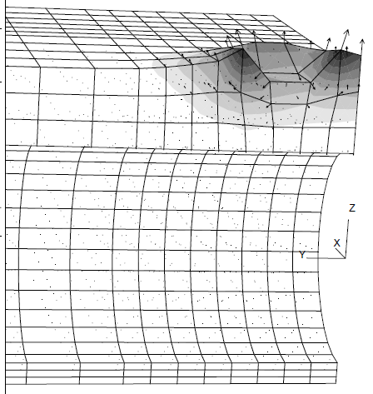
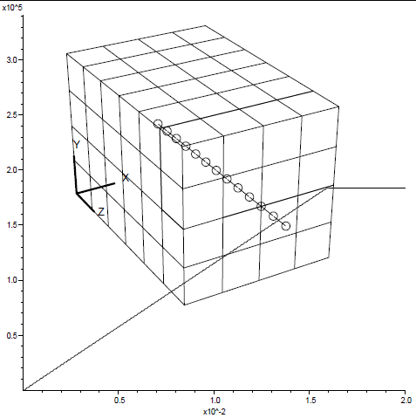
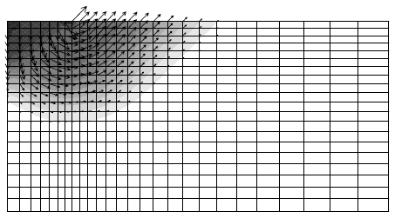

Slide 9
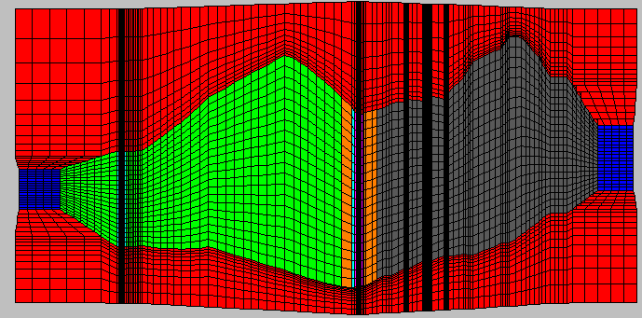
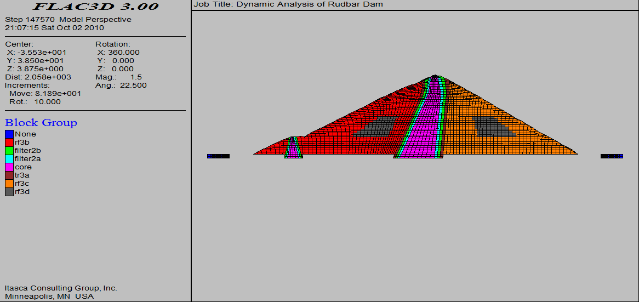
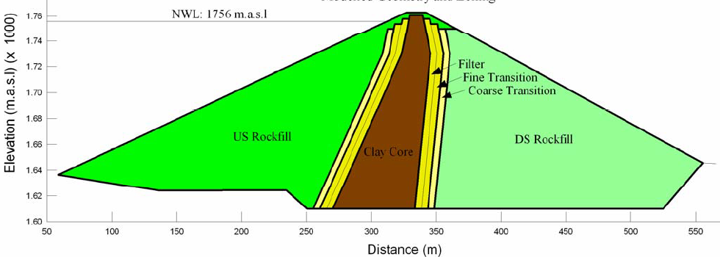
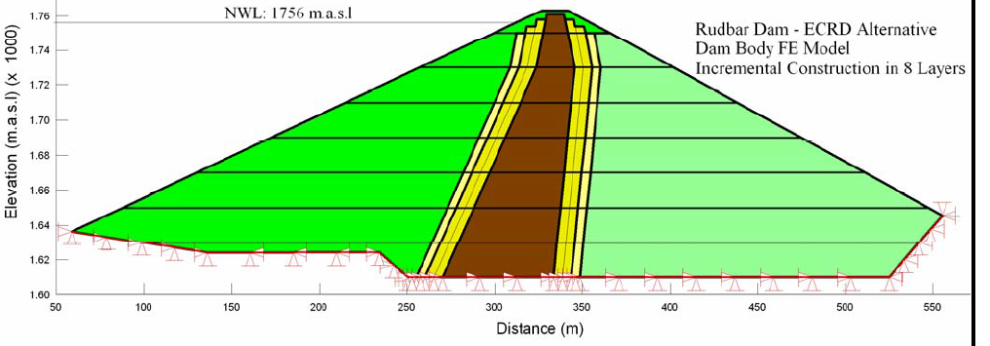
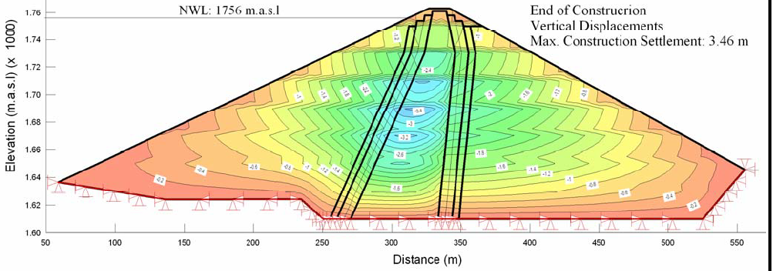

Slide 10
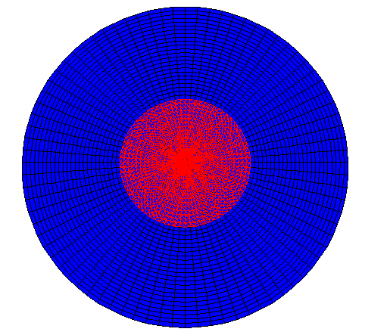

Slide 11
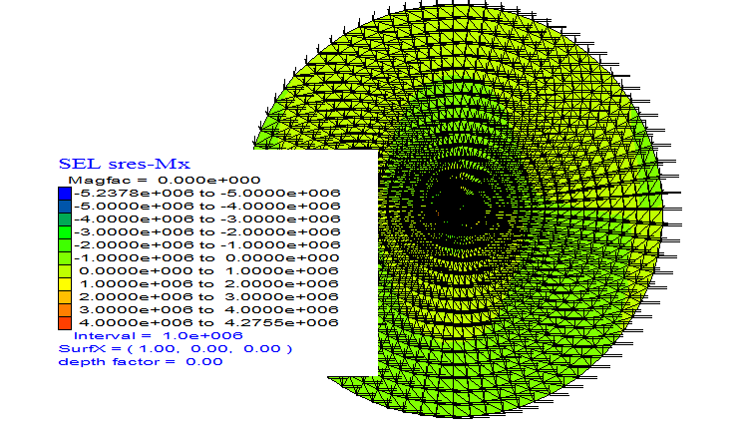
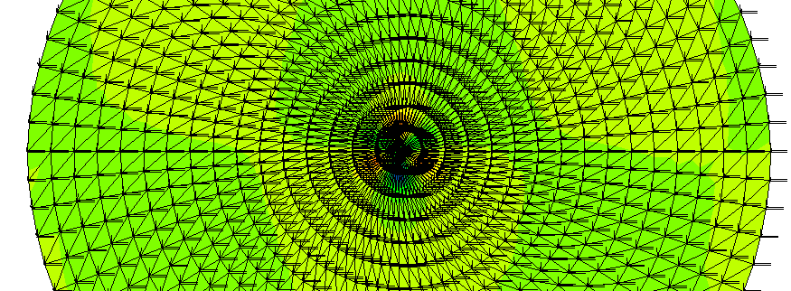

Slide 12
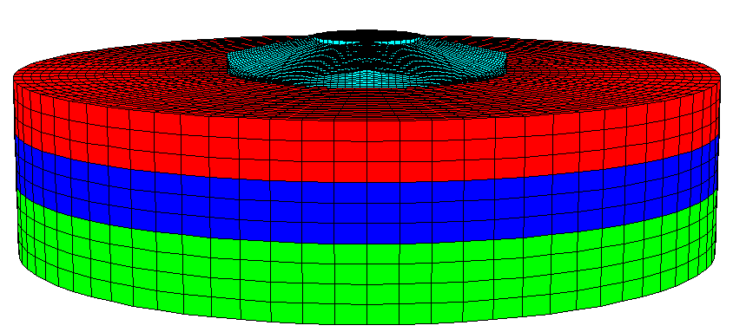

Slide 13
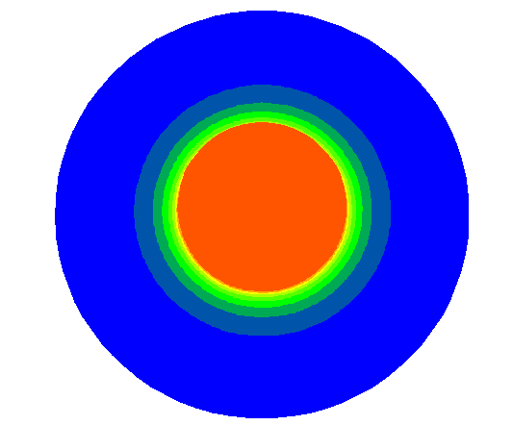
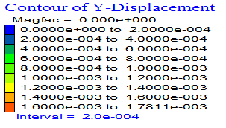

Slide 14
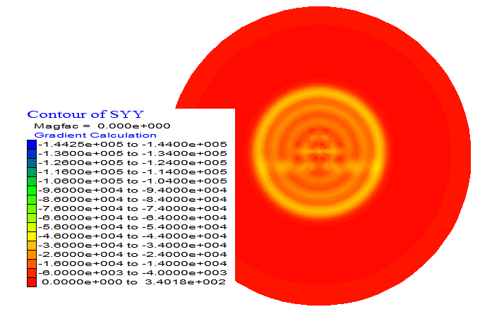

Slide 15
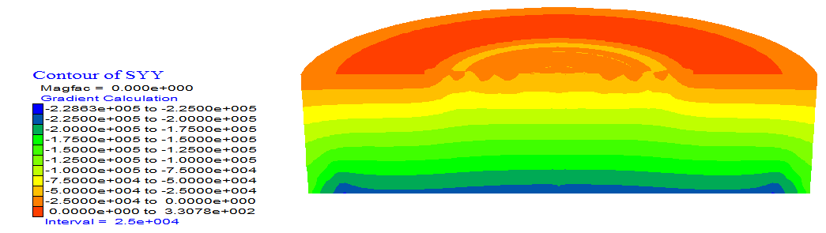

Slide 16
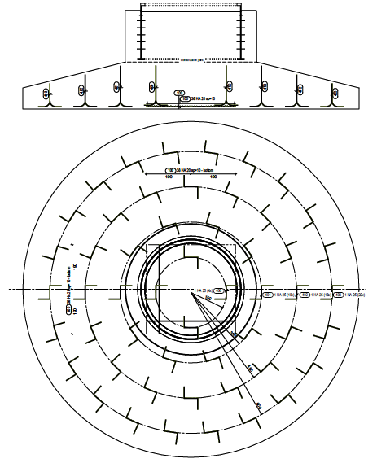
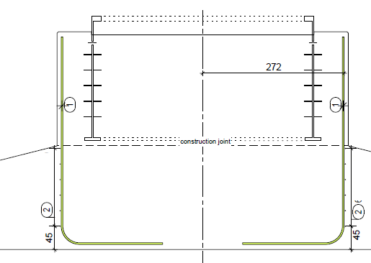

Slide 17
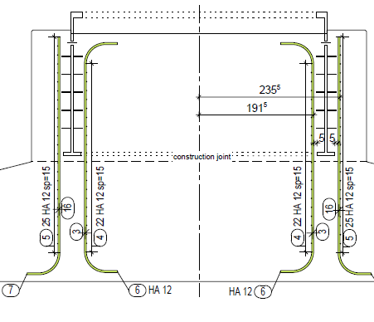
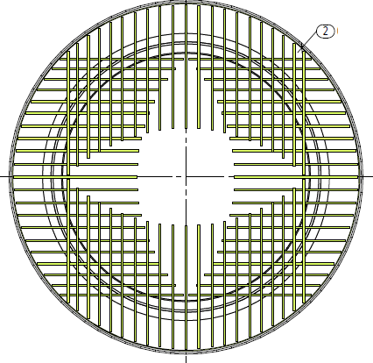
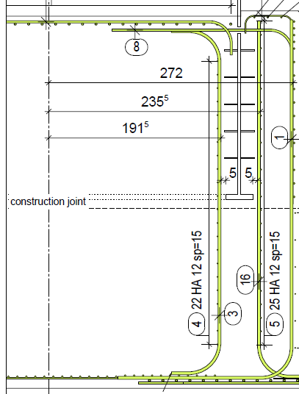
  II - WTG FOUNDATION DESIGN AND CONSTRUCTION

Slide 18
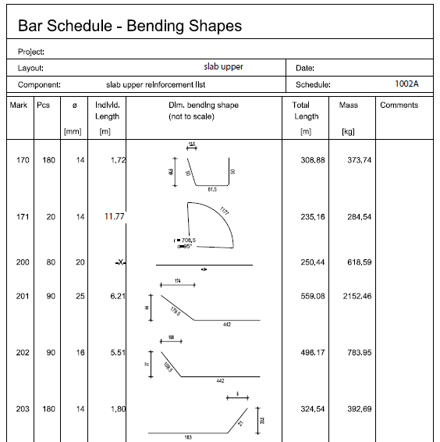

Slide 19
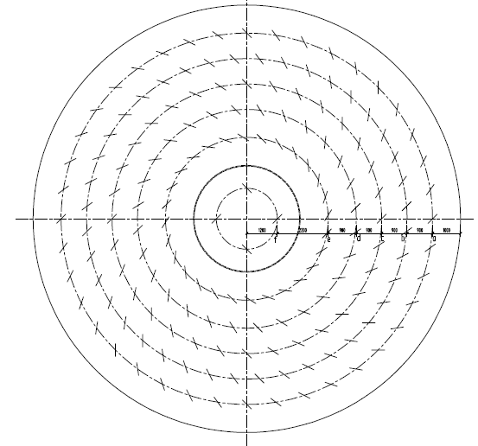


Slide 20
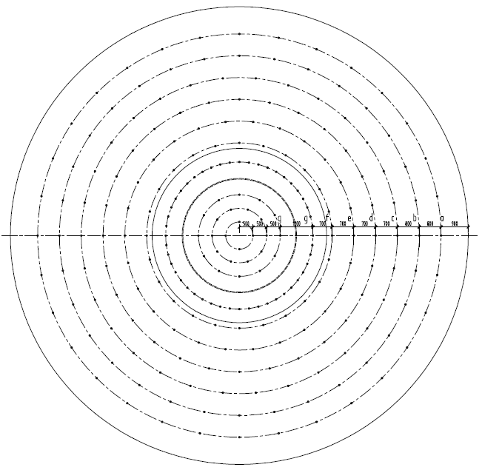


Slide 21


Slide 22

1. Mathematical Preliminaries and Tools
1.1 Review of Matrix Algebra

Slide 23

1.1 Review of Matrix Algebra ...

Slide 24

1.1 Review of Matrix Algebra ...

Slide 25

1.1 Review of Matrix Algebra ...

Slide 26


1.1 Review of Matrix Algebra ...

Slide 27


1.1 Review of Matrix Algebra ...

Slide 28

1.1 Review of Matrix Algebra ...

Slide 29

1.1 Review of Matrix Algebra ...

Slide 30

1.1 Review of Matrix Algebra ...

Slide 31


1.1 Review of Matrix Algebra ...

Slide 32

1.2 Solution Methods
Refer to your Numerical Methods course (Undergraduate)

Slide 33
1.3 Introduction to MATLAB
MATLAB: an interactive, matrix-based system for scientific and engineering numeric computation and visualization.
You can solve complex numerical problems …
MATrix LABoratory.
Accessing MATLAB.
Command matlab
Quit or Exit.
Entering matrices.
MATLAB works with essentially only one kind of object-a rectangular numerical matrix with possibly complex entries
Variables represent matrices.
Variables represent vectors.

Slide 34
1.3 Introduction to MATLAB ... Cont‘d
Matrices introduction into MATLAB:
  An explicit list of elements,
  Built-in statements and functions,
  Loaded from external data files or applications
For example, either of the statements
A = [1 2 3; 4 5 6; 7 8 9]
and
A = [
1 2 3
4 5 6
7 8 9 ]
Separated by commas and/ or a blank.
2.34e-9), blank spaces

Slide 35
1.3 Introduction to MATLAB ...Cont‘d
MATLAB … complex numbers in all its operations and functions.
B = [1+5i 2+6i;3+7i 4+8i]
2+6i in a matrix, blank spaces must be avoided.
Imaginary units i or j.
ii = sqrt(-1)
Matrices can also be generated with a For- loop
Individual matrix and vector entries can be referenced with indices inside parentheses in the usual manner.
… Try it
… accept positive integers as indices.

Slide 36
1.3 Introduction to MATLAB ...Cont‘d
Matrix and Array operations
The following matrix operations are available in MATLAB:
    + addition
    - subtraction
    * multiplication
    ^ power
    ‘ conjugate transpose
    \ left division
    / right division
These matrix operations apply, of course, to scalars (1-by-1 matrices) as well.
Compatibility of the sizes of the matrices …
Except in the case of scalar-matrix operations …

Slide 37
1.3 Introduction to MATLAB ... Cont‘d
The “matrix division" operations deserve special comment.
If A is an invertible square matrix and b is a compatible column, resp. row, vector, then:
x = A/b is the solution of A*x = b &
x = b\A is the solution of x * A = b.
Array operations.
The matrix operations of addition and subtraction already operate entry-wise but the other matrix operations given above do not-they are matrix operations.
It is important to observe that the other operations, *, ^, /, and \, can be made to operate entry-wise by preceding them by a period.
For example, either [1,2,3,4].*[1,2,3,4] or [1,2,3,4].^ 2 will yield [1,4,9,16]. Try it.

Slide 38
1.3 Introduction to MATLAB ... Cont‘d
Statements, expressions, and variables, saving a session.
MATLAB is an expression language;
MATLAB statements are usually of the form:
variable = expression, or simply
expression %% Expressions are usually composed from operators,
functions, and variable names.
Evaluation of the expression produces a matrix…
If the variable name and = sign are omitted, …
Separation by commas or semicolons.
If the last character of a statement is a semicolon, then…
This is essential in suppressing unwanted printing of intermediate results.

Slide 39
1.3 Introduction to MATLAB ... Cont‘d
MATLAB is case-sensitive in the names of commands, functions, and variables.
The command who (or whos)
The command clear/or clear variable name..
But not applicable to the permanent variable like eps - gives the machine unit round-off about 10E-16 on most machines.
CTRL-C (CTRL-BREAK on a PC).
Saving a session.
When one logs out or exits MATLAB all variables are lost. However, invoking the command save before exiting causes all variables to be written to a non-human-readable disk file named matlab.mat.

Slide 40
1.3 Introduction to MATLAB ... Cont‘d
Matrix Building Functions.
Some important convenient matrix building functions are:
  eye - identity matrix
  zeros - matrix of zeros
  eig – eigenvlaues of a matrix
  [C,D]=eig(A)-
  ones - matrix of ones
  diag - create or extract diagonals
  triu - upper triangular part of a matrix
  tril - lower triangular part of a matrix

Slide 41
1.3 Introduction to MATLAB .. Cont‘d
For example, zeros(m,n) produces an m-by-n matrix of zeros
zeros(n) produces an n-by-n one.
If A is a matrix, then zeros(size(A)) produces a matrix of zeros having the same size as A.
If x is a vector, diag(x) is the diagonal matrix with x down the diagonal
If A is a square matrix, then diag(A) is a vector consisting of the diagonal of A. What is diag(diag(A))? Try it.

Slide 42
1.3 Introduction to MATLAB ... Cont‘d
Matrices can be built from blocks.
For example, if A is a 3-by-3 matrix, then B = [A, zeros(3,2); zeros(2,3), eye(2)] will build a certain 5-by-5 matrix. Try it.
For, while, if - and relations.
In their basic forms, these MATLAB flow control statements operate like those in most computer languages.

Slide 43
1.3 Introduction to MATLAB ... Cont‘d
For
For example, for a given n, the statement
x = [ ]; for i = 1:n, x=[x,i^2], end
Or
x = [ ];
for i = 1:n
x = [x,i^2]
end
will produce a certain n-vector & the statement
x = [ ]; for i = n:-1:1, x=[x,i^2], end
will produce the same vector in reverse order. Try them.
Note that a matrix may be empty (such as x = [ ]).

Slide 44
1.3 Introduction to MATLAB ... Cont‘d
The statements
    for i = 1:m
    for j = 1:n
    H(i, j) = 1/(i+j-1);
    end
    end
    H
Interpretation
    s = 0;
    for d = A
    s = s + sum(d);
    end
computes the sum of all entries of the matrix A by adding its column sums (Of course, sum(sum(A)) does it more efficiently.

Slide 45
1.3 Introduction to MATLAB ... Cont‘d
While.
The general form of a while loop is
  while relation
  statements
  end
The statements will be repeatedly executed as long as the relation remains true.
Eg- the following will compute and display the smallest non-negative integer n such that
2^{n} >= a:
  n = 0;
  while 2^n < a
  n = n + 1;
  end
  n

Slide 46
1.3 Introduction to MATLAB ... Cont‘d
If
The general form of a simple if statement is
  if relation
  statements
  end
The statements will be executed only if the relation is true. Multiple branching is also possible, as is illustrated by
  if n < 0
  Value = 0;
  elseif rem(n,2) == 0
  Value = 2;
  else
  Value = 1;
  end
In two-way branching the elseif portion would, of course, be omitted.

Slide 47
1.3 Introduction to MATLAB ... Cont‘d
Relations.
The relational operators in MATLAB are
  < less than
  > greater than
  <= less than or equal
  >= greater than or equal
  == equal
  ~= not equal.
Note that ‘’=" is used in an assignment statement while ‘’==" is used in a relation.
Relations may be connected or quantified by the logical operators
  & and
  | or
  ~ not.

Slide 48
1.3 Introduction to MATLAB ... Cont‘d
Scalar functions.
Certain MATLAB functions operate essentially on scalars, but operate element-wise when applied to a matrix.
The most common such functions are:
  sin asin exp abs round
  cos acos log (natural log) sqrt floor
  tan atan rem (remainder) sign ceil
Vector functions.
A few of these functions are:
  max sum median any
  Min prod mean all
  sort std

Slide 49
1.3 Introduction to MATLAB ... Cont‘d
Matrix functions.
Much of MATLAB's power comes from its matrix functions. The most useful ones are:
  eig eigenvalues and eigenvectors
  chol cholesky factorization
  inv inverse
  lu LU factorization
  expm matrix exponential
  sqrtm matrix square root
  poly characteristic polynomial
  det determinant
  size size
  rank rank

Slide 50
1.3 Introduction to MATLAB ... Cont‘d
MATLAB functions may have single or multiple output arguments. For example,
y = eig(A), or simply eig(A)
produces a column vector containing the eigenvalues of A while
[U,D] = eig(A)
produces a matrix U whose columns are the eigenvectors of A and a diagonal matrix D with the eigenvalues of A on its diagonal. Try it.
Submatrices and colon notation.
Vectors and submatrices are often used in MATLAB to achieve fairly complex data manipulation effects.
Colon notation:
used both to generate vectors and reference submatrices. Creative use of these features to vectorize operations permits one to minimize the use of loops (which slows MATLAB) and to make code simple and readable.
The expression 1:5 (met earlier in for statements) is actually the row vector [1 2 3 4 5].

Slide 51
1.3 Introduction to MATLAB ... Cont‘d
The numbers need not be integers nor the increment one.
For example, 0.2:0.2:1.2 gives [0.2, 0.4, 0.6, 0.8, 1.0, 1.2], & 5:-1:1 gives [5 4 3 2 1].
Eg- x = [0.0:0.1:2.0]’;
      y = sin(x);
      [x y]
The colon notation can be used to access submatrices of a matrix. Eg- A(1:4,3) is the column vector consisting of the first four entries of the third column of A.
A colon by itself denotes an entire row or column:
A(:,3) is the third column of A, and A(1:4,:) is the first four rows.
Arbitrary integral vectors can be used as subscripts:
A(:,[2 4]) contains as columns, columns 2 and 4 of A.
Such subscripting can be used on both sides of an assignment statement:
A(:,[2 4 5]) = B(:,1:3) replaces columns 2,4,5 of A with the first three columns of B.

Slide 52
1.3 Introduction to MATLAB ... Cont‘d
M-files.
MATLAB can execute a sequence of statements stored in diskfiles.
Such files are called M-files" because they must have the file type of .m as the last part of their filename.
Much of your work with MATLAB will be in creating and refining M-files. M-files are usually created using your local editor.
There are two types of M-files: script files and function files.

Slide 53
1.3 Introduction to MATLAB ... Cont‘d
Graphics.
MATLAB can produce planar plots of curves, 3-D plots of curves & 3-D mesh, surface plots.
The primary commands for these facilities are plot , plot3, mesh, and surf resp.
Planar plots:#,
The plot command creates linear x-y plots; if x and y are vectors of the same length, the command plot(x,y) opens a graphics window and draws an x-y plot of the elements of x versus the elements of y.
One can draw the graph of the sine function over the interval -4 to 4 with the following commands:
x = -4:.01:4; y = sin(x); plot(x,y) Try it.
The vector x is a partition of the domain with meshsize 0.01 while y is a vector giving the values of sine at the nodes of this partition.
You will usually want to keep the current graphics window (figure) exposed- but moved to the side- and the command window active.

Slide 54
1.3 Introduction to MATLAB ... Cont‘d
Linetypes: solid (-), dashed (--). dotted (:), dashdot (-.)
Marktypes: point (.), plus (+), star (*), circle (o), x-mark (x)
Colors can be specified for the line- and mark-types.
Colors: yellow (y), magenta (m), cyan (c), red (r), green (g), blue (b), white (w), black (k)
For example:
x = -1.5:.01:1.5; y = exp(-x.^2); plot(x,y, 'r--')

Slide 55
2. Finite Element Discretization and the Direct Stiffness Method
  2.1 General Overview
  2.2 The Direct Stiffness Method
  2.3 Finite Element Method Modeling

Slide 56

  2.1 General Overview
What is Mechanics?
  2.1.1 Computational Mechanics

Slide 57

  2.1.1 Computational Mechanics… Cont’d

Slide 58


  2.1.1 Computational Mechanics… Cont’d

Slide 59


  2.1.1 Computational Mechanics… Cont’d

Slide 60

  Finite Element Method Variants
  2.2 FINITE ELEMENT METHOD
Introduction to Finite Element Method

Slide 61

  2.2 FINITE ELEMENT METHOD … Cont’d

Slide 62

  2.2 FINITE ELEMENT METHOD … Cont’d

Slide 63

  The Finite Element Analysis Process

Slide 64

  The Finite Element Analysis Process … Cont’d

Slide 65

  The Finite Element Analysis Process … Cont’d

Slide 66

  The Finite Element Analysis Process … Cont’d

Slide 67

  The Finite Element Analysis Process … Cont’d

Slide 68

  Interpretations of Finite Element Method

Slide 69

2.2 The Direct Stiffness Method

Slide 70

2.2 The Direct Stiffness Method …Cont’d
Model Based Simulation

Slide 71

2.2 The Direct Stiffness Method …Cont’d

Slide 72

2.2 The Direct Stiffness Method …Cont’d

Slide 73


2.2 The Direct Stiffness Method …Cont’d

Slide 74

2.2 The Direct Stiffness Method …Cont’d

Slide 75

2.2 The Direct Stiffness Method …Cont’d

Slide 76

2.2 The Direct Stiffness Method …Cont’d

Slide 77

2.2 The Direct Stiffness Method …Cont’d

Slide 78

2.2 The Direct Stiffness Method …Cont’d

Slide 79

2.2 The Direct Stiffness Method …Cont’d

Slide 80

2.2 The Direct Stiffness Method …Cont’d

Slide 81

2.2 The Direct Stiffness Method …Cont’d

Slide 82

2.2 The Direct Stiffness Method …Cont’d

Slide 83

2.2 The Direct Stiffness Method …Cont’d

Slide 84

2.2 The Direct Stiffness Method …Cont’d

Slide 85

2.2 The Direct Stiffness Method …Cont’d
The numerical solution of which can be worked out using the MatLab tool.
Please try it!

Slide 86

2.3 Finite Element Method Modeling
2.3.1 FEM Terminology
Degrees of Freedom (DoF)
Variables - State or primary/conjugate
  Displacements
  Forces
Stiffness Matrix
Master Stiffness Equations

Slide 87

2.3 Finite Element Method Modeling … Cont’d

Slide 88

2.3 Finite Element Method Modeling … Cont’d

Slide 89

2.3 Finite Element Method Modeling … Cont’d

Slide 90

2.3 Finite Element Method Modeling … Cont’d

Slide 91

2.3 Finite Element Method Modeling … Cont’d

Slide 92
2.3 Finite Element Method Modeling … Cont’d
Finite Element Attributes
Dimensionality
Nodes serve two purposes:
  Geometric definition
  Home for DoFs - connectors
Degrees of freedom (DOFs) or "freedoms“
Conjugate node forces
Material properties
Fabrication properties

Slide 93

2.3 Finite Element Method Modeling … Cont’d

Slide 94
2.3 Finite Element Method Modeling … Cont’d
Classification of Mechanical Finite Elements
Primitive Structural Elements
Continuum Elements
Special Elements
Macro-elements
Substructures

Slide 95

2.3 Finite Element Method Modeling … Cont’d

Slide 96

2.3 Finite Element Method Modeling … Cont’d

Slide 97

2.3 Finite Element Method Modeling … Cont’d

Slide 98

2.3 Finite Element Method Modeling … Cont’d

Slide 99

2.3 Finite Element Method Modeling … Cont’d

Slide 100

2.3 Finite Element Method Modeling … Cont’d

Slide 101
3. Formulation of Finite Element and Finite Element Modeling Tips
  1-D Finite Elements
  2-D Finite Elements
  3-D Finite Elements
  Isoparametric Element Representation
  Variational Formulation of 1-D Bar Element
  Finite Element Modeling Tips

Slide 102


General
Types of Finite Elements
  2.2 1D Finite element

Slide 103

  1-D Finite Element
Spring Element

Slide 104

  1-D Finite Element … Cont’d

Slide 105


  1-D Finite Element … Cont’d

Slide 106

  1-D Finite Element … Cont’d

Slide 107

  1-D Finite Element … Cont’d

Slide 108

  1-D Finite Element … Cont’d

Slide 109

  1-D Finite Element … Cont’d

Slide 110

  1-D Finite Element … Cont’d

Slide 111


  1-D Finite Element … Cont’d

Slide 112

  1-D Finite Element … Cont’d

Slide 113

  1-D Finite Element … Cont’d

Slide 114

  1-D Finite Element … Cont’d

Slide 115


  1-D Finite Element … Cont’d

Slide 116


  1-D Finite Element … Cont’d

Slide 117

  1-D Finite Element … Cont’d

Slide 118

  1-D Finite Element … Cont’d

Slide 119

  1-D Finite Element … Cont’d

Slide 120

  1-D Finite Element … Cont’d

Slide 121
  1-D Finite Element … Cont’d
Steps to be followed:
Step-1: Delinating and discretizing the domain
Step-2: Writing the ESM
Step-3: Assembling the ESM to get the GSM
Step-4: Applying the BCs
Step-5: Solving the Eqns
Step-6: Post processing

Slide 122


  Bar and Beam Element

Slide 123




Slide 124



Slide 125



Slide 126



Slide 127


Slide 128


Slide 129


Slide 130



Slide 131


Slide 132



Slide 133





Slide 134



Slide 135


Exercise:
Check your solution obtained above if the load P is reduced by half

Slide 136


  2D Finite Element

Slide 137

  2-D Finite Element … Cont’d

Slide 138

  2-D Finite Element … Cont’d

Slide 139

  2-D Finite Element … Cont’d

Slide 140

  2-D Finite Element … Cont’d

Slide 141

  2-D Finite Element … Cont’d

Slide 142

  2-D Finite Element … Cont’d

Slide 143


  2-D Finite Element … Cont’d

Slide 144

  2-D Finite Element … Cont’d

Slide 145


  2-D Finite Element … Cont’d

Slide 146

  2-D Finite Element … Cont’d
What if, there is a hole inside?

Slide 147


  2-D Finite Element … Cont’d

Slide 148

  2-D Finite Element … Cont’d

Slide 149

  2-D Finite Element … Cont’d

Slide 150

  2-D Finite Element … Cont’d

Slide 151

  2-D Finite Element … Cont’d

Slide 152


  2-D Finite Element … Cont’d

Slide 153


  2-D Finite Element … Cont’d

Slide 154


  2-D Finite Element … Cont’d

Slide 155

  2-D Finite Element … Cont’d

Slide 156


  2-D Finite Element … Cont’d
Natural Coordinate

Slide 157

  2-D Finite Element … Cont’d

Slide 158

  2-D Finite Element … Cont’d

Slide 159

  2-D Finite Element … Cont’d

Slide 160

  2-D Finite Element … Cont’d

Slide 161

  2-D Finite Element … Cont’d

Slide 162

  2-D Finite Element … Cont’d

Slide 163

  2-D Finite Element … Cont’d

Slide 164

  2-D Finite Element … Cont’d

Slide 165


  2-D Finite Element … Cont’d

Slide 166

  2-D Finite Element … Cont’d

Slide 167




Slide 168



Slide 169


Slide 170


  The Isoparametric Element Representation

Slide 171

  The Isoparametric Element Representation

Slide 172

  The Isoparametric Element Representation

Slide 173

  The Isoparametric Element Representation

Slide 174

  The Isoparametric Element Representation

Slide 175

  The Isoparametric Element Representation

Slide 176

  The Isoparametric Element Representation

Slide 177

  The Isoparametric Element Representation

Slide 178

  The Isoparametric Element Representation

Slide 179

  The Isoparametric Element Representation

Slide 180

  The Isoparametric Element Representation

Slide 181

  The Isoparametric Element Representation

Slide 182

  The Isoparametric Element Representation

Slide 183

  The Isoparametric Element Representation

Slide 184

  Example:
Step-1: Delinate and discretize the domain
Step-2: Develop ESM

Slide 185


Slide 186

Step-3: Assembling the ESM to get the GSM
The problem has 4 nodes and hence 8 dof (8x8 matrix)

Slide 187


Slide 188



Step-4: Apply BC (Refer to paper)
Step-5: Solve (thru partitioning)

Slide 189





Step-6: Post-processing

Slide 190



Slide 191

Principal stresses and angle

Slide 192


Slide 193


Slide 194

Bilinear Quadrilateral Element

Slide 195


Slide 196


Slide 197


Slide 198


Slide 199


Slide 200


Slide 201


3-D (solid) Finite Element – Linear Tetrahedral Element

Slide 202


Slide 203


Slide 204


Slide 205


Slide 206



Slide 207

3.4 Variational Formulations
For details of the variational concepts refer to Theory of elasticity in Geotechnical Engineering lecture.
For illustration, we use the bar element as shown below

Slide 208

3.4 Variational Formulations

Slide 209

3.4 Variational Formulations

Slide 210

3.4 Variational Formulations

Slide 211

3.4 Variational Formulations

Slide 212



3.4 Variational Formulations

Slide 213

3.4 Variational Formulations

Slide 214

3.4 Variational Formulations

Slide 215

3.4 Variational Formulations

Slide 216

3.4 Variational Formulations

Slide 217

3.4 Variational Formulations

Slide 218
3.5 FE Modeling
3.5.1 Introduction:
Finite element numerical methods are based on the concept of subdividing a continuum into small pieces.
They describe the behavior or actions of the individual pieces and then reconnecting all the pieces to represent the behavior of the continuum as a whole.
This process of subdividing the continuum into smaller pieces is known as discretization or meshing.
The pieces are called finite elements

Slide 219
3.5 FE Modeling...
3.5.2 Meshing:
Discretization or meshing is one of the three fundamental aspects of FE modeling.
The other two are defining material properties and boundary conditions.
Diescretization involves defining geometr, distance, area, and volume.
It is the component that deals with the physical dimensions of the domain.

Slide 220
3.5 FE Modeling...
General FEM Modeling Rules:
Use the simplest elements that will do the job
Never, never, never use complicated or special elements unless you are absolutely sure of what you are doing
Use the coarsest mesh that will capture the dominant behavior of the physical model, particularly in design situations
3 word summary: Keep It Simple!

Slide 221
3.5 FE Modeling...
Mesh Refinement:
Use a relatively fine (coarse) discretization in regions where you expect a high (low) gradient of strains and/or stresses.
Regions to watch out for high gradients are:
  Near entrant corners, or sharply curved edges.
  In the vicinity of concentrated (point) loads, concentrated reactions, cracks and cutouts.
  In the interior of structures with abrupt changes in thickness, material properties or cross sectional areas.

Slide 222

3.5 FE Modeling...
Where Finer Meshes Should be Used:

Slide 223


3.5 FE Modeling...
Where Finer Meshes Should be Used:

Slide 224


3.5 FE Modeling...
Field Variable Distribution
In FE formulation, it is necessary to adopt a model describing the distribution of the primary variable within the element.
This could be linear or curved

Slide 225

3.5 FE Modeling...
Element and mesh compatibility
Elements must have common nodes in order to be considered connected, and the distibution of the primary unnown along an element edge must be the same for an edge common to two elements.

Slide 226


3.5 FE Modeling...
Mesh compatibility

Slide 227

3.5 FE Modeling...
Elements Must Not Cross Interfaces

Slide 228


3.5 FE Modeling...
Element Aspect Ratio (2D/3D):
Elongated or “skinny” elements
How small or large should this be??

Slide 229

3.5 FE Modeling...
Element Geometry Preferences:
Other things being equal, prefer
2D: Quadrilaterals over Triangles
3D: Bricks over Wedges
Wedges over Tetrahedra

Slide 230




3.5 FE Modeling...
Creating Mesh:
Automatic/ manual
Structured/unstructured
Interface

Slide 231

3.5 FE Modeling...
Direct Lumping of Distributed Loads
Distributed surface traction
Volume loads
Consistent load
Node by Node (NbN) Distributed Load Lumping

Slide 232

3.5 FE Modeling...
Element by Element (EbE) Distributed Load Lumping

Slide 233

3.5 FE Modeling...
EbE Shortcut for Linearly Varying Line Load
(Bypasses Centroid Calculation)

Slide 234
3.5 FE Modeling...
Boundary Conditions (BCs)
The most difficult topic for FEM program users
Two types
    Essential
    Natural
If a BC involves one or more DOF in a direct way, it is essential and goes to the Left Hand Side (LHS) of Ku = f
Otherwise it is natural and goes to the Right Hand Side (RHS) of Ku = f

Slide 235


3.5 FE Modeling...
Support Conditions

Slide 236
3.5 FE Modeling...
Symmetry and antisymmetry conditions
Engineers doing finite element analysis should be on the lookout for conditions of symmetry or antisymmetry.
Judicious use of these conditions allows only a portion of the problem to be analyzed, with a consequent saving in data preparation and computer processing time.
A symmetry line in two-dimensional motion can be recognized by remembering the “mirror” displacement pattern.
An antisymmetry line can be recognized by the displacement pattern.

Slide 237


3.5 FE Modeling...

Slide 238
4. Computer Implementation of the FEM
  This requires formulating the equations and then solving them using mathematical tool. For this either MatLab or Mathematica will be used.
  Implementation of One-, Two-, and Three- Dimensional Finite Elements
    Model Definition
    Element Level Calculation
    Assembling Process
    Creating the FEM Equations
    Solving the FEM Equations
    Stress and Strain Recovery

Slide 239
5 Application of FEM in Geotechniques using FE based software
One to two examples from each of the lists below will be solved using FE based software.
  Deformation Analysis
  Embankment/excavation construction
  Excess pore-water pressures
  Soil-structure interaction
  Seepage analysis
5.1 Deformation Analysis
  Foundations
  Embankments (road, dam)
  Slopes (Man-made & Natural)
  Excavations and tunnels

Slide 240



Stress Analysis
Constitutive Models
Linear Elastic

Slide 241


Anisostropic Linear Elastic
Constitutive matrix in local coordinate system

Slide 242



Anisostropic Linear Elastic
Constitutive matrix in global coor.

Slide 243

Anisostropic Linear Elastic

Slide 244








Nonlinear Elastic (Hyperbolic)
R_{f} is ratio of asympt value to
max shear strength value (0.75-1)

Slide 245




Nonlinear Elastic
Yield Criterion:
Duncan and Chang relationship:
Mohr‘s diagram:
Using above eqn:

Slide 246


Nonlinear Elastic
Parameter determination

Slide 247

Parameter determination for nonlinear elastic model

Slide 248









Elastic-plastic

Slide 249





Slide 250


Strain-softening

Slide 251








Cam-clay (Modified Cam-clay)

Slide 252


Cam-clay Constit Model
Modified Cam-clay Const

Slide 253


Modified/Cam-clay Constit Model

Slide 254
FE based software will be required!
Estimate the settlement of circular mat foundation of silos of dimension 8 m dia and height of 5 m resting on a layered soil. The contact pressure as a result of the footing is 50 kPa. The upper 6 m of soil has a modulus of elasticity of 3.5 Mpa and the lower 24 m of soil has a modulus of elasticity of 4.5 Mpa. Take the Poisson‘s ratio of the top and bottom soil layers to be 0.35 and 0.45 respectively.

Slide 255


Slide 256
Show the vertical and horizontal stress distributions along the vertical line passing thru the center line of the footing.
Do the above problem for the displacements.

Slide 257


Slide 258


Slide 259



5 Application of FEM…

Slide 260

5 Application of FEM…

Slide 261


Slide 262

Seepage Problem

