Slide 1
Geodynamics and reference systems
Lecture 09

Slide 2
Geodynamics and reference systems
Global plate tectonics
    Mechanism, main plate boundaries
    Relation to geodetic reference systems
Postglacial rebound (land uplift)
    Mechanism, determination methods,
    Implication for height definitions
Earth tide
    Phenomena, equilibrium vs real tides, Love’s numbers
    Periodic vs permanent tides, direct vs indirect tides

Slide 3
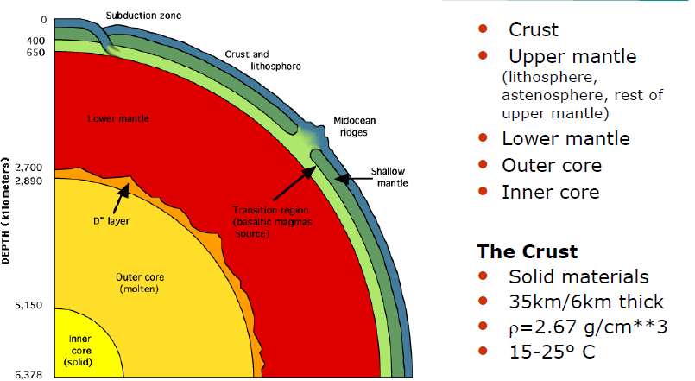
Earth’s interior

Slide 4
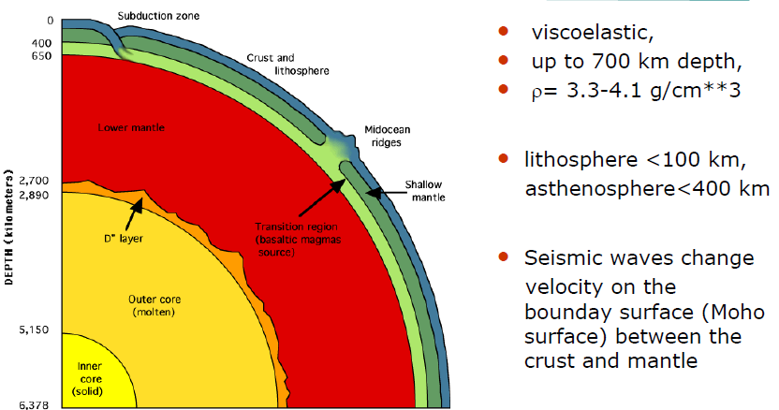
Earth’s interior – Upper mantle

Slide 5
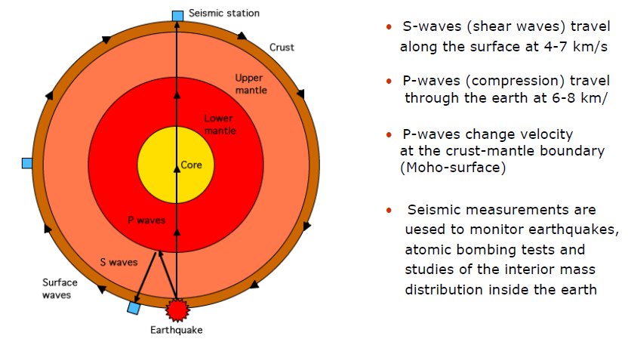
Surface waves & compression waves

Slide 6
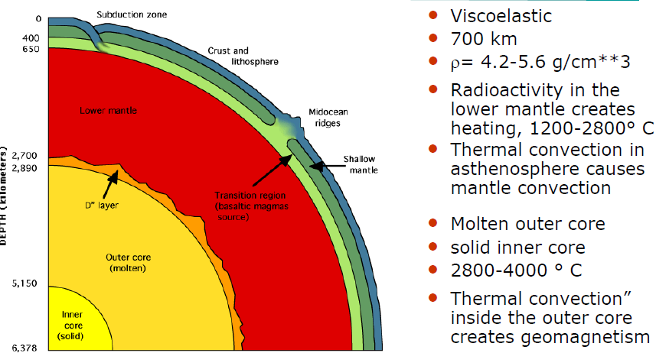
Lower mantle, outer core, inner core

Slide 7
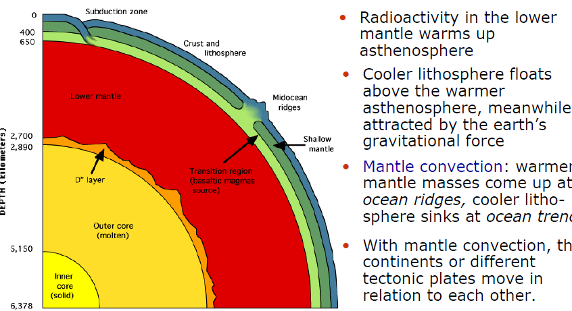
Mechanism of plate tectonics

Slide 8
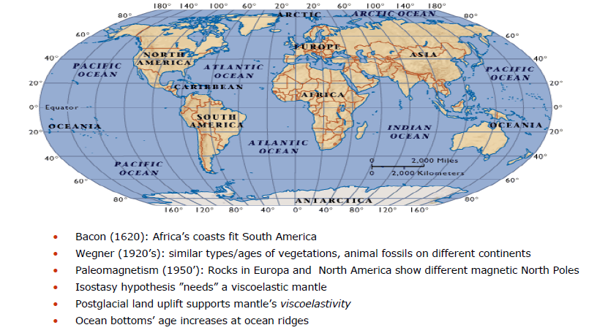
Evidences of continental drift

Slide 9
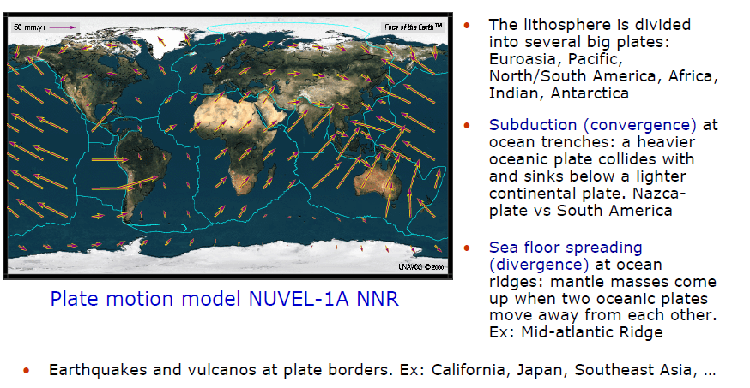
Characteristics of global tectonics

Slide 10
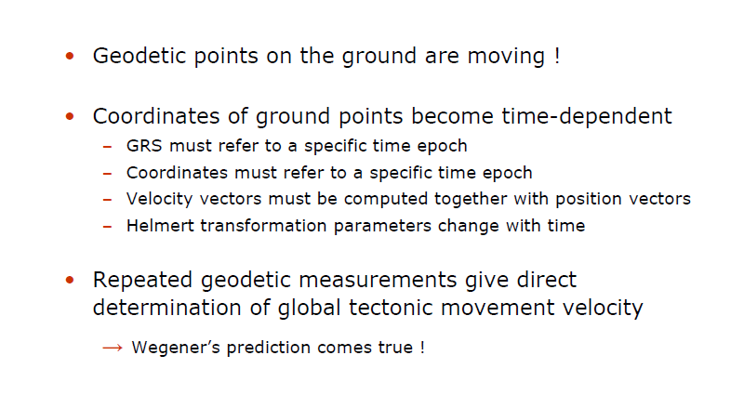
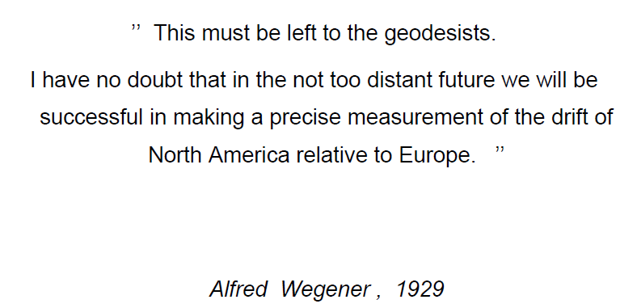
Implication of Global Tectonics

Slide 11
ITRF2000 stations at tectonic zones

Slide 13
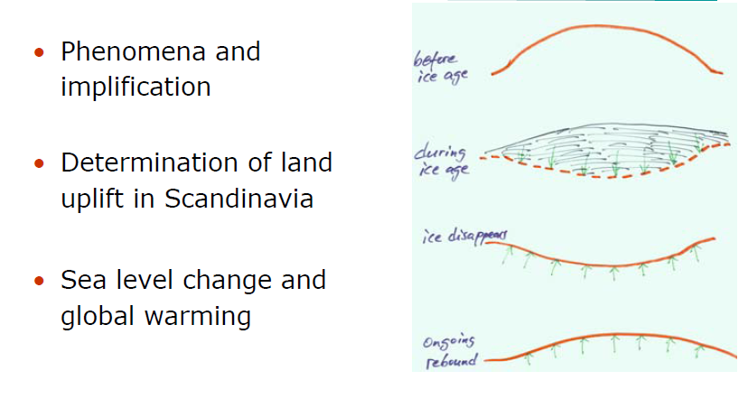
Land uplift - postglacial rebound

Slide 14
Relative sea level at tide gauge

Slide 15
Global warming 1880-1995

Slide 16
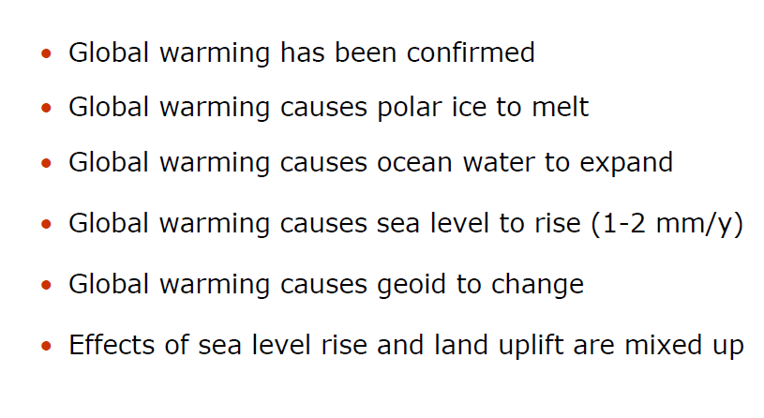
Global warming and global sea level rise

Slide 17
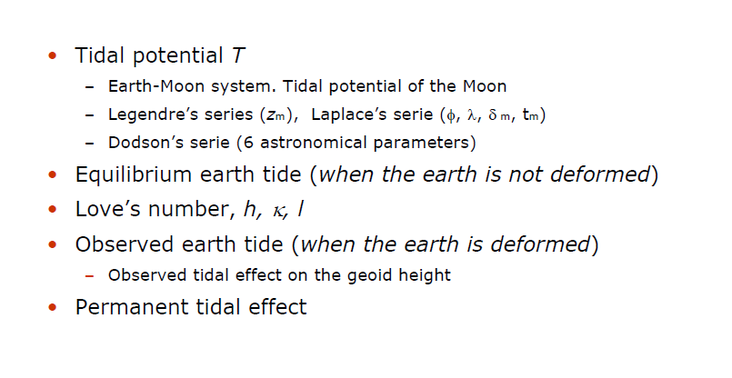
Earth Tide

Slide 18
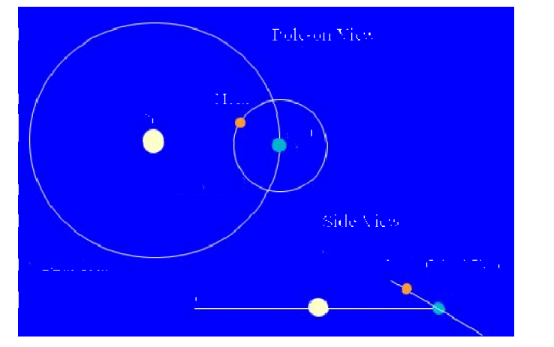
Sun-Earth-Moon System

Slide 19
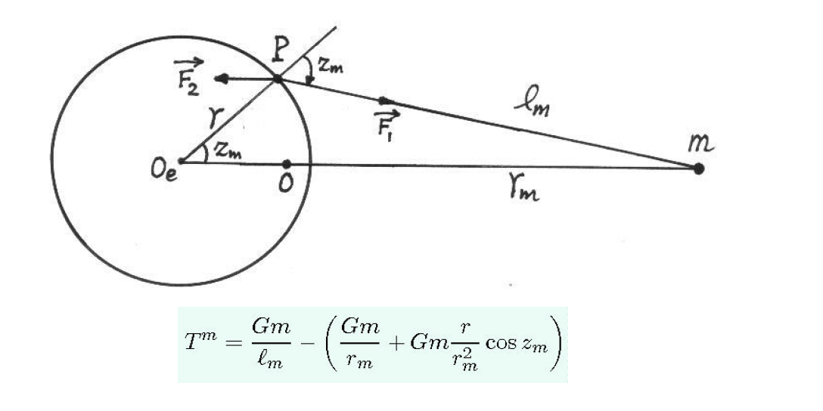
Tidal potential of the Moon

Slide 20
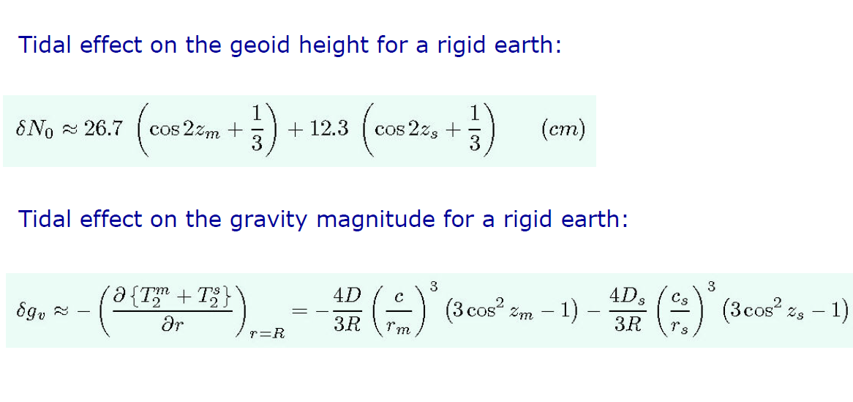
Equilibrium tides for a rigid earth

Slide 21
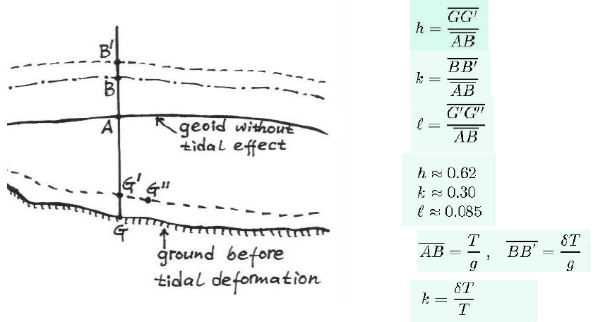
Love’s Numbers

Slide 22
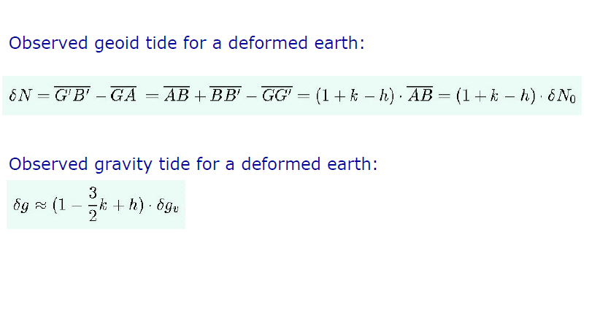
Observed tides for a deformed earth

Slide 23
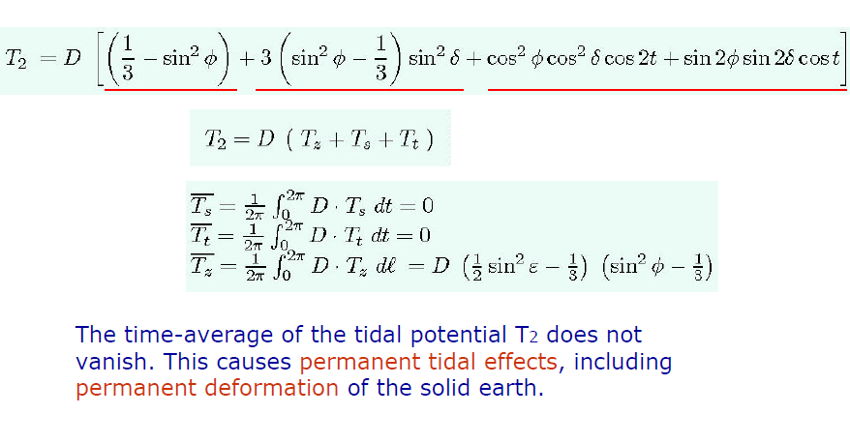
Non-zero time-average

Slide 24
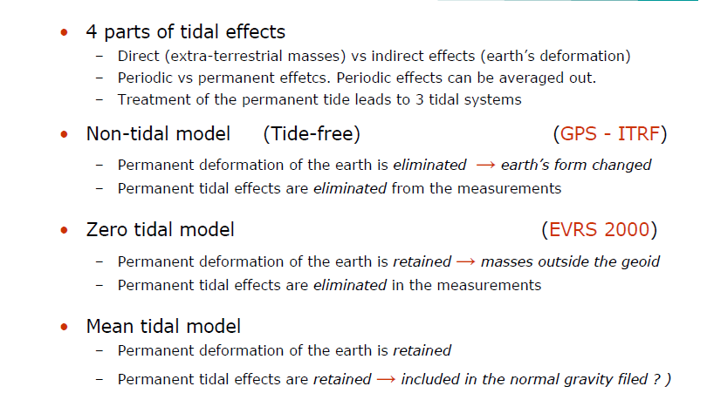
Permanent tide and tidal systems

Slide 25
Tidal Systems: Non-Tidal, Mean vs Zero Tide

Slide 26
Tidal Systems: geoidal differences

