Slide 1
Laser scanning and 3D Point Clouds

Slide 2
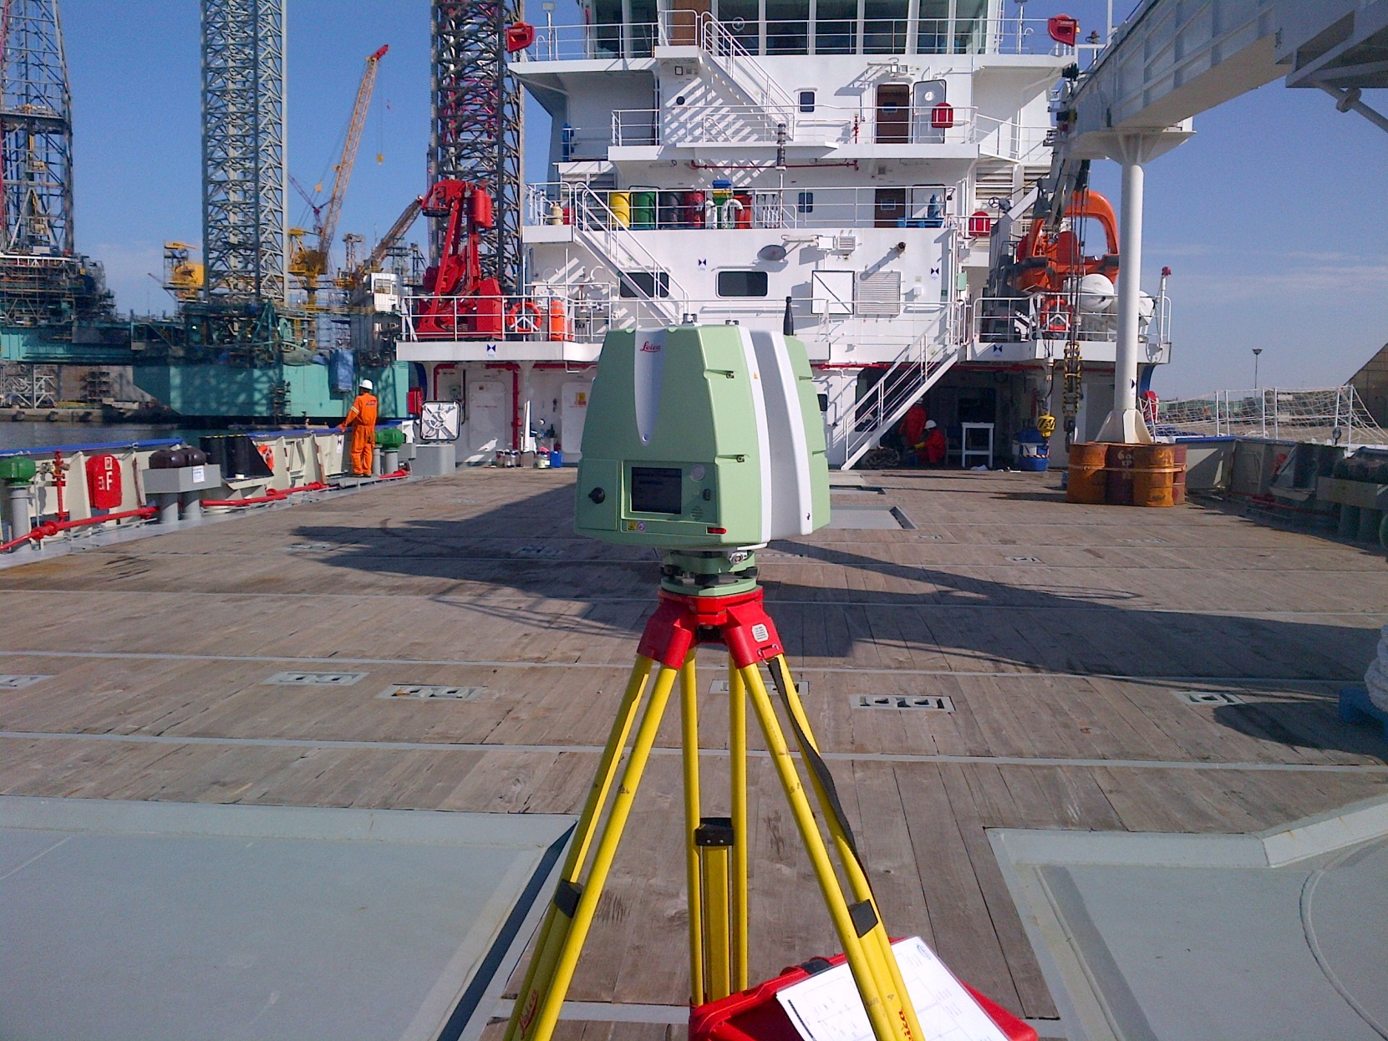
The concept
Notes:
2

Slide 3
Light Detection And Ranging
Device that automatically collects 3D co-ordinates at a high rate
Terrestrial Laser Scanning (TLS) = Technique that uses LiDAR (Light Detecting and Ranging) measurement technology. TLS consists of scanning with a LASER beam from the surface of the earth
Like taking a photograph with depth information
Each measured point has range and intensity values determined by the laser pulse properties plus an X, Y, Z value determined by the scanner’s orientation.
LiDAR is often used to refer to airborne laser scanning but can also apply to some ground based systems.

Slide 4
What is LASER
A laser is a device that emits light through a process of optical amplification based on the stimulated emission of electromagnetic radiation.
The term "laser" originated as an acronym for "light amplification by stimulated emission of radiation”

Slide 5
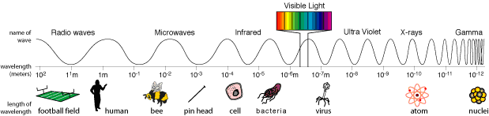
Principles of laser scanning
The electromagnetic spectrum
Mobile phones
Radio, Television
Microwave
Human eye
X-ray

Slide 6
How laser works

Slide 7
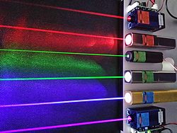
Principles of laser scanning
Laser light:
High degree of spatial coherence
→ propagates dominantly in a well defined direction
→ moderate beam divergence
High degree of temporal coherence
→ large propagation distances
Narrow spectral bandwidth
→ pure colour, e.g. red, green or blue
Linearly polarized
→ oscillates in a particular spatial direction.
Travel with a finite and constant velocity in a certain medium
Highly suited for the measurement of objects

Slide 8
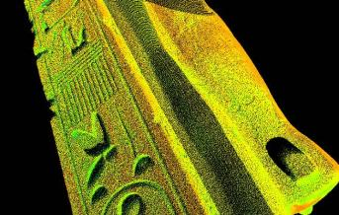
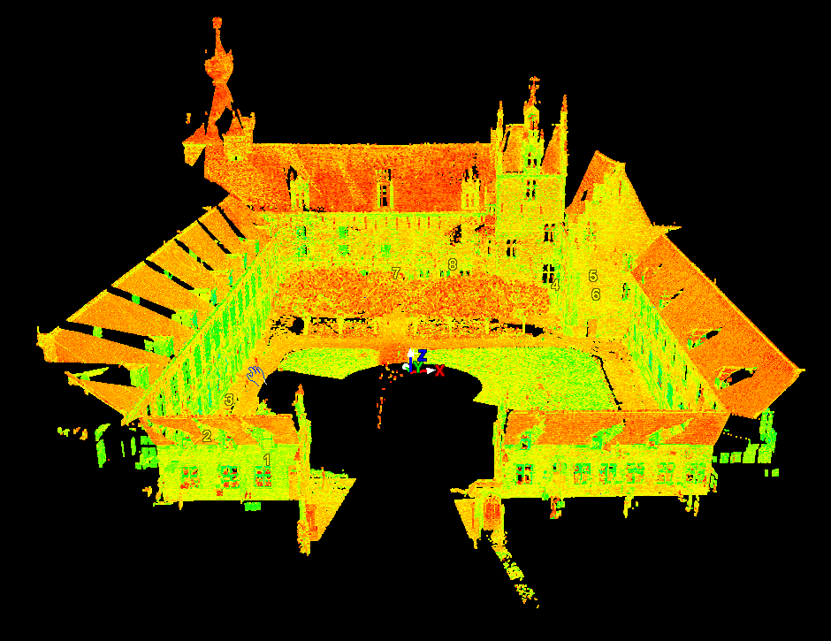
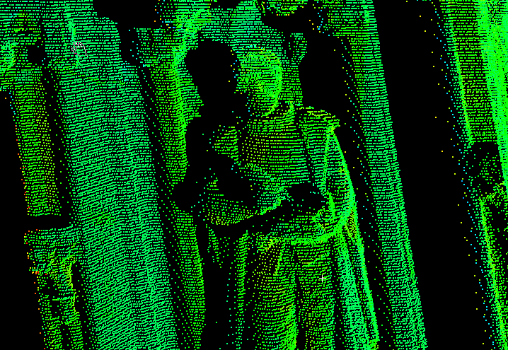
What is laser scanning ?

Slide 9
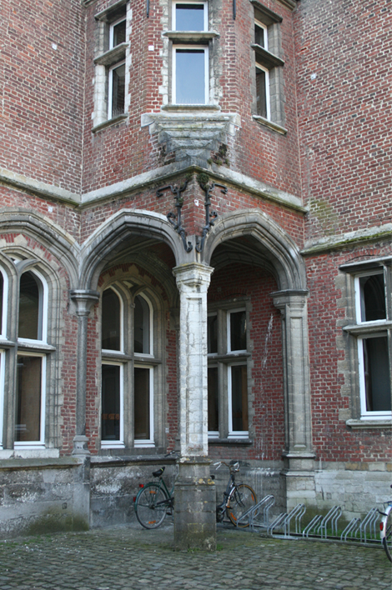
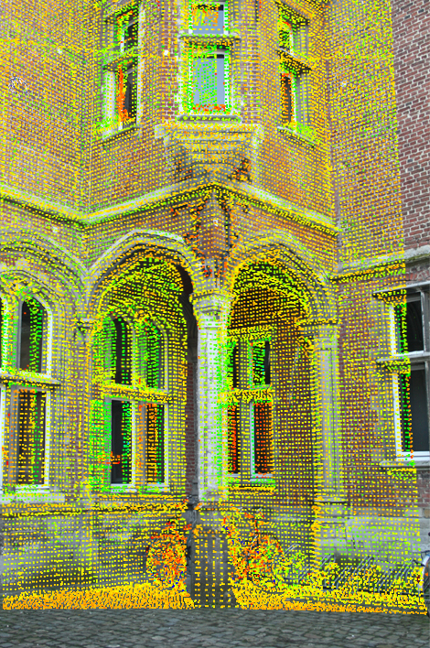
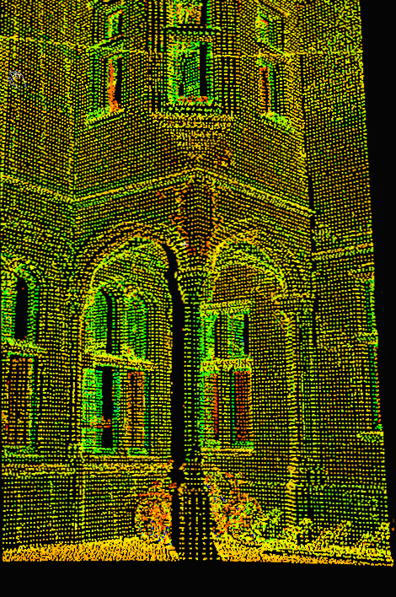
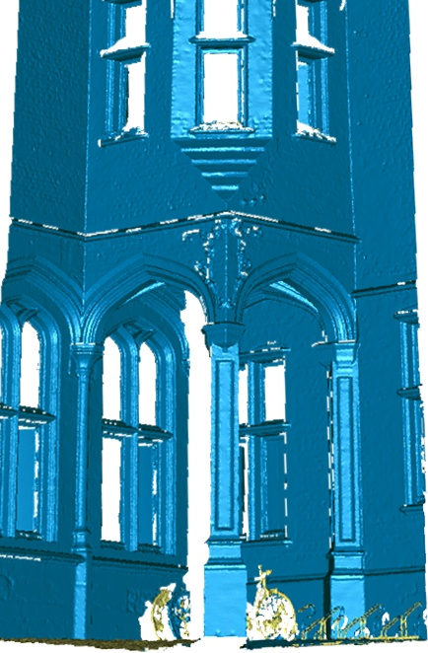
What is laser scanning ?

Slide 10
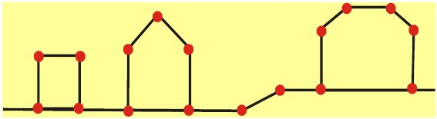
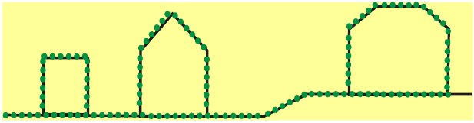
What is laser scanning ?
Total Station → point based
Laser Scanner → surface based
The laser scanner are not pointable measuring devices unlike Total station. It measures
range in uniform increments of arc.

Slide 11
Types of laser scanning
Static
Terrestrial
Dynamic
Aerial
Manned aircraft
Drones
Mobile mapping

Slide 12
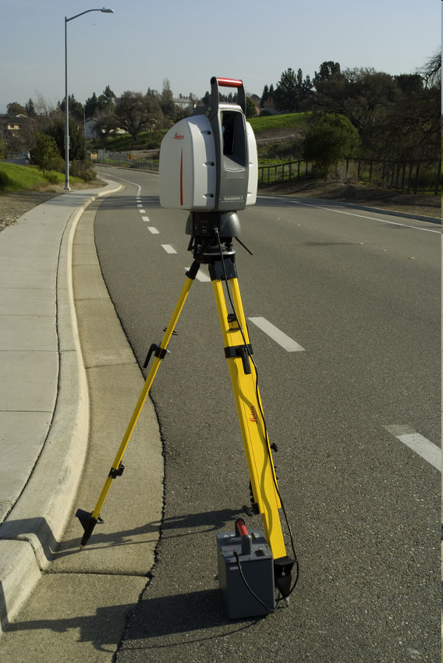
Types of laser scanning
Static
Dynamic
Aerial
Manned aircraft
UAV
Terrestrial
Mobile mapping

Slide 13
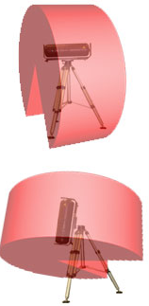
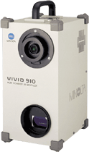
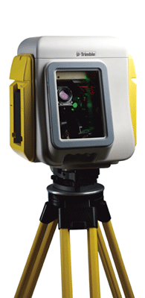
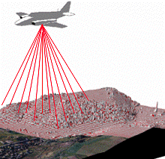
Types of laser scanning
Field of view
Range
Accuracy
Speed
  Close range sub mm 100 pt/sec
  Mid range mm 1000-500000 pt/sec
  Long range centimeter > 500000 pt/sec
(0.5-2m)
(1-150m)
(150-1000m)

Slide 14
Categories of laser range finding

Slide 15
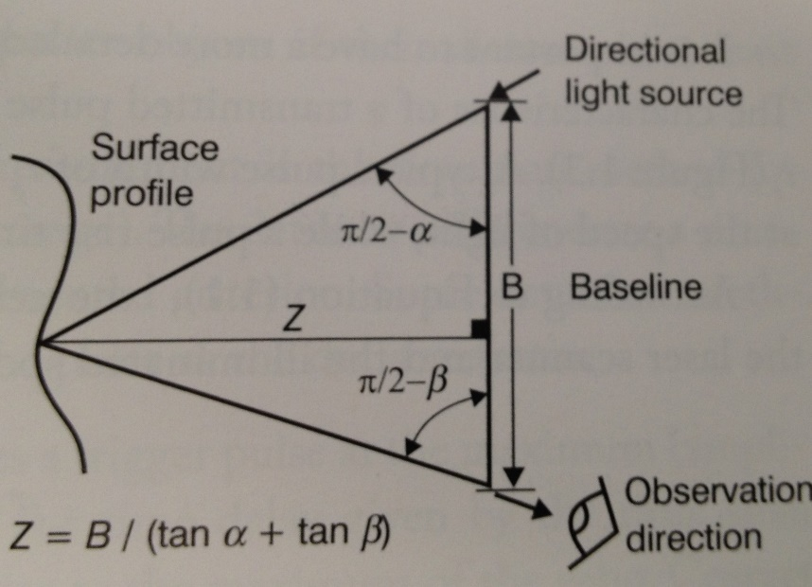
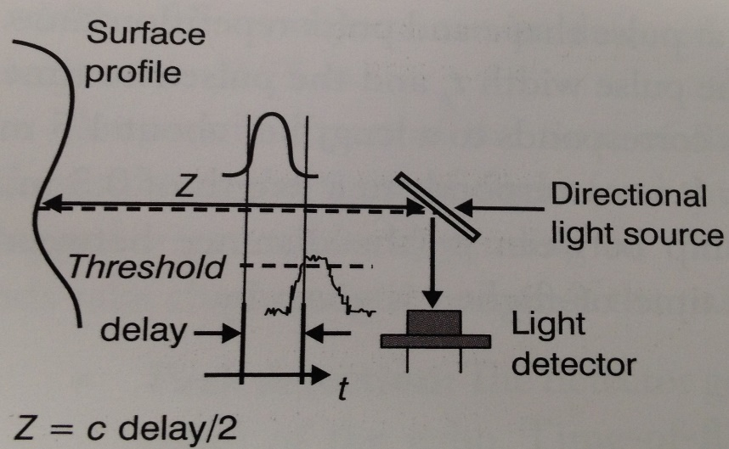
Categories of laser range finding
Triangulation scanner
a
γ
β
b
c
α

Slide 16
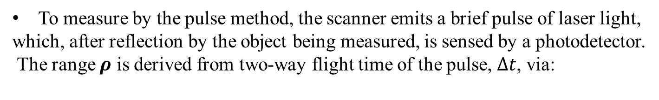
Laser pulse-based, time based
Time of flight (TOF)
Since C=300 mm/ns (speed of light), 1mm range resolution requires 6.7 ps time
interval measurement resolution
n the refractive index of atmopshere

Slide 17
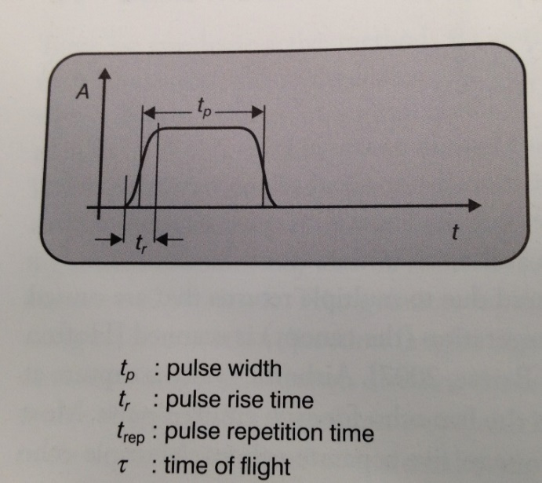
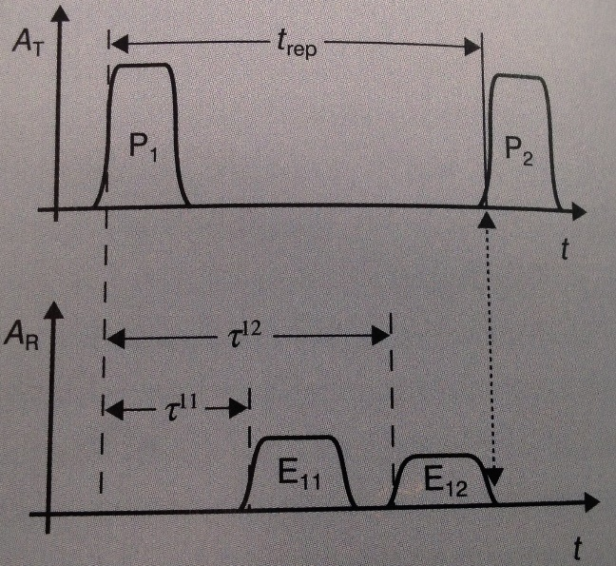
Time of flight: Pulse characteristics
Time of flight can be 6.7 microseconds
Survey height of 1km.
=Pulse length

Slide 18
Laser pulse-based, time based
Pulse laser scanners are reflectorless systems.
The energy of the reflected pulse depends on both physical factors : electric permittivity, magnetic permeability and conductivity
This depends on wavelength of the laser.
The time of flight is derived once the return Pulse amplitude crosses an internally defined threshold.

Slide 19
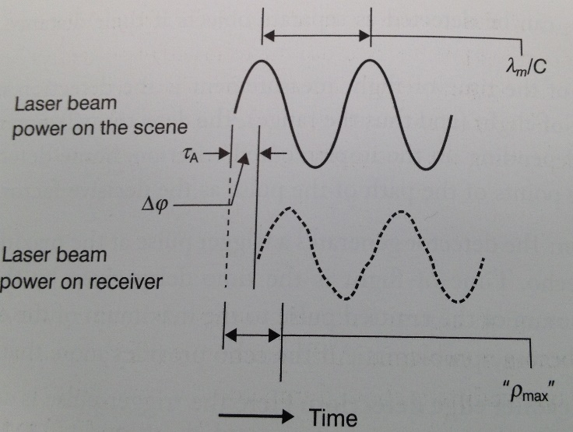
Phase measurement techniques
Emitted light is amplitude-modulated with a constant frequency, f, sinusoid
Much higher measurement rates: several 100 kHz (pulsed: several kHz)
The measured phase shift between the emitted and received signal, Δφ, is used to calculate the time of flight
where n is the integer number of full wavelengths
The range is

Slide 20
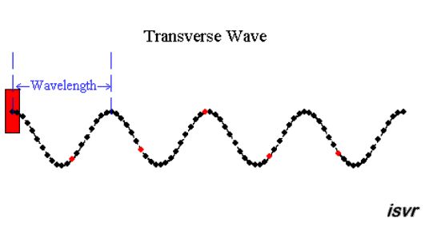

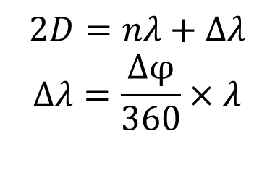




Phase measurement techniques
(a)
The technique is ambiguous
(b)
Amplitude
0
90
180
270
360
90
D
D
Notes:
The phase shift is the change occurs in the phase or in the phase difference between two. A signal is transmitted by the total station and reflected by lens. As shown in the figure, the two way distance can be expressed as this equation. The fractional cycle can be computed by the difference of phase.

Slide 21
TLS Selection and Classification
  According to the range measurement principle
  Triangulation: up to a few m range, accuracy < mm level
  Phase: up to 100 m, ~mm level accuracy
  Pulse (TOF), up to several 100 m, ~cm level accuracy

Slide 22
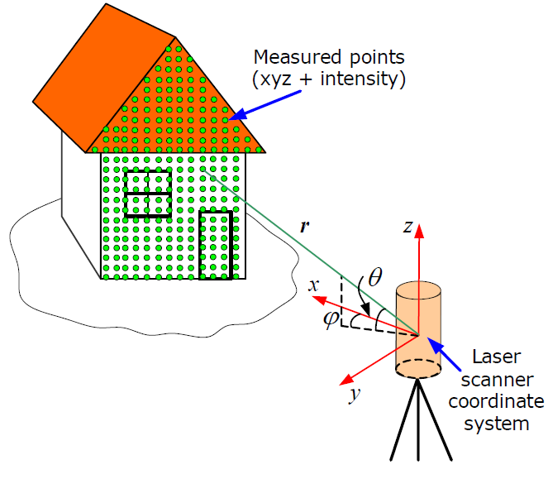

Principle of Laser scanning
Four raw observables observable
Range
Angular measurements (Horizontal direction and Vertical angle)
Intensity (properties of the reflected signal) of the reflected laser signal
Time, to see the evolution of the measurements
Cartesian coordinates (X,Y,Z) are the quantities provided as output from most
scanners and are usually treated as observables.

Slide 23
3D Point Cloud
Cartesian transformation of the laser pulse data transformation of the range and reflectance images as (well as the calculated XYZ coordinates) in scanner centred reference frame
3D point cloud of discrete locations derived from
superimposing range and reflectance image for each
laser Pulse
3D point clouds are the basis for subsequent analysis and used to create CAD or GIS models

Slide 24
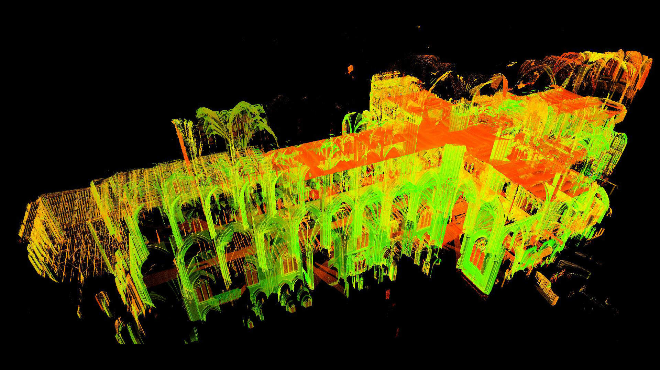
Point clouds with intensity
The intensity is a measure of the electronic signal strength obtained by converting and amplifying the backscattered optical power.

Slide 25
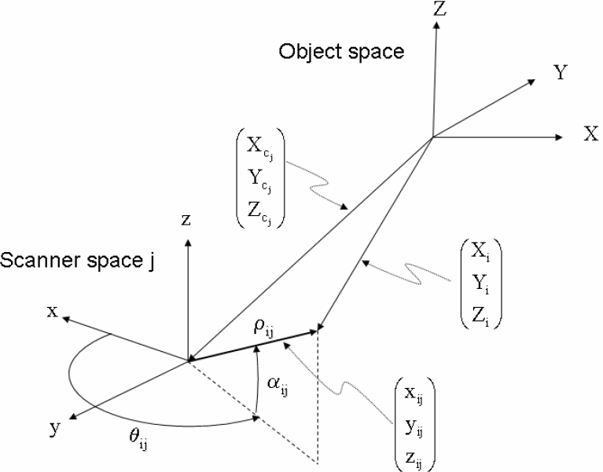
TLS Geometry
(external system)
(Sensor frame)
are coordinates of object point I In scan j

Slide 26
TLS observations
The basic observation equations are
  Range
  Horizontal direction
  Elevation angle (Zenith angle)

Slide 27
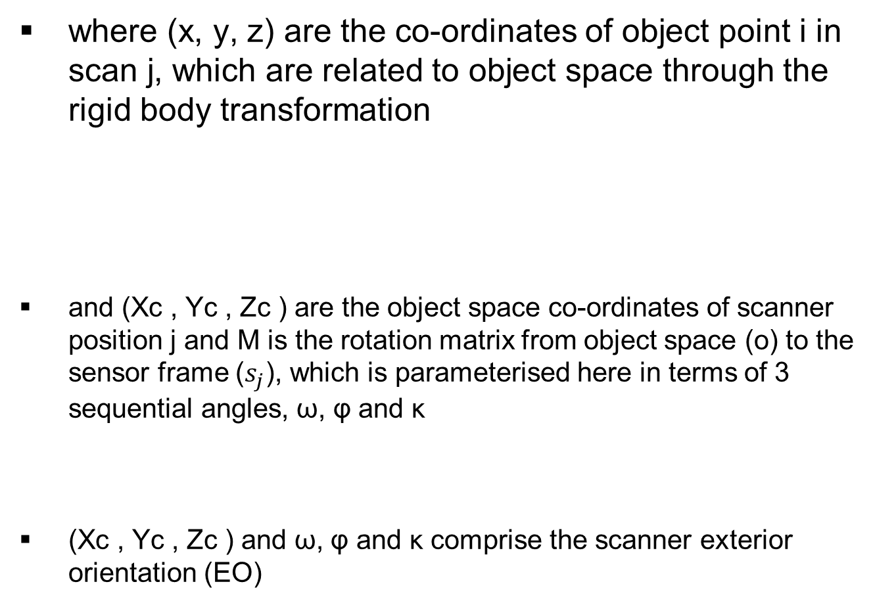
Observations (continued)

Slide 28
Registration of 3D Point Clouds from Multiple scans

Slide 29
Registration and Georeferencing in TLS
To obtain a complete representation of the scanned object, the point clouds (scans) should be first transformed to a common coordinate system. This procedure is called registration, whereby the registered scans are combined in one dataset
Large/complex objects needs to be scanned at multiple setups. However, the scanner measures the point clouds with reference to internally defined sensor frame
In order to be able to integrate the TLS data into other geospatial data [e.g. digital maps or DTM], the user has to transform the “registered” point cloud of the whole object into a chosen external (geodetic) coordinate system, which is either local or national. This procedure is called georeferencing

Slide 30
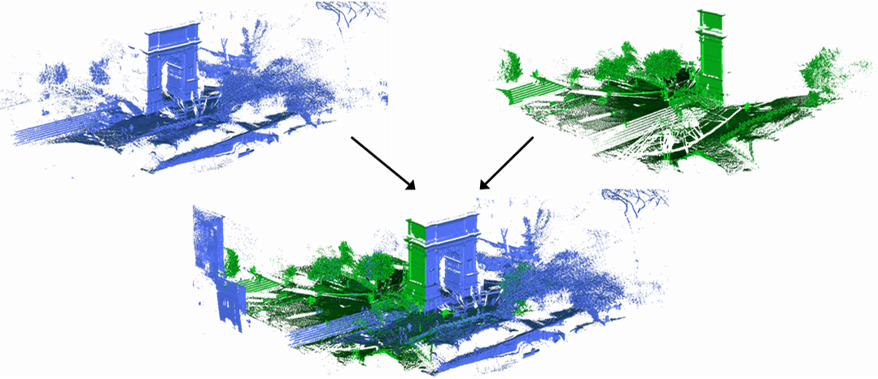
Multiple scan poistions
Scan position 1
Scan position 2

Slide 31
Registration
(external system)
(Sensor frame)
are coordinates of object point I In scan j

Slide 32
Registration : Indirect registration
  3D space resection problem
  6 unknowns per point cloud
  6 co-ordinates from 3 non-collinear points needed for unique solution
  Most often formulated in terms of Cartesian scanner co-ordinates, i.e.,
In Spherical
Coordinates

Slide 33
Registration (Continued)
Parametric least-squares used to estimate the 6 transformation parameters
Transformation of scanned points into object space is thus given by
Strictly speaking, the problem is best formulated in terms of observed spherical co-ordinates, i.e.

Slide 34
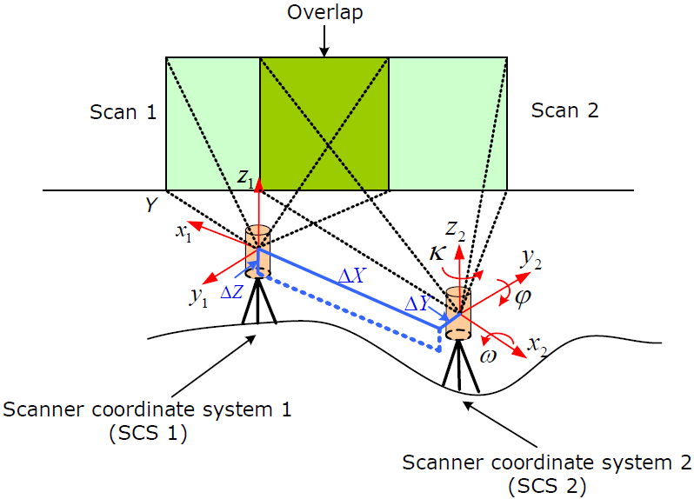
Registration of multiple scans
3 translations along the 3
coordinate axes: ΔX, ΔY, ΔZ;
3 rotations around the 3
coordinate axes: ω, φ , κ.
The figure shows two scans of the object from two different positions.
In order to transform the Scan 2 into the CS of the Scan 1, determine the
transformation parameters between these two coordinate systems.

Slide 35
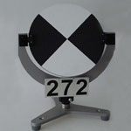
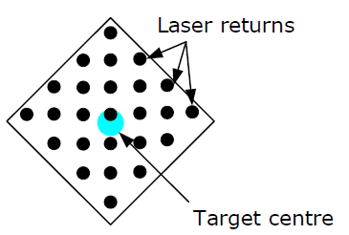
Target based registration
Target type
scan 1
T1
scan 2
T1
T2
T2
T3
T3
scan 1
scan 2
Tie-points
T1
T2
Scan 1 and scan2
registered
T3
Overlap
Determine the targets centres to which the coordinates, used in the
registration, are referred.
Scan the targets with high resolution, so-called fine scans, with higher than the resolution of the main scan.
It should be a highly reflective target.

Slide 36
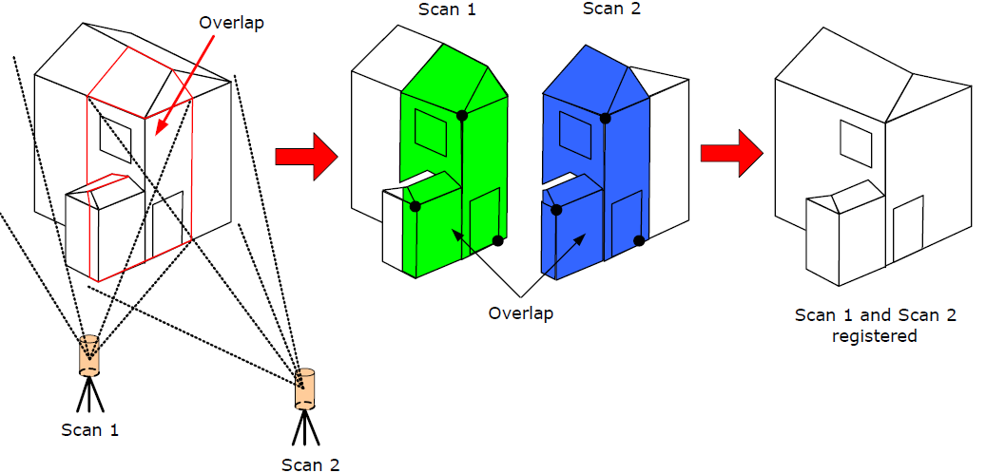
Surface Matching
This approach assumes matching together the overlapping areas of the point clouds instead of matching just the common targets or natural point features. Since the overlapping areas contain typically thousands of points, the redundancy involved may lead to a better solution than using discrete tie-points alone
The figure shows how surface matching works

Slide 37
Benefits of laser scanning
Non contact measurement
High accuracy
Long range
Speed
Safety
Accessibility of the object
Quantity of information
5 dimensional information
  X, Y, Z
  Intensity
  time

Slide 38
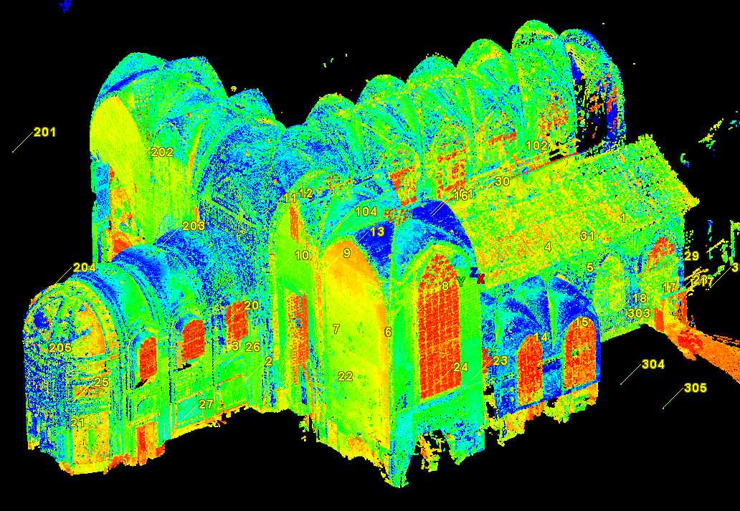
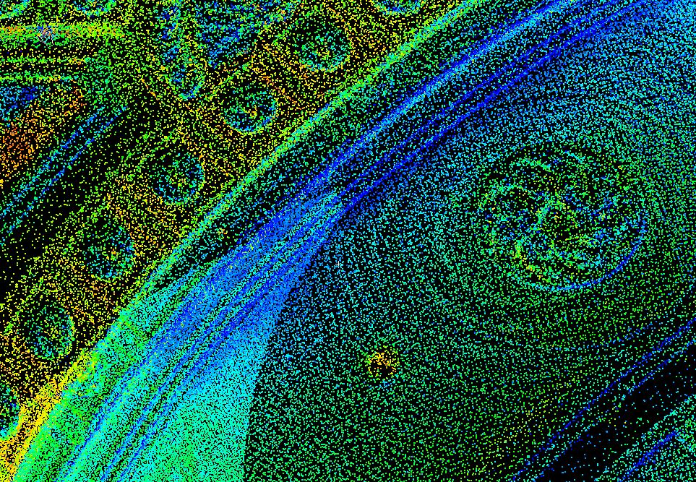
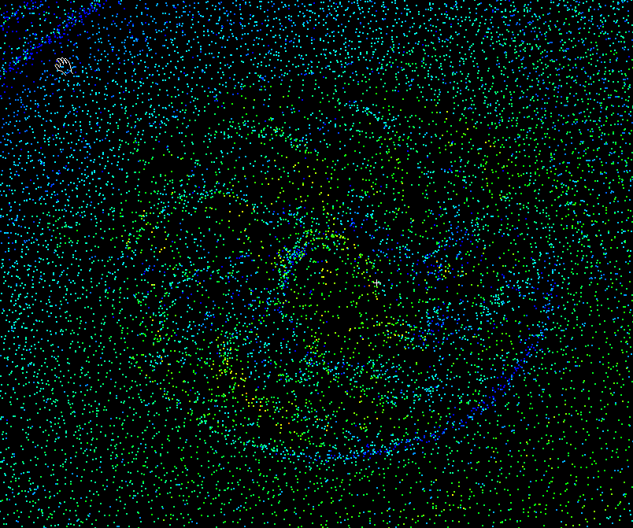
Important issues
Scanner output = point cloud

Slide 39
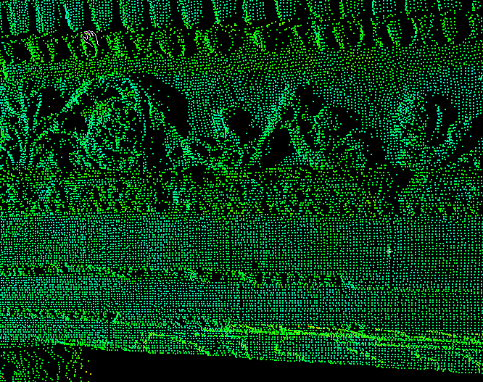
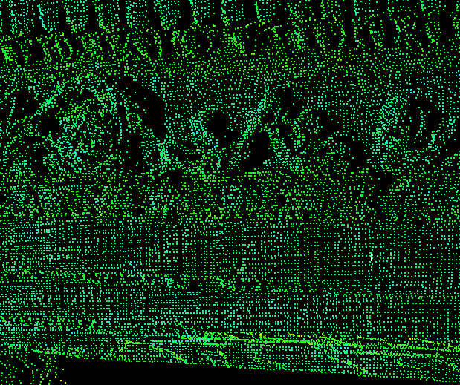
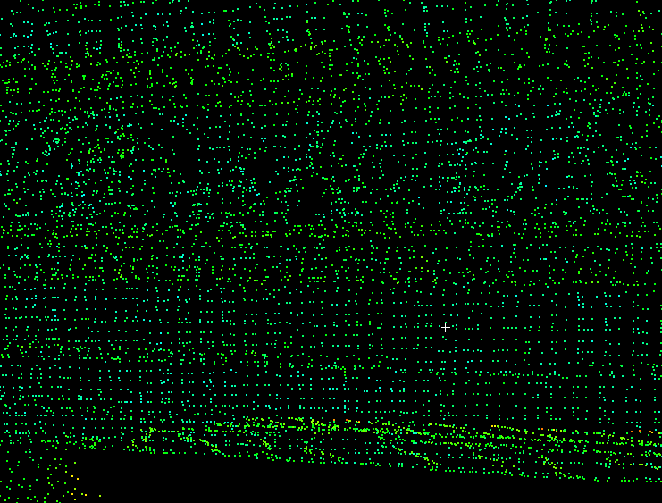
Important issues
Resolution ≠ Accuracy
Resolution
The average distance between XYZ co-ordinates in a point cloud
5x5mm
10x10mm
20x20mm

Slide 40
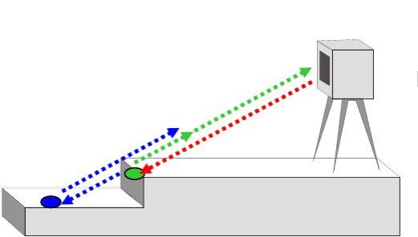
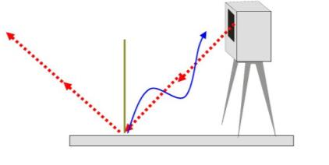
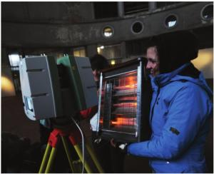
Metrological Aspects: Errors
Instrumental
Propagation of laser beam
Mixed edge problem
Range uncertainty
Angular uncertainty
Object-related
Environmental
Temperature
Atmosphere
Interfering radiation
Distortion from motion
Methodological errors

Slide 41
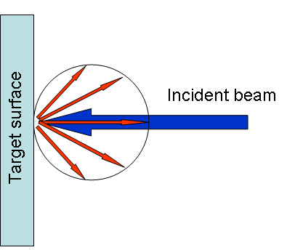
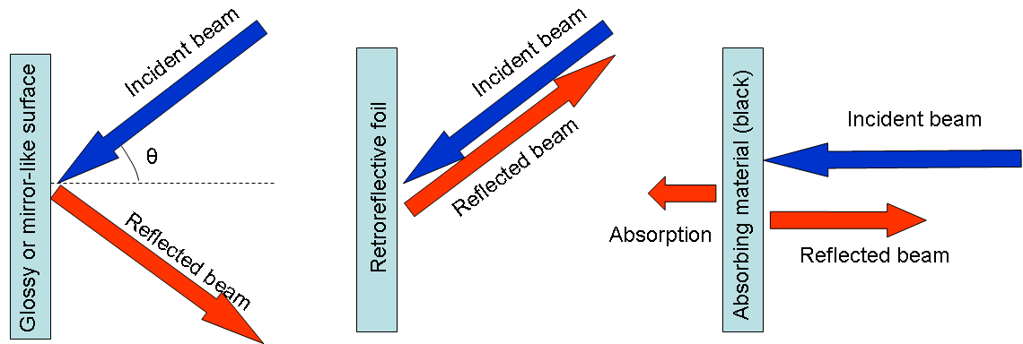
Material Reflection

Slide 42
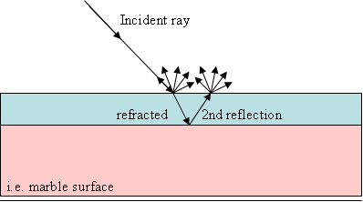
Material Reflection
Marble surface
Black surface

Slide 43
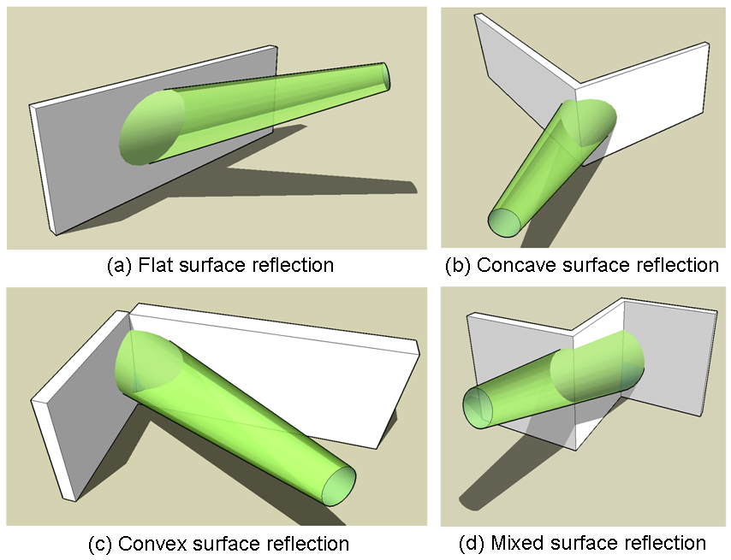
Reflection on Multiple Surfaces

Slide 44
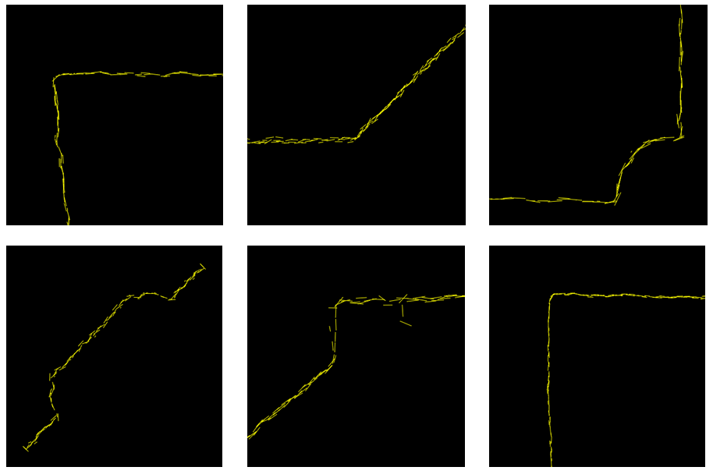
APPLICATIONS

Slide 45
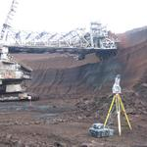
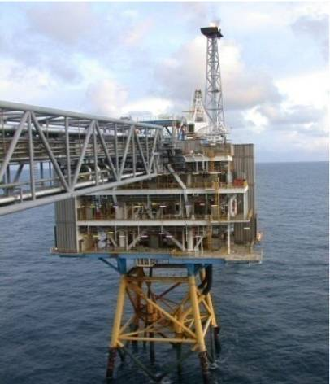




Applications
Heritage ( stability analysis for virtual tour ), reverse engineering, chemical industry, forensics, monitoring reclamations, etc.
Notes:
45

Slide 46

Multipurpose use .
petrochemistry
civil
Damage survey
Everyday survey
Art
3D Laserscanning
Archaeology &
heritage
Mining
geology

Slide 47





Quality checking .
Area of Application .

Slide 48



3D Management of Facilities .
Area of Application .

Slide 49


Preparing a shutdown .
Area of Application .

Slide 50




Design & Constructability .
Area of Application .

Slide 51



Damage Survey .
Collision material
Petrochemistry explosion
Forensic
Area of Application .
Notes:
Aanrijding van een transportband door een vrachtwagen in beerse
Gat in een tank
Overstroming van een spaarbekken, monitoring, …
Auto ongevallen

Slide 52








Re-Engineering .
Area of Application .

Slide 53


Other Possibilities .
Clash Detection
Simulation
  Impact of explosion
  Evacuation routes
As Built plans
  Growing safety regulations
  Minimizing Engineering schedules
Pre-survey scan for new installations
...
Area of Application .

Slide 54









Civil .
Roads
Railways
Tunnels
Bridges
Buildings
Area of Application .
Notes:
Globe is using it’s laserscanner for many different purposes.

Slide 55


Art & Nature .
Area of Application .
Notes:
Aanrijding van een transportband door een vrachtwagen in beerse
Gat in een tank
Overstroming van een spaarbekken, monitoring, …
Auto ongevallen

Slide 56
TLS applications
Landscape evolution
Fault mapping
Paleoseismology
Paleontology
Cryosphere
Ecology
Landslides
Volcanoes
Sediment transport
Stratigraphy
Coastal processes
Non-Earth sciences:
forensics, movies, games, architecture, archaeology, civil engineering, manufacturing, etc.
And many more …

