Slide 1
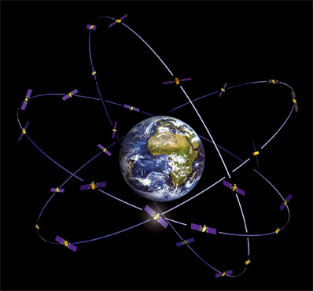
Global Navigation Satellite System (GNSS)

Slide 2
Development of GPS and objectives
Designed primarily for military users, GPS is managed and under the control of the United States of Department of Defense (DoD)
The current system became fully operational in 1994 when the 24th satellite was launched
DoD wanted a system that is passive for military users (passive because users should not transmit anything, as they might be detected)
With GPS it is possible to get 3-D coordinates anywhere on Earth at any time (day or night) for all weather conditions
Since GPS is a passive system and users simply receive GPS signals, there is no limit to GPS receivers without overloading the system – like TV and radio where millions can tune in at any time without affecting the broadcast

Slide 3
GPS Segments
3 segments:
  Space Segment
    Constellation of satellites orbiting the Earth
  Control Segment
    Monitor and operation of satellites and signals
  User Segment
    Anybody that receives and uses a GPS signal

Slide 4
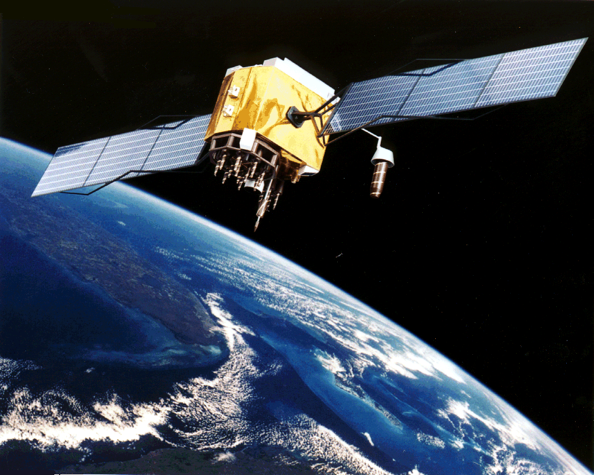
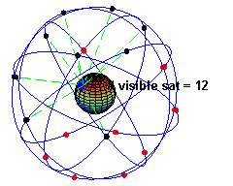
Space Segment
Very high orbit
20,000km
1 revolution per ~ 12 hours
GPS satellite essentially provides a platform for radio transmitter, atomic clocks, computers and various ancillary equipment

Slide 5
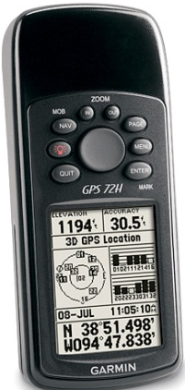
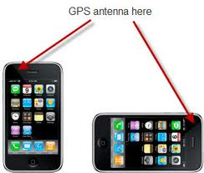
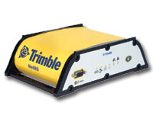
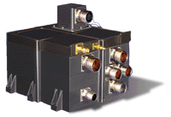
GPS user segment
GPS receivers are specialized “radios” that track GPS signals and produce position and velocity solutions
  Wide range of cost/sophistication depending on the application
Signals from 4 or more GPS satellites are required, but 8-12 are typically available at any time
Many civil (Standard SPS) receivers track only the L1 C/A signal
Precision civil users track both L1 and L2, without the P(Y) codes
PPS receivers have special keys that allow tracking of the military P(Y) code over both L1 and L2 (more on this later)
Military Spacecraft (~$1,000,000)
Surveying/Science
($10,000)
courtesy Garmin
courtesy Trimble
Consumer Recreation
(~$100)
courtesy General Dynamics

Slide 6
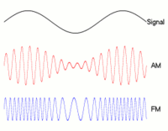

GPS signal Structure
Each GPS satellite continuously broadcast two electromagnetic signals that are in L-band used for radio communication.
The precise atomic clocks in the satellite have a fundamental clock rate or frequency $f_{0}=10.23 MHz$
Two L-band frequencies assigned to GPS are derived from the atomic clocks
$$L_{1}=154×f_{0}=1575.42 MHz→λ=0.190 m$$
$$L_{2}=120×f_{0}=1227.60 MHz→λ=0.244 m$$
$$L_{5}=115×f_{0}=1176.45 MHz→λ=0.255 m$$
Both $L_{1}, L_{2},$and $L_{5}$ signals act as carrier
waves and have information modulated
onto them that can be used by a receiver to
determine position

Slide 7
Fundamentals of Satellite Navigation
Satellite based navigation is fundamentally based on:
  The precise measurement of time
  The constancy of the speed of light
GPS and other systems use the concept of trilateration:
  Satellite (transmitter) positions are known
  Receiver position is unknown
  Satellite-to-receiver range measurements are used to estimate positions
Notes:
GPS positioning is based on trilateration: estimation of position based on measurement of distances.
GPS is a time of arrival system, as the distance between the transmitter and receiver can be determined
by measuring the transit time of the signal.

Slide 8
GPS positioning methods
There are two basic methods for determining position with GPS equipment
Code ranging
Carrier phase measurements

Slide 9

Code ranging
To measure the distance, a receiver measures the time taken by the Coarse/Acquisition (C/A) code to travel from satellite to the receiver
All satellites use atomic clocks to generate individual C/A codes, and also known as PRN codes
When the receiver locks onto a satellite, the incoming signal triggers the receiver to generate a C/A code identical to the transmitted one by the satellite
The replica code is compared with the satellite code a process called Autocorrelation
The amount by which the receiver generated code is shifted is equal to the propagation delay between the satellite and receiver ($ρ=∆t×c$)

Slide 10
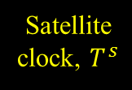
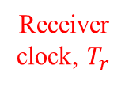
How do we know when the signal left the satellite?
One of the clever ideas of GPS
Use the same code at a receiver and satellite, PRN (Pseudo Random Noise) code
Synchronize satellites and receivers so they're generating same code at same time
Then we look at the incoming code from the satellite and see how long ago our receiver generated the same code
measure time
Satellite
clock, $T^{s}$
difference between
same part of code
Code Transmitted by satellite
Replica of Code generated in receiver
Receiver
clock, $T_{r}$

Slide 11

Code ranging
For GPS point positioning, the C/A code broadcast on L1 frequency allows to the standard positioning service(SPS) which is used for most civilian applications and has a three-dimensional accuracy of about 10-20m.
The coordinate of GPS like other quantities in surveying, have a measurement uncertainty associated with them, the accuracy is normally quoted at the 95% probability.
This means 95% of the time, the coordinates will be as good as or better than 10-20m, but 5% chance they may not be.

Slide 12
GPS Signals
The satellites transmit as part of their unique Spread Spectrum signal a clock or timing signal
All 24 GPS satellites transmit on the same two frequencies but use a different ID sequence (PRN)
The range or distance to the satellite is obtained by measuring how long it takes for the transmitted signal to reach the receiver
This is not the “true” range due to clock errors - what is obtained is known as the “pseudo-range”

Slide 13
Carrier phase measurements
The accuracy of ranging is clearly inadequate for high –precision surveying where accuracies at the centimetre level or better are required.
The system uses the same principle as electro-optical distance measurements work in Total station using the phase shift method

Slide 14
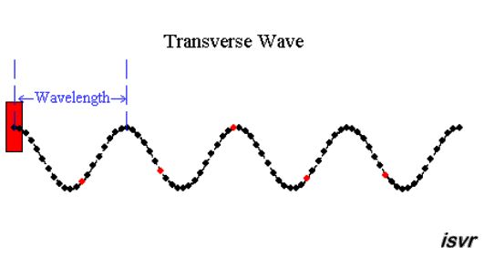





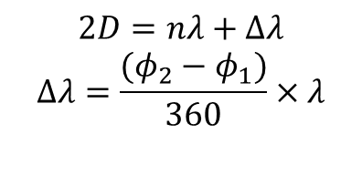
Phase shift method
λ
(a)
Phase shift is any change that occurs in the phase of one quantity, or in the phase difference between two or more quantities
(b)
Amplitude
0
90
360
90
$$φ$$
180
270
Figure. Sinusoidal wave motion (a) as a function of distance or time (b) as a function of phase angle $φ$
$$2D=nλ+Δλ$$
$$Δλ=\frac{(φ_{2}−φ_{1})}{360}×λ$$
$$φ=0^{o}$$
$$φ={90}^{o}$$
$$nλ_{m}$$
D
D
$$Δλ_{m}$$

Slide 15

Measurement Equation
GPS receiver measures “Pseudorange” by measuring the transit time of the signal:
$$ρ_{r}^{s}=c (t_{r}−t^{s})$$
time of signal reception,
(based on receiver clock,
can be significantly in error)
time of transmission,
encoded in signal by
GPS satellite clock
(known precisely)

Slide 16





Observation model
Consider:
  4 satellites in view from receiver “E”
    Receiver index: E
    Satellite index: $S=1,2,3,4$
Pythagoras theorem
    $$D_{1}^{2}={\left(X_{1}−X_{E}\right)}^{2}+{\left(Y_{1}−Y_{E}\right)}^{2}+{\left(Z_{1}−Z_{E}\right)}^{2}$$
    $$D_{2}^{2}={\left(X_{2}−X_{E}\right)}^{2}+{\left(Y_{2}−Y_{E}\right)}^{2}+{\left(Z_{2}−Z_{E}\right)}^{2}$$
    $$D_{3}^{2}={\left(X_{3}−X_{E}\right)}^{2}+{\left(Y_{3}−Y_{E}\right)}^{2}+{\left(Z_{3}−Z_{E}\right)}^{2}$$
    $$D_{4}^{2}={\left(X_{4}−X_{E}\right)}^{2}+{\left(Y_{4}−Y_{E}\right)}^{2}+{\left(Z_{4}−Z_{E}\right)}^{2}$$
(X₂, Y₂, Z₃)
(X₁, Y₁, Z₁)
(X₃, Y₃, Z₃)
(X₄, Y₄, Z₄)
  Known: Navigation message gives us
    satellite positions (X^{1,2.3,4} , Y^{1,2,3,4} , Z^{1,2,3,4})
  4 unknowns:
    receiver position (X_{E}, Y_{E} , Z_{E})
    receiver clock error δt_{E}
Z
Y
(X_{E}, Y_{E}, Z_{E})
X

Slide 17



The Integer Ambiguity--What is it?
Receiver measures partial wavelength when it first locks-on
Receiver counts successive cycles afterwards
Receiver does not know the whole number of wavelengths after the first partial one, which exists between the receiver and the SV
This unknown, N, is called the integer ambiguity or bias (also called phase ambiguity) – the number of full carrier phase wavelengths at lock-on
Unknown
$$L$$
Measured
$$L=\frac{Nλ+φ}{2}$$
Total station
$$L=φ+Nλ$$
GPS

Slide 18
Errors sources in GPS observations
Tropospheric errors
Ionosphere errors
Multipath
Satellite orbital errors
Satellite and receiver clock errors
Dilution of position

Slide 19
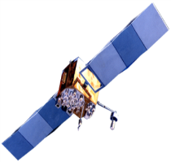


Troposphere (Neutral Atmosphere)
GPS signal from the satellite
doesn’t follow a straight line.
Refraction is the bending of
light as it travels through one
media to another
Error ~ 2.3m at Zenith
Troposphare
0 - 50 km
Troposphere
Air
Glass
θ_{r}
θ_{r}
θ_{i}
At low elevation the effect is several
tens of meters
Air
θ_{r}
θ_{r}
θ_{i}

Slide 20
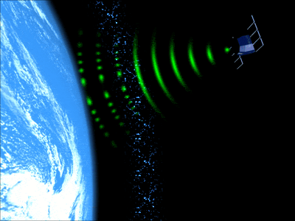
Ionosphere
20,000 km
1000 km
_{Ionosphere}
50 km
The Ionosphere is the electrically charged component of the higher atmosphere
A dual frequency receiver helps to mitigate 99% of the ionospheric effects
For single-frequency receivers, one should use Ionospheric model
For single-frequency GPS users, the error can reach up to100 meters

Slide 21
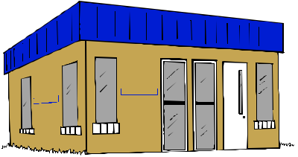
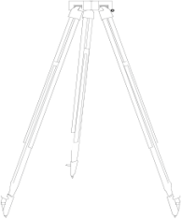
Multipath
Multipath : The antennae used for receiving GPS signals are designed to track a wide area and can not be directional. Multipath errors occur when the signal does not travel directly but is reflected from nearby surfaces
Reflected Signal
Direct Signal
Reflected Signal

Slide 22

Satellite orbit error
True Orbit
Orbital error
broadcast Orbit
A result of incorrect satellite orbits
can be related to the length of a GPS
Baseline :
$$baseline error=\frac{d}{20,000}×orbital error$$
Type of orbit (broadcast or precise)

Slide 23
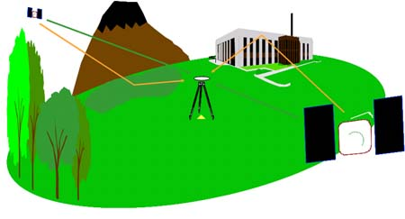

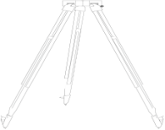
Geometry – Dilution of Precision
Geometric Dilution of Precision (GDOP) is a measure of the quality of the receiver-to-GPS satellite range geometry
  Related DOPs exist for position, horizontal, vertical, and time dilutions of precision
For GPS, DOP can range from 1 to infinity, with values in the 1-3 range being typical.
Good GDOP
Poor GDOP
Good DOP values are between 1 and 3. Higher values mean poor position accuracy due to spacing of satellites (when the satellite are only in one portion of the sky)

Slide 24
Improving the accuracy of GPS
The various error sources that affect GPS observations causes for point positioning to have an accuracy of around 10-20m using C/A code on L1.
For high end applications such as surveying the accuracy can be improved using differential and relative techniques in which two or more receivers work together.
One of the receivers is located at a point whose coordinate is known – a reference receiver and another receiver called a rover moves around the survey area collecting data.

Slide 25
Differential GPS (DGPS)
Generally refers to real-time correction of code-based positions
Compared to point positioning DGPS accuracy of about 0.5-5m
Real-time capabilities presume radio link between receivers
The “differential” is the difference between a GPS code position and a known position at a single receiver

Slide 26

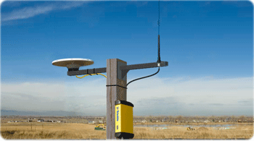
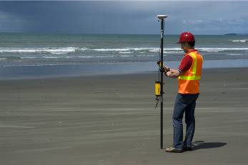
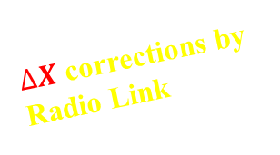
Differential GPS (DGPS)
$∆X$corrections by Radio Link
Known
Reference
Station
Rover
Problem: Must use IDENTICAL satellites
for ΔX to be valid

Slide 27
Precise relative GPS
With an accuracy of DGPS at the meter level, DGPS is not good enough for work on site. In order to improve the accuracy another type of differential surveying known as a precise relative GPS is applied to carrier phase measurements
Two or more receivers are required
In precise relative GPS, differencing techniques are used to remove most errors, differencing involves forming several types of differences.
Single difference
Double difference
Triple difference

Slide 28

Precise relative GPS
(a) Single difference (b) Double difference
($t_{1}$) ($t_{2}$)
R1
R2
R1
R2
R1
(c) Triple difference
R2

Slide 29
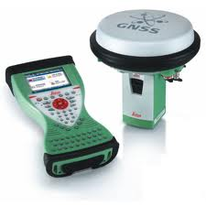
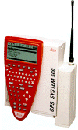

Real Time Kinematic GPS (RTK)
“RTK GPS” similar to “Differential GPS”
    Both use radio transmissions from a reference station
      “Differential GPS” Pseudorangecorrections
      “RTK GPS” dual frequency phase data
    RTK requires FM radio link, or mobile, or internet
      Higher data rate required than for differential GPS (10 Hz -1Hz)
      Limit on radio transmitter power due to legal restrictions (UK 0.5 Watt)
      Short range (~15 km)
      Generally line of sight works best
    RTK must find correct values for $N$
      More difficult if receiver is moving
      “On the fly” ambiguity resolution
      Range limited by effect of ionosphere on finding $N$
UoLhas Leica’s RTK system 500 and GS15
  plus mobile link and hand held controller
GS15 System
GPS500 System

Slide 30
More on RTK …
The Key component of RTK survey is the communication link between the reference (base) station and rover- many systems use UHF or VHF radio modems.
The range of the radio link depends on the power of the transmitter at base station (the accuracy degrade @1ppm ~ 1cm every 10km)
A radio link should generally be line of site between base and rover station
To avoid signal obstructions the base station should be located on high ground or the transmitter can be mounted on a pole or mast or tall building.
The latest technology for linking a base station to a rover is to use mobile telephones; but this can be more expensive
Example GSM (Global System for Mobile Communications, originally called Group Speciale Mobile)

Slide 31
Network-RTK
An RTK Network is a network of permanent GPS and/or GNSS receivers whose combined data is used to generate RTK corrections for a rover
RTK Networks can vary in size, from small local networks consisting of only a few reference stations, to dozens of reference stations covering a whole country (e.g. SPSLUX, SAPOS, WALCORS).
A user subscribes to a Network RTK Service to receive RTK corrections with their rover (instead of setting up their own reference/base station).
These RTK corrections can be implemented by more than one technique - Master-Auxiliary corrections (MAX), Individualized MAX (i-MAX) and Virtual Reference Station – more information on these methods in the next section.
But before going too deep it is useful to give an overview of what exactly Network RTK is. The easiest way to explain this is by comparing Single Reference Station RTK and Network RTK.

Slide 32
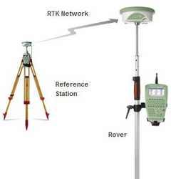
Single Reference Station RTK
RTK rovers traditionally receive RTK data from a single RTK reference station. The reference station may be permanently setup (e.g. on the roof of the office) or it might be temporarily set up in the field. In both cases the principle is the same.
The Principle
Setup up on a known point; compute corrections and send these to the rover via a communication link (normally a one-way radio modem or GSM connection)
Both the reference and rover are observing a common set of satellites.
The reference sends all its position and satellite observations to the rover.
The rover combines these reference station observations with its own
observations to compute an RTK position.

Slide 33
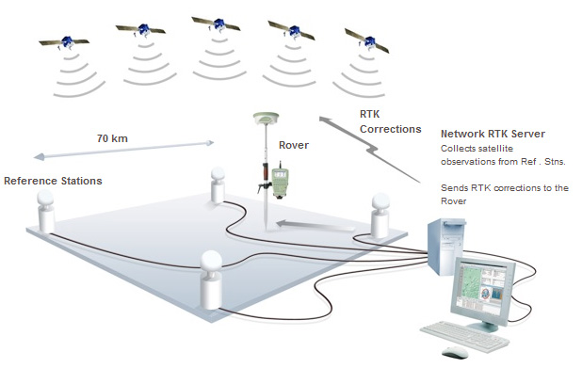
Network RTK
The Principle
The principle of Network RTK begins with all reference stations within the RTK Network continuously streaming satellite observations to a central server running Network RTK software, such as Leica GNSS Spider.
The Network RTK server software begins
the process by:
Fixing the integer ambiguities of the satellites (being
observed by the reference stations) within the network
; and using the data from all (or a subset of) reference
stations to generate corrections that are sent out to the
rover.

Slide 34
Different Methods of Network RTK
Three different Network RTK methods, MAX, i-MAX and Virtual Reference Station. There are significant differences between these methods and therefore different quality RTK solutions are achieved.
The MAX Method
The transmission of Master Auxiliary Corrections (MAX) is based on the Master Auxiliary Concept (MAC) proposed by Leica
The i-MAX Method
Individualized MAX (i-MAX) was developed at the same time as MAX to support older receivers that cannot support the MAX corrections.
The Virtual Reference Station Method
Terrasat developed the Virtual Reference Station method in the late 1990s and is comparable to i-MAX.

Slide 35
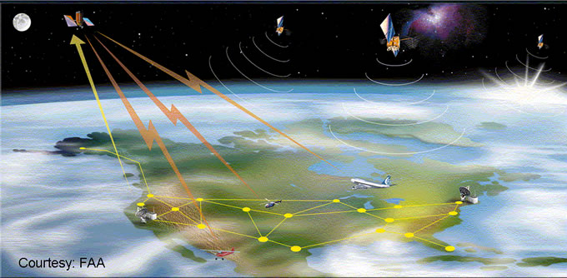
Satellite-based Augmentation Systems(SBAS)
In addition to ground based communications links, satellite are used to submit differential corrections to GNSS receivers derived from measurements taken at base stations:
The corrections are first sent to one or more satellites which broadcast them to enabled receivers.
There are several service around the world:
Euro Geostationary Navigation Overlay Service (EGNOS), EUROPE
Wide Area Augmentation Systems (WAAS), USA
Multifunctional Satellite Augmentation System (MSAS), JAPAN
GPS Aided GEO Augmented Navigation technology Demonstration System (GAGAN), INDIA

Slide 36
Achievable GPS accuracy
Accuracies that can be achived depending on techniques of GPS used for the observations
Postpro-
cessing
Relative
Phase Measurement
DGPS
RTK
Relative
Code-
measurment
DGPS
Code-
measuremnt
GPS
0,001
0,01
0,1
1,0
10,0
Accuracy in[m]
Detail
surveying
Spatial data
collections
Location,
Navigation

Slide 37
Developments and Future for satellite surveying
The American GPS improvements are planned and new satellite systems are emerging
GPS
Due to the success of GPS for Civilian user, the DoD is adding a second civilian frequency to L2 signal which is called L2C
C/A code will become available across the GPS constellation on L2 signal as well as L1 signal
To add a third civilian frequency known as L5 at 1176.45MHz
GLONASS
Operated by Russian, now it is fully operational since October 2011
GALILEO
Developed by the European Union and will provided a guaranteed global positioning service under civilian control
Will consists of 30 satellite (27 operational + 3 spares)
With a ground control segment located in Europe.
Beidou (Chinese GPS constellation)

Slide 38





Height from GPS
Orthometric height and Ellipsoidal heights
The ellipsoidal height $h$ is not a height referenced to any level surface but simply a distance along a normal above or below the surface of an ellipsoid.
Orthometric height ($H$) is measured when a levelling or using total station is referred to the geoid and is a distance measured along the local gravity vector (the vertical) from the geoid
Topographic
surface
Local level
Equipotential
surface
$$H$$
$$h$$
Geoid
$$N$$
Ellipsoid

Slide 39
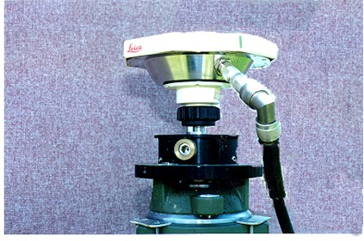
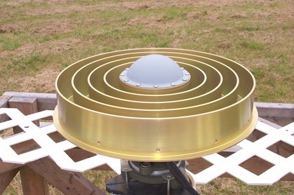
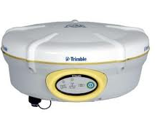
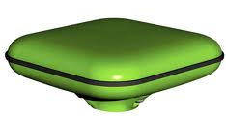
GPS Antennas
  Antenna types
    single or dual frequency
    Helical (bulky) or microstrip (flat)
  Backplanes
    antenna often bolted down on top of a backplane
    to reduce multi-pathing
    can be a large metallic disc
    can be a “choke ring”
  Size/Portability
    Backplanes are obviously heavier and larger
    Antennas can be
      mounted on ground (reduce multipath)
      placed on tripod (improve horizon)
      fixed to a “bipod” for large scale surveying
      can be physically integrated with receiver
Leica AT502
Ashtech Choke ring
Javad antenna
Trimble integrated antenna with a receiver

Slide 40

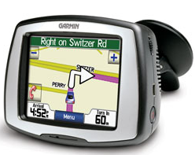
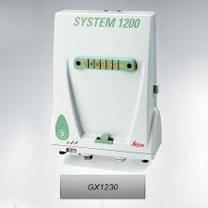
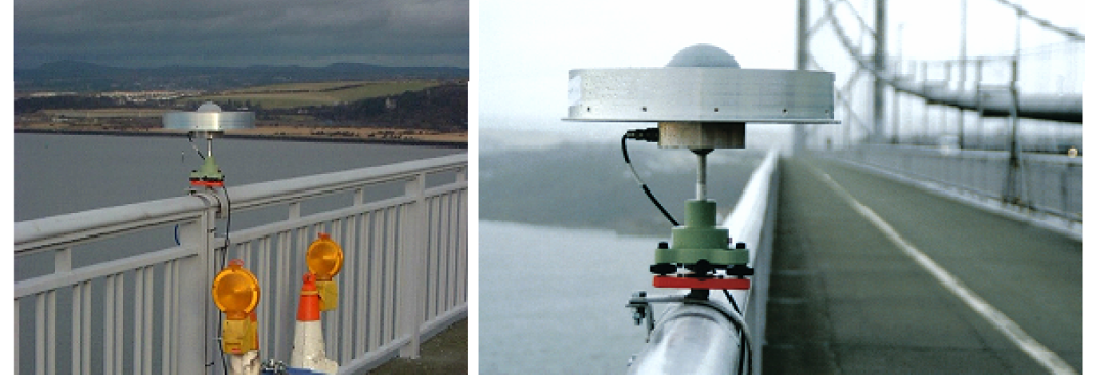
GPS receivers
There are three types of receivers
Code based
Navigation grade receivers for hand held devices (your IPhone)
Mapping grade
For use in GIS data collections (uses code ranging and DGPS)
to determine position
Geodetic
Use nearly in all work in surveying on construction sites; a high-precision geodetic dual-frequency receiver (survey grade receiver)
e.g Load Response on a Large Suspension bridge

