Slide 1
Surveying

Slide 2
Surveying
Surveying, has traditionally been defined as the science, art, and technology of determining the relative positions of points above, on, or beneath the Earth’s surface, or of establishing such points.
Surveying can be regarded as that discipline that encompasses all methods for measuring and collecting information about the physical Earth and our environment, processing that information, and disseminating a variety of resulting products to a wide range of clients.

Slide 3
Tasks of surveyors
The determination of the size and shape of the earth and the measurements of all data needed to define the size, position, shape and contour of any part of the earth and monitoring any change therein.
The positioning of objects in space and time as well as the positioning and monitoring of physical features, structures and engineering works on, above or below the surface of the earth.
The development, testing and calibration of sensors, instruments and systems for the above-mentioned purposes and for other surveying purposes.
The acquisition and use of spatial information from close range, aerial and satellite imagery and the automation of these processes.
The determination of the position of the boundaries of public or private land, including national and international boundaries, and the registration of those lands with the appropriate authorities.
The design, establishment, and administration of geographic information systems (GIS), and the collection, storage, analysis, management, display and dissemination of data.
The analysis, interpretation, and integration of spatial objects and phenomena in GIS, including the visualization and communication of such data in maps, models and mobile digital devices.
The planning, measurement and management of construction works, including the estimation of costs.

Slide 4
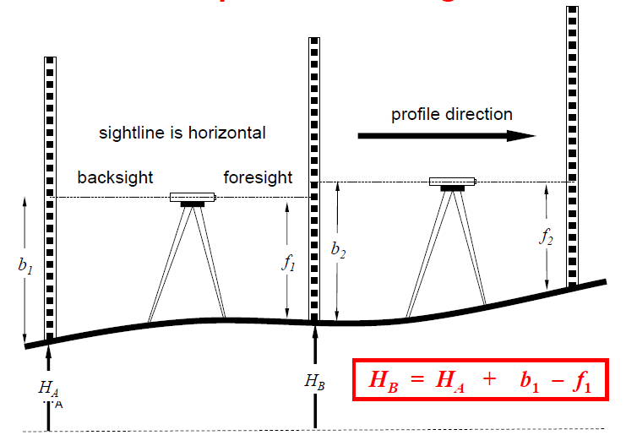
Principles of levelling

Slide 5
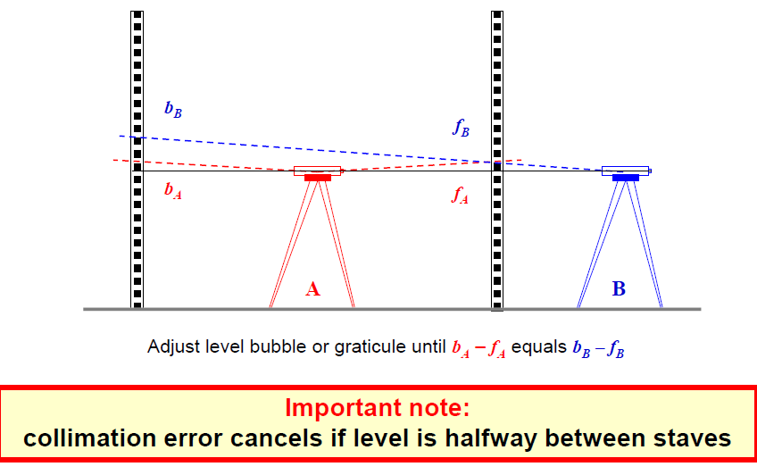
Testing for collimations errors

Slide 6
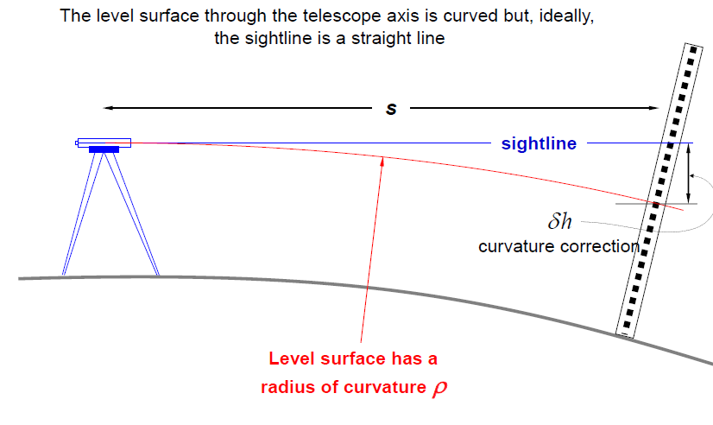
Curvature of the level surface

Slide 7
Tower height determination
• Vertical auxiliary triangle ( one-sided)
• With horizontal auxiliary triangle elevation
• With levelling
• Reflector prism
• Angle measurement : Each 3 times with full sets

Slide 8
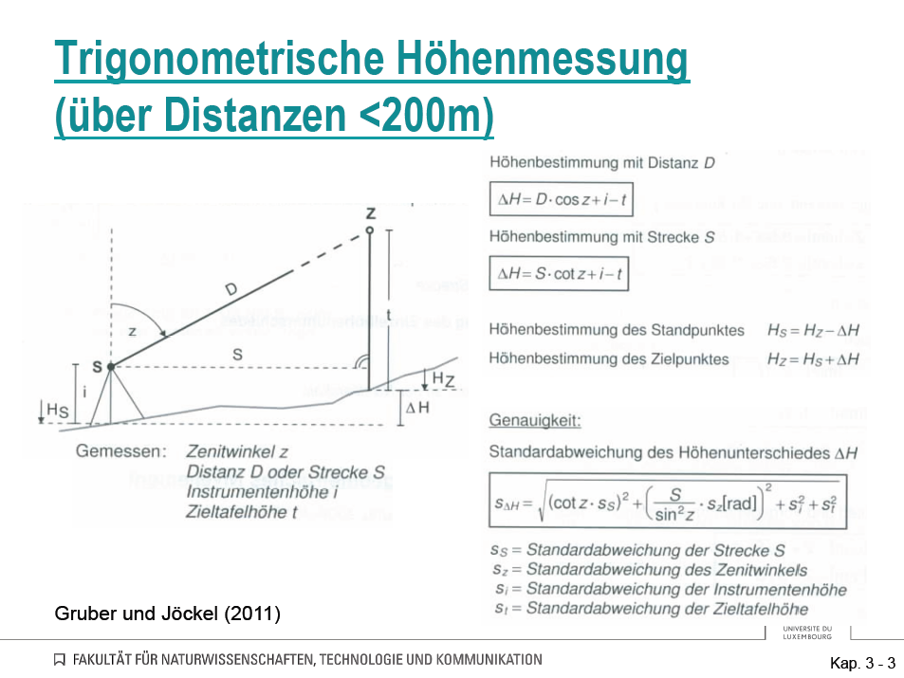
Trigonometric heightening

Slide 9
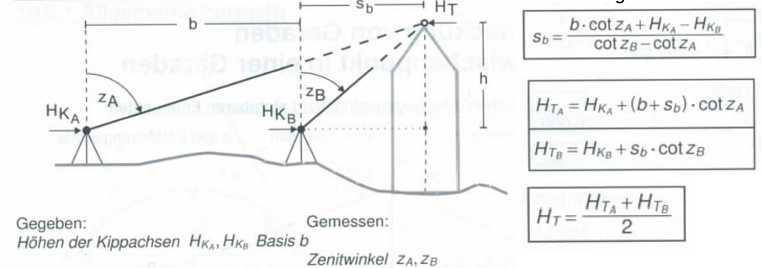
Vertical Triangle Method
Given Height of H_KA, H_KB
Measured: b, Zenith angles Z_A and Z_B

Slide 10
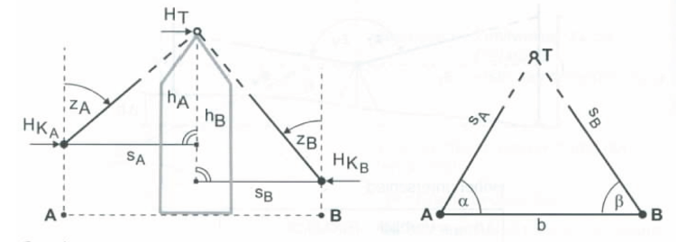
Horizontal Triangle Method

Slide 11
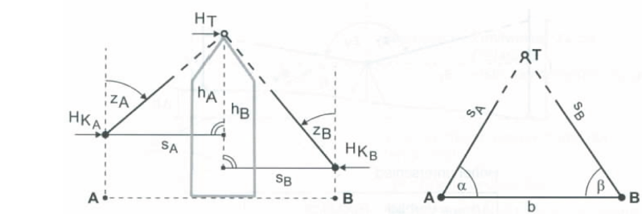
Horizontal Triangle Method
Given Height of H_KA, H_KB
Measured: b, Horizontal angles, α and β
And Zenith angles : Z_A and Z_B

Slide 12
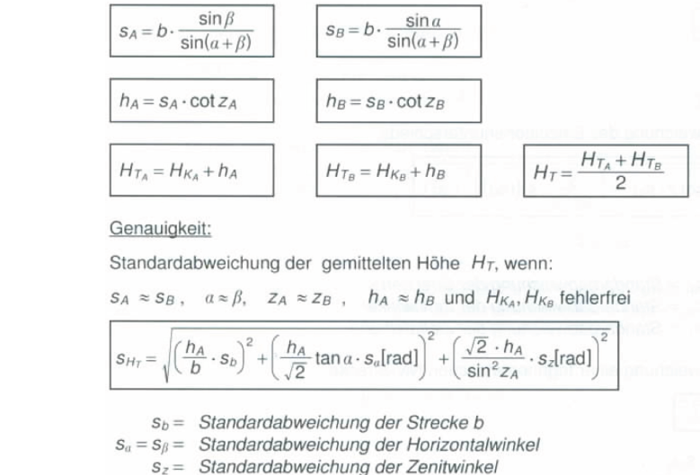
Horizontal Triangle Methods
Error analysis calculations formula : Knowing the accuracy of the instrument you have used

Slide 13
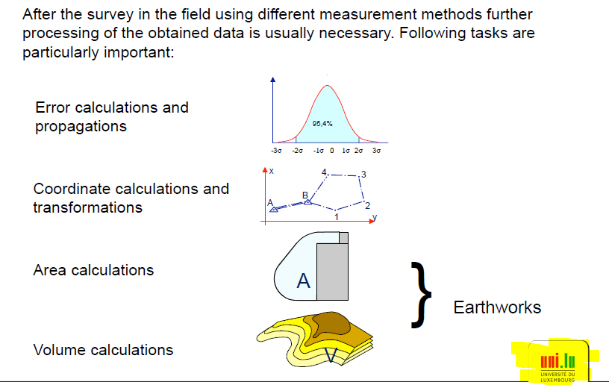
Geodetic Computations

Slide 14
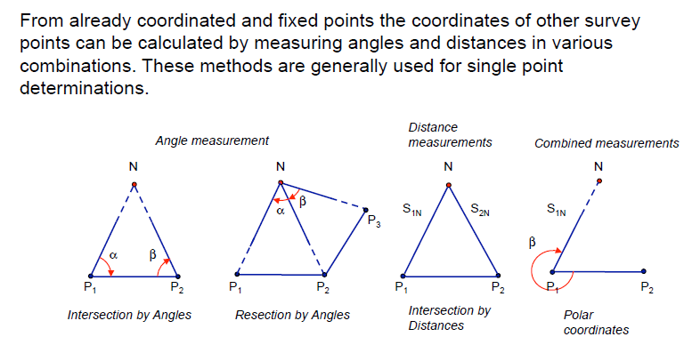

Conventional Control Surveys

Slide 15
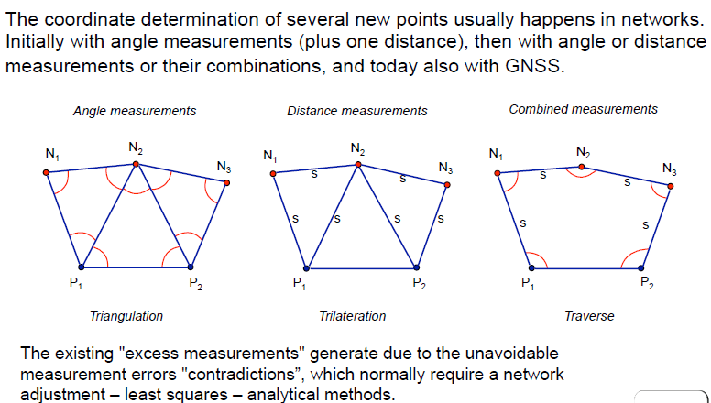
Conventional Control Surveys

Slide 16
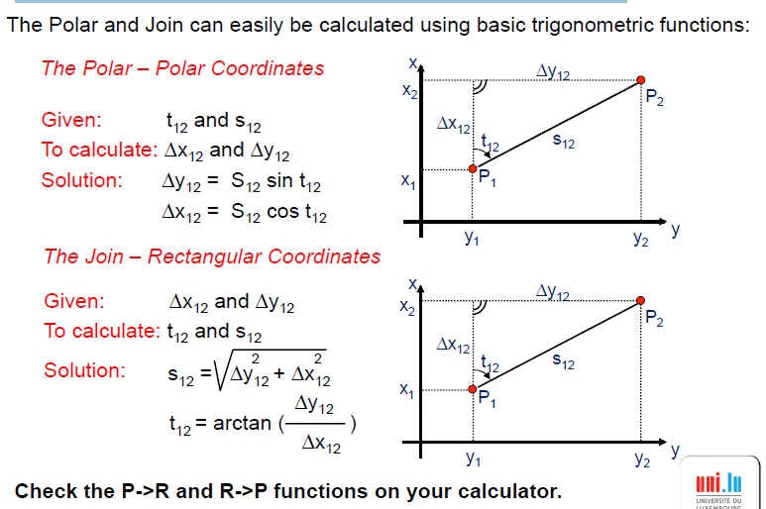
Polar and Rectangular Coordinates

Slide 17
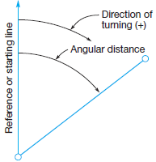
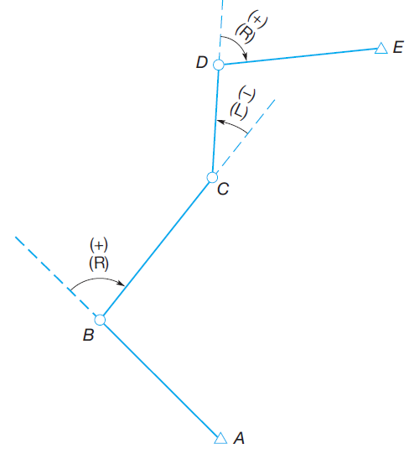
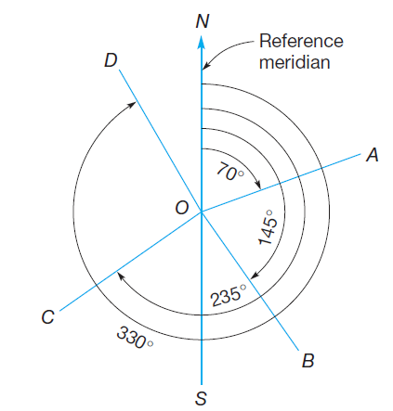
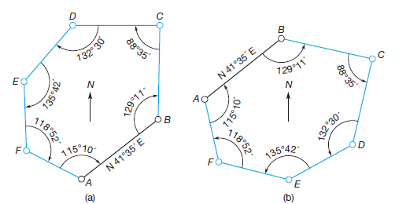
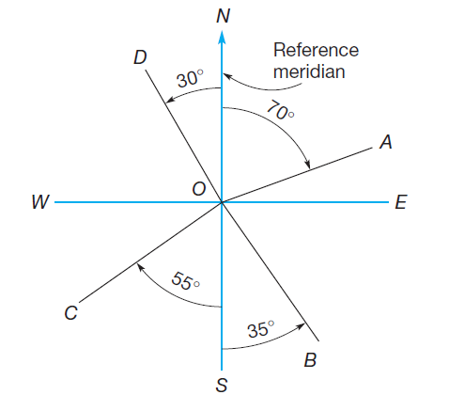
Angles, Azimuths, and Bearings
Deflection angles.
(a) Clockwise interior angles (angles to the right).
(b) Counterclockwise interior angles ( angles to the left).
Azimuths.
Bearing angles.

Slide 18
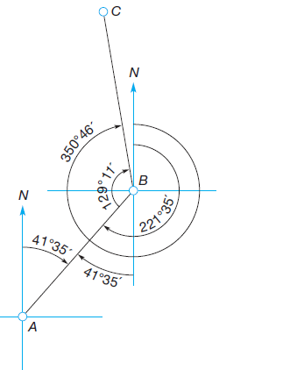
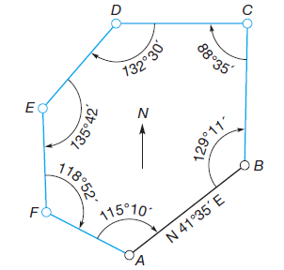
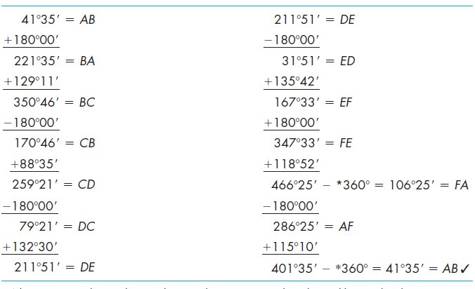
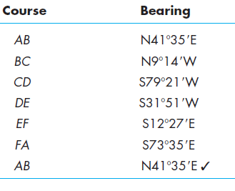
Computation of Azimuths (from North) and Bearing

Slide 19
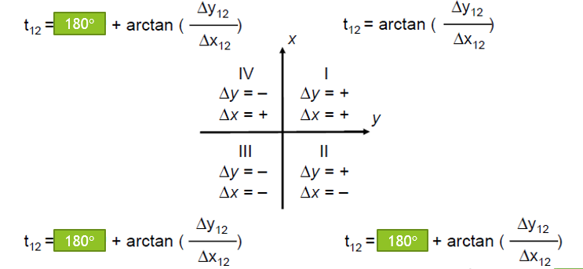
Azimuth Quadrants
Since the arctan - function is only uniquely defined in the first quadrant (0 – 90°) the azimuth in other quadrants needs additional information, i.e. the positive/negative Δx or Δy, to identify the correct azimuth.

Slide 20
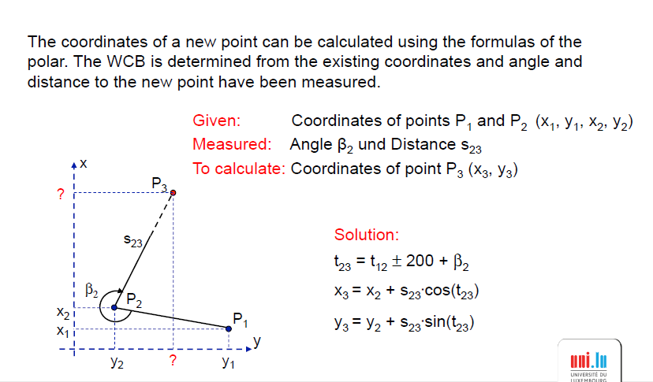
Coordinates from Measurements

Slide 21
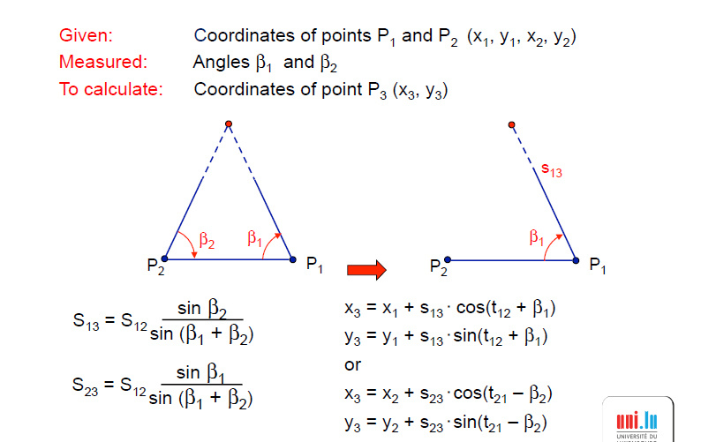
Intersection by Angles: Example

Slide 22
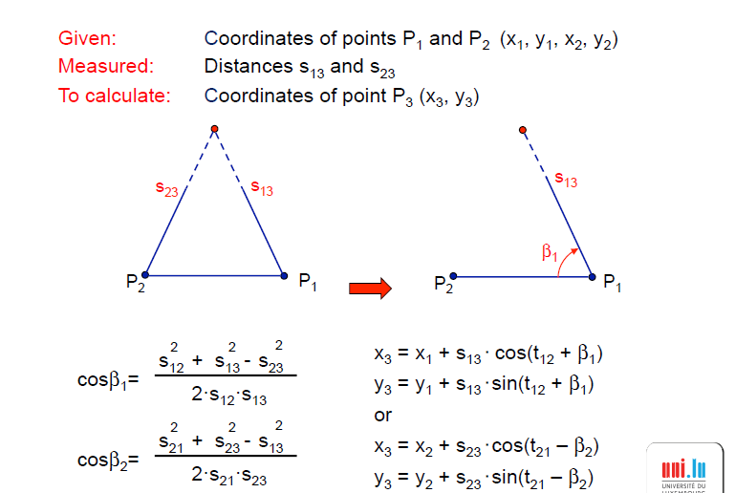
Intersection by Distances: Example

Slide 23
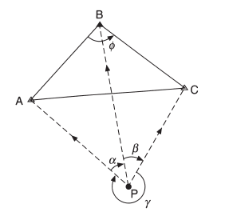
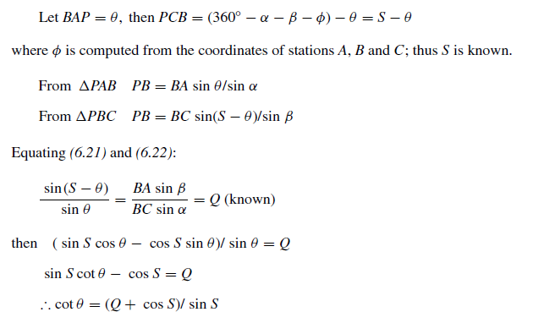
Resection
This involves the angular measurement from P out to the known points A, B, C. It is an extremely useful technique for quickly fixing position where it is best required for setting-out purposes.

Slide 24
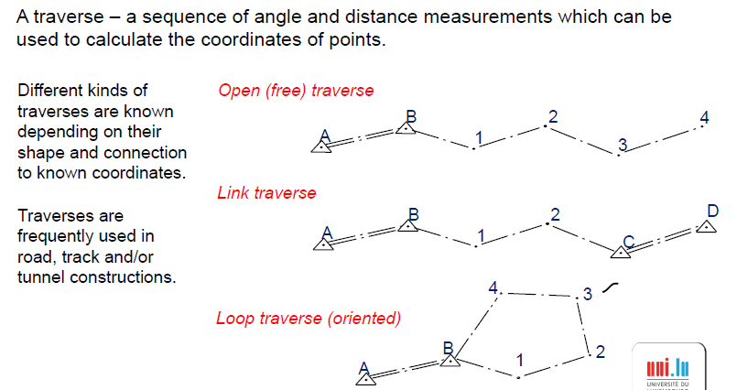
Traverse

Slide 25
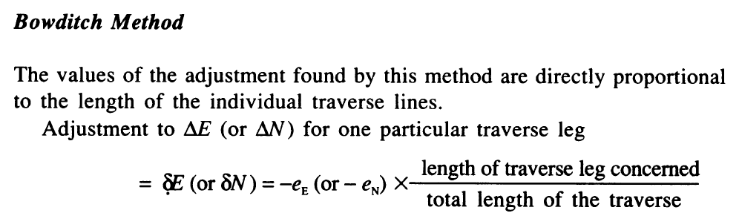
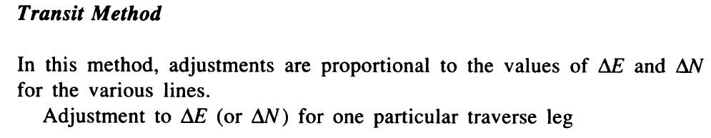
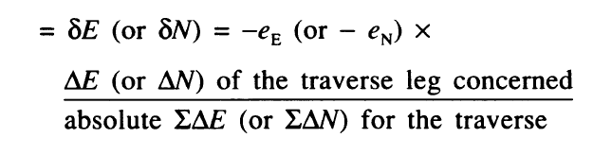
Distribution of the Misclosure

Slide 26
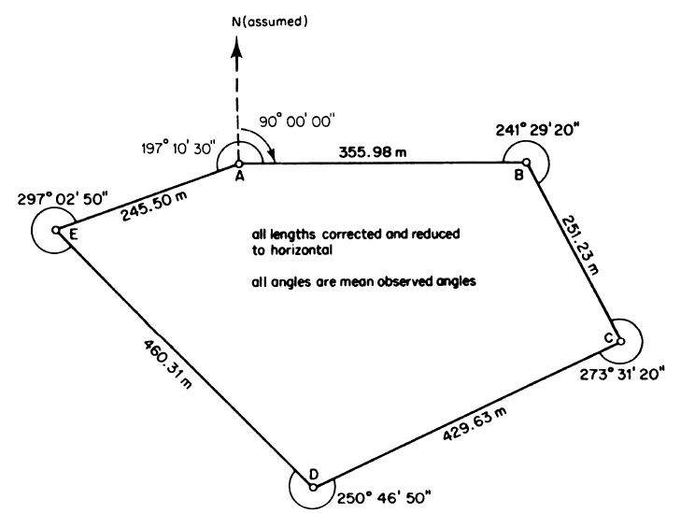
Worked Examples: Traversing

Slide 27
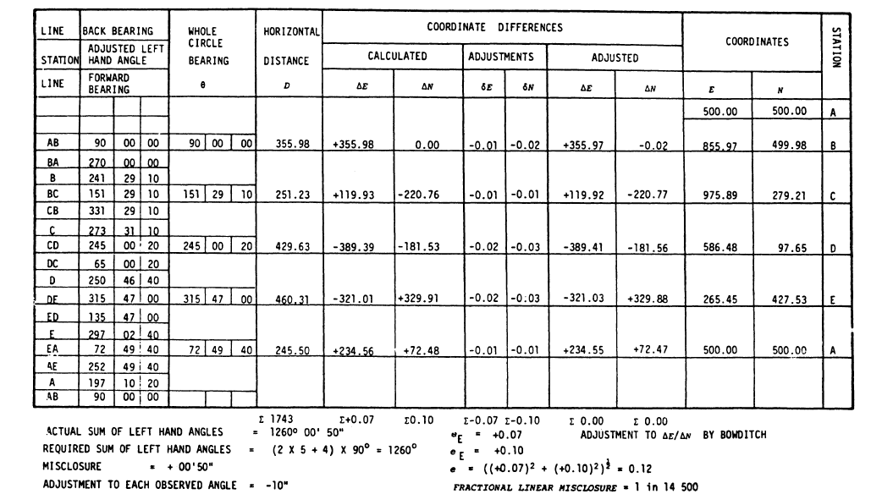
Worked Examples: Traversing

Slide 28
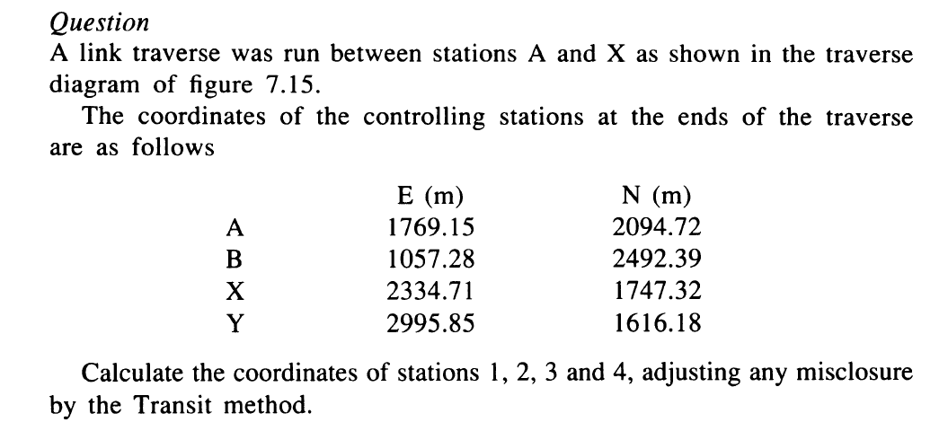
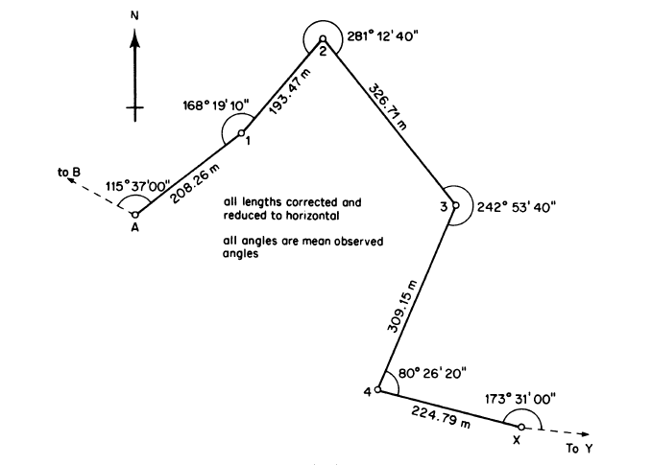
Link Traverse

Slide 29
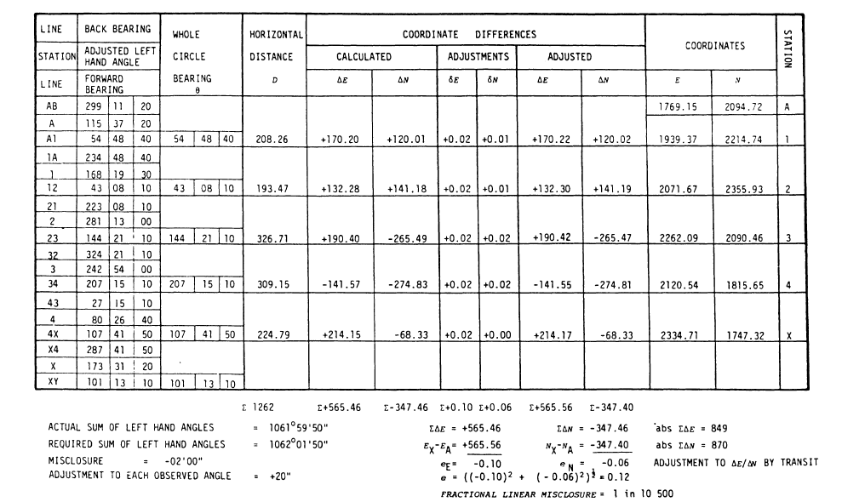

Slide 30
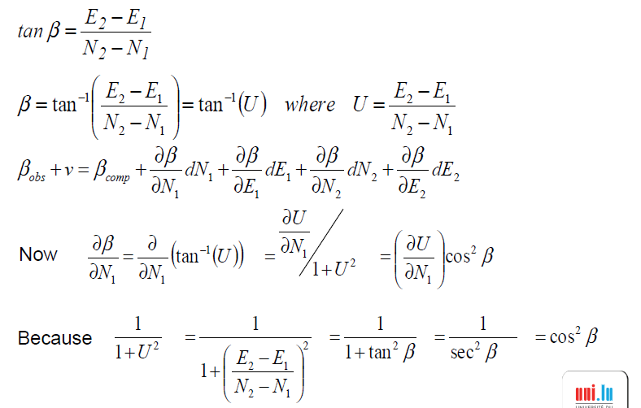
Least Squares Adjustment-Distance Observation Equation

Slide 31
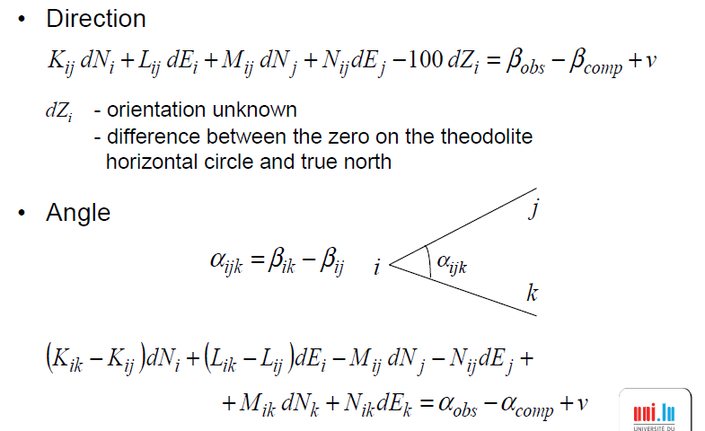
Least Squares Adjustment-Direction and Angle Observation Equation

Slide 32

Computation Procedure
Compute approximate coordinates
Calculate ‘computed’ distances and bearings between provisional positions
Set up one observation equation for each observation
Weight observations equations
Form normal equations - tabular method, matrix algebra
Solve for corrections - dN, dE
Add corrections to the approximate coordinates
…… to give final coordinates
Iterate

