Slide 1
Chapter 2
Nonlinear System analysis

Slide 2
Contents
Second Order Systems
Phase plane analysis
Describing function method

Slide 3
Second order systems
Consider a nonlinear system described by
A usual analysis method for such system is a plot of x1 vs x2 which is called state plane plot or state plane trajectory
A special case of such systems is when

Slide 4
Analysis of nonlinear systems
Existence of solution
In linear systems, a solution to the system differential equation always exists and is unique
However in nonlinear systems, solution may not exist or may not be unique
To guarantee the existence and uniqueness of solution, conditions must be satisfied
For a nonlinear system differential given by
Two conditions for global existence are:
Where kT and hT are constants

Slide 5
Analysis of nonlinear systems
The above condition is called global Lipschitz condition
Example: check if the following nonlinear system satisfies global Lipschitz condition
A)
B)
Two important analysis methods are
Phase plane analysis
Describing function method

Slide 6
Phase plane analysis
Is study of a second order system using graphical method
Is a plot of motion trajectories corresponding to various initial conditions without solving the nonlinear system equations
Used to analyze stability and motion patterns of the system

Slide 7
Phase plane analysis
This is used for second order systems of the form
For such systems, we choose two state variables x1 and x2 as
Then the state equation becomes
A plot of time variation of x2 versus x1 is known as phase plane plot or phase plane trajectory
The phase plane trajectory gives some picture on the stability of the nonlinear system under study

Slide 8
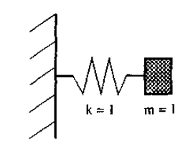
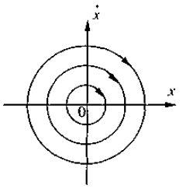
Phase plane analysis
Example: Consider the spring mass damper system shown below

Slide 9
Equilibrium points
Consider a nonlinear state space model given by
A vector xo is called an equilibrium if
This means when a system has an equilibrium point,
the system moves to the equilibrium point from any initial condition
The system remains at the equilibrium point if it starts from it
Equilibrium points are solutions of the differential equation
Each solution point determines an equilibrium point

Slide 10
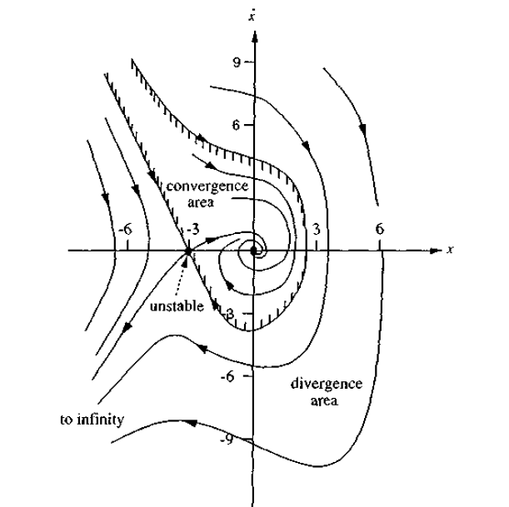
Equilibrium points
Consider the system given by
Determine the equilibrium points

Slide 11
Equilibrium points
Equilibrium points are also known as singular points
The slope of the phase portrait at the equilibrium points is indeterminate
Stability is completely determined by the nature of the singular points for linear system but for nonlinear system limit cycle should also be considered

Slide 12
Phase plane analysis
Phase portrait may have symmetry about the origin or about x1 or x2 axes
Methods used
Method of analytical solutions
Method of isocline
Delta method
Pell’s method

Slide 13
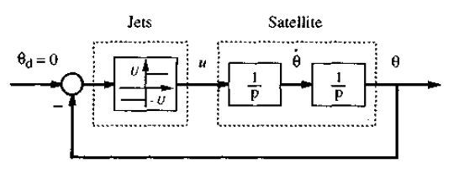
Phase portrait analysis
Analytical method
is solving the differential equation for x1 and x2 and then eliminating the time variable
Directly solving the ration of dx2/dx1 and generating the equation relating x2 to x1
Consider the example below

Slide 14
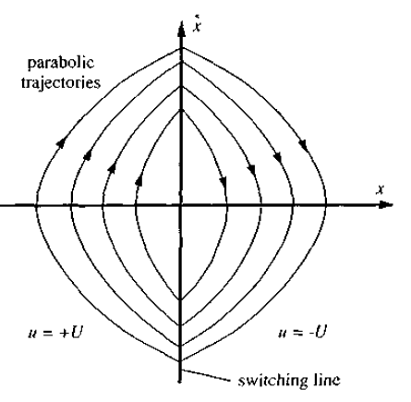
Phase plane analysis
The system dynamics and the control signal is given by
Solving the dynamic equation analytically

Slide 15
Phase plane analysis
Method of isocline
Isocline is the locus of points with the same slope
Consider the following system
Then the isocline equation is

Slide 16
Phase plane analysis
Determine the phase plane trajectory for Van der Pol’s equation using isocline method and computer program.
Compare your results

Slide 17
Describing function method
This is a method which consists of replacing a nonlinear element with in a system by an equivalent linear time invariant system which gives the best approximation of the nonlinear system
In replacing the nonlinear element with linear one we use various approximations
Optimal quasi linearization
Where a nonlinear system N is approximated by a linear system H and the approximation is measured by an error criteria given as
Where the integral is integral of difference of impulse responses and r is a reference input

Slide 18
Describing function method
The reference input usually taken is sinusoidal input
For such an input the nonlinear system output will have transient part and steady state part
Transient part is decaying
Steady state part is periodic
In optimal quasi linearization, we try to find a linear system which can have a similar steady state part to the first harmonic of the steady state part of the nonlinear system output for the input r(t)
If we assume the first harmonic of the steady state output of the nonlinear system to be given by
Then the optimal quasi linearization of the nonlinear system is given by a linear system whose frequency response is given by

Slide 19
Describing function method
Describing function
By definition the describing function of a nonlinear system N is given by
Where
Is the first harmonic of the steady state output of the nonlinear system and a is the amplitude of the sinusoidal input r

Slide 20
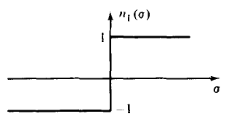
Describing function method
Consider the sign nonlinear function given as
The describing function of this nonlinearity is then
Output of the nonlinear system for sinusoidal input is square wave whose first harmonic is 4/pi

