Slide 1
Chapter 7
RADIATION
HEAT TRANSFER
Yilma Tadesse(PhD)
School of Mechanical and Industrial Engineering
AAiT
Addis Ababa University

Slide 2
Introduction
Radiative heat transfer or thermal radiation is the science of transferring energy in the form of electromagnetic waves.
Unlike heat conduction, electromagnetic waves do not require a medium for their propagation. Therefore, because of their ability to travel across vacuum, thermal radiation becomes the dominant mode of heat transfer in low pressure (vacuum) and outer-space applications.

Slide 3
Another distinguishing characteristic between conduction (and convection, if aided by flow) and thermal radiation is their temperature dependence. While conductive and convective fluxes are more or less linearly dependent on temperature differences, radiative heat fluxes tend to be proportional to differences in the fourth power of temperature (or even higher).
For this reason, radiation tends to become the dominant mode of heat transfer in high-temperature applications, such as combustion (fires, furnaces, rocket nozzles), nuclear reactions (solar emission, nuclear weapons), and others.

Slide 4

All materials continuously emit and absorb electromagnetic waves, or photons, by changing their internal energy on a molecular level. Strength of emission and absorption of radiative energy depend on the temperature of the material, as well as on the wavelength λ, frequency ν, or wave number η, that characterizes the electromagnetic waves,

Slide 5
Thermal radiation is that electromagnetic radiation emitted by a body as a result of its temperature. Unlike conduction and convection, it requires no matter for the transfer. All electromagnetic radiations are propagated at the speed of light, given as the product of wavelength and frequency.
c = λν
1Å (angstrom) = 10⁻⁸ cm.
A portion of the electromagnetic spectrum is shown in figchp11\fig11.1.pptx
Thermal radiation lies in the range about 0.1 to 100μm. The visible light is between 0.35 to 0.75 μm.

Slide 6
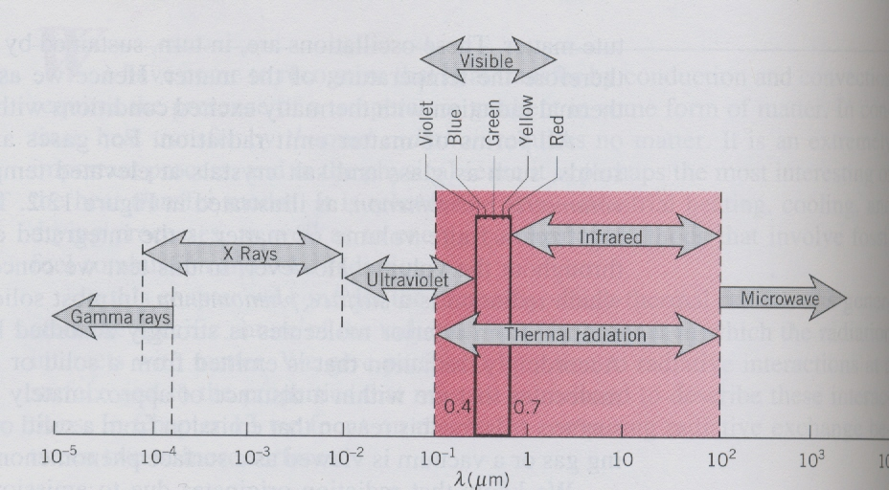
Fig.11.1 Spectrum of electromagnetic radiation

Slide 7
The modern theory views thermal radiation as the propagation of a collection of particles called photons or quanta with quantum of energy given by
E = hν h=6.625x10⁻³⁴ J.s (Planck’s constant)
Using E = mc² = hν one can find the momentum of a photon as
Momentum = mc = hν/c
Quantum – statistical thermodynamics gives the energy density of radiation per unit volume and per unit wave length as

Slide 8
When the above is integrated over all wavelengths it gives
The above is called the Stefan-Boltzmann law, E_{b} is the energy(W) radiated per unit time and per unit area by the ideal radiator, and σ is the Stefan-Boltzmann constant given by
σ = 5.669x10⁻⁸ W/m².K⁴

Slide 9
Radiation Properties
When radiant energy is incident on a surface (called irradiation), part of the radiation is reflected, part is absorbed, and part is transmitted as shown in figchp11\fig11.2.pptx .
For irradiation given by G
G = αG +ρG + τG or α +ρ+τ =1
α = Absorptivity ρ = Reflectivity τ = Transmissivity
For solid bodies that do not transmit
α +ρ =1
Two types of reflections:
Specular- incidence and reflection angles are

Slide 10
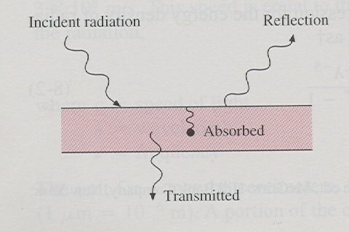
Fig.11.2 Sketch showing effects of radiation

Slide 11
equal.
Diffuse – incident beam is distributed uniformly in all directions after reflection figchp11\fig11.3.pptx
The emissive power of a body E is defined as the energy emitted by the body per unit area per unit time. Shown in figchp11\fig11.4.pptx the black enclosure will absorb all the incident radiation falling upon it. It will also emit radiation according to the T⁴ law. Let the radiant flux arriving at some area in the enclosure be q_{i} W/m². If a body is placed inside the enclosure and allowed to come to equilibrium, the energy absorbed and emitted by the body are equal.

Slide 12
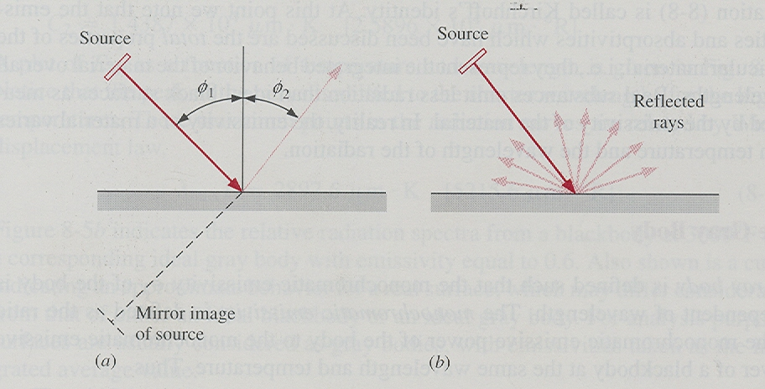
Fig.11.3 (a) Specular ( ) and (b) diffuse reflection

Slide 13
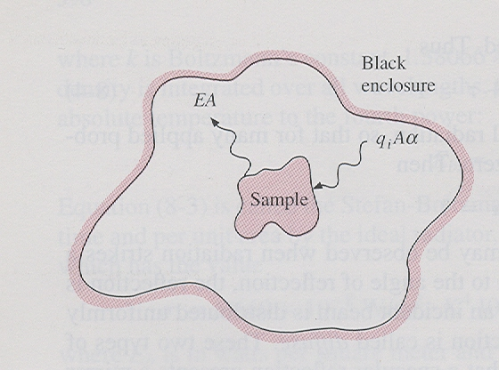
Fig.11.4 Model used to derive Kirchoff’s law

Slide 14
At equilibrium
EA = q_{i}Aα
If the body had been a black body, then
E_{b}A = q_{i}A(1)
The above will give the ratio of the emissive power of a body to the emissive power of a blackbody at the same temperature as the absorptivity. This ratio is also defined as the emissivity ε of the body, given as

Slide 15
The equality of α and ε is called Kirchoff’s identity.
The Gray Body
A gray body has its monochromatic emissivity ε_{λ} independent of the wavelength. Monochromatic emissivity is defined as the ratio of the monochromatic emissive power of the body to the monochromatic emissive power of a black body at the same wavelength and temperature.

Slide 16
The total emissivity of the body and that of a blackbody can be determined as
From the above
If the gray body condition is imposed, ε_{λ} = constant, the above equation reduces to
ε = ε_{λ}

Slide 17
It has to be noted that the emissivities of various substances vary widely with wavelength, temperature, and surface condition.
For a blackbody, according to Planck, E_{bλ} (spectral emissive power) is given by
λ=wavelength, μm
T=temperature, K
C₁ = 3.743 x 10⁸ W.μm⁴/m²
C₂ = 1.4387 x 10⁴ μm . K

Slide 18
This emissive power is plotted in figchp11\fig11.5.pptx . Close observation of the curves shows a shift of the peak points to the shorter wavelengths for higher temperatures. This shift is defined by Wien’s displacement law given by
λ_{max} T = 2897.6 μm.K
The sun at 5800 K is considered as a black body. The maximum emission is in the visible range and this appears as white. For a black body at 1000K, peak emission occurs at 2.90 μm (not visible), with some of the emitted radiation appearing visible as red light.

Slide 19
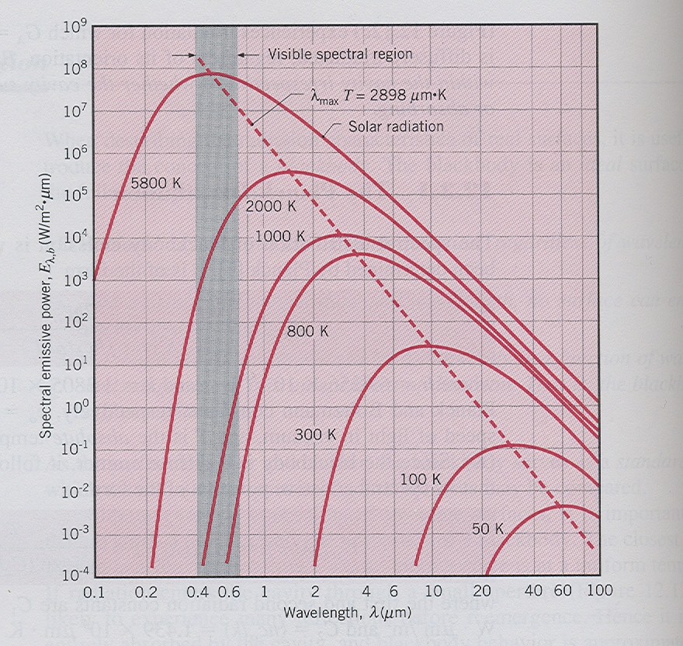
Fig.11.5 Spectral blackbody emissive power

Slide 20
figchp11\fig11.6.pptx shows the spectral energy density of a black body at 1922 K, a corresponding gray body with ε = 0.6 and approximate behavior of a real surface.
Band Emissions
Frequently it will be of interest to get the amount of energy radiated from a black body in a certain specified wavelength range, figchp11\fig11.7.pptx. This is expressed as a fraction given by

Slide 21
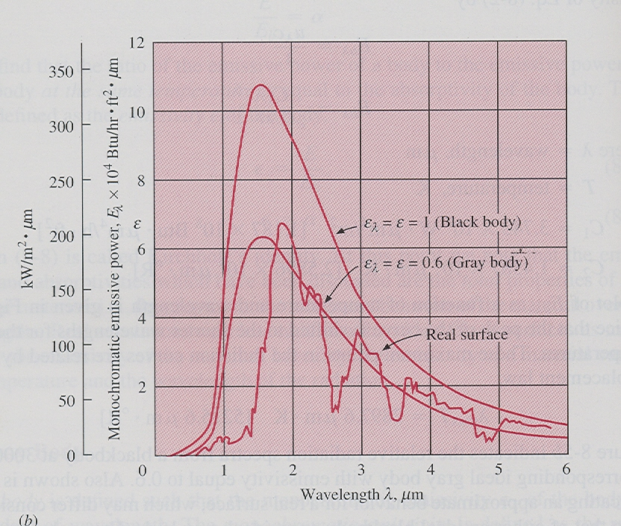
Fig.11.6 Comparison of emissive power of ideal blackbodies, and gray bodies with that of a real surface

Slide 22
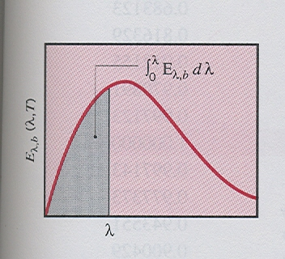
Fig.11.7 Blackbody radiation emission in the spectral band 0 to λ

Slide 23
Rearranging the spectral emission equation as
The results of the above have been tabulated (Table 1) and graphically in figchp11\fig11.8.pptx .
For radiant energy emitted between wavelengths λ₁ and λ₂
From practical observations, ordinary glass is transparent to solar radiation while not transmitting

Slide 24
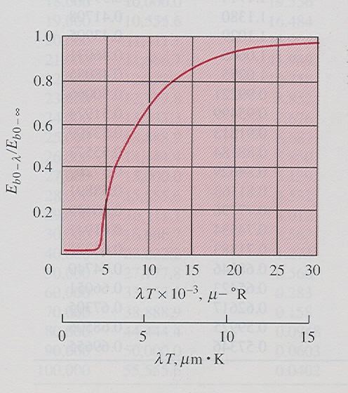
Fig. 11.8 Fraction of blackbody radiation in wavelength interval

Slide 25
earthly radiations. This is what is called the greenhouse effect.
Solar radiation approximates that of a black body at 5800K. Ordinary window glass transmits radiation up to about 2.5 μm. This gives λT= 2.5 x 5800 = 14500 μm.K. Referring to the table, about 97 % of the radiation emitted is transmitted through the glass. Glass is transparent for solar radiation. Whereas earthly radiations at about 300 K λT=2.5 x 300 = 750 μm.K. The table shows only a minute fraction (less than 0.001 percent) of this radiation is transmitted. Glass is opaque for earthly radiations. There comes the greenhouse effect!

Slide 26
Example 11.1
A glass plate 30 cm square is used to view radiation from a furnace. The transmissivity of the glass is 0.5 from 0.2 to 3.5 μm. The emissivity may be assumed to be 0.3 up to 3.5 μm and 0.9 above that. The transmissivity of the glass is zero, except in the range from 0.2 to 3.5 μm. Assuming that the furnace is a blackbody at 2000ºC, calculate the energy absorbed in the glass and the energy transmitted.
Solution
T = 2000ºC = 2273 K

Slide 27
λ₁T = (0.2)(2273) = 454.6 μm.K
λ₂T = (3.5)(2273) = 7955.5 μm.K
A = (0.3)² = 0.09 m²
From table
σT⁴ = (5.669 x 10⁻⁸)(2273)⁴ = 1.5133 x10⁶ W/m²
Total incident radiation is
0.2 μm < λ <3.5 μm
= (1513.3)(0.85443 - 0)0.09= 116.4 kW
Total radiation transmitted = (0.5) (116.4) = 58.2 kW

Slide 28
Total radiation absorbed = 34.92 +17.84 = 52.76 kW

Slide 29
Radiation Shape Factor
Given two black surfaces which see each other, as shown in figchp11\fig11.9.pptx , a general expression for energy exchange between such surfaces at different temperatures will be required. This will require the concept of radiation shape factors or view factors. These are defined as follows.
F₁₋₂ = fraction of energy leaving surface 1 which reaches surface 2
F₂₋₁ = fraction of energy leaving surface 2 which reaches surface 1
F_{m-n} = fraction of energy leaving surface m which reaches surface n

Slide 30
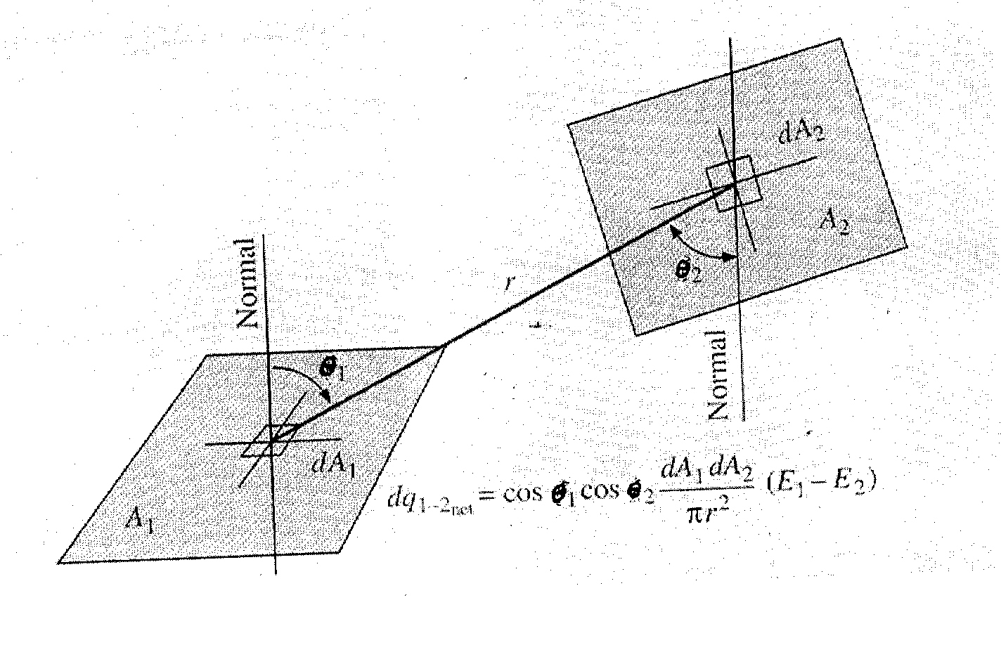
Fig. 11.9 Area elements used in deriving shape factor

Slide 31
The energy leaving surface 1 and arriving at surface 2 is E_{b1}A₁F₁₂
and the energy leaving surface 2 and arriving at surface 1 is E_{b2}A₂F₂₁
All radiations falling on black surfaces will be completely absorbed.
The net energy exchange is given by
Q₁₋₂ = E_{b1}A₁F₁₂ - E_{b2}A₂F₂₁
For T₁ = T₂, Q₁₋₂ =0
This will give A₁F₁₂ = A₂F₂₁
This reciprocity relation will hold true for all situations.

Slide 32
The net heat exchange will therefore be
Q₁₋₂ = A₁F₁₂(E_{b1} – E_{b2}) = A₂F₂₁(E_{b1} – E_{b2})
The general reciprocity relation for any two surfaces i and j will be
A_{i}F_{ij} = A_{j}F_{ji}
The direction of emission from dA₁ is given with reference to the zenith and azimuthal angles as shown in figchp11\fig11.10.pptx . This radiation passes through a differential area dA_{n} which is normal to the path of the radiation. This area subtends a solid angle dω when viewed from a point on dA₁. The similarity of the angle subtended by an arc and

Slide 33
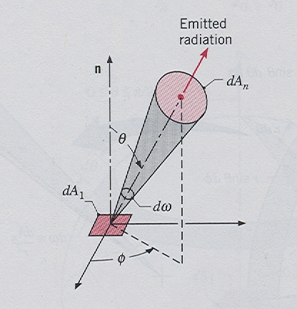
Fig.11.10 Emission of radiation from a differential area dA₁ into a solid angle dω subtended by dA_{n} at a point dA₁

Slide 34
the solid angle subtended by an area is shown in figchp11\fig11.11.pptx . The plane angle dα has a unit of radians while that of dω is the steradian (sr).
To determine a general relation for shape factors, consider the angles θ₁ and θ₂, the angles with reference to the normals of the surfaces. The projection of dA₁ on the line between centers is
dA₁ cos θ₁
The radiation intensity is that emitted per unit area and per unit of solid angle in a certain specified direction. This is given by I_{b} considering a black surface.

Slide 35
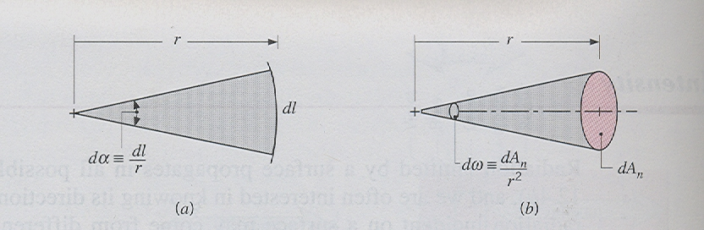
Fig.11.11 Definition of (a) plane and (b) solid angles

Slide 36
The differential solid angle can easily be determined as shown in figchp11\fig11.12.pptx . This is given by
Thus the energy leaving dA₁ in the direction of θ₁ is
I_{b} dA₁ cos θ₁
The radiation arriving at some areal element dA_{n} at a distance r from A₁ would be
I_{b} dA₁ cos θ₁ (dω)
The intensity from the differential area can be determined in terms of the emissive power by

Slide 37
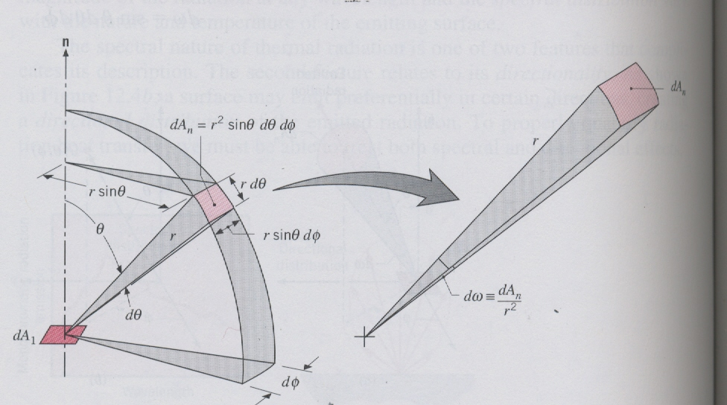
Fig.11.12 The solid angle subtended by dA_{n} at a point on dA₁ in the spherical coordinate system

Slide 38
integrating over a hemisphere enclosing the elemental area dA₁ as shown in figchp11\fig11.13.pptx .
With respect to the line, r, connecting the two differential areas dA₁ and dA₂, the area dA_{n} is given by
dA_{n} = cos θ₂ dA₂
This will give the energy leaving dA₁ and arriving

Slide 39
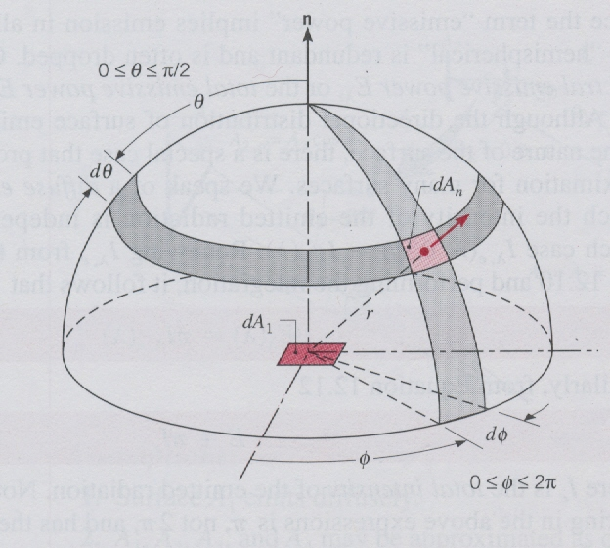
Fig.11.13 Emission from a differential element of area dA₁ into a hypothetical hemisphere centered at a point on dA₁

Slide 40
at dA₂ as
And the energy leaving dA₂ and arriving at dA₁ will be
As the integrals are exactly the same, the above equations give the reciprocity relation
A_{i}F_{ij} = A_{j}F_{ji}

Slide 41
The view factor for an enclosure with N surfaces with temperatures T₁, T₂, …., T_{N} is given by
The term F_{ii} is non zero if it sees itself.
For radiation exchange in an enclosure of N surfaces, a total of N² view factors is needed as arranged in the matrix form

Slide 42
Out of this N² view factors, which require N² equations, there are N equations formed by the summation rule and N(N-1)/2 equations formed by the reciprocity relations. This will then require only (N²-N(N-1)/2)=N(N-1)/2 view factors to be determined. For a three surface enclosure we need to determine three view factors only to completely determine the view factors.
As an example consider a two surface enclosure involving two spheres as shown in figchp11\fig11.15.pptx . For this we will need to determine four view factors (F₁₁, F₁₂, F₂₁, F₂₂).

Slide 43
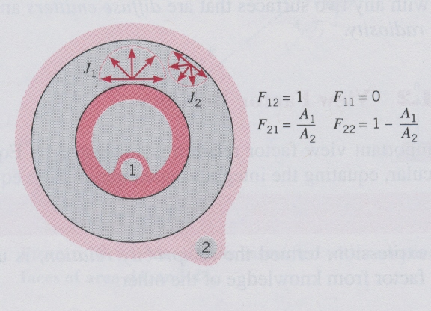
Fig.11.15 View factors for the enclosure formed by two spheres

Slide 44
Only N(N-1)/2 view factors need to be determined to completely get the values of the view factors. One view factor is to be determined directly. By inspection F₁₁ = 0 . For the rest use the equations formed by summation given by
F₁₁ + F₁₂ =1 F₁₂ =1
F₂₁ + F₂₂ =1
And the reciprocity relation
A₁F₁₂ = A₂F₂₁
(three equations and three unknowns)
F₂₁= A₂ /A₁ F₂₂ = 1 - F₂₁ = 1 - A₂ /A₁

Slide 45
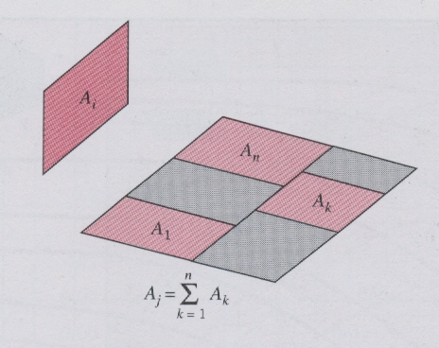
Fig.11.14 Areas used to illustrate view factor relations

Slide 46
For other complicated geometries, the double integral equations have been solved and the results given in tables and graphs.(tables 2&3, and graphs 1, 2, and 3)
For view factors to a subdivided surface shown in figchp11\fig11.14.pptx, consider the radiation from surface i to surface j, which is divided into n components, the view factor is given as a summation

Slide 47
The view factor when radiation originates from a subdivided surface can be determined as follows:
Multiplying the above equation by A_{i} and applying the reciprocity relation gives

Slide 48
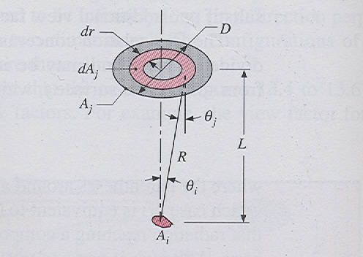
Example 11.2
Consider a diffuse circular disk of diameter D and area A_{j} and a plane diffuse surface of area A_{i} <<A_{j}. The surfaces are parallel, and A_{i} is located at a distance L from the centre of A_{j}. Obtain an expression for the view factor F_{ij}.

Slide 49
Solution
We will use
θ_{i}, θ_{j}, and R are approximately independent of position on A_{i}, the above reduces to
Using R² =r² +L², cos θ = (L/R) and dA_{j} = 2πrdr , the integration will give

Slide 50
Example 11.3
Determine all the view factors for the following geometries.
Sphere of diameter D inside a cubical box of length L=D.
Diagonal partition within a long square duct.
End and side of a circular tube of equal length and diameter.

Slide 51
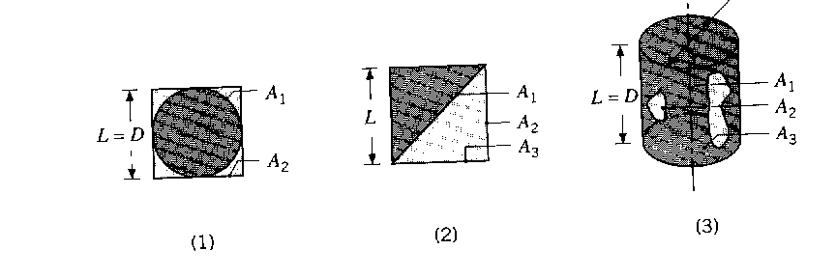
Solution
1. Sphere within a cube:
F₁₂ =1 F₂₁ = (A₁/A₂)F₁₂ = (πD²/(6L²)x1 = π/6
From summation relation
F₁₁ + F₁₂ = 1 → F₁₁ = 0
F₂₁ + F₂₂ = 1 → F₂₂ = (1- π/6)

Slide 52
Partition within a square duct
By inspection F₁₁ = F₂₂ = F₃₃ = 0
Summation equations
F₁₂ + F₁₃ = 1 (symmetry F₁₂ = F₁₃ =0.5)
F₂₁ + F₂₃ = 1
F₃₁ + F₃₂ = 1
A₂ = A₃ = L A₁ = (√2)L
Reciprocity
A₁F₁₃ = A₃F₃₁ F₃₁ = (A₁/A₃)F₁₃= (√2)F₁₃=0.71
A₁F₁₂ = A₂F₂₁ F₂₁ = (A₁/A₂)F₁₂=(√2)F₁₂ =0.71
A₂F₂₃ = A₃F₃₂ F₃₂ = (A₂/A₃)F₂₃= F₂₃
F₂₃ = 1-F₂₁=1-0.71=0.29
F₃₂ = F₂₃ = 0.29

Slide 53
3. Circular tube:
Using Graph 2 with r₃/L = 0.5 and L/r₁ = 2 will give F₃₁≈0.17
F₁₁ = 0 F₃₃ = 0
A₁ = A₃ = (πD²/4) A₂ = πD²
Summation equations
F₁₂ + F₁₃ = 1
F₂₁ + F₂₂ + F₂₃ = 1 (symmetry F₂₁ = F₂₃)
F₃₁ + F₃₂ = 1 (F₃₂ = 1-F₃₁ = 0.83)
Reciprocity
A₂F₂₃ = A₃F₃₂ F₂₃ = (A₃/A₂)F₃₂= (1/4)F₃₂=0.208 F₂₁=0.208
A₁F₁₃ = A₃F₃₁ F₁₃ = (A₃/A₁)F₃₁= F₃₁=0.17
F₂₂ = 1 – (F₂₁ + F₂₃) = 0.58
A₁F₁₂ = A₂F₂₁ F₁₂ = (A₂/A₁)F₂₁=(4)F₂₁=0.83

Slide 54
Radiation Exchange Between Surfaces
When radiation falls on an opaque surface there will be a possibility of absorption and reflection. In an enclosure there will be multiple reflections with partial absorptions.
Blackbody Radiation Exchange
The simplest radiation exchange will be between black surfaces where there will be no possibility of reflection.
The following terms will need to be defined.
G = irradiation
= total radiation incident upon a surface per unit time per unit area

Slide 55
J = radiosity
= total radiation which leaves a surface per unit time per unit area
For a black surface radiosity is the same as the emission.
For the analysis of radiative heat transfer between black surfaces, we will use figchp11\fig11.16.pptx.
Define q_{i→j} as the rate at which radiation leaves surface i and is intercepted by surface j. This can be expressed as

Slide 56
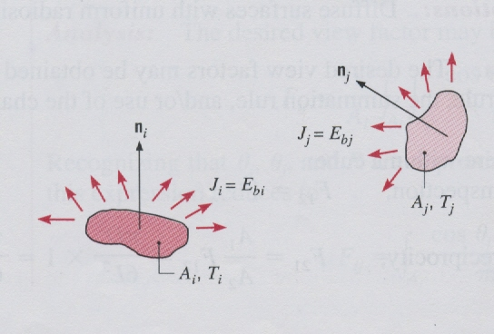
Fig.11.16 Radiation transfer between two surfaces that may be approximated as black bodies

Slide 57
This will allow the construction of a thermal network that satisfies

Slide 58
For surface i being in an enclosure and interacting with N surfaces at different temperatures, the above equation can extended to
Example 11.4
A furnace cavity, which is in the form of a cylinder of 75 mm diameter and 150 mm length, is open at one end to large surroundings that are at 27ºC. The sides and bottom, which may be approximated as black bodies, are heated electrically, well insulated,

Slide 59
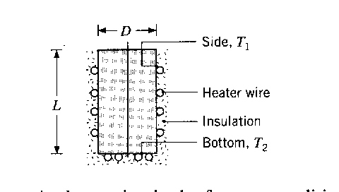
and maintained at temperatures of 1350 and 1650ºC, respectively. How much power is required to maintain the furnace conditions.

Slide 60
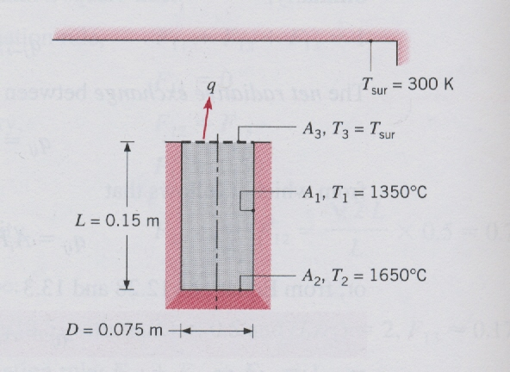
Solution
Since the surrounding is large it may be treated as a black body. Here the heat transfer by convection will be assumed to be negligible compared to the radiative heat transfer.

Slide 61
With T₃ = T_{sur}, the heat loss can be expressed as
q = q₁₃ + q ₂₃
Using appropriate equations for radiation between black surfaces
For the two opposing surfaces (top and bottom), using (r_{j}/L) = (0.0375/0.15) = 0.25 and
(L/r_{i}) = (0.15/0.375) = =4
F₂₃ = 0.06 (From view factor graphs)
Use summation rule
F₂₁ + F₂₃ =1 F₂₁ = 1-0.006 = 0.94

Slide 62
Use reciprocity relation
A₁F₁₂ = A₂F₂₁ to get
From symmetry F₁₃ = F₁₂
Substitution in q gives

Slide 63
q = 1639 +205 = 1844 W
Radiative exchange between nonblackbodies
Here for an opaque body, the radiosity will also involve the reflected part from the irradiation as shown in figchp11\fig11.17.pptx . More complication is when the reflection is back and forth between the heat transfer surfaces several times.
The radiosity is given by
J = εE_{b} +ρG
Using ρ = 1 – α = 1- ε

Slide 64
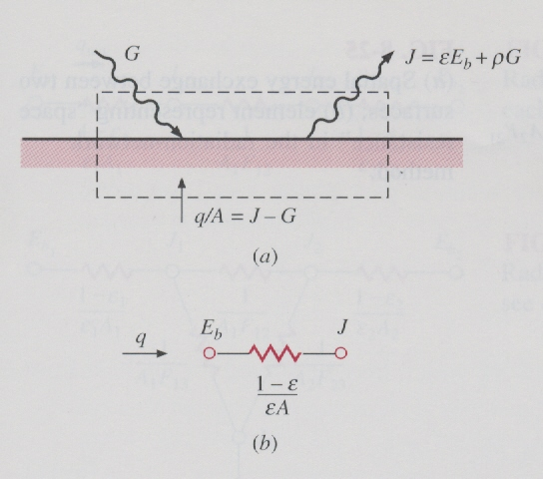
Fig.11.17 (a) Surface energy balance for opaque materials; (b) element representing “surface resistance” in the radiation network method

Slide 65
the radiosity expression becomes
J = εE_{b} + (1 – ε)G G = (J - εE_{b} )/(1 – ε)
The difference between the radiosity and the irradiation gives net energy leaving the surface as
(q/A) = J – G =J - (J - εE_{b} )/(1 – ε)
After substitution of G and simplification gives
The above allows the construction of a network with the surface resistance as indicated.

Slide 66
If we consider the radiant energy exchange between two surfaces, A₁ and A₂, the net heat transfer from surface 1 to surface 2 can easily be determined as
q₁₋₂ = J₁A₁F₁₂ – J₂A₂F₂₁
Using the reciprocity relation A₁F₁₂=A₂F₂₁
q₁₋₂ = (J₁– J₂)A₁F₁₂ = (J₁– J₂) A₂F₂₁
For network construction the above can be written as
where the resistance is indicated as space resistance.

Slide 67
The radiation exchange between two surfaces which exchange heat with each other and nothing else can be represented as a network given by figchp11\fig11.18.pptx . From this network the net heat transfer from surface 1 to surface 2 can easily be determined as
For other two surface enclosures, Table 4 gives the necessary information.

Slide 68
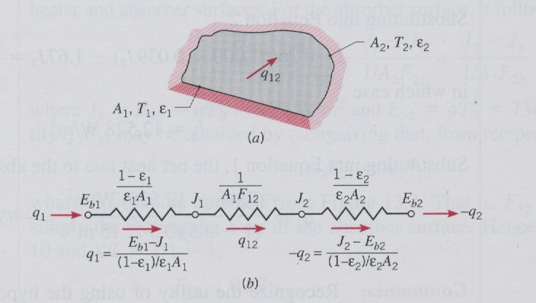
Fig.11.18 The two surface enclosure with network representation

Slide 69
For a three body problem, the network is given in figchp11\fig11.19.pptx .
Kirchoff’s current law can be used to determine the radiosities. Sum of heat transfers to a node is zero.
This can be extended for a radiative interaction of a surface with other surfaces that form an enclosure as
For any number N of surfaces forming the enclosure there will be N equations with J_{N} unknowns.

Slide 70
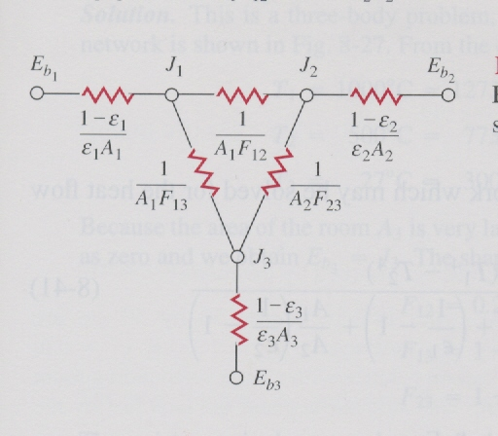
Fig.11.19 Radiation network for three surfaces which see each other and nothing else

Slide 71
Radiation Shields
Radiation shields use low emissivity materials (high reflectivity) placed between radiating surfaces as shown in figchp11\fig11.20.pptx (a).
If such a surface is placed additional surface and space resistances will be created, thus reducing the heat transfer. The network is shown in (b). The heat transfer rate can easily be determined from the series resistance network as

Slide 72
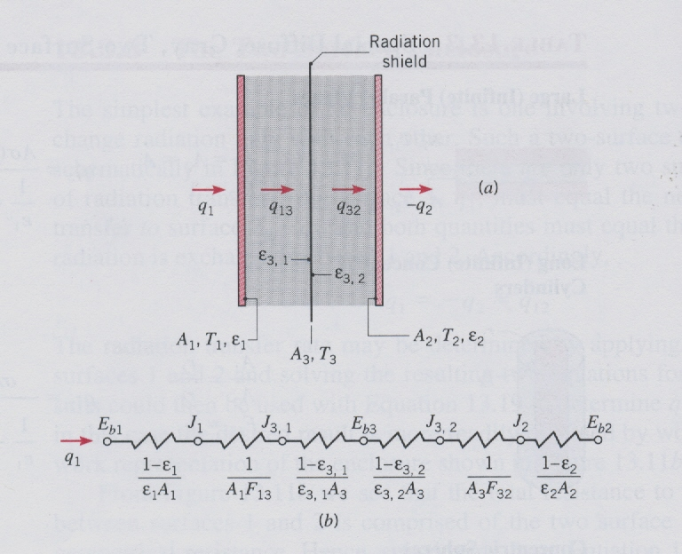
Fig.11.20 Radiation exchange between large parallel planes with a radiation shield and its network representation

Slide 73
Insulated surfaces and Surfaces with large areas.
For a perfectly insulated surface or that reradiates all the energy incident upon it, the heat flow from such a surface is zero. This makes the potential difference across the surface resistance to be zero, resulting in J=E_{b}. The insulated surface does not have zero resistance.

Slide 74
Large surface area (A→∞) has a surface resistance approaching zero. This behaves as a black body as it tends to absorb all the radiant energy falling on it. For this the surface resistance is zero (ε=1) and this gives J = E_{b}. Thus the two cases – insulated surface and surface with a large area – both have J = E_{b} .
If two flat or convex surfaces are connected by or enclosed in a reradiating surface as shown in the combustion furnace (figchp11\fig11.21.pptx for the schematic figchp11\fig11.22.pptx ), as no net heat is exchanged with this body, J_{R} = E_{bR}.
F_{1R} = 1 – F₁₂ F₁₁ = F₂₂ = 0
F_{2R} = 1 – F₂₁

Slide 75
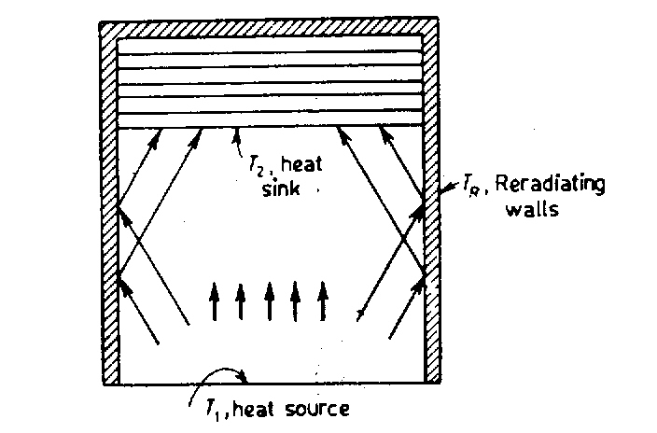
Fig.13.21 Enclosure with reradiating surface

Slide 76
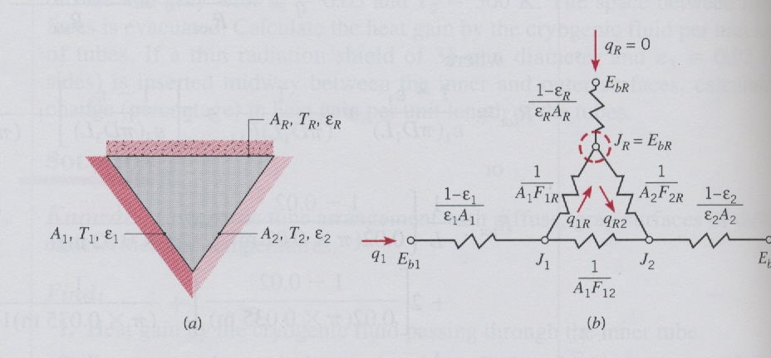
Fig.11.22 A three surface enclosure with one surface reradiating and the network representation

Slide 77
The network is a simple series parallel arrangement which can be shown to give
After determining J₁ and J₂, then J_{R} can be determined from
Since the temperature of the reradating surface can be determined

Slide 78
Example 11.5
A paint baking oven consists of a long, triangular duct in which a heated surface is maintained at 1200 K and another surface is insulated. Painted panels, which are maintained at 500 K, occupy the third surface. The triangle is of width W = 1 m on a side, and the heated insulated surfaces have an emissivity of 0.8. The emissivity of the panels is 0.4. During the steady-state operation, at what rate must energy be supplied to the heated side per unit length of the duct to maintain its temperature at 1200 K? What is the temperature of the insulation surface?

Slide 79
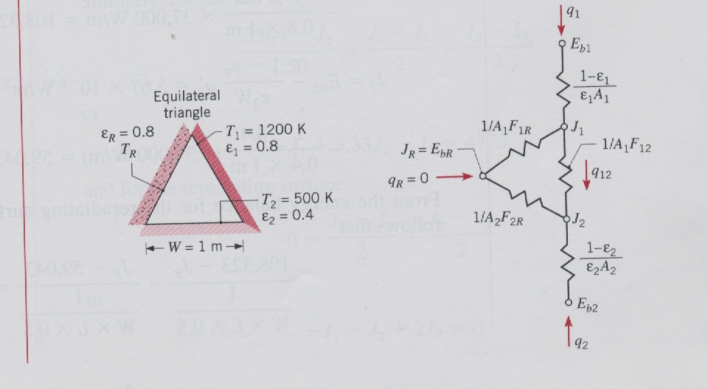
Solution
The system will be modeled as a three surface enclosure as shown in the figure below

Slide 80
1. The heat transfer rate to be supplied is determined from
Symmetry: F₁₂ = F_{1R} = F_{2R}
A₁ = A₂ = WL L is length of duct

Slide 81
2. For the temperature of the insulated surface use will be made of the equality of J_{R} and E_{bR}. To get J_{R} use

Slide 82
Substitution gives

