Slide 1
Chapter 3
AVAILABILITY ANALYSIS

Slide 2
AVAILABILITY ANALYSIS
Qualitative aspect of work and heat- Work is an expensive and dear commodity, can be efficiently changed into different forms of energy, 100% into heat. Heat converted into work very inefficiently.
Quality of energy is the potential of that energy to produce useful work, related to work potential which is dependent on the environment. If in a process the work potential is reduced , then the energy is said to be degraded.

Slide 3
This chapter is the first part of two methods usually followed in thermodynamics
AVAILABILITY(EXERGY) ANALYSIS
ENTROPY GENERATION MINIMIZATION (EGM).
Previous chapter has shown that the entropy generation and lost work are related. The many efficiency maximization processes followed are nothing but entropy generation minimizations.

Slide 4
3.1 REVERSIBLE WORK, AVAILABILITY, IRREVERSIBILITY, AND 2ND LAW EFFICIENCY
Absent from 1st law is the term for irreversibilities and absent from the 2nd law is the term for work. The two laws will be combined to get a relation between work and entropy generation.
A control volume (Fig 3.1 )interacting with thermal reservoirs (temperatures T₁,…T_{j})including the environment at T_{o} will be considered. The cm can be seen as a special case. The corresponding heat transfer rates are Q_{o} and Q₁,…,Q_{j}. The general 1st law for cv is given by

Slide 5
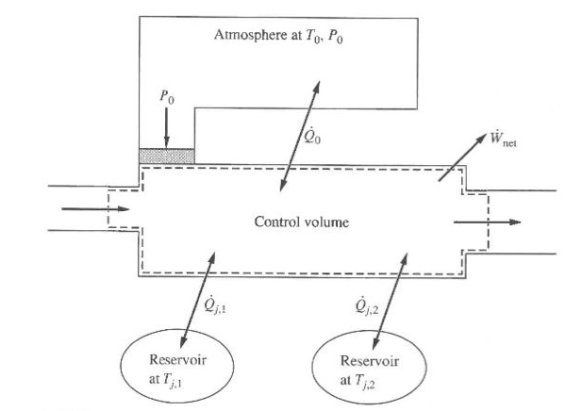
Fig 3.1 Schematic for the development of the work potential for a process

Slide 6
With

Slide 7
As the work produced is reduced by the work done on the environment, the useful cv work will be
The entropy balance for the cv is
The above three equations will be used to get a relation for under actual and reversible conditions.

Slide 8
3.1.1 Reversible Work
Equating the Q_{o}’s of the two laws will give
The expression for the work can be determined as
In some texts the above is also called available work rate.

Slide 9
For interactions at the control surface only, it can easily be shown
Zero entropy generation gives the reversible work given for both cases ie. With the interaction extended to the environment and with interaction at the control surface only, respectively.

Slide 10
Values of T_{o} and P_{o} are usually taken as 25ºC and 1 atm respectively.

Slide 11
3.1.2 Availability or Exergy
When a system undergoes a process and its final state is in equilibrium with the surrounding then it is said to be in a dead state.
It will not have any potential to produce any more work. Such a process leads to the maximum possible reversible work associated with a system at a given state.
The dead state will be indicated by P_{o} and T_{o} and also zero velocity and zero elevation. This equilibrium is the so-called thermo-mechanical equilibrium and characterized as a restricted dead state. Complete equilibrium will include chemical equilibrium too. Definition of exergy will follow shortly.

Slide 12
3.1.3 Irreversibility
This is the difference between the reversible work (W’_{rev},W_{rev}) and work (W’,W) given by
Volume change Rigid control Irreversibility
of cv considered surface
Usually control surfaces are rigid ( ) and hence
Irreversibility designated by I is given by

Slide 13
Irreversibility represents destruction of work potential and is proportional to the rate of entropy generation.
In some texts irreversibility is designated as lost work and the above equation is historically known as Guoy-Stodola theorem.
For a closed system
I_{cm} = W’_{rev} – W’ = W_{rev} – W = T_{o}S_{gen,cm} ≥ 0
If we include the external irreversibility for the cv, then the equation will take the form

Slide 14
How effectively the process is proceeding is defined in terms of first law efficiency based on how well the energy is used. Some times a portion of this energy may not at all be possible to change it into useful work. The 2nd law or exergetic efficiency excludes this part and considers the performance based on what is available to be changed into useful work.
1st law efficiency – conservation principle applied on equipment and cycles
2nd law efficiency-based on non-conserved properties-
Entropy and availability- effects are S_{gen} and I, respectively

Slide 15
Based on this the 2nd law, efficiency is defined as:
The above can also be written as a rate equation. Outputs and inputs of availabilities will depend on defining the desired output and input.

Slide 16
3.2 AVAILABILITY TRANSFER WITH HEAT TRANSFER
For heat transfer Q_{i} across a system boundary at T_{i} associated was entropy transfer of magnitude Q_{i}/T_{i} . Associated is also availability transfer with heat transfer Q_{i} across a temperature difference T_{i} – T_{o} . This is the maximum work or W_{rev} which is the Carnot heat engine work given by
Φ_{Q,i} defines the availability transfer associated with heat transfer for cm or a cycle at a particular boundary surface.

Slide 17
For the total availability transfer the summation on the surface will give
The above can also be written as a rate equation.
For availability transfer to or from a thermal reservoir at T_{i} = T_{R}

Slide 18
For j reservoirs
The above can also be written as a rate equation.
The above equations show:
For system temperature greater than T_{o}, system gains availability when heat is added or vice versa.
For system temperature less than T_{o}, system loses availability with heat gain and vice versa.

Slide 19
The irreversibility I_{Q} of a heat transfer process can be determined from the SSSF equation without mass flow or work interactions as:
The summation shows the availability transfers (in and out) in the heat transfer space. For heat transfer from source reservoir at T_{A} and sink reservoir at T_{B}, through a heat transfer space (Fig 3.2)

Slide 20
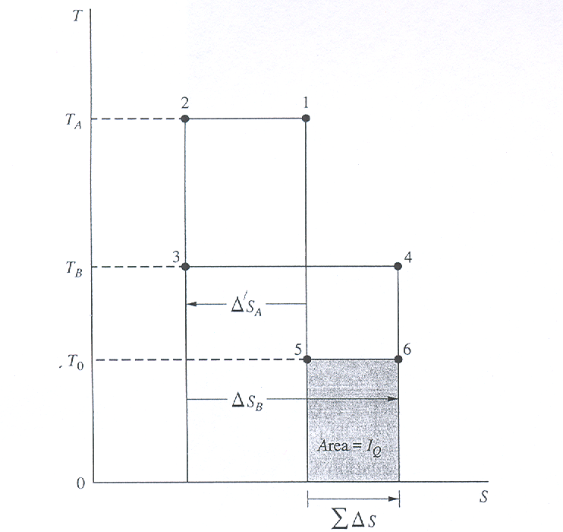
Fig.3.2 Graphical representation of irreversibility I_{Q}

Slide 21
For many closed system processes, the boundary temperature is uniform but may vary during the process.
Use of δQ = dU + PdV and δQ/T = ΔS has been made.
Example 3.1 in Example 2-2 a heat transfer of 100kJ occurred between two thermal reservoirs with temperatures of 300 and 1000K. For a To value of 300 K, determine the availability transfers and the irreversibility of the heat exchange process, in kilojoules.
.

Slide 22
As a practical application we may consider a high temperature (constant) combustion source with T_{s} and heat supply rate Q_{s} , for heating process.
Heat transfer rate Q_{u} for useful purpose at T_{u} (constant) and heat loss rate Q_{i} at boundary surfaces (furnace) with T_{i} are to be considered.
Additional inclusion is the irreversibility rate within the cv due to other effects. For SSSF process the energy and availability balance will be

Slide 23
This can also be written in a form of availability balance equation as
Or
If the 2nd law efficiency compares the useful availability and input availability, then
Example 3.2 100kJ of heat is transferred from a reservoir of 1000 K to a reservoir of a)27ºC b) 40ºC c) 200ºC and d)420 ºC for some useful purpose. Neglecting the heat losses determine the 2nd law efficiency. Take T_{o} as 300 K.

Slide 24
3.3 REVERSIBLE WORK, AVAILABILITY, AND IRREVERSIBILITY FOR A CLOSED SYSTEM
For the cm the general equation of the cv can be used by making the mass flow rates to be zero. This will give
Integrating over the time interval Δt will give

Slide 25
And

Slide 26
The reversible work is determined by setting S_{gen,cm}=S_{gen,tot}=0 and this will give (for a single reservoir)
W_{rev} = -(ΔE-T_{o}ΔS+P_{o}ΔV) + Φ_{Q}
W_{rev} = -(ΔE-T_{o}ΔS+P_{o}ΔV) + Φ_{Q,R}
E=U +m V²/2 +mgz and e= u +V²/2 +gz
For a process with beginning and end states 1 and 2 while exchanging heat solely with the environment
(Q_{R} or q_{R}=0; ) and under reversible condition will give
W_{rev}= (u₁-u₂)+P_{o}(v₁-v₂)-T_{o}(s₁-s₂)
Now we are ready to define control mass availability.

Slide 27
Closed System Availability
The availability of a closed system in a given state is the maximum useful work output that may be obtained from a system-atmosphere combination as the system proceeds from a specified equilibrium state to the dead state, while exchanging heat solely with the environment.
The mathematical expression follows from the last equation.
W_{rev}=(E-E_{o})-T_{o}(S-S_{o})+P_{o}(V-V_{o})=Φ
Φ is also known as nonflow exergy. This is always positive whether T is less or greater than T_{o} or P is less or greater than P_{o}. (E_{o}=U)

Slide 28
On a unit mass basis
= (u-u_{o})-T_{o}(s-s_{o})+P_{o}(v-v_{o})+V²/2+gz
For a closed system between states 1 and 2, the above equation becomes
= (u₂-u₁)-T_{o}(s₂-s₁)+P_{o}(v₂-v₁)+Δke+Δpe
Usually the last two expressions are zero for control system and will not be considered from here on. Using the above in equations (slide 23)

Slide 29
If we substitute back W=W’-P_{o}ΔV and rearrange one of the equations
Availability Availability transfers Availability
Change destruction
The above form is a sort of availability balance. For no change in V, W’=W.
The total irreversibility can easily be determined to be proportional to S_{gen}=ΔS_{cm}+ΔS_{o}+ΔS_{R,j}) as follows:

Slide 30
Using 1st law Q=ΔU+W’=Q_{o}+∑Q_{j} and substitution will give

Slide 31
Rearrangement will give
The above result will be more clear if the environment, heat reservoirs and control mass are in an isolated enclosure.
The internal irreversibility can easily be derived as

Slide 32
3.4 CLOSED SYSTEM AVAILABILITY EXAMPLES
The basic equations to be used are
While the irreversibility is
I_{cm}=W’_{rev}-W’=W_{rev}-W
3.4.1 Energy Addition to a Control Mass
For a control mass the general availability balance

Slide 33
Rearranging into inputs and outputs
outputs inputs
The effectiveness(2nd law efficiency) of the availability transfers can be determined as
The differences in these effectiveness lie in the relative values of and W for a given change of state.

Slide 34
Example 3.3
Oxygen initially at 300k and 100kPa is contained in a rigid tank. Two alternative processes are to be considered to increase its temperature to 500K. The gas receives energy (a) adiabatically by means of a paddle wheel driven by an external source and (b) by means of an external heat reservoir at 600K. In the second case the temperature at the boundary is taken as the gas temperature throughout the process. Determine (1) the availability change and (2) the irreversibility in kJ/kmol, and (3) the 2nd law efficiency of the overall process for the two parts of the problem. The value of TO is 300K.

Slide 35
3.4.2 Adiabatic Compressor Work
For the adiabatic compression of a gas in a piston-cylinder device the energy and availability balances and the irreversibility are
w’=w=-∆u; =-w-i_{cm} or w’=w+P_{o}Δv=- Δu
Example 3.4; Carbon dioxide is compressed adiabatically in a piston cylinder from 10 bars and 300K to 50 bars and 450K. The fluid is modeled as (a) an ideal gas and (b) a real gas. For the Two models, determine (1) the availability change and (2) the irreversibility, in kJ/kg, and (3) the 2nd law efficiency.

Slide 36
3.4.3 Energy Exchange Between Incompressible Substances
When two incompressible substances at two different temperatures are in thermal contact ∆U=0 for the subsystems. For a common final temperature T_{f}, 1st law equation gives
[mc(T_{f}-T_{i})]_{A} + [mc(T_{f}-T_{i})]_{B}= 0
∆Φ=∆U+P_{o}∆V-T_{o}∆S= mc(T_{f}-T_{i})-mcT_{o}ln(T_{f}/T_{i})
Second law efficiency is best described by
for B heated by A.

Slide 37
3.5 REVERSIBLE WORK, AVAILBILITY, AND IRREVERSIBILITY FOR SSSF CONTROL VOLUME
Because properties are invariant with time
d(E+P_{o}V-T_{o}S)/dt=0

Slide 38
Define b=h*-T_{o}S where h*=h+ke+pe, then
For a cv inlet state (1) and outlet state (2), on a unit mass basis (single inlet and exit)

Slide 39
3.5.1. Stream or Flow Availability
Availability associated with a fluid crossing a control surface is termed stream or flow availability or exergy. The definition is as follows:
The stream availability of a fluid is defined as the maximum work output which can be obtained as the fluid is changed reversibly from the given state to a dead state while exchanging heat solely with the environment.
Referring to the reversible work equation for q_{j}=0
w_{rev}= (h+ke+pe-T_{o}s)₁-(h+ke+pe-T_{o}s)₂
For a final dead state, designating stream availability by ψ
ψ=(h+V²/2+gz-T_{o}s) - (h_{o}-T_{o}s_{o})
=(h-h_{o})-T_{o}(s-s_{o}) +V²/2+gz

Slide 40
Change in availability can be determined as
ψ₂-ψ₁=(h₂-h₁)-T_{o}(s₂-s₁)+(ke₂-ke₁)+(pe₂-pe₁)=b₂-b₁
Unlike the nonflow availability , the value of ψ can take on negative values Slide 41 (Fig 3.3) .
The 1st and 2nd law combined equation (slide 7) can be written as availability balance equation as follows:
For a control volume in SSSF and for single inlet and outlet, the above equation simplifies to

Slide 42
Rate of exergy Exergy transfer Exergy destruction
change rate rate
On a unit mass basis
ψ₂ – ψ₁ = – w – i_{cv}
A similar procedure can be followed as done for the control mass to determine the irreversibility.
Consider the cv, the environment and the thermal reservoirs in an isolated enclosure. This will give(for a single inlet, outlet flow and cv interacting with one thermal reservoir)

Slide 43
3.6 Control Volume Availability
steady flow process applications involve tubines,compressors,nozzles,diffusers,pumps, Throttling devices, and heat exchangers.
For steady flow through those devices with one inlet and one outlet the availability balance on
a unit mass basis is :

Slide 44
3.6.1 Turbines
The applicable availability balance equation for a turbine is given by
The 2nd law efficiency (adiabatic turbine) will be
Energy and Exergy accounting can also be made graphically by using diagrams called Sankey or band diagrams as illustrated in example 3.4

Slide 45
Example 3.4
Steam enters a turbine at 40 bars, 500 oC, and 140 m/s and leaves as a saturated vapor at 100 oC and 80 m/s. The measured work output is 746.0 kJ/kg. The average temperature Tb at the surface of the turbine where heat transfer occurs to the environment is taken as the average of the inlet and outlet steam temperatures. The potential energy change is negligible. (a) determine (1) the specific availability change and (2) the specific irreversibility, both in kJ/kg, for the process within the turbine, and (3) the 2nd law efficiency of the process. (b) Now, enlarge the control volume so that the local environment at 25 oC is included. Find the specific availability change and the irreversibility in this new situation.

Slide 47
i_{cv} can be shown to be a function of η_{t} and P₁/P₂for an adiabatic turbine with an ideal gas (c_{p} and k are constants) as a working fluid. Entropy change for an adiabatic expansion is given by
Using η_{t}=(T₁-T_{2a})/(T₁-T_{2s}), replaceT_{2a} in the entropy change expression. This will give
(T_{2a} = T₁ – η(T₁ – T_{2s}) find c_{p} ln(T_{2a}/T_{2s})

Slide 48
3.6.2 Compressors and Pumps
The availability balance equations are the same as that of the turbine. But the signs of work and availability changes are reversed.
The 2nd law efficiency (adiabatic compressor or pump) will be

Slide 49
As was done for the turbine, it can easily be shown, for compressors too, that the irreversibility is related to the pressure ratio and the 1st law efficiency as follows:
For an incompressible fluid such as liquids frictional heating(heat generation) of magnitude q_{F} and the irreversibility can be quantified as follows.
q_{F}=w_{s}-w, w_{s}=-vΔP, and η_{P}=w_{s}/w

Slide 50
Substitution in the expression for q_{F} will give
For the liquid essentially at a constant temperature T the entropy generated will be q_{F}/T. Then the irreversibility can be given as

Slide 51
3.6.3 Nozzles
Here the main aim is to accelerate the fluid. For adiabatic expansion with no work and negligible change in the potential energy, 1st law gives

Slide 52
The availability balance equation for a nozzle is given by
ψ₂ - ψ₁ = -I
The 2nd law efficiency becomes
3.6.4 Throttling
This is an isenthalpic process, (q=0,w=0,Δke=0, Δpe=0) ie. h₁=h₂. The availability balance reduces to ψ₂ - ψ₁ = -i. Also
s_{gen}=s₂-s₁ δi=T_{o}ds

Slide 53
Using the 2nd Tds equation given by
Tds=dh – vdP = 0 – vdP = -vdP, ds = -vdP/T, and
For an incompressible substance, assuming temperature to be constant at T₁, then
For an ideal gas v/T=R/P and substitution will give

Slide 54
The above equations show
For incompressible fluids, irreversibility decreases with temperature
For ideal gases, irreversibility is independent of temperature
But for real gases Pv=ZRT, where Z is a compressibility factor dependent on temperature
2nd law efficiency is same as that of nozzles

Slide 55
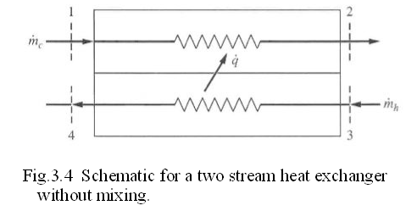
3.6.5 Heat Exchange
Entropy generation and 2nd law efficiency during heat exchange will depend whether there is a mixing process or not.
Without Mixing
The 1st law and the availability balance equations are

Slide 56
Entropy generation is shown in Fig 3.5
Two forms of 2nd law efficiency definitions
Based on increase in availability of cold fluid (output) and availability decrease of hot fluid (input)
Base on inlet and outlet availabilities
The first is more common

Slide 58
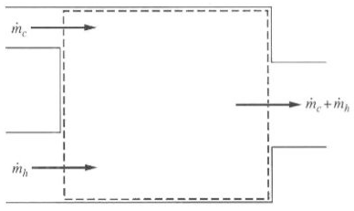
With Mixing
The conservation of mass, 1st law and availability balance equations are given below
As in the previous case there are two alternate definitions for the 2nd law efficiency
Fig. 3.6 Schematic of a direct mixing heat exchanger

Slide 59
Based on availability change of the cold fluid (output on stream 1) and availability change of hot fluid (input of stream 2)
Based on availability output at the exit and availability input at the inlet

