Slide 1
Chapter Four
Availability Analysis of Cycles

Slide 2
Availability analysis of simple cycles such as heat engines, refrigerators and heat pumps will be dealt with followed by typical applications of these cycles.
4.1 SIMPLE CYCLES
A comparison of the entropy generation in heat engines,refrigerators,and heat pumps due to irreversible heat transfer or irreversibilities within the device itself can be used to determine which source is the major contributor to the degradation of performance of the device.
In this chapter a cycle will be considered as nonflow entity and the interaction of this closed system with its surroundings will be seen in detail. The analysis will involve the determination of availability Ф and irreversibility I.

Slide 3
The basic equations to be used for this purpose were derived as :
And for cycles ΔФ=0 and this will give
This can also be written as

Slide 4
4.1.1 Heat Engine Cycles
Fig 4.1 shows reservoirs temperatures as T_{H}, T_{L} with the corresponding engine temperatures asT_{A}, T_{B} and heat transfers Q_{H},Q_{L}.
Energy balance on engine gives:
2nd law for the engine gives (ΔS_{eng}=0)
Signs of Q’s are with respect to engine.

Slide 5
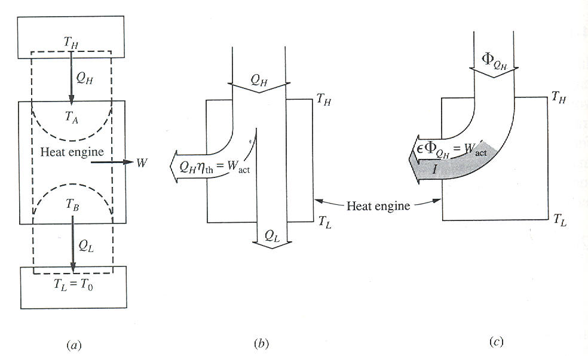
Fig.4.1 Schematic of a heat engine with Sankey diagrams.

Slide 6
Case (a)
Reversible heat transfer and reversible engine
Here T_{A} = T_{H} and T_{B} = T_{L}. Essentially this is a Carnot heat engine and satisfies
This will give

Slide 7
Case (b)
Reversible heat transfer and irreversible engine
Not a Carnot heat engine

Slide 8
The irreversibility can also be determined from availability transfer equations as follows: (T_{L}=T_{o})
Case (c)
Both heat transfer and engine are irreversible
Temperatures on the engines are T_{A} and T_{B}.
There will be two more additional irreversibilities due to heat transfers at these points.

Slide 9
I_{eng} can be shown in two forms as follows
Where
W=ΣQ_{i}=Q_{H} +Q_{L} (Q_{L}<0 and Q_{H}>0)
The other two irreversibilities are due to the heat transfer interactions at the two reservoirs and these are given by

Slide 10
The sum of the irreversibilities
I_{tot}=W_{rev,tot} - W=
This must also give
I_{tot}=T_{o}S_{gen,tot}=T_{o}(ΔS_{H}+ΔS_{eng}+ΔS_{L})=T_{o}(ΔS_{H}+ΔS_{L})
The second law efficiency of the cycle is again defined in terms of availability input as: (T_{L}=T_{o})
This can also be expressed in relation to the first law efficiency as follows

Slide 11
Remembering W = η_{1st} Q_{H} , substituting in the 2nd law efficiency will give
The previous figure (Fig 4.1 b&c) shows Sankey diagrams for 1st law in (b) and the availability transfers in (c). As T_{L} is considered to be the same as T_{o}, there is no availability transfer to the lower reservoir.
Example 4.1
A heat engine operates between two heat reservoirs, of which the temperatures are 1000 and 300K. First, consider the situation where the cyclic system is also at 1000 K while receiving heat and 300 K while rejecting heat. In addition, the measured efficiency is 50 percent. If the heat supplied during one cycle of operation is 100kJ, (a) determine the irreversibility of the engine, in kilojoules, for one cycle. Now, consider the same situation except that the engine temperature T_{A} during heat addition is 900 K and T_{B} during heat rejection is 350 K. The actual thermal efficiency is now 40 percent. Determine the irreversibility, in kilojoules, for (b) the heat engine, (c) the high temperature heat supply process, and (d) the low temperature heat rejection process. To = 300K

Slide 12
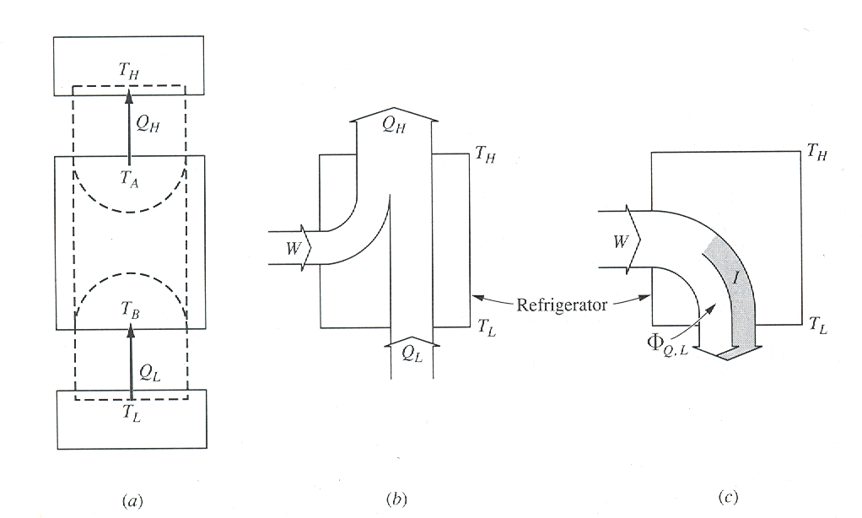
4.1.2 Refrigeration Cycle
The cycle is shown in fig below. Here availability transfer in the form of work is supplied which enables the cycle to receive heat Q_{L} from a reservoir at low temperature T_{L} (T_{L}<T_{o}) and rejecting heat Q_{H} to a reservoir at T_{H}. The regions of the refrigerator where heat is received and rejected are at temperatures T_{B} and T_{A}.
Fig.4.2 Schematic of a refrigerator and Sankey diagrams

Slide 13
The applicable equations are:
First Law:
Second Law:
Case (a)
Heat transfers and cycle are reversible
T_{A}=T_{H}, T_{B}=T_{L} and the cycle is a reversed Carnot heat engine where
This will give I_{ref} = 0

Slide 14
Case (b)
Reversible heat transfer and irreversible refrigerator:
Not a reversed Carnot cycle (ΔS_{ref}=0, T_{o}=T_{H})
I_{ref} can also be determined from availability transfer quantities as

Slide 15
Case (c)
Both heat transfer and refrigerator are irreversible.
Here T_{A}>T_{H} and T_{L}>T_{B}
I_{ref} can be determined in two ways:
where W = Q_{H}+Q_{L} and Q_{H}<0 and Q_{L}>0
The other irreversibilities are due to heat transfers at the two ends of the cycle and these are:

Slide 16
The sum of the irreversibilities can also be determined as: (from the reservoirs point of view)
I_{tot}=W_{rev,tot}-W=∑Ф_{Q,j} - W =
This must also give
I_{tot}=T_{o}S_{gen,tot}=T_{o}(ΔS_{H}+ΔS_{ref}+ΔS_{L})=T_{o}(ΔS_{H}+ΔS_{L})
Note that the availability transfer to the low temperature refrigerant is negative which implies the availability transfer is to the reservoir (cold space). This is the availability output.
Recalling the coefficient of performance for a refrigerator given by

Slide 17
The 2nd law efficiency as related to exergy input will be
The above assumes T_{o}=T_{H}.
(exergy transfer to cold space is positive)

Slide 18
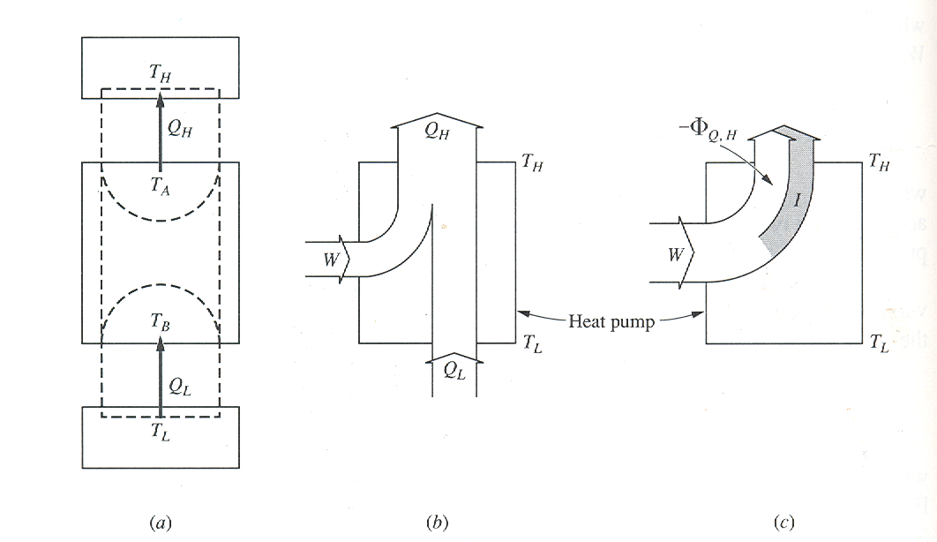
4.1.3 Heat Pumps
The cycle is the same as the refrigeration cycle with the same input but for a different purpose ( fig 4.3) . The output of interest is the heat rejected at the top end of the cycle usually used for space heating. The availability output of interest is also due to this heat transfer. Usually the heat transfer at the cold end is from ambient. There will be exergy gained by the hot space.
Fig.4.3 Schematic and Sankey diagrams for a heat pump

Slide 19
First Law:
Second Law:
Case (a)
Heat transfers and cycle are reversible
T_{A}=T_{H}, T_{B}=T_{L} and the cycle is a reversed Carnot heat engine where
This will give I_{hp} = 0

Slide 20
Case (b)
Reversible heat transfer and irreversible heat pump:
Not a reversed Carnot cycle (ΔS_{hp}=0, T_{o}=T_{L})
I_{hp} can also be determined from availability transfer quantities as

Slide 21
Case (c)
Both heat transfer and refrigerator are irreversible.
Here T_{A}>T_{H} and T_{L}>T_{B}
I_{hp} can be determined in two ways:
where W = Q_{H}+Q_{L} and Q_{H}<0 and Q_{L}>0
The other irreversibilities are due to heat transfers at the two ends of the cycle and these are:

Slide 22
The sum of the irreversibilities can also be determined as: (from the reservoirs point of view)
I_{tot}=W_{rev,tot}-W=∑Ф_{Q,j} - W =
This must also give
I_{tot}=T_{o}S_{gen,tot}=T_{o}(ΔS_{H}+ΔS_{hp}+ΔS_{L})=T_{o}(ΔS_{H}+ΔS_{L})
The exergy output is shown as the gain in exergy of the hot space or loss of exergy of the cycle.
Recalling the coefficient of performance for a heat pump given by

Slide 23
The 2nd law efficiency as related to exergy input will be
The above assumes T_{o}=T_{L}.

Slide 24
4.2 CYCLE APPLICATIONS OF AVAILABILITY
Availability analysis on common power and refrigeration cycles will be developed. Initially analysis on the component processes will be worked out.
4.2.1 Gas Turbine Cycle
Referring to fig 4.4 , an open cycle which considers the irreversibilities in the compressor, turbine and applications of the first law, availability balance, and the corresponding efficiencies will be seen.

Slide 25
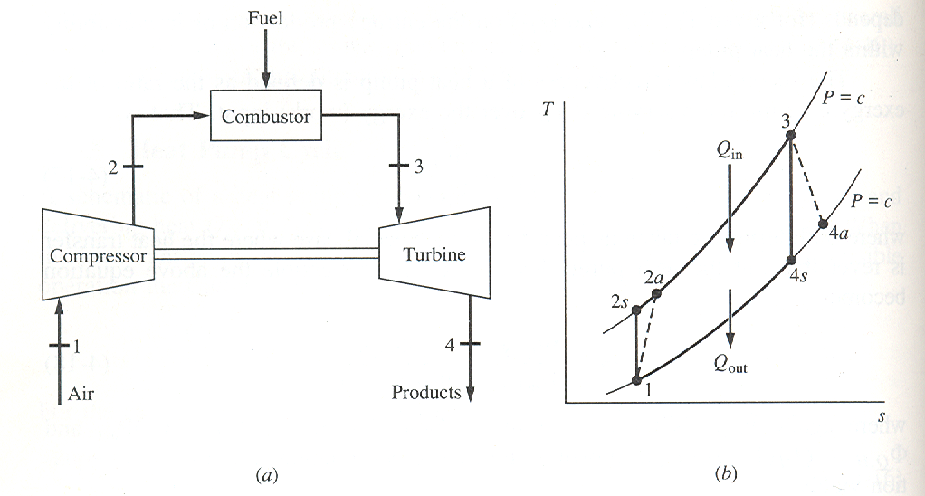
Fig.4.4 Open gas turbine cycle (a) Schematic of equipment (b) T-s diagram

Slide 26
1st Law:
Availability balance:

Slide 27
Example 4.2
An irreversible gas-turbine power plant operates between pressures of 1.0 bar and 6.4 bars with compressor and turbine inlet temperatures of 22 and 807 ºC,respectively. Determine (a) the compressor and turbine work, (b) the heat supplied to the combustor, (c) the change in availability across the three devices, and (d) the irreversibility in all three devices, all answers in kJ/kg air. T_{o} = 25 ºC
The thermal efficiency of a gas turbine cycle can be enhanced by the use of a regenerator within the cycle. As shown in FIG 4.5 it uses the waste energy of the exhaust gas to elevate the temperature of the incoming fluid into the combustor. The result is that for the same work output, there will be a decrease in heat input and this could increase both the first law and second law efficiencies.
Defining the regenerator effectiveness as

Slide 28
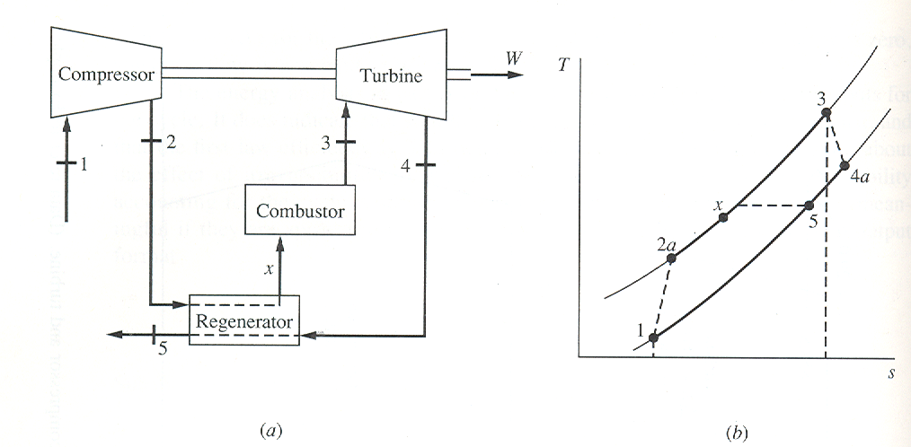
Fig.4.5 Schematic of equipment and Ts diagram for a regenerative open cycle gas turbine.

Slide 29
The availability balance for the regenerator is
Using a regenerator of 75% effectiveness in the example cycle increases the 1st and 2nd law efficiencies to 31% and 48%, respectively

Slide 30
4.2.2 Simple Steam Power Cycle
The simple Rankine steam power cycle Fig 4.6 with irreversible turbine and pump will be considered
1st Law:
Availability balance

Slide 31
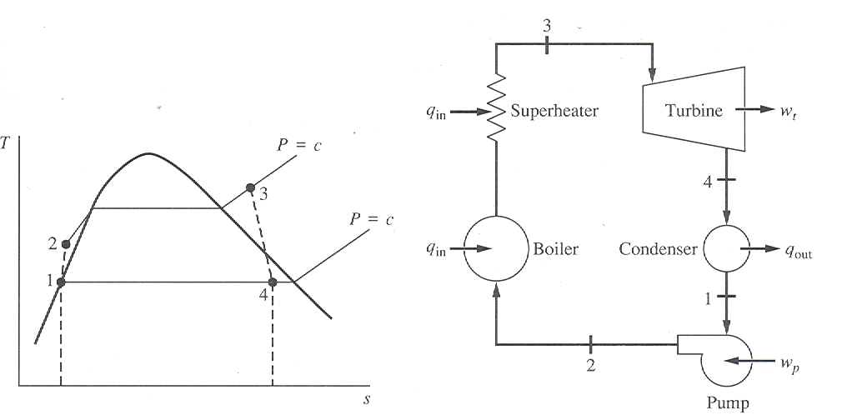
Fig.4.6 Ts diagram and equipment schematic for a Rankine cycle with superheating

Slide 32
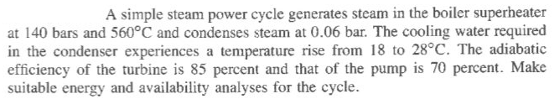
Pump:
Cycle Efficiency:
The irreversibility in the condenser can be determined using the first law and entropy generation equations.
1st law:
(for adiabatic condenser surface)
Example 4.3

Slide 33
Availability flow diagram for the simple steam power (Rankine) cycle showing transfers and losses.

