Slide 1
Continued from previous slides

Slide 2
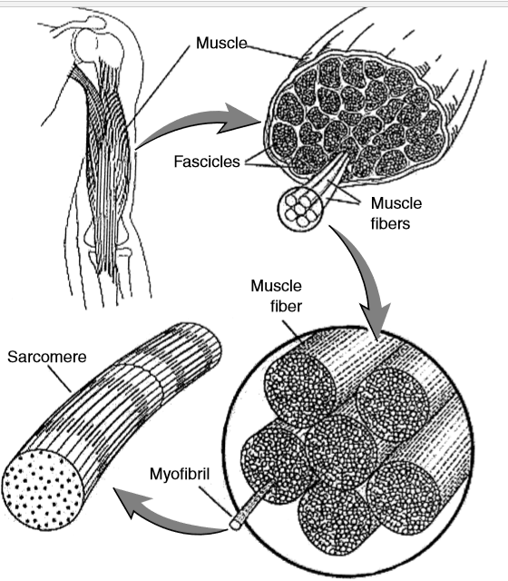
Skeletal Muscle Organization
Actin and myosin molecules ➔ myofibrils ➔sarcomeres and myofilaments ➔ myofibers ➔ fascicles ➔ muscle

Slide 3
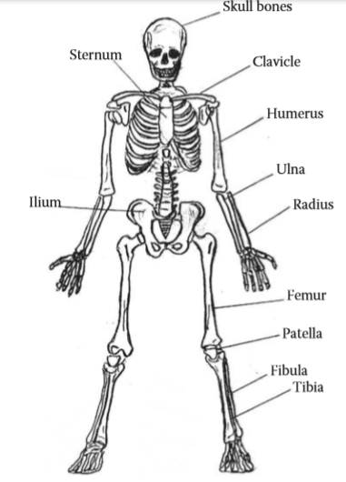
Skeletal Anatomy

Slide 4
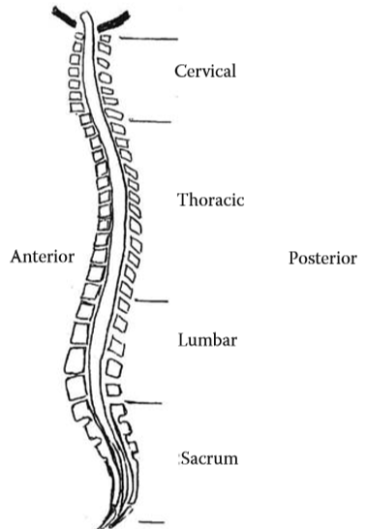
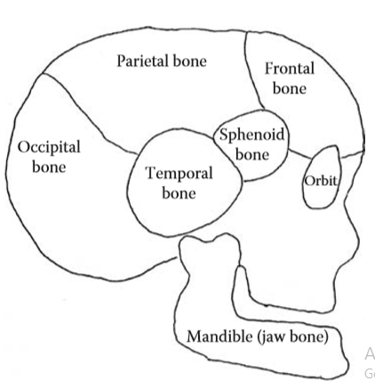
Spine: principal supporting structure of the torso (four gr.)
Skull and Jaw

Slide 5
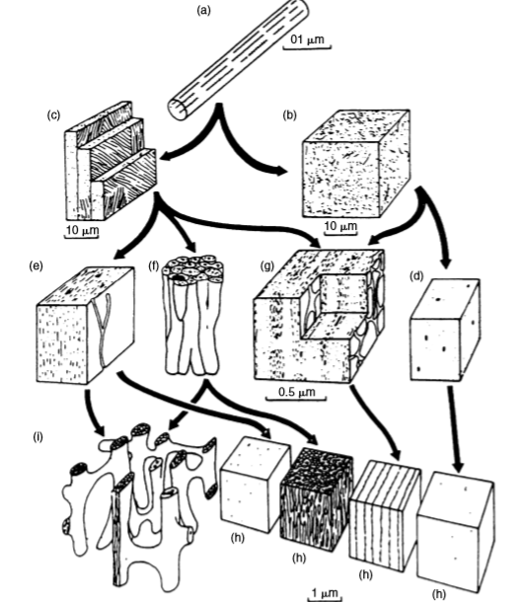
Bone Organization
Collagen fibril with associated mineral crystals
Woven bone
Lamellar bone
Woven bone
Primary lamellar bone
Haversian bone
Laminar bone
Compact bone
Cancellous bone

Slide 6
Reference
Principles of Biomechanics by Ronald Huston
Biomechanics by Donald R Peterson

