Slide 1
Biomechanics
By Dr. Hailu Getachew
14/3/2020

Slide 2
Course Outline
Musculoskeletal Anatomy, Basic Statics and Joint Mechanics (elbow, shoulder, spine, hip, knee, ankle)
Basic Dynamics to Human Motion: Review of linear and angular kinematics; Kinetic equations of motion; Work & energy methods; Momentum methods; Examples in biomechanics; Modern kinematic measurement techniques; Applications of human motion analysis
Structure, Function, and Adaptation of Major Tissues and Organs: Bones, Cartilage, Ligaments, Tendons, Muscles, Skin, Heart, Artery, Vein, Lung, Liver, Kidney, Intestine
Fundamental Strength of Materials in Biological Tissues: Introduction to Viscoelasticity and Comprehensive Review

Slide 3
Today’s Discussion…
Introduction
Musculoskeletal Anatomy

Slide 4
Introduction
Definition of biomechanics
discussion with students….
previous experience of the students in the field…
Its benefit for engineers
what do the students expect from the course?
how do the students like the course to be conducted?
  Availability and accessibility of biomechanics laboratory in the institution or any other related institution….

Slide 5
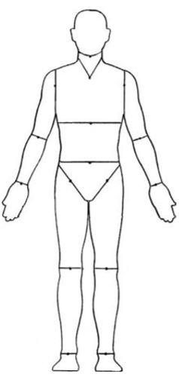
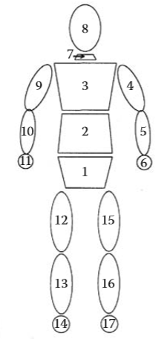
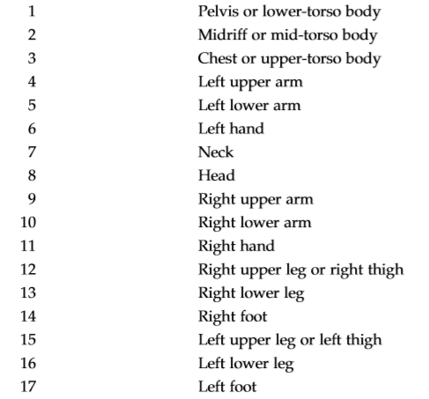
General Overview of Human Frame

Slide 6
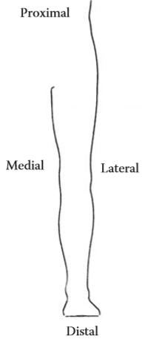

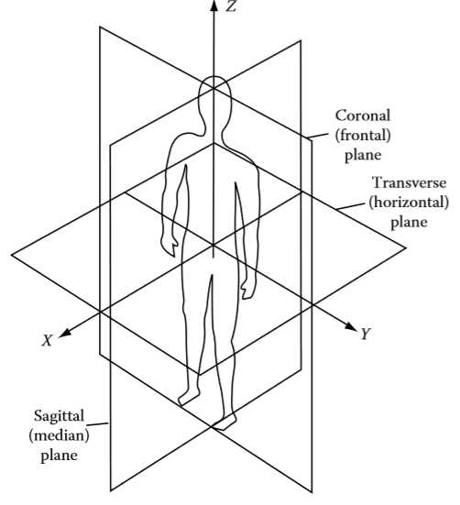
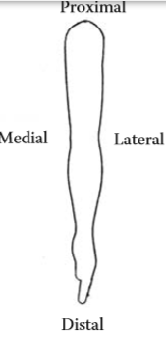
Principal planes of the human body
Torso is used as a reference

Slide 7
Musculoskeletal Anatomy
Muscle Group
>600 muscles in human body
Types:
  Cardiac muscles (heart)
  Smooth muscles (in stomach, intestinal tracts, blood vessel wall)
  Skeletal muscle ( connected to bones)

Slide 8
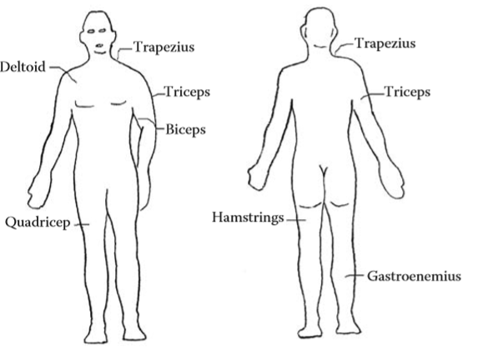
Musculoskeletal Anatomy (cont…)
Major Skeletal Muscles

