Slide 1
Part #4
Curve & Surface
Modeling
April 2020

Slide 2
Geometric Modeling Objects:
The model of an engineering object consists of geometry, topology and auxiliary information.
Geometry includes points, lines, circles, planes, cylinders and other surfaces. It defines the basic shape characteristics.
Topology represents the relationships of the geometry of an object.
In addition to its shape, an engineering object also possesses some other attributes: dimensions, tolerances, and surface finish.

Slide 3
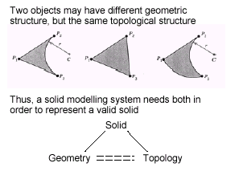
Cont’d…
Many properties of products have to be modeled, including form, dimension, tolerance and structure.
In all of these areas geometry, images and spatial manipulation are very important. For this reason, CAD is founded on computational geometry and computer graphics.

Slide 4
Defining the Model:
Methods of defining elements in interactive computer graphics
1. Points
Methods of defining points in computer graphics include:
  Pointing to the location on the screen by means of cursor control.
  Entering the coordinates via the alphanumeric keyboard.
  The intersection of two lines.

Slide 5
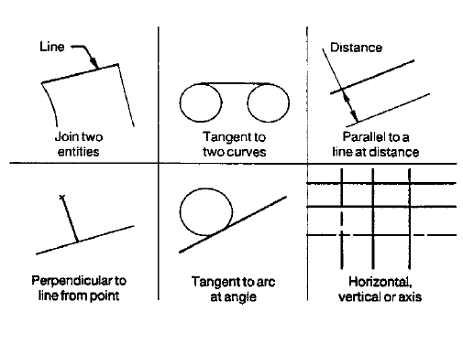
Cont’d…
2. Lines
Methods of defining lines include:
Using two previously defined points.
Using one point and specifying the angle of the line with the horizontal.
Using a point and making the line either normal or tangent to a curve.
Using a point and making the line either parallel or perpendicular to another line.
Making the line tangent to two curves.
Making the line tangent to a curve and parallel or perpendicular to a line.

Slide 6
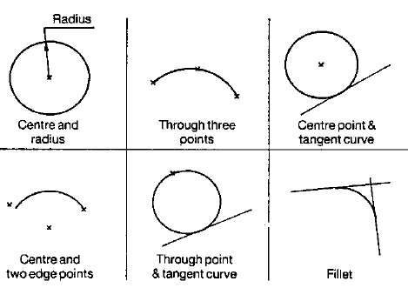
Cont’d…
3. Arcs, Circles & Curves
Methods of defining arcs and circles include:
Specifying the center and the radius.
Specifying the center and a point on the circle.
Making the curve pass through three previously defined points.
Making the curve tangent to two lines.
Specifying the radius and making the curve tangent to two lines or curves.

Slide 7
4. Surface Modeling
A surface is a 2D space in an object that has breadth and width much like a piece of cloth.
A surface has two degrees of freedom. This means that a point on surface can be moved in 2 independent directions.
The x, y coordinates of any point on the surface are determined by these free variables or parameters( i.e. u & v).

Slide 8
Cont’d…
Surface is controlled by series of control points and boundaries.
Classification of surfaces:
Planar surfaces: a flat 2D surface.
Curved surfaces:
  Single curved surfaces: It s a simple curved surface obtained by rotating straight lines around an axis
  Ex: Cylindrical, conical, pyramid surfaces, prisms
  Conics: are double curved surfaces: They are complex surfaces generated by complex curved lines/surfaces.
  Ex: Spherical, Torous, Ellipsoid, Parabaloid, Fuselage, Automobiles, etc

Slide 9
Techniques in Geometric
Modeling
The various methods for representing the solids are:
  Boundary representation method (B-rep)
  Constructive solid geometry (CSG and C-rep)
  Sweep representation
  Analytical solid modeling (ASM).

Slide 10
Boundary Representation
Method (B-rep)
In surface/solid modeling and computer-aided design, boundary representation often abbreviated as B-rep or BREP - is a method for representing shapes using the limits.
A solid is represented as a collection of connected surface elements, the boundary between solid and non-solid.
Boundary representation models are composed of two parts:
    Topology and
    Geometry (surfaces, curves and points).

Slide 11
Cont’d…
The main topological items/ primitives of B-rep are:
  Vertex (V) : It is a unique point (an ordered triplet) in space.
  Edge (E): It is finite, non-self intersecting, directed space curve bounded by two vertices that are not necessarily distinct.
  Face (F): It is defined as a finite connected, non-self-intersecting, region of a closed oriented surface bounded by one or more loops
  Loop (L): It is an ordered alternating sequence of vertices and edges.
  Body/Shell(B) : It is a set of faces that bound a single connected closed volume.

Slide 12
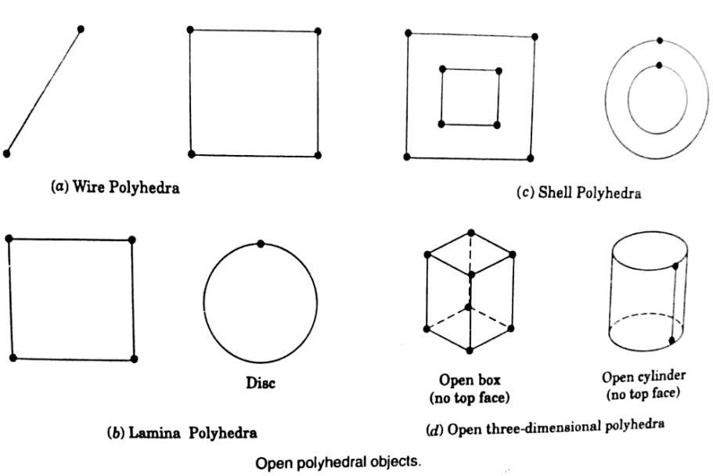
Cont’d…
A minimum body is a point; topologically this body has one face, one vertex, and no edges.
Geometry:
i. Open polyhedral objects

Slide 13
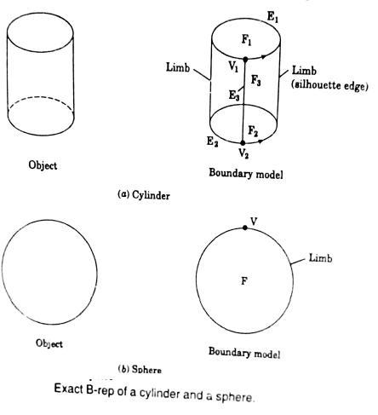
Cont’d…
ii. Curved Objects

Slide 14
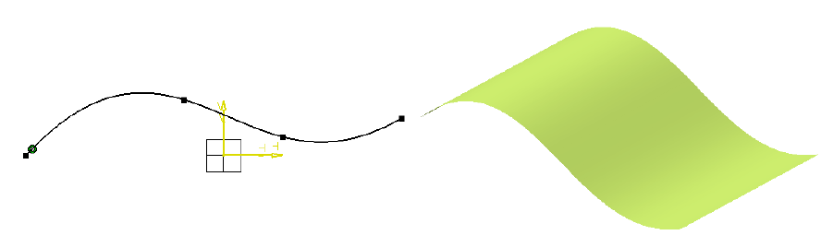
Modeling Surfaces:
Ex1. Creating Extruded Surfaces
Notes:
Ex. form galvanized iron sheet

Slide 15
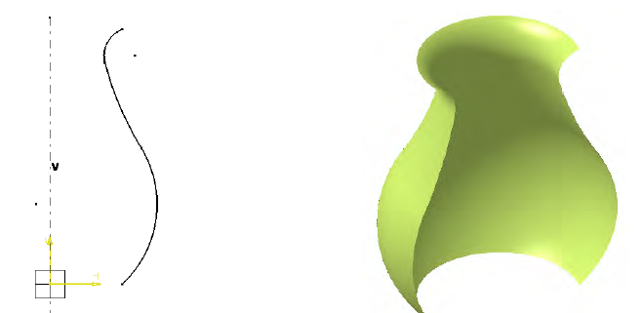
Ex. 2 - Creating Revolved Surfaces

Slide 16
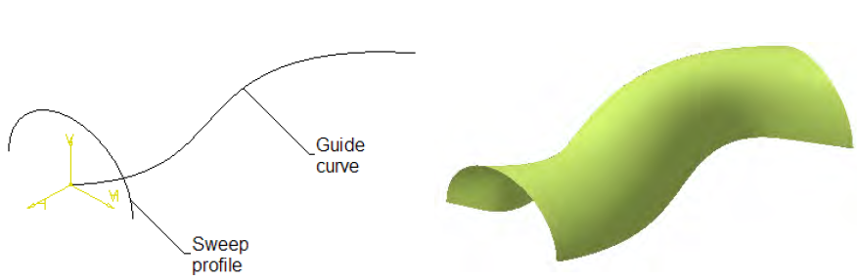
Ex.3 - Creating Swept surfaces
You can create a swept surface by sweeping out a profile in planes normal to a spine curve while taking other user-defined parameters (such as guide curves and reference elements) into account.
Click the Sweep icon
2. Select the planar profile to be swept out, that is the circle.
3. Select a guide curve.
4. If needed, select a spine. If no spine is selected, the guide curve is implicitly used as the spine.
5. If needed, select a second guide curve.
6. If you want to control the position of the profile during the sweep, you can select a reference surface. You can impose a reference angle on this surface.
7. Click OK to create the swept surface.
Notes:
Profile and guiding curve should be 2 separate sketches( body in a set)
Define the guiding curve on d/t axis (ZX)

Slide 17
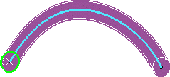
Creating Swept Surfaces
Cont’d…
Swept circle along a curvilinear guiding curve.

Slide 18
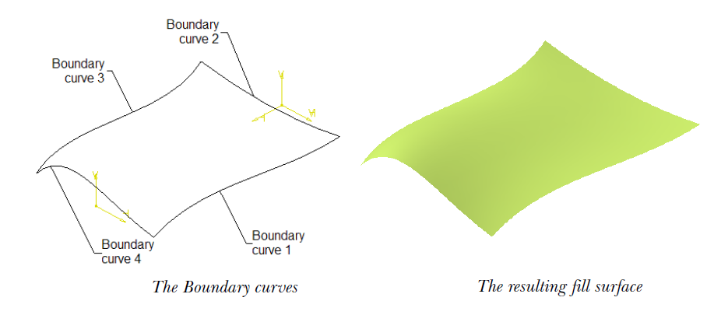
Ex. 4. Creating Fill Surfaces
Notes:
Before creating a fill surface, draw the boundary curves.
Next, choose Fill button from the Surface toolbar

Slide 19
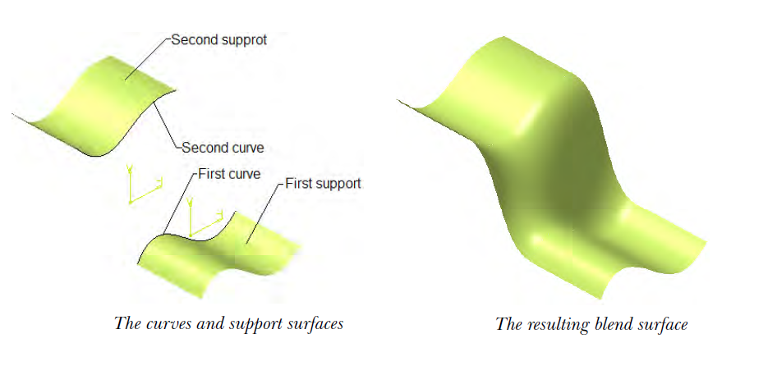
Ex.5. Creating Blended Surfaces
Notes:
allows you to create a surface by blending two curves. These curves can be
sketched curves, wireframe geometries, or edge of existing surfaces. If you select
support surfaces with curves, the resulting blend surface will be tangent to the
support surfaces.
1st form the 1st surface
2nd insert body in a set and form the 2nd surface
3rd blend the two surfaces
You can ontinue the same for both edges

Slide 20
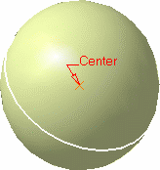
Ex. 6. Creating Spherical Surfaces
The spherical surface is based on a center point, an axis-system defining the meridian & parallel curves orientation, and angular limits.
Click the Sphere icon from the Extrude-Revolution toolbar.
Select the center point of the sphere.
Select an axis-system
Click Apply to preview the surface.
Modify the Sphere radius and the Angular Limits as required
This axis-system determines the orientation of the meridian and parallel curves, and therefore of the sphere.
Notes:
Define center point and axis, then form a sphere in 2 ways
On sphere surface def window, select sphere and give r
Form by defining param like par angles and merd angles

Slide 21
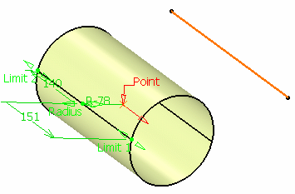
Ex. 7. Creating Cylindrical Surfaces
Click the Cylinder icon
Select the Point that gives the center of the circle to be extruded and specify the desired Direction of the cylinder axis
Select the Radius of the cylinder.
Enter values or use the graphic manipulators to define the start and end limits of the extrusion.
You can click the Reverse Direction button to display the direction of the cylinder on the other side of the selected point or click the arrow in the 3D geometry.
Click OK to create the surface

Slide 22
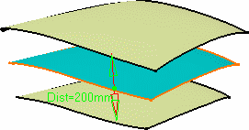
Ex. 8 Creating Offset Surfaces
Click the Offset icon
Select the Surface to be offset.
Specify the Offset by entering a value or using the graphic manipulator. An arrow indicates the proposed direction for the offset.
The offset surface is displayed normal to the reference surface.
Click Apply to preview the offset surface
Check the Both sides button to generate two offset surfaces, one on each side of the reference surface.
Click OK to create the surfaces.
Notes:
Form the surface and the offset it by a given distance either direction is possible

