Slide 1
Chapter 3
Plant design

Slide 2
Plant design refers to the overall design of a manufacturing enterprise/facility.
It is the planning of finances, the plant location and all the planning necessary for the physical requirements of an overall design of a plant
It moves through several stages before it is completed.
The stages involved are :
  identification and selection of the product to be manufactured,
  feasibility analysis and appraisal,
  design,
  economic evaluation,

Slide 3
  design report preparation,
  procurement of materials including plant and machinery construction,
  installation and commissioning.
The design should consider
  technical and economic factors,
  various unit operations involved,
  existing and potential market conditions etc.

Slide 4
Plant design specifies:
equipment to be used
performance requirements for the equipment
interconnections and raw material flows in terms of flow charts and plant layouts
placement of equipment, storage spaces, shop facilities, office spaces, delivery and shipping facilities, access ways, site plans and elevation drawings
required instrumentation and controls, and process monitoring and control interconnections
utility and waste treatment requirements, connections and
Facilities

Slide 5
  rationale for site selection
  basis for selecting and sizing critical pieces of equipment
  ways in which the design was optimized and the engineering basis for such optimization
They also often provide economic analyses of plant profitability in terms of various product demand and price and material cost scenarios.

Slide 6
Plant design situations may arise due to one or more of the following:
design and erection of a completely new plant
design and erection of an addition to the existing plant
facility or plant operations and subsequent expansion restricted by a poor site, thereby necessitating the setting up of the plant at a new site
addition of some new product to the existing range
adoption of some new process /replacement of some existing equipment
modernization / automation of the existing facility
expansion of the plant capacity
relocating the existing plant at a new site because of new economic, social, legal or political factors

Slide 7
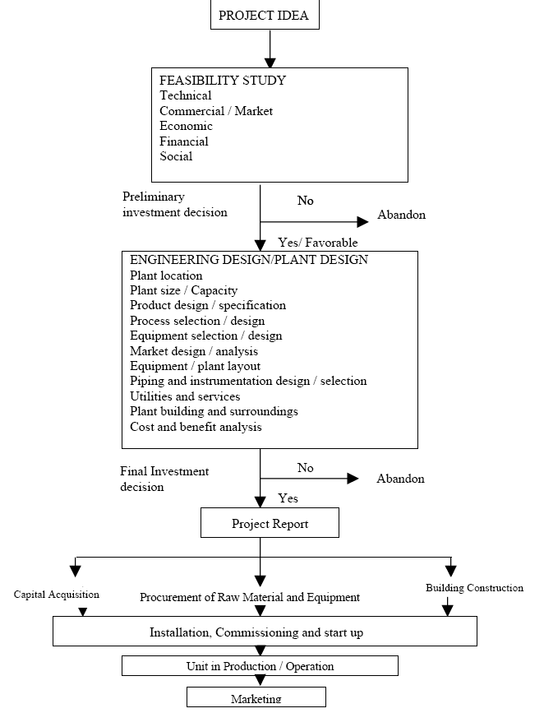

Slide 8
Phase of Plant design
1. FEASIBILITY STUDY
The basis for the success of the design of any plant is a comprehensive feasibility study and evaluation.
The feasibility study involves an analysis and evaluation of the design concept from all the relevant angles.
The study provides an immediate indication of the probable success of the enterprise and also shows what additional information is necessary to make a complete evaluation.
It gives an insight in to: requirements of human, financial and material resources; plant and machinery, technology; and economic gains or profitability of the proposed venture.

Slide 9
The feasibility study can, therefore, be seen as a series of activities culminating in the establishment of a certain number of study elements and documents, which permit decision making.
Stages of feasibility study
  Identification stages,
  preliminary selection stage,
  analysis stage and
  evaluation and decision stage.

Slide 10
A. Identification Stage
Once a product idea occurs, the starting point of analysis is the establishment of the objectives to be attained.
The objective may be to prove that it is possible and desirable to manufacture a certain product or group of products, to add a piece of equipment to the existing plant or to utilize certain resources.
The ideas for new products or diversification can be generated in an informal and spontaneous manner from customers, distributors, competitors, sales people, and others, or the entrepreneur can rely on a systematic process of idea generation.

Slide 11
The following is suggested for identification of the need.
study existing industries for backward and forward product integration to indicate input and output needs
analyze population trends and demographic data for their affect on the market
study development plans and consult development agencies for development needs and venture opportunities
examine economic trends in relation to new market needs and opportunities .
analyze social changes
study the effects of new legislations in relation to creation of new opportunities

Slide 12
The following list should be useful in finding idea.
investigate local materials and other resources for their current utilization pattern, utilization potential and convertibility into more value added products
examine import substitutions for indigenous production
study local skills for production and marketing of value added products
study implications of new technologies for improvement of existing products or to create / produce new ones
study and analyze published sources of ideas

Slide 13
B. Preliminary Screening of Ideas
By following the above approaches, it should be possible to develop a long list of potential venture opportunities.
Obviously, it would not be realistic to conduct a detailed feasibility analysis for each idea.
What is needed is a preliminary screening to eliminate the many ideas that have little or no hope for success and to provide, if possible, a rank-ordering of the remaining few.
The screening can be conducted as two-phase process.
  In the first phase venture ideas are eliminated on a go/no-go basis.

Slide 14
A "Yes" response to any of the following should eliminate the idea from further consideration.
  Are the capital requirements excessive?
  Are environmental effects contrary to Government regulations?
  Is venture idea inconsistent with national policies, goals and restrictions?
  Will effective marketing need expensive sales and distribution system?
  Are there restrictions, monopolies, shortages, or other causes that make any factor of production unavailable at reasonable cost?

Slide 15
C. Comparative Rating of Product Ideas
After elimination of unattractive venture ideas, it is desirable to choose the best of those remaining for further analysis.
Various comparative schemes have been proposed for rating venture ideas.
For a product idea to lead to a successful venture, it must meet the following four requirements:
  An adequate present market
  Market growth potential
  Competitive costs of production and distribution
  Low risk in factors related to demand, price, and costs

Slide 16
Present Market:-
The size of the presently available market must provide the prospect of immediate sales volume to support the operation.
Sales estimates should not be based solely on an estimate of the number of potential customers and their expected individual capacity to consume.
Some factors that effect sales are:
  Market size (number of potential customers)
  Product's relation to need
  Quality-price relationship compared to competitive products
  Availability of sales and distribution systems and sales efforts required
  Export possibilities

Slide 17
2. Market Growth Potential:
There should be a prospect for rapid growth and high return on invested capital.
Some indicators are:
  Projected increase in need and number of potential customers
  Increase in customer acceptance
  Product newness
  Social, political and economic trends (favorable for increasing consumption)

Slide 18
3. Costs (Competitive costs of production and distribution):
The costs of production factors and distribution must permit an acceptable profit when the product is priced competitively.
The comparative rating process should consider factor likely to result in costs higher than those of competitive producers should:
  Costs of raw material inputs
  Labor costs
  Selling and distribution costs
  Efficiency of production processes
  Patents and licenses

Slide 19
4. Risks :
Obviously it is impossible to look into the future with certainty, and the willingness to assume risk is the major characteristic that sets the entrepreneur apart.
The following factors should be considered.
  Market stability in economic cycles
  Technological risks
  Import competition
  Size and power of competitors
  Quality and reliability risks (unproven design)
  Initial investment cost
  Predictability of demand,
  Vulnerability of inputs (supply and price)
  Legislation and controls
  Time required to show profit
  Inventory requirements

Slide 20
D. Pre selection / Pre feasibility Stage
The preliminary screening may have several ideas which appear to be worthy of further study.
Since a complete feasibility study is time consuming and expensive, it may be desirable to perform a pre-feasibility analysis in order to further screen the possible ideas.
The purpose of a pre feasibility study is to determine.
  Whether the project seems to justify detailed study
  What matters deserve special attention in the detailed study (e.g. market analysis, technical feasibility, investment costs)
  An estimate of cost for the detailed study
For many ideas the pre-feasibility analysis may provide adequate evidence of venture profitability if certain segments are more carefully verified.

Slide 21
The pre-feasibility study may include some or all of the following elements.
1. Product description.
The product's characteristics should be briefly described, along with possible substitutes which exist in the market place.
Also, allied products should be identified, which can or should be manufactured with the product under study.
2 Description of market.
The present and projected potential market and the competitive nature of the market should be delineated.
  Where is the product now manufactured?
  How many plants exist and how specialized are they?
  What are the national production, imports, and exports?
  Are there government contracts or incentives?
  What is the estimated product longevity or future consumption?
  What is the price structure?

Slide 22
3. Outline of technological variants. The technology choices that exist for the manufacture of the product should be described briefly. Also, the key plant location factors should be identified.
4. Availability of main production factors. Production factors such as raw materials, water, power, fuel and labor skills should be examined to ensure availability.
5. Cost estimates. Estimates should be made of the necessary investment costs and costs of operation.
6. Estimate of profit. The data gathered should include estimates of profits of firms manufacturing similar products or, if the preliminary data are extensive, an actual estimated profit for the project under study.

Slide 23
7. Other data: In certain cases, local attitudes toward industry; educational, recreational and civic data; and availability of local sites, may be the most important in the evaluation of the suitability of a proposed product, especially in the case of the establishment of a new firm.
Thus pre feasibility study can be viewed as a series of steps culminating in a document which permits determination of whether or not a complete detailed feasibility study should be made.
It does not possess the depth the detailed study is expected to have, and the data usually are gathered in an informal manner.

Slide 24
E. Analysis Stage
At the analysis stage various alternatives in marketing, technology and capital availability need to be studied.
The analysis can be conducted at different levels of effort with respect to time, budget and personnel, depending on the circumstances.
The complete study is referred to as techno-economic feasibility study. In some cases such a detailed study is not necessary.
if the product has an assured market, in-depth market analysis is not required. In some cases, a partial study of the market or of the technologies satisfies the data requirements for decision making.

Slide 25
The detailed analysis should include the following.
1. Market analysis / study
Market analysis can serve as a tool for screening venture ideas and also as a means of evaluating the feasibility of a venture idea in terms of the market.
It provides:
  understanding of the market
  information on feasibility of marketing the product
  analytical approach to the decision making
  In addition, it assists in analyzing the decisions already taken.

Slide 26
Market analysis answers questions about.
  size of market and share anticipated for the product in terms of volume and value
  pattern of demand
  market structure
  buying habits and motives of buyers
  past and future trends
  price which will ensure acceptance in the market
  most efficient distribution channels,
  company's strong points in marketing

Slide 27
Market analysis involves systematic collection, recording, analysis, and interpretation of information on:
  existing and potential markets
  marketing strategies and tactics
  interaction between market and product
  marketing methods
  current or potential products

Slide 28
Basic steps involved in a market study for a new enterprise are outlined below:
  Define objectives of the study and specify information required
  Workout details of the study as under:
    identify sources of information (both secondary and primary)
    time and cost involvement
    methodology and action plan
    Select samples and decide contacts and visits
    Prepare the questionnaire as the survey instrument and field test the same
    Conduct the survey and analyze information
    Prepare the report with findings and interpretations

Slide 29
The analysis should generally contain:
A brief description of the market including the market area, methods of transportation existing rates of transportation, channels of distribution, and general trade practices
Analysis of past and present demand including determination of quantity and value of consumption, as well as identification of the major consumers of the product
Analysis of past and present supply broken down as to source, information on competitive position of the product such as selling prices, quality, and marketing practices of the competitors
Estimate of future demand of the product
Estimate of the project’s share of the market considering all above factors

Slide 30
2. Technical analysis:
The technical analysis must establish whether or not the identified venture is technically feasible and, if so, make tentative choices among technical alternatives and provide cost estimates in respect of:
  fixed investment,
  manufacturing costs and expenses, and
  start-up costs and expenses.
In order to provide cost estimates, tentative choices must be made among technical alternatives such as:
  level of product / manufacturing technology,
  raw material inputs,
  equipment,
  methods,
  organization, and
  facilities location and design.

Slide 31
The analysis should incorporate:
Description of the product, including specifications relating to its physical, mechanical, and chemical properties as well as the uses of the product
Description of the selected manufacturing process showing detailed flow charts as well as presentations of alternative processes considered and justification for adopting the one selected
Determination of plant size and production schedule, which includes the expected volume for a given time period, considering start-up and technical factors
Selection of machinery and equipment, including specifications, equipment to be purchased and origin, quotations from suppliers, delivery dates, terms of payment, and comparative analysis of alternatives in terms of costs, reliability, performance and spare parts availability .

Slide 32
Identification of plant's location and assessment of its desirability in terms of its distance from raw material sources and markets. For a new project this part may include a comparative study of different sites, indicating the advantages and disadvantages of each.
Design of a plant layout and estimation of the costs of erection of the proposed types of buildings and land improvements
Study of availability of raw materials and utilities, including a description of physical and chemical properties, quantities, needed, current and prospective costs, terms of payment, source of supply and their location and continuity of supply

Slide 33
Estimate of labor requirements including a breakdown of the direct and indirect labor supervision required for the manufacture of product
Determination of the type and quantity of waste to be disposed of, description of the waste disposal method, its costs and necessary clearance from the authorities
Estimation of the production cost for the product

Slide 34
The elimination of inappropriate technology alternatives for producing the identified product can be done on the basis of side effects.
The factors which may be considered as side effects include:
  contribution to employment
  requirements for scarce skills
  energy requirements
  capital requirements
  need for imported equipment
  support of indigenous industry
  multiplier effect of the venture operation
  environmental effects.
  safety and health hazards,

Slide 35
Information concerning manufacturing processes and equipment, which may facilitate the selection and decision making, may be obtained from:
  existing manufacturers of the product,
  trade publications,
  trade associations and organizations, and
  equipment manufacturers.

Slide 36
Financial analysis
The financial analysis emphasizes on the preparation of financial statement, so that the venture idea can be evaluated in terms of commercial profitability and the magnitude of financing required.
It requires the assembly of the market and the technical cost estimates into various proforma statements.
If more information on which to base an investment decision is needed, a sensitivity analysis or, possibly, a risk analysis can be conducted.
The depth of analysis would depend, to a certain extent, on the venture idea and the overall objectives of the feasibility analysis.

Slide 37
The financial analysis should include:
For existing companies-audited financial statements, such as balance sheets, income statements and cash flow statements
For new companies-statements of total project costs, initial capital requirements and cash flows relative to the project time table
For all projects-financial projections for future time periods, including income statements, cash flows and balance sheets
Supporting schedules for financial projections, stating assumptions used as to collection period of sales, inventory levels, payment period of purchases and expenses, elements of product costs, selling, administrative and financial expenses

Slide 38
financial analysis showing return on investment, return on equity, breakeven volume and price analysis
Sensitivity analysis to identify items that have a large impact on profitability or possibility of risk analysis
Profitability measures, which consider the time value of money, that is, discounted cash flow methods, are net present value (NPV), internal rate of return (IRR), and the discounted benefit / cost ratio.
For a rule of thumb, the following are the percentages of the venture cost factors:
  Project development and detailed project report (DPR) preparation - 2 %
  Engineering and design - 13 %
  Brought out materials and equipment-55 %
  Fabrication and construction- 30 %
Depending on the type of venture, sector and complexity, these can vary on either side.

Slide 39
Lecture 3

Slide 40
The basic decision that must taken for effective plant design include:
(i) Acquisition of Capital
  Obtaining capital for the initial establishment;
  Raising funds to cover operating costs;
  Secure funds for expansion.
The primary sources of capital are:
      Personal savings;
      Loans and sales of bonds;
      Profit plowback
  (ii) Sales Planning for Requirement:
It is important to know the market demand with the understanding of seasonal variation.

Slide 41
Cont’d
(iii) Determination of the Production Process: Process planning is closely allied with plant layout.
(iv) Make or Buy:
The determination of unit cost is usually the first step in a make-buy analysis. In such analysis management is interested in:
  Reducing unit material and processing costs;
  Minimizing cash investment;
  Improving product.
(v) Plant Size:
The size of a plant dependent upon the volume of output proposed for it.
vi) Product Price Range:
The choice of competent price range will influence the quality, quantity and the manufacturing process of the product.

Slide 42
Plant design …..Cont’d
(vii) Plant Location:
Selecting a location involves large commitments of capital as a result it must be done with utmost care.
(viii) Plant Layout:
It is the plan of, or the act of planning, a good workable disposition of industrial facilities, like operating equipment, storage space, materials handling equipment and all other supporting services, along with the design of the best structure to contain these facilities.
(ix) Building Type Selection:
Selection of the type of building will take place before, or during the plant layout phase.
(x) Diversification:
To diversify doesn't mean widening the scope of the presently manufactured line, but rather mean entering a completely new field.

Slide 43
Cont’d
(xi) Organization Development:
The manner in which the overall objectives of an enterprise are clearly defined, the objectives of various subdivisions are determined and clearly specified influences the arrangement of plant facilities.
(xii) Product Design:
The design of the product is the foundation upon which a plant layout is built.
Design for function:
In order to create a satisfied customer or to attract customers, a product must perform the function for which its customer intends to.
Design for manufacturing: a product that solves the functional problem nicely, but is impossible to manufacture, is worthless.
Design for selling: a product that functions well and easy to make, but wanted by no one is useless.

Slide 44
The design process
Recognition of need realizes a problem that exists for which some action can be taken.
Definition of the problem involves a thorough specification of the item to be designed.
Synthesis, Analysis are closely related and highly interactive in the design process
Evaluation is measuring the design against the specifications in the problem definition phase.
Presentation is the documentation of the design by means of drawings, material specifications, assembly lists, and so on.

Slide 45
Design process
Recognition of need
Computer-aided design
The design Process
Recognition of need
Definition of Problem
Problem Definition
Synthesis
Geometric Modeling
Synthesis
Analysis and Optimization
Analysis and Optimization
Engineering Analysis
Evaluation
Evaluation
Design Review and evaluation
Presentation
Presentation
Automated Drafting
The general design process
Design process Using CAD

Slide 46
PLANT LAYOUT

Slide 47
Plant layout
Plant layout has been defined as a plan of, or the act of planning an optimum arrangement of industrial facilities, including personnel, operating equipment, storage space, materials handling equipment and all other supporting services along with the design of the best structure to contain these facilities
Since a layout once implemented cannot be easily changed and costs of such a change are substantial, the plant layout is a strategic decision.
A poor layout will result in continuous losses in terms of higher efforts for material handling, more waste and rework, poor space utilization etc.

Slide 48
Plant layout means planning:
  for the location of all machines, utilities, employee workstations, customer service areas, material storage areas, aisles, restrooms, lunchrooms, internal walls, offices, and computer rooms
  for the flow patterns of materials and people around, into, and within buildings
  infrastructure services such as the delivery of line communications, energy, and water and the removal of waste water all make up basic utilities.

Slide 49
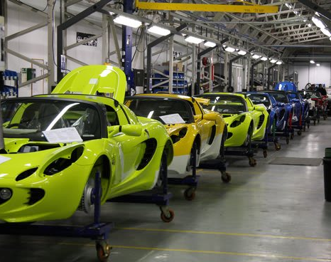

Slide 50
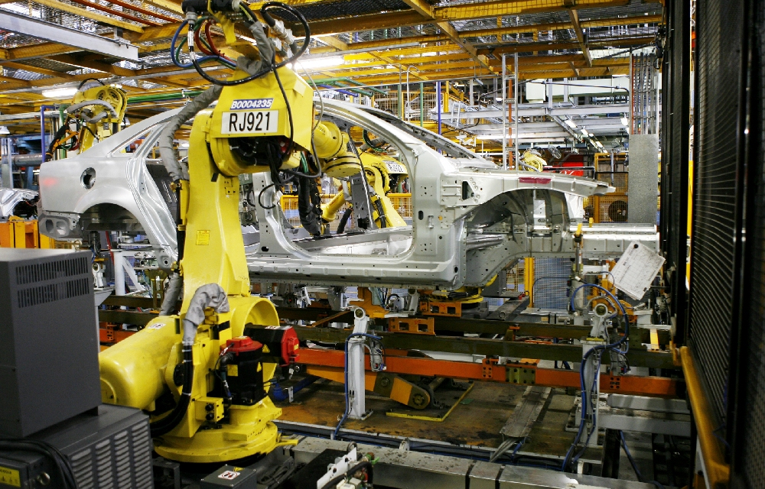

Slide 51
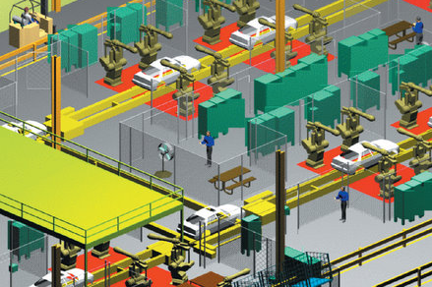

Slide 52
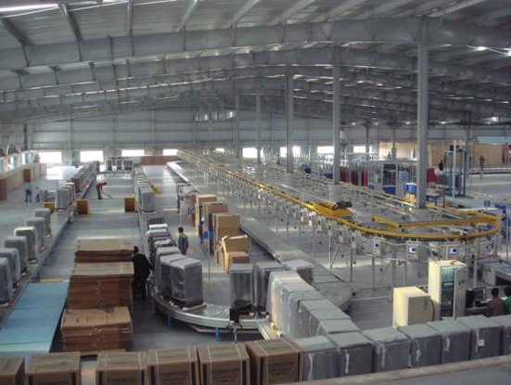

Slide 53
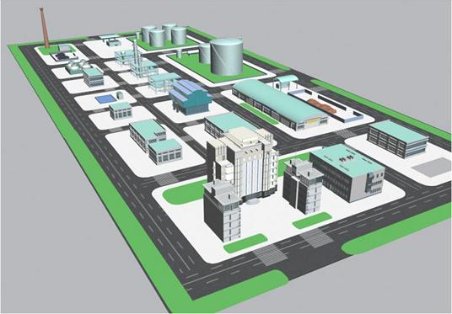

Slide 54
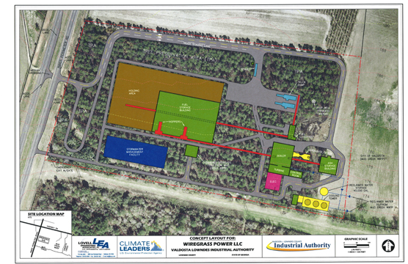

Slide 55
Locate All Areas In and Around Buildings
  Equipment
  Work stations
  Material storage
  Rest/break areas
  Utilities
  Eating areas
  Aisles
  Offices

Slide 56
Characteristics of the Facility Layout Decision
  Location of these various areas impacts the flow through the system.
  The layout can affect productivity and costs generated by the system.
  Layout alternatives are limited by
  the amount and type of space required for the various areas
  the amount and type of space available
  the operations strategy
  . . . more

Slide 57
Machine shop process layout
Receiving Grin-
Mills ders
Raw matl. Large number
of
storage Assem- low volume
bly products
Drills
Planers
Finished
Inspec- goods
Lathes Automatics tion storage
Part A
Part B

Slide 58
Problems of layout develop when needed:
to start a new product,
to change the product design,
to reduce the cost;
And when
the market demand changes,
the plant, the product, the building become obsolete,
accidents occur frequently,
the working environment is poor.
competitive cost reduction
adoption of new safety standards
decision to build a new plant

Slide 59
The resulting problems involve
planning a completely new plant,
re-arranging a presently installed layout,
making adjustments to existing layout.
Minor modifications in present layout

Slide 60
Objectives and advantages
Some of the important objectives of a good plant layout are as follows:
Overall simplification of production process in terms of equipment utilization, minimization of delays, reducing manufacturing time, and better provisions for maintenance
Overall integration of man, materials, machinery, supporting activities and any other considerations in a way that result in the best compromise.
Minimization of material handling cost by suitably placing the facilities in the best flow sequence
Saving in floor space, effective space utilization and less congestion

Slide 61
Increased output and reduced in-process inventories
Better supervision and control
Worker convenience and worker satisfaction
Better working environment, safety of employees and reduced hazards
minimization of waste and higher productivity
avoid unnecessary capital investment
higher flexibility and adaptability to changing conditions

Slide 62
The objectives of a good study of plant layout are:
ensure effective space utilization,
minimize the cost of material handling (internal transports),
foresee future developments of the plant according to a rational master plan,
improve workers convenience as well as safety and create job satisfaction, and
avoid unnecessary capital investment.

Slide 63
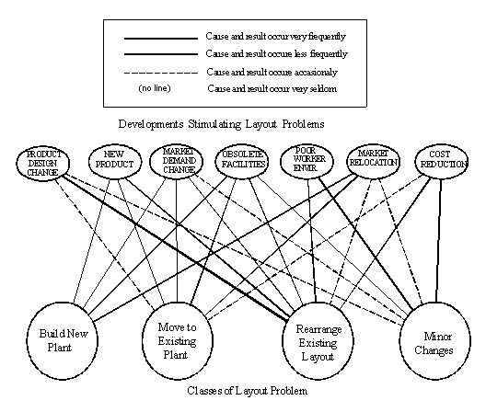

Slide 64
PLANT LAYOUT FACTORS
The design of any layout is governed by a number of factors and the best layout is the one that optimizes all the factors. The factors influencing any layout are categorized into the following eight groups:
The material factor: includes design, variety, quantity, the necessary operations, and their sequence.
The main factor: includes direct workers, supervision and service help, safety and manpower utilization.
The machinery factor: includes the process, producing equipment and tools and their utilization
The movement factor: includes inter and intradepartmental transport and handling at the various operations, storage and inspection, the materials handling equipment.
The waiting factor: includes permanent and temporary storage and delays and their locations.

Slide 65
The service factors: include service relating to employee facilities such as parking lot, locker rooms, toilets, waiting rooms etc.; service relating to materials in terms of quality, production control, scheduling, dispatching, waste control; and service relating to machinery such as maintenance.
The building factor: includes outside and inside building features and utility distribution and equipment.
The change factor: includes versatility, flexibility and expansion Each of the above mentioned factors comprise a number of features and the layout engineer must review these in the light of his problem.

Slide 66
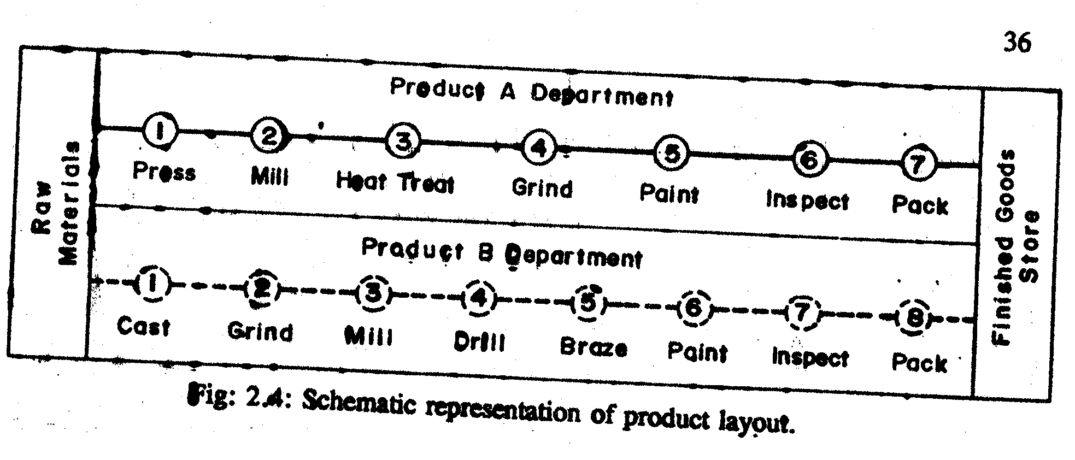
Types of Layout
Product Layout: In this type of layout, only one product or one type of product is produced in a given area.
The product must be standardized and manufactured in large quantities in order to justify the product layout.

Slide 67
Some of the Advantages of Product Layout are:
lower total material handling cost,
lower total production time,
less work in process,
greater incentive for groups of workers to raise level of performance,
less floor area required per unit of production and
greater simplicity of production control, fewer control records needed and lower accounting cost.

Slide 68
Product Layout is Used When:
one or few standard products are to be produced,
large volume of production of each item over a considerable time is needed,
minimum of inspection is required during sequence of operations,
minimum of very heavy equipments or equipments requiring special facilities are needed,
materials and products permit bulk or continuous handling of mechanical means and
one machine is always used for one purpose.

Slide 69
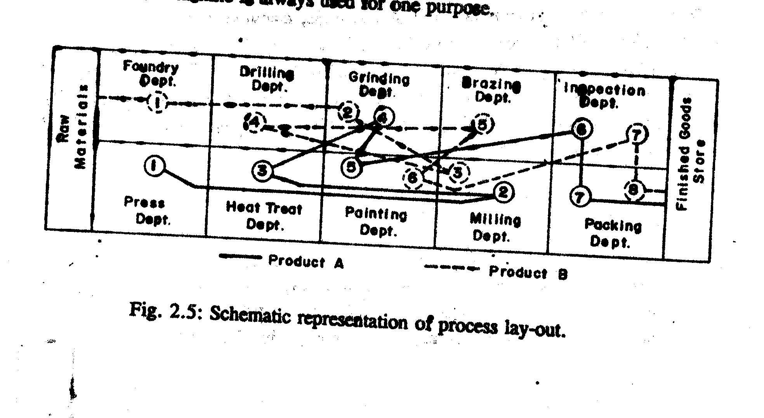
Process Layout
Process Layout: Similar equipment and similar operations are grouped together in the process or functional layout. It is particularly useful where low volume is required.

Slide 70
Some of the Advantages of Process Layout are:
less duplication of equipment, hence lower investment cost,
greater flexibility of production,
better and more efficient supervision,
greater incentive for individual workers to raise level of performance,
better control of complicated or precision processes,
easier to handle breakdowns of equipment by transferring work to anther machine or station.

Slide 71
Process Layout is Used when
many types or styles of products are on special order ,
relatively low volume of production on individual items is needed,
many inspections are required during a sequence of operations,
high proportion of very heavy equipment or equipment requiring special treatment exist,
materials or products become too large or too heavy to permit bulk or continuous flow and
one machine is used for different operations.

Slide 72
Cellular or group layout
It is a special type of functional layout in which the facilities are clubbed together into cells.
This is suitable for systems designed to use the concepts, principles and approach of group technology.
Such a layout offers the advantages of mass production with high degree of flexibility.
In such a system the facilities are grouped into cells which are able to perform similar type of function for a group of products.
Also known as ‘Group Technology’

Slide 73
Advantages :
Each cell manufactures products belonging to a single family.
Cells are autonomous manufacturing units which can produce finished parts.
Commonly applied to machined parts.
Often single operators supervising CNC machines in a cell, with robots for materials handling.
Productivity and quality maximised. Throughput times and work in progress kept to a minimum.
Flexible.
Suited to products in batches and where design changes often occur.

Slide 74
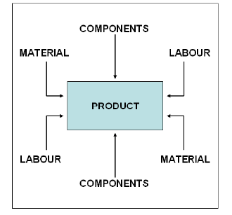
Fixed-Position Layout
In this type of layout, the material or major component remains in a fixed location, and tools, machinery, men as well as other pieces of material are brought to this location. Typical examples are ship building, construction industries, aircraft building and bench work exercises.
This type of layout is not frequently used in industrial enterprises. For this reason we are not going to look into its advantage and disadvantages.

Slide 75
LAYOUT DESIGN PROCEDURE
The overall layout design procedure can be considered to be composed of four phases Viz.,
Phase I: Location
Phase II: General Overall Layout
Phase III: Detailed layout
Phase IV: Installation

Slide 76
Phase I: Plant Location
Plant location decisions are strategic, long term and non-repetitive in nature.
Without sound and careful location planning in the beginning itself, the new plant may pose continuous operating disadvantages.
Location decisions are affected by many factors, both internal and external to the organization’s operations.
Internal factors include the technology used, the capacity, the financial position, and the work force required.
External factors include the economic, political and social conditions in the various localities.

Slide 77
When Does a Location Decision Arise?
It may arise when a new plant is to be established.
In some cases, the plant operations and subsequent expansion are restricted by a poor site, thereby necessitating the setting up of the facility at a new site.
The growing volume of business makes it advisable to establish additional facilities in new territories.
It could happen that the original advantages of the plant have been outweighed due to new developments.
New economic, social, legal or political factors could suggest a change of location of the existing plant.

Slide 78
Cont’d
The decision usually is made in two stages but there is substantial overlap, as shown.
      The selection of general territory
      2.The selection of a specific community and site

Slide 79
Selection of a General Territory
Cost of construction may very form one territory to the other.
Market may be concentrated or distributed
  Locating a plant or facility nearer to the market is preferred if promptness of service is required particularly if the product is susceptible to spoilage.
  Also if the product is relatively inexpensive and transportation costs add substantially to the cost, a location close to the market is desirable.
Wages and Labor are lower in one area than in the other, depending upon the living cost.
Availability of Raw material
  A material index has been proposed, which equals the weight of localized material used in the finished product divided by the weight of the finished product.
  If the material index is greater than unity, location should be nearer to the source of raw material and if it is less than unity, then a location nearer to market is advised.

Slide 80
Cont’d
v. Transport: Refers to the external transportation of the raw material and the finished product.
  Adequate transportation facilities are essential for the economic operation of production system.
vi. Energy: Other than electric power, in most plants it may be necessary to use gas, coal fuel oil, etc.
vii. Infrastructure: This factor refers to the availability and reliability of power, water, fuel and communication facilities in addition to transportation facilities.
viiI. Legislation and taxation: Factors such as financial and other incentives for new industries in backward areas or no-industry-district centers, exemption from certain state and local taxes etc. are important.

Slide 81
Selection of a Specific Site
Community Attitude: The plant has to be located according to the master plan of the city or the region;
Community facilities: These involve factors such as quality of life which in turn depends on availability of facilities like education, places of worship, medical services, police and fire stations, cultural, social and recreation opportunities, housing, good streets and good communication and transportation facilities.
Transport: It is important to consider the transportation infrastructure of the area.
Water: There are certain industrial processes, which require large quantities of water.

Slide 82
Cont’d
iv. Communication: The new plant has to be located in proximity to one or more of communication systems
v. Wind Direction: If the industry produces smoke, gas, odor, etc, it will be necessary to place the pant with respect to the dominating wind direction.
vi. Condition of the Site: The ground has to have a good resistance to the load induced by the foundation of the building.
vii. Waste disposal: The facilities required for the disposal of process waste including solid, liquid and gaseous effluent need to be considered. The plant should be positioned so that prevailing winds carry any fumes away from populated areas and that the waste may be disposed off properly and at reasonable costs.

Slide 83
Cont’d
vii. Ecology and pollution: These days, there is a great deal of awareness towards maintenance of natural ecological balance. There are quite a few agencies propagating the concepts to make the society at large more conscious of the dangers of certain available actions.
viii. Site size: The plot of land must be large enough to hold the proposed plant and parking and access facilities and provide room for future expansion.
iX. Future Development: The plant has to be in a position to develop or change product quantity, type and size. Space has to be at its disposal for its future development.
X. Complementary pant: an industry, to produce as intended, may need material; service and assistance form other plants.

Slide 84
Cont’d
Wind Direction: If the industry produces smoke, gas, odor, etc, it will be necessary to place the pant with respect to the dominating wind direction.
Topography: -The topography, soil structure and drainage must be suitable. If considerable land improvement is required, low priced land might turn out to be expensive.
Condition of the Site: The ground has to have a good resistance to the load induced by the foundation of the building.

Slide 85
Cont’d
xiv. Land costs: These are generally of lesser importance, as they are nonrecurring and possibly make up a relatively small proportion of the total cost of locating a new plant.
xv. Future Development: The plant has to be in a position to develop or change product quantity, type and size. Space has to be at its disposal for its future development.
xvi. Complementary plant: an industry, to produce as intended, may need material; service and assistance form other plants.

Slide 86
Location Factor | Territory Selection | Selection of Site and Community
Market Raw Materials Transportation Power Climate and Fuel Labor and Wages Laws and Taxation Comm.ty Services and Attitude 9. Water and Waste | * * * * * * * | * * * * * *
A typical team studying location possibilities might include accountants, lawyers, marketing experts, various consultants, executives, and industrial engineers.

Slide 87
Requirements governing choice of a city location are:
Availability of adequate supply of labour force · High proportion of skilled employees
Rapid public transportation and contact with suppliers and customers
Small plant site or multi floor operation
Processes heavily dependent on city facilities and utilities
Good communication facilities like telephone, telex, post offices
Good banking and health care delivery systems

Slide 88
Requirements governing the choice of a suburban location are:
Large plant site close to transportation or population centre
Free from some common city building zoning (industrial areas) and other restrictions
Freedom from higher parking and other city taxes etc.
Labour force required to reside close to the plant
Community close to, but not in large population centre
Plant expansion easier than in the city

Slide 89
Requirements governing the choice of a rural location are:
Large plant site required for either present demands or expansion
Dangerous production processes
Lesser effort required for anti-pollution measures
Large volume of relatively clean water
Lower property taxes, away from Urban Land Ceiling Act restrictions
Protection against possible sabotage or for a secret process
Balanced growth and development of a developing or underdeveloped area
Unskilled labour force required
Low wages required to meet competition

Slide 90
Evaluating Locations
Transportation Model
  Decision based on movement costs of raw materials or finished goods
Factor Rating
  Decision based on quantitative and qualitative inputs
Center of Gravity Method
  Decision based on minimum distribution costs

Slide 91
For the bamboo plant, the following selection criterions are considered:-
  Land availability and building costs
  Availability and nearness to the sources of raw material
  Transportation and distribution systems
  Availability of Infrastructural facilities
  Labor availability and cost
  Operating/running costs
  Banking and financial institutions/services
  Community attitude and culture
  Safety and security
  Incentives packages
  Natural or climatic conditions
  Future expansion
  Proximity to market
  Rules and regulations

Slide 92
Level-1 Goal
Bamboo Plant site Selection
Level-2 eria
.
Level-3 Alternatives

Slide 93
Super decision software
The Super Decisions software is used for decision-making
Super Decisions extends the Analytic Hierarchy Process (AHP) that uses the same fundamental prioritization process based on deriving priorities through judgments on pairs of elements or from direct measurements.
Site selection process is potentially very complex because of many variables that influence the decision.

Slide 94
Preference Level | Numerical value
Equally preferred | 1
Equally to moderately preferred | 2
Moderately preferred | 3
Moderately to Strongly preferred | 4
Strongly preferred | 5
Strongly to very strongly preferred | 6
Very strongly preferred | 7
Very strongly to extremely preferred | 8
Extremely Preferred | 9
Table1 Standard Preference Table

Slide 95
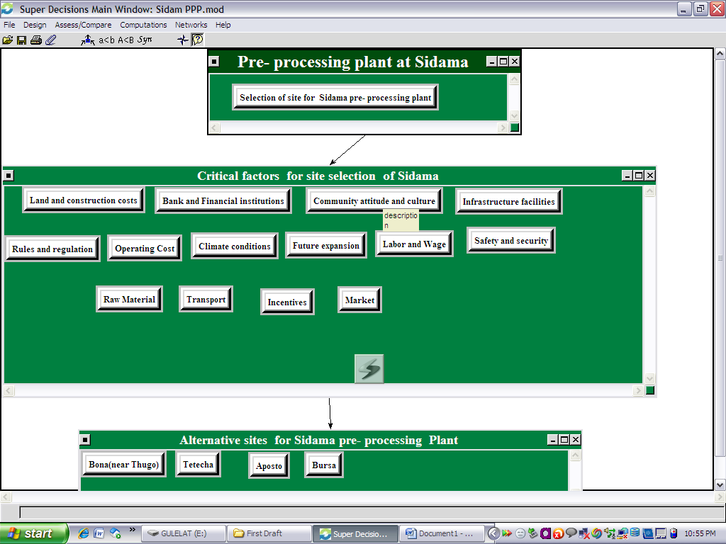

Slide 96
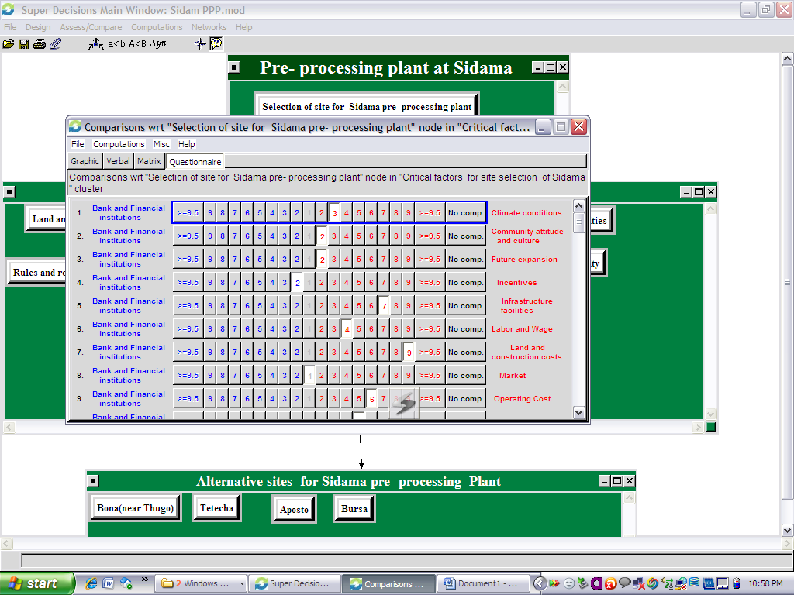

Slide 97
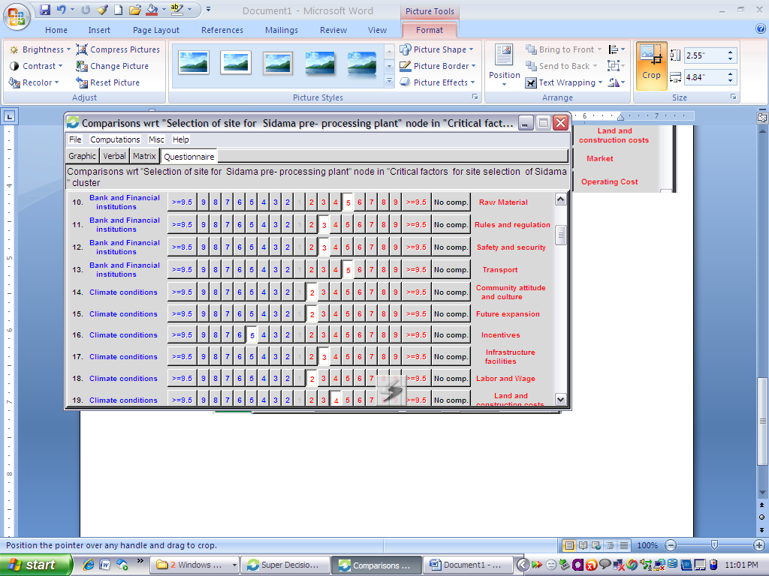

Slide 98
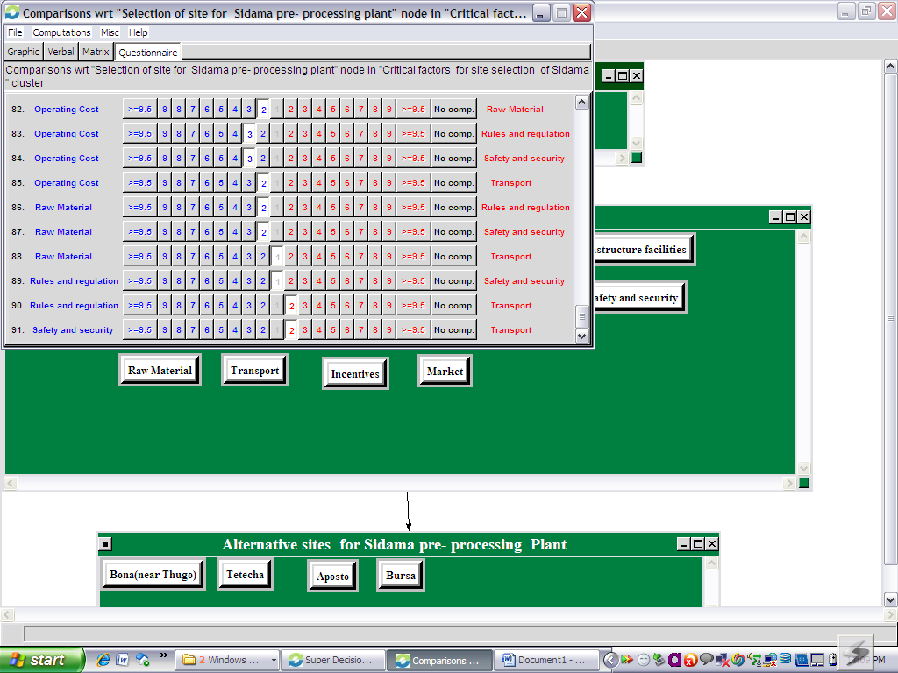

Slide 99
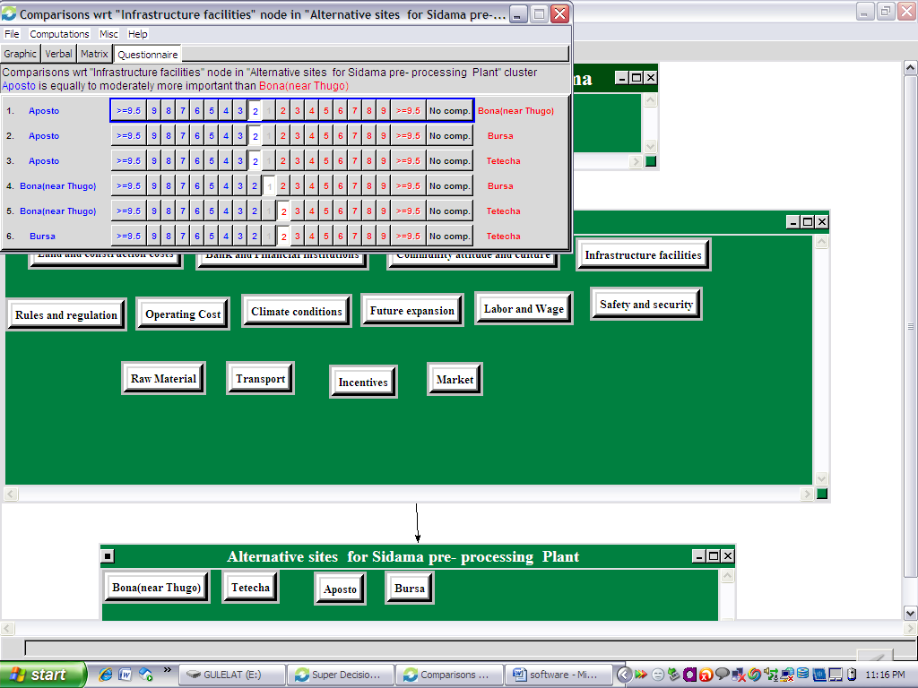

Slide 100
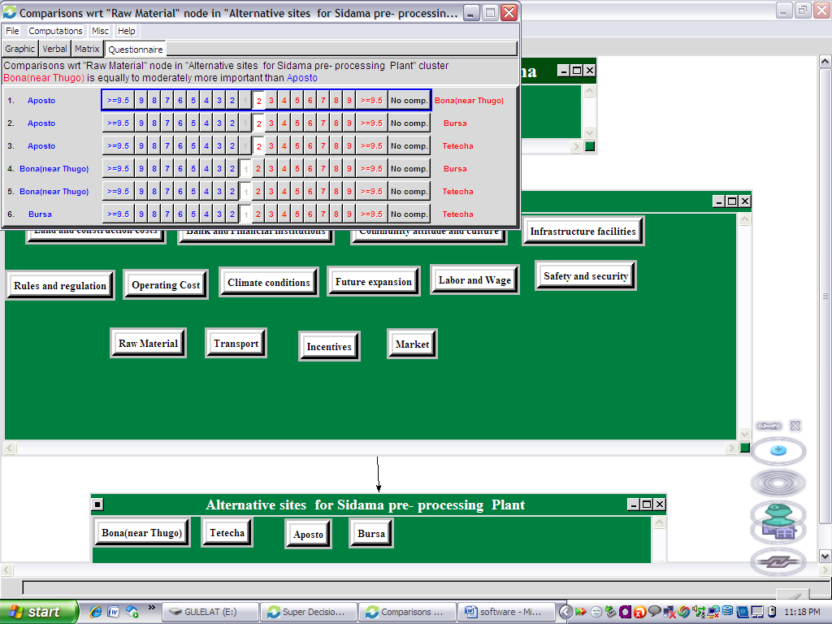

Slide 101
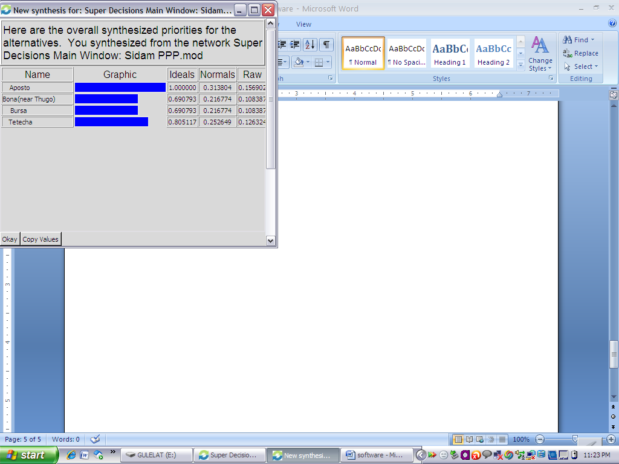

Slide 102
Synthesis - Getting the Results
Report of Ambo pre processing plant
 | Alternatives |  | Normal | Ideal | Ranking
 | Ambo |  | 0.2394 | 0.8772 | 3
 | Guder |  | 0.2729 | 1.0000 | 1
 | Shenen |  | 0.2269 | 0.8314 | 4
 | Tikur Inchini |  | 0.2608 | 0.9558 | 2

Slide 103
  Report of Sidama pre processing plant
 | Alternatives |  | Normal | Ideal | Ranking
 | Aposto |  | 0.3138 | 1.0000 | 1
 | Bona(near Thugo) |  | 0.2168 | 0.6908 | 4
 | Bursa |  | 0.2168 | 0.6908 | 3
 | Tetecha |  | 0.2526 | 0.8051 | 2

Slide 104
Report of main Industrial Plant
 | Alternatives |  | Normal | Ideal | Ranking
 | Mojo( near to cement factory) |  | 0.2231 | 0.6619 | 3
 | Mojo(Between Nazret road and Express way) |  | 0.3370 | 1.0000 | 1
 | Mojo(Pittard tannery) |  | 0.2512 | 0.7454 | 2
 | Mojo-Minjar road |  | 0.1888 | 0.5602 | 4

Slide 105
Lecture 4

Slide 106
Phase II – General overall layout
The major steps that have to be followed in the layout design are outlined as follows:
state the problem in terms of its objective, scope and factors to be considered
Collect basic data on sales forecasts, production volumes, production schedules, part lists, operations to be performed, work measurement, existing layouts, building drawing etc.
Analyze data and present it in the form of various charts
Plan the production process and its arrangement
Plan the material flow pattern and develop the overall material-handling plan

Slide 107
Estimate plant and machinery requirements
Select material handling equipment
Determine storage requirements
Design and plan activity relationships
Plan auxiliary and service facilities including their arrangement
Determine space requirements and allocate activity areas
Develop plot plan and block plan i.e. integrate all plant operations
Develop detailed layouts and plan building along with its arrangement
Evaluate, modify and check the layouts
Install layouts and follow up

Slide 108
Methodology of layout
Systematic Layout Planning (SLP) methodology:-
The solution of any size and type of plant layout problems could be facilitated by using a systematic and logical approach.
An early pioneer in this area was Richard Muther, developer of the Systematic Layout Planning (SLP) methodology.
The SLP procedure leads the planner through
  Abstraction (analysis)
  Search
  evaluation

Slide 109
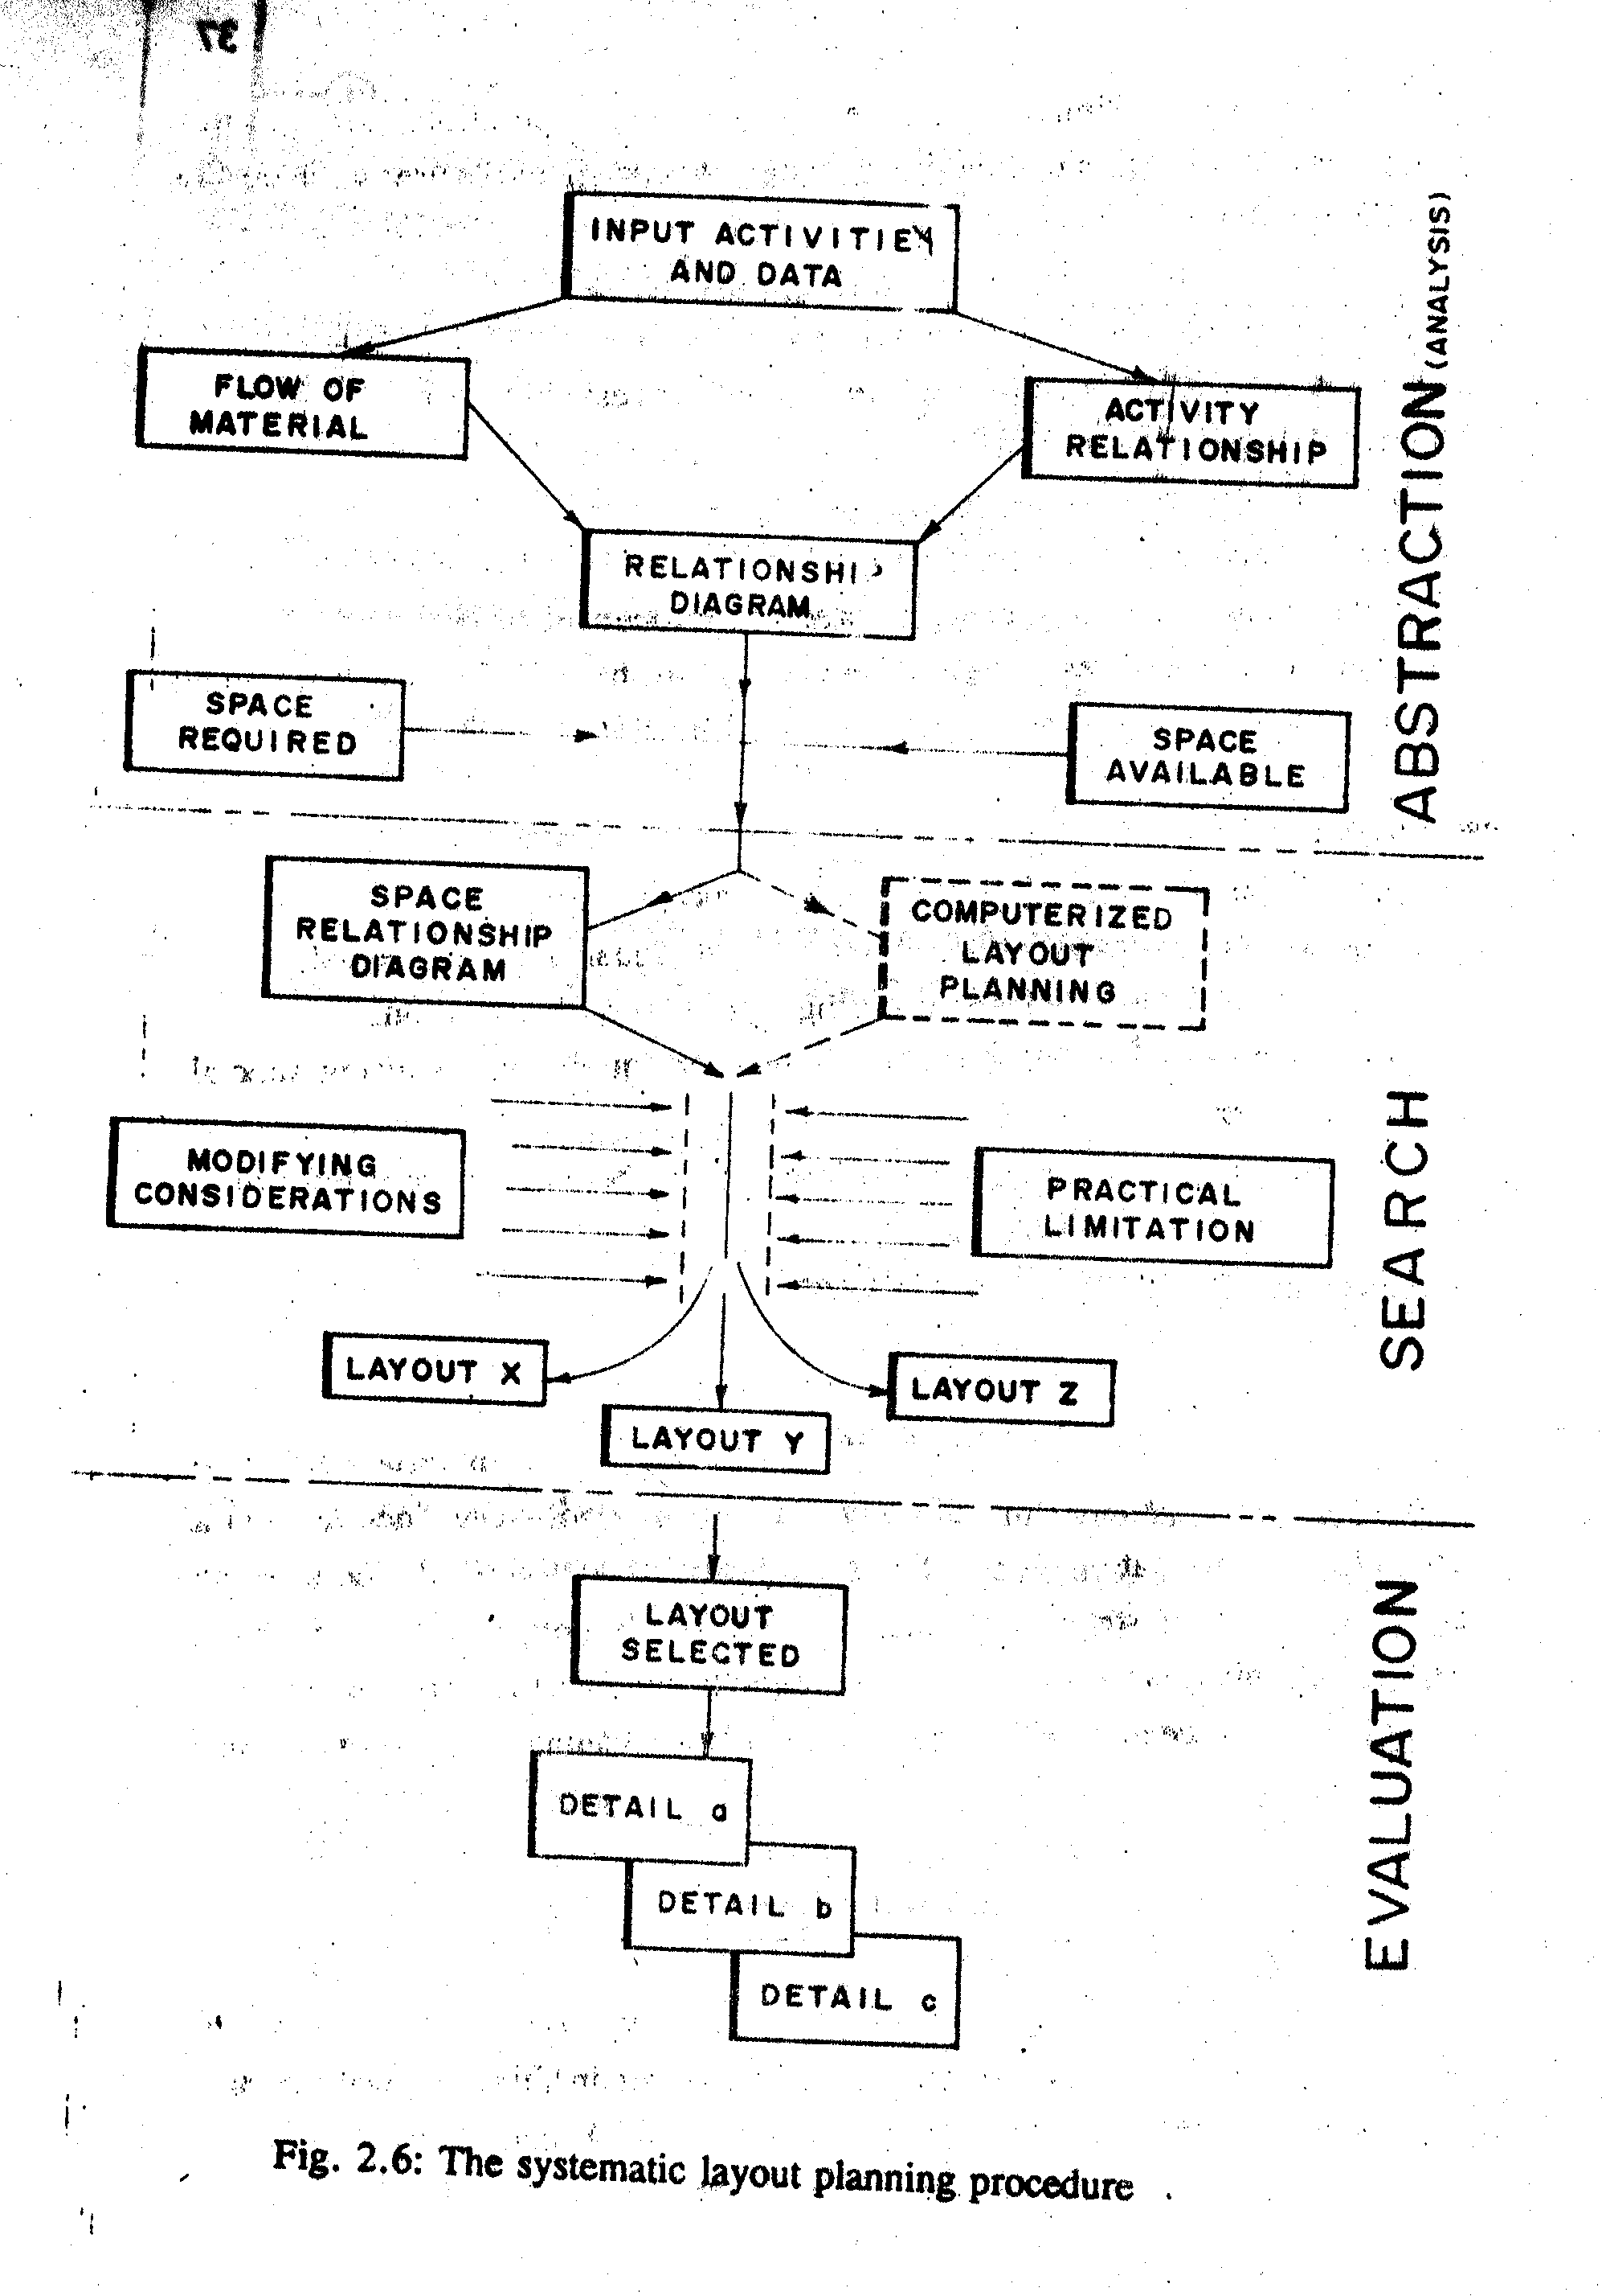

Slide 110
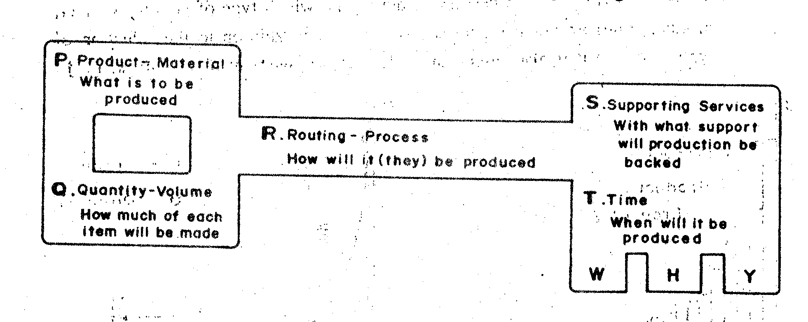
1. Abstraction (Analysis)
There are two basic elements on which every layout problem rests
    Product (or material)
    Quantity (or volume)
These two elements underline all other features or conditions directly or indirectly in layout work.

Slide 111
In general, information about the following is needed:
the list of items to produce and store, and the relative quantity;
successive operations needed for every product;
the volume, the weight and the characteristics of materials to transport along the production line;
the number, type and technical data of machines and plants necessary;
the manpower needed;
the necessary electric energy, steam, water, compressed air, fuel, oil, etc;
the necessary general service (offices, labs, cafeteria etc);
the necessary auxiliary services like maintenance department, tool store, etc;
the possible variation of the product in the future.

Slide 112
2. Search for Possible Solution
The systematic approach of generating possible alternatives of plant layout is conducted by taking in to consideration:
type of layout,
the possible internal transport systems and
the working condition.

Slide 113
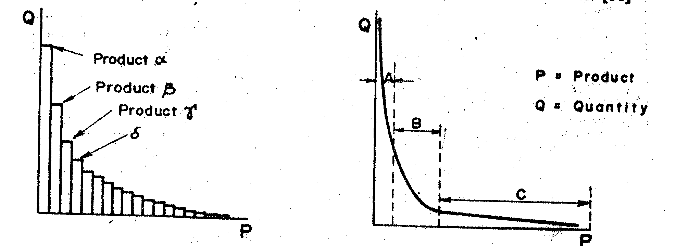
A. types of layout
Type of Layout: It is necessary to determine which type of layout to select, product (line) or process (functional) layout.
In addition to the selection of type of layout it is also important to fix the arrangement of machines.
In region A there are few types of products but in a great quantity. For these products it is advisable to have product layout.
In region C there are very many products in small quantity. Hence, preferred to have process layout.
For products in region B (medium types of products and medium quantity) the case has to be studied closely so as to be able which layout to select.

Slide 114
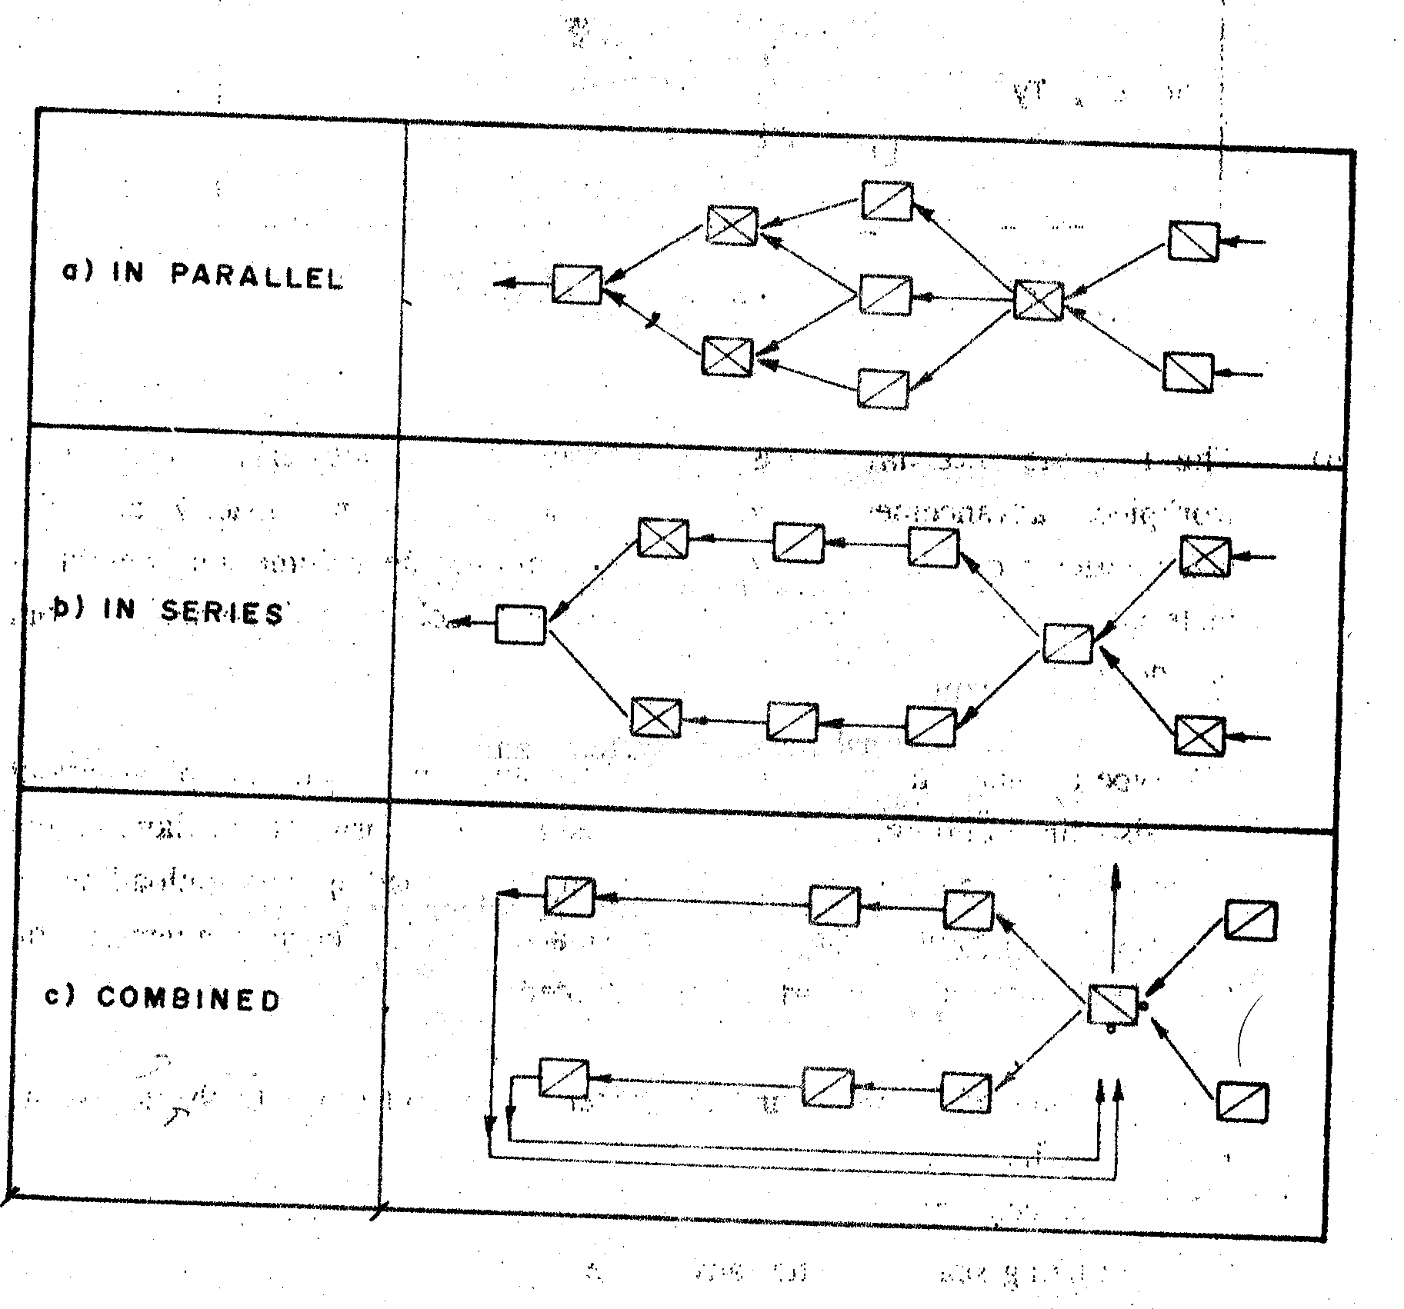
There are different types of machine arrangements.
The form of an industrial building is mainly dependent on machine arrangements and the advancement of a work piece.
The usual forms are shown

Slide 115
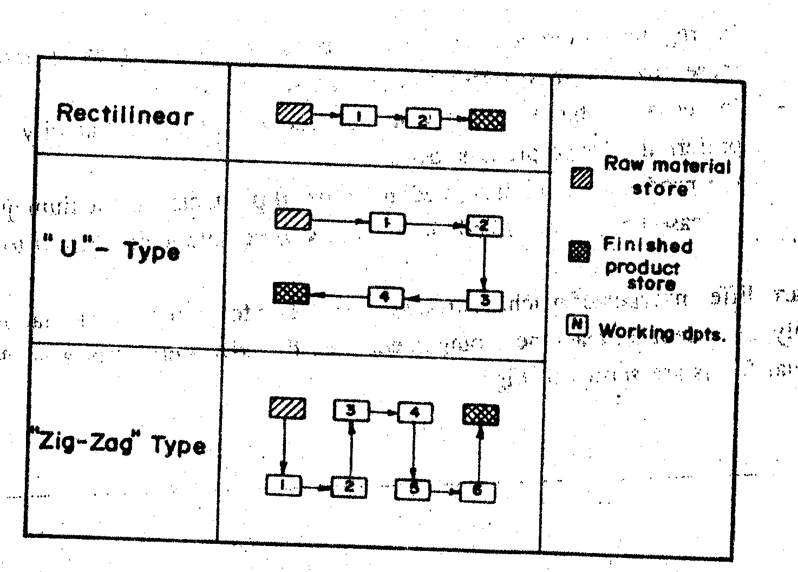

Slide 116
B. The Possible Internal Transport System:
It is necessary to examine the volume and weight of materials that has to be transported from one machine to the other, or from one department to the other.
The type of material handling equipment influences directly the plant layout and also the building.
The working position, the form of the layout, the height, width and length of the building, the loading and unloading of materials, the positions and dimensions of accessibility depends in general, on the type of internal transport system adopted.

Slide 117
The type of material handling equipment influences directly the plant layout and also the building.
The working position, the form of the layout, the height, width and length of the building, the loading and unloading of materials, the positions and dimensions of accessibility depends in general, on the type of internal transport system adopted.

Slide 118
A good study of internal transport system may boil down to the following major benefits:
Reduce costs by
  - utilizing space to better advantage,
  - increasing productivity and
  - making few number of effective movements.
Reduce waste by
  - eliminating damage to material during the handling process and
  maintaining proper control over in-and-out of stock handling process.
Improve working conditions by
  providing safer working conditions and
  reducing worker fatigue.
Improve the efficiency of the plant by
  improving location of storage facilities,
  improving routing and
  increasing productivity.

Slide 119
The objective function to be evaluated is:
TC = Total internal transport cost
Cij = Cost of internal transport, per unit distance per unit weight, for material movement between department i and j
Wij =Weight of material transported, per unit time, from department i to j
Dij = Distance from department i to j

Slide 120
The routine accepts input data of Wij and Cij in the form of a FROM - TO chart.
It may also accept Dij in the form of a FROM - TO charter, or it may accept the co-ordinates of the work centers.
A FROM - TO chart is a square matrix whose elements represent flow or distance between departments.
The chart is constructed by listing the departments down the left hand column and then across the top in the same order.
The departments on the left are the originating (FROM) departments and the ones at the top are the receiving (TO) ones.

Slide 121
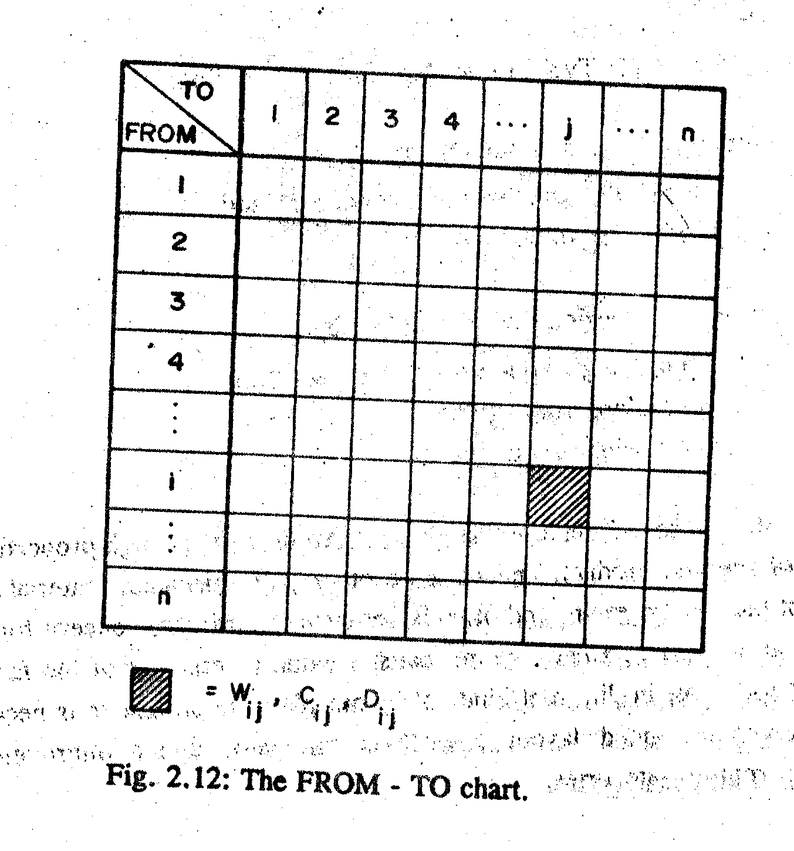

Slide 122
C. Working Conditions
Proper working conditions increase production effectiveness. They are influenced by many factors, over which the employee has very little or no control.
  Lighting facilitates accuracy and ease of seeing.
  Air Conditioning is used for to control contamination by dust, bacteria and toxic gases and air temperature and humidity.
  Noise The reduction of noise may be brought about by a variety of methods. Some of these methods are:
    - Control of the noise at the source.
    - Isolation of the noise.
    - Use of baffles and sound absorbers.
    - Acoustical treatment.
    - Use of ear protection devices.

Slide 123
  Noise: A wide variety of sound exists in industry. Continuous exposure to high noise levels frequently result in temporary or even permanent loss of hearing.
  Color: The objective of utilizing scientifically selected colors is to bring about a clear three dimensional vision.
Different colors have different psychological effects.
  Red - Hot and heavy, exciting, stimulating.
  Orange - Hot, exciting and stimulating less than red.
  Yellow - Hot, exciting lovely.
  Green - Fresh and light, pacific.
  Blue - Light, pacific.
  Violet - Light, loneliness.
  White - Cold, brilliant (seems to increase volume).
  Black - Hot (seems to decrease volume) depressing.

Slide 124
Work space requirements
The layout man often finds himself involved in work space arrangement; at any rate, he must determine the floor space that will be required by an operator.
The study of floor space needed considers the following points:
While at work, the operator's arms and hands should move as easily as possible and he ought to reduce, to the minimum the movement of his shoulders, his body and his person from one position to another.

Slide 125
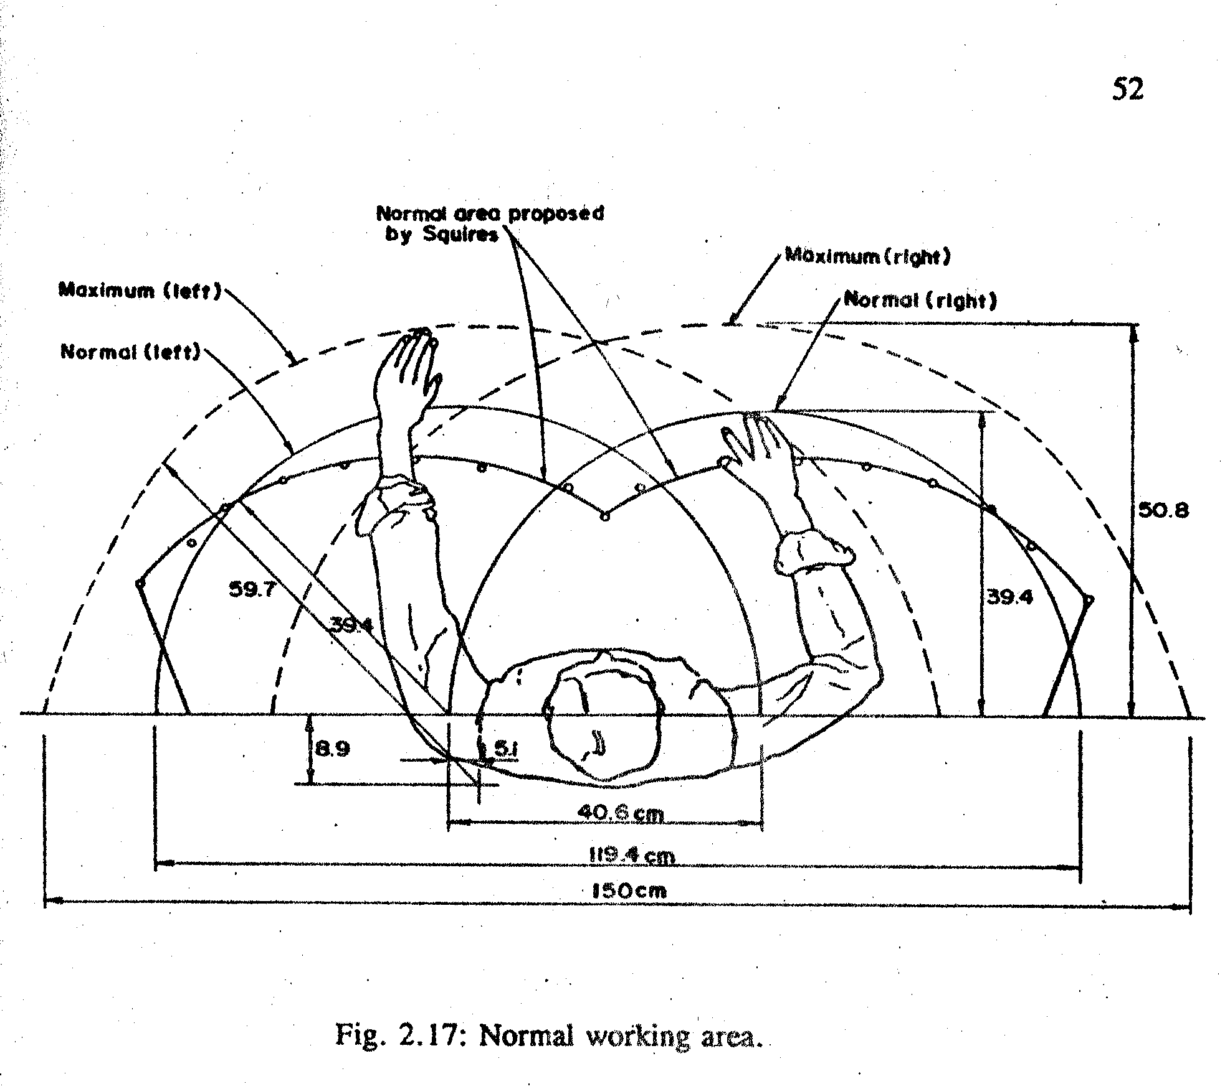

Slide 126
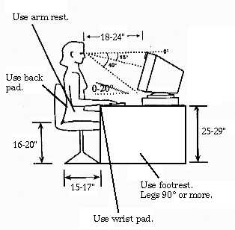

Slide 127
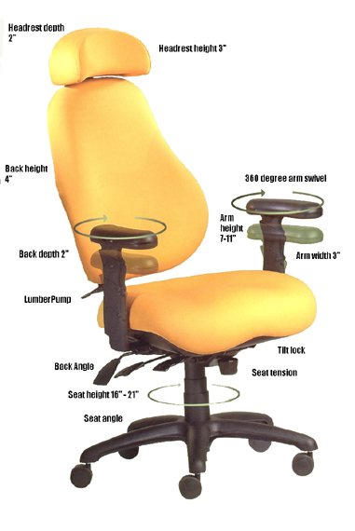

Slide 128


Slide 129


Slide 130
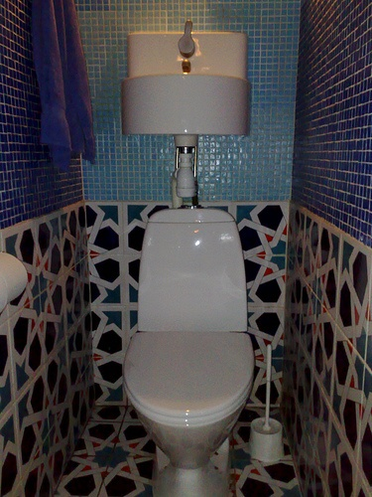

Slide 131


Slide 132
Safety :
A good plant layout should consider the safety of all personnel.
Some of the safety hazards to be watched for in plant layout are:
  inadequate passage,
  insufficient storage space allowance for safe handling procedures,
  insufficient handling equipment capacity,
  floor load capacity,
  floor obstructions,
  slippery finish floors,
  inadequate exits,
  inadequate stairs, ramps and ladders,
  inaccessible fire extinguisher and first aid boxes
  unguarded moving parts of equipment ,
  workers located under the above hazards and
  improper ventilation for removal of dangerous or toxic gases.

Slide 133
3. Selection
Every layout plan has intangible costs which to all intents and purposes cannot be measured in terms of dollars and cents.
Moreover, a comparative cost analysis of alternative layouts is sometimes a standoff, no one plan has a clear-cut financial advantage over the other.
As a result, perhaps the most effective general method of evaluating layout alternatives is that termed factor analysis
Follows a list of the most commonly involved factors or considerations; not in order of importance

Slide 134
ease of future expansion,
adaptability and versatility,
flexibility of layout,
flow of materials effectiveness,
materials handling effectiveness,
storage effectiveness,
space utilization,
effectiveness of supporting service integration,
safety and housekeeping,

Slide 135
working conditions and employee satisfaction,
ease of supervision and control,
appearance, promotions value, public or community relations,
quality of products,
maintenance problems,
fit with company organization structure,
equipment utilization,
utilization of natural conditions or surroundings ,
ability to meet capacity or requirements,
investment or capital required and
savings, payout, returns, profitability.

Slide 136
Site layout:
A good site layout provides safe and economical flow of materials and personnel.
A material sheet for the site is therefore prepared which then allows the various processes to be positioned relative to one another.
The services (e.g. boiler house, effluent plant etc.) are then added in the most convenient positions.
The central buildings (administration, canteen, laboratories etc.) are placed in such a manner that the distances traveled by personnel to use them are minimized.
Finally the road and rail systems are marked in.

Slide 137
Broad guidelines for preparation of the site layout are given below:
Minimize the distance that materials have to travel to or from stores or during processing
Separate the raw material unloading and finished product loading Facilities
Isolate the hazardous operations
Locate storage areas close to unloading and loading facilities locate boiler room, power station, cooling towers, water pumping station etc. on periphery but adjacent to the area of largest use
The usual clearances between pipes including flanges and lagging and between pipes and other objects should be 25 mm but this should be increased if hot pipes run near plastic pipes, cables etc.

Slide 138
Steam and water mains, electricity and telephone cables etc. should, in general, run parallel to the road system and should avoid going through plant area
Locate office building close to the main entrance
Provide adequate parking facilities for vehicles waiting to load / unload, cars, scooters etc.
Plan roads in such a manner that the vehicles do not pass through process areas. Ideally, outside of a plant should be accessible on all four sides by road
Workshop and general stores should be located within easy access of the processing units.

Slide 139
Building Layout
The design shall provide:
a. Adequate ventilation;
b. Adequate lighting;
c. Adequate heating;
d. Adequate drainage;
e. Dehumidification equipment, if necessary;
f. Accessibility of equipment for operation, servicing, and removal;
g. Flexibility of operation;
h. Operator safety;
i. Convenience of operation;
j. Chemical storage and feed equipment in a separate room to reduce hazards and dust problems;
k. Employee facilities per State Plumbing Code

Slide 140
Symbols used for plant design and layout
Process diagrams can be broken down into two major categories: process flow diagrams (PFDs) and Process and Instrument Drawings (P & IDs), sometimes called piping and instrumentation drawings.
A flow diagram is a simple illustration that uses process symbols to describe the primary flow path through a unit.
A process flow diagram provides a quick snapshot of the operating unit.
Flow diagrams include all primary equipment and flows.

Slide 141
The P&ID includes a graphic representation of the equipment, piping, and instrumentation.
Process operators can look at their process and see how the engineering department has automated the unit.
Pressure, temperature, flow, and level control loops are all included on the unit P&ID.
Process technicians use P&IDs to identify all of the equipment, instruments, and piping found in their units.

Slide 142
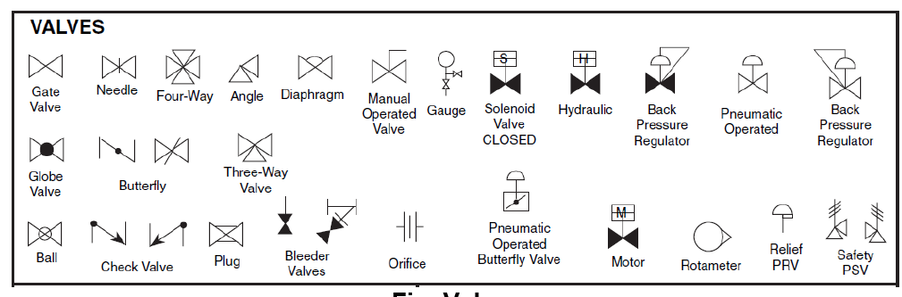

Slide 143
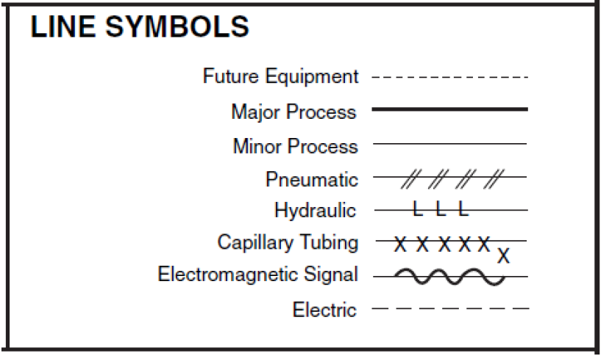

Slide 144
Others plant design consideration

Slide 145
1. Instrumentation
Instruments are used in an industrial plant to measure process variables such as; temperature, pressure, density, viscosity, specific heat, conductivity, pH, humidity, liquid level, flow rate, chemical composition, moisture content, etc.
By use of instruments having varying degrees of complexity, the values of these variables can be recorded continuously and controlled within narrow limits.
Automatic control is widely used with resulting savings in labor combined with improved ease and efficiency of operations. (which overcomes the added expense for instrumentation)
This control is achieved through the use of high speed computers.

Slide 146
2. Utilities
Utilities are the process supplements of an industrial plant as power, steam or water.
The most common sources of energy are oil, gas, coal and nuclear energy.
In production industry the required power is primarily in the form of electricity, other sources are steam engines, internal-combustion engines and hydraulic turbines.
When a design engineer is setting up the specifications for a new plant, a decision must be based on whether to use purchased power or producing its own power.
The quantity of steam used in a process varies depending on thermal and mechanical requirements and should be generated from whatever fuel is cheapest.

Slide 147
Water for industrial purposes can be obtained from the plant’s own sources or a municipal supply.
If the demands for water are large, it is more economical for the plant to provide its own water sources. Such a supply may be obtained from drilled wells, rivers, lakes, dammed streams or other supplies.
Before a company agrees to go ahead with a new project, it must ensure itself of a sufficient supply of water for all industrial, sanitary and safety demands both present and future.
Treatment of water significantly increase the operational cost for a plant. Increased cost of water processing necessitates maximum yields for the use of processed water.

Slide 148
3. Waste Disposal
Waste from an industrial plant in form of gas, liquid or solid cause to pollution.
In order to control this pollution several factors should be evaluated as;
    pollution source (pollutants and the total volume dispersed)
    properties of pollution emissions
    design of the collection and transfer systems
      the size of the equipment is directly related to the volume being treated, therefore exhaust volume should be reduced to decrease equipment cost. If a reduction in pollution source can be obtained process or raw materials can be changed.
  selection of the control device
      selection of the most appropriate control device requires consideration of the pollutant being handled and the features of the control device.
  dispersion of the exhaust to meet applicable regulations.

Slide 149
4. Health and Safety
Chemical Hazards
Many chemicals can cause damages when come into contact with living tissues. If such chemicals are used in the process the time and amount of exposure should be determined and controlled by the design engineer.
Fire and Explosion Hazards
Hazardous operations should be isolated by location in separate buildings or separated areas by brick-fire walls.
The design and construction of high pressure tanks should follow the standards and should be tested at 1.5 to 2 times the design pressure.
In order to prevent fire, smoking, welding and cutting machines, open electrical connections, heated materials and other ignition sources should be eliminated.

Slide 150
The installation of sufficient fire alarms, temperature alarms, fire-fighting equipment and sprinkler systems are to be included in the design.
Fire protection systems are classified as active and passive systems. Active systems include water sprays, foam and dry chemicals which requires action to be taken either by plant personnel or by automatic fire protection systems.
Passive protection systems are designed and installed at the construction stage and remain until needed. (like fire proof insulating materials)
Personnel Safety
In the design project, health and safety of plant personnel should be considered.
All machinery must be equipped with control and warning devices.
Physical hazards if unavoidable must be clearly defined.
Protected walkways, platforms, stairs and work areas should be provided.
Medical services and first aid must be readily available.

Slide 151
5. Patents
A patent may be obtained on any new and useful process, machine, method of manufacture, composition of matter or plant, provided that it is not known or used by others before the person applying for the patent made his invention or discovery.
A patentee may treat the patent as personnel property with the right to sell it or license it in any form desired.
The inventor can be paid by a lump sum, a periodic payment, a percent of the profit, a set amount per each unit produced or in any other way that is agreeable to the parties involved.

Slide 152
Assignment 1
Develop area and size required for different facilities within the layout (workshop, laboratory, fire station, main road, side road, pathway canteen, administration, toilet, etc…)
Develop clearance between various unit to the adjacent unit of site layout( plant area, boiler and furnace, cooling tower, gas holders, warehouse, loading area, garage, fire station, office and canteen, clinic, etc….)
Assignment 2
Develop Process and Instrumentation Diagram (P&ID)symbol and their function and area of application.
Submission date : January 10, 2019

Slide 153
Project Guidelines
Chapter one : Design of warehouse
  Overview of warehouse
  Warehouse objective and operation
  Warehouse philosophy and safety
  Background of the warehouse project
  Determination of quantity of inventory
Chapter two : Material handling selection
  Pallet design
  Storage system design / Rack design
  Internal transportation design
Chapter three : Receiving and shipping design
  Transportation selection (lorry, truck…)
  Dock design

Slide 154
Chapter four : Design support facilities
  Determine number of workers
  Design required facility
Chapter five : Design of working condition
  Lighting
  Air conditioning
  Noise
  Color
  Safety
chapter 6: Cost and scheduling of the project
  Project Cost analysis
  Project schedule
Chapter 7: Conclusion and recommendation
  Conclusion
  Recommendation

Slide 155
Lecture 6

Slide 156
Procedures for plant layout
Procure the basic data
Analyse the product and production process
Make or buy parts decision
Plan the material flow pattern
Consider general material handling plan
Calculate equipment requirement
Plan individual workstation

Slide 157
Select specific material handling equipment
Coordinate group of related opertation
Construct flow diagram for production centers
Plan service and auxiliaries activities
Determine space requirements
Allocate activity area and plot plan
Consider building type

Slide 158
Construct master layout
Seek opinions and suggestions
Evaluate adjust and select the best layout
Check final layout
Obtain official approvals
Install layout
Follow up on implementation of the layout.

Slide 159
Analytical Techniques
Usually, the criterion or objective is to minimize some cost function. Often, the distance traveled is chosen as the cost function. Thus, the objective becomes one of minimizing total distance traveled.
Another possible stratification is in the distance measure used. Sometimes the straight-line or Euclidean distance may be more appropriate.

Slide 160
Cont’d
If two facilities are located at points represented by (X1,Y1) and ((X2,Y2), then the Euclidean distance between the two is
While the rectilinear distance is

Slide 161
Transportation Method of Linear Programming
It is simple to formulate a location problem as a transportation linear programming problem involving minimization of total cost to distribute the product. Then total cost can be calculated, various locations tried, and the location with the least total cost chosen.

Slide 162
Example
Production and distribution costs per unit
 | L | M | N | O | P | Weekly Capacity | Production. Costs
A | 5.00 | 3.00 | 2.00 | 3.00 | 2.00 | 7.000 | $75.00
B | 6.50 | 5.00 | 3.50 | 1.50 | .20 | 5,500 | $70.00
C | 1.50 | .50 | 1.80 | 6.50 | 500 | 12,500 | $70.00
D | 3.80 | 5.00 | 8.00 | 7.50 | 8.00 | 12,500 | $67.00
Dem./Week | 5,000 | 6,000 | 4,000 | 7,000 | 3,000
To
From

Slide 163
The cost in the transportation matrix
 | L | M | N | O | P | Plant Capacity
A | 80.00 | 78.00 | 77.00 | 78. 00 | 77.00 | 7,000
B | 76.50 | 75.00 | 73.50 | 71.50 | 70.20 | 5,500
C | 71.50 | 70.50 | 71.80 | 76.50 | 75.00 | 12,500
Dem./Week | 5,000 | 6,000 | 4,000 | 7,000 | 3,000 | 25,000
TO
From

Slide 164
Cont’d
There are several ways of solving this problem. Some give optimal solutions with a relatively high cost of time and effort and others yield very fast, good but not necessarily optimal solutions with a relatively low cost. The latter procedures are called heuristic; the former procedures are called optimal seeking

Slide 165
Least cost assignment
From TO | L |  | M |  | N |  | O |  | P |  | Plant Capacity
A |  | 80.00 |  | 78.00 | ⑥ 2,500 | 77.00 | ⑦ | 78.00 |  | 77.00 | 7,000
 |  |  |  |  |  |  | 4,500
B |  | 76.50 |  | 75.00 |  | 73.50 | ④ | 71.50 | ① | 70.20
 |  |  |  |  |  |  |  | 2500 |  | 3000 |  | 5,500
C | ③ | 71.50 | ② | 70.50 | ⑤ | 71.80 |  | 76.50 |  | 75.00 | 12,5000
 | 5,000 |  | 6,000 |  | 1,500
Demand (Weekly) | 5,000 |  | 6,000 |  | 4,000 |  | 7,000 |  | 3,000 |  | 25,000

Slide 166
Cont’d
The total cost for location C is 2,500(77) + 4,500(78) + 2,500(71.50) + 3,000(70.20) + 5,000(71.50) + 6,000(70.50) + 1,500(71.80) = $1,821,050
Similarly for location D the total cost is
4,000(77) + 3,000(78) + 2,500(71.50) + 3,000(70.2) + 5,000(70.80) + 6,000(72) + 1,500(74.50) = $1,829,100
The total weekly cost of C town is $1,821,050, which $8,050 per week more economical than the total cost D.

Slide 167
Public Sector Location Problems
In the location of public sectors ( fire stations, hospitals, emergency centers, equipment yards, and landfills) the objective is to minimize some maximum response time.
Example Location of Blood Bank

Slide 168
Hospital or Research Center | Map Location | Weekly Trips
Hillcrest | (22.5, 5.5) | 10
South community | (26.5, 9.5) | 10
Capitol Hill | (29.5, 14.0) | 5
St. Anthony | (28.5, 24.0) | 3
Bone and Joint | (28.5, 24.5) | 1
Mercy | (29.0, 25.0) | 3
Polyclinic | (30.0,25.0) | 1
Wesley | (29.5.24.5) | 1
University | (32.0,24.5) | 3
School of medicine | (32.0, 25.0) | 1
Research Institute | (32.5, 25.0) | 1
Admin. Hospital | (33.0, 25.0) | 1
Crippled Children’s | (32.5, 24.5) | 1
Deaconess | (16.0, 36.5) | 5
Baptist Memorial | (18.0, 37.5) | 4

Slide 169
Solution Procedure
Location of a new facility with respect to several existing facilities (rectilinear distances assumed):
  Arrange all facilities in increasing order of the X coordinates. Add up the number of trips for that same order. The optimum X location is such tat no more than half the trips are to the left and no more than half to the right.
  Repeat for the Y coordinate such that no more than half the trips are above and no more than half below.

Slide 170
Cont’d
  3.The X and Y coordinates just chosen are the optimum locations. The price of land, neighborhood, and other parameters must now be considered.

Slide 171
Cont’d
In the example problem the calculations for the X coordinate are
The total number of trips is 50. The optimum X location than is that location where no more than 25 trips are to the left and no more than 25 are to the right. This occurs exactly at
For the Y coordinate, the same procedure is required

Slide 172
Cont’d
There are 50 total trips. At
25 trips are to the left and exactly 25 trips are to the right of the blood bank. This implies that the optimum location is at 14, 0.

Slide 173
Distance Measurements
Typically measured from department center to department center.
Euclidean distances are appropriate when the layout space is very open and movement within it can follow a direct path.
Rectilinear (sometimes called rectangular) distance is more appropriate for layouts aisles or hallways where one generally reaches a destination after making one or more right turns.

Slide 174
Load Distance Analysis
Each department is 10 feet by 10 feet, distances are rectilinear, which of the following two layouts is better?

Slide 175
Routing/Travel Distances

Slide 176
Routing/Travel Distances

Slide 177
Solution (1/2)
Compute the total travel for each product through each layout alternative.

Slide 178
Solution (2/2)
Compute total distance traveled per month by each product through each layout alternative.

Slide 179
Plant Location
Criterion |  | Weighting | Possible Factory Location
 |  |  | A |  | B |  | C |  | D |  | E
PROXIMITY TO: | Skilled labour | 7 | 2 | 14 | 3 | 21 | 0 | 0 | 1 | 7 | 4 | 28
 | A pool of unskilled labour | 8 | 5 | 40 | 2 | 16 | 0 | 0 | 4 | 32 | 2 | 16
 | A motorway | 7 | 3 | 21 | 2 | 14 | 1 | 7 | 3 | 21 | 4 | 28
 | An airport | 4 | 1 | 4 | 3 | 12 | 4 | 16 | 2 | 8 | 2 | 8
 | The sea / a river | 0 | 2 | 0 | 5 | 0 | 5 | 0 | 2 | 0 | 1 | 0
 | Housing | 5 | 4 | 20 | 3 | 15 | 0 | 0 | 3 | 15 | 4 | 20
 | Amenities | 5 | 3 | 15 | 2 | 10 | 0 | 0 | 2 | 10 | 3 | 15
Potential for expansion |  | 7 | 2 | 14 | 1 | 7 | 5 | 35 | 3 | 21 | 2 | 14
Availability of grants/incentives |  | 8 | 1 | 8 | 2 | 16 | 5 | 40 | 1 | 8 | 3 | 24
Safety |  | 2 | 3 | 6 | 2 | 4 | 5 | 10 | 2 | 4 | 2 | 4
Planning constraints |  | 5 | 2 | 10 | 3 | 15 | 5 | 25 | 4 | 20 | 2 | 10
Environmental impact |  | 4 | 3 | 12 | 2 | 8 | 4 | 16 | 1 | 4 | 2 | 8
TOTAL |  |  | 164 |  | 138 |  | 149 |  | 150 |  | 175

Slide 180
Activity Relationship Analysis

Slide 181
Establishing Relationships
A relationship diagram that provides a visual means to determine the intensity of flow between processed based activities.

Slide 182
Establishing Relationships- Between Activities
6
7
4
5
2
8
13
3
1
9
The fewer the lines between activities, the lower the “intensity”

Slide 183
Establishing Relationships- Based on Material Flow
A method to quantity what is moving within the plant
Graphically establish existing flowpaths between activities
Optimize the material flowpaths
Optimizing distances between activities should be based on materials handling cost

Slide 184
Activity Relationship Analysis
Activity Relationship diagram shows the relationship of every department, office, or service area with every other department and area. In order to establish this relationship, we use closeness codes to “weight” the decision.

Slide 185
Closeness Codes
Code | Definition
A | Absolutely required proximity
E | Especially important
I | Important
O | Ordinary importance
U | Unimportant
X | Closeness undesirable

Slide 186
Closeness Codes
“A” Codes Between Departments:
Restricted to massive materials movements
Used for great movements of people
Limit it to no more than eight (8) with one department
Example- raw steel storeroom to the shearing department

Slide 187
Closeness Codes
“E” Codes Between Departments:
Used if there is any doubt that it is an “A”
Much material or people movement, but not all at one time
Example- restrooms, or break rooms

Slide 188
Closeness Codes
“I” & “O” Codes Between Departments:
Used when some level of importance is desired
Some consultants omit these codes, however, use them on the first few layout designs

Slide 189
Closeness Codes
“U” Codes Between Departments:
Useful because they tell us that no activity or interface is needed
Indicates that these departments can be placed far away from each other

Slide 190
Closeness Codes
“X” Codes Between Departments:
As important as “A” codes
The opposite of “A” codes
Indicates less than desired closeness
Example- Welding next to flammables, or paint areas near grinding operations

Slide 191
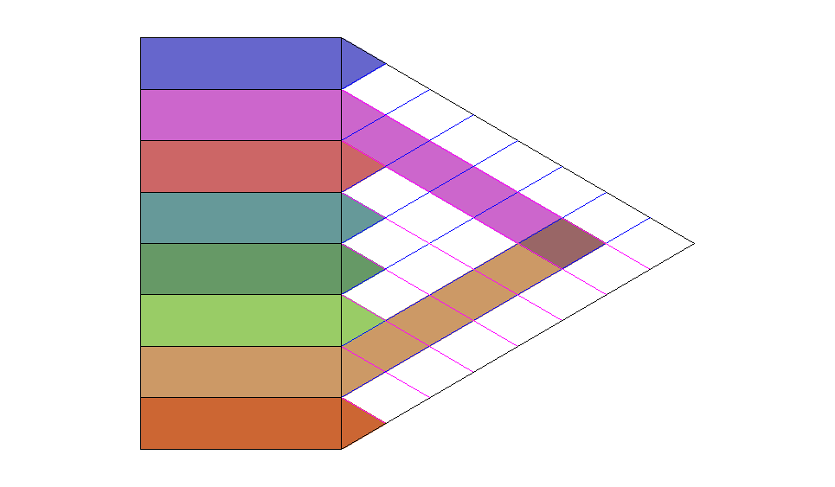

Relationship Chart
Relationship between departments A and F
Dept 1
The relationship chart
is a subjective approach
to defining a quantifiable
relationship between
departments.
Dept A
E
Dept B
O
E
A
Dept C
O
I
U
I
X
X
Dept D
I
U
U
I
Dept E
X
U
Dept F
Relationship
A - absolutely necessary
E - very important
I - important
O - ordinary importance
U - unimportant
X - undesirable
Dept 8
Code | Percentage
“A” “E” “I” “O” | 5% 10% 15% 25%

Slide 192
Relationship Chart
The total number of relationships, N, between all possible pairs of work centers in any facility can be determined as:
n(n – 1)
N
=
2
Where n = number of departments or work centers in the facility. For example, for a facility with 25 different departments or work centers:
25(25 – 1)
N
=
=
300 total codes
2
Facility planners rule of thumb states that you should have no more than 15 “A” codes (300 x 5% = 15). Similarly, it is reasonable to expect that the number of “E” and “I” codes should not exceed 30 and 45, respectively.

Slide 193
REL chart
Assignment of the closeness rating is subjective.
Rule of thumb:
Very few A and X relationships should be assigned. (no more than 5% of the closeness ratings to be an A and X).
No more than 10% should be an E.
No more than 15% to be an I.
No more than 20% to be an O.
Which means that about 50% of the relationships should be U.

Slide 194
Activity Relationship Factors
Do they share common utilities?
Are they part of a common process?
Does one department supply the other?
What are the management and personnel common between the departments?
Is the process in one department harmful to the other?
Other. . .

Slide 195
Nonflow Factors
Usually collected through interviews with the operators, management, etc.
These areas include:
  Maintenance
  Tool storage
  Lunchroom
  Restrooms
  Offices
Use the same charting/weighting concept

Slide 196
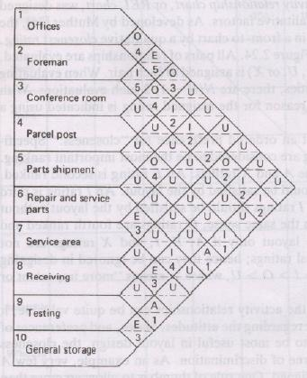
REL chart example

Slide 197
REL chart – REL diagram
From REL chart, we construct activity relationship diagram (REL diagram).
The purpose is to depict spatially the relationships of the activities.
The basic premise is that geographic proximity can be used to satisfy particular relationships.
For example, when the activity relationships reflect the magnitudes of material flows, pairs of activities having the greatest pair wise flow are located next to each other.
Similarly, pairs of activities having an A rating are located adjacently.

Slide 198
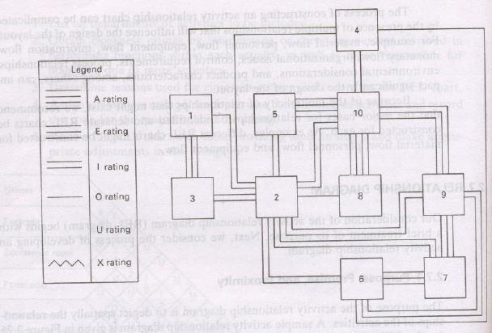
Activity relationship diagram

Slide 199
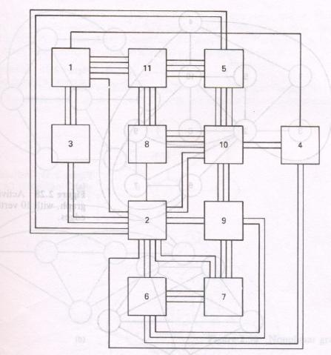
Activity relationship diagram

Slide 200
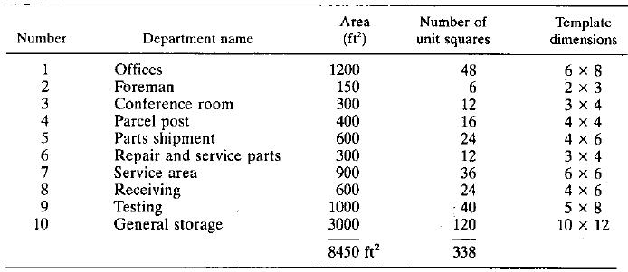
Sample: Space relationship table

Slide 201
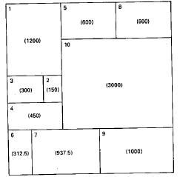
Example: Alternate block diagram

Slide 202
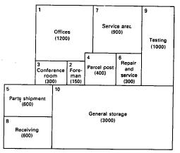
Example: Alternate block diagram

Slide 203
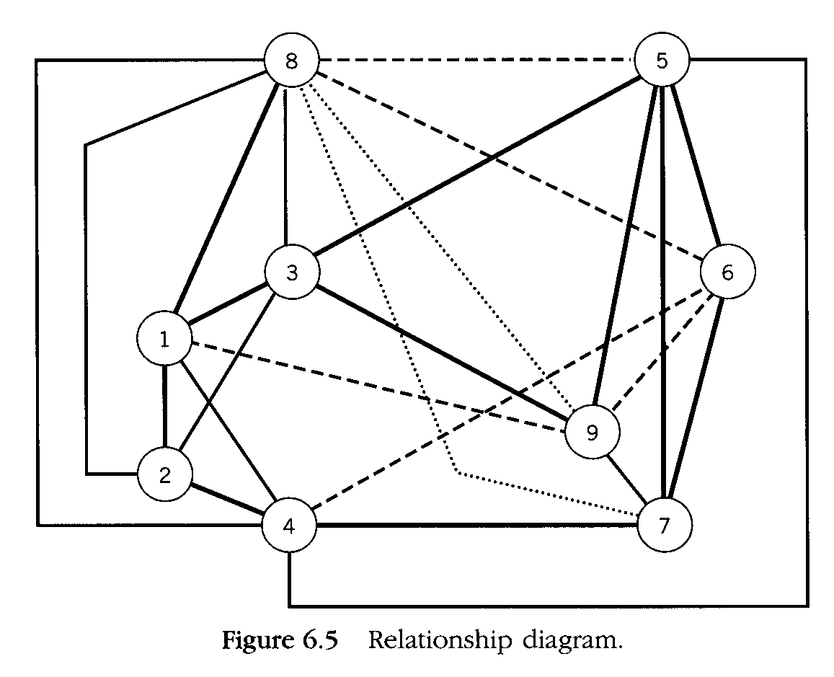
    A Absolutely Necessary
    E Especially Important
    I Important
    O Ordinary Closeness O.K.
    U Unimportant
    X Undesirable
      A and X > E > I > O > U
O
X
E
A

Slide 204
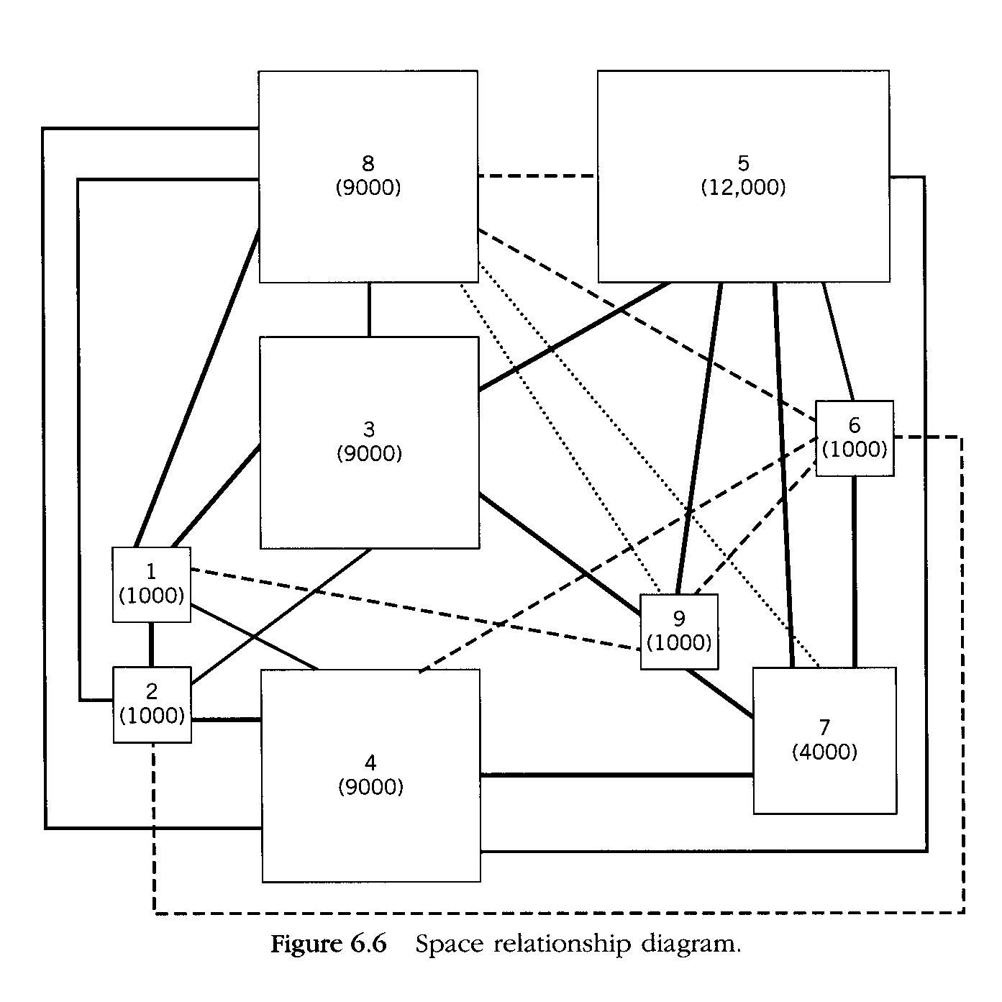

Slide 205
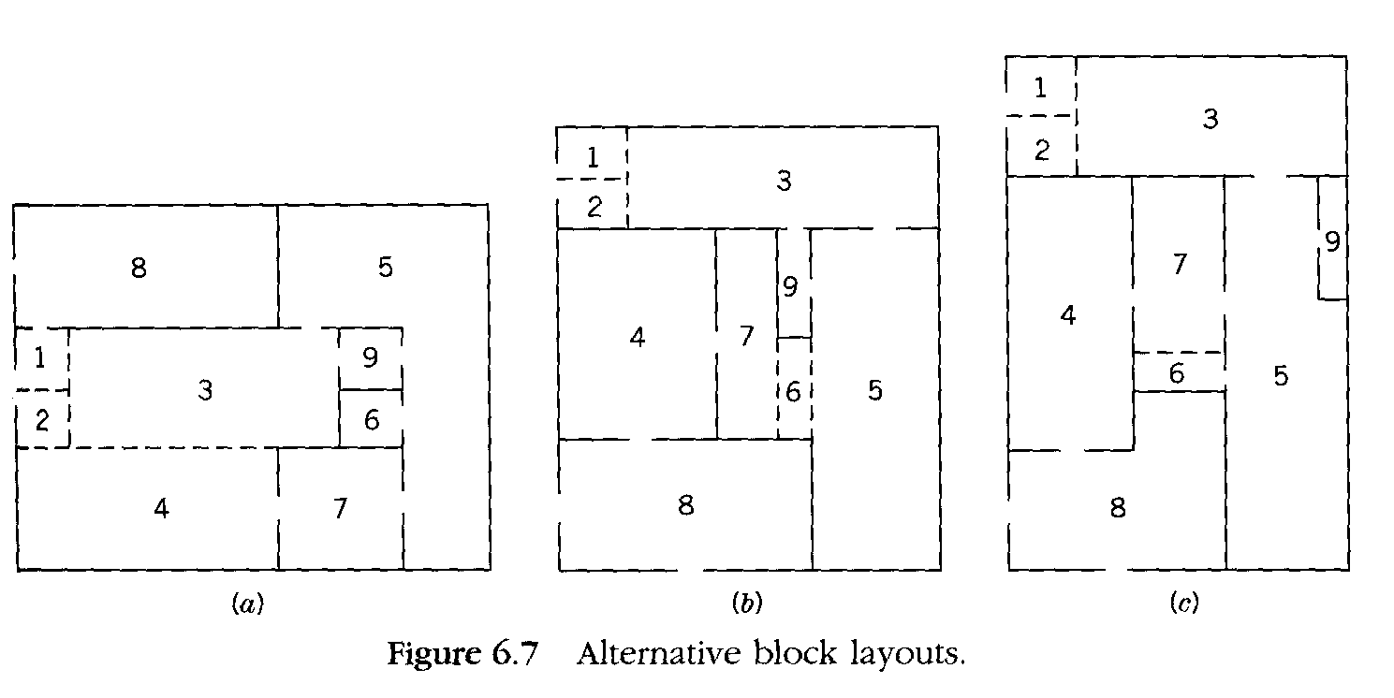

Slide 206
Exercise
A factory has five production departments: M (milling), D (drilling), T (turning), G (grinding), and F (finishing). Products are routed for processing through these departments in the quantities and sequences indicated in the table below. (a) Based on these data, construct the from-to chart. (b) Develop the activity relationship chart for these five departments, given that the from-to chart is the only basis for it.

Slide 207
 | Product | Quantities per day | Sequence
 | 1 | 25 | M-D-G
 | 2 | 5 | T-G-F
 | 3 | 10 | T-F
 | 4 | 50 | D-M-D-G-F
 | 5 | 25 | M-T-F
 | 6 | 15 | M-G

Slide 208
Solution: (a) From-to chart and (b) activity-relationship chart.
To determine the closeness ratings in (b), the following divisions were used: “A” = number of trips > 75; “E” = number of trips = 50 to 75; “I” = number of trips = 25 to 49; “O” = number of trips = 1 to 24, and “U” = zero trips.

Slide 209
 | (a) | From-to chart |  |  |  |  |  | (b) Activity-relationship chart
 | From\To | M | D | T | G | F |  |  | M | D | T | G | F
 | M | - | 75 | 25 | 15 |  |  | M | - | A | I | O | U
 | D | 50 | - |  | 75 |  |  | D |  | - | U | E | U
 | T |  |  | - | 5 | 35 |  | T |  |  | - | O | I
 | G |  |  |  | - | 55 |  | G |  |  |  | - | E
 | F |  |  |  |  | - |  | F |  |  |  |  | -

Slide 211
Space planning and Area Allocation
Main activity centers for various types of facilities are
Offices
Receiving
Production
Tool room
Medical services
Parking
Recreation facilities

Slide 212
Maintenance
Warehouse
Shipping

Slide 213
Factors considered for area allocation
Expansion
Flexibility
Aisles
Inter building handling
Point of use ( decentralized)
Building characteristics
Activity interrelationships
Space available
Fund available
Location of services

Slide 214
Procedure for area allocation
Production flow
Activity relationship chart
Space requirement

