Slide 1
Chapter Four
Failure Data and Goodness of Fit Analysis
Topics:
Introduction
Failure Trend Analysis
Goodness of fit test (Kolmogorov/Smirnov test)
Introduction of stress-strength modeling
Homogeneous Markov models
Reliability evaluation of cold, warm, and failure interactions and Markov analysis

Slide 2
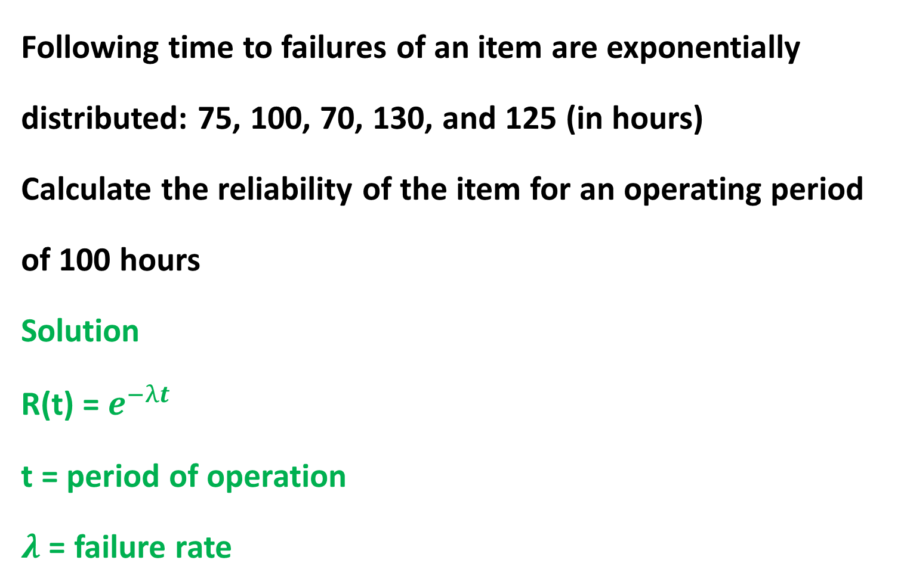
Following time to failures of an item are exponentially distributed: 75, 100, 70, 130, and 125 (in hours)
Calculate the reliability of the item for an operating period of 100 hours
Solution
R(t) = $e^{−λt}$
t = period of operation
$λ$ = failure rate
Introduction
The failure rate h(t) is a measure of proneness to failure as a function of age, t.
The purpose for quantitative reliability measurements is to define the rate of failure relative to time and to model that failure rate in a mathematical distribution for the purpose of understanding the quantitative aspects of failure.
The most basic building block is the failure rate, which is estimated using the following equation:

Slide 3
Where:
λ = Failure rate (sometimes referred to as the hazard rate)
T = Total running time/cycles/miles/etc. during an investigation period for both failed and non-failed items.
r = The total number of failures occurring during the investigation period.

Slide 4
For example, if five electric motors operate for a collective total time of 50 years with five functional failures during the period, the failure rate is 0.1 failures per year.

Slide 5
MTBF/MTTF
The only difference between MTBF and MTTF is that we employ MTBF when referring to items that are repaired when they fail.
For items that are simply thrown away and replaced, we use the term MTTF. The computations are the same.
The basic calculation to estimate MTBF and MTTF is simply the reciprocal of the failure rate function.

Slide 6
The MTBF for our industrial electric motor example is 10 years, which is the reciprocal of the failure rate for the motors.
Incidentally, we would estimate MTBF for electric motors that are rebuilt upon failure.
For smaller motors that are considered disposable, we would state the measure of central tendency as MTTF.

Slide 7
Example
Five oil pumps were tested with failure hours of 45, 33, 62, 94 and 105. What is the MTTF and failure rate?
Note: considering pumps as non repairable systems, Use MTTF.
MTTF = (45+33+62+94+105) / 5 = 67.8 hours
Failure rate = 5 / (45+33+62+94+105) = 0.0147 per hour.

Slide 8
Failure Trend Analysis
The failure rate is a basic component of many more complex reliability calculations.
The failure rate is expected to vary over the life of a product – a good example is a ‘Bathtub Curve’

Slide 9
A-B Early Failure / Infant mortality / Debugging / Break-in
‘Teething’ problems. Caused by design/material flaws
Eg: Joints, Welds, Contamination, Misuse, Misassembly
B-C Constant Failure / Useful life.
Lower than initial failure rate and more or less constant until end of life
C-D End of life failure / Wear out phase.
Failure rate rises again due to components reaching end of life Eg: Corrosion, Cracking, Wear, Friction, Fatigue, Erosion, Lack of PM

Slide 10
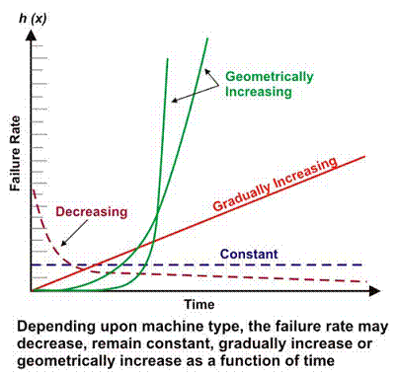
However, depending upon the mechanical/electrical design, operating context, environment and/or maintenance effectiveness, a machine’s failure rate as a function of time may decline, remain constant, increase linearly or increase geometrically (Figure).

Slide 11
The failure rates of various components can be estimated using historical information from records at site.
For example, if you had 5 hydraulic pumps in standby mode and each ran for 2000 hours in standby and 3 failed during the standby time
The failure rate during standby mode is:
  Total standby hours = 5(2000 hours) = 10000 hours
  Failure rate in standby mode = 3 / 10,000
= 0.0003 failures per hour

Slide 12
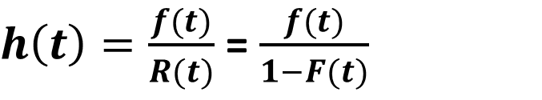
Relationship Between h(t), f(t), F(t) and R(t)
h(t) = failure rate
f(t) = pdf
F(t) = cdf
R(t) = reliability function
$h\left(t\right)=\frac{f(t)}{R(t)}$ = $\frac{f(t)}{1−F(t)}$

Slide 13
Goodness of fit test (Kolmogorov/Smirnov test)
This test is used in situations where a comparison has to be made between an observed sample distribution and theoretical distribution.

Slide 14
Suppose that we have observations X₁,...,X_{n}, which we think come from a distribution P.
The Kolmogorov-Smirnov Test is used to test
H₀ : the samples come from P,
against
H₁ : the samples do not come from P.
The null hypothesis assumes no difference between the observed and theoretical distribution.

Slide 15
Given: observed sample distribution
-0.16 -0.68 -0.32 -0.85 0.89 -2.28 0.63 0.41 0.15 0.74 1.30 -0.13 0.80 -0.75 0.28 -1.00 0.14 -1.38 -0.04 -0.25 -0.17 1.29 0.47 1.23 0.21 -0.04 0.07 -0.08 0.32 -0.17 0.13 -1.94 0.78 0.19 -0.12 -0.19 0.76 -1.48 -0.01 0.20 -1.97 -0.37 3.08 -0.40 0.80 0.01 1.32 -0.47 2.29 -0.26 -1.52 -0.06 -1.02 1.06 0.60 1.15 1.92 -0.06 -0.19 0.67 0.29 0.58 0.02 2.18 -0.04 -0.13 -0.79 -1.28 -1.41 -0.23 0.65 -0.26 -0.17 -1.53 -1.69 -1.60 0.09 -1.11 0.30 0.71 -0.88 -0.03 0.56 -3.68 2.40 0.62 0.52 -1.25 0.85 -0.09 -0.23 -1.16 0.22 -1.68 0.50 -0.35 -0.35 -0.33 -0.24 0.25
Do they come from N(0,1)?

Slide 16

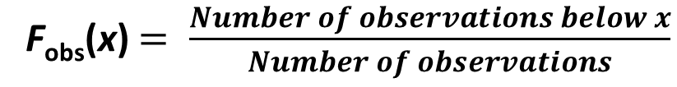
Cumulative Distribution Function and Empirical Distribution Function
The cumulative distribution function F(x) of a random variable X, is
F(x) = P(X ≤ x).
The cumulative distribution function uniquely characterizes a probability distribution.
Given observations x₁,...,x_{n} the empirical distribution function F_{obs}(x) gives the proportion of the data that lies below x,
F_{obs}(x) $= \frac{Number of observations below x}{Number of observations}$
If we order the observations y₁ ≤ y₂ ≤ ··· ≤ y_{n}, then
.

Slide 17
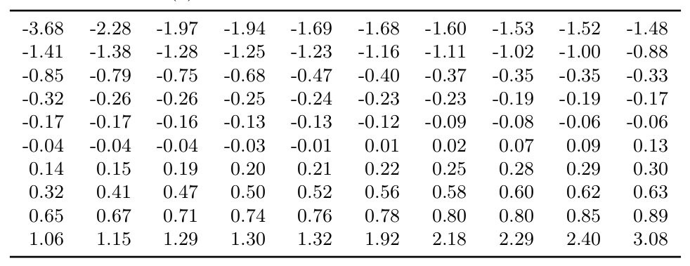
Order the data

Slide 18

Compute the empirical distribution function
If our data is ordered, x₁ being the least and x_{n} being the largest, then

Slide 19
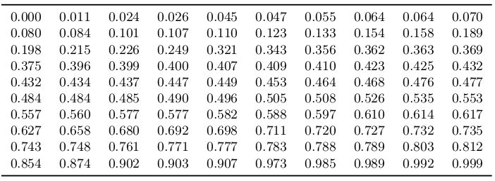
For each observation x_{i} compute F_{exp}(x_{i}) = P(Z ≤ x_{i}). Result is given below.
In this case, we use the standard normal table to determine the expected distribution function.

Slide 20
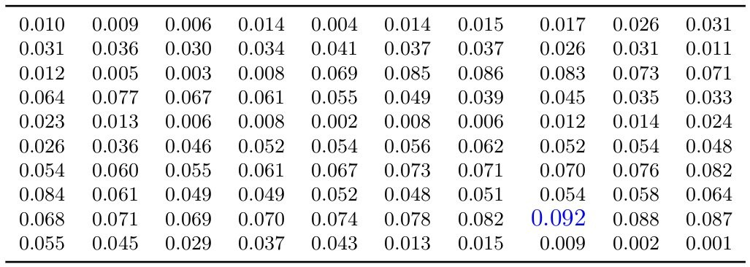
We want to compare the empirical distribution function of the data, F_{obs}, with the cumulative distribution function associated with the null hypothesis, F_{exp} (expected CDF).
The Kolmogorov-Smirnov statistic is D_{n} = max|F_{exp}(x) − F_{obs}(x)|. x
The Kolmogorov-Smirnov statistic D_{n} = 0.092 is the maximum shown in the table.

Slide 21
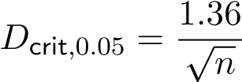
What is the Critical Value?
At the 95% level the critical value is approximately given by
Here we have a sample size of n = 100 so D_{crit} = 0.136.
Acceptance criteria: if calculated value is less than critical value accept the null hypothesis
Since 0.092 < 0.136 do not reject the null hypothesis.
Rejection criteria: if calculated value is greater than table value reject null hypothesis.

Slide 22
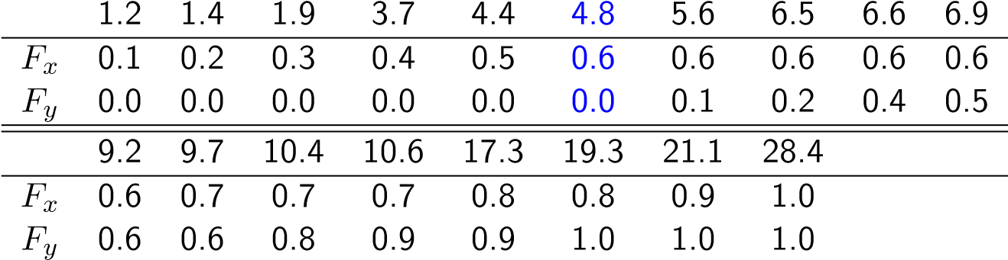
Given two samples, test if their distributions are the same.
Compute the observed cumulative distribution functions of the two samples and compute their maximum difference.
X : 1.2,1.4,1.9,3.7,4.4,4.8,9.7,17.3,21.1,28.4
Y : 5.6,6.5,6.6,6.9,9.2,10.4,10.6,19.3.

Slide 23
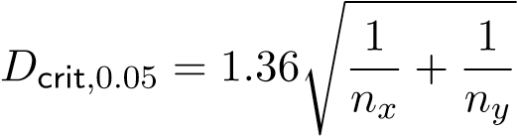
We sort the combined sample, in order to compute the empirical cdf’s:
The Kolmogorov-Smirnov statistic is again the maximum absolute difference of the two observed distribution functions.
Here D_{n} = 0.6.
For two samples, the 95% critical value can be approximated by the formula:
In our case n_{x} = 10 and n_{y} = 8 and thus D_{crit} = 0.645
So we retain the null hypothesis.

Slide 24
Statistical Type I and Type II Errors
Type I error: H₀ is rejected, although it’s true (”false alarm”).
Type II error: H₀ isn’t rejected, although it’s false.
The actual attributes of the population distribution(s) and the error types divide the results to four cases:
 | H₀ is true | H₀ is false
H₀ isn’t rejected | The right decision | Type II error
H₀ is rejected | Type I error | The right decision

Slide 25
Type I error, also known as a “false positive”: the error of rejecting a null hypothesis when it is actually true.
It is the error of accepting an alternative hypothesis (the real hypothesis of interest) when the results can be attributed to chance.
It occurs when we are observing a difference when in truth there is none (or more specifically - no statistically significant difference).

Slide 26
Type II error, also known as a "false negative": the error of not rejecting a null hypothesis when the alternative hypothesis is the true state of nature
It is the error of failing to accept an alternative hypothesis when you don't have adequate power.
It occurs when we are failing to observe a difference when in truth there is one.
So the probability of making a
type II error in a test with rejection region R is 1− P R H( | _{a} is true). The power of the test can be P R H( | _{a} is true).

Slide 27
The probability of type I error is called the risk or the level of significance of the test and it is often denoted by α.
The greatest allowed level of significance α is often a starting point of hypothesis testing.
The probability of type II error can’t often be calculated, for H₀ may be false in many ways.
Often some sort of an (over) estimate is calculated by assuming a typical relatively insignificant way for H₀ to break down.
This probability is usually denoted by β. The value 1 − β is called the power of the test.
The more powerful a test is, the smaller deviation it notices from H₀.

