Slide 1
Unit 4: Carrier Transport,
Recombination, and Generation

Slide 2
Unit 4 is all about how charge carriers, electrons, and holes respond out of equilibrium under the normal operating conditions of a semiconductor device.

Slide 3
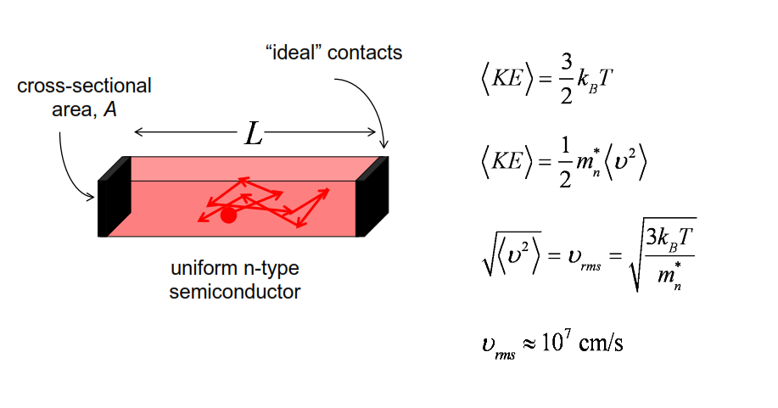
Semiconductor in equilibrium
This slab is just sitting there in equilibrium. But thermal energy is rattling the atoms around. The atoms are interacting with the electrons and knocking them around. So these electrons are in random, thermal, chaotic motion.Their overall average velocity is zero.

Slide 4
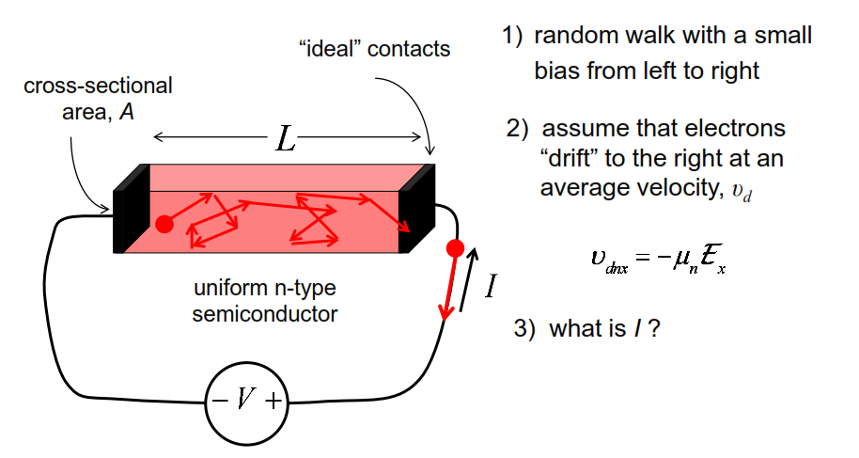
Semiconductor under bias
The average drift velocity is proportional to the electric field. The constant of proportionality is the mobility

Slide 5
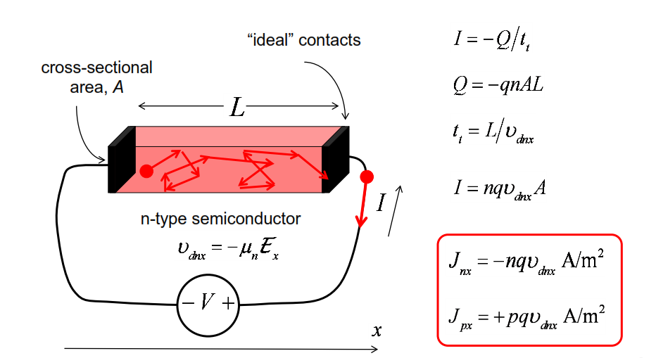
Drift current and drift velocity

Slide 6
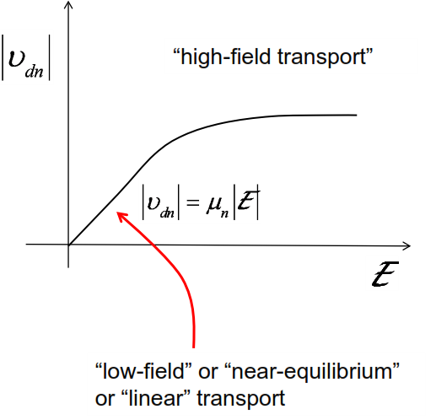
Velocity and electric field
If you apply large voltages, we can see that the current doesn't increase indefinitely. The velocity doesn't increase indefinitely. It tends to saturate at a value.
When you measure in the lab the average velocity versus electric field of electrons, and holes, in bulk semiconductor. The characteristic will look something like this

Slide 7
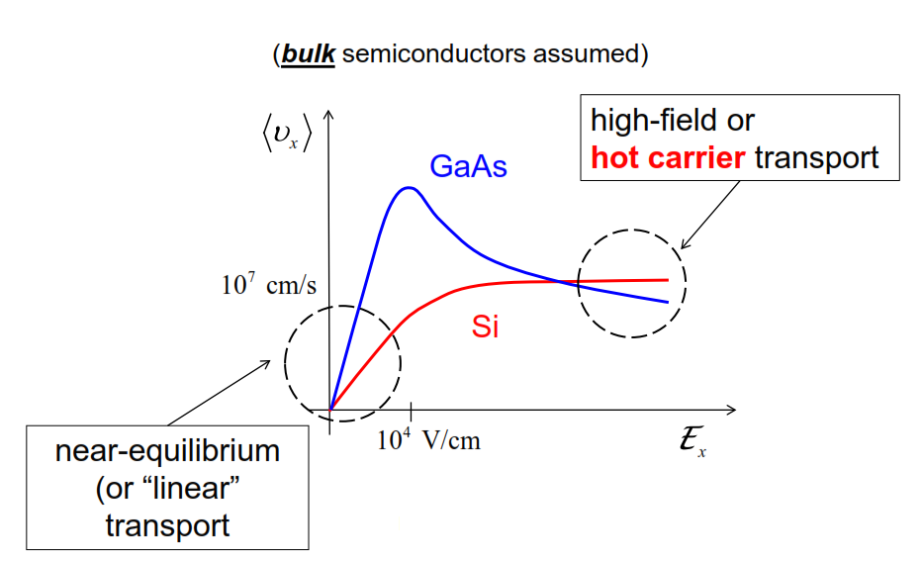
Velocity vs. electric field
In almost any semiconductor, you will find that under high electric fields, the velocity is reduced to on the order of 10 to the 7th centimeters per second. That's sort of the speed limit for electrons and holes in bulk semiconductors

Slide 8
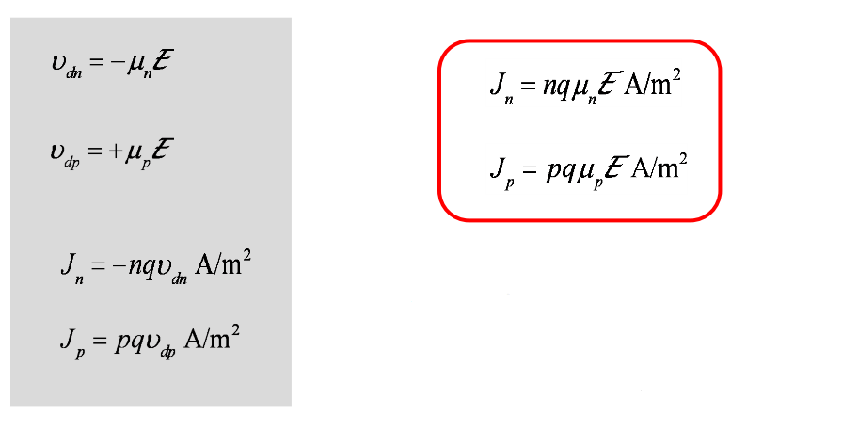
Drift current

Slide 9
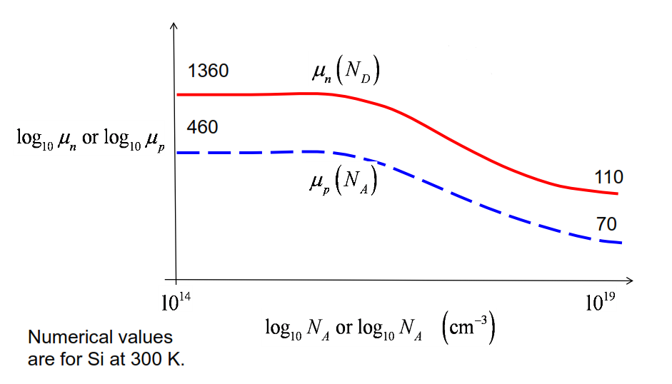
Mobility vs. doping
As long as we're in the low-field regime, the mobility is simply a material-dependent quantity, tightly related to the scattering.
Why is the mobility getting lower and lower? Well, the reason has to do with increased scattering.

Slide 10
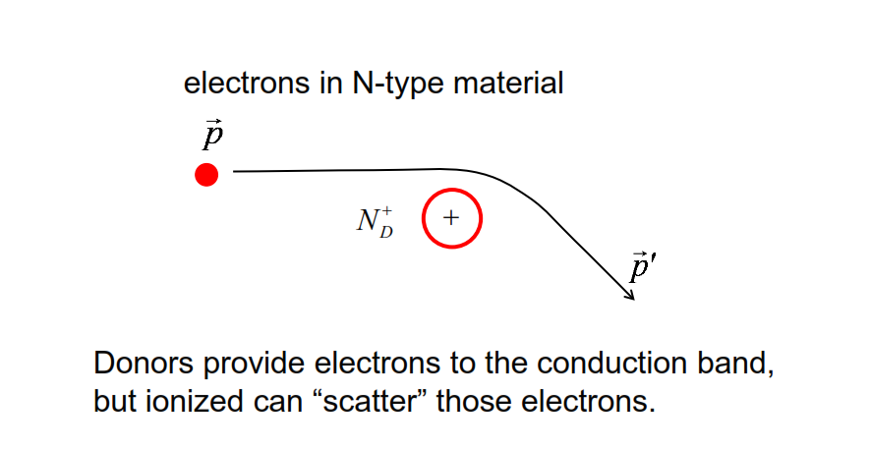
Ionized impurity scattering
That will reduce the
velocity of the electrons in one particular direction, and lower the mobility.

Slide 11
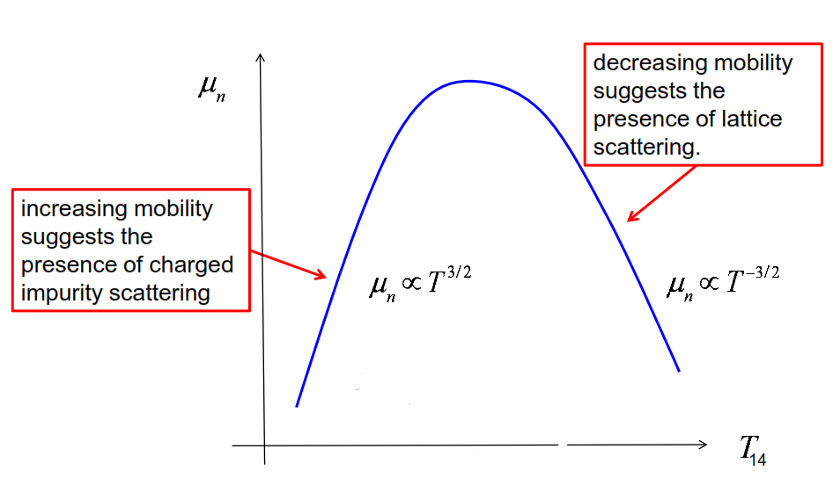
Mobility vs. temperature
At high temperatures, there's much more random, thermal motion of the lattice jiggling around. That lattice interacts with electrons and knocks electrons around more rigorously. The time between scattering events drops, the mean free path drops, and the mobility drops the higher the temperature is due to that process
As the temperature increase , the average thermal velocity increase . So, electrons zip past these charged, ionized impurities faster. They interact less.They're scattered less. So, the mobility gets higher

Slide 12
Comment
If we're working with semiconductor devices, we will undoubtedly need to know the mobility. In order to understand what the mobility is or to look it up in a table, we need to know what the doping is and we need to know what the temperature is

Slide 13
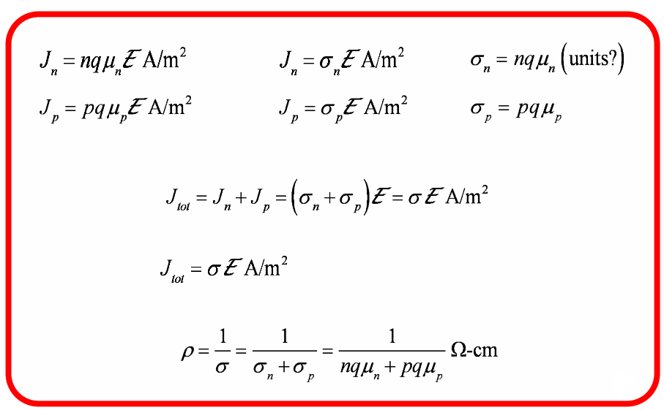
Drift current, conductivity, resistivity
Conductivity =
Resistivity=

Slide 14
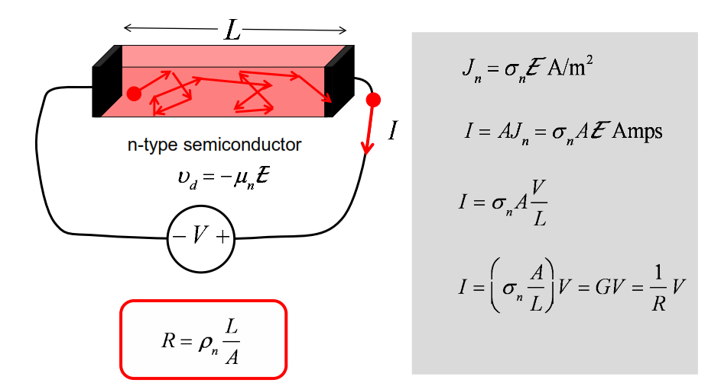
Resistance

Slide 15
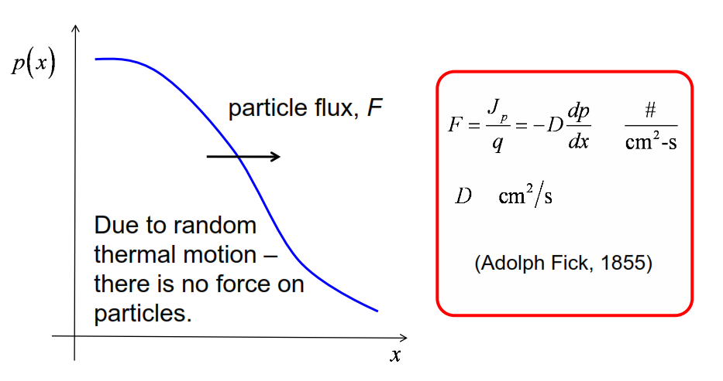
Fick’s Law of diffusion
There is no actual force that's pushing the holes in this case from high concentration to low concentration. It's simply a statistical effect.

Slide 16
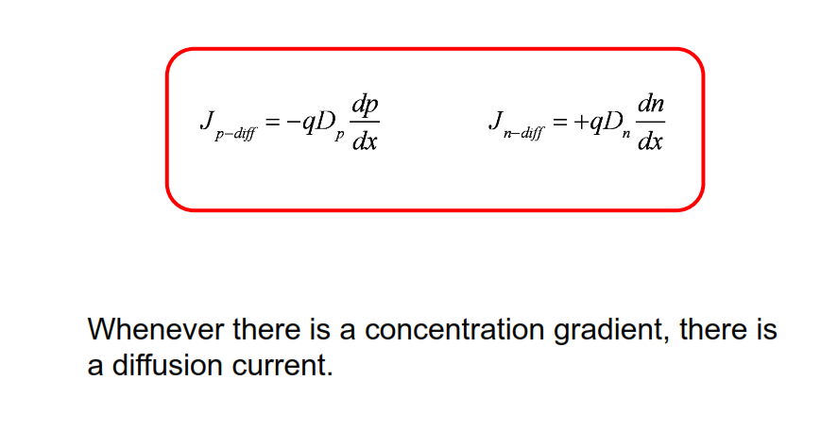
Diffusion currents

Slide 17
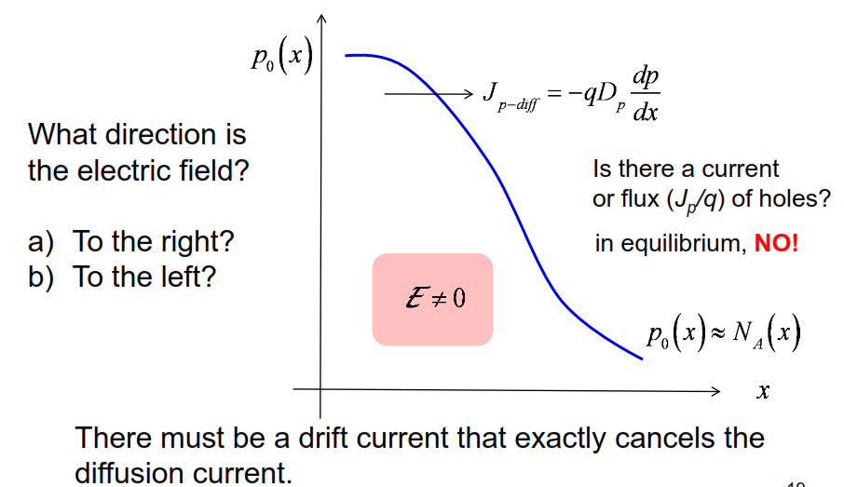
Nonuniformly doped semiconductor in equilibrium

Slide 18
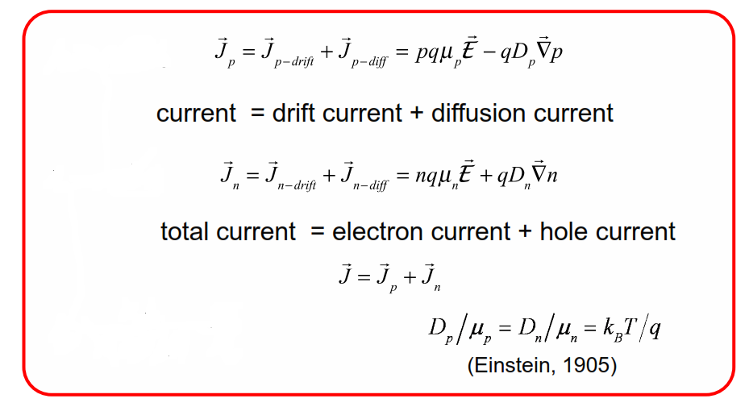
Summary: Drift- diffusion equation

Slide 19
Unit 4: Carrier Transport,
Recombination, and Generation
Lecture 4.4:
Carrier recombination

Slide 20
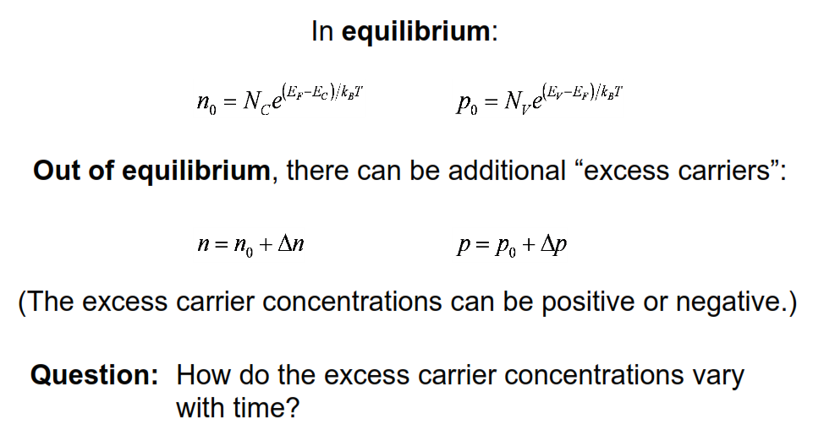
Equilibrium and non-equilibrium

Slide 21
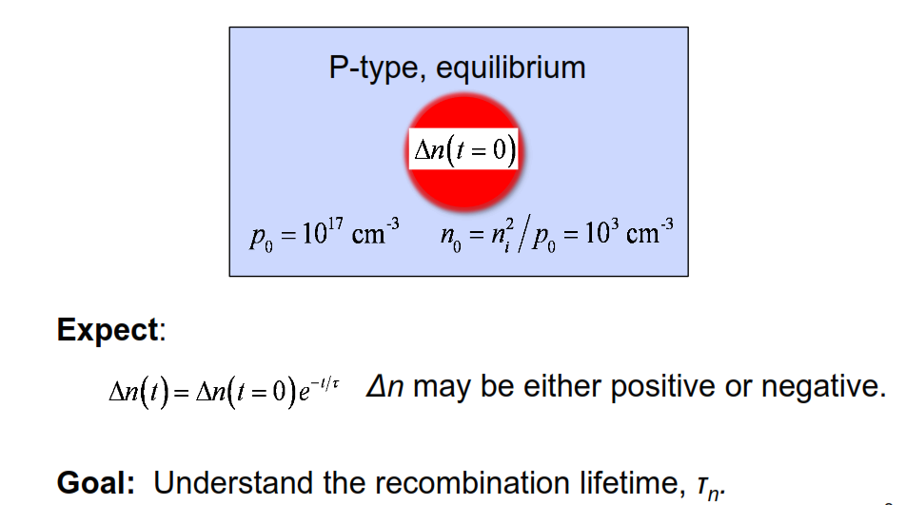
Carrier recombination
intuitively, if we perturb a system, we expect the system to respond by trying to return to equilibrium. And oftentimes, this return to equilibrium is an exponential process.

Slide 22
How can excess carriers recombine?
We will discuss three different ways:
  1) Band-to-band (radiative) recombination
  2) Auger recombination
  3) SRH (defect-assisted) recombination
There are three different important and common ways that this recombination can occur

Slide 23
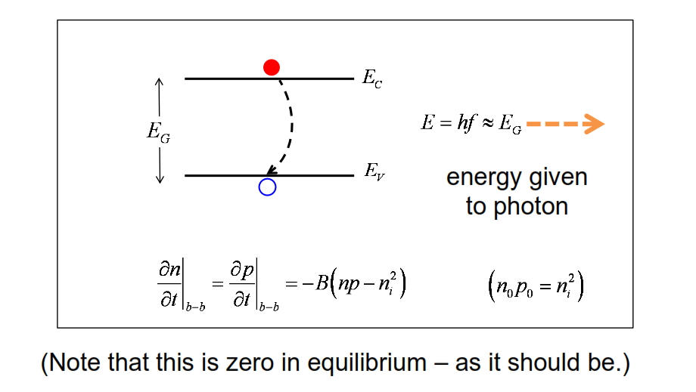
1) Band-to-band (radiative) recombination
The change is negative because it's reducing their concentration.

Slide 24
Low level injection
The term “low level injection” means that the excess carrier concentration is orders of magnitude smaller than the equilibrium majority carrier concentration but orders of magnitude larger that the equilibrium minority carrier concentration.

Slide 25
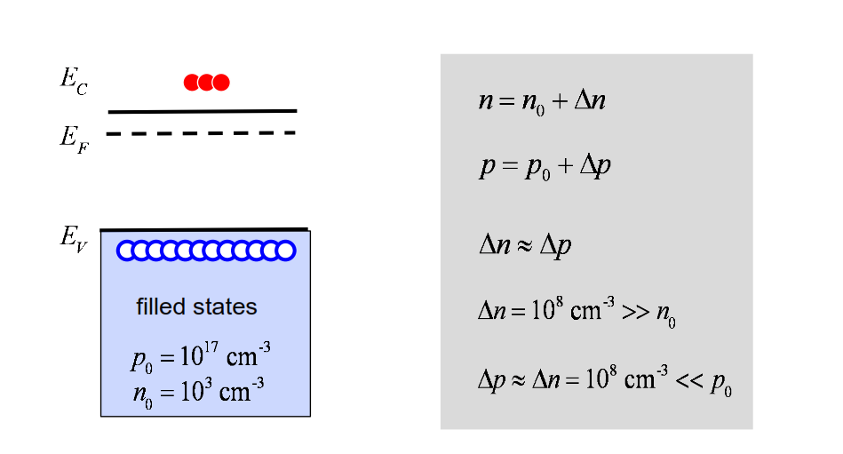
Example: Low level injection in a p-type semiconductor
Low level injection has negligible influence on the majority carriers. It has a huge influence on the minority carriers.

Slide 26
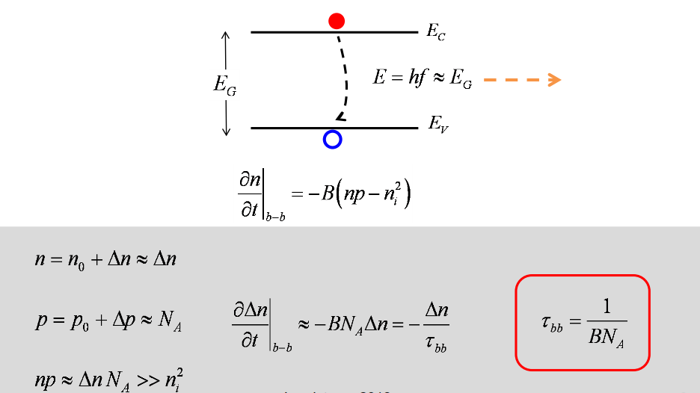
Low level injection in a p-type semi
It's a characteristic time for this recombination process.

Slide 27
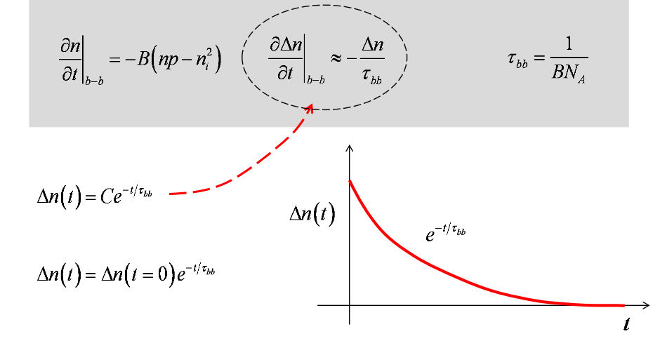
Excess carrier concentration vs. time

Slide 28
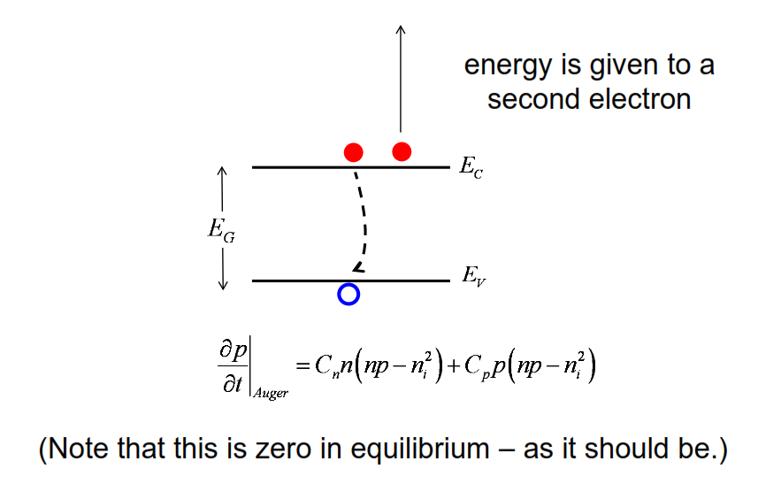
2) Auger recombination
If it's an n-type semiconductor there are a lot of electrons nearby. They might give up the energy to a nearby electron and kick it way up in the conduction band.

Slide 29
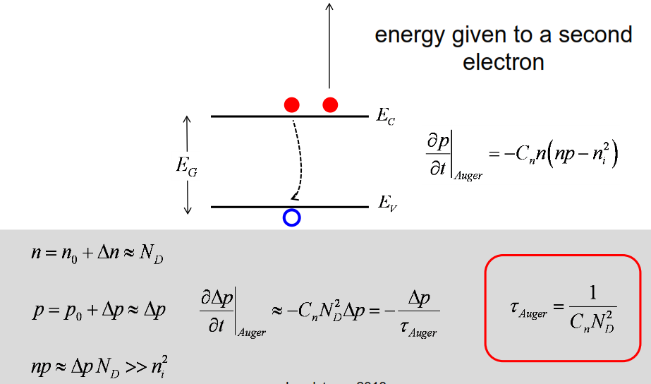
Low level injection in an n-type semiconductor
Auger recombination time

Slide 30
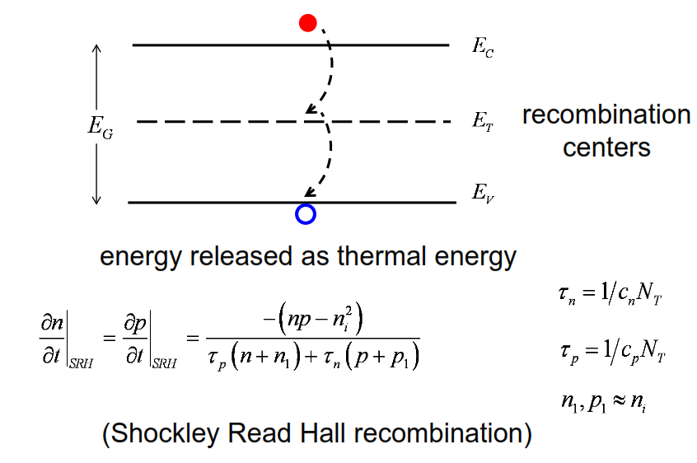
3) SRH (defect-assisted) recombination
The current can't flow through these defects. But these defects can mediate recombination processes.
The statistics of this recombination process are described by this equation.
concentration of traps= N sub T.

Slide 31
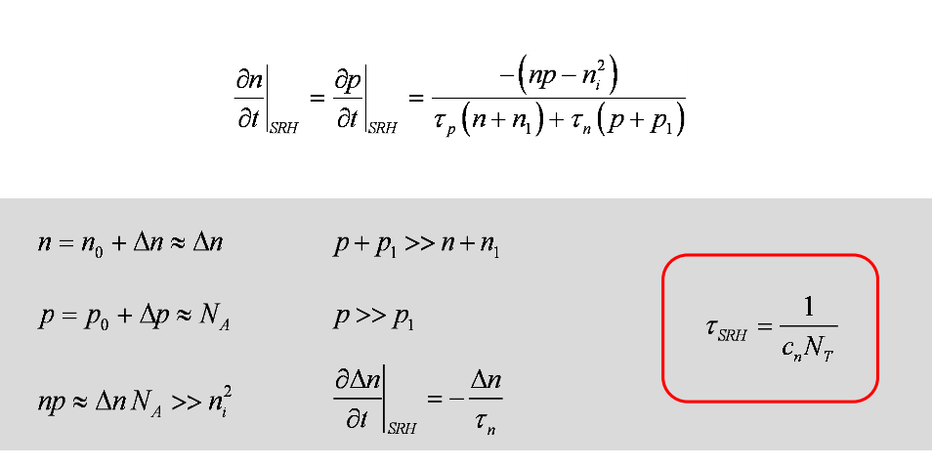
Low level injection in a p-type semiconductor

Slide 32
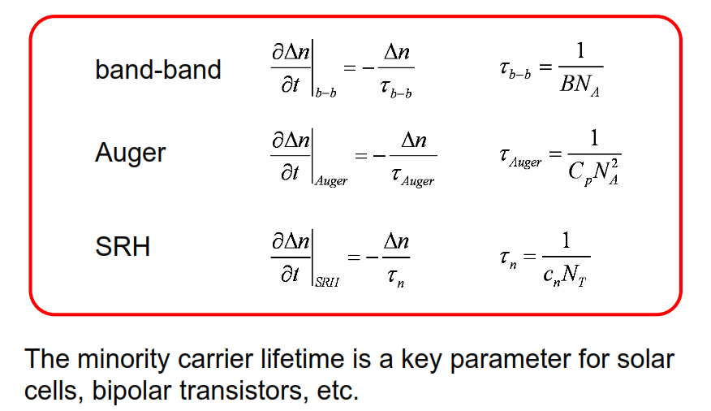
Recombination under low level injection

Slide 33
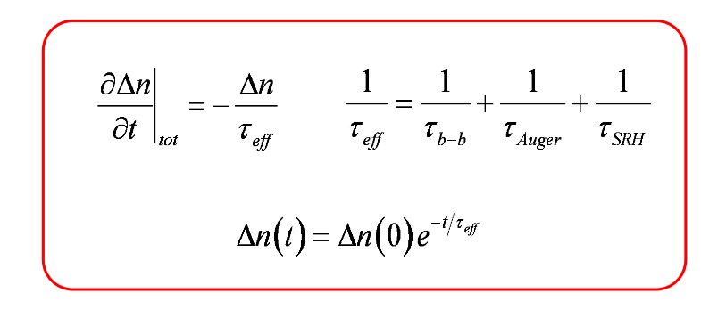
Multiple recombination processes

Slide 34
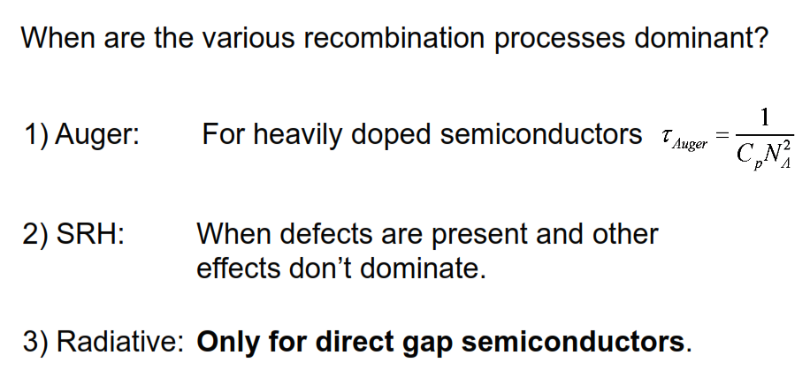
Discussion

Slide 35
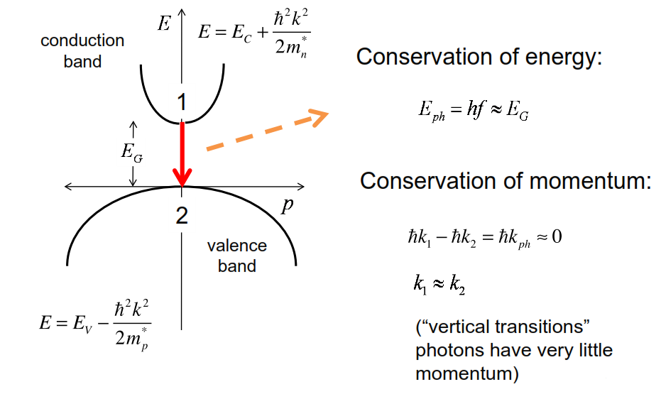
BB recombination in direct gap semiconductors

Slide 36
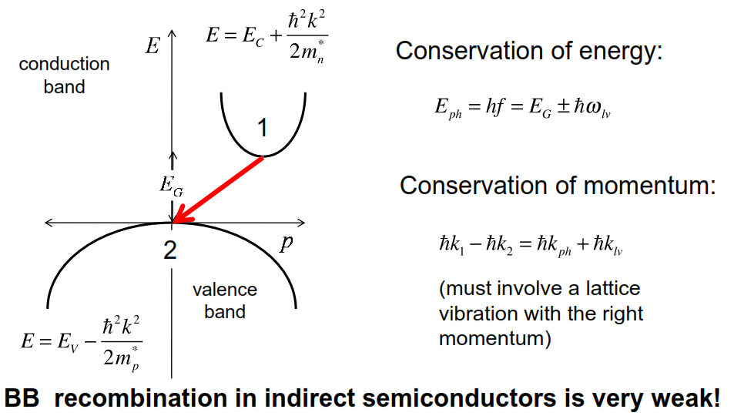
BB recombination in indirect gap semiconductors
to find the right lattice vibration with the right momentum to facilitate this process is going to be harder to do.

Slide 37
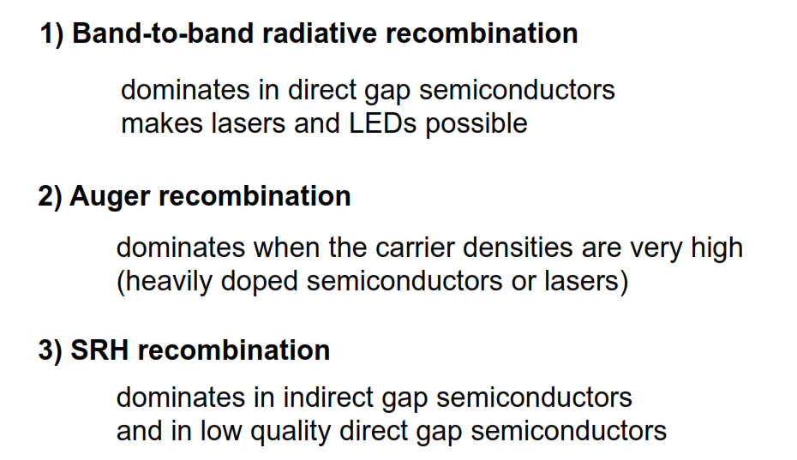
Three type of recombination

Slide 38
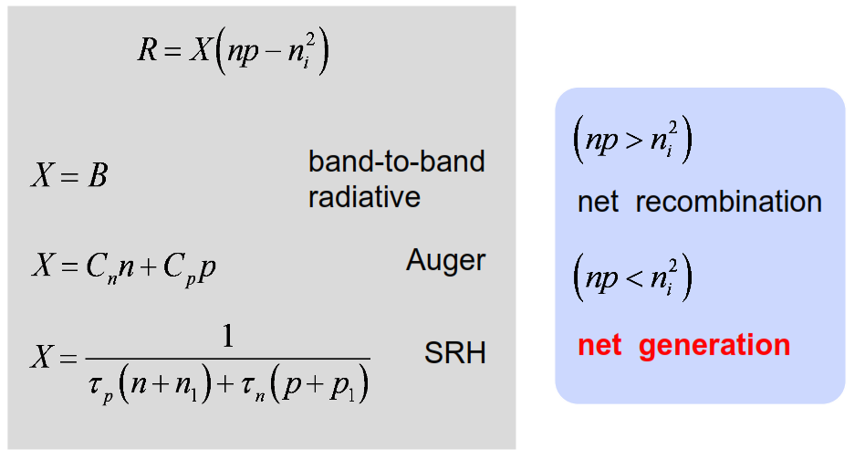
Recombination-generation

Slide 39
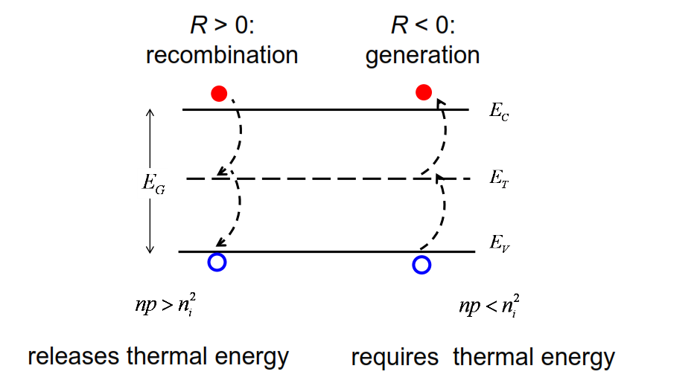
3) SRH (defect-assisted) generation

Slide 40
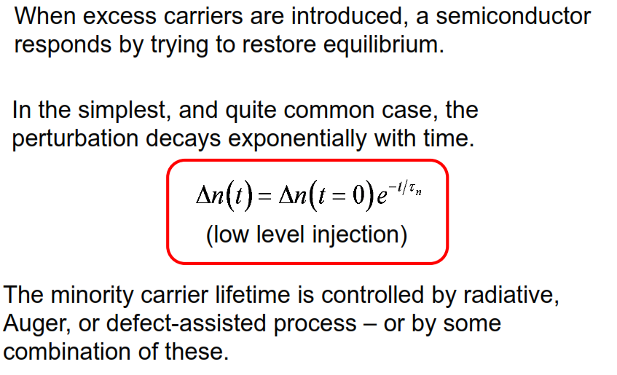
Summary

Slide 41
Unit 4: Carrier Transport,
Recombination, and Generation
Lecture 4.5:
Carrier generation

Slide 42
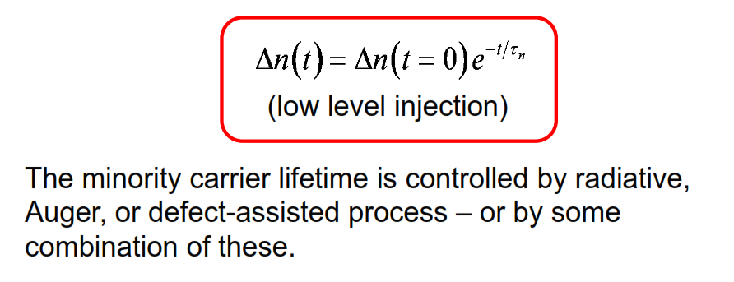
Recombination

Slide 43
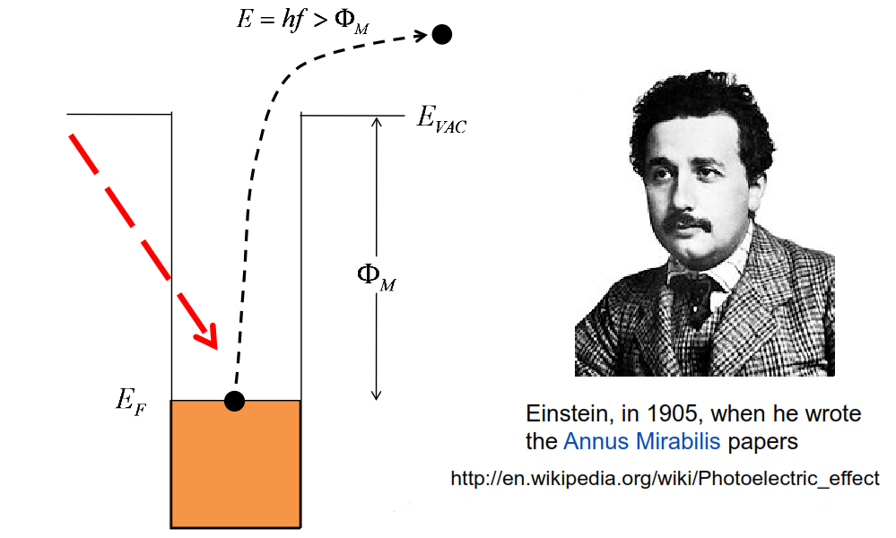
Photoelectric effect (optical generation)
If the energy of the photons is above the work function of a metal, then we can eject electrons out of this potential well that holds them in the metal into the vacuum and detect the current. This is called the photoelectric effect

Slide 44
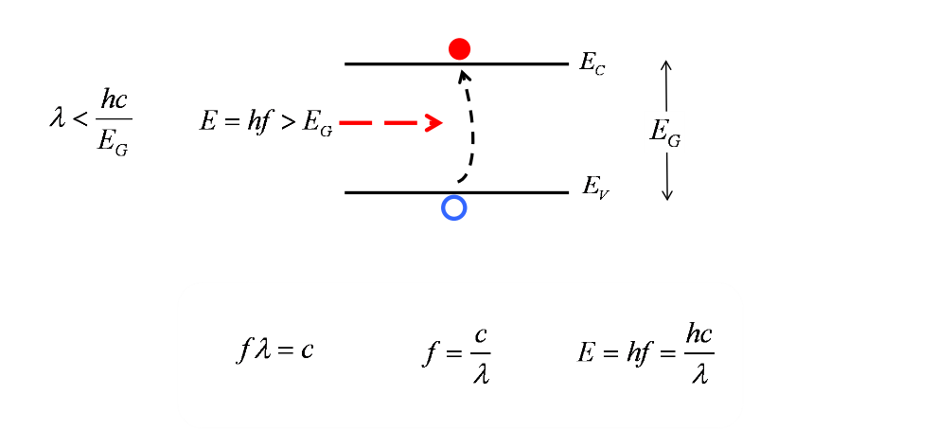
Optical generation in semiconductors
This is just an equivalent way of expressing energy in terms of wavelength

Slide 45
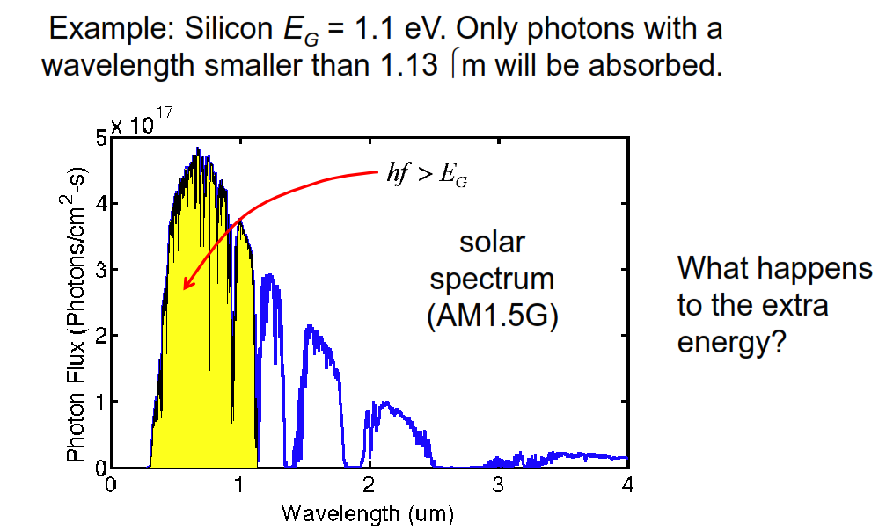
Carrier generation from a solar spectrum
The wavelengths that are less than 1.13 micrometers, those photons have enough energy to create electron-hole pairs.

Slide 46
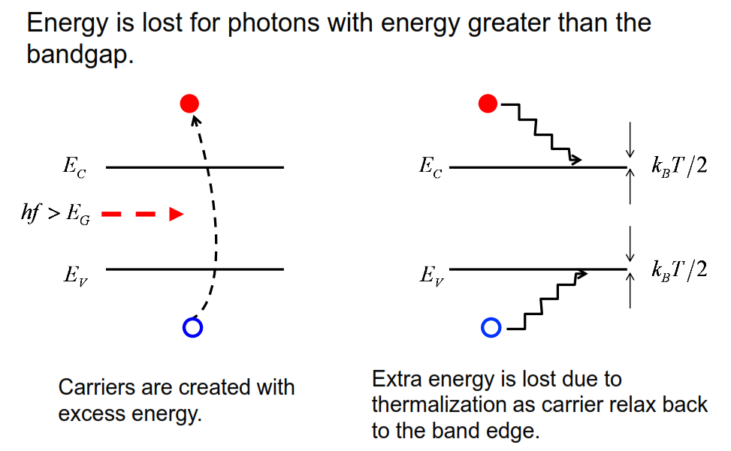
Thermalization
That extra energy will be shed by various scattering processes. And in a few, probably tens of femtoseconds, the electrons will end up down at the bottom

Slide 47
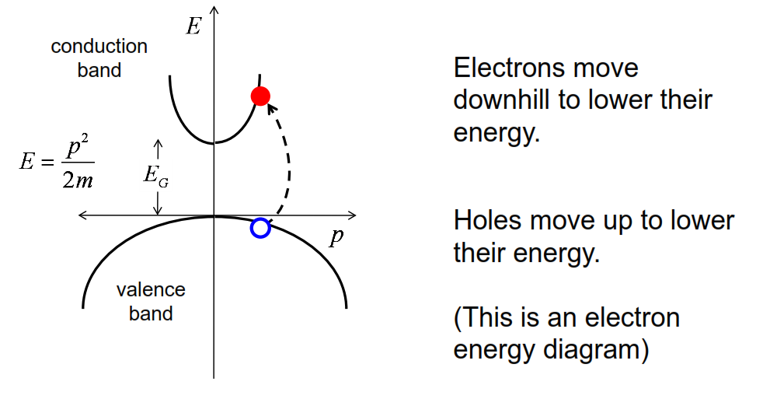
Thermalization on an E(k) diagram

Slide 48
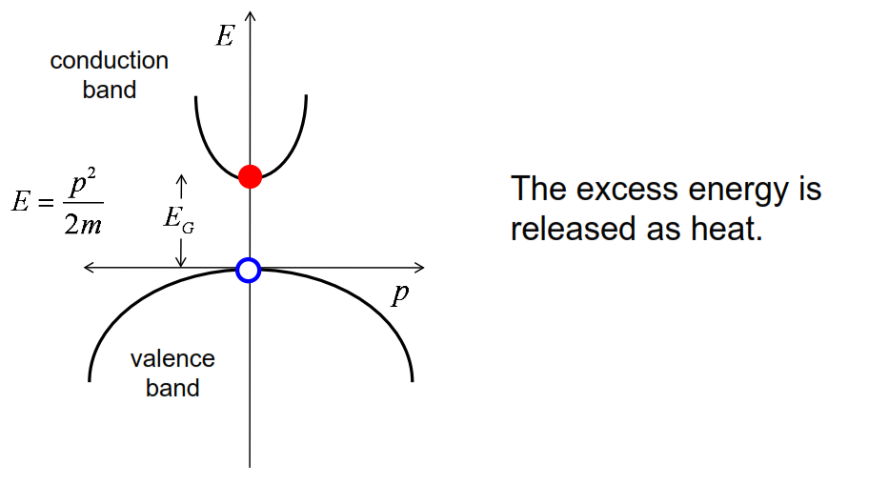
Thermalization on an E(k) diagram
excess energy then during the thermalization process would typically be released as heat. And that's an undesirable side-effect of this process. It's energy that is just wasted.

Slide 49
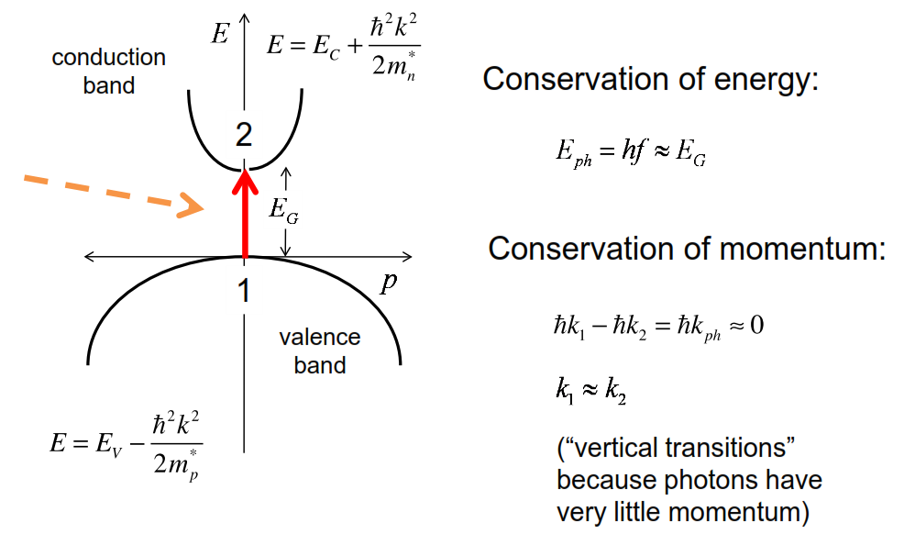
Optical absorption in a direct gap semiconductor
Now that process needs to conserve energy and momentum!

Slide 50
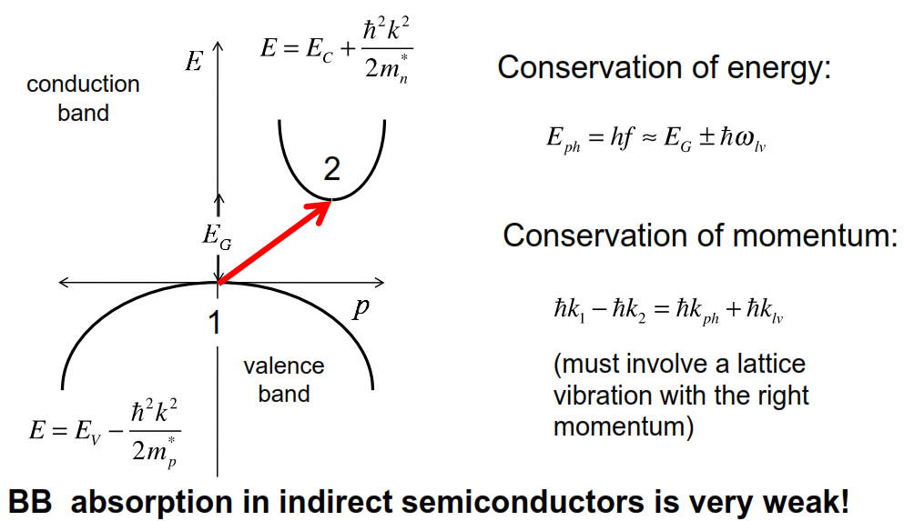
Optical absorption in an indirect gap semiconductor
Energy and momentum must still be conserved, but in order to do this, we're going to need a lattice vibration.
because now we need to find a phonon,
a lattice vibration, with a proper momentum to facilitate the transition. So that's a less probable event.

Slide 51
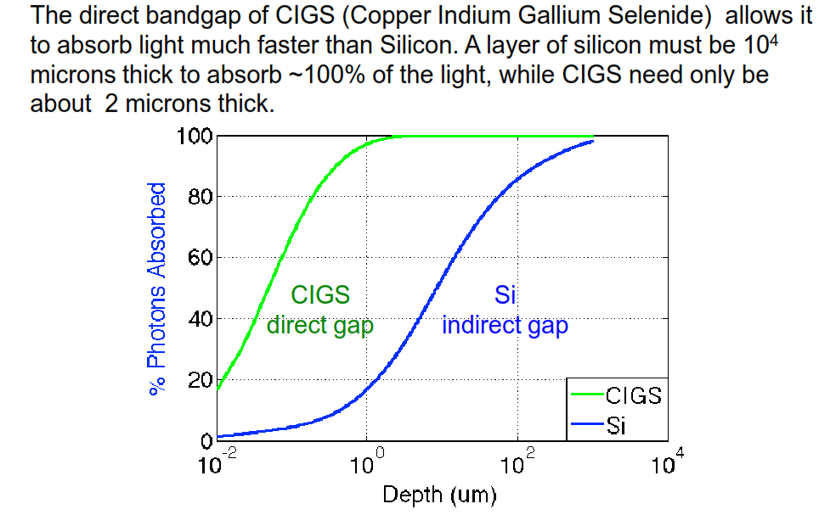
Optical absorption vs. semiconductor thickness

Slide 52
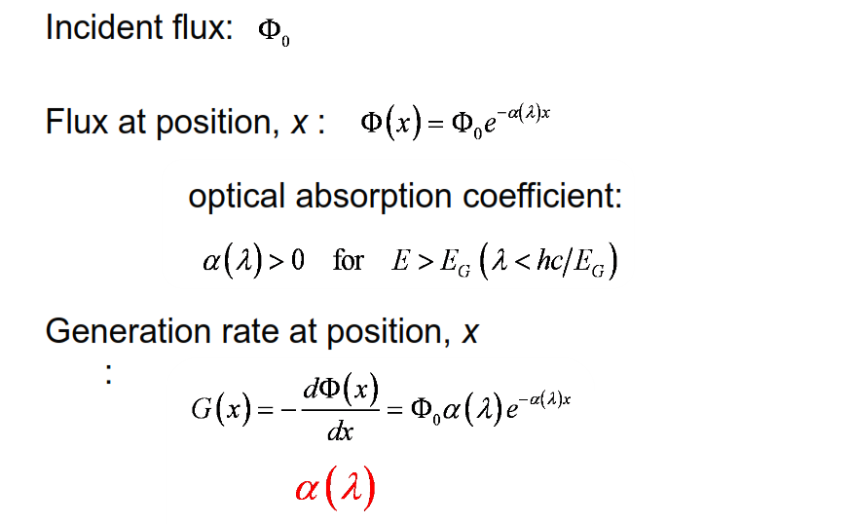
Absorption coefficient
That flux will be absorbed as it penetrates into the semiconductor. And it will be absorbed through this expression. Where x is the depth into the semiconductor and Alpha is the absorption coefficient
We simply differentiate this position-dependent flux, and the expression gives us the generation rate of electrons and hole pairs
So alpha is an important parameter. It's very strong in direct gap semiconductors. It's much weaker in indirect gap semiconductors

Slide 53
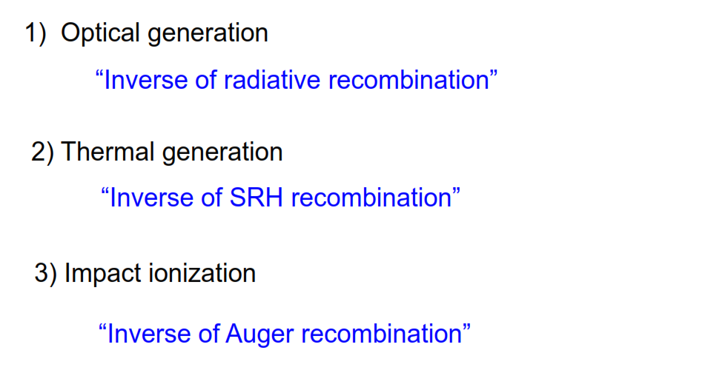
Types of generation

Slide 54
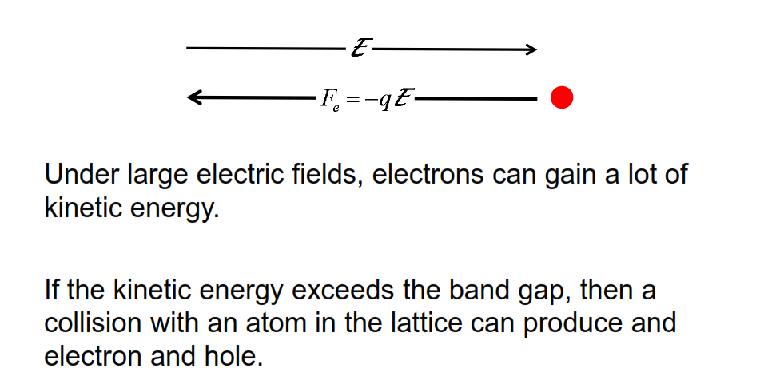
Impact ionization
Now as the energy continues to increase, the electron might gain so much energy that it has more energy than the band gap, and it can break the covalent bond, and a collision can occur with the lattice, and it can create an electron hole pair.

Slide 55
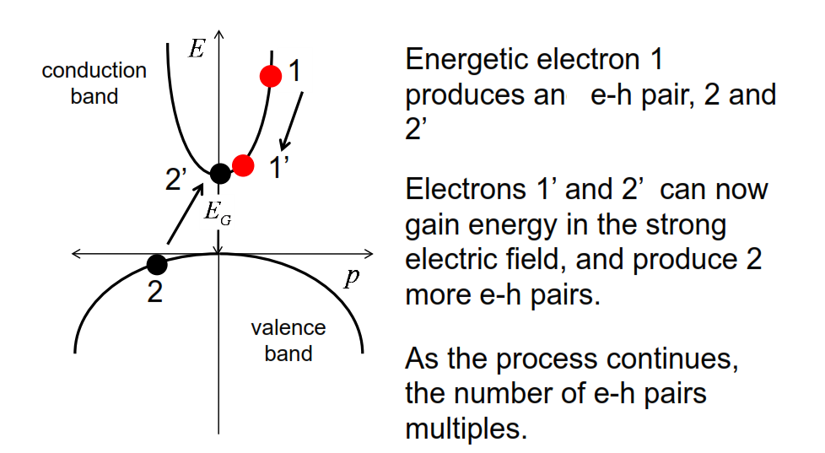
Impact ionization: E(k) picture

Slide 56
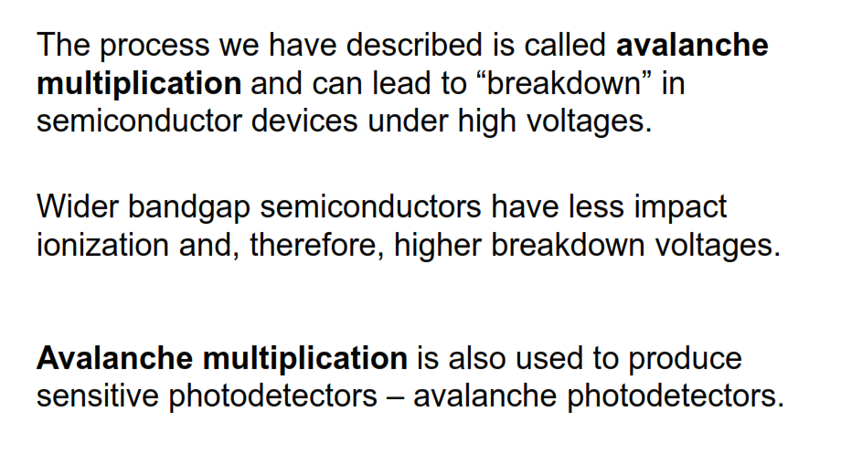
Impact ionization

Slide 57
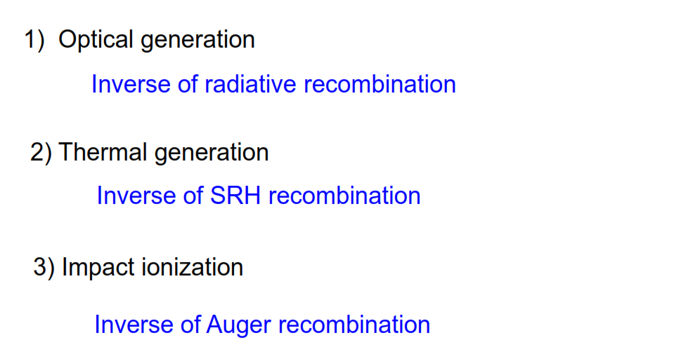
Generation

Slide 58
Unit 4: Carrier Transport,
Recombination, and Generation
Lecture 4.6:
Unit 4 Summery

Slide 59

Drift-diffusion equation
There's a component that we call the drift component due to the force an electric field exerts on carriers that pushes them along. And there is a component due to the diffusion of free carriers, electrons or holes, down a concentration gradient.
The mobility tells us how fast the carriers move in an electric field, and the diffusion coefficient tells us how quickly the carriers diffuse down a concentration gradient.

Slide 60

Drift-diffusion equation

Slide 61

Drift-diffusion equation

Slide 62

Recombination

Slide 63

Recombination processes

Slide 64

Generation processes

Slide 65

Unit 4 summary

