Slide 1
Unit 3: Equilibrium Carrier Concentrations
Lecture 3.1:
The Fermi function

Slide 2
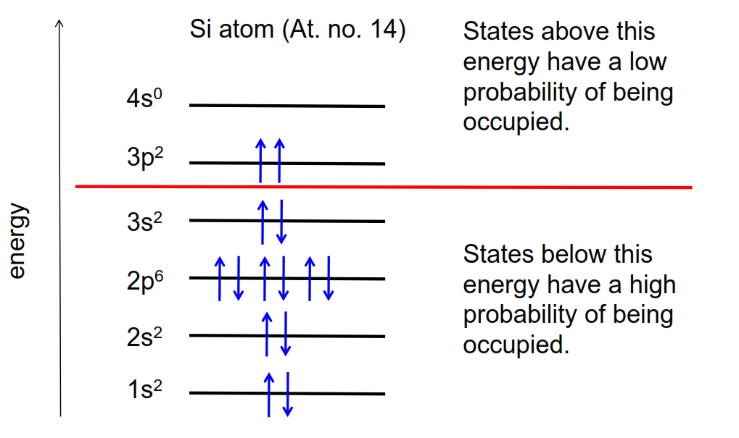
Occupation of states
Here is the dividing line between the filled states and the empty states. That line will turn out to be very useful to us in semiconductors.
The topic of Unit 3 is understanding how we compute the equilibrium concentrations of electrons and holes in semiconductors. Our first step towards doing that is to understand a quantity known as the Fermi function.

Slide 3
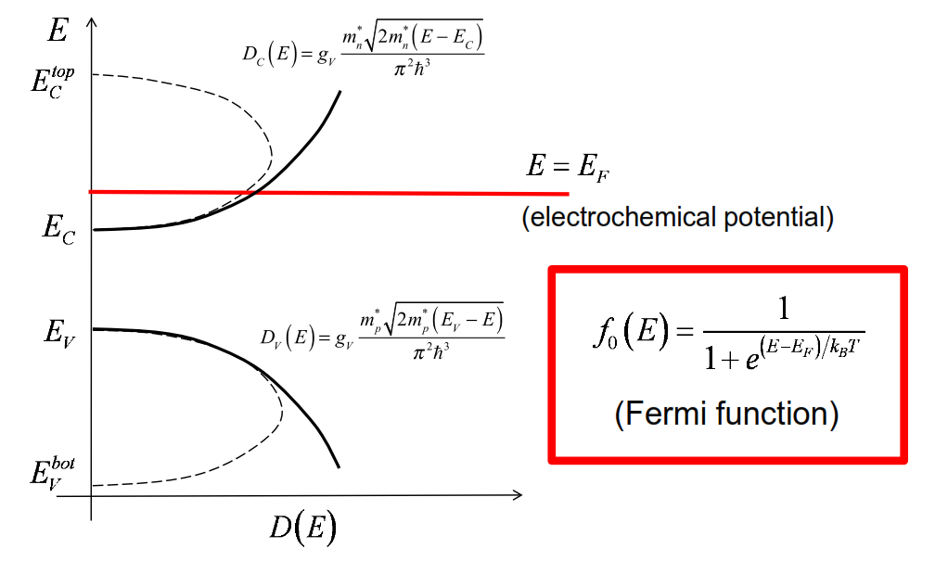
Fermi level
we can draw a line and that line we're going to call the Fermi level below that line the states will be mostly filled. Above that line, the states will be mostly empty
there is a very simple equation that
describes the probability the state at any energy is occupied by an electron. That simple equation is the Fermi function

Slide 4
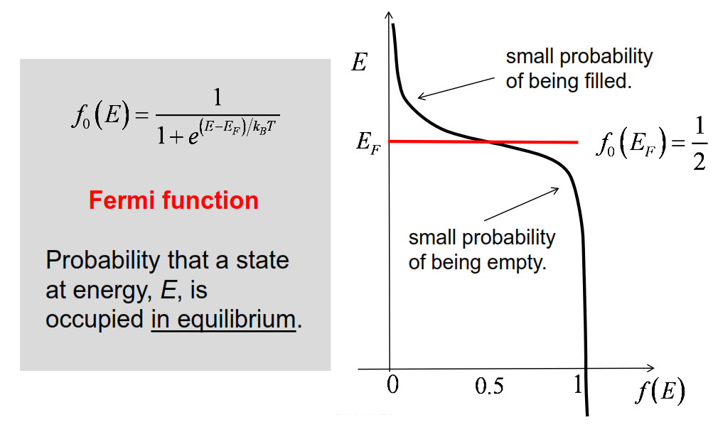
The Fermi function

Slide 5
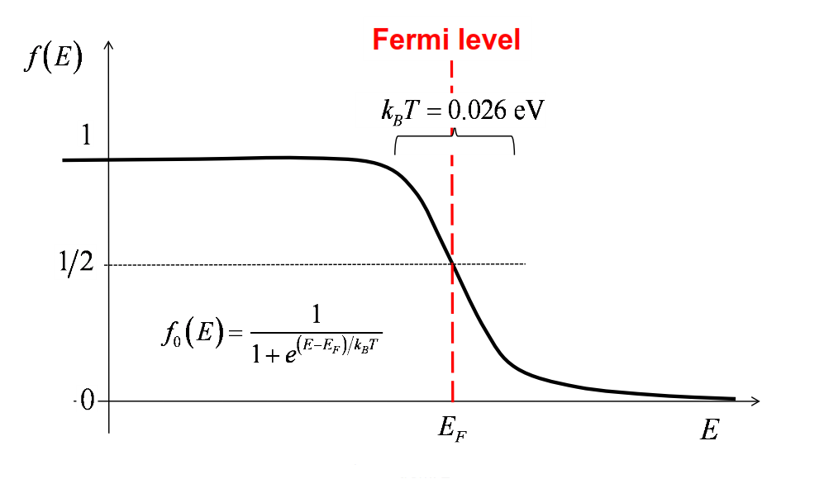
More about the Fermi function
What we'll find is that the width of that transition is determined by the temperature.

Slide 6
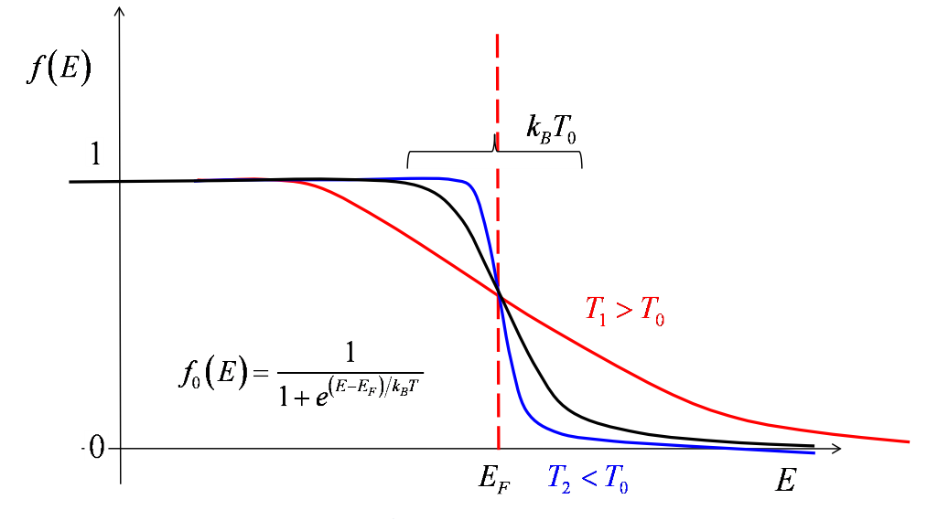
Effect of temperature
If the temperature increase, the width of the transition from high probability of being occupied to low probability of being occupied gets broader. As the semiconductor cool down, the width of that region gets sharper.

Slide 7
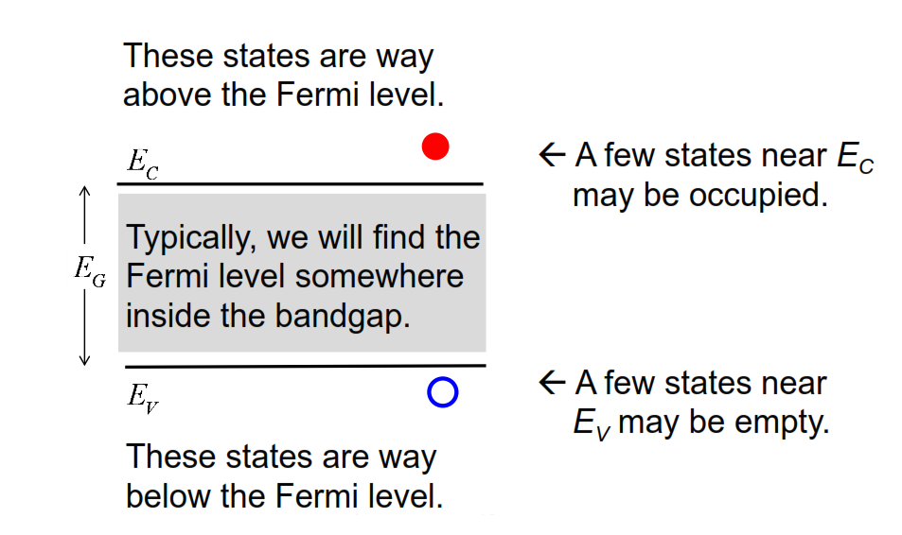
Electrons and holes
Given a semiconductor, where is the Fermi level?

Slide 8
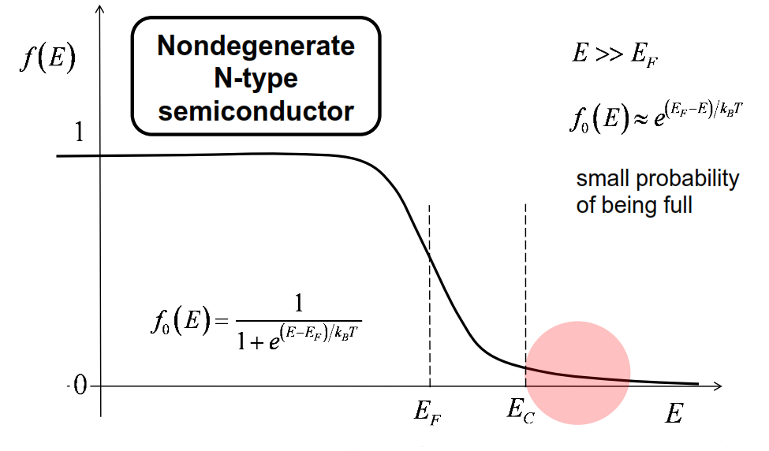
Conduction band
A nondegenerate n-type semiconductor is one in which the states have a small probability of being filled.
now let's apply this Fermi function to the conduction band.

Slide 9
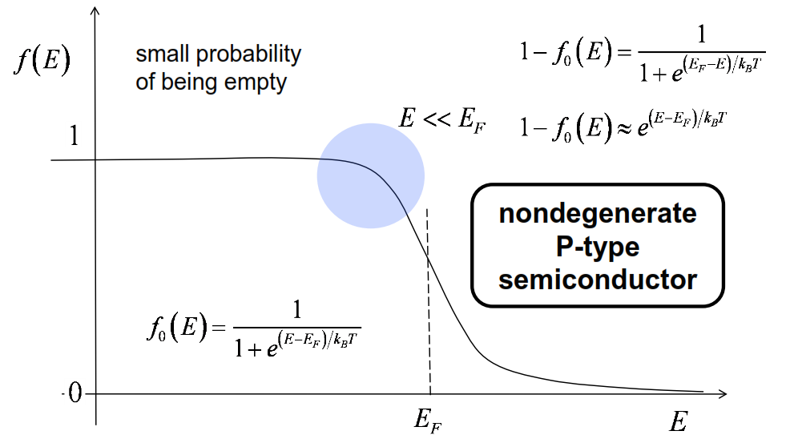
Valence band
A nondegenerate p-type semiconductor, there will be a small probability that the states are empty in the valence band.

Slide 10
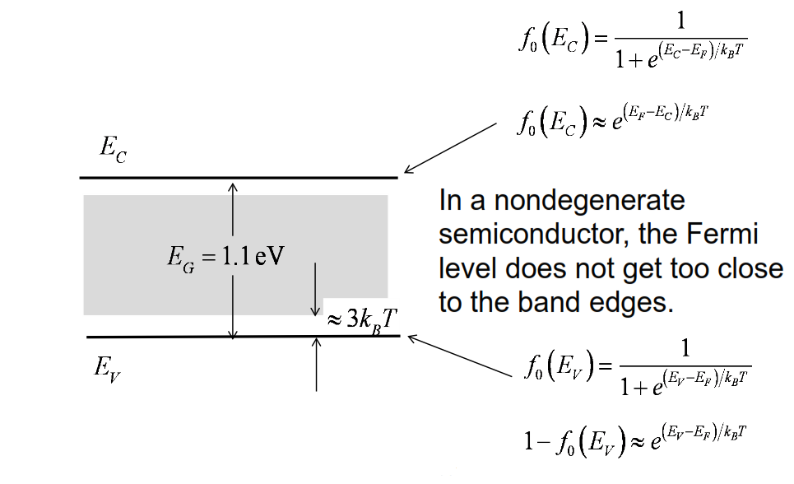
Nondegenerate semiconductors
In other words, a nondegenerate semiconductor is one in which the states in the conduction band are always well above the Fermi energy, and the states in the valence band are well below the Fermi energy

Slide 11
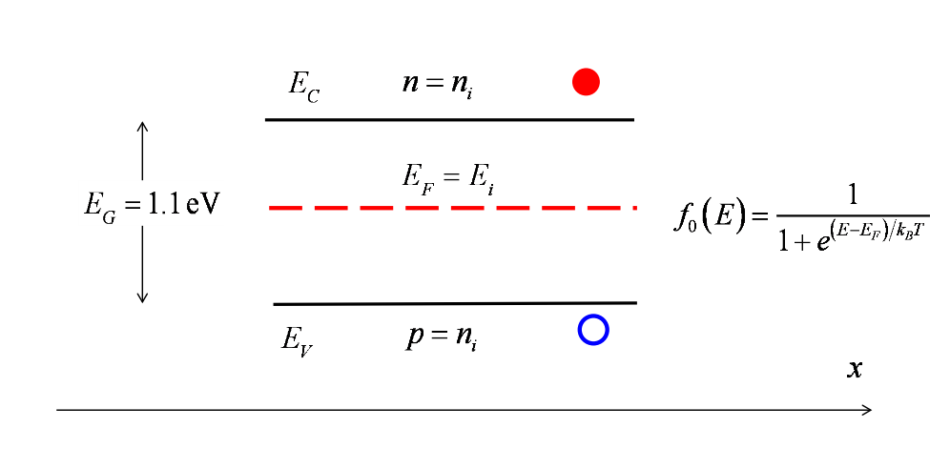
Energy band diagram of an intrinsic semiconductor
It turns out it's not exactly in the middle. We'll see why later, but that's because the density of states in the valence band is slightly different from the density of states in the conduction band.

Slide 12
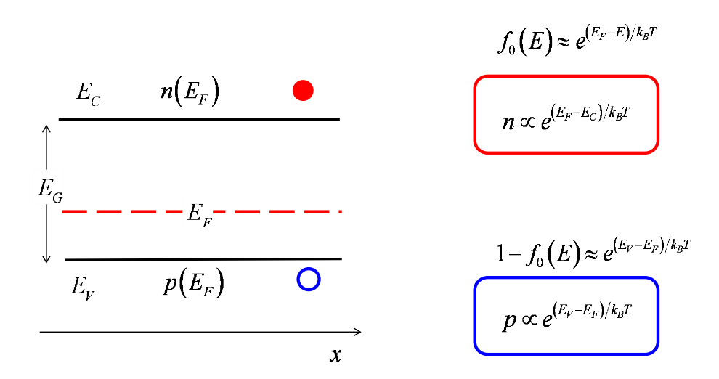
Energy band diagram and carrier densities

Slide 13
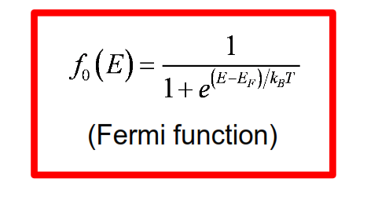
Summary
The Fermi function gives the probability that a state (if it exists) is occupied in equilibrium.
The two key parameters in the Fermi function are the Fermi level and the temperature.

Slide 14
Unit 3: Equilibrium Carrier Concentrations
Lecture 3.2:
Fermi-Dirac integrals

Slide 15
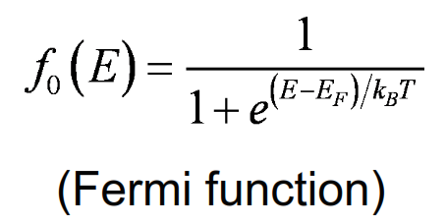
The Fermi function
The Fermi function gives the probability that a state (if it exists) is occupied in equilibrium.
The two key parameters in the Fermi function are the Fermi level and the temperature.
The reason we need to understand the Fermi function is because it is used to compute carrier densities in semi-conductors

Slide 16
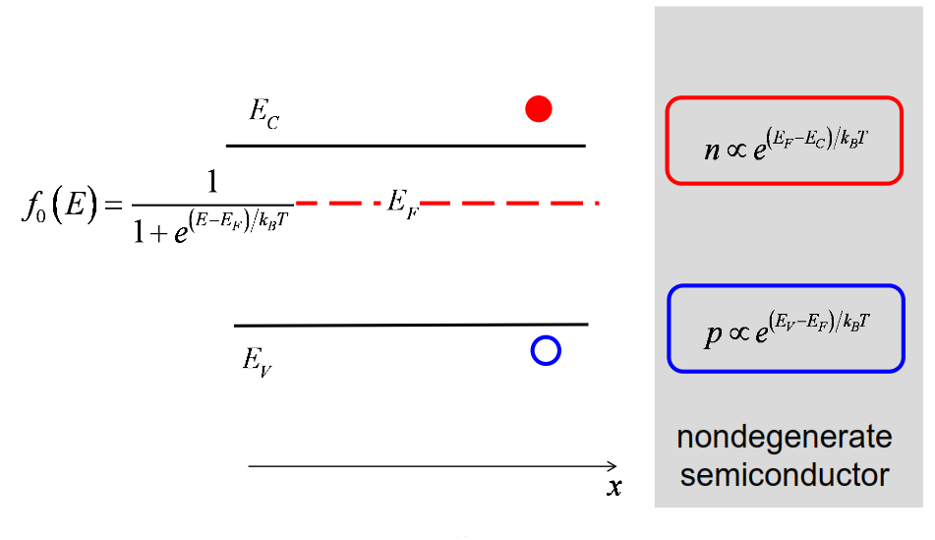
Equilibrium carrier densities
So our goal is to understand what the carrier density is in the conduction band, and what the hole density is in the valence band given a particular location of this Fermi energy

Slide 17
Two options
Our goal is to relate the carrier density to the Fermi level and to the properties of the semiconductor.
We can do the calculation two ways:
  1) In k-space
  2) In energy space

Slide 18
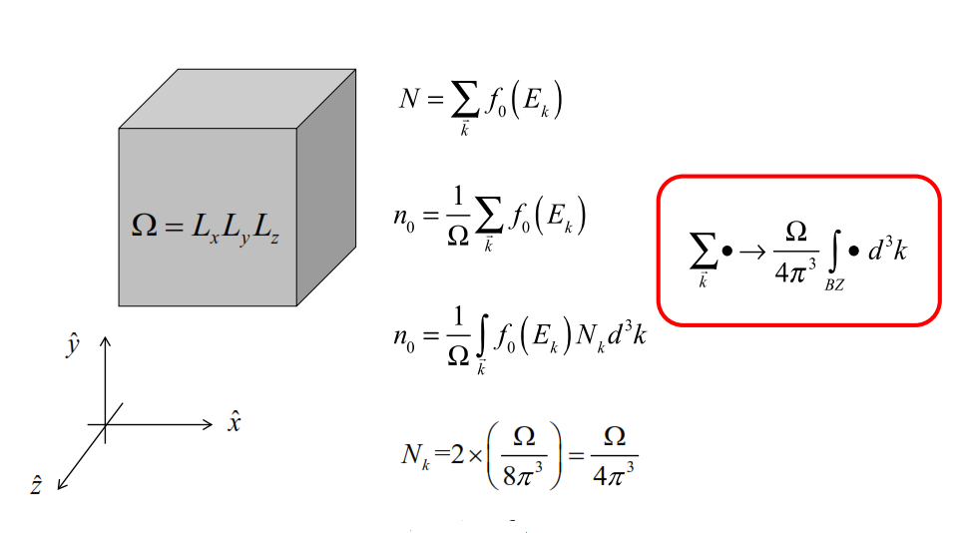
3D bulk semiconductor: k-space

Slide 19
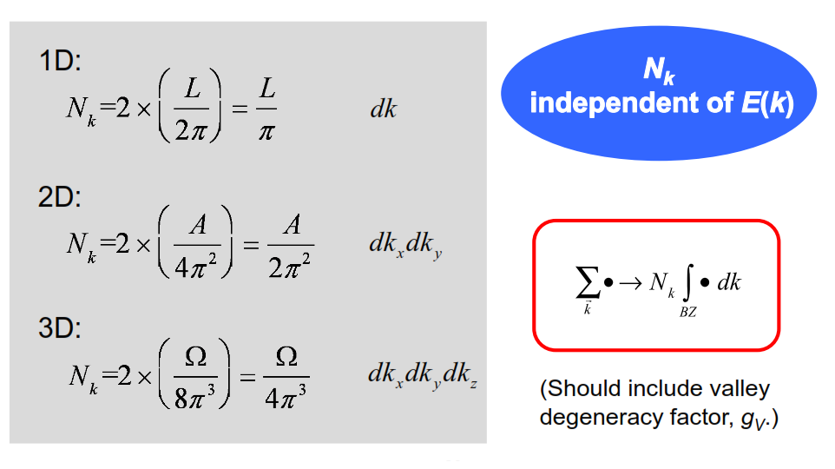
Density-of-states in k-space

Slide 20
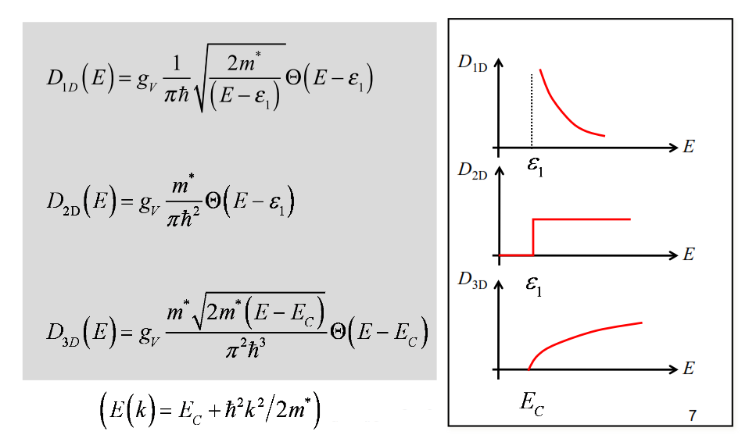
Energy space (parabolic bands)
Let's do the calculation in 3D

Slide 21
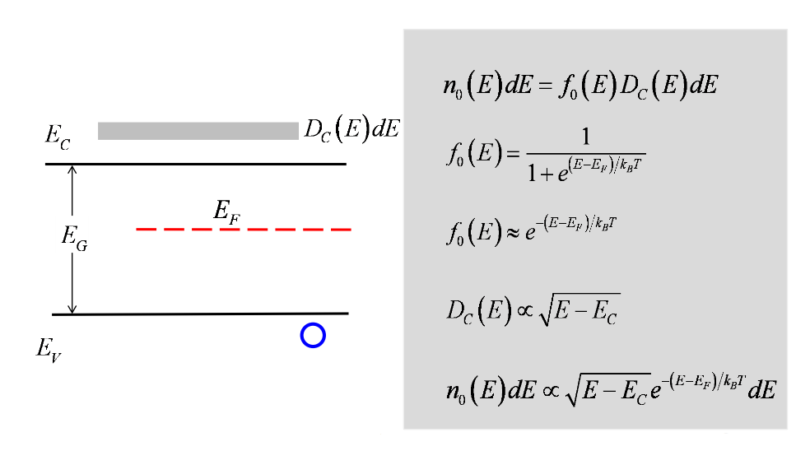
Distribution of electrons in the conduction band

Slide 22
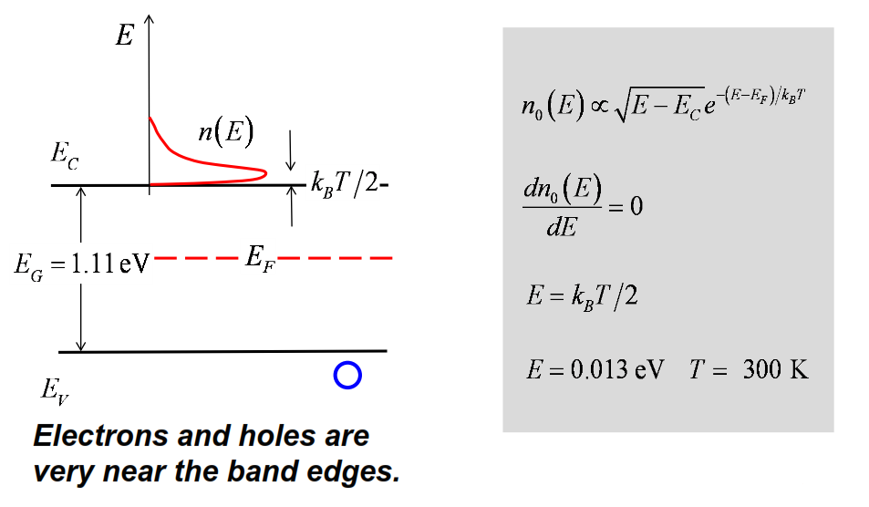
Distribution of electrons in the conduction band

Slide 23
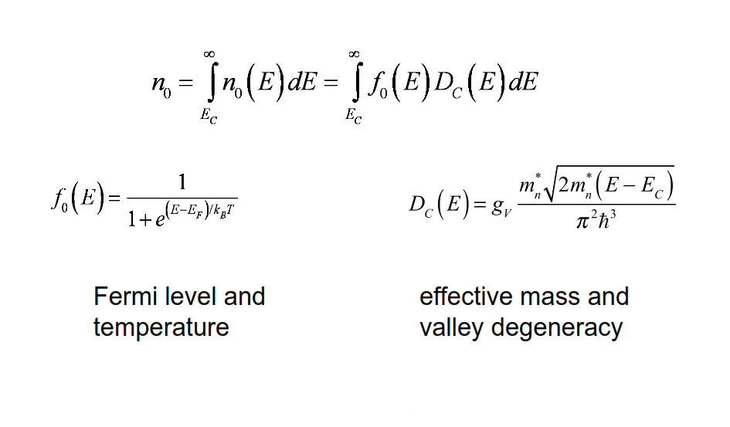
Compute the electron density
I can see that the result is going to depend on Fermi level and temperature. Because those two parameters are in the Fermi function. The result is also going to depend on the effective mass of the semiconductor and the number of equivalent valleys because those quantities are in the density of states.

Slide 24
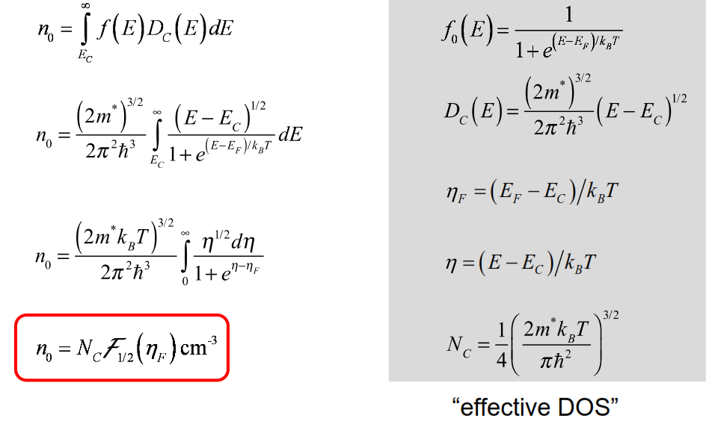

Energy space (3D)
A couple of definitions
That integral cannot be done analytically. It has to be done numerically!. The integral is called a Fermi-Dirac integral of order 1/2

Slide 25
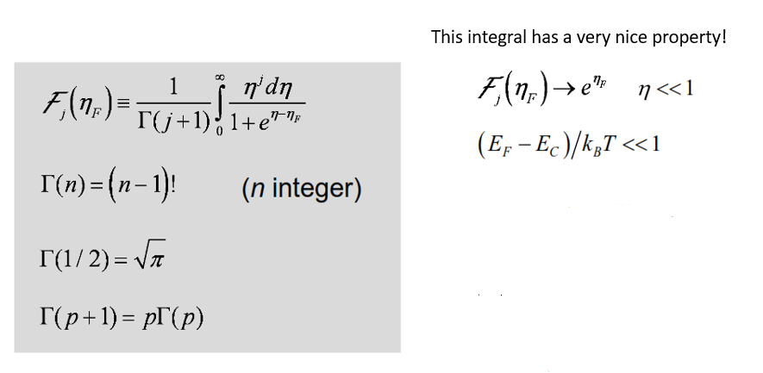
Fermi-Dirac integrals
In a nondegenerate semiconductor this complicated Fermi-Dirac integral reduces to the familiar exponential.

Slide 26
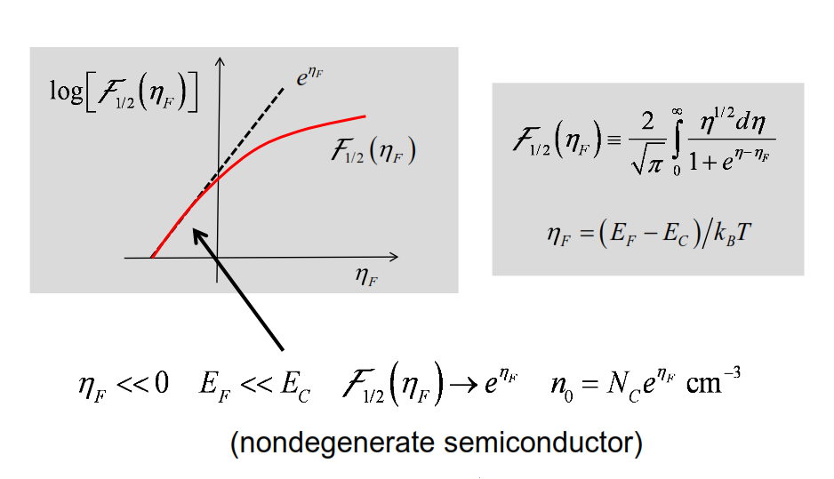
Fermi-Dirac integral of order 1/2

Slide 27
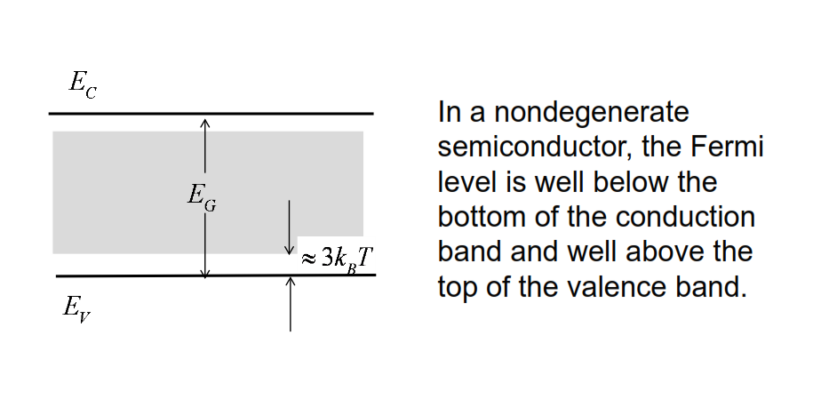
Nondegenerate semiconductor

Slide 28
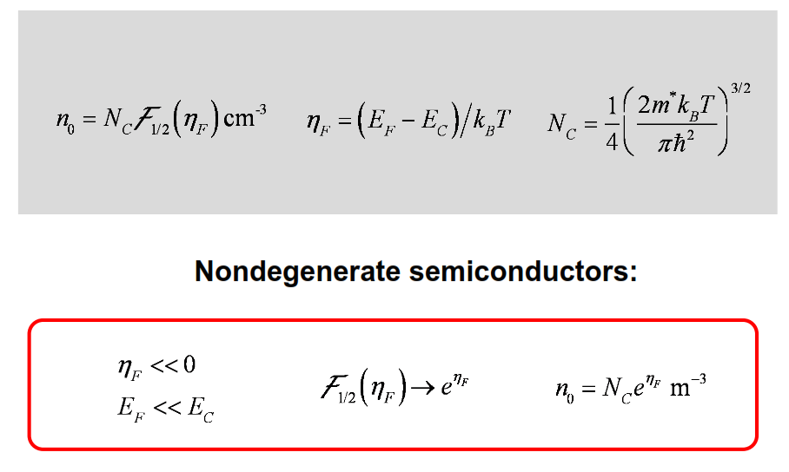
Compute the electron density

Slide 29
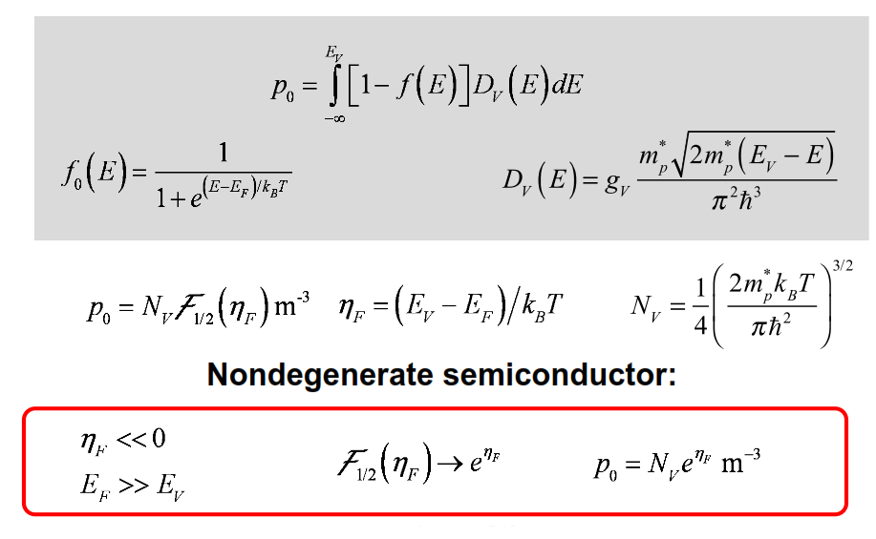
Compute the hole density

Slide 30
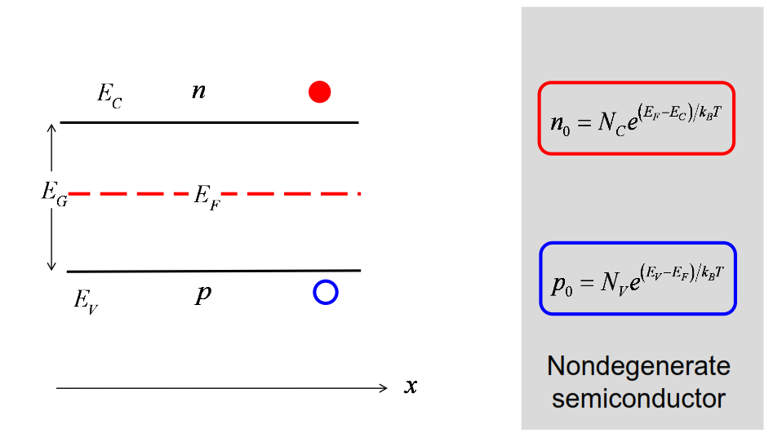
Summary

Slide 31
Unit 3: Equilibrium Carrier Concentrations
Lecture 3.3:
Carrier concentration
vs. Fermi level

Slide 32
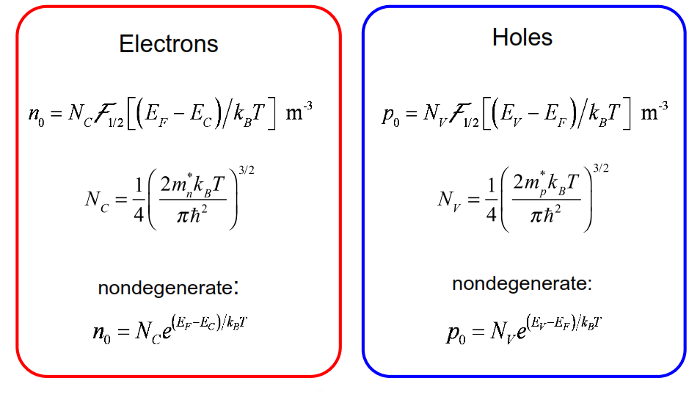
Carrier concentrations

Slide 33
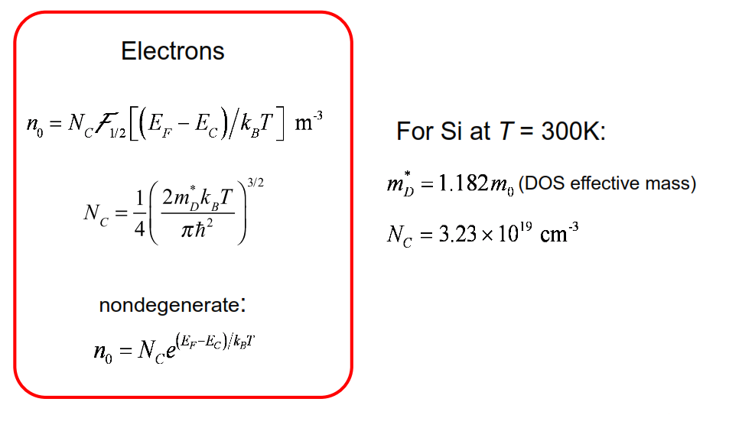
Electron concentration

Slide 34
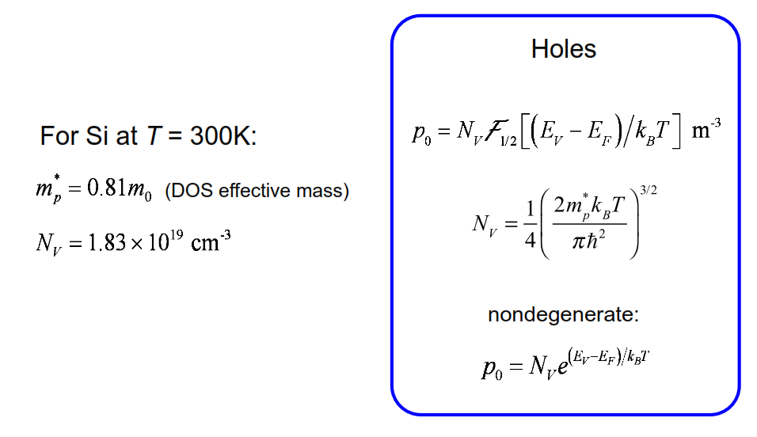
Hole concentration

Slide 35
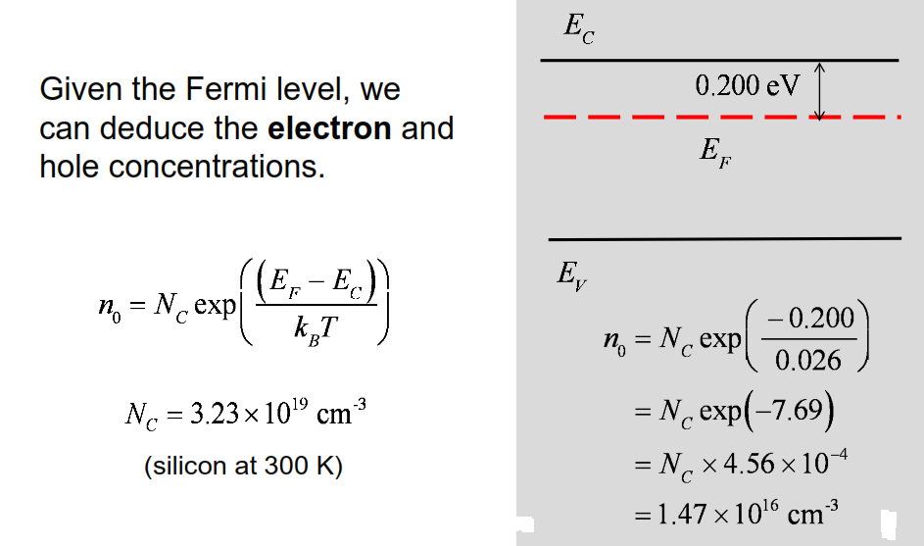
Fermi level and electron concentration

Slide 36
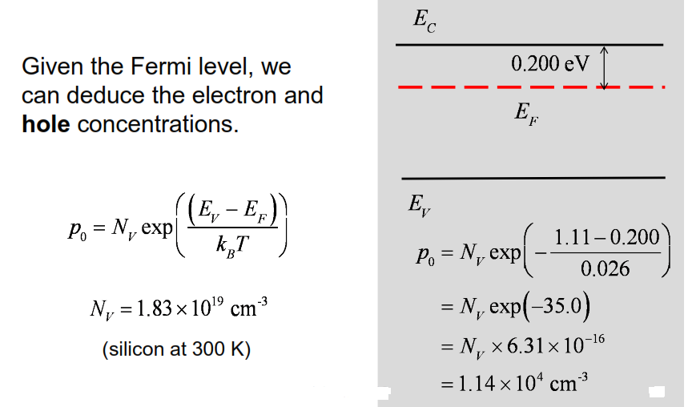
Fermi level and hole concentration

Slide 37
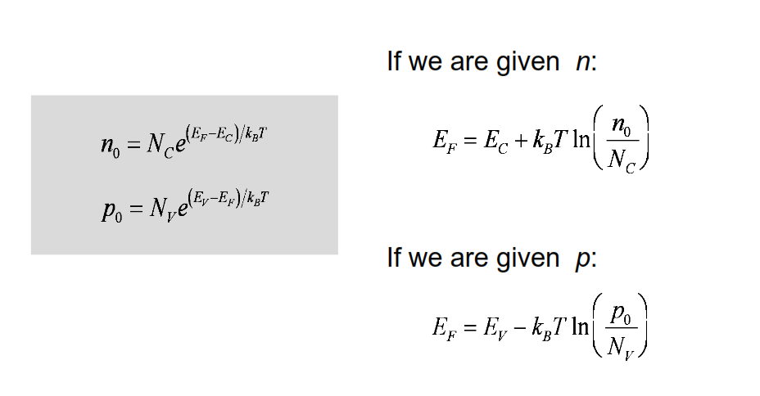
From carrier concentration to Fermi level
So we can go either way. Given n, we can compute EF. Given EF, we can compute n.

Slide 38
np product
The equilibrium product of the electron and hole concentrations is a very important quantity for a semiconductor.

Slide 39
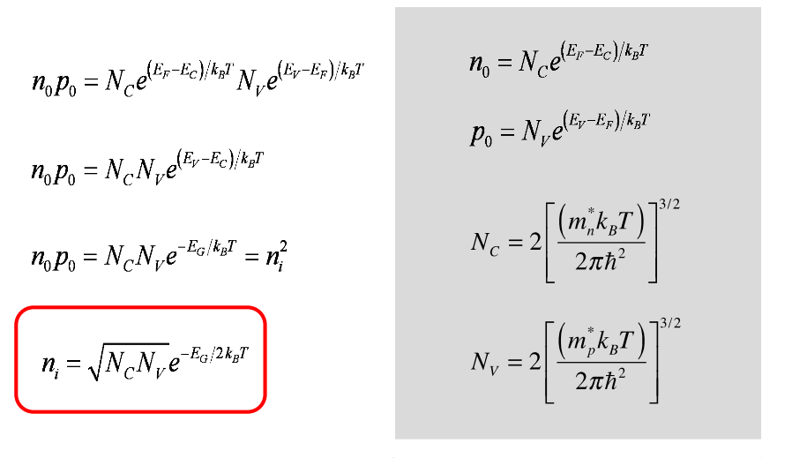
np product
ni doesn't depend on the Fermi level, so it's valid in an intrinsic semiconductor or any semiconductor.

Slide 40
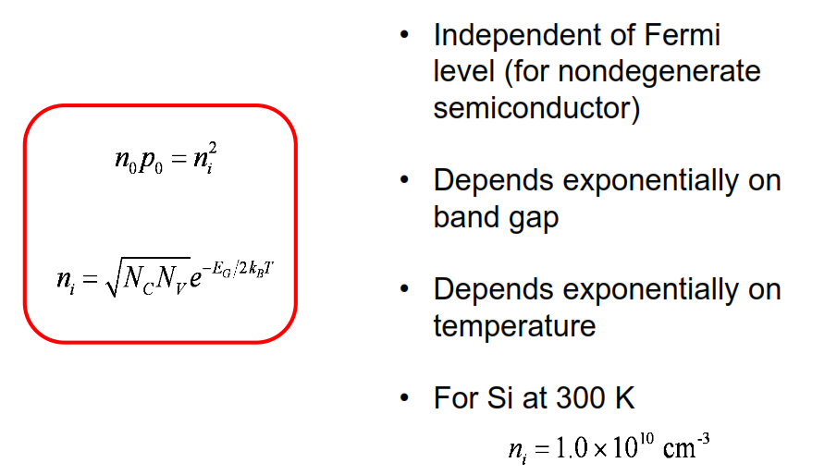
np product
The wider the band gap, the harder it is to break those covalent bonds. The higher the temperature, the easier it is for the thermal energy to break those covalent bonds

Slide 41
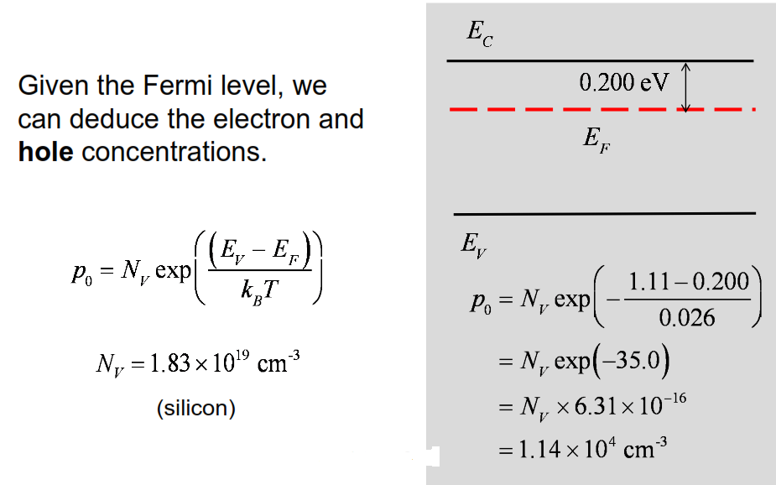
Recall: Fermi level and hole concentration

Slide 42
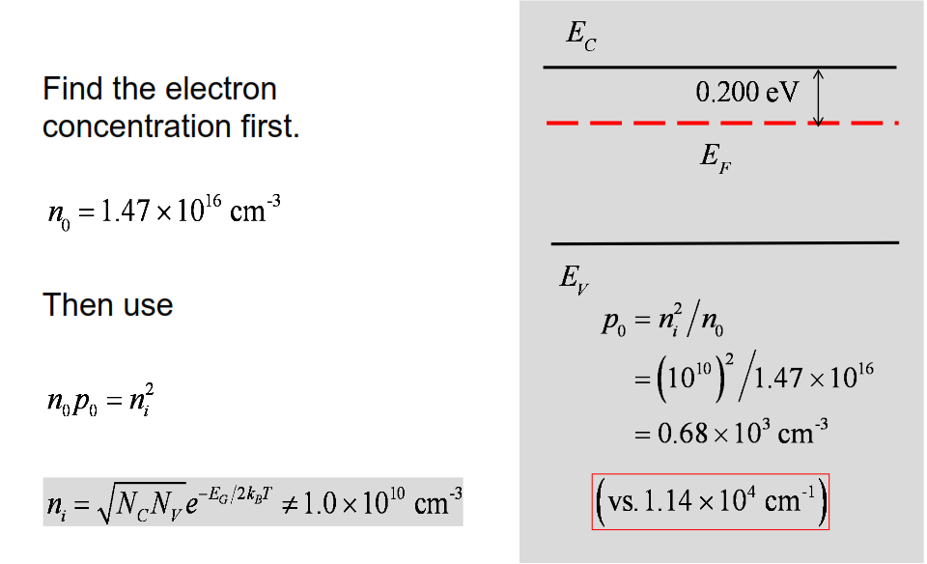
Another way
Now we have another way to do this problem
ni is difficult to compute exactly! because it depends exponentially on band gap and temperature

Slide 43
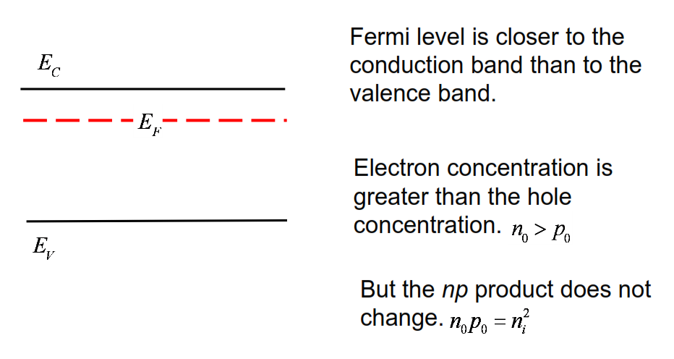
E-band diagram for N-type semiconductor

Slide 44
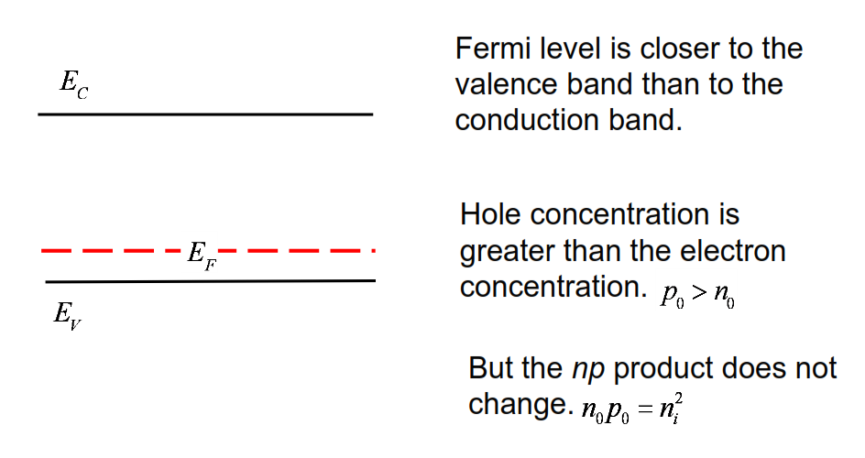
E-band diagram for P-type semiconductor

Slide 45
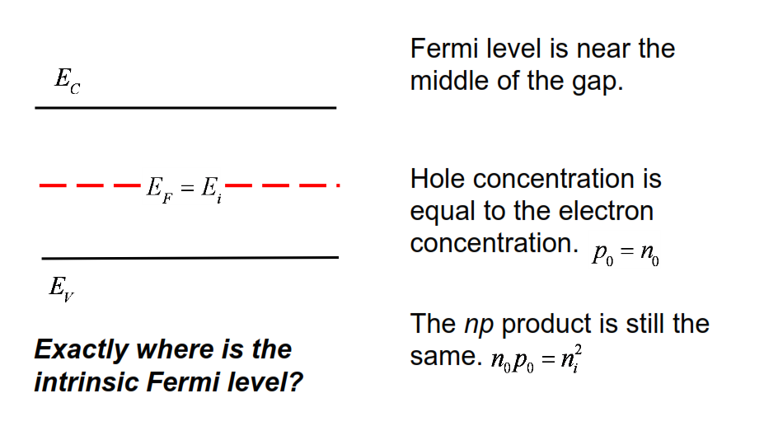
Intrinsic semiconductor

Slide 46
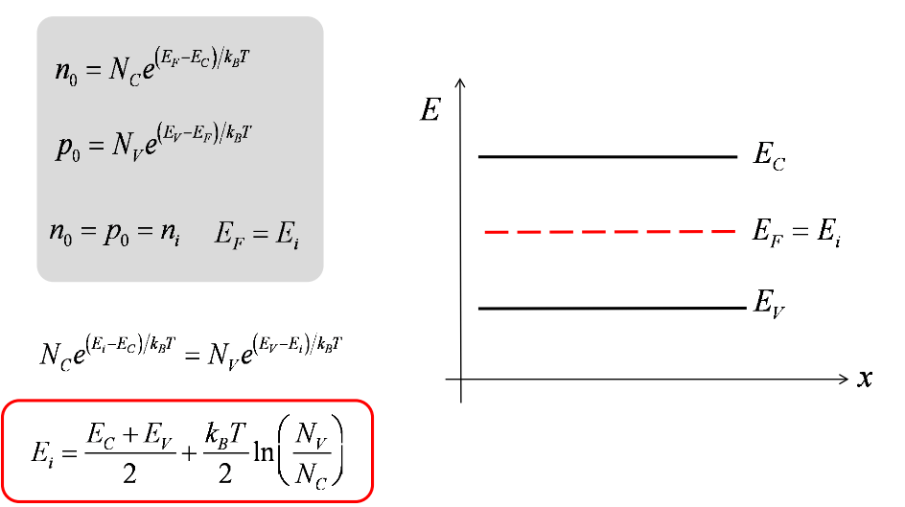
The intrinsic Fermi level
We will call the Fermi level in the intrinsic condition Ei instead of EF.

Slide 47
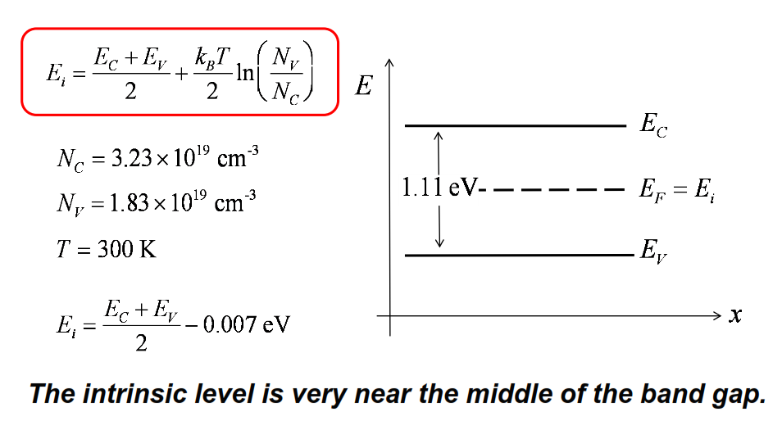
The intrinsic level: Silicon
let's work out some numbers for silicon

Slide 48
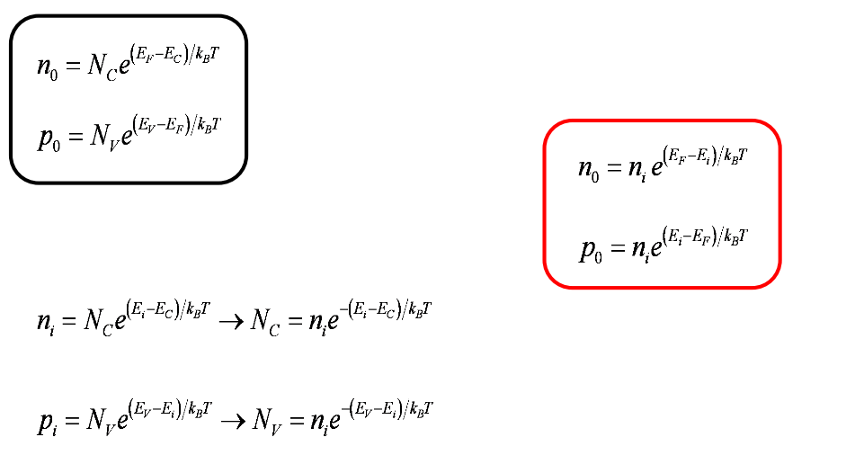
Alternative expression for carrier densities
These two relations relate the carrier densities to the Fermi level and they're perfectly adequate. But there's another way to do this that's commonly done and it is useful also.
These two expressions are equal.

Slide 49
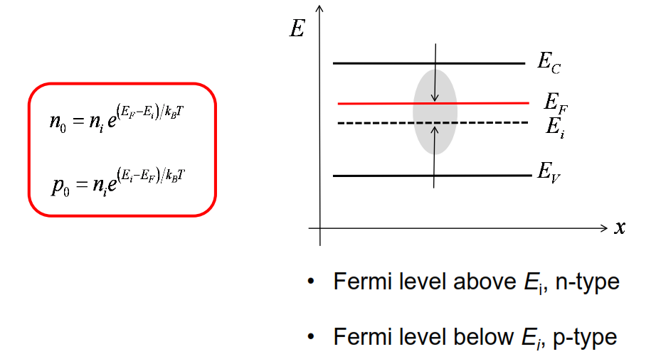
“Reading” an E-band diagram

Slide 50
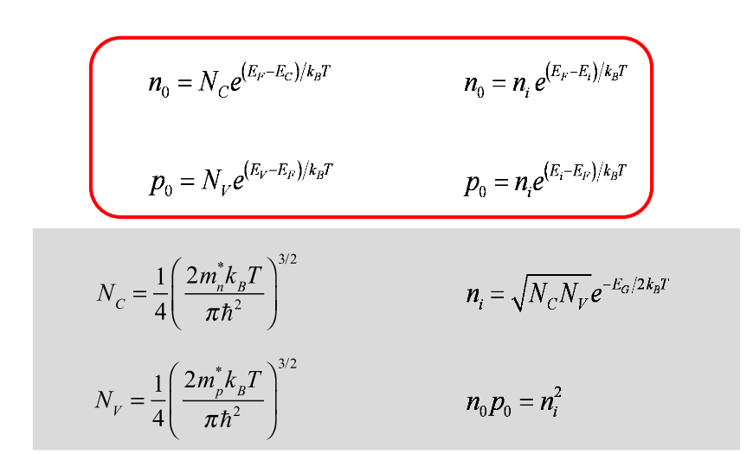
Summary

Slide 51
Unit 3: Equilibrium Carrier Concentrations
Lecture 3.4:
Carrier concentration
vs. doping density

Slide 52
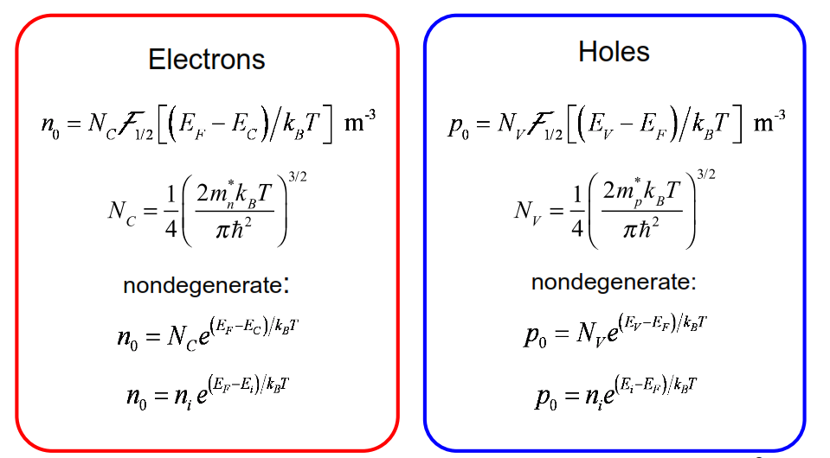
Carrier concentrations vs. Fermi level

Slide 53
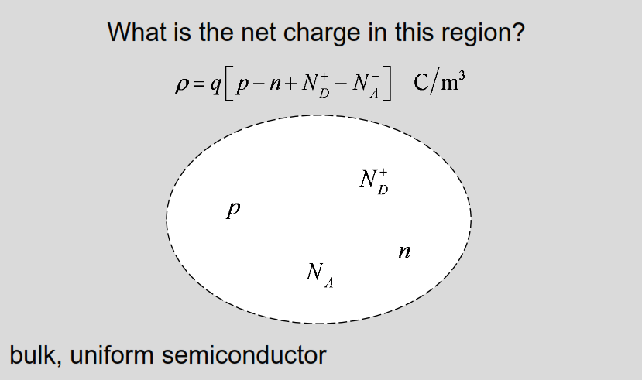
Space charge density

Slide 54

Space charge neutrality
Nature abhors a charge.
Mobile charges (electrons and holes) will be attracted to the immobile ionized dopants), so that the net charge is zero.
Almost uniform semiconductors will be nearly neutral, but with strong non-uniformities (e.g. PN junctions), there will be a space charge.

Slide 55
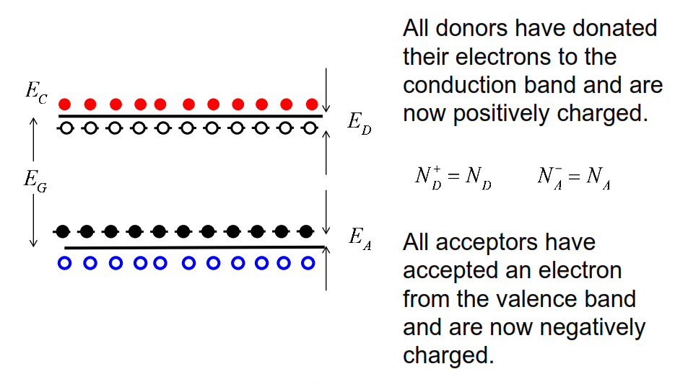
Fully ionized dopants

Slide 56
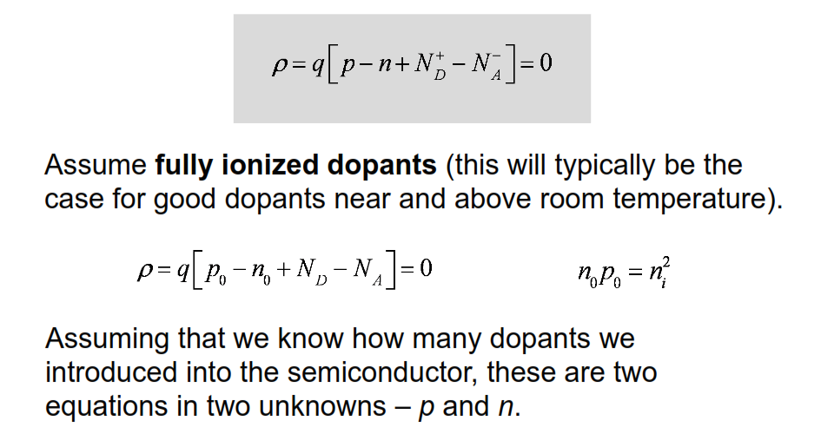
Space charge neutrality again

Slide 57
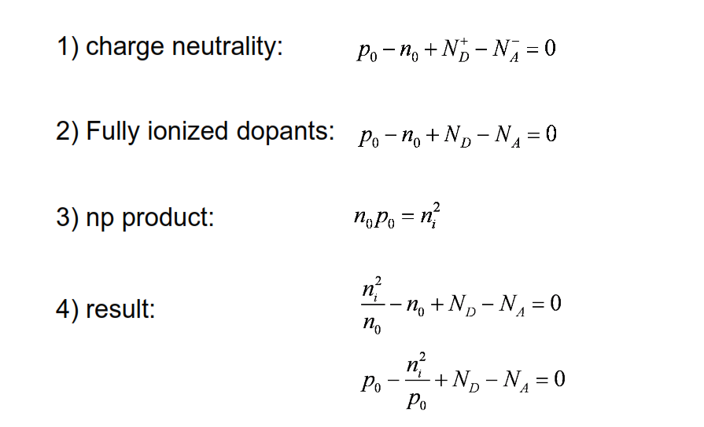
Solving for the carrier density

Slide 58

Result: N-type

Slide 59

Result: P-type

Slide 60

Example 1

Slide 61

Soln

Slide 62

Example 2

Slide 63

Soln

Slide 64

Conclusion

Slide 65

Summary

Slide 66
Unit 3: Equilibrium Carrier Concentrations
Lecture 3.5:
Carrier concentration
vs. temperature

Slide 67

Carrier concentration vs. temperature
How the carrier concentration varies with temperature?

Slide 68

The extrinsic region

Slide 69

The extrinsic region

Slide 70

The intrinsic region

Slide 71

Result: N-type

Slide 72

Result: P-type

Slide 73


Example 3

Slide 74

Soln

Slide 75

Soln

Slide 76

Comment

Slide 77

The freeze-out region
Net doping density >> intrinsic concentration

Slide 78

Solving for the carrier density: N-type

Slide 79

Low temperature

Slide 80

Ionized donor concentration

Slide 81

Ionized donor concentration

Slide 82

Ionized dopant concentration

Slide 83

Example: N-type sample

Slide 84

The freeze-out region

Slide 85

The freeze-out region

Slide 86

Comment

Slide 87

Metal-insulator transition

Slide 88
Question
We now understand how the carrier concentration varies with temperature. How does the Fermi level vary with temperature?

Slide 89

Fermi level vs. temperature

Slide 90

Summary

Slide 91
Unit 3: Equilibrium Carrier Concentrations
Lecture 3.6:
Unit 3 Summary

Slide 92

Fermi function
The Fermi function gives the probability that a state (if it exists) is occupied in equilibrium.
The two key parameters in the Fermi function are the Fermi level and the temperature.

Slide 93

Fermi level and temperature

Slide 94

Distribution of carriers in the bands

Slide 95

Fermi-Dirac integrals

Slide 96

FD integrals and exponentials

Slide 97

Nondegenerate semiconductors

Slide 98

Carrier densities for nondegenerate semiconductors

Slide 99

np product

Slide 100

The intrinsic Fermi level

Slide 101

Carrier concentration relations (nondegenerate)

Slide 102

Reading an e-band diagram

Slide 103

Carrier concentration vs. doping

Slide 104

Extrinsic region

Slide 105

The intrinsic region

Slide 106

The freeze out region (just for your information)

Slide 107

Fermi level vs. temperature

Slide 108

Unit summary

