Slide 1

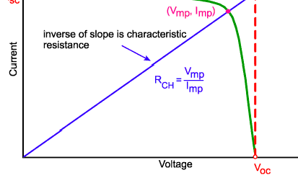


Resistive Effect
Characteristic Resistance
  The characteristic resistance of a solar cell is the output resistance of the solar cell at its maximum power point.
  If the resistance of the load is equal to the characteristic resistance of the solar cell, then the maximum power is transferred to the load and the solar cell operates at
its maximum power point.
  It is a useful parameter in solar cell analysis, particularly when examining the impact of parasitic loss mechanisms.
    The characteristic resistance of a solar cell is the inverse of the slope of the line, shown in the figure
    It can alternately be given as an approximation where

Slide 2
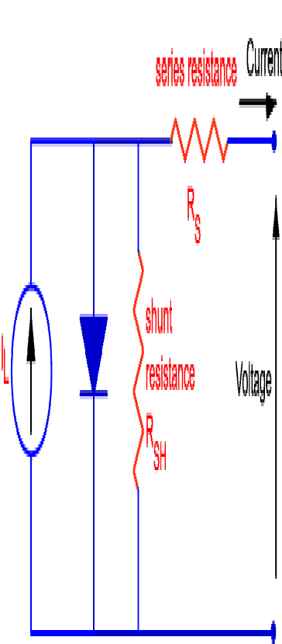
Resistive Effect
Effect of Parasitic Resistance
  Resistive effects in solar cells reduce the efficiency of the solar cell by dissipating power in the resistances.
  The most common parasitic resistances are series resistance and shunt resistance.
  The inclusion of the series and shunt resistance on the solar cell model is shown in the figure below.
In most cases and for typical values of shunt and series resistance, the key impact of parasitic resistance is to reduce the fill factor.
Both the magnitude and impact of series and shunt resistance depend on the geometry of the solar cell, at the operating point of the solar cell.

Slide 3

Resistive Effect
Effect of Parasitic Resistance
  Since the value of resistance will depend on the area of the solar cell, when comparing the series resistance of solar cells which may have different areas, a common unit for resistance is in Ωcm².
  This area-normalized resistance results from replacing current with current density in Ohm's law as shown below:

Slide 4
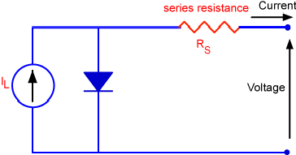
Resistive Effect
Series Resistance
  Series resistance in a solar cell has three causes:
  firstly, the movement of current through the emitter and base of the solar cell
  secondly, the contact resistance between the metal contact and the silicon
  finally the resistance of the top and rear metal contacts
  The main impact of series resistance is to reduce the fill factor, although excessively high values may also reduce the short-circuit current.

Slide 5

Resistive Effect
Series Resistance
where: I is the cell output current, I_{L} is the light generated current, V is the voltage across the cell terminals, T is the temperature, q and k are constants, n is the ideality factor, and R_{S} is the cell series resistance.
The formula is an example of an implicit function due to the appearance of the current, I, on both sides of the equation and requires numerical methods to solve.
Series resistance does not affect the solar cell at open-circuit voltage since the overall current flow through the solar cell, and therefore through the series resistance is zero.
However, near the open-circuit voltage, the IV curve is strongly effected by the series resistance.
A straight-forward method of estimating the series resistance from a solar cell is to find the slope of the IV curve at the open-circuit voltage point.

Slide 6
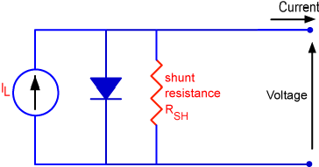
Resistive Effect
Shunt Resistance
Significant power losses caused by the presence of a shunt resistance, R_{SH}, are
typically due to manufacturing defects, rather than poor solar cell design.
Low shunt resistance causes power losses in solar cells by providing an alternate current path for the light-generated current.
Such a diversion reduces the amount of current flowing through the solar cell junction and reduces the voltage from the solar cell.
The effect of a shunt resistance is particularly severe at low light levels, since
there will be less light-generated current.
The loss of this current to the shunt therefore has a larger impact.
In addition, at lower voltages where the effective resistance of the solar cell is high, the impact of a resistance in parallel is large.

Slide 7

Resistive Effect
Shunt Resistance
  The equation for a solar cell in presence of a shunt resistance is:
where: I is the cell output current, I_{L} is the light generated current, V is the voltage across the cell terminals, T is the temperature, q and k are constants, n is the
ideality factor, and R_{SH} is the cell shunt resistance.
An estimate for the value of the shunt resistance of a solar cell can be determined from the slope of the IV curve near the short-circuit current point.
The impact of the shunt resistance on the fill factor can be calculated in a manner similar to that used to find the impact of series resistance on fill factor.
The maximum power may be approximated as the power in the absence of shunt resistance, minus the power lost in the shunt resistance.

Slide 8
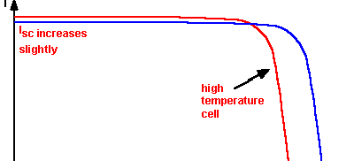

Resistive Effect
Effect of Temperature
  Like all other semiconductor devices, solar cells are sensitive to temperature.
  Increases in temperature reduce the band gap of a semiconductor, thereby effecting most of the semiconductor material parameters.
  The decrease in the band gap of a semiconductor with increasing temperature can be viewed as increasing the energy of the electrons in the material. Lower energy is therefore needed to break the bond.
  In the bond model of a semiconductor band gap, reduction in the bond energy also reduces the band gap. Therefore increasing the temperature reduces the band gap. In a solar cell, the parameter most affected by an increase in temperature is the open-circuit voltage.

Slide 9
Resistive Effect
Effect of Light Intensity
  Changing the light intensity incident on a solar cell changes all solar cell parameters, including the short-circuit current, the open-circuit voltage, the FF, the efficiency and the impact of series and shunt resistances.
  The light intensity on a solar cell is called the number of suns, where 1 sun corresponds to standard illumination at AM1.5, or 1 kW/m².
  For example a system with 10 kW/m² incident on the solar cell would be operating at 10 suns, or at 10X.
  A PV module designed to operate under 1 sun conditions is called a "flat plate" module while those using concentrated sunlight are called "concentrators".

Slide 10

Resistive Effect
Concentrators
A concentrator is a solar cell designed to operate under illumination greater than 1
sun.
The incident sunlight is focused or guided by optical elements such that a high intensity light beam shines on a small solar cell.
Concentrators have several potential advantages, including a higher efficiency potential than a one-sun solar cell and the possibility of lower cost.
The short-circuit current from a solar cell depends linearly on light intensity, such
that a device operating under 10 suns would have 10 times the short-circuit current as the same device under one sun operation.
However, this effect does not provide an efficiency increase, since the incident power also increases linearly with concentration.
Instead, the efficiency benefits arise from the logarithmic dependence of the
open-circuit voltage on short circuit. Therefore, under concentration, V_{oc} increases logarithmically with light intensity, as shown in the equation below;
where X is the concentration of sunlight.

Slide 11
Resistive Effect
Low Light Intensity
Solar cells experience daily variations in light intensity, with the incident power
from the sun varying between 0 and 1 kW/m².
At low light levels, the effect of the shunt resistance becomes increasingly important.
As the light intensity decreases, the bias point and current through the solar cell also decreases, and the equivalent resistance of the solar cell may begin to approach the shunt resistance.
When these two resistances are similar, the fraction of the total current flowing through the shunt resistance increases, thereby increasing the fractional power loss due to shunt resistance.
Consequently, under cloudy conditions, a solar cell with a high shunt resistance retains a greater fraction of its original power than a solar cell with a low shunt resistance.

Slide 12

Resistive Effect
Ideal Factor
The ideality factor of a diode is a measure of how closely the diode follows the
ideal diode equation.
The ideal diode equation assumes that all the recombination occurs via band to band or recombination via traps in the bulk areas from the device (i.e. not in the junction).
Using that assumption the derivation produces the ideal diode equation below and the ideality factor, n, is equal to one.
These recombinations produce ideality factors that deviate from the ideal.

Slide 13
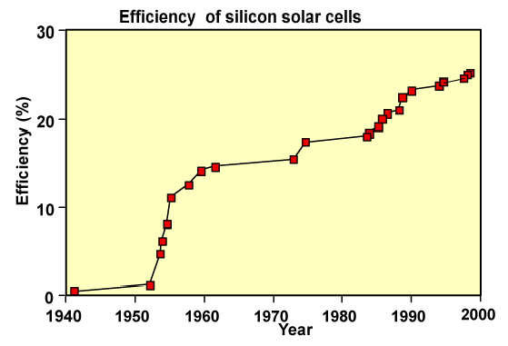
Solar Cell Design Principles
Principles
  Solar cell design involves specifying the parameters of a solar cell structure in order to maximise efficiency, given a certain set of constraints.
The theoretical efficiency for photovoltaic conversion is in excess of 86.8%. However, the 86.8% figure uses detailed balance calculations and does not describe device implementation.
For silicon solar cells, a more realistic efficiency under one sun operation is about 29% . The maximum efficiency measured for a silicon solar cell is currently 24.7% under AM1.5G.

Slide 14
Solar Cell Design Principles
Principles
The difference between the high theoretical efficiencies and the efficiencies
measured from terrestrial solar cells is due mainly to two factors.
The first is that the theoretical maximum efficiency predictions assume that energy from each photon is optimally used, that there are no unabsorbed photons and that each photon is absorbed in a material which has a band gap equal to the photon energy.
This is achieved in theory by modeling an infinite stack of solar cells of different band gap materials, each absorbing only the photons which correspond exactly to its band gap.
The second factor is that the high theoretical efficiency predictions assume a high concentration ratio.
Assuming that temperature and resistive effects do not dominate in a concentrator solar cell, increasing the light intensity proportionally increases the short-circuit
current.
Since the open-circuit voltage (V_{oc}) also depends on the short-circuit current, V_{oc} increases logarithmically with light level.

Slide 15
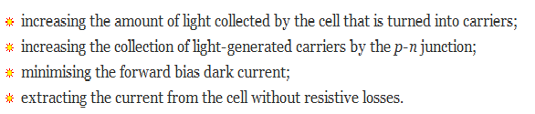
Solar Cell Design Principles
Principles
  Furthermore, since the maximum fill factor (FF) increases with V_{oc}, the maximum
possible FF also increases with concentration. The extra V_{oc} and FF increases with
concentration which allows concentrators to achieve higher efficiencies.
In designing such single junction solar cells, the principles for maximising cell efficiency are:

Slide 16
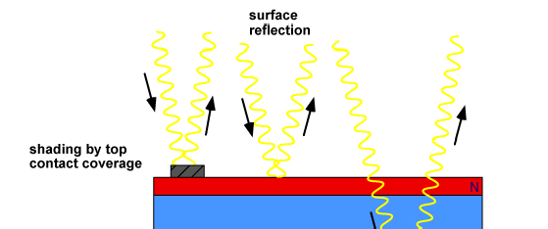

Solar Cell Design Principles
Optical Losses
Optical losses chiefly effect the power from a solar cell by lowering the short-
circuit current.
Optical losses consist of light which could have generated an electron-hole pair, but does not, because the light is reflected from the front surface, or because it is not absorbed in the solar cell.
For the most common semiconductor solar cells, the entire visible spectrum has enough energy to create electron-hole pairs and therefore all visible light would ideally be absorbed.

Slide 17
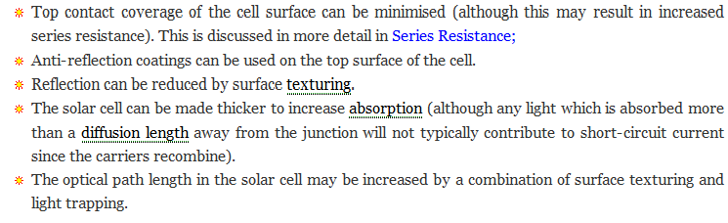
Solar Cell Design Principles
Optical Losses
  There are a number of ways to reduce the optical losses:

Slide 18
Solar Cell Design Principles
Anti-Reflection Coatings
Anti-reflection coatings on solar cells are similar to those used on other optical
equipment such as camera lenses.
They consist of a thin layer of dielectric material, with a specially chosen thickness so that interference effects in the coating cause the wave reflected from the anti-reflection coating top surface to be out of phase with the wave reflected from the semiconductor surfaces.
These out-of-phase reflected waves destructively interfere with one another, resulting in zero net reflected energy.
In addition to anti-reflection coatings, interference effects are also commonly encountered when a thin layer of oil on water produces rainbow-like bands of colour.

Slide 19
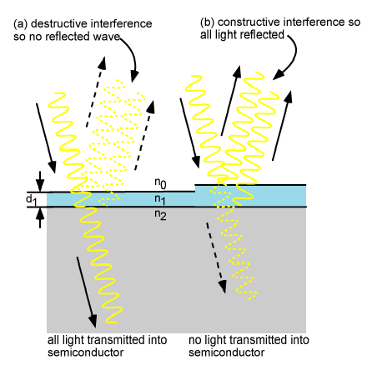
Solar Cell Design Principles
Anti-Reflection Coatings
The thickness of the anti-reflection coating is chosen so that the wavelength in the dielectric material is one quarter the wavelength of the incoming wave.

Slide 20


Solar Cell Design Principles
Anti-Reflection Coatings
  For a quarter wavelength anti-reflection coating of a transparent material with a refractive index n₁ and light incident on the coating with a free-space wavelength λ₀, the thickness d₁ which causes minimum reflection is calculated by:
Reflection is further minimised if the refractive index of the anti-reflection coating is the geometric mean of that of the materials on either side; that is, glass or air and the semiconductor. This is expressed by:
While the reflection for a given thickness, index of refraction, and wavelength can be reduced to zero using the equations above, the index of refraction is dependent on wavelength and so zero reflection occurs only at a single
wavelength.
For photovoltaic applications, the refractive index, and thickness are chosen in order to minimise reflection for a wavelength of 0.6 µm. This wavelength is chosen since it is close to the peak power of the solar spectrum.

Slide 21
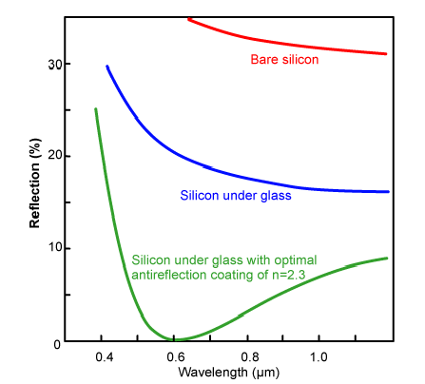
Solar Cell Design Principles
Anti-Reflection Coatings
By adding more than one anti-reflection layer, the reflectivity can be reduced over a wide range of wavelengths. However, this is usually too expensive for most commercial solar cells. The equations for multiple antireflection coatings are more complicated than that for a single layer.
By adjusting the refractive index and thickness of the two layers it is possible to produce two minima and a overall reflectance of less than 3%.

