Slide 1
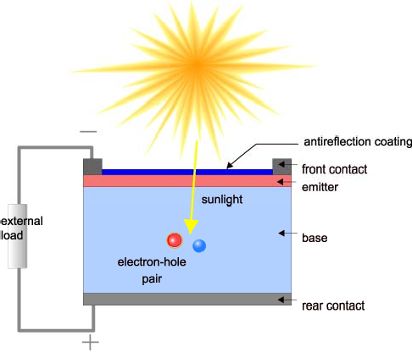
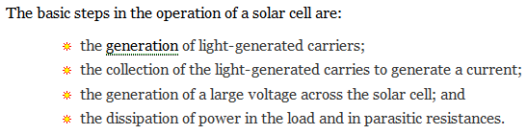
Solar cell operation
Solar cell structure
  A solar cell is an electronic device which directly converts sunlight into electricity.
  (1) This process requires firstly, a material in which the absorption of light raises an electron to a higher energy state, and (2) secondly, the movement of this higher energy electron from the solar cell into an external circuit. (3) The electron then dissipates its energy in the external circuit and returns to the solar cell.

Slide 2
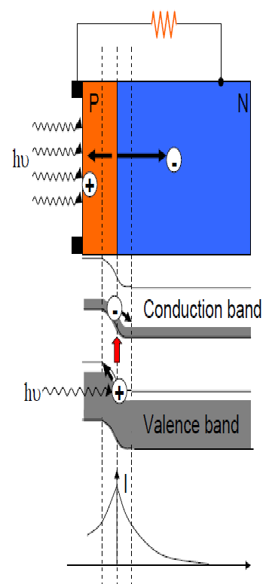
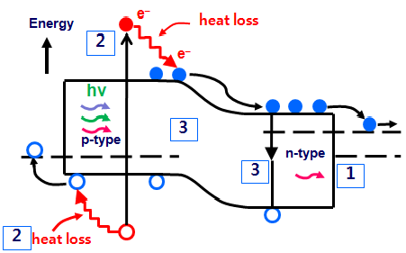
Solar cell operation

Slide 3
Solar cell operation
Light Generated Current
  The generation of current in a solar cell, known as the "light-generated current", involves two key processes.
  The first process is the absorption of incident photons to create electron-hole pairs.
  Electron-hole pairs will be generated in the solar cell provided that the incident photon has an energy greater than that of the band gap.
  However, electrons (in the p-type material), and holes (in the n-type material) are meta-stable and will only exist, on average, for a length of time equal to the minority carrier lifetime before they recombine. If the carrier recombines, then the light-generated electron-hole pair is lost and no current or power can be generated.

Slide 4
Solar cell operation
Light Generated Current
A second process, the collection of these carriers by the p-n junction, prevents this recombination by using a p-n junction to spatially separate the electron and the hole.
The carriers are separated by the action of the electric field existing at the p-n
junction.
If the light-generated minority carrier reaches the p-n junction, it is swept across
the junction by the electric field at the junction, where it is now a majority carrier.
If the emitter and base of the solar cell are connected together (i.e., if the solar cell is short-circuited), the light-generated carriers flow through the external circuit.

Slide 5
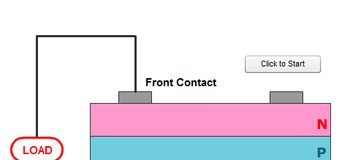
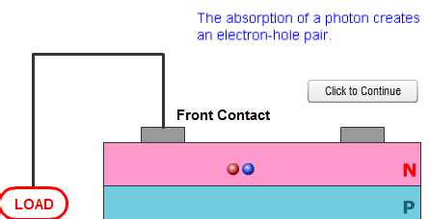
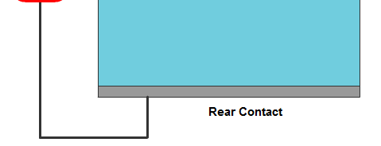
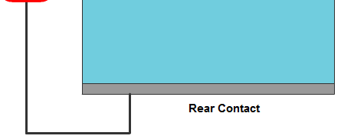
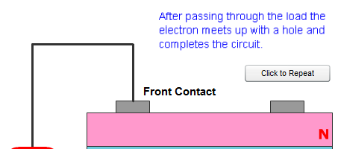
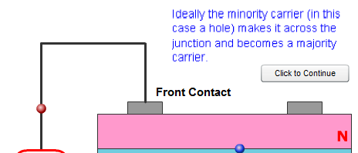
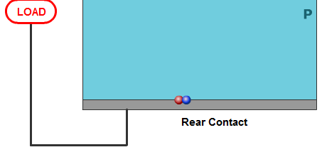
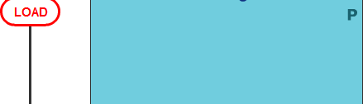

Solar cell operation
(1)
(2)
(4)
(3)

Slide 6
Solar cell operation
Collection probability
  The "collection probability" describes the probability that a light generated carrier absorbed in a certain region of the device will be collected by the p-n junction and therefore contribute to the light-generated current, but probability depends on the distance that a light-generated carrier must travel compared to the diffusion length.
  The collection probability of carriers generated in the depletion region is unity as the electron-hole pair are quickly swept apart by the electric field and are collected.
  Away from the junction, the collection probability drops. If the carrier is generated more than a diffusion length away from the junction, then the collection probability of this carrier is quite low.
  Similarly, if the carrier is generated closer to a region such as a surface with higher recombination than the junction, then the carrier will recombine. The impact of surface passivation and diffusion length on collection probability is illustrated.

Slide 7


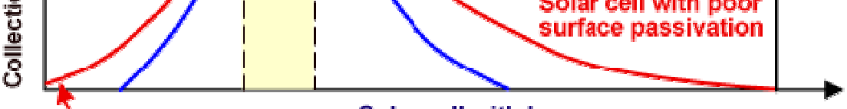

Solar cell operation

Slide 8
Solar cell operation
Collection probability
  The collection probability in conjunction with the generation rate in the solar cell determine the light-generated current from the solar cell.
  The light-generated current is the integration over the entire device thickness of the generation rate at a particular point in the device, multiplied by the collection probability at that point.
  The equation for the light-generated current density (J_{L}), with an arbitrary generation rate (G(x))and collection probability (CP(x)), is shown below, as is the generation rate in silicon due to the AM1.5 solar spectrum:
where:
q is the electronic charge;
W is the thickness of the device;
α(λ) is the absorption coefficient;
H₀ is the number of photons at each wavelength.

Slide 9
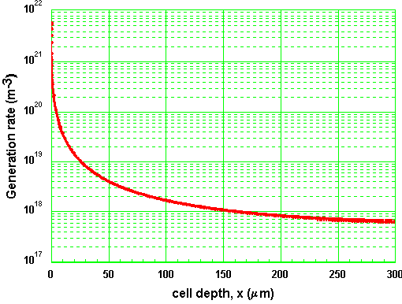



Solar cell operation
Collection probability
A non-uniform collection probability will cause a spectral dependence in the light-generated current.
For example, at the surfaces, the collection probability is lower than in the bulk. Comparing the generation rates for blue, green and infrared light below, blue light is nearly completely absorbed in the first few tenths of a micron in silicon. Therefore, if the collection probability at the front surface is low, any blue light in the solar spectrum does not contribute to the light-generated current.

Slide 10
Solar cell operation
Quantum efficiency
The "quantum efficiency" (Q.E.) is the ratio of the number of carriers collected by the solar cell to the number of photons of a given energy incident on the solar cell.
The quantum efficiency may be given either as a function of wavelength or as energy.
If all photons of a certain wavelength are absorbed and the resulting minority carriers are collected, then the quantum efficiency at that particular wavelength is
unity.
The quantum efficiency for photons with energy below the band gap is zero.

Slide 11
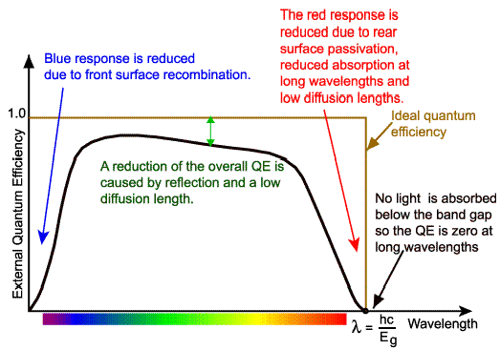
Solar cell operation

Slide 12
Solar cell operation
Quantum efficiency
While quantum efficiency ideally has the square shape shown above, the quantum efficiency for most solar cells is reduced due to recombination effects.
The same mechanisms which affect the collection probability also affect the quantum efficiency.
For example, front surface passivation affects carriers generated near the surface, and since blue light is absorbed very close to the surface, high front surface
recombination will affect the "blue" portion of the quantum efficiency.
Similarly, green light is absorbed in the bulk of a solar cell and a low diffusion length will affect the collection probability from the solar cell bulk and reduce the quantum efficiency in the green portion of the spectrum.
The quantum efficiency can be viewed as the collection probability due the generation profile of a single wavelength, integrated over the device thickness and normalized to the incident number of photons.

Slide 13
Solar cell operation
Quantum efficiency
  The "external" quantum efficiency of a silicon solar cell includes the effect of optical losses such as transmission and reflection.
  However, it is often useful to look at the quantum efficiency of the light left after the reflected and transmitted light has been lost.
  "Internal" quantum efficiency refers to the efficiency with which photons that are not reflected or transmitted out of the cell can generate collectable carriers.
  By measuring the reflection and transmission of a device, the external quantum efficiency curve can be corrected to obtain the internal quantum efficiency curve.

Slide 14
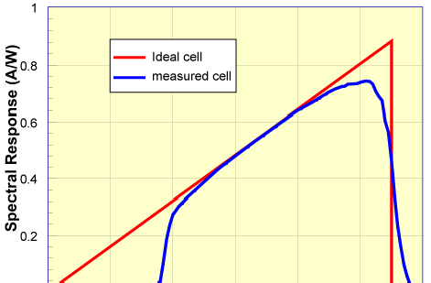

Solar cell operation
Spectral Response
  The spectral response is conceptually similar to the quantum efficiency.
  The quantum efficiency gives the number of electrons output by the solar cell compared to the number of photons incident on the device, while the spectral response is the ratio of the current generated by the solar cell to the power incident on the solar cell.

Slide 15
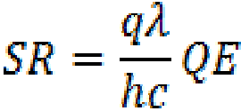
Solar cell operation
Spectral Response
  The ideal spectral response is limited at long wavelengths by the inability of the semiconductor to absorb photons with energies below the band gap.
  However, unlike the square shape of QE curves, the spectral response decreases at small photon wavelengths. At these wavelengths, each photon has a large energy, and hence the ratio of photons to power is reduced.
  Any energy above the band gap energy is not utilised by the solar cell and instead goes to heating the solar cell. (1)The inability to fully utilize the incident energy at high energies, and (2)the inability to absorb low energies of light represents a significant power loss in solar cells consisting of a single p-n junction.
  Spectral response is important since it is the spectral response that is measured from a solar cell, and the quantum efficiency is calculated from this spectral response.
  The quantum efficiency can be determined from the spectral response by replacing the power of the light at a particular wavelength with the photon flux for that wavelength. This gives:

Slide 16
Solar cell operation
The photovoltaic effect
The collection of light-generated carriers does not by itself give rise to power generation.
In order to generate power, a voltage must be generated as well as a current. Voltage is generated in a solar cell by a process known as the "photovoltaic effect".
The collection of light-generated carriers by the p-n junction causes a movement
of electrons to the n-type side and holes to the p-type side of the junction.
Under short circuit conditions, there is no build up of charge, as the carriers exit the device as light-generated current.
However, if the light-generated carriers are prevented from leaving the solar cell, then the collection of light-generated carriers causes an increase in the number of electrons on the n-type side of the p-n junction and a similar increase in holes in the p-type material.
This separation of charge creates an electric field at the junction which is in opposition to that already existing at the junction, thereby reducing the net electric field.

Slide 17
Solar cell operation
The photovoltaic effect
Since the electric field represents a barrier to the flow of the forward bias diffusion current, the reduction of the electric field increases the diffusion current.
The current from the solar cell is the difference between I_{L} and the forward bias
current.
Under open circuit conditions, the forward bias of the junction increases to a point where the light-generated current is exactly balanced by the forward bias diffusion current, and the net current is zero.
The voltage required to cause these two currents to balance is called the "open- circuit voltage".

Slide 18
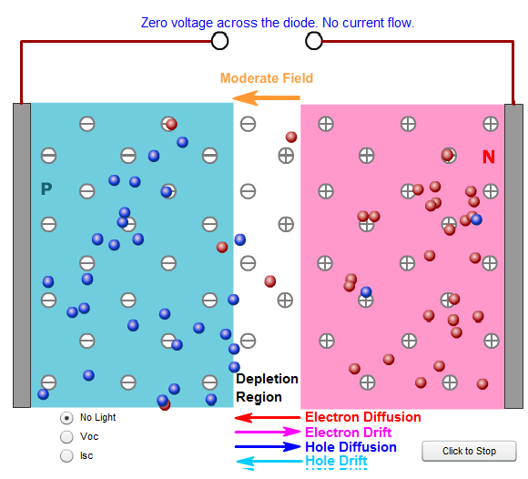
Solar cell operation
In equilibrium (i.e. in the dark) both the diffusion and drift current are small.

Slide 19
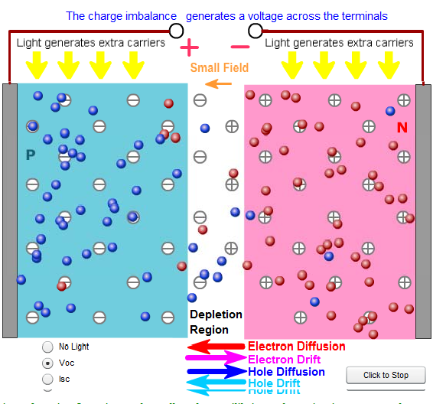
Solar cell operation
Under open circuit conditions, the light-generated carriers forward bias the junction, thus increasing the diffusion current. Since the drift and diffusion current are in opposite direction, there is no net current from the solar cell at open circuit.

Slide 20
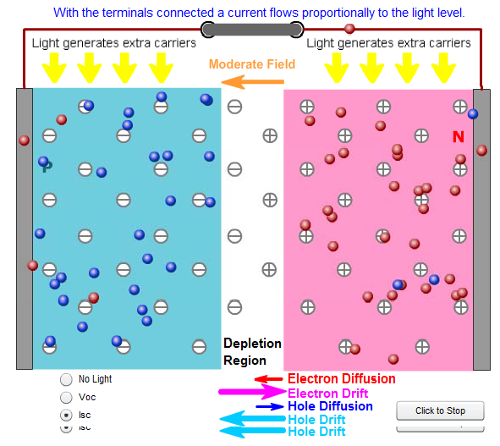
Solar cell operation
Under short circuit conditions, the minority carrier concentration on either side of the junction is increased and the drift current, which depends on the number of minority carriers, is increased.

Slide 21



Solar cell Parameters
IV Curve
  The IV curve of a solar cell is the superposition of the IV curve of the solar cell diode in the dark with the light-generated current.
  The light has the effect of shifting the IV curve down into the fourth quadrant where power can be extracted from the diode.
  Illuminating a cell adds to the normal "dark" currents in the diode so that the diode law becomes:
where I_{L} = light generated current.
The equation for the IV curve in the first quadrant is:
The exponential term is usually >> 1 except for voltages below 100 mV. Further, at low voltages the light generated current I_{L} dominates the I₀ (...) term so the -1 term is not needed under illumination.

Slide 22
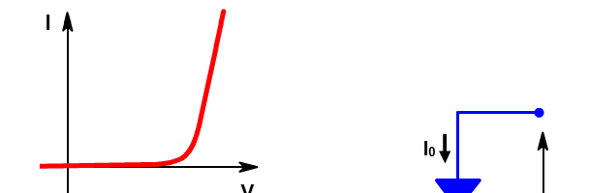
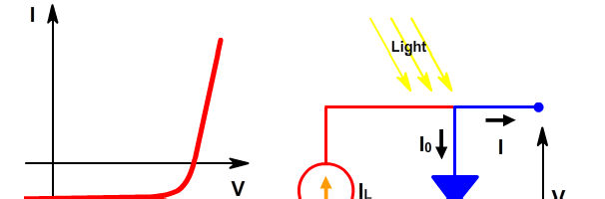
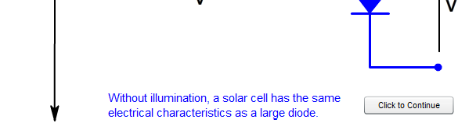
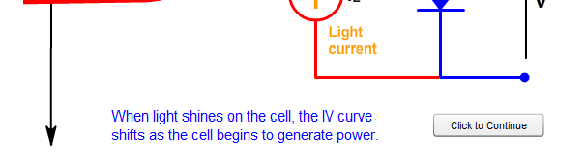
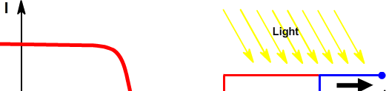
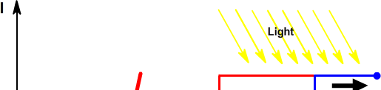
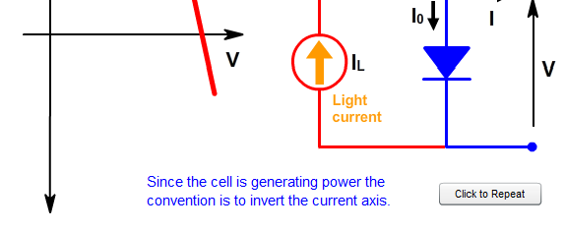
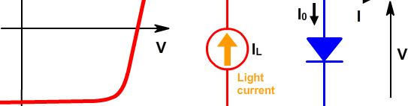

Solar cell parameters
(1)
(2)
(4)
(3)

Slide 23
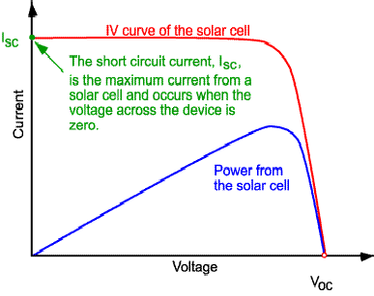
Solar cell Parameters
Short-Circuit Current
  The short-circuit current is the current through the solar cell when the voltage across the solar cell is zero (i.e., when the solar cell is short circuited). Usually written as I_{SC}, the short-circuit current is shown on the IV curve below.
The short-circuit current is due to the generation and collection of light-generated carriers. For an ideal solar cell at most moderate resistive loss mechanisms, the short-circuit current and the light-generated current are identical. Therefore, the short-circuit current is the largest current which may be drawn from the solar cell.

Slide 24
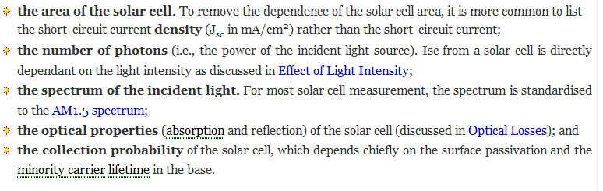
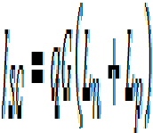
Solar cell Parameters
Short-Circuit Current
  The short-circuit current depends on a number of factors which are described below:
When comparing solar cells of the same material type, the most critical material parameter is the diffusion length and surface passivation. In a cell with perfectly passivated surface and uniform generation, the equation for the short-circuit current can be approximated as:
where G is the generation rate, and L_{n} and L_{p} are the electron and hole diffusion lengths respectively.

Slide 25
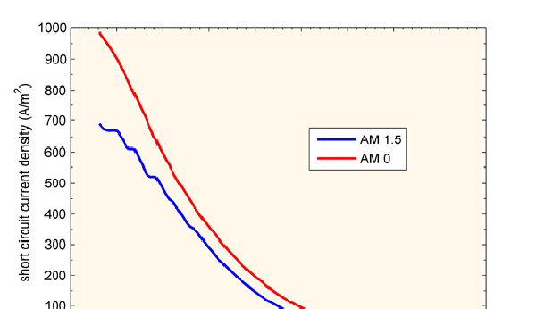

Solar cell Parameters
Short-Circuit Current
  Silicon solar cells under an AM1.5 spectrum have a maximum possible current of 46 mA/cm². Laboratory devices have measured short-circuit currents of over 42 mA/cm², and commercial solar cell have short-circuit currents between about 28 mA/cm² and 35 mA/cm².

Slide 26
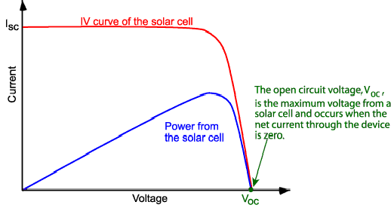

Solar cell Parameters
Open-Circuit Voltage
  The open-circuit voltage, V_{OC}, is the maximum voltage available from a solar cell, and this occurs at zero current. The open-circuit voltage corresponds to the amount of forward bias on the solar cell due to the bias of the solar cell junction with the light-generated current. The open-circuit voltage is shown on the IV curve below.
An equation for V_{oc} is found by setting the net current equal to zero in the solar cell equation to give:

Slide 27

Solar cell Parameters
Open-Circuit Voltage
The above equation shows that V_{oc} depends on the saturation current of the solar cell and the light-generated current.
While I_{sc} typically has a small variation, the key effect is the saturation current,
since this may vary by orders of magnitude.
The saturation current, I₀ depends on recombination in the solar cell.
Open-circuit voltage is then a measure of the amount of recombination in the
device.
Silicon solar cells on high quality single crystalline material have open-circuit voltages of up to 730 mV under one sun and AM1.5 conditions, while commercial devices on multicrystalline silicon typically have open-circuit voltages around 600 mV.
The V_{OC} can also be determined from the carrier concentration
where kT/q is the thermal voltage, N_{A} is the doping concentration, Δn is the excess carrier concentration and n_{i} is the intrinsic carrier concentration.

Slide 28


Solar cell Parameters
Voc as a function of bandgap, Eg
  Where the short-circuit current (I_{SC}) decreases with increasing bandgap, the open- circuit voltage increases as the band gap increases. In an ideal device the V_{OC} is limited by radiative recombination and the analysis uses the principle of detailed balance to determine the minimum possible value for J₀.
  The minimum value of the diode saturation current is given by
where:

Slide 29
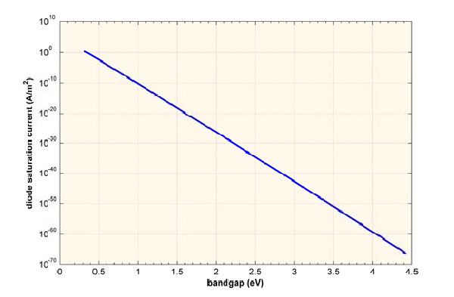
Solar cell Parameters
Voc as a function of bandgap, Eg

Slide 30
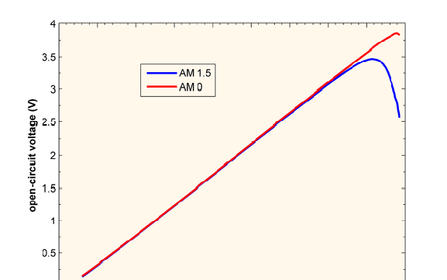
Solar cell Parameters
Voc as a function of bandgap, Eg
  The J₀ calculated above can be directly plugged into the standard solar cell equation given at the top of the page to determine the V_{OC} so long as the voltage is less than the band gap, as is the case under one sun illumination.

Slide 31
Solar cell Parameters
Fill Factor
  The short-circuit current and the open-circuit voltage are the maximum current and voltage respectively from a solar cell. However, at both of these operating points, the power from the solar cell is zero.
  The "fill factor", more commonly known by its abbreviation "FF", is a parameter which, in conjunction with V_{oc} and I_{sc}, determines the maximum power from a solar cell.
  The FF is defined as the ratio of the maximum power from the solar cell to the product of V_{oc} and I_{sc}.
  Graphically, the FF is a measure of the "squareness" of the solar cell and is also the area of the largest rectangle which will fit in the IV curve.

Slide 32
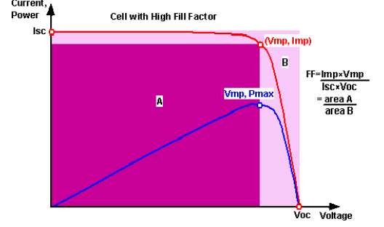
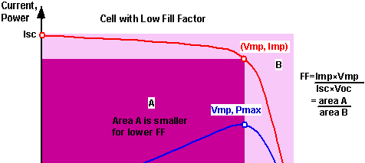

Solar cell Parameters
Fill Factor

Slide 33




Solar cell Parameters
Fill Factor
  As FF is a measure of the "squareness" of the IV curve, a solar cell with a higher voltage has a larger possible FF since the "rounded" portion of the IV curve takes up less area.
  The maximum theoretical FF from a solar cell can be determined by differentiating the power from a solar cell with respect to voltage and finding where this is equal to zero. Hence:
However, the above technique does not yield a simple or closed form equation. The equation above only relates V_{oc} to V_{mp}, and extra equations are needed to find I_{mp} and FF. A more commonly used expression for the FF can be determined empirically as:
where v_{oc} is defined as a "normalized V_{oc}":

Slide 34
Solar cell Parameters
Fill Factor
  The above equations show that a higher voltage will have a higher possible FF. However, large variations in open-circuit voltage within a given material system are relatively uncommon.
  For example, at one sun, the difference between the maximum open-circuit voltage measured for a silicon laboratory device and a typical commercial solar cell is about 120 mV, giving maximum FF's respectively of 0.85 and 0.83.
  However, the variation in maximum FF can be significant for solar cells made from different materials. For example, a GaAs solar cell may have a FF approaching 0.89.
  The above equation also demonstrates the importance of the ideality factor, also known as the "n-factor" of a solar cell. The ideality factor is a measure of the junction quality and the type of recombination in a solar cell.
  For the simple recombination mechanisms discussed in Types of Recombination, the n-factor has a value of 1.
  However, some recombination mechanisms, particularly if they are large, may introduce recombination mechanisms of 2.

Slide 35


Solar cell Parameters
Efficiency
  The efficiency is the most commonly used parameter to compare the performance of one solar cell to another.
  Efficiency is defined as the ratio of energy output from the solar cell to input energy from the sun. In addition to reflecting the performance of the solar cell itself, the efficiency depends on the spectrum and intensity of the incident sunlight and the temperature of the solar cell.
  Therefore, conditions under which efficiency is measured must be carefully controlled in order to compare the performance of one device to another.
  Terrestrial solar cells are measured under AM1.5 conditions and at a temperature of 25°C.
  Solar cells intended for space use are measured under AM0 conditions. The efficiency of a solar cell is determined as the fraction of incident power which is converted to electricity and is defined as:
In a 10 x 10 cm² cell the input power is 100 mW/cm² x 100 cm² = 10 W.

