Slide 1
PN Junction
Doping
It is possible to shift the balance of electrons and holes in a silicon crystal lattice by "doping" it with other atoms.
Atoms with one more valence electron than silicon are used to produce "n-type" semiconductor material.
These n-type materials are group V elements in the periodic table, and thus their atoms have 5 valence electrons that can form covalent bonds with the 4 valence
electrons that silicon atoms have.
Therefore, more electrons are added to the conduction band and hence increases the number of electrons present.
Atoms with one less valence electron result in "p-type" material. These p-type materials are group III elements in the periodic table.
Therefore, p-type material has only 3 valence electrons with which to interact
with silicon atoms. The net result is a hole, as not enough electrons are present to form the 4 covalent bonds surrounding the atoms.
In p-type material, the number of electrons trapped in bonds is higher, thus effectively increasing the number of holes.

Slide 2
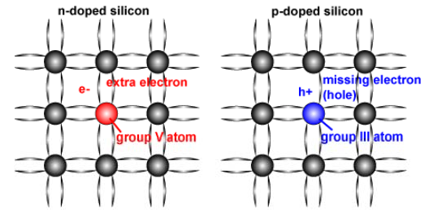
PN Junction
Doping
  In doped material, there is always more of one type of carrier than the other and the type of carrier with the higher concentration is called a "majority carrier", while the lower concentration carrier is called a "minority carrier."

Slide 3
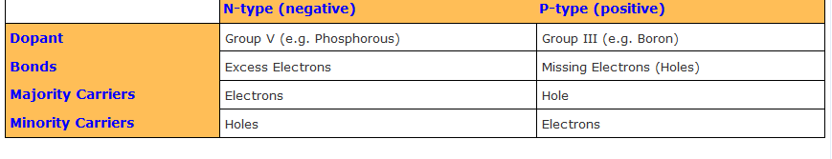
PN Junction
Doping
  In a typical semiconductor there might be 10¹⁷cm⁻³ majority carriers and 10⁶cm⁻³ minority carriers.
  Expressed in a different form, the ratio of minority to majority carriers is less than one person to the entire population of the planet.
  Minority carriers are created either thermally or by incident photons.

Slide 4

PN Junction
Equilibrium Carrier Concentration
  The number of carriers in the conduction and valence band with no externally applied bias is called the equilibrium carrier concentration.
  For majority carriers, the equilibrium carrier concentration is equal to the intrinsic carrier concentration plus the number of free carriers added by doping the semiconductor.
  Under most conditions, the doping of the semiconductor is several orders of magnitude greater than the intrinsic carrier concentration, such that the number of majority carriers is approximately equal to the doping.
  At equilibrium, the product of the majority and minority carrier concentration is a constant, and this is mathematically expressed by the Law of Mass Action.
where n_{i} is the intrinsic carrier concentration and n₀ and p₀ are the electron and hole equilibrium carrier concentrations.

Slide 5
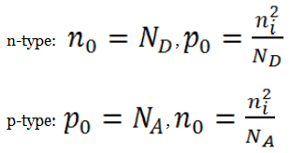
PN Junction
Equilibrium Carrier Concentration
  Using the Law of Mass Action above, the majority and minority carrier concentrations are given as:
where N_{D} is the concentration of donor atoms and N_{A} is the concentration of acceptor atoms.
The above equations show that the number of minority carriers decreases as the doping level increases. For example, in n-type material, some of the extra electrons added by doping the material will occupy the empty spots (i.e., holes) in the valance band, thus lowering the number of holes.

Slide 6
PN Junction
Absorption of Light
  When the energy of a photon is equal to or greater than the band gap of the material, the photon is absorbed by the material and excites an electron into the conduction band.
  Both a minority and majority carrier are generated when a photon is absorbed.
  The generation of charge carriers by photons is the basis of the photovoltaic production of energy.
  Photons falling onto a semiconductor material can be divided into three groups based on their energy compared to that of the semiconductor band gap:
    E_{ph} < E_{G} Photons with energy E_{ph} less than the band gap energy E_{G} interact only weakly with the semiconductor, passing through it as if it were transparent.
    E_{ph} = E_{G} have just enough energy to create an electron hole pair and are efficiently absorbed.
    E_{ph} > E_{G} Photons with energy much greater than the band gap are strongly absorbed. However, for photovoltaic applications, the photon energy greater than the band gap is wasted as electrons quickly thermalize back down to the conduction band edges.

Slide 7
PN Junction
Absorption of Light
  The absorption of photons creates both a majority and a minority carrier.
  In many photovoltaic applications, the number of light-generated carriers are of orders of magnitude less than the number of majority carriers already present in the solar cell due to doping.
  Consequently, the number of majority carriers in an illuminated semiconductor does not alter significantly.
  However, the opposite is true for the number of minority carriers.
  The number of photo-generated minority carriers outweighs the number of minority carriers existing in the doped solar cell in the dark (because in doping the minority carrier concentration is so small), and therefore the number of minority carriers in an illuminated solar cell can be approximated by the number of light generated carriers.

Slide 8
PN Junction
Absorption Coefficient
  The absorption coefficient determines how far into a material light of a particular wavelength can penetrate before it is absorbed.
  In a material with a low absorption coefficient, light is only poorly absorbed, and if the material is thin enough, it will appear transparent to that wavelength.
  The absorption coefficient depends on the material and also on the wavelength of light which is being absorbed.
  Semiconductor materials have a sharp edge in their absorption coefficient, since light which has energy below the band gap does not have sufficient energy to excite an electron into the conduction band from the valence bad.
  Consequently this light is not absorbed. The absorption coefficient for several semiconductor materials is shown below.

Slide 9
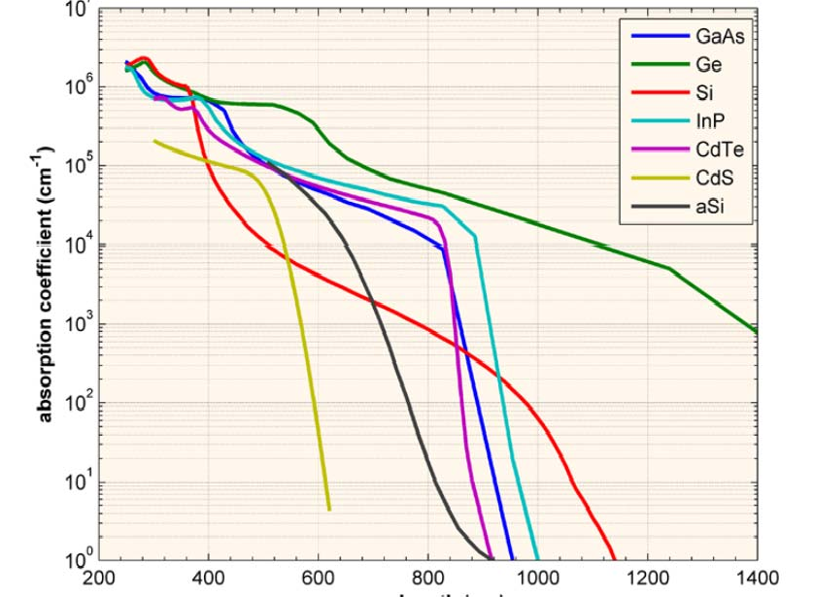
PN Junction
Absorption Coefficient

Slide 10

PN Junction
Absorption Coefficient
  The above graph shows that even for those photons which have an energy above the band gap, the absorption coefficient is not constant, but still depends strongly on wavelength.
  The probability of absorbing a photon depends on the likelihood of having a photon and an electron interact in such a way as to move from one energy band to another.
  For photons which have an energy very close to that of the band gap, the absorption is relatively low since only those electrons directly at the valence band edge can interact with the photon to cause absorption.
  As the photon energy increases, not just the electrons already having energy close to that of the band gap can interact with the photon. Therefore, a larger number of electrons can interact with the photon and result in the photon being absorbed.
where λ is the wavelength. If λ is in nm, multiply by 10⁷ to get the absorption coefficient in the units of cm⁻¹.

Slide 11
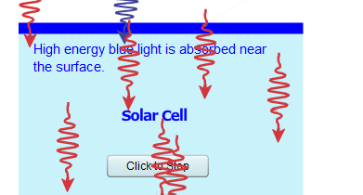

PN Junction
Absorption Depth
  The absorption depth is given by the inverse of the absorption coefficient, and describes how deeply light penetrates into a semiconductor before being absorbed.
  The absorption depth is given by the inverse of the absorption coefficient, or α⁻¹.
  Higher energy light is of a shorter wavelength and has a shorter absorption depth than lower energy light, which is not as readily absorbed, and has a greater absorption depth.
  Absorption depth affects aspects of solar cell design, such as the thickness of the semiconductor material.

Slide 12
PN Junction
Generation Rate
  The generation rate gives the number of electrons generated at each point in the device due to the absorption of photons. Generation is an important parameter in solar cell operation.
  Neglecting reflection, the amount of light which is absorbed by a material depends on the absorption coefficient (α in cm⁻¹) and the thickness of the absorbing material.
  The intensity of light at any point in the device can be calculated according to the equation:
  where α is the absorption coefficient typically in cm⁻¹; x is the distance into the material at which the light intensity is being calculated; and I₀ is the light intensity at the top surface.
  The above equation can be used to calculate the number of electron-hole pairs being generated in a solar cell.

Slide 13

PN Junction
Generation Rate
  Assuming that the loss in light intensity (i.e., the absorption of photons) directly causes the generation of an electron-hole pair, then the generation G in a thin slice of material is determined by finding the change in light intensity across this slice.
  Consequently, differentiating the above equation will give the generation at any point in the device. Hence:
where N₀ = photon flux at the surface (photons/unit-area/sec.);
α = absorption coefficient; and
x = distance into the material.
The above equations show that the light intensity exponentially decreases throughout the material and further that the generation is highest at the surface of the material.
For photovoltaic applications, the incident light consists of a combination of many different wavelengths, and therefore the generation rate at each wavelength is different.

Slide 14
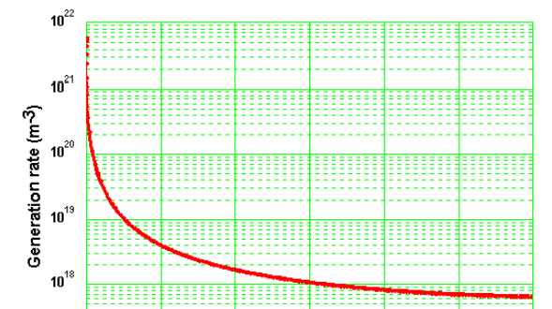

PN Junction
Generation Rate
  To calculate the generation for a collection of different wavelengths, the net generation is the sum of the generation for each wavelength.
  The generation as a function of distance for a standard solar spectrum (AM 1.5) incident on a piece of silicon is shown below.
  The y-axis scale is logarithmic showing that there is an enormously greater generation of electron-hole pairs near the front surface of the cell, while further into the solar cell the generation rate becomes nearly constant.

Slide 15
PN Junction
Recombination
Any electron which exists in the conduction band is in a meta-stable state and will
eventually stabilize to a lower energy position in the valence band.
When this occurs, it must move into an empty valence band state. Therefore, when the electron stabilizes back down into the valence band, it also effectively
removes a hole.
This process is called recombination. There are three basic types of recombination in the bulk of a single-crystal semiconductor. These are:
Radiative recombination;
Auger recombination; and
Shockley-Read-Hall recombination.

Slide 16
PN Junction
Radiative (Band-to-Band) Recombination
  Radiative recombination is the recombination mechanism that dominates in direct
bandgap semiconductors.
  The light produced from a light emitting diode (LED) is the most obvious example of radiative recombination in a semiconductor device.
  Concentrator and space solar cells cells are typically made from direct bandgap materials (GaAs etc) and radiative recombination dominates.
  However, most terrestrial solar cells are made from silicon, which is an indirect bandgap semiconductor and radiative recombination is extremely low and usually neglected.
  The key characteristics of radiative recombination are:
    In radiative recombination, an electron directly combines with a hole in the conduction band and releases a photon; and
    The emitted photon has an energy similar to the band gap and is therefore only weakly absorbed such that it can exit the piece of semiconductor.

Slide 17
PN Junction
Recombination thorough Defect Levels
  Recombination through defects, also called Shockley-Read-Hall or SRH recombination, does not occur in perfectly pure, undefected material. SRH recombination is a two-step process.
  The two steps involved in SRH recombination are:
An electron (or hole) is trapped by an energy state in the forbidden region which is introduced through defects in the crystal lattice. These defects can either be unintentionally introduced or deliberately added to the material, for example in
doping the material; and
If a hole (or an electron) moves up to the same energy state before the electron is thermally re-emitted into the conduction band, then it recombines.
The rate at which a carrier moves into the energy level in the forbidden gap depends on the distance of the introduced energy level from either of the band edges.
Therefore, if an energy is introduced close to either band edge, recombination is less likely as the electron is likely to be re-emitted to the conduction band edge rather than recombine with a hole which moves into the same energy state from the valence band.
For this reason, energy levels near mid-gap are very effective for recombination.

Slide 18
PN Junction
Auger Recombination
  Auger Recombination involves three carriers.
  An electron and a hole recombine, but rather than emitting the energy as heat or as a photon, the energy is given to a third carrier, an electron in the conduction band.
This electron then thermalizes back down to the conduction band edge.
Auger recombination is most important at high carrier concentrations caused by
heavy doping or high level injection under concentrated sunlight.
In silicon-based solar cells (the most popular), Auger recombination limits the lifetime and ultimate efficiency.
The more heavily doped the material is, the shorter the Auger recombination lifetime.

Slide 19
PN Junction
Life Time
  If the number of minority carriers is increased above that at equilibrium by some transient external excitation (such as incident sun), the excess minority carrier s will decay back to that equilibrium carrier concentration due to and through the process of recombination.
  A critical parameter in a solar cell is the rate at which recombination occurs.
  Such a process, known as the "recombination rate" depends on the number of excess minority carriers.
  If for example, there are no excess minority carriers, then the recombination rate must be zero.
  Two parameters that are integral to recombination rate are the minority carrier lifetime and the minority carrier diffusion length.
  The minority carrier lifetime of a material, denoted by τ_{n} or τ_{p}, is the average time which a carrier can spend in an excited state after electron-hole generation before it recombines.
  It is often just referred to as the "lifetime" and has nothing to do with the stability of the material.

Slide 20



PN Junction
Life Time
  Stating that "a silicon wafer has a long lifetime" usually means minority carriers generated in the bulk of the wafer by light or other means will persist for a long time before recombining.
  Depending on the structure, solar cells made from wafers with long minority carrier lifetimes will usually be more efficient than cells made from wafers with short minority carrier lifetimes.
  The low level injected material (where the number of minority carriers is less than the doping) the lifetime is related to the recombination rate by:
  where τ is the minority carrier lifetime, Δn is the excess minority carriers concentration and R is the recombination rate.
Auger lifetime is a function of the carrier concentration and is given by:
Where the auger coefficient, C, for silicon is typically given as: 1.66 × 10⁻³⁰cm⁶/s

Slide 21
PN Junction
Diffusion Length
  The second related parameter to recombination rate, the "minority carrier diffusion length," is the average distance a carrier can move from point of generation until it recombines.
The minority carrier lifetime and the diffusion length depend strongly on the type
and magnitude of recombination processes in the semiconductor.
For many types of silicon solar cells, SRH recombination is the dominant recombination mechanism.
The recombination rate will depend on the number of defects present in the material, so that as doping the semiconductor increases the defects in the solar cell, doping will also increase the rate of SRH recombination.
In addition, since Auger recombination is more likely in heavily doped and excited material, the recombination process is itself enhanced as the doping increases.
The method used to fabricate the semiconductor wafer and the processing also have a major impact on the diffusion length.

Slide 22


PN Junction
Diffusion Length
  In silicon, the lifetime can be as high as 1 msec. For a single crystalline silicon solar cell, the diffusion length is typically 100-300 µm.
  These two parameters give an indication of material quality and suitability for solar cell use.
  The diffusion length is related to the carrier lifetime by the diffusivity according to the following formula:
where L is the diffusion length in metres, D is the diffusivity in m²/s and τ is the lifetime in seconds.

Slide 23
PN Junction
Surface Recombination
  Any defects or impurities within or at the surface of the semiconductor promote recombination.
  Since the surface of the solar cell represents a severe disruption of the crystal lattice, the surfaces of the solar cell are a site of particularly high recombination.
The high recombination rate in the vicinity of a surface depletes this region of minority carriers.
A localized region of low carrier concentration causes carriers to flow into this region from the surrounding, higher concentration regions.
Therefore, the surface recombination rate is limited by the rate at which minority
carriers move towards the surface.
A parameter called the "surface recombination velocity", in units of cm/sec, is used to specify the recombination at a surface.
In a surface with no recombination, the movement of carriers towards the surface is zero, and hence the surface recombination velocity is zero.
In a surface with infinitely fast recombination, the movement of carriers towards
this surface is limited by the maximum velocity they can attain, and for most semiconductors is on the order of 1 x 10⁷ cm/sec.

Slide 24
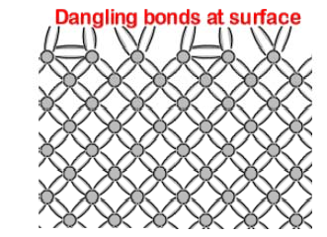
PN Junction
Surface Recombination
The defects at a semiconductor surface are caused by the interruption to the periodicity of the crystal lattice, which causes dangling bonds at the
semiconductor surface.
The reduction of the number of dangling bonds, and hence surface recombination, is achieved by growing a layer on top of the semiconductor surface which ties up some of these dangling bonds.
This reduction of dangling bonds is known as surface passivation.

Slide 25
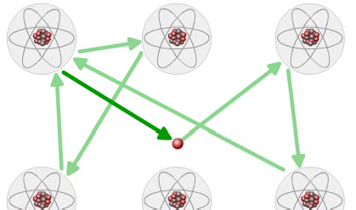

PN Junction
Movement of Carriers in Semiconductors
  Electrons in the conduction band and holes in the valence band are considered
"free" carriers in the sense that they can move throughout the semiconductor lattice that makes up the crystal structure of the material.
The carrier moves in this random direction for a distance called the scattering
length before colliding with a lattice atom.
Once the collision takes place, the carrier moves away in a different random direction.

Slide 26
PN Junction
Movement of Carriers in Semiconductors
  The velocity of the carriers is determined by the temperature of the lattice. Carriers in a semiconductor crystal at a temperature T move on average.
  The thermal velocity is the average carrier velocity.
  Carriers have a thermal velocity that is normally distributed around this average thermal velocity. Therefore, some carriers having a greater velocity and some lower.
  There is no net movement of carriers in any direction. Each direction of carrier movement is equally likely, therefore the motion of a carrier in one direction will eventually be balanced by the movement of the carrier in the opposite direction.
  Although carriers in a semiconductor are in constant random motion, there is no net motion of carriers unless there is a concentration gradient or an electric field.

