Slide 1


Doctoral Thesis
2018. 05. 11
Investigation of one dimensional Ti-O based materials and their derivatives for energy storage application
Advisor: Professor Do Kyung Kim
Anteneh Marelign
Department of Materials Science and Engineering,
Korea Advanced Institute of Science and Technology

Slide 2
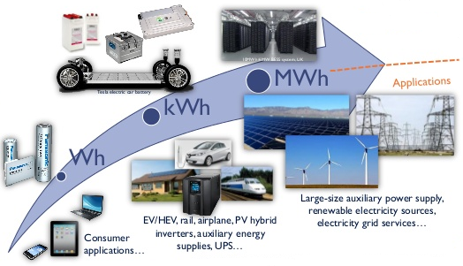
Energy storage demand
Environmental concerns are demanding to replace fossil fuel base energy by renewable sources
  Smart grid development is underway
Replacing ICE vehicles by EV is also one of the major strategies to reduce emission
Energy storage is a very important integral part of smart grids and EVs
  Energy storage demand escalate from watt-hours to mega-watt-hours
<With https://www.slideshare.net/Yole_Developpement/yole-stationary-batteryenergystoragesolutionsmay2015sample/9>
01/43

Slide 3
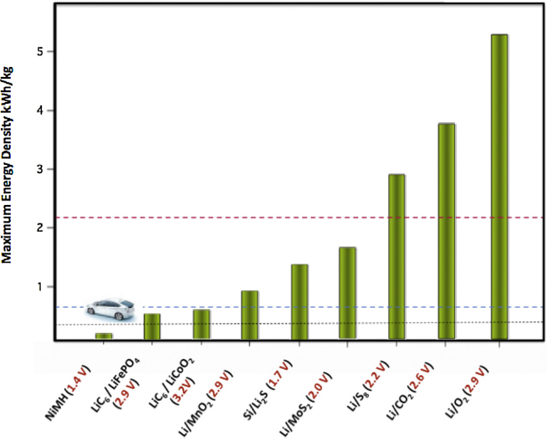
Energy storage capability
The current intercalation based Li-ion battery
  Low energy density →Technically and economically not feasible for EV and smart grid applications
Conversion based Li-batteries
  Li-sulfur battery
    Practical energy density 500 – 600 W h/kg
    Used very cheap material
    Promising candidate for EV and smart grid applications
  Li-air
    Can offer the highest energy density among storage devices
    Has a lot of unresolved technical issues
    May take long for development
US Advanced battery Consortium (USABC)
Potential near term solution for emerging ES demands
Energy density of gasoline (for 18% efficient ICE)
Energy density target of USABC by 2020
<Nano Today (2015) 10, 315—338>
02/43

Slide 4
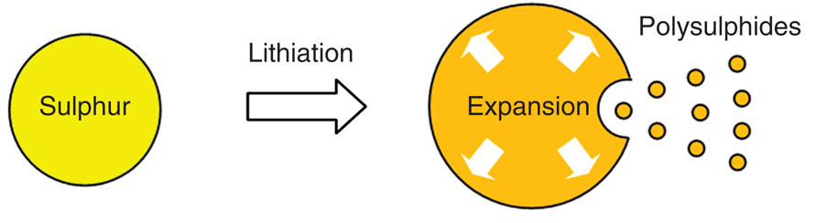
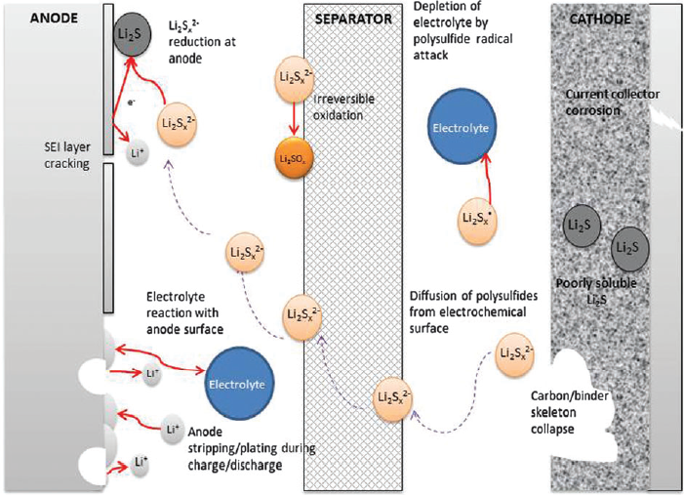
Li-Sulphur battery:- Challenges
Several challenges are facing Li-S system
  1) Highly insulative nature of sulfur (~5ｘ10⁻³⁰ S cm⁻¹⁾) and Li₂S (1ｘ10⁻¹⁴ S cm⁻¹)
    Demands conductive host compromising energy density
    Low active material utilization
    Passivation of anode by insulative Li₂S
  2) High solubility and diffusivity of polysulfides
    Polysulfide shuttling
      Active material loss
      Self discharge
      Anode corrosion
  3) Excessive volume expansion upon lithiation (~80%)
    Pulverization of cathode
<Nat. Commun., vol. 4, 2013>
Better accessibility of electron flow
Polysulfide immobilization within the cathode
Accommodation of volume expansion w/o
damage
<Energy Environ. Sci., vol. 8, no. 12, pp. 3477–3494, 2015>
03/43

Slide 5
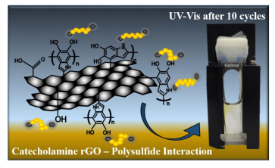
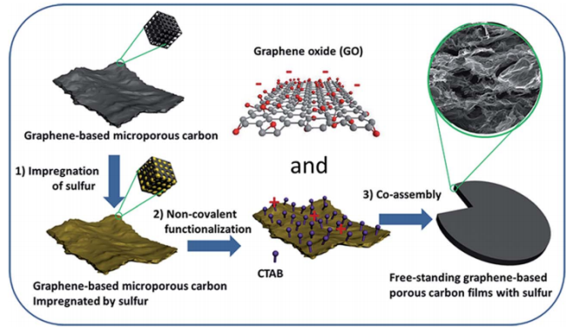
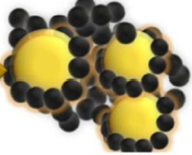
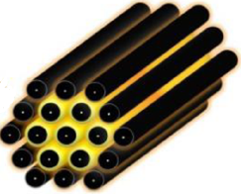
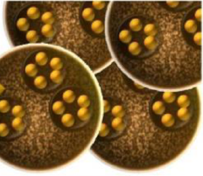
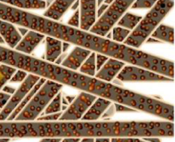
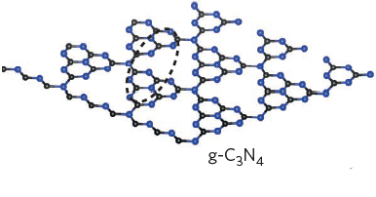
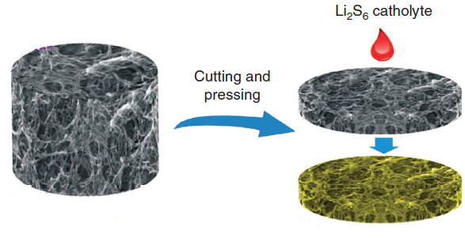
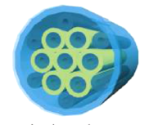
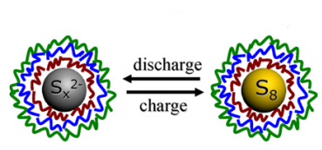
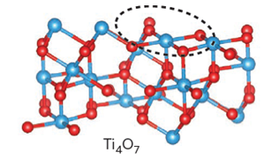
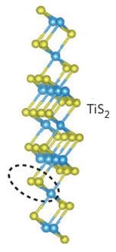
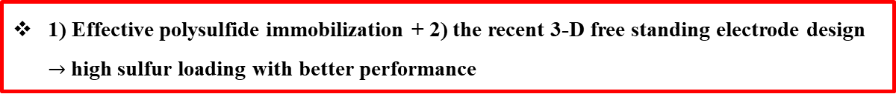
Li-Sulphur battery:- Progresses in cathode design
Physical entrapment
Chemical entrapment
High loading
Entrapment of sulfur by conductive carbon nanostructures
Inducing chemical interaction with polysulfide's using polar materials and functional groups
Sulfur or polysulfide impregnation in 3-D free standing electrodes
Functionalizing graphene
<Electrochimica Acta 246 (2017) 451–458>
Sulfur impregnated free standing electrode
<J. Mater. Chem. A, 2015, 3, 9438–9445>
Sulfur confined in different carbon nano structures
N-doping
<Chem. Rev. 2014, 114, 11751−1178>
Sulfur confined in conductive polymers
Inorganic polar additives & hosts
Polysulfide impregnated free standing electrode
<Colloids and Surfaces A: Physicochem. Eng. Aspects 414 (2012) 98–103>
<NATURE COMMUNICATIONS | 6:7760 | DOI: 10.1038/ncomms8760>
<NATURE ENERGY | VOL 1 | SEPTEMBER 2016>
1) Effective polysulfide immobilization + 2) the recent 3-D free standing electrode design
$→$high sulfur loading with better performance
04/43

Slide 6
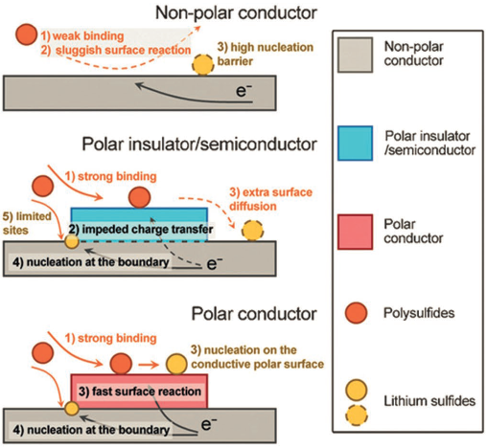
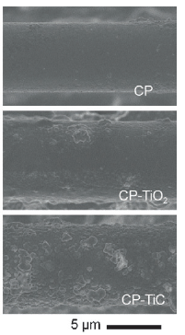
Li-Sulphur battery:- Inorganic polar compounds as additive
Enhanced electrochemical kinetics using polar conductive additive
  Sufficient surface binding
  Efficient charge transport
Nonpolar:-
  poor polysulfide binding & high Li₂S nucleation barrier
Polar, insulator/semiconductor:-
  good polysulfide binding but direct conversion of polysulfide at the surface is impeded.
Polar, conductor:-
  sufficient binding and efficient charge transport
No Li₂S at the surface
Li₂S deposition
radial non uniform
Li₂S deposition
radial uniform
<Angew. Chem. Int. Ed. 2016, 55, 12990 –12995>
05/43

Slide 7
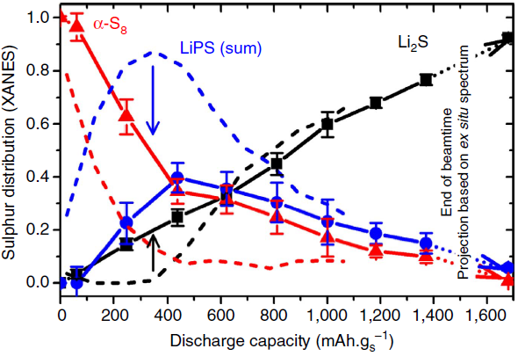
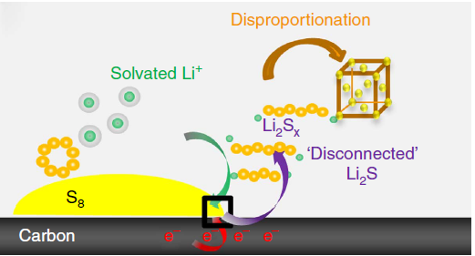
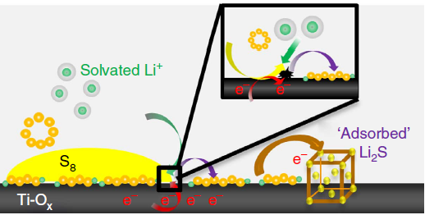
Li-Sulphur battery:- Inorganic polar compounds as host
Improved kinetics of LiPS reduction to Li₂S in case of polar conductive host (Ti₄O₇) using operando XANES analysis
LiPS intermediates are much less in case of Ti₄O₇ host compared to carbon, in all stage of discharge
Li₂S precipitate much earlier and more progressively for the case of Ti₄O₇ host than carbon (i.e the LiPSs adsorbed on Ti₄O₇ more readily reduced to Li₂S than those on carbon)
<NATURE COMMUNICATIONS | 5:4759 | DOI: 10.1038/ncomms5759>
Effective polysulfide immobilization & access to electrons are the key for better performance
06/43

Slide 8
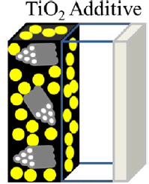
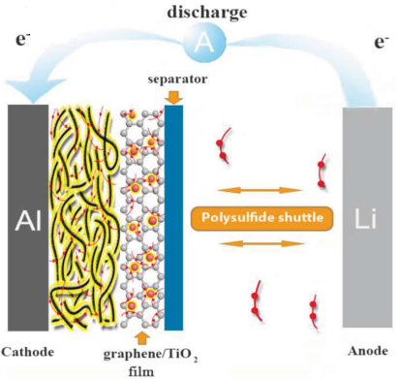
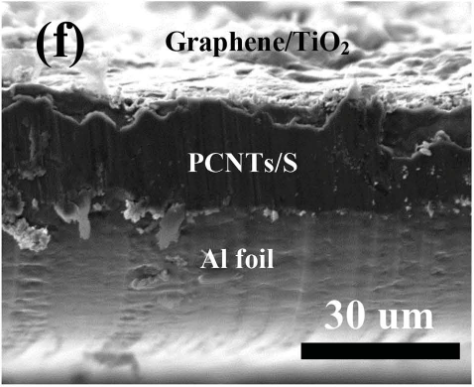
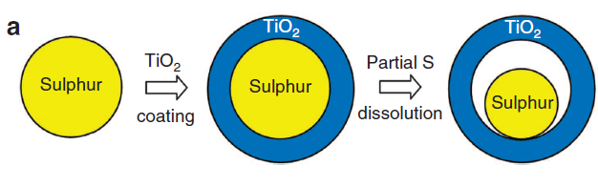
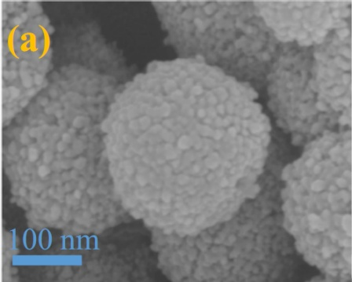
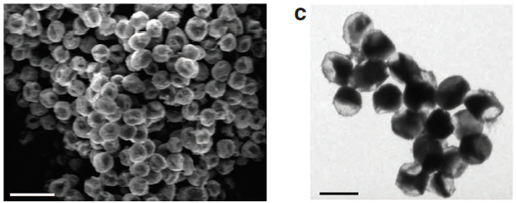
TiO₂ in Li-sulfur battery
Several studies report the use of TiO₂ for Li-S battery both as a host and as additive
  Its strong polar nature and its chemical inertness makes it a good candidate
Graphene/TiO₂ film interlayer
<J. Phys. Chem. C 2012, 116, 19653−19658>
<Adv. Mater. 2015, 27, 2891–2898>
As additive
Sulphur–TiO₂ yolk–shell
<NATURE COMMUNICATIONS, 2013>
Mesoporous TiO₂ spheres
<Materials Letters 189 (2017) 188–191>
As Host
All demonstrate remarkable performances but with areal loading < 2mg/cm²
07/43

Slide 9
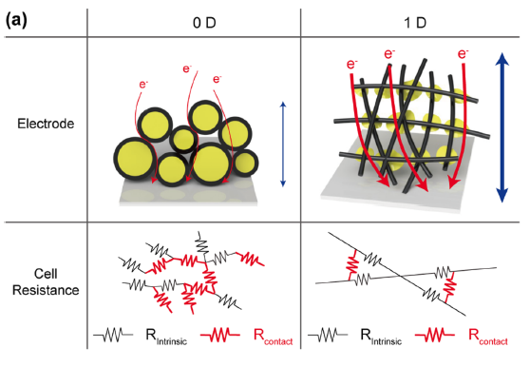
One-dimensional materials : Structural integrity
Nano Lett. 2018, 18, 475-481
1-D materials
1) Smaller contact resistance than 0-D materials
2) Good electron pathway
3) Structural integrity → excellent host for high sulfur loading
08/43

Slide 10
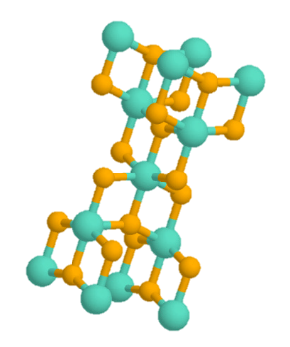
Work scope
Ti-based material
Polar host
Polysulfide immobilizer
1-D material
Structural integrity
Low contact resistance
Synthesis & characterization of one-dimensional Ti-based material for Li-S
09/43

Slide 11

Research scope
Part I
Synthesis and crystal growth mechanism analysis of 1-D rutile TiO₂ in molten salt
CrystEngComm, 2018, 20, 487–495 | 487
Synergy of polar TiO₂ and conductive carbon in TiO₂/C composite freestanding electrode for enhanced performance Li-Polysulfide battery
Part II
Part III
Poly crystalline 1-D TiN based freestanding composite electrode for better performance Li-polysulfide cell
10/43

Slide 12
Introduction:-TiO₂ overview
TiO₂ is one of the highly investigated transition metal oxides owing to its:-
  Favorable physicochemical properties
  Abundance
  Moderate cost
  Environmentally friendliness
Leading
to
Its properties can be modified to fit particular applications by:-
  Size tailoring
  Morphology/structure optimization
  Facet control
  Electronic structure manipulation
<ChemPhysChem 2012, 13, 2824 – 2875>
Tailoring phase and morphology of a material as desired is one most intriguing field of research
<ChemNanoMat 2016, 2, 764 – 775>
11/43

Slide 13
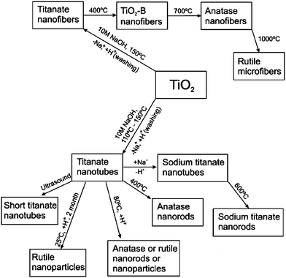
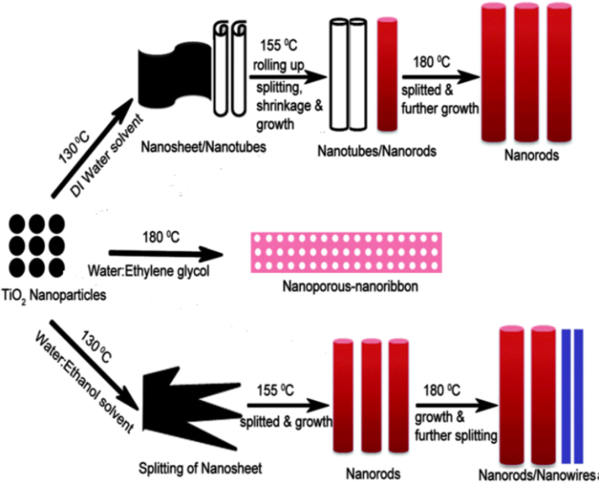
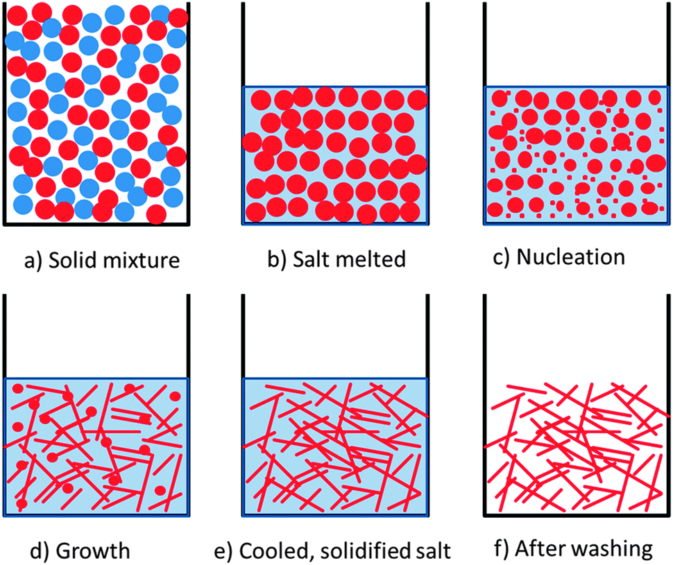
Introduction:-Synthesis of 1-D rutile TiO₂
1-D TiO₂ is commonly synthesized from TiO₂ nanoparticles in solution based synthesis
Hydrothermal
<J. Mater. Chem., 2010, 20, 5993–6008>
<Chem. Soc. Rev., 2014, 43, 2187—2199>
Molten salt synthesis
Salt
Molten salt synthesis is more simple and easily scalable technique compared to hydrothermal for 1-D rutile TiO₂ synthesis
Precursor
Unlike the hydrothermal case 1-D TiO₂ crystal growth in molten salts is not well studied
To have better control over the phase and morphology, studying 1-D rutile TiO₂ crystal growth in molten salt worth doing.
<Chem. Soc. Rev., 2014, 43, 2187—2199>
12/43

Slide 14
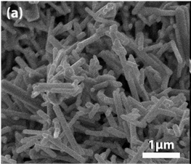
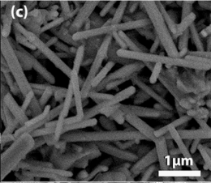
Introduction:-Synthesis of 1-D rutile TiO₂(molten salt method)
Few reports have demonstrated synthesis of 1-D rutile TiO₂ using molten salt from TiO₂ (anatase, rutile mix), NaCl, & Na₂HPO₄ salt mixtures
<J. Am. Chem. Soc. 2013, 135, 9995−9998>
<Nanoscale Research Letters 2014, 9:673>
Plausible explanation has not been give for the 1-D growth in molten salts
13/43

Slide 15
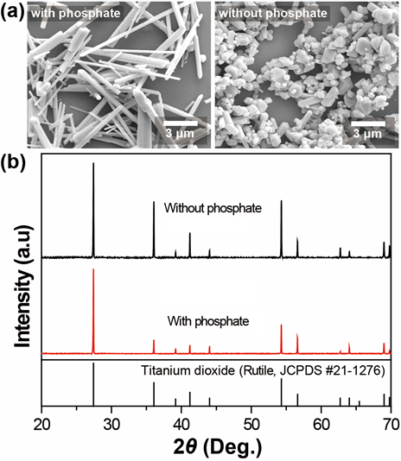
Synthesis of 1-D rutile TiO₂ in molten salt
Synthesis Procedure
Result
TiO₂ (A:R,10:1 Wt ratio),
NaCl, & (NaPO₃)₆
Mixed powder
1:4:8 Wt. ratio
Forming
pellet
Heat treatment (box furnace)
800ºC, 4h
pellet
Washing, Drying, Grinding
Rutile TiO₂
The presence of (NaPO₃)₆ in the salt matrix was necessary for the successful synthesis of 1-D rutile TiO₂
14/43
Notes:
Anatase is precursor, rutile is seed and NaCl is the molten media but the role of (NaPO₃)₆ , which is important for the 1-D growth as can be seen from the result, is not known.
The probable guess could be to make eutectic melt with lower melting point.

Slide 16
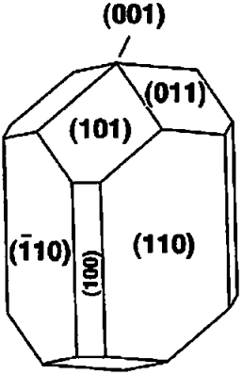
Understanding the role of (NaPO₃)₆ for the 1-D growth
Surfaces | Surface energy (J/m²)
(110) | 0.74
(101) | 1.11
(100) | 0.76
(001) | 1.51
(011) | 1.11
(111) | 1.51
<Applied Surface Science 436 (2018) 989–994>
(001) crystallographic surface has the highest surface
It is expected that the crystal grow in the <001> direction to reduce the overall surface energy.
Equilibrium shape of rutile TiO₂
The XRD shows the presence of phosphate is helping fast growth in the expected direction probably has influence on the mobility of growth unit to growth
15/43
Notes:
If the environment is conducive rutile TiO₂ tends to grow in (001) direction.
As can be seen the XRD in (NaPO₃)₆ containing salt mixture the crystal is growing in <001> direction

Slide 17
Understanding the role of (NaPO₃)₆ for the 1-D growth
Other oxy-salts were tested to check whether they have similar effect
  NaNO₃, Na₂CO₃, NaOH, Na₂SO₄
Morphology
Phase
Key:-
NaNO₃, (b)Na₂CO₃, c) NaOH, d) Na₂SO₄, e) (NaPO₃)₆ & f)No additive
The phase and morphology of particle is not similar in case of the different additives
16/43
Notes:
The results show variability even in phase based on the type of additive used which implies the role of the additives is not about making eutectic melt only (it is beyond that).

Slide 18
Understanding the role of (NaPO₃)₆ for the 1-D growth
Analysis
  Solubility of precursor is determinant for the phase and morphology of the product in solution based synthesis
  Solubility enhancement strategies
    Physical means:- increasing temperature (reducing viscosity)
    Chemical means:- inducing acid base interaction or complexing
  The phase variation of the final products in case of using the different additives indicate they are participating in some form of chemical interaction
<Chem. Soc. Rev., 2014, 43, 2187—2199>, <Mater. Chem. Phys., 2005, 92, 104–111>
The acid-base concept in the molten environment:-
  Governed by Lux-flood acid base definition
  Lux-flood definition:
      Acids:- O²⁻ acceptor
      Bases :- O²⁻ donners
Acid-base rxn.
Acid +O²⁻ →Base
17/43
Notes:
As the core concept in solution based synthesis is solubility of precursor, the additive has to do with enhancing solubility of anatase in the molten environment.

Slide 19

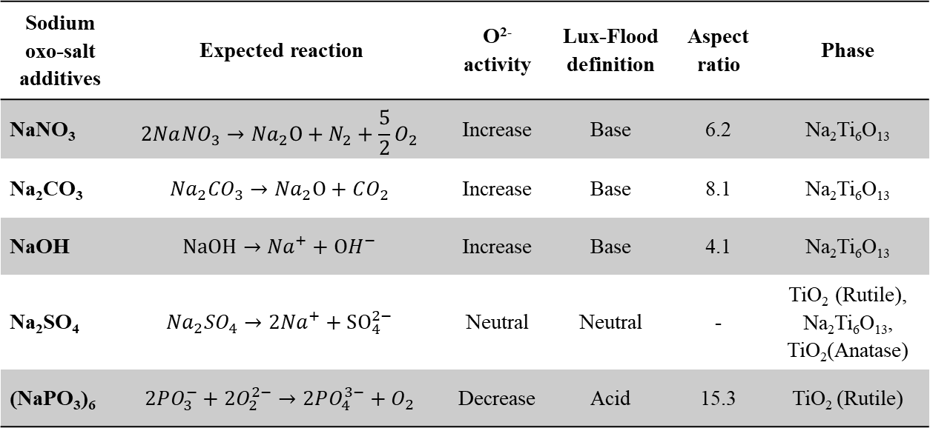


Understanding the role of (NaPO₃)₆ for the 1-D growth
The phase variation in the final powder is justified according to the Lux-Flood definition
Sodium oxo-salt additives | Expected reaction | O²⁻ activity | Lux-Flood definition | Aspect ratio | Phase
NaNO₃ | $$2Na{NO}_{3}→{Na}_{2}O+N_{2}+\frac{5}{2}O_{2}$$ | Increase | Base | 6.2 | Na₂Ti₆O₁₃
Na₂CO₃ | $${Na}_{2}{CO}_{3}→{Na}_{2}O+CO_{2}$$ | Increase | Base | 8.1 | Na₂Ti₆O₁₃
NaOH | $$NaOH→{Na}^{+}+OH^{−}$$ | Increase | Base | 4.1 | Na₂Ti₆O₁₃
Na₂SO₄ | $${Na}_{2}{SO}_{4}→{2Na}^{+}+SO_{4}^{2−}$$ | Neutral | Neutral | - | TiO₂ (Rutile), Na₂Ti₆O₁₃, TiO₂(Anatase)
(NaPO₃)₆ | $$2PO_{3}^{−}+2O_{2}^{2−}→2PO_{4}^{3−}+O_{2}$$ | Decrease | Acid | 15.3 | TiO₂ (Rutile)
Discussion:-
  NaNO₃, Na₂CO₃ decompose to gives Na₂O (strong Lux-Flood base) & NaOH gives OH⁻ (also lux base)
  Na₂SO₄ stable at synthesis condition
  (NaPO₃)₆ is strong Lux-Flood acid
$TiO_{2}\left(anatase\right)+O^{2−}⟶TiO_{3}^{2−}$(solubilized)
$TiO_{2}\left(anatase\right)⟶TiO_{2}$(rutile)
$TiO_{2}\left(anatase\right)−{O2}^{2−}⟶{Ti}^{4+}$(solubilized )
18/43

Slide 20
Understanding the role of (NaPO₃)₆ for the 1-D growth
Schematic representation of the concept
→ Naturally anisotropic titanates will
be formed in basic media
Similar to hydrothermal case
→ Solid state phase
transformation
Very less mobility
Particles grow equiaxially thorough Ostwald ripening
→ Phase transformation through
dissolution & re-precipitation
Very high mobility of growth units to growth sites
Highly anisotropic crystal growth
19/43

Slide 21
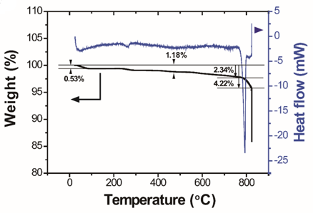
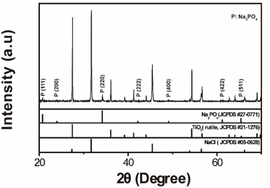

Understanding the role of (NaPO₃)₆ for the 1-D growth
    TG_DSC analysis has been done on (NaPO₃)₆ containing sample to further confirmation
Endothermic peak at ~250^{O} probably corresponds to desorption of water molecules attached in the crystal lattice (phosphate is hygroscopic)
~500º endothermic hump
Mass loss from the hump to the start of melting ~1.26%
O₂ is the only one leaving the system based on the stoichiometry and it calculated mass it ~ 1.2%
$$2PO_{3}^{−}+2O_{2}^{2−}→2PO_{4}^{3−}+O_{2}$$
The result is further supported by XRD analysis of the unwashed sample.
All the XRD peaks match with Rutile TiO₂, NaCl, and Na₃PO₄ phases.
The appearance of the Na₃PO₄ rather than the starting (NaPO₃)₆ in the unwashed sample further confirms the validity of the hypothesized rxn equation.
20/43

Slide 22
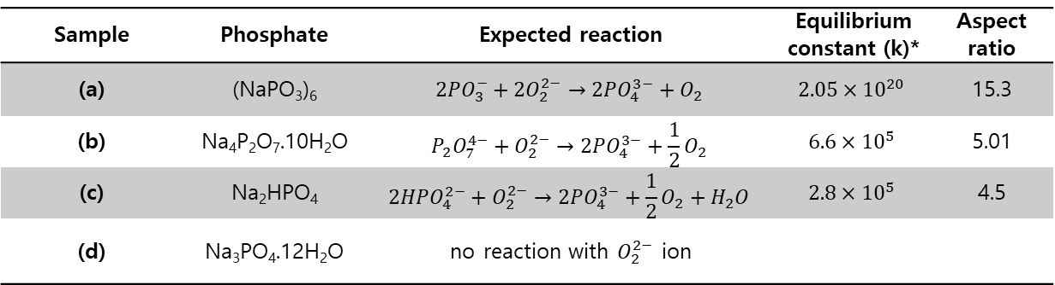
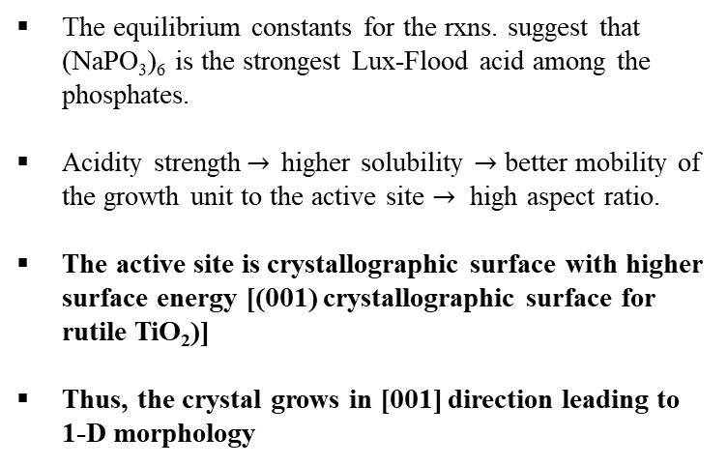
Understanding the role of (NaPO₃)₆ for the 1-D growth
The effect of the different degree of Lux-flood acidity has also been analyzed
Sample | Phosphate | Expected reaction | Equilibrium constant (k)* | Aspect ratio
(a) | (NaPO₃)₆ | $$2PO_{3}^{−}+2O_{2}^{2−}→2PO_{4}^{3−}+O_{2}$$ | $$2.05×{10}^{20}$$ | 15.3
(b) | Na₄P₂O₇.10H₂O | $$P_{2}O_{7}^{4−}+O_{2}^{2−}→2PO_{4}^{3−}+\frac{1}{2}O_{2}$$ | $$6.6×{10}^{5}$$ | 5.01
(c) | Na₂HPO₄ | $$2HPO_{4}^{2−}+O_{2}^{2−}→2PO_{4}^{3−}+\frac{1}{2}O_{2}+H_{2}O$$ | $$2.8×{10}^{5}$$ | 4.5
(d) | Na₃PO₄.12H₂O | no reaction with $O_{2}^{2−}$ion
*<I. Douglas and D. G. Lovering, Ionic Liquids, Plenum Press, New York, 1981>
The equilibrium constants for the rxns. suggest that (NaPO₃)₆ is the strongest Lux-Flood acid among the phosphates.
Acidity strength$→$ higher solubility $→$ better mobility of the growth unit to the active site $→$ high aspect ratio.
The active site is crystallographic surface with higher surface energy [(001) crystallographic surface for rutile TiO₂)]
Thus, the crystal grows in [001] direction leading to 1-D morphology
<Surface science reports 48 (2003) 53-229>
21/43

Slide 23
Conclusion
High aspect ratio 1-D rutile TiO₂ has been synthesized from anatase TiO₂ in molten NaCl using (NaPO₃)₆ additive.
The role of (NaPO₃)₆ phosphate for the 1-D crystal growth has been analyzed by using alternative oxy-additives and comparing the phase and morphology of the resulting powder.
Lux-Flood acid base interaction is found to enhance the solubility of the precursor.
Both Lux-Flood acids and bases result 1-D morphology but the rutile phase is found only in the case of Lux-Flood acid [which is (NaPO₃)₆]
Enhanced solubility leads to better mobility of growth unit to growth site and tendency to avoid high crystallographic surface leads to 1-D crystal growth
The higher the acidity, the higher the solubility consequently the higher becomes aspect ratio of 1-D rutile TiO₂.
22/43

Slide 24
Part I
Synthesis and crystal growth mechanism analysis of 1-D rutile TiO₂ in molten salt
CrystEngComm, 2018, 20, 487–495 | 487
Synergy of polar TiO₂ and conductive carbon in TiO₂/C composite freestanding electrode for enhanced performance Li-Polysulfide battery
Part II
Part III
Poly crystalline 1-D TiN based freestanding composite electrode for better performance Li-polysulfide cell
23/43

Slide 25
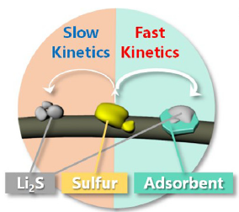
TiO₂ in Li-sulfur battery
Synergy between polysulfide immobilization and good electron flow is key for fast kinetics
e⁻
e⁻
e⁻
e⁻
Li-Polysulfides
e⁻
e⁻
Carbon
Li₂S
1-D TiO₂
e⁻
<Nano Today 18 (2018) 35–64 >
24/43

Slide 26
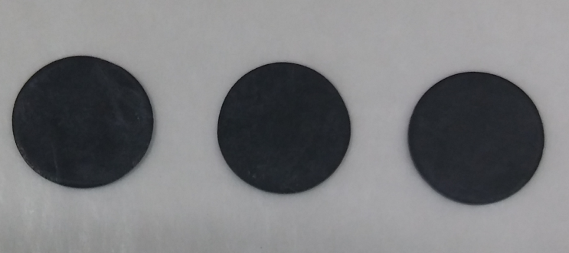
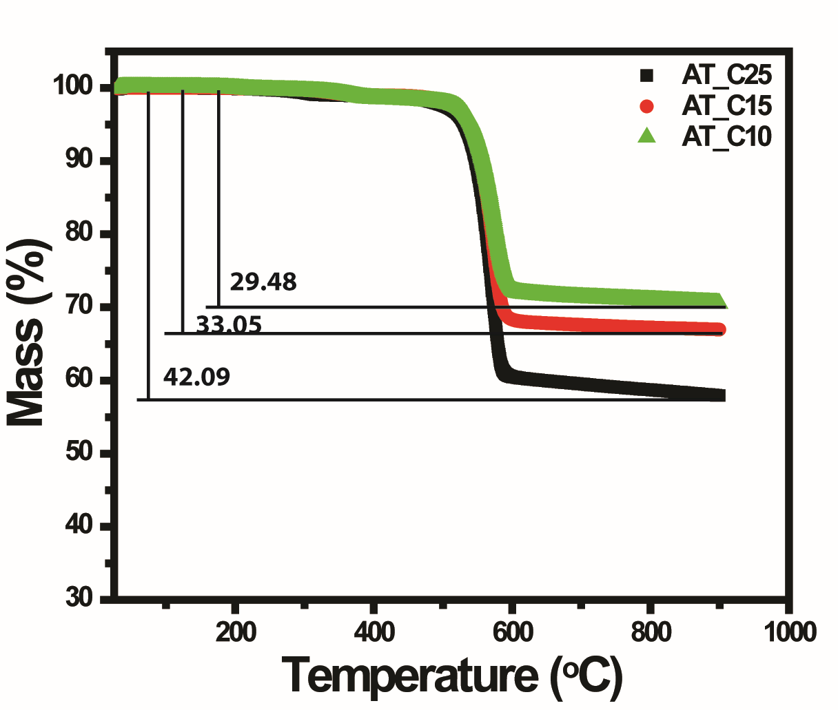
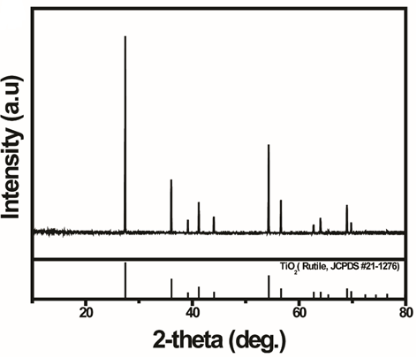
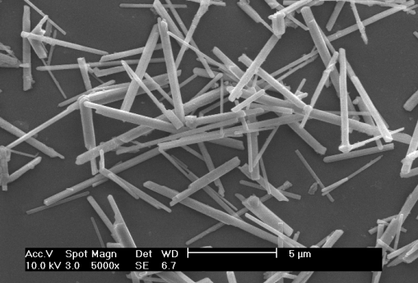
TiO₂/C composite freestanding electrode:-fabrication
Fabrication of the free standing electrodes
  1-D rutile TiO₂ /carbon (90/10, 85/15, and 75/25 wt. ratio), and PTFE binder were grounded in to pastes using IPA solvent
  The thick pastes are made in to sheet using roller on a flat surface
  The sheets are punched and dried inside an oven
AT_C25
AT_C15
AT_C10
Composition of the electrodes in wt.%
 | AT_C25 | AT_C15 | AT_C10
TiO₂ | 57.91 | 66.95 | 70.52
Super P | 19.39 | 11.85 | 7.88
PTFE | 22.7 | 21.2 | 21.6
Starting 1-D TiO₂:-pure rutile phase, ~5um length & ~250nm diameter
25/43

Slide 27
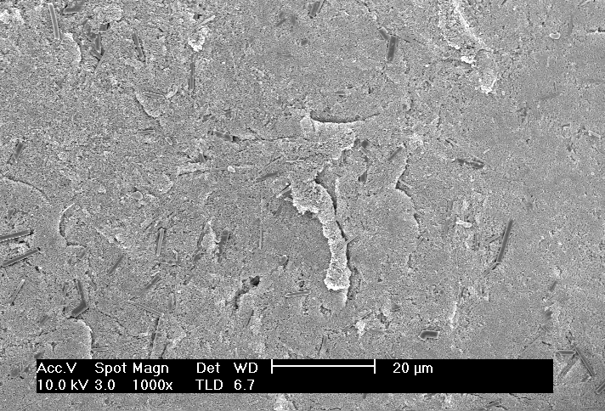
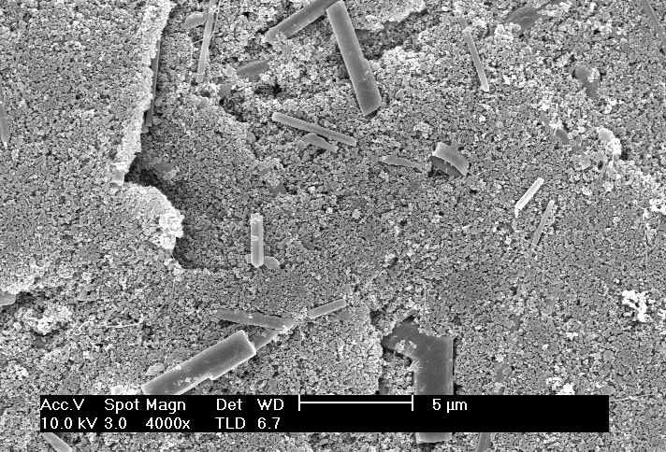
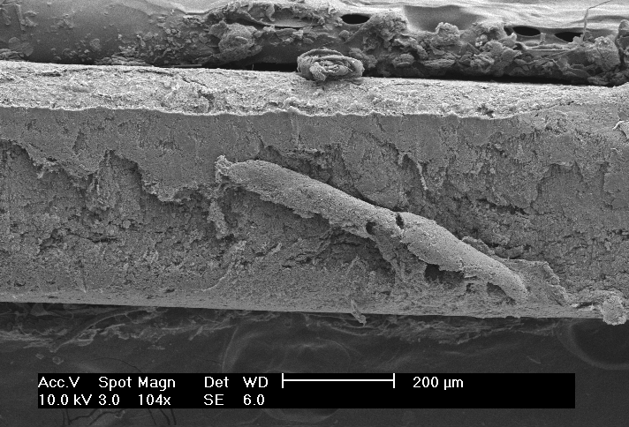

TiO₂/C composite freestanding electrode:-structural analysis
AT_C25
Surface view
1-D TiO₂
Cross-sectional view
461µm
PTFE Binder
26/43

Slide 28




TiO₂/C composite freestanding electrode:-structural analysis
AT_C15
Surface view
TiO₂
Cross-sectional view
PTFE
287µm
27/43

Slide 29




TiO₂/C composite freestanding electrode:-structural analysis
AT_C10
Surface view
Cross-sectional view
253µm
28/43

Slide 30
TiO₂/C composite freestanding electrode:-structural analysis
Summary of the structural analysis
 | Composition wt. % |  |  | Thickness (µm) | remark
 | TiO₂ | Super P | PTFE
AT_C25 | 57.91 | 19.39 | 22.7 | 461 | Few TiO₂ particles at the surface 1-D TiO₂ particles are surrounded carbon particles
AT_C15 | 66.95 | 11.85 | 21.2 | 287 | Relatively higher TiO₂ particles ate observable at the surface TiO₂ particles are surround by relatively less amount of carbon
AT_C10 | 70.52 | 7.88 | 21.6 | 253 | Large quantity of TiO₂ are observable at the surface Very less amount of carbon surrounds TiO₂ particles
The electrodes contain approximately the same percentage of binder
The higher the amount of carbon the thicker (lighter ) the electrode
The TiO₂ particles have better contact with the surrounding carbon as percentage of carbon increases
29/43

Slide 31


Electrochemical performance analysis
Polysulfide impregnation
  22.1µl of 0.5M Li₂S₈ soln, corresponding to 2.5mg/cm² sulfur loading, is impregnated
Electrochemical performance test
  Working electrode: Li₂S₈ impregnated free standing electrodes
  Counter electrode: Li foil
  Electrolyte: 1M LiTFSI + 0.2M LiNO₃ in DOL/DME
  Voltage window: 1.7-2.8V
Result
The result indicates perpetual synergy b/n efficient polysulfide immobilization & good electron flow is essential for long term cycling
  AT_C25, no enoughTiO₂ surface to accommodating new PSs while giving time for the slow Li₂S₂ & Li₂S rxns
  AT_C15, enough TiO₂ surface & fair enough electron flow for perpetual cycling
  AT_C10, not enough carbon to make electron flow accessible, TiO₂ surfaces will be passivated by trapped PSs
30/43

Slide 32

Electrochemical performance analysis
Schematic illustration of the concept discussed above
Discharge
AT_C25
e⁻
Li-Polysulfides
e⁻
e⁻
e⁻
Carbon
e⁻
e⁻
e⁻
e⁻
e⁻
Li₂S
AT_C15
1-D TiO₂
e⁻
e⁻
e⁻
e⁻
e⁻
AT_C10
e⁻
e⁻
e⁻
31/43

Slide 33

Electrochemical performance analysis
AT_C25
AT_C15
AT_C25
Low polarization initially which becomes very high later
The tip of the discharge curve is almost vertical
0.15V
~ 0.2V
AT_C15
Relatively higher polarization initially but show only slight increment later
Show inclined curve at the tip of discharge curve indicating efficiency of Li₂S₂ to Li₂S rxn
decay
AT_C10
AT_C10
Relativity higher polarization initially and become very high later
Initially the tip of discharge curve was inclined, later it becomes almost vertical ⇒ degradation of Li₂S₂ to Li₂S conversion efficiency.
~ 0.2V
decay
32/43

Slide 34
Conclusion
Polysulfide impregnated TiO₂/C freestanding electrode with a relatively higher sulfur loading was demonstrated as a Li-polysulfide cathode.
The synergy between the polysulfide immobilization by TiO₂ surface and electron flow by the conductive carbon was found to impact the performance significantly
Ensuring the perpetuity of the performance for long term cycling was found to be dependent on the perpetuity of the synergy b/n TiO₂ and carbon which a function of their proportion.
AT_C15 electrode which contained better TiO₂/C proportion has show outstanding performance for 100 cycles
This work is an early attempt to demonstrate the use inorganic nanomaterials for freestanding electrode design.
33/43

Slide 35
Part I
Synthesis and crystal growth mechanism analysis of 1-D rutile TiO₂ in molten salt
CrystEngComm, 2018, 20, 487–495 | 487
Synergy of polar TiO₂ and conductive carbon in TiO₂/C composite freestanding electrode for enhanced performance Li-Polysulfide battery
Part II
Part III
Poly crystalline 1-D TiN based freestanding composite electrode for better performance Li-polysulfide cell
34/43

Slide 36






Introduction: TiN in Li-sulfur battery
Several studies demonstrate TiN in Li-S battery owing to is high electronic conductivity and good polarity
Mesoporous TiN
lithium/dissolved polysulfide batteries
<Adv. Mater. 2016, 28, 6926–6931>
<Journal of Power Sources 321 (2016) 87-93>
No attempt of using TiN in free standing electrode design and with sulfur loading >2 mg/cm²
35/43

Slide 37

Synthesis and characterization of 1-D TiN
Synthesis:
  Carbothermal reduction followed by nitridation of 1-D TiO₂ is followed to synthesize 1-D TiN
TG-DSC analysis
900ºC
400ºC
1-D rutile TiO₂
Forming
HT
$$+$$
N₂ (g)
Polycrystalline 1-D TiN
Melamine
Endothermic peaks at ~360 ºC with ~78% mass loss → sublimation of melamine
Endothermic peaks ~667 ºC, corresponding ~4% mass → poly-condensation of melamine to C₆H₆N₁₀ and C₆H₃N₉ with the release of ammonia
~ 815 ºC, C₆H₃N₉ decomposition, carbothermal reduction and nitridation reactions
<Journal of Thermal Analysis, Vol. 34 (1988) 423-429>
36/43

Slide 38

Synthesis and characterization of 1-D TiN
Morphology
Phase
XRD analysis reveals pure TiN phase
TEM and SEM analysis reveal the 1-D morphology of the particles
HRTEM and SAD patterns reveal the poly crystallinity of the powder
Polycrystalline 1-D TiN, pure phase, has been synthesized
37/43

Slide 39

Electrochemical performance analysis
The free standing electrodes were made in similar manner to TiO₂ electrodes. Testing conditions were similar too.
CV
The onset potentials of the redox peaks were comparable
  Indicates similar capability of adsorbing reactive intermediate
peak potentials upshifted for TiN
  Faster rxn kinetics on TiN surface
EIS
Charge transfer resistance is lower in case of TiN than TiO₂
0.1C
0.1C
0.2C
0.5C
Discharge capacity curve
TiN electrode shows higher initial capacity and better capacity retention
1C
2C
Rate capability
At a high rate of 2C TiN electrode give a stable capacity of ~400mAh/g
1-D TiN electrode show superior performance that the starting 1-D rutile TiO₂
38/43

Slide 40

Electrochemical performance analysis
Voltage capacity curve
  2nd cycle shows comparable polarization
  TiO₂ shows significant increase in polarization at 10th cycle, but for TiN even after 100cycles no significant increase.
  The tip of the discharge curve for TiN also show efficient conversion of Li₂S₂ to Li₂S
ΔV~0.2V
decay
The TiN electrode seems to perform efficiently until the end, the slight capacity loss could be active material loss due to adsorption on PTFE binder (~20% by weight of electrode)
ΔV~0.2V
39/43

Slide 41


Electrochemical performance analysis
<Angew. Chem. Int. Ed. 2016, 55, 12990 –12995>
At high rates, TiO₂ couldn’t cop up with the high charge transfer rate
  no second plateau at all
TiN, even at 2C, the second plateau is observable
  Slow Li₂S₄ to Li₂S₂ & Li₂S rxns was possible even at such fast rate
  ~ 25% of the active material was participating rxn at 2C
40/43

Slide 42

Polysulfide trapping test
 | BET (m²/g)
TiO₂ | 3.34
TiN | 4.33
Super P | 62
Both photographic image & UV-Vis analysis showTiO₂ and TiN were efficient in trapping PSs
Super P hardly trap PSs despite its high surface area
No significant difference in terms of PS trapping ability b/n TiO₂ & TIN
41/43

Slide 43

Post-mortem analysis
XPS analysis was done on TiN based freestanding electrodes before PS infiltration and after 100 cycles
Before
After
2.4 eV
Nitride peak shifted 2eV to the higher binding energy after cycling showing the strong interaction with PSs
Carbon show no difference implying no interaction with PSs
42/43

Slide 44
Conclusion
Polycrystalline 1-D TiN was synthesized through carbothermal reduction and consequent nitridation of 1-D TiO₂.
Polysulfide infiltrated freestanding electrode were made using the 1-D TiN & the starting 1-D TiO₂ and electrochemical performance of these electrode were analyzed.
Compared to the 1-D TiO₂ based electrode 1-D TiN based electrode demonstrated a much better cyclability and active material utilization even at high rate
Polysulfide trapping experiments demonstrate both TiO₂ and TiN are good in trapping PSs.
The significant performance difference was attributed to the good electronic conductivity of TiN which catalyzes the electrochemical redox reaction effectively
43/43

Slide 45
Thank you

Slide 46
Crystal growth trend
Studying the phase and morphology evolution trend
  Sampling were done at different points in the course of the reaction to see how the phase and morphology evolves
  The sampling were done starting from 785ºC where the melting starts (as can be seen from DSC curve)
Phase
morphology
Key:- (a) 785ºC, (b) 790ºC, (C) 795ºC, (d) 800ºC, 0min (e) 800ºC, 2.5min, (f) 800ºC, 5min, (g) 800ºC, 7.5min, and (h) 800ºC, 10min
19/42

Slide 47
Crystal growth trend
Discussion
  Progressive increase of rutile TiO₂ phase (relative anatase TiO₂) and particulate morphology with time and temperature is observable from the phase and morphology analysis.
  It seems the particulates (anatase TiO₂) converts progressively to 1-D rutile TiO₂
  To check weather there is relationship between phase and morphology, HRTEM and SAD analysis has been done both on the particulate and 1-D morphologies.
Phase fraction analysis from the XRD peaks
I_{R}- 110 peak of rutile
I_{A}-101 peak of anatase
Three stages:-
1st at the begining→ low solubility of anatase→ many particles few rods
2nd During melting→ moderate solubility→ higher proportion of rods
3rd post melting→ temperature increases→ solubility increases
HRTEM & SAD pattern for the 1-D morphology [(a)&(b)] corrosponds to rutile TiO₂ phase & that of the particle[(c) &(d)] corresponds to anatase TiO₂
20/42

