Slide 1
Phase equilibrium in ceramics
Part III
Class II

Slide 2
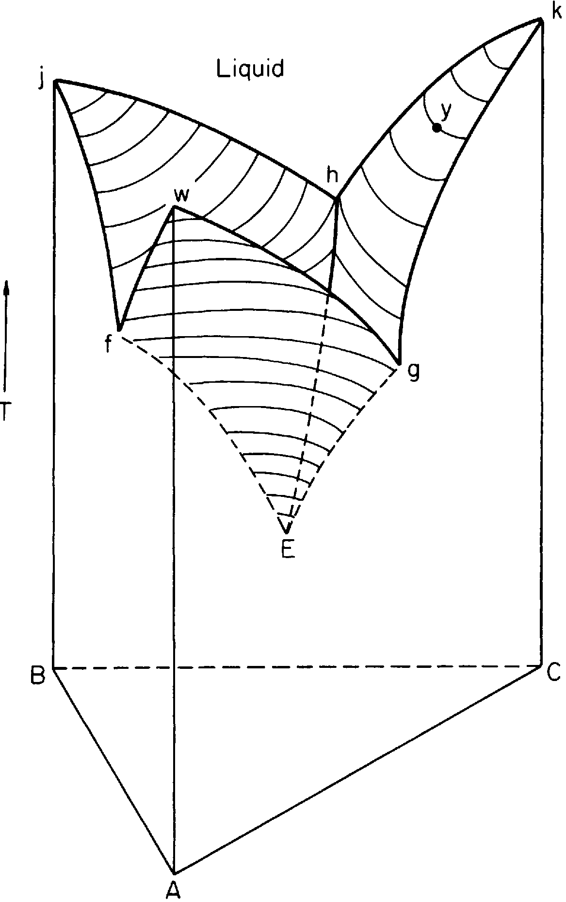
Ternary Systems
Systems containing three components
phase rule becomes F = 3 - P + 2
If pressure is constant, the phase rule for the system is F= 4 - P, and an invariant point involves equilibrium between four phases
The ternary system can be represented by a three-dimensional figure
Points f, h, and g, represent binary eutectic for binary systems, A-B, B-C, C-A,
Points on the liquidus surface represent equilibrium between a liquid and a solid phase.
The locus of intersections points of the liquidus surfaces form the boundary lines hE, fE, and gE represent equilibrium between two crystalline phases and a liquid
Fig. Diagram of a ternary system containing one ternary eutectic.

Slide 3
Point E is the ternary eutectic and Crystals of A, B, and C are in equilibrium with a liquid at this point. It represents the lowest melting mixture of crystals of A, B, and C

Slide 4
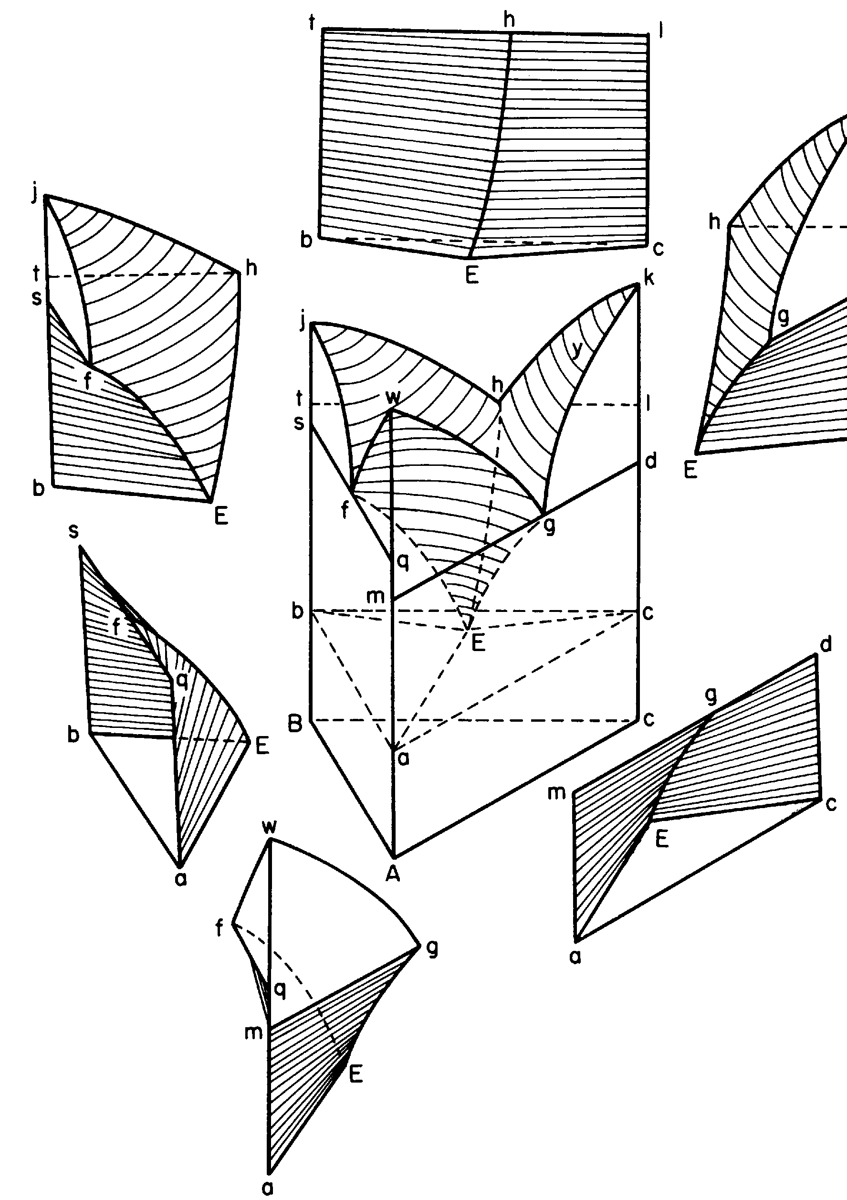
liquid space:- the region above the liquidus surface and is composed
of liquid only
three spaces of primary crystallization, A + liquid, B + liquid, and C+liquid:- bounded on their upper surfaces by the liquidus surfaces and their lower surfaces by the surfaces made by sliding the horizontal lines, for example mg and qf along the lines ma/gE and ma/fE respectively for primary crystallization of A.
three spaces of binary crystallization A + B + liquid, A + C + liquid, and B + C +liquid:- bounded by the lower surfaces of the spaces of primary crystallization and the horizontal plane abc which contains the eutectic point E
space containing crystalline phases only:- space below the plane abc and is composed of crystals of A, B, and C

Slide 5
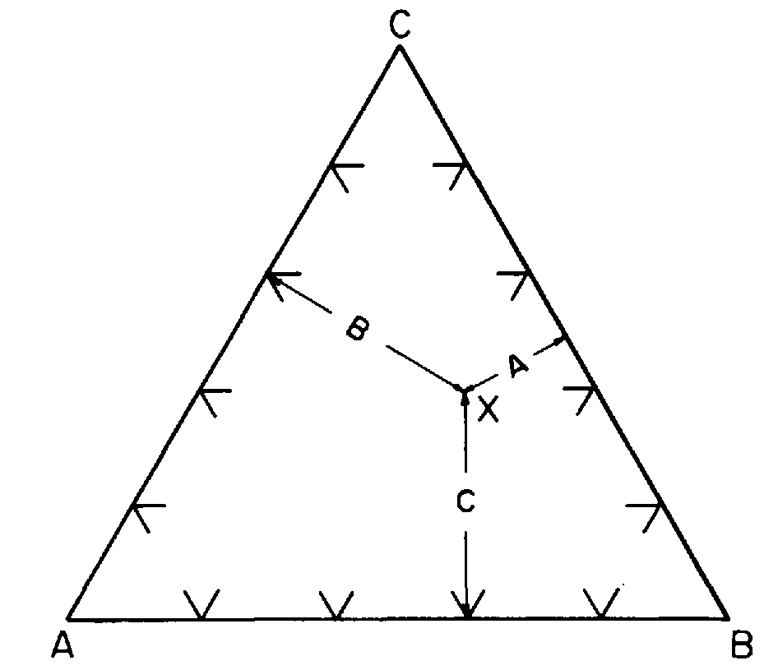
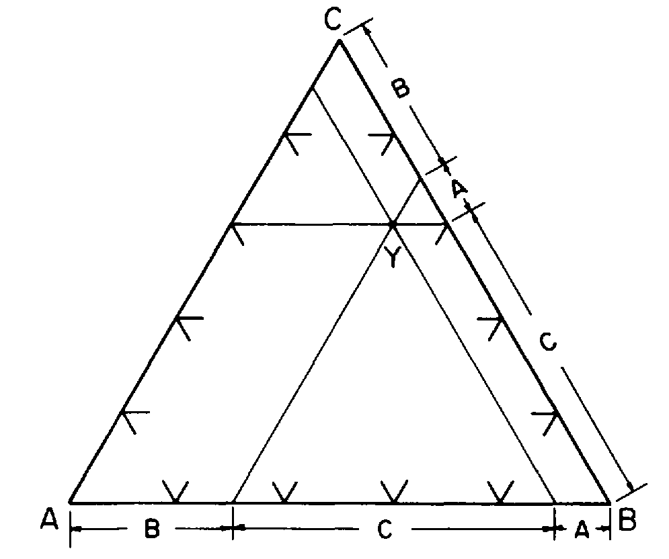
Method of Determining Composition
The equilateral triangle which forms the base of the ternary figure permits the representation of all possible combinations of the three components.
Methods for determining the composition of a point within the triangle:-
The lengths of the perpendiculars drawn from the sides of the composition triangle to the point are proportional to the quantities of the crystals in the sample. For example, in Fig. a the composition X is composed of 40% C , 20% A, and 40% B.
Lines are drawn through the composition point and parallel to the sides of the triangle. The intersection of these lines with any side gives the proportions of the crystalline phases represented by the point. For example, in Fig. b the point Y is composed of 10% A, 30% B, and 60% C.
a,
b,

Slide 6
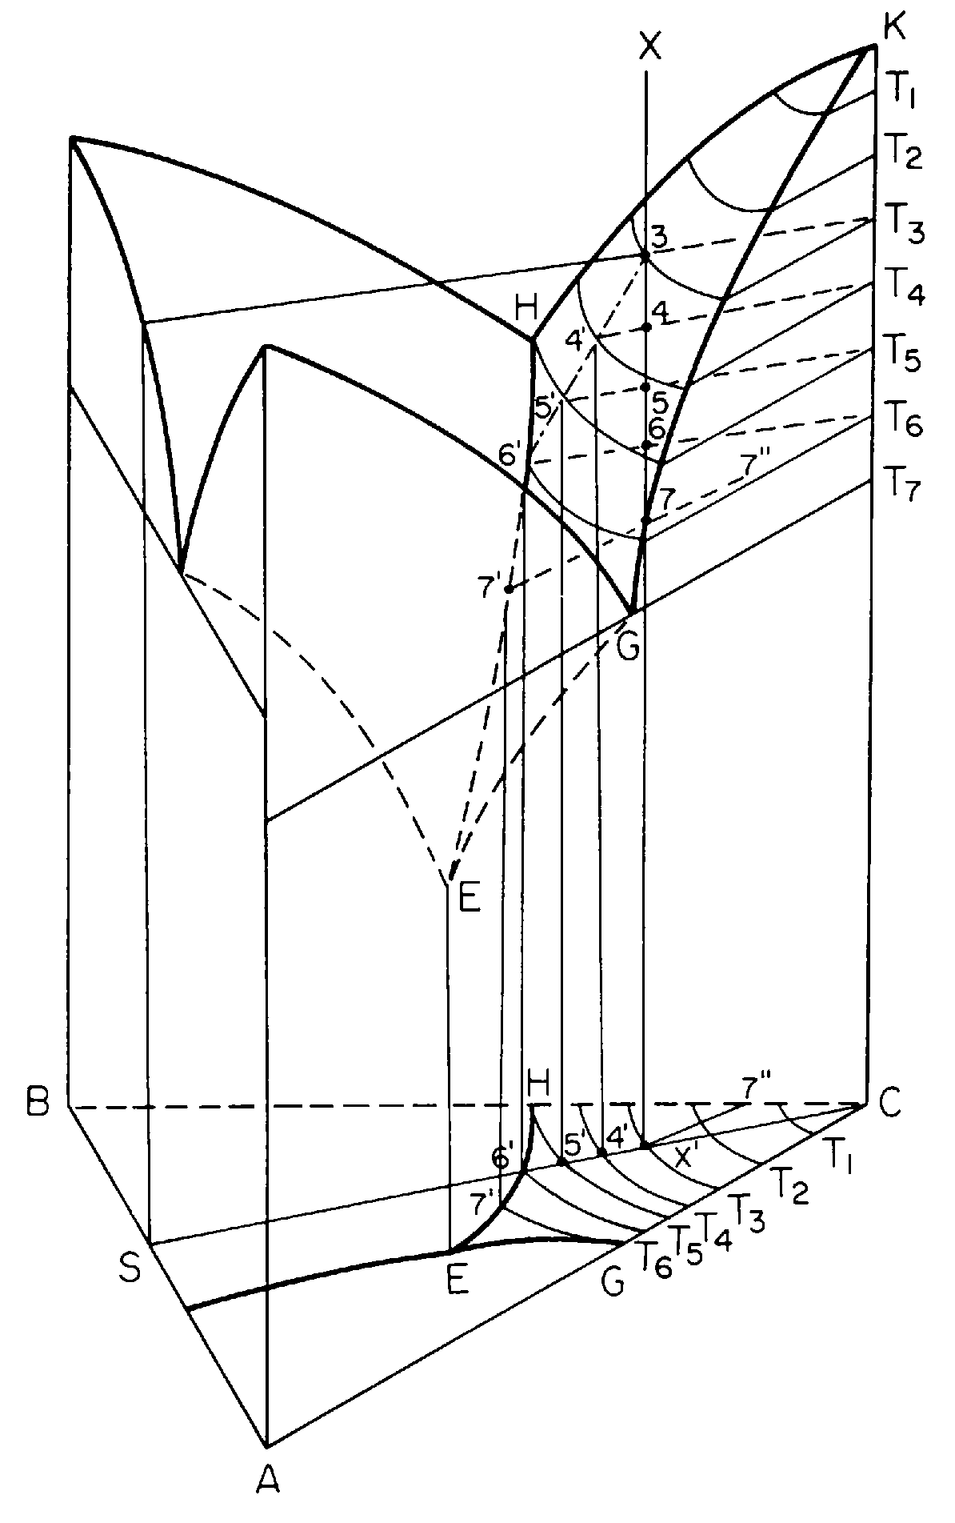
lsoplethal Studies in Ternary Systems
Lets consider an isopleth ( X X ’ ) for the composition X
The plane projection of the liquidus surface is shown at the base of the three dimensional figure.
Isopleth intersect with the liquidus surface at point 3, with corresponding temp. T₃ and tie line, T₃ – 3 connect the equilibrium phases (liquid of composition 3 and crystal C)
Corresponding projection onto the plane is denoted by the point X ’ and the line C X ’
Cooling further to temperature T₄ :- crystals of C precipitate from the melt and the concentration of C in the melt decreases. Tie line T₄ – 4 represents the equilibrium phases & the projection is represented by C4’. The quantities of the respective phases are obtained by lever rule.

Slide 7
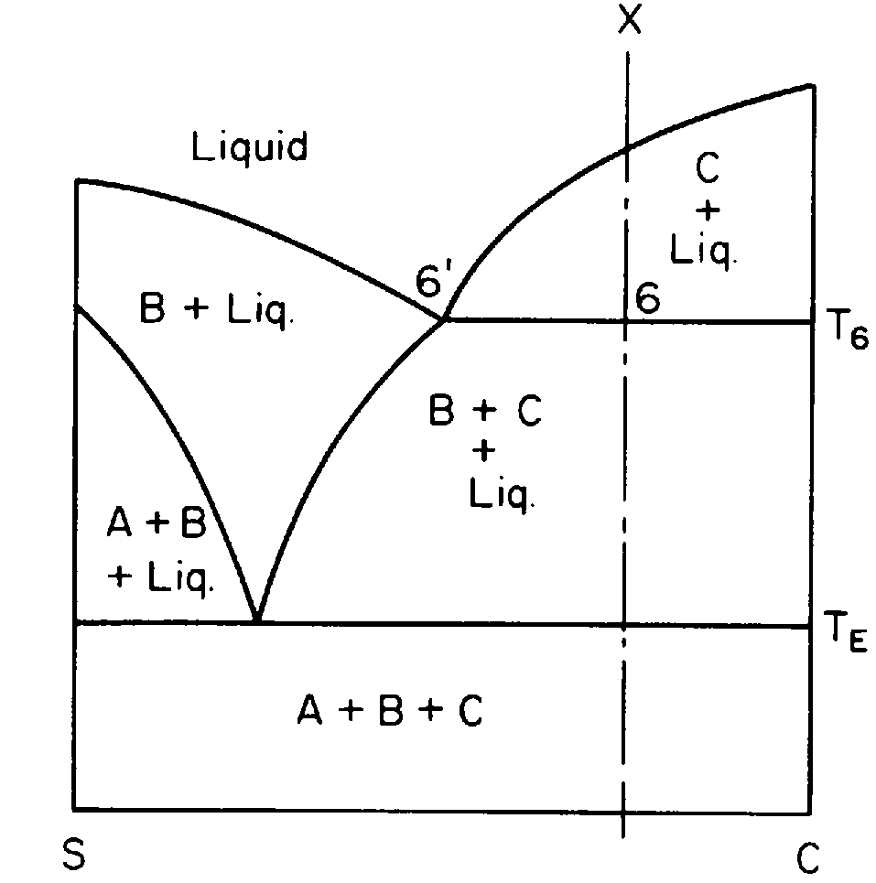
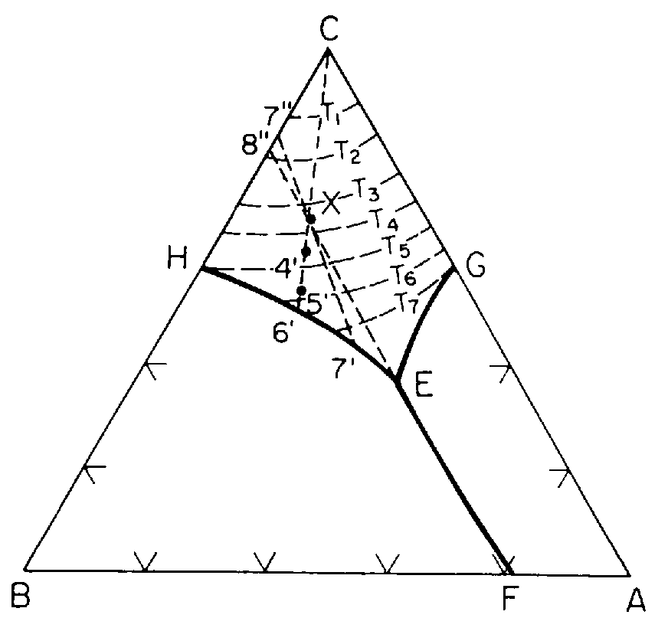
Cooling to point 7 places the composition into the space of binary crystallization, C + B + liquid. The composition of the melt is given by the point at 7 ’ , and the crystalline portion of the sample is composed of B and C
Further cooling to the eutectic temperature, leads the melt composition moves along the boundary line from 7 ’ to E . Simultaneously, additional quantities of C and B precipitate from the melt
Cooling to slightly below that of E , the melt crystallizes in eutectic proportions

Slide 8
Quantitative analysis
Temperature T₃ :- sample composed of melt plus infinitesimal quantity of crystals of C
Temperature T₄:-
CX/C4’*100 = % melt of composition 4‘, X4’/C4’*100 = % crystals of C
Temperature T₅:- CX/C5’*100 = % melt of composition 5‘, X5’/C5’*100 = % crystals of C
Temperature T₆:- CX/C6’*100 = % melt of composition 6‘, X6’/C6’*100 = % crystals of C and infinitesimal quantity of crystals B
At temperature T₇, new tie line is drawn from 7' through X and on to its intersection with the line BC and point 7 "
7“X/7“7‘*100 = % melt of composition 7‘, X7‘/7“7‘*100 = % crystals (7“B/CB*100 =% C and 7“C/CB*100 =% B)
At T_{E}⁺ (temperature slightly above the eutectic temperature)
8“X/8“E*100 = % melt of composition E, XE/8“E*100 = % crystals (8“B/CB*100 =% C and 8“C/CB*100 =% B)
At T_{E}⁻ (temperature slightly below the eutectic temperature)
8“X/8“E*100 = % Eutectic (44%A, 36%C and 20%B), XE/8“E*100 = % crystals (8“B/CB*100 =% C and 8“C/CB*100 =% B)

Slide 9
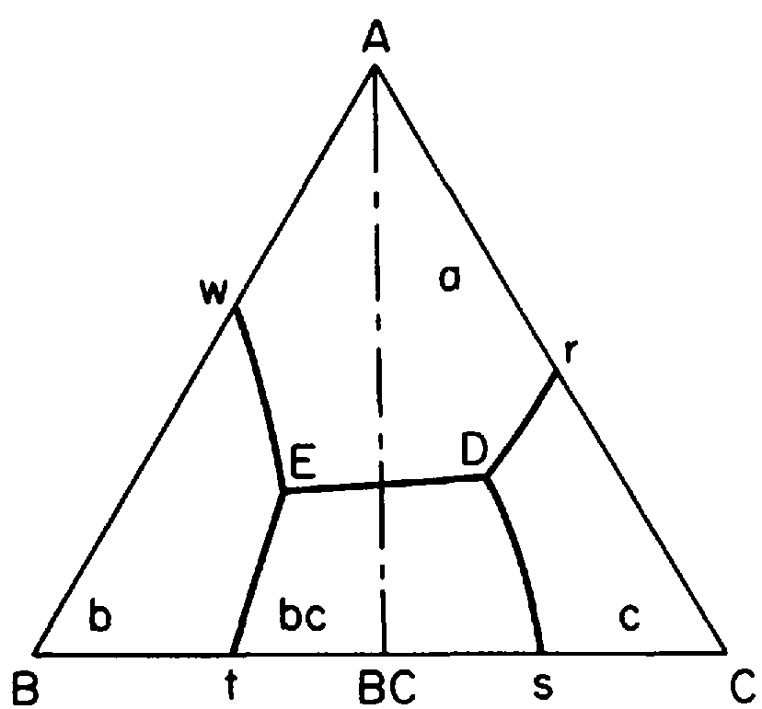
Alkemade Lines
A straight line connecting the points representing the compositions of the crystals in the ternary system is called a binary join.
Join connecting the compositions of the primary crystals of two areas having a common boundary line is called an Alkemade line
Lines AC, AB, B-BC, A-BC, and BC-C are Alkemade line
Line BC, a join but not an Alkemade b/c it does not fulfill the condition of the common boundary line because areas c and b are not adjacent.

Slide 10
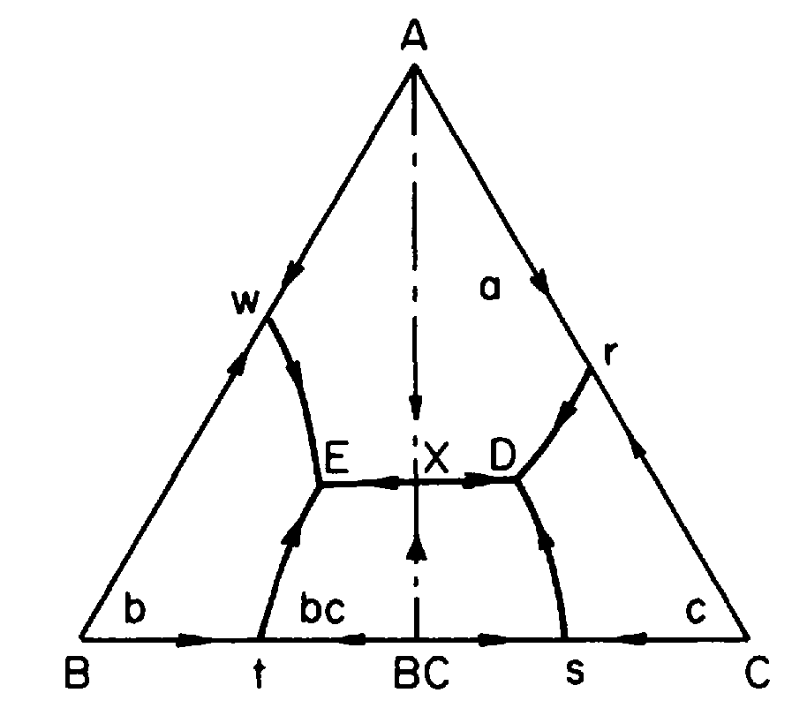
Alkemade theorem :- states the intersection of a boundary line (or boundary line extended) with its corresponding Alkemade line (or Alkemade line extended) represents a temperature maximum on that boundary line and a temperature minimum on the Alkemade line.
Alkemade lines never cross one another
Application of the Alkemade theorem to determine slopes of boundary lines.

Slide 11
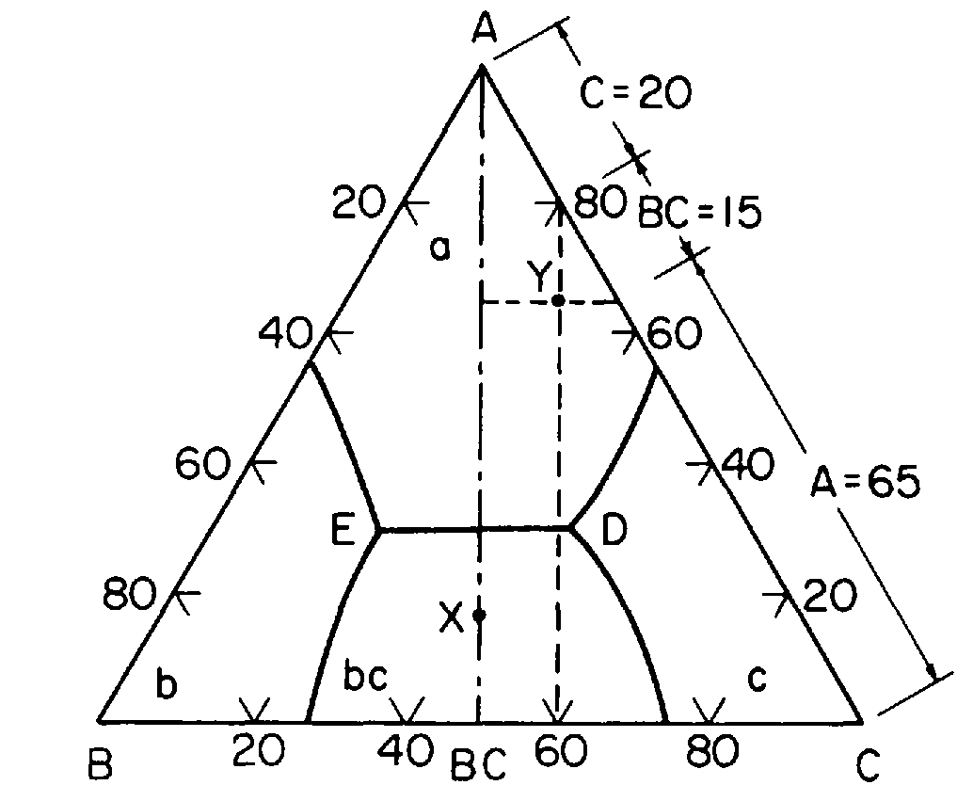
Composition Triangles
Composition triangle is always made up of three Alkemade lines
For example, in Fig. below composition Y is located within the composition triangle A-BC-C
When melt Y solidifies, the sample will be composed of the crystals represented at the apices of this composition triangle
The composition of the final crystals is A =65%, BC= 15%, and C = 20%. A portion of the crystals will, of course, be contained in the eutectic structure
If a melt is on an Alkemade line, it will solidify as the crystals represented by the extremities of the Alkemade line and in a proportion indicated by its position on the line.

Slide 12
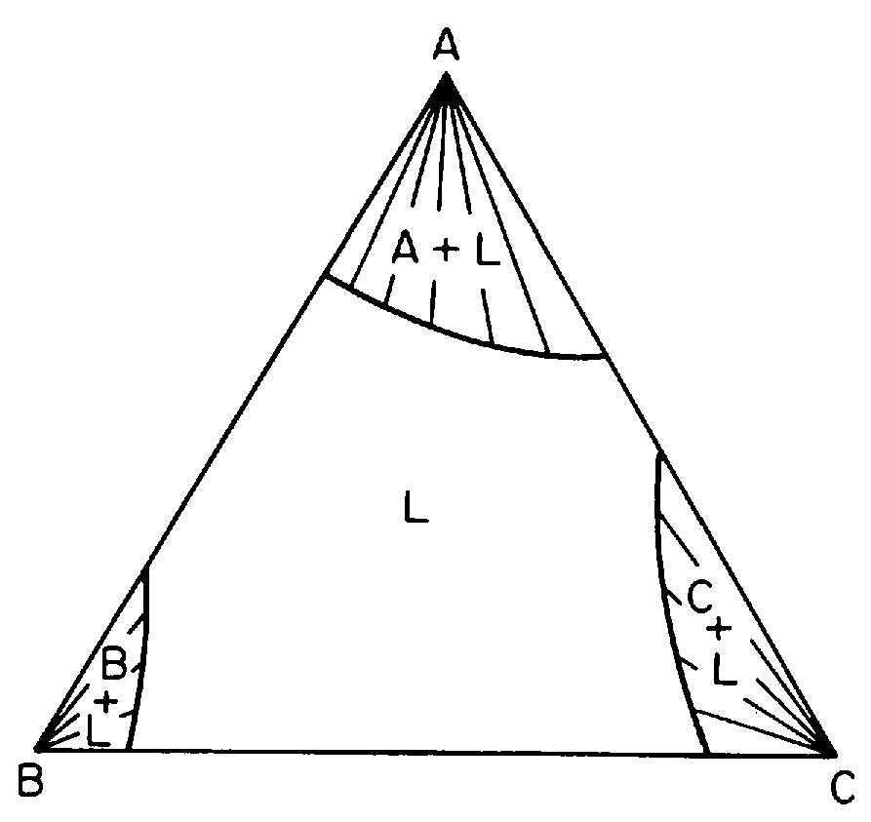
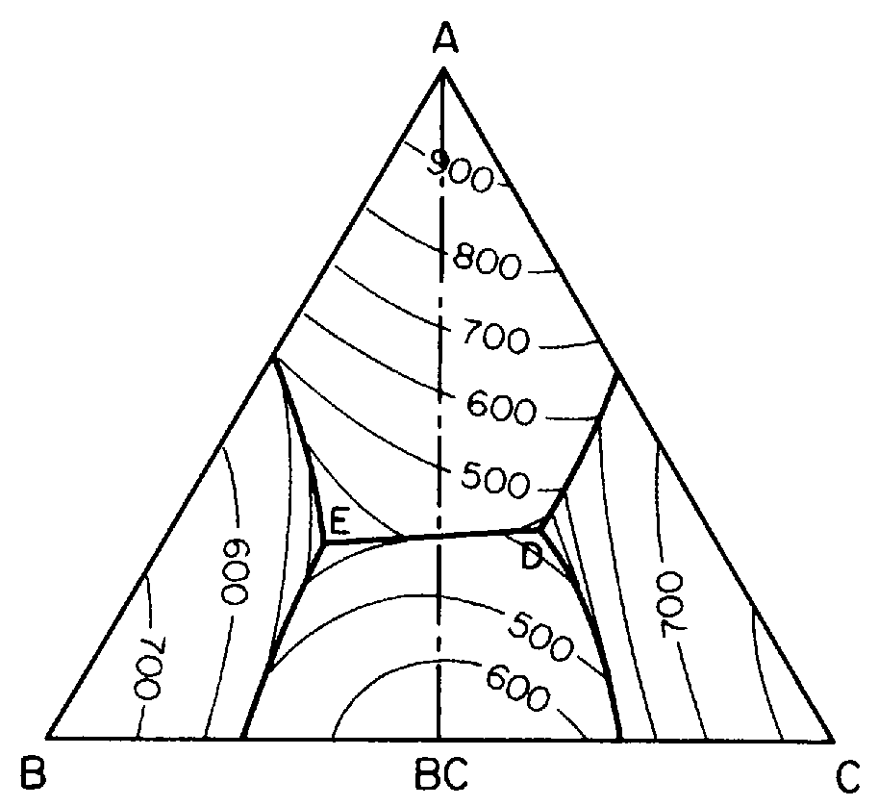
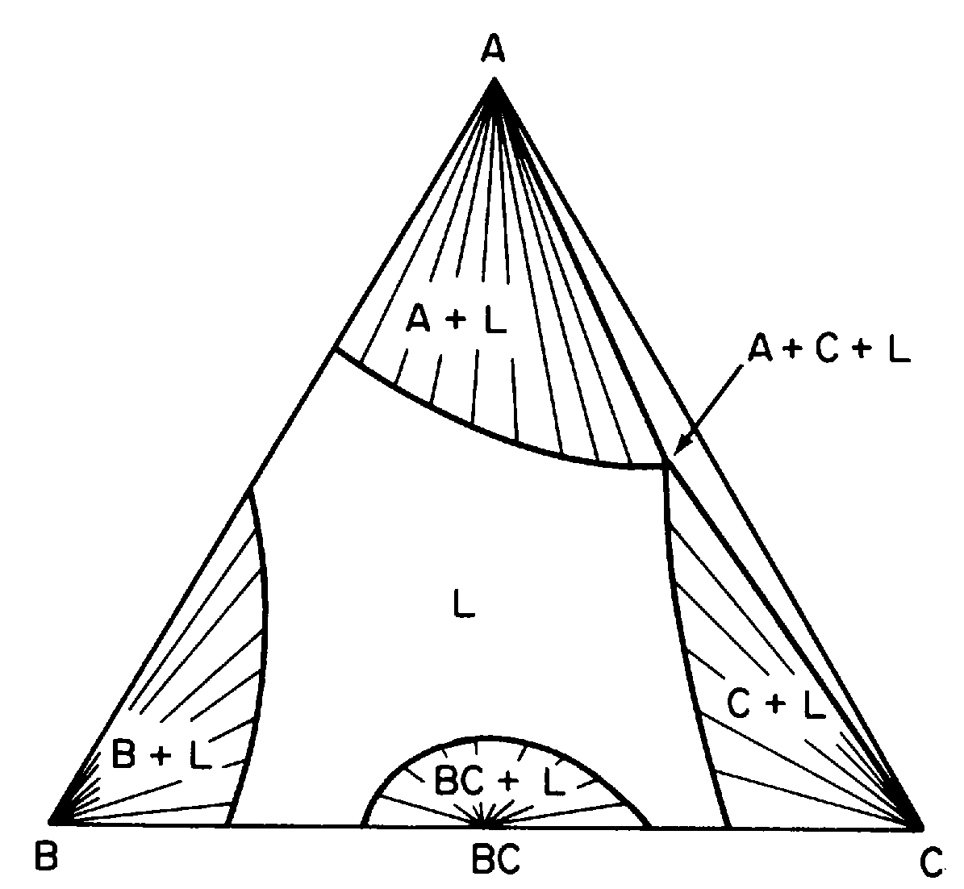
Isothermal Sections
The primary crystallization spaces of A, B, and C and the liquid space have all been intersected by the 700°C plane.
The primary crystallization space of BC is intersected at 600ºC, as is the space of binary crystallization, A + C + L.
700oC
600oC

Slide 13
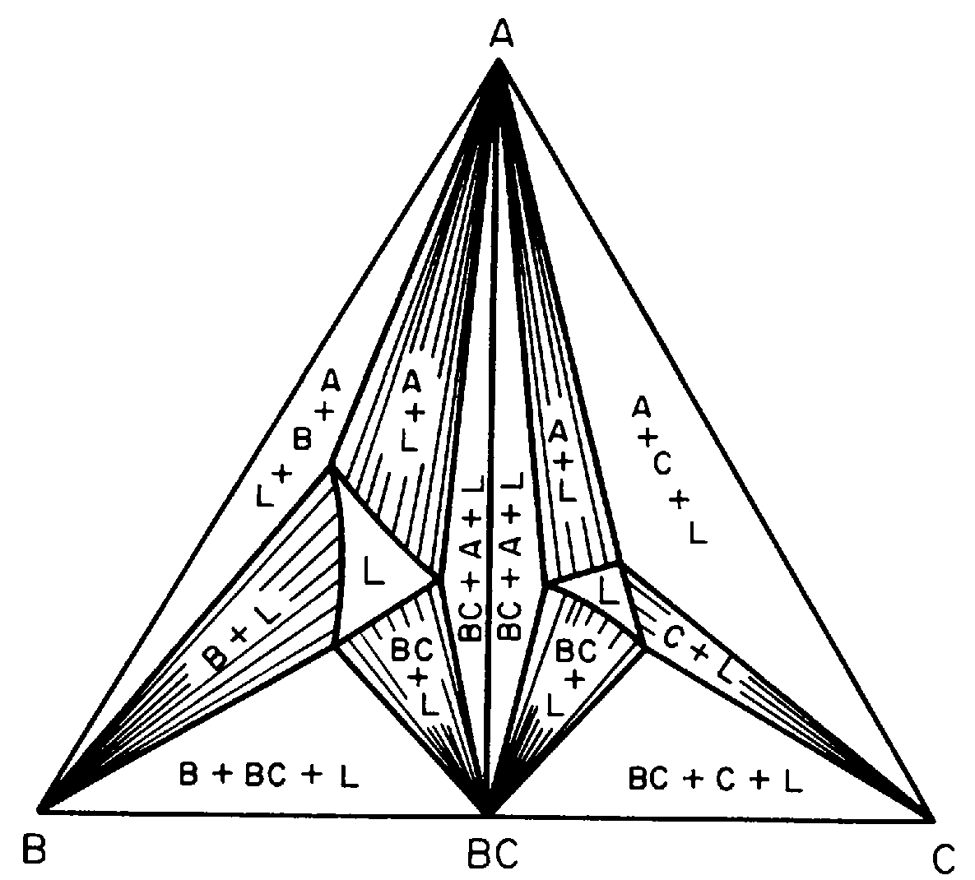
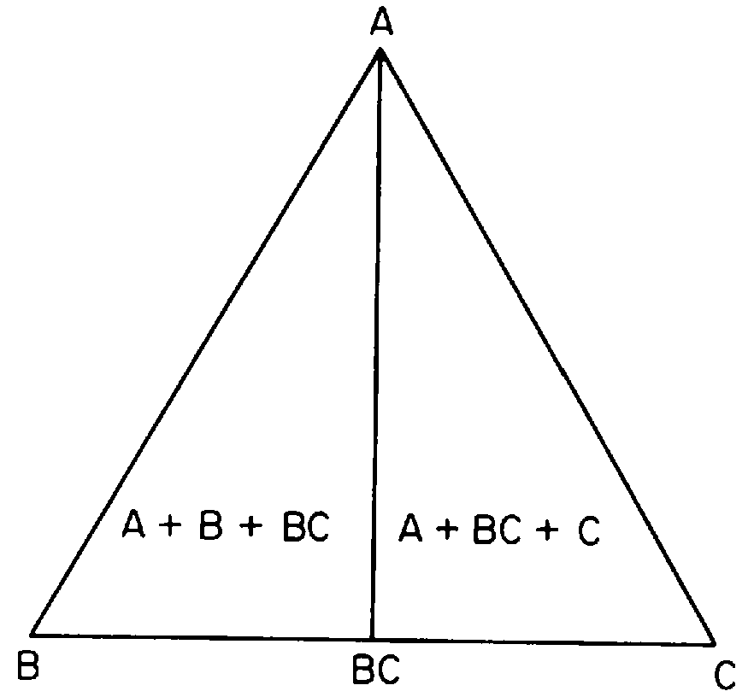
At 400ºC, which is below the temperature corresponding to the intersection of the Alkemade line A-BC with its boundary line, the isothermal section shows the separation of the system into two separate ternary systems.
At 300°C, which is below the temperature of either eutectic point, the isotherms is not observable.
400oC

Slide 14
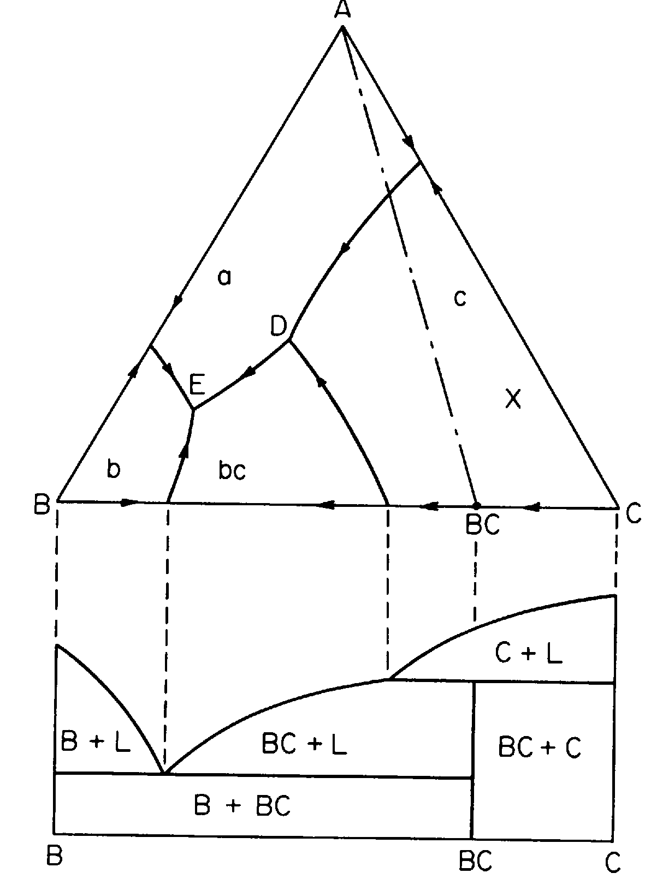
System with a Binary Compound Melting incongruently
Only one ternary eutectic forms because the Alkemade line A-BC does not intersect its boundary line.
Boundary line DE slopes away from its Alkemade line A-BC from the point D toward E.
A melt, such as that indicated by point X , occurring in the composition triangle A-BC-C will, on cooling to solidification, be made up of crystals of A, BC, and C.
The only point at which these three crystals are in equilibrium is at point D, which is outside the composition triangle A-BC-C.
Point D is a peritectic point (not a eutectic point); it is the point to which the melt will cool and also represents the temperature of final solidification of the melt.

Slide 15
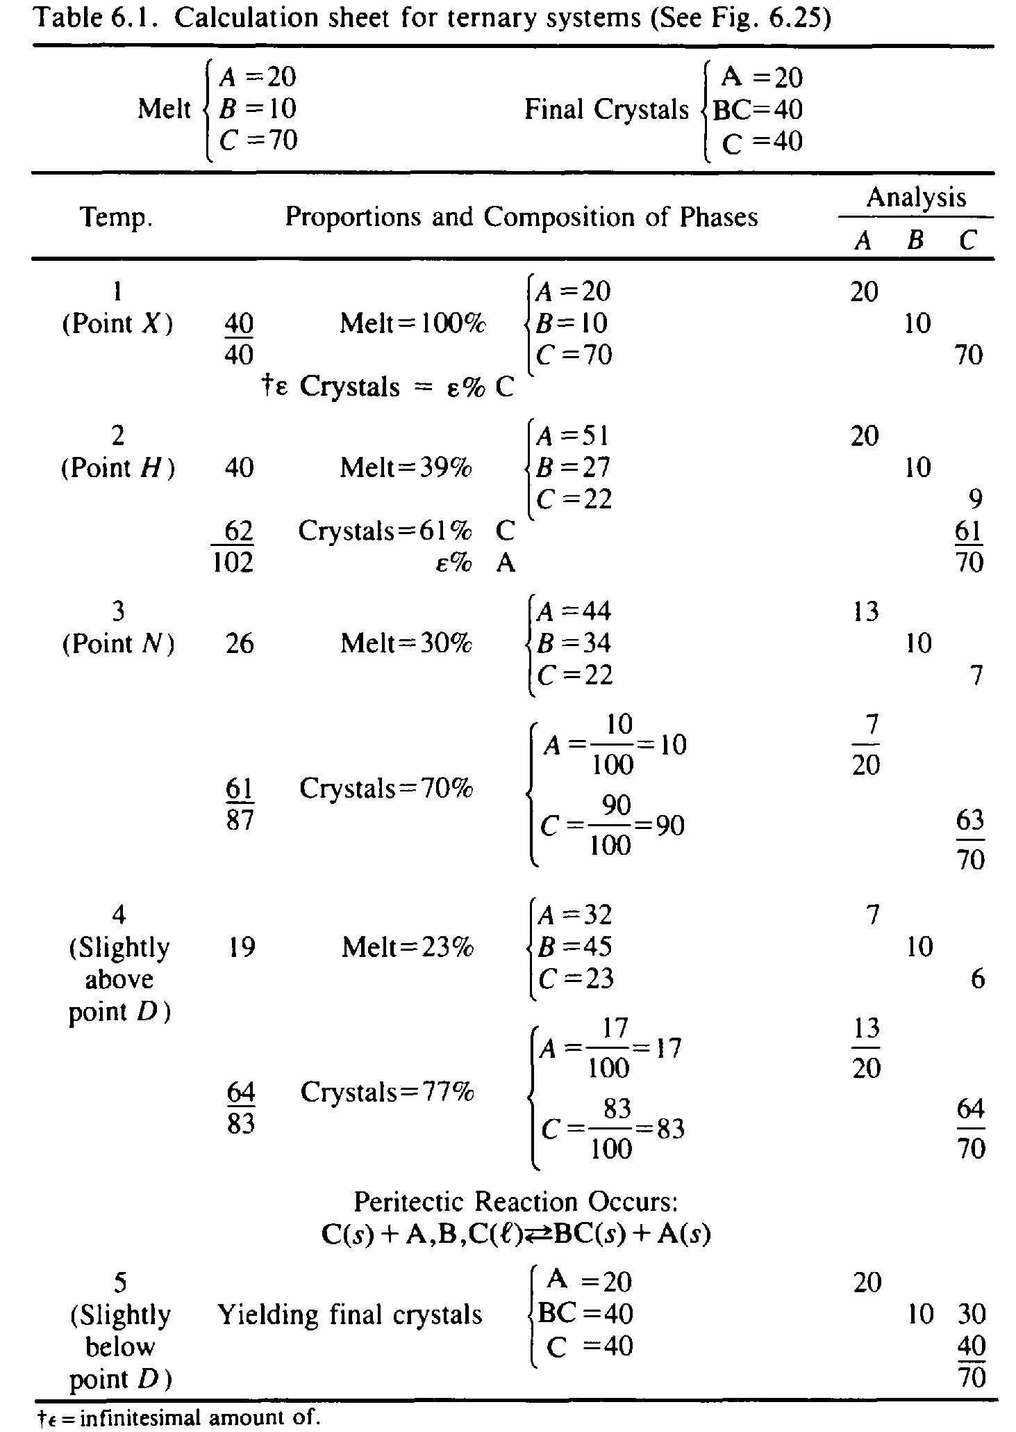
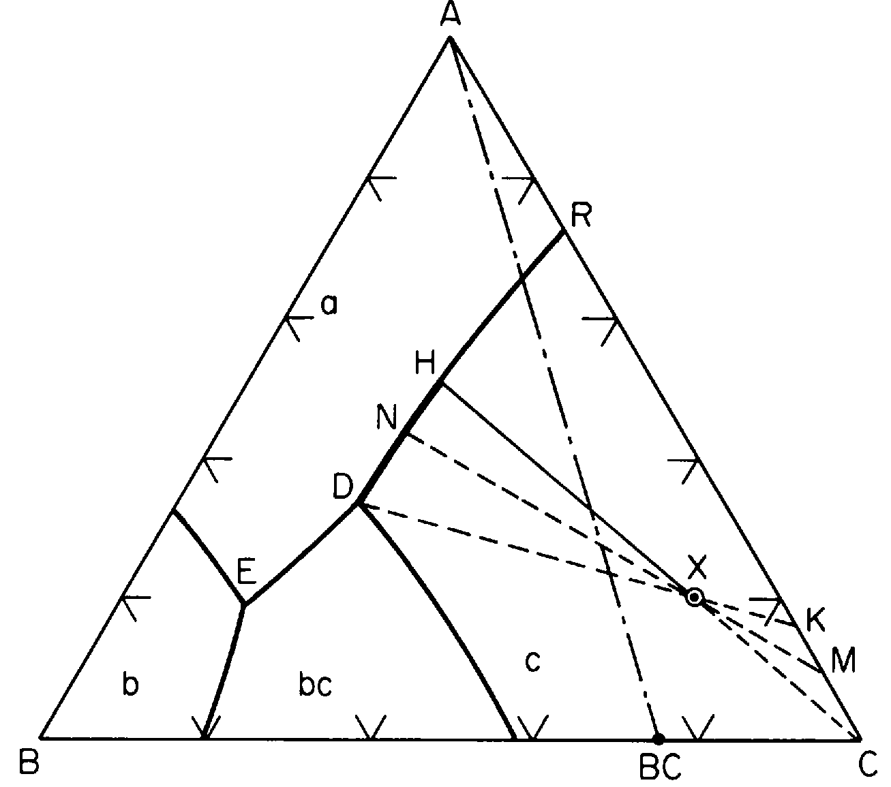
Lets see lsoplethal Study for this system
Final Crystals. Composition X (A = 20%, B = 10%, C = 70%)

