Slide 1
Engineering Ceramics
Class -2
Defects in ceramics

Slide 2
Defects in ceramics
Many properties of crystals are determined by imperfections.
Electrical conductivity
Diffusion transport imperfection
Optical properties
Rate of kinetic process
Kinetic processes
Densification
Precipitation
Grain coarsening
High temperature creep deformation

Slide 3
Point defects

Slide 4
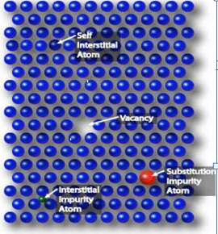
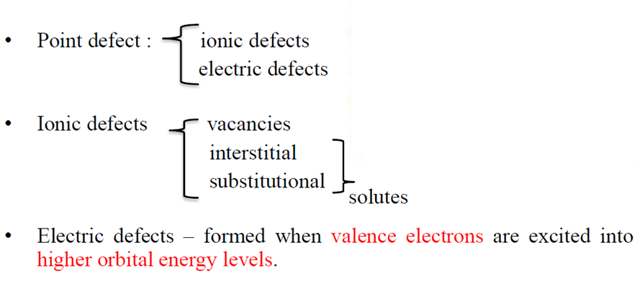

Slide 6
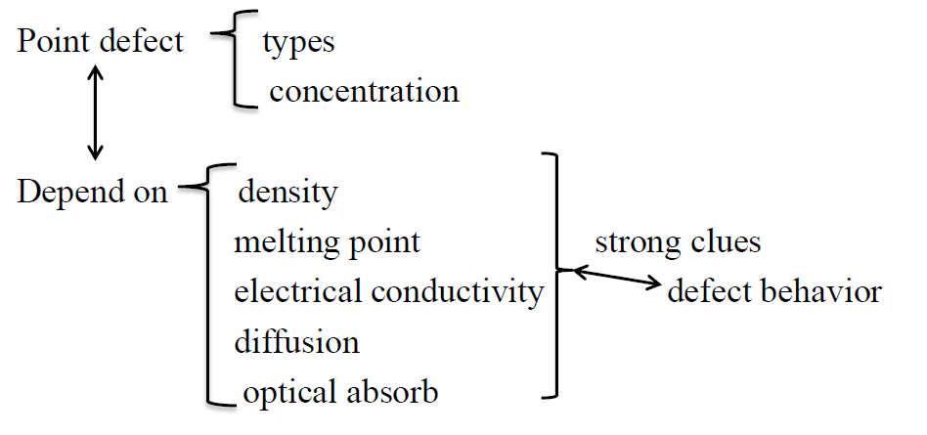

Slide 13
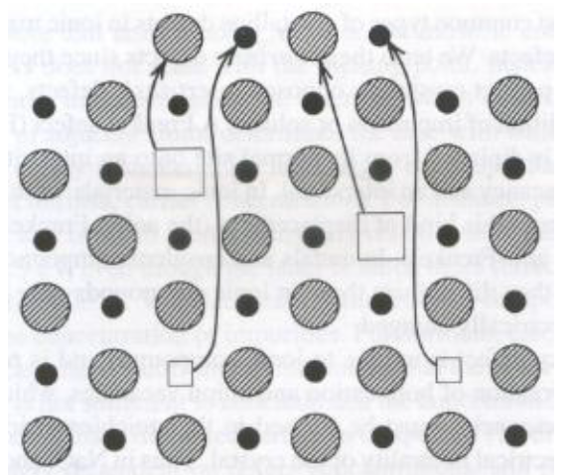

Slide 15
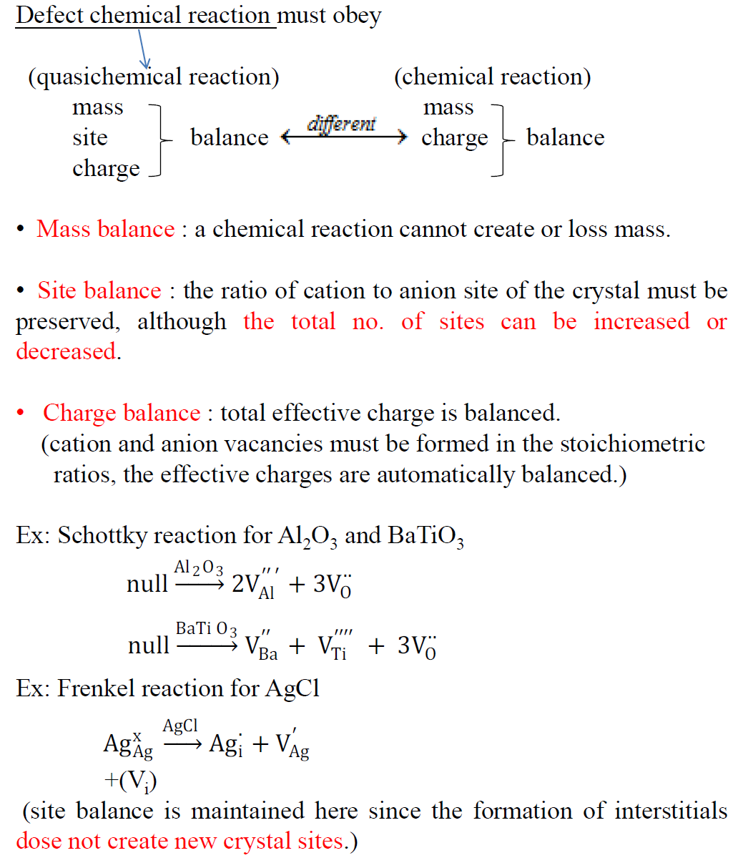

Slide 16
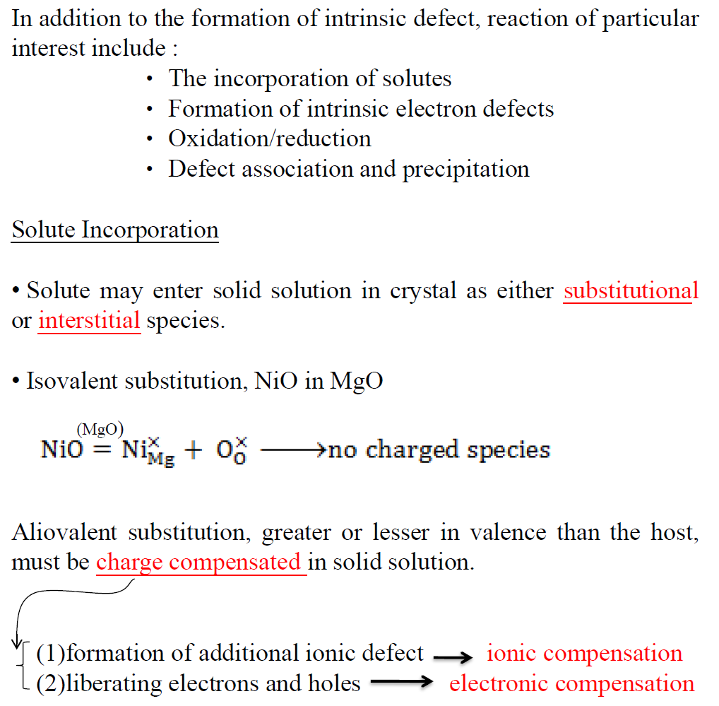

Slide 17
